Slide 1

Status of Beam Loss Monitor Ionisation Chamber (BLM IC) Production
Gerhard Schneider for BLM IC team
15th HL-LHC Collaboration Meeting, CERN, 01.10.2025

Slide 2
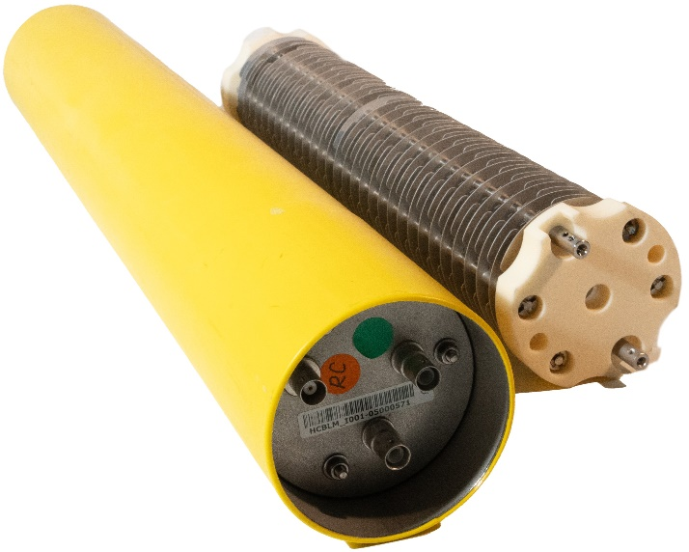
Contents
Short Introduction to BLM IC
Status of the Project
Outlook
Summary

Slide 3
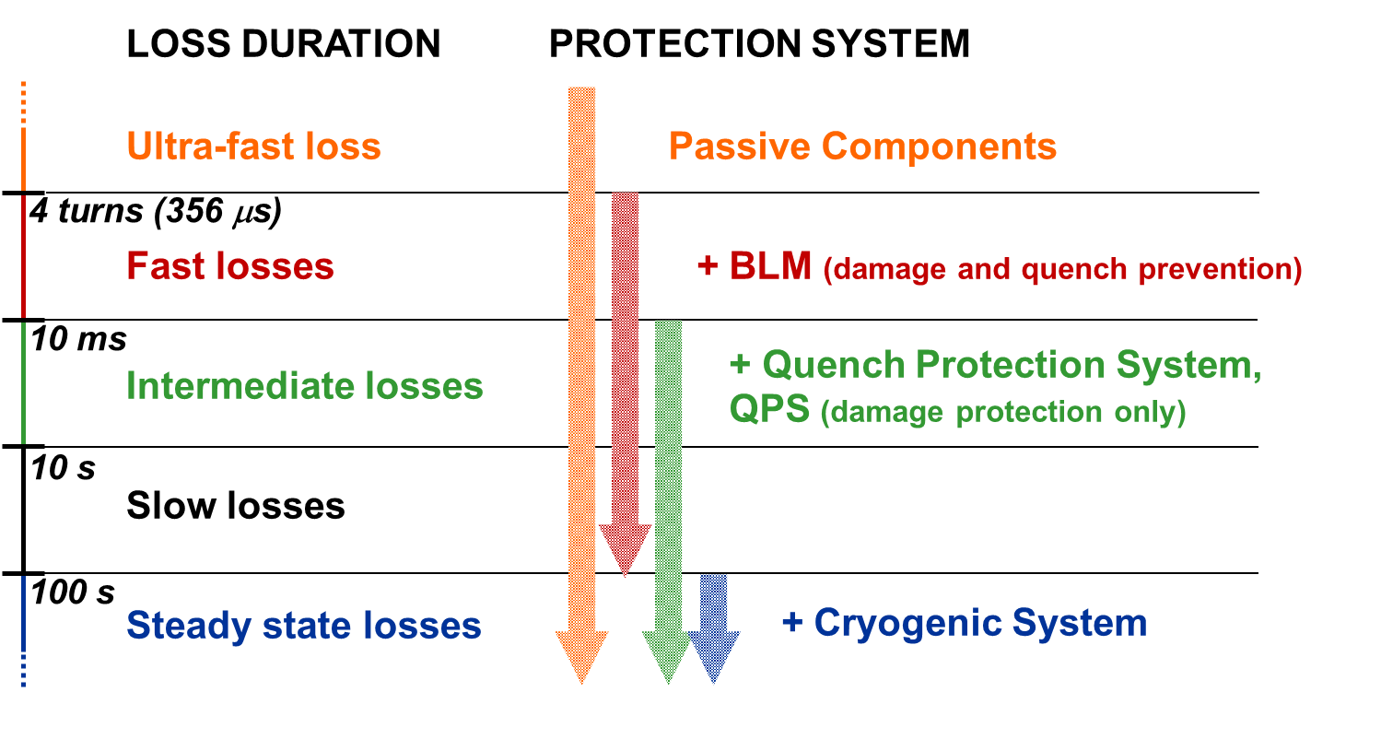
Beam Loss Duration and Protection Systems
50 – 150 μs
Achieved
by BLM LHC
100 s
Impossible to have active protection from ultra-fast losses
No real redundancy for fast losses; later additions of beam and magnet current change monitoring
Courtesy: C. Zamantzas

Slide 4
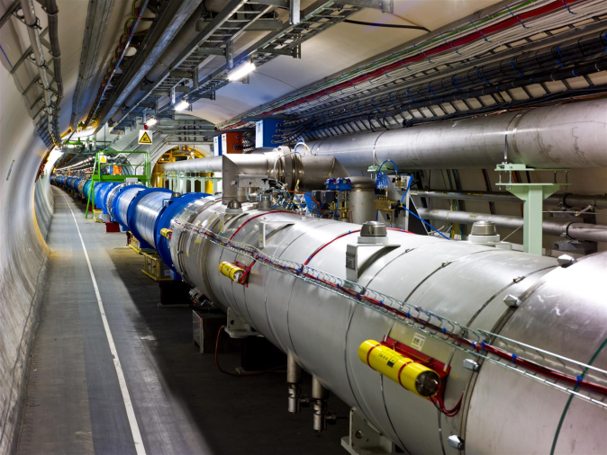

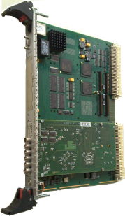

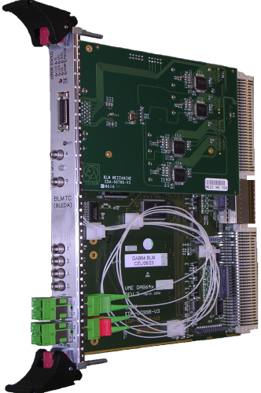
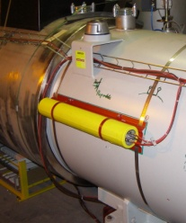
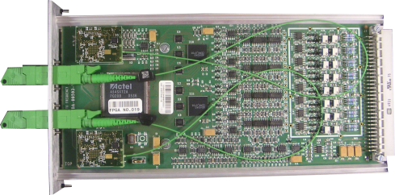
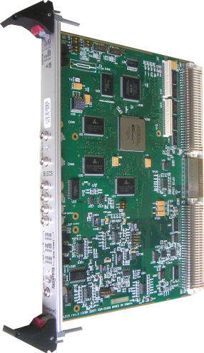
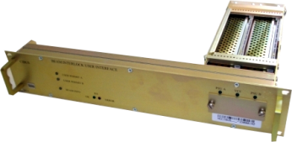
LHC BLM System Overview
A highly critical system for the protection of the LHC.
Deployed throughout the 27 km tunnel.
Speed, reliability, fail-safety are required.
A large amount of measurement data is published continuously.
Settings and Thresholds
Front-end CPU
Databases, fixed displays…
Processing, Analysis & Decision Modules
BLM IC
x27
Acquisition Modules
Combiner and Survey
Beam Interlock Interfaces
x400
x4000
x800
x27
around the LHC ring
x16
Tunnel
Surface
Courtesy: C. Zamantzas

Slide 5
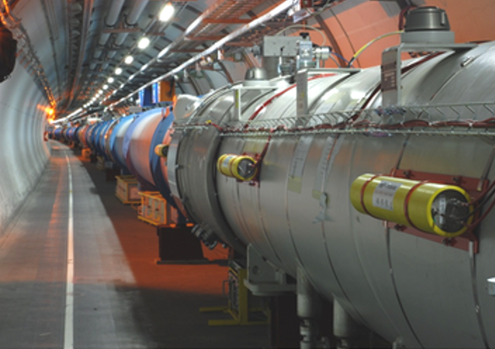
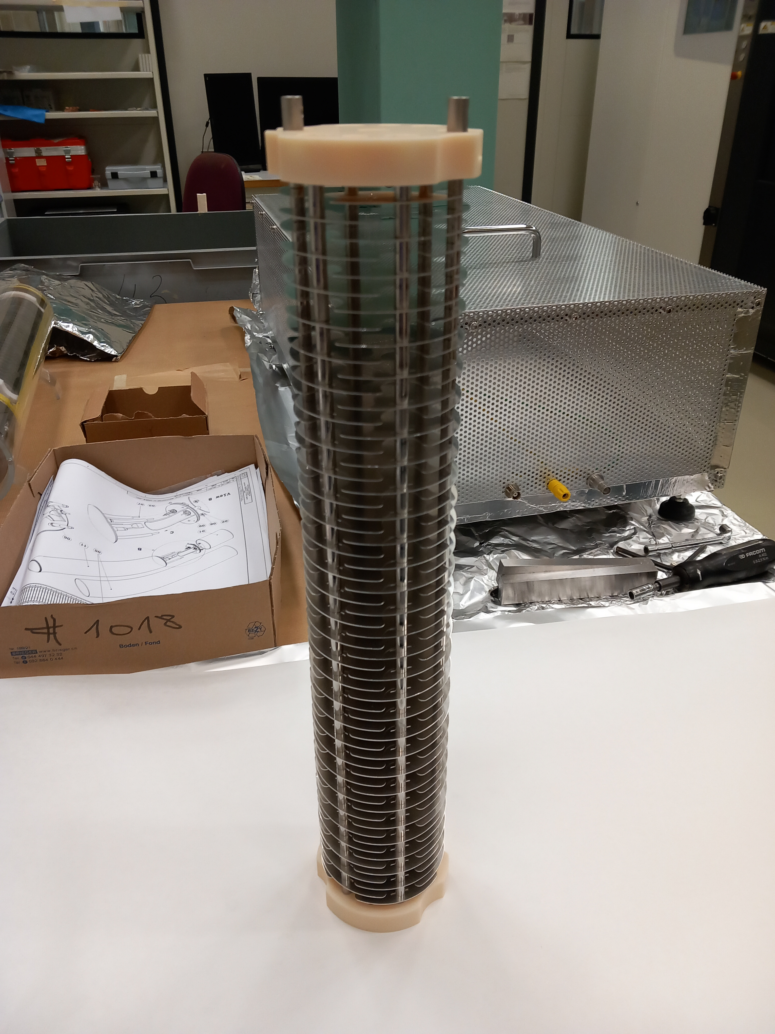
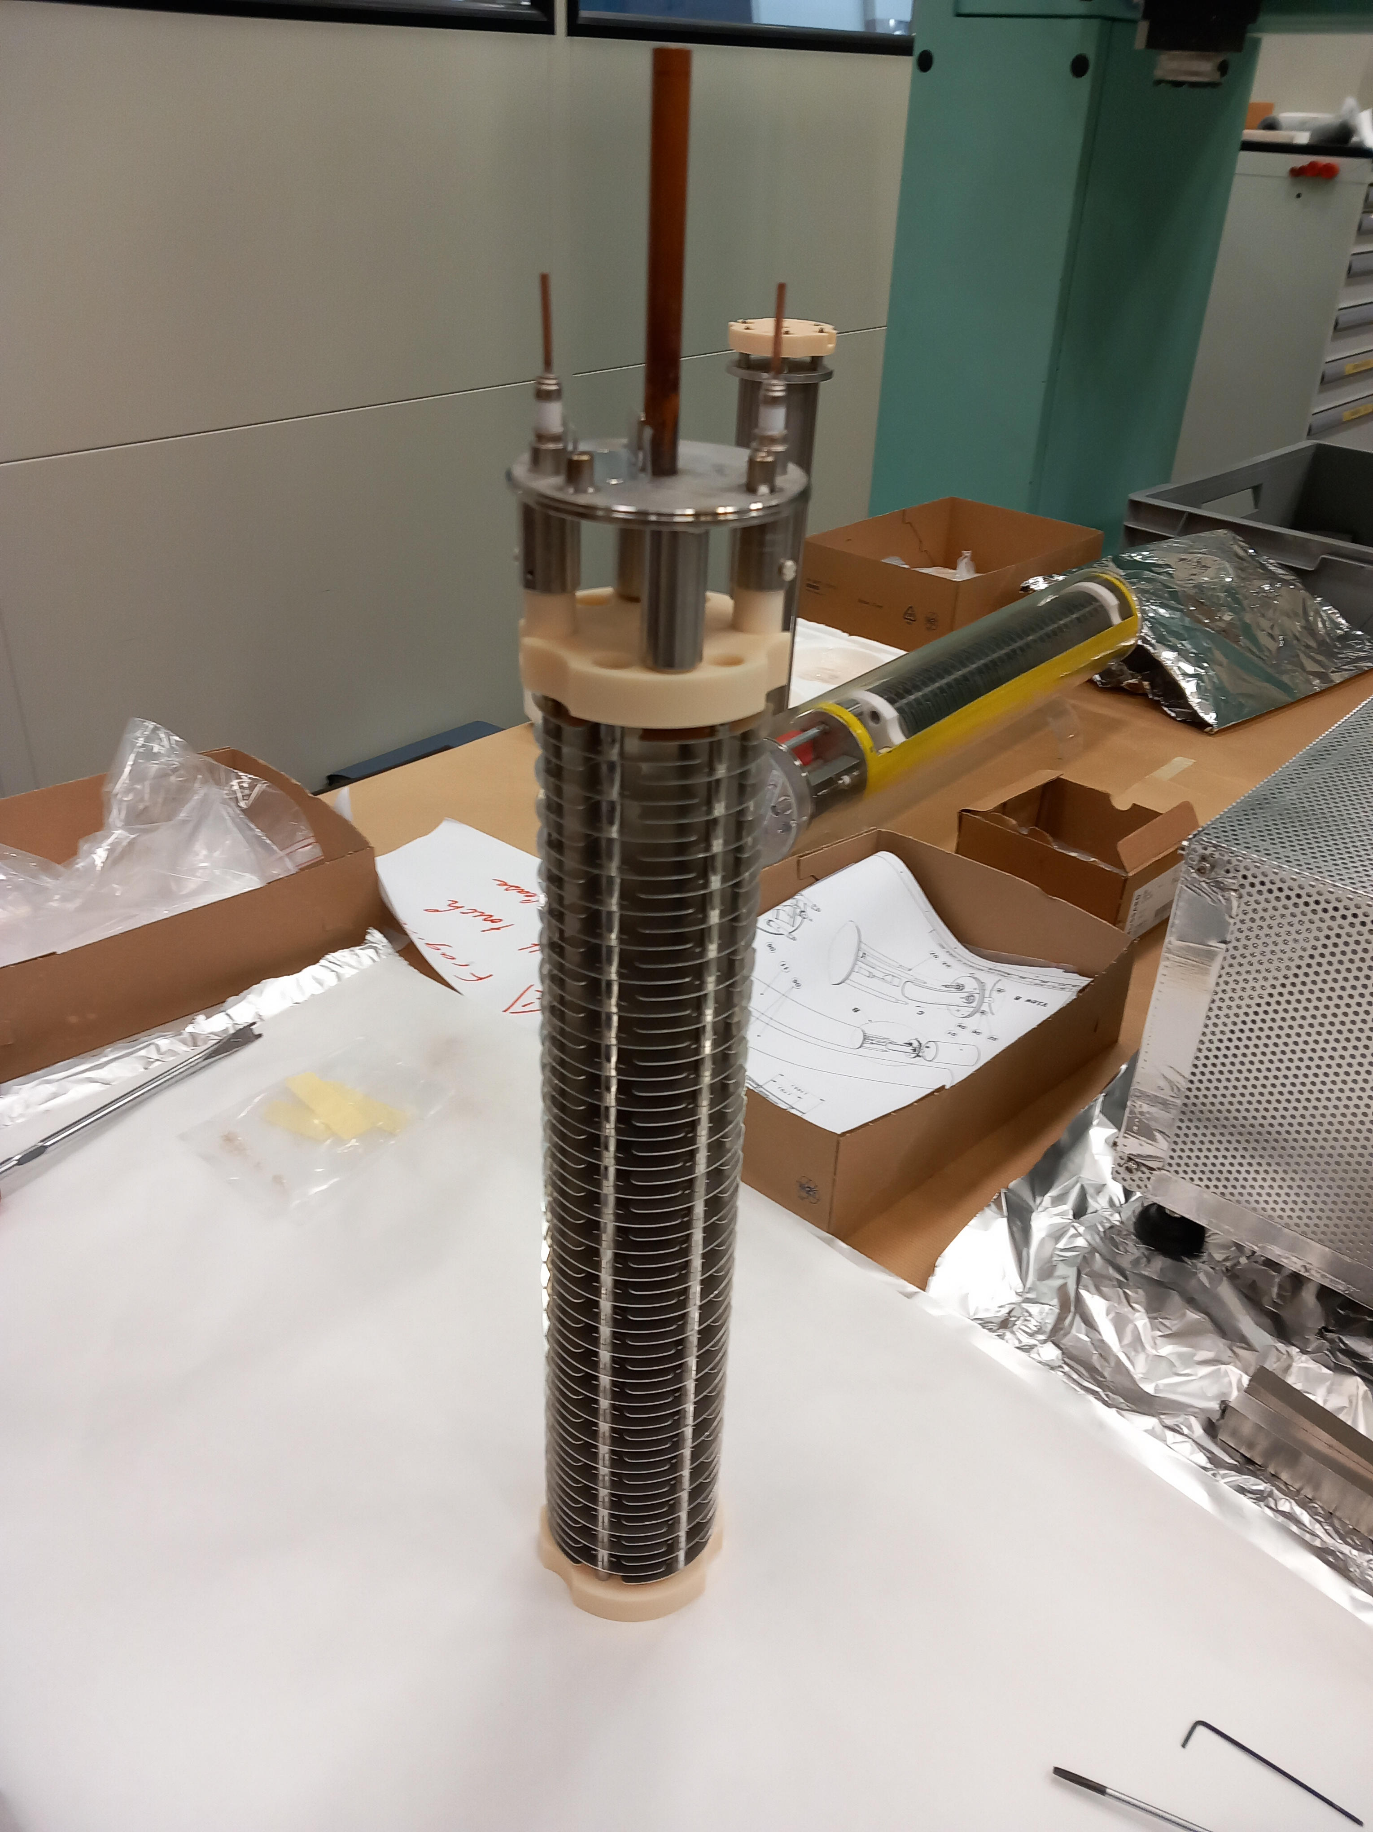
Work Principle of the BLM IC
Voltage 1500 V
1.1 bar Nitrogen Gas
61 Electrodes
Particle Ionising Gas
Measure Current

Slide 6
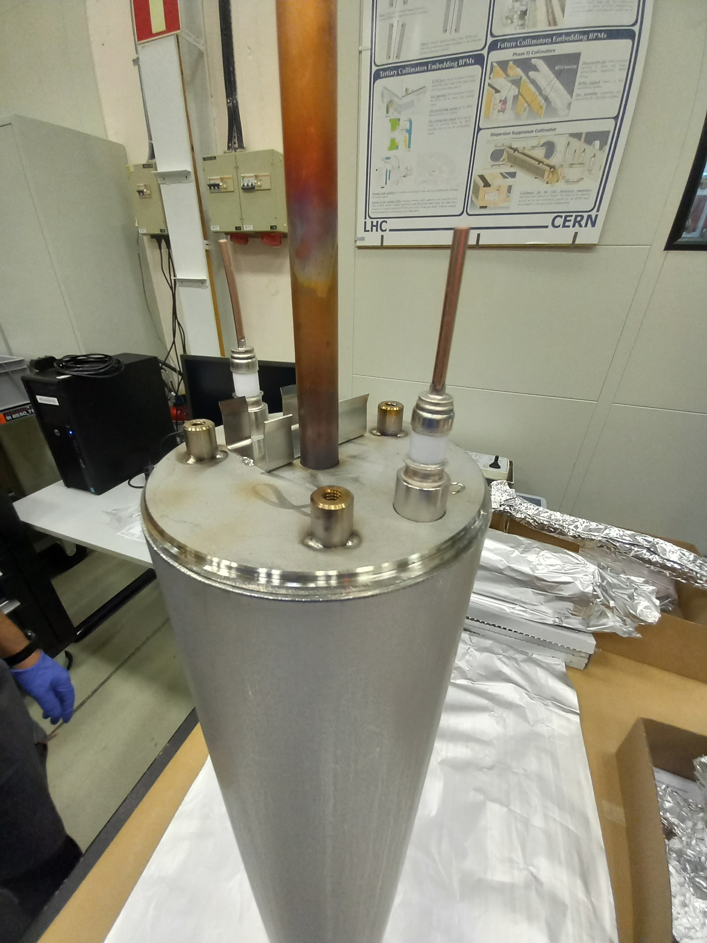
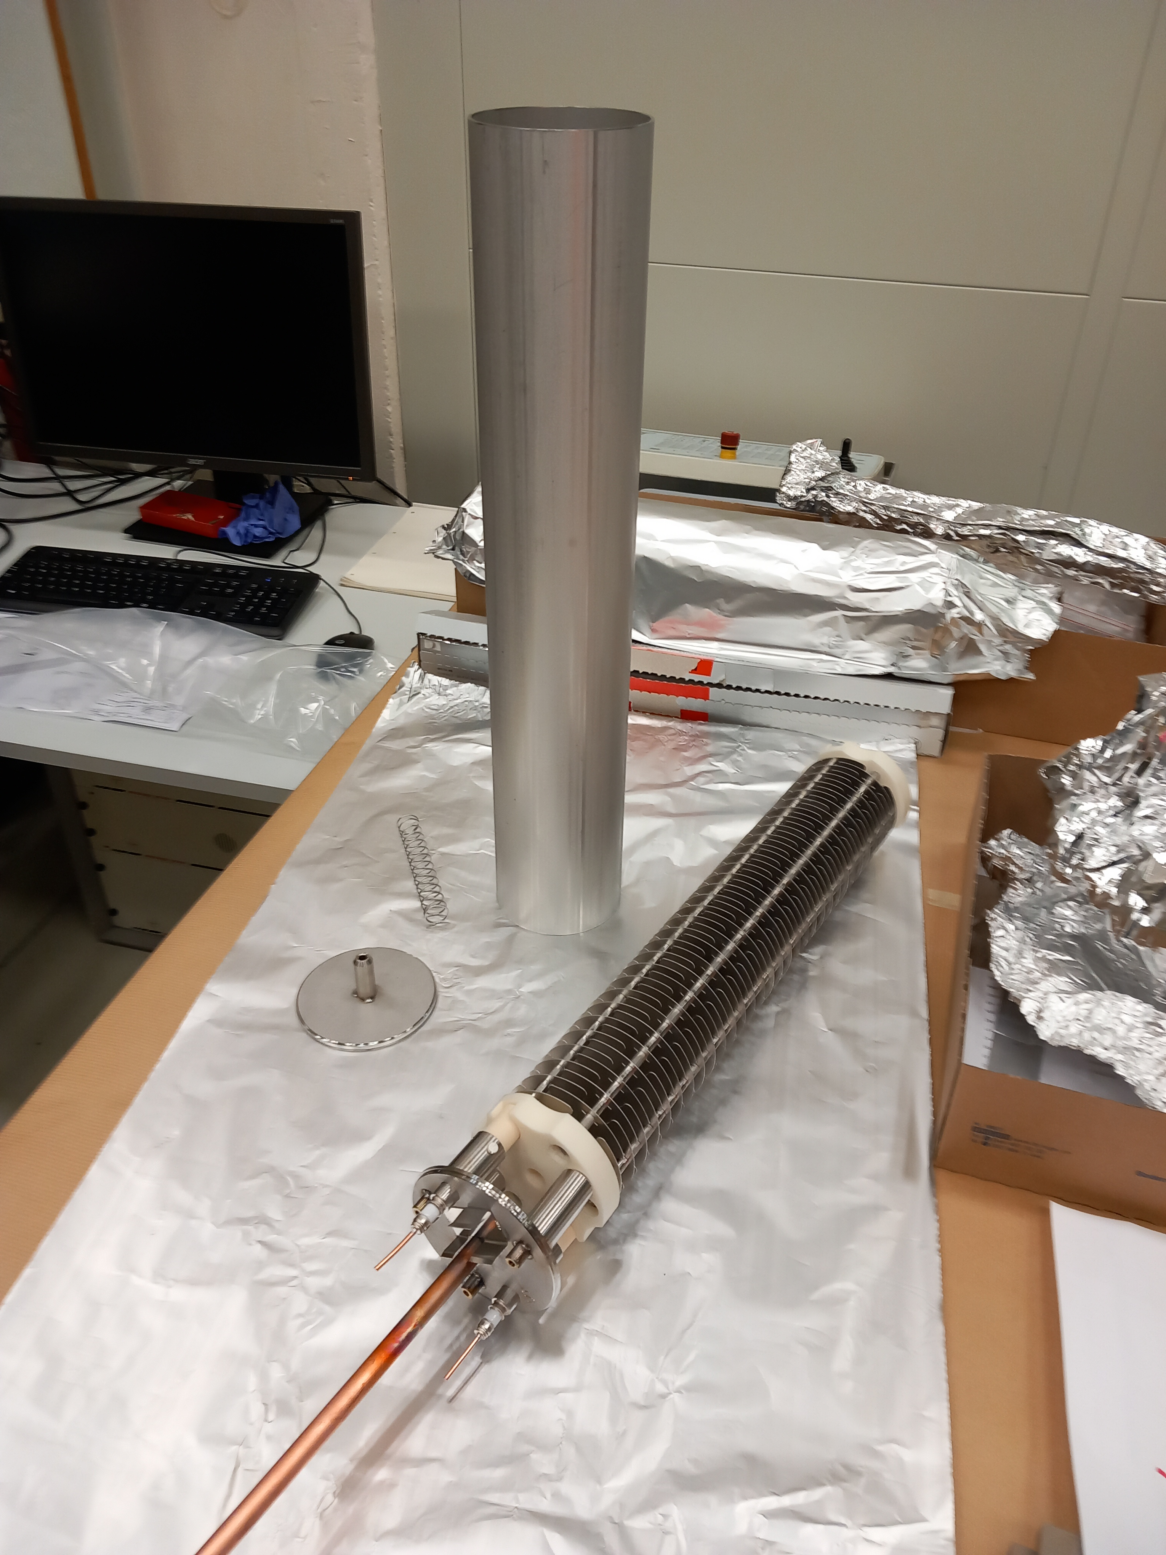
BLM IC Parts Assembly
Make the stack of electrodes and spacers
Insert the stack, including the end-plate, into the vacuum housing.
Total 330 parts in each BLM IC.
Two leak-tight welds are made on either end of the tube.

Slide 7
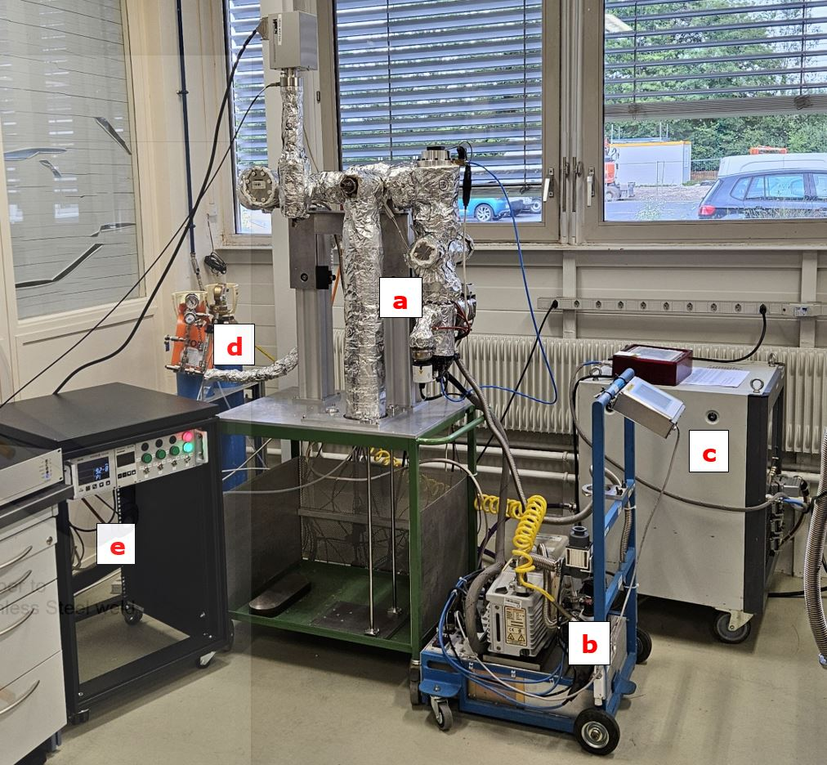
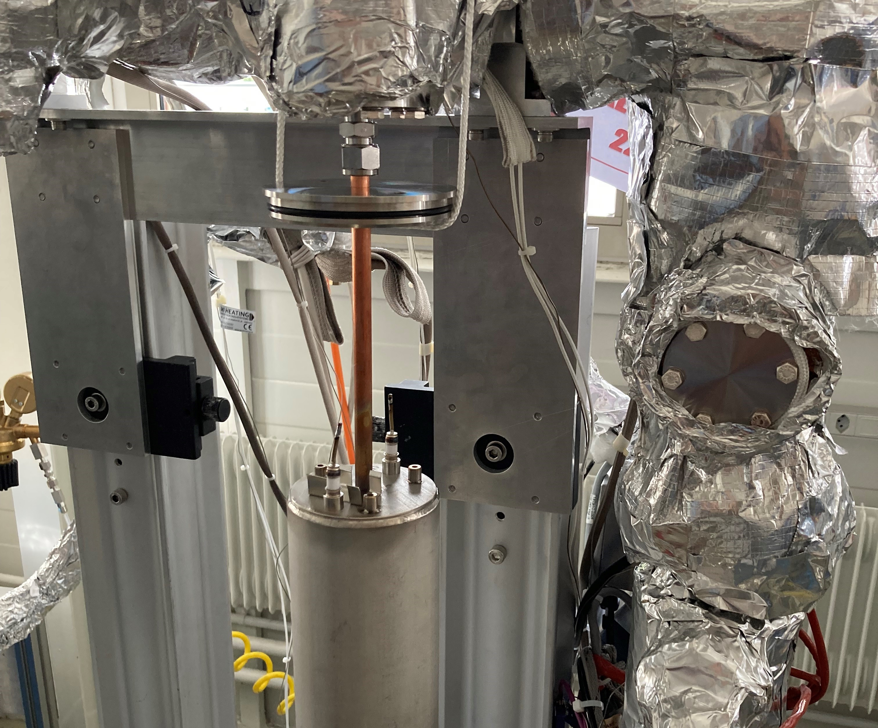
Finalise BLM IC on Vacuum Test Stand
Pump the BPM IC
Leak Check
Bakeout to 220 °C
Residual Gas Analysis
Refill with Nitrogen to 1,100mbar absolute (100 mbar overpressure)
“Pinch-off”
Electrical Checks
→Complex expert procedure

Slide 8
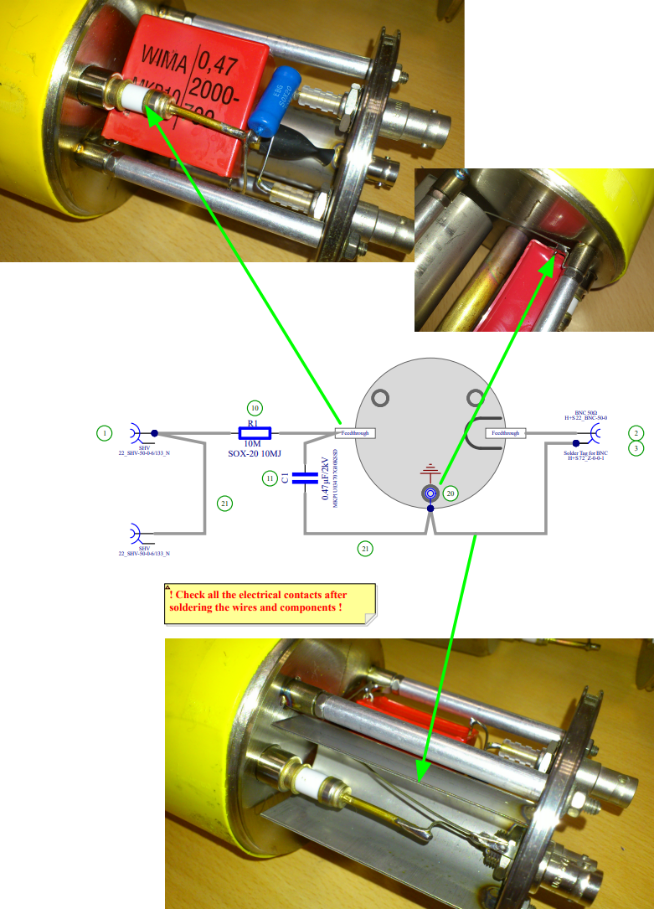
Add the electronic components and yellow sleeve
Add all electrical components to the BLM IC.
Install the yellow sleeve onto the BLM IC.

Slide 9
BLM IC History at CERN
More than 4,000 BLM ICs are operating at CERN.
About 93% are installed in the LHC.
They were previously produced in collaboration with external institutes.
The end of long-term collaboration with these institutes made re-engineering of the BLM IC necessary.

Slide 10
Production Objectives
Produce 1000 BLM ICs:
200 for HL-LHC
800 for the renovation in the LHC injector complex

Slide 11

Status of the Production: Procurement of parts
All orders for parts for the 1000 BLM ICs made
Total 34 orders made since Genova meeting
Raw Material Orders: 17
Fabrication Contracts: 12
Large Asset Orders (Kyocera and Reuter): 2
Manufacturing studies: 3
1 MCHF committed
~ 100 kCHF billed
CERN procures all relevant materials for subassemblies

Slide 12
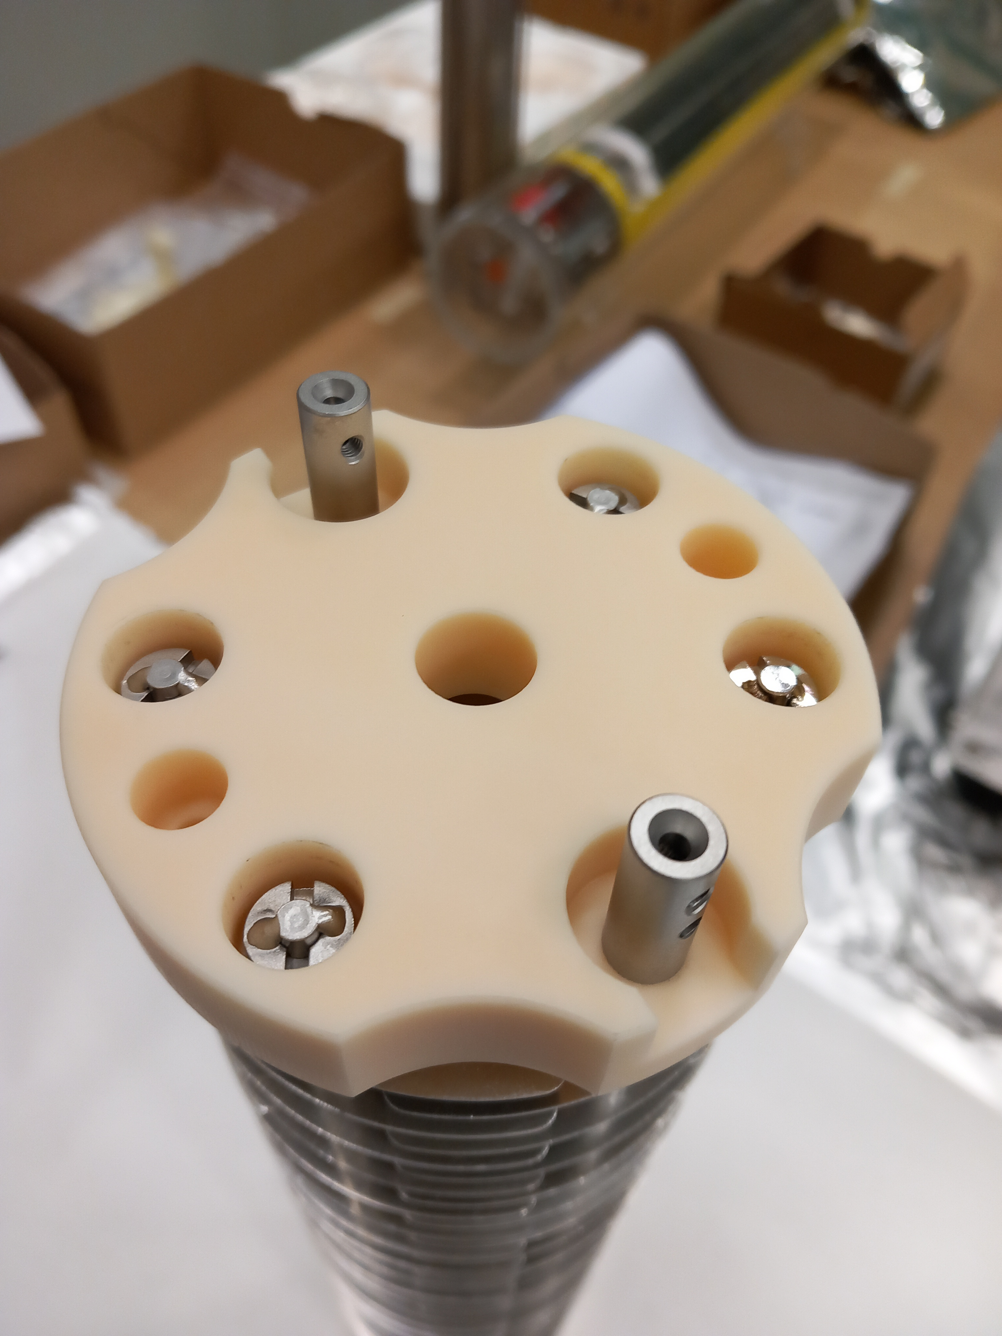
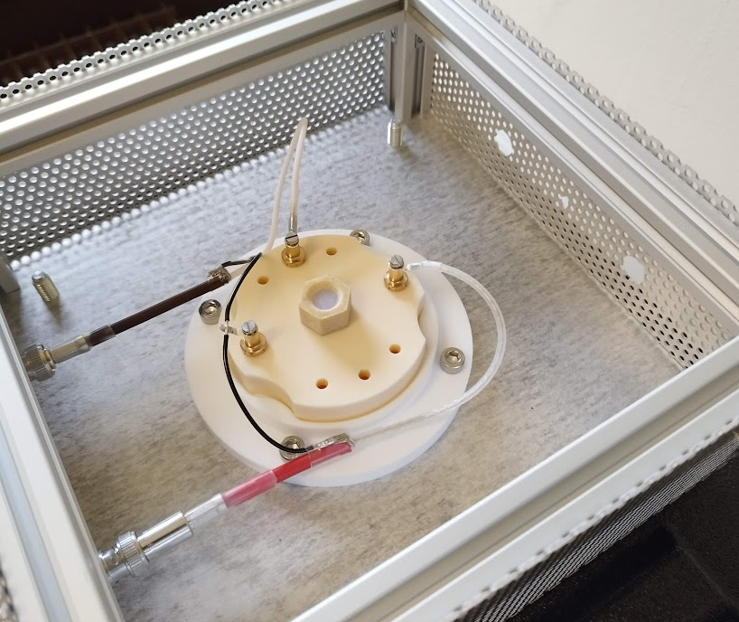
Status of the Production: Ceramic Insulator
Ceramic Insulator Production LHCBLM__0005 contract placed with German company Kyocera (ex Friatec) in February 2025, total 2000 needed DO-34404/SY/HL-LHC (DR-10411247)
Precision ceramic Al₂O₃
Ultra-high resistance: < 1 pA when 1.5 kV applied
Resistivity checks in a controlled environment to guarantee consistent measurements
UHV-clean delivery
Pre-series delivered
Dimensional and degassing tests successful
Issues with the Ultra-high resistance
Surface contamination, not the bulk material
Good collaboration across CERN services and Kyocera to understand and remove the contamination
Manual procedure successfully identified, process to industrialise the cleaning on-going.

Slide 13
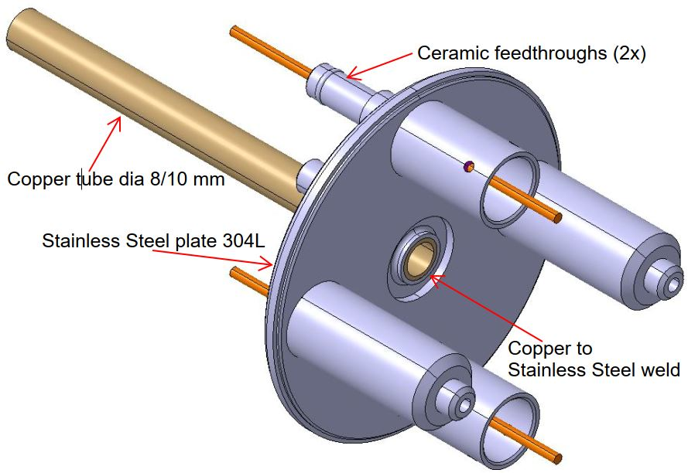
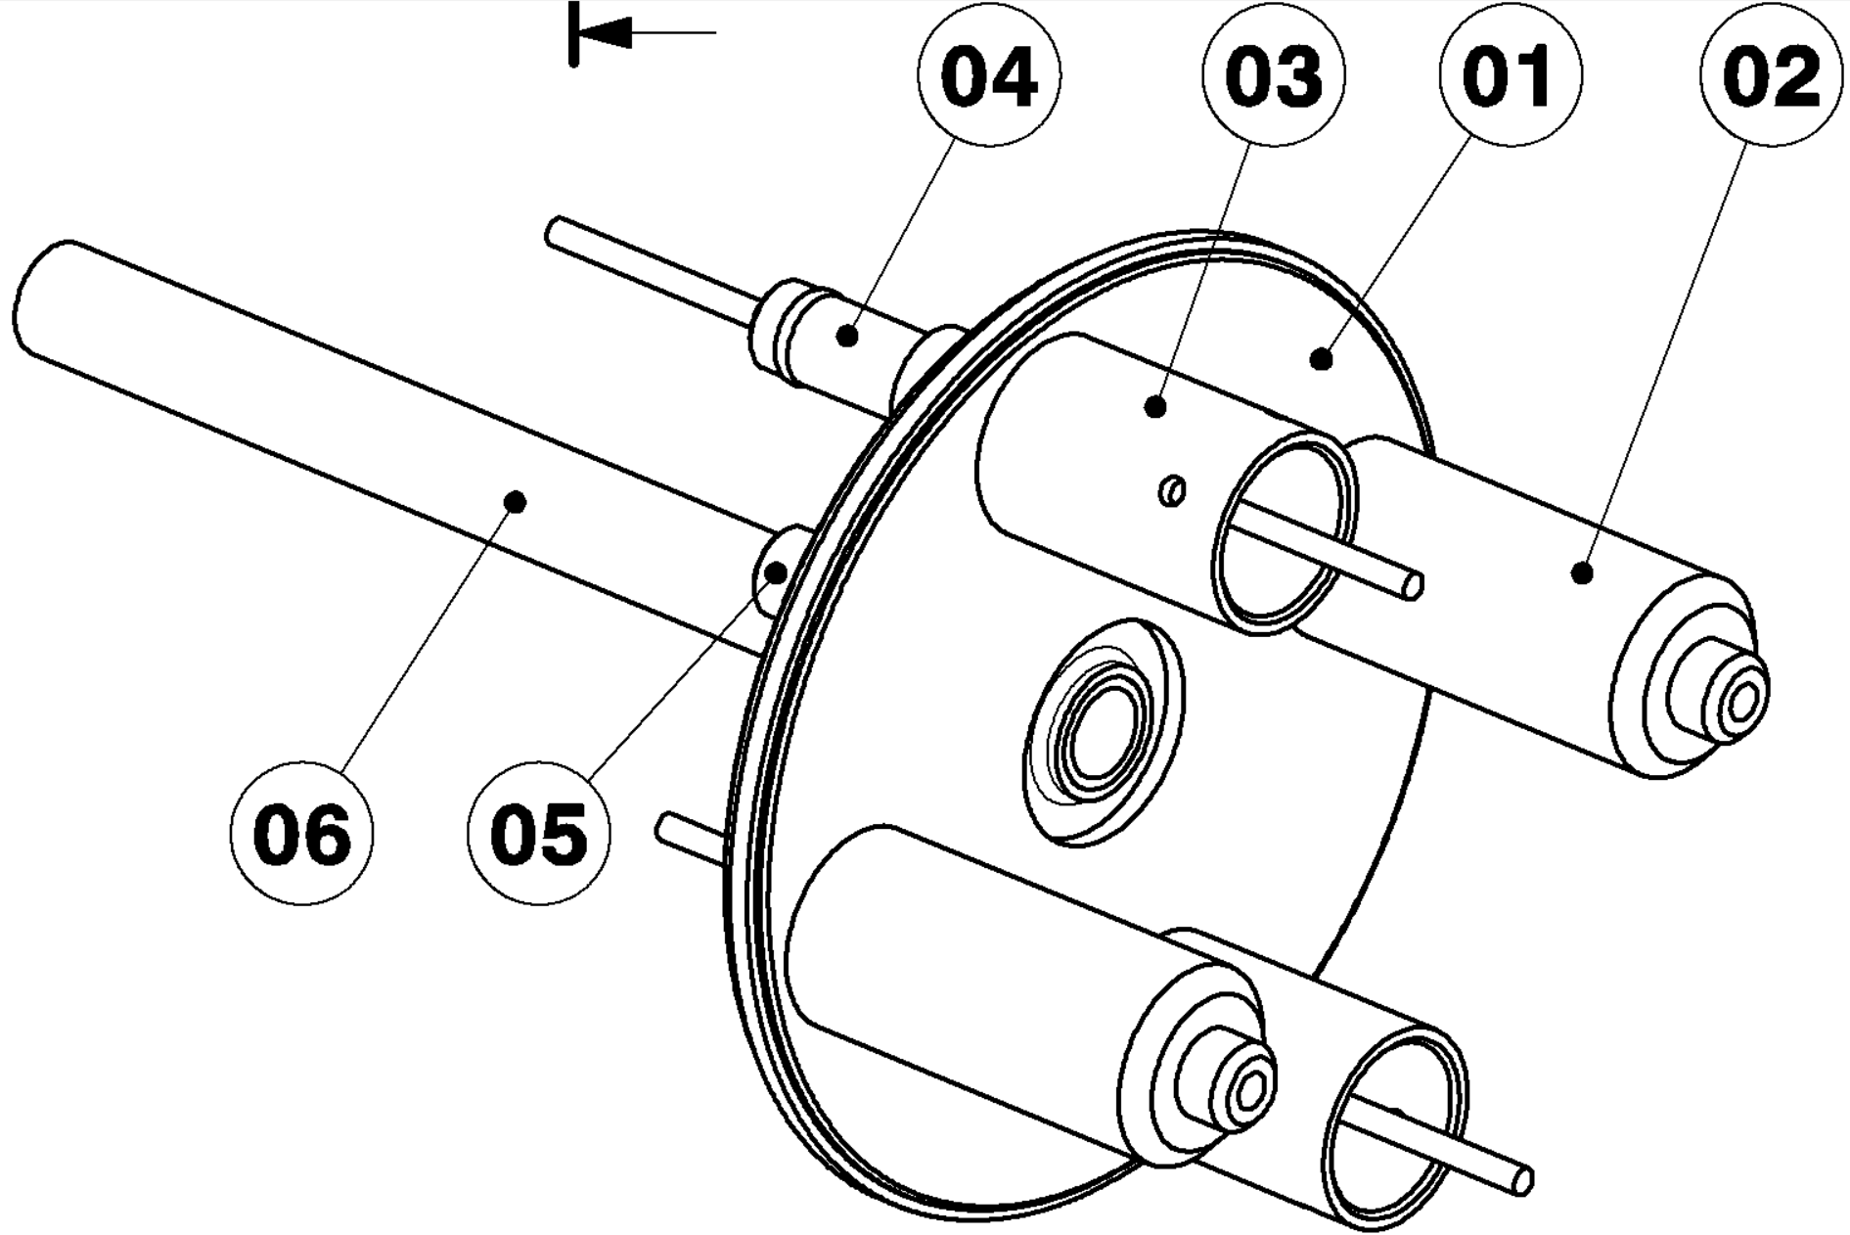
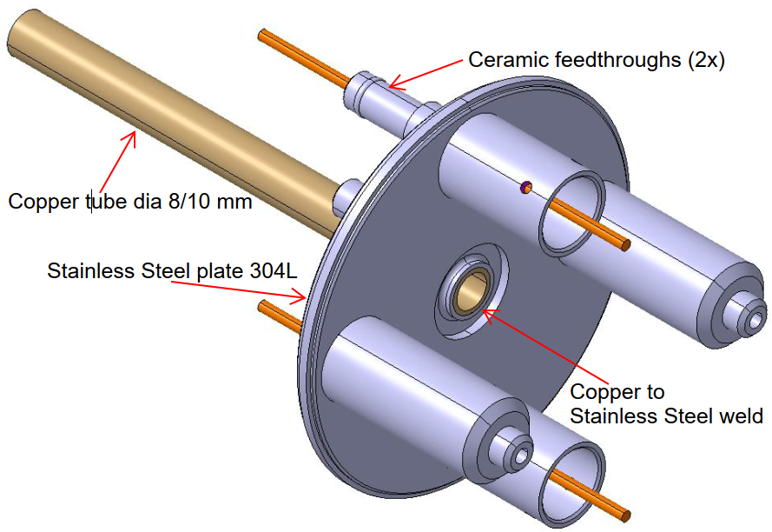
Status of the Production: Endplate (1/2)
Endplate Production LHCBLM__0002
Precision machining
UHV cleaning
UHV-compatible assembly and welding of copper “pinch-off” tube (SS/Cu) and electric feedthroughs (SS/SS)
Dimensional and basic electrical checks
Leak check

Slide 14
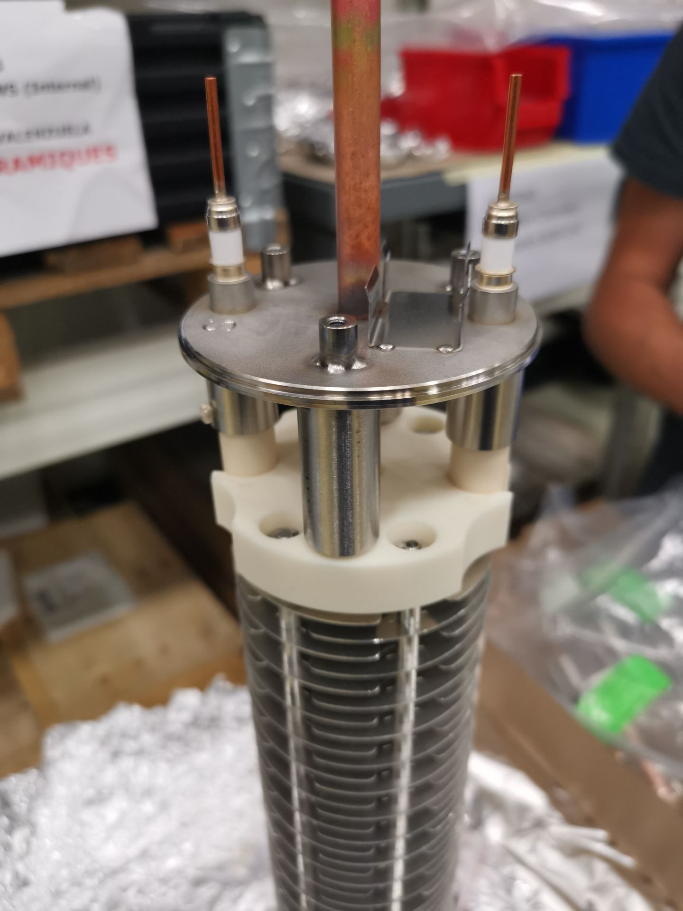
Status of Production: Endplate (2/2)
Contract placed with German company Reuther Technology in February 2025, total 1000 needed; DO-34448/SY/HL-LHC (DR-10441935)
Pre-series delivered
Assembly tests successful
Electric tests successful
Vacuum outgassing tests successful
Metrology inspection successful
CERN weld destructive test and leak check pending

Slide 15
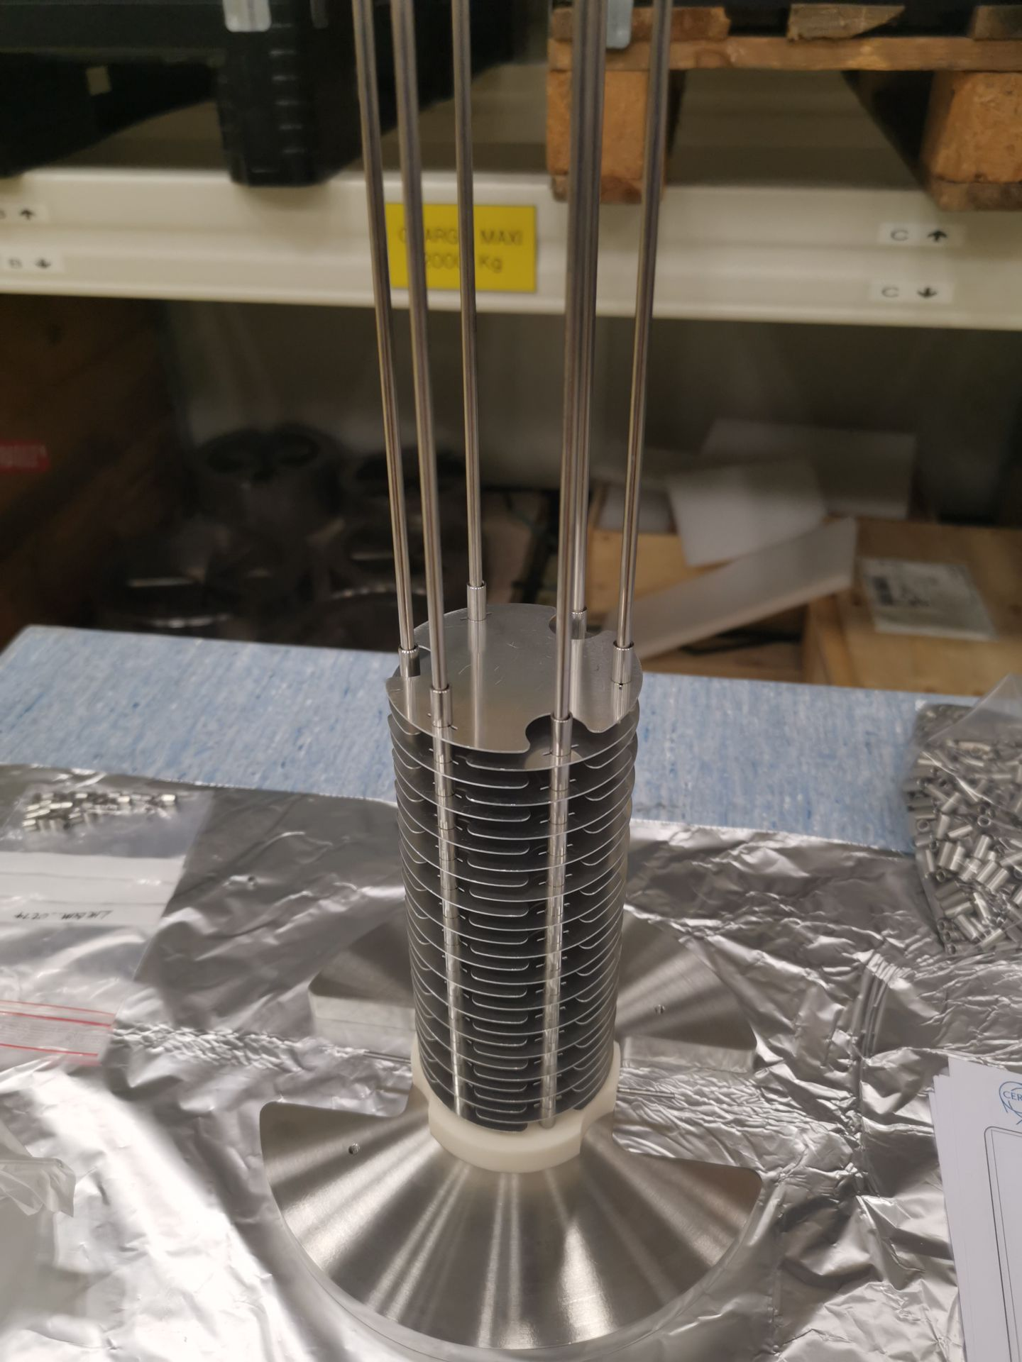
Status of all other Parts production: All ordered
61000 Electrodes needed
183000 Spacers needed
….
The usual small hick-ups of production, (burrs, quality of threads, dimension discussion)
→ nothing critical neither on quality or delivery dates

Slide 16
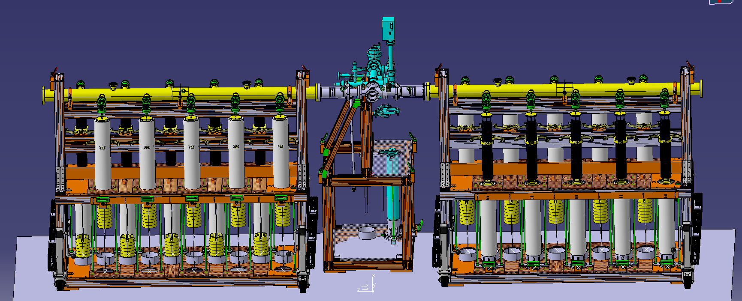
Status of Production: Vacuum Test Stand
Test Stand Extension to produce 20 units in one batch designed to its end in Q3 2025
All parts ordered
Assembly foreseen in Q4 2025 with commissioning Q1 2026

Slide 17
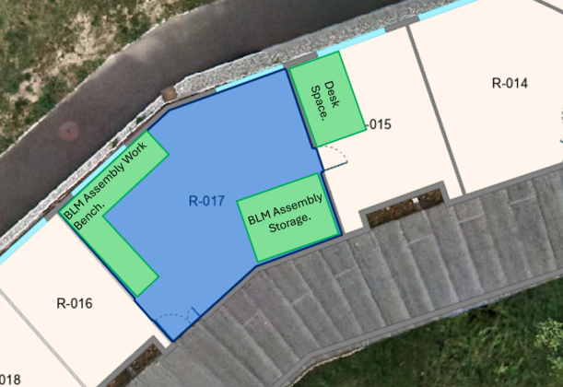
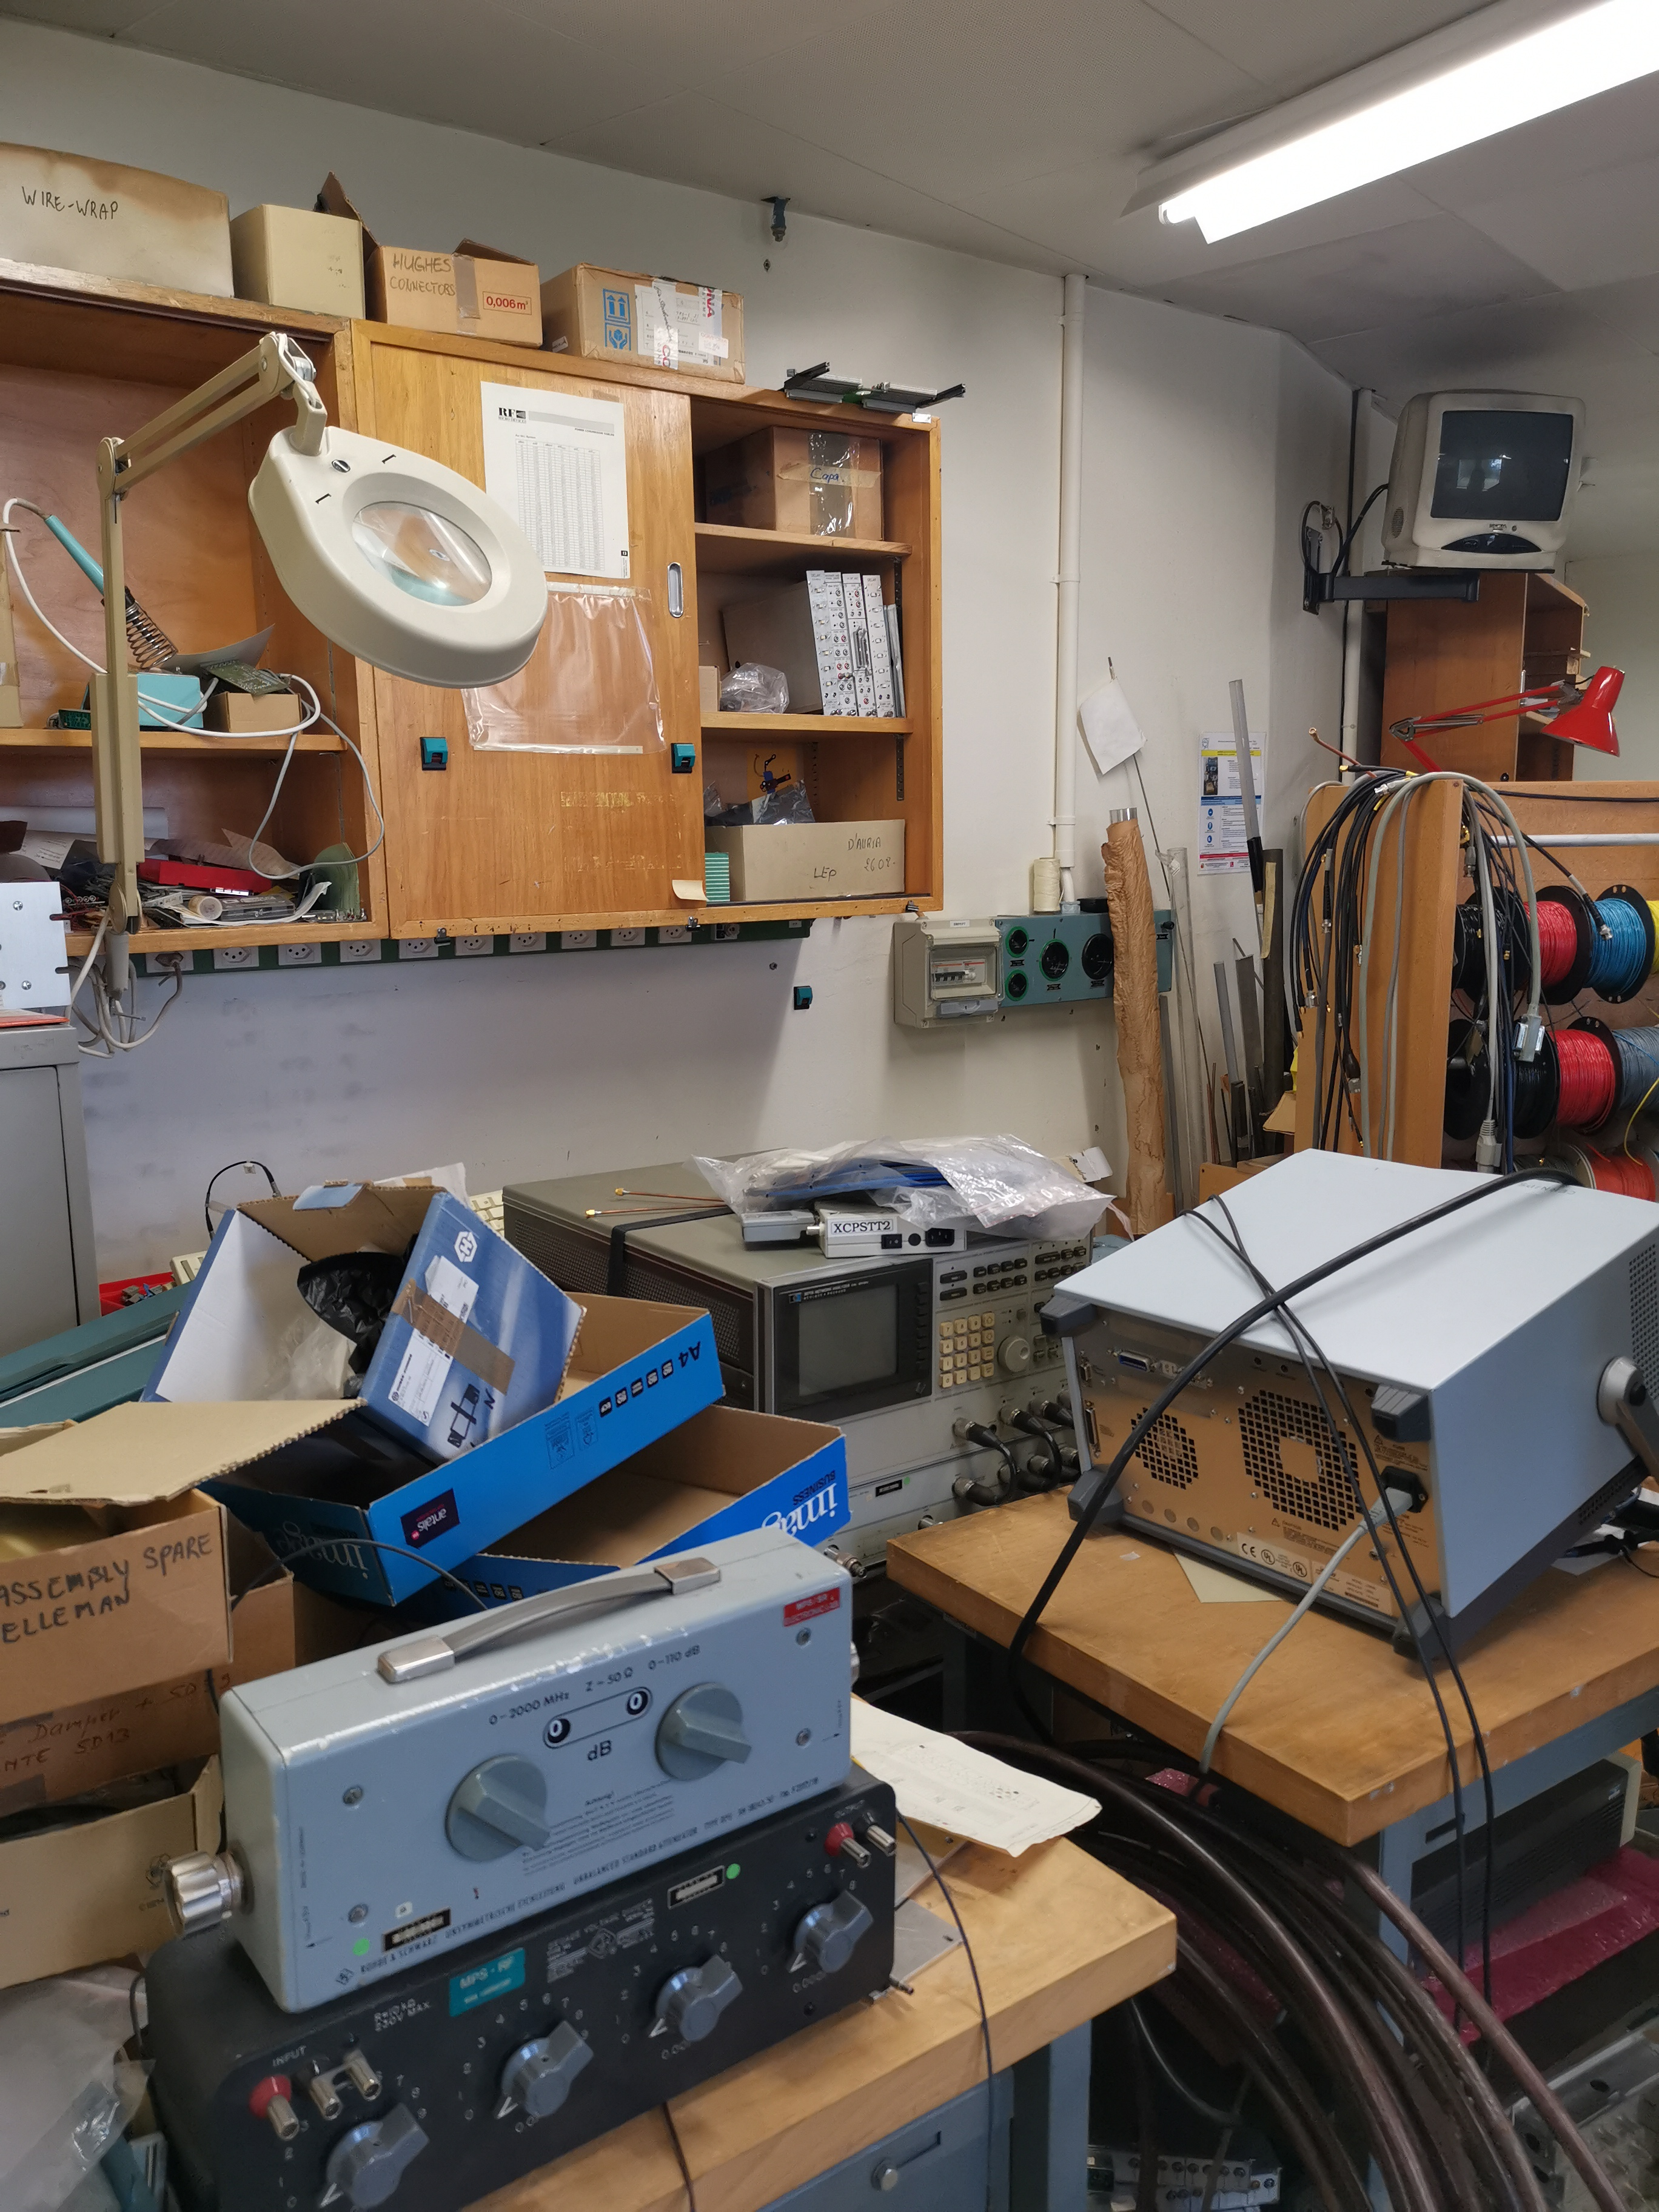
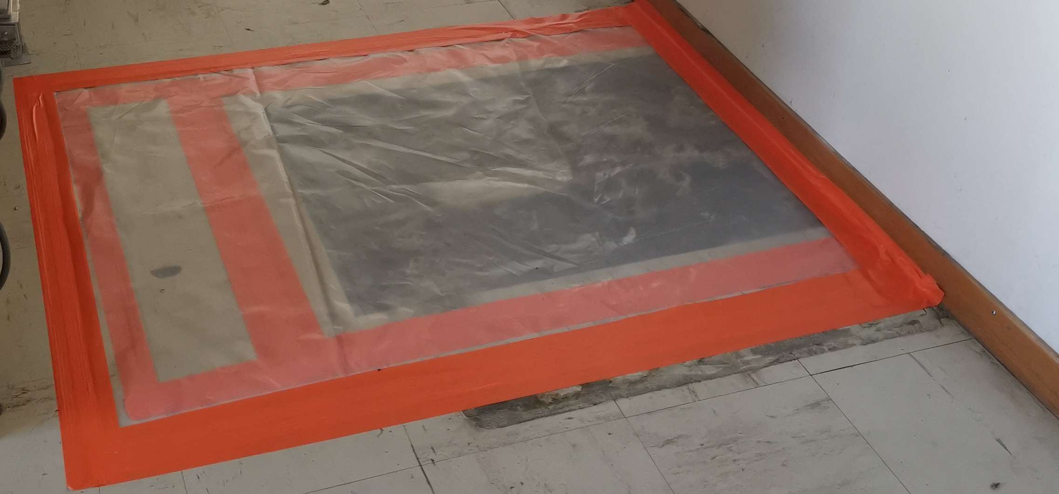
Status of the Production Sites – “Stacking” of BLM ICs in 37/R-17
Room clear of excess material
Removal of all items necessary in order to access the floor to assure vacuum compatible floor sealing
Asbestos found in the floor. Refurbishing ongoing in agreement with CERN HSE (safety department)
Works expected to be finished by Q4 2025

Slide 18
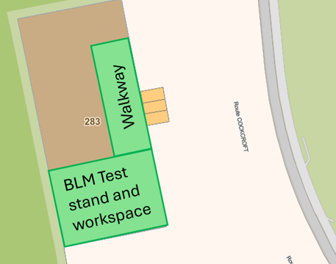
Status of the Production Sites – Vacuum Test Stand Building 283
Space cleared to allow for the installation of the BLM Vacuum Test Stand
Total about 8m by 6m needed for the installation
Pallets of material arriving as from now on
Surface refurbishment foreseen in Q4 2025
Walls to avoid drafts installed in Q4 2025/Q1 2026

Slide 19

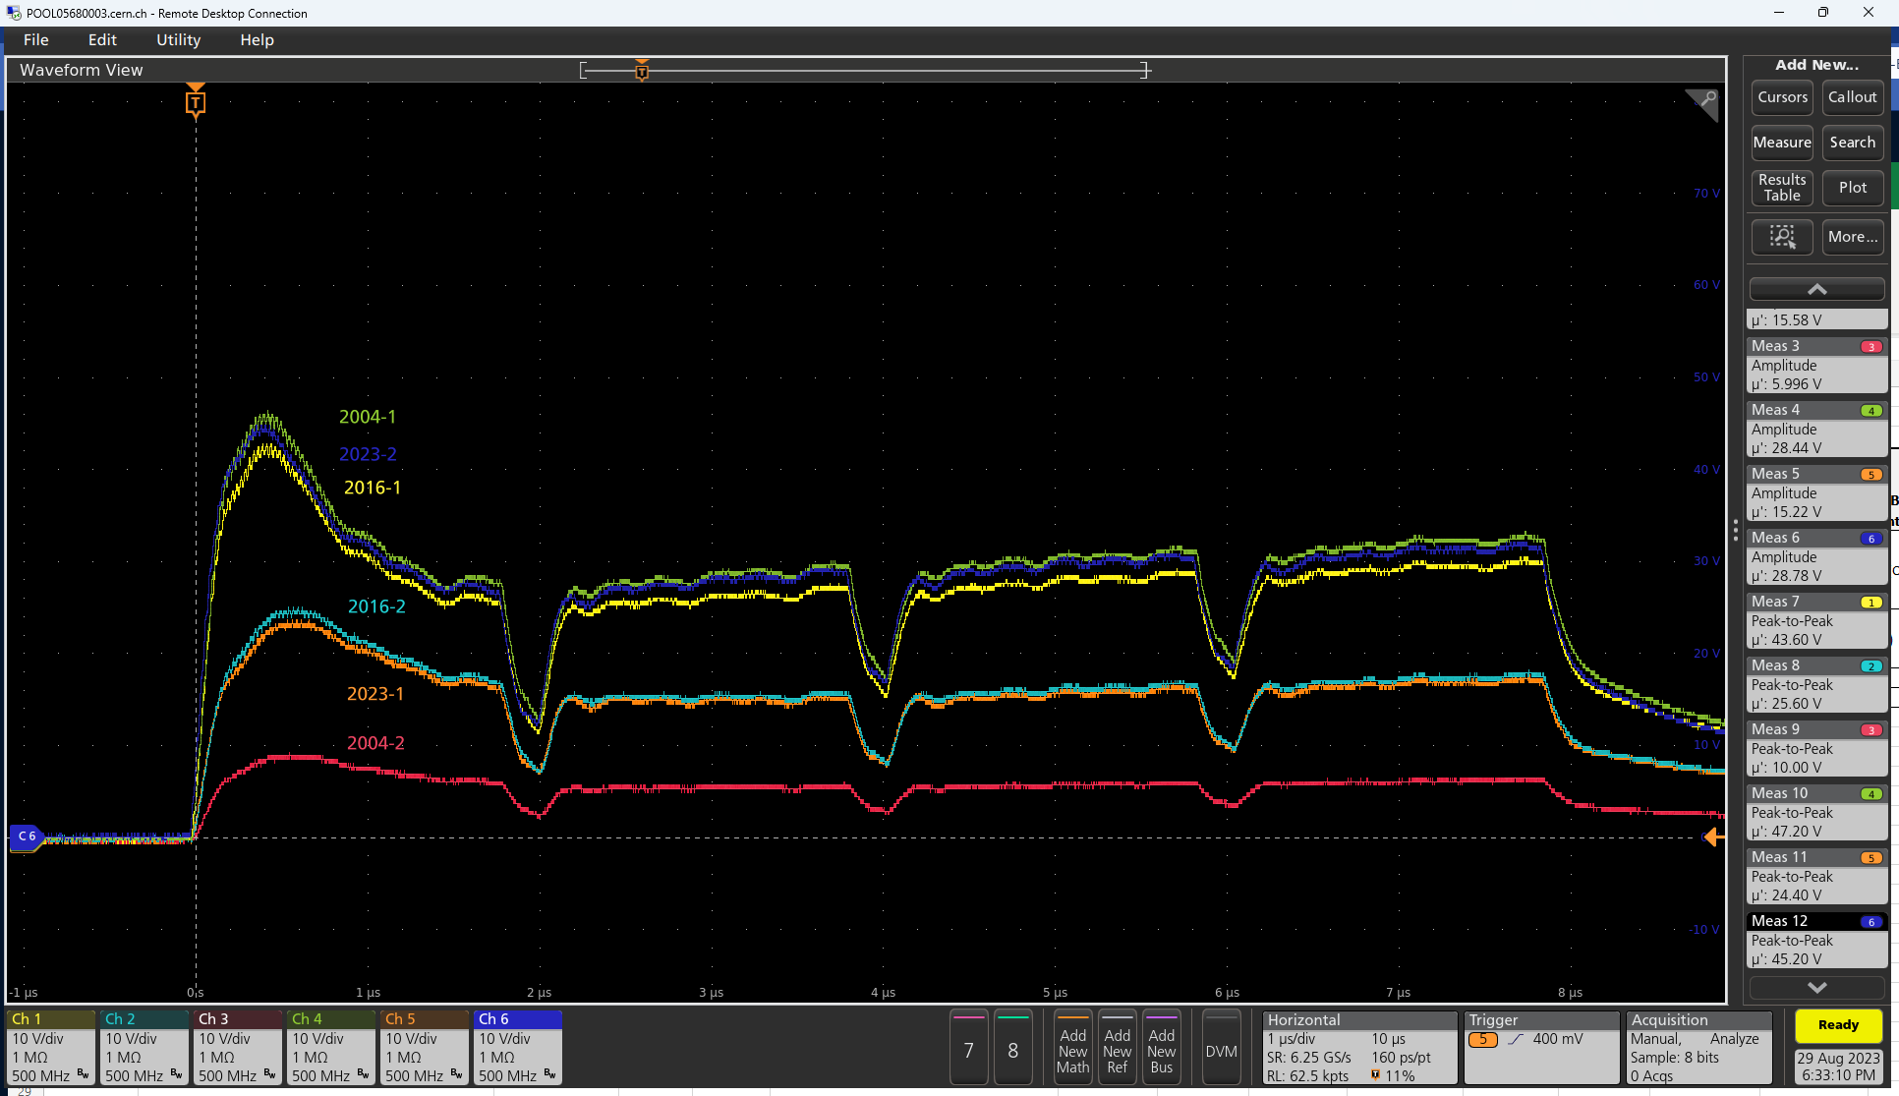
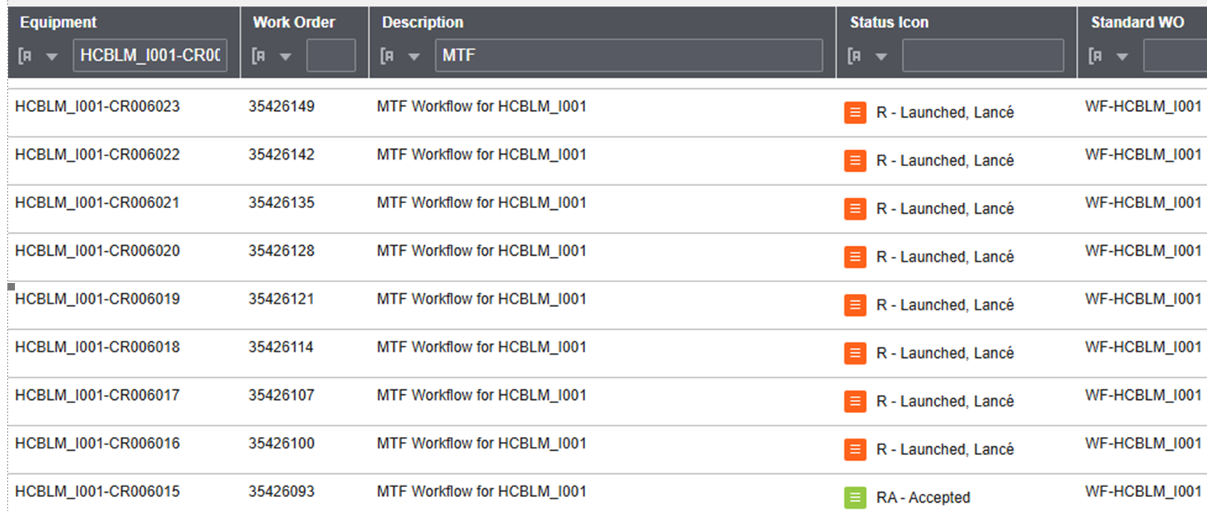
Status and Strategy of the Quality Assurance
All incoming parts checked
Full BLM IC assembly made with each new batch to check assembly and functionality to its end
Checks of the full assembly made in HiRadMat facility, until now all performing as expected
CERN inhouse EAM quality documentation system used
Courtesy: C. Zamantzas

Slide 20
Outlook
Timeline:
30 units to be delivered by end 2025, of which 15 are already made
Each 400 units to be delivered by end 2026 and 2027
Remaining units in 2028

Slide 21

The core team
Victoria: Following up orders, building management, quality assurance, procedures, vacuum test stand operation…
Wilker, Dion, William: Electrical checks, BLM Electronics
Coline (Technical Student): Finalise design of vacuum stand, procurement of components
Pedro (PJAS from Brasil, start today): Ramp up the production, Assembly test stand, QA
Morard: Mechanics
Thibaut (Coiffet) EN-MME: Prototyping, welding
Jean-Mark EN-MME: Procurement raw material and components
Nicolas, Isaiah: Manufacturing designs
Alvaro IPT/PI: Purchasing of big contracts
Cesar TE/VSC: Vacuum acceptance tests
Gerhard: Presentations
Christos: The BLM man
… and many more from ATS-DO, HSC-OHS, TE-VSC, EN-MME, …
Ready to ramp up the production

Slide 22
Summary
1,000 BLM ICs to be produced, including 200 for HL-LHC.
All relevant series raw materials are procured by CERN to guarantee the quality, especially for vacuum-critical material.
All material and sub-components is ordered.
Vacuum Test Stand designed and now under manufacture.
Lab space preparation advanced, asbestos in the floor slowed the refurbishment down.
Series production started.
Ramp-up of the production in 2026.
Total 400 units by end 2026
Total 800 units by end 2027
Remaining in 2028
Systematic checks of orders and assemblies made to assure quality, documented in EAM.

Slide 23
Questions

Slide 24
Reserve Slides

Slide 25

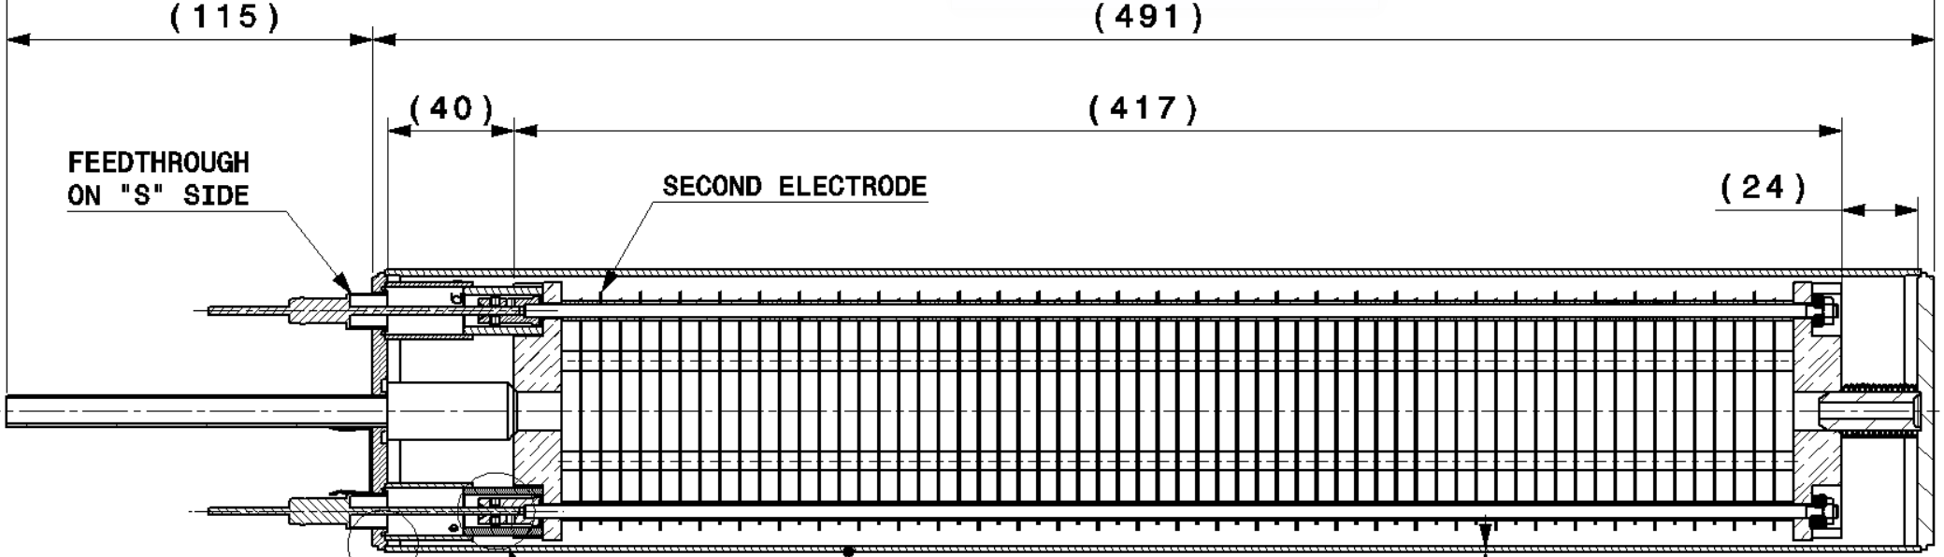
BLM IC Parts Overview
Ceramics Al₂O₃ with very low conductance (2x)
Electrodes: Al EN6082 (61x)
Ceramic Feedthroughs (2x)
Welded cover with all vacuum welds done by TIG
Vacuum container
Many other components, totaling 330 parts

Slide 26
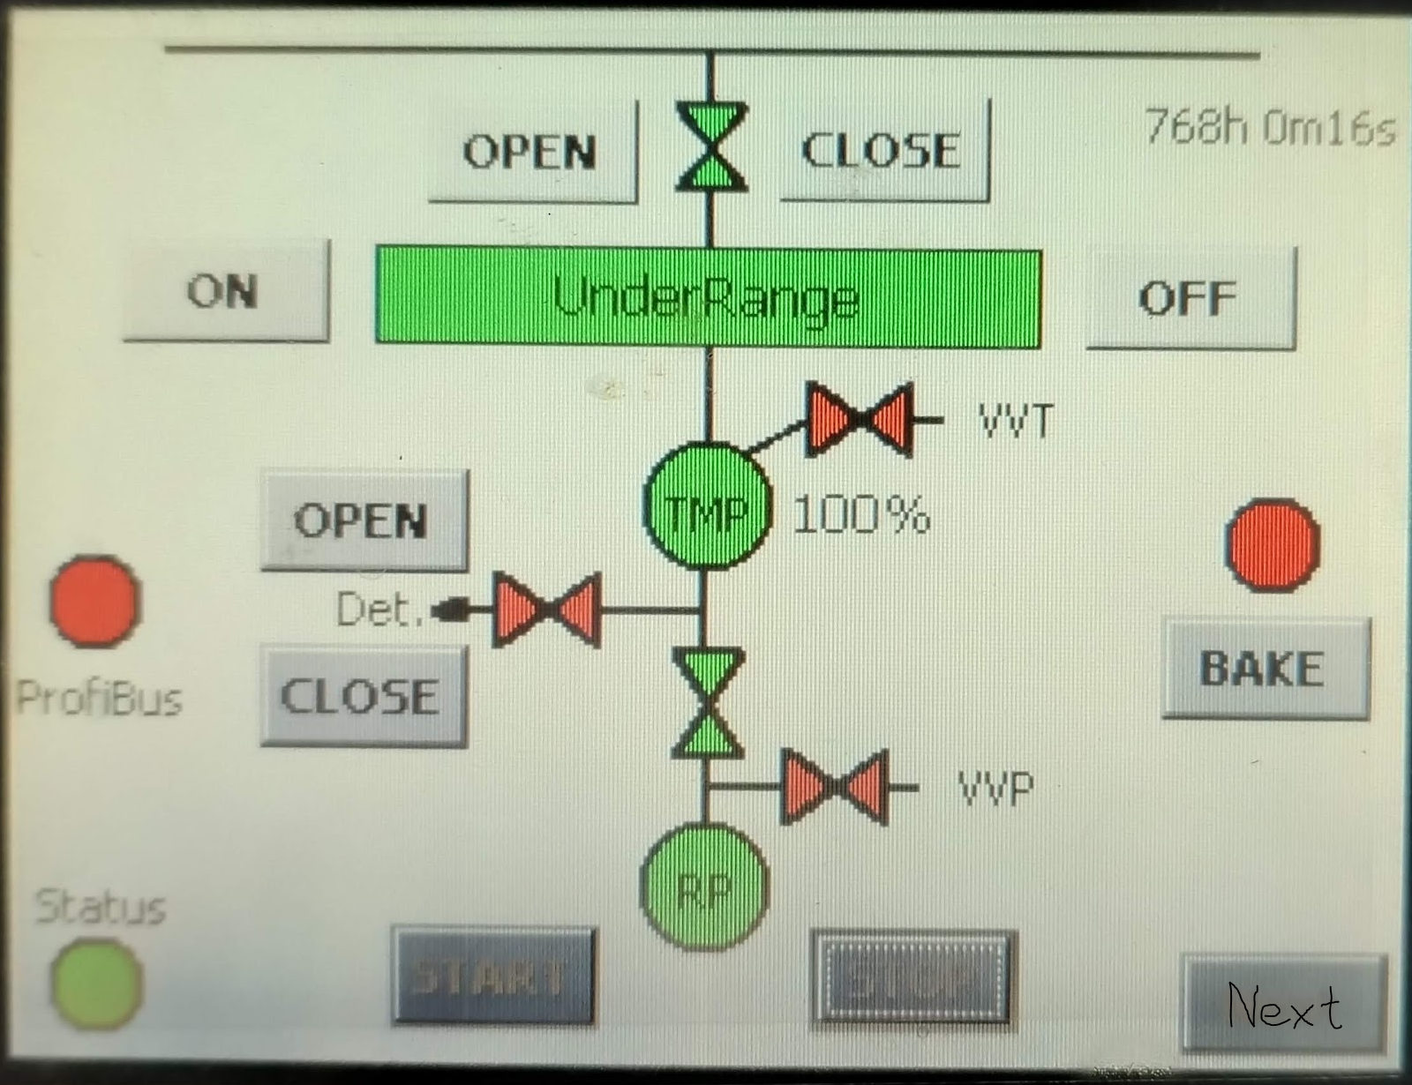
Test Stand Synoptic
Vacuum controls for pumping system including Turbo Molecular and primary Pumps
Procedure for BLM IC leak tightness tests, bake-out, N2 filling and RGA with use of vacuum stand EDMS 2916501

Slide 27
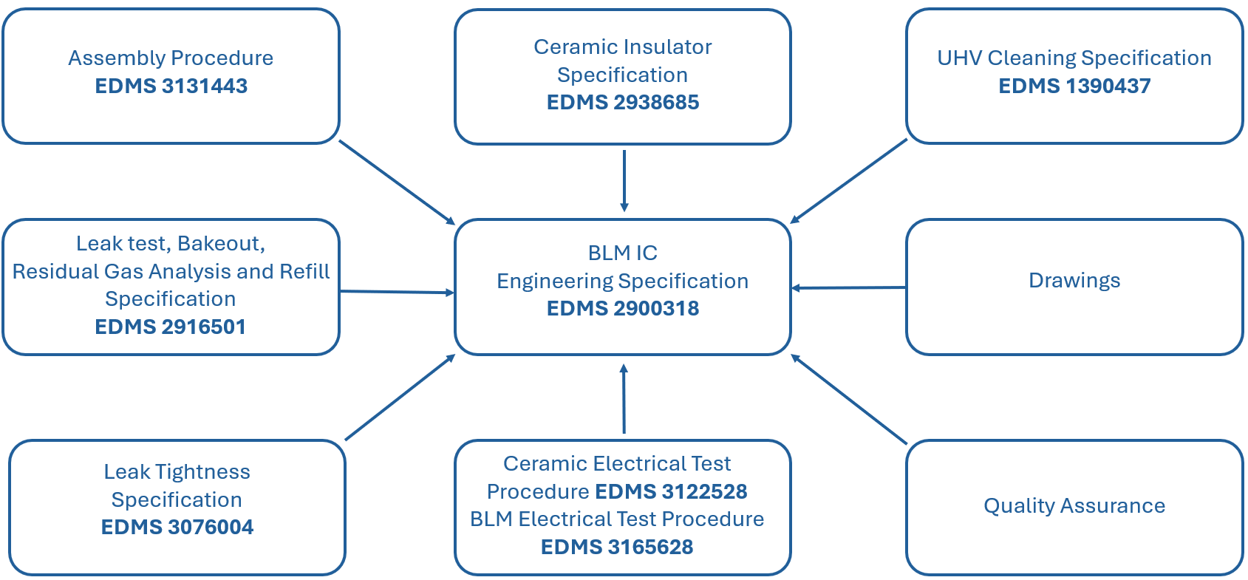
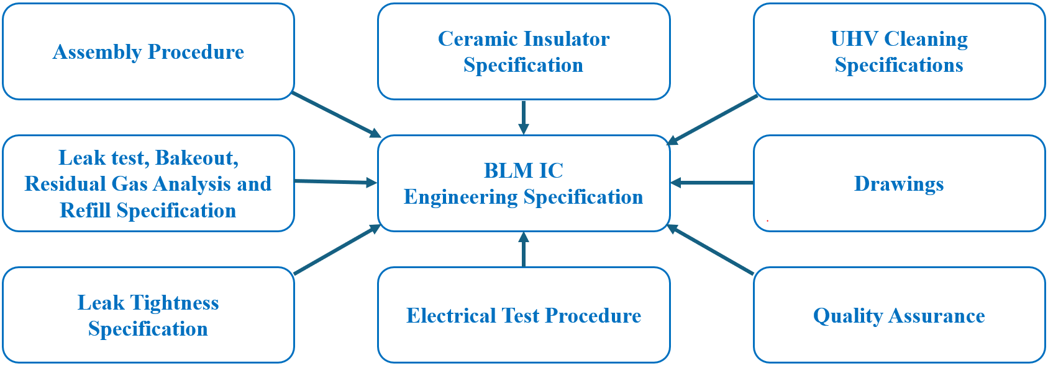
Documentation scheme
Following the end of the collaboration, a significant amount of re-engineering was required to ensure the function and quality of the BLM IC production.
The result of this process has resulted in several drawings and engineering specifications.

Slide 28
Status of the Project – Produce New BLM ICs with the New Procedures 23 and 24 in HiRadMat
Done with a beam of 288b (4x42b)
Similar Trend as previous measurements
Total 6 BLM tested: Performance as expected
Courtesy: C. Zamantzas

