Slide 1

BPM acquisition chain: overview and status
E. Balci, M. Barros Marin, M. Gonzalez Berges, A. Boccardi, I. Degl’Innocenti, C. Hulley, S. Jackson, A. Jevtic, M. Krupa, T. Wlostowski
15th HL-LHC Collaboration Meeting, CERN, 1 October 2025
Notes:
Hello, I am Irene Degl’Innocenti and today I am presenting in behalf of my team the overview and status of the beam position monitor acquisition chain for Hilumi.

Slide 2
Outline
Introduction
HL-LHC Beam Position Monitors upgrade
Motivation for a new acquisition chain
Measuring two beams in the same pipe
Key concepts for the acquisition chain
Overview
Architecture of the acquisition chain
Signal processing
Calibration
Status
Status of the hardware production
Status of development and test
Expected performances
Summary and outlook
Notes:
I will first introduce you to the system, why we need a new acquisition chain, what are the technical challenges and how we tackle them
In the overview I’ll describe the architecture of the acquisition chain and in particular the signal processing and calibration functionalities
I’ll then present the status of the hardware production and of the development and testing of the system, with a brief comment on the expected performances
Finally, summary and outlook of our activities.

Slide 3
Introduction

Slide 4
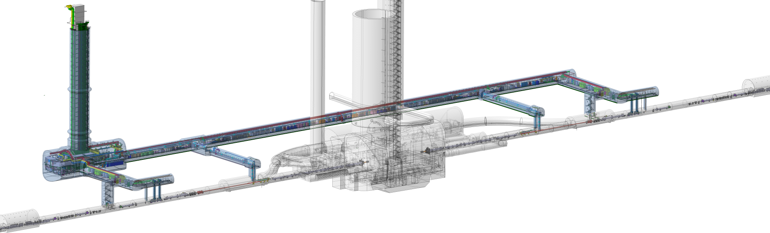
HL-LHC Beam Position Monitors Upgrade
HL-LHC upgrade: smaller beams with more particles; 10x more physics data
Extremely precise measurement of beam trajectory: >10x improvement
New beam position monitors (BPM) required
Among others, 24 new BPM with new electronics close to IP 1 and 5
Shown: IP5 (CMS)
Equivalent installation in IP1 (ATLAS)
6x new BPMs
Beam collision point
6x new BPMs
Notes:
As we know, HL-LHC upgrade aims at producing 10 times more physics data than today, by producing smaller beams with more particles.
To do so we need an extremely precise measurement of the beam trajectory, a factor ten improvement.
This will be possible by installing new beam position monitors, and in particular 24 new bpms will be installed close to the interaction point 1 and 5 (here below we see the location of the 12 around CMS collision point). This talk is about the new electronics for these specific BPMs.

Slide 5
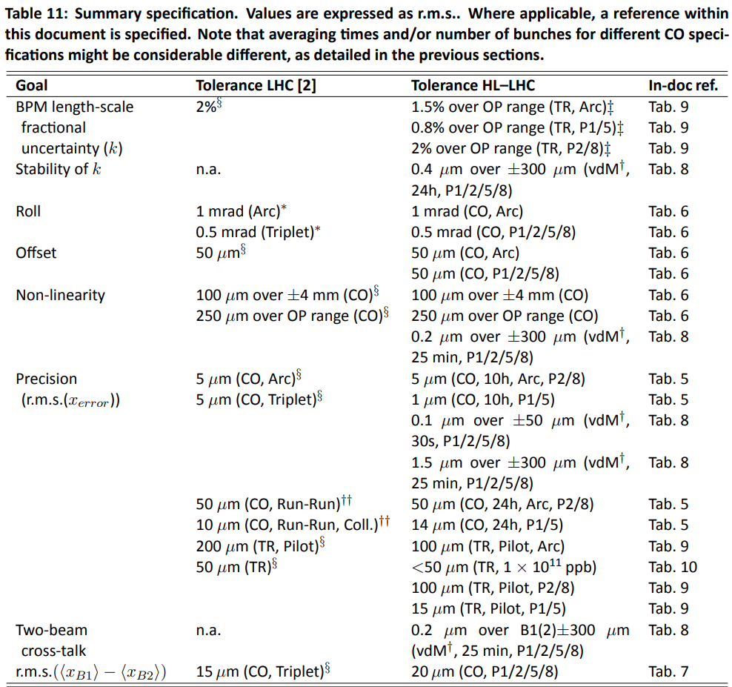
Motivation for a new acquisition chain
Challenging requirements:
BPM with larger aperture (50% less sensitivity)
…but better performances requested
Stability: not achievable with the thermal drift of the current LHC system
Bunch-by-Bunch, Turn-by-Turn resolution:
Not available with DOROS
Better then current LHC BPM
Two-beam cross-talk
Problematic in new location
Excerpt from HL-LHC BPM Functional Specifications (EDMS 2387369)
Notes:
Why these BPMs need a new acquisition chain? These pickup will have a larger aperture, which means 50% less sensitivity
But reading the system specifications, you see here an extract, we require higher performance than today.
The most challenging ones:
Stability: 400 nm over 24h, which will be very hard to get and for sure it is not achievable with the current LCH BPM system given its thermal drifts
Then for precision (or resolution): we have the bunch by bunch and turn by turn resolution required to be below 15um, and the current system does not do better than 50um, while the other system we have in the LHC, DOROS is not producing bunch-by-bunch measurements. Another challenge is the 20um precision requirement in presence of two-beam cross talk, and this is particularly problematic for the location these BPMs will.

Slide 6
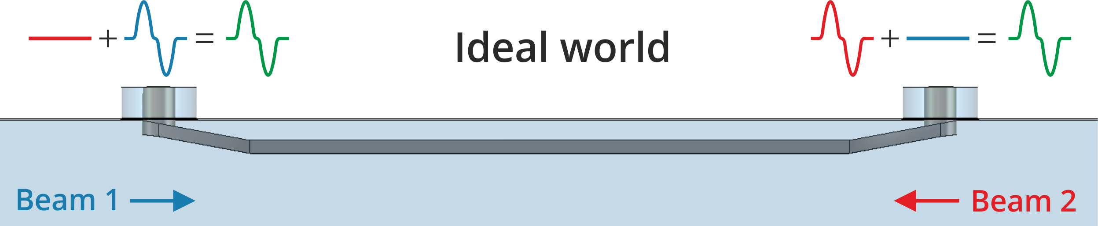
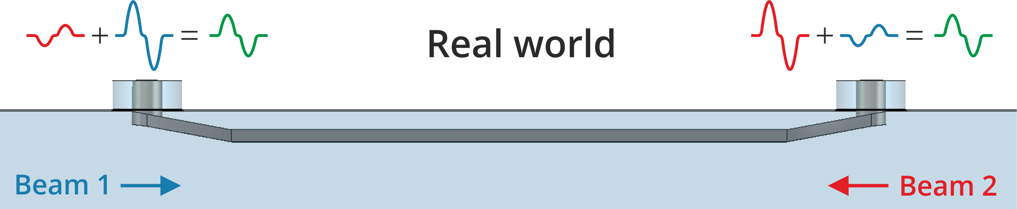
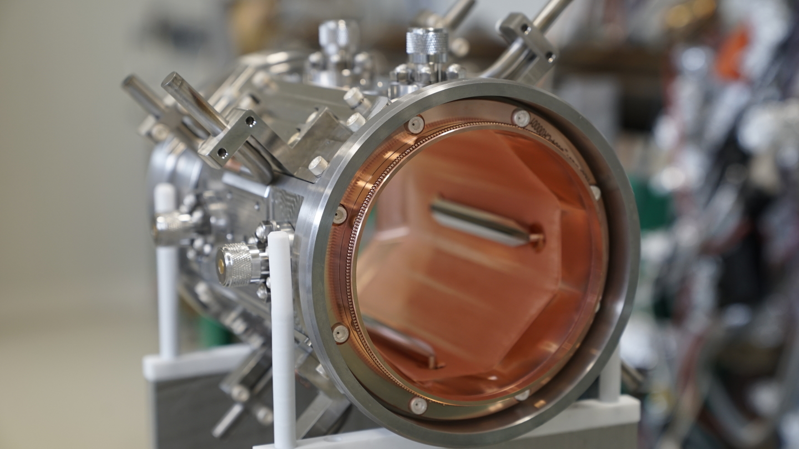
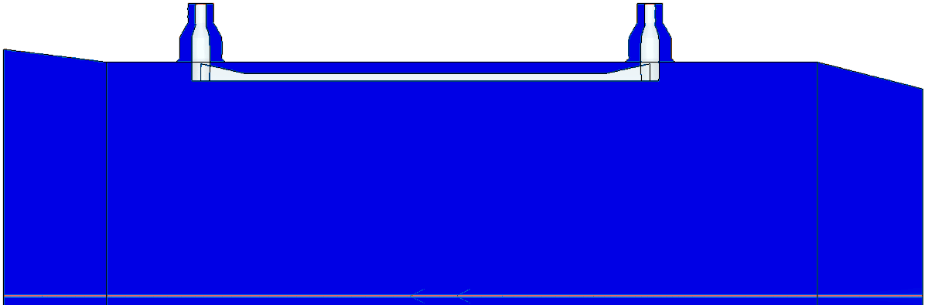
Measuring two beams in the same pipe
BPMs see both counter-rotating beams
Design of Stripline BPMs optimised to minimise signal from the other beam at the upstream port
F. E. Thompson, “First BPM for the HL-LHC in-house production at CERN”, 2025 https://cds.cern.ch/record/2932522
CST model and simulation by Michal Krupa
Notes:
These BPM will measure two beams within the same pipe. We can design stripline BPMs optimized to minimize the signal from the other beam, as the HL-LHC BPM stripline we have designed and you see in picture. In the ideal world at each port you see only the signal from the upstream beam.
In the real world, there will always be some signal left from the counter rotating beam.

Slide 7
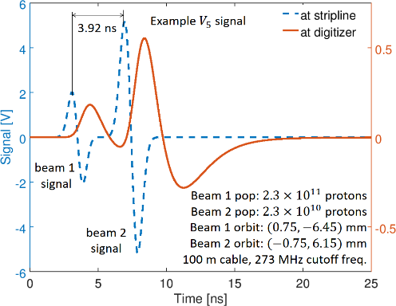
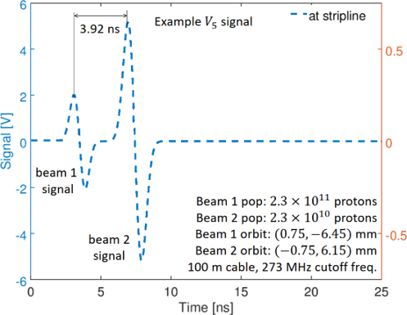
Measuring two beams in the same pipe
The presence of the other beam affects the measurement when:
Short bunch-crossing time
Intensity of the other beam is significantly higher
Include cabling dispersion and filtering
Simulation: error ~100 um
To compensate this error the processing system must be capable of separately measure and compare the two sub-signals for all the 8 electrodes at the same time for each bunch (every 25 ns)
Counter-rotating beam
Beam we want
to measure
Simulation by Doug Bett of one electrode voltage signal
Notes:
BY looking at the signal it is evident when this is a problem. This is a problem when the two beams pass almost at the same time, which is true close to the interaction point and our worst case is a bunch crossing time less than 4ns, as pictured here.
It is also worse when the intensity of the counter rotating beam is significantly higher, like a factor 10 as in the picture. And the necessary cabling and filtering also mix up the two sub signals.
By simulation we estimated an error in the order of the 100um, which is way higher than 20 um.
We need to compensate this error and so the acquisition chain must be capable of separately measure and compare these two sub-signals for all the 8 ports at the same time for each bunch, so every 25 ns.

Slide 8
Key concepts for the acquisition chain
Very long cables (100-350m) and electronics out of radiation
Nearly-direct digitization and advanced DSP:
Filtering and gain adjustment in analog front-end
8 multi-gigasamples ADCs for 8 BPM ports
8 channels real-time processing with mixing of 8 input signals for two-beam cross-talk correction
Long-term stability: calibration embedded in the system to measure and correct drifts
Notes:
So what are the key concepts for the system we have been developing:
Very long cables to get high performance electronics out of radiation
Nearly-direct digitization and advanced digital signal processing, so an analog front-end to filter and adjust gain levels, then 8 multi-gigasamples ADCs for 8 ports, and processing logic capable of processing 8 channels in real-time and mixing them to perform two-beam cross-talk correction.
Then to ensure long-term stability the system needs embedded calibration functionalities.

Slide 9
Overview

Slide 10
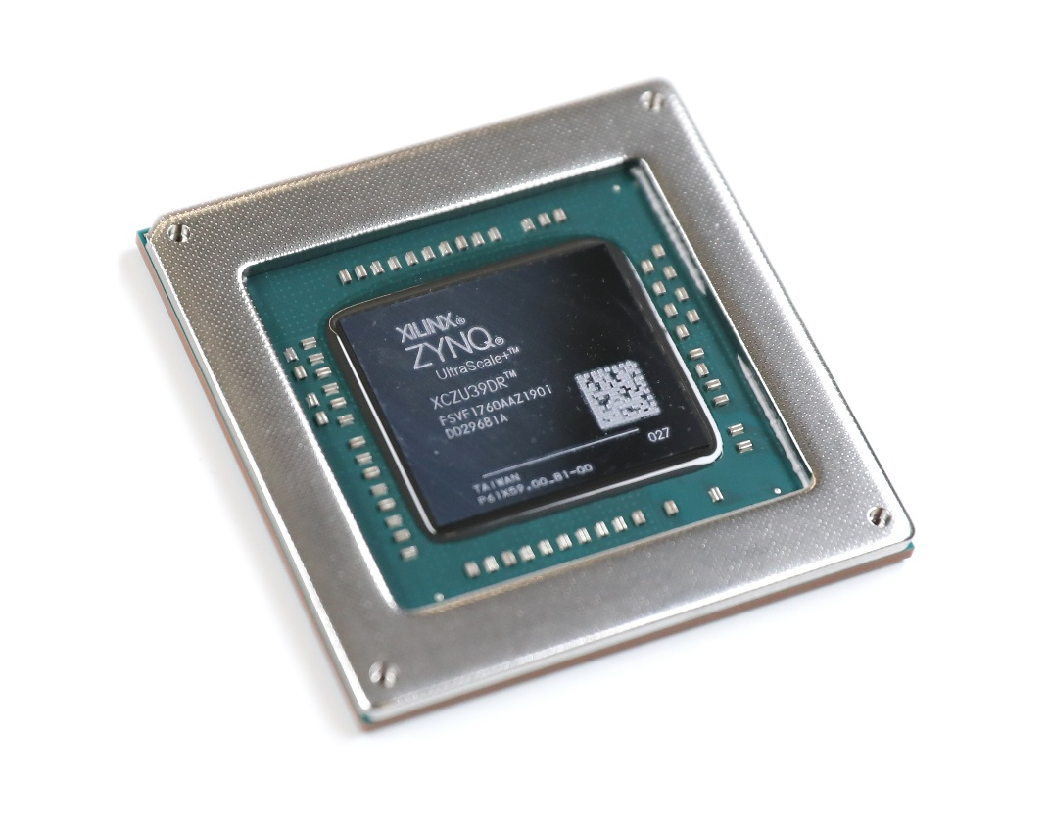
Architecture of the acquisition chain
Based on Xilinx Zynq UltraScale+ RFSoC
Integrated in the same device:
8 ADCs 14-bit 5GSPs and 8 DACs 14-bit 8GSPs
Processing System
FPGA
Performance and cost analysis (IPAC’23 THPL089)
Compatible with ATS SoC Framework development
SoC integrated in accelerator control system as standard front-end computer
Modular HW platform in a pizza-box:
Commercial RFSoC SoM, system specificities moved in CERN-designed carriers
AFE with HL-LHC BPM analog signal processing
System carrier with beam timing interface and ATS SoC Framework dependencies
BPM signals
Network
SoM
AFE
System carrier
Notes:
First of all the architecture of the system
It is based on the Xilinx Zynq UltraScale+ RFSoC, a device where are integrated: high-performance RF components, 8 Analog to Digital converter and 8 Digital to Analog converters
A processing system with multi-cores CPUs, and FPGA programmable logic. We have evaluated this component and found it to be performance-wise and cost-wise comparable with discrete component solution with equivalent RF performance, but with the perks of simplified integration.
This platform is compatible with the development fot the ATS sector SoC Framework, so we will be able to integrate this SoC in the accelerator control system as a standard front-end computer
We will have then a modular HW platform in a pizza-box. We are buying commercial RFSoC System on Module PCBs, and move all the system specificities to CERN designed carriers.
An analog front-end carrier with HL-LHC BPM specific analog signal processing
And a system carrier with interface to the beam timing and all the dependencies of the ATS SoC Framework.

Slide 11
Signal processing
BPM electrode port signals:
Wideband (DC-6 GHz) pulse for each bunch (every 25 ns)
Including pulse from the other beam
Amplitude → bunch displacement
Pulses are conditioned:
Dispersion: 100m – 350m long cables
Filters: LP (200MHz) + anti-aliasing
Gain adjustment
Digitisation:
ADC 5 GSps (125 samples per bunch), 14 bit (68 dB DR), free-running clock
8 channels produce 490 Gbps of raw data!
Notes:
Which signal processing steps we are implementing in the chain.
Looking at the signal produced by the BPM electrode, for each bunch we have a wideband pulse, including the one from the other beam, and keep in mind that we want to retrieve its amplitude, which depends on the bunch displacement.
The pulses are conditioned and stretched by cabling and filtering and gain adjustment
They are then digitized by the SoC, at 5 GSPs with 68 dB of Dynamic range and a free-running clock. 8 channels produce 490 Gbps of raw data!

Slide 12
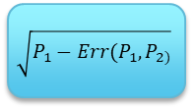
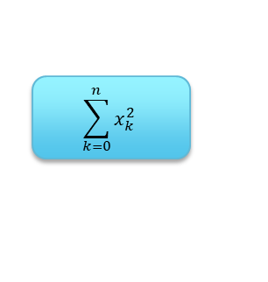
Signal processing
FPGA:
Synchronisation with beam timing to the sample (~200 ps)
Bunch electrode port integral power
Amplitude computation with two-beam cross-talk correction by power compensation algorithm (Details: EDMS 2669844)
Data averaging and/or aggregation
FESA (SW) in the SoC Processing System:
Bunch position computation from electrode amplitudes
Intensity normalization + polynomial correction
Continuous logging to NXCALS
Control and storage on NFS of on demand acquisitions
$$\sum_{k=0}^{n}{x_{k}^{2}}$$
$$\sqrt{P_{1}−Err(P_{1},P_{2)}}$$
Position (mm)
Notes:
This data is handled by the FPGA in the SoC
It is first synchronized with the beam timing to the sample
We then compute the Bunch electrode port integral power and we use the 8 powers to compute the amplitude with two-beam cross talk coreection applying a power compensation algorithm.
We than average and or aghgregate the data depending on the data acquisition mode.
Finally the FESA class, our SW running in the SoC processing system, computes the bunch position out of the electrode amplitudes, and performs logging and storage.

Slide 13
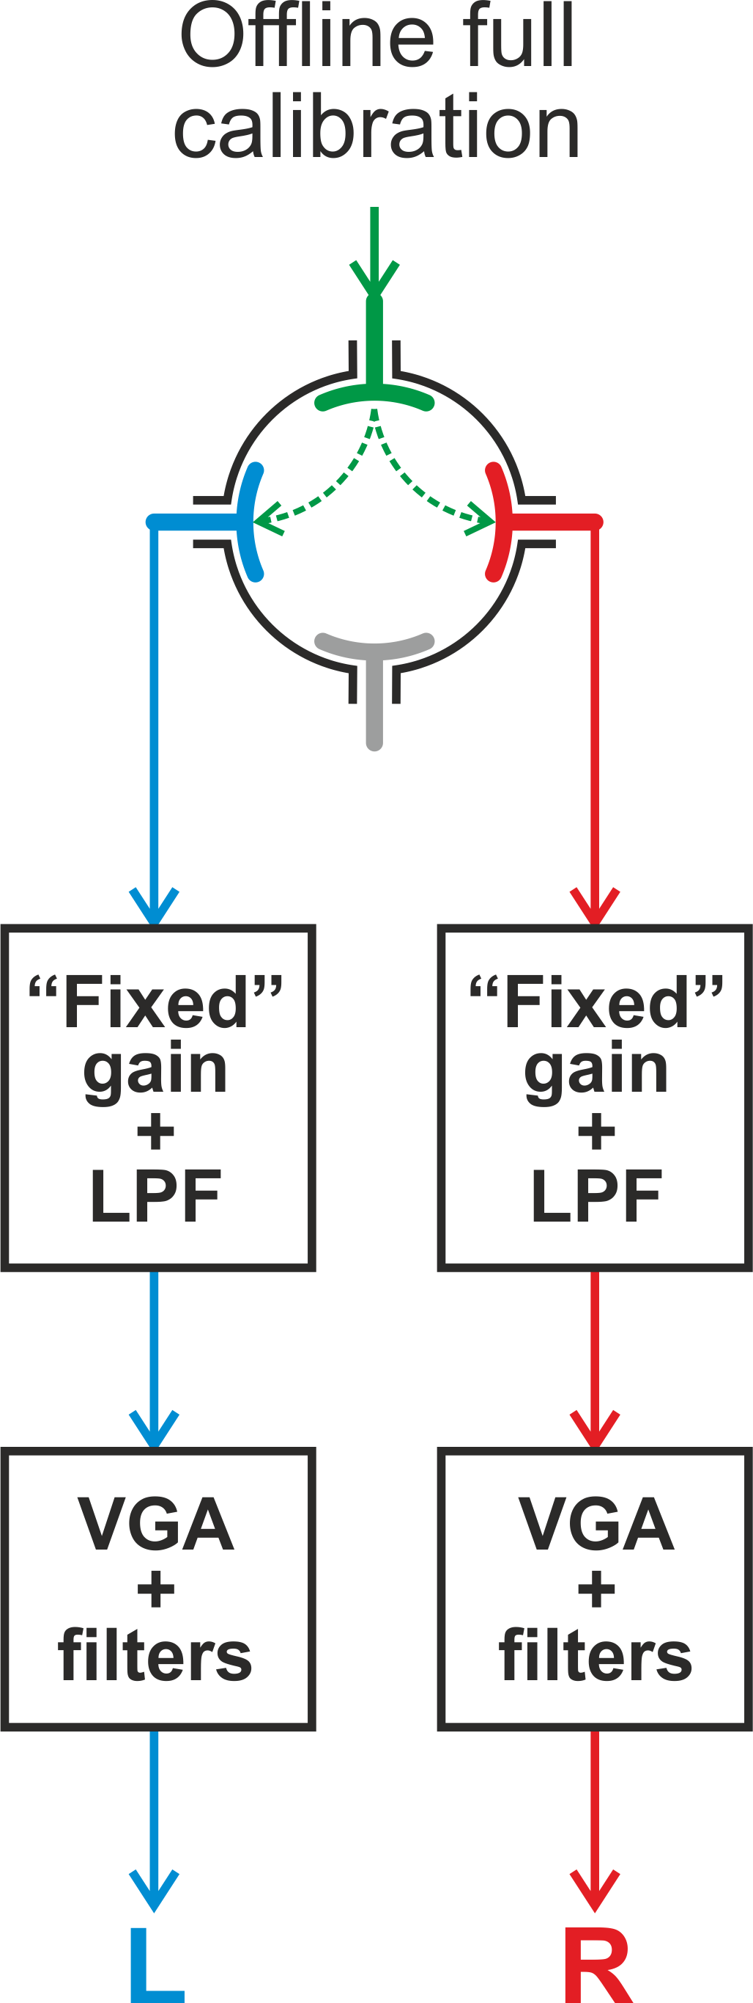
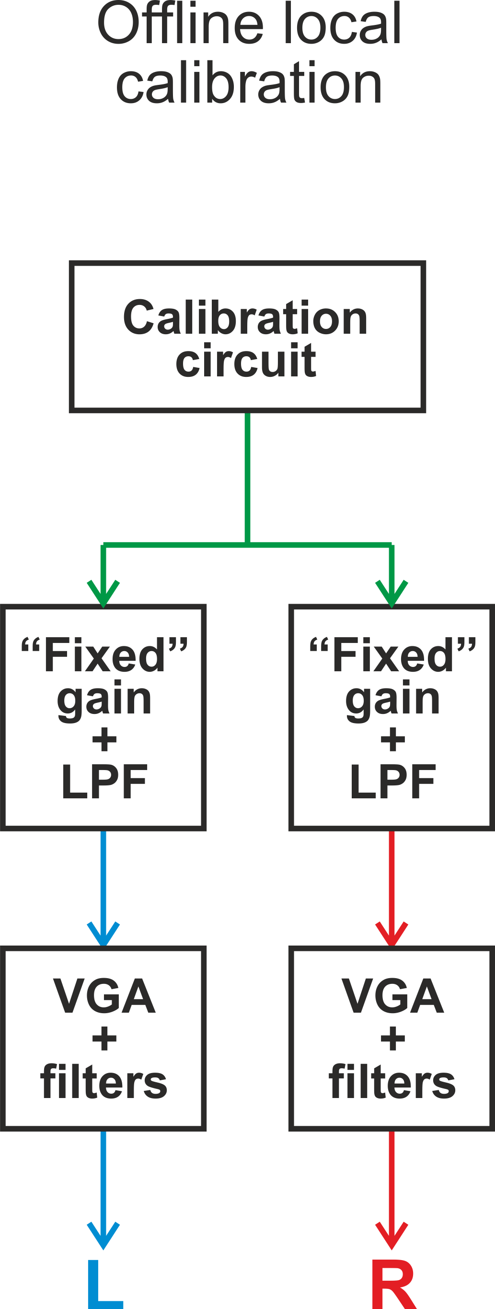
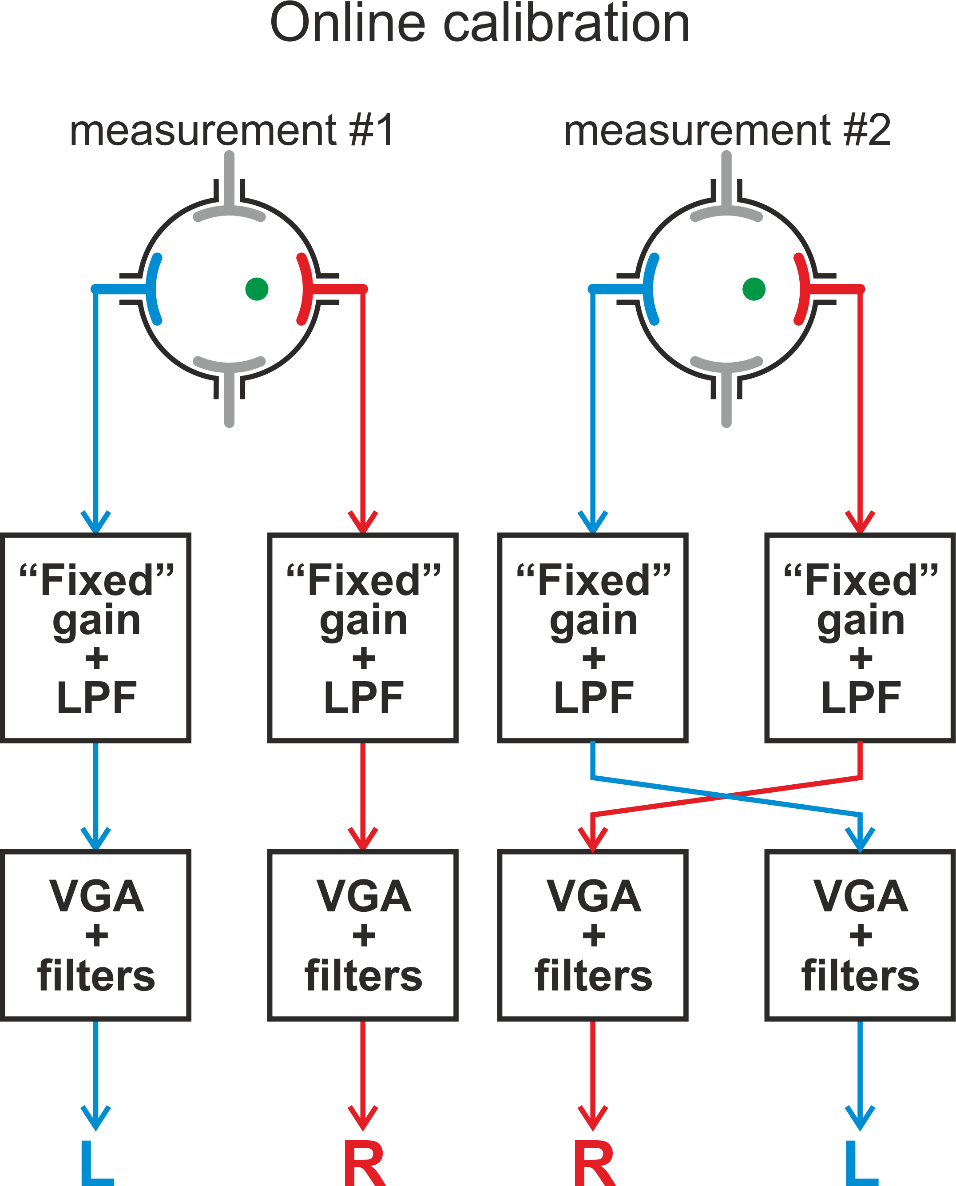
Calibration
Unbalance in two opposite channels
→ an erroneous beam position
3 types of calibration methods foreseen
Online: Cross-bar switching
Offline:
signal through AFE
signal through BPM
Implementation in SoC PS + DAC:
Fast switching control
DAC signal generation
Notes:
Regarding calibration, we know that any unbalance in two opposite channels creates an erroneously measured beam displacement.
So we are implementing 3 types of calibration,
An online calibration by cross-switching the channels,
And offline calibration by injecting calibration signals in the analog front-end and through the pick-up
This is implementing in the real-time processing unit of the SoC and by making use of the DACs

Slide 14
Status
Notes:
Concerning the status of the system

Slide 15
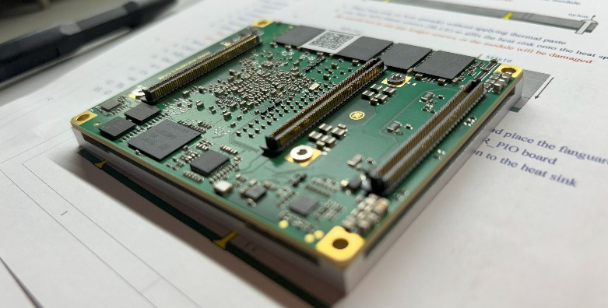
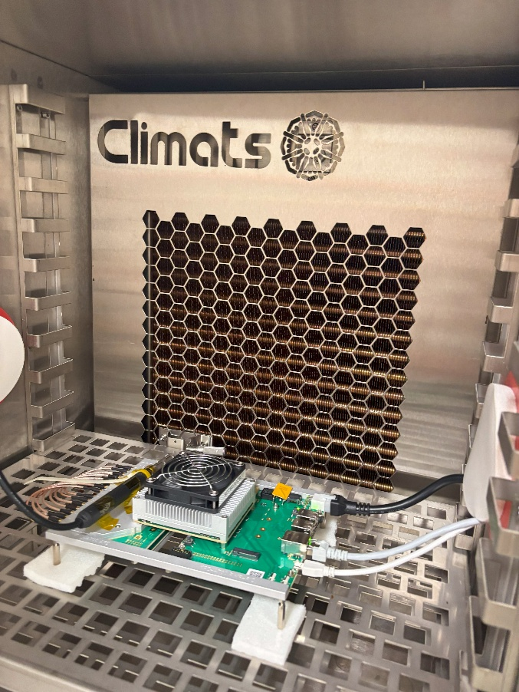
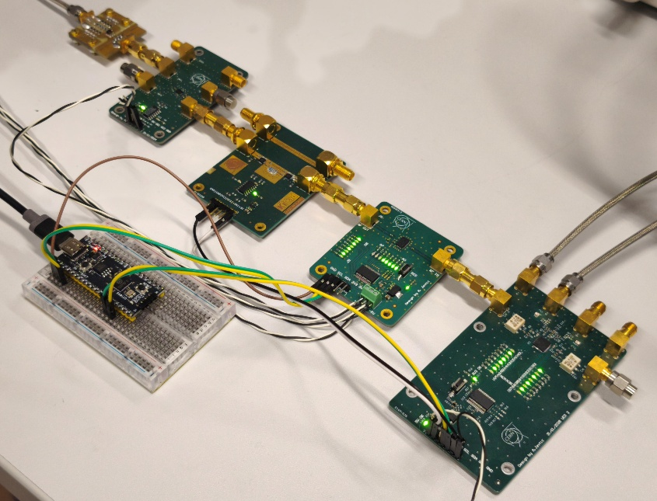
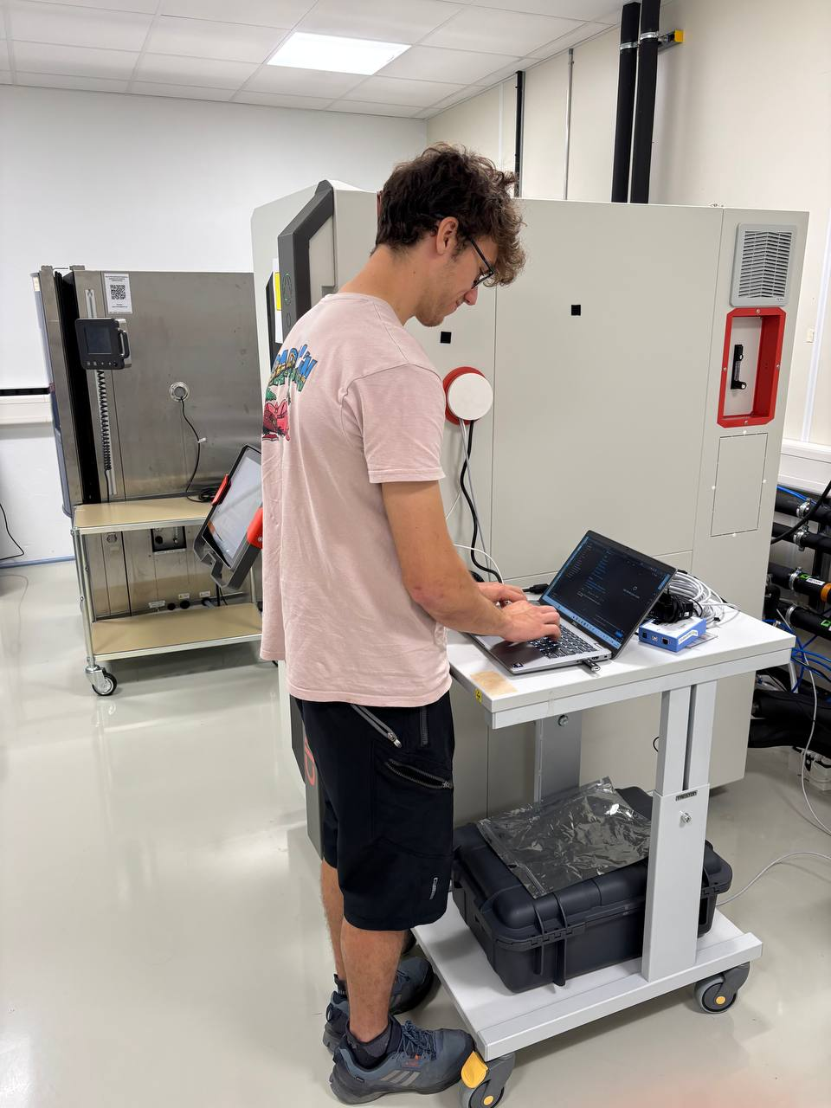
Status of the hardware production
SoM:
Procurement of 70 KRM-4ZU47DR
Successful qualification of the pre-series
Test in climate chamber for 10 days
Thanks to RAWG and QART Lab support!
Prototyping of AFE and System carrier ongoing
Notes:
For hardware production we have made a big advancement by closing the procurement for 70 SoMs from Knowledge Resources (KR). We have already succesfully qualified the pre-series by stress-testing them in a climate chamber for 10 days, and I’d like to thank the reliability working group and the QART lab for their support.
The selection of the SoM also speeded up the development of the AFE and system carriers for which prototyping is ongoing, you see here the modules for the AFE carrier

Slide 16
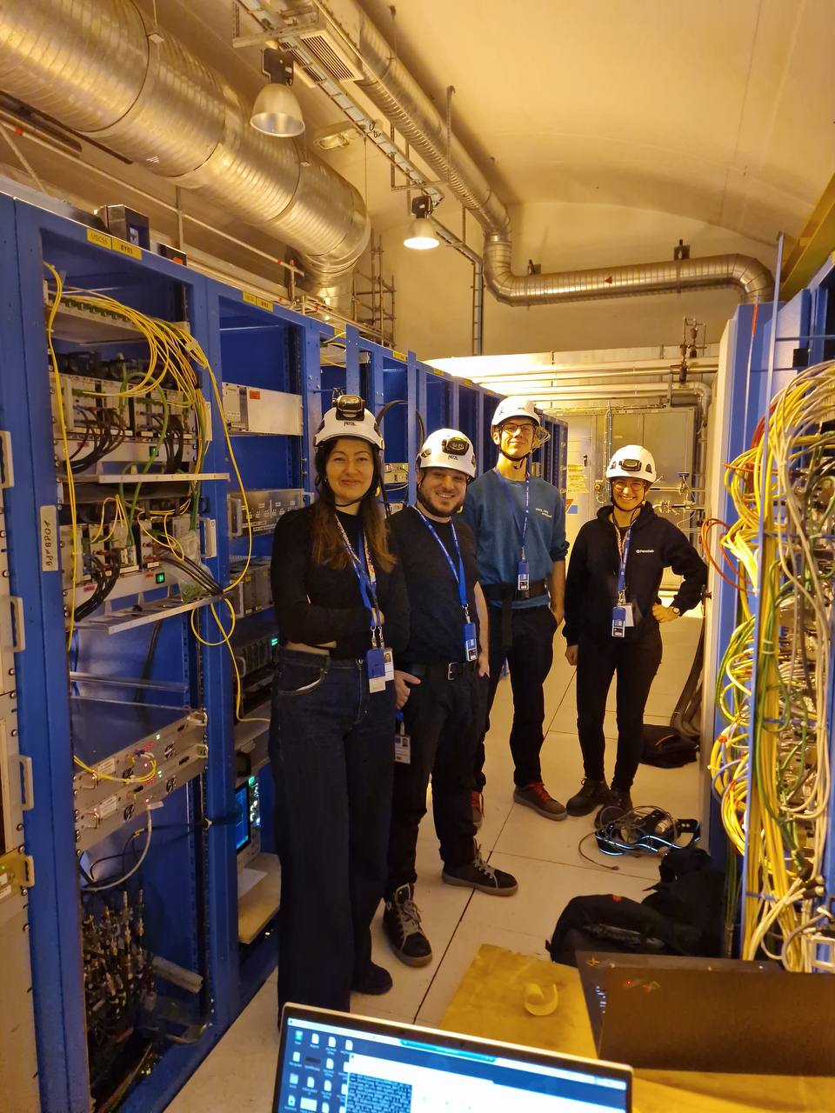
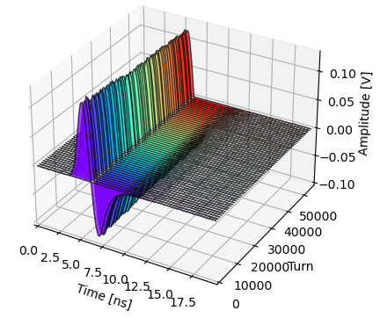
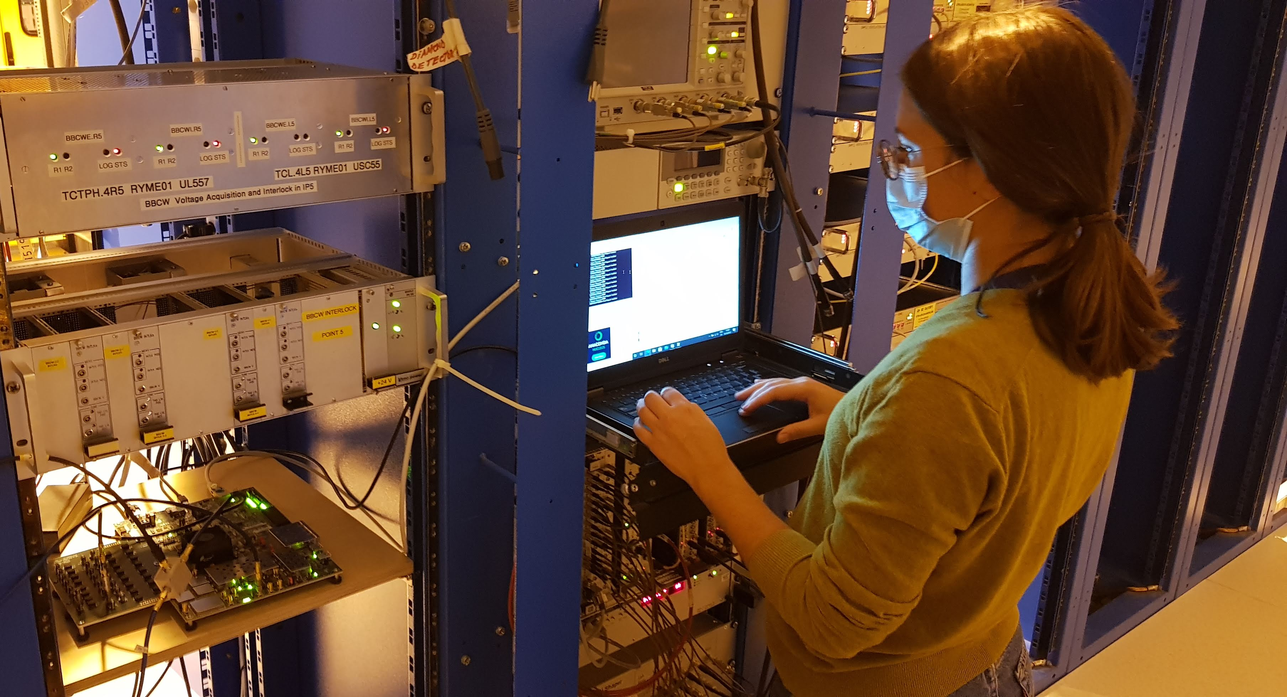
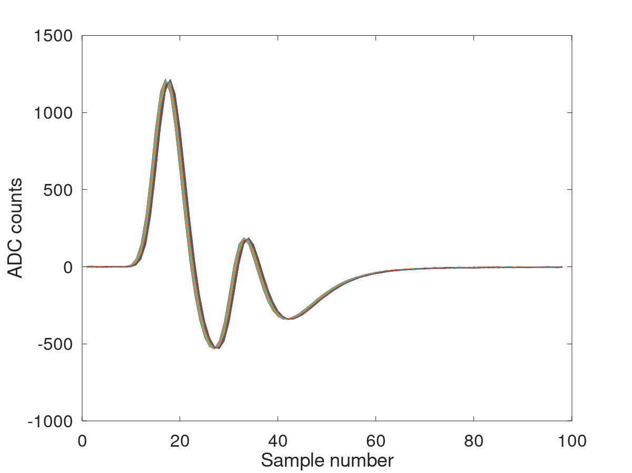
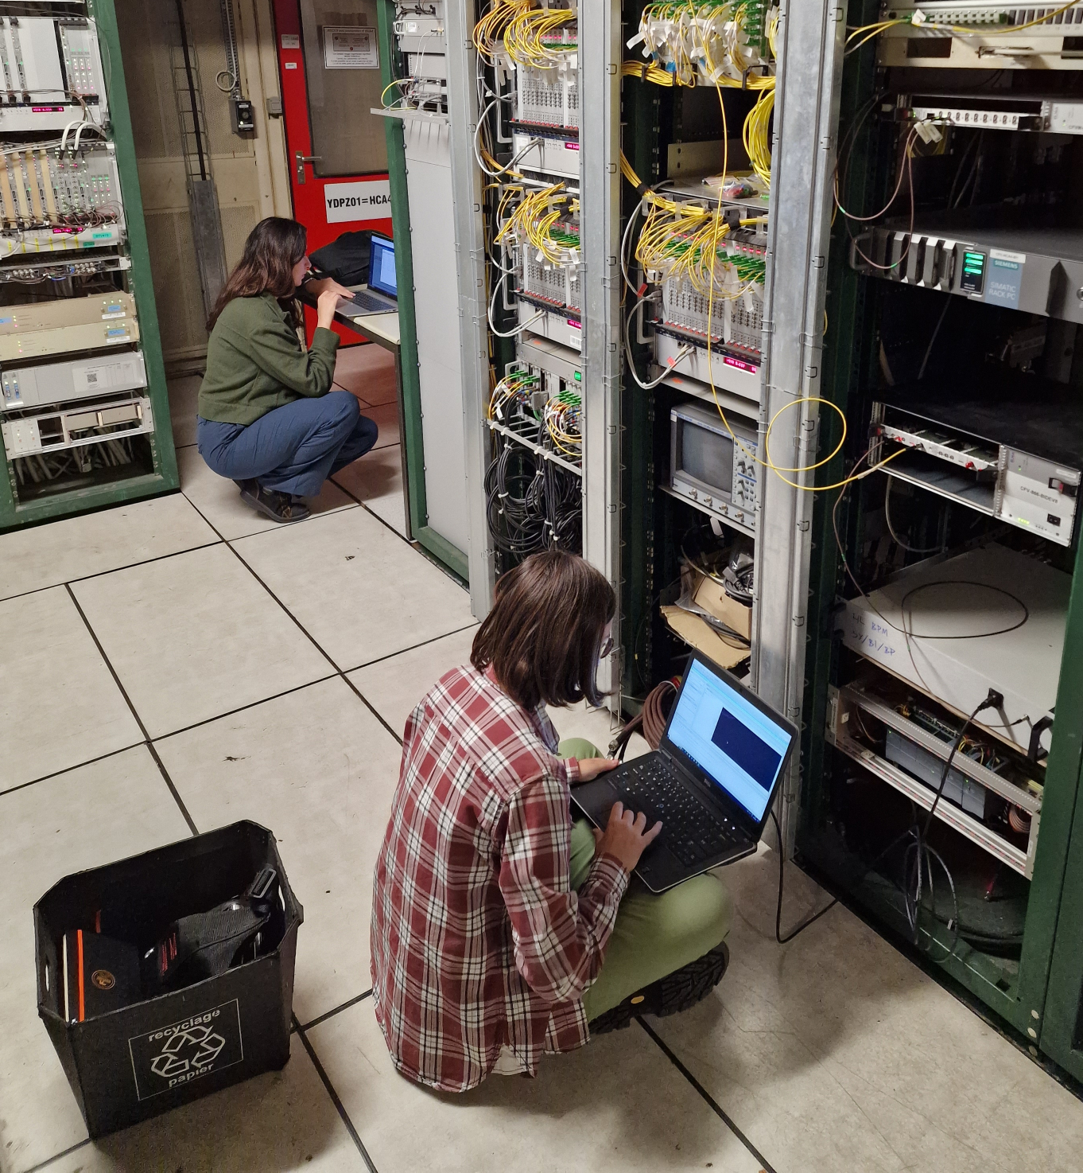
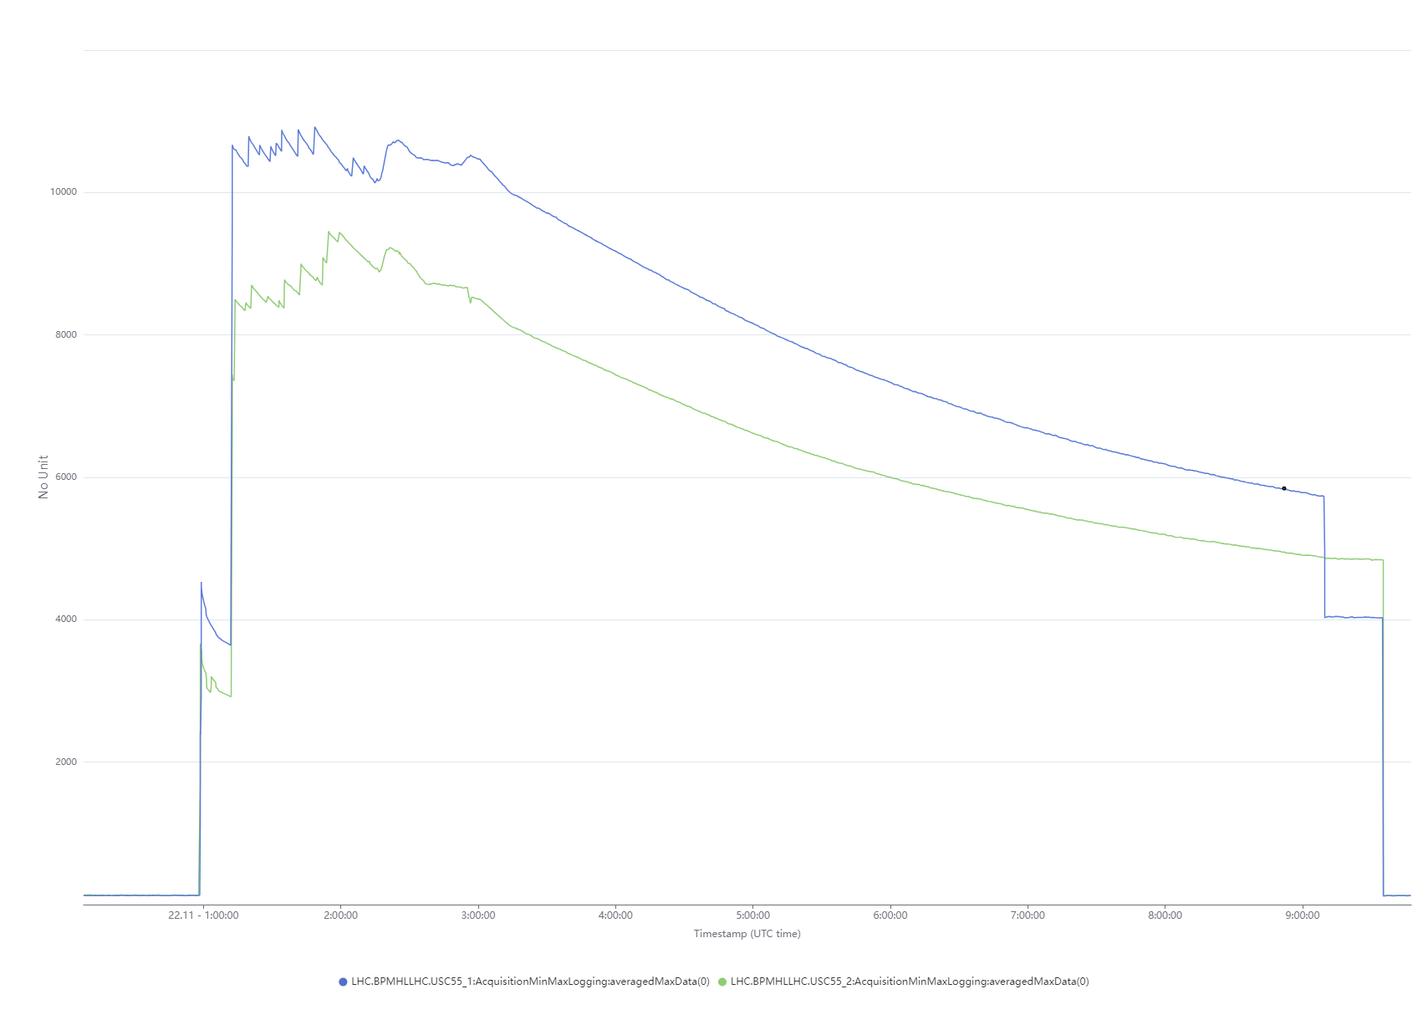
Status of development and test
Already tested with beam:
MD to gather raw data for validation of two-beam cross-talk correction algorithm
RFSoC performances with 8x5GSps ADC
Continuous acquisition and logging with beam synchronous event
Planned by end 2025:
Beam data acquisition with SoM-based electronics
ATS SoC Framework integration
Bunch electrode power computation
Planned by 2026:
Test of prototype analog front-end and system carrier
Orbit and trajectory position measurement
Planned in ~2029:
Commissioning in AWAKE of the same electronics
Notes:
Regarding development and test
We had already performed several tests until now.
In a MD we gathered raw data for the validation of the two-beam cross talk algorithm.
We have evaluated the RFSoC performance with beam data and using 8 adcs at the maximum speed.
And we tested continuous acquisition in FESA with logging of data with synchronously with beam events.
Planned by end of 2025 we have beam data acquisition using the new SoM Based electronics
Integrating as well the newly available ATS SoC framework
To perform the online bunch electrode power computation.
Then by 2026 we want to make use of the remaining beam time to test the prototype of the analog front-end and system carrier and perform orbit and trajectory position measurement.
Then roughly in 2029 we plan the commissioning of the same electronics in AWAKE.

Slide 17
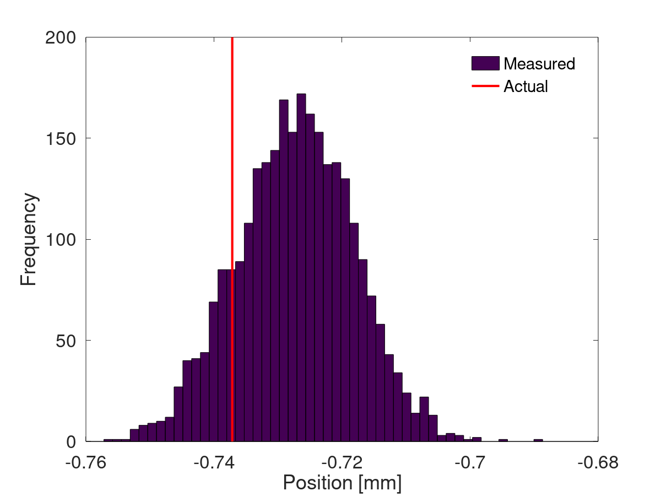
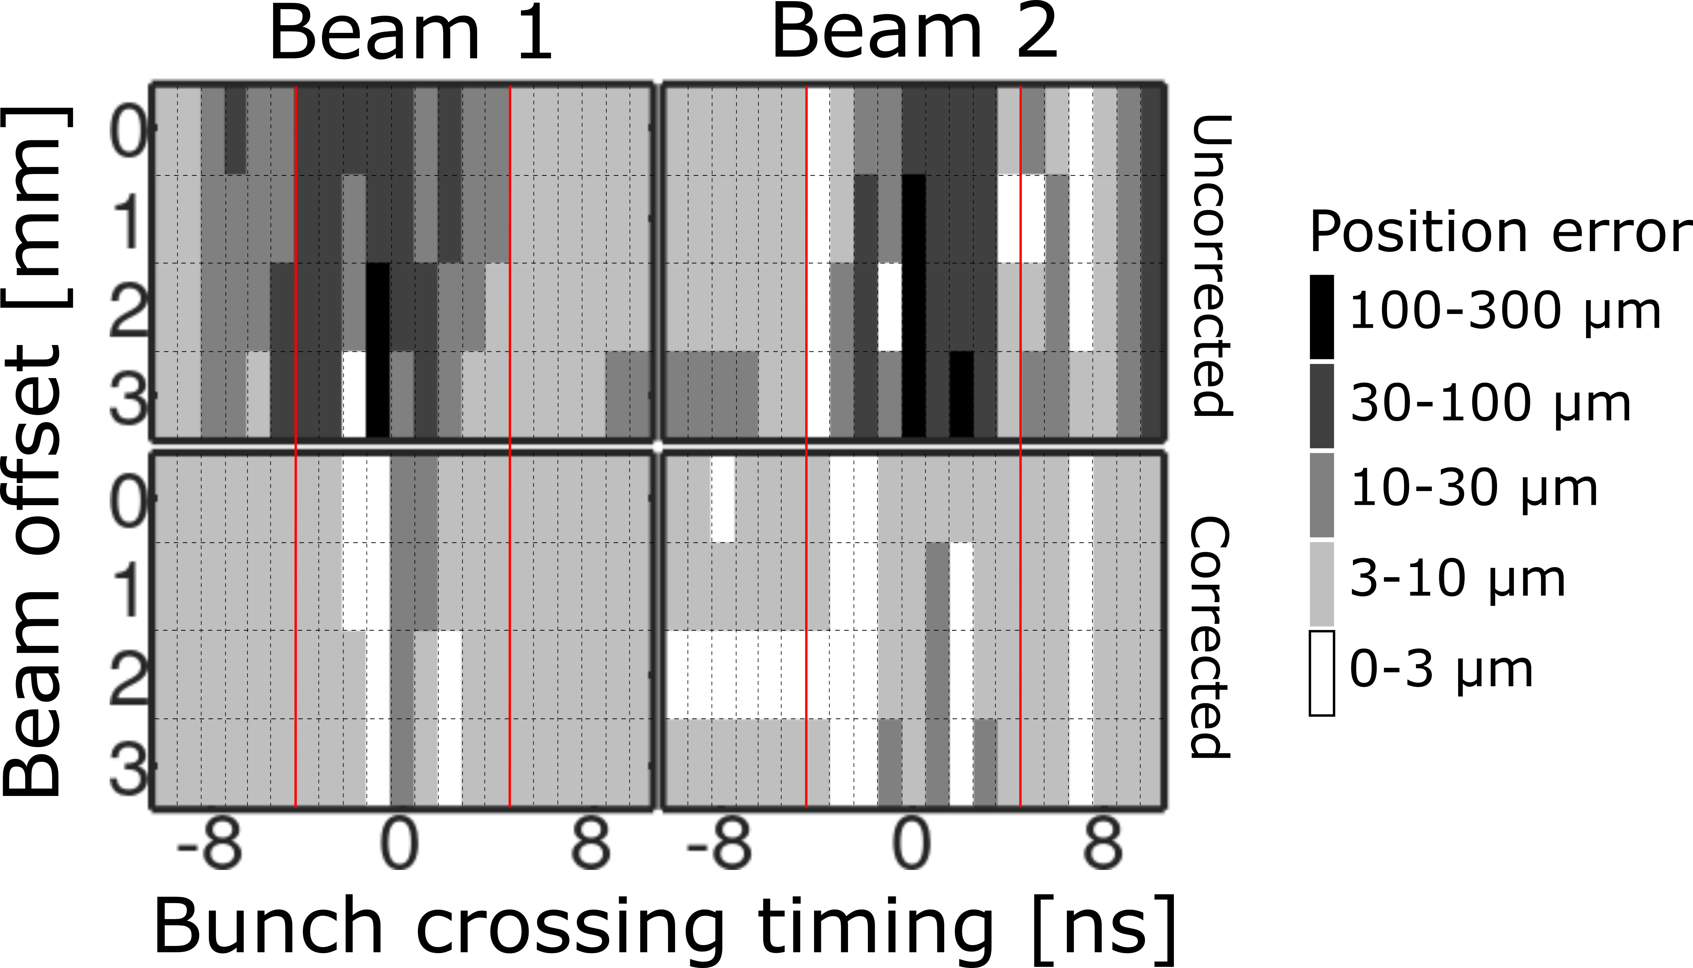
Expected performances
Check 14th HL-LHC Coll. Meeting talk
Dependent on AFE design
Expected ~DOROS
RMS:
10 μm (LHC)
~ 12 μm (HL-LHC)
Excerpt from HL-LHC BPM Functional Specifications (EDMS 2387369)
Based on offline data analysis
Notes:
Concerning performances: Michal gave an excellent talk about this last year, and to summarise:
For stability this will depend on the final AFE front-end, but we expect similar performance to DOROS.
For precision and two-beam-cross talk correction, the offline data analyses make us confident that we’ll meet this requirements.

Slide 18
Summary and outlook

Slide 19
Summary and outlook
HL-LHC Beam Position Monitor requires a new data acquisition system with high sampling rate and fast digital processing capabilities
A new acquisition system based on the RFSoC technology is in the making
Signed procurement contract of 70 SoM boards
ATS SoC Framework project for controls integration
Development and procurement are progressing according to the defined schedule and budget
Expected performance mostly in line with specifications
Based on offline analysis of raw beam data acquired with prototype electronics
To be verified with online processing of beam data and close-to-final hardware
Electronics to be commissioned in AWAKE before LHC Run 4
Notes:
Finally summarizing.
The HL-LHC BPM requires a new data acquisition system with high sampling rate and fast digital signal processing capabilities

Slide 20
Acknowledgements
Algorithm design and data analysis JAI collaboration: Doug Bett
ATS SoC Framework: Alen Ariaz Vazquez, Steen Jensen, Greg Kruk, Ioan Kozsar, Frederique Hoguin, Vasileios Amoiridis, Michael Lettrich, Andre Pinho, Greg Daniluk, Dariusz Zielinski, Nikos Tsipinakis, Federico Vaga, David Cobas, Thomas Oulevey, Pieter Van Trappen,…
SoC Interest Group community, and in particular Ralf Spiwoks, Hamza Boukabache, Clyde Laforge
RAWG: Felix Johannes Waldhauser, Lukas Felsberger
QART Lab: Ruddy Costanzi, Abhishek Sharma

Slide 21
DAQ system: Xilinx Zynq US+ RFSoC
Connectivity
Processing System
Application Processing Unit
4xArm Cortex-A53
Real-Time Processing Unit
2xArm Cortex-R5
Memory Controller
DDR4/3 Support
Platform Management Unit
High-speed
USB3.0, SATA 3.0, PCIe Gen2…
General
GigE, UART, SPI, SD/eMMC…
AXI bus and ports
Programmable Logic
8 ADCs 14-bit
5 GSps
Connectivity
100G Ethernet MAC
PCIe Gen4…
FPGA fabric
Logic elements
DSP
BlockRAM
8 DACs 14-bit
8 GSps

Slide 22
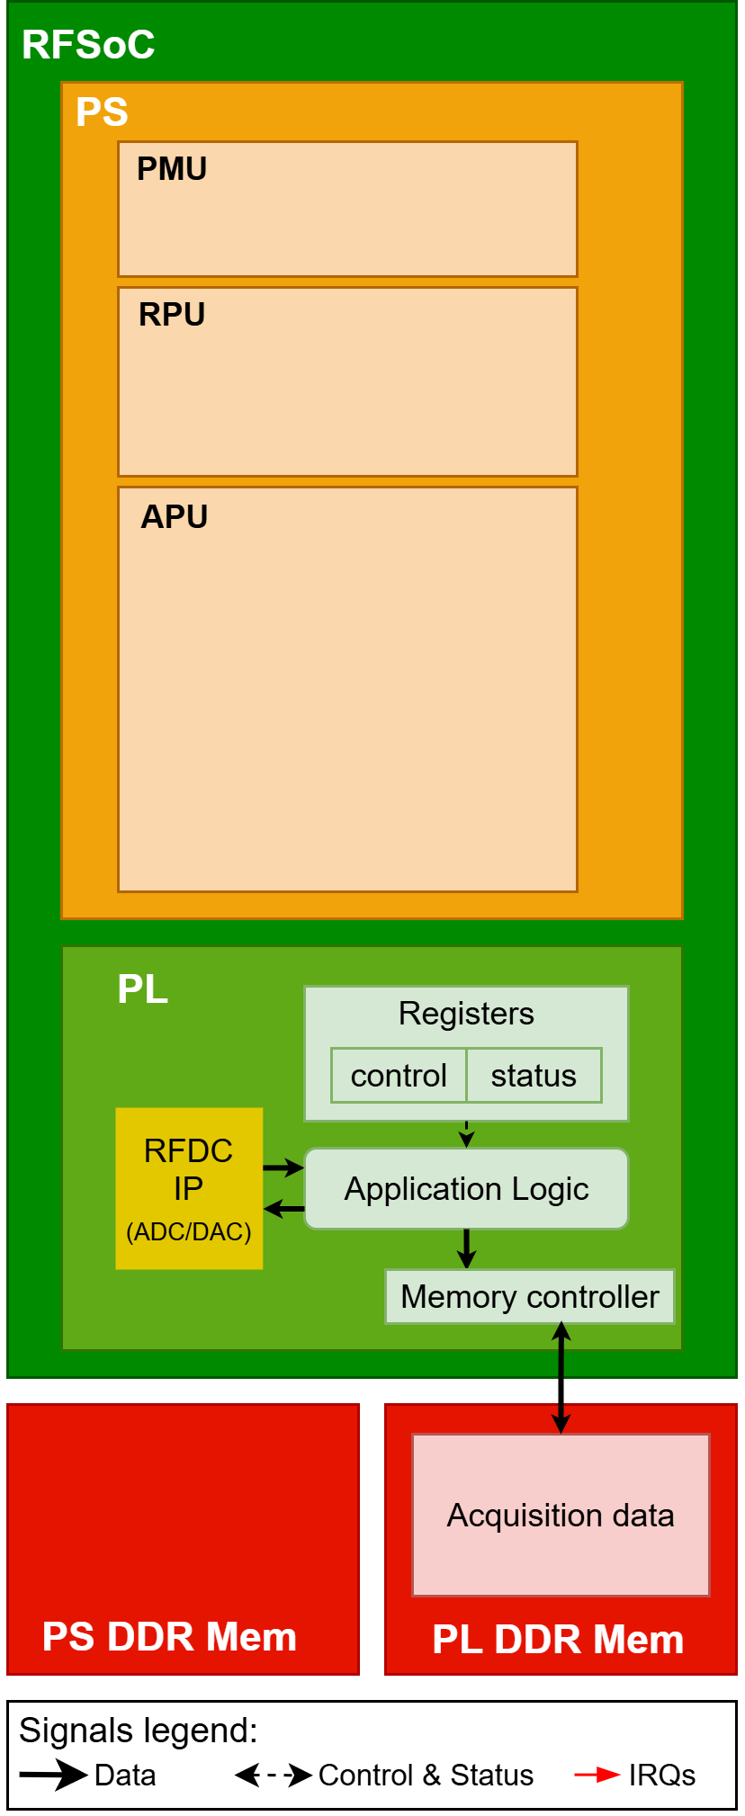
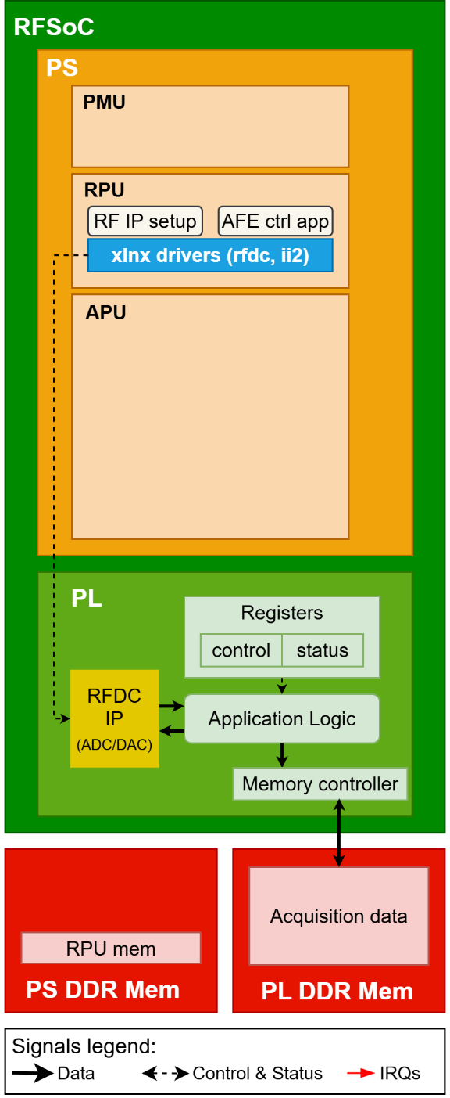
DAQ system: Gateware and Firmware
Gateware (FPGA code) functionalities:
Handles raw data from the integrated ADCs (>500 Gbps)
For each of 8 BPM port:
digital computation of bunch-by-bunch signal amplitude with Root Sum Square algorithm, synchronised with beam timing
beam to beam correction algorithm for each bunch
Implementation of LHC BPM acquisition modes
Orbit averaged data stored in registers
On-demand acquisition buffers in PL memory
DAC Signal generation for calibration
Firmware (RPU C application) functionalities:
RF Clocks and ADC/DAC initialisation
AFE control (gain level, switches)
Calibration control

Slide 23
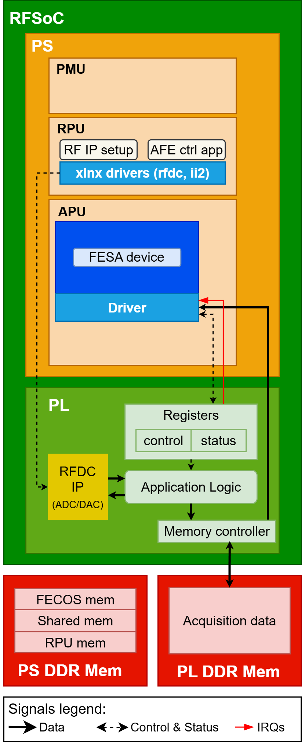
Software: FESA class
Functionalities:
Beam position computation from electrode amplitudes
Continuous logging to NXCALS
System status
Orbit measurements
Control and storage on NFS of on demand acquisitions
One FESA device per beam (two per system)
Fully integrated with current LHC BPM system

Slide 24
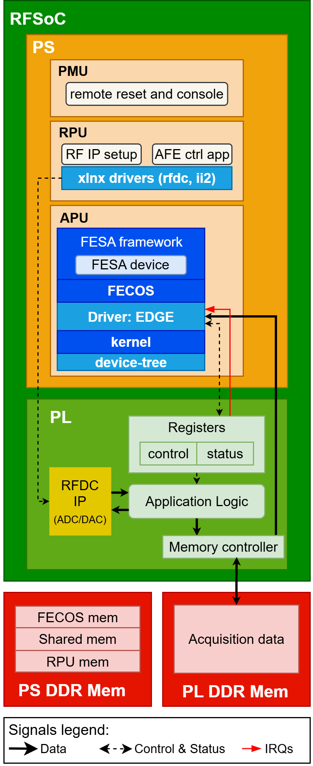
Controls: ATS SoC Framework
The system is a user and beta-tester of the ATS SoC Framework project
Sector level project
Goal: to provide standard control infrastructure to stand-alone SoC, for their integration in the accelerator control system
Linux Operating system (FECOS) and booting infrastructure
Standard driver framework (EDGE)
FESA framework and timing libraries
Remote-reset and console

