Slide 1




15th HL-LHC Collaboration Meeting
Reducing the dose to the VAX equipment
Daniel Prelipcean, Kate Taylor, Francesco Cerutti, Philippe Schoofs
WP10
Energy deposition & R2E
CERN, October 1st, 2025

Slide 2
Outline
The FLUKA model
Dose in ATLAS
Dose in CMS
15th HL-LHC Collaboration Meeting

Slide 3
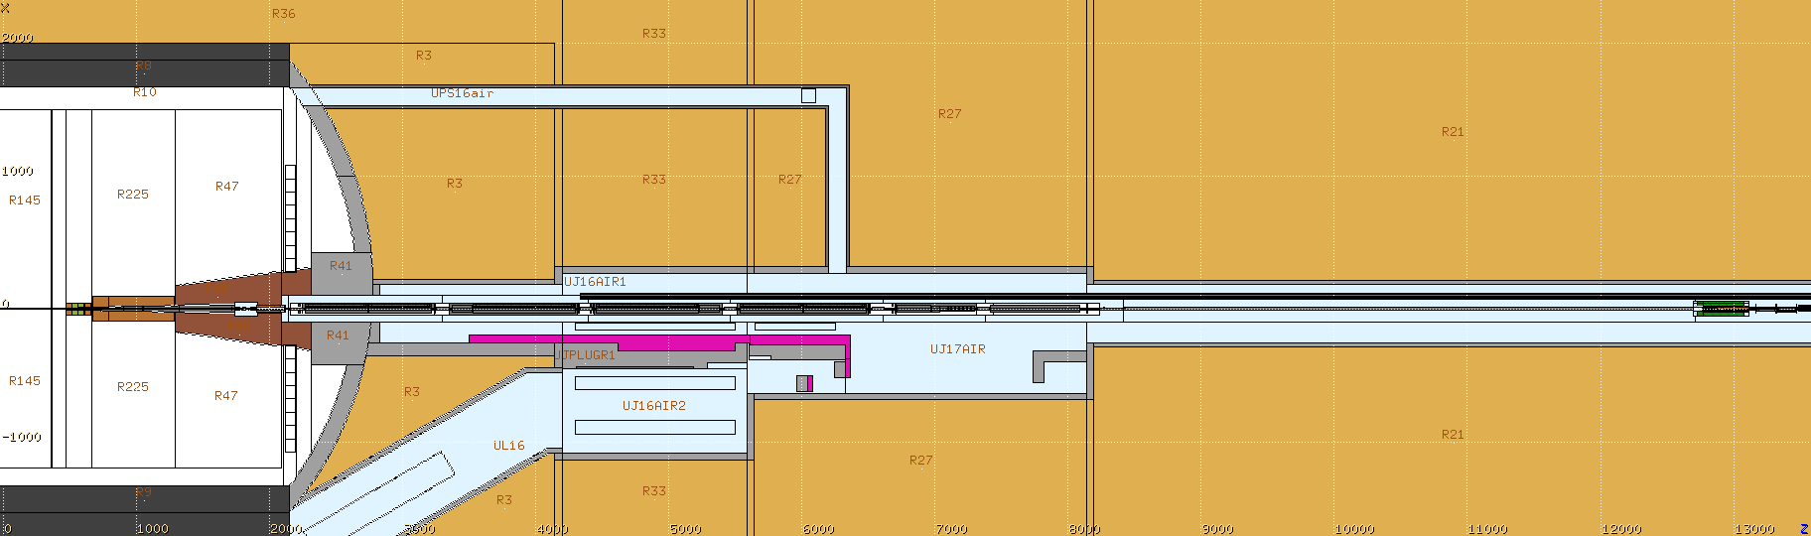
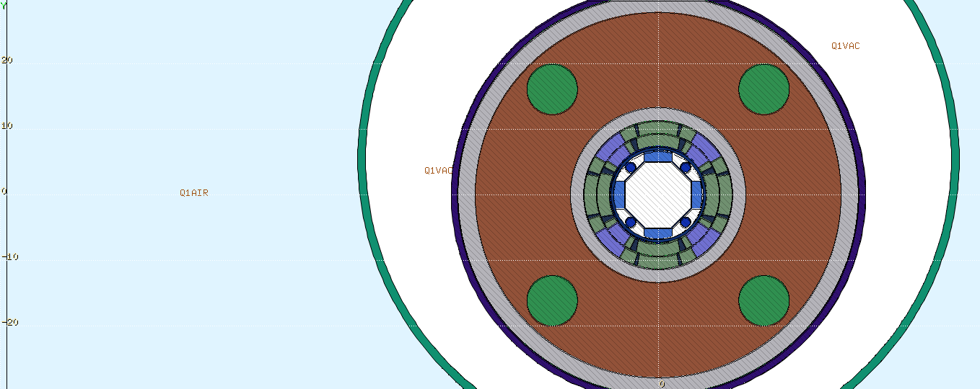
IR FLUKA model
optics/layout v1.5
250 urad
half crossing angle
horizontal in ATLAS,
vertical in CMS
(50% up and 50% down)
15th HL-LHC Collaboration Meeting

Slide 4
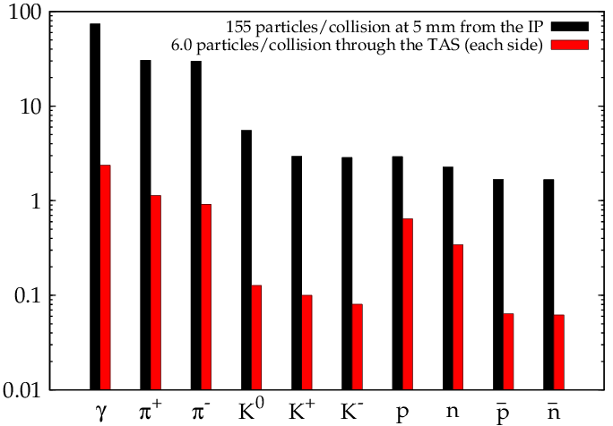
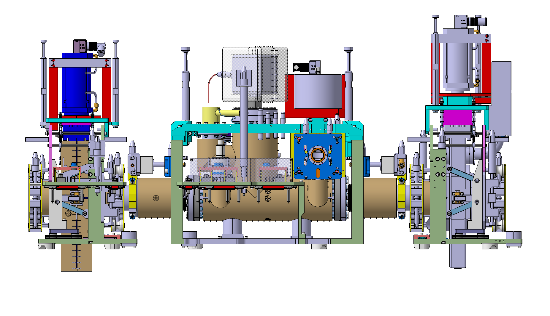
and the area of interest
The radiation source
5 mm
60 mm
IP
21 m
7 TeV p + 7 TeV p
several shielding configurations
have been investigated,
in the following the final one is presented
15th HL-LHC Collaboration Meeting

Slide 5
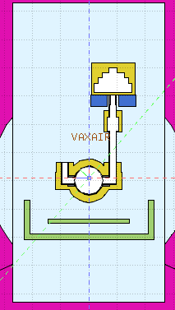
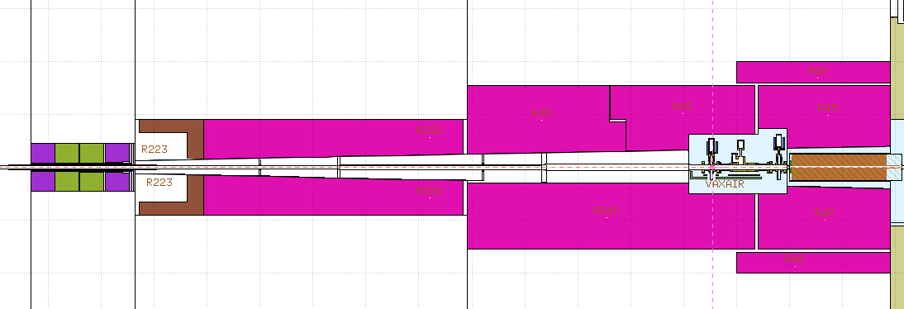
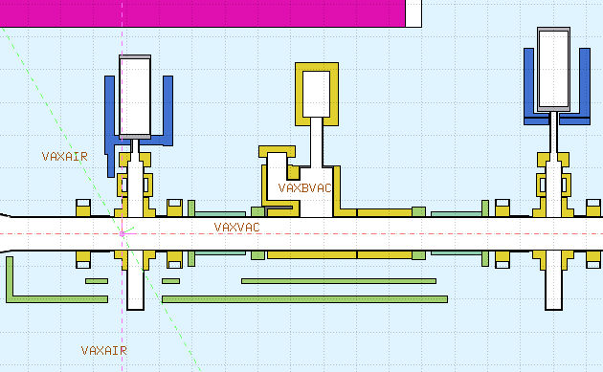
VAX in ATLAS (v3)
M2
shielding thickness increased from 3 cm (IR1v2) to 4 cm (IR1v3)
M1
U-shape
shielding
(IR1v3 = IR1v2)
M3
added as much shielding as possible below and another 2 cm shielding piece in front (“4-shape”)
15th HL-LHC Collaboration Meeting

Slide 6
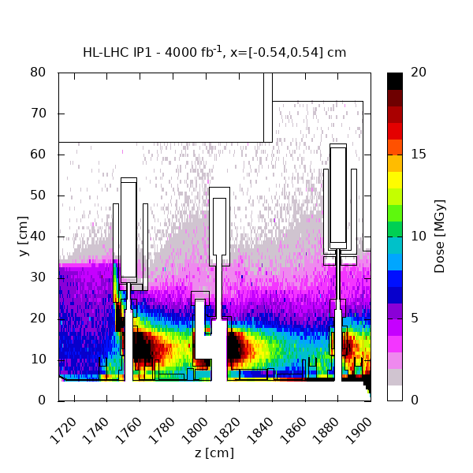
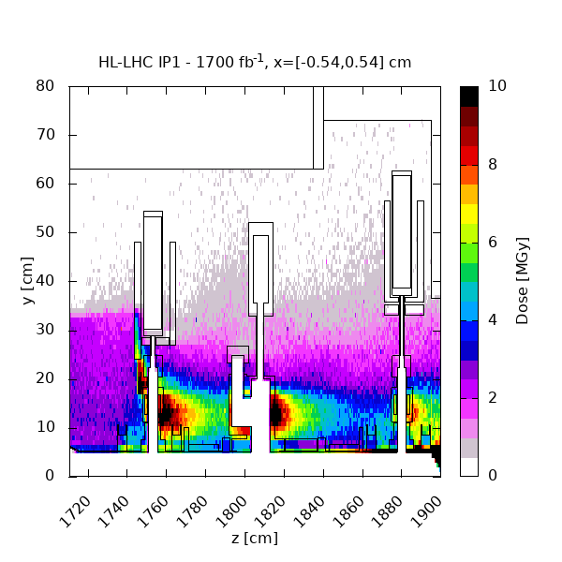
Dose map
ultimate target
longest (nominal) Run*
* https://edms.cern.ch/document/3160539/1.1
15th HL-LHC Collaboration Meeting

Slide 7
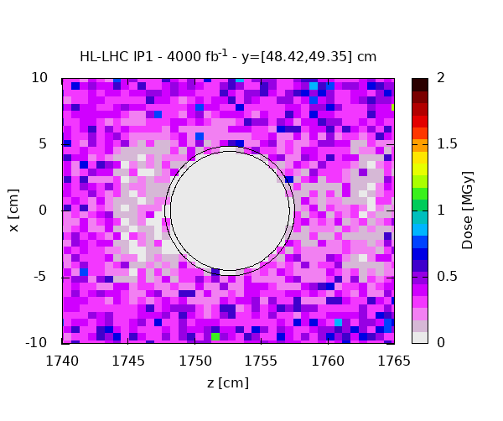
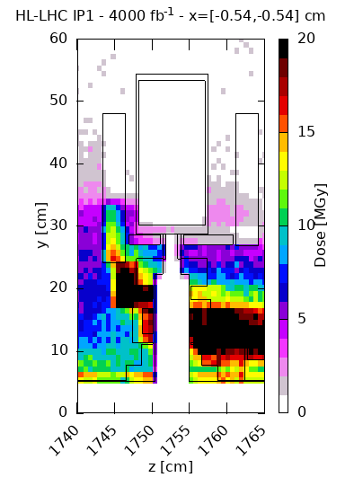
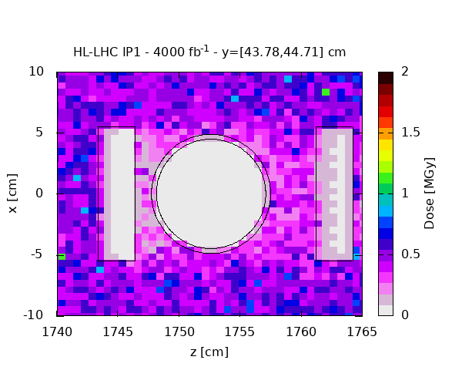
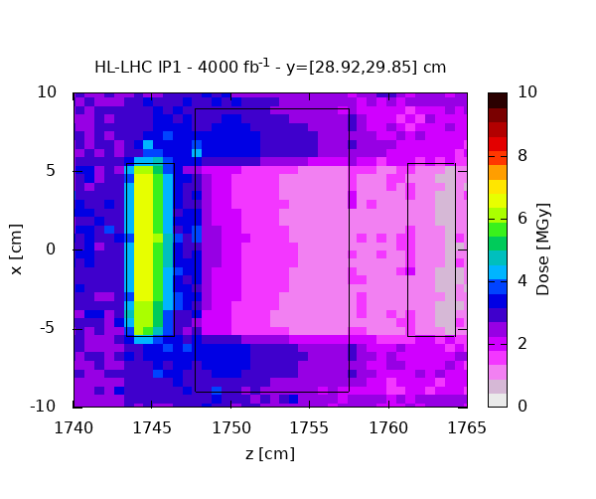
M3
0.5 MGy
y = 485 mm
0.2 MGy
y = 440 mm
0.5 MGy
0.2 MGy
y = 293 mm
2 MGy
0.8 MGy
for 1700 fb⁻¹
15th HL-LHC Collaboration Meeting

Slide 8
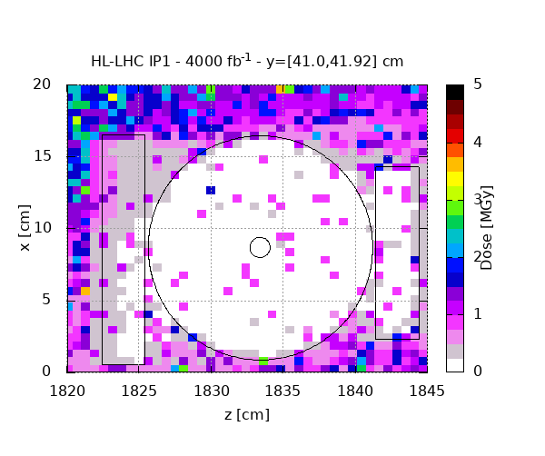
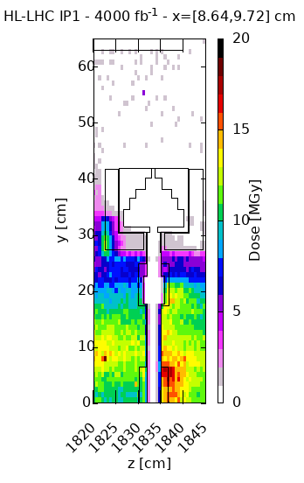
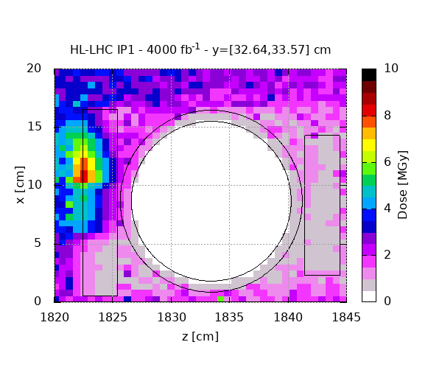
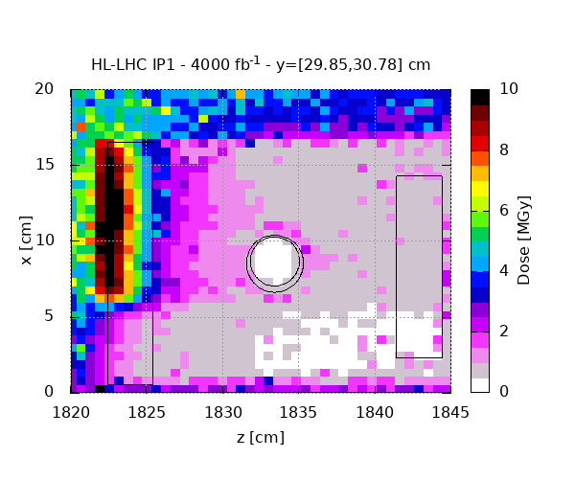
M2
0.5 MGy
y = 414 mm
0.2 MGy
y = 322 mm
2 MGy
0.8 MGy
y = 309 mm
2 MGy
0.8 MGy
for 1700 fb⁻¹
15th HL-LHC Collaboration Meeting

Slide 9
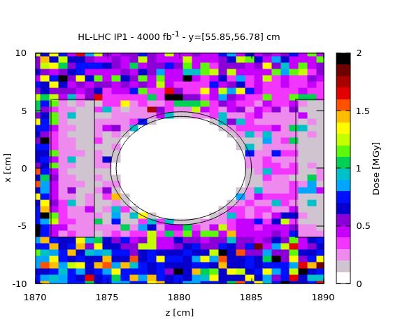
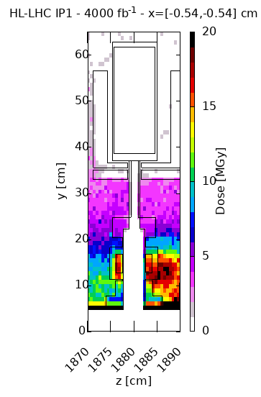
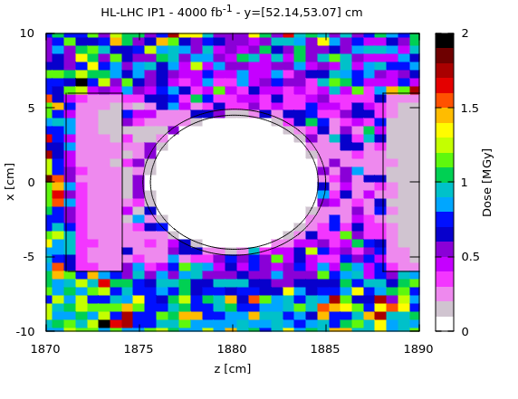
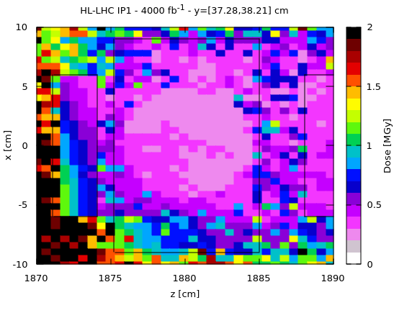
M1
0.5 MGy
y = 567 mm
0.2 MGy
y = 521 mm
0.5 MGy
0.2 MGy
y = 376 mm
0.5 MGy
0.2 MGy
for 1700 fb⁻¹
15th HL-LHC Collaboration Meeting

Slide 10
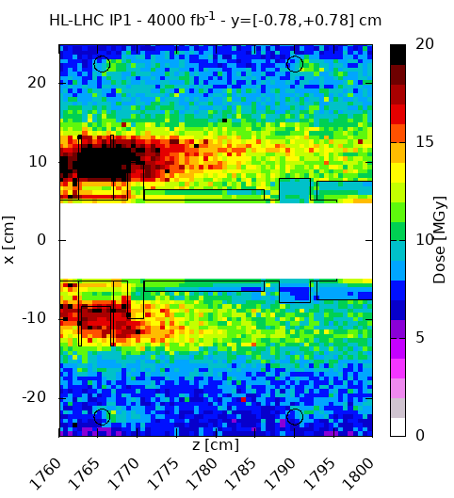
Staubli connectors
2
10 MGy
10 MGy
1
4 MGy
for 1700 fb⁻¹
10 MGy
3
4
10 MGy
15th HL-LHC Collaboration Meeting

Slide 11
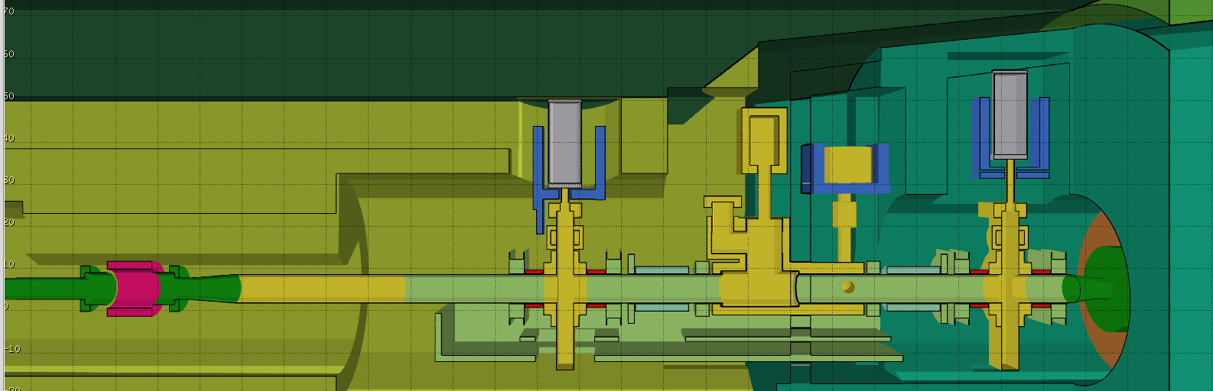
VAX in CMS (v4)
raised by 41.5 mm
“4-shape” shielding, as thick as possible
raised by 124 mm
U-shape shielding
U-shape shielding
CMS shielding
15th HL-LHC Collaboration Meeting

Slide 12
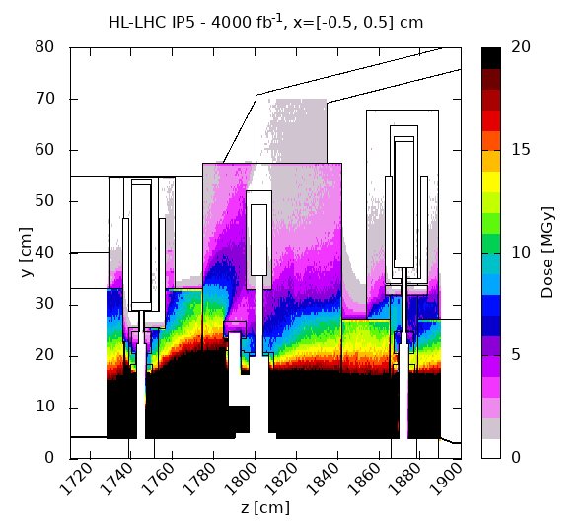
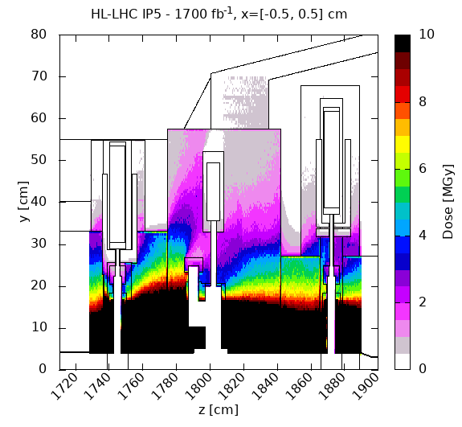
Dose map
15th HL-LHC Collaboration Meeting

Slide 13
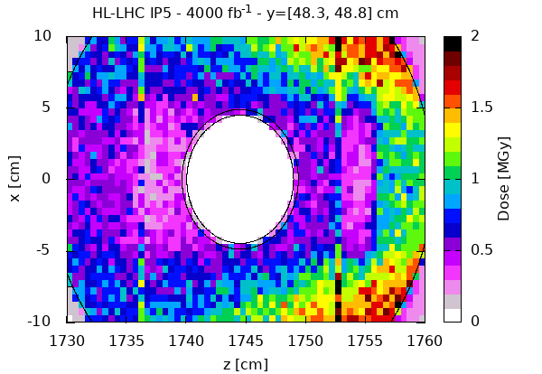
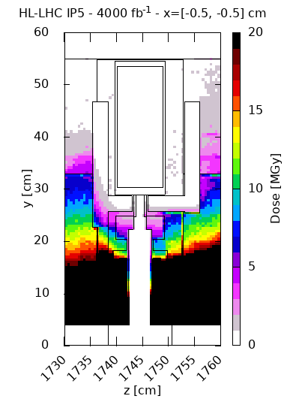
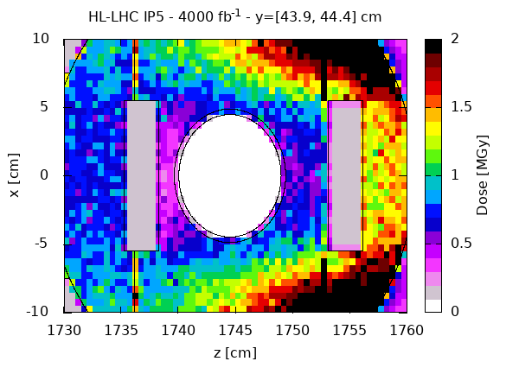
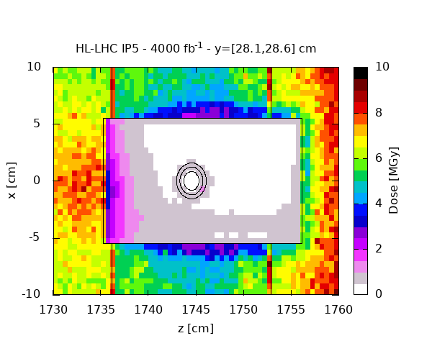
M3
0.5 MGy
y = 485 mm
0.2 MGy
y = 440 mm
0.85 MGy
0.35 MGy
y = 293 mm
0.95 MGy
0.4 MGy
for 1700 fb⁻¹
15th HL-LHC Collaboration Meeting

Slide 14
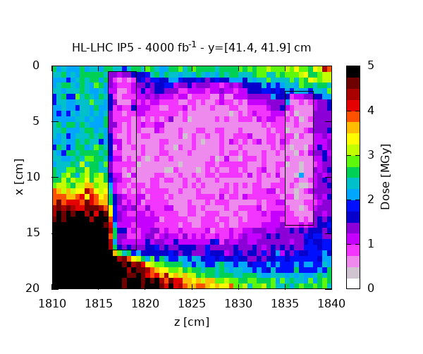
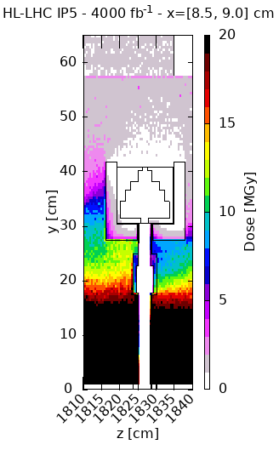
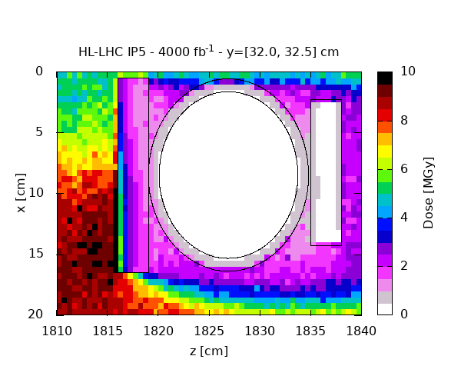
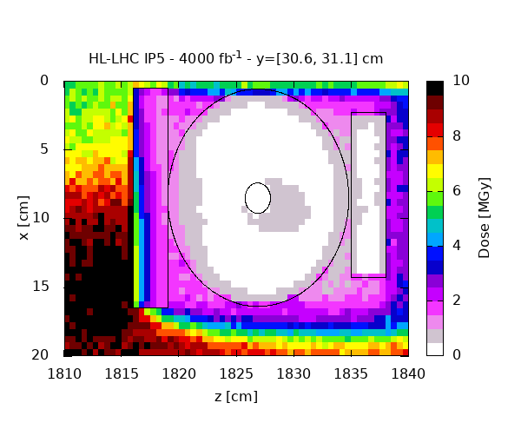
M2
0.7 MGy
0.3 MGy
y = 414 mm
y = 322 mm
1.3 MGy
0.55 MGy
y = 309 mm
0.85 MGy
0.35 MGy
for 1700 fb⁻¹
15th HL-LHC Collaboration Meeting

Slide 15
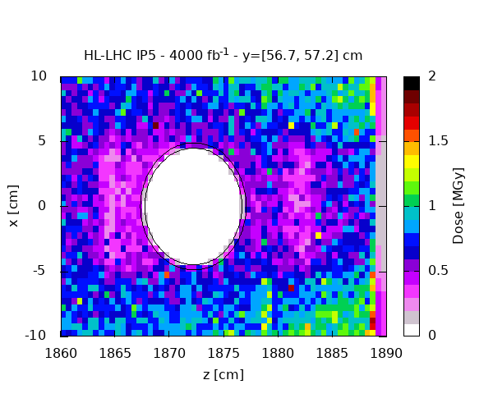
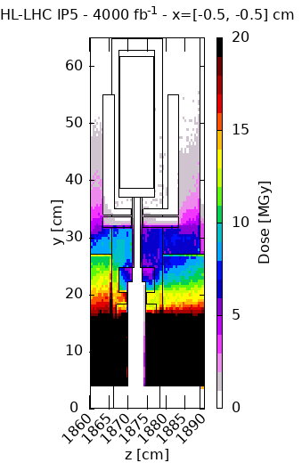
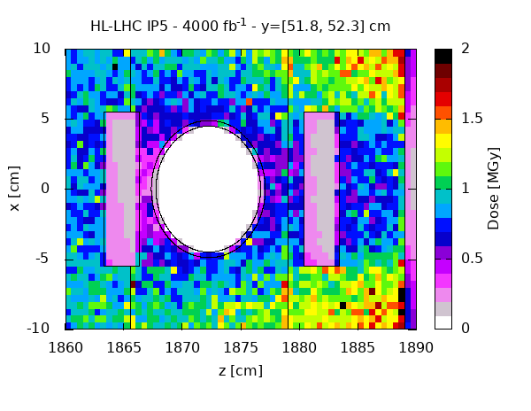
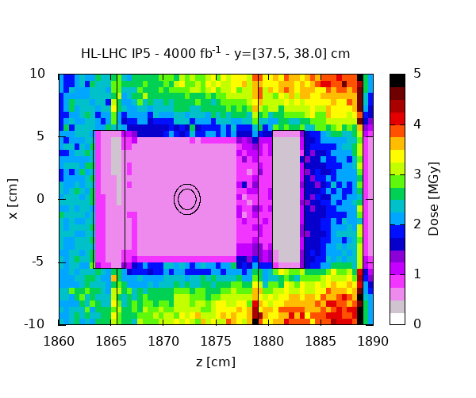
M1
0.5 MGy
y = 567 mm
0.2 MGy
y = 521 mm
0.5 MGy
0.2 MGy
y = 376 mm
1.05 MGy
for 1700 fb⁻¹
0.45 MGy
15th HL-LHC Collaboration Meeting

Slide 16
Summary
M3 |  |  | M2 |  |  | M1
Height [mm] | Dose [MGy] |  | Height [mm] | Dose [MGy] |  | Height [mm] | Dose [MGy]
 | IR1 | IR5 |  | IR1 | IR5 |  | IR1 | IR5
485 | 0.50 | 0.50 | 414 | 0.50 | 0.70 | 567 | 0.50 | 0.50
440 | 0.50 | 0.85 | 322 | 2.0 | 1.3 | 521 | 0.50 | 0.50
293 | 2.0 | 0.95 | 309 | 2.0 | 0.85 | 376 | 0.50 | 1.05
for 4000 fb⁻¹
With the designed shielding in place, the 1 MGy limit is exceeded only in a few relevant locations, but it’s not expected to be reached over a single Run (1700 fb⁻¹), allowing in principle for equipment replacement during a LS.
Conversely, the Staubli connectors, at beam height, are predicted (in ATLAS) to absorb 10 MGy per 4000 fb⁻¹, i.e., 4 MGy over a 1700 fb⁻¹ Run.
15th HL-LHC Collaboration Meeting

