Slide 1

TAXS AND VAXBOX PRODUCTION AND INSTALLATION
Antonio Alonso, WPE
On behalf of WP8 (Collider experiment interface) and collaborators
F. Sanchez Galan, O. Boettcher, D. Soskic, E. Luke Barnes, S. di Giovannantonio, S. Kamugasa, J. Perez Espinos, M. Perez Ornedo.
Special thanks to: S. Altun, D. Brethoux & F. Luiz
15th HL-LHC Collaboration Meeting, CERN- 01/10/2025

Slide 2
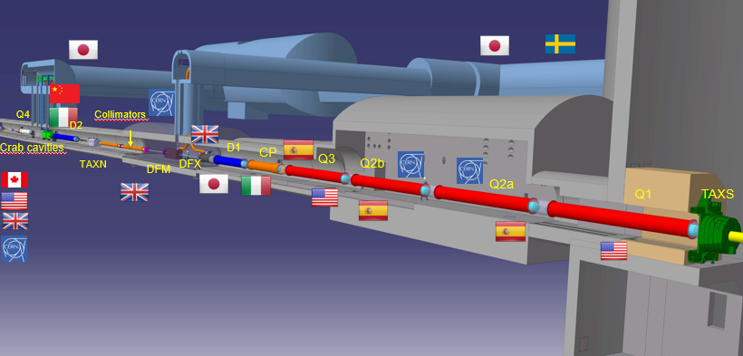
WP8 – COLLIDER EXPERIMENT INTERFACE
TAXS
  Introduction
  Design
  Manufacturing
  Current status
  Test campaign
TAXS Alignment system
  Alignment system manufacturing plan
TAXS Survey system
  Survey system manufacturing plan
VAXBOX
  CMS VAXBOX
  ATLAS VAXBOX
  VAXBOX Test campaign
The work package 8 will be in charge of the deinstallation of the Secondary and Neutral absorbers (TAS and TAN), the design, manufacturing and installation of the new Secondary and Neutral absorbers in the LHC machine (TAXS, TAXN), and the optimization of the machine-interface regions such as the adaptation of the experiment shielding following the new HL-LHC baseline layout.
This includes coordinating the integration and remote handling studies being performed together with other work packages, experiments and the machine, and the reporting to the correspondent HL-LHC and machine working groups.

Slide 3
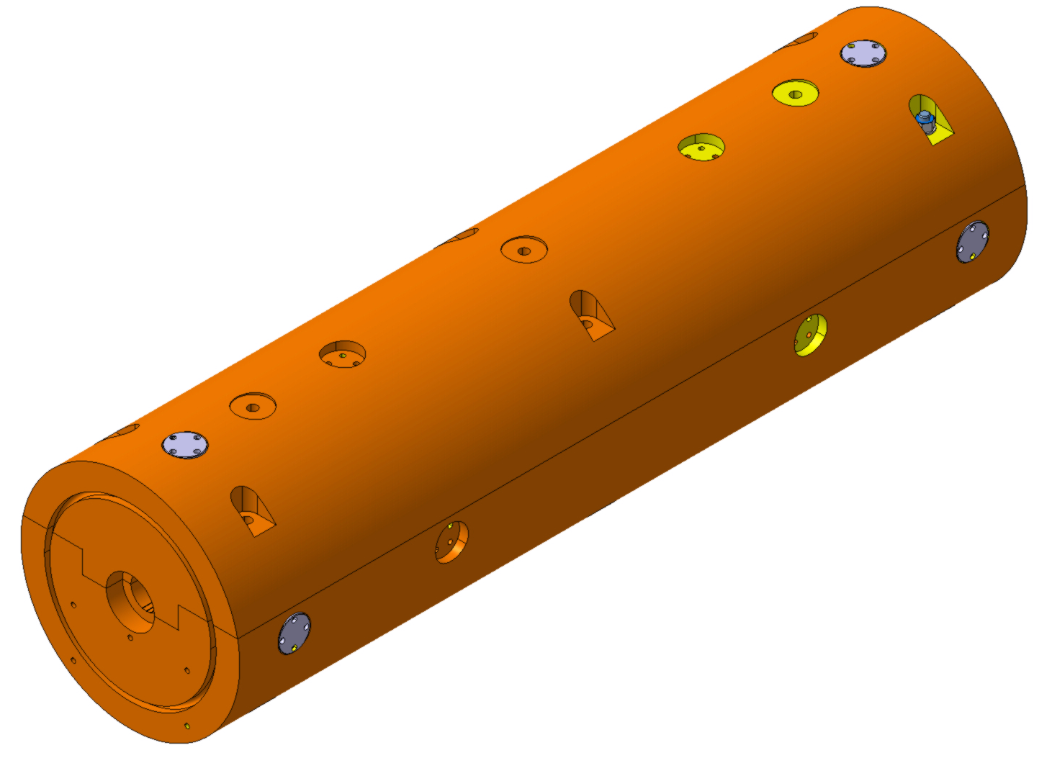
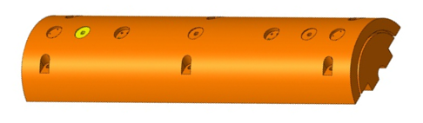
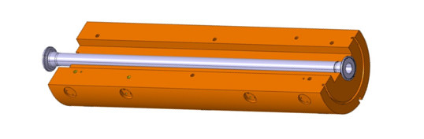
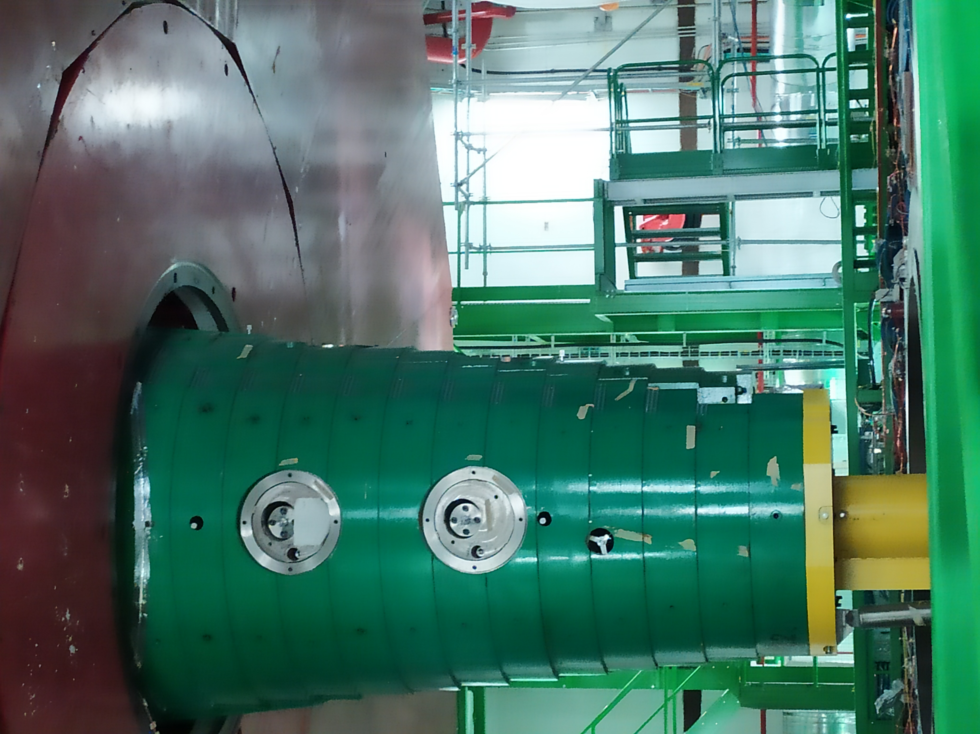
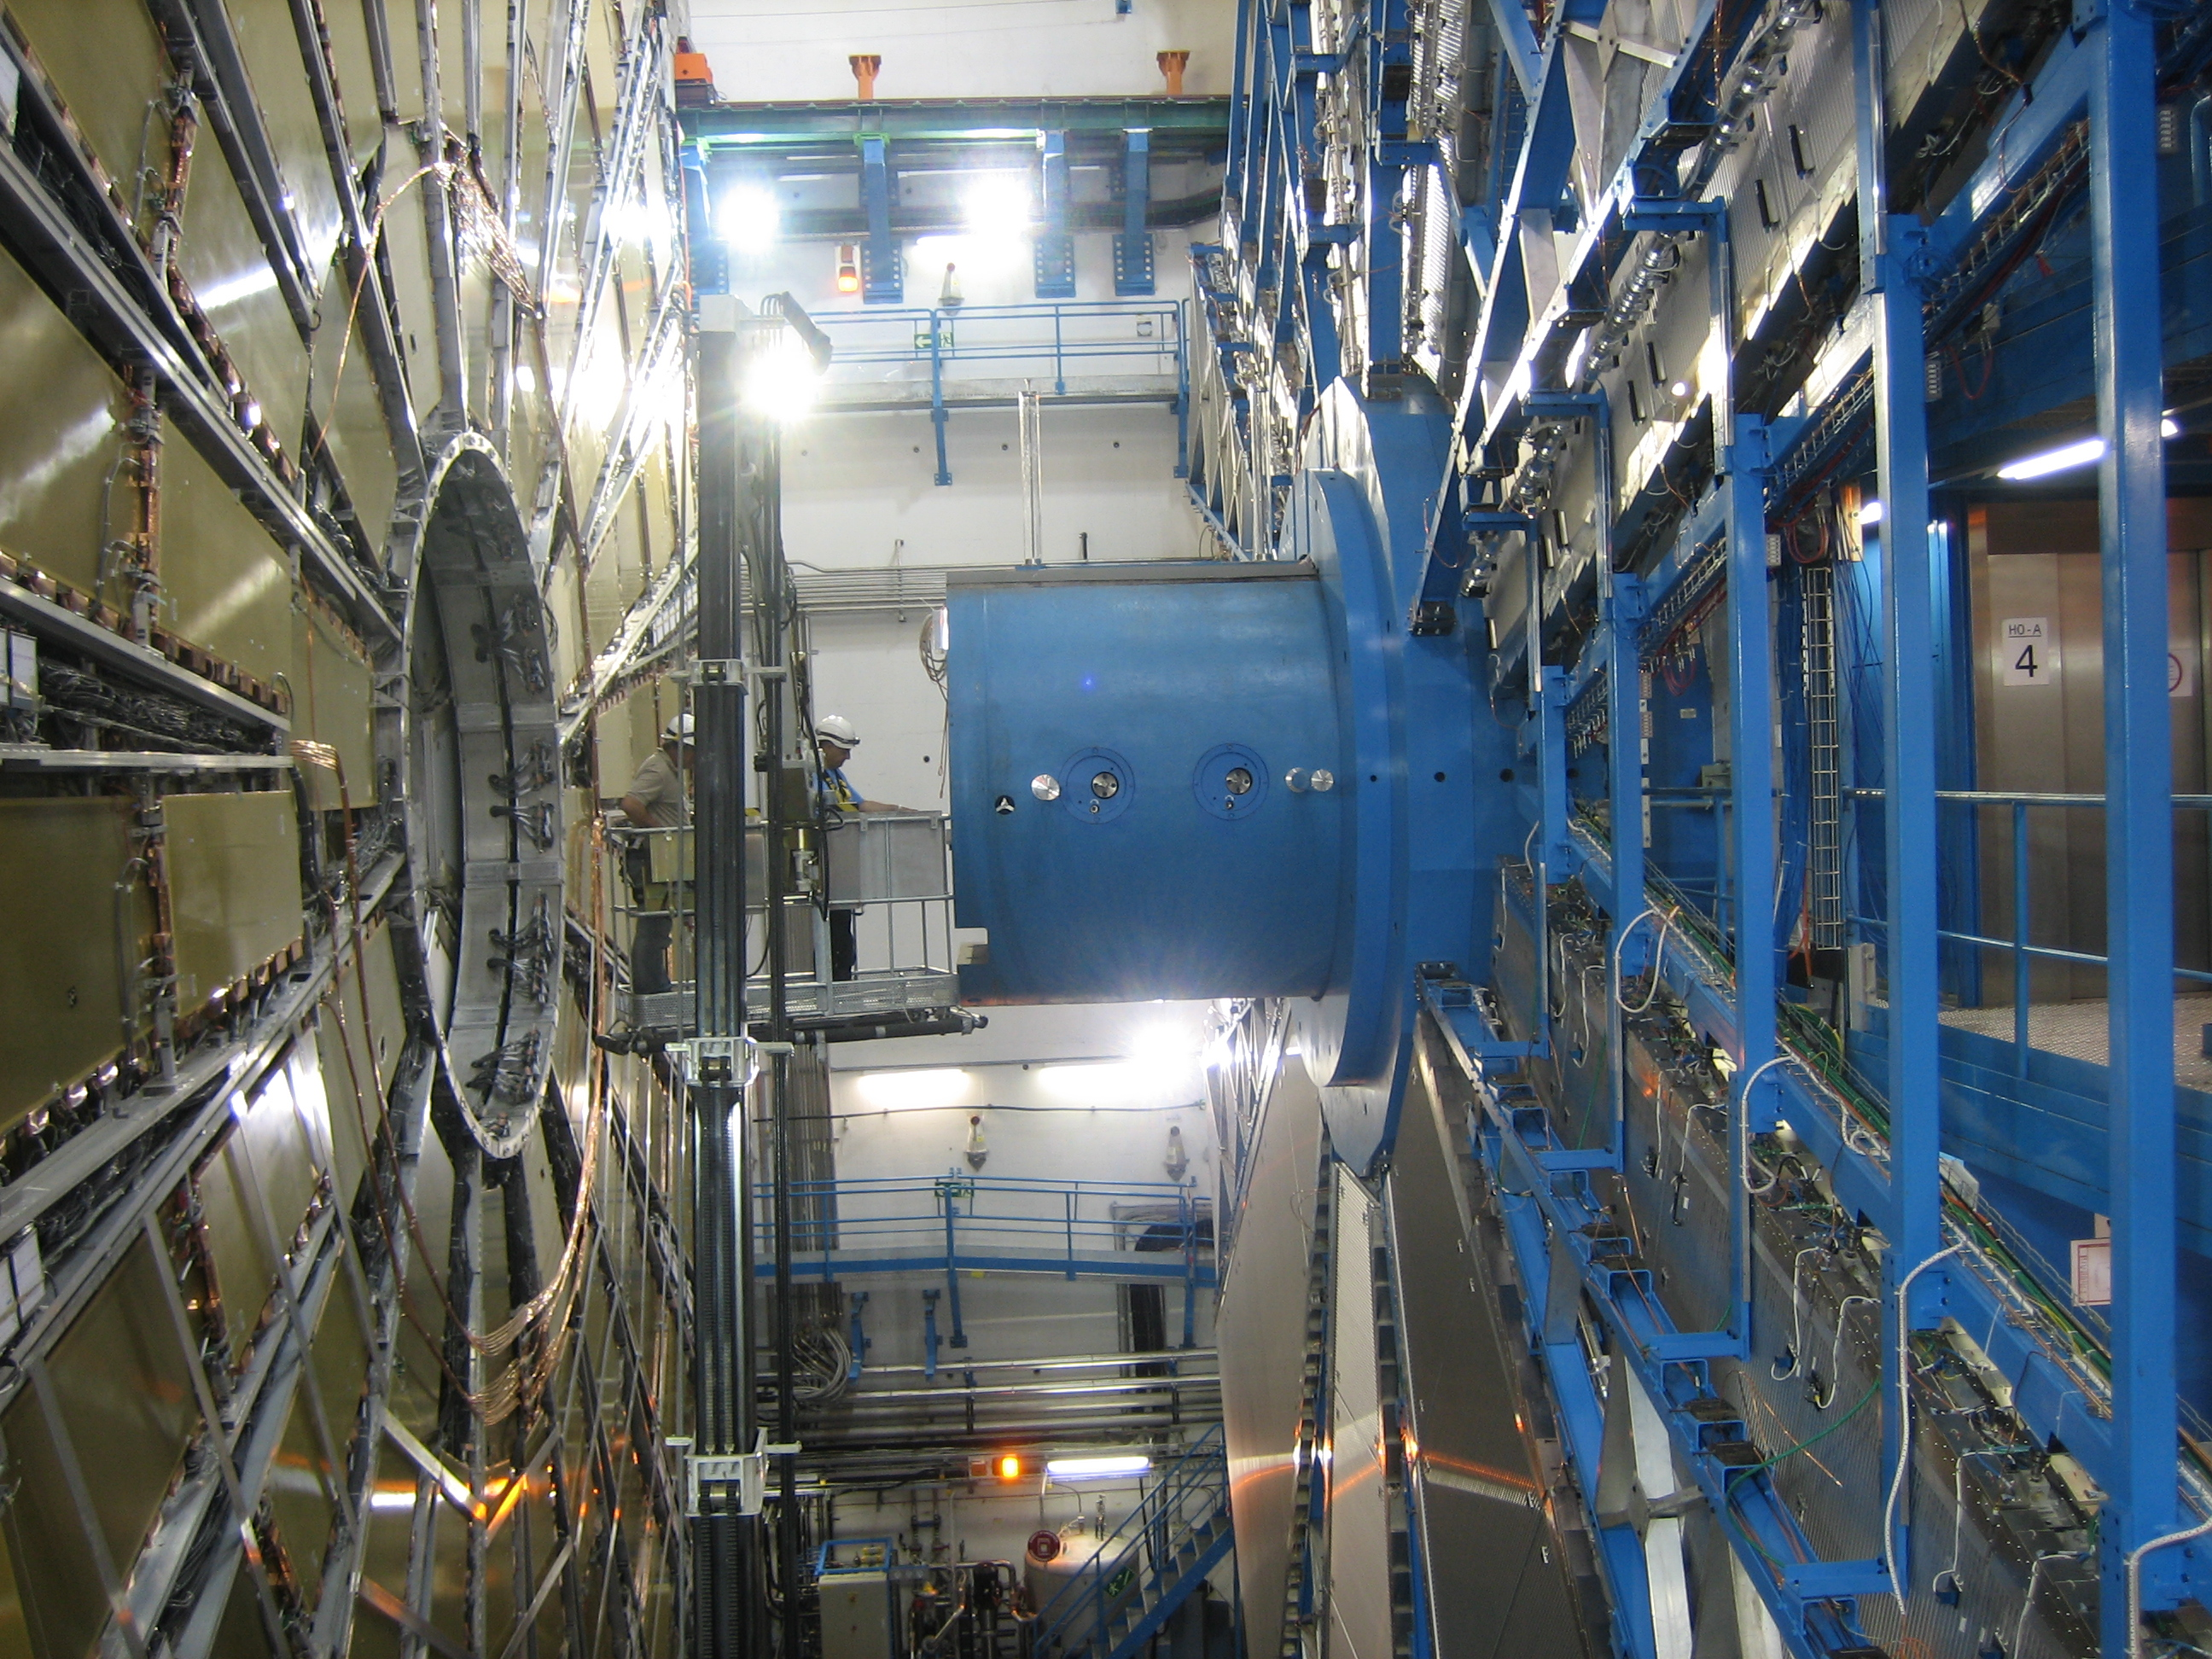
TAXS (Target Absorber “Upgraded” for Secondary particles)
When the particle bunches traveling in opposite directions meet at the Interaction Point there is a probability that two or more particles will come close enough to interact. In this event a number of collision products will be generated.
Special purpose absorbers are needed to protect superconducting magnets from this radiation to prevent them from quenching. The absorbers also localize the induced activation to the absorbers and surrounding shielding.
The function of the TAXS is to absorb those secondary particles, primarily pions and photons, leaving the IPs of the ATLAS and CMS experiments, that would otherwise impinge on the front face of the inner triplet superconducting quadrupole Q1.
During operation, the induced radiation heats the TAXS with approximately 750 W of heating power. The heat load deposited in the TAXS and the reduced interspace available for ambient cooling requires the installation of an active cooling system inside the machined grooves existing at one of its sides.
The TAXS contain a vacuum tube and will be installed in 2027 (ATLAS) & 2029 (CMS), they will run until the end of the HL-LHC era.

Slide 4
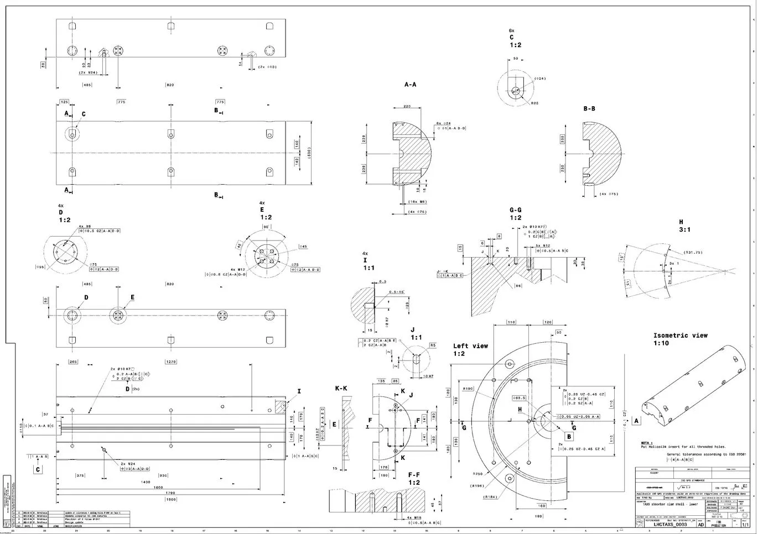
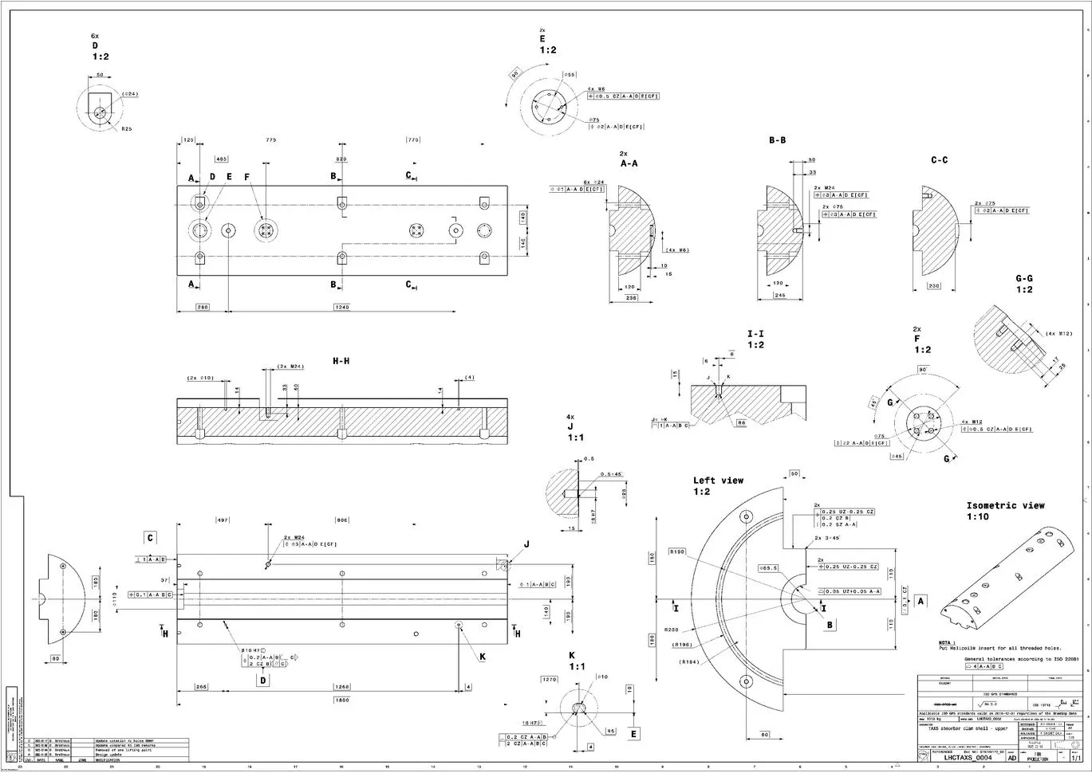
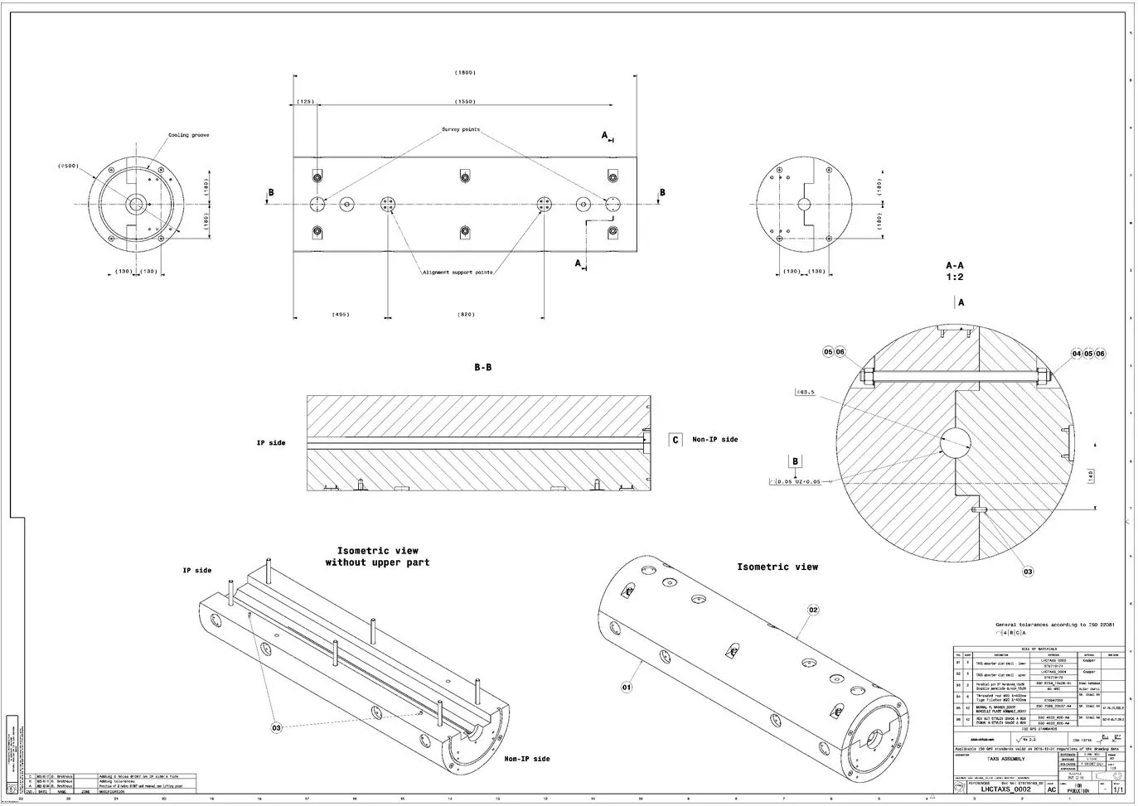
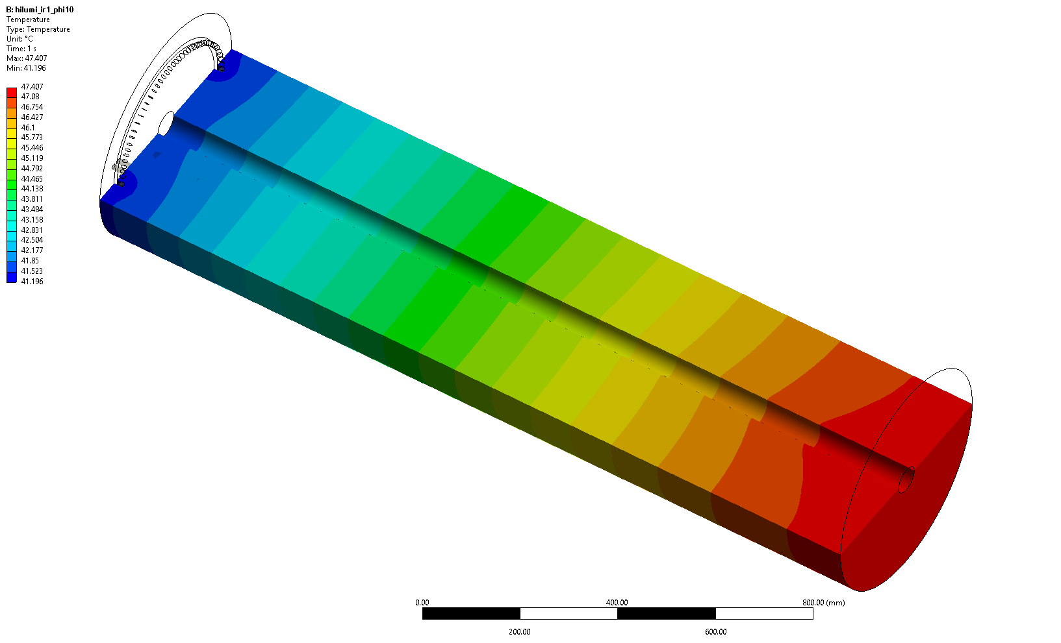
TAXS DESIGN
Manufacturing drawings:
TAXS
Diameter 500mm | Length 1800mm | Material ~99.9% Cu | Quantity X4 assemblies | Weight 3054Kg
LHCTAXS_0002
LHCTAXS_0003
LHCTAXS_0004
The TAXS is located just in front of the first inner triplet superconducting quadrupole Q1. There are two TAXS, on either side of the cavern.
The TAXS is conformed of two halves that clamp the beam pipe, It contains a water-cooling loop in the tunnel face to dissipate the heat deposition from the secondary particles and slot for the installation of X3 PT-100 thermal sensors.
The TAXS was designed to be fully compatible with an ultimate performance luminosity scenario of 7.5 1034cm-2s-1(Int. L 4000 fb-1).
The key parameter for the TAXS design and performance is the inner aperture, 63.5mm, being an interplay between the two requirements:
Sufficiently small to provide the necessary protection from IP particles the inner triplet Quadrupoles and protect the inner detector of the experiment from beam losses;
Sufficiently large to allow the two beams to pass through, leaving room for possible steering and adjustment corrections.
TAXS Thermal Analysis: https://edms.cern.ch/document/3305941/1
LHC Point | Power input (W) | Maximum temperature (°C) | Minimum temperature (°C) | Average temperature (°C)
ATLAS P1 | 514.12 | 57.717 | 48.375 | 53.046
CMS P5 | 474.65 | 55.294 | 46.724 | 51.009
Thermal simulations results for 7.5Lo

Slide 5
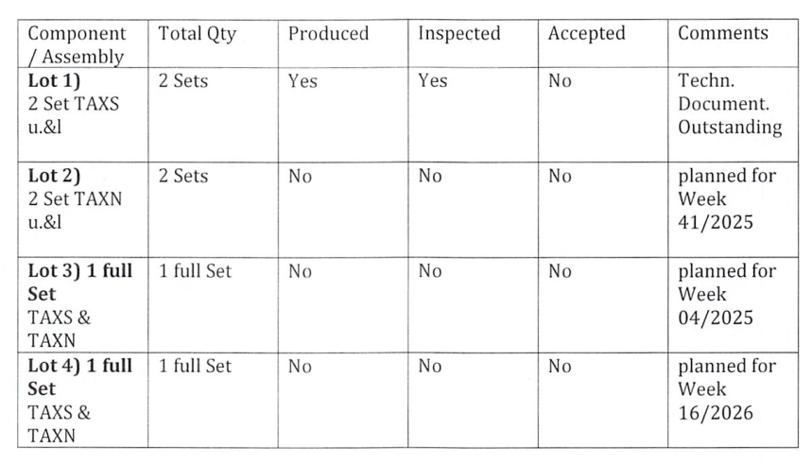

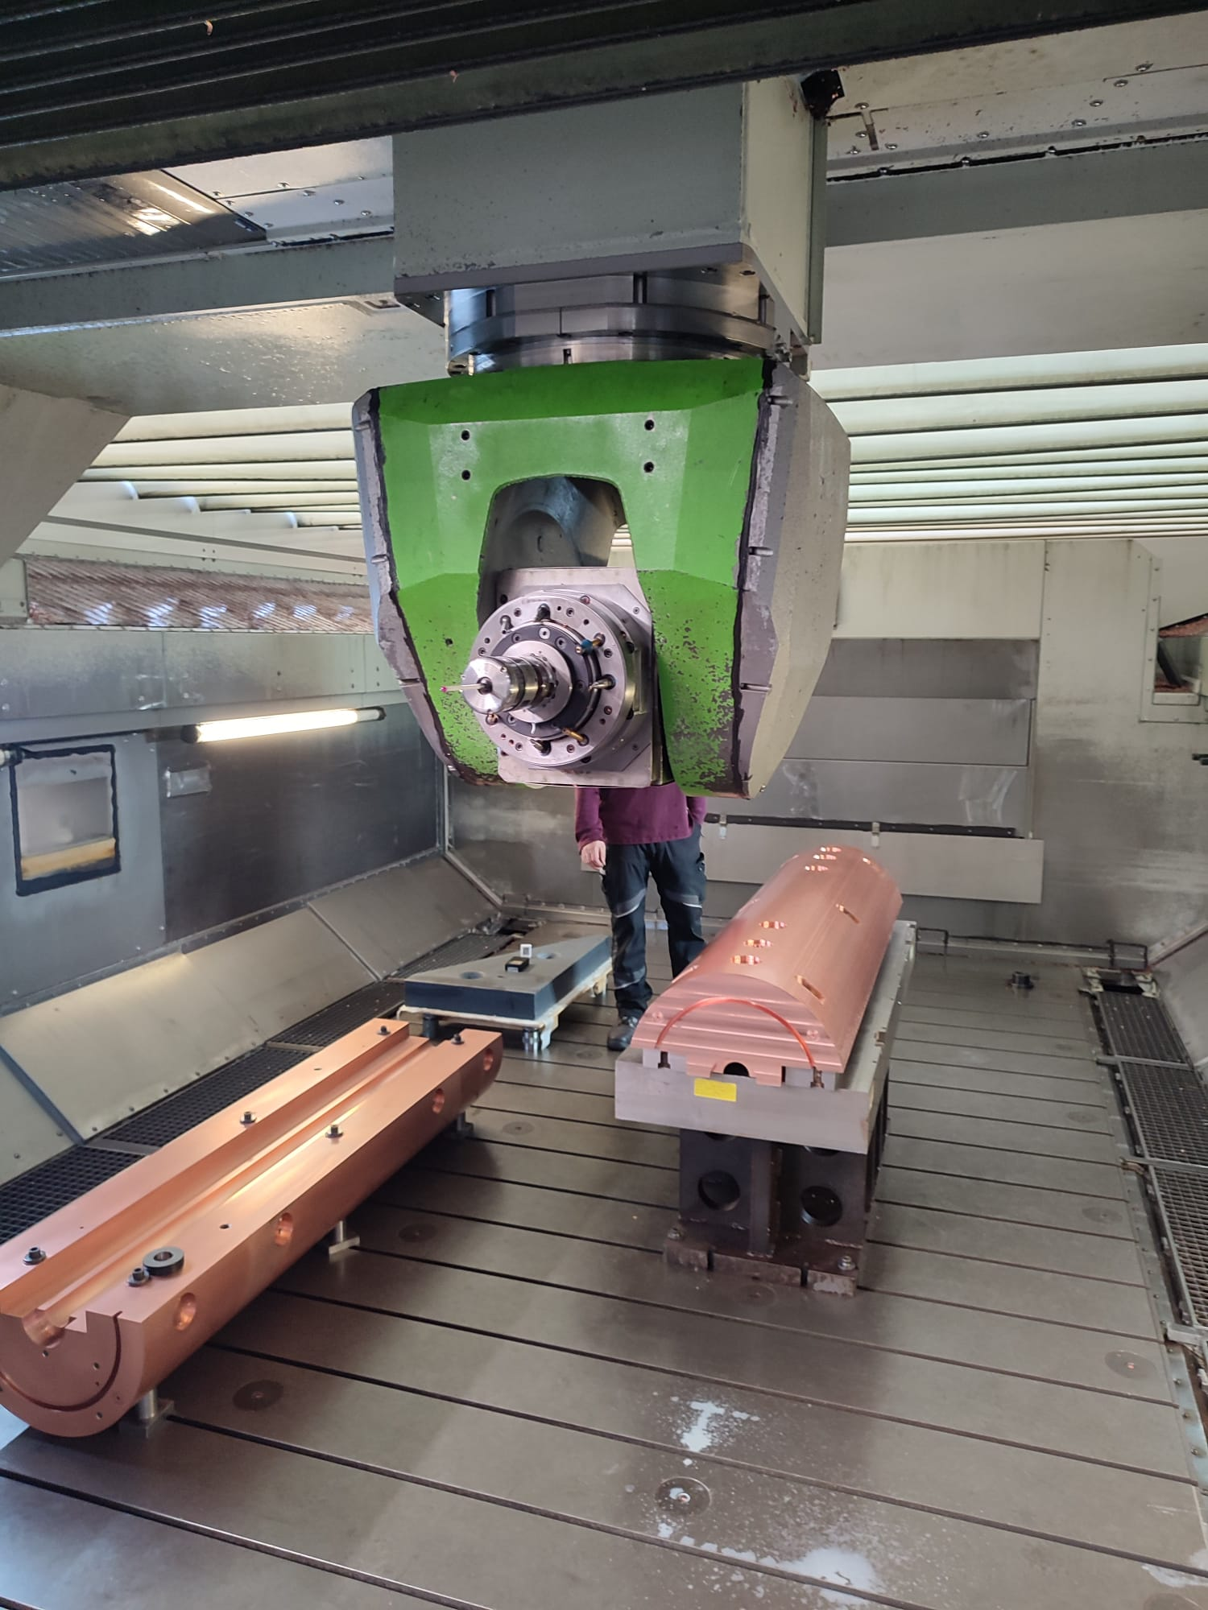
TAXS Manufacturing plan
TAXS Manufacturer
Wilnsdorf • Germany
As communicated by CSN August 2025

Slide 6
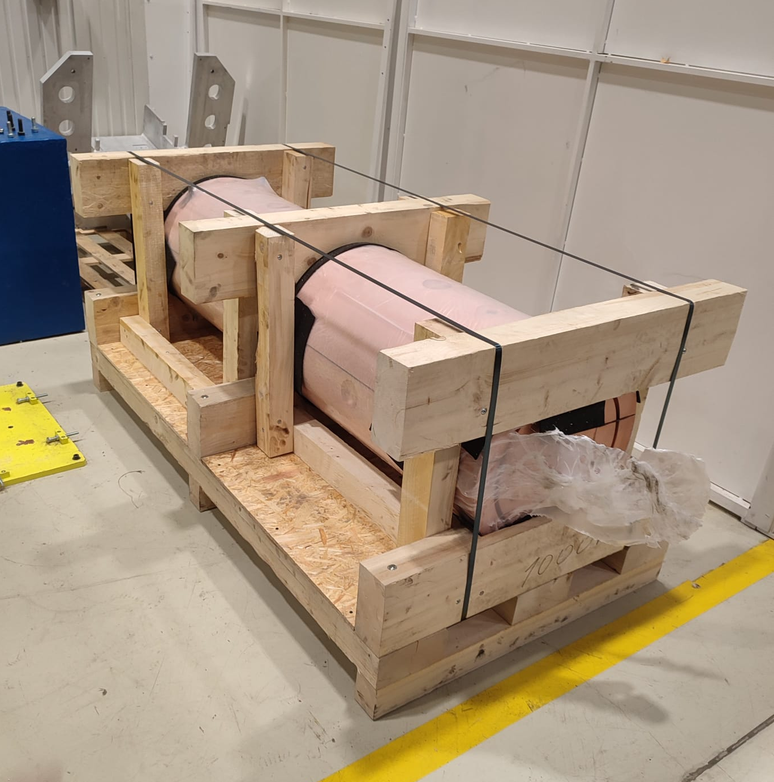
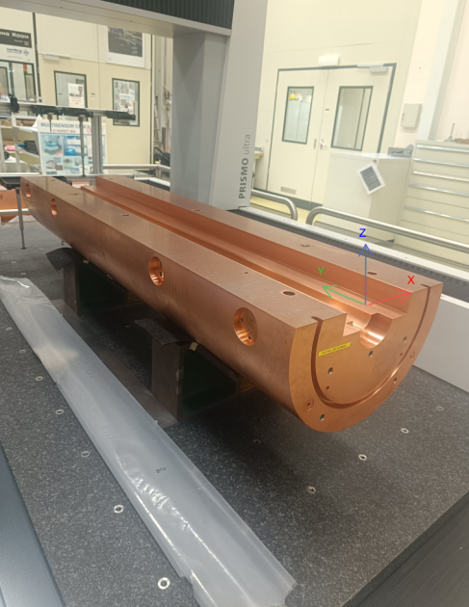
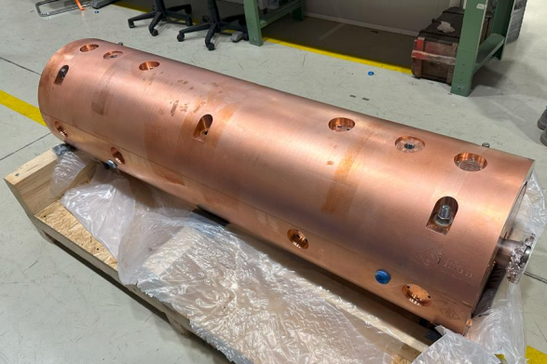
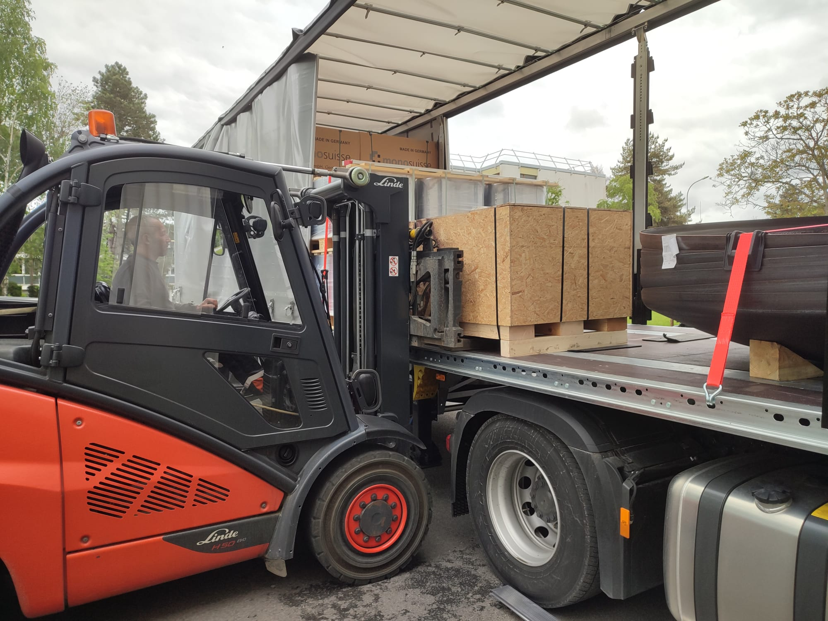
TAXS CURRENT STATUS
CERN Metrology report
  https://edms.cern.ch/document/3327891/1
  Result successful
TAXS Beam pipe clamping test
  https://edms.cern.ch/document/3336030/1
  Result successful
2x ATAS TAXS now stored in 867/R-K75
Key dates from in-work v0.6 LS3 planning
TAS removal
  ATLAS A&C - Jan 2027
  CMS R54&R56 -Feb 2027
TAXS & M1 support installation
  ATLAS A&C -Jan 2027
  CMS R54&R56 -18 Jun-13 Jul 2029
ATLAS‘ 2x TAXS Arrival at CERN
05/05/25

Slide 7
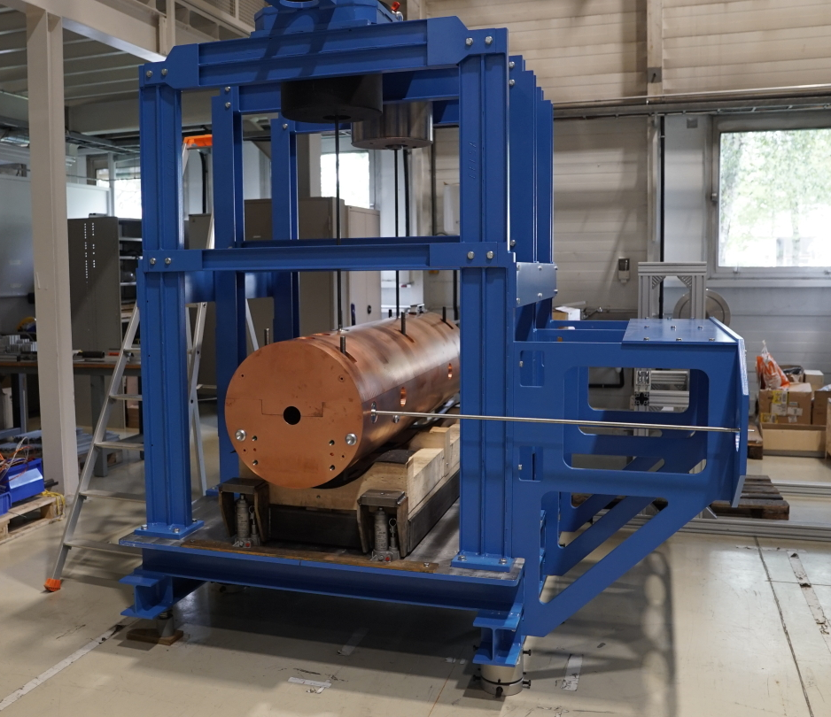
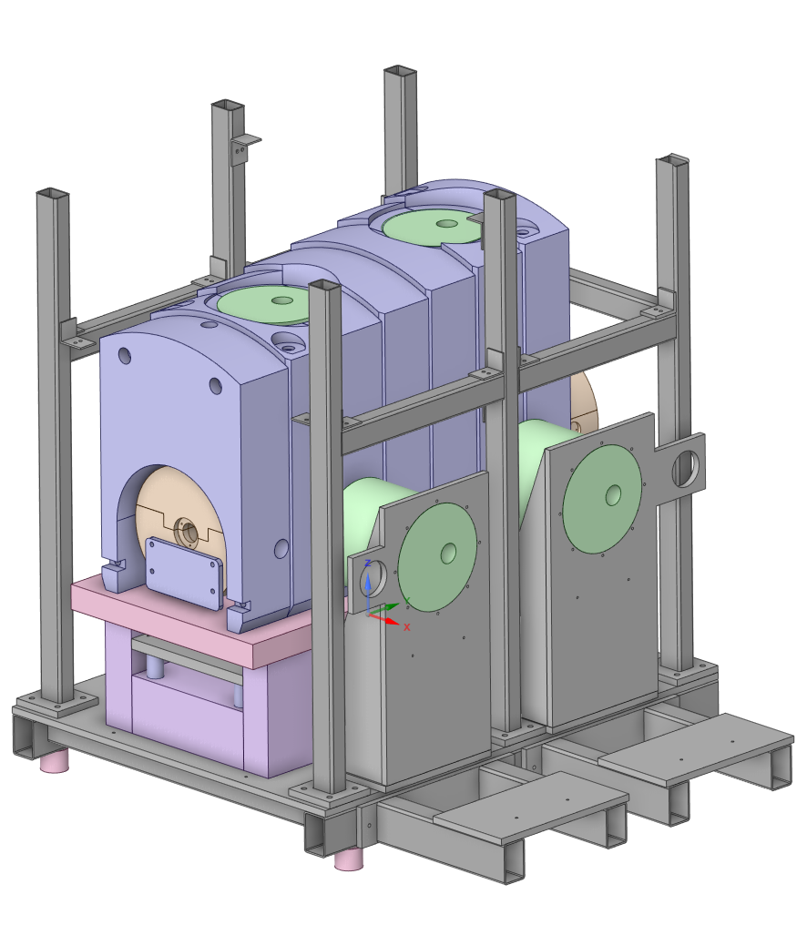
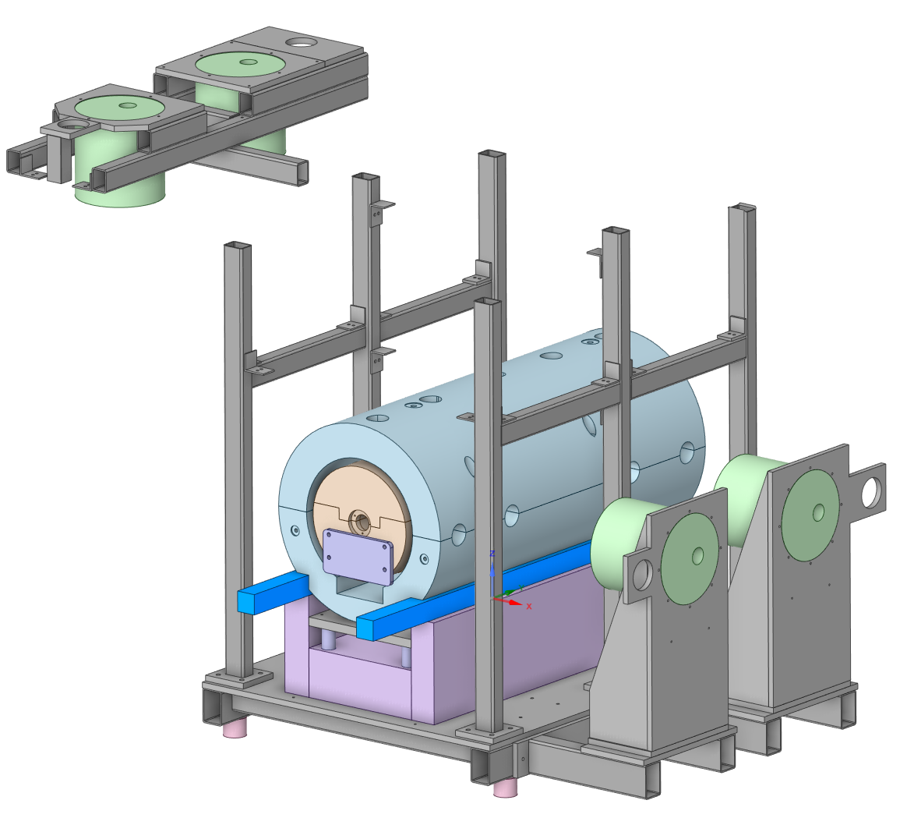
TAXS TEST CAMPAIGN
Next TAXS testing campaign
  Survey system operation
  Alignment system operation
  TAXS Bell effect
  ATLAS Horizontal spring need
  TAXS-VAX-Modules connection
  TAXS alignment under different conditions
  Any other test request from stakeholders
HL-LHC Drawings
Atlas LS3 side A (Run Config): ST0667842_01
  Envelope pumping lines ATLAS A side: ST1A49239_01
ATLAS LS3 side A (Standard access config): ST0667842_02
ATLAS LS3 side C (Run config): ST1554083_01
  Envelope pumping lines ATLAS C side: ST1A53185_01
CMS LS3 side RB54 : ST0711686_01
CMS LS3 side RB56 : ST1553945_01
TAXS Testbench structure Gallus V2 -READY
  Allow to tilt as tunnel
  Allow to test ATLAS and CMS configuration
  Allow to include ATLAS Cradle and CMS nose plug
  Allow to be integrated in ATLAs chimney mockup
  Allow to be integrated in the VAXBOX mockup

Slide 8
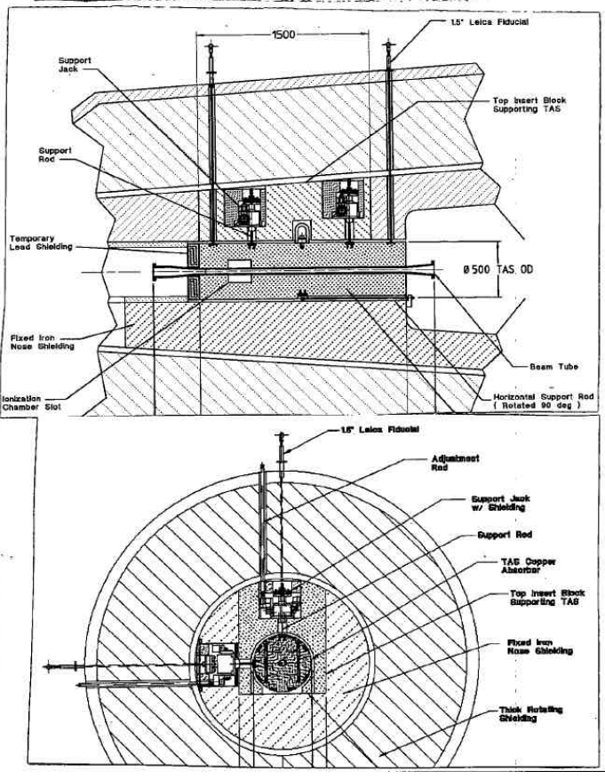
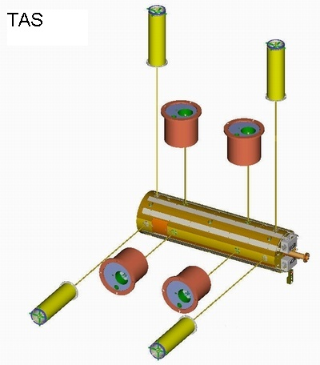
TAXS ALIGNMENT SYSTEM
For the precise positioning of the TAS inside the ATLAS and CMS shielding an alignments system was built
It consist in four (Two horizontal, two vertical) alignment pots, where a screw jack connected to a rod is attached to the TAS, by moving up and worn those 4 screw jacks is possible to control the vertical, horizontal and tilt positions of the TAS
For HL-LHC is expected a +-5mm alignment capacity
Originally designed by Berkeley 2002, updated design made by CERN improving performance
ALIGNMENT: Orange
SURVEY: Yellow

Slide 9
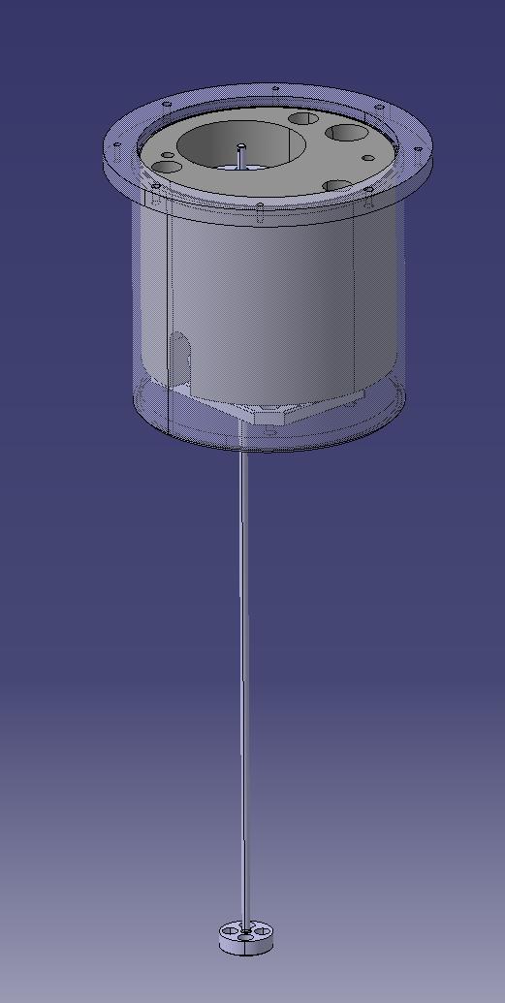
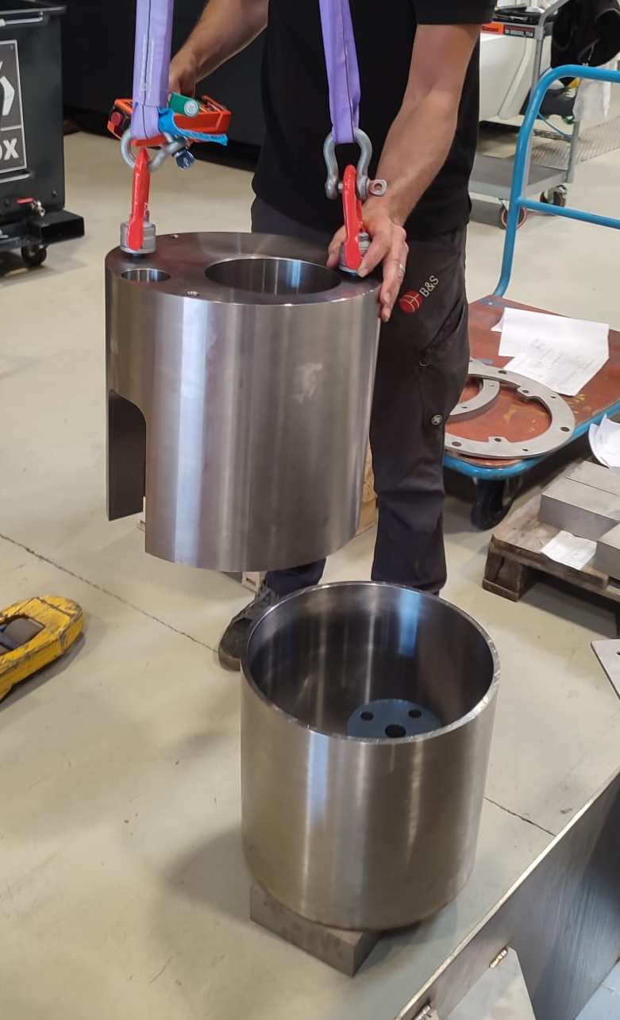
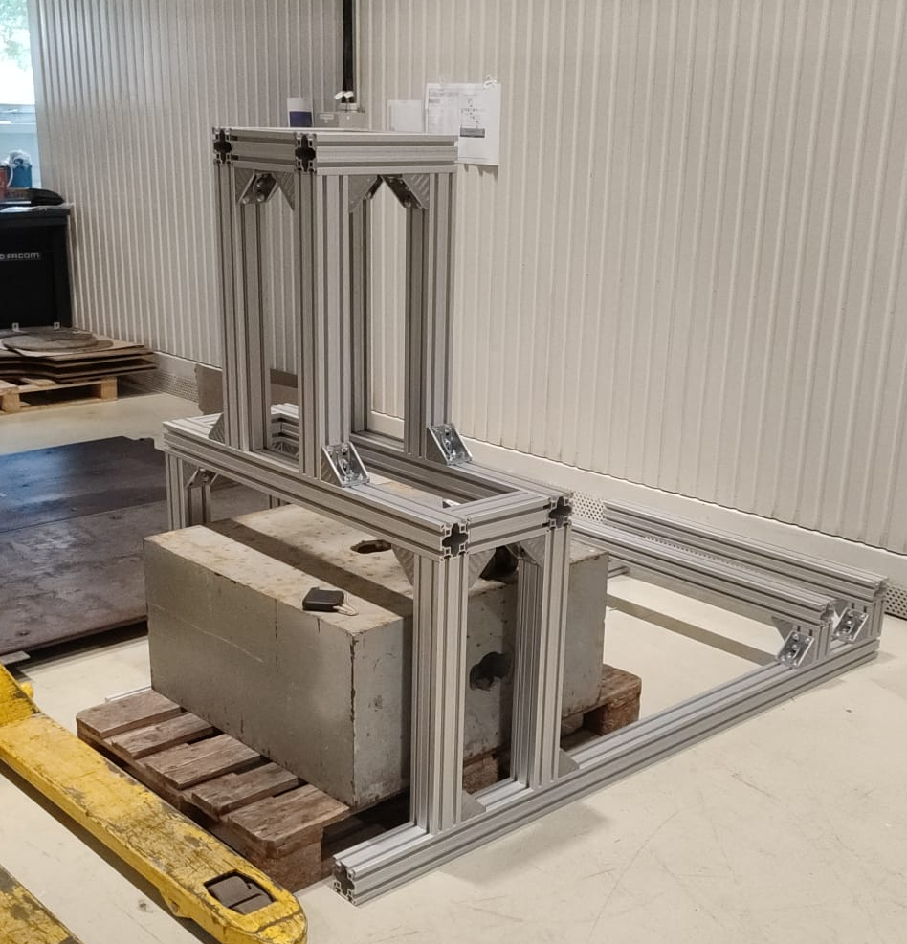
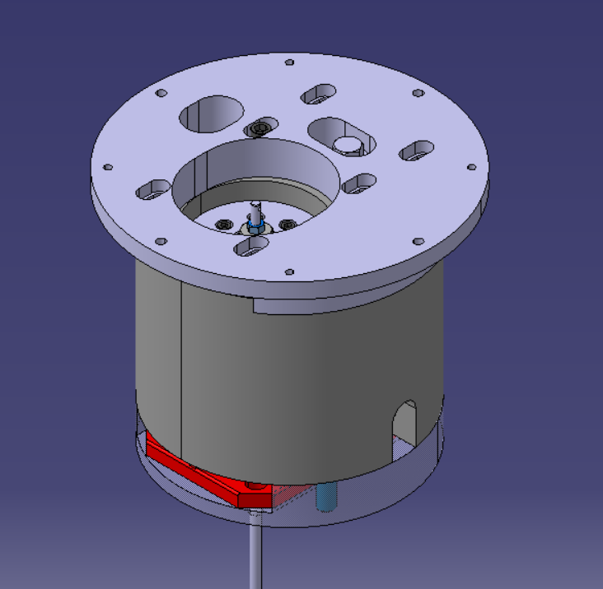
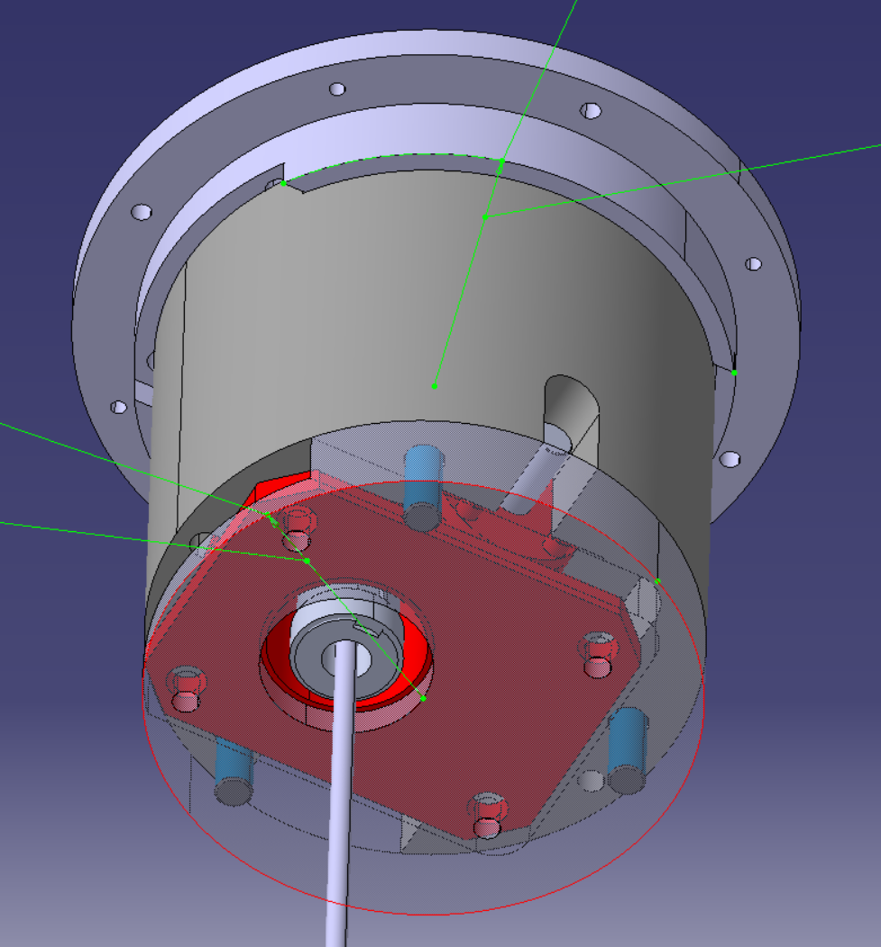
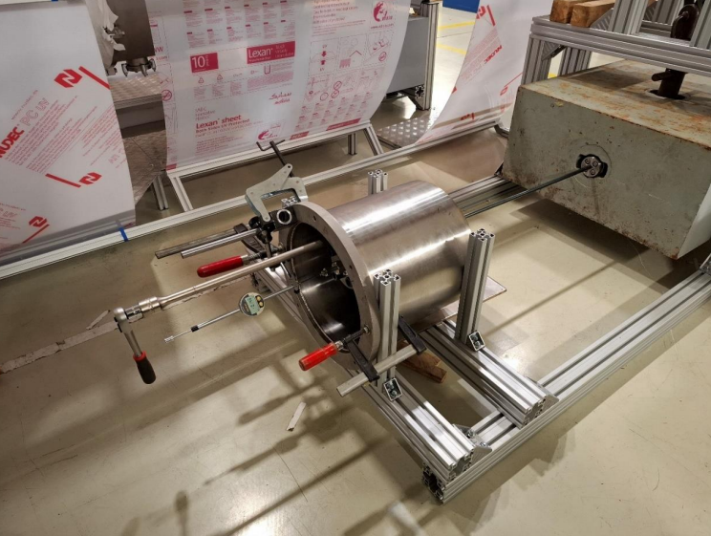

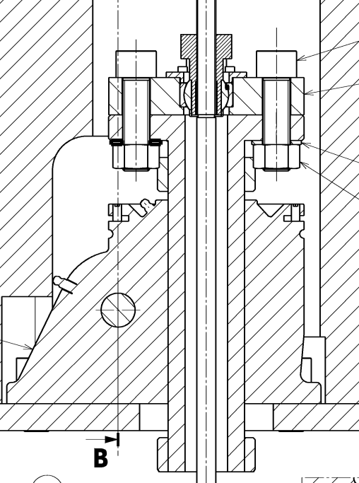
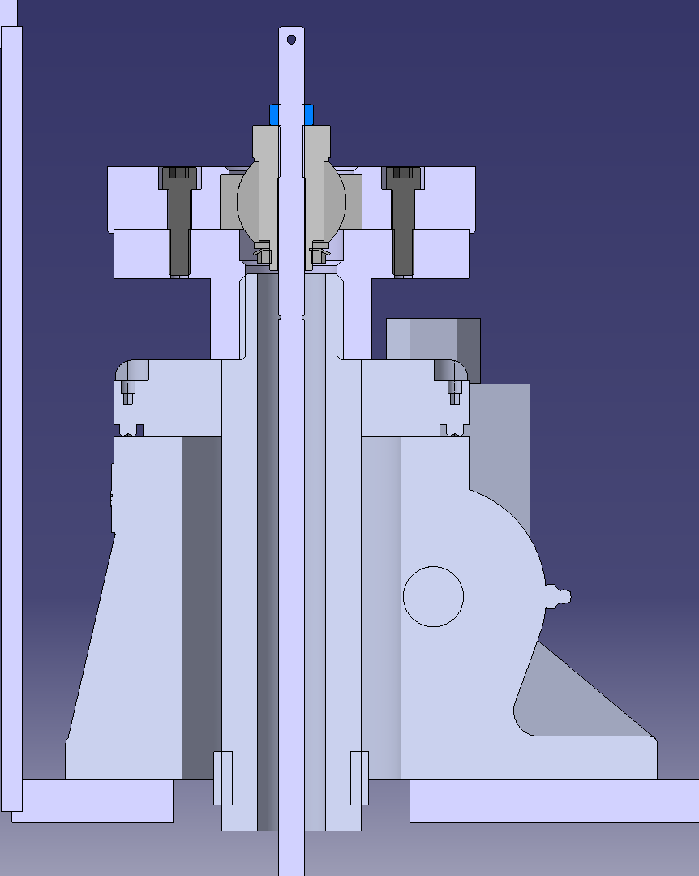

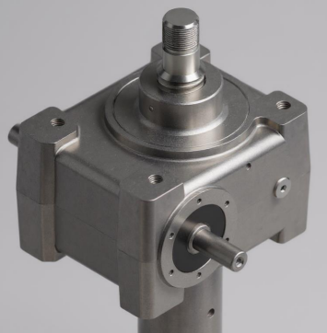
TAXS ALIGNMENT SYSTEM Manufacturing plan
Building one old Alignment system as the ones installed in ATLAS and CMS –DONE
  LHCTAS__0090
Building Test Structure for Alignment system -DONE
Test old Alignment pot - lessons learned -DONE
  Survey report: https://edms.cern.ch/document/3223180/2
  WP8 Calculation note: https://edms.cern.ch/document/3318156/1
Desing upgraded alignment system based on lessons learnt -DONE
  Metric system
  European manufacturer
  Simplified design
  Z regulation capability
  Backlash reduction
  Radiation-resistant grease
Test new alignment system prototype proposals to find best one –DONE
  UK Survey report: https://edms.cern.ch/document/3332346/1
  UK WP8 Calculation note: https://edms.cern.ch/document/3354620/1
  ITA Survey report: https://edms.cern.ch/document/3352002/1
  ITA WP8 Calculation note: https://edms.cern.ch/document/3354614/1
Manufacturing drawings new alignment system –ONGOING
Test full updated unit -Q4/25
Manufacture full set for ATLAS new alignment system -Q1/26
BACKLAS REDUCTION FROM
0.29mm to 0.07mm ~76%.
OLD
NEW
Less pieces
Less backlash
No weldings
Counter nut

Slide 10
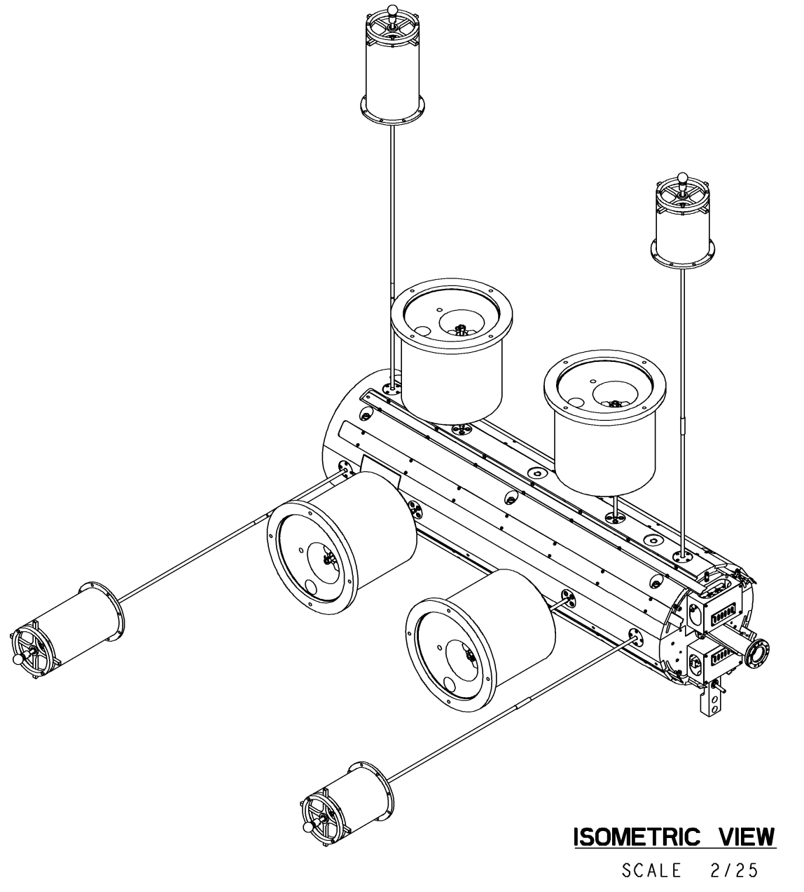
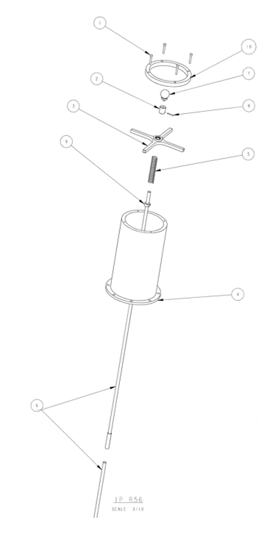
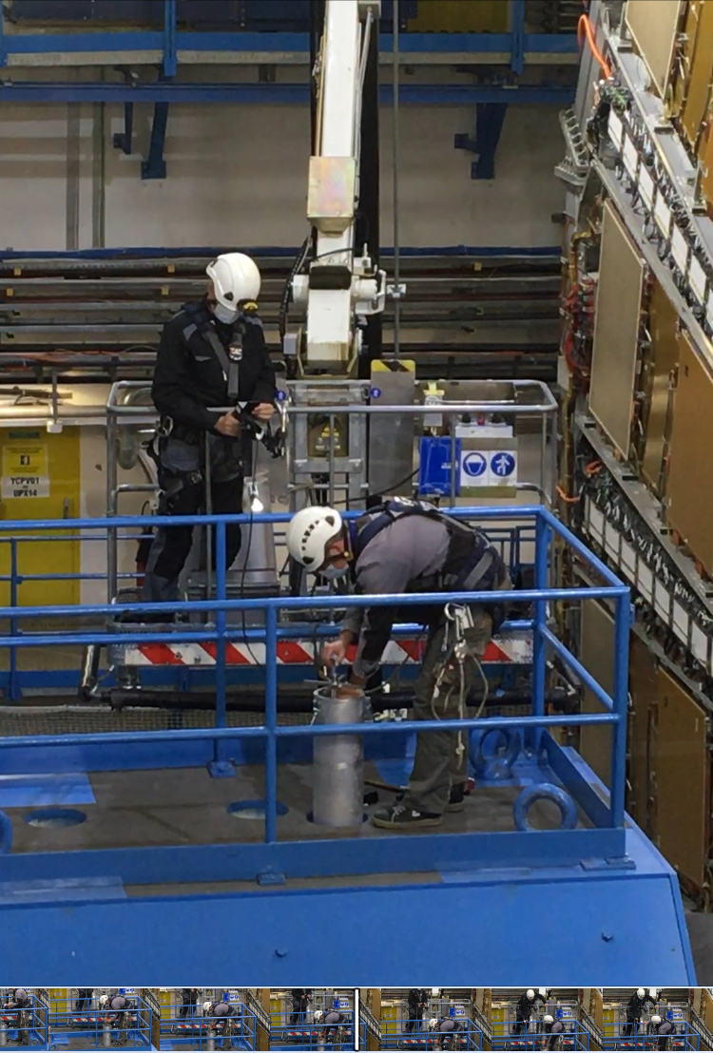
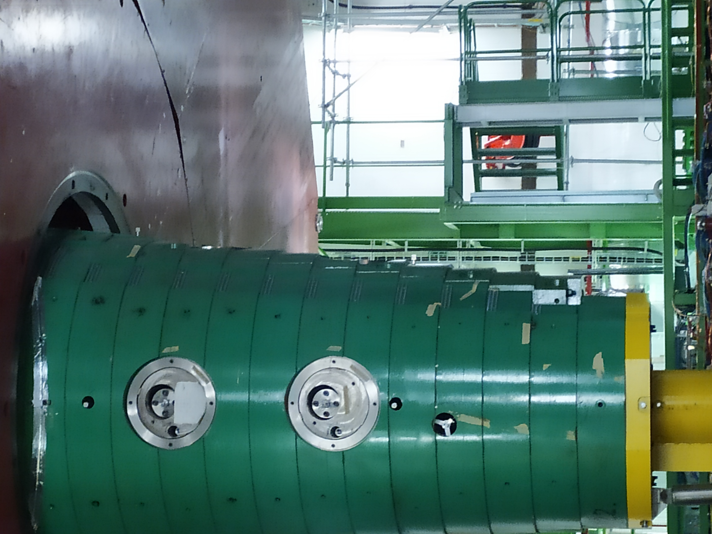
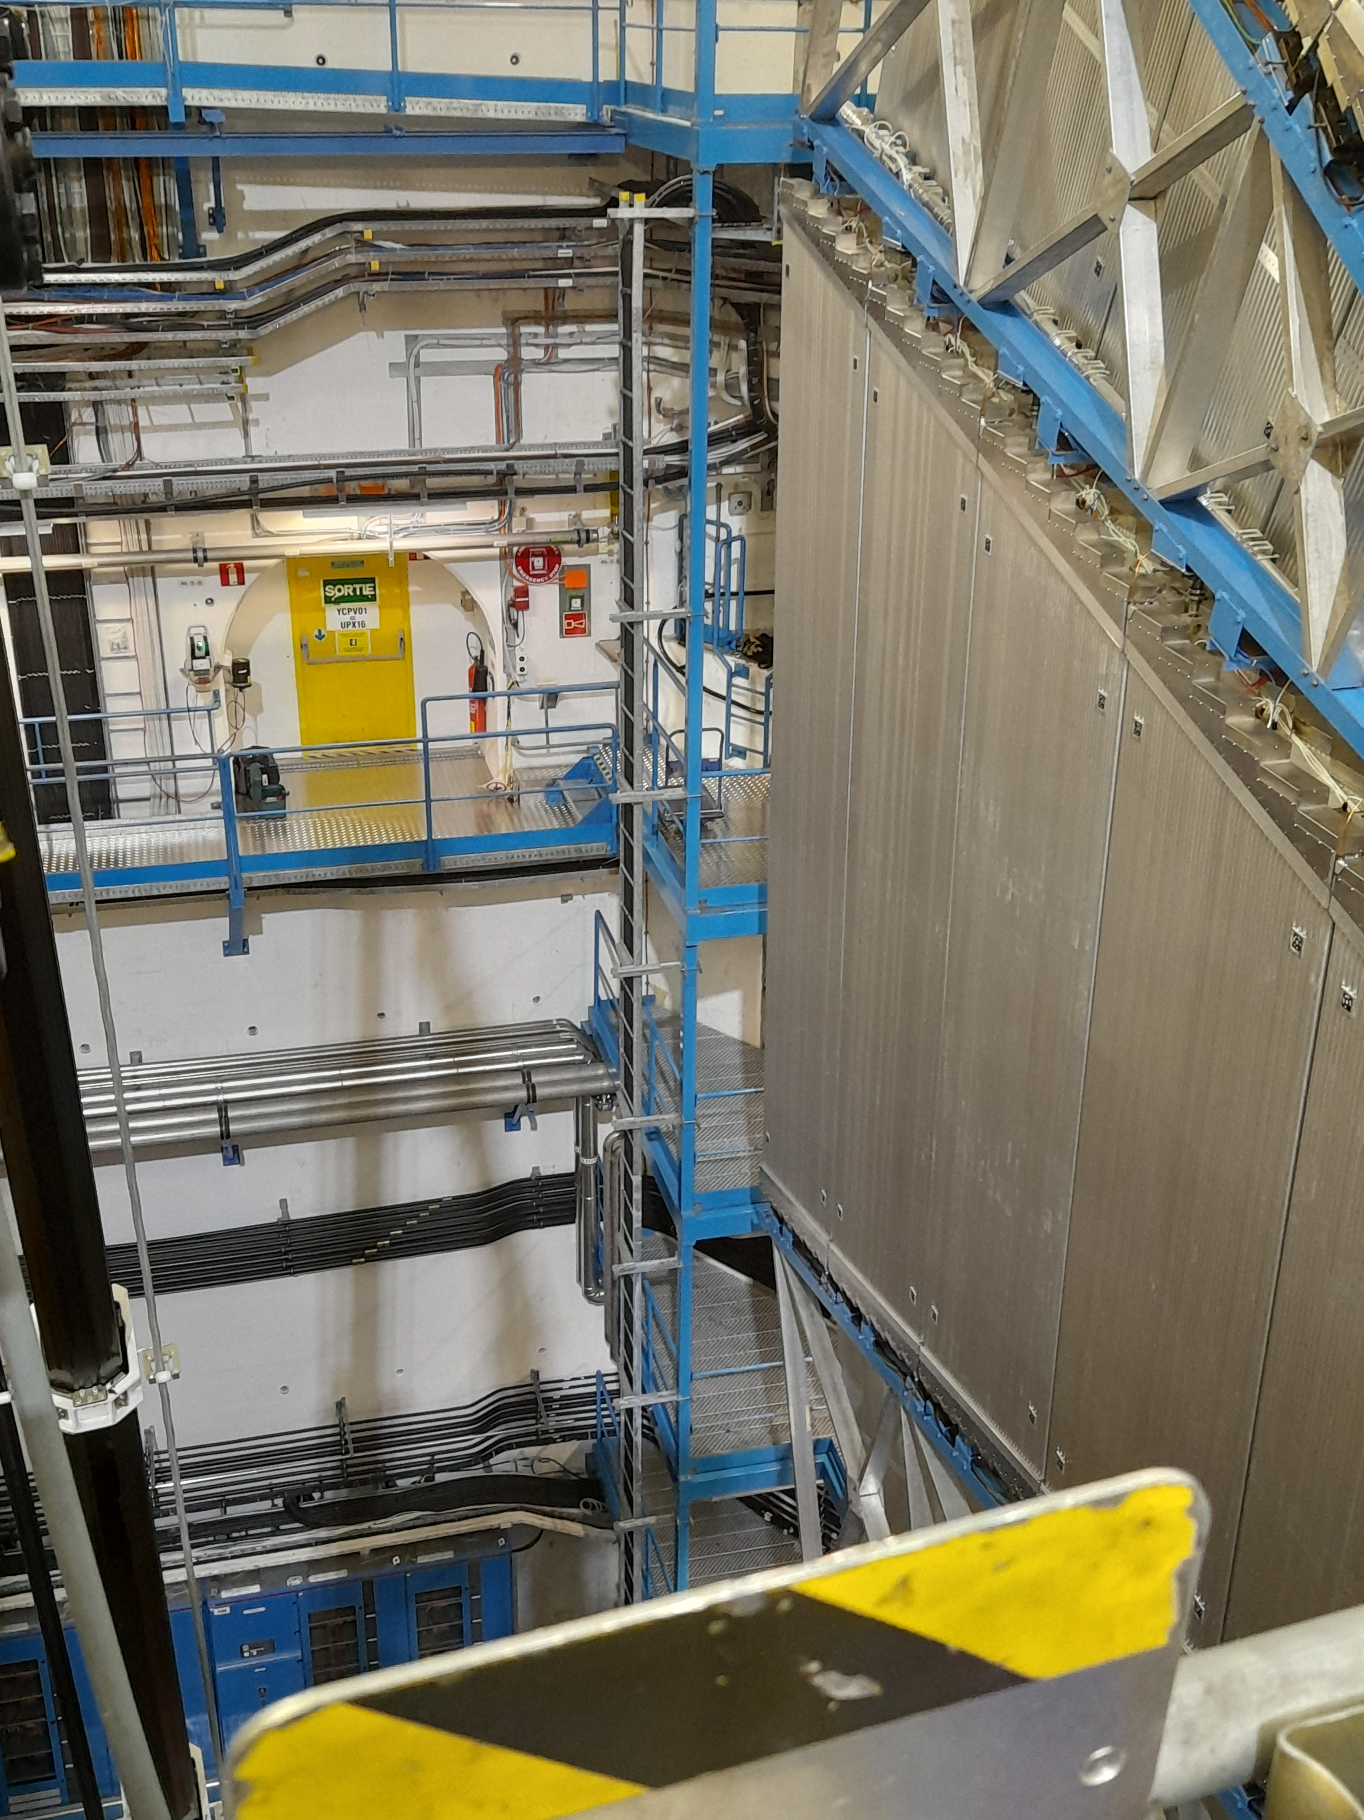
TAXS SURVEY SYSTEM
For the precise alignment on the TAS, measurements are taken every year
The survey system consist in four (Two horizontal, two vertical) survey rods, one tip attached to the TAS and the other tip protruding from the shielding on which a survey sphere is attached for allowing laser tracker measurements inside the experimental caverns
The ATLAS survey rods are split in two due to the movement of the Octagon Shielding, making necessary a yearly connection and disconnection of the rods for taking the measurements
On CMS the rods are always in place and measurements are possible when the rotating shielding is open.

Slide 11
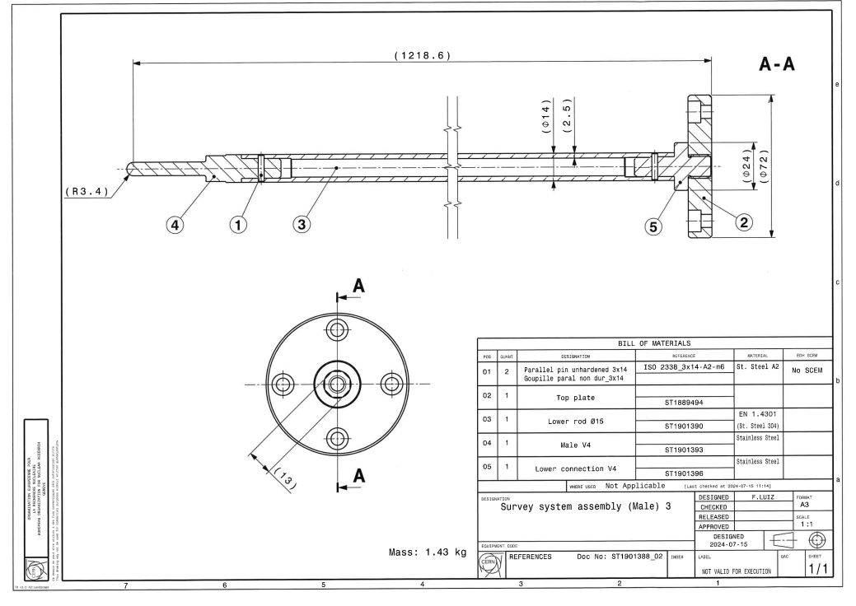
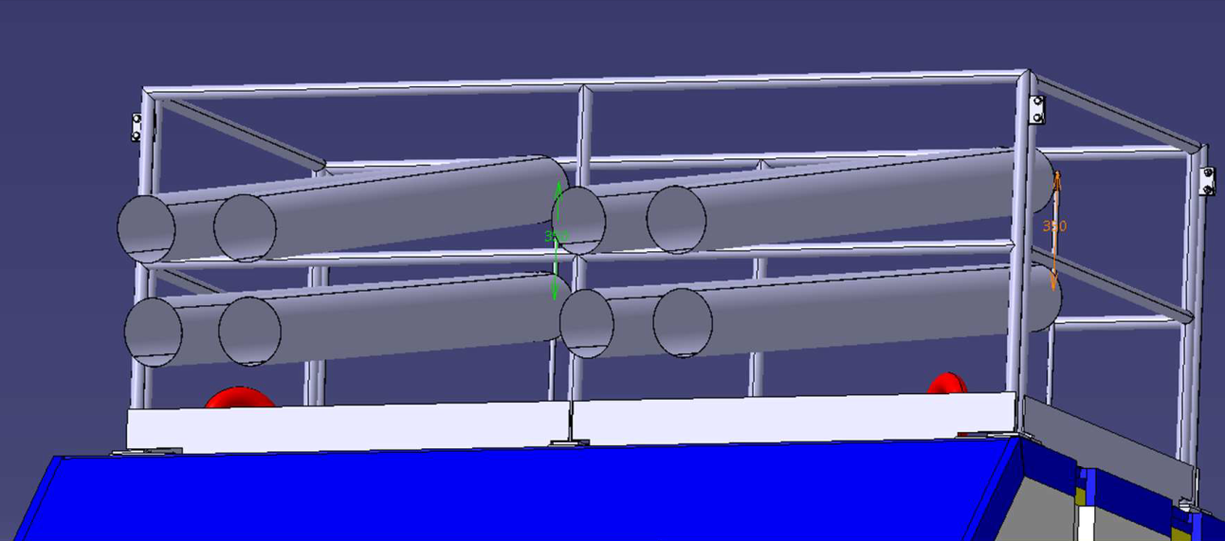
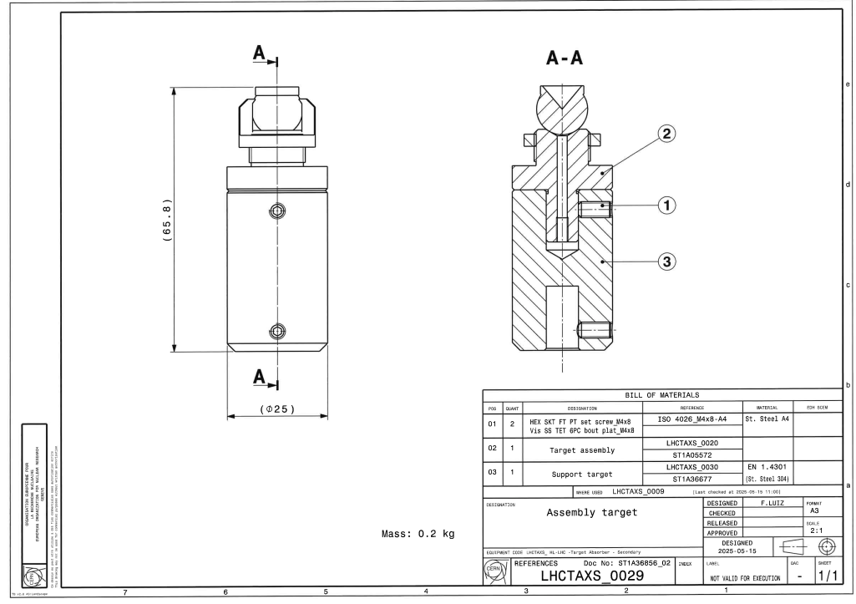
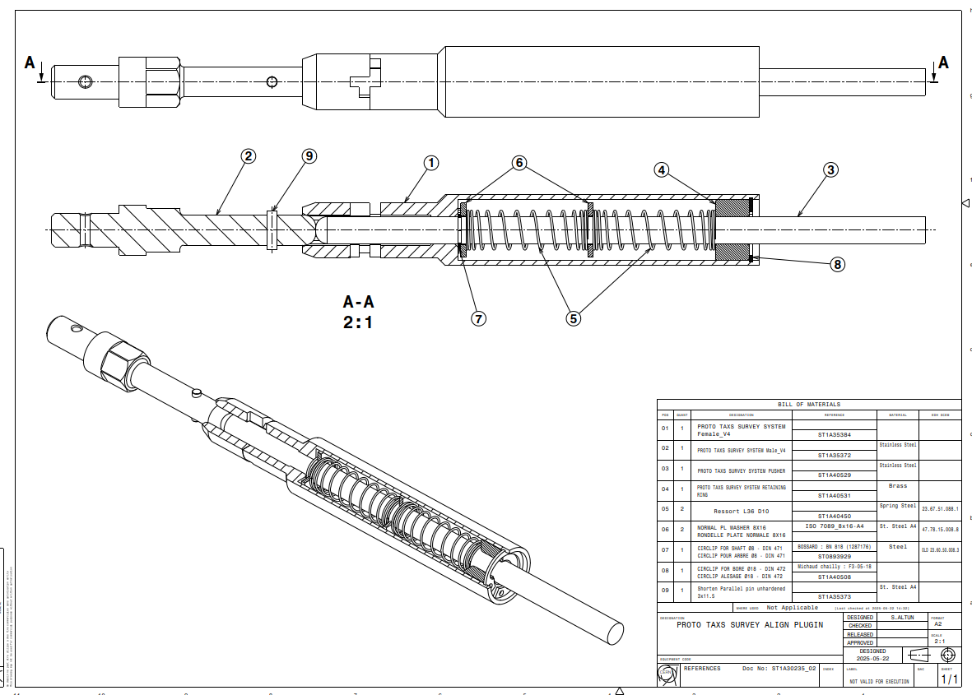
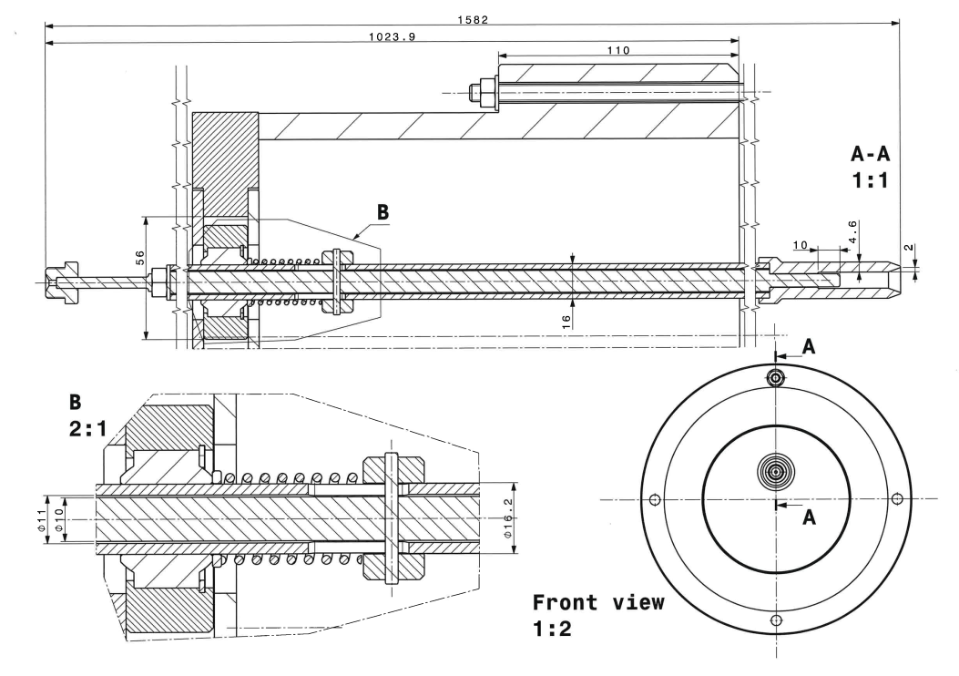
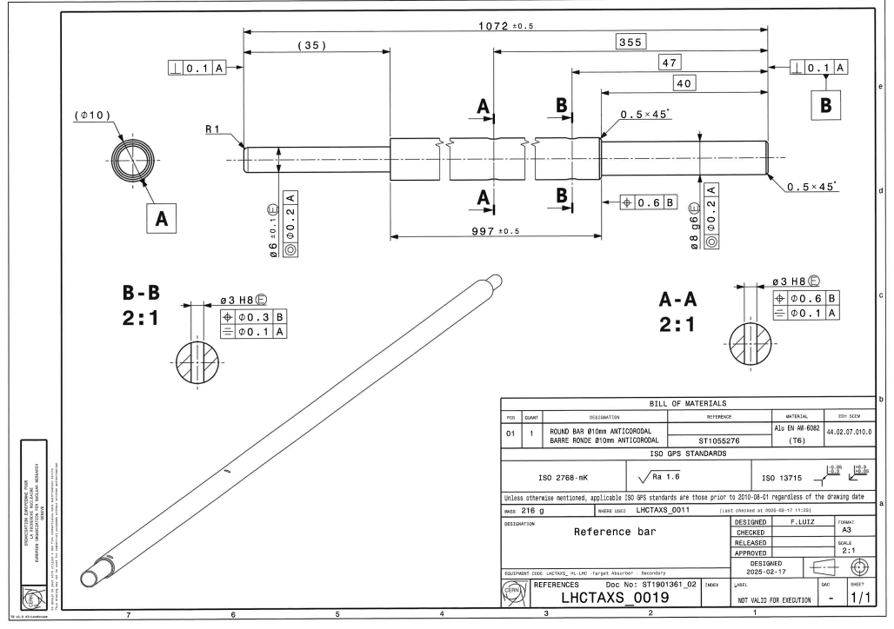
TAXS SURVEY SYSTEM Manufacturing plan
Design the new survey system with lessons learned from the current system and survey advice –ONGOING
  Standardized design
  CMS bars more rigid to allow all DOF measurements
  ATLAS bars easier engagement to shorten intervention time
  ATLAS bars updated pipe holder to shorten intervention time
  Better connection system to prevent loosening of screws
  More compact to shorten intervention time
  Engagement indicator
Build and test one prototype survey system –ONGOING
Build all ATLAS survey set -Q1/26

Slide 12
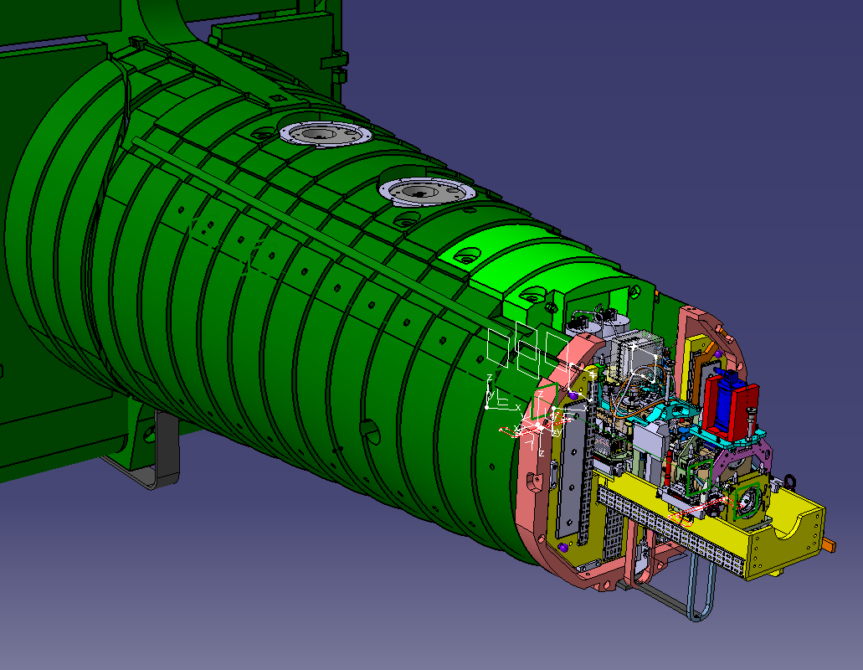
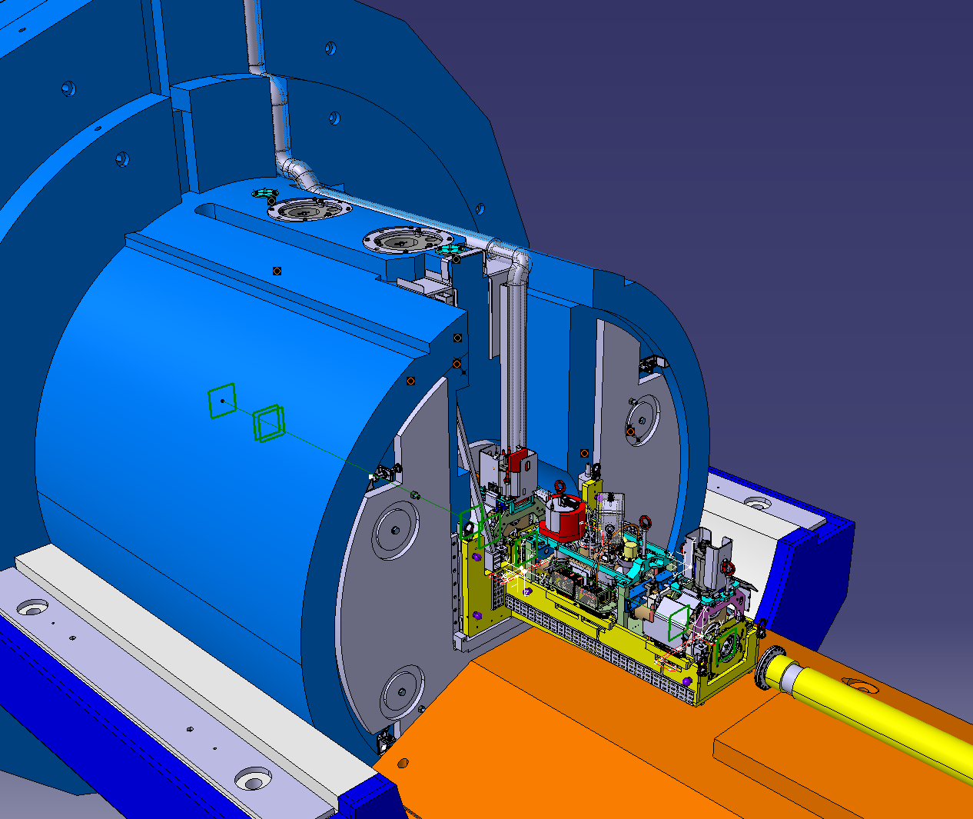
VAXBOX
The ATLAS and CMS VAXBOXs are supports to hold the VAX modules, they are attached to the ATLAS and CMS shielding through support plates and should be able to hold the modules and their services inside the narrow shielding envelope
CMS VAXBOX
ATLAS VAXBOX

Slide 13
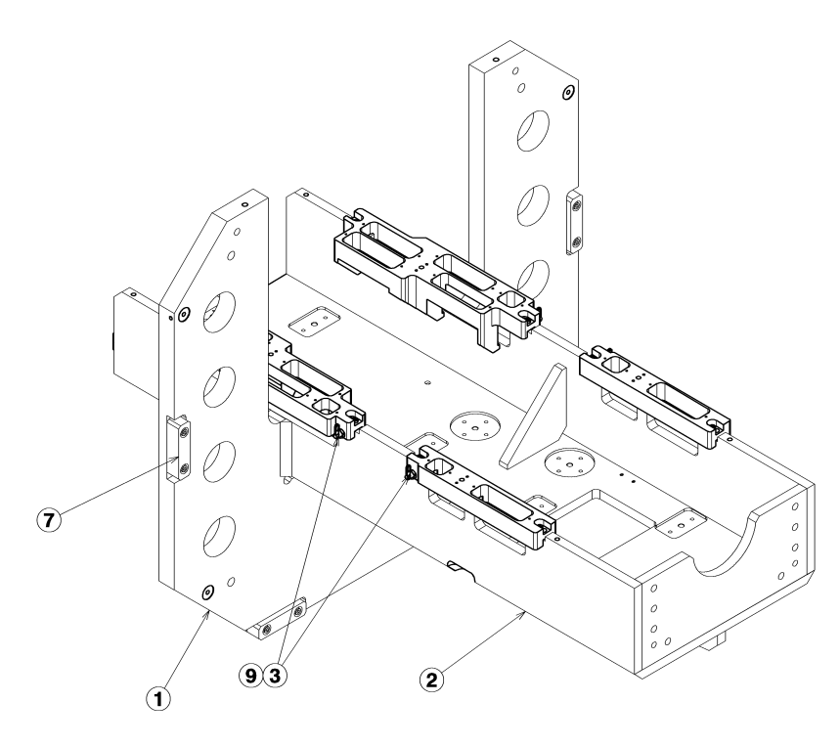
CMS VAXBOX
Design the New CMS VAXBOX –DONE (Validation pending)
    LHCTACS50003
    LHCTACS50004
    LHCTACS50005
  Lessons learned from current VAXBOX and robotic workshop tests
  Lessons learn from bolt fixation deformation tests
    Survey report: https://edms.cern.ch/document/3349677/1/
    WP8 Report: https://edms.cern.ch/document/3031612/0.1
  New Staubli connectors
  New services lines interface
  New modules
  Improved reference system
Mechanical calculation with the latest module loads -TBD
Update the Prototype VAXBOX in Workshop 867 to the new geometry –ONGOING
  867 CMSVAXBOX Metrology report prior update: https://edms.cern.ch/document/3225405/1
Test campaign with proposed final configuration –Q4/25 - Q1/26
Built the new CMS VAXBOXs –Q2/26
Inputs needed (WP12)
Final weight and canter of gravity of modules
Final weight and geometry of the Beampipe nose
To discuss (WP12):
Interface VAXBOX-Beampipe nose
Improving of alignment procedure and geometry (Lessons learnt from deformation test)

Slide 14
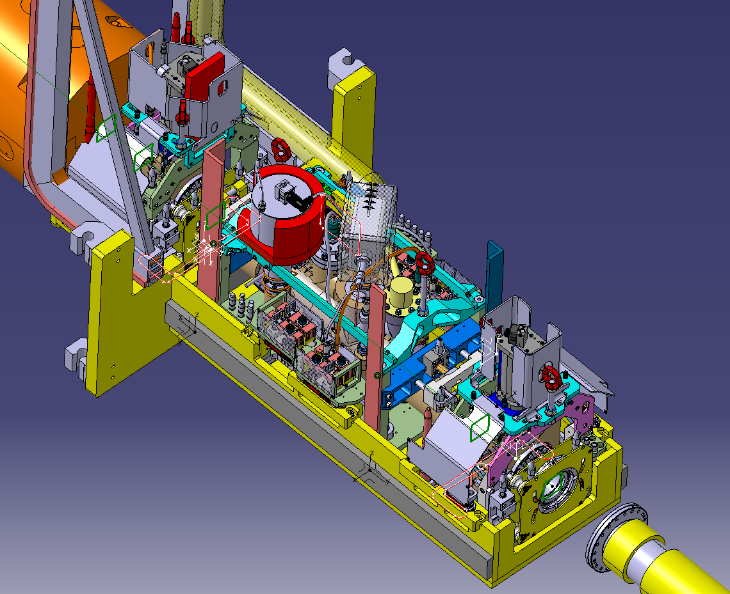
ATLAS VAXBOX
Design the New ATLAS VAXBOX -ONGOING
    ST1851331_01
  Lessons learned from current VAXBOX and workshop tests
  New Staubli connectors
  New services lines interface
  New modules
  Material change
  Improved reference system
Mechanical calculation with the new loads -TBD
Built the new ATLAS VAXBOXs –Q2/26
Test with final configuration –Q3/26
FINAL DESIGN ONGOING
Inputs needed (WP12)
Final weight and centre of gravity of modules
Final weight, interface and geometry of the Beampipe nose

Slide 15
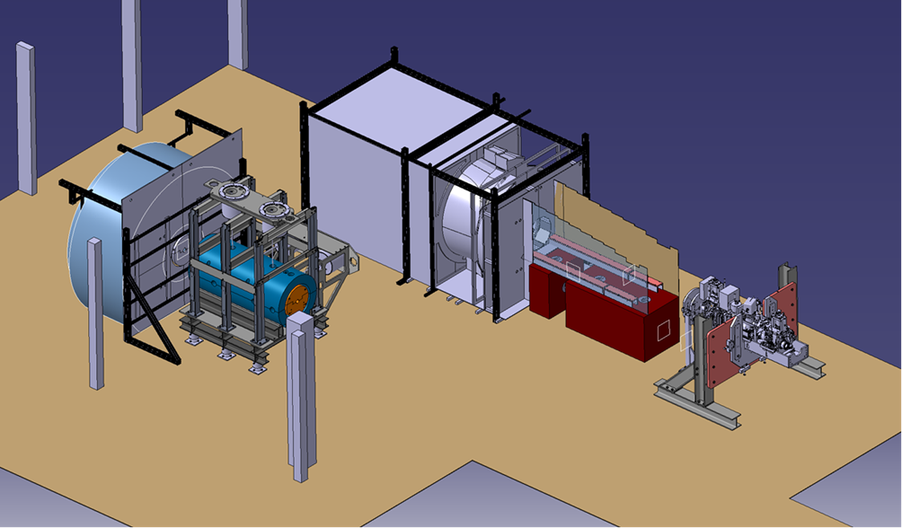
VAXBOX TEST CAMPAIGN
NEXT FEATURERS TO BE TESTED IN THE FOLLOWING TEST CAMPAING
Updated valve cutouts
Final version of the M1 support
Updated Staubli position
Narrow final tolerances
VSeats-Ball connection test
New Bushings-columns interface
Preguiding system proposal
Staubli robotic spring connection
Lateral CMS vacuum connection
New guiding columns positioning
FOLLOWING SCHEDULED TEST CAMPAINGS
Test in ATLAS within final environment –Q1/26
FUTURE TEST CAMPAIGNS
Vacuum beam nose connection
Final Staubli geometry test
VABXOX installation and alignment
Full module installation and deformation test
Nest Testing campaign will start as soon as the VAXBOX modification is done (Currently in MME) (Tentative Q4/25)
Similar test will be carried out when ATLAS VAXBOX is done
The interface is similar to the CMS VAXBOX

Slide 16
MANY THANKS TO ALL THE WORKING GROUPS FOR THEIR CONTRIBUTIONS

