Slide 1
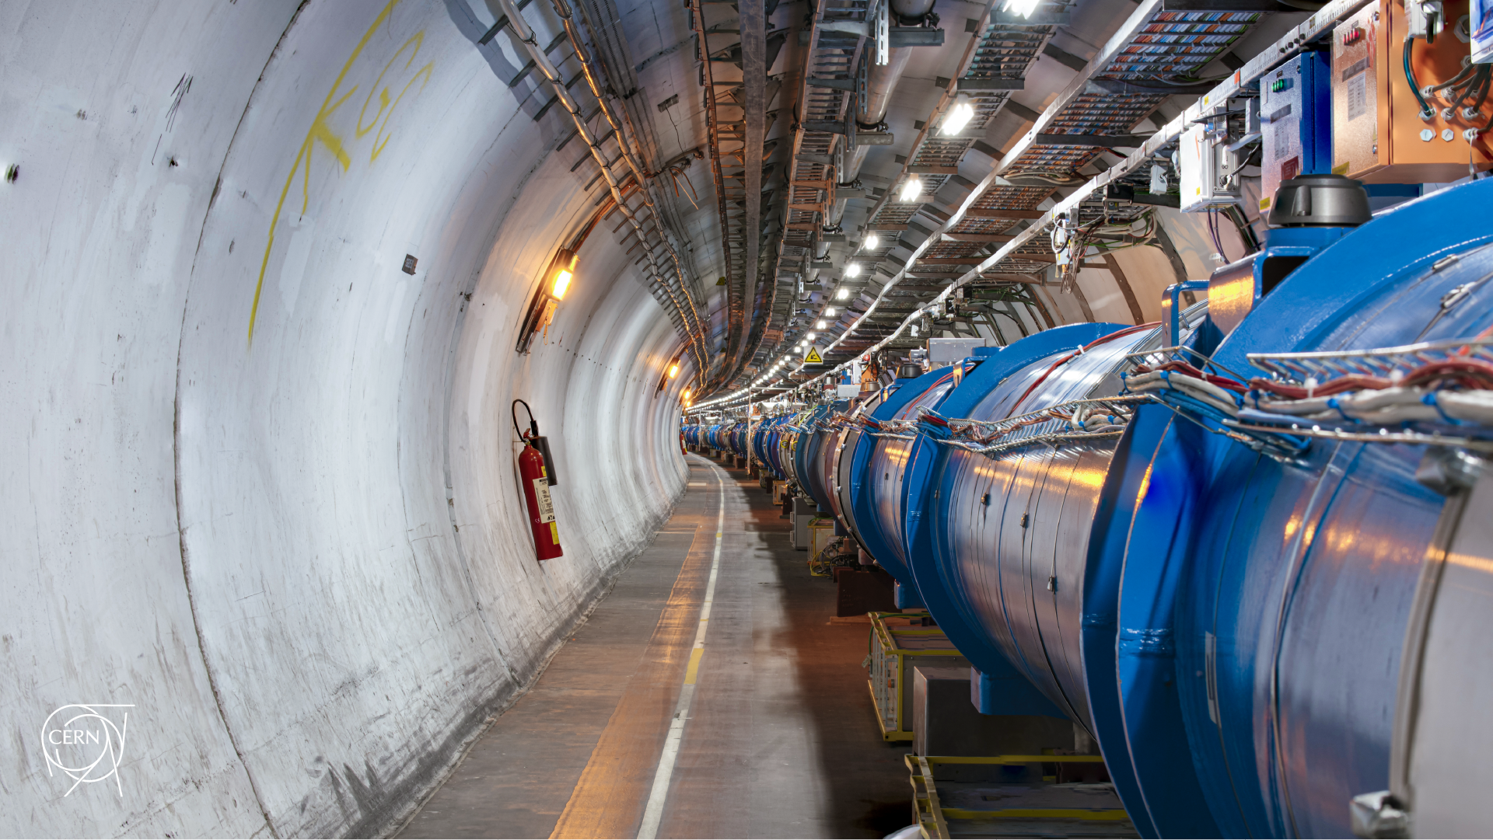
Run3 observations as input for Run4 commissioning
D. Mirarchi on behalf of BE-OP-LHC team
Acknowledgments: X. Buffat, E. Maclean, L. Mether, S. Redaelli
15th HL-LHC Collaboration Meeting

Slide 2
Introduction
Restarting after a Long Shutdown
Unexpected limitations, commissioning, and validation
Possible conceptual limitations
Conclusions

Slide 3
Outline
Restarting after a Long Shutdown
Unexpected limitations, commissioning, and validation
Possible conceptual limitations
Conclusions

Slide 4
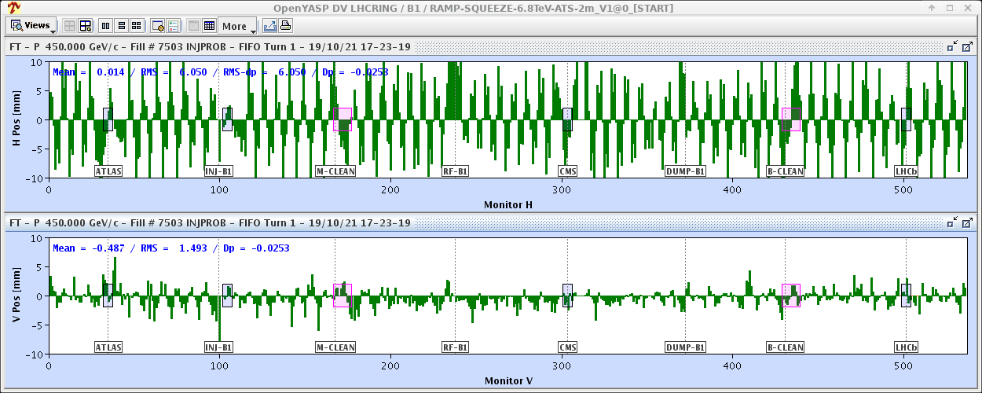
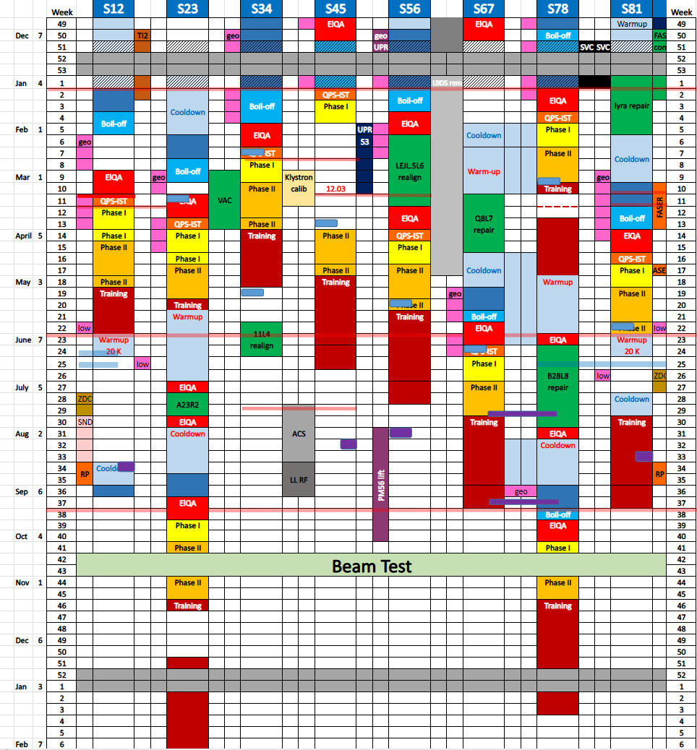
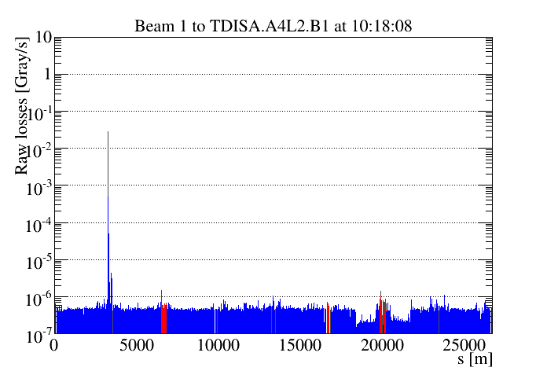
First beam after LS2!
Threading
Some delays at end of LS2 (Covid-19, partial/complete warm-up during HW comm.) pushed start of Run3
2020
LS2
2021
Beam 1
B2 took several hours (debug/solve all issues)
Hardware Commissioning
(Training campaign to 6.8 TeV)
B1 took short over 1h
Checkout
Short before 6pm both beams happily circulating!
Quite efficient first hours of beams, but then…
Beam TEST
Hardware Commissioning
(Training campaign to 6.8 TeV)

Slide 5
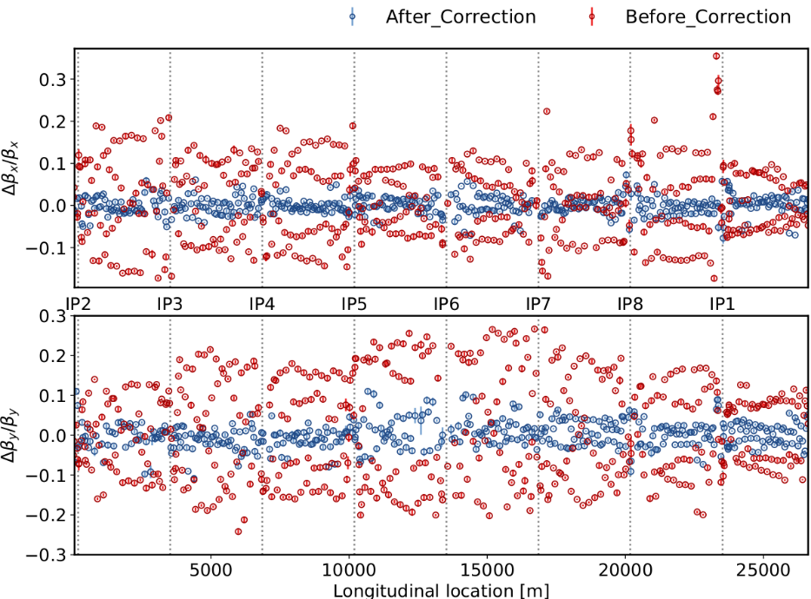
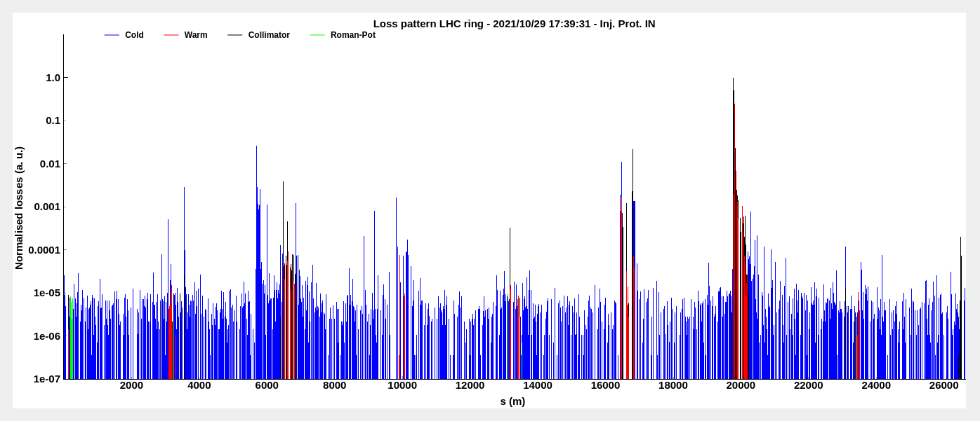
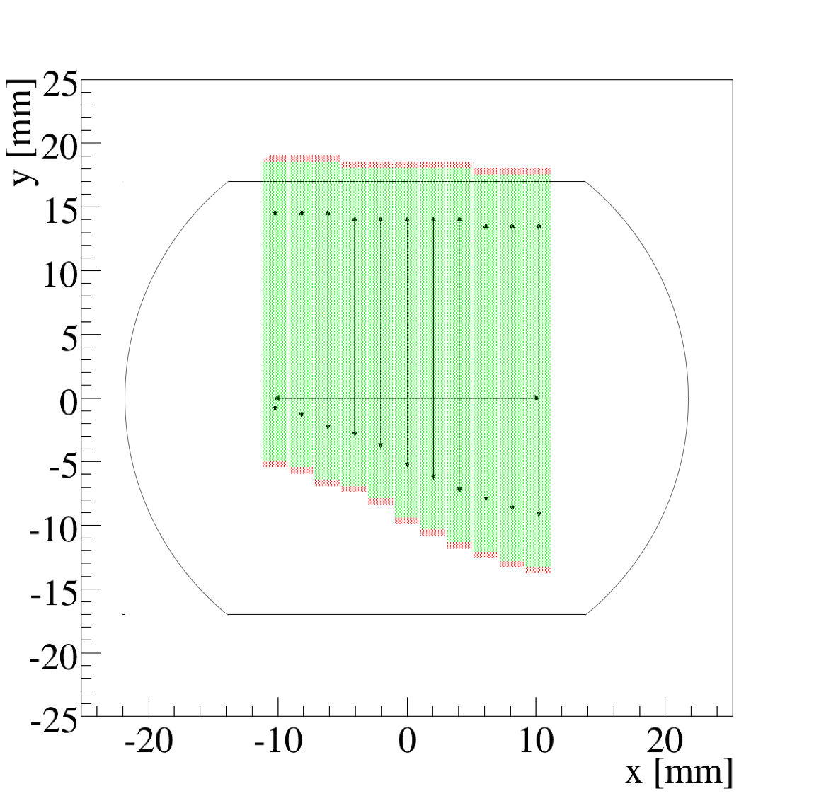
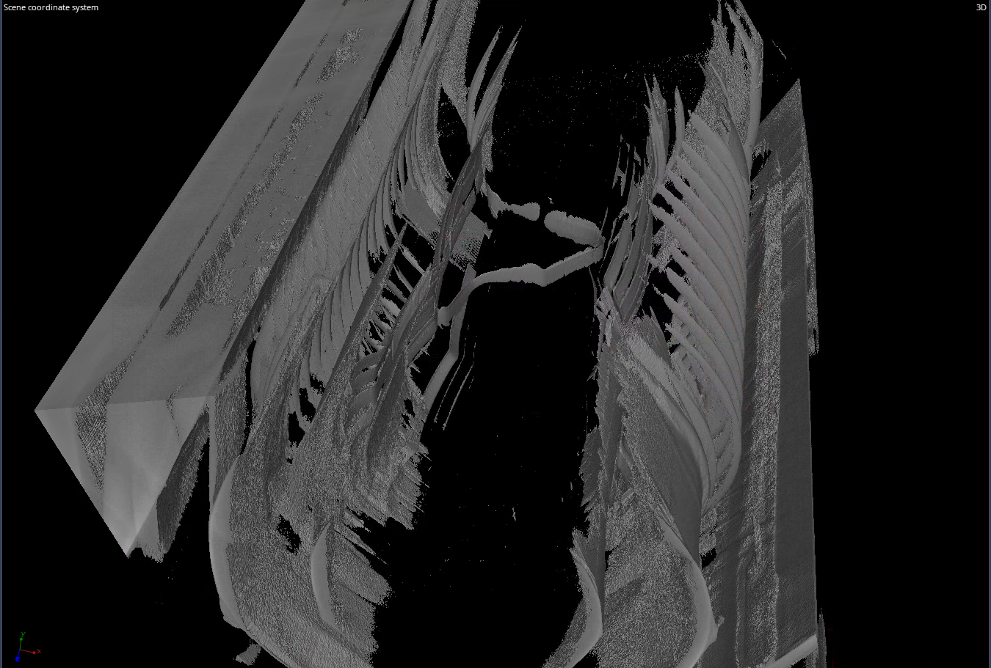
Unexpected surprises
Beam 1
Identified old non-conformity on day 2:
Swapped RQTL7.R3B1 ⇄ RQTL7.R3B2
Identified in 2008, cured in 2009, and re-introduced in LS2
Fixed at control system level
Optics corrected on day 4, achieving δβ/β ~10%, comparable to 2018
Circuits
First hint of issues identified during Loss Maps (LM)
Confirmed by local aperture meas.
x-ray & tomography
showed buckled RF finger
MQ-MB.C 21L3
Aperture
Beam 1
Warm-up of S23
for repair

Slide 6
Lessons from 2 weeks beam test after LS2
Restarting a machine like the LHC after several years without beam can hide unexpected issues
Even few days with safe beam at injection can have a significant outcome:
Test and commission key instrumentation
Test old & new software tools
Pre-commissioning of key systems (RF, Inj/Dump, Collimation)
First collisions provided as well for pre-commissioning of detectors
Unveal unexpected issues in advance with respect to planned start of Run3, reducing impact of delay
Good initial training for renewed OP crew
If similar boundary conditions as after LS2
to be kept in mind to have a similar 2 weeks beam test towards end of LS3

Slide 7
Outline
Restarting after a Long Shutdown
Unexpected limitations, commissioning, and validation
Possible conceptual limitations
Conclusions

Slide 8
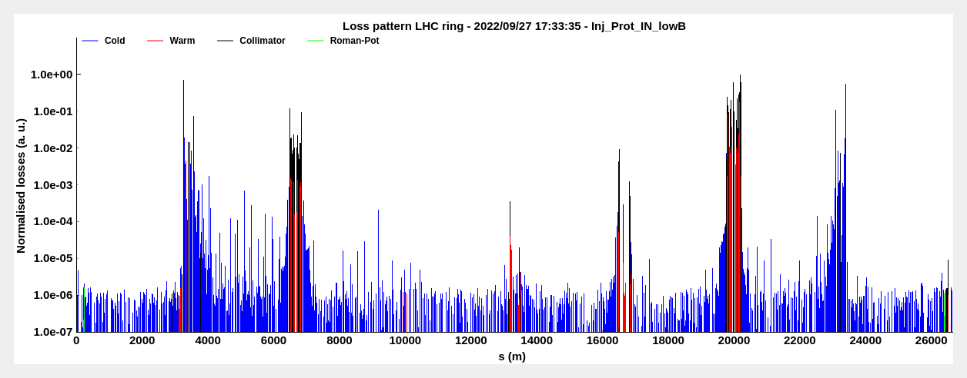
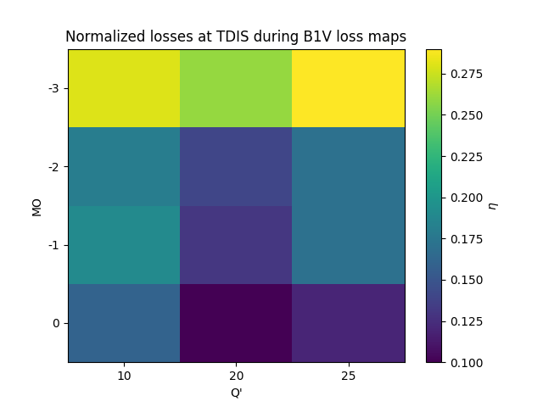
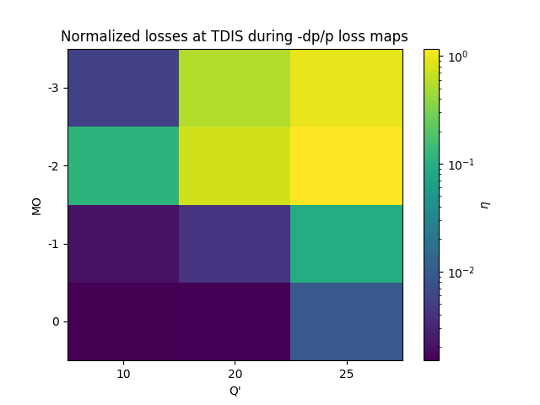
2022 run
Broken collimation hierarchy identified during LM at injection for -δp/p (comm. after RF disk incident repair)
TDIS.2
TCP.3
TCP.7
Beam 1
Beam 2
Broken hierarchy
Parametric scan of MQ and Q’ showed significant impact from non linearities
Mitigation strategy: phase knob implementation (MOPL019 and IPAC23)

Slide 9
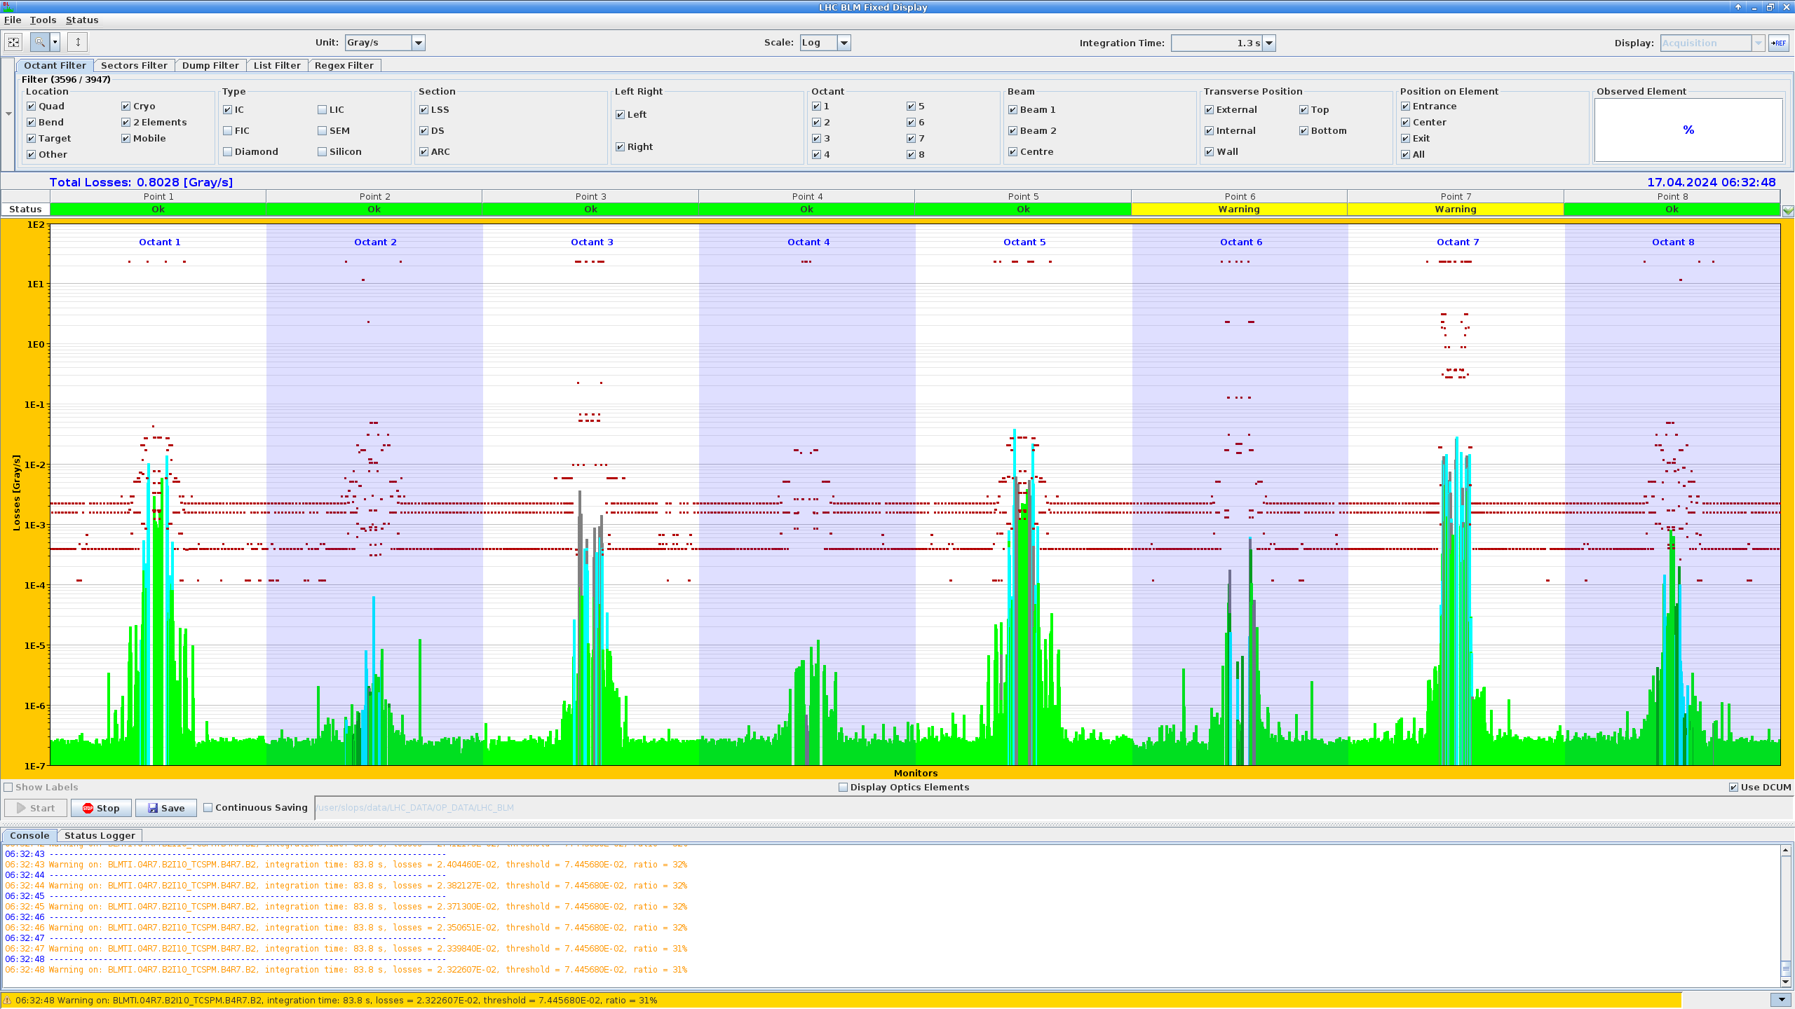
2024 run
Broken collimation hierarchy observed during β* levelling (first 1800b fill reaching warning dump losses)
Investigations performed as End of Fill, revealed:
linked with two-high intensity-beam effect
isolated to Beam 2, caused by vertical beam loss
sensitivity to bunch population, Q’, MO, Xing
TCSG.D4R7.B2
Mitigation strategy after TS1:
Increased on_disp = +250 μrad (Xing = 150 μrad)
Reduced to Q’ = 6 (from Q’ = 20)
a3 correction for IR5

Slide 10
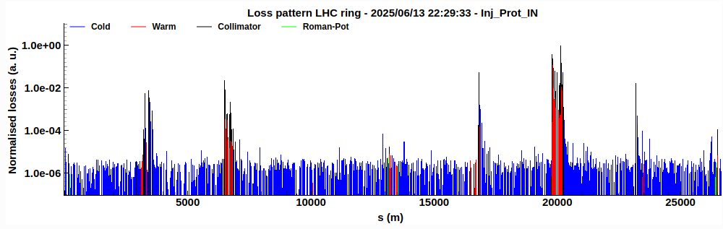
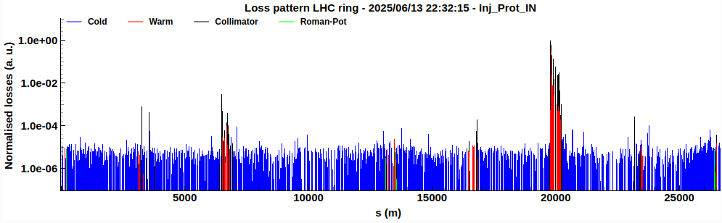
2025 run
Broken collimation hierarchy observed at start of ramp in Beam 1 (first 1800b reaching warning dump losses)
TCP.7
TCSG.6R7.B1
Breakage successfully reproduced in -δp/p LM at inj.
TCP.3
Beam 1
Parametric studies revealed dependence on:
MO polarity
MO strength
Phase knob
With phase knob = 1.5
Mitigation strategy:
Temporary decrease of MO = 1.5 (from MO = 2)
Increased phase knob = 1.5 after TS1 (from 1) (start of ramp losses moved from IR3 to IR7, not yet fully understood)

Slide 11
What do they have all in common and lessons learnt?
Issues became clear while already running with full machine
Earlier detection must be pursued to avoid potentially dangerous events
All linked to large non linearities and particles with large betatronic and momentum offset (see Frederik Thu.)
Machine working point fine tuned during intensity ramp-up driven by beam stability considerations
 | Q1H/Q1V – Q2H/Q2V | Q’ | MO
Expected | .295/.313 – .295/.313 | 20 | 1÷1.5
Physics | .282/.305 – .286/.308 | 20 | 2
Example 2025 at injection:
Impact historically expected to be low and validation loss maps nominal Q, Q’ = 10, and MO = 1
Do we need to review/update/integrate validation strategy?

Slide 12
How could we update validation strategy?
Overall commissioning workflow already presented by Georges at Chamonix 2024, which still holds
time
Initial commissioning
with safe beams
First intensities above safe beams and first Stable Beams with INDIVs
Fine tuning during scrubbing with long trains + full beam-beam pattern
Subset of static points to be validated with full non linearities (after 400b step?):
Injection
Flat Top
Before collisions (most critical for aperture)
End of cycle (lowest β*)
Important to keep present validation strategy of cycle validation via complete loss map matrix
Avoid surprises with high intensity beams (not easy to spot them promptly)
Re-validation after TS: same subset but for both sets of non-linearities to check stability?

Slide 13
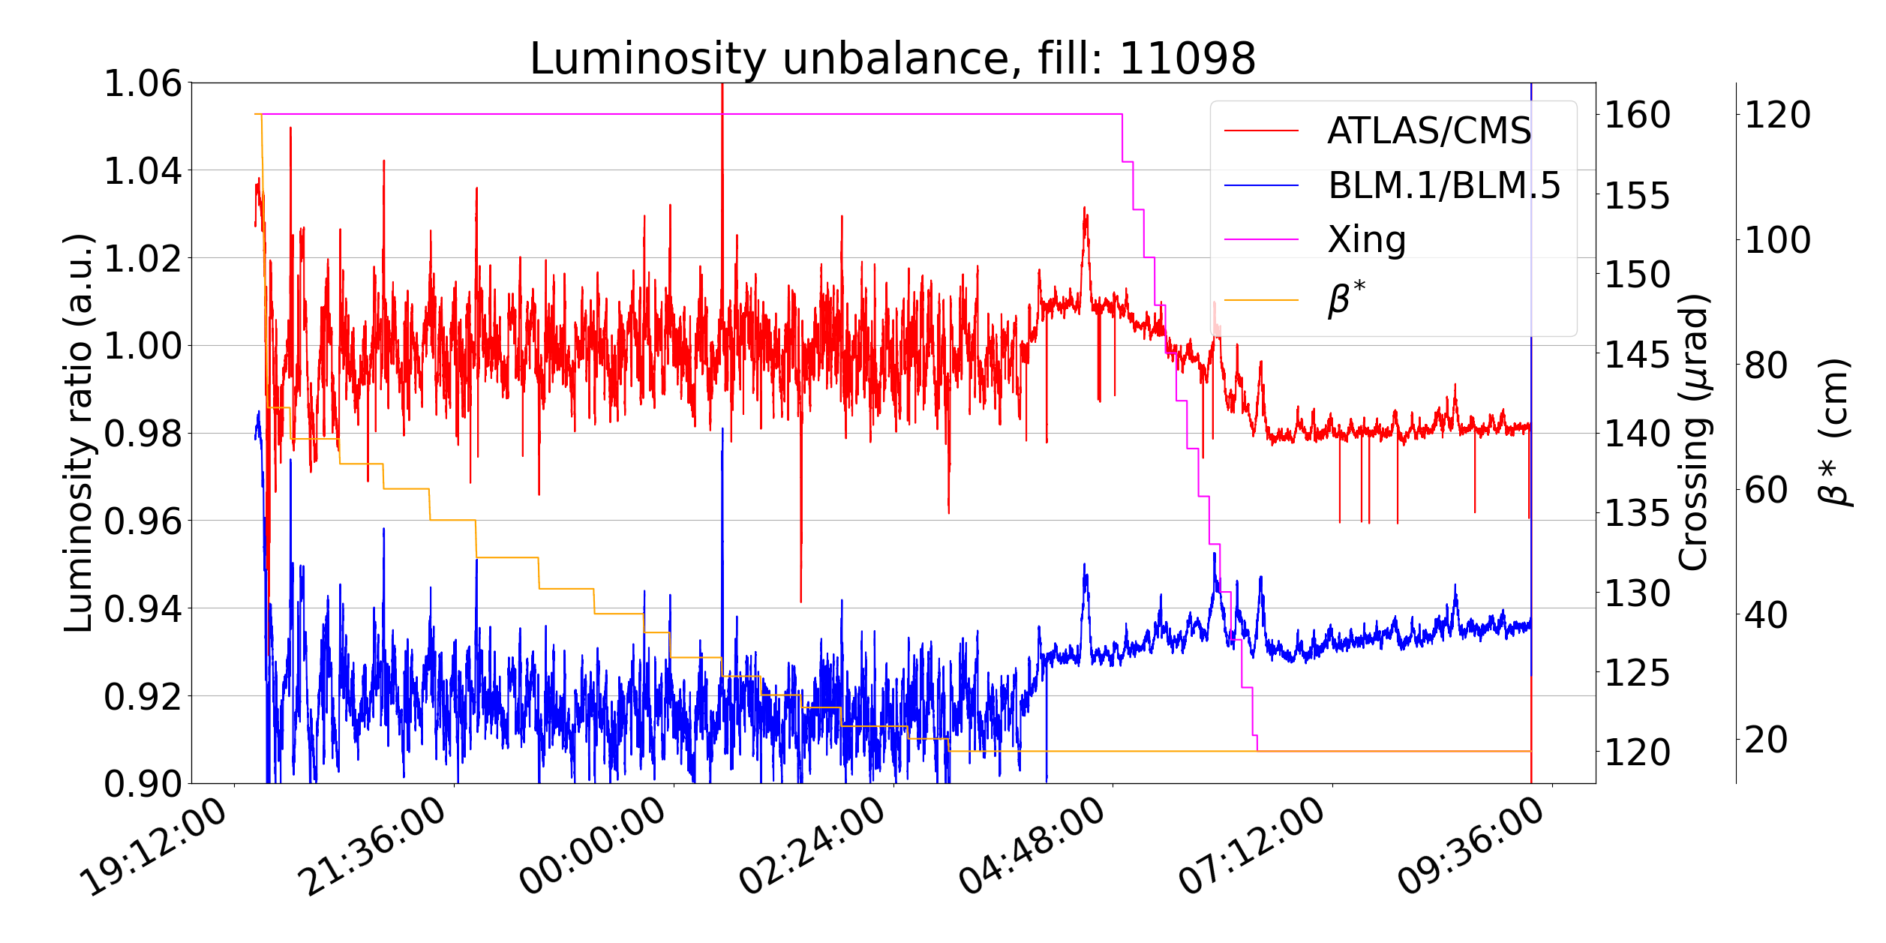
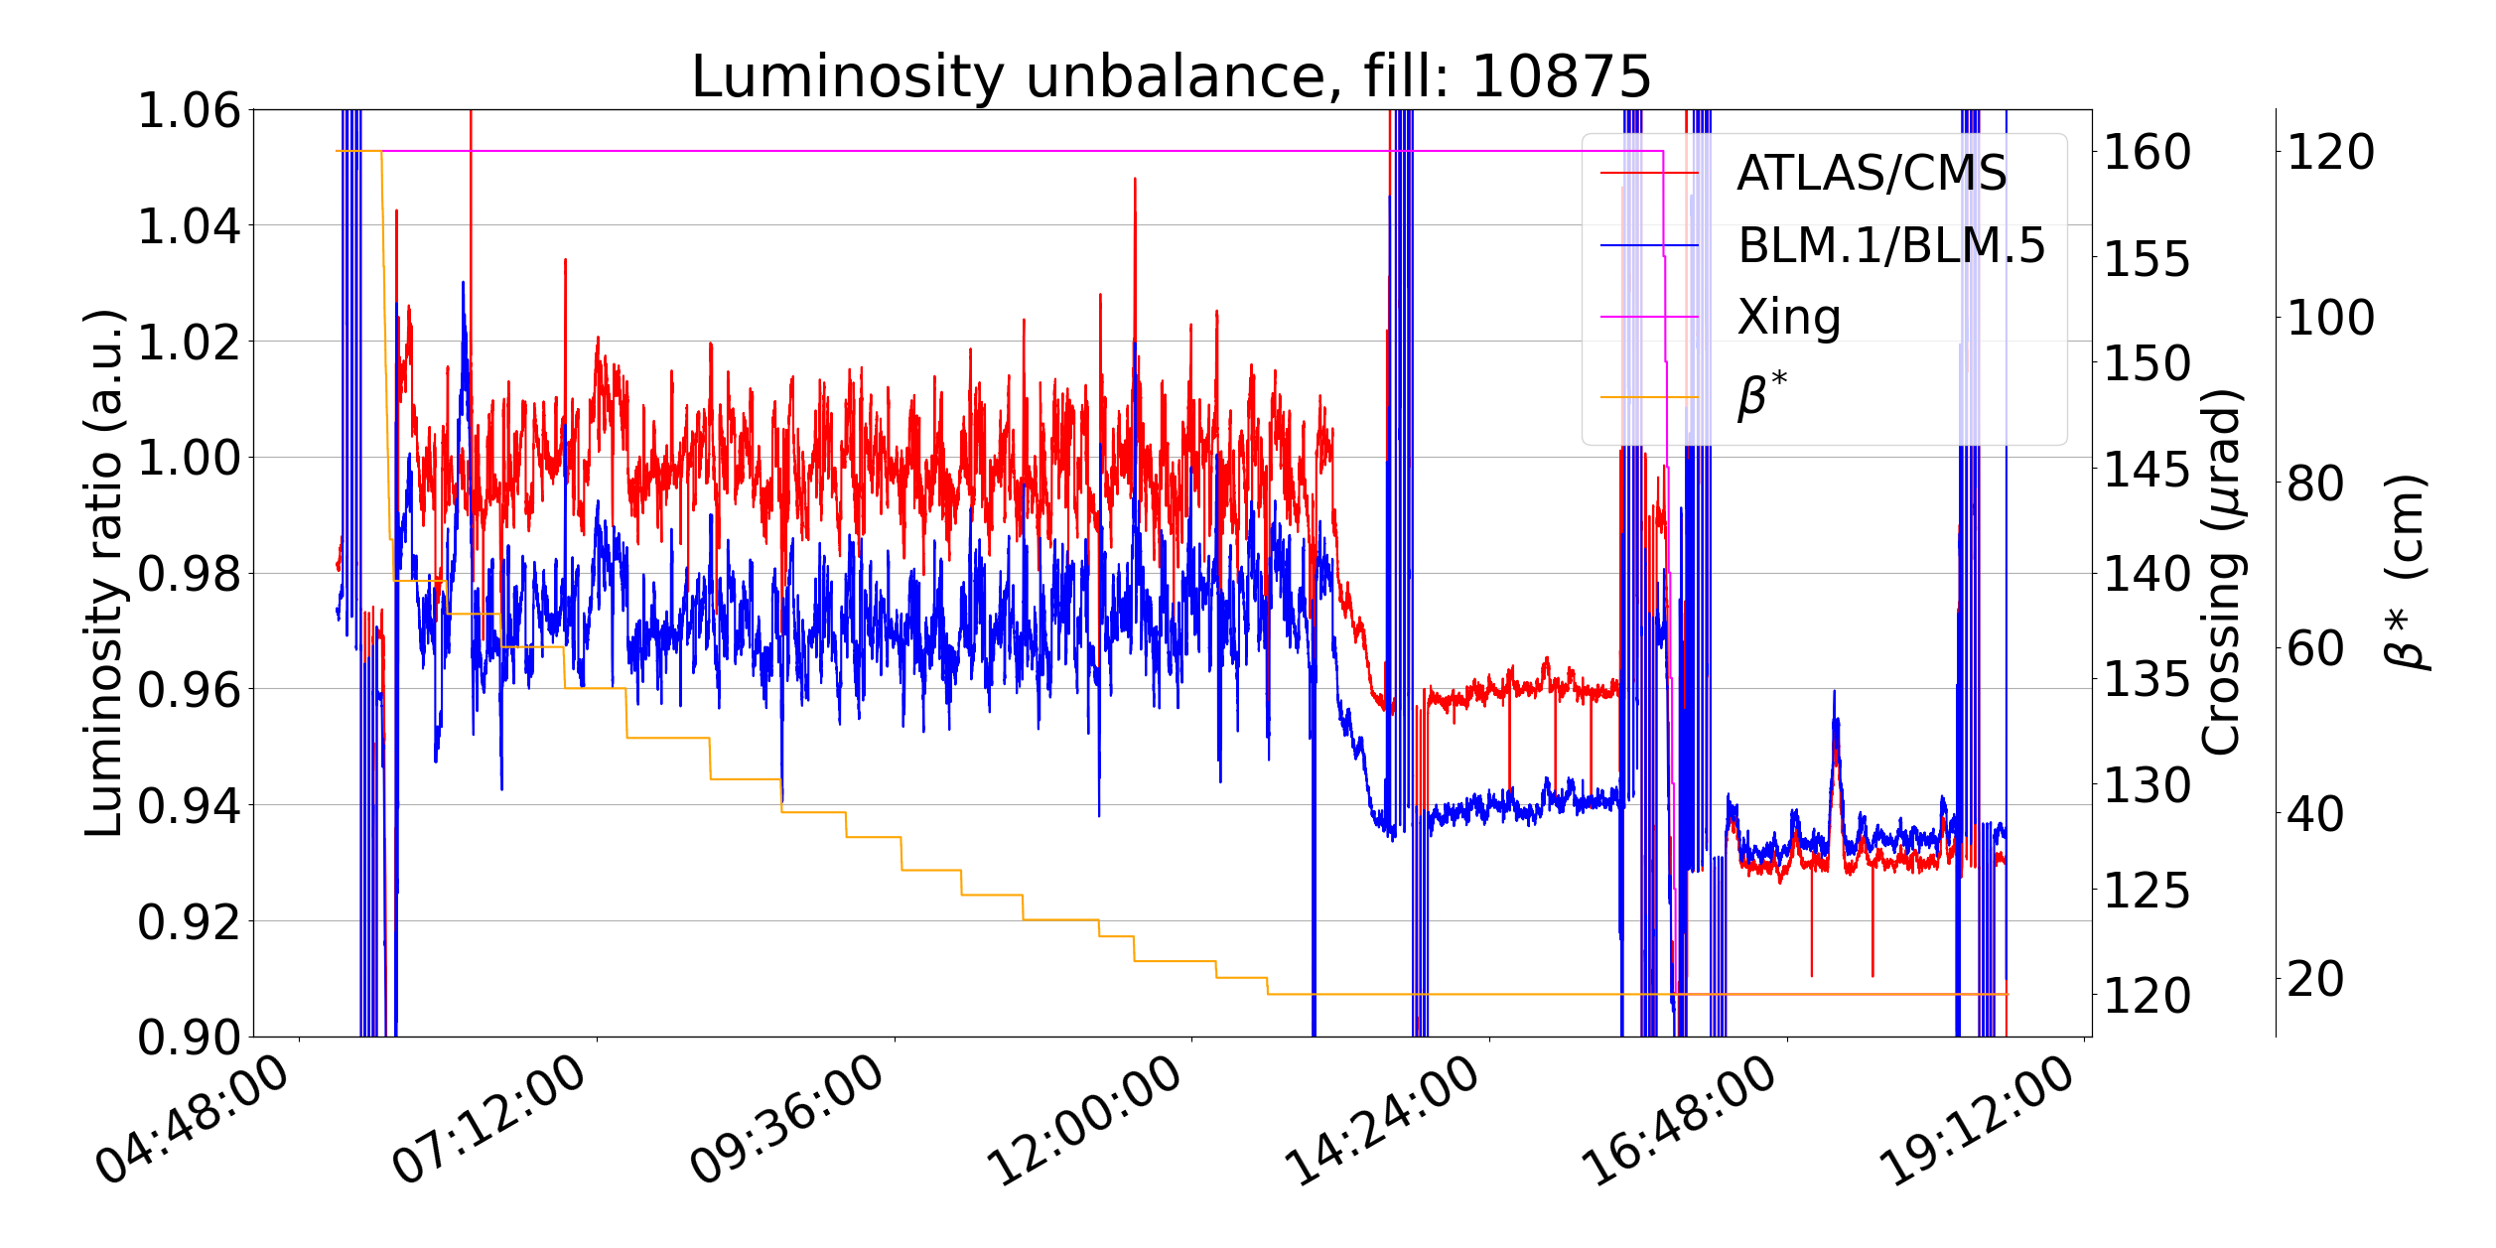
Lumi unbalance
The smaller the β*, the larger the impact any error of ℒ_{IP1/IP5} unbalance (beating, waist shift, …)
See Joanna’s talk for more details!
Timescale of ATLAS & CMS calibration much longer than LHC needs (>1 year after vdM program)
Any bias on provided ℒ will translate in bias on ∫ℒ:
high management decision outside our control
Even if most of ∫ℒ done during levelling,
~4% change of CMS ℒ calibration
significant discussions may arise from unbalance when head-on
Inevitably attributed to not optimal LHC setup
Important to review comm. strategy and have OMC + independent ℒ,
to ensure ℒ_{IP1/IP5} < 5% during commissioning/early stages

Slide 14
Outline
Restarting after a Long Shutdown
Unexpected limitations, commissioning, and validation
Possible conceptual limitations
Conclusions

Slide 15
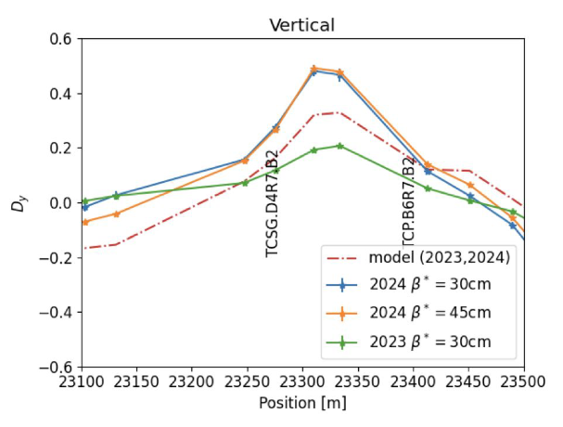
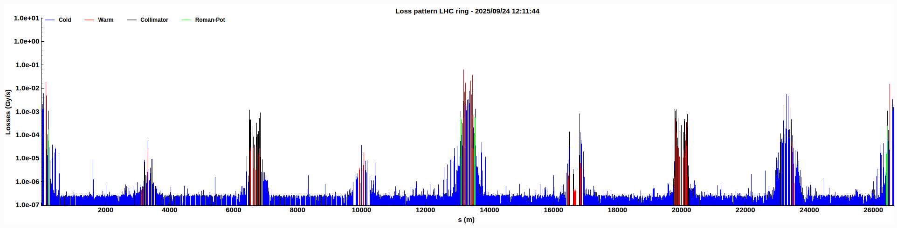
Model dispersion
T. Persson
Broken hierarchy during β* levelling in 2024 normalised D_{y}^{TCS.7}/D_{y}^{TCP.7}
Mitigated in 2025 with updated on_disp knob
Full compensation of D_{y} with ad-hoc knob also for IP2 and IP8 in HL?
Near miss broken hierarchy in 2025:
TCSP.6.B1
TCP.7.B1
Increase D_{x} in IR6.B1 during β* levelling
Intrinsic optics feature
Alternative solutions must be studied to avoid yet another hierarchy breakage, if not possible to mitigate in design (e.g. followup on possible asymmetric TCSP settings)

Slide 16
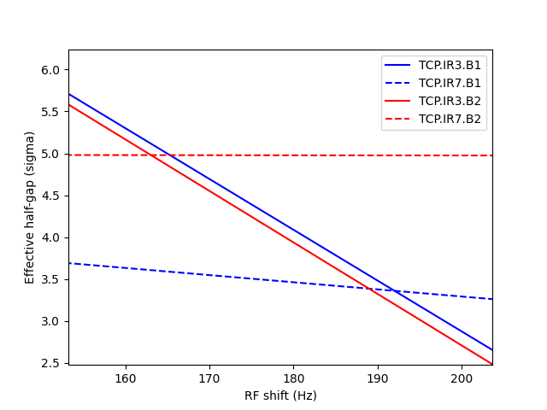
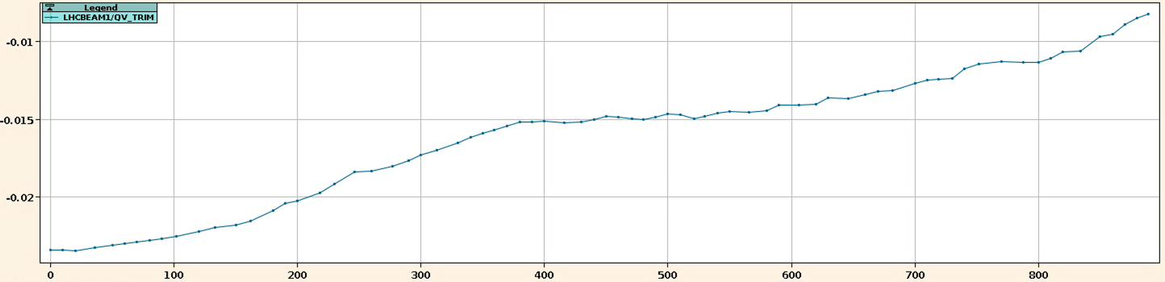
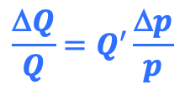
Loss Maps
Required trim ΔF/F > 160 Hz to get Losses_{IR3} > Losses_{IR7} at top energy
In collisions QH = 0.31, QV=0.32
$$\frac{\text{D}Q}{Q}=Q^{′}\frac{\text{D}p}{p}$$
160 Hz ≈ 1.1e-3 δp/p
Not possible to validate +δp/p LM with operational Q’ and collisions Q, because the 3rd order resonance is inevitably hit!
Significant FF during operations
to compensate beam-beam Q shift:
Are we really compensating only or changing working point empirically? Theoretically expectations?
FF to be anyhow removed during validation after TS!
How much are +δp/p LM with collision Q representative and is still worth doing them? How to take into account beam-beam for all LM in collisions (MD16225)?

Slide 17
Outline
Restarting after a Long Shutdown
Unexpected limitations, commissioning, and validation
Possible conceptual limitations
Conclusions

Slide 18
Conclusions
Restarting a machine like the LHC after several years without beam can hide unexpected issues
Very valuable test beam at end of LS2, to be considered for end on LS3 if similar boundary conditions
Unexpected issues in Run 3 linked to large non linearities and large betatronic and momentum offset
Beneficial to extend validation strategy for an early detection and avoid surprises with full machine
Freezing machine configuration earlier would allow extended theoretical checks from various teams
Some possible conceptual limitations may be present and must be addressed
LS3 and start of Run4 represents a unique occasion to brainstorm and integrate procedures based on state-of-the-art knowledge and available tools

Slide 19
Outline
BACKUP

Slide 20
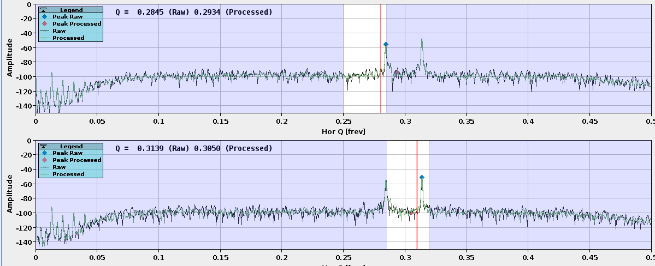
First beam after LS2!
First key system checks
RF capture
Tune corrections
Collimators at coarse settings, not aligned
First check of ADT
Preliminary check of some instrumentation

Slide 21
Bump amplitude for ASD
Apparently random dump experienced during Async. Dump validation:
Issue identified with bump amplitude of 1.2 mm ≈ 2.4 σ displacement at TCDQ.6/TCSP.6
The issue
Collimation hierarchy tightened over the years and now only 2.3 σ clearance TCP.7-TCSP.6
Right jaw of TCSP.6 becomes primary stage, leading to dump on losses (MQY.6) depending on tail population
IR6 BPM for HW interlock were only available for implementation in SIS
The history
0.5 mm needed just for pattern systematic on orbit BPM
>3 σ clearance TCP.7-TCSP.6
The tolerance was set to 1.2 mm and the bump amplitude matched to the edge of the SIS tolerance
Temporary: bump amplitude reduced to 1 mm
Mitigation
Long term: detailed review of new tolerance, SIS on BPM of TCSP now available (~0.5 mm tolerance)

Slide 22
Collimator settings at injection
Collimator settings definition: measured beam sizes used at injection; model beam sizes used at top energy
Less accurate optics corrections at injection and comparative studies done at beginning of LHC
Main drawbacks of using measured beam sizes at injection:
Prone to errors during alignment
More complex settings generation
Optics corrections reached similar performance at injection and top energy nowadays
Is it still necessary to use measured beam sizes at injection?
Comparative studies should be planned at start of Run 4

