Slide 1
Latest Plans For High Intensity Test in 2026
Matteo Solfaroli BE/OP
HL-LHC annual meeting
Oct 1st, 2025

Slide 2
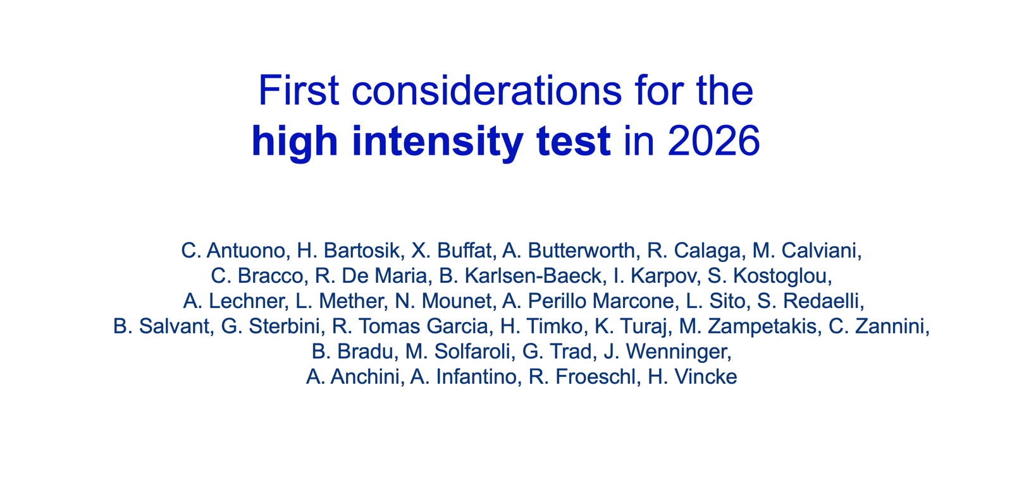
+ obviously Jorg Wenninger
(LBOC presentation)

Slide 3
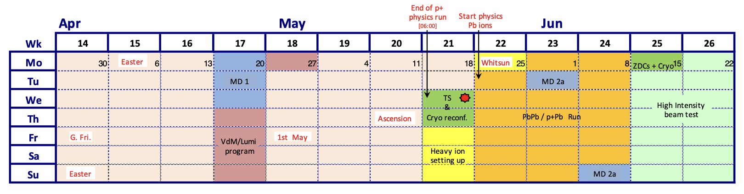
Introduction : HL-LHC intensity test
A test was proposed to push the bunch intensity towards nominal HL-LHC beam, beyond Run3 limitations, to anticipate (before LS3) unexpected problems that could become limitations for Run4. Goal:
Probe beam-induced heating with HL beams in 2026 in preparation for Run 4
Reach HL-LHC operational parameters:
Maximum total beam intensity in both beams (2760 x 2.3e¹¹ ppb)
Target bunch length of 1.2 ns
Maintain conditions for as long as possible
Test as much as possible: besides 25 ns beams, 8b4e is also important as it allows exploring additional spectra and to prepare in case hybrid beams are required by heat load limitation
In order to reduce the risk of jeopardizing Run3 physics program, the test is proposed for the last 2-weeks of Run3, just before the start of LS3

Slide 4
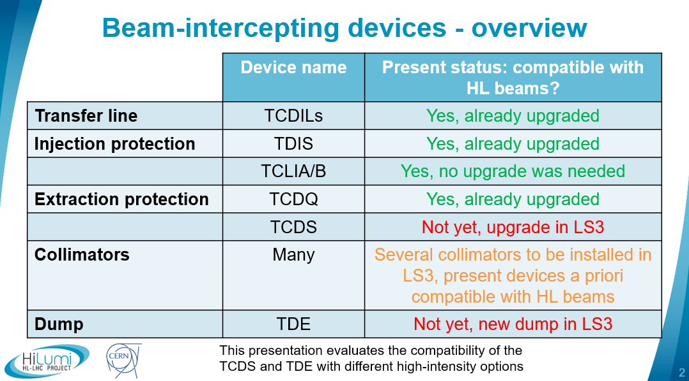
Protection devices and dump
A. Lechner, C. Bracco,
A. Perillo Marcone, M. Calviani
HL-LHC WP2 meeting (06.05.2025)

Slide 5
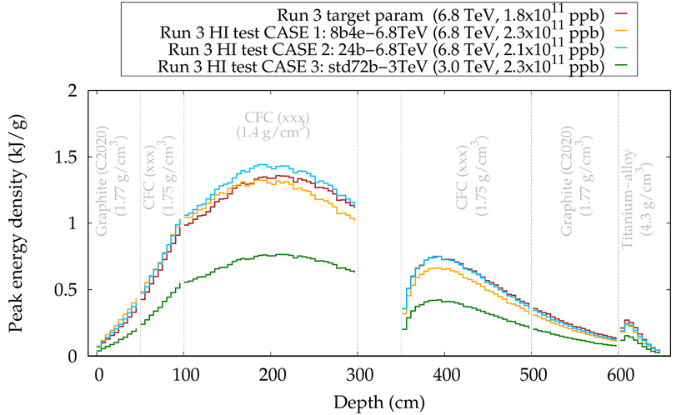
TCDS
Block changes are foreseen in LS3 to make TCDS compatible with HL beams
Structure will be re-used ➔ damage should be avoided
The TCDS can intercept 46 consecutive bunches (every 25ns bucket filled)
Gaps in the filling schemes matter (8b4e)

Slide 6
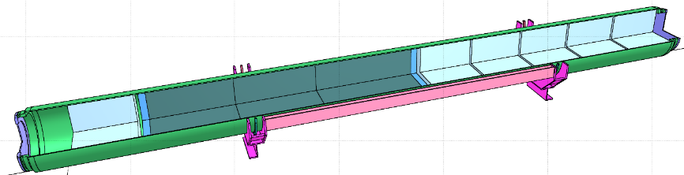
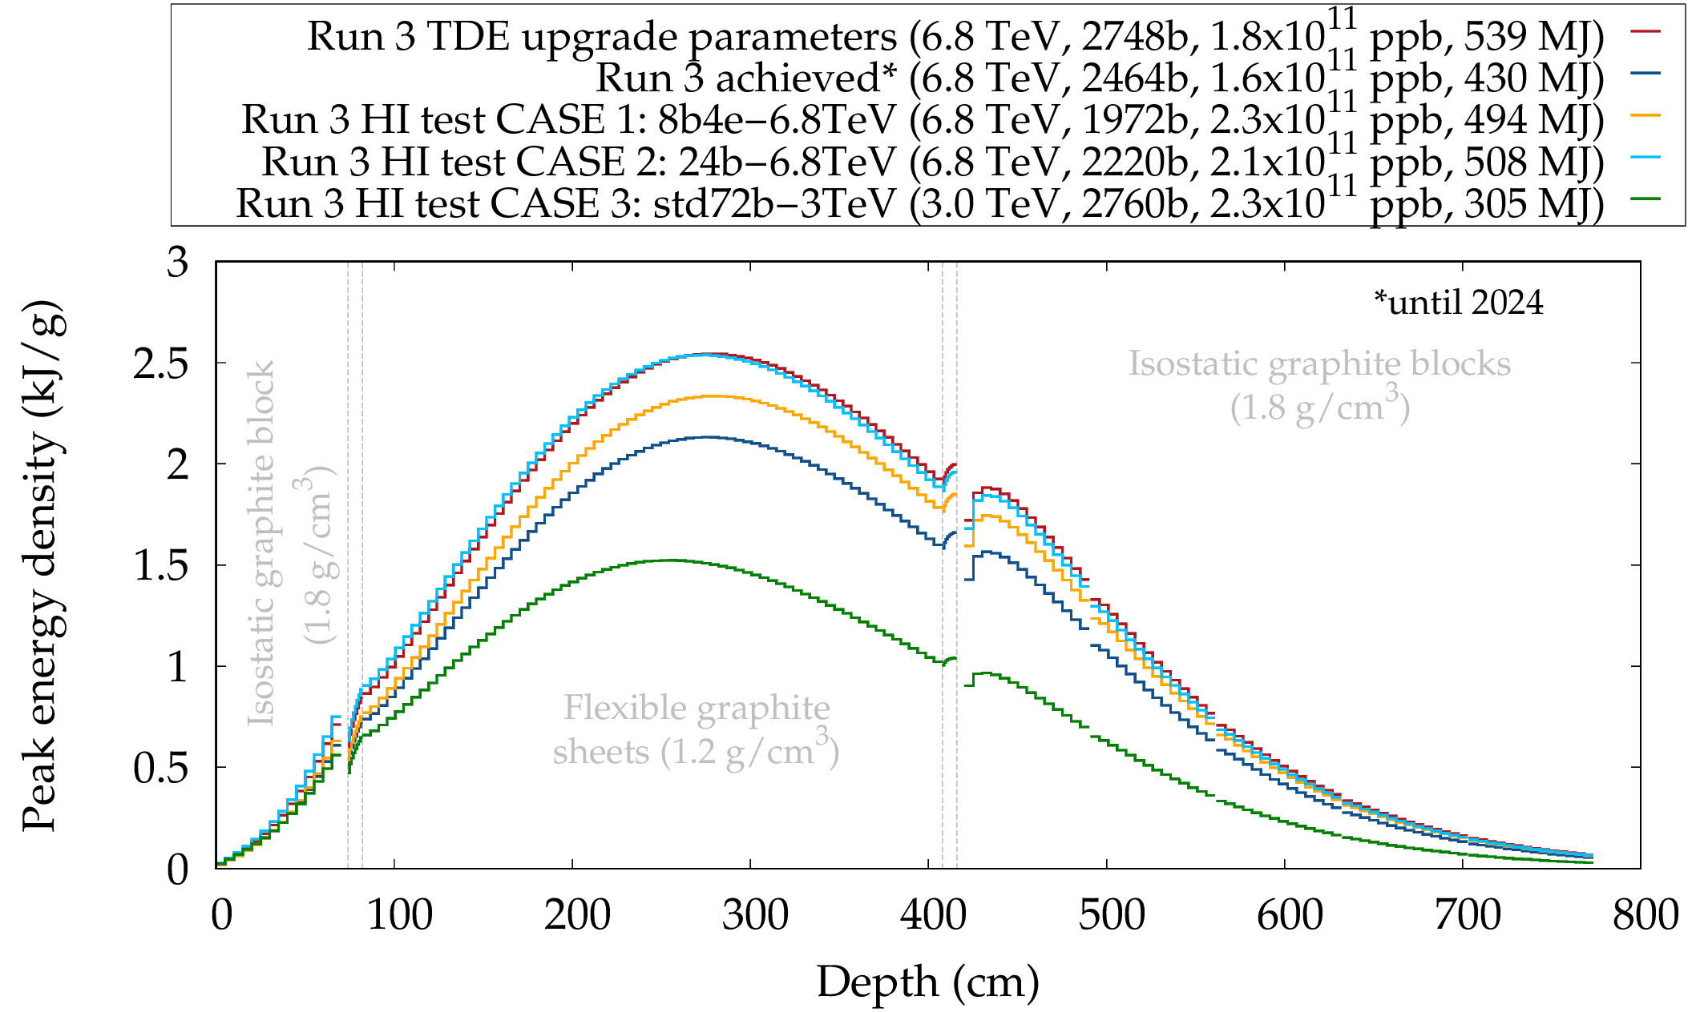
TDE
Isostatic graphite
(1.8 g/cm³)
Flexible graphite (1.2 g/cm³)
Isostatic graphite
(1.8 g/cm³)
Beam
Current Run 3 TDE is designed for 540 MJ
Energy deposition in dump components depends on dumped intensity and beam energy
TDE will be replaced in LS3
Run 3 operational scenario (red curve) is higher than any of the options below

Slide 7
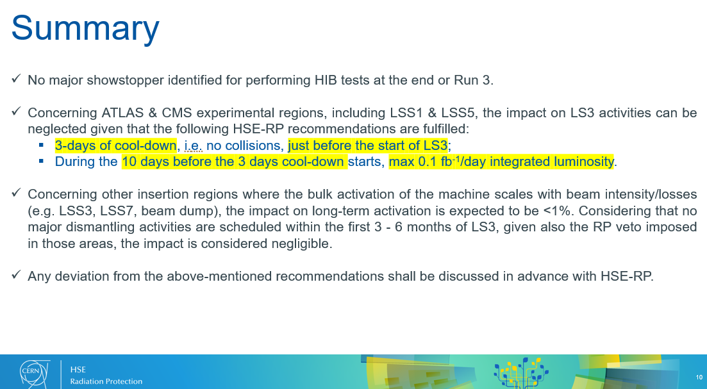
Radiation protection constraints
Report by HSE-RP on the boundary conditions for the high intensity test.
https://edms.cern.ch/document/3304331
No showstoppers for the test
Some room for collisions:
Up to 3 days before LS3:
L = 1×10³³ cm⁻² s⁻¹ OK
L = 2×10³⁴ cm⁻² s⁻¹ max ~1h/day
Last 3 days before LS3:
NO collisions!

Slide 8
Heat load limitation
Main limitation for heating test come from e-cloud generated heat load
The capacity of the cryogenic system to cope with 25 ns beams of 2.3e¹¹ ppb is extrapolated from observations during operation and MDs
6.8 TeV:
Trains of 4x36b: machine full is beyond the cryogenic capacity
Option for single beam – not a valid test for the common beam regions in IR2 and IR8 (original module failure occurred in 4L1: common region!)
8b4e (or hybrid) beam: NO limitation (1900+ bunches)
Trains of 3x36b: 1700 bunches

Slide 9
Energies
Injection:
NO limitations: machine can be filled with nominal HL-LHC beam (4x72b may be at the limit)
Already explored in MD up to 1200 bunches
Fundamental starting point, although beam heating is limited by long bunch length (~1.3-1.4 ns)
Intermediate energy:
IBS growth time >> SR damping times: around 5-5.7 TeV, depending on beam parameters
3 TeV seems to be a good choice:
Last heat load estimate ~2000 bunches for 4x72b OR 2748 bunches for 5x48b
6.8 TeV:
Heat load limits 4x72b to one beam only
NO heat load limitation for 8b4e (or mixed) beam
Limitation due to dump protection to be taken into account
…and obviously not to forget the start of the ramp (losses)

Slide 10
First step
Recovering high intensity on production cycle
After a 1-month break for ions, pp operation at high intensity must first be restored in nominal Run3 situation (intensity and configuration)
If modified for IONS, cryogenic system must be reconfigured for high heat load
Commissioning of new cycle(s) to high intensity
The configuration(s) to be used for the test must be commissioned
Optics checks at key points
MP validation of relevant cycle parts
…
~2 days
(with no cryo overhead)
Estimate strongly depends on variety and complexity of configurations
(~1.5/2 days per cycle)

Slide 11
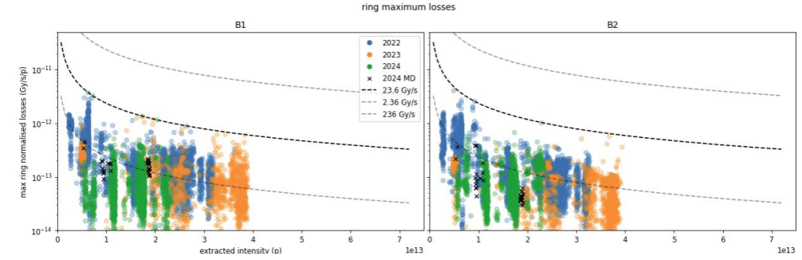
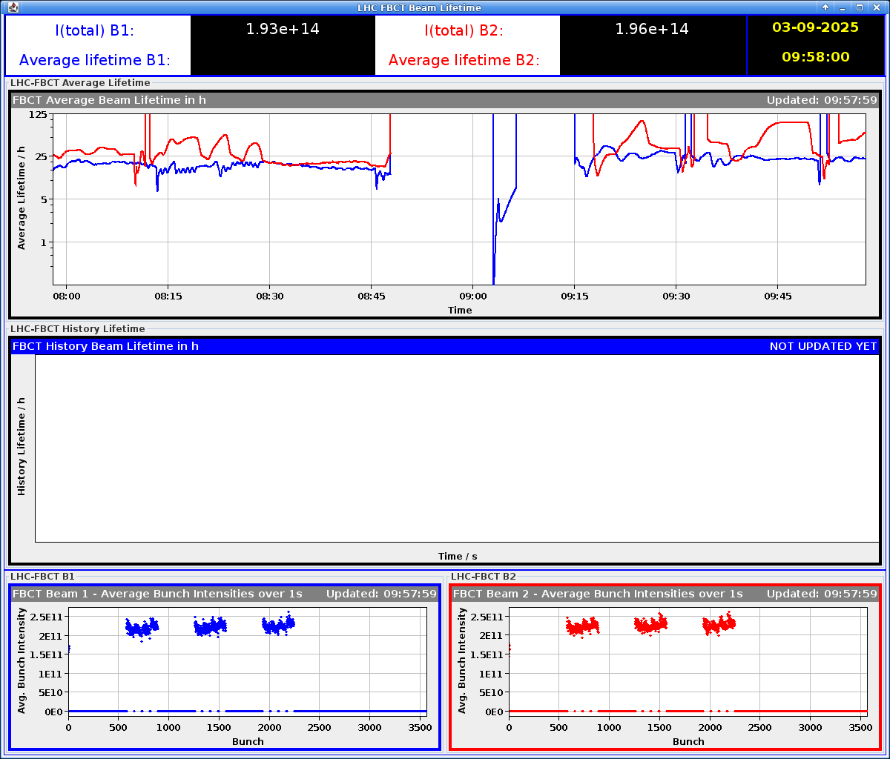
MD observations – Injection of HL trains
MD 13743: High-intensity trains injection
Motivation: characterise injection losses at HL-level
Injection of 4x72 bunches
Losses between 40 and 60%, with SPS scraping at 1% in the vertical and 2% in the horizontal planes
Limit reached with present BLM thresholds, change can give some margin
Optimized RF capture in both beams by adjusting the cavity tune line by line
Confirmed that 6 MV is roughly the highest voltage that can be maintained with the present system for HL beam

Slide 12
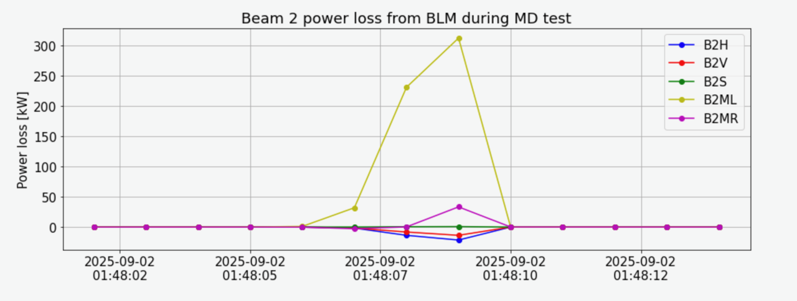
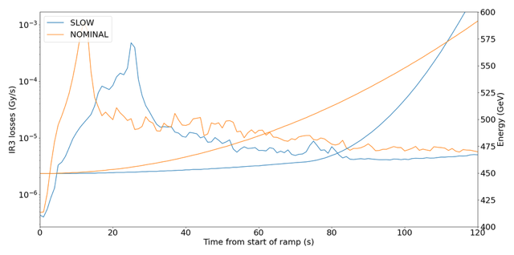
MD observations – Start of ramp losses
MD 15209: Assess sustainability of design 200 kW losses at start of ramp
300 kW power deposition in IR3 from B2 (MD2)
Higher value (up to ~500 kW) will be probed in MD3
Present power deposition in nominal operation ~15 kW (BLM thresholds set for 60 kW)
Start ramping with 6 MV will require high BLM thresholds (no high efficiency klystrons yet)
MD 16023: verify loss distribution at start of energy ramp, with slower momentum change
Used for the ramp in steps cycle
12b ramped, clear spread in power deposition over longer running sums, with slower momentum change

Slide 13
Option #1
Ramp to 3 TeV
Possibility to probe both beams with closed to HL intensity (4x72b or 5x48b)
4x72b → ~2000b (e-cloud estimate): “important to measure the heat load with 4x72b at 3 TeV (impact of synchrotron radiation, bunch length) even with a reduced number of bunches” from Lotta’s presentation
5x48b → 2748b at cryo limits
3 TeV cycle is being prepared for MD3 (up to 6xHL-INDIVs foreseen)
Dominated by IBS:
Arriving at 1.1 ns, bunch length will reach rapidly (1-2h) 1.2 ns
Short fills ➔ Test sensitive to availability and with short constant heating window
Main objective: check heating impact
Cycle to be (partly?) commissioned

Slide 14
Option #2
Ramp single nominal HL beam (or 1 full and 1 partially filled) to 5 TeV
Good for IBS: small bunch length for extended amount of time ➔Less sensitive to availability
Equipment exposed to constant heating for longer time
Single beam or partially filled second beam means less (or no) heating for elements in the common aperture but it has strong interest to refine the knowledge of the heat load by cell for BS treatment during LS3
Needs to be validated for TCDS and TDE
Doing this test at 6.8 TeV may be beneficial (no additional cycle to commission), if risks from equipment limitations are considered acceptable
Main objectives: check heating, BS heat load benchmarking
Cycle to be commissioned

Slide 15
Option #3
Ramp 8b4e beams to 6.8 TeV (~2000 b)
Interesting for impedance as it probes additional frequencies
Important to probe the (backup) solution of hybrid
No limitations from e-cloud nor equipment
Small bunch length for extended amount of time, less sensitive to availability
Not representative of standard beam
Heating power equivalent to up to 1.96e¹¹ ppb & 2760, due to reduced number of bunches
Still need to achieve 4x56 8b4e with 2.3e¹¹ ppb in the injectors!!
Parallel studies possible
debunching, start of ramp losses, emittance growth, tail population, losses at the end of adjust, luminosity, lifetime,…
Main objectives: Heating, Beam dynamics
Cycle ready

Slide 16
MD observations - 8b4e at HL intensity
MD 15383 & MD 16843: Losses when bringing the beams into collision (nominal Run3 beam/8b4e)
Principle proven in MD1 with Run3 nominal beams
Scheduled for MD3 with HL 8b4e
Study the fast diffusion of a significant part of halo and tail particles to the collimators, due to abrupt change of the dynamic aperture when the strong beam-beam force at the IP (head-on)
MD 16003: Collisions of 8b4e trains with HL bunch intensity
Study evolution of beam quality in preparation for 2026 HL test
560b per beam with 2.3e¹¹ ppb and 12b non-colliding operational beams foreseen for MD#3
Study beam dynamics and losses during collisions (with high pile-up)

Slide 17
Option #4 (back-up?)
Ramp 24b, 2.1e¹¹ ppb to 6.8 TeV (~2200b)
Option to ramp full machine to 6.8 TeV, if 8b4e high intensity not achievable
Small bunch length for extended amount of time
Less sensitive to availability
No limitations from e-cloud, dump & RF
Other studies in parallel possible
Heating power equivalent to up to 1.87e¹¹ ppb & 2760, due to reduced number of bunches with no other benefits w.r.t to standard
24b beam was never used
Cycle ready
(beams to be prepared)

Slide 18
Summary
E [TeV] | N_{b} | I_{b} [e¹¹ ppb] | Trains | PROS | CONS
3 Partially commissioned | 2400-2760 | 2.3 | 48b/72b | - ~Full machine with HL beam intensity and bunch length - Fast turnaround | - Sensitive to availability - Short exposure to heating
5 To be commissioned | 2760 (only one full beam) | 2.3 | 48b/72b | - Long exposure to heating - HL reference test | - Less (or no) probing in IR2/8 common areas
6.8 ready | 2000 | 2.3 (heating equivalent to 1.96 & 2760) | 8b4e | - Probing back-up solution - Parallel studies | - Not representative of standard beam
 | 2200 | 2.1 (heating equivalent to 1.87 & 2760) | 24b | - 25 ns beam with full machine at FT - Parallel studies | - Long exposure to (less!) heating
 | 2760 (only one full beam) | 2.3 | 36b | - Fully representative heating | - Less (or no) probing in IR2/8 common areas Risk for equipment - Long exposure to heating

Slide 19
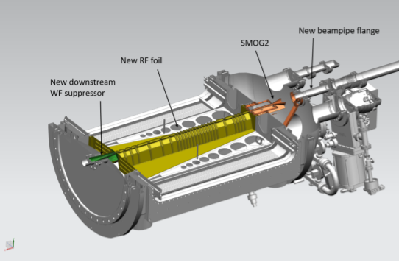
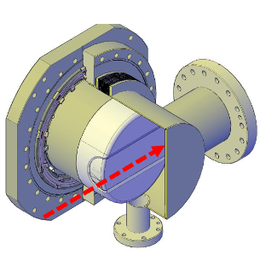
Experiments heating tests
Although no problems are expected, the CTPPS roman pots and the VELO should also be tested “in beam” positions:
XRPs can be inserted without collisions (once aligned)
Closing VeLo (possible at 3 TeV) requires collisions, but a low rate is sufficient (collisions must be maintained)
Testing at 3 TeV requires collision setup and XRP alignment

Slide 20
General considerations & open questions
Considering a general availability of 75% the 10+4 (MD) days window becomes 10.5 days
Effective time left ~1 week
Each cycle costs is ~1.5/2 days for commissioning/intensity ramp-up
We should carefully evaluate:
Benefits against costs
Possibility to profit from the heating fills for parallel studies
MKI2: Heating may lead to several hours waiting for cooldown, reducing availability if we hit the limit where we can’t increase threhsolds

Slide 21
Summary
Work on the conditions and requirements for the 2026 HI test is ongoing
LBOC is foreseen on November 11th: https://lhc-beam-operation-committee.web.cern.ch
Important information will come from MD3 and MD4
Beam heating is the central although not the only goal of the test
25 ns beams: cycle to intermediate energy most promising configuration to test
Are multiple short exposures representative than less longer ones?
8b4e: at 6.8 TeV
Perform beam dynamics studies at top energy
Probe back-up operational solutions
Injection and (start of) ramp of nominal HL-LHC beams are important milestones, as well as beam parameters evolution at FT
Single beam tests (with both beams) are important to validate the heat load projections in ARC for after LS3 (without BST and further degradation obviously)

