Slide 1


HL-LHC WP3 magnet and cold powering tests
Gerard Willering
1 October 2025
15th HL-LHC Collaboration Meeting
Geneva, Switzerland
Franco Mangiarotti, Vincenzo di Capua, Gaëlle Ninet, Guillaume Pichon, Stian Juberg, Jerome Feuvrier, Michael Boczan, Olivier Ditsch, Patrick Viret our FSU support and all other teams involved.
Acknowledgements to all teams in WP3 and and TE-CRG.

Slide 2
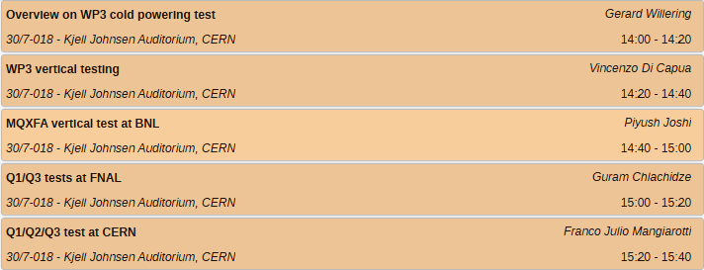
Overview WP3 magnet testing
WP3 Standalone magnet tests
MCBRD, MCBXF: see talk by Vincenzo
MQXFA: see talk by Piush
HO-correctors: completed in earlier annual meeting
WP3 Cryo-assemblies
Q1/Q3: see talk by Guram
Q2 and Q1/Q3 at CERN: See talk by Franco
CP, D1, and D2, this talk
Magnetic field and alignment measurements:
See full session tomorrow
Contents this talk:
Overall overview and progress
Reporting on CP, D1, and D2 tests.
Detailed discussion on flattop quenches
2026 test challenges in SM18
Conclusion

Slide 3
Test status of magnets
Cryo-assemblies since last year
5 out of 8 Q2 cold masses tested and qualified. No major NC found, on track.
First D2 series tested in one CD with excellent results. Second CD ongoing. MM to be confirmed.
Two CP tests completed. One installed in the String.
Q1/Q3 qualification ongoing at FNAL, one magnet in preparation for test in the next week.
Stand alone magnet tests since last year
6 MCBXF magnets tested, only 1 away from having all magnets for installation
3 MCBRD’s tested.
IT-diode stacks tested.
Good progress, still 75 % of all series cryo-assemblies to be tested.
In general very good results!

Slide 4
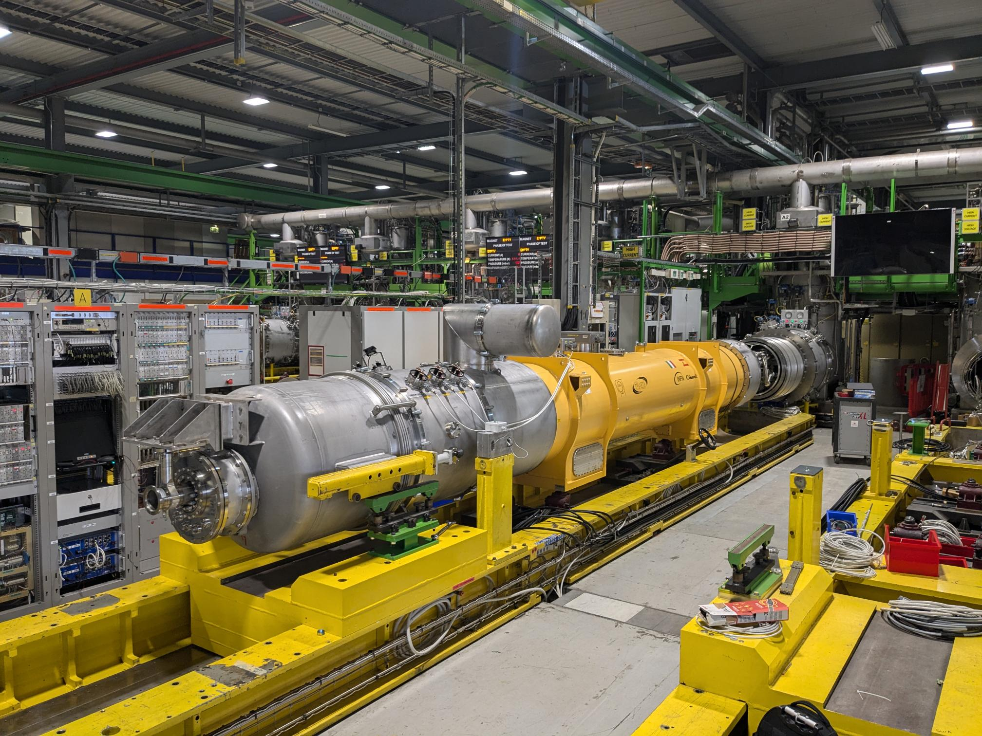
Corrector Package WP engineer J. C. Perez
LMCXF1 – test report in EDMS 3213574
LMCXF4 – test report in EDMS 3352418

Slide 5
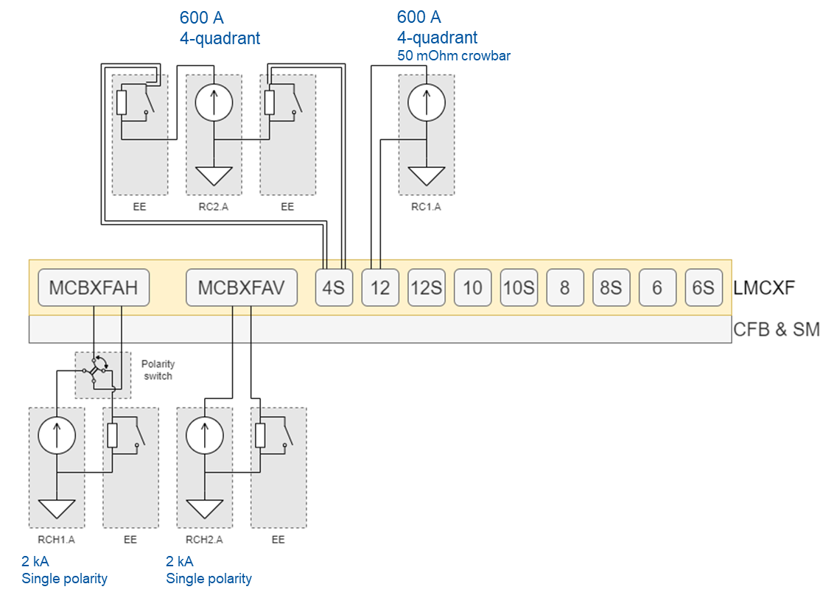
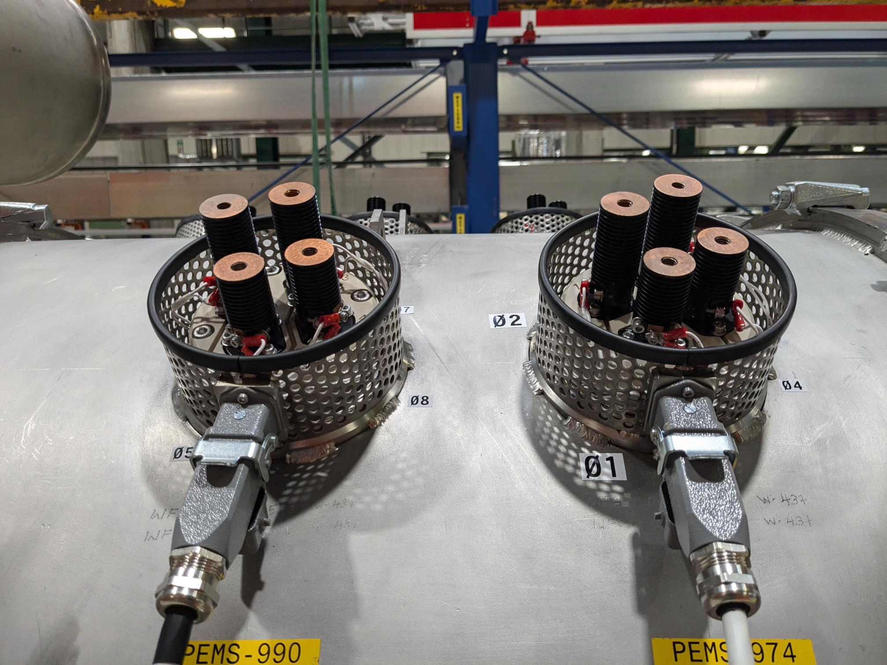
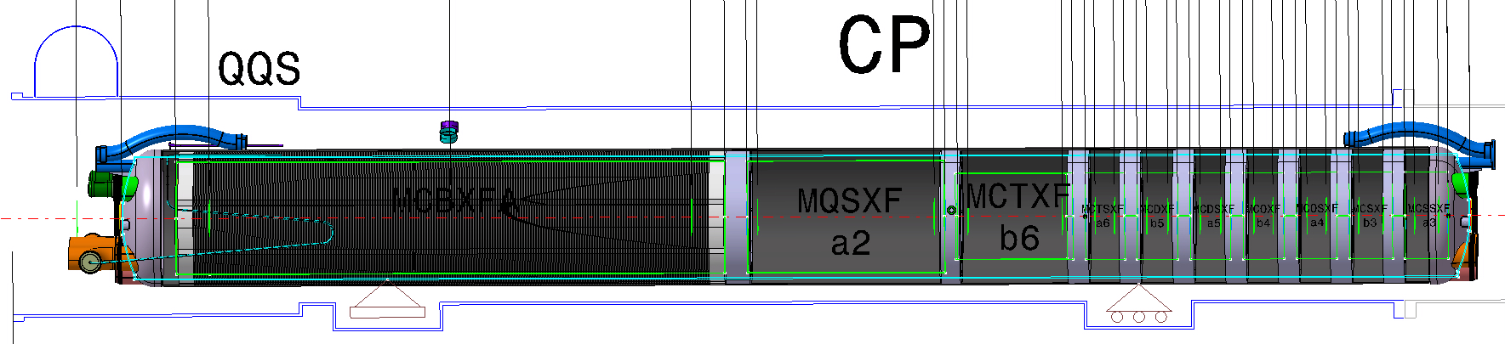
Corrector Package
11 magnet circuits - 4 power converters.
Single and combined powering for the 2kA MCBXFA magnets horizontal and vertical nested dipoles.
The MQSXF skew quadrupole remains always connected to the 600 A PC with the 2 EE systems. It is the only magnet requiring ~200 A and has a double lead connection.
The other 8 circuits, all ~100 A, will be powered one by one with another 600 A PC, no EE.
The 100 A lead heat interception point is cooled by gas at ~ 70 K.
120 A leads on the side of the cold mass.
2 kA leads through CFB

Slide 6
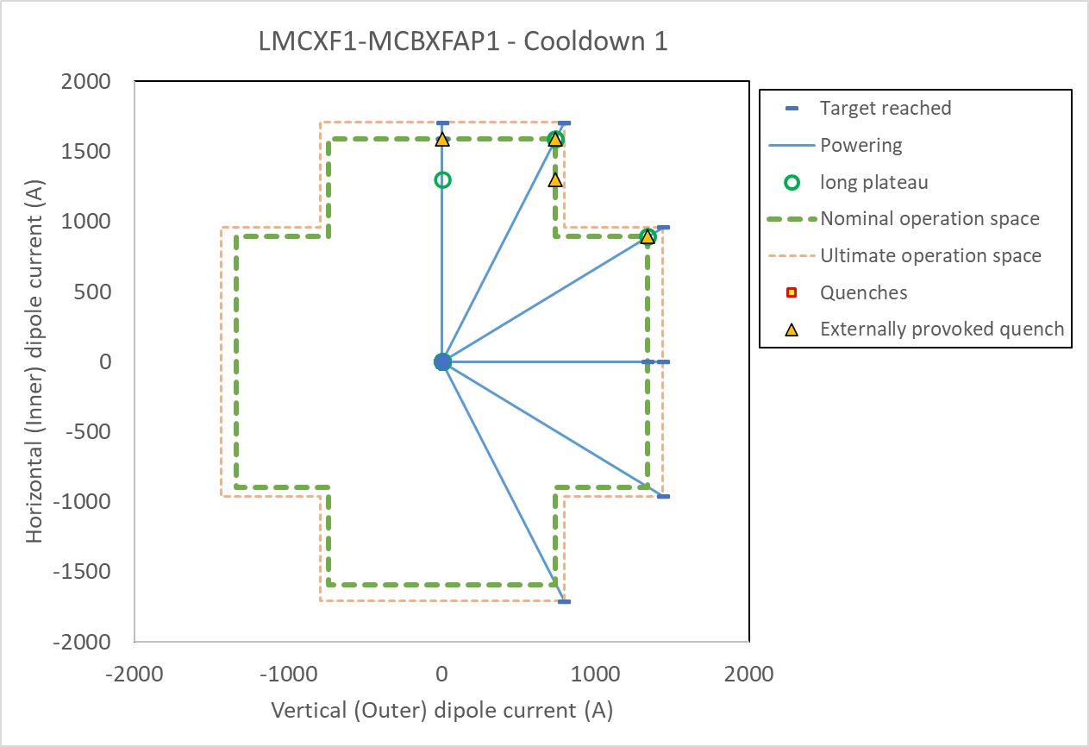
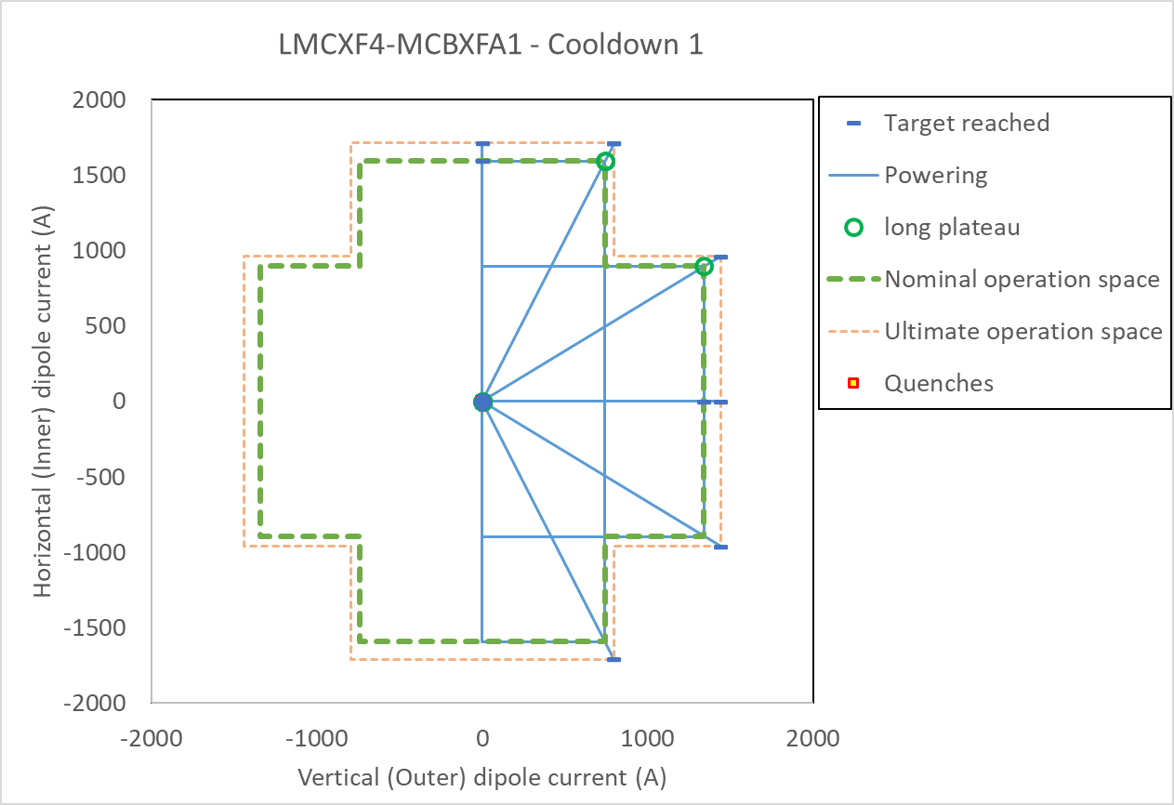
Corrector Package – MCBXFA magnet powering
LMCXF1 – one cool down
LMCXF4 – one cool down
No quenches in MCBXFAP1
(except flattop quenches with external trigger. See later slides.)
No quenches in MCBXFA1.
All powering OK.

Slide 7
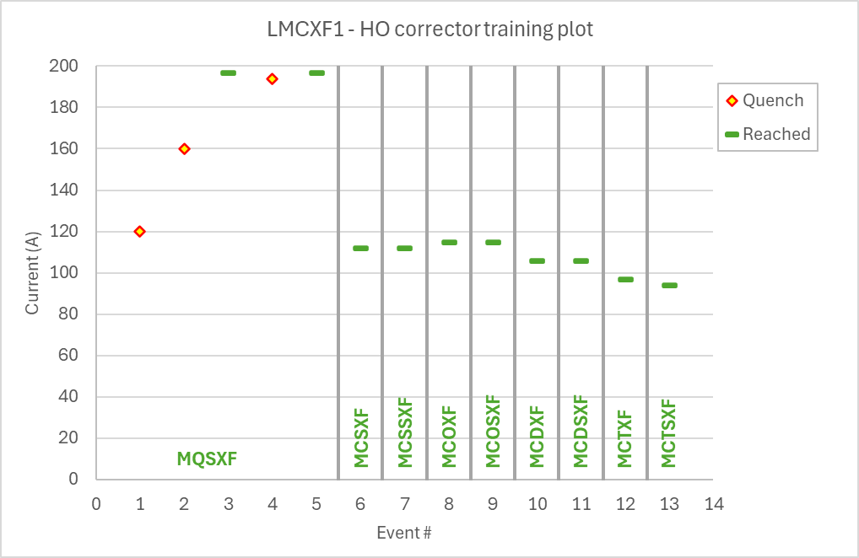
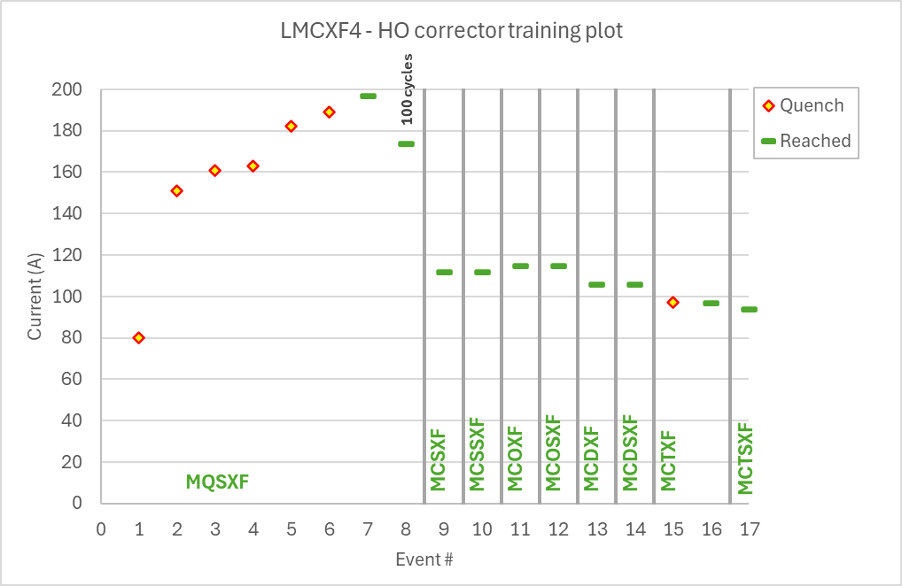
Corrector Package – HO corrector magnet powering
LMCXF1 – one cool down
LMCXF4 – one cool down
MQSXF had in both cryo-assemblies more than 1 quench although the were pre-trained before installation in the cold mass. For both a minor NCR will be made.
Otherwise, only 1 other quench was reported at ultimate current in an MCTXF magnet.

Slide 8
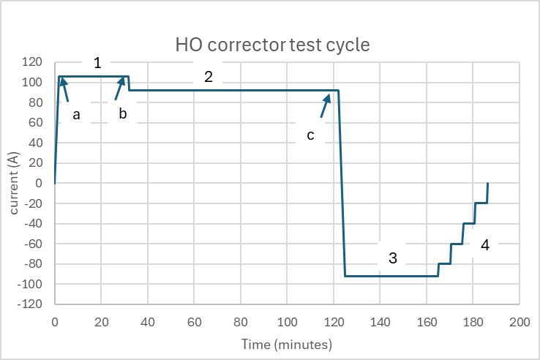
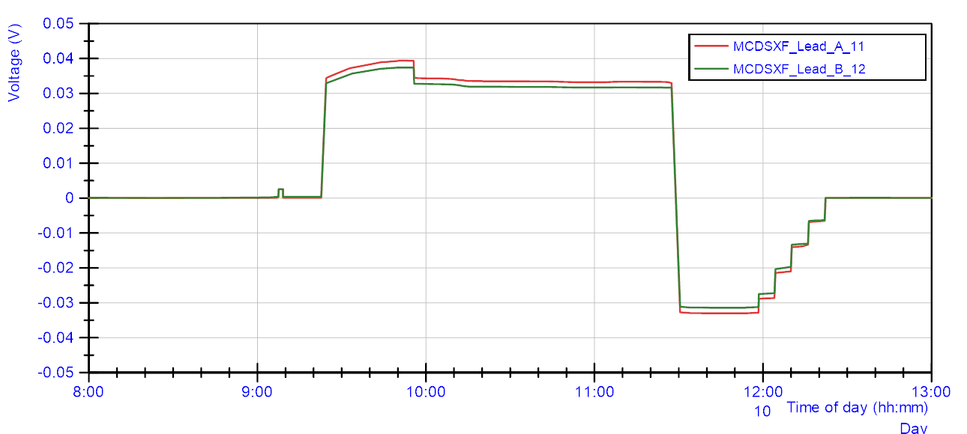
Corrector Package – HO corrector powering
Only a single powering cycle is designed per HO corrector to test efficiently.
Ramp to I_{ult} (training)
30 minutes at I_{ult}
1h30 at I_{nom} (includes MM)
30 minute at –I_{nom} (includes MM)
Qualification of the leads by measuring resistance
When reaching ultimate
After 30 min at ultimate
After 1h30 at nominal.

Slide 9
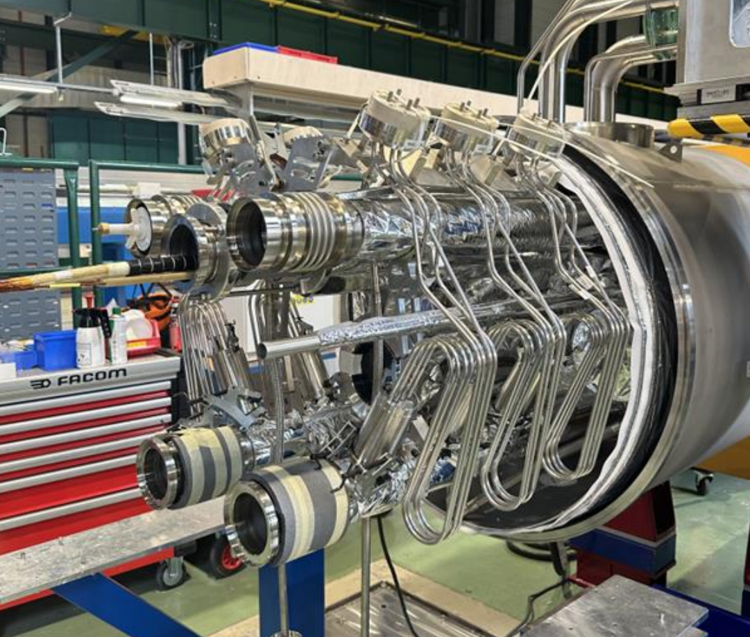
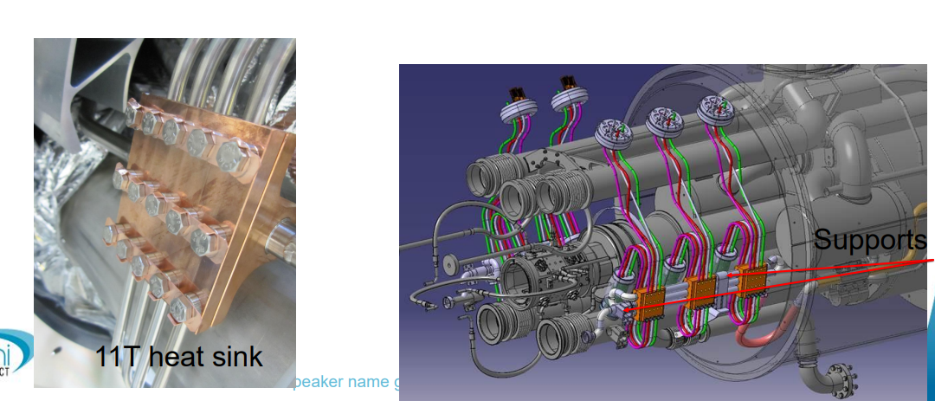
Corrector Package – Normal conducting current leads
Full characterization of all leads done for both cryo-assemblies.
Very stable behaviour, all within 0.30 to 0.37 mOhm at nominal current, when the interception point is regulated to 70 K.

Slide 10
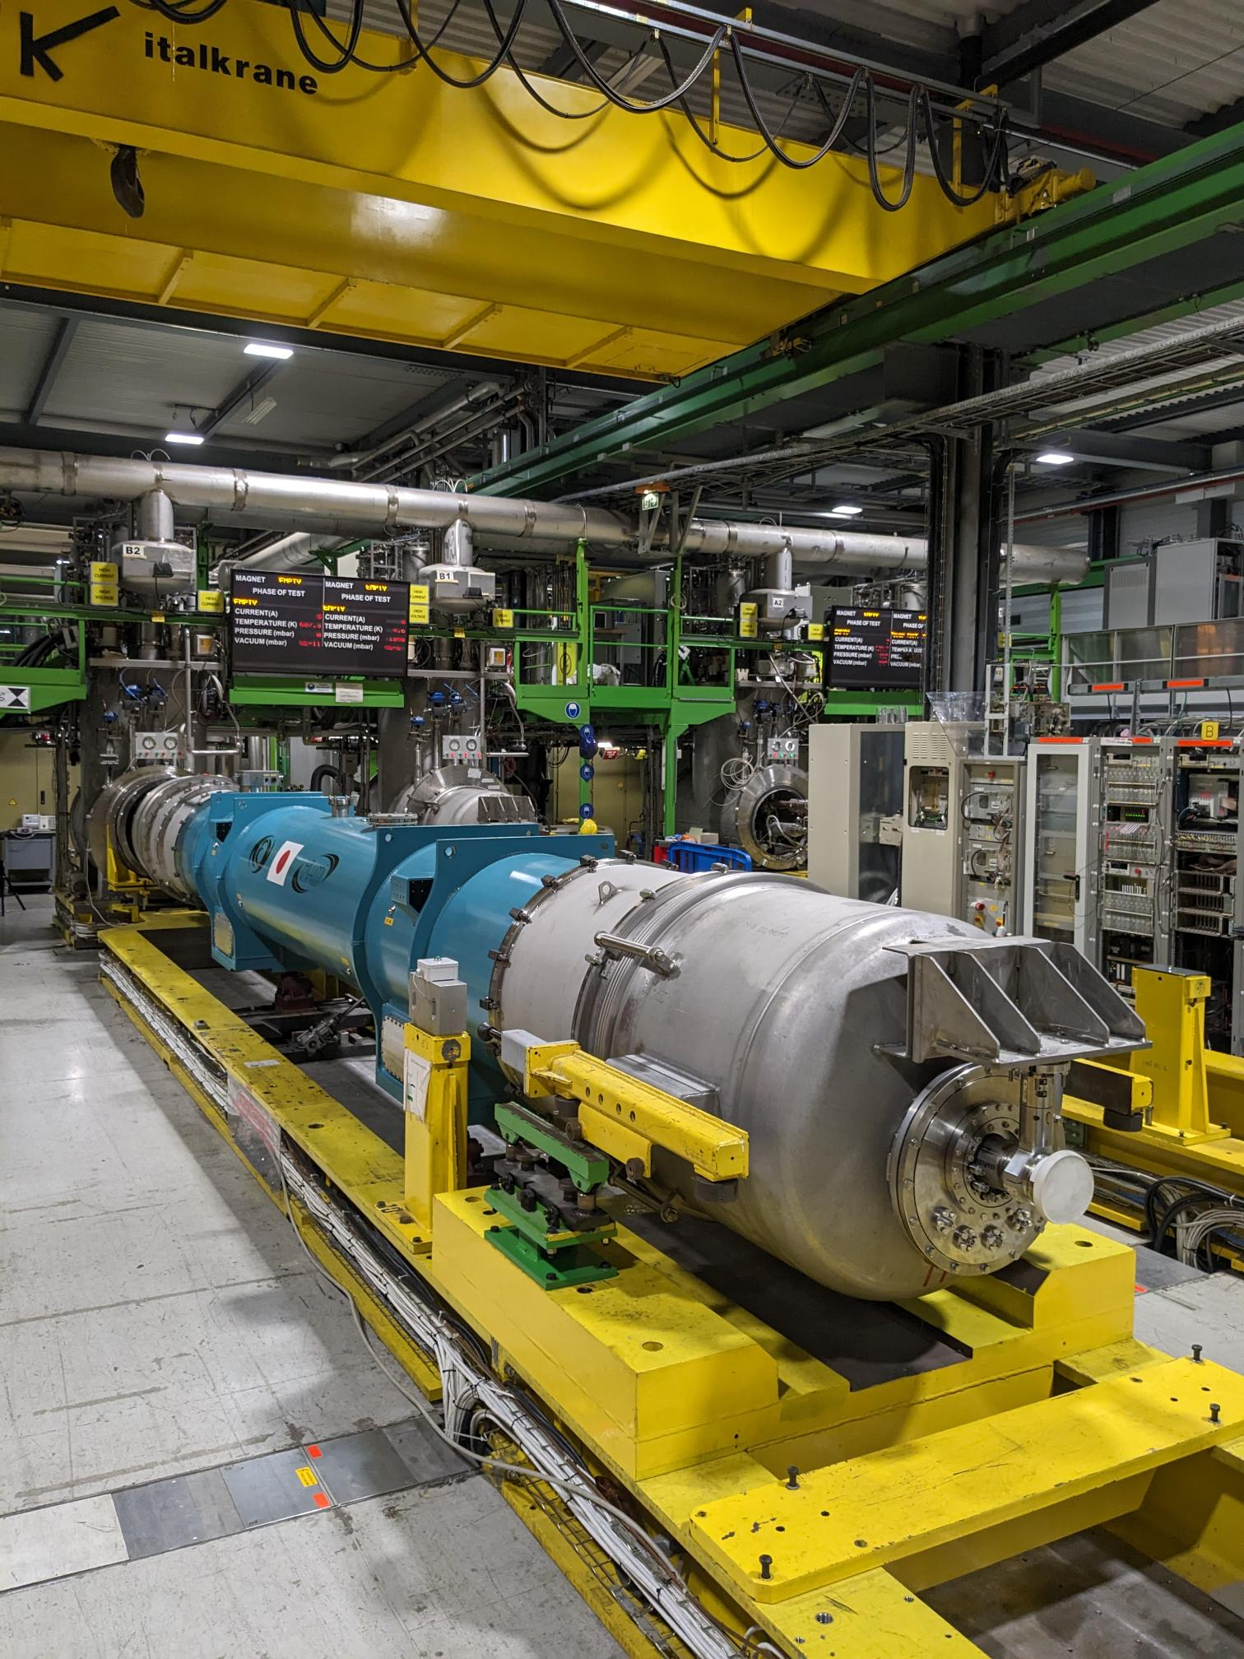
D1 cryo-assembly
WP engineer J. C. Perez
LMBXF1

Slide 11
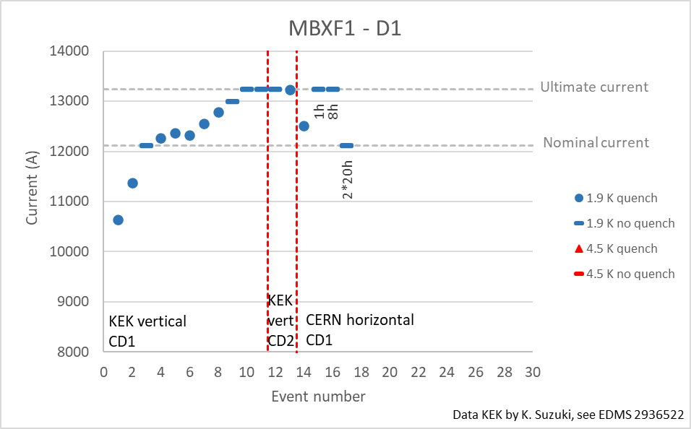
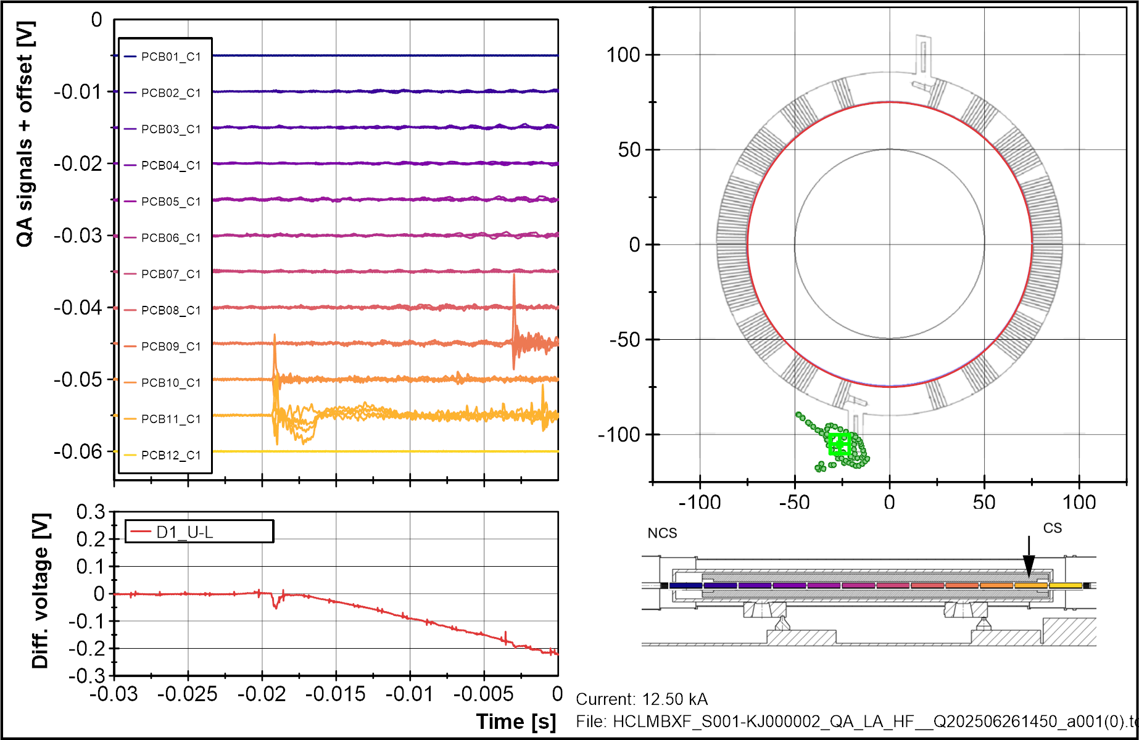
D1 - LMBXF1
One cool down, one magnet, only one quench. Smooth and fast tests, all OK.
One quench, recorded and localized with quench antenna in one of the layer exits.

Slide 12
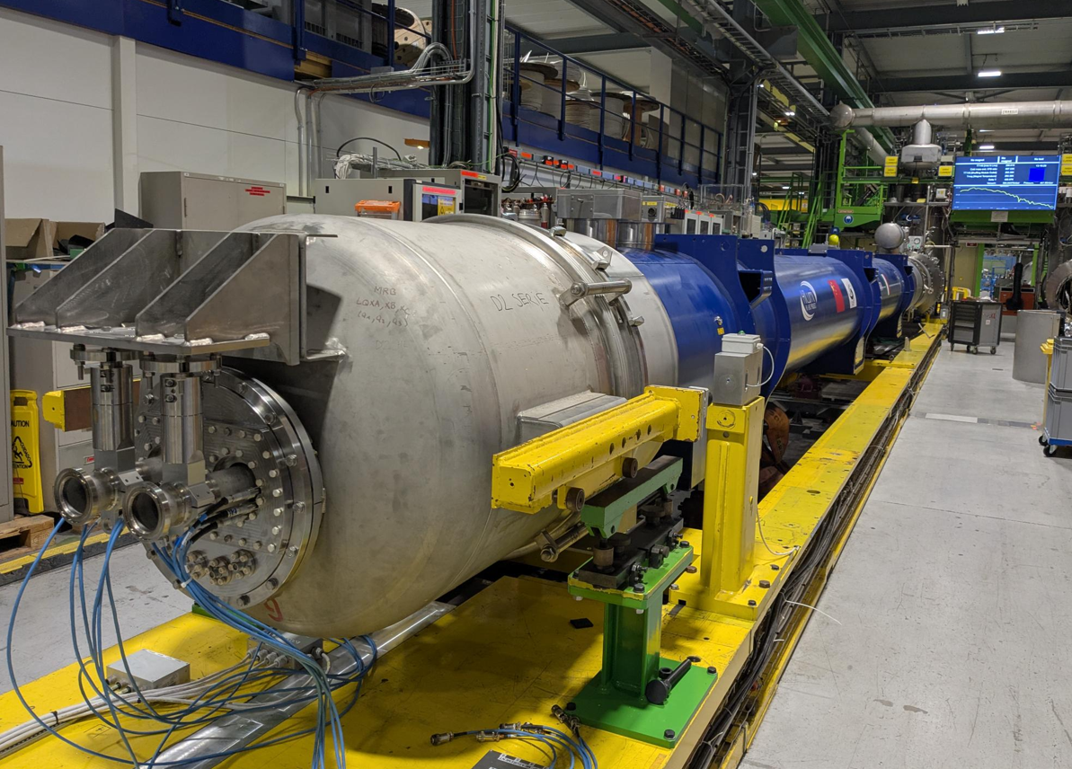
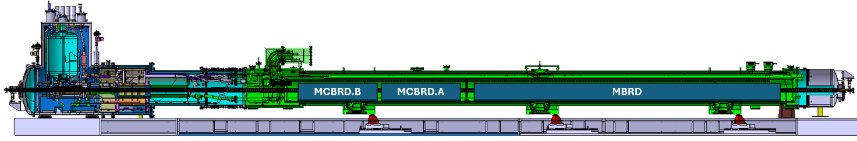
D2
WP engineer A. Foussat
LMBRD01 – first series magnet
Cool down 1 in May-June – no anticryostats, no magnetic measurements.
Cool down 2 September (cryo-OK since yesterday) – with anticryostat and MM.
Three magnets are in the cold mass:
MBRD2 – INFN + ASG
MCBRDP3b – CERN prototype
MCBRDP4 – CERN prototype

Slide 13
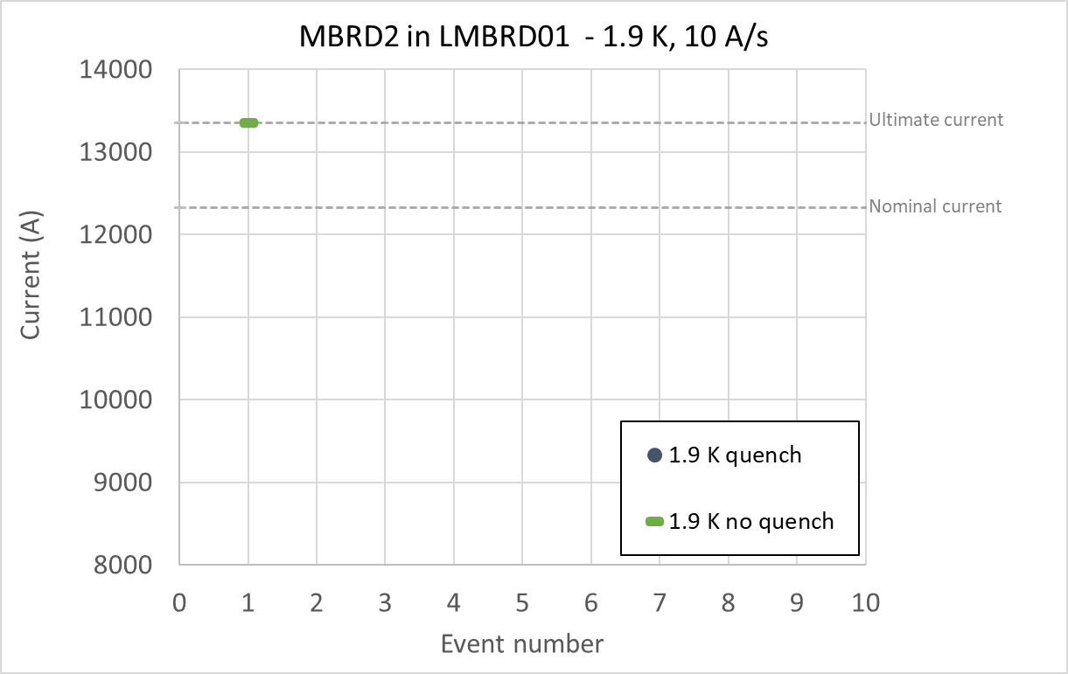
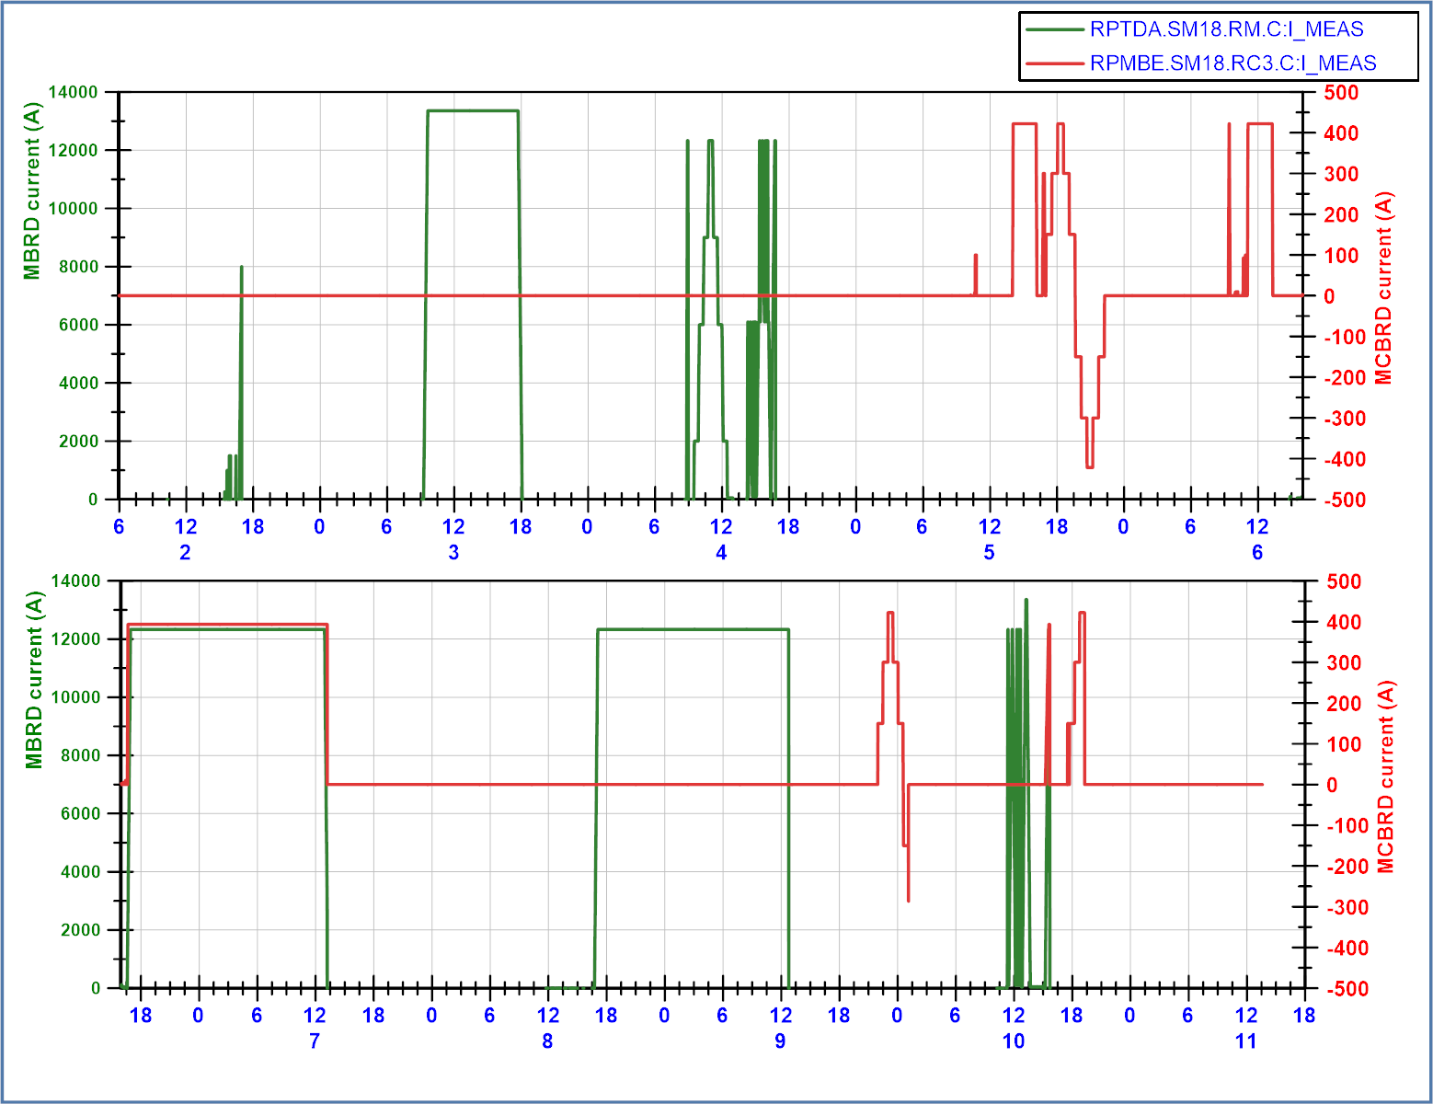
D2 – LMBRD01
MBRD and MCBRD Powering all without quench.
HV test and QH tests all OK.
Splices within specs.
Second cool down ongoing.

Slide 14
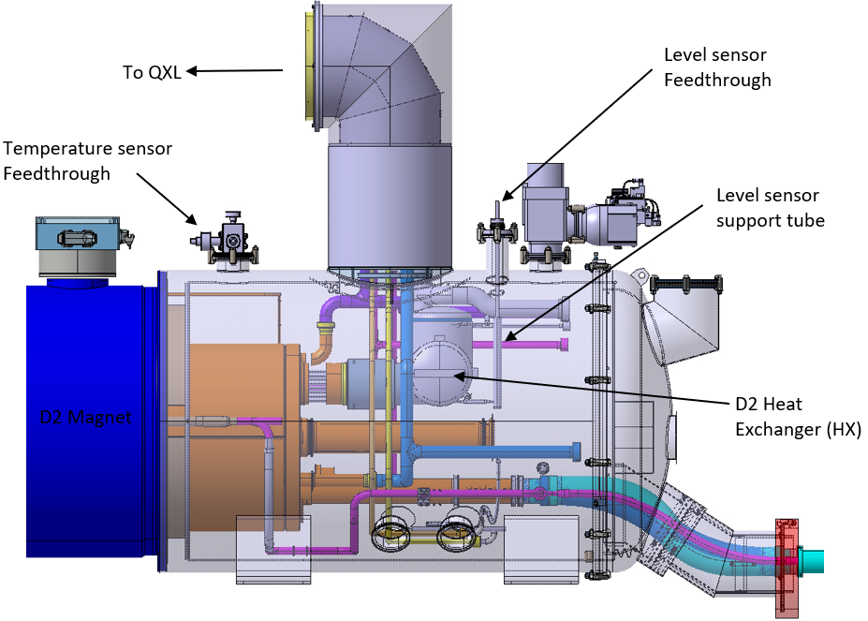
D2 – LMBRD02 – heat exchanger
D2 is the only cryo-assembly in the LHC not cooled by a heat exchanger tube, but a heat exchanger on one side of the magnet.
Operation in one go without issues, thanks to TE-CRG operation team.
Figure 2. D2 Heat Exchanger integrated into the D2 Magnet cryostat. Source EDMS 2510567.

Slide 15
Flattop quenches

Slide 16
Flattop quenches
Both the Q3 (LMQXFA01) and the CP (LMCXFA1) had flattop quenches during operation, and were discussed in an earlier meeting without clear explanation.
What I will try to show in a few slides:
We see systematic spikes in vacuum pressure and temperature in the vacuum part of the cold mass, 5 to 10 seconds before each quench.
Both magnets were on the test bench A2 which had helium leak into vacuum compartment. It is repaired and now we don’t have the problem anymore.
Accumulation of liquid helium condensating on the 1.9 K pipes in the vacuum space could be the root cause of the pressure/temperature spikes. This may also be the reason why we don’t see spikes at 4.5 K, since at that temperature helium does not condensate on tubes.
No clear calculation on how the magnet can quench.
What we conclude:
These quenches are triggered by external events, the magnet is not at fault. This can be additionally validated in the IT-string where these two magnets are installed.

Slide 17
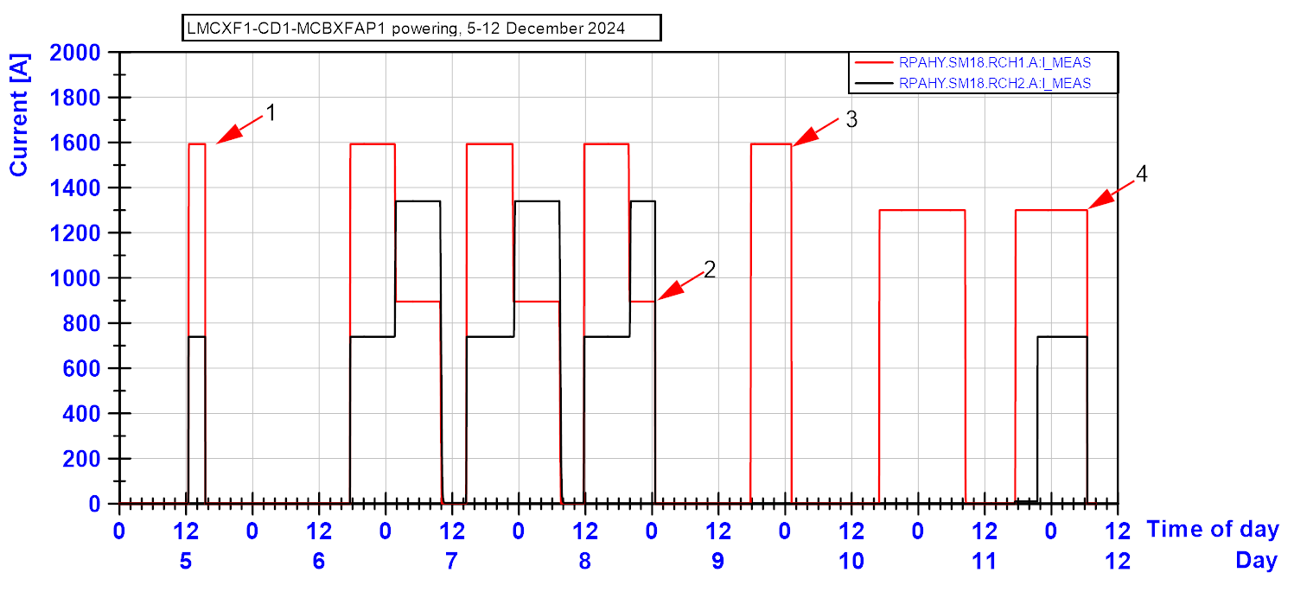
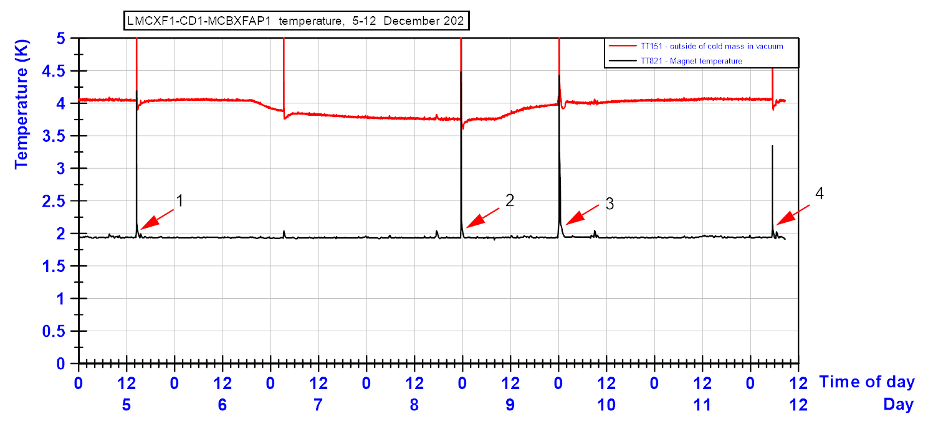
Recall MCBXFAP1: 4 flattop quenches
TT821 shows no temperature changes in the superfluid helium temperature before the quench starts. (except quench 3 where the temperature had slow rise to 2.05 K.)
At the time, TT151 temperatures were placed in the plot since it showed some variations due to thermal screen temperature control variations.
One spike in TT151 was recorded without giving a quench. This triggered additional questions.
Spike with current, but no quench

Slide 18
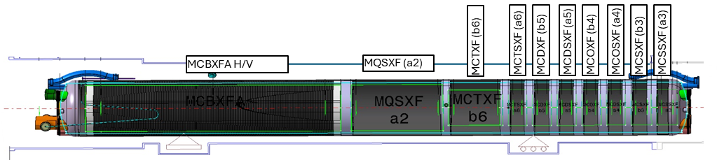
CP-assembly on the SM18 test bench
CFB
MRB
TT151. On the outside of the cold mass in the vacuum.
TT821 – Temperature on the yoke, in the liquid helium bath, around 2 meter from end of cold mass.

Slide 19
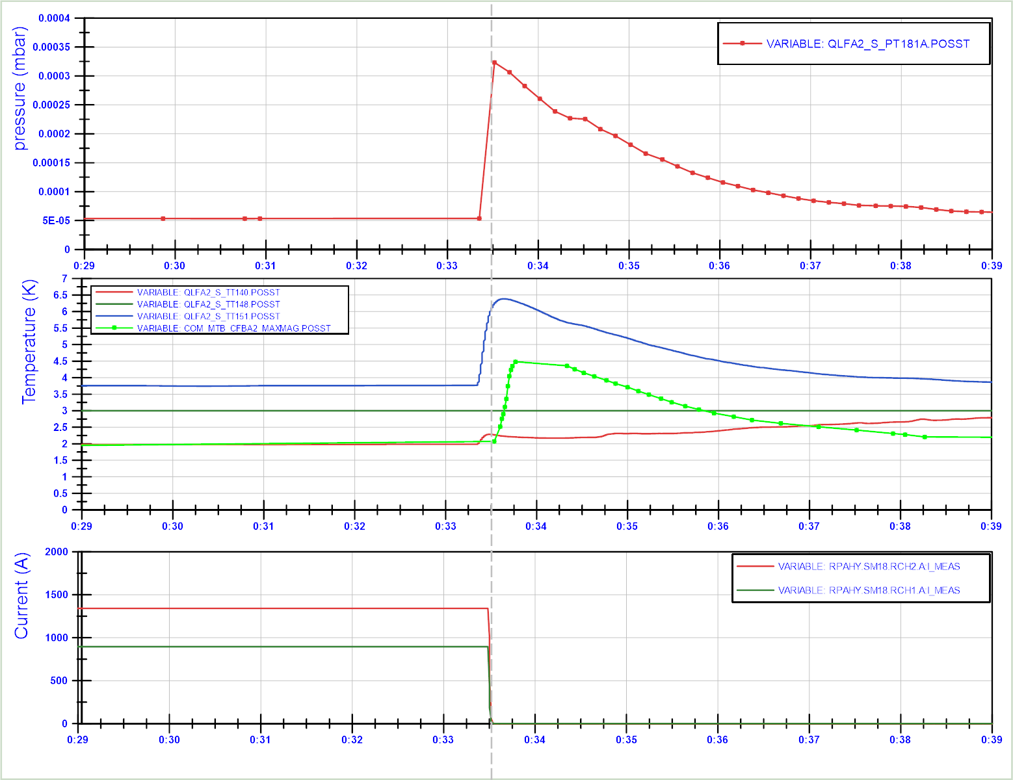
MCBXFAP1: Flattop quench event at 900 A (10 minute plot window)
Recent additional investigation shows that the TT151 and the TT140 (inlet tube with superfluid helium liquid) show a temperature increase before the quench.
Also the pressure in PT181 (vacuum pressure) seems to have a large spike before the quench moment. (Note that the data refreshrate for samples in NXCALS is low. )
For all 4 quenches, the data looks similar.
TT151
TT821
TT140
Time (hh:mm)

Slide 20
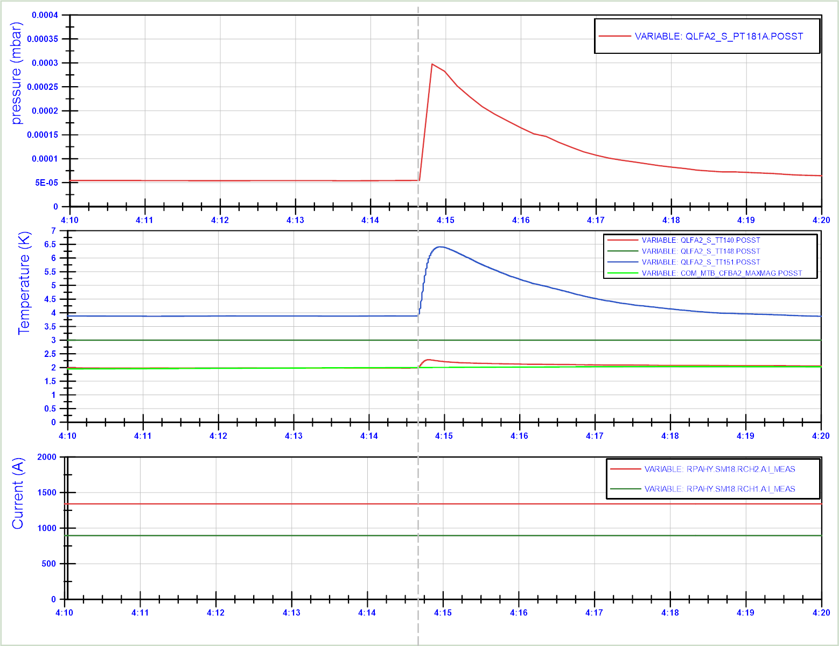
MCBXFAP1: Flattop No-quench event (10 minute plot window)
Signature of the spike in vacuum pressure and TT151 and TT140 are identical to the quench in the previous slide.
Only here, the TT821 measuring the liquid helium temperature is not changing significantly. It shows that the vacuum temperature and pressure are impacted much stronger by the transient than the liquid temperature.
It also shows that this event is not caused by a quench, or heat from the magnet, since the current is stable.
Vacuum pressure
TT151
TT148
TT140
TT821
Time (hh:mm)

Slide 21
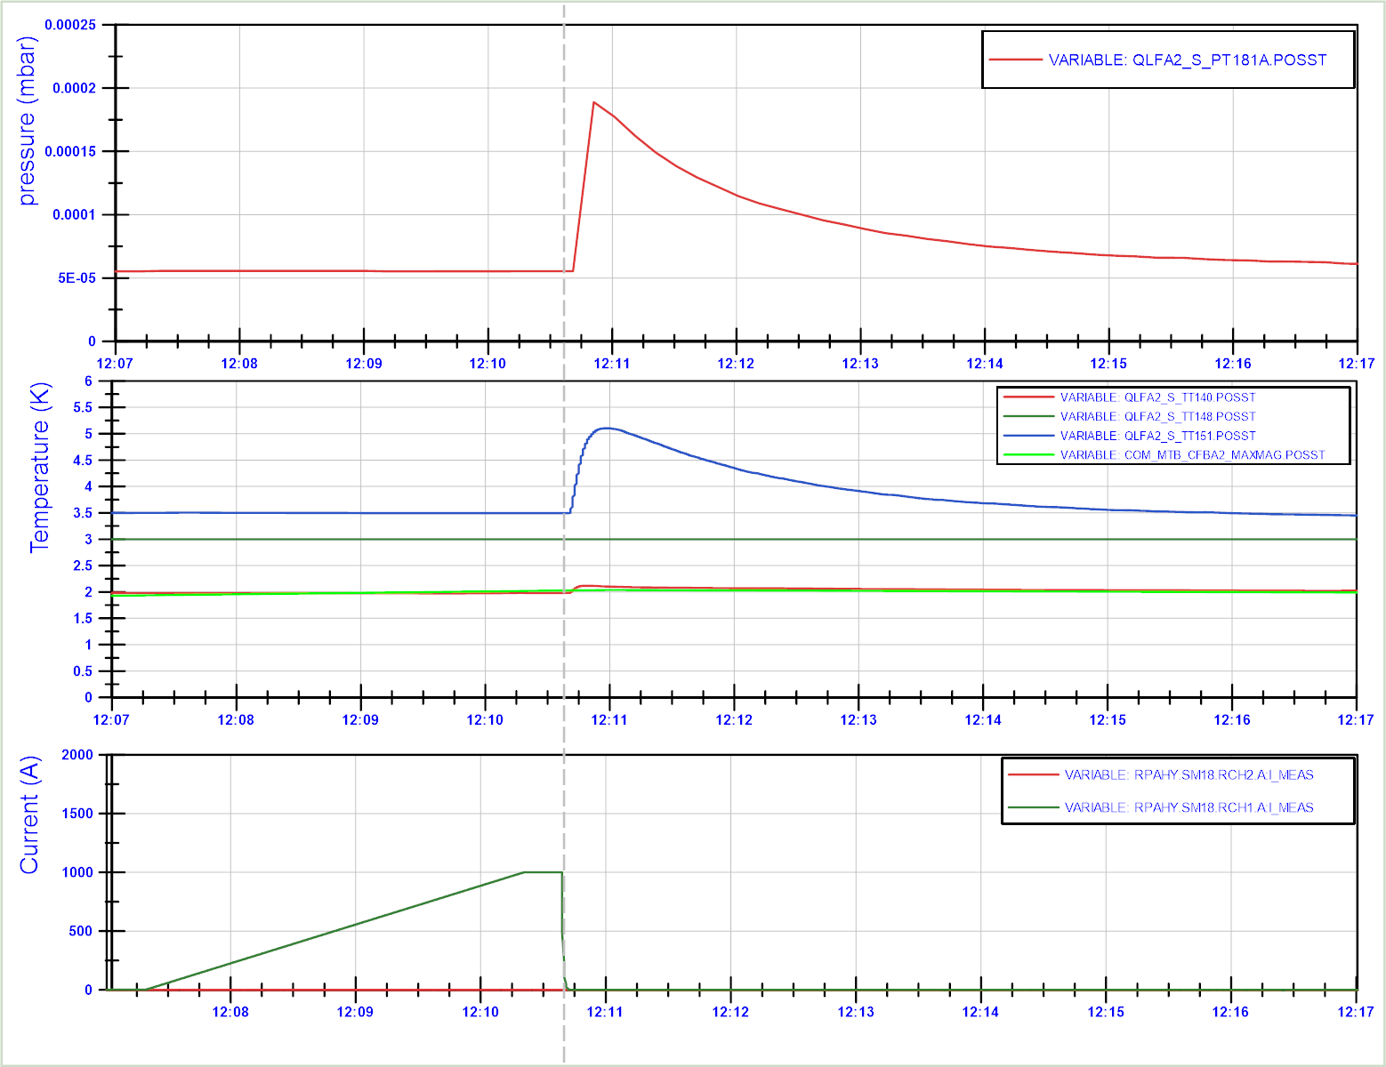
MCBXFAP1: Provoked energy extraction trigger event (10 minute plot window)
When triggering the energy extraction, a similar transient in TT151, TT140 and PT181A is triggered, but now only starting after the quench.
To be investigated why.
TT151
TT140
TT821

Slide 22
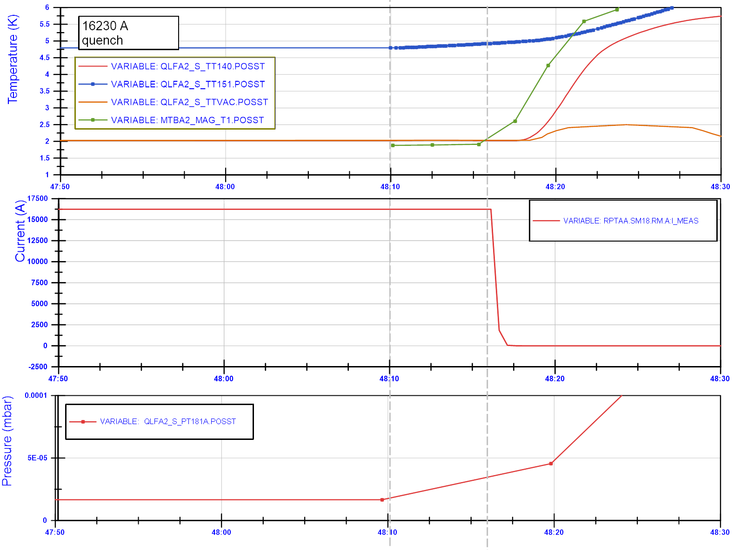
MQXFA in Q3: Flattop quench event at 16.23 kA (40 second plot window)
Example of a flattop quench in Q3:
Temperature rise in TT151 precedes quench by about 5 seconds.
No effect on helium bath temperature in magnet (TT821, named here Mag_T1)
Pressure rise in PT181 is only recorded every 10 seconds, so not usefull.
TT151
TT148
Time (mm:ss)
Precursor spikes in the Q3 are less pronounced, but still systematic, and the quench starts after 5 seconds.
Time (mm:ss)
Time (mm:ss)

Slide 23
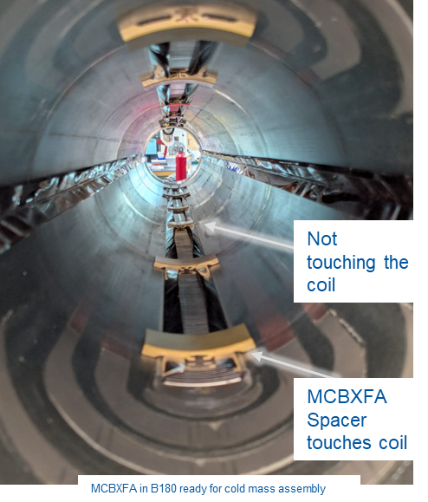
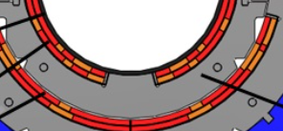
MCBXFA in CP, schematic.
MCBXFA spacers
Warm air at 300 K
(only stretched wire in the CP, no rotating shaft).
Anti-cryostat (warm bore 300 K, heaters, superinsulation, and thermal screen).
The anticryostat and space between anti-cryostat and bore tube share vacuum with the CFB and cryostat.
G10 spacers anticryostat (2.5 mm thick)
G10 spacer bore tube (surrounded by superfluid helium)
Spike in vacuum pressure could induce high heat load from 300 K anti-cryostat to 1.9 K magnet, and raise its temperature to ~ 7 K?
Not studied in detail. Seems difficult to pass through the helium, but maybe through the support spacers?
Coil

Slide 24
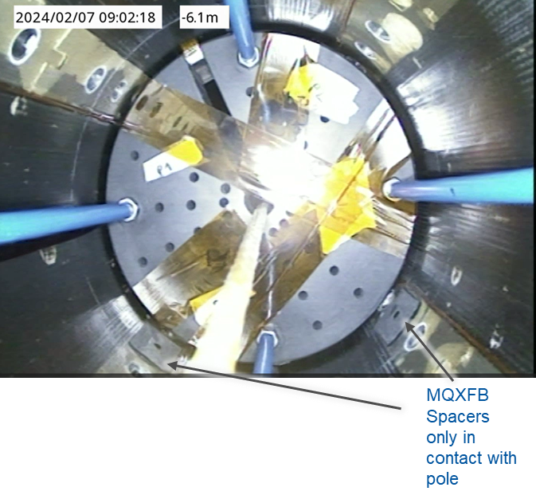
MCBXFA spacers
MQXFB spacers
Although there is no full confirmation of all sequences towards the flattop quench, but gained confidence that this is not a magnet problem.
Additional data and discussion done in https://indico.cern.ch/event/1556936/
Major NCR that was declared earlier will be modified.

Slide 25
2026 challenges

Slide 26
2026 magnet test schedule
2026 will be a very full year, with a large cryogenic load in SM18 mostly used for the HL-LHC project (cavities, magnets, magnet string).
Magnet test benches and magnet test plan are optimized.
Experienced magnet test operation team.
Daily optimization and prioritization between all teams will be required.

Slide 27
Summary
Two CP, one D1 and almost one D2 are qualified for installation in the HL-LHC. Magnet test results are very good. No major non-conformities.
Currently ~33 % of cryo-assemblies to be installed are tested, or 25 % of cryo-assemblies including spares.
25 % of SC-link systems are tested.
Flattop quenches in LMQXFA01 and LMCXF01 were triggered by external events in the vacuum part of the cryo-assembly. Probable cause is the helium leak into the vacuum on test station side that has been repaired.
2026 will be a very full year of tests, with daily optimization and prioritizing needed.

Slide 28
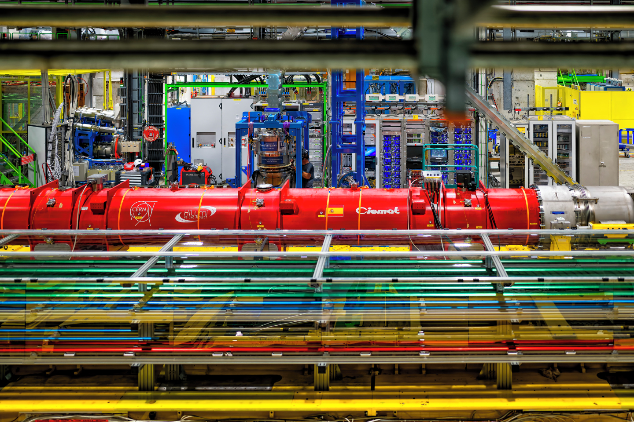
Thank you for your attention
Photo by Vincent Hofer
OPEN-PHO-ACCEL-2025-021-6, CDS.CERN.CH

