Slide 1
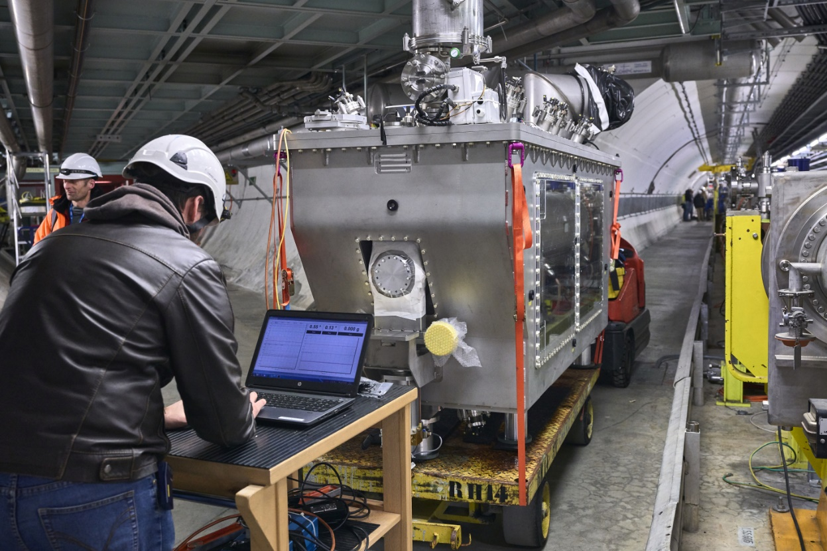

CRAB Mechanical measurements overview and next steps
M. Guinchard (EN/MME Mechanical Measurement Lab)
15th HL-LHC Collaboration Meeting, CERN, 29 September - 2 October 2025

Slide 2
Outline
Reminder about optical mechanical measurements
CRAB Mechanical Instrumentation
A decade of measurements
Recent activities
Ongoing and future activities

Slide 3
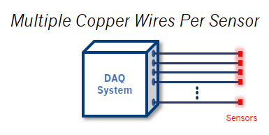
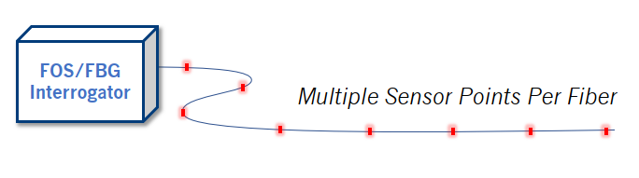
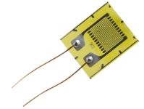
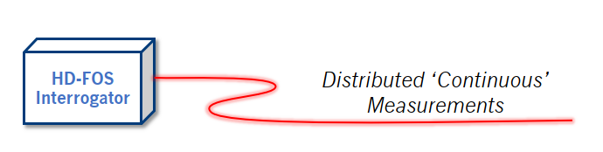
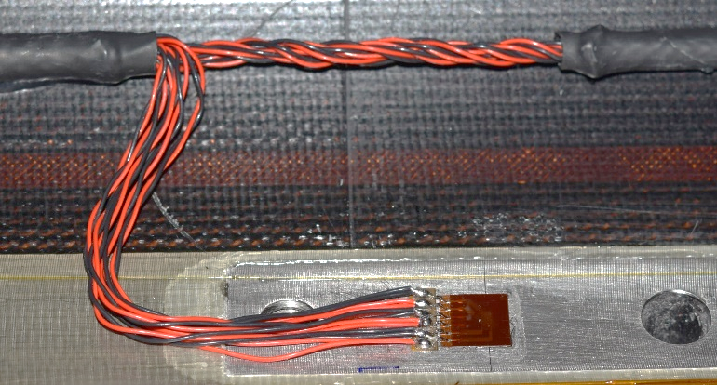

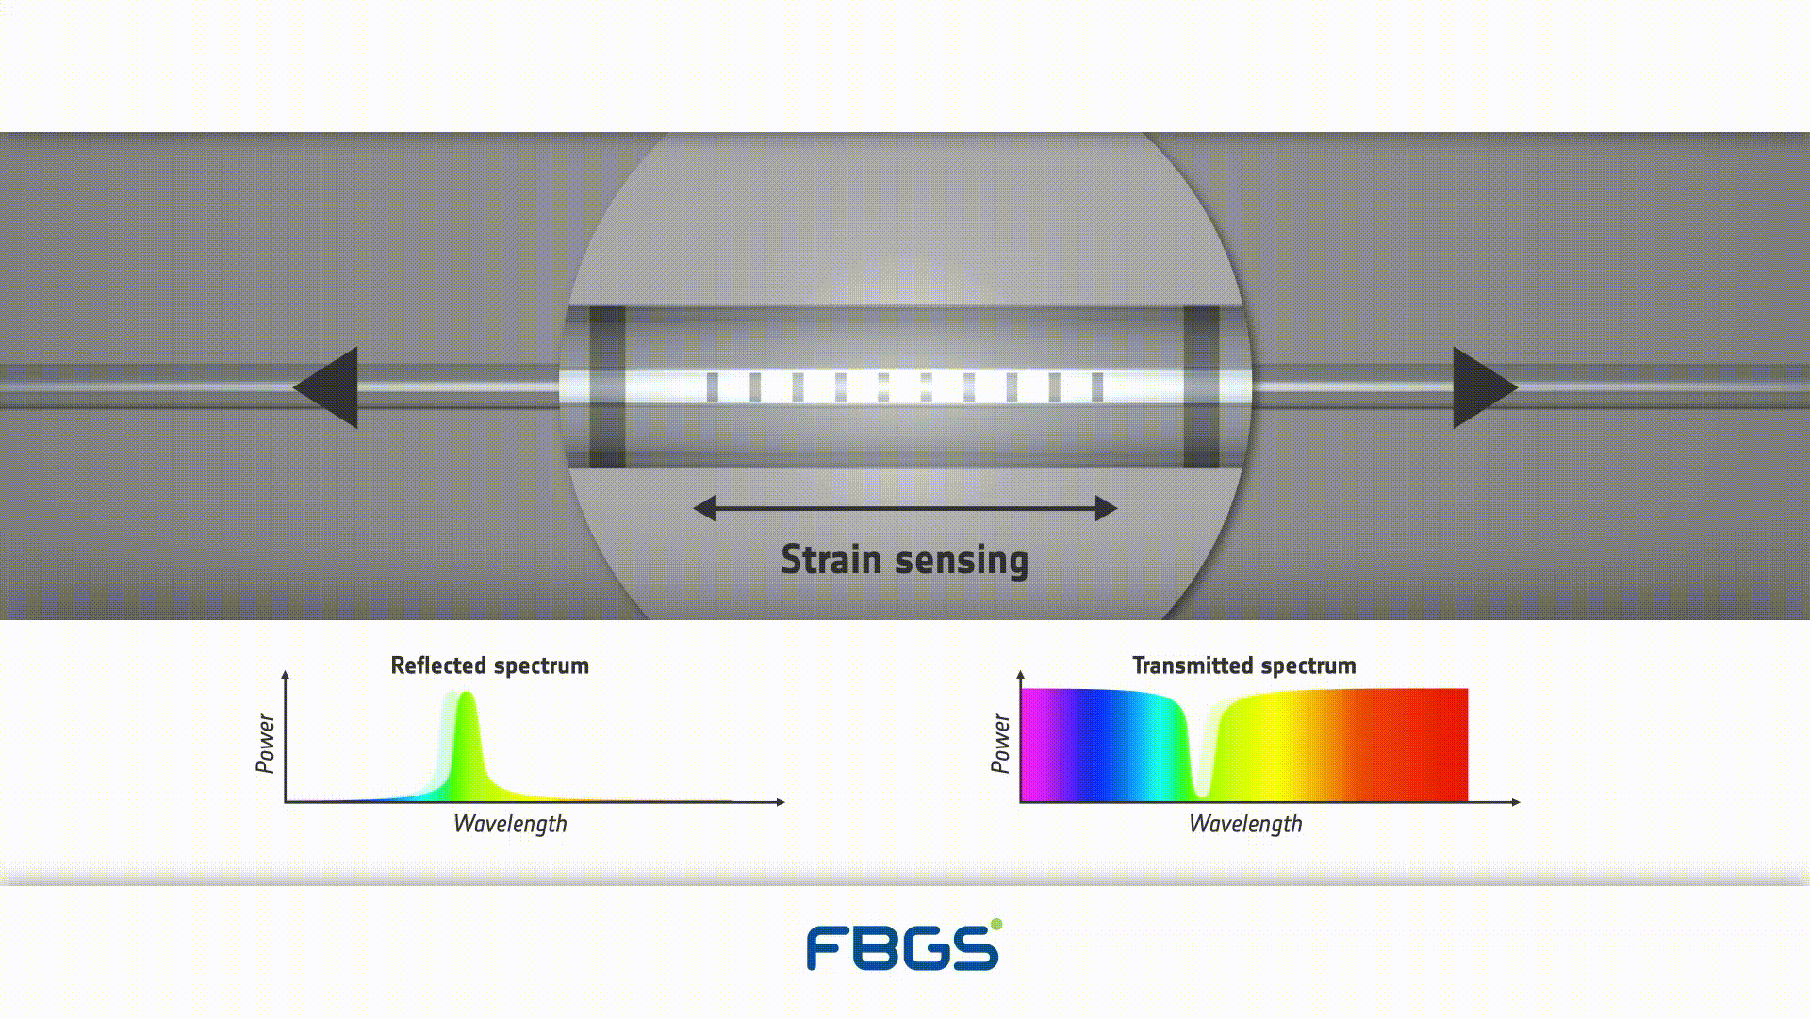
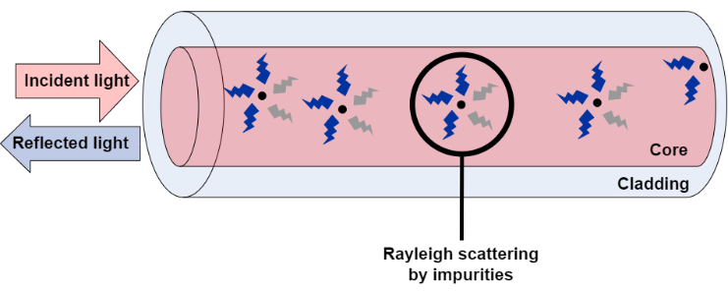

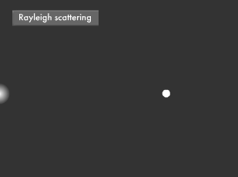

Reminder about strain measurements
80’s
2011
2021
Electrical Strain Gauge (ESG)
Fiber Bragg Grating (FBG)
Rayleigh Backscattering
(RBS)
Discrete
Distributed
Robust well proven technology
Bulky cabling
Single optical fiber
Challenging bonding process for
cryogenic temperatures
Single optical fiber
Sub mm spatial resolution
Challenging bonding process for cryogenic temperatures
3

Slide 4
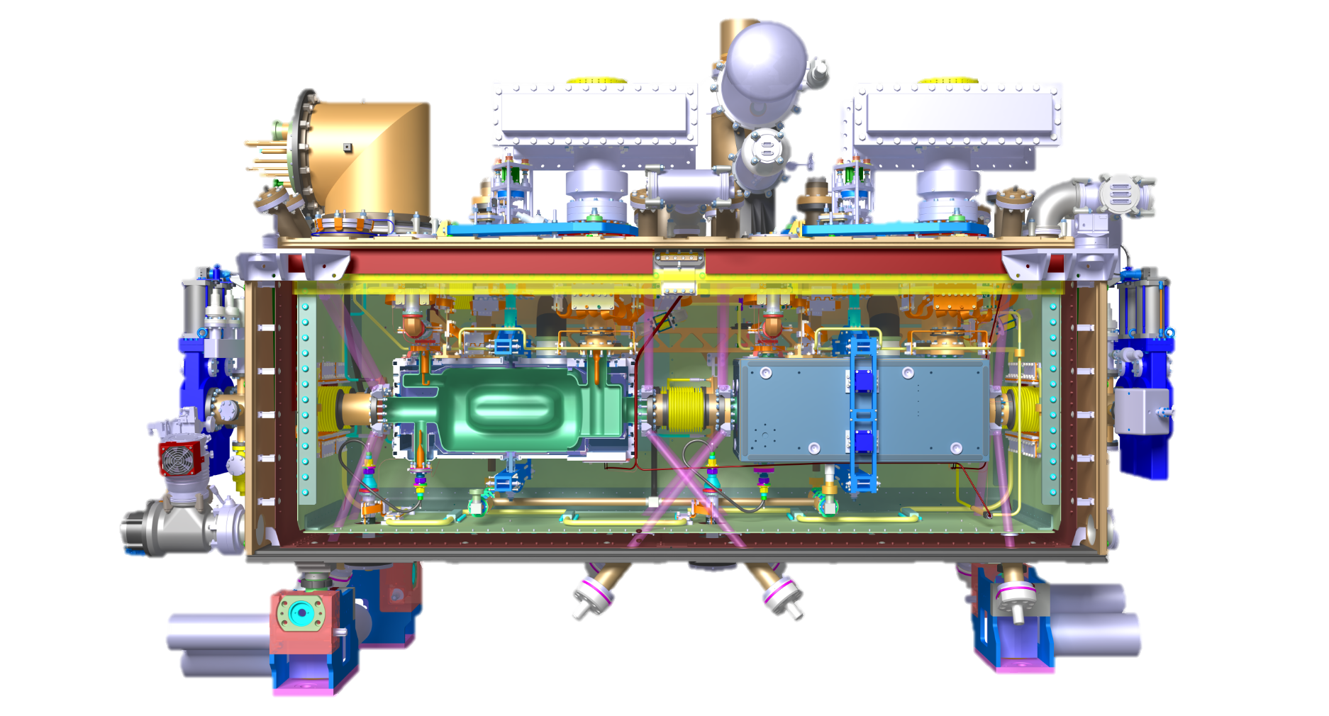
Reminder about strain measurements
80’s
2011
2021
Electrical Strain Gauge (ESG)
Fiber Bragg Grating (FBG)
Rayleigh Backscattering
(RBS)
Discrete
Distributed
Robust well proven technology
Bulky cabling
Single optical fiber
Challenging bonding process for
cryogenic temperatures
Single optical fiber
Sub mm spatial resolution
Challenging bonding process for cryogenic temperatures
4

Slide 5
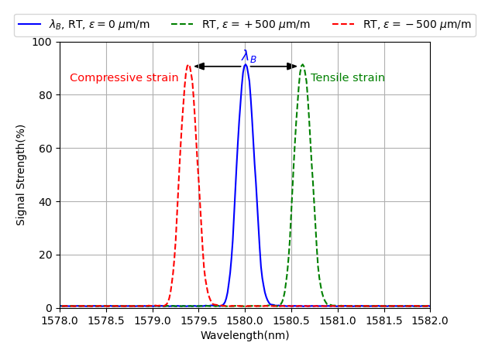
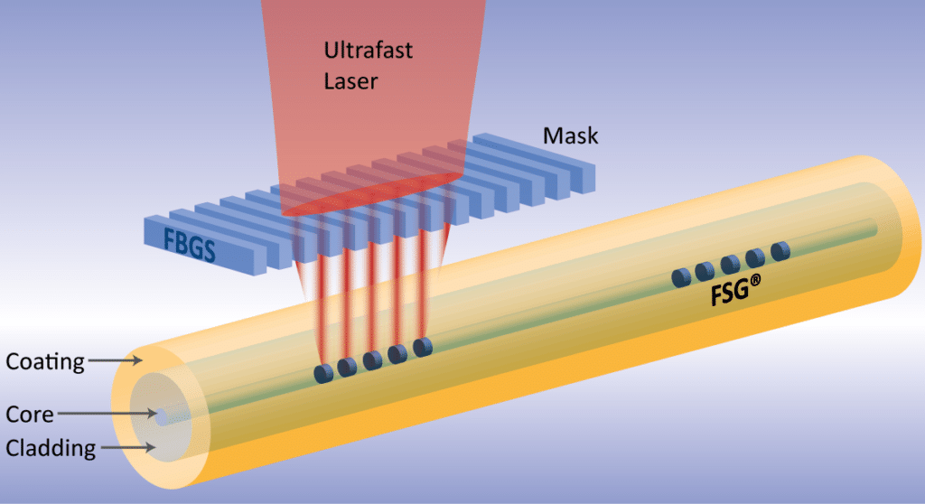

Reminder about strain measurements
Reflection spectra of an FBG presenting the effect of tensile and compressive strains on the Bragg wavelength :
$Δλ_{B}=λ_{B}\left[\left(1−p_{e}\right)ε+\left(α+ξ\right)ΔT\right]$
Through-coating FBG inscription process
Fabricated with ultra short femtosecond laser pulses
Static measurement up to 1 kHz !

Slide 6
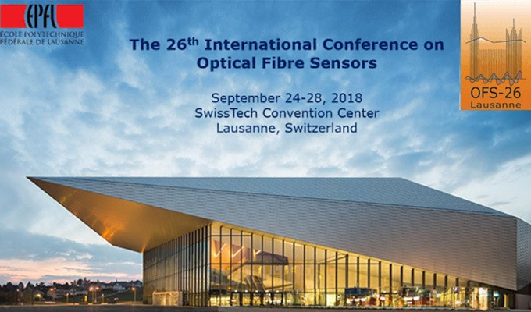
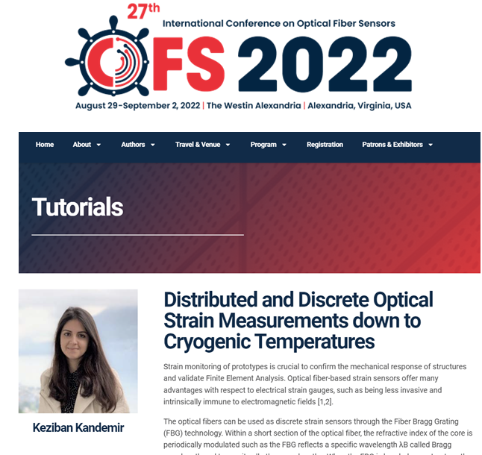
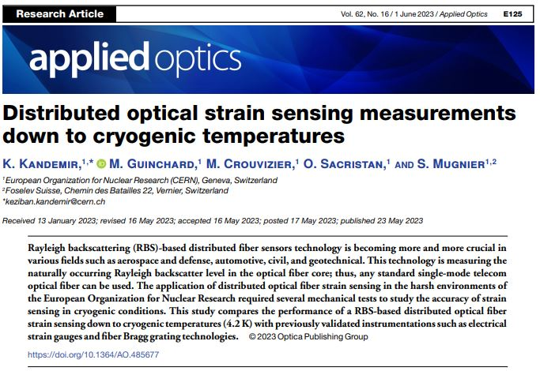
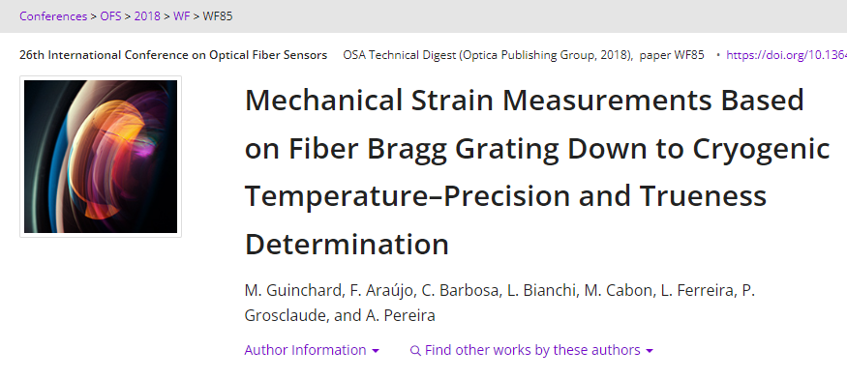
More information…
Optical and strain gauges validation campaign down to cryogenic temperatures

Slide 7
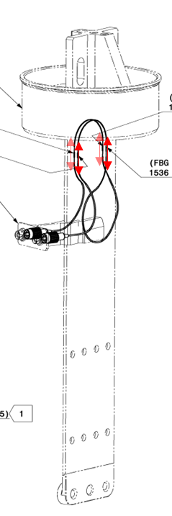
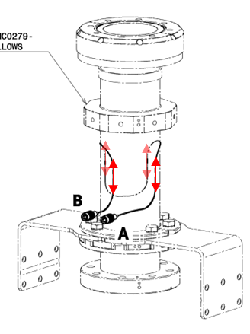
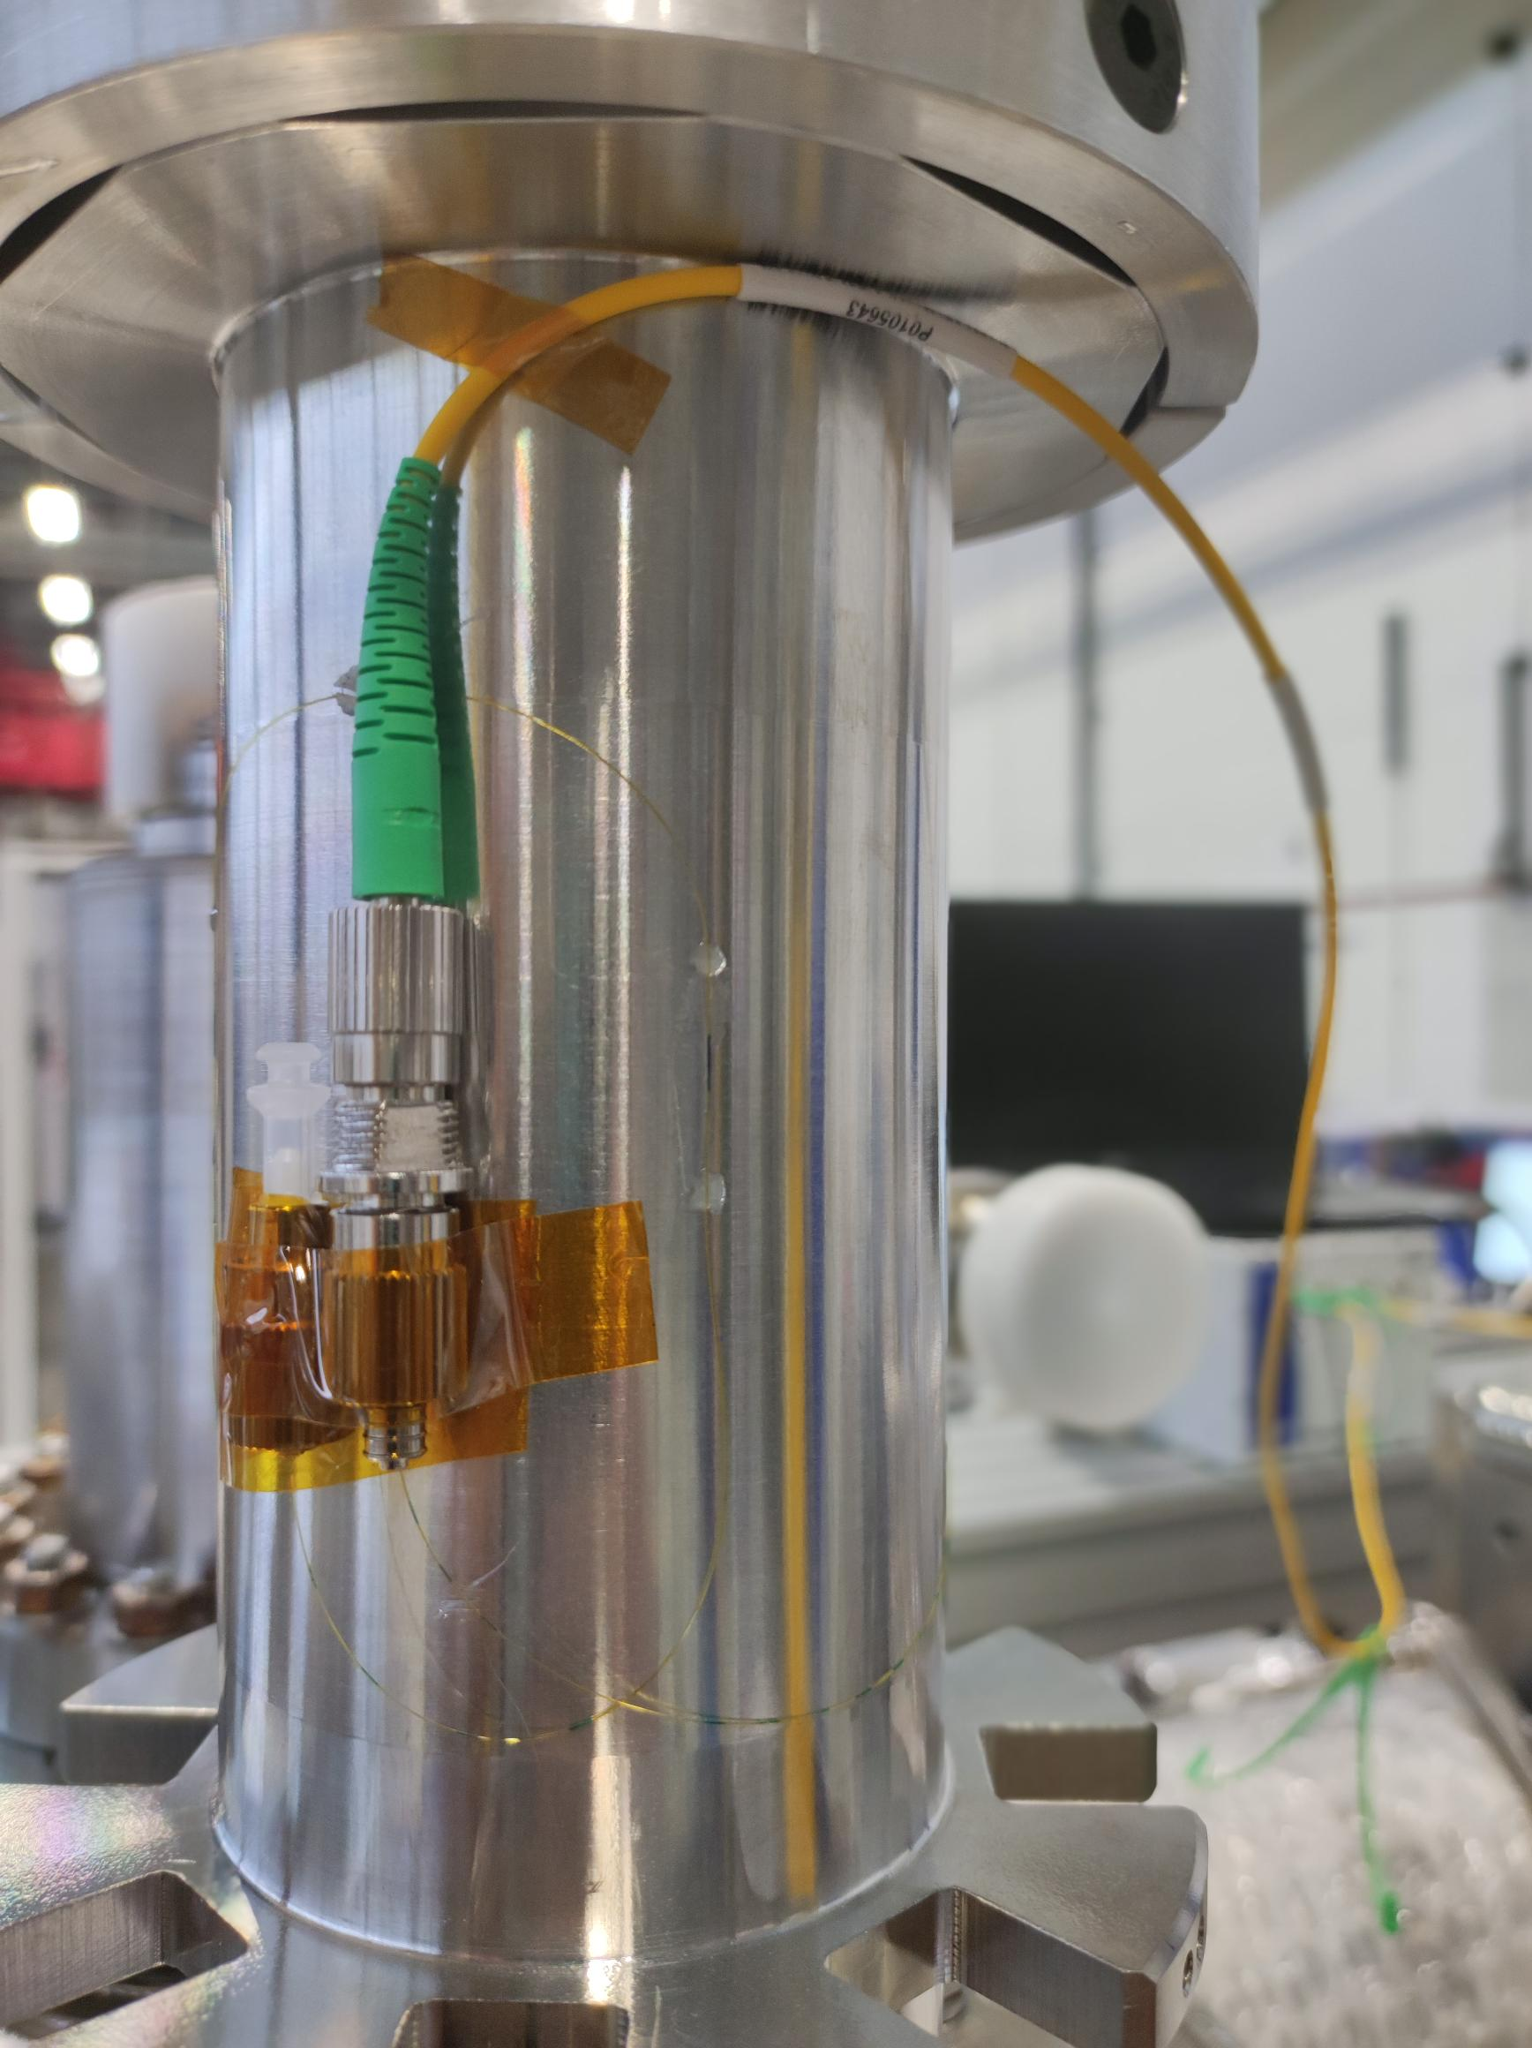
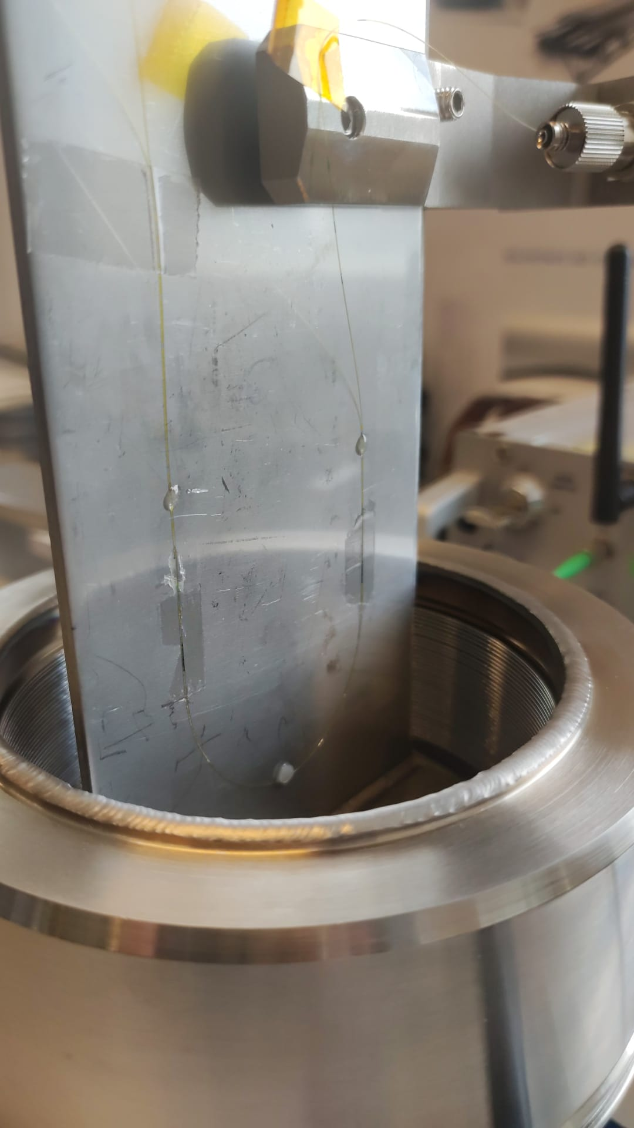
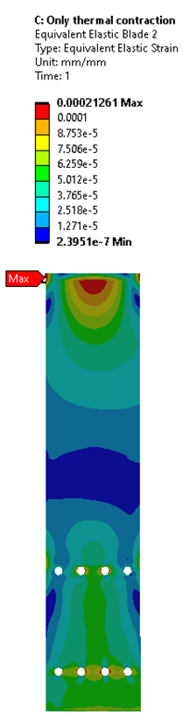
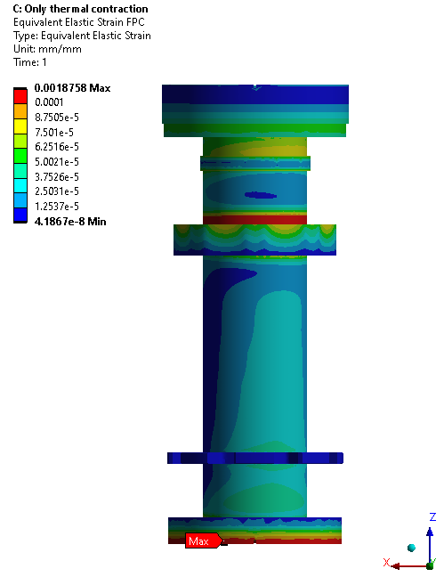
CRAB Mechanical Instrumentation
FPC Tubes
Blades
Traction / Compression Measurement
Bending Measurement (2x directions)
Traction / Compression Measurement
Bending Measurement

Slide 8
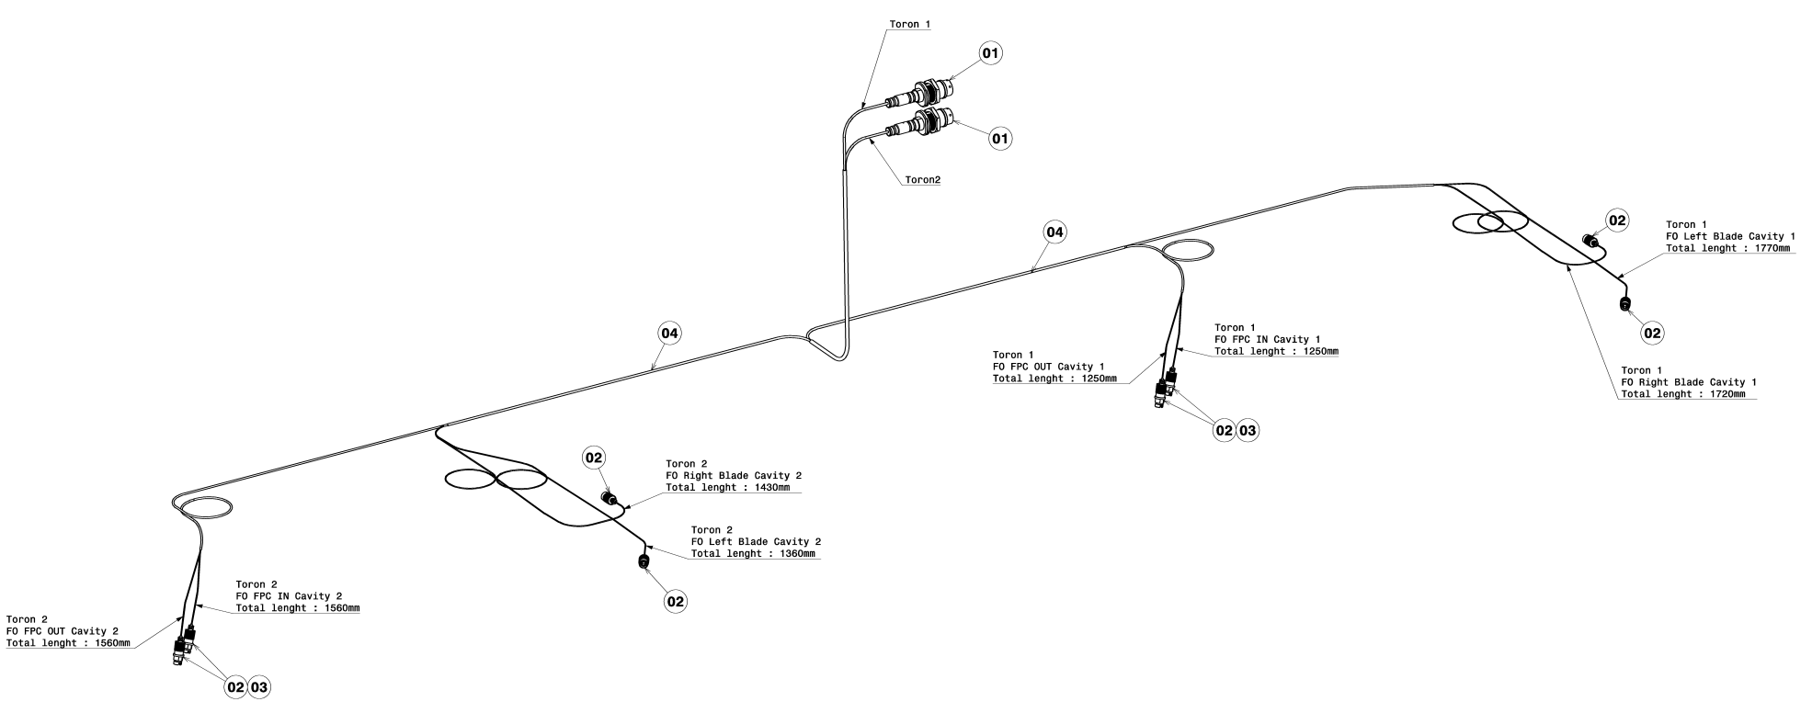
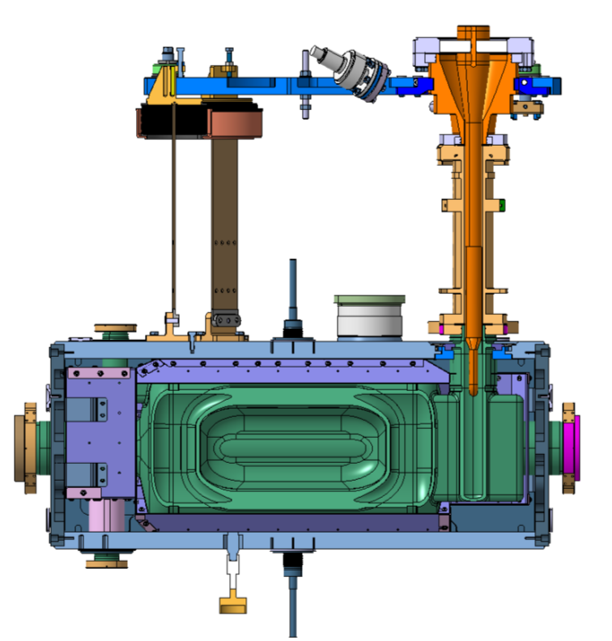
CRAB Mechanical Instrumentation

Slide 9
CRAB Mechanical Instrumentation
Network of optical fibers (EDMS#3093538 v.3):
24 strain measurement spots
Traction/compression measurements on both components
Bending stress measurements of the blades
Bi-axial Bending stress measurements of the FPC tubes
Temperature compensation
For cryomodule transport :
Shocklog® Systems with GPS and GSM connections worldwide: shocks, Temp, HR, Tilt :

Slide 10
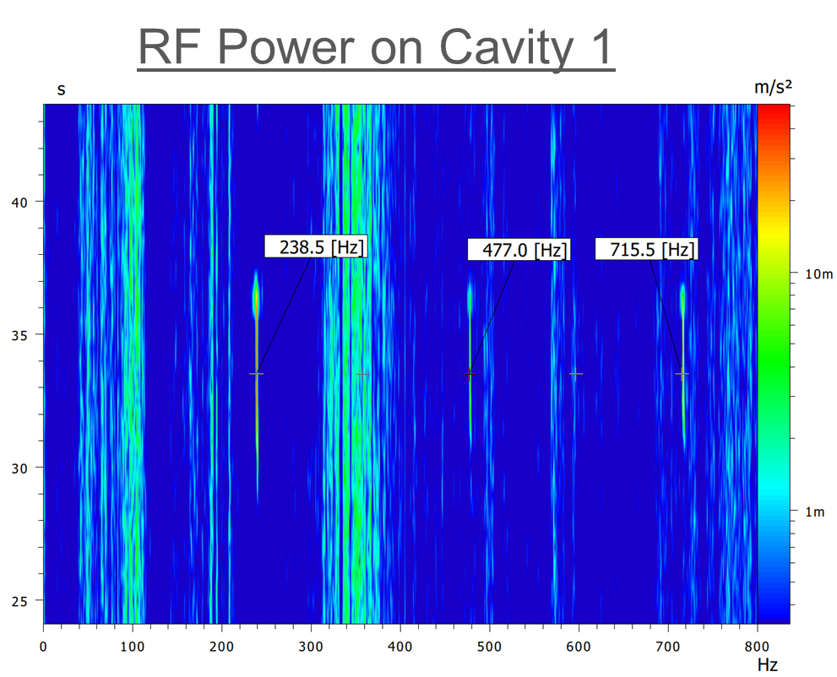
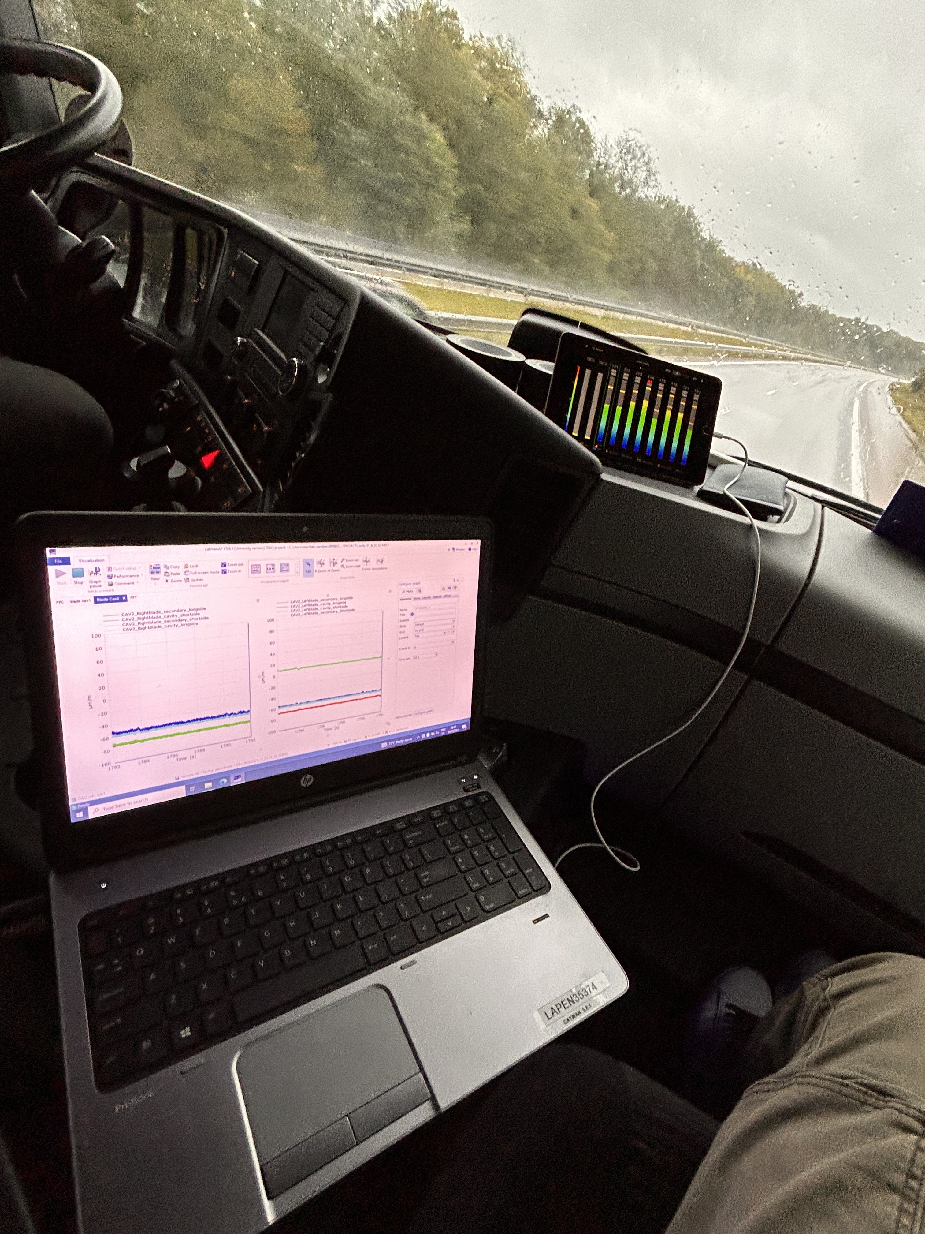
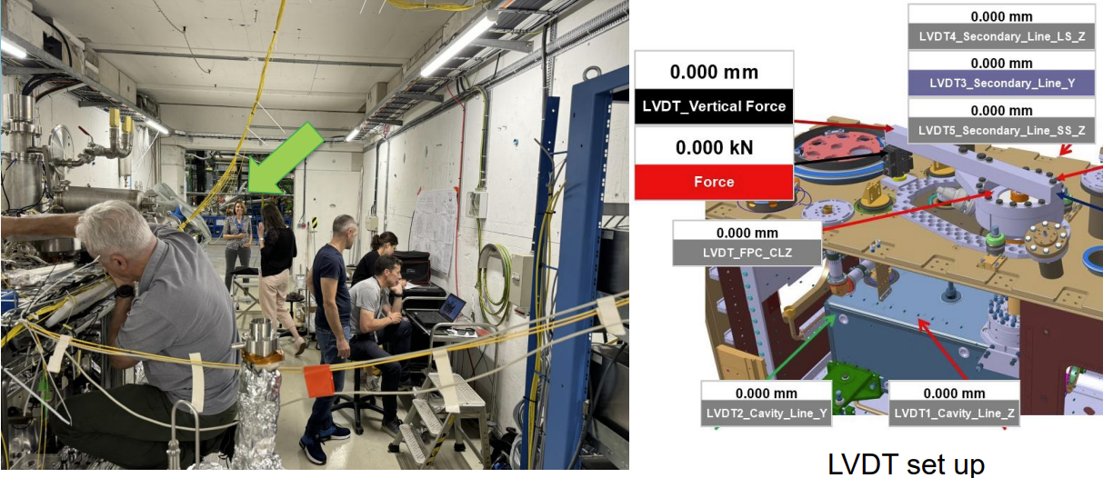
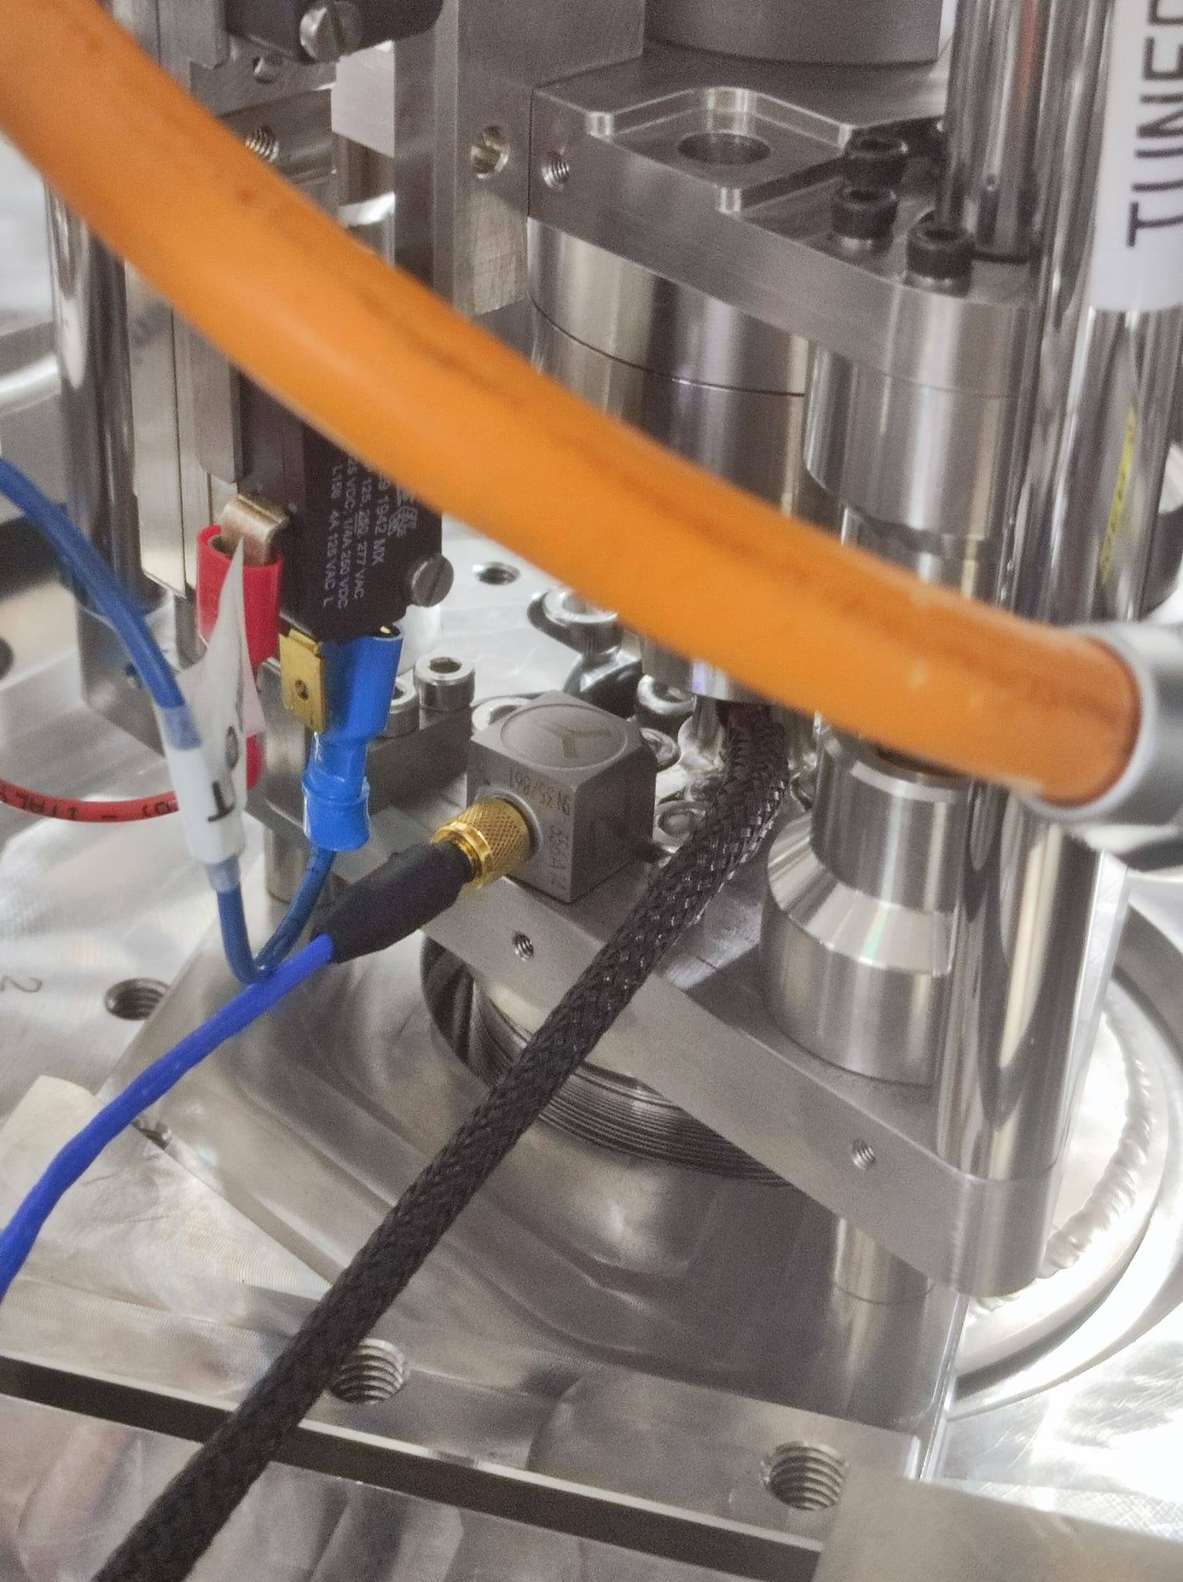
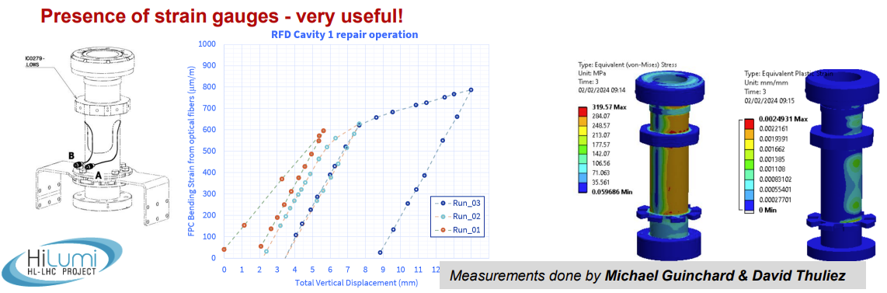
A decade of measurements…
Tightening torque for M5 bolts in jacketed cavities (2015) EDMS#1538926
Experimental modal analysis of CRAB cavity DQW (2017) EDMS#1771639
CERN DQW Cryomodule : Mechanical instrumentation (2017) EDMS#1845561
Experimental modal analysis of the CERN CRAB DQW cryo-module EDMS#1856390
Mechanical tests of brazed joint between SS and Ti with SCP and Gapasil EDMS#2113224
Mechanical stress measurements during welding of pipe test connection EDMS#2594239
Vibration monitoring of the RFD cavity during transport to STFC EDMS#2594511
Stiffness characterization of the CRAB Cavity Tuning Frame EDMS#2655717
RFD Cryomodule transport STFC to CERN (October 2023) EDMS#2755675
RFD Cryomodule repair at CERN (March 2024) EDMS#2755675
250 Hz investigations in the RF bunker EDMS#2755675

Slide 11
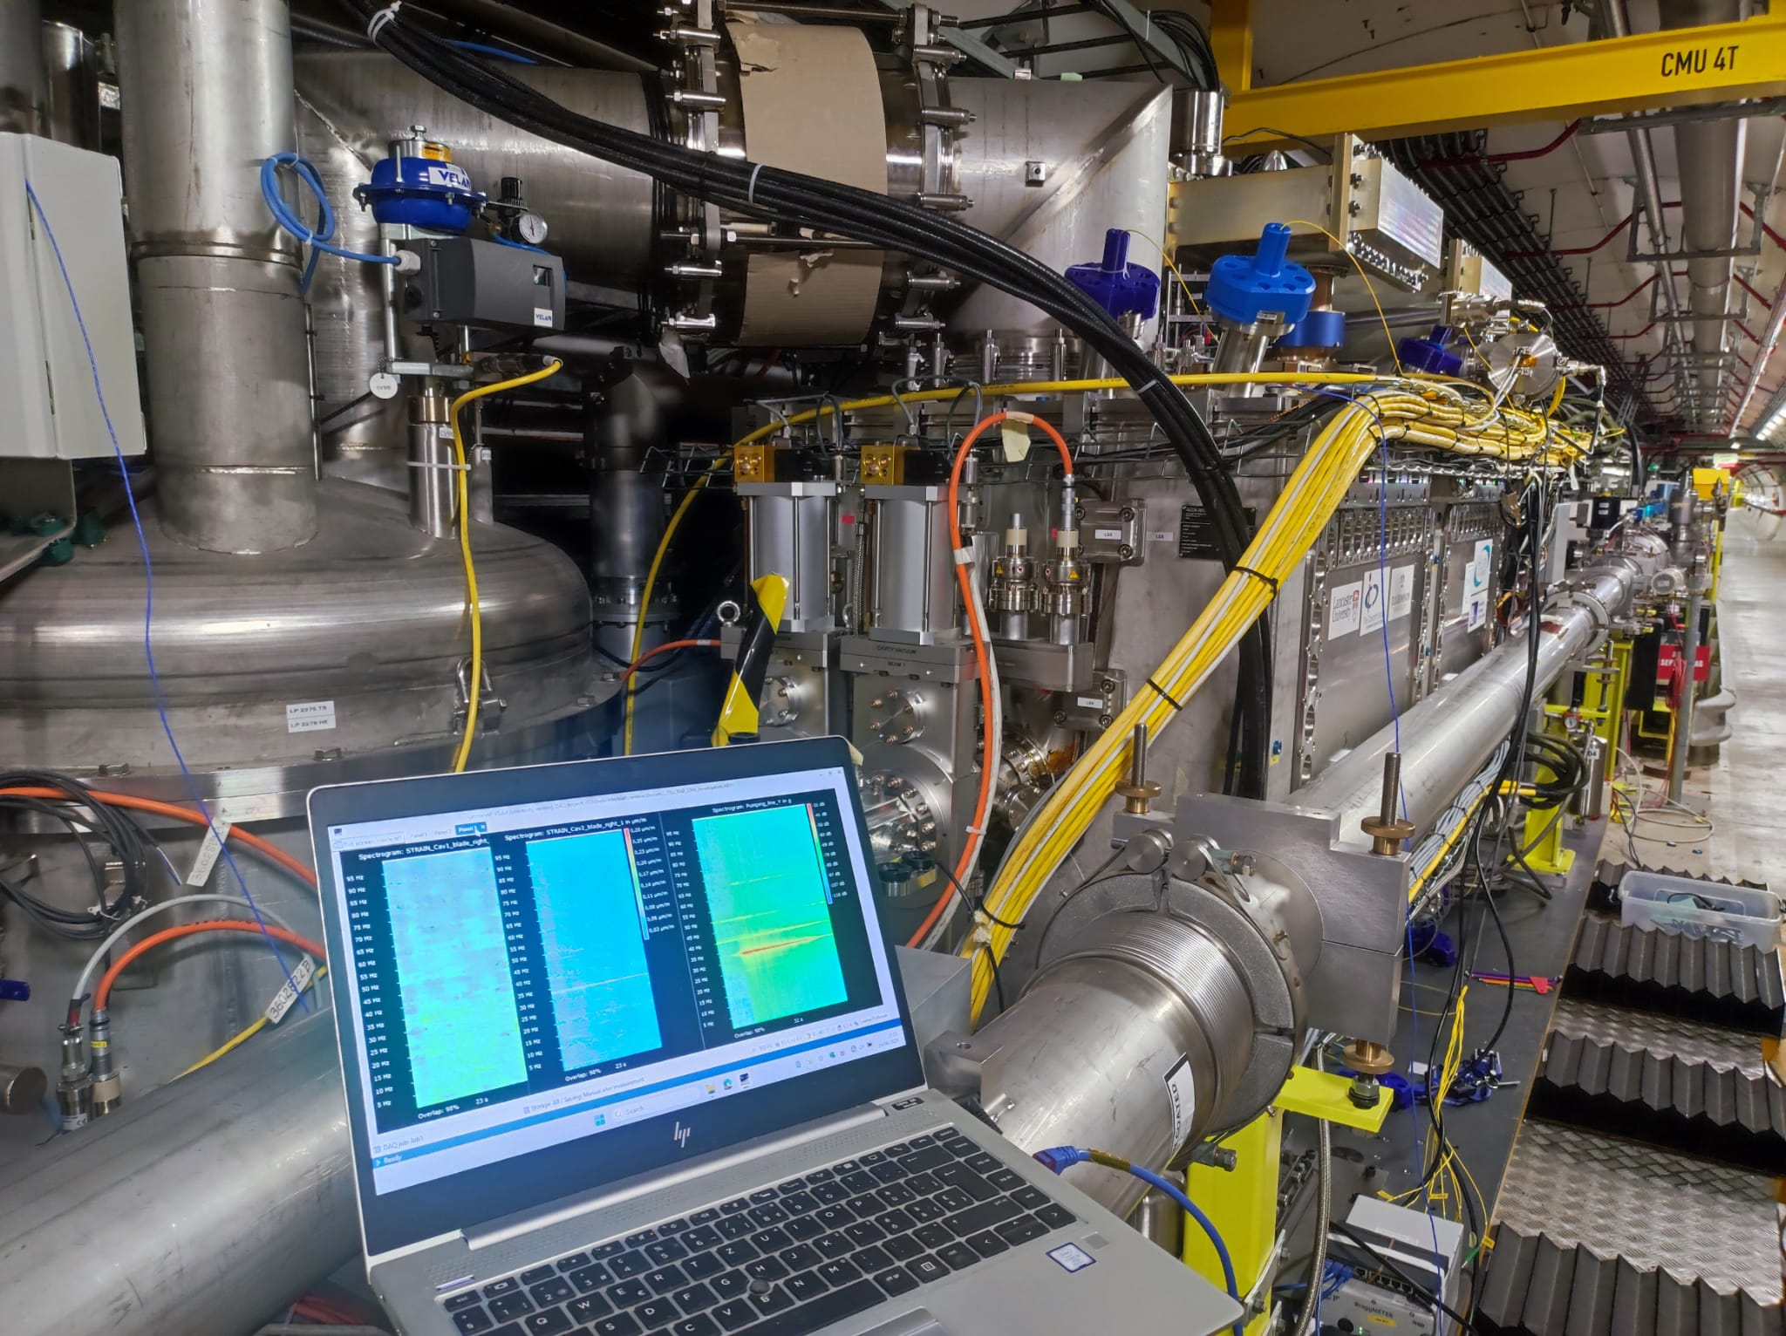
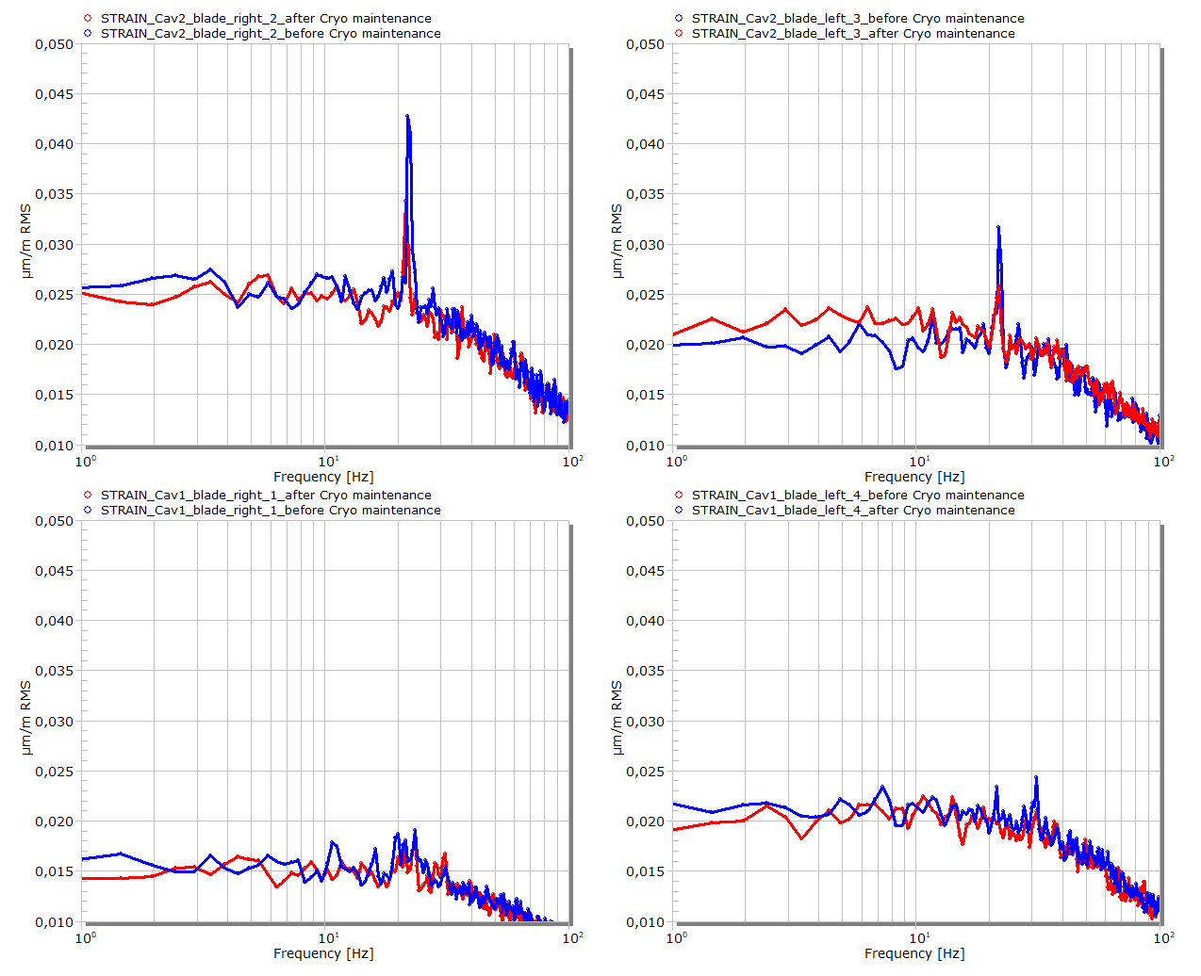
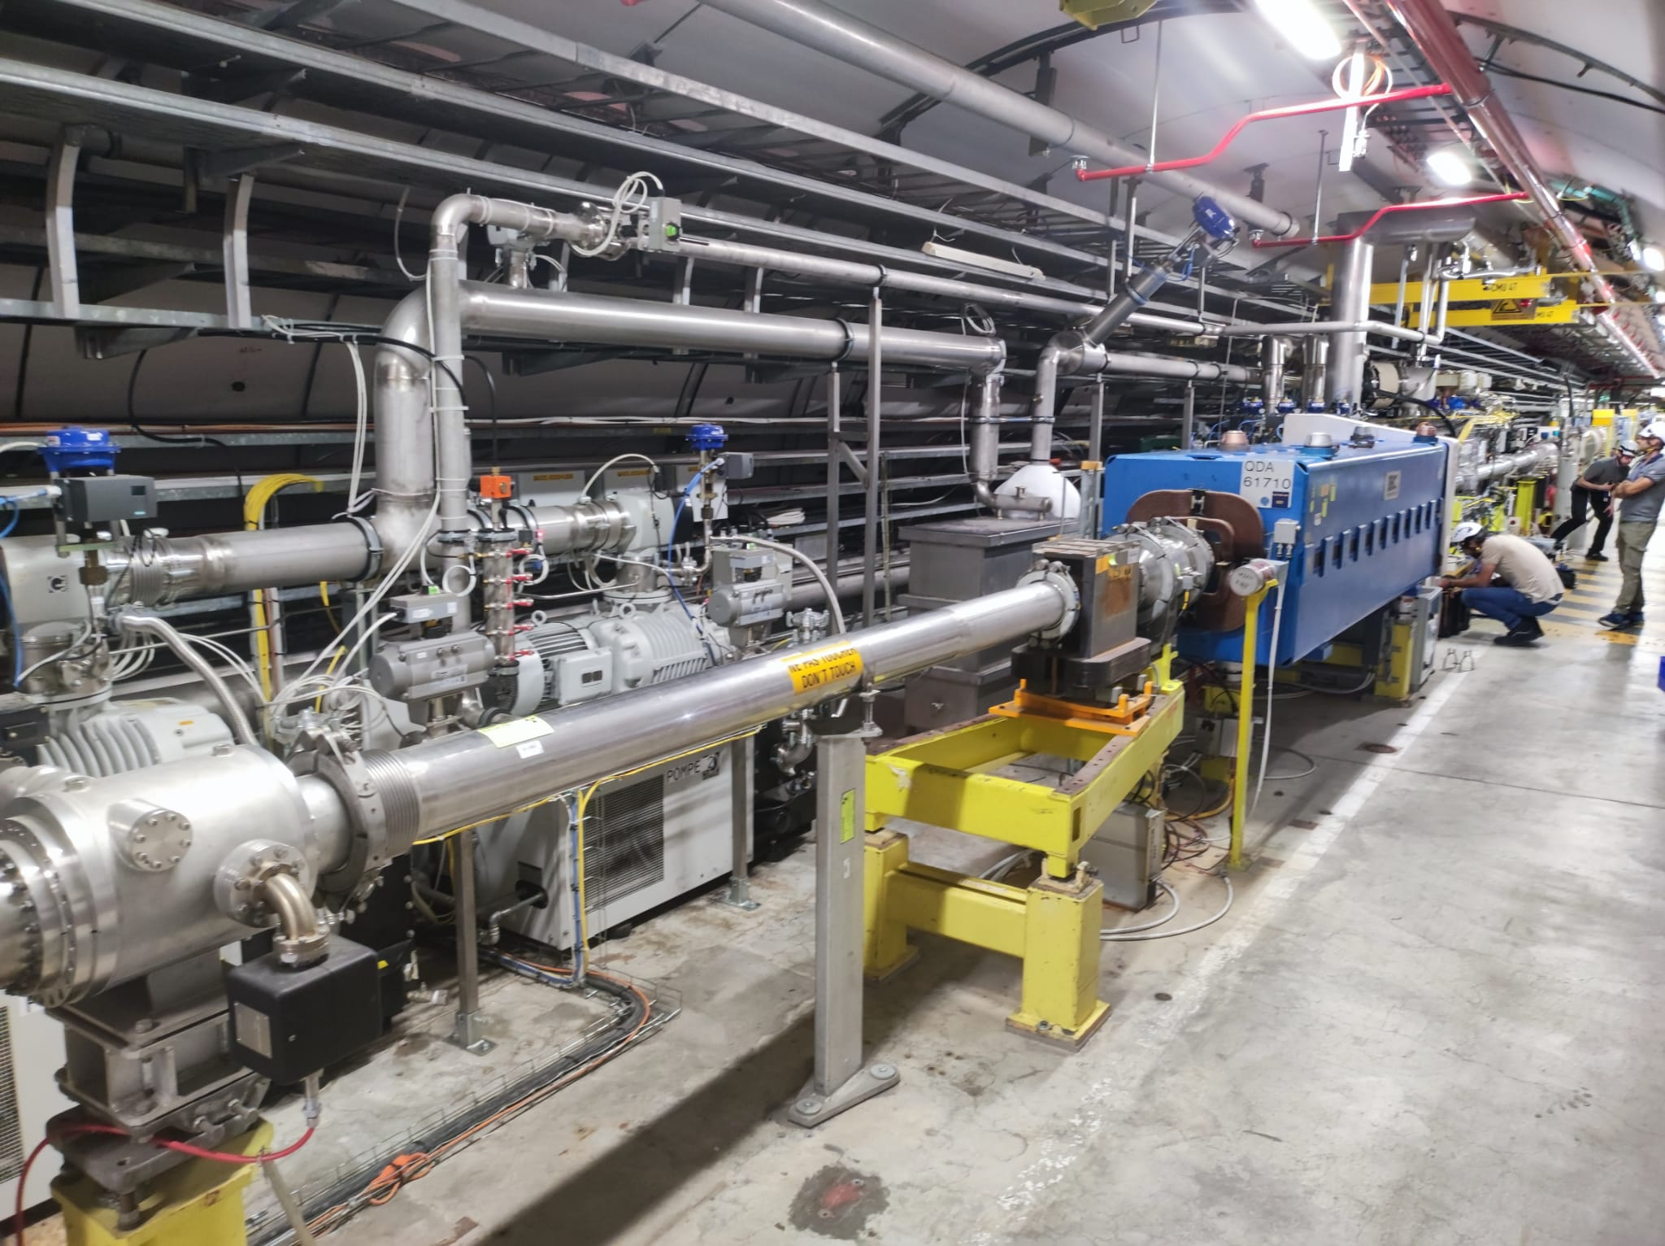
Recent activities
Training + Lab visit at CERN from TRIUMF colleagues (October 2024) Indico 1463317
Training + Lab visit at CERN from STFC colleagues (January 2025) Indico 1463317
SPS Tunnel investigation about 23 Hz RF disturbances (June 2025) In progress

Slide 12
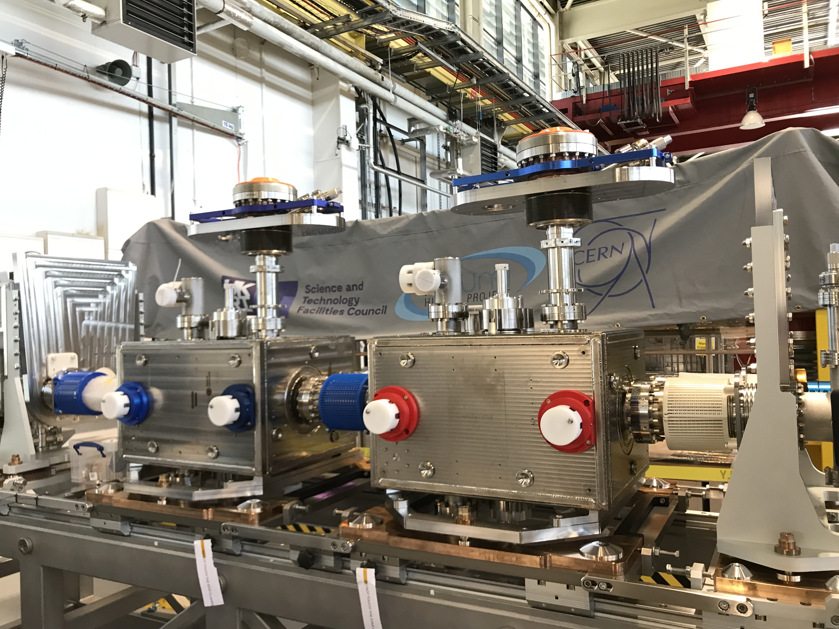
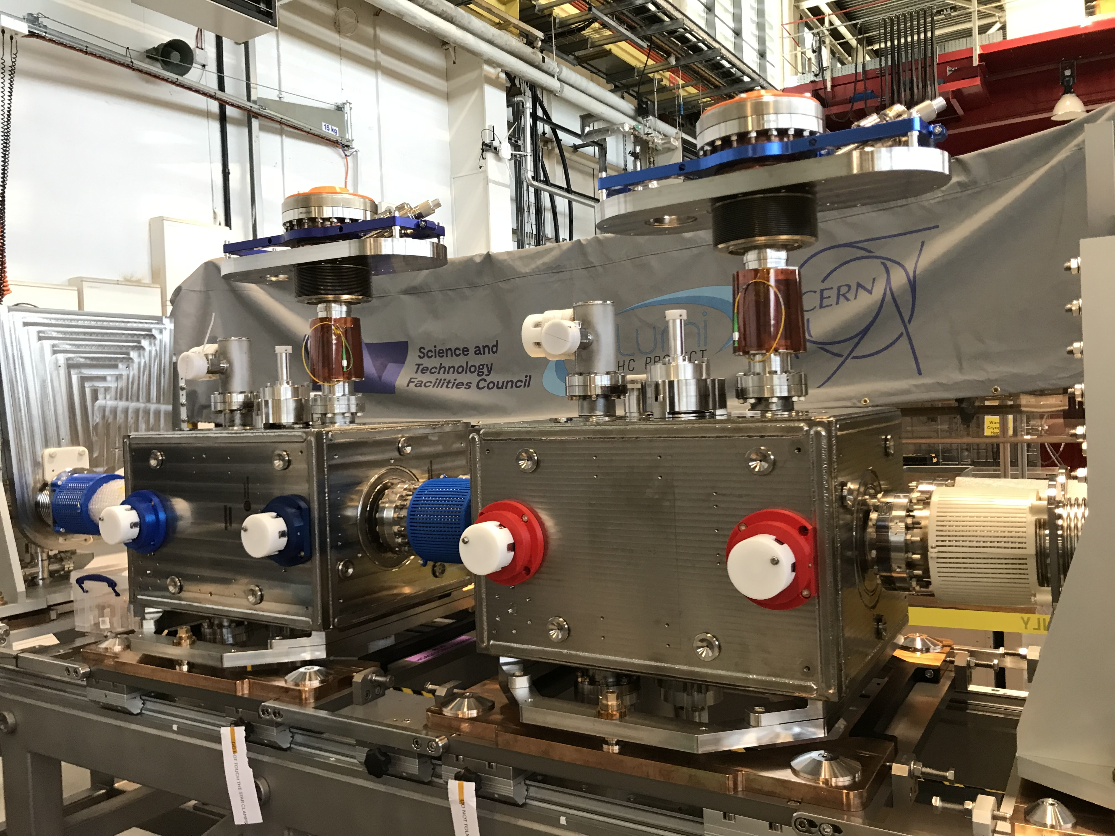
Ongoing and future activities
Cryomodule UKCM2 : FPC tubes instrumentation at STFC (April 2025) EDMS#3286571

Slide 13
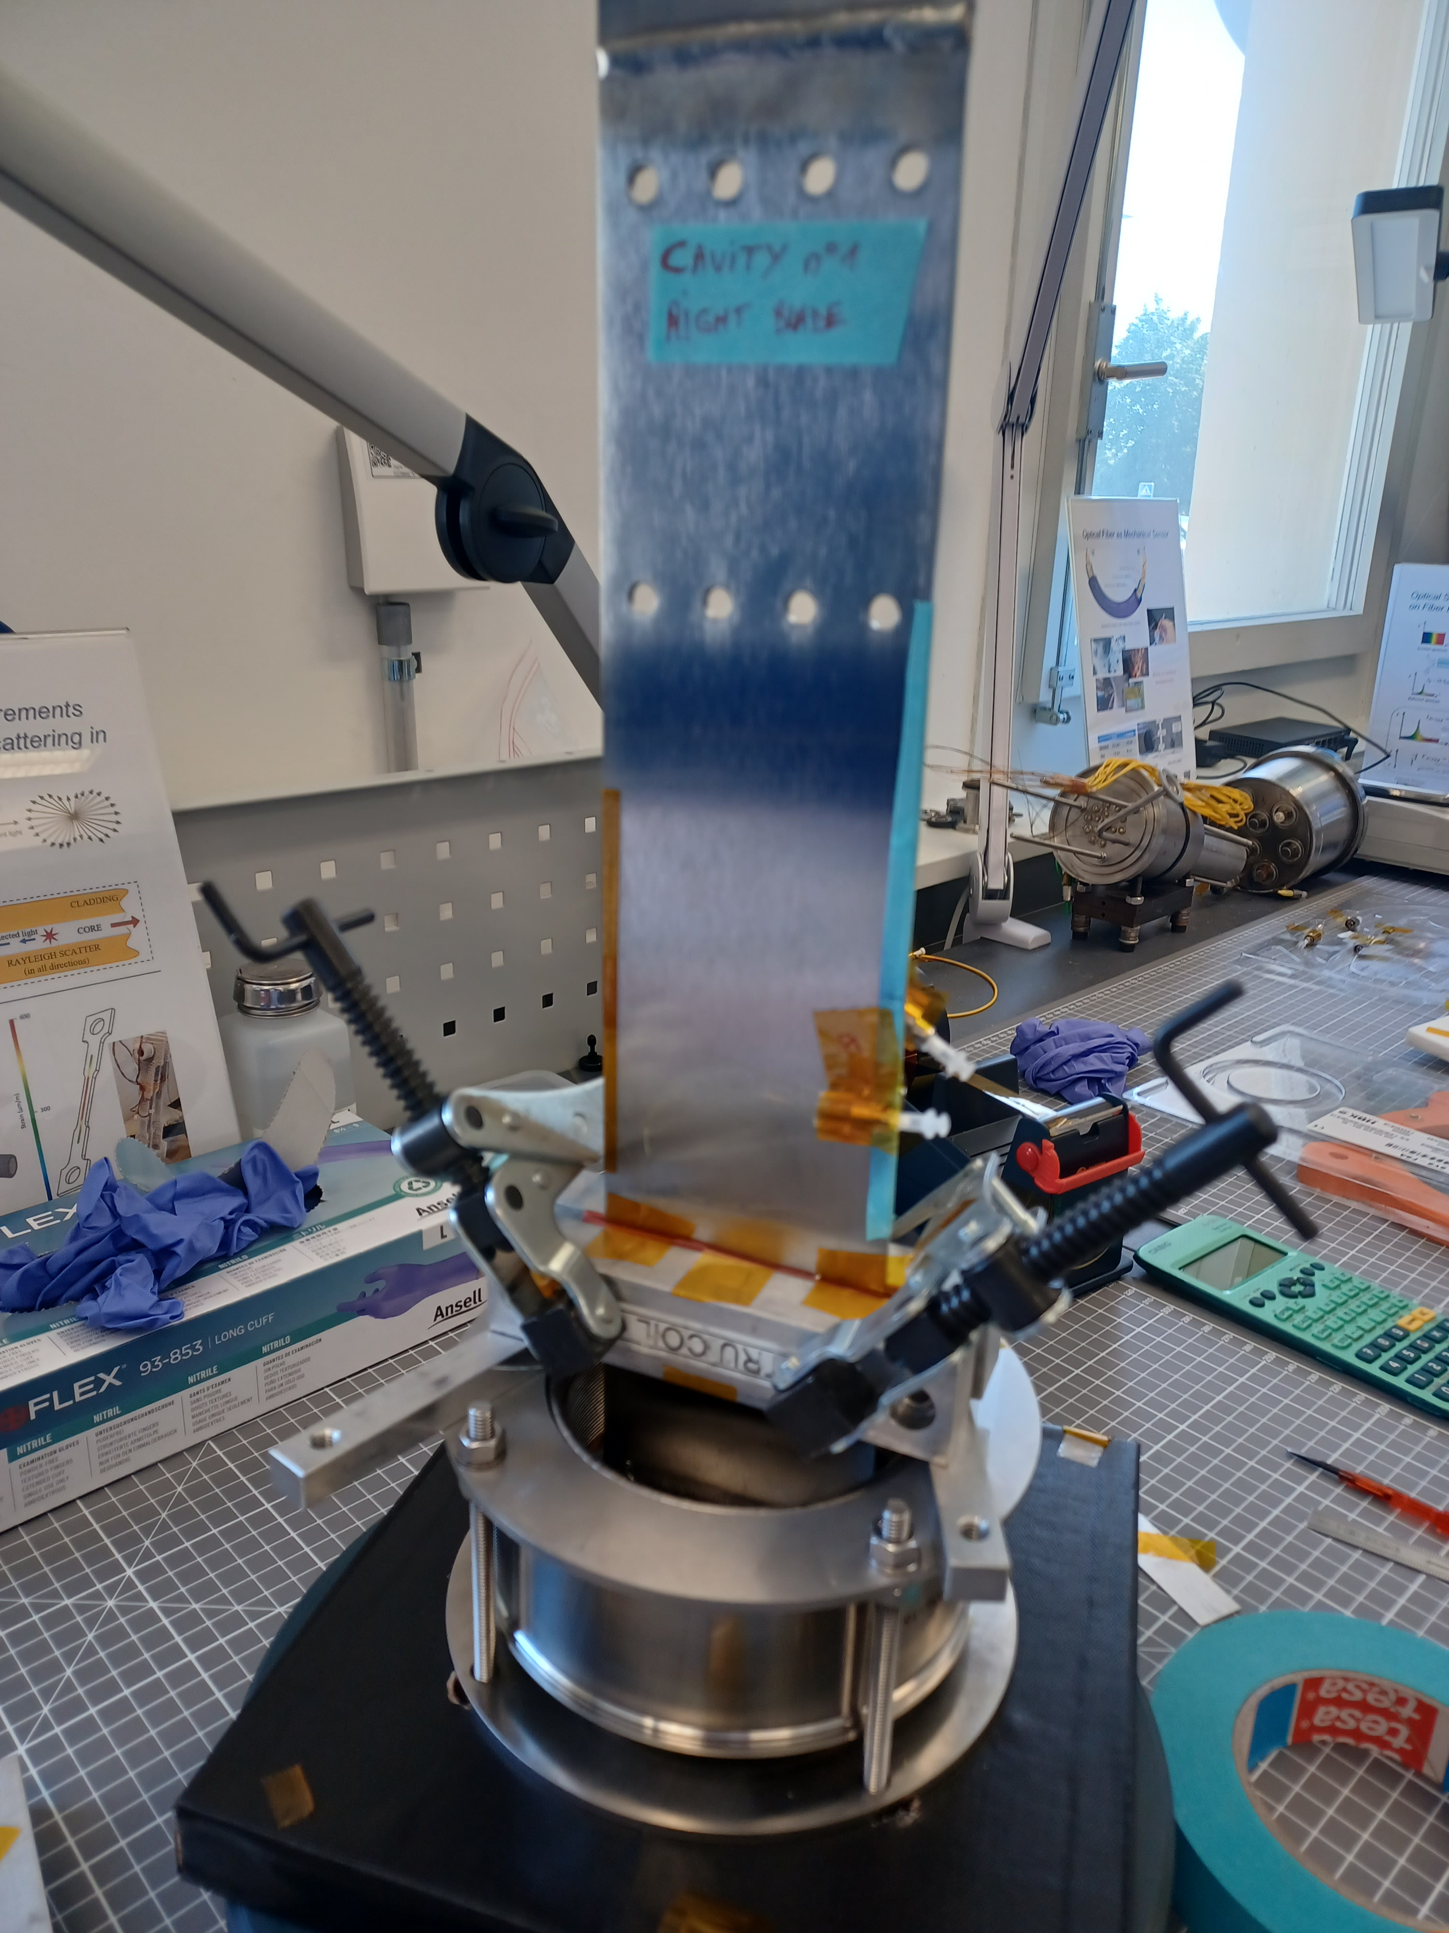
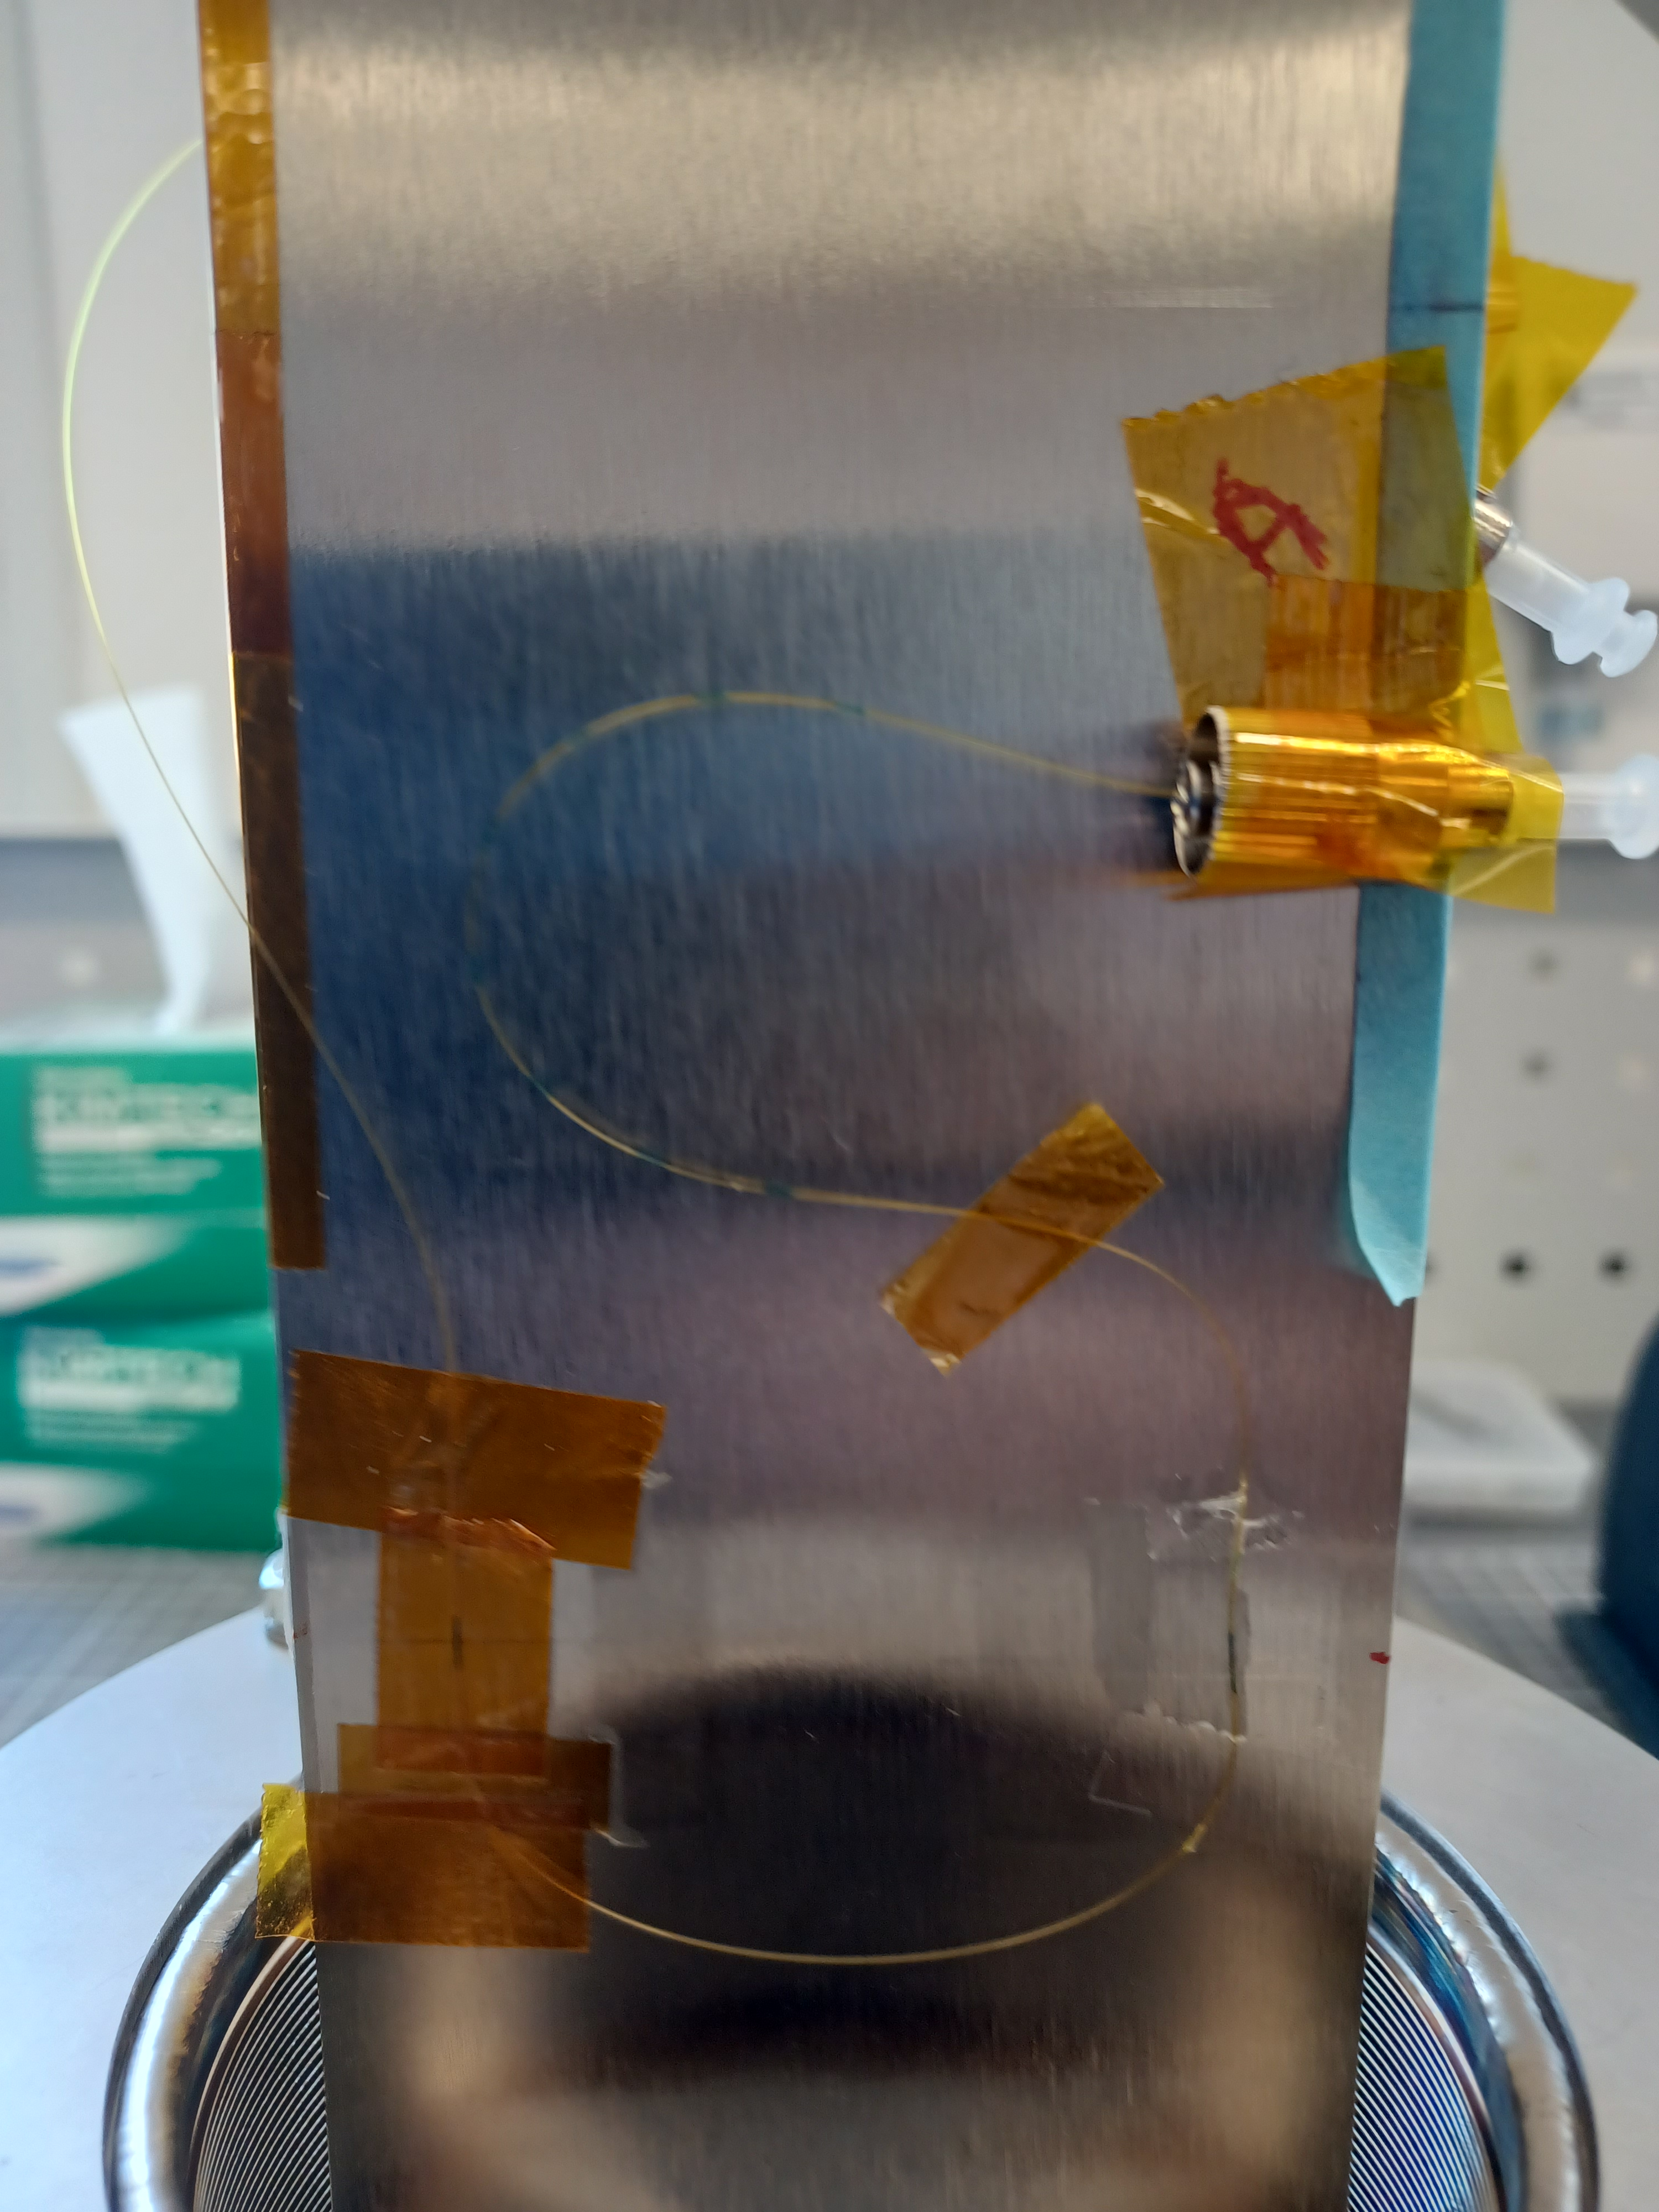
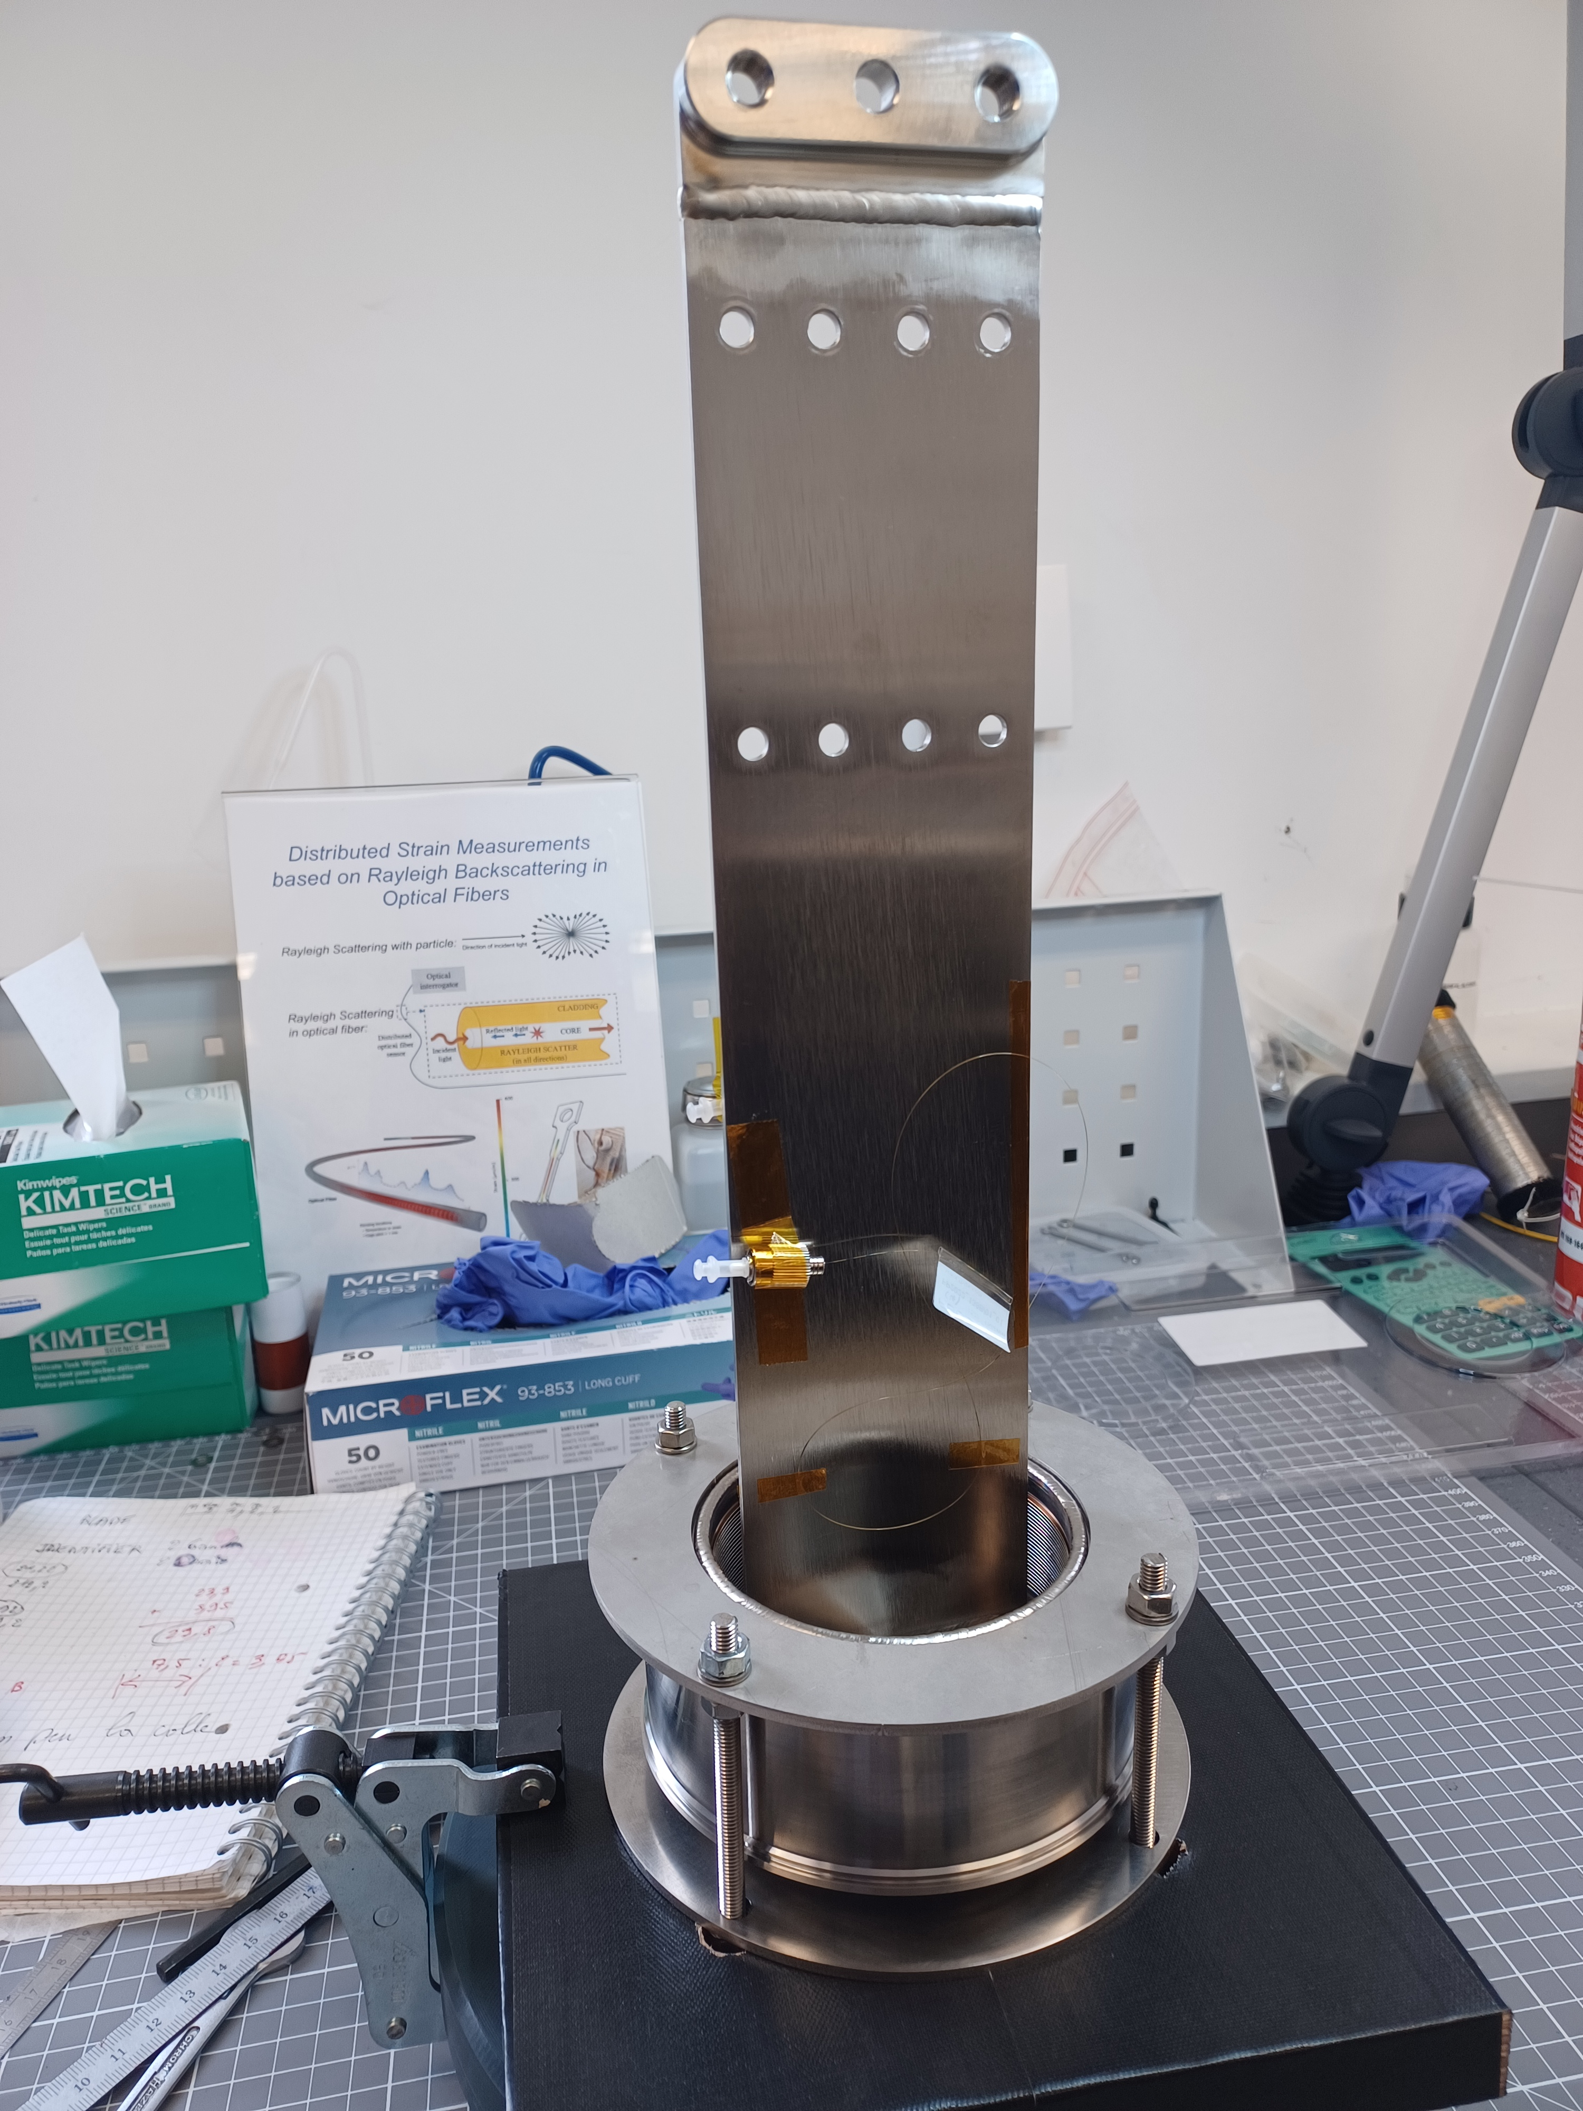
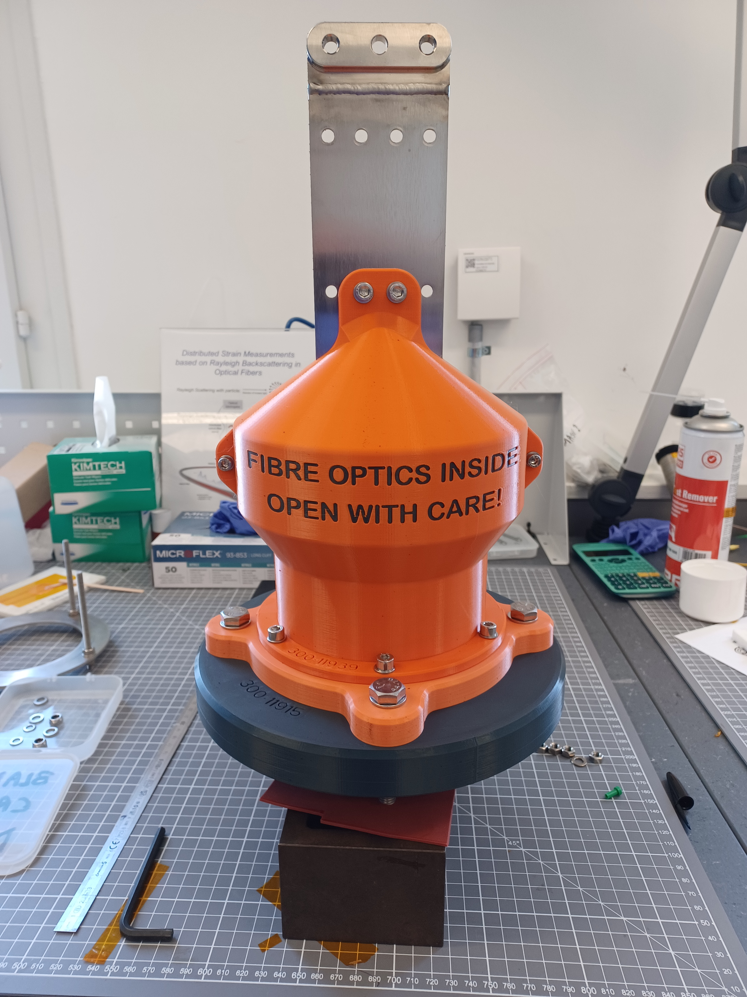
Ongoing and future activities
Cryomodule RFD UKCM2 : Blades instrumentation at CERN (July 2025) EDMS#3286571
Bonding process
Quality control
Securing the optical fibre
Packaging for transport

Slide 14
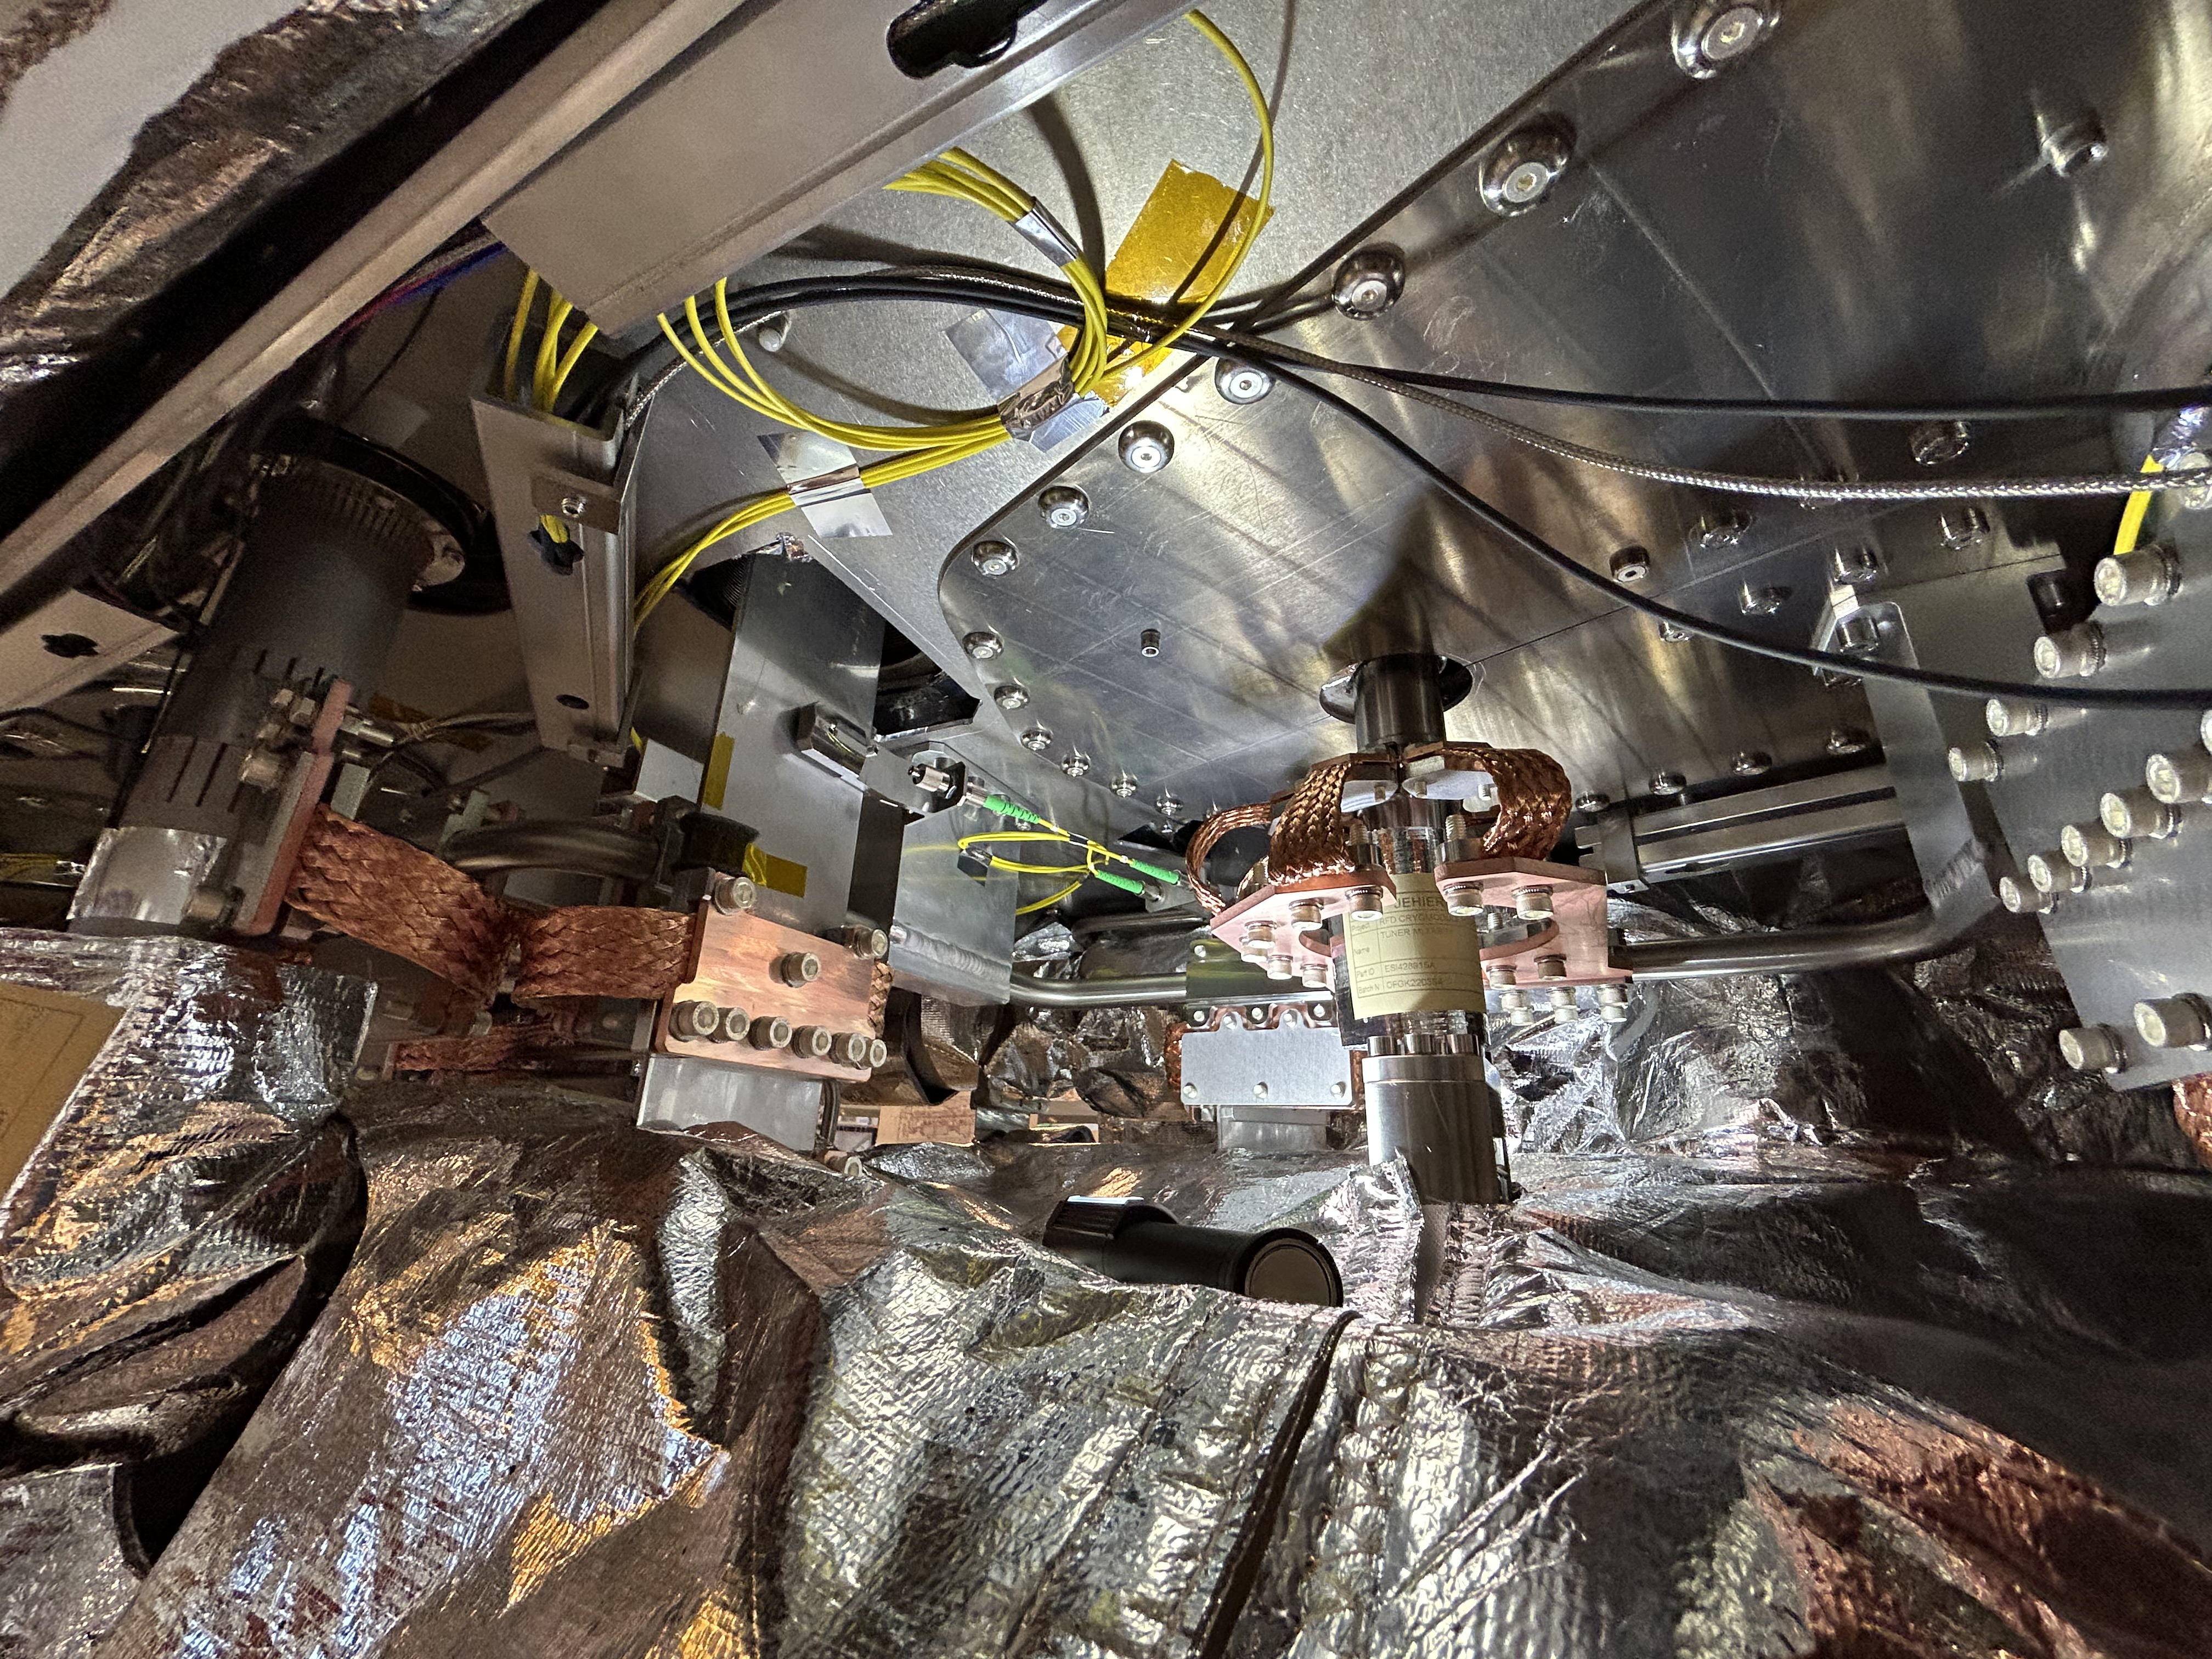
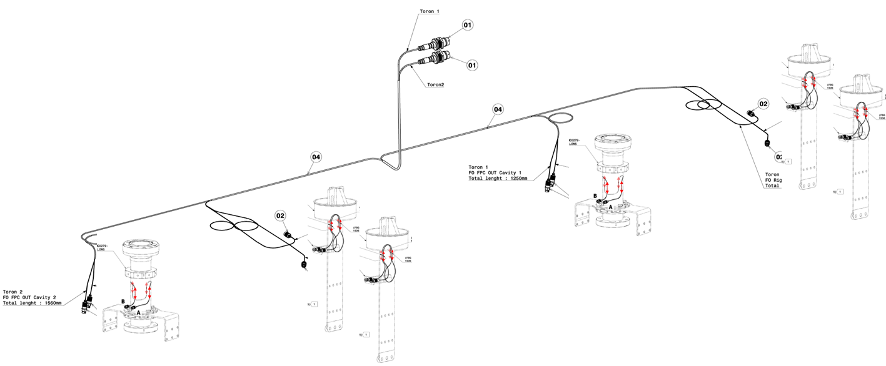
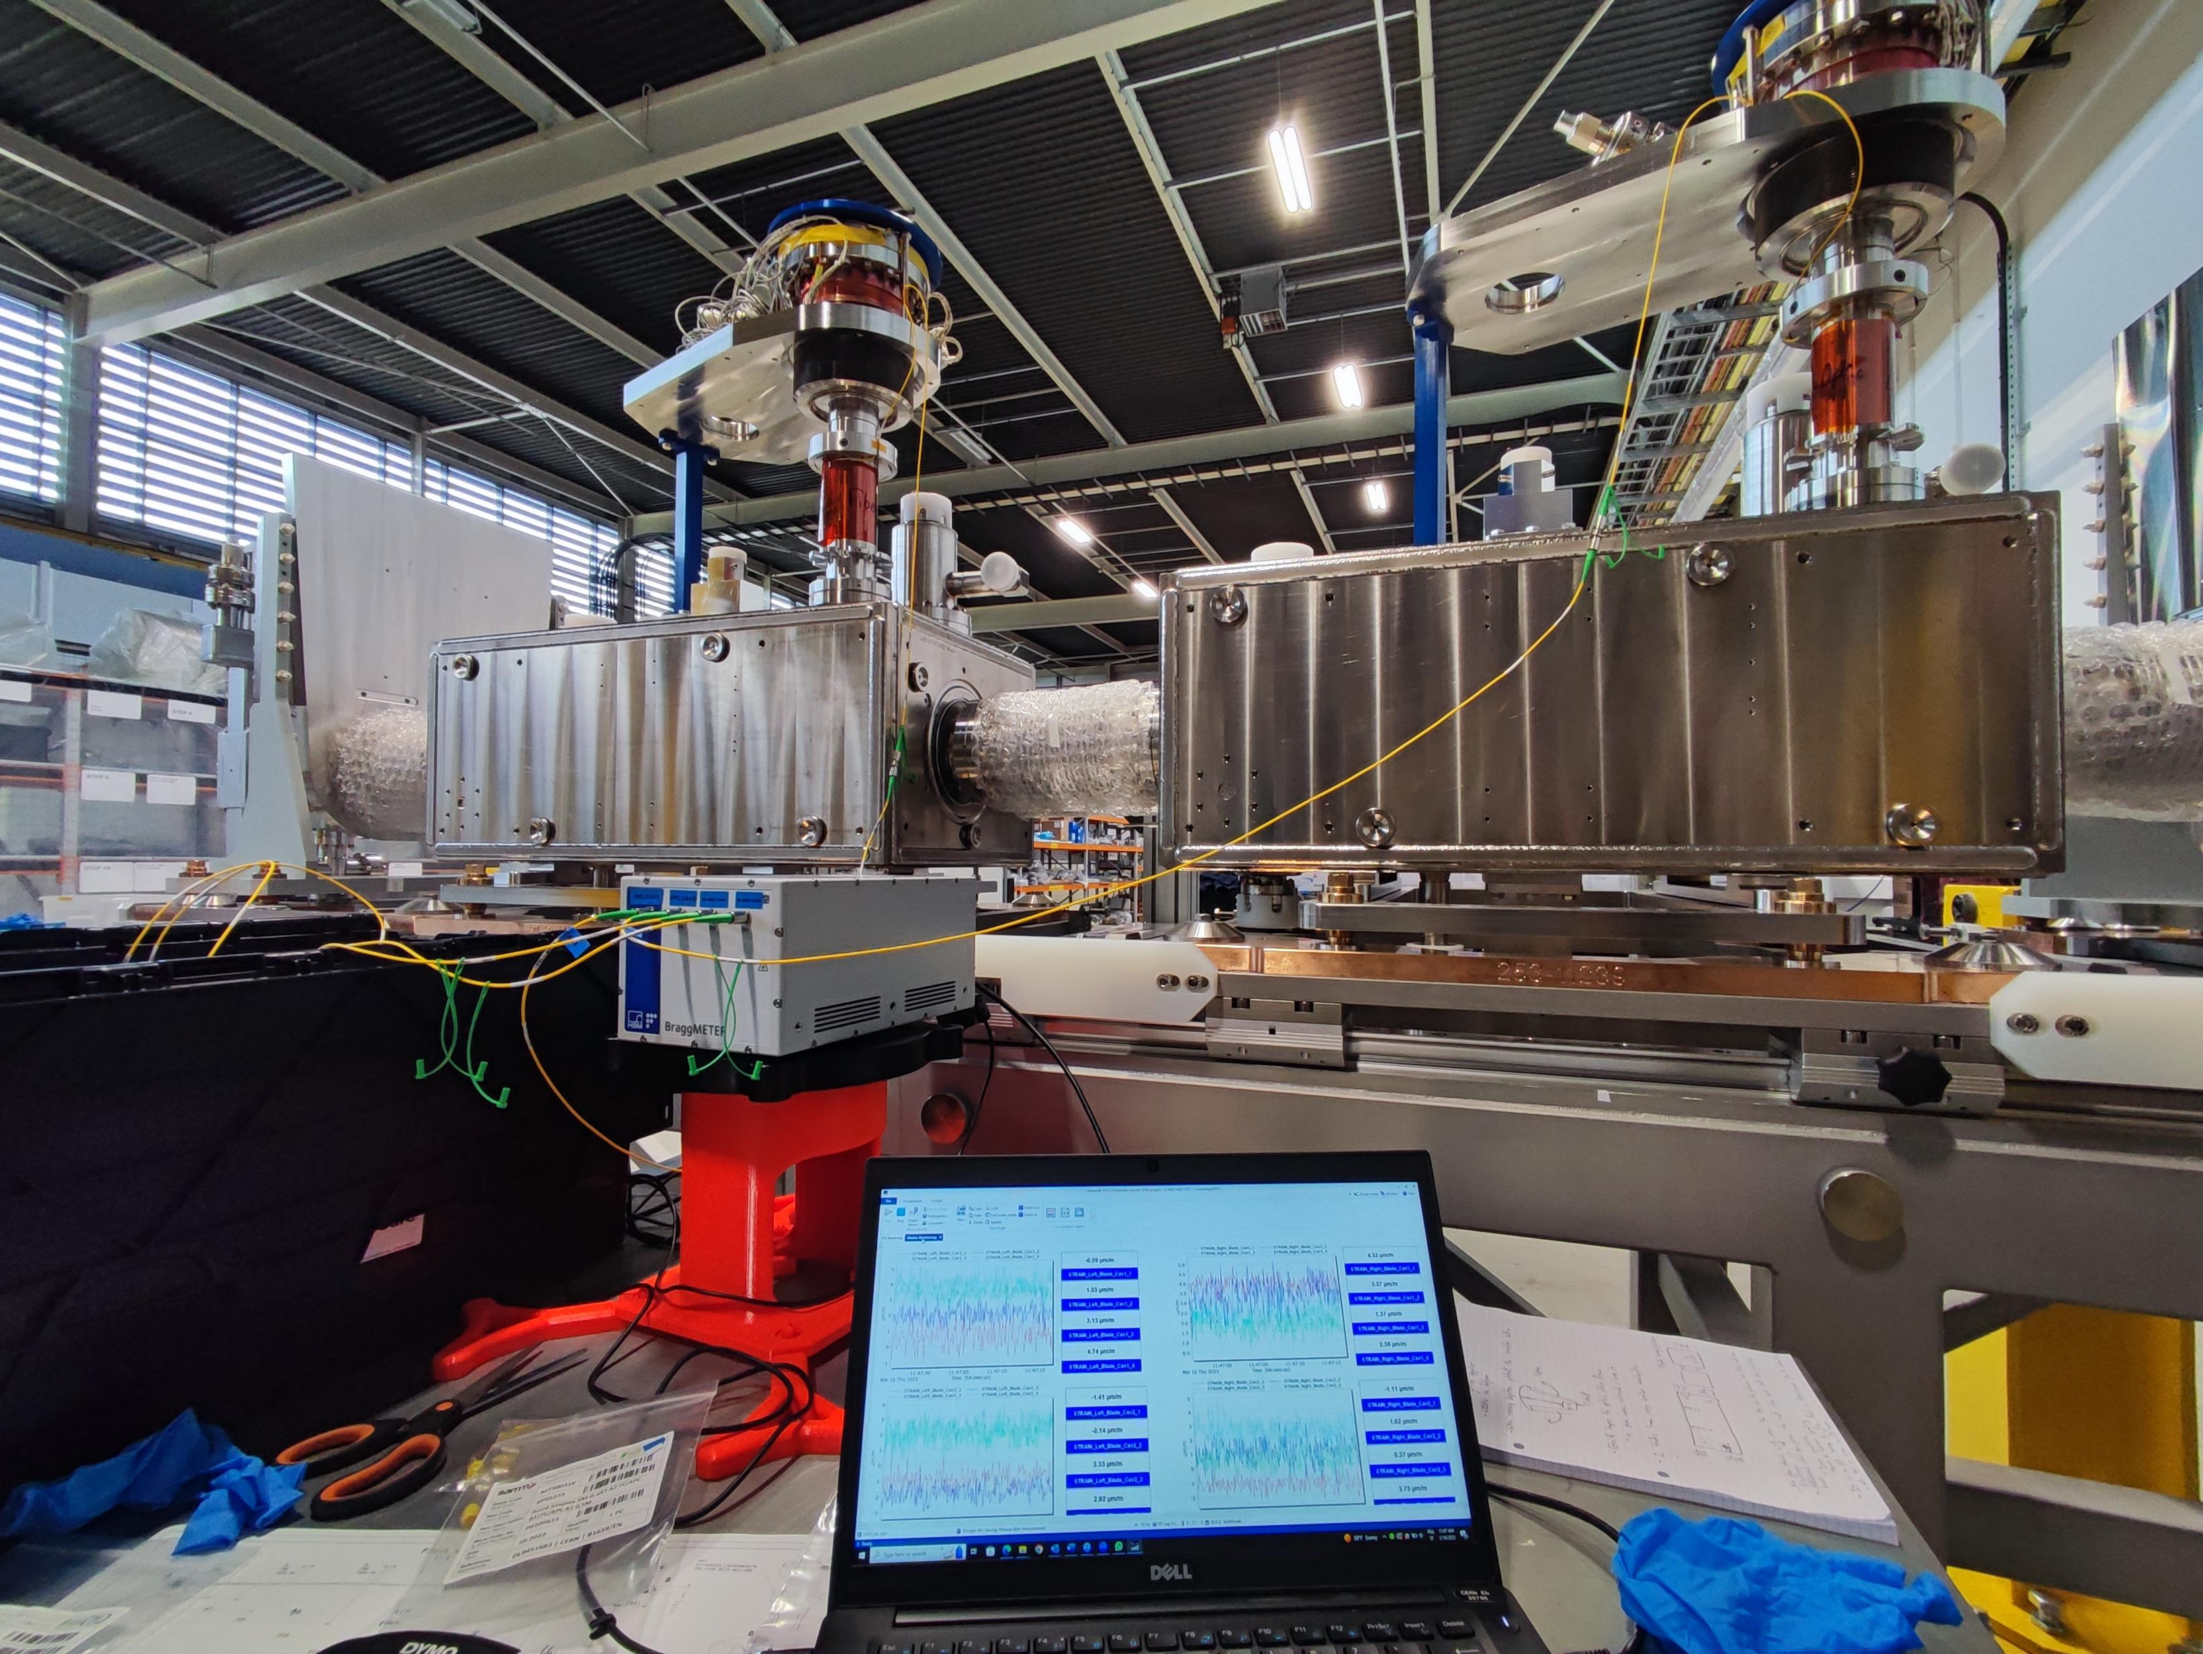
Ongoing and future activities
Cryomodule RFD UKCM2 : Optical connections at STFC (in 2 weeks) EDMS#3286571
Activities expected from the 8th to 10th October :
Optical connections between blades, FPC tubes and the optical feedthrough;
Optical checks and DAQ connections;
Real time monitoring from this date ;
Transfer to the top plate to be monitored,

Slide 15
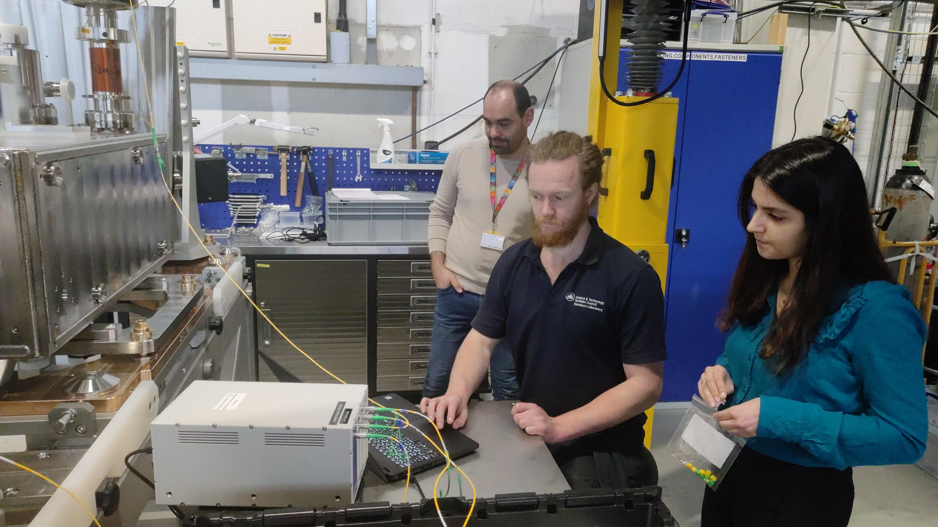
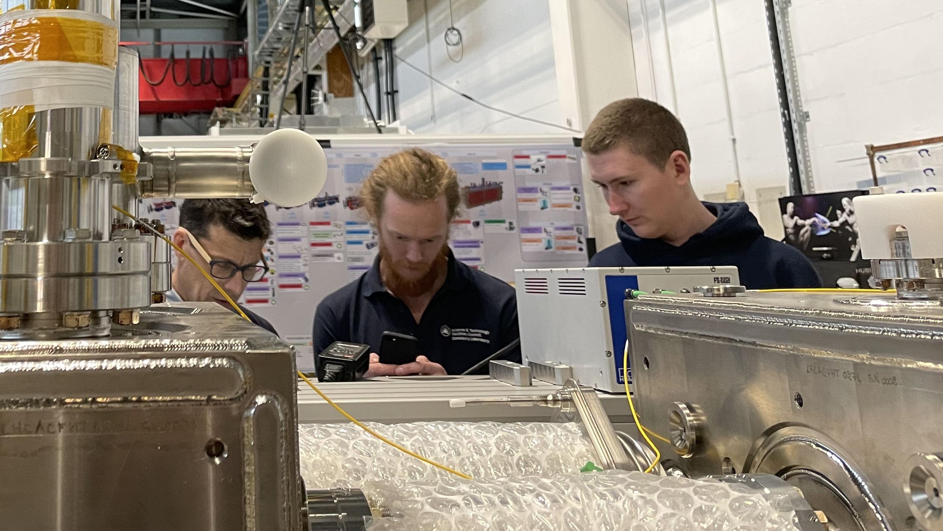
Summary
Continuous collaboration and training with local experts are essential to support our activities remotely.
Internal instrumentation based on optical fibres is valuable not only for transport and operations, but also, during assembly phases : → Optical instrumentation should remain connected most of the time !

Slide 16
Thank you !

