Slide 1
UK cryoline manufacture inspection, test experience, and lessons learnt
Carlos Granjeiro and Andrew Blackett-May
15th HL-LHC Collaboration Meeting – CERN – 1st October 2025
Notes:
Technical progress:
Milestones and Deliverables updates:
Staffing:
Budget:
Highlights: (Publications, results, awards etc):
Issues:

Slide 2
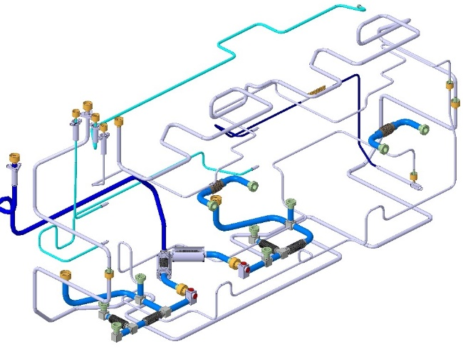
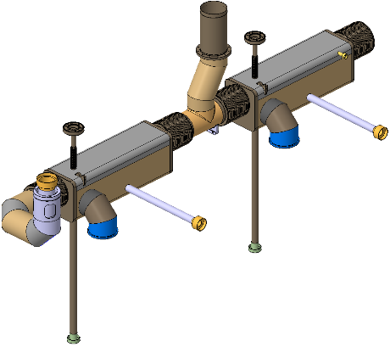
Cryolines Procurement Overview
Following lessons learnt exercise on RFD prototype build, two key decisions made:
Raw materials and bellows procurement would be decoupled from cryoline fabrication and managed by STFC+CERN (free issued to manufactures)
Fabrication split in two: Biphase Line (most complex), and the remaining Cryogenic Lines.
Design: CERN Design: CERN
Procurement: STFC Procurement: STFC
Manufacture: Hyde Manufacture: Fieldhouse

Slide 3
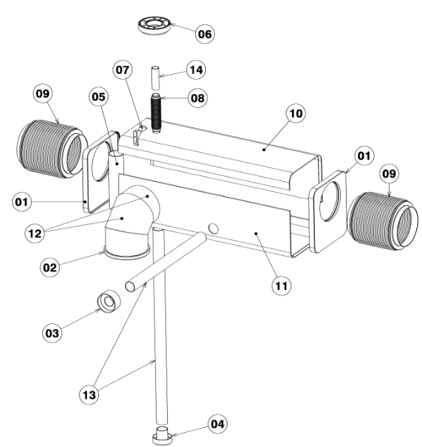
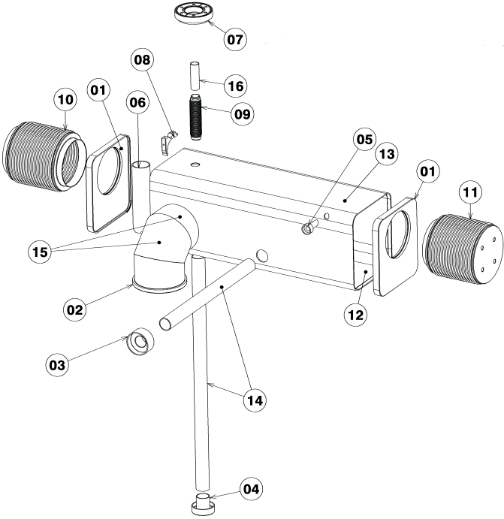
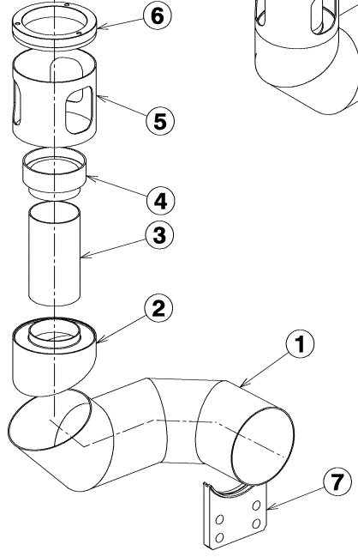
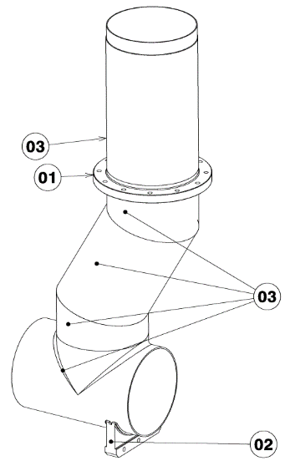

Biphase Cryoline Procurement
First contract awarded for 1off fabrication (CM2)
Subcomponents and pipes free-issued
Material traceability managed by STFC+CERN
Drawing pack and engineering specification provided to vendor

Slide 4
Hyde Scope
MIP (ITP)
All weld documentation
Production drawings
Machining of remaining sub-parts from free-issued material (pipes)
Parts Cleaning (procedure and operation)
Welding Operations
NDT Inspections
Leak testing
Pressure testing
Tooling design
STFC

Slide 5
Timeline for First Biphase
Contract awarded June 2024
Period of documentation/procedure development, multiple rounds of feedback July-Nov 2024
Fabrication started Jan 2025, expected delivery March 2025 (3 month build per Gantt chart)
Delays due to:
Failed leak test of box end + D132 bellows
Tube seam weld repair
Bottleneck in metrology
Complex weld shrinkage leading to metrology NCs; review + corrective actions
Delivered July 2025, overall STFC and CERN happy with quality, review held, and order placed for remaining 3 lines with same supplier Sept 2025
5 NCRs, managed, detailed later in slides
(Next biphase line needed Dec 2025 (CM3), so we need to move quickly, especially regarding weld shrinkage evaluation)

Slide 6
Documentation and Procedures
MIP
Complex, developed collaboratively, many rounds of feedback!
v.13 released before starting to cut metal
Minor revisions for next 3 biphase lines following lessons learnt
Weld documentation
Filler material certs, WPQRs, WQTCs, production schedules all agreed and released before work started
WPSs and weld books draft versions approved before welding, completed versions after fabrication
To be reused for next 3 biphase lines
Cleaning procedures
HYDE/FW/SOP/004 Issue 1 + data sheets reviewed + approved before work started
To be reused for next 3 biphase lines

Slide 7
Deviation Requests
(EDMS 3197343) Single request for biphase lines, re Hyde’s RT qualifications to EN ISO 9712 to be accepted by CERN in lieu of BS EN 4179
Request written by STFC, reviewed + accepted by CERN (scope extended to cover CM3-5 following award of contract for next 3 lines)

Slide 8
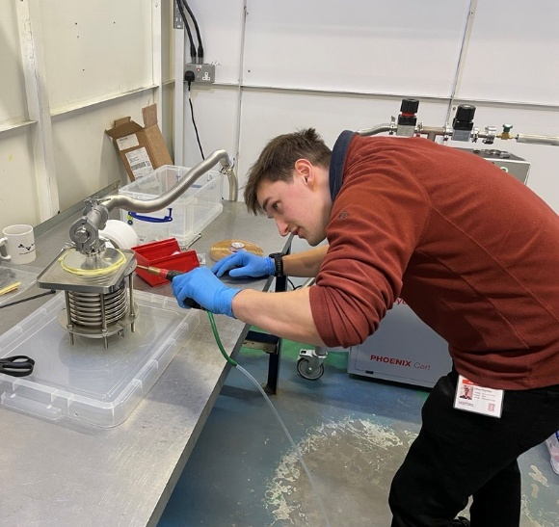
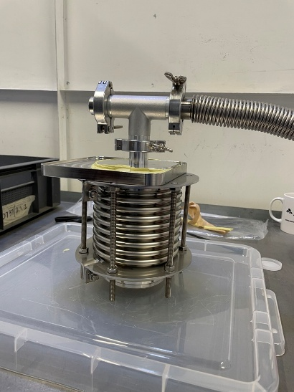
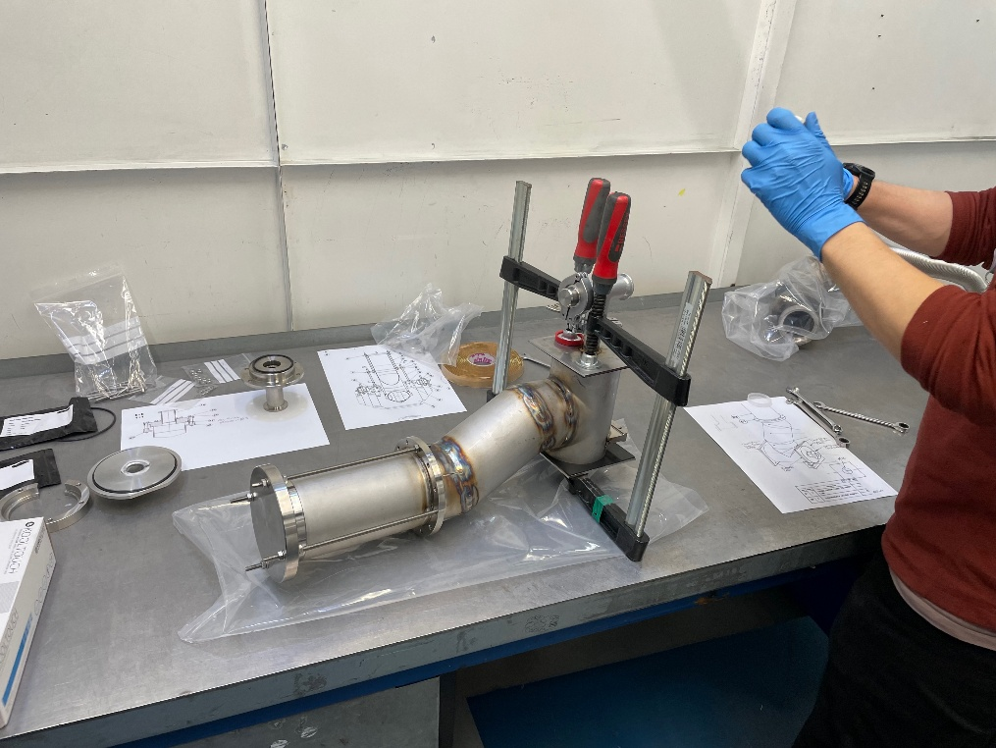
Leak Testing
Hyde didn’t have capability at start of project
STFC agreed to support leak testing, done in batches:
4off biphase box end + D132 bellows (3/4 passed) on 30th Jan
(replacement set) on 13th Feb – passed
Jumper and Safety Tee 6th March
Jumper repeat after hot pass to correct concentricity issue 28th March
Final assembly 14th and 15th July at Hyde
Again, post-pressure test at DL on 18th July
Carried out by various combinations of Stuart, Ollie, Liam, and Andy from STFC – huge thanks to all
Expectation is to use same procedures and tooling for CM3-5, and to carry out in batches to make best use of STFC visits and then final individually 1x at Hyde and 1x at STFC post-pressure test, but only if ok for CM3 build schedule

Slide 9
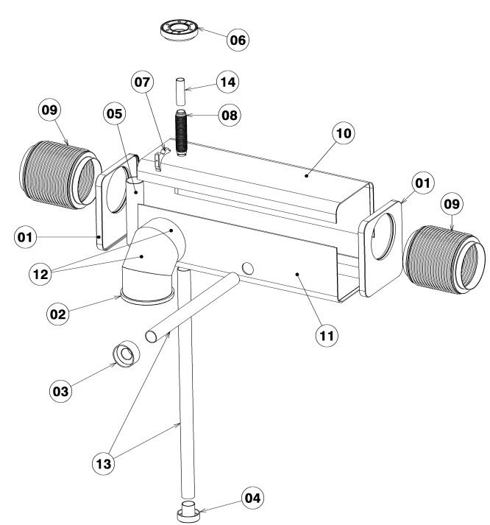

NCR – Weld Leak on Biphase Box End + D132 Bellow
Weld between box end and bellows inaccessible for repair following box build
MIP written to include leak test here to allow repair/replacement if needed
Weld leaked
Quickly identified by leak test (MIP did its job)
Root cause (Excessive gap prior to weld) quickly identified
Spare parts free issued quickly to Hyde, welded with gap adjusted, successfully passed leak test
EDMS 3231017

Slide 10
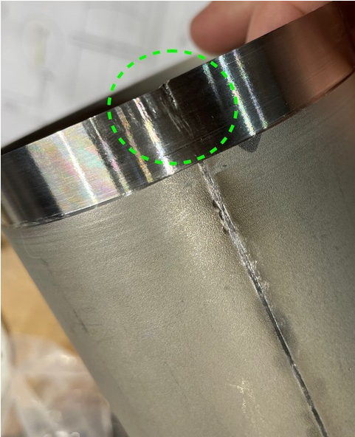
NCR - Tube Seam Weld
Safety extension includes D103/100 tube, free issued by CERN to Hyde
Weld defect apparent after machining of step in tube – Hyde inspector flagged, quickly communicated to STFC
Weld repaired at Hyde, controlled by VT+RT, minimal delay
For the remaining 3 biphase cryolines, >5 mm overlength shall be removed from any seam-welded tubing
EDMS 3231330

Slide 11
NCR - weld shrinkage and dimensional issues
Most significant issue during build, caused longest delay and most extra work
Metrology identified dimensional NCs due to weld shrinkage on box 1, box 2, jumper, and safety tee, flagged before final integration welds (MIP did its job)
Huge thanks to Julien Dequaire for his quick analysis and detailed corrective action plan – luckily it was possible to add compensating parts and make changes to the relative positions of boxes to be welded so – whilst this did cause significant delay to the delivery – the subassemblies were all usable
Preventive actions:
Reviewed with Hyde, revised weld shrinkage allowances (overlengths and compensating angles) to be accounted for in future builds
Also proposed to prepare samples to validate these shrinkage calculations; as 3 further biphase lines are required, it is proposed to weld the assemblies in series with metrology checks to confirm dimensional compliance before proceeding to the next
EDMS 3245144

Slide 12
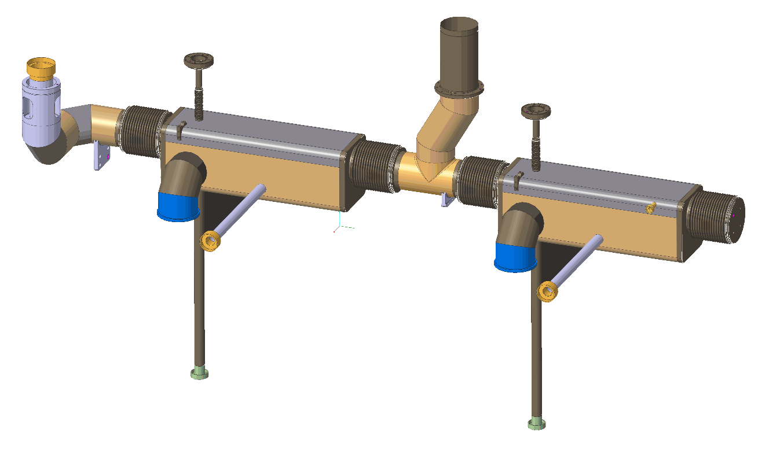
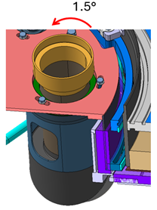
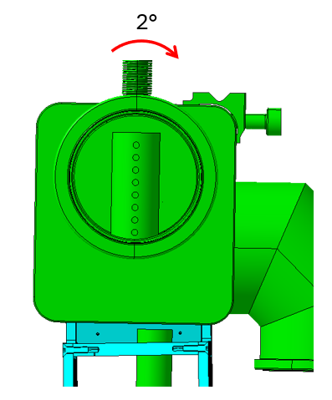
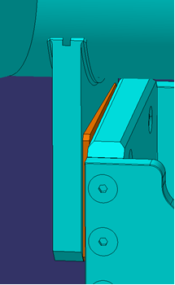
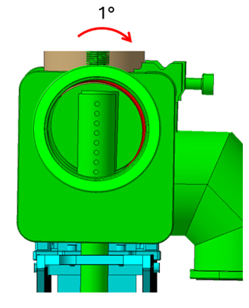
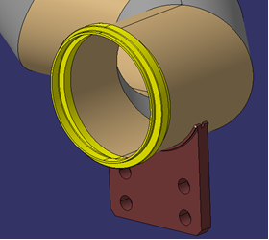
NCR - weld shrinkage and dimensional issues
21st May 2025: First detailed correction plan
Jumper Interface
#2 Box Orientation
#1 Box Orientation
Spacer Wedge
Adaptor Piece

Slide 13
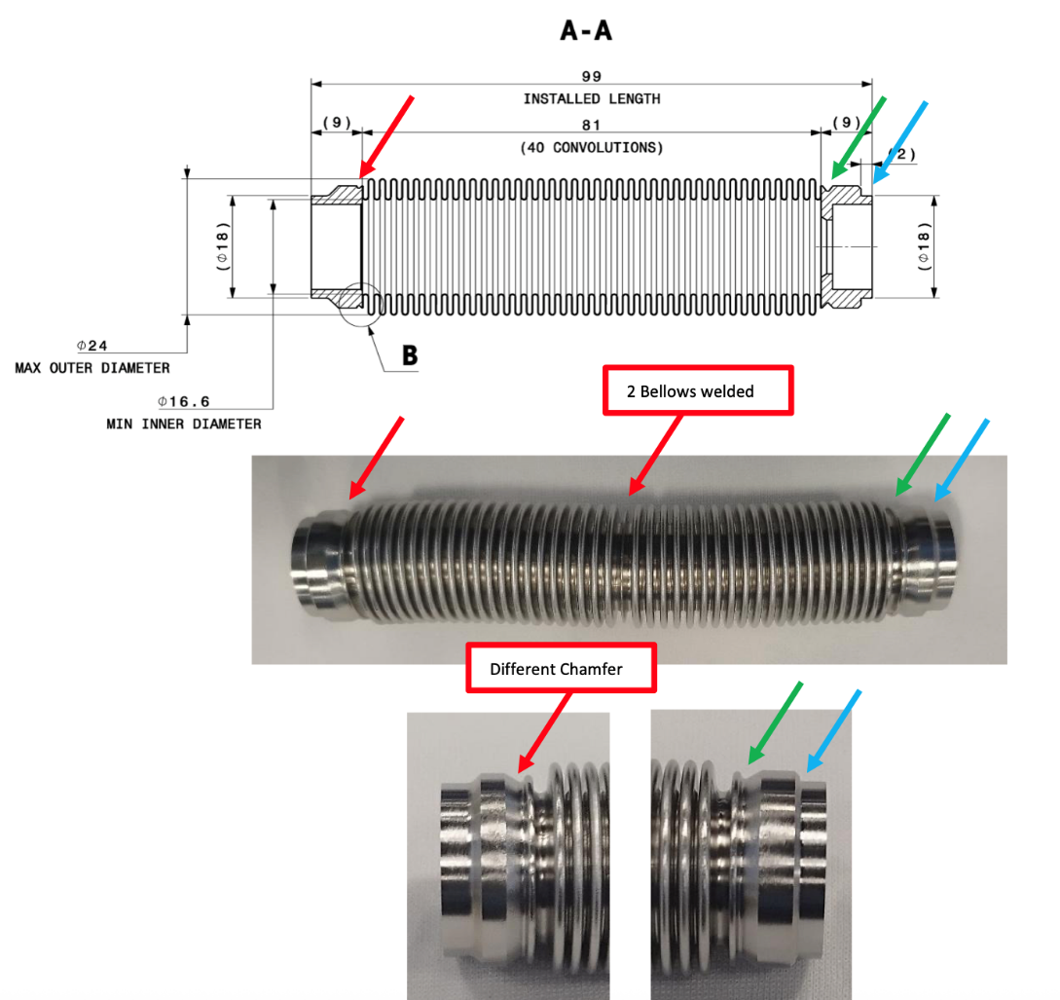
NCR - Level Port Bellows
Level port bellows welded upside down
Subtle but noticeable difference in ends of bellows
Possibly further complicated by the fact that supplied bellows differed from drawing
MIP to be revised to ensure this doesn’t reoccur for future builds (need to add inspection step)
Can be accepted for CM2, although modifications to tooling and level probe required
EDMS 3331046

Slide 14
Other Lessons Learnt
NDT reported as passed by Hyde, but reports delivered late. The increased risk of integration was accepted by STFC due to schedule constraints.
Feedback from CERN forwarded to Hyde, reports to be supplied at point of delivery for next 3 lines
Line arrived at STFC with some fasteners found to be loose, some positioning studs not fully engaged. Fortunately, no consequences, however, a transport plan was requested from Hyde for shipping of next 3 biphase lines and will be review by STFC+CERN

Slide 15
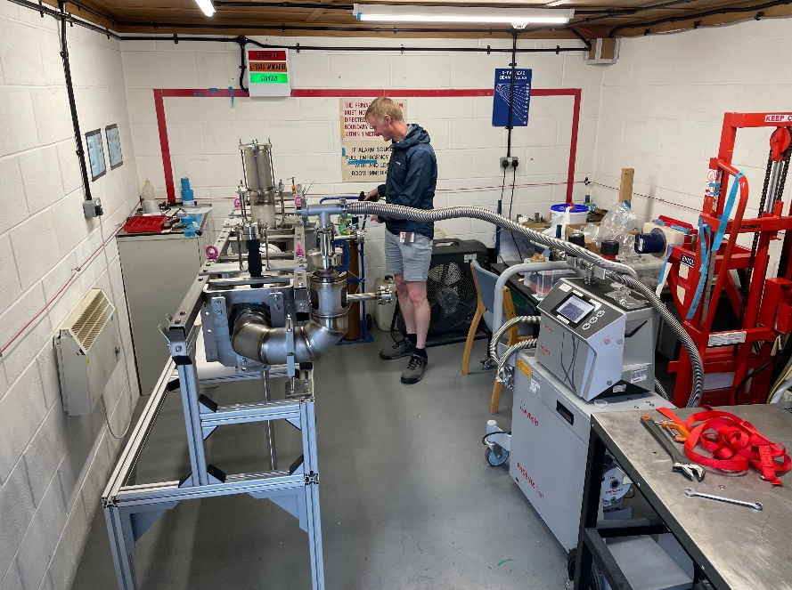
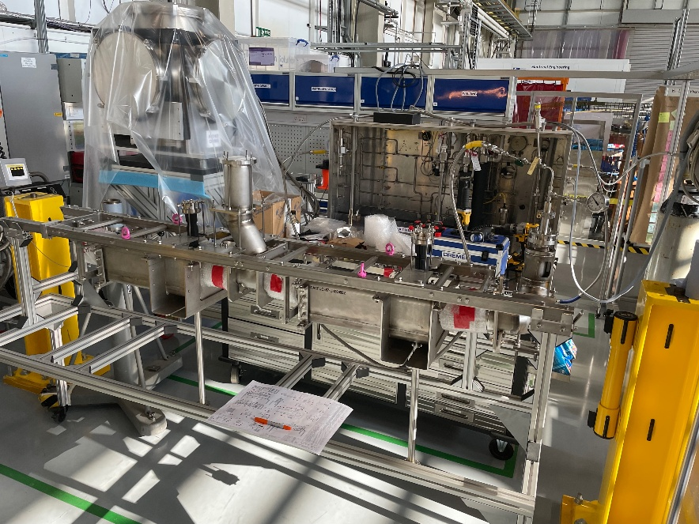
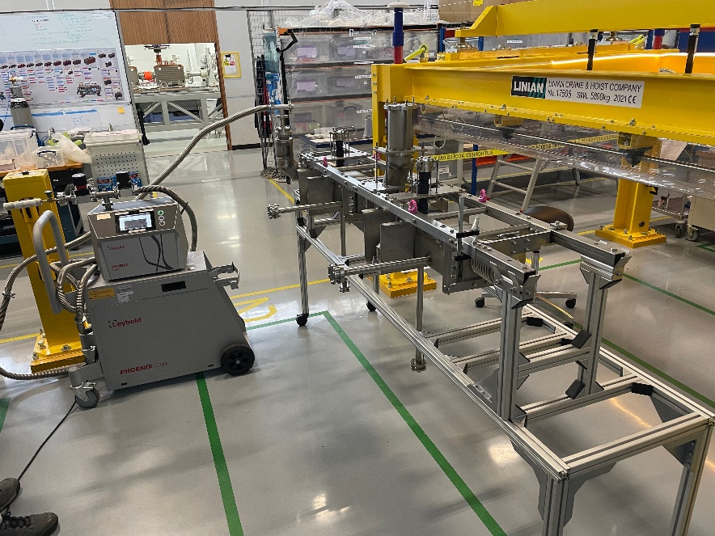
Leak and Pressure Testing of Final Assembly
Hyde managed manufacture and assembly of CERN-designed leak/pressure test tooling design under STFC contract
Hyde didn’t have capability to pressure test assembly of this size. Also risks to manage around bellows restraints
Therefore, agreed that first leak test would be carried out at Hyde by STFC staff, then ship to STFC, pressure test by STFC staff, and then final leak test to verify no issues arisen during shipping or pressure test
Both LTs passed. PT nominally passed, however some pressure drop was seen at test pressure, attributed to leaking fitting to test kit. Pass of subsequent leak test validated tightness of assembly

Slide 16
Biphase Summary
A very challenging fabrication with strict requirements and large amount of documentation
Tight communication throughout build between Hyde+STFC+CERN
Large amount of documentation with multiple revisions managed well - huge thanks to Julien, Myriam, Julien, Luca, Teddy, Claudia, and many other CERN colleagues for the quick and detailed feedback!
Whilst issues were encountered, these were always raised quickly, and team worked cohesively to analyse and resolve
Overall, STFC and CERN happy with experience of build, looking forward to continuing in the same manner for 3 remaining lines
Clear lessons from this fabrication - vital that we learn from these for remaining builds to
minimise NCRs
work efficiently to keep to CM3-5 build schedules

Slide 17

Remaining Cryogenic Lines
Contract awarded for 4 sets of Cryolines
Sub parts and raw materials free-issued
Material traceability managed by STFC+CERN
Drawing pack and engineering specification provided to vendor
Contract awarded to FEng after competitive process

Slide 18
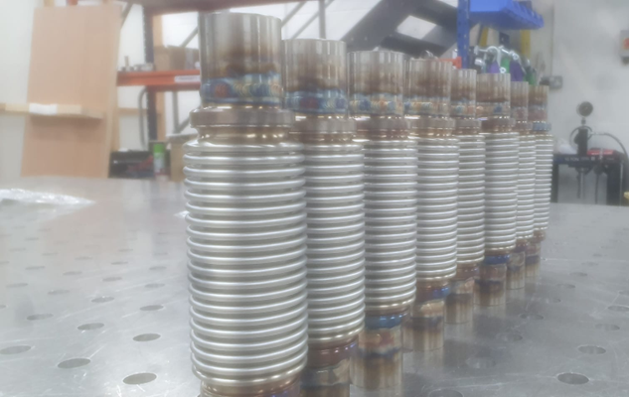
FEng scope
MIPs
All weld documentation
Production drawings
Machining of sub-parts from free-issued material
Parts cleaning (procedure and operation)
Welding operations
NDT
Leak testing
Pressure testing
Tooling design and production

Slide 19
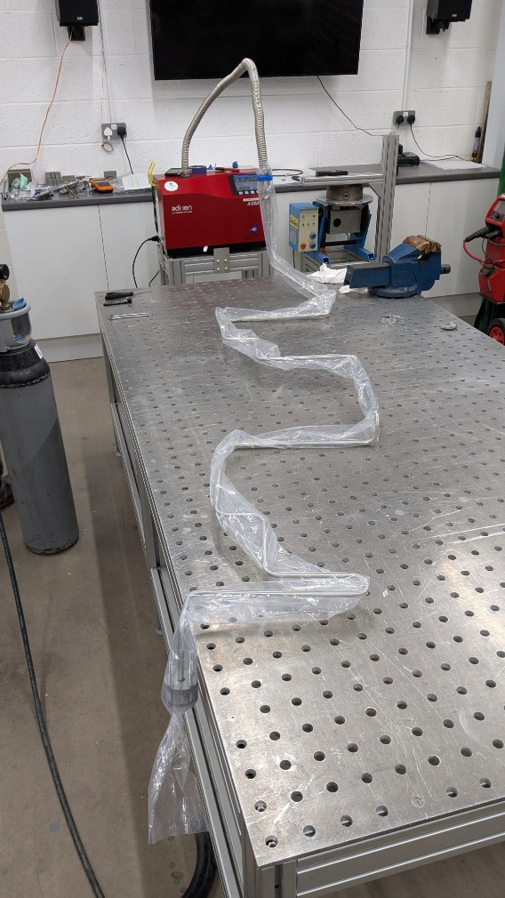
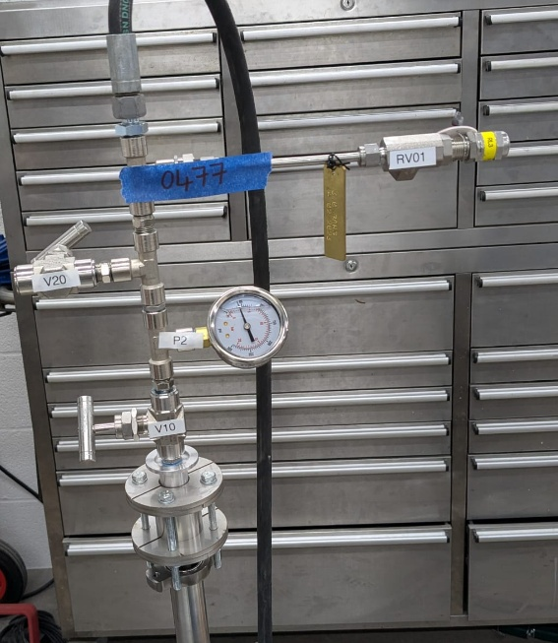
Timeline
CM2 cryolines split into two batches
Production organized into 2 groups/batches
CM3-5 cryolines delivered as complete sets
Same organization
STFC (Andy) performed a site visit in Jan 2025
Delays?
CM2 delivered in 14-02-2025 (1st Group)
CM2 delivered in 09-06-2025 (2nd Group)
CM3/4/5 1st Group Awaiting Leak and Pressure Testing after NDT reports approval
CM3/4/5 2nd Group ready for NDT inspection
Full delivery expected within 1 Month (late October)

Slide 20
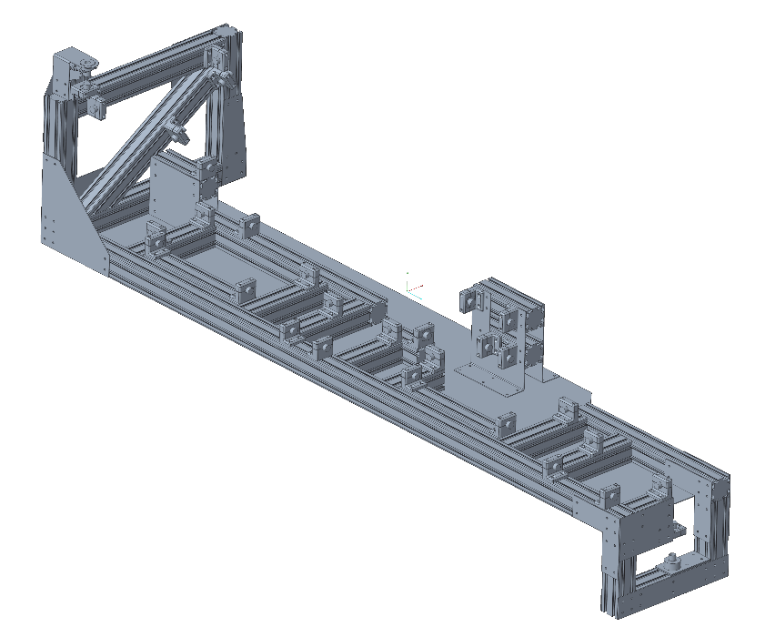
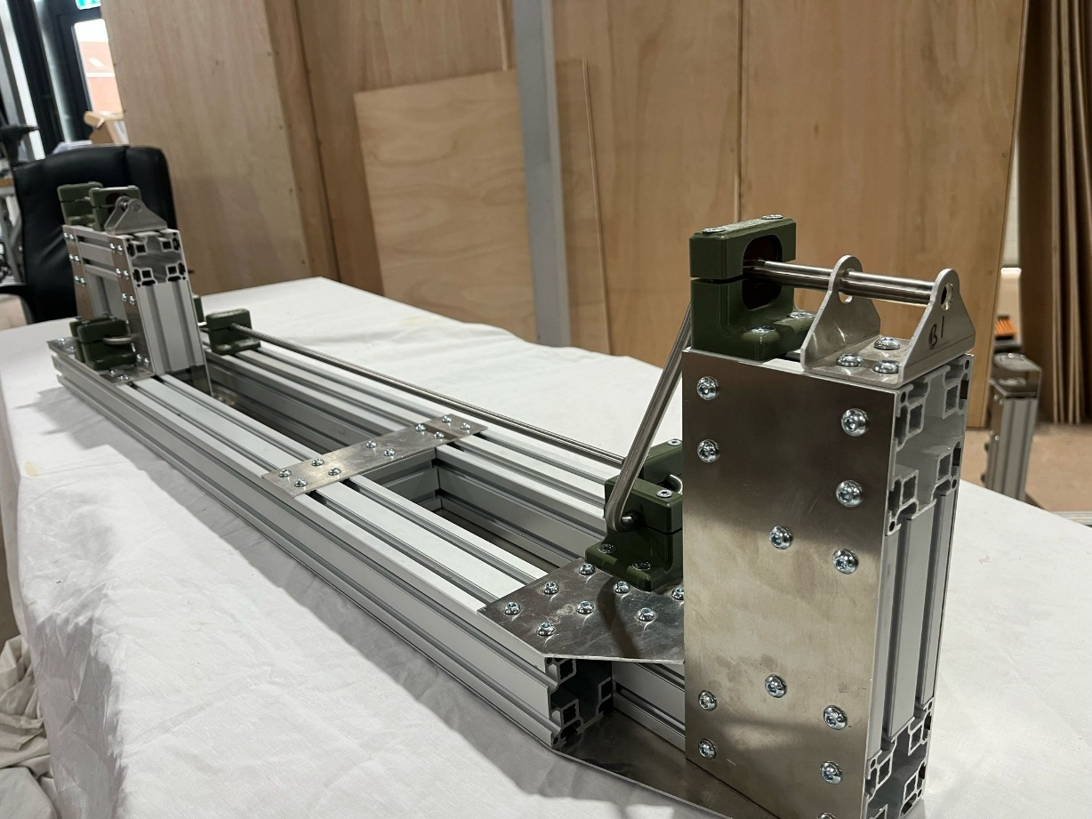
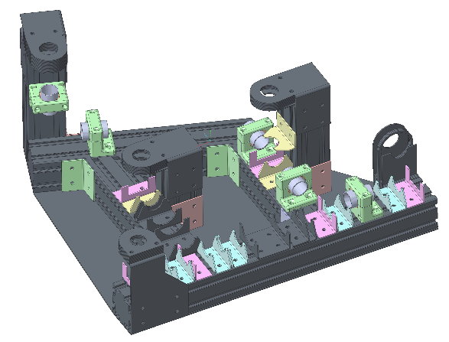
Metrology
A Metrology Check solution developed by Fieldhouse using Jigs serving as a go-nogo for the lines (only the jigs were measured).

Slide 21
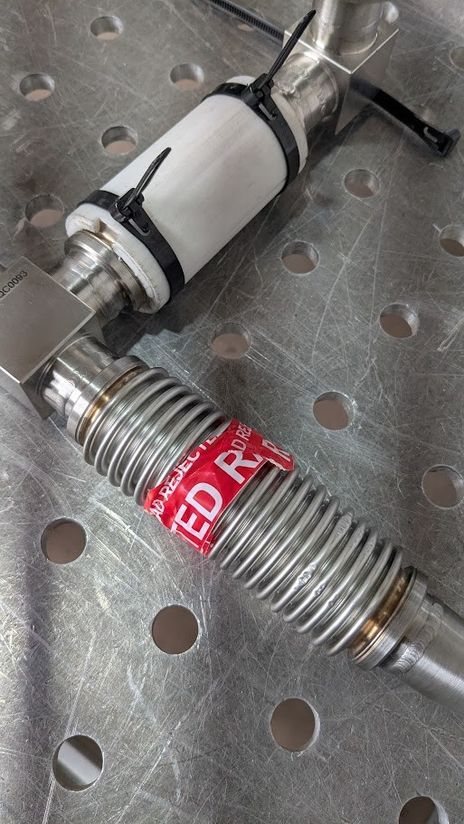
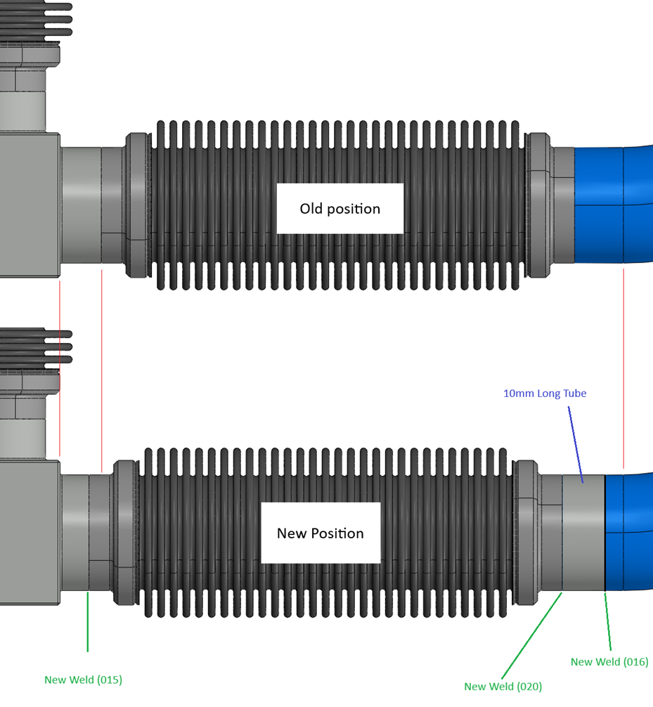
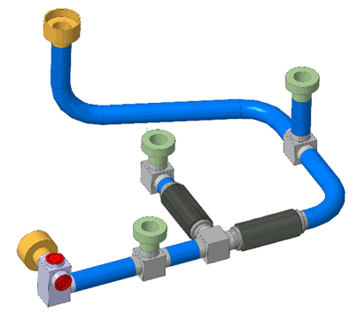
NCRs
1 NCR: Damaged bellow by NDT company
HCACFQC436-UK000005
Bellow position shifted to avoid welding the same area

Slide 22
Summary and lessons
All documentation approved before beginning of production
Not enough tube length spare
Documentation for the first lines for CM2 lagged creating issues for the correct approval and traceability.
Low number of problems encountered during fabrication.

Slide 23
Questions?

