Slide 1


Mitigation strategies tested: what can be done at HL-LHC?
B. Lindström, R. Bruce, A. Donadon, S. Gibson, A. Keyken, S. Redaelli, F. Van der Veken
Thanks to: J. Boyd, S. Ilieva, S. Fartoukh, M. Hostettler, M. Solfaroli, J. Wenninger, C. Young
15th HL-LHC Collaboration Meeting, Geneva 2025

Slide 2
Introduction
FASER & SND: forward physics experiments on ATLAS line of sight
Muon background issues:
Saturates emulsion films → limits data taking
Frequent emulsion replacement → affects beam operation and other experiments
Reducing muon background highly desirable
2024: reversed triplet polarity → unintended increase of high-energy muon flux to SND / FASER
2025: normal polarity + changed xing plane → much lower background than 2024, still higher than 2023
Background campaign launched in 2024 to identify sources and study mitigations

Slide 3
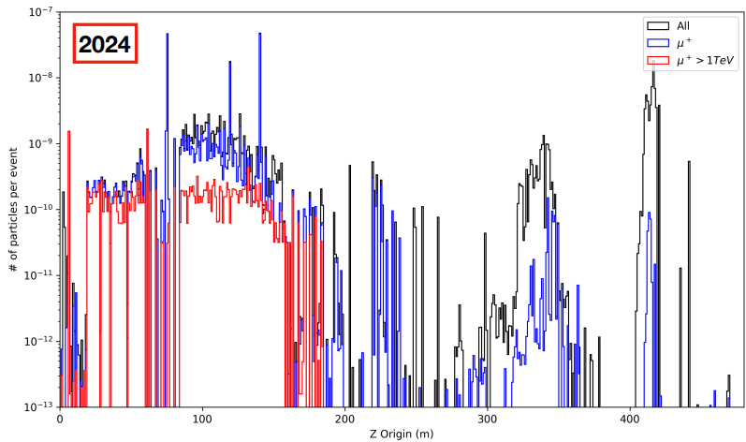
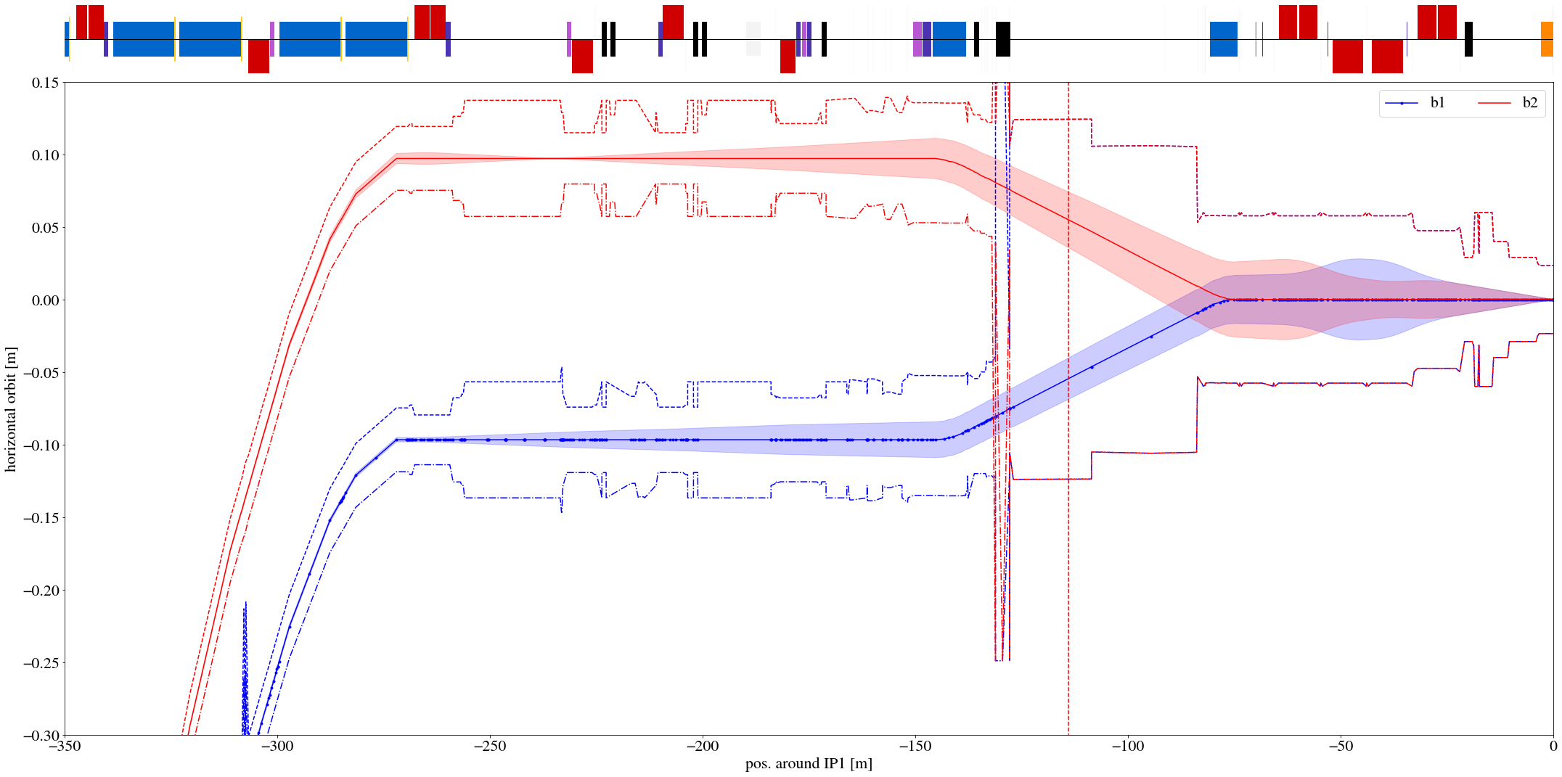
Source of muons
A. Keyken, BDSIM
Low energy muons (<~1 TeV) produced by diffractive protons lost in DS aperture
Increase in 2025 due to cell 11 losses: FLUKA – A. Șerban, LBS#127 (indico.cern.ch/event/1561451)
High energy muons (>~1 TeV) produced upstream of TAN
TCLs
FASER
TAN

Slide 4
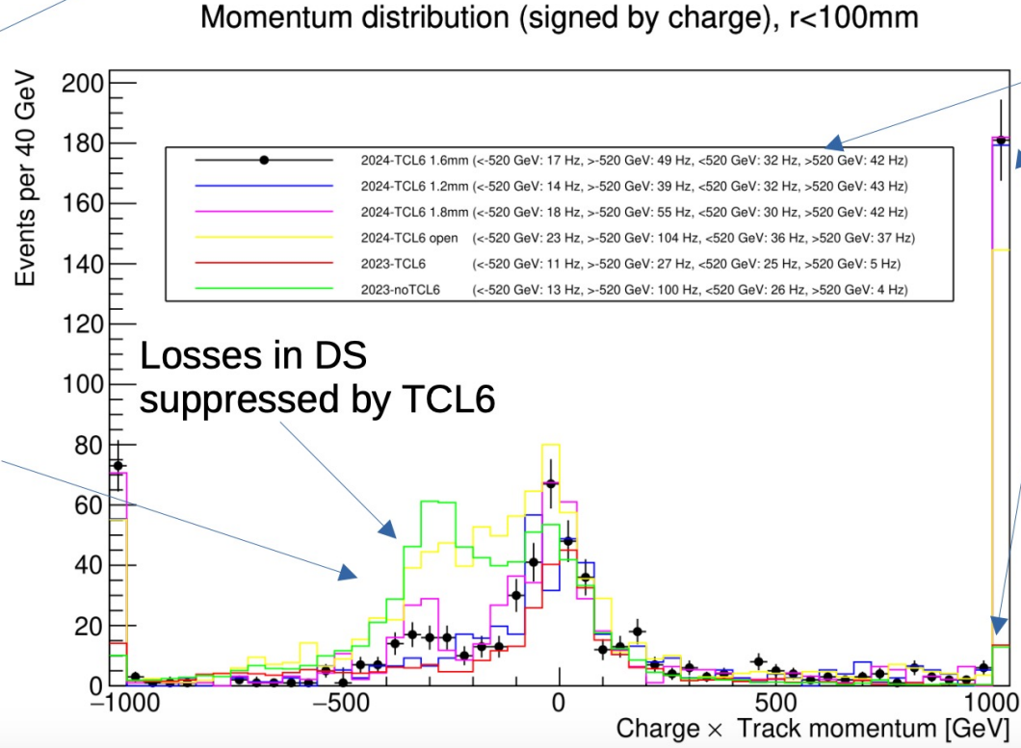
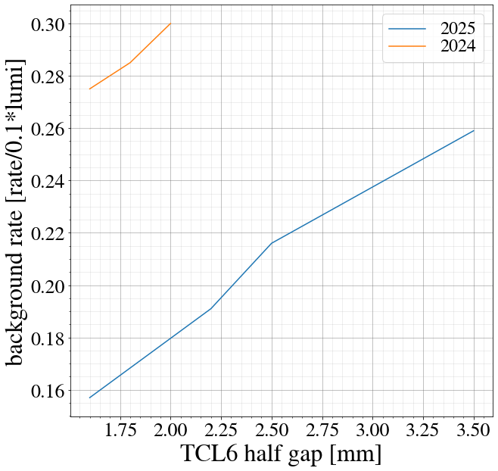
TCL settings
TCL: physics debris collimators, cells 4, 5 and 6 downstream of IP
Both a source of muons and stopper of the muon parent particles
With RP optics, the source effect was dominating
TCL setting has other implications as well:
R2E in the arcs
Local dose rates (roman pots, work in the tunnel)
Collimation hierarchy
Balance needed – in general, tighter is better for SND / FASER
B. Petersen, J. Boyd LBS#124
courtesy of J. Boyd
more data: https://faser-public-plots.app.cern.ch/Figures/TDAQ/FirstData/TCL6.pdf

Slide 5
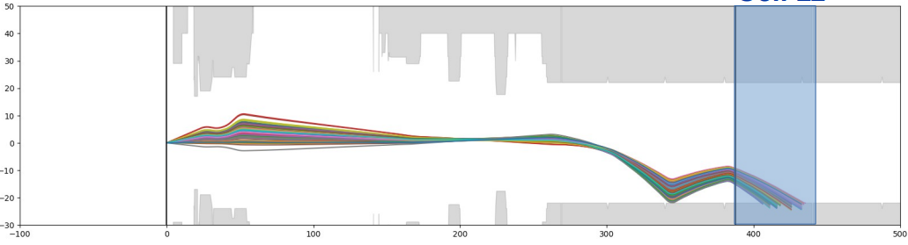
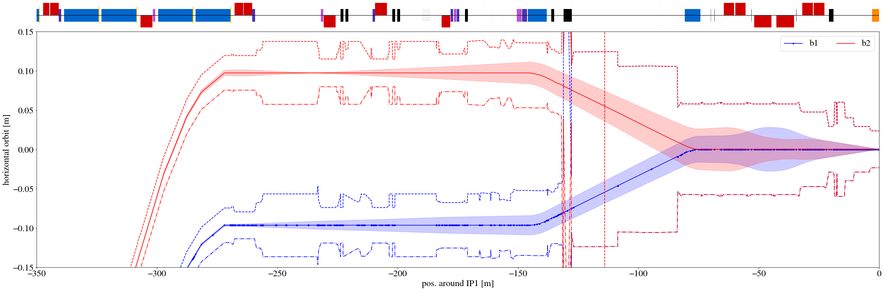
Low energy muons
Adjust TCL settings to intercept protons before they are lost in DS
Due to limited dispersion, unable to intercept all diffractive protons
Displace loss locations of protons in the DS using orbit bumps
Diffractive protons generated by beam-beam interaction in Xcoll-FLUKA (A. Donadon, LBS#129)

Slide 6
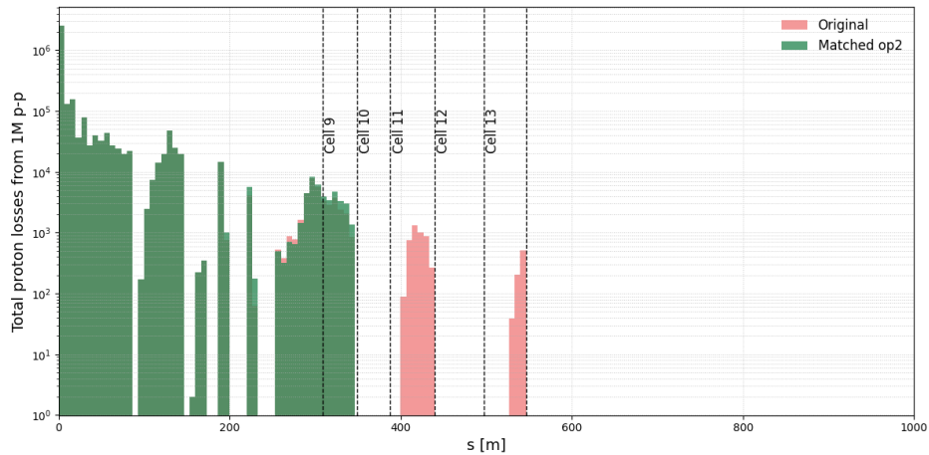
Low energy muons: Orbit bumps
Several bumps investigated to displace losses either upstream or downstream
Used Xsuite to directly optimize the losses in different cells*
Can shift losses upstream and completely remove them from cells 11 / 13
* code example in backup slides

Slide 7
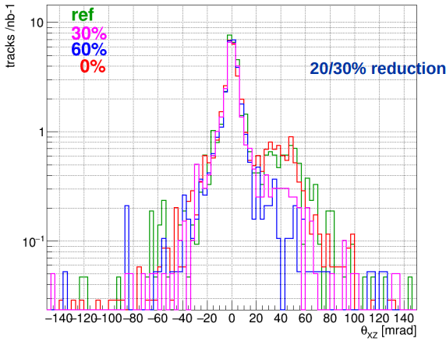
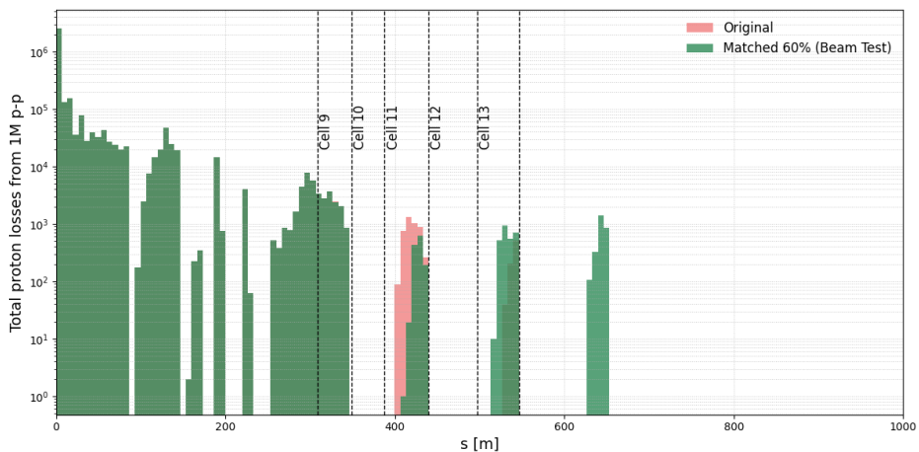
Low energy muons: Orbit bumps
S. Ilieva, LBS#129
Beam test (for SND only) on 20250907
20 % reduction of overall muon rate, 60 % for muons above 10 mrad
Muon spectrum symmetrized – cell 11 source appears cured
Improved bump to be tested for FASER and SND at next opportunity

Slide 8
High energy muons
Produced upstream of TAN – cannot be intercepted
Focused by magnetic lattice onto detector
Mitigation requires optics changes – full 3D simulations and detailed magnet geometries / fields necessary
2024 issue: reverse triplet polarity optics → stronger focusing of µ+ (vs µ- with normal polarity)
µ+ dominate in production
Benchmarking simulations and exploring mitigations:
Xing angle and plane scans
Dedicated orbit bumps to sweep away muons

Slide 9
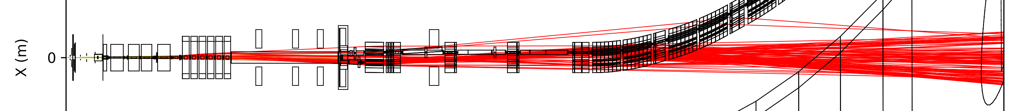
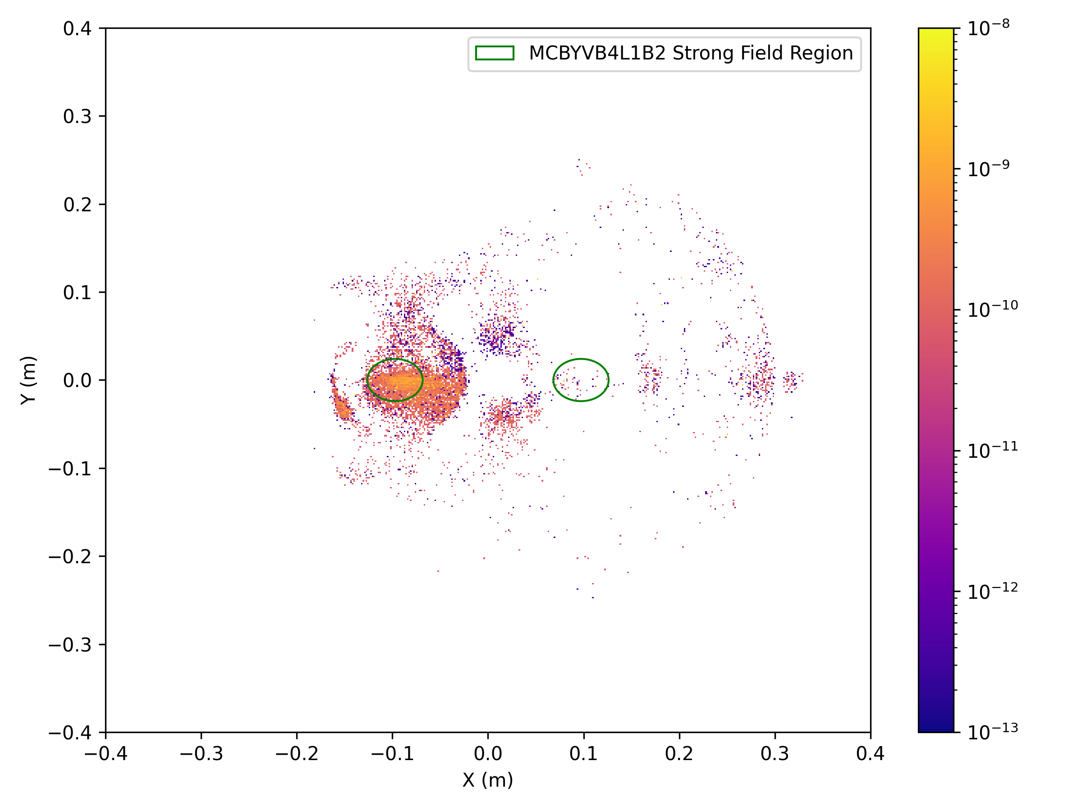
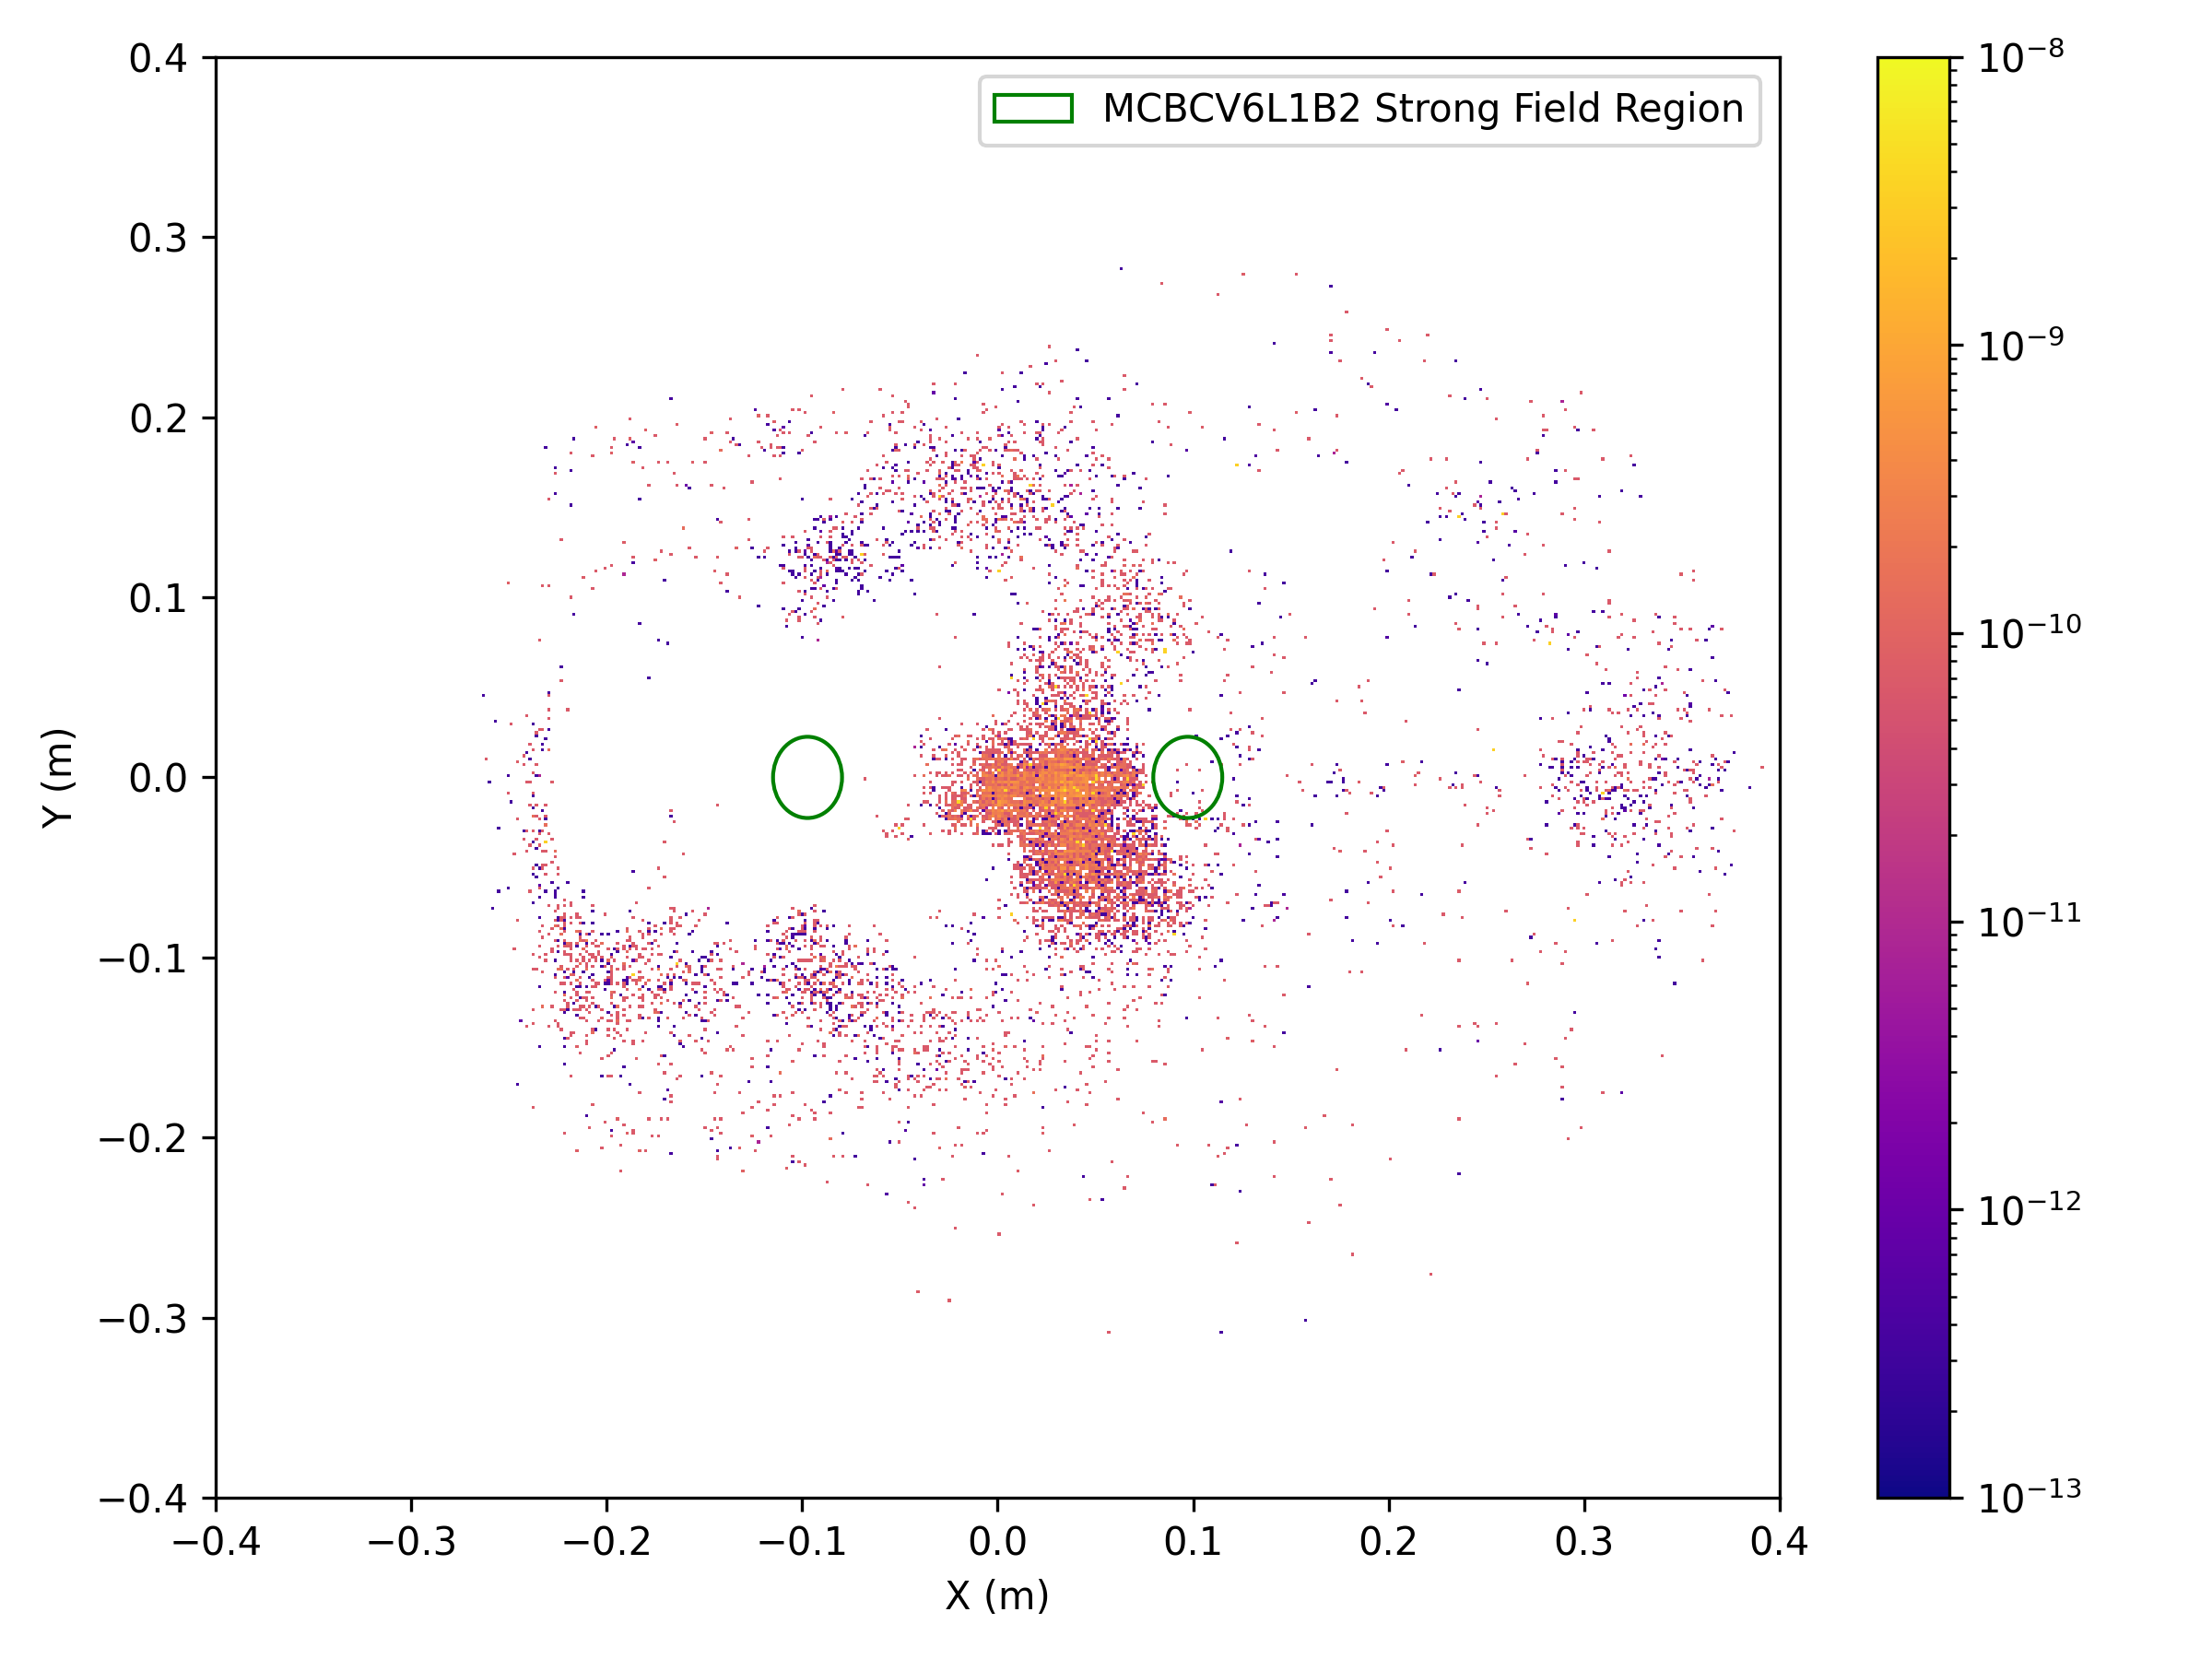
Potential mitigation: first attempt
Tracks of >1TeV pos. muons reaching FASER simulated with BDSIM (A. Keyken)
Vertical orbit corrector
Vertical orbit corrector

Slide 10
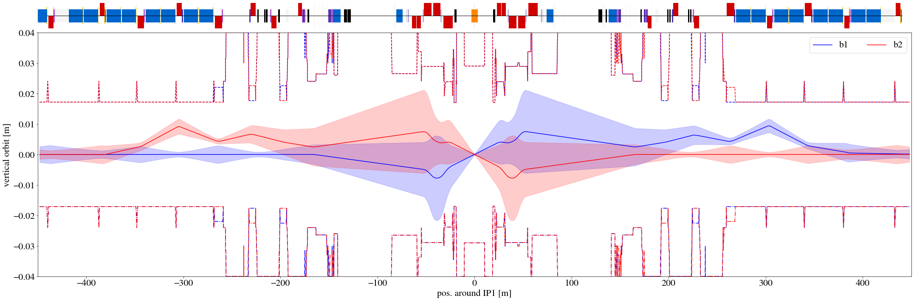
Vertical Orbit Bump (1/2)
Max field (with op. margins) in cell 4 and 6
97 µrad (@ 6.8 TeV) in cell 4 (up to ~21 cm displacement at detector)
9.3 mm peak amplitude (17.4 sigma aperture margin)
A. Keyken
A. Keyken

Slide 11
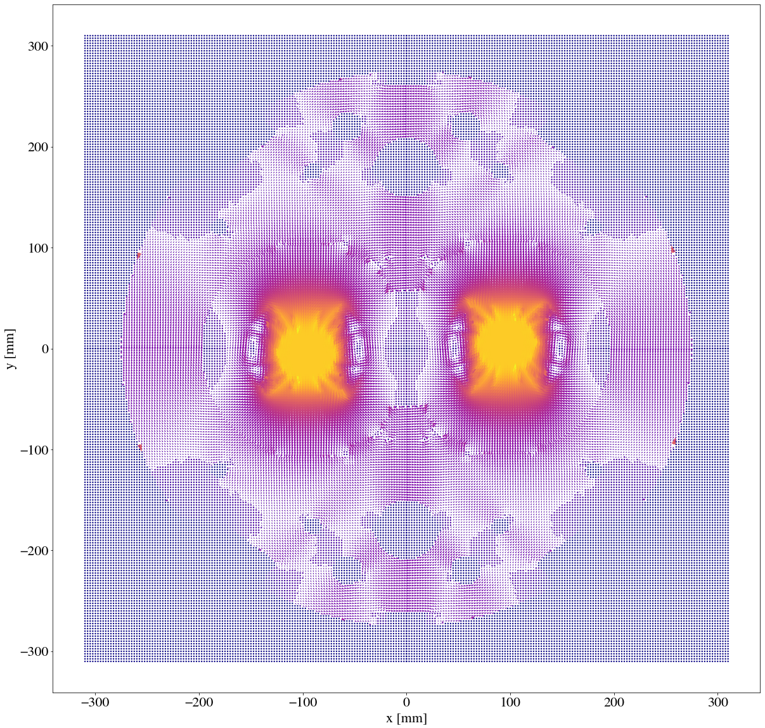
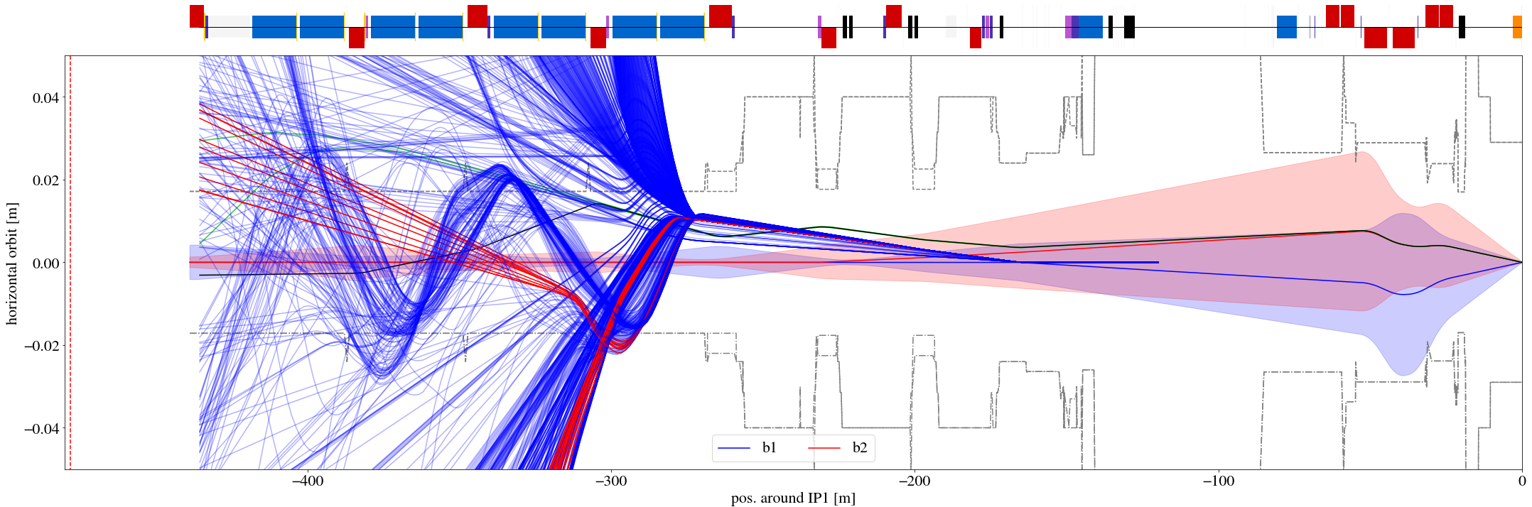
Vertical Orbit Bump (2/2)
No reduction in BDSIM simulations of vertical bump
Yoke field in MB (2 T) focuses vertically
vertical orbit [m]

Slide 12
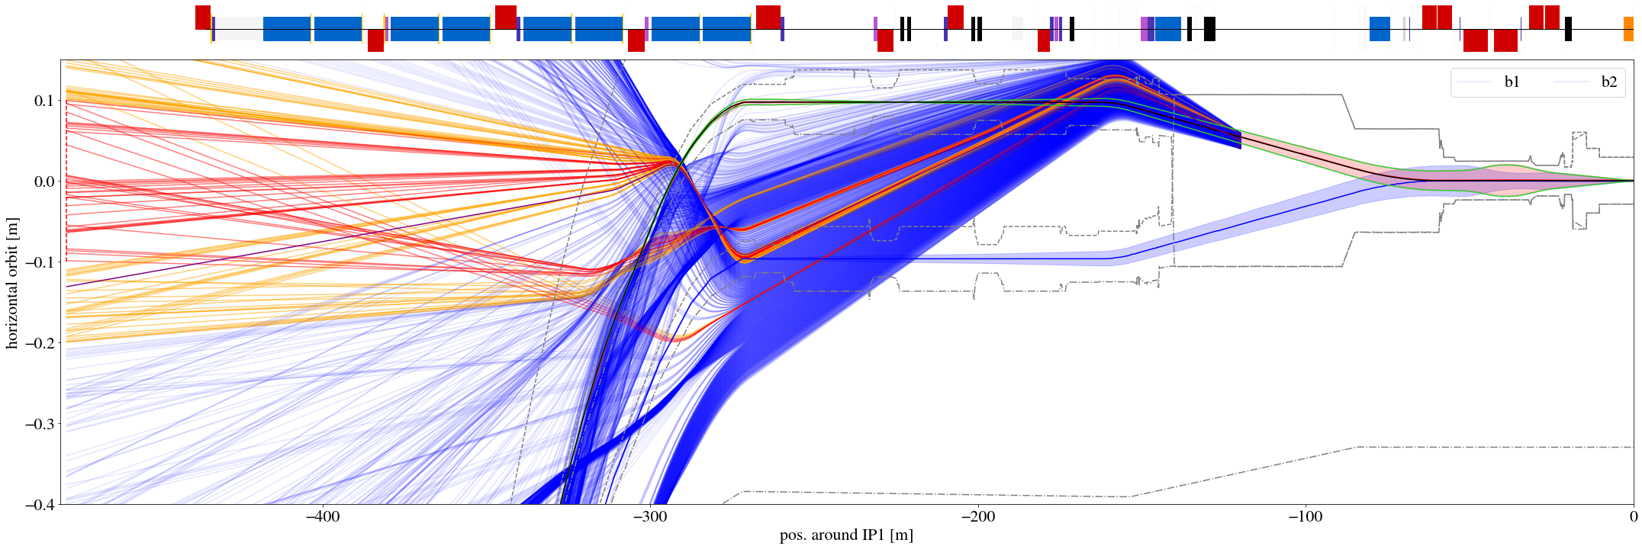
Horizontal Orbit Bump (1/3)
Large cluster of muons enter B1 beampipe and are deflected towards FASER

Slide 13
Horizontal Orbit Bump (2/3)
Large cluster of muons enter B1 beampipe and are deflected towards FASER
Deflect the cluster horizontally instead?

Slide 14
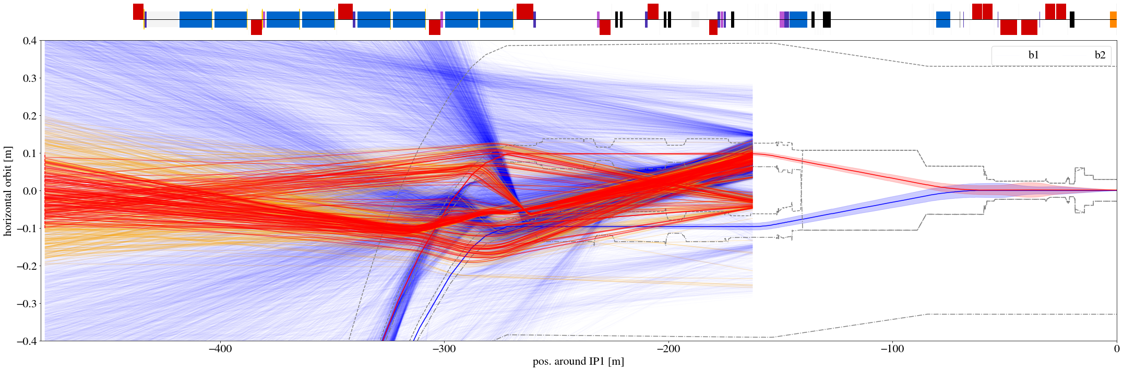
Horizontal Orbit Bump (3/3)
Simple python model for tracking muons through field maps
Useful to gain qualitative understanding
Quick iteration between beam dynamics and full particle-matter simulations → managed to find promising config that could be implemented in the LHC for testing
Final configurations must be simulated by FLUKA or BDSIM

Slide 15
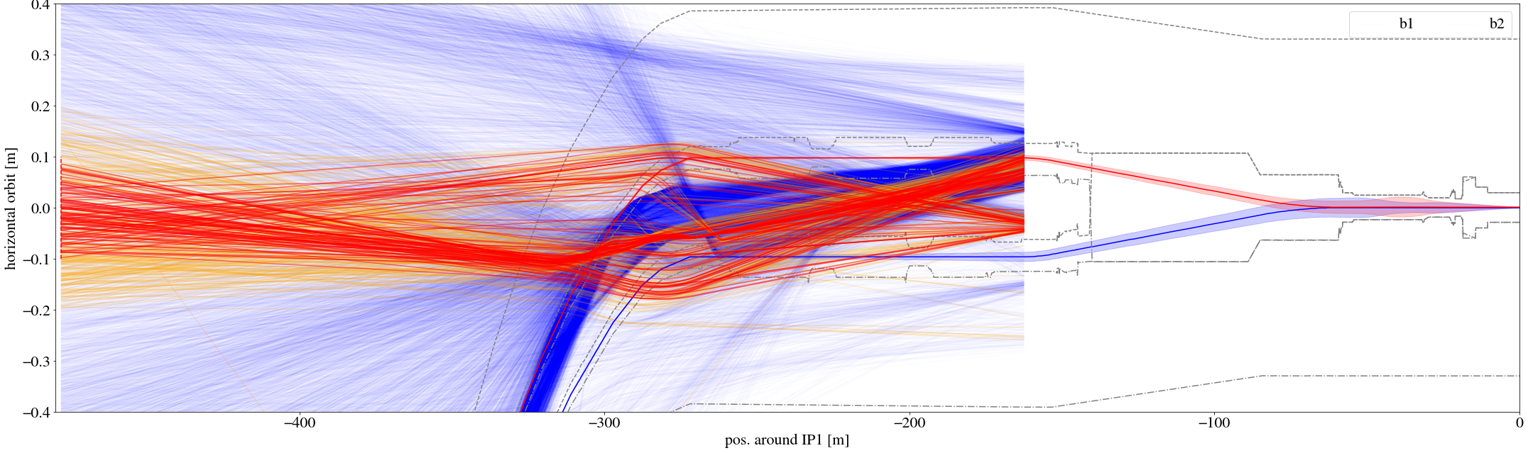
Horizontal Orbit Bump (3/3)
Simple python model for tracking muons through field maps
Useful to gain qualitative understanding
Quick iteration between beam dynamics and full particle-matter simulations → managed to find promising config that could be implemented in the LHC for testing
Final configurations must be simulated by FLUKA or BDSIM
pos. H bump puts muons between MB beam pipes, muons get channeled into arc

Slide 16
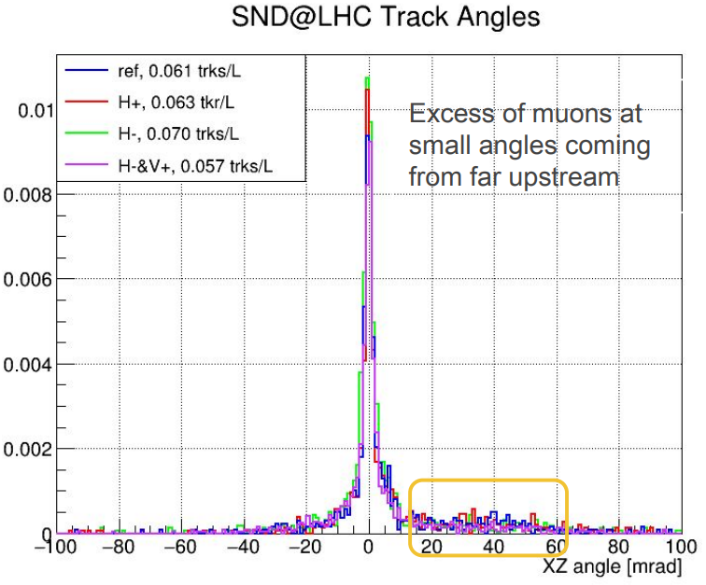
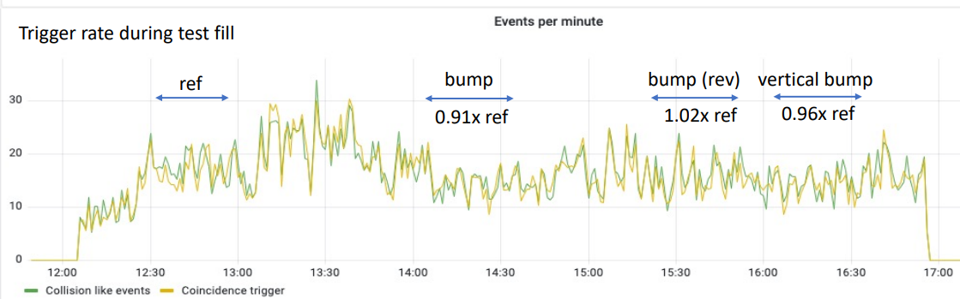
High energy muons: bump test
Tested horizontal, vertical and skew bumps on 20241014
Results not satisfactory, however:
Shows that mitigations are possible
Important data for improving simulation models to more accurately simulate future scenarios
S. Ilieva, LBS#125
J. Boyd, LBS#125
config | FASER (sim) | FASER (meas) | SND (meas)
V+ bump | 1.03 | -- | --
H+ bump | 0.75 | 0.91 +- 0.05 | 1.03 +- 0.03
H- bump | 0.84 | 1.02 +- 0.05 | 1.16 +- 0.03
H- & V+ bump | 1.03 | 0.96 +- 0.05 | 0.93 +- 0.03
< 15 % of total muons
For more details, see talk by A. Keyken tomorrow!

Slide 17
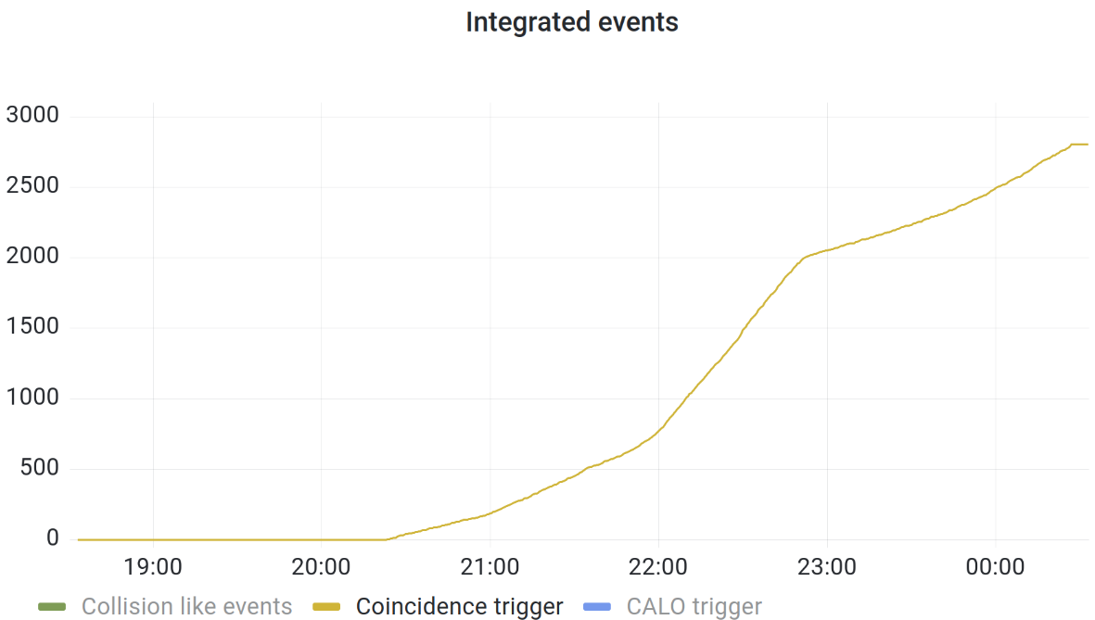
High energy muons: xing angle / plane
Background events measured live by FASER
V -160 µrad
H +160 µrad
H -160 µrad
V +160 µrad
(nominal)
squeeze to 60 cm

Slide 18
High energy muons: xing angle / plane
Background events measured live by FASER
plane | angle | bkg rate | comp. to ref
V | +160 | 1.68 | 1
V | -160 | 1.91 | 1.1
H | +160 | 3.83 | 2.3
H | -160 | 1.06 | 0.6
V -160 µrad
H +160 µrad
H -160 µrad
V +160 µrad
(nominal)
squeeze to 60 cm

Slide 19
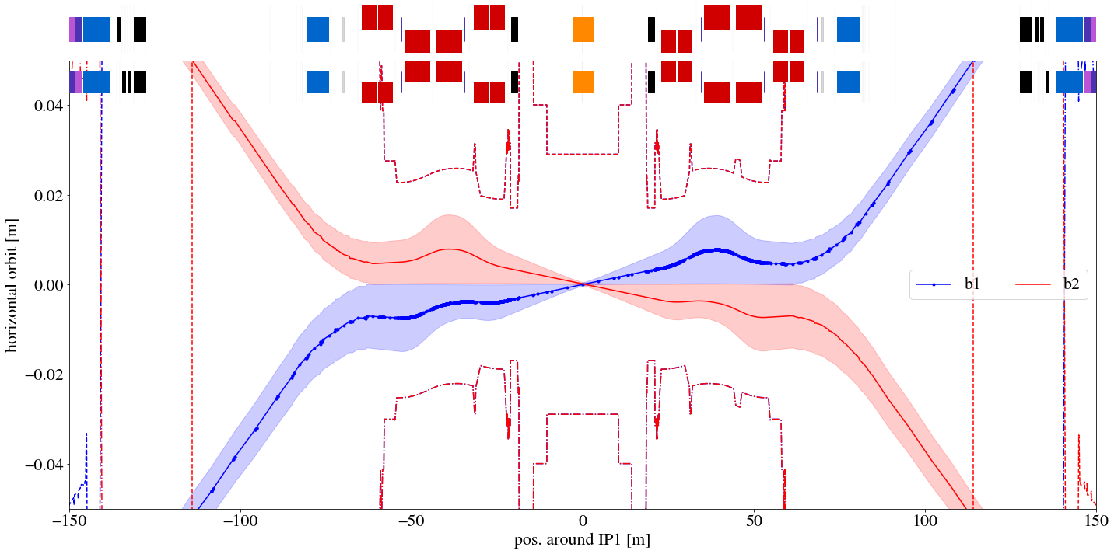
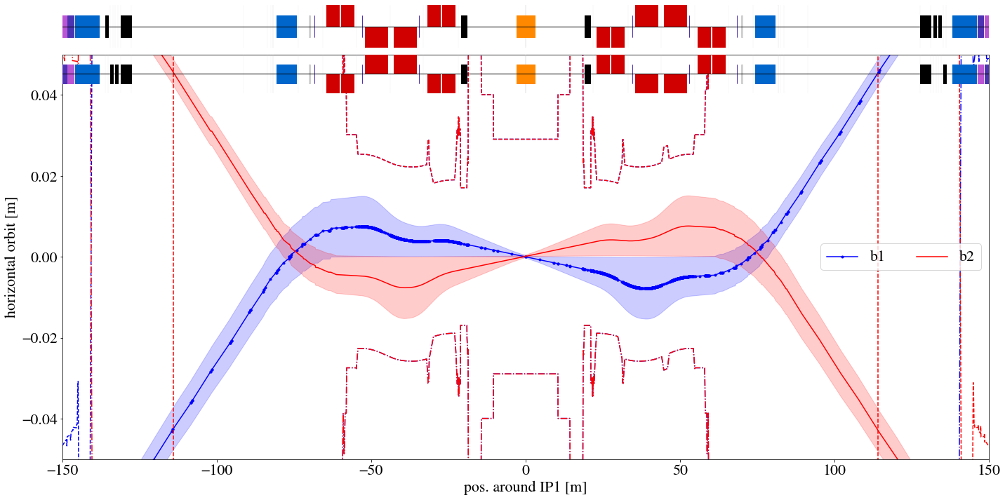
H xing
H xing with neg polarity gives three collision points
Use skew xing?
H +160 µrad
H -160 µrad

Slide 20
Future potential mitigations
Optics design is already constrained, and its effects on the background complex to predict
Place magnetic muon sweepers outside the beam pipes?

Slide 21
Conclusions
Background to SND / FASER: challenging, requiring accelerator + particle-matter + experiment teams
Certain optics configurations detrimental to experiments → critical to simulate proposed optics well in advance (see next talk by A. Șerban)
Tight TCL settings: key for background suppression
Orbit bumps: simple to implement, effective for muon background
Simulations complex; beam tests provide valuable benchmarking data
HL-LHC: need to study mitigations to keep optics flexibility without harming experiments
Thanks to LPC & experiments for allowing test time during physics runs

Slide 22
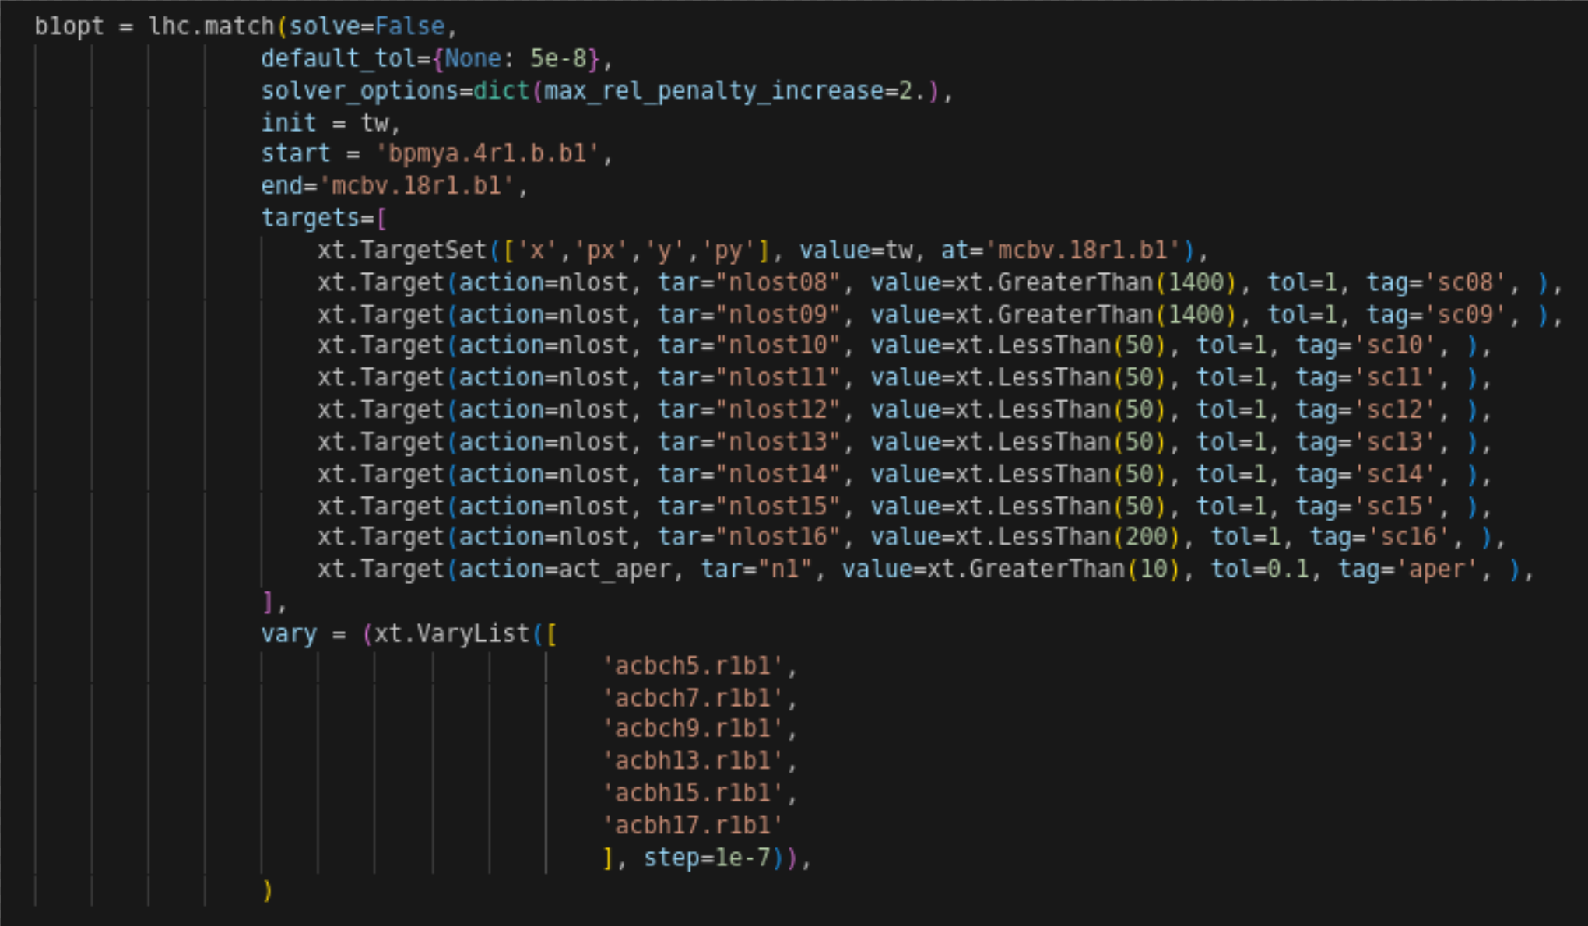
Code example (1/2)
Standard optimizer (matching) object in xsuite
Target uses an action nlost, defined as a class (next slide)

Slide 23
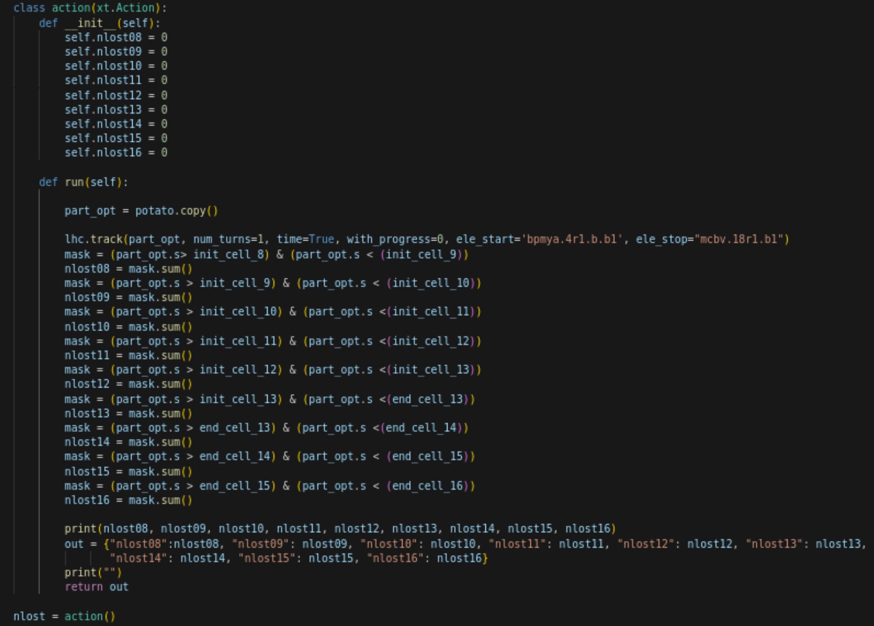
Code example (2/2)
Action that tracks particle object potato and returns a dictionary with number of losses per cell (defined outside of action):

