Slide 1


HL-LHC longitudinal beam stability for updated impedance model
Ivan Karpov, Theodoros Argyropoulos, Rama Calaga, Heiko Damerau, Frank Gerigk, Leandro Intelisano, Birk Karlsen-Baeck, Christophe Lannoy, Nicolas Mounet, Michela Neroni, Sigurd Nese, Elena Shaposhnikova, Helga Timko, Christine Vollinger, and Michail Zampetakis
Acknowledgements: Simon Albright, Ylenia Brischetto, Lorenzo Giacomel, Alexandre Lasheen, Benoit Salvant, and CPS/SPS/LHC OP teams
15th HL-LHC Collaboration Meeting, 02.10.2025

Slide 2
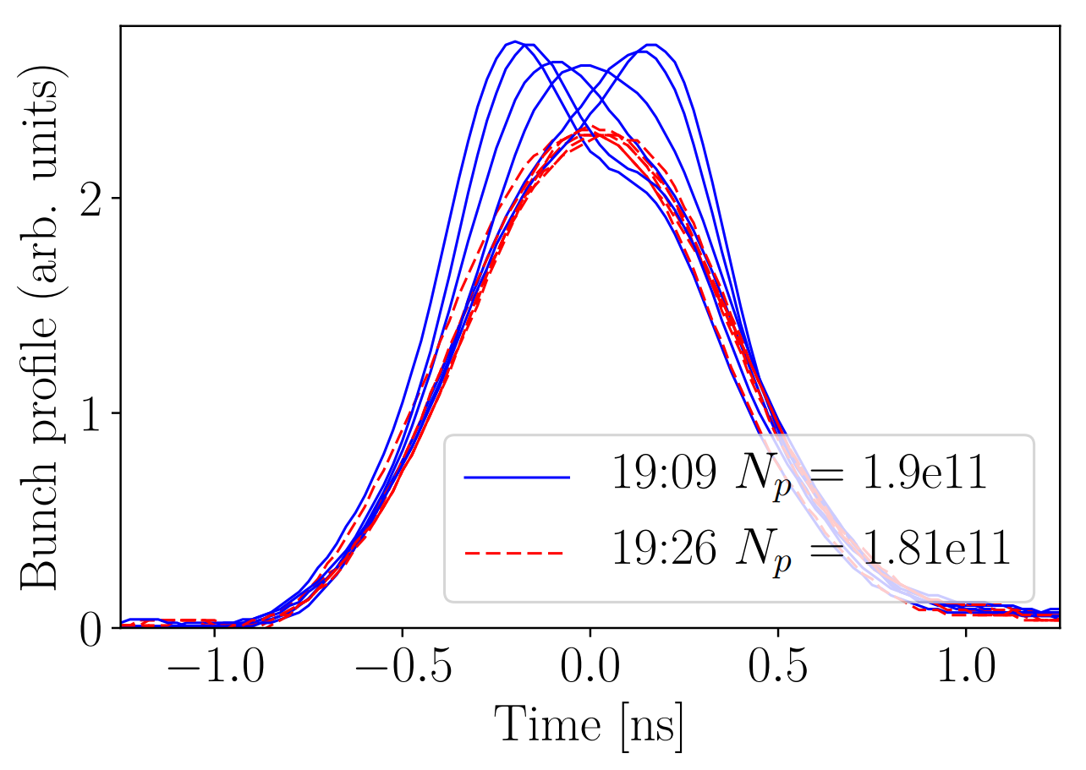
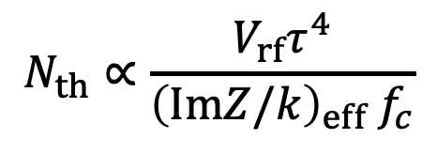

Recap on single-bunch stability
Persistent oscillations after injection indicate that we are approaching the threshold of loss of Landau damping (LLD) for HL-LHC parameters
The LLD threshold is defined as (IK, T. Argyropoulos, E. Shaposhnikova, PRAB, 2021)
Complicated impedance model can be substituted by an effective broad-band (BB) impedance (IK, T. Argyropoulos, S. Nese, and E. Shaposhnikova, HB, 2021)
Persistent oscillations after injection, resulting in particle losses
LHC MD 2017
$V_{rf}=6$ MV
$$N_{th}∝\frac{V_{rf}τ^{4}}{{\left(ImZ/k\right)}_{eff}{ f}_{c}}$$
Effective impedance
Effective cut-off frequency
H. Timko et al., HB, 2018

Slide 3
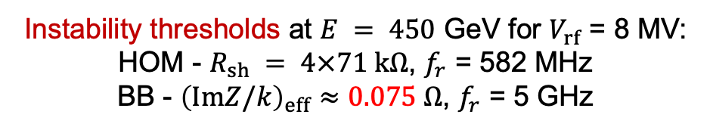
Destabilizing effect of broad-band impedance
Instability thresholds at $E = 450$ GeV for $V_{rf}$ = 8 MV: HOM - $R_{sh} = 4×71 kΩ$, $f_{r}$ = 582 MHz
BB - ${\left(ImZ/k\right)}_{eff}≈0.075 Ω$, $f_{r}$ = 5 GHz
Coupled-bunch instabilities (CBI) driven by higher-order modes (HOM) were not observed in the LHC so far
HL-LHC will operate at higher intensity compared to LHC and crab cavities with strongly damped HOMs will be installed
In the presence of BB impedance, the CBI threshold is reduced below the LLD threshold
Semi-analytical result using MELODY*
IK, WP2/WP4 Meeting, 30.11.2021
*IK, Matrix Equations for LOngituDinal stabilitY code

Slide 4
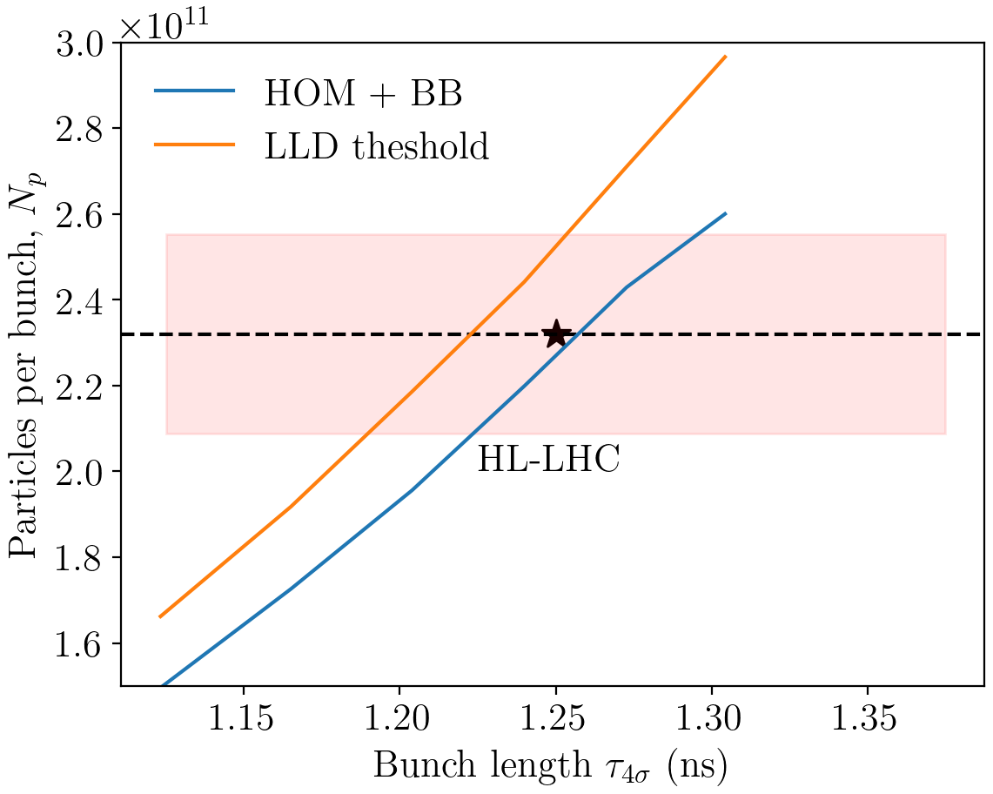
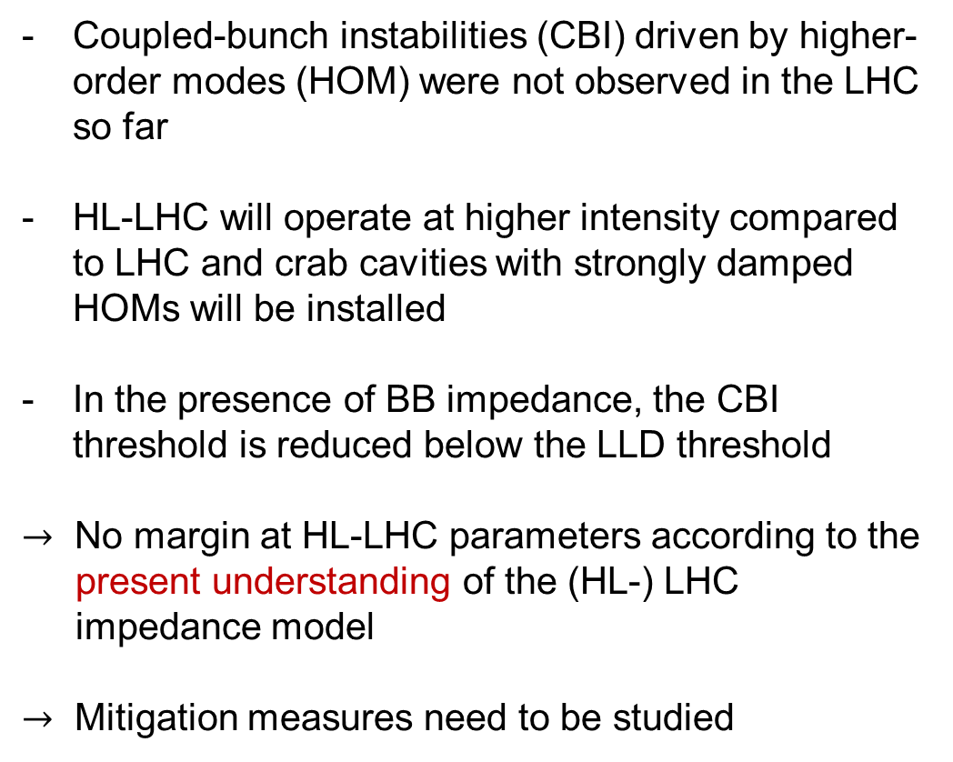
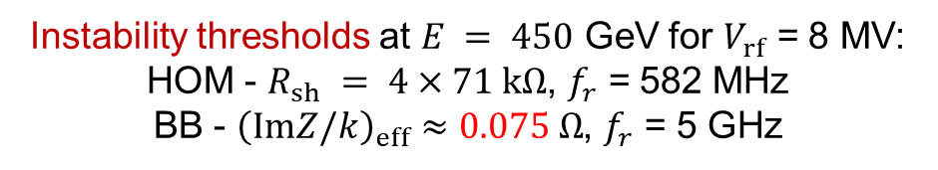
Destabilizing effect of broad-band impedance
Instability thresholds at $E = 450$ GeV for $V_{rf}$ = 8 MV: HOM - $R_{sh} = 4×71 kΩ$, $f_{r}$ = 582 MHz
BB - ${\left(ImZ/k\right)}_{eff}≈0.075 Ω$, $f_{r}$ = 5 GHz
Coupled-bunch instabilities (CBI) driven by higher-order modes (HOM) were not observed in the LHC so far
HL-LHC will operate at higher intensity compared to LHC and crab cavities with strongly damped HOMs will be installed
In the presence of BB impedance, the CBI threshold is reduced below the LLD threshold
$→$ No margin at HL-LHC parameters according to the present understanding of the (HL-) LHC impedance model
$→$ Mitigation measures need to be studied
Semi-analytical result using MELODY*
Parameter spread
IK, WP2/WP4 Meeting, 30.11.2021
*IK, Matrix Equations for LOngituDinal stabilitY code

Slide 5
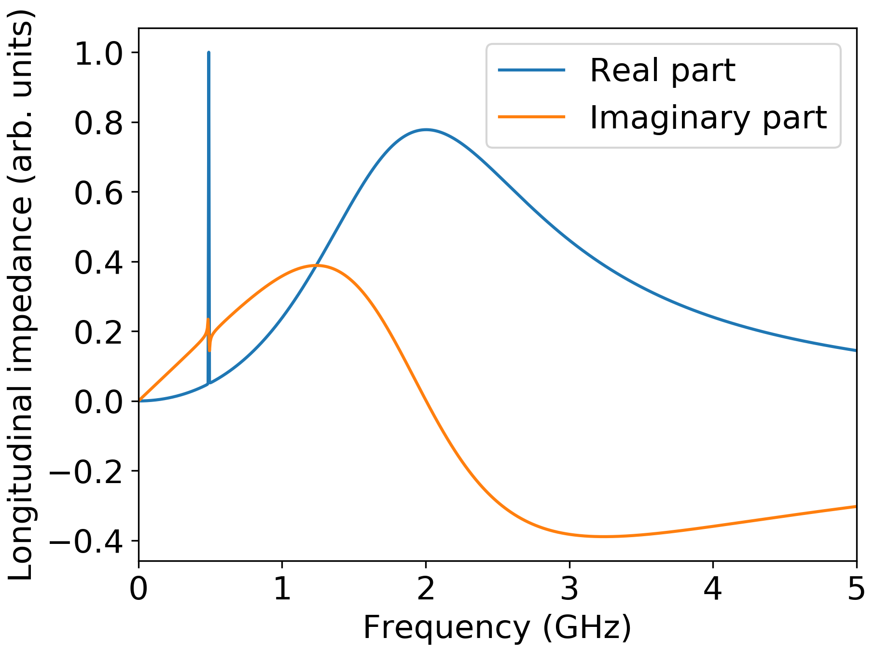
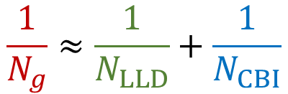

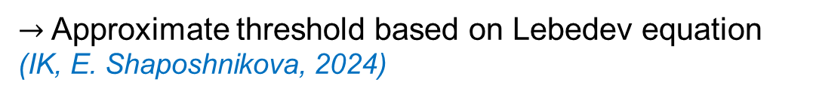
Generalized threshold
Growth rates of most unstable modes for 9 bunches (MELODY - lines, BLonD - crosses)
Higher-order mode (HOM)
Broadband impedance
$$\frac{1}{0.34}=\frac{1}{0.52}+\frac{1}{1}$$
Typically, broadband (bb) and narrowband (nb) impedance sources are treated separately, except in a few examples of CBI growth rate calculations
$→$ Approximate threshold based on Lebedev equation (IK, E. Shaposhnikova, 2024)
$$\frac{1}{N_{g}}≈\frac{1}{N_{LLD}}+\frac{1}{N_{CBI}}$$

Slide 6
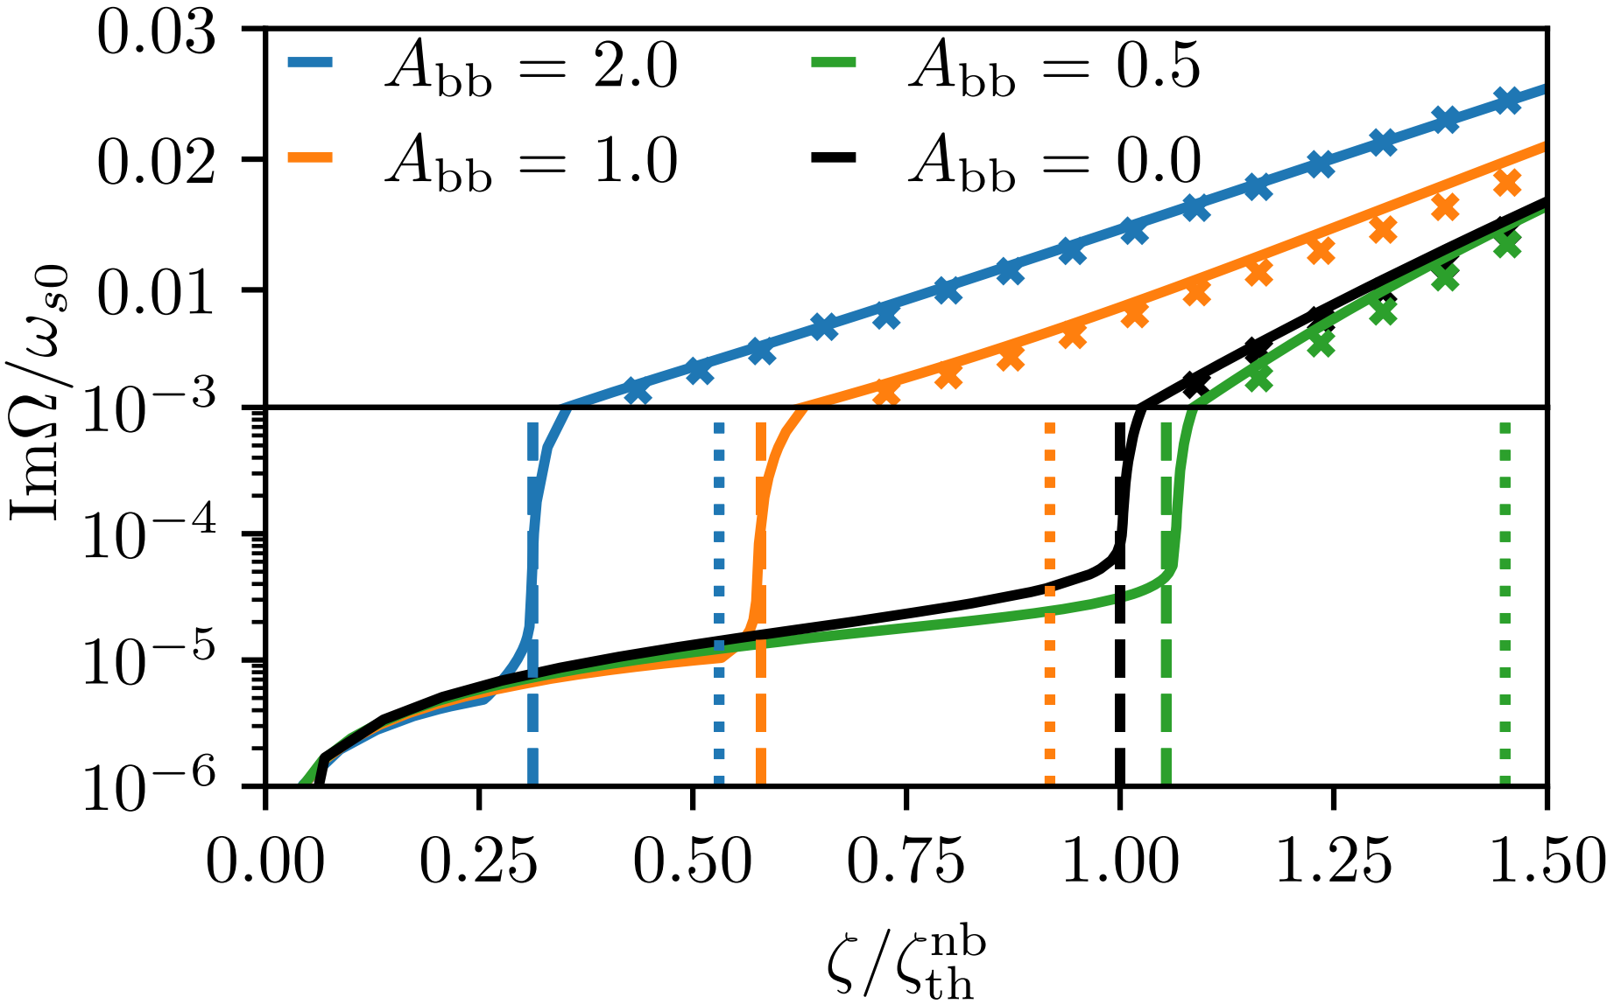
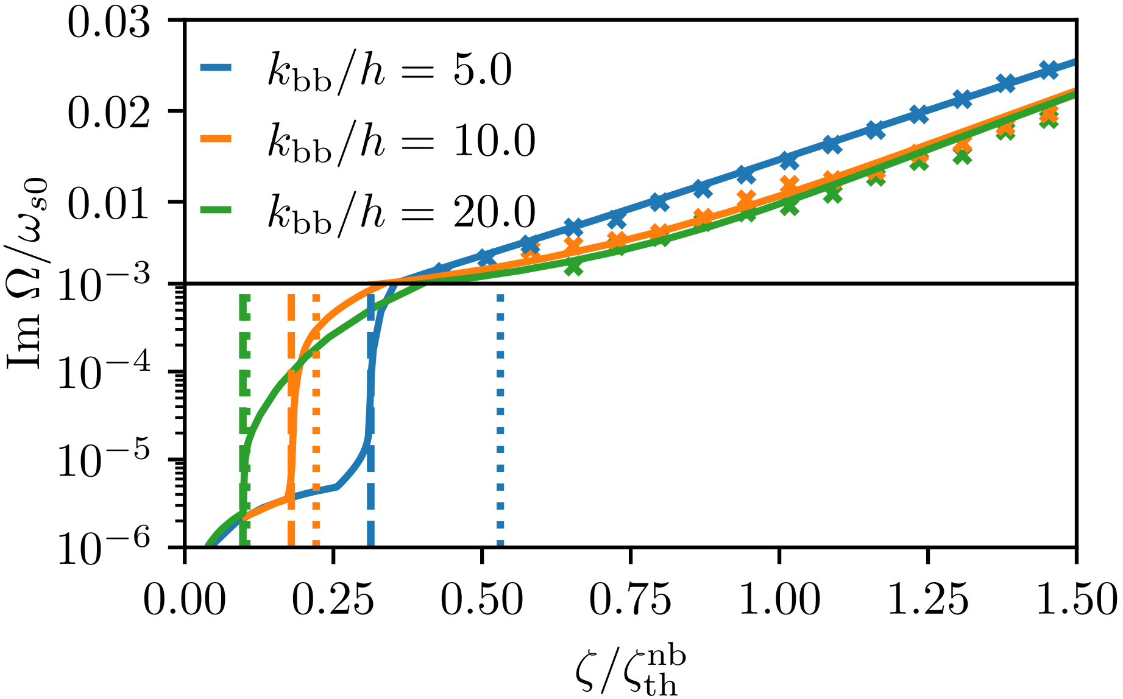

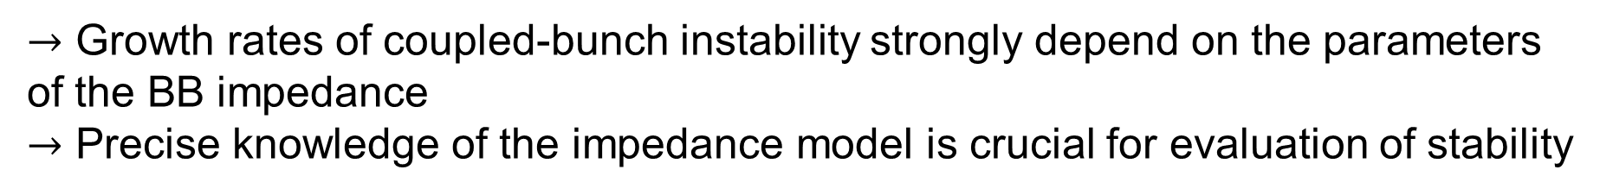




Impact of BB impedance parameters
Parameters: $h=9,k_{nb}/h=11/9, Q_{nb}=100, R_{nb}=37 kΩ, Q_{bb}=1, R_{bb}=3A_{bb}× (k_{bb}/h)$
$$A_{bb}=2$$
$$k_{bb}/h=5.0$$
$$k=f/f_{0}$$
$$N_{p}/N_{CBI}$$
$$N_{p}/N_{CBI}$$
$→$ Growth rates of coupled-bunch instability strongly depend on the parameters of the BB impedance
$→$ Precise knowledge of the impedance model is crucial for evaluation of stability

Slide 7
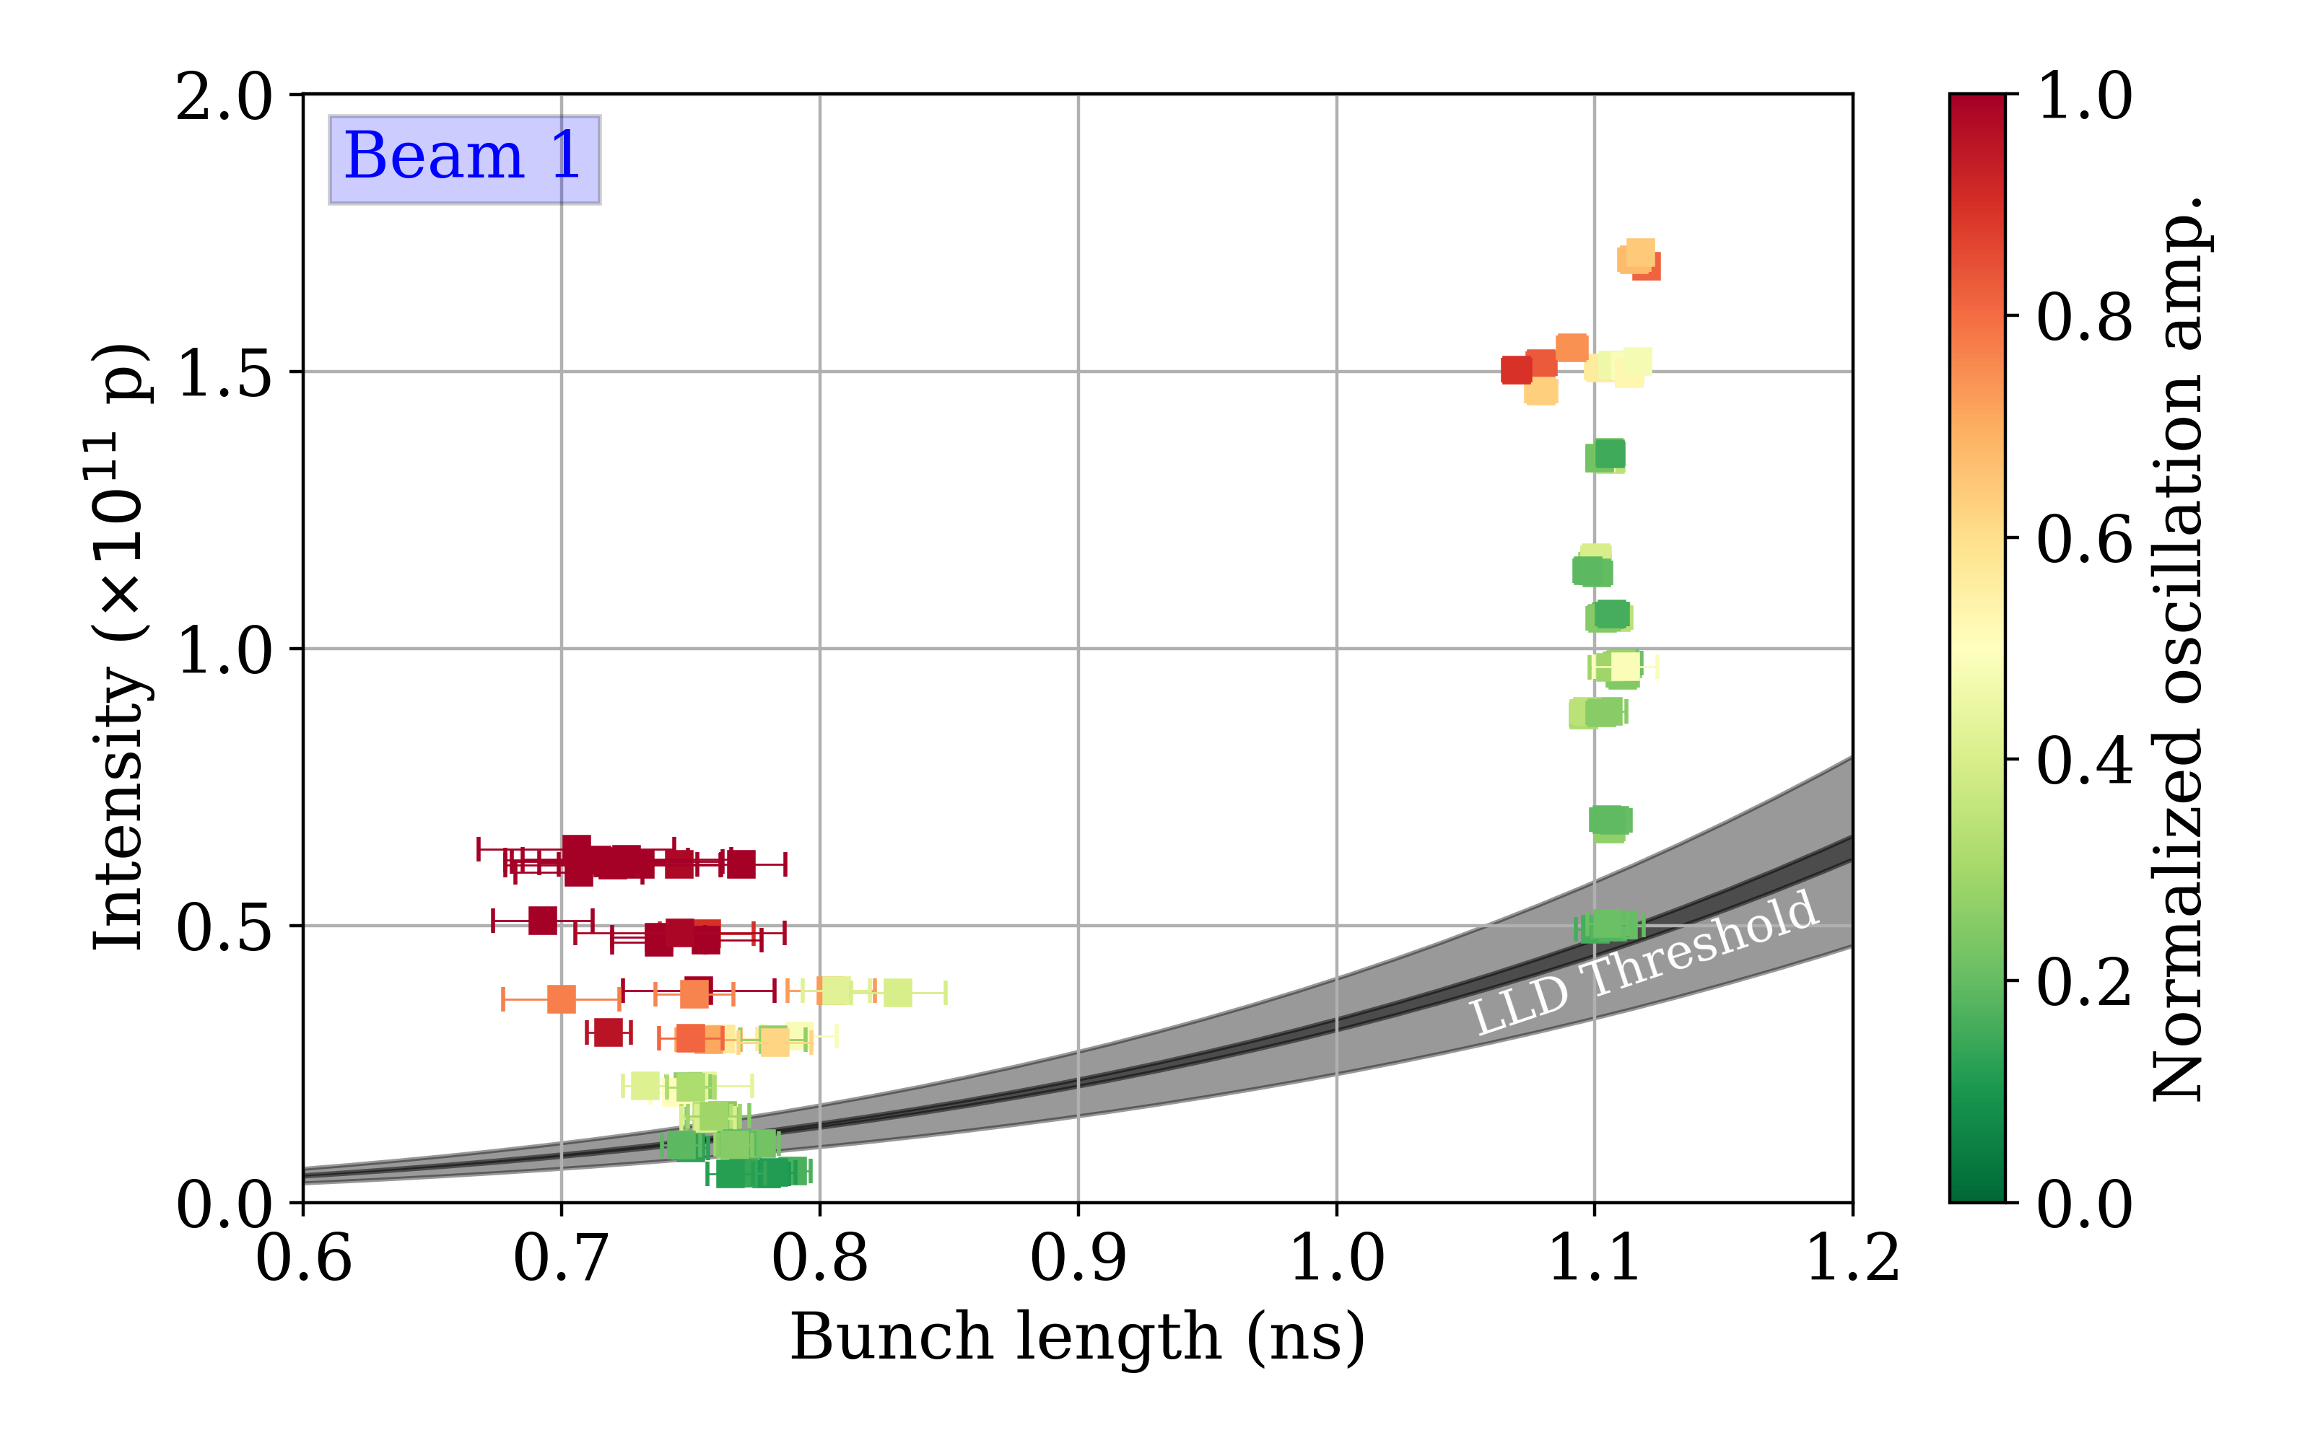
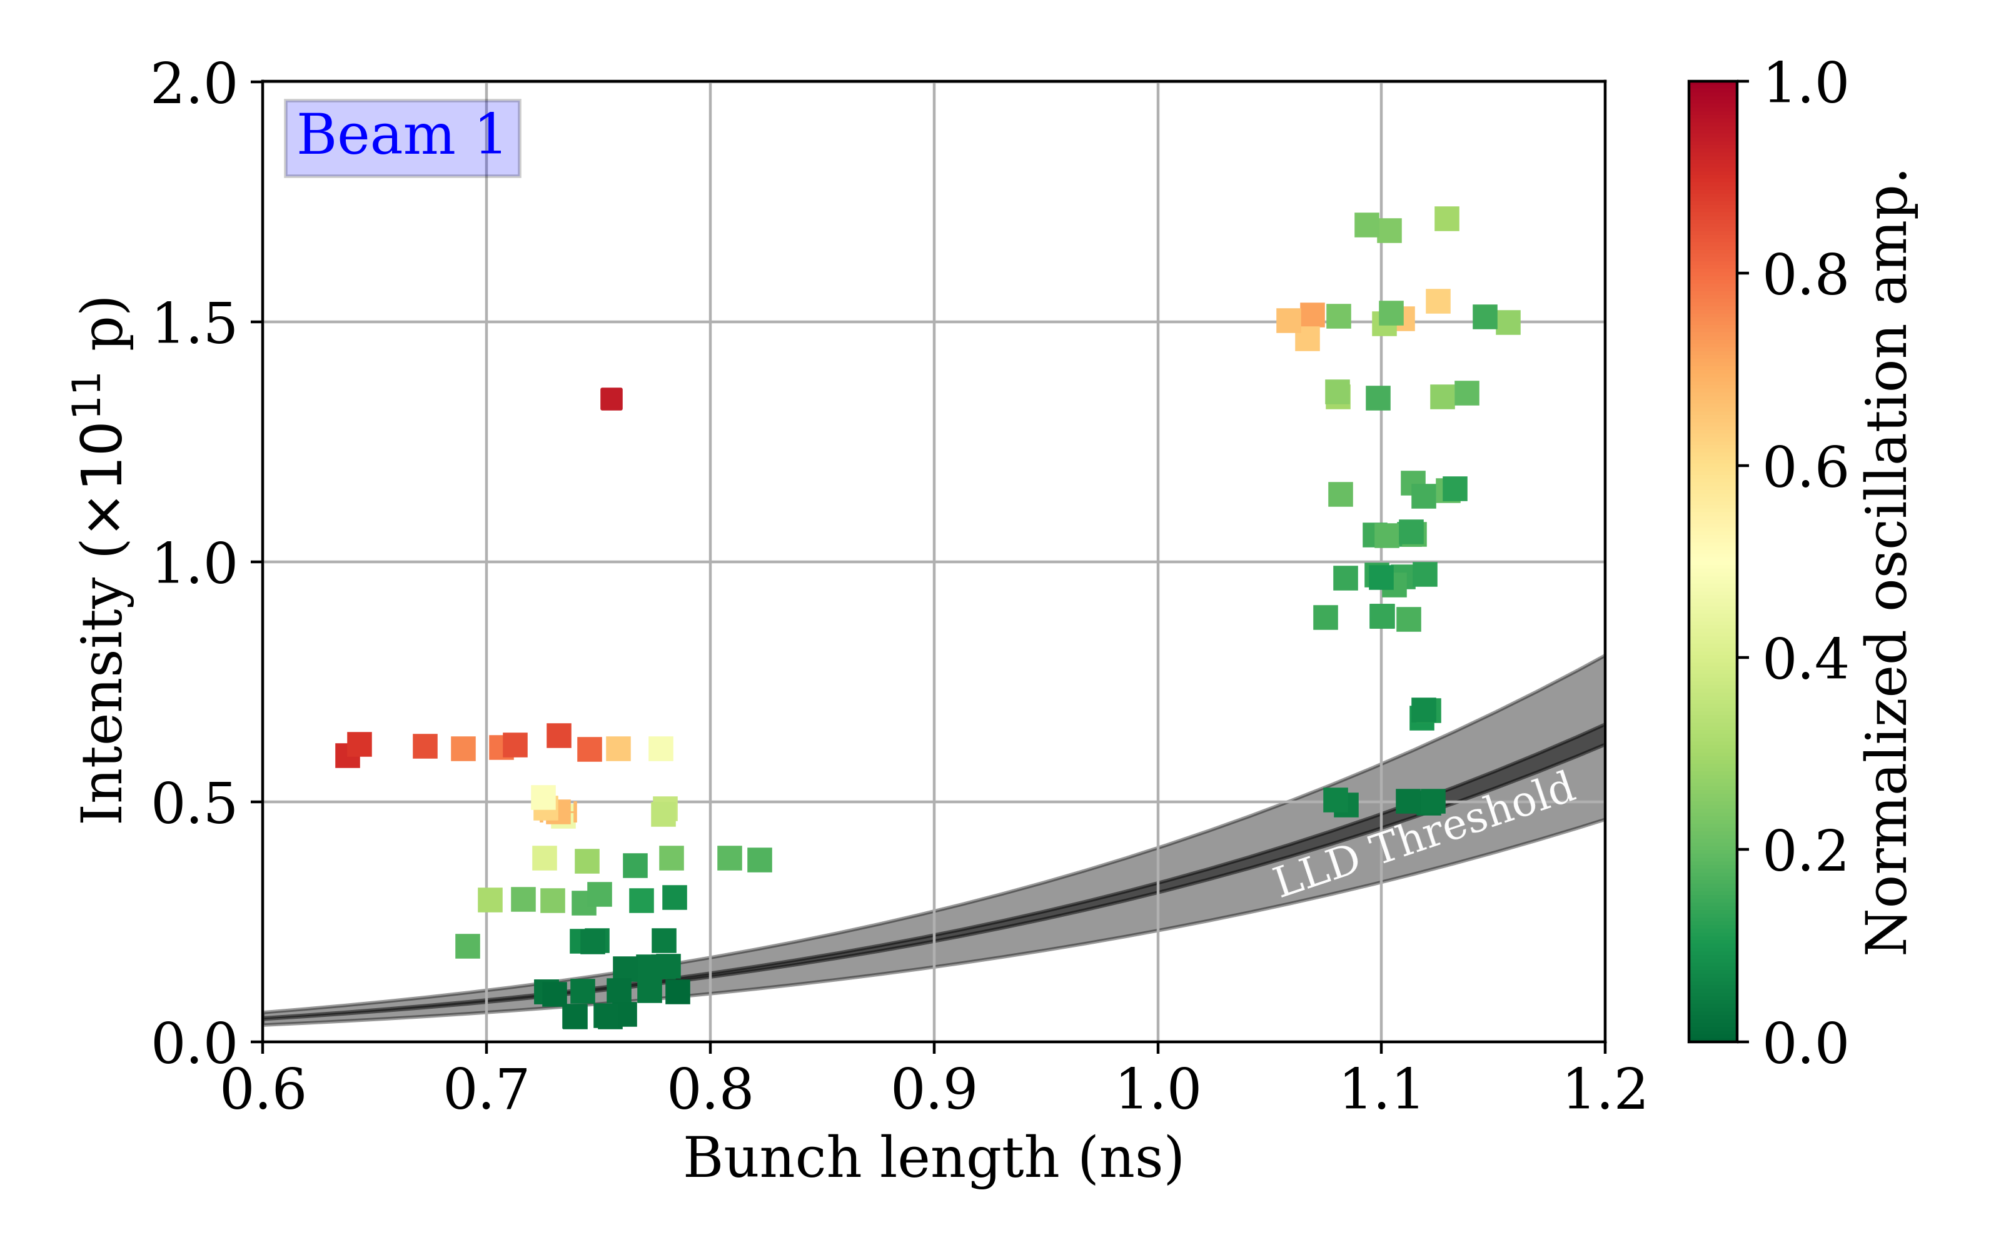
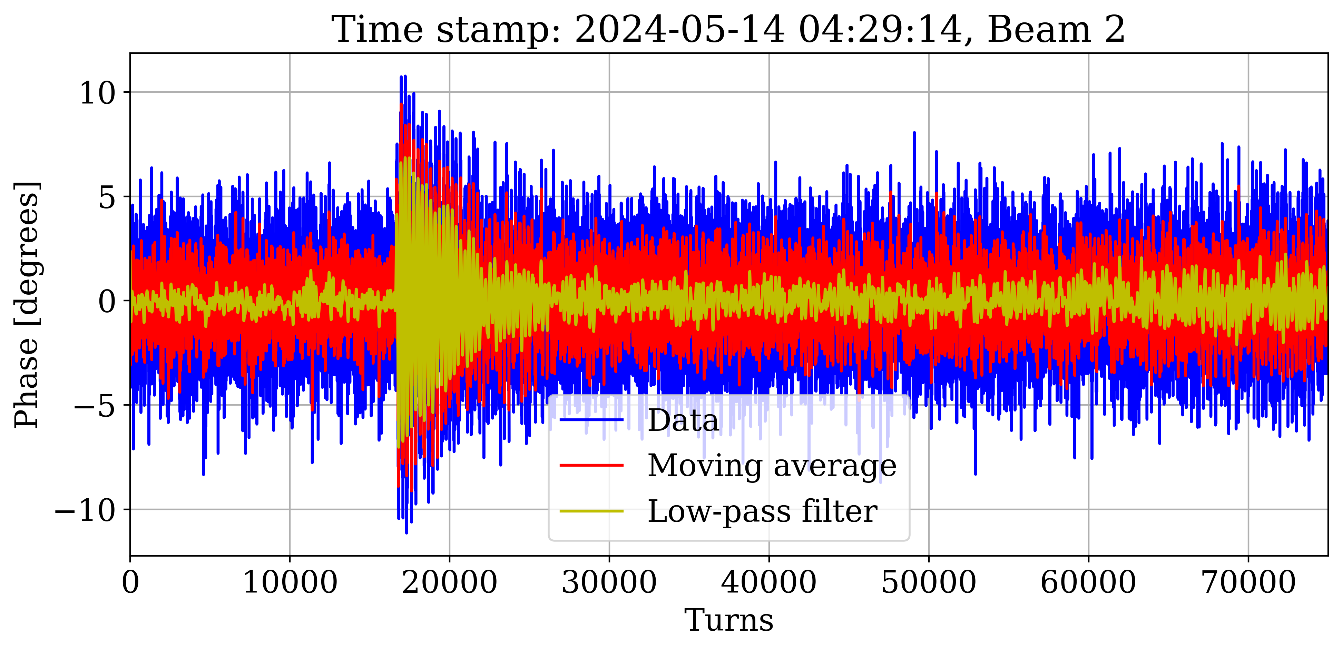
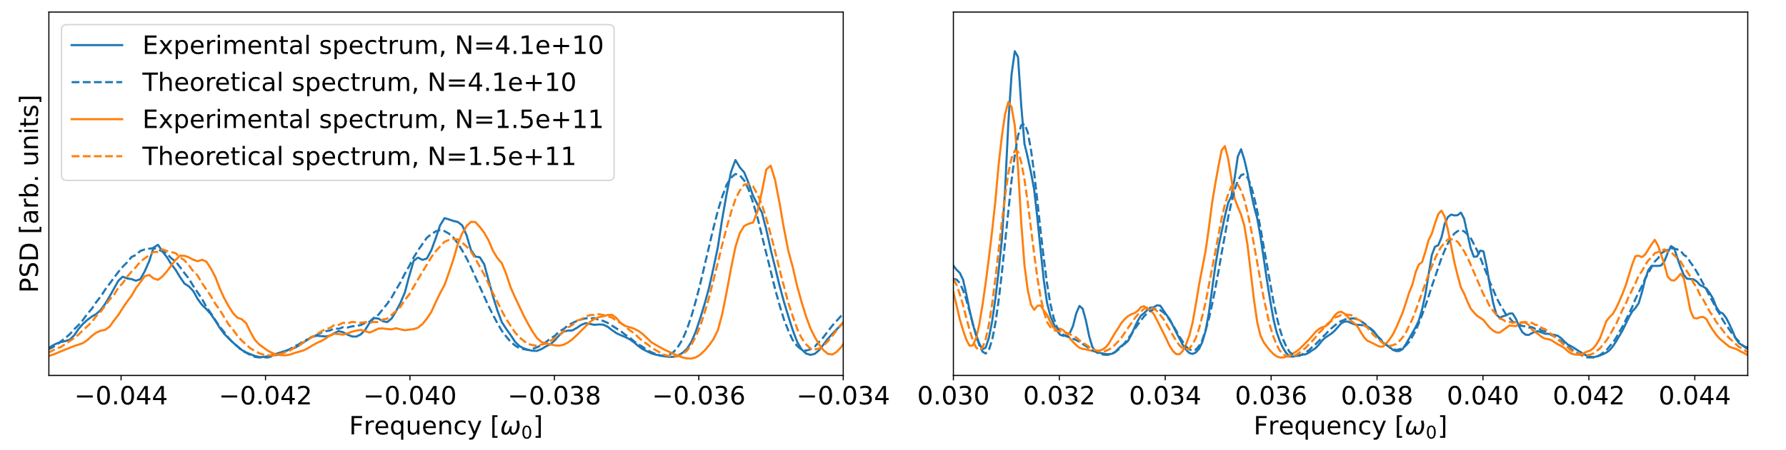

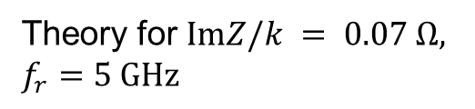
Latest measurements of BB impedance
Measurements
Simulations for $ImZ/k = 0.085 Ω, f_{r}=5 GHz$
Simulations
Kick-response method
M. Zampetakis et. al, HL-LHC CM, 2024 and 2025 MD results
Theory for $ImZ/k = 0.07 Ω,$
$f_{r}=5 GHz$
Longitudinal Schottky spectra
C. Lannoy et. al, HL-LHC CM, 2024

Slide 8
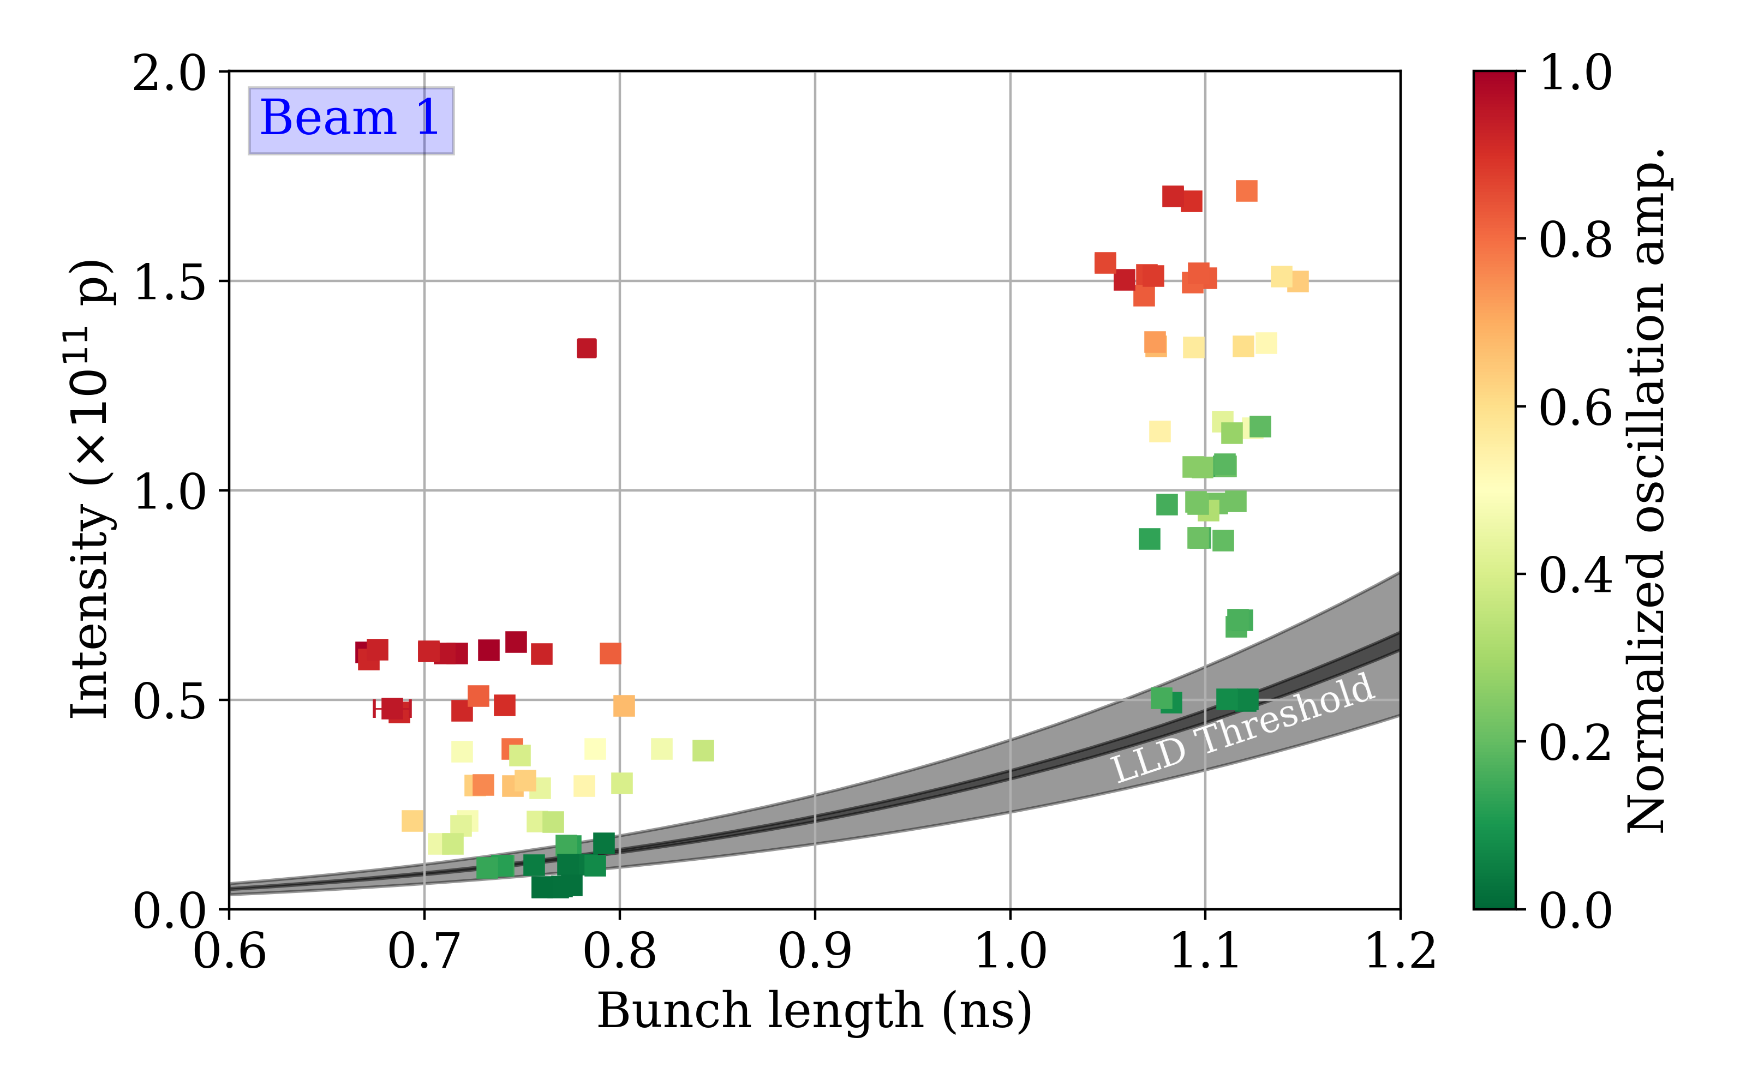
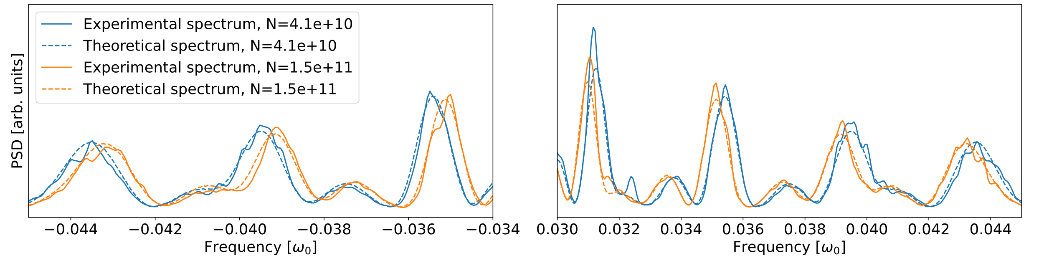

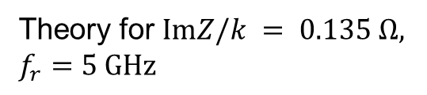
Latest measurements of BB impedance
Measurements
Simulations for $ImZ/k = 0.143 Ω, f_{r}=3.4 GHz$
Simulations
Kick-response method
M. Zampetakis et. al, HL-LHC CM, 2024 and 2025 MD results
Theory for $ImZ/k = 0.135 Ω,$
$f_{r}=5 GHz$
Longitudinal Schottky spectra
C. Lannoy et. al, HL-LHC CM, 2024

Slide 9
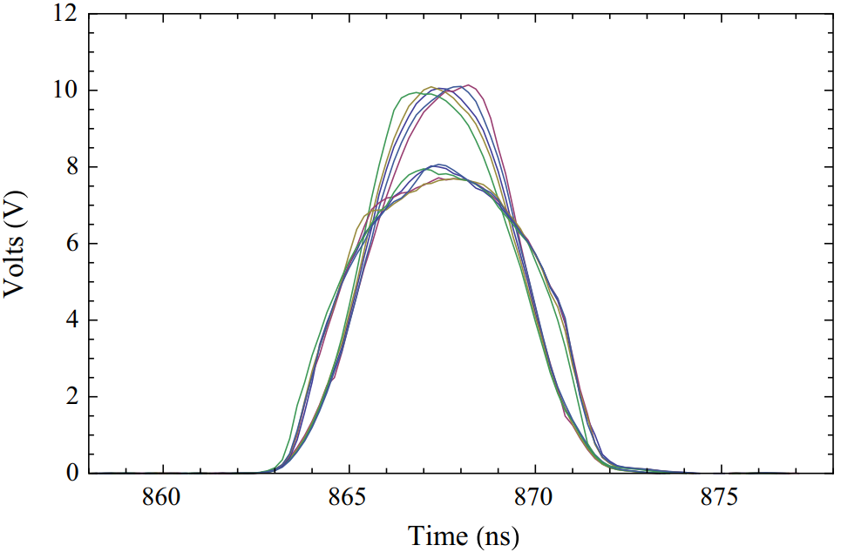
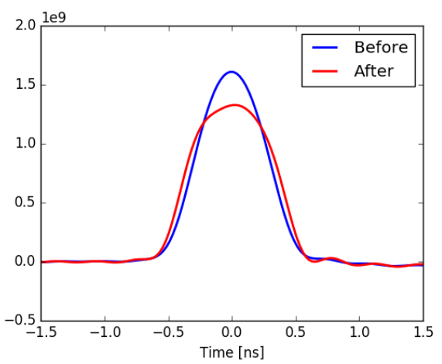

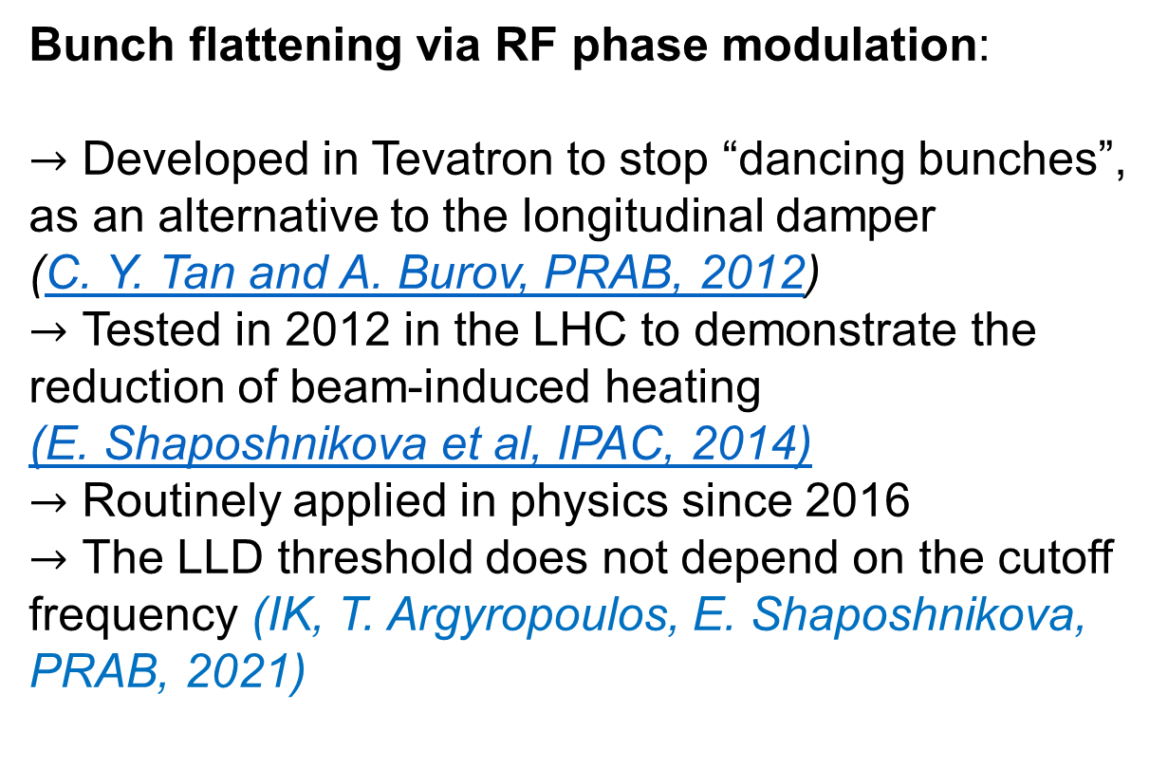
Possible cures: flattened particle distribution
Measurements in Tevatron
Bunch flattening via RF phase modulation:
$→$ Developed in Tevatron to stop “dancing bunches”, as an alternative to the longitudinal damper (C. Y. Tan and A. Burov, PRAB, 2012)
$→$ Tested in 2012 in the LHC to demonstrate the reduction of beam-induced heating (E. Shaposhnikova et al, IPAC, 2014)
$→$ Routinely applied in physics since 2016
$→$ The LLD threshold does not depend on the cutoff frequency (IK, T. Argyropoulos, E. Shaposhnikova, PRAB, 2021)
LHC
$$N_{th}∝\frac{V_{rf}τ^{5}}{{\left(ImZ/k\right)}_{eff}}$$
H. Timko et al, Evian, 2019

Slide 10
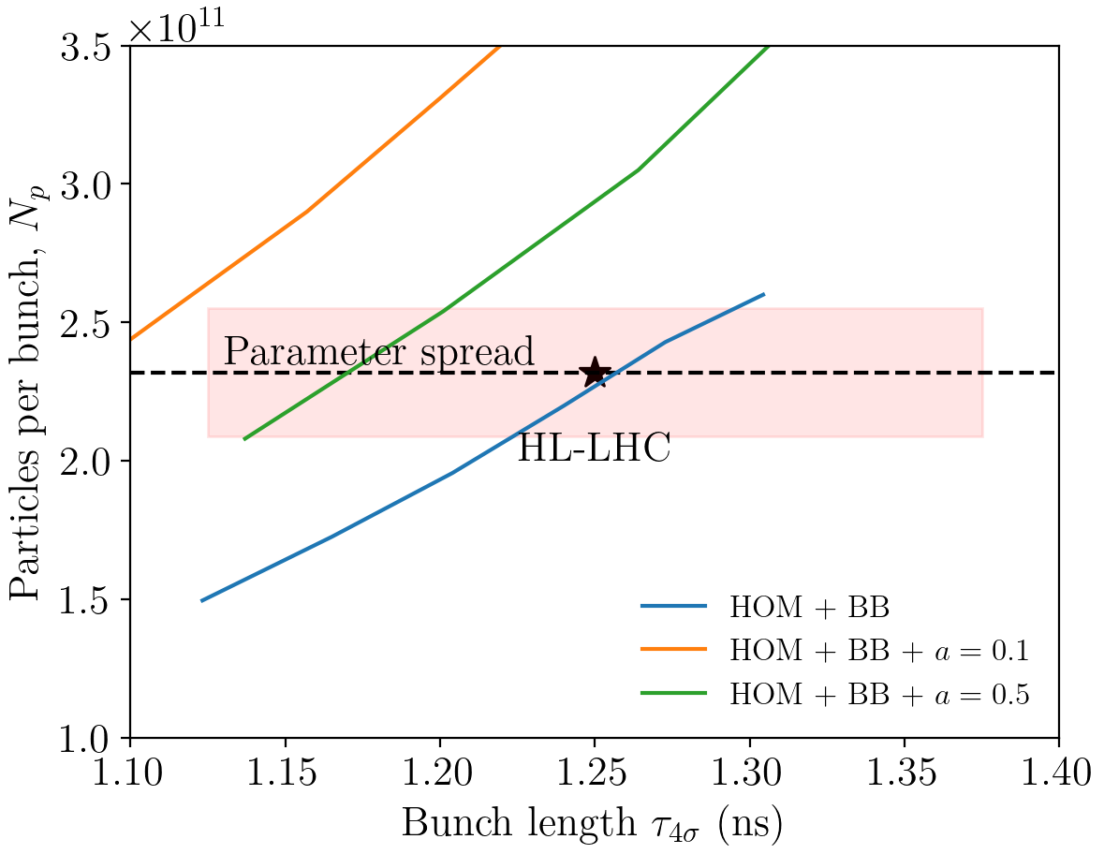
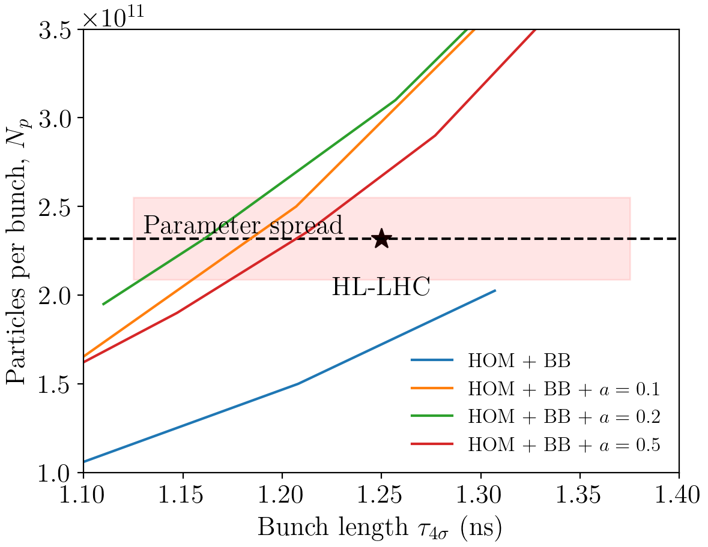
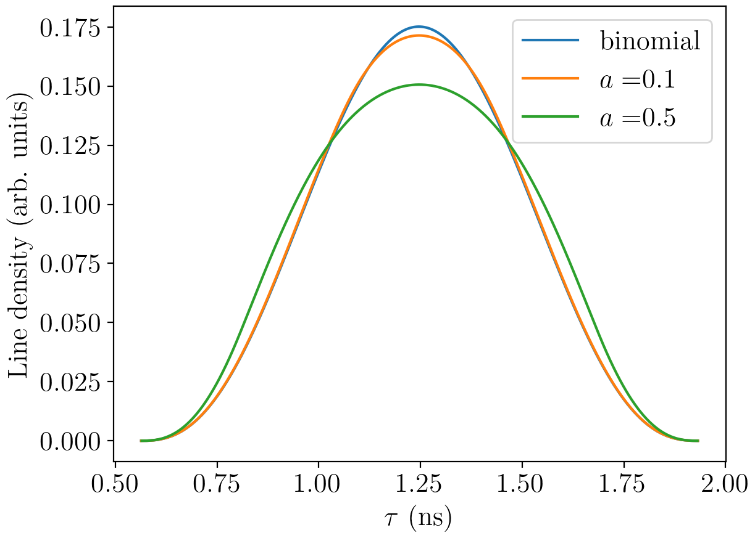

Results for flattened distribution
Present model
Measurement-based model
Flatness parameter $a$
Semi-analytical analysis confirms that a modified distribution can raise the instability threshold
Stability gain is sensitive to the “flatness” of the line density
Since the “measurement-based” model has a higher $ImZ/n$, improvement is more limited

Slide 11
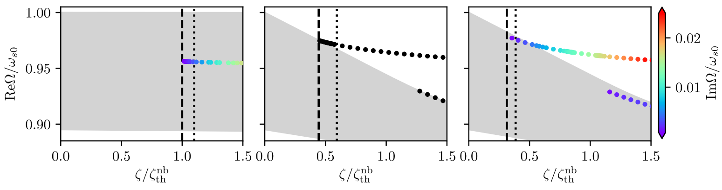
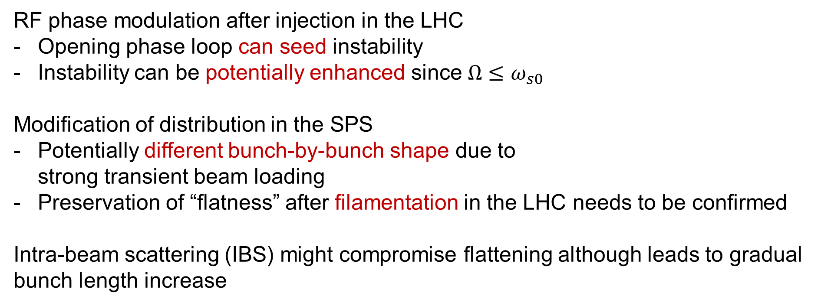

Implementation scenarios and potential challenges
HOM + Broadband
RF phase modulation after injection in the LHC
Opening phase loop can seed instability
Instability can be potentially enhanced since $Ω≤ω_{s0}$
Modification of distribution in the SPS
Potentially different bunch-by-bunch shape due to strong transient beam loading
Preservation of “flatness” after filamentation in the LHC needs to be confirmed
Intra-beam scattering (IBS) might compromise flattening although leads to gradual bunch length increase
$$N_{p}/N_{CBI}$$

Slide 12
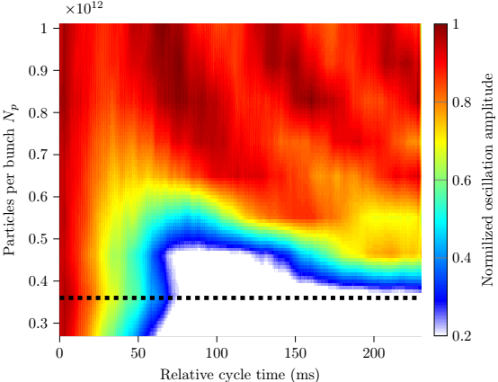
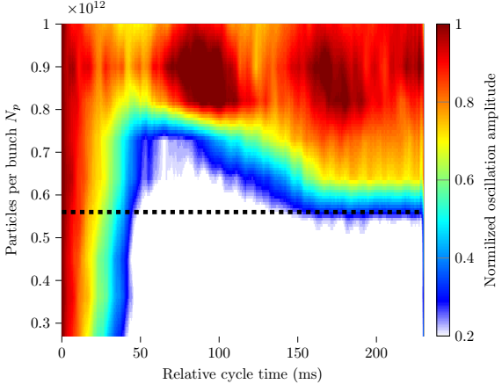
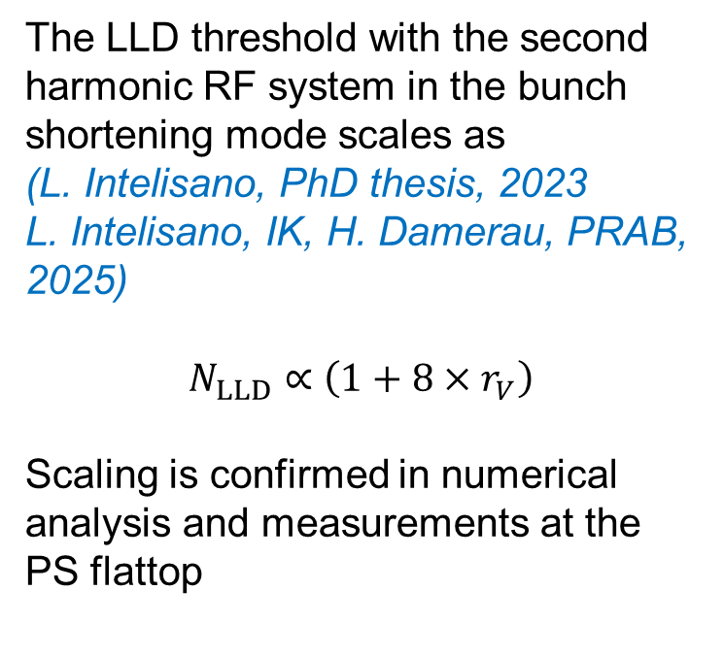
Possible cures: double-harmonic RF system
Measurements in PS at 26 GeV
The LLD threshold with the second harmonic RF system in the bunch shortening mode scales as (L. Intelisano, PhD thesis, 2023
L. Intelisano, IK, H. Damerau, PRAB, 2025)
$$N_{LLD}∝\left(1+8{×r}_{V}\right)$$
Scaling is confirmed in numerical analysis and measurements at the PS flattop
Single RF (10 MHz)
Double RF (10 + 20 MHz)
The same scaling also applies to the coupled-bunch instability threshold (V. I. Balbekov and S. V. Ivanov, 1987), but the impact of BB impedance needs to be confirmed

Slide 13
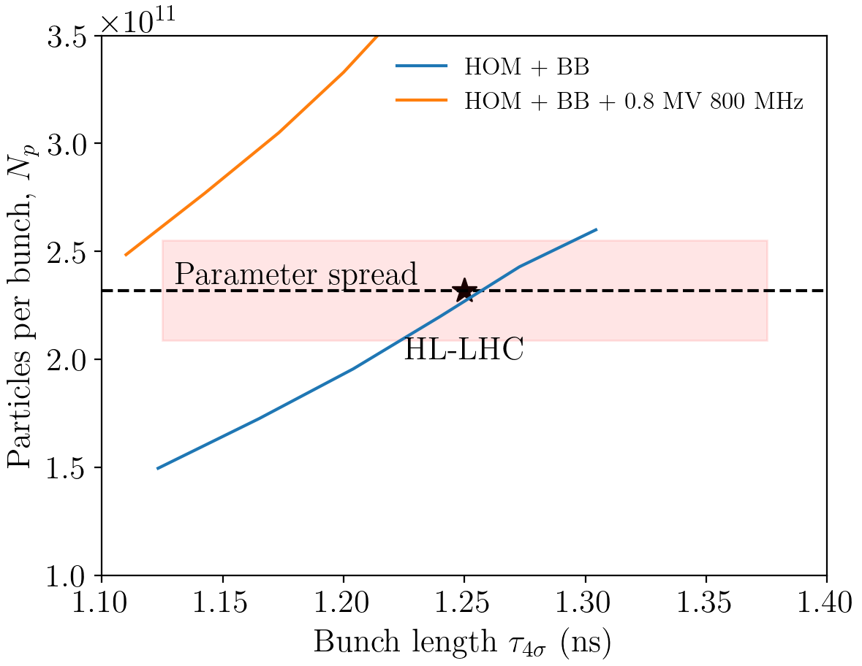
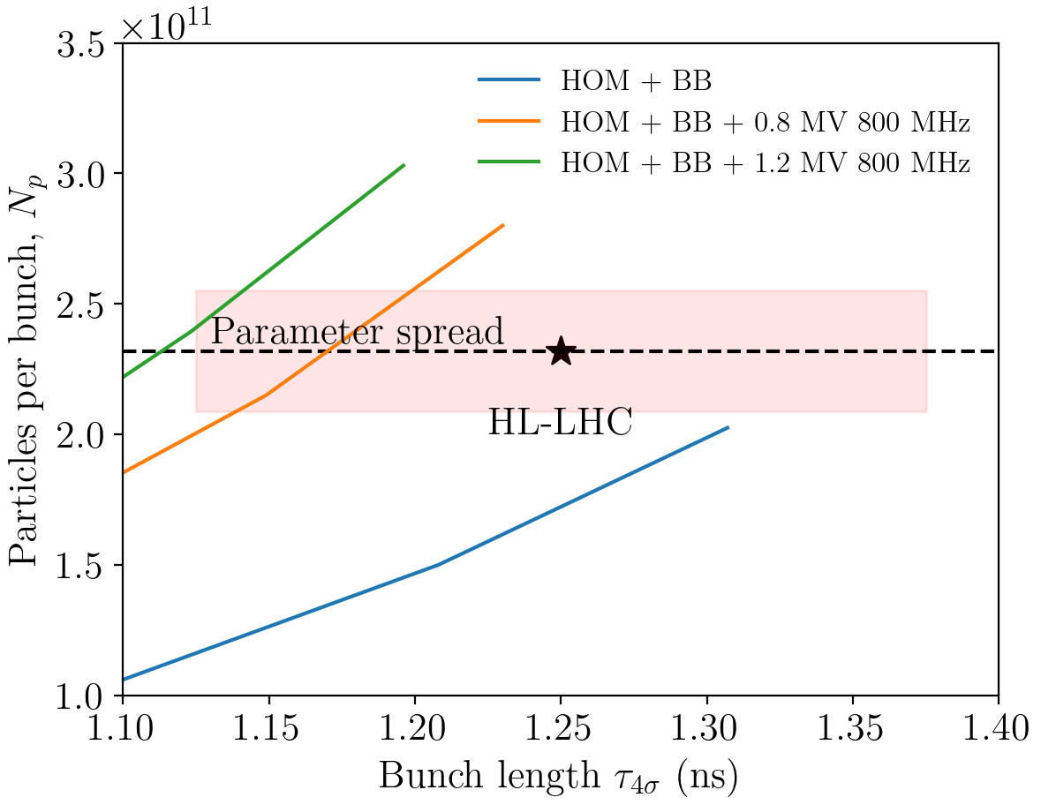
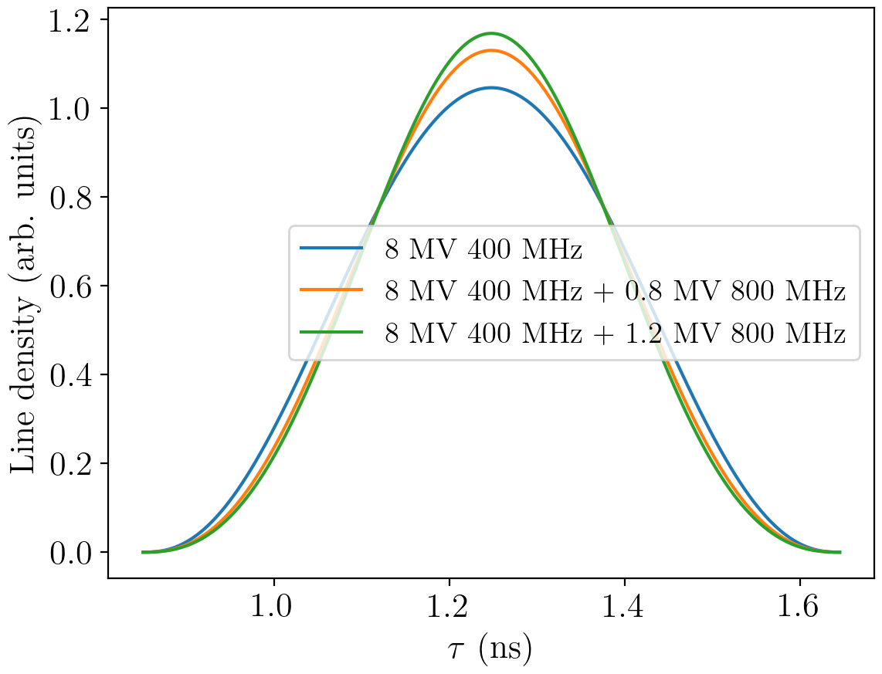
Results for double-harmonic RF system
Present model
Measurement-based model
The instability threshold can be significantly increased by operation in the bunch-shortening mode with a moderate RF voltage (one or two single-cell 800 MHz cavities per beam)
Slightly higher peak line density can impact blow-up due to IBS

Slide 14
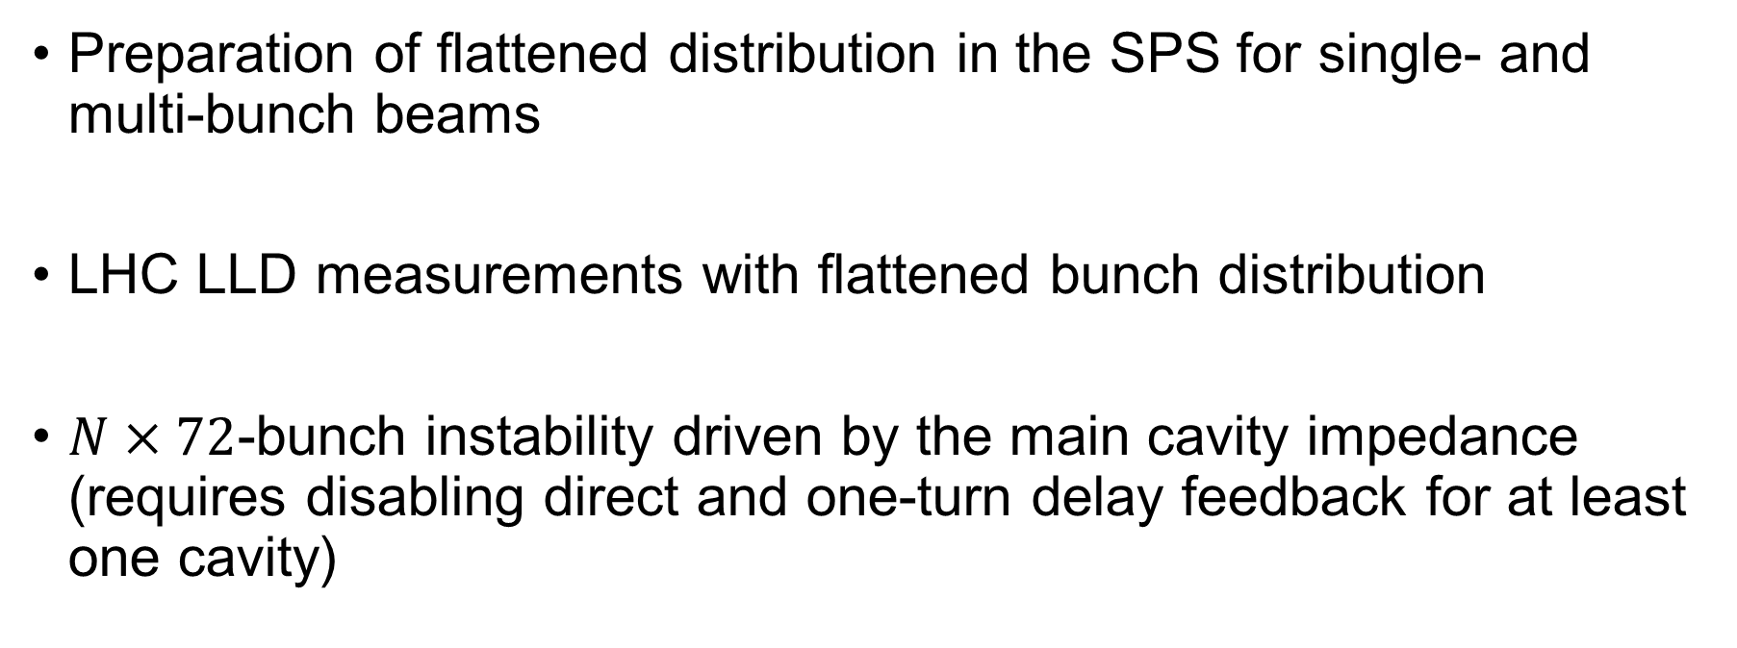
Possible future measurements
Preparation of flattened distribution in the SPS for single- and multi-bunch beams
LHC LLD measurements with flattened bunch distribution
$N×72$-bunch instability driven by the main cavity impedance (requires disabling direct and one-turn delay feedback for at least one cavity)

Slide 15
Summary
Loss of Landau damping and coupled-bunch instability are closely related in the longitudinal plane
The theoretical model was developed to describe semi-analytical results and confirmed by simulations
Knowledge of the (HL-)LHC impedance (especially the broadband part) was improved in the past years, while further refinements are ongoing
Instability driven by HOMs could be a serious performance limitation since LLD was already observed in LHC
Possible cures of multi-bunch instabilities (modified distribution function and second-harmonic RF system) are under investigation
Thank you for your attention!

Slide 16
Backup slides

Slide 17
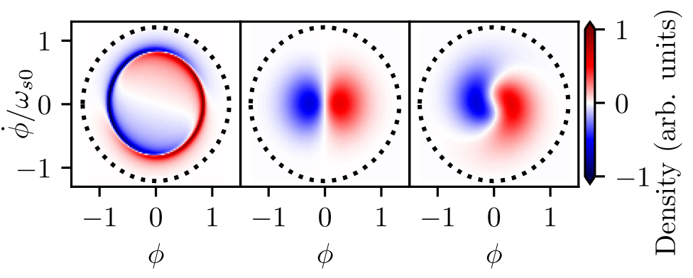



Different instability mechanisms
HOM only
Broadband only
HOM + Broadband
$$N_{p}/N_{CBI}$$
$$N_{p}/N_{CBI}$$
$$N_{p}/N_{CBI}$$
$→$ BB impedance modifies the structure of the unstable mode

Slide 18
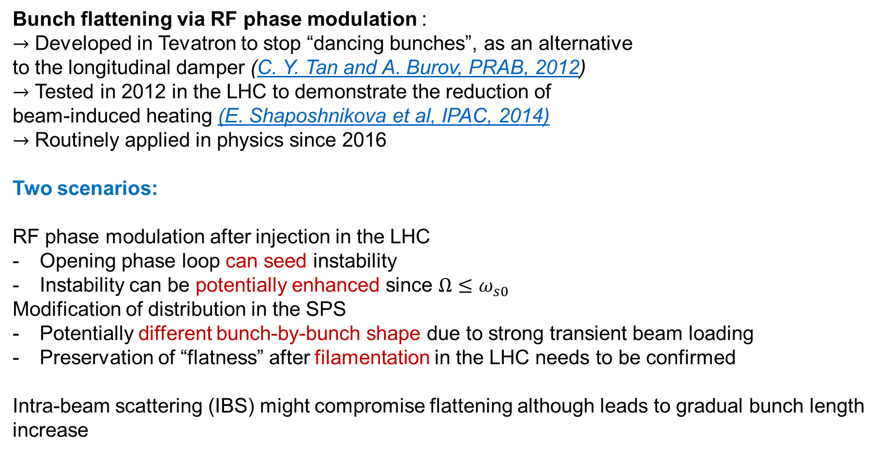
Possible cures: flattened particle distribution
Bunch flattening via RF phase modulation :
$→$ Developed in Tevatron to stop “dancing bunches”, as an alternative to the longitudinal damper (C. Y. Tan and A. Burov, PRAB, 2012)
$→$ Tested in 2012 in the LHC to demonstrate the reduction of beam-induced heating (E. Shaposhnikova et al, IPAC, 2014)
$→$ Routinely applied in physics since 2016
Two scenarios:
RF phase modulation after injection in the LHC
Opening phase loop can seed instability
Instability can be potentially enhanced since $Ω≤ω_{s0}$
Modification of distribution in the SPS
Potentially different bunch-by-bunch shape due to strong transient beam loading
Preservation of “flatness” after filamentation in the LHC needs to be confirmed
Intra-beam scattering (IBS) might compromise flattening although leads to gradual bunch length increase
Measurements in Tevatron

Slide 19
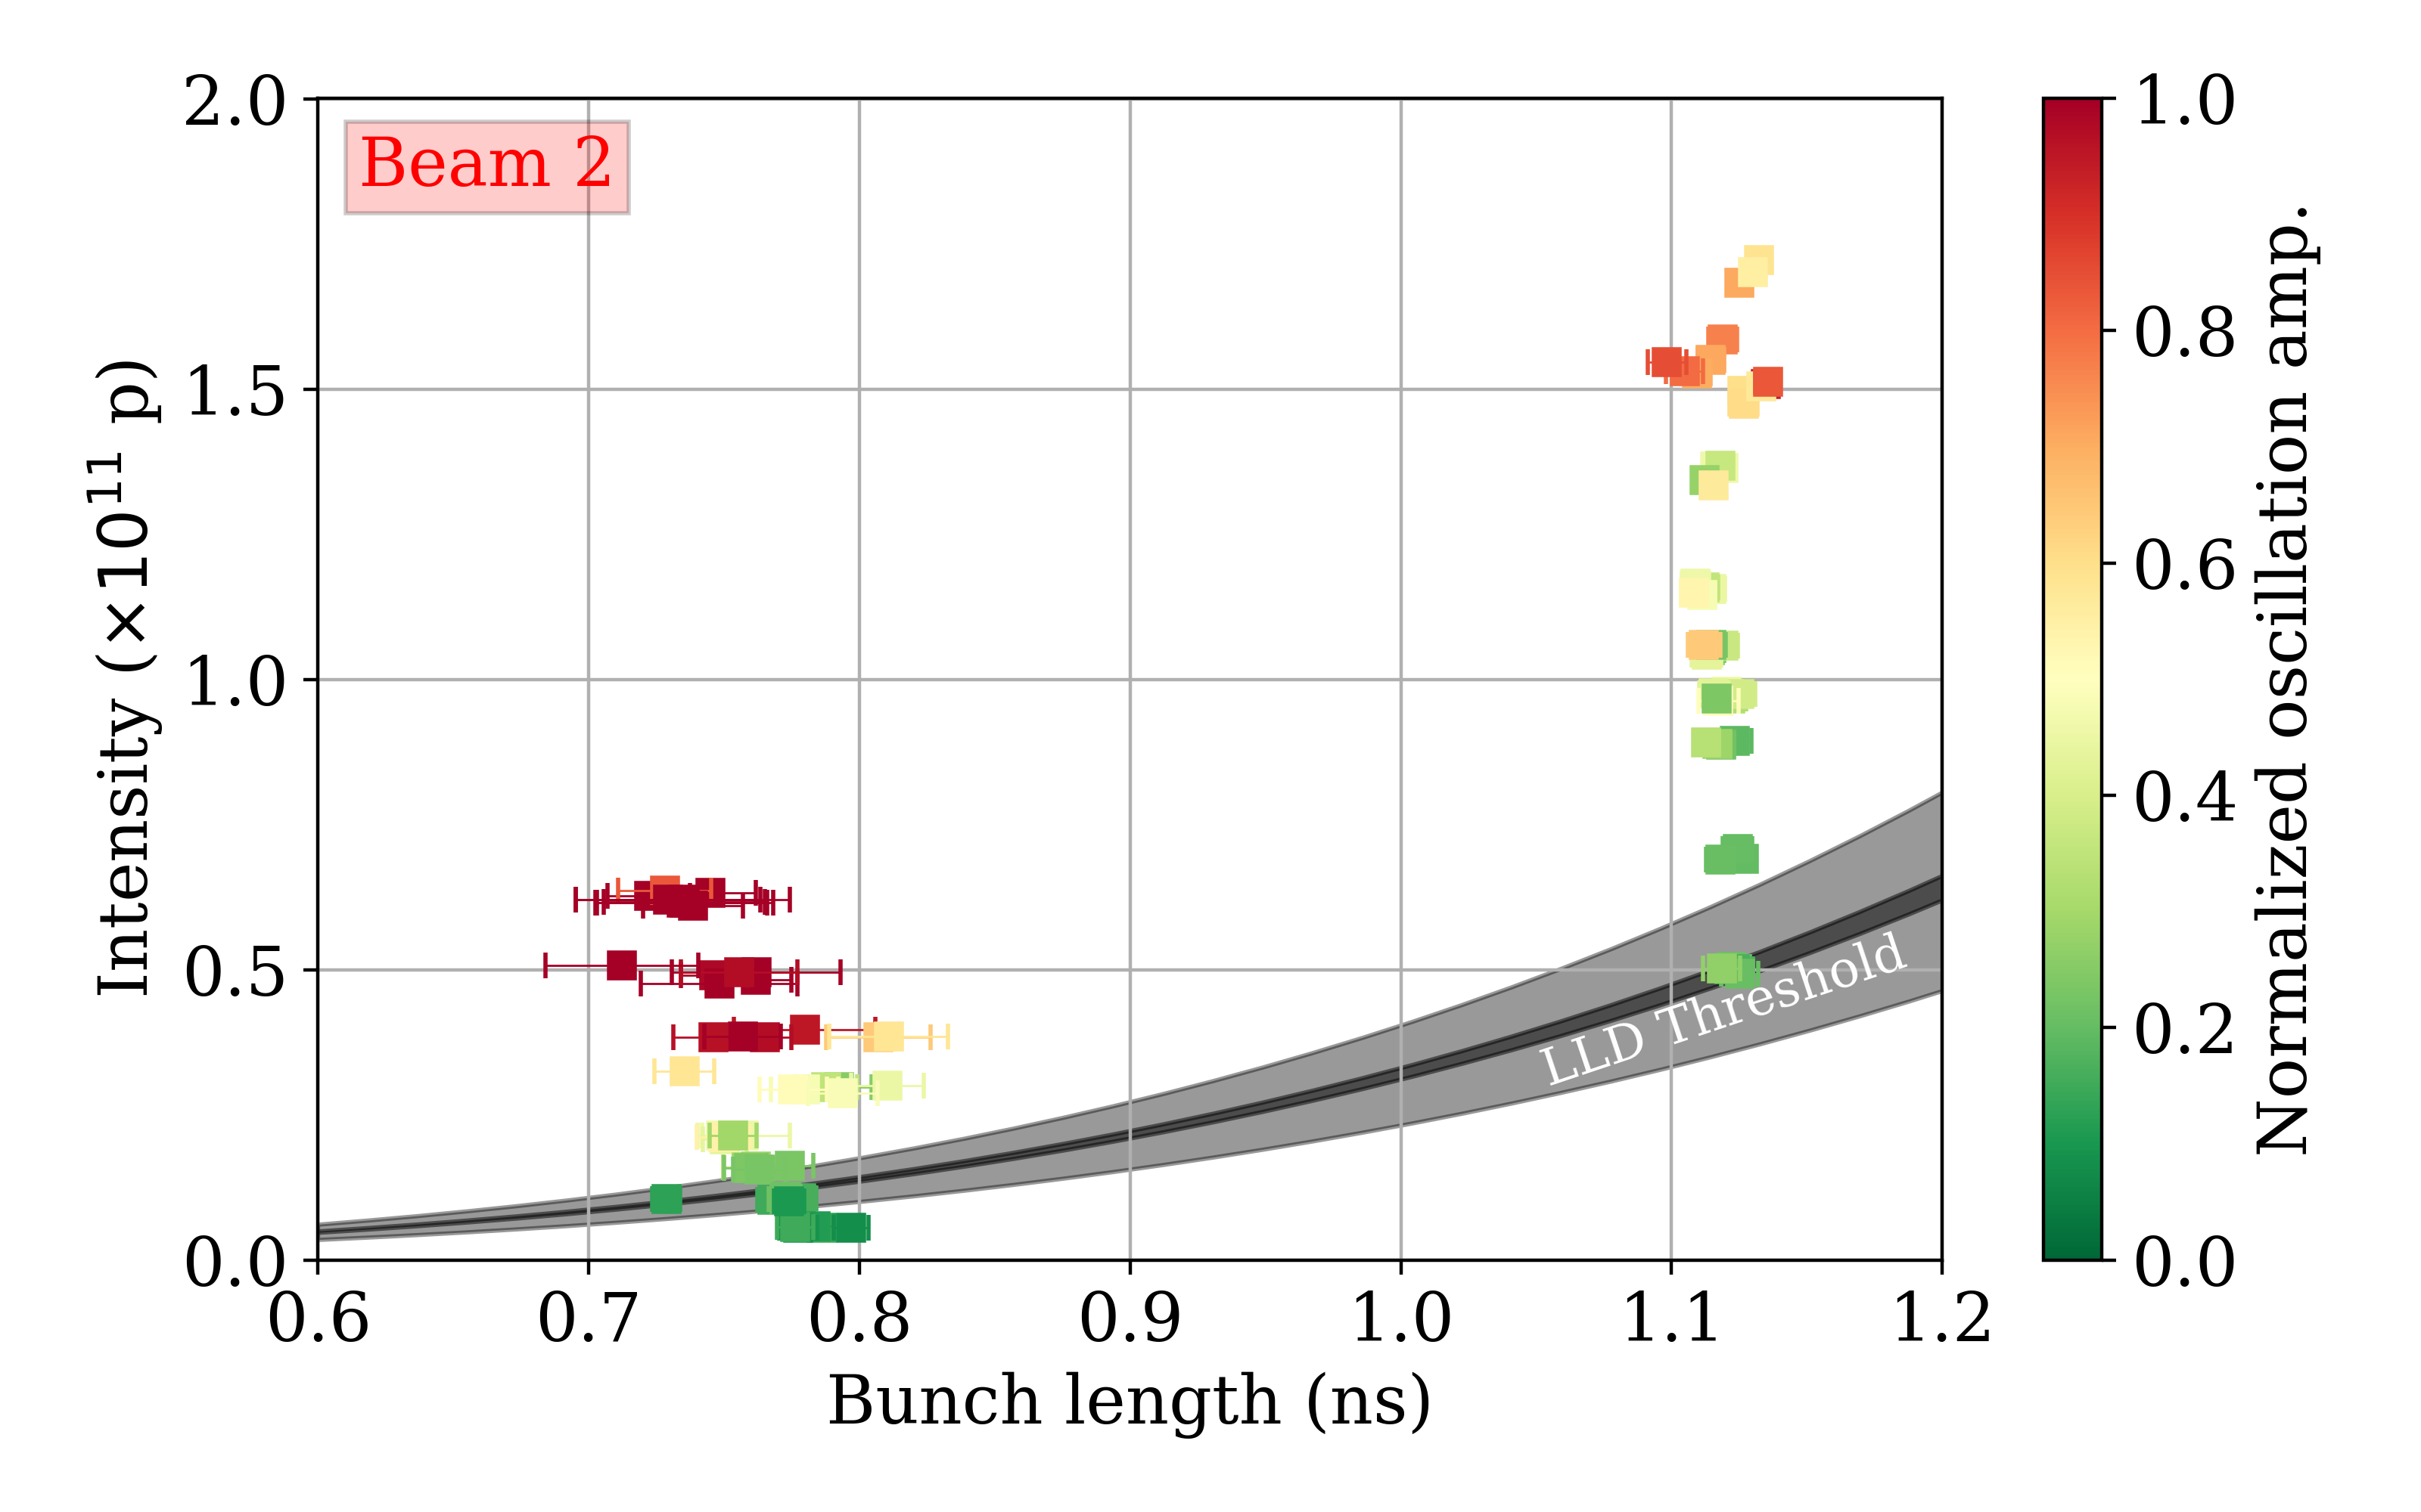
Measurements results
Courtesy of M. Zampetakis

Slide 20
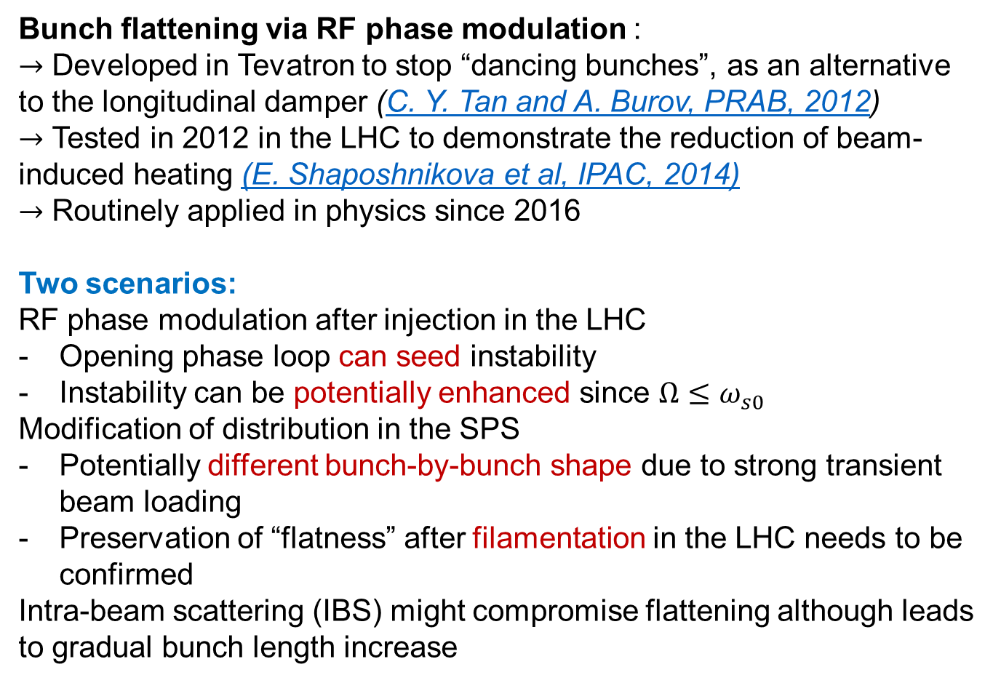
Possible cures: flattened particle distribution
Bunch flattening via RF phase modulation :
$→$ Developed in Tevatron to stop “dancing bunches”, as an alternative to the longitudinal damper (C. Y. Tan and A. Burov, PRAB, 2012)
$→$ Tested in 2012 in the LHC to demonstrate the reduction of beam-induced heating (E. Shaposhnikova et al, IPAC, 2014)
$→$ Routinely applied in physics since 2016
Two scenarios:
RF phase modulation after injection in the LHC
Opening phase loop can seed instability
Instability can be potentially enhanced since $Ω≤ω_{s0}$
Modification of distribution in the SPS
Potentially different bunch-by-bunch shape due to strong transient beam loading
Preservation of “flatness” after filamentation in the LHC needs to be confirmed
Intra-beam scattering (IBS) might compromise flattening although leads to gradual bunch length increase
Measurements in Tevatron
LHC
H. Timko et al, Evian, 2019

Slide 21
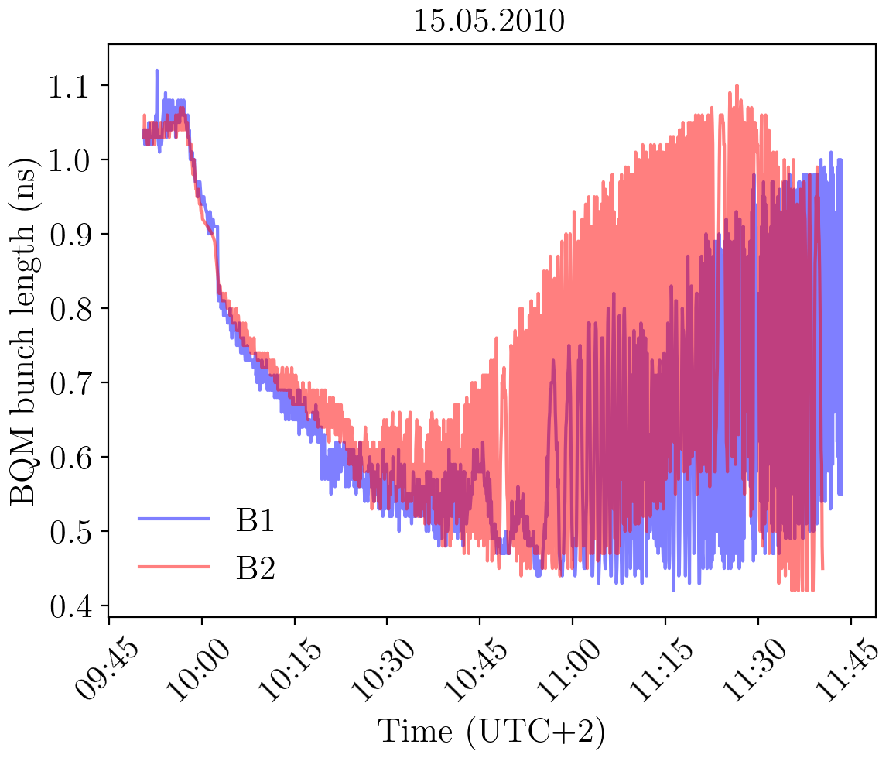
LHC Longitudinal collective effects
First observation loss of Landau damping (LLD)
E. Shaposhnikova et al, IPAC, 2011

Slide 22
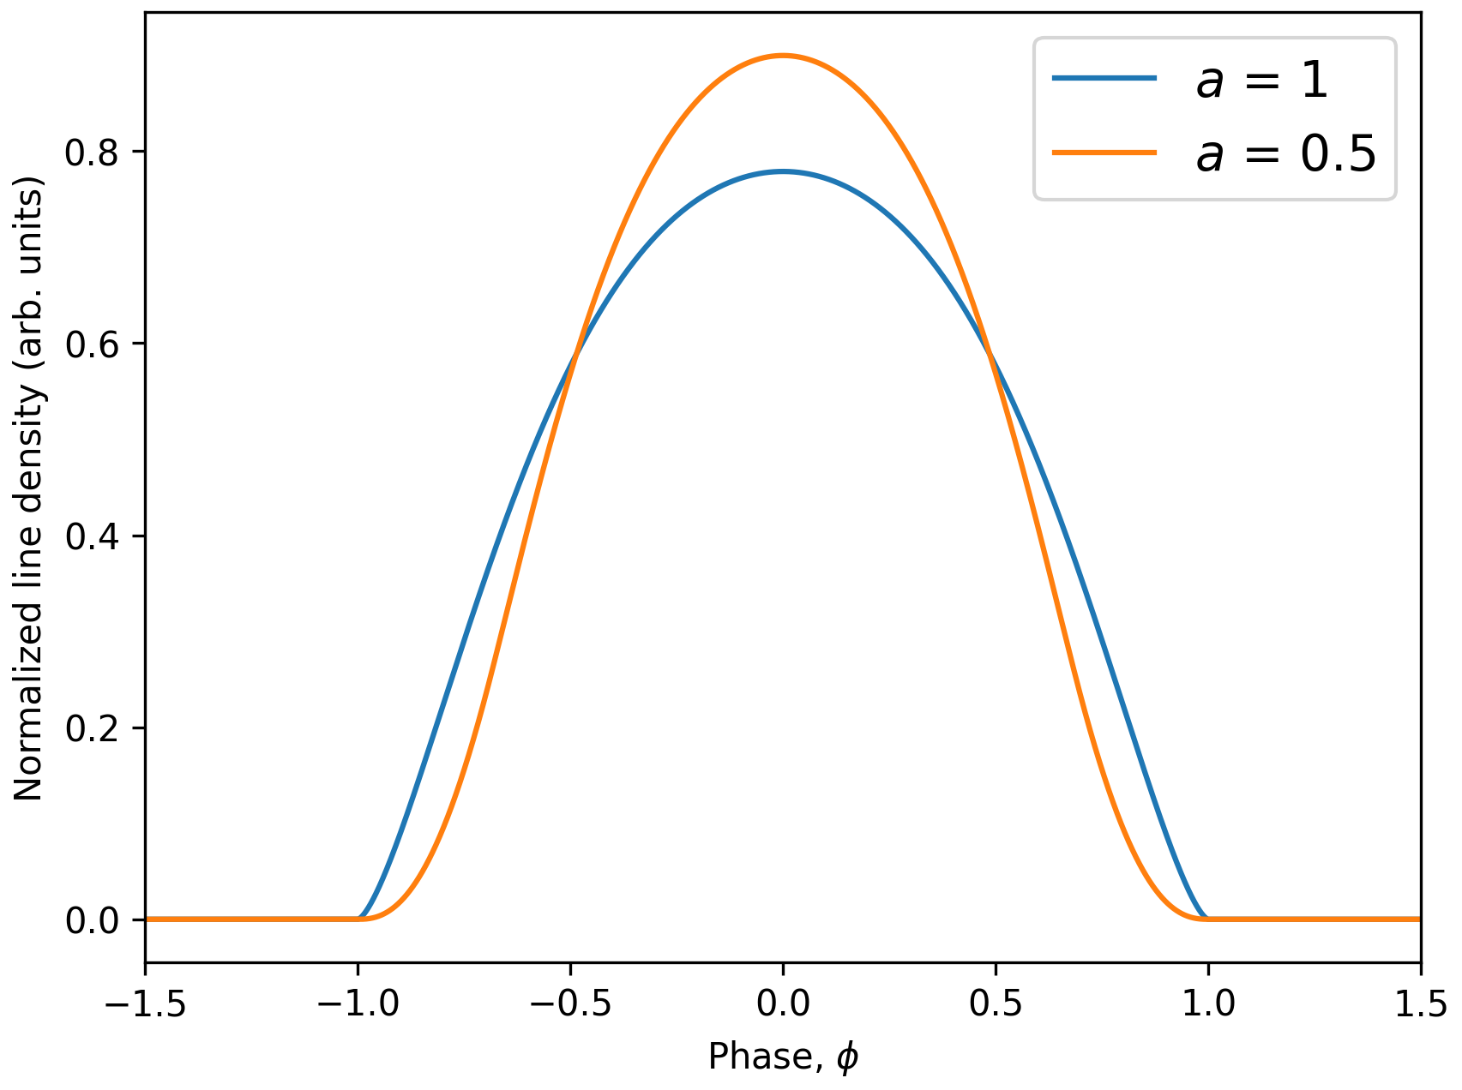
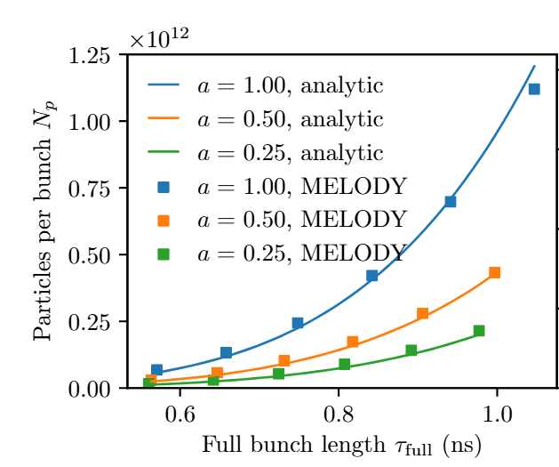
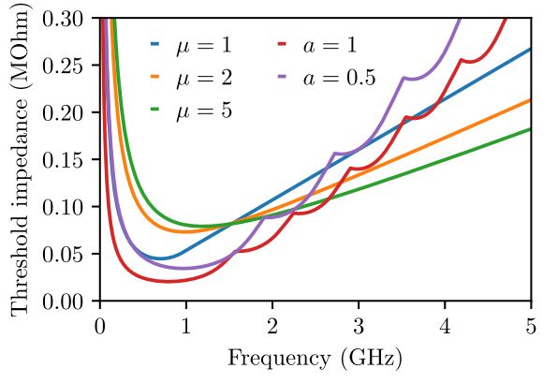
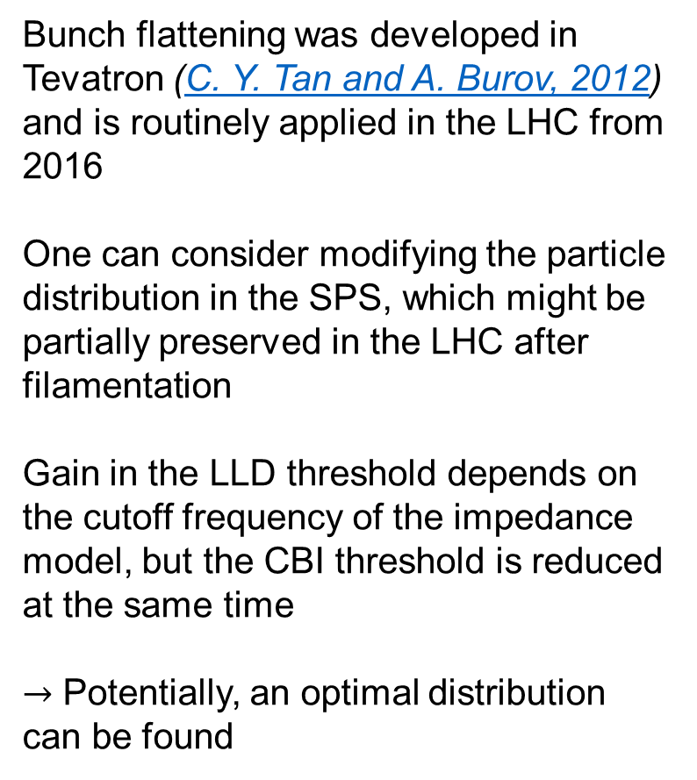
Possible cures: modified particle distribution
Bunch flattening was developed in Tevatron (C. Y. Tan and A. Burov, 2012) and is routinely applied in the LHC from 2016
One can consider modifying the particle distribution in the SPS, which might be partially preserved in the LHC after filamentation
Gain in the LLD threshold depends on the cutoff frequency of the impedance model, but the CBI threshold is reduced at the same time
$→$ Potentially, an optimal distribution can be found
H. Timko et al, Evian, 2019

Slide 23
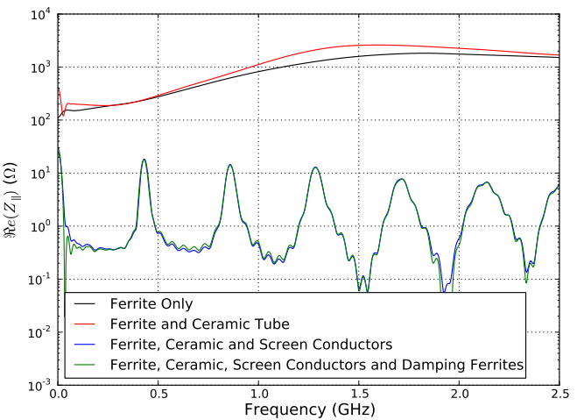
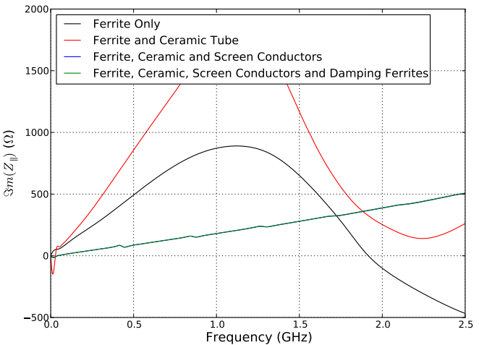
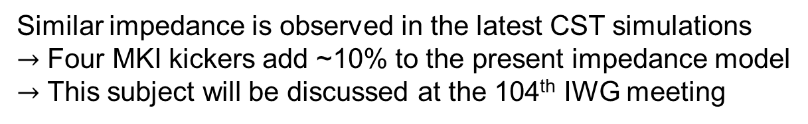

Possible missing impedance
During preparation for the 2024 JAP workshop, the imaginary part of the MKI (and MKI-cool) and other kicker impedance was found to be missing in the LHC impedance model
Example of past CST simulations (H. Day, PhD thesis, 2013)
$$ImZ/k≈2mΩ$$
Similar impedance is observed in the latest CST simulations
$→$ Four MKI kickers add ~10% to the present impedance model
$→$ This subject will be discussed at the 104th IWG meeting

Slide 24
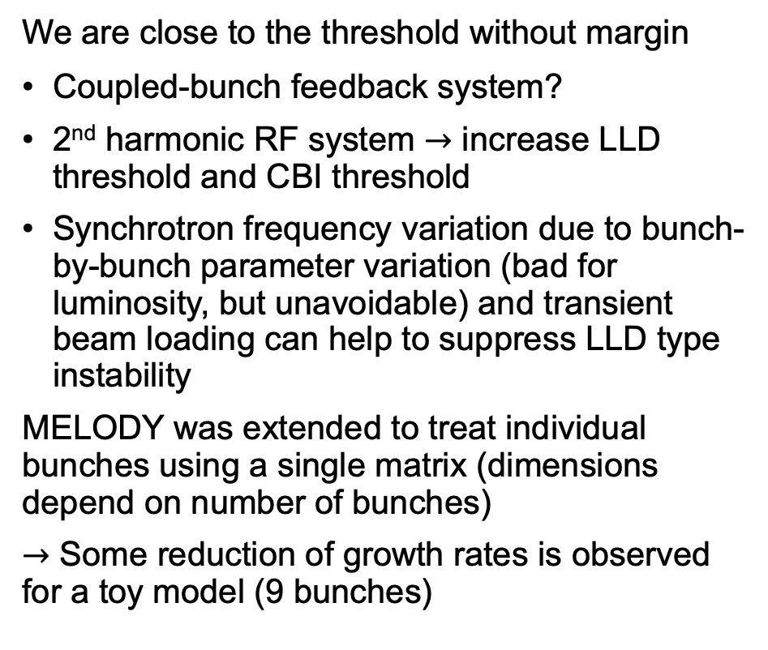
Possible cures
We are close to the threshold without margin
Coupled-bunch feedback system?
2nd harmonic RF system $→$ increase LLD threshold and CBI threshold
Synchrotron frequency variation due to bunch-by-bunch parameter variation (bad for luminosity, but unavoidable) and transient beam loading can help to suppress LLD type instability
MELODY was extended to treat individual bunches using a single matrix (dimensions depend on number of bunches)
$→$ Some reduction of growth rates is observed for a toy model (9 bunches)
Example for short bunches of ~0.8 ns

Slide 25
Possible cures
We are close to the threshold without margin
Coupled-bunch feedback system?
2nd harmonic RF system $→$ increase LLD threshold and CBI threshold
Synchrotron frequency variation due to bunch-by-bunch parameter variation (bad for luminosity, but unavoidable) and transient beam loading can help to suppress LLD type instability
MELODY was extended to treat individual bunches using a single matrix (dimensions depend on number of bunches)
$→$ Some reduction of growth rates is observed for a toy model (9 bunches)
Example for short bunches of ~0.8 ns

Slide 26
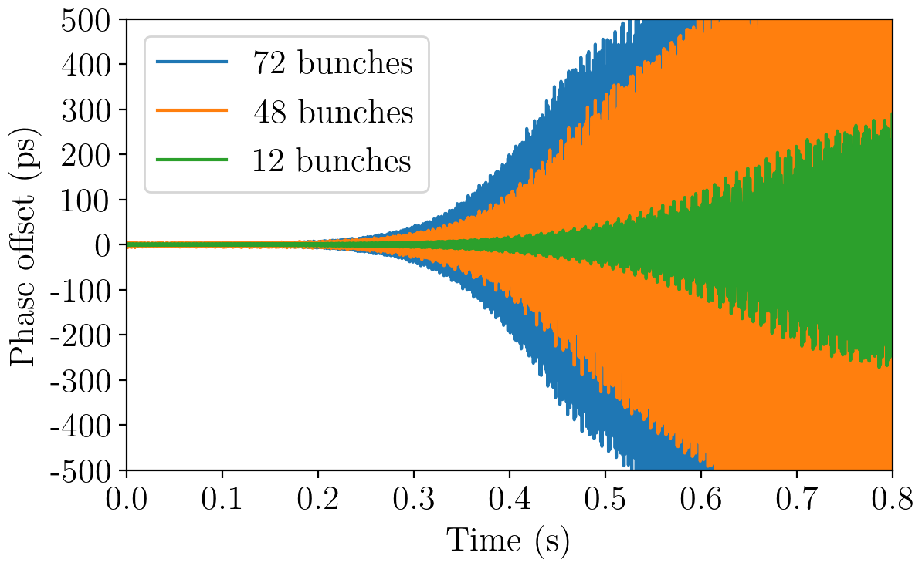


Comparison with simulations
Coupled-bunch instability for bunch trains with 25 ns spacing, $V_{rf} =7.2$ MV, $E = 450$ GeV (MELODY)
Example of simulations using BLonD
$τ_{4σ} = 1.3$ns
LLD threshold
Overall good agreement with some discrepancies
Consistent with beam observations, as higher-harmonic RF system (800 MHz) is necessary to reach even LHC nominal intensity
More accurate measurements to be done

Slide 27
HL-LHC impedance model
Real part
Imaginary part
Input from N. Mounet
BB contributions from different elements are added as a single BB resonator with $f_{r}$= 5 GHz
$→$ It dominates the effective impedance of HL-LHC
$→$ Model refinement is necessary for precise predictions of instability threshold (new fellow is arriving)

Slide 28

Beam-based measurements of LLD threshold
Different measurements were performed before LS2 (J. E. Muller, PhD thesis, 2016)
Example of SPS MD on 29.04.2022
Phase kick
Injection with phase loop on
Phase loop off
$→$ This technique is already used in the SPS and PS (PhD project of L. Intelisano)
$→$ Precise knowledge of RF voltage is important (see details in talk by B. Karlsen-Baeck)

Slide 29


Beam-based measurements of LLD threshold
Different measurements were performed before LS2 (J. E. Muller, PhD thesis, 2016)
Example of SPS MD on 29.04.2022
Phase kick
Injection with phase loop on
Phase loop off
$→$ This technique is already used in the SPS and PS (PhD project of L. Intelisano)
$→$ Precise knowledge of RF voltage is important (see details in talk by B. Karlsen-Baeck)
$→$ Residual oscillation amplitude contains information about impedance (IK, T. Argyropoulos, and E. Shaposhnikova, PRAB, 2021)

Slide 30


Sensitivity to the cut-off frequency
MELODY results for single BB impedance at LHC flatbottom
$f_{r}$= 4 GHz
$f_{r}$= 8 GHz
LLD threshold
LLD threshold
$→$ Oscillation amplitude after the kick strongly depends on the effective cut-off frequency
$→$ Scanning parameter space allows to probe longitudinal impedance

Slide 31


