Slide 1
High-intensity MD results
& impact on luminosity
S. Kostoglou, C. Antuono, P. Arrutia, F. Asvesta, H. Bartosik, C. Bracco, R. Bruce, X. Buffat, D. Butti,
R. De Maria, Y. Dutheil, I. Efthymiopoulos, C. Hernalsteens, M. Hostettler, G. Iadarola, B. Karlsen-Baeck,
A. Kastrinellis, T. Levens, K. Li, C. Marelli, I. Mases, L. Mether, D. Mirarchi, S. Morales, N. Mounet,
Y. Papaphilippou, J. Pucek, A. Radoslavova, S. Redaelli, G. Rumolo, B. Salvachua, B. Salvant,
M. Solfaroli, F. Soubelet, G. Sterbini, H. Timko, R. Tomas, G. Trad, J. Uythoven, D. Valuch, F. Vellotti,
J. Wanczyk, J. Wenninger, C. Wiesner, D. Wollmann, M. Zampetakis, C. Zannini
Thanks to: MD coordinators, MP, LHC OP, Injectors OP, WP2..
15th HL-LHC Collaboration Meeting
02/10/2025

Slide 2
Towards HL-LHC operational scenario
1. Luminosity
2. Dynamic Aperture
Target: 3000 fb⁻¹ (Run 1-6)
Beam & machine parameter evolution: models, DA, Run3 & HL MD experience.
Schedule: operational days + intensity ramp-up.
Alternative scenarios: flat optics, filling schemes, ultimate pileup, LHCb upgrade..
DA targets for acceptable beam lifetime.
Optics: Round vs Flat.
Critical phases: End of adjust, start/end of leveling.
Crossing angle leveling.
* Covered yesterday (link)
3. Experience from Run3
4. HL-LHC MDs
Negative octupole polarity.
Flat optics.
Losses in Adjust & tails.
Emittance growth in collisions
Crossing angle leveling.
BCMS vs standard beams.
HL-LHC INDIVs → Collisions.
4x72b@2.3e11 ppb (1200b) → Injection.
2x56b@2.3e11 (600b) → Flat Top.

Slide 3
Overview
2026 high intensity tests
HL-LHC
2025 MDs
2026 MDs
 | Phase | Beam type | N_{b}
MD1 | Collisions | HL INDIVs | 6
MD2 | Flat top | 8b4e 2x56 | 560
 | Injection | standard 4x72 | 1152
Goals for MD3-4 | Collisions | 8b4e 2x56 | 560
 | Ramp 500 GeV | standard 1x72 | 300
 | Ramp 500 GeV | BCMS 2x36 | 300
 | 3 TeV | HL INDIVs | 6

Slide 4
Overview
2026 high intensity tests
HL-LHC
2025 MDs
2026 MDs
MD Merit
 | Phase | Beam type | N_{b}
MD1 | Collisions | HL INDIVs | 6
MD2 | Flat top | 8b4e 2x56 | 560
 | Injection | standard 4x72 | 1152
Goals for MD3-4 | Collisions | 8b4e 2x56 | 560
 | Ramp 500 GeV | standard 1x72 | 300
 | Ramp 500 GeV | BCMS 2x36 | 300
 | 3 TeV | HL INDIVs | 6
Beam quality evolution with single HL bunches (emittance growth and tail studies along the cycle via WS). Importance of transverse tails for minimizing losses in Adjust & experimentally measured gain in integrated luminosity with “low-tails”.
Collisions in aggressive BB regime, reached 160 pileup!

Slide 5
Overview
2026 high intensity tests
HL-LHC
2025 MDs
2026 MDs
MD Merit
 | Phase | Beam type | N_{b}
MD1 | Collisions | HL INDIVs | 6
MD2 | Flat top | 8b4e 2x56 | 560
 | Injection | standard 4x72 | 1152
Goals for MD3-4 | Collisions | 8b4e 2x56 | 560
 | Ramp 500 GeV | standard 1x72 | 300
 | Ramp 500 GeV | BCMS 2x36 | 300
 | 3 TeV | HL INDIVs | 6
Tried to collide for the 1st time with HL trains, dumped x3 due to corrector trip – unrelated to MD or beam type.
Reached for the 1st time flat top with HL trains!
Studied beam quality from Injection to Flat top.
HL alternative baseline (4x56) not available from injectors yet.
First step towards 2026 high intensity tests@6.8TeV!

Slide 6
Overview
2026 high intensity tests
HL-LHC
2025 MDs
2026 MDs
MD Merit
 | Phase | Beam type | N_{b}
MD1 | Collisions | HL INDIVs | 6
MD2 | Flat top | 8b4e 2x56 | 560
 | Injection | standard 4x72 | 1152
Goals for MD3-4 | Collisions | 8b4e 2x56 | 560
 | Ramp 500 GeV | standard 1x72 | 300
 | Ramp 500 GeV | BCMS 2x36 | 300
 | 3 TeV | HL INDIVs | 6
Injection losses, RF aspects, debunching & intra-batch ADT cleaning, beam quality at Injection with long trains (emittance growth & tail increase).
MD ended after 6L2 pressure spike→ limits imposed for next 2025 MDs.
First step towards HL baseline!

Slide 7
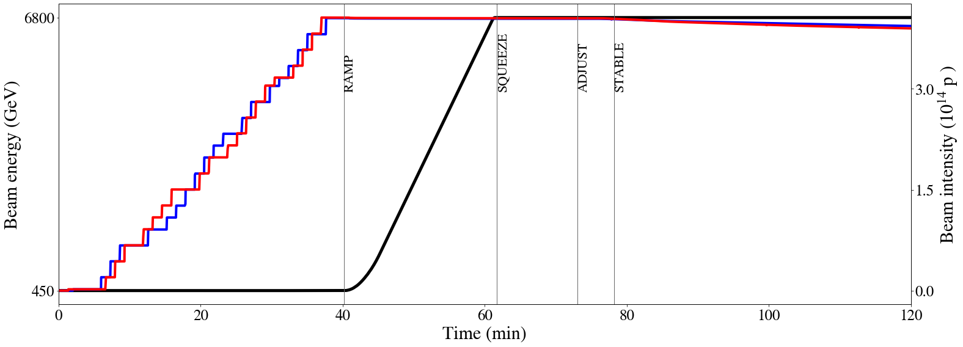
Critical phases for HL performance

Slide 8
Critical phases for HL performance
Head-on BB regime
Long-range BB regime
Beam quality from injectors
Losses end of adjust & during collisions
Injection losses
Emittance growth of unknown source
Beam quality transfered in LHC
PC ripple
Emittance growth of unknown source
Start of ramp losses
Emittance growth of unknown source
Tail evolution
Losses in Adjust: See X. Buffat this session
Start of ramp losses: See H. Timko this session
PC ripple: See G. Sterbini yesterday afternoon
Debunching

Slide 9
Critical phases for HL performance
Head-on BB regime
Long-range BB regime
Beam quality from injectors
Losses end of adjust & during collisions
Injection losses
Emittance growth of unknown source
Beam quality transfered in LHC
PC ripple
Emittance growth of unknown source
Start of ramp losses
Emittance growth of unknown source
Tail evolution
Debunching

Slide 10
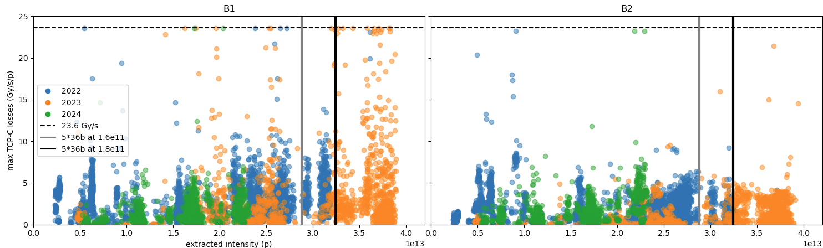
Injection: Injection losses with HL trains
2023: Losses during B1 injection, reaching BLM saturation in IR7 for RS01. High losses but also high variability across fills.
2024-25: Situation improved, but cause still unclear. Hypothesis was that it was due to shorter trains.
HL long trains: Currently being explored in MDs by ABT.
Y. Dutheil, F. Velotti, C. Bracco,
B. Salvachua, S. Morales
4x72→6.6e13p
B1
B2
BLM limit

Slide 11
Injection: Injection losses with HL trains
2023: Losses during B1 injection, reaching BLM saturation in IR7 for RS01. High losses but also high variability across fills.
2024-25: Situation improved, but cause still unclear. Hypothesis was that it was due to shorter trains.
HL long trains: Currently being explored in MDs by ABT.
MD results (see backup slides):
  2x56: 5-10% of BLM thresholds. 4x56 to be tested in 2026.
  4x72: injected successfully, reaching 50-60% BLM thresholds (30% of electronic limit) with only 2-3% SPS scraping.
Conclusion:
  Feasible with tight margin, BE/SY to review BLM changes needed for LS3.
  Improvement w.r.t to 2023 pointing to injectors’ optimization of tails.

Slide 12
Injection: Beam quality from SPS to LHC
 | SPS (after scraping) |  | LHC injection | LHC injection
 | Emittance | q-factor | Emittance | q-factor | Bunch intensity (ppb) | Bunch length (ns)
8b4e, 2x56 | ε_{H}=1.6 μm ε_{V}=1.5 μm LIU target=1.65 μm | q_{H}=1.07 q_{V}=1.06 | ε_{H}=1.7 μm ε_{V}=1.5 μm | q_{H}=1.2 q_{V}=1.1 | 2.31e11 | 1.2
Standard, 4x72 | ε_{H}=2.3 μm ε_{V}=2.1 μm LIU target=2.1 μm | q_{H}=1.15 q_{V}=1.16 | ε_{H}=2.4 μm ε_{V}=2.1 μm | q_{H}=1.25 q_{V}=1.1 | 2.25e11 | 1.25
BCMS, 5x48 | ε_{H}=1.6 μm ε_{V}=1.4 μm LIU target=1.65 μm | q_{H}=1.22 q_{V}=1.25 | - | - | - | -
Conclusion: Reaching LHC injection with good brightness and controlled tails for both 8b4e and standard. Full scheme BCMS & 8b4e to be tested in next MD blocks 2025-26.
From I. Mases LBOC

Slide 13
Critical phases for HL performance
Head-on BB regime
Long-range BB regime
Beam quality from injectors
Losses end of adjust & during collisions
Injection losses
Emittance growth of unknown source
Beam quality transfered in LHC
PC ripple
Emittance growth of unknown source
Start of ramp losses
Emittance growth of unknown source
Tail evolution
Debunching

Slide 14
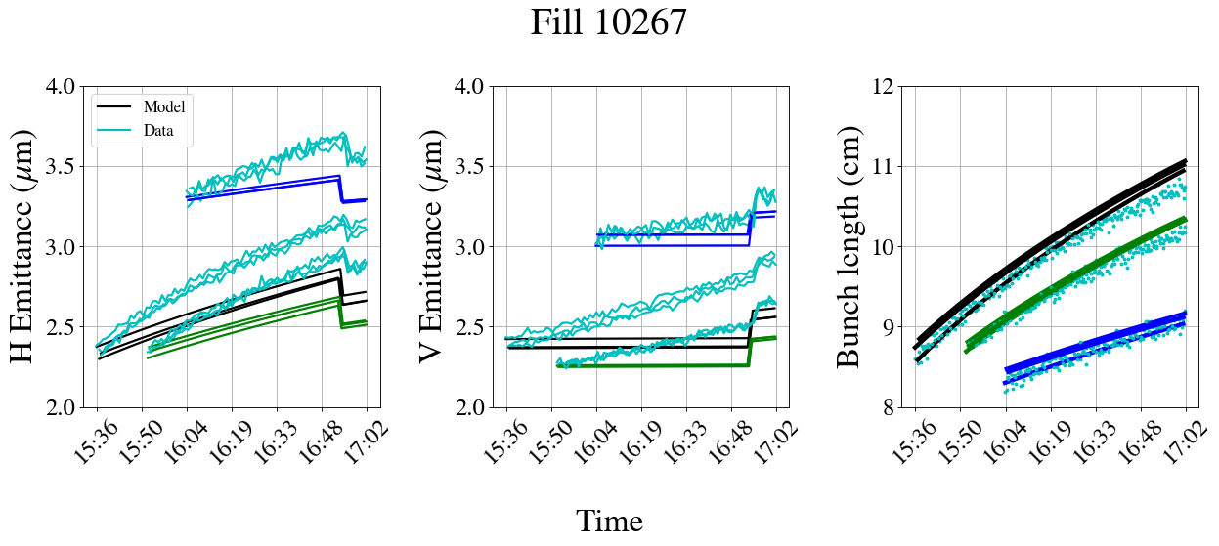
Injection plateau: Emittance growth
Emittance growth during injection of unknown source, ~0.2 μm/h beyond IBS.
MD results:
  Although exact source not identified, brightness independent.
  Confirmed with both HL INDIVs and trains.
Max. brightness, model → HL INDIV
-20% brightness, model
-60% brightness, model
Measurements

Slide 15
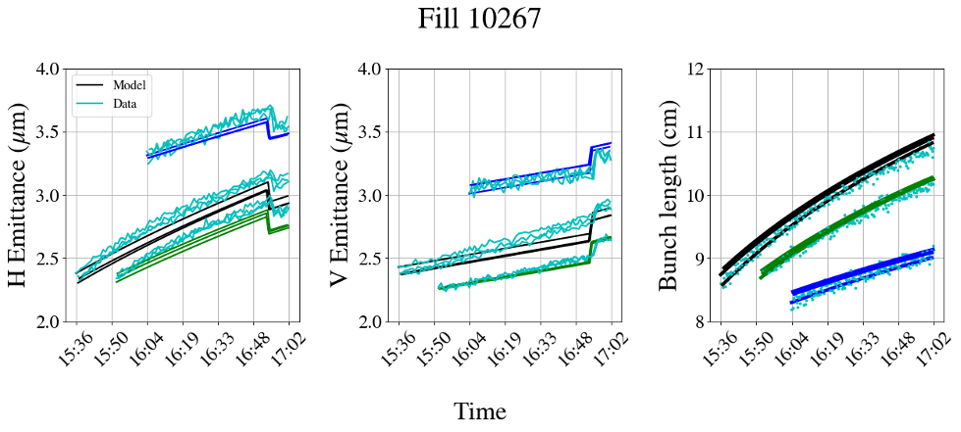
Injection plateau: Emittance growth
Emittance growth during injection of unknown source, ~0.2 μm/h beyond IBS.
MD results:
  Although exact source not identified, brightness independent.
  Confirmed with both HL INDIVs and trains.
Max. brightness, model → HL INDIV
-20% brightness, model
-60% brightness, model
Measurements
IBS + 0.2 μm/h

Slide 16
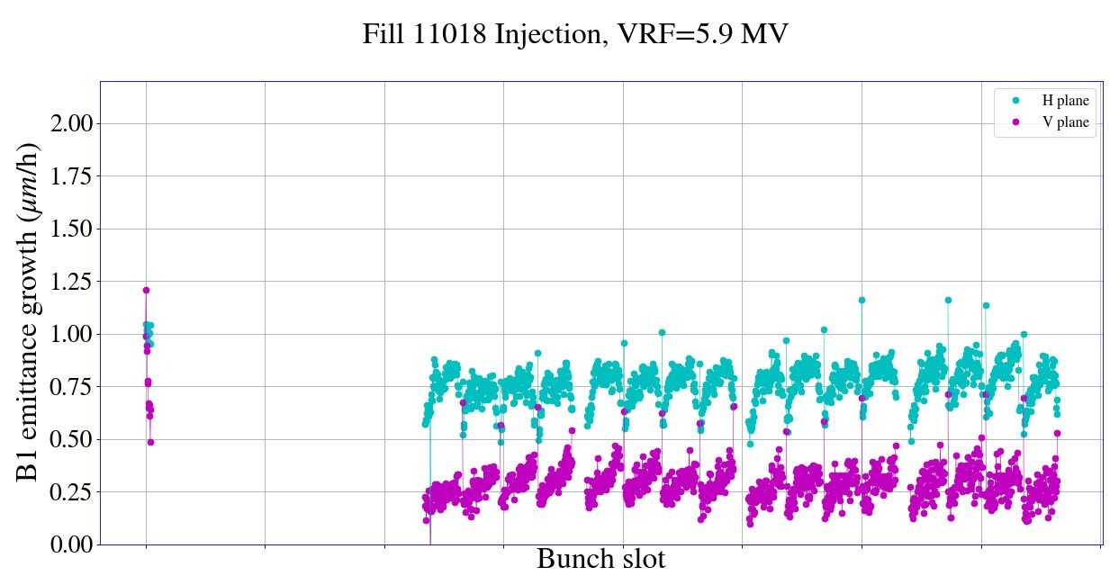
Injection plateau: Emittance growth
Emittance growth during injection of unknown source, ~0.2 μm/h beyond IBS.
MD results:
  Although exact source not identified, brightness independent.
  Confirmed with both HL INDIVs and trains.
Conclusion: Not expected to degrade for HL beams.
Max. brightness, model → HL INDIV
-20% brightness, model
-60% brightness, model
Measurements
HL trains
IBS + 0.2 μm/h
H
IBS growth rate
V

Slide 17
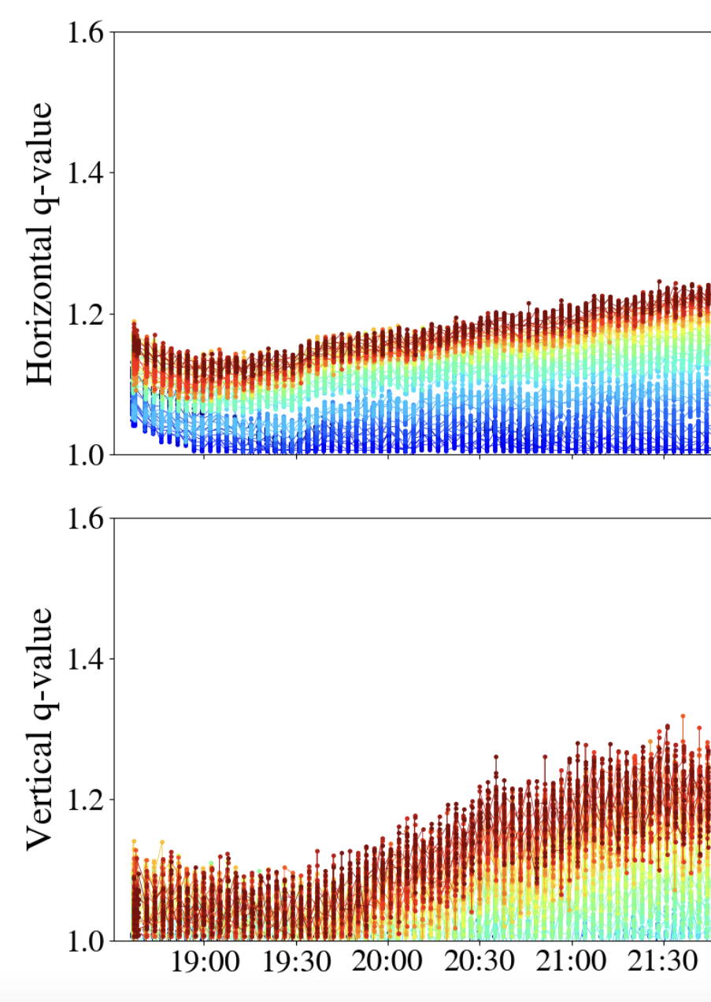
Injection plateau: Tail population
q-factor
MD results:
  Tail increase of bunches at the end of the train (e-cloud related) during injection with long trains.
  Also observed during scrubbing with 2x72 and nominal bunch intensity.
  Based on correlation of transverse tails & losses at the end of Adjust (combined with tight DA at start of leveling for HL), can result in important intensity losses in Adjust → might be solved with e-cloud mitigation measures put in place for HL.
Conclusion: Tail development at injection due to e-cloud might be an issue for HL long trains.
H
V
Blue: bunches at the start of the train
Red: bunches at the end of the train

Slide 18
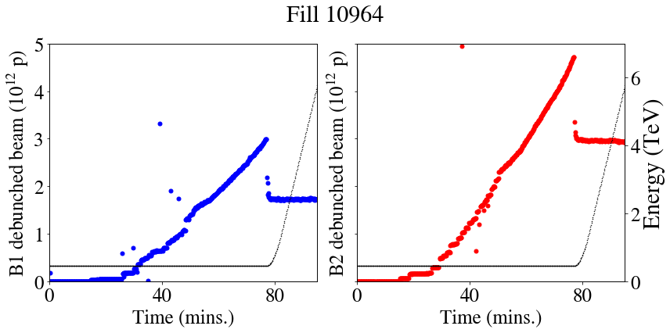
Ramp: Debunched beam & start of ramp losses
Studies led by RF (see H. Timko, B. Karlsen-Baeck this session).
After TS1, 1h extended stay at injection in nominal operation & corresponding amount of debunched beam → ~55% BLM thresholds at start of ramp.
Debunched beam
Nominal operation – extended stay at injection
B1
B2

Slide 19
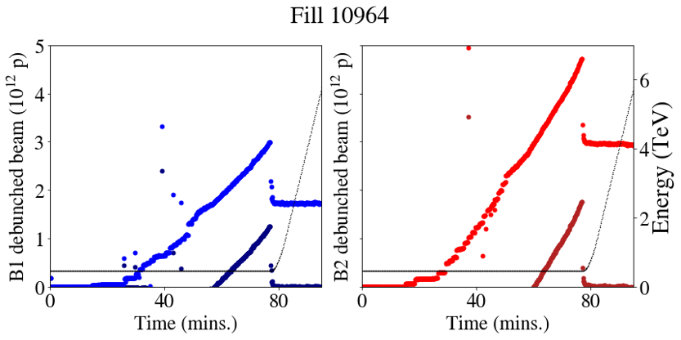
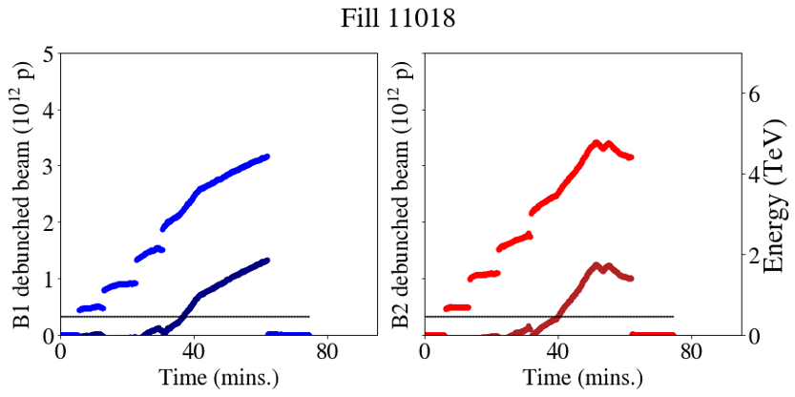
Ramp: Debunched beam & start of ramp losses
Studies led by RF (see H. Timko, B. Karlsen-Baeck this session).
After TS1, 1h extended stay at injection in nominal operation & corresponding amount of debunched beam → ~55% BLM thresholds at start of ramp.
MD results:
  Similar levels of debunched beam at 4x72b, 1200b MD but cannot be directly confirmed (no ramp).
  8b4e, 600b: 5-8% BLM thresholds at start of ramp.
Debunched beam
Nominal operation – extended stay at injection
4x72 MD
Applying FBCT/DCBCT calibration factor
B1
B2

Slide 20
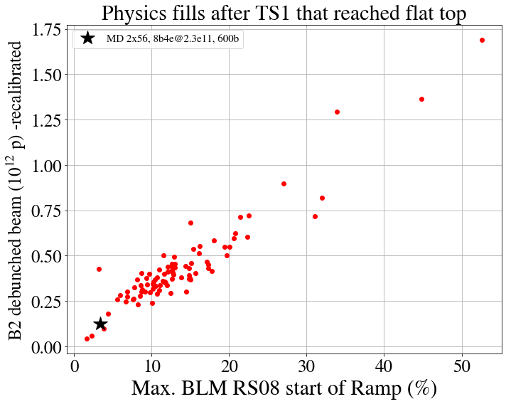
Ramp: Debunched beam & start of ramp losses
Statistics from 2025 operation after TS1 (see backup slides)

Slide 21
Ramp: Debunched beam & start of ramp losses
4x72@2.3e11 ppb,
1200b projection
Statistics from 2025 operation after TS1 (see backup slides)
8b4e MD, measured

Slide 22
Ramp: Debunched beam & start of ramp losses
Conclusions:
Clear need to ramp HL trains with large number of bunches for more accurate projections (RF MDs in 2025 & 2026).
Ramping a full HL machine will require mitigation measures:
  Clean debunched beam:
    ADT intra-batch cleaning (X. Buffat, D. Valuch et al.).
  Increase margin for losses at start of ramp:
    Raise BLM thresholds (D. Mirarchi, B. Salvachua et. al).
    PPLP (H. Timko, M. Solfaroli et. al).
  Prevent debunching:
    Increase RF voltage with high efficiency klystrons.
    Degrade emittances at injection to avoid debunching & preserve intensity.
4x72@2.3e11 ppb,
1200b projection
Statistics from 2025 operation after TS1 (see backup slides)
8b4e MD, measured

Slide 23
Critical phases for HL performance
Head-on BB regime
Long-range BB regime
Beam quality from injectors
Losses end of adjust & during collisions
Injection losses
Emittance growth of unknown source
Beam quality transfered in LHC
PC ripple
Emittance growth of unknown source
Start of ramp losses
Emittance growth of unknown source
Tail evolution
Debunching

Slide 24
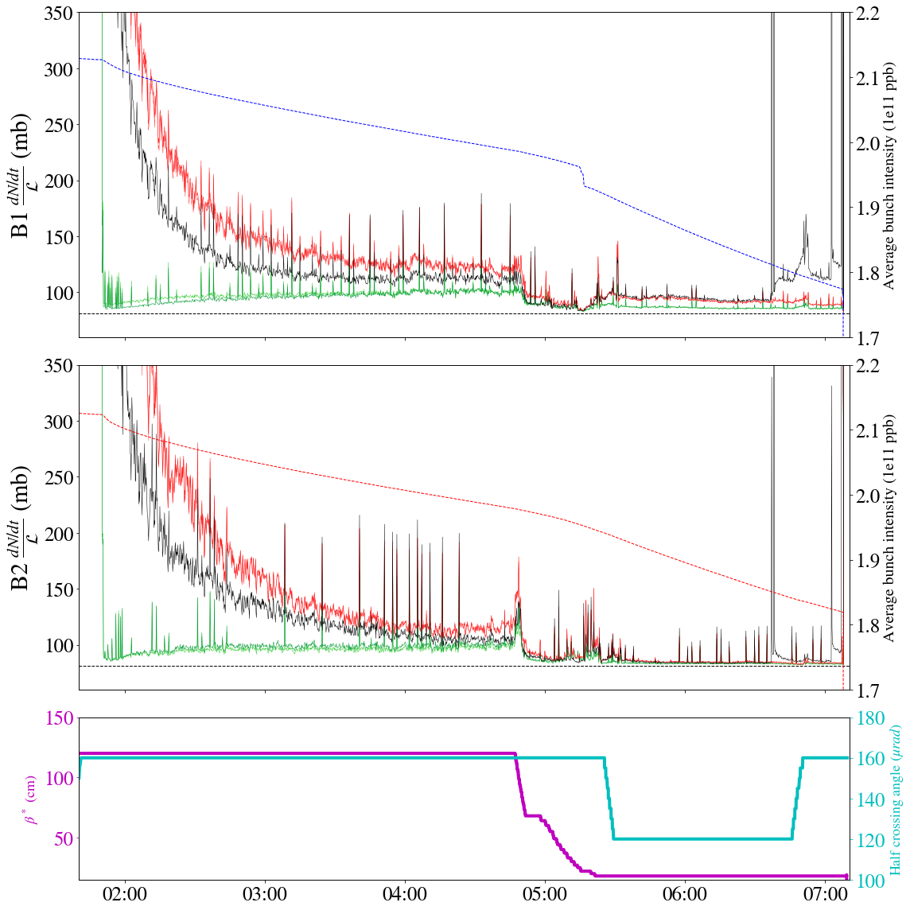
Adjust: Minimizing losses at the end of adjust
Losses at the end of Adjust when entering head-on BB dominated regime. More critical for high brightness HL bunches.
MD results:
  Phase of cycle only tested with HL INDIVs at the moment.
  Injected two groups of bunches with different tail population (q=1 and q=1.5)
  Needs to be tested with trains.
Conclusion: Clear improvement of losses with Gaussian bunches. Measured 3% gain in integrated luminosity. Backed-up by simulations.
B1
q=1 q=1.5
Burn-off limit
B2
β*
xing

Slide 25
Critical phases for HL performance
Head-on BB regime
Long-range BB regime
Beam quality from injectors
Losses end of adjust & during collisions
Injection losses
Emittance growth of unknown source
Beam quality transfered in LHC
PC ripple
Emittance growth of unknown source
Start of ramp losses
Emittance growth of unknown source
Tail evolution
Debunching

Slide 26
Collisions: Emittance growth
Emittance growth during collisions of unknown source, especially in V.
MD results (see backup slides):
  Measured 0.05-0.09 μm/h, operational levels in 2025 ~0.07 μm/h.
  Non-colliding bunches blowing up less.
  Tails tend to gaussianize in time.
  Measured only with HL INDIVs and needs to be tested with trains.
Conclusion: HL INDIVs have similar emittance growth levels to current operation in physics. Pending validation with HL trains.

Slide 27
Overview & Next steps
2026 high intensity tests
HL-LHC
2025 MDs
2026 MDs
 | Phase | Beam type | N_{b}
MD1 | Collisions | HL INDIVs | 6
MD2 | Flat top | 8b4e 2x56 | 560
 | Injection | standard 4x72 | 1152
Goals for MD3-4 | Collisions | 8b4e 2x56 | 560
 | Ramp 500 GeV | standard 1x72 | 300
 | Ramp 500 GeV | BCMS 2x36 | 300
 | 3 TeV | HL INDIVs | 6

Slide 28
Overview & Next steps
2026 high intensity tests
HL-LHC
2025 MDs
2026 MDs
MD Merit
 | Phase | Beam type | N_{b}
MD1 | Collisions | HL INDIVs | 6
MD2 | Flat top | 8b4e 2x56 | 560
 | Injection | standard 4x72 | 1152
Goals for MD3-4 | Collisions | 8b4e 2x56 | 560
 | Ramp 500 GeV | standard 1x72 | 300
 | Ramp 500 GeV | BCMS 2x36 | 300
 | 3 TeV | HL INDIVs | 6
Collide HL trains, aiming for levelling at HL pileup for a few hours!
Start of ramp losses, beam quality comparison of all HL variants, limited in batches + number of bunches due to 6L2.
First step towards 2026 high intensity tests@3 TeV!

Slide 29
Overview & Next steps
2026 high intensity tests
HL-LHC
2025 MDs
2026 MDs
MD Merit
 | Phase | Beam type | N_{b}
MD1 | Collisions | HL INDIVs | 6
MD2 | Flat top | 8b4e 2x56 | 560
 | Injection | standard 4x72 | 1152
Goals for MD3-4 | Collisions | 8b4e 2x56 | 560
 | Ramp 500 GeV | standard 1x72 | 300
 | Ramp 500 GeV | BCMS 2x36 | 300
 | 3 TeV | HL INDIVs | 6
Phase | Beam type | *N_{b}
Collisions | 8b4e 4x56 | 672
3 TeV | BCMS 5x48 | 1200
3 TeV | standard 4x72 | 1200
4x56b, blowup emittances at injection + other mitigations put in place, impact on start of ramp losses, impact on integrated luminosity.
Last opportunity for collisions with HL trains >1h.
Second step towards 2026 high intensity tests@6.8TeV!
*To be reviewed based on operational levels

Slide 30
Overview & Next steps
2026 high intensity tests
HL-LHC
2025 MDs
2026 MDs
MD Merit
 | Phase | Beam type | N_{b}
MD1 | Collisions | HL INDIVs | 6
MD2 | Flat top | 8b4e 2x56 | 560
 | Injection | standard 4x72 | 1152
Goals for MD3-4 | Collisions | 8b4e 2x56 | 560
 | Ramp 500 GeV | standard 1x72 | 300
 | Ramp 500 GeV | BCMS 2x36 | 300
 | 3 TeV | HL INDIVs | 6
Phase | Beam type | *N_{b}
Collisions | 8b4e 4x56 | 672
3 TeV | BCMS 5x48 | 1200
3 TeV | standard 4x72 | 1200
All HL variants with proper filling scheme & large number of bunches for beam quality comparison + start of ramp losses.
Second step towards 2026 high intensity tests@3 TeV!
+ e-cloud studies.
*To be reviewed based on operational levels

Slide 31
Overview & Next steps
2026 high intensity tests
HL-LHC
2025 MDs
2026 MDs
 | Phase | Beam type | N_{b}
MD1 | Collisions | HL INDIVs | 6
MD2 | Flat top | 8b4e 2x56 | 560
 | Injection | standard 4x72 | 1152
Goals for MD3-4 | Collisions | 8b4e 2x56 | 560
 | Ramp 500 GeV | standard 1x72 | 300
 | Ramp 500 GeV | BCMS 2x36 | 300
 | 3 TeV | HL INDIVs | 6
Phase | Beam type | *N_{b}
Collisions | 8b4e 4x56 | 672
3 TeV | BCMS 5x48 | 1200
3 TeV | standard 4x72 | 1200
Phase | Beam type | N_{b}
Flat top | 8b4e 4x56 | 1972
3 TeV | BCMS 5x48 | 2748
3 TeV | standard 4x72 | ~2000
*To be reviewed based on operational levels

Slide 32
Overview & Next steps
2026 high intensity tests
HL-LHC
2025 MDs
2026 MDs
 | Phase | Beam type | N_{b}
MD1 | Collisions | HL INDIVs | 6
MD2 | Flat top | 8b4e 2x56 | 560
 | Injection | standard 4x72 | 1152
Goals for MD3-4 | Collisions | 8b4e 2x56 | 560
 | Ramp 500 GeV | standard 1x72 | 300
 | Ramp 500 GeV | BCMS 2x36 | 300
 | 3 TeV | HL INDIVs | 6
Phase | Beam type | *N_{b}
Collisions | 8b4e 4x56 | 672
3 TeV | BCMS 5x48 | 1200
3 TeV | standard 4x72 | 1200
Phase | Beam type | N_{b}
Flat top | 8b4e 4x56 | 1972
3 TeV | BCMS 5x48 | 2748
3 TeV | standard 4x72 | ~2000
*To be reviewed based on operational levels
In 2025-26 MDs we will progressively ramp intensity & refine injection/ramp/collisions strategies in view of 2026 high intensity tests & approach as much as possible HL baseline.
HL-LHC MDs are extremely important to obtain experience with HL aspects, identify limitations & prepare as best as possible to reach HL targets.

Slide 33
Backup

Slide 34
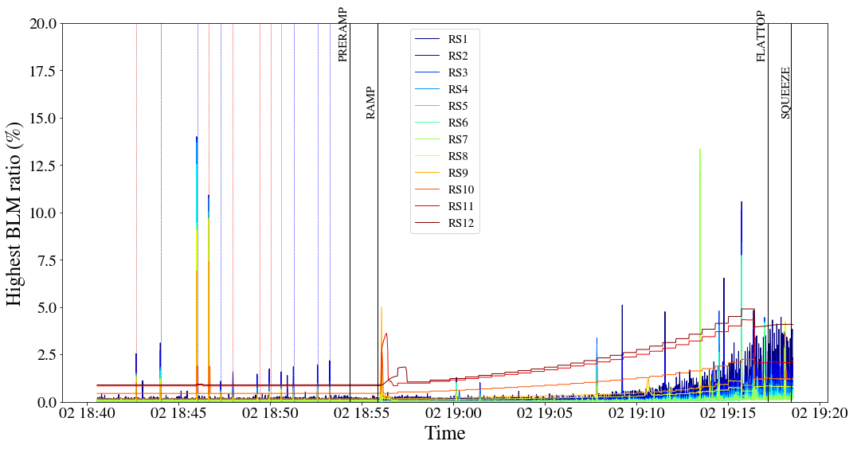
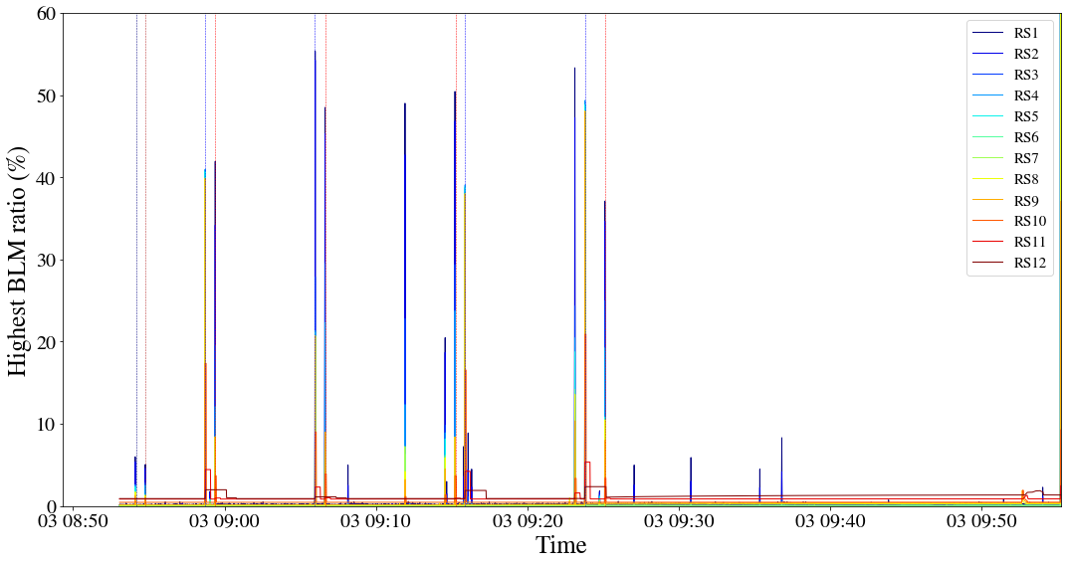
Injection: Injection losses with HL trains
MD results:
  2x56: 5-10% of BLM thresholds. 4x56 to be tested in 2026.
  4x72: injected successfully, reaching 50-60% BLM thresholds (30% of electronic limit) with only 2-3% SPS scraping.
Conclusion: Feasible with tight margin, BE/SY to review BLM changes needed for LS3. Improvement w.r.t to 2023 pointing to injectors’ optimization of tails.
Highest BLM ratios for all Running Sums
Vertical lines: injection B1/B2
Y. Dutheil, F. Velotti, C. Bracco,
B. Salvachua, S. Morales
20%
60%
8b4e MD, up to FT
4x72 MD, injection
RS1

Slide 35
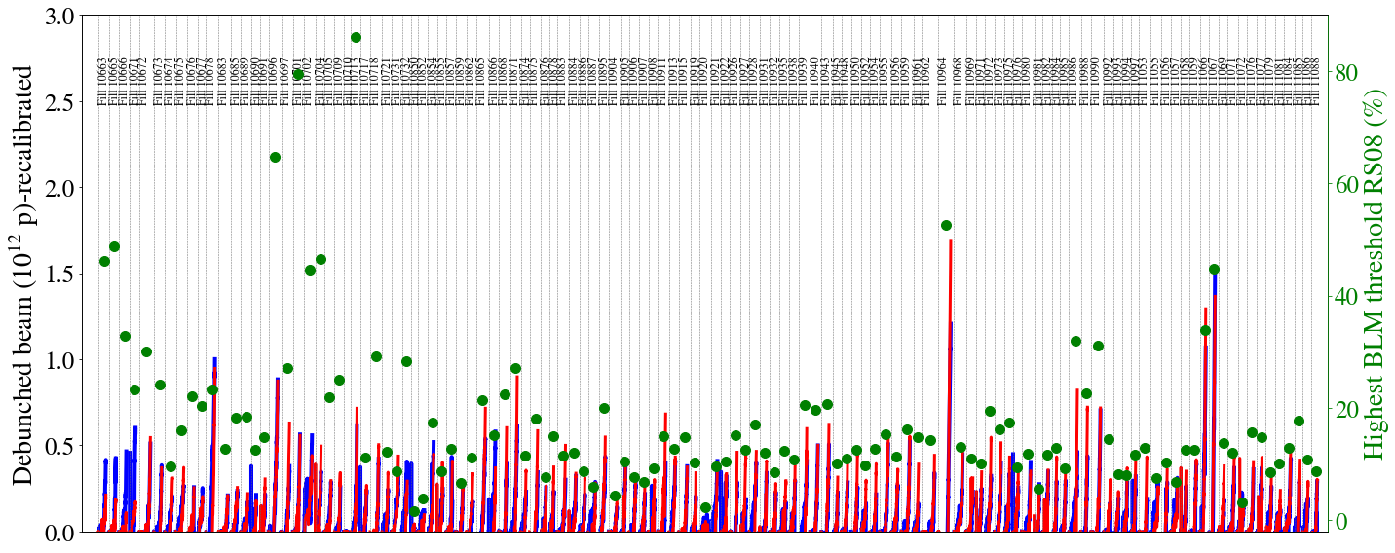
Ramp: Debunched beam & start of ramp losses
Before TS1: collimation hierarchy breakage issue, losing in IR7 TCLA, excluded from analysis.
TS1
Debunched beam B1/B2 vs start of ramp losses, 2025 statistics
B1
B2

Slide 36
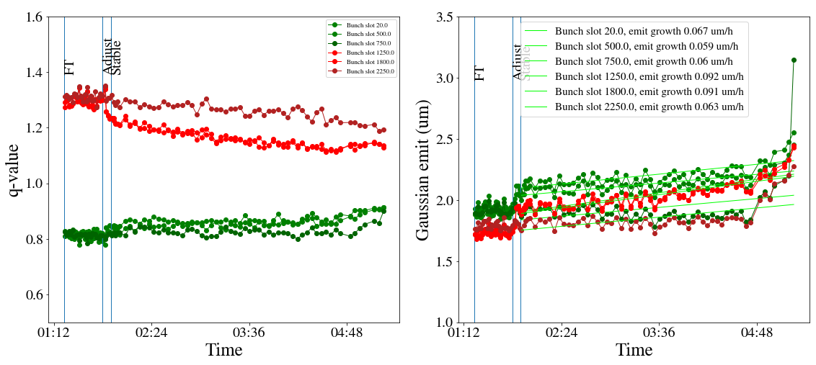
Collisions: Emittance growth
Emittance growth during collisions of unknown source, especially in V.
MD results:
  Measured 0.05-0.09 μm/h, operational levels in 2025 ~0.07 μm/h.
  Non-colliding bunches blowing up less.
  Tails tend to gaussianize in time.
  Measured only with HL INDIVs and needs to be tested with trains.
Conclusion: HL INDIVs have similar emittance growth levels to current operation in physics.
q-factor
  Emittance
B1V
Gaussian, colliding iP1/5
Gaussian, non-colliding
Non-gaussian, colliding IP1/5
Non-gaussian, non-colliding

Slide 37

Overview & Next steps
2026 high intensity tests
HL-LHC
2025 MDs
2026 MDs
 | Phase | Beam type | N_{b}
MD1 | Collisions | HL INDIVs | 6
MD2 | Flat top | 8b4e 2x56 | 560
 | Injection | standard 4x72 | 1152
Goals for MD3-4 | Collisions | 8b4e 2x56 | 560
 | Ramp 500 GeV | standard 1x72 | 300
 | Ramp 500 GeV | BCMS 2x36 | 300
 | 3 TeV | HL INDIVs | 6
2025 MD1-2 awards
Reached 160 pileup with HL INDIVs
Thanks to fast beta* levelling, crossing angle leveling, high brightness.
Ramped HL trains to top energy.
Thanks to 8b4e.
Injected 4x72 HL baseline beams in the LHC
Thanks to injector preparation, acceptable injection losses, RF capture & optimizations.

Slide 38
Overview & Next steps
2026 high intensity tests
HL-LHC
2025 MDs
2026 MDs
 | Phase | Beam type | N_{b}
MD1 | Collisions | HL INDIVs | 6
MD2 | Flat top | 8b4e 2x56 | 560
 | Injection | standard 4x72 | 1152
Goals for MD3-4 | Collisions | 8b4e 2x56 | 560
 | Ramp 500 GeV | standard 1x72 | 300
 | Ramp 500 GeV | BCMS 2x36 | 300
 | 3 TeV | HL INDIVs | 6
Nominated 2025 MD3-4 awards
Collisions with 8b4e HL trains.
All HL variants (8b4e, BCMS, standard) tested & ramped in the LHC.

Slide 39
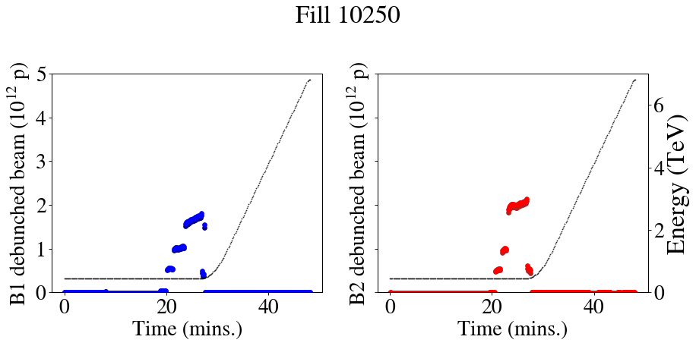
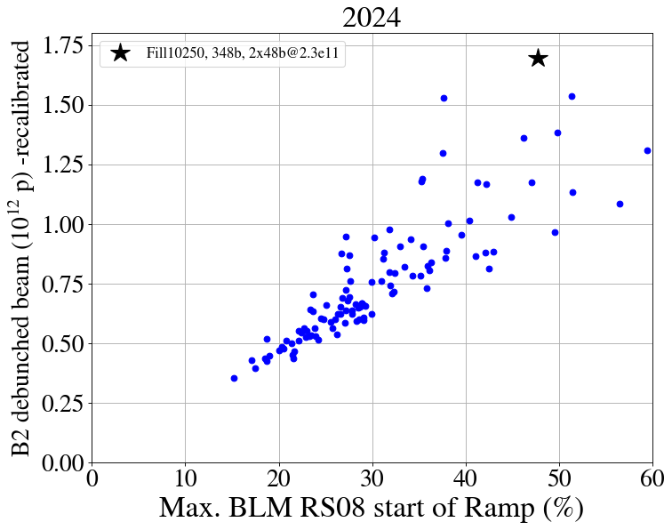
2x48b@2.3e11pb, fill 10250, 348b

Slide 40
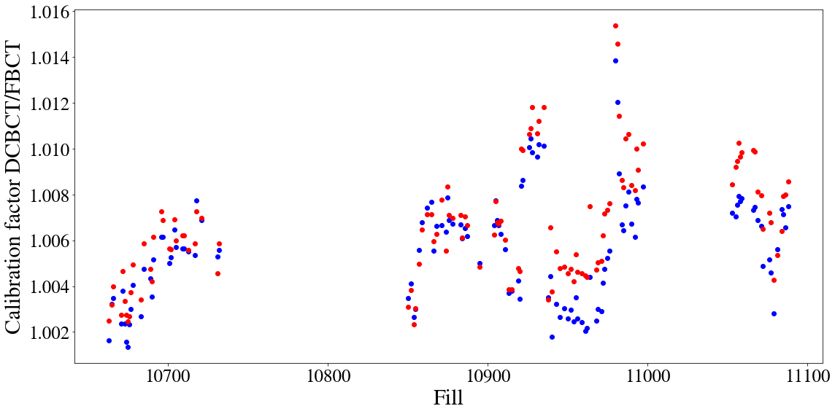

Slide 41
