Slide 1



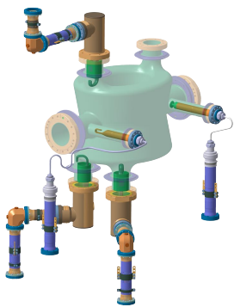

DQW HOM Measurements &
Qualification of RF Lines
Amelia Edwards on behalf of HL-LHC WP4
15th HL-LHC Collaboration Meeting
CERN, Geneva, 29th Sept to 2nd Oct 2025
Notes:
Hello, I am Amelia and I am speaking on behalf of WP4

Slide 2
Part 1: DQW Series Cavities
HOM Measurements & Impedance
Part 2: Qualification of adapters & RF Lines
Notes:
So as you may have seen from the title my talk will be split into two quite distinct sections,
although they are very much related they don't flow together seamlessly. So in the first section I will speak about the HOM measurement on DQW series dressed cavities. And following in the second section of the talk I will speak about the work done at CERN to qualify the impedance adapters and RF lines.

Slide 3
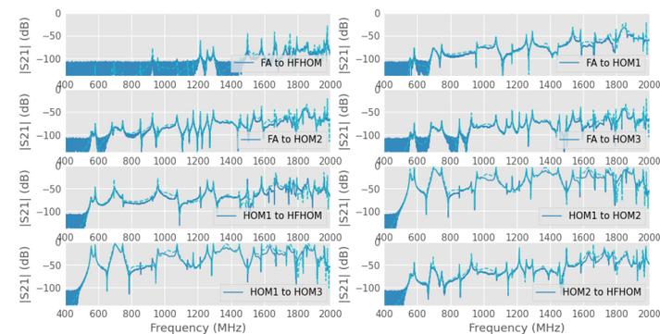
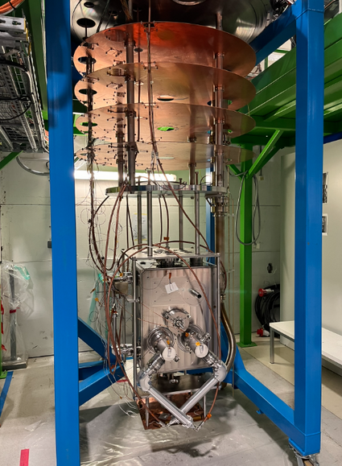
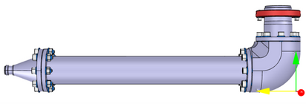
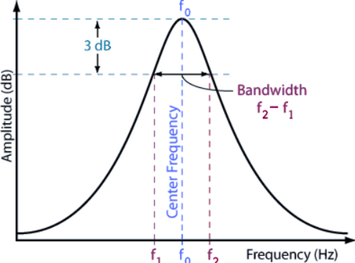
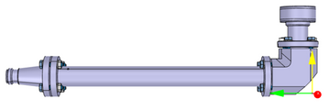



Part 1 - DQW Series Cavities
Overview of the HOM Measurement
At 2K, high resolution S21 measurements are taken between all ports
DQW Series
Cavities concerned:
Dressed cavity with impedance adapters
Verified at warm with TDR & Warm HOM measurements
RI DQW1
In post-processing Q & frequency are extracted & finally Z is computed
RI DQW2
CERN DQW1
CERN DQW2
Notes:
So I just wanted to give some context and a short introduction the the HOM measurements
As we heard from Katy yesterday we qualified the first four series cavities of the DQW type, so the cavities concerned are the following: RI 1 & 2 and CERN 1&2
So and aside from the headline results of voltage & Q there is also the HOM measurements forming part of the cavity qualification
So to briefly describe the measurement, the dressed cavity is installed with the impedance adapters which are verified at warm by TDR & HOM spectrum
At 2K the test is paused and high resolution S21 measurements are taken, at least 100,000 points & often several spans. All port combinations are taken, for DQW including FA
That is how we reach the impedance plots which I will show here in the following slides and which you may now be familiar.

Slide 4
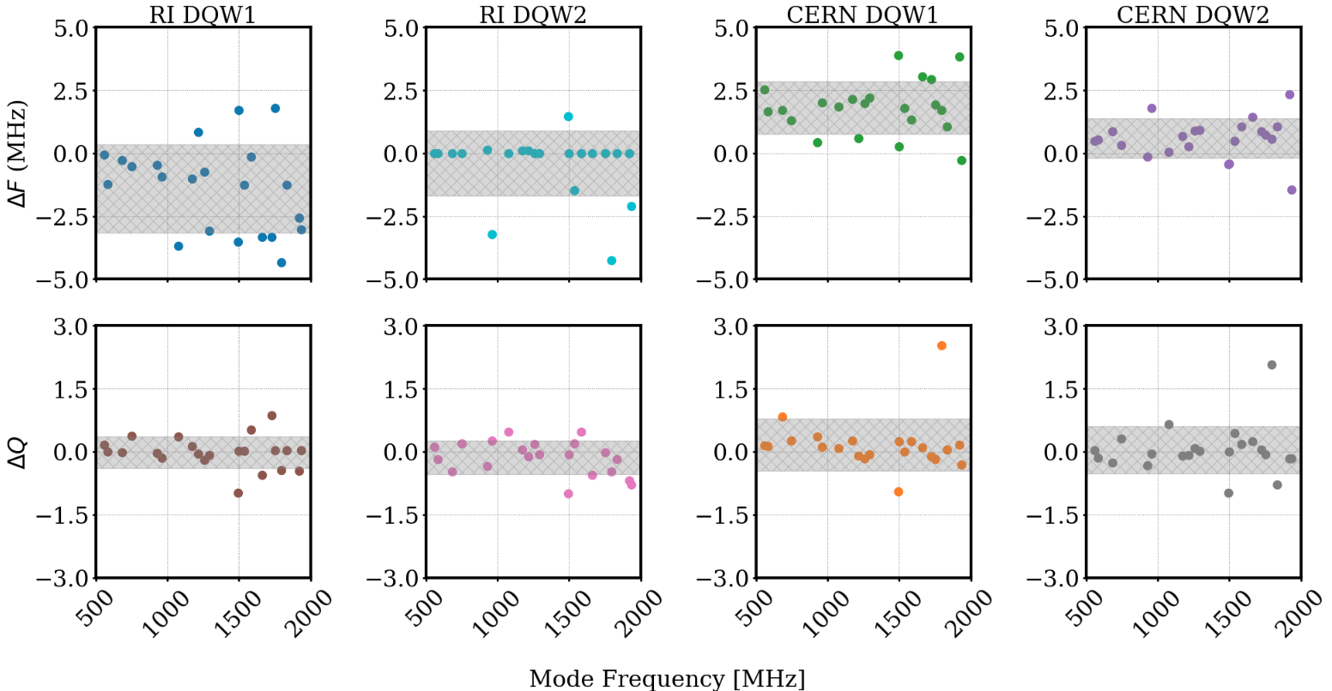
Part 1 - DQW Series Cavities
Frequency & Q deviation from Simulation
  Comparison with simulated values from CST simulations: EDMS 1347072
  Measured differences in frequency and quality factor w.r.t simulated values
 | Freq (kHz) | Q
RI 1 | -1.4 ± 1.76 | -0.02 ± 0.38
RI 2 | -0.4 ± 1.29 | -0.14 ± 0.4
CERN 1 | -1.8 ± 1.05 | -0.17 ± 0.62
CERN 2 | -0.6 ± 0.79 | -0.04 ± 0.57
Notes:
So from the transmission measurements
Here I am showing for each cavity how the frequency and quality factor of the HOM modes matches with the simulated values.
The first row showing the deviation in frequency and the second row showing deviation Q with respect to simulation
In general theres good agreement between measured values and what was simulated,
Some spread in values between the cavities is actually welcomed as it prevents multiplication of the impedance

Slide 5
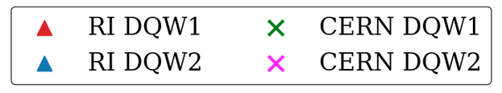
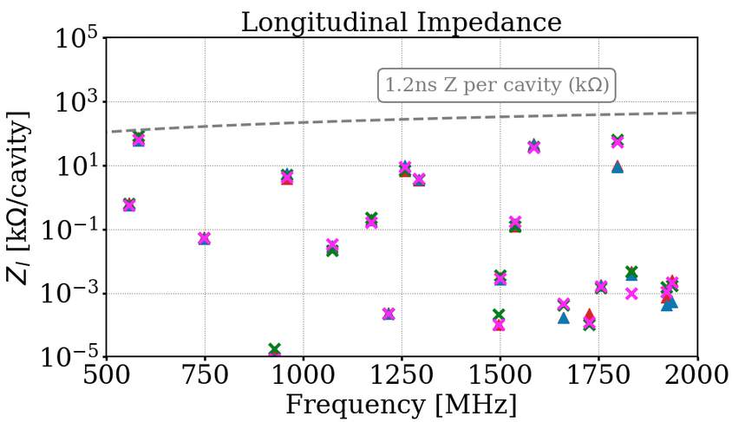
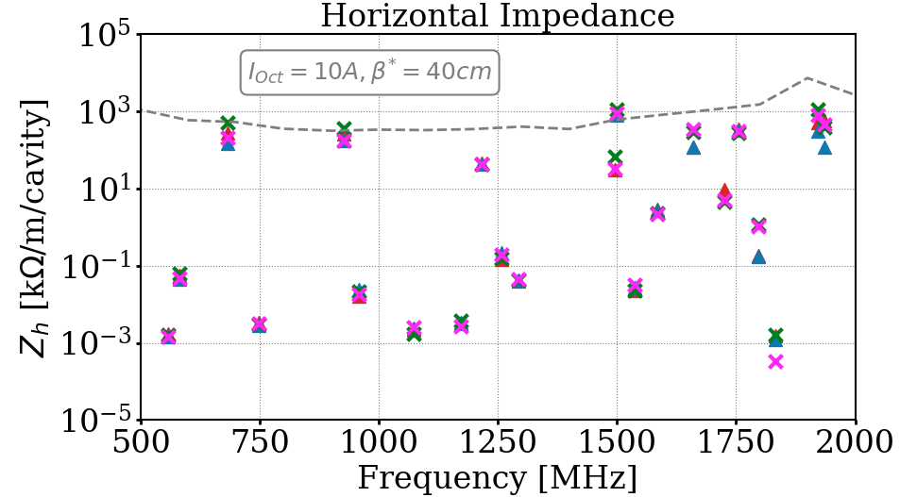
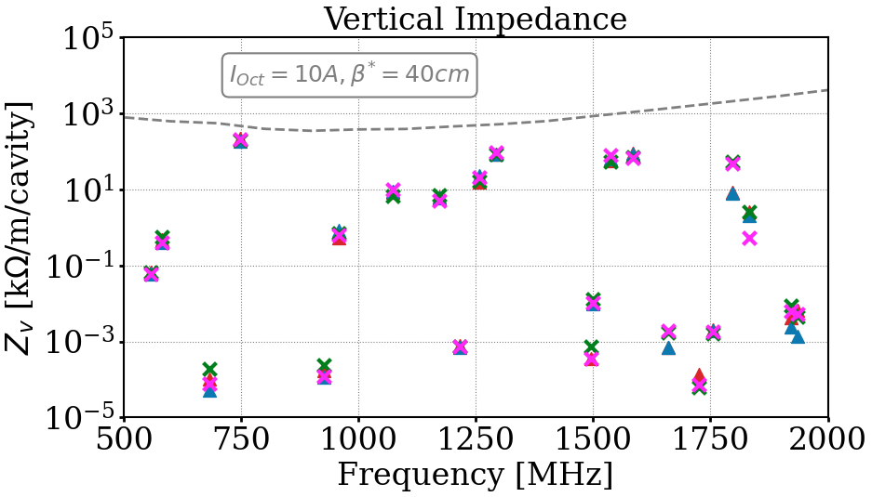
Part 1 - DQW Series Cavities
Measured Impedance at 2K
  So far measurements for x4 series cavities are consistent!
  Final impedance values have been provided to WP2 - See talk of C. Antuono
Notes:
So here is the impedance values from the four DQW series cavities from measurements at 2K
So what can we say so far from these results:
1. Firstly that from this view there appears to be very little spread in the values between the four cavities and not major outliers. Therefore we can suggest the cavities are consistent
2. and comparing with the simulated values

Slide 6
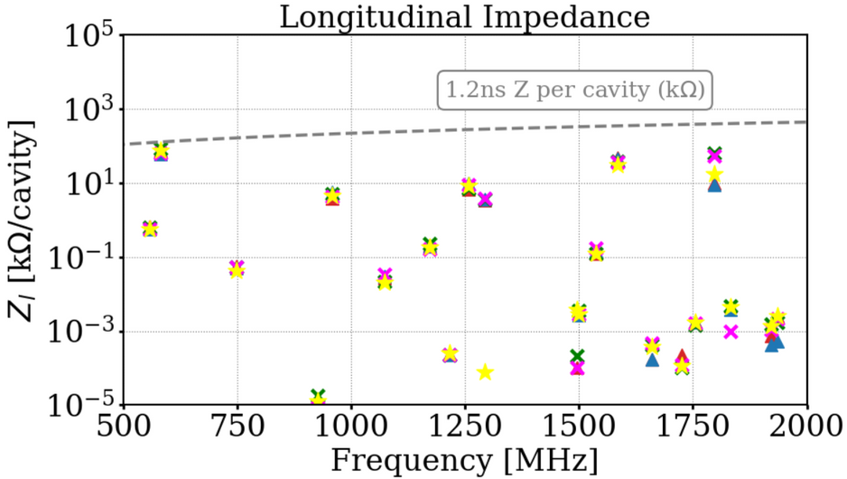
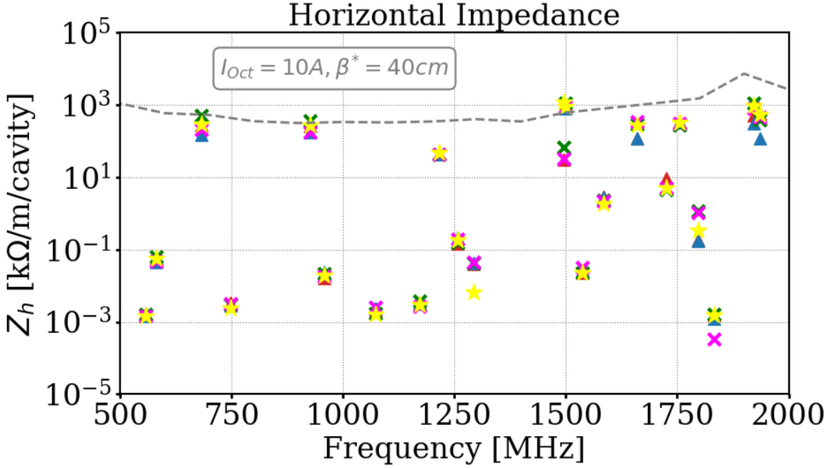
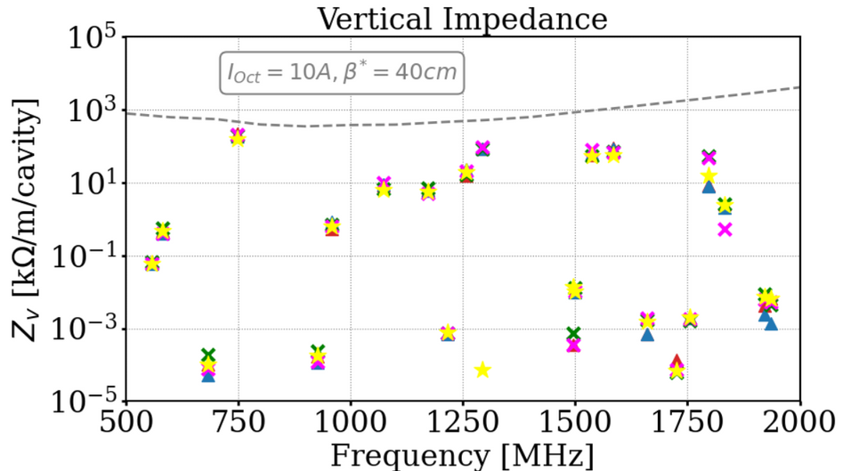
Part 1 - DQW Series Cavities
Measured Impedance at 2K
  So far measurements for x4 series cavities are consistent!
  Final impedance values have been provided to WP2 - See talk of C. Antuono
Notes:
So here these plots show the results from the final cold test of the four series dressed cavities.
So what can we say so far from these results:
1. Firstly that from this view there appears to be very little spread in the values between the four cavities and not major outliers. Therefore we can suggest the cavities are consistent
2. and comparing with the simulated values

Slide 7
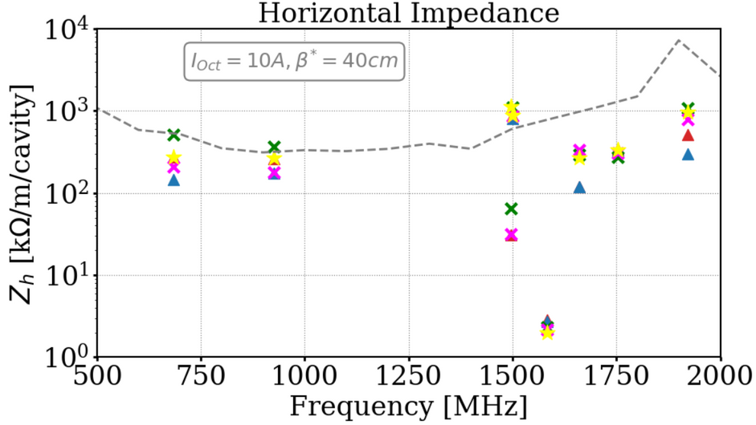
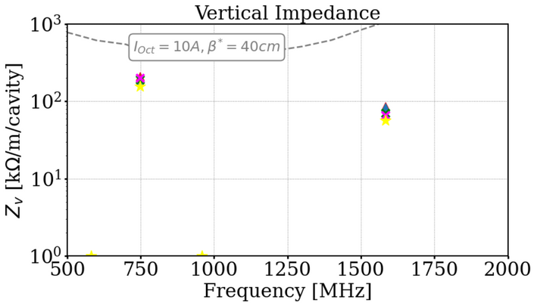
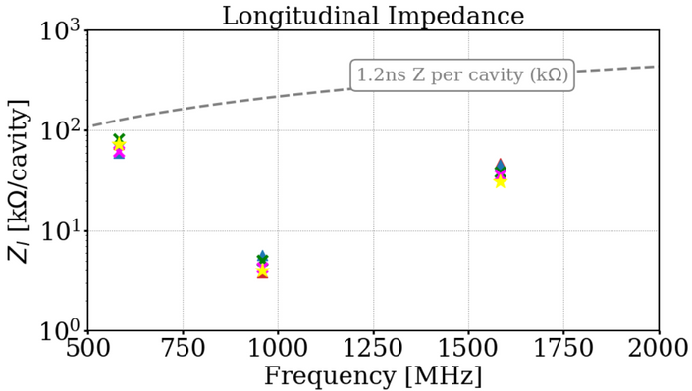
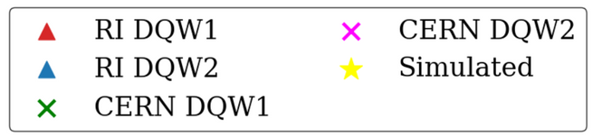
DQW Series Cavities:
Impedance of Critical HOMS
  Focusing on the critical modes from HOM Annex: EDMS 2488213
  There are several reasons these modes are flagged e.g. excess power or high impedance
Notes:
So previously I was focusing on all the modes from simulation but I should flag that there is a smaller subset of modes for each cavity which have been flagged for lose follow up as their characteristics, for various reasons, could be particularly problematic. Considering just these modes
longitudinal modes lead to high power (e.g. 959MHz)
high impedances from transverse modes (e.g. 1496MHz)
modes being trapped by their field distribution (e.g. 1754MHz)

Slide 8
Part 2: Qualification of Impedance Adapters & RF Lines
“We had to qualify 25 Ω, not as simple as expected”
Eric Montesino, HiLumi 2021
Notes:
So changing direction slightly I will speak about some work we have been doing here to qualify the other RF components for the upcoming cryomodules
Critical components required by all collaborators now that cryomodules are entering series production.
Adapters designed and manufactured for both cold test & cryomodule

Slide 9
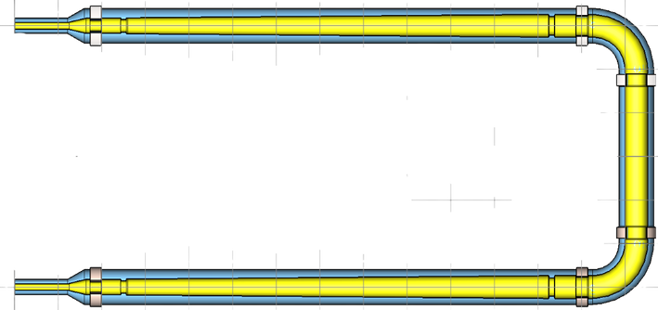
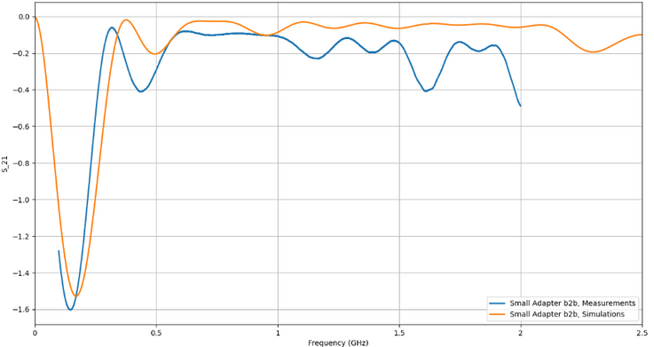
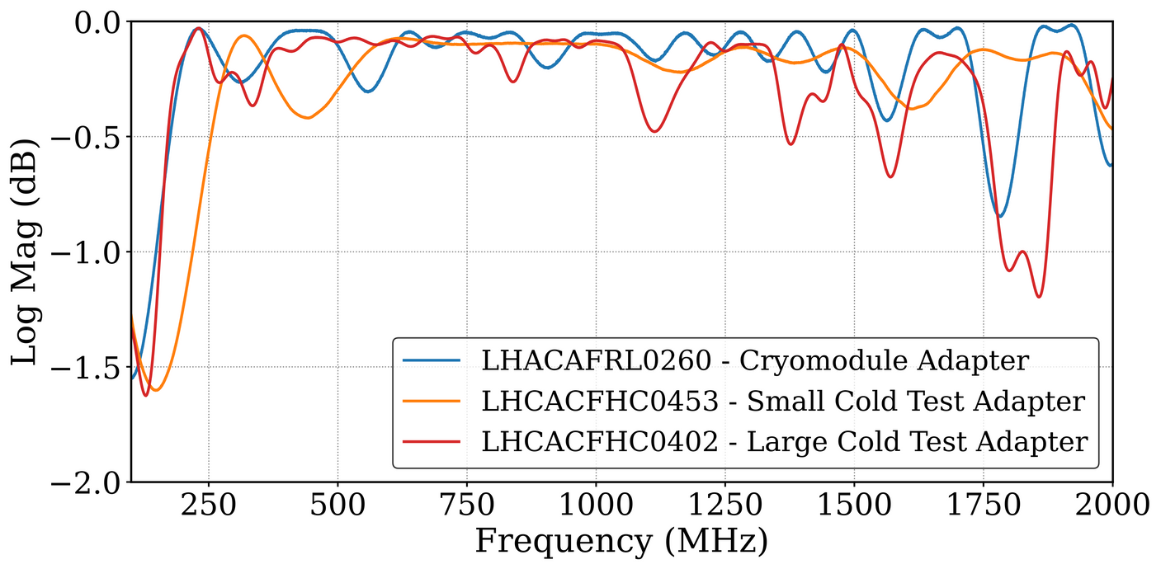
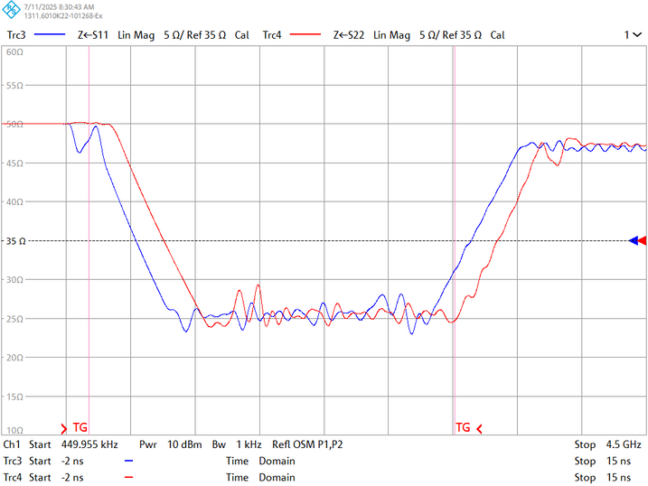
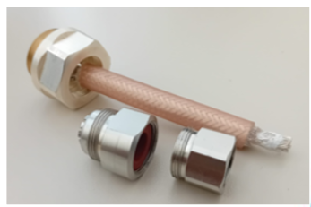
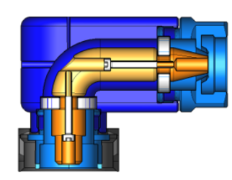
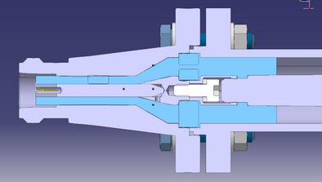
Part 2 - Qualification RF Lines
Summary
4.
Courtesy of R. Calaga
  S21 transmission measurements taken ‘back-to-back’ is found to be most robust & reliable measurement
  TDR and gated TDR attempted
  Z11 & Z22 measurements also developed
  Simulations developed from drawings
  Issues corrected with flex cable & ‘cone’ in small cold test adapter
1.
5.
3.
Notes:
This is just one slide where I capture many aspects of the work we did for this.
In his presentation in this meeting from 2021 Eric already mentioned the difficulty to measure these pieces.
We studied different RF measurement methods by which we can validate the adapters
The most robust is S21 and also the easiest for others to replicate in the future as it is a standard measurement

Slide 10
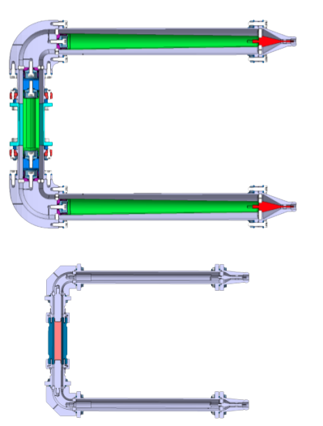
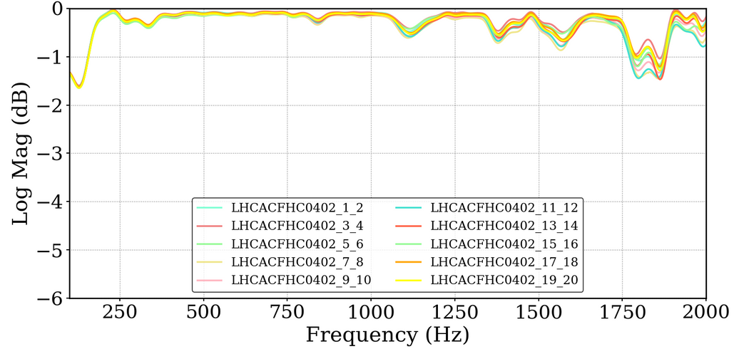
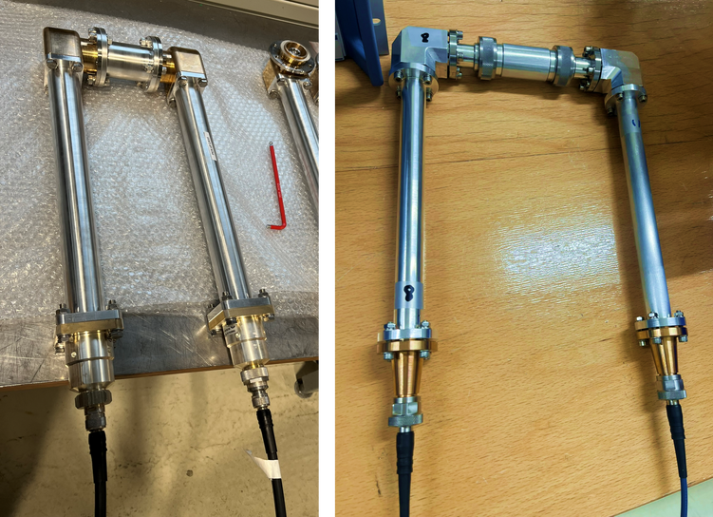
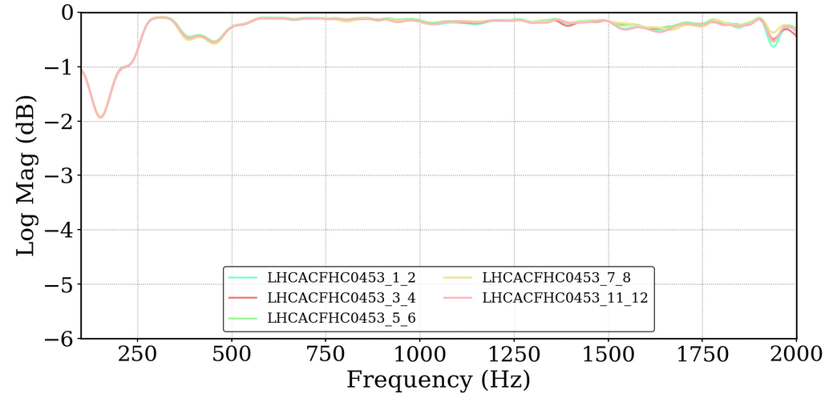
Part 2 - Qualification RF Lines
Impedance Adapters for cold test & warm measurements
  All adapters measured before shipment & measurements available in EDMS
‘Large’ Adapters
‘Small’ Adapters
Notes:
So the adapters are measured in a 'back-to-back' configuration, as shown in the top corner, using transmission line segments in the middle.
Firstly considering the Impedance adapters for cold testing and warm measurements on the dressed cavities. Since the last meeting many of you received these components from us and all of them were measured and validated at CERN before shipment.

Slide 11
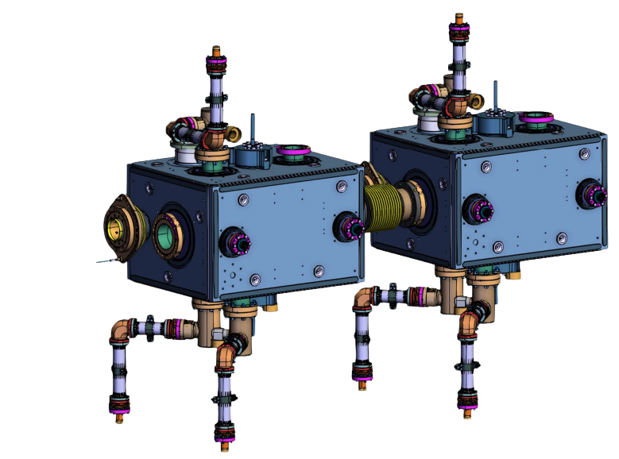
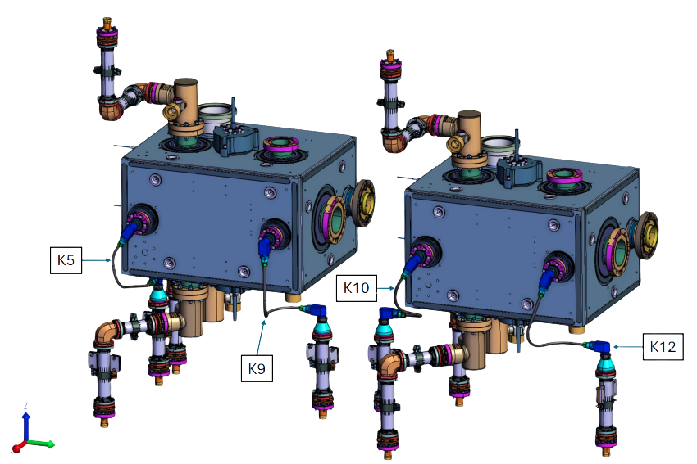
Part 2 - Qualification RF Lines
Internal RF Lines - DQW Cryomodule
  All internal RF lines for first DQW cryomodule are validated and have been shipped
Notes:
So now onto the measurements are the results, the examples shown here will be repeated and shared for all upcoming cryomodules. You can see here all the RF internal lines required for the DQW cryomodules. Just to remind that all these parts are 25Ω

Slide 12
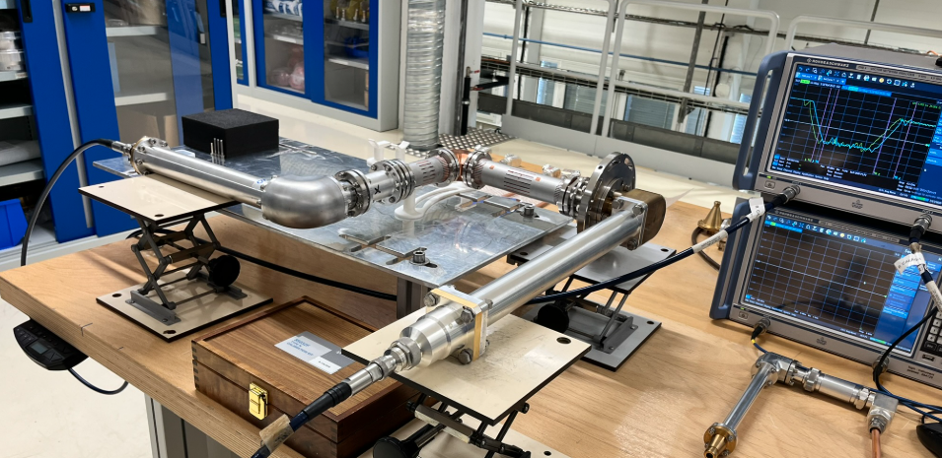
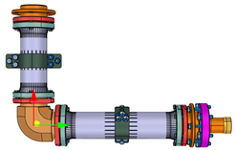
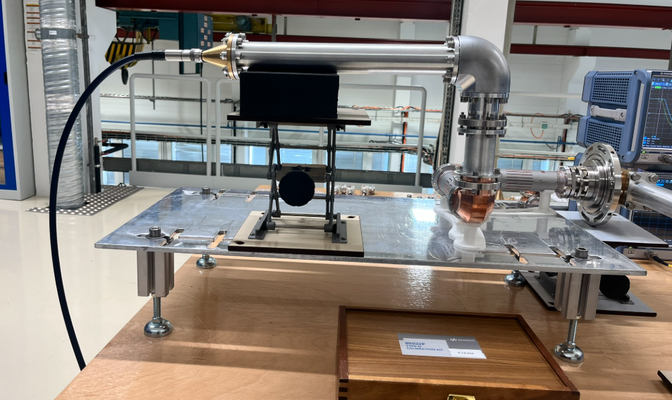
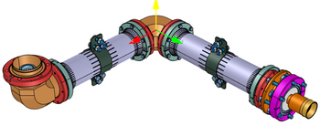
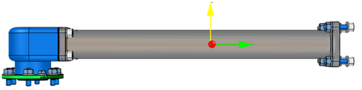
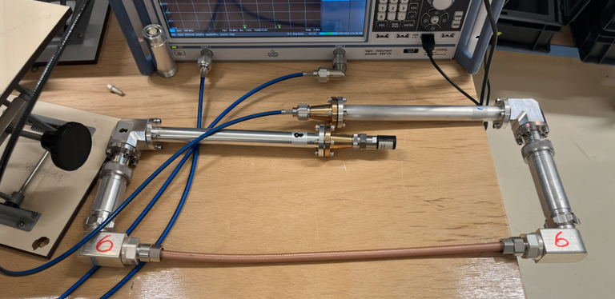
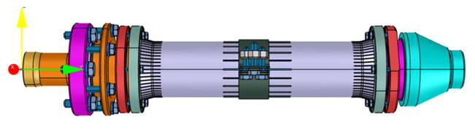
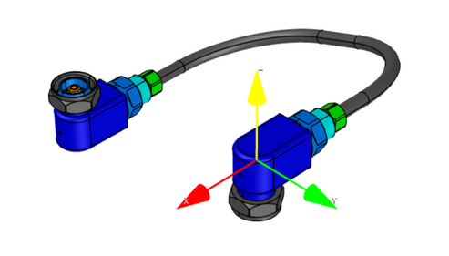
Part 2 - Qualification RF Lines
Internal RF Lines - DQW Cryomodule
CDD | Quantity
LHCACFRL0261 | x4
LHCACFRL0259 | x2
LCHACFRL0260 | x10
LHCACFRL0258 | x4
LHCACFRL0284 | x4
Notes:
And same here is just showing

Slide 13
Part 2 - Qualification RF Lines
Internal RF Lines - DQW Cryomodule
S21 of two small adapters ‘back-to-back’ is always used as reference
RF Line
Cold Test Adapter
Transition Piece
Cryomodule Adapter
Notes:
Here is a few images of the measurement setup. In the following slides two small test adapters are always shown as a reference point and comparison.
For the measurement of the line you see us using one cold test adapter, one cryomodule adapter, the transition piece here is exactly the same as for the cryomodule and in the centre you see the RF line under test. This mimics well the lines setup as it will be installed. In the bottom you see how we carefully support the line during the measurement as these are still complex & delicate pieces.

Slide 14
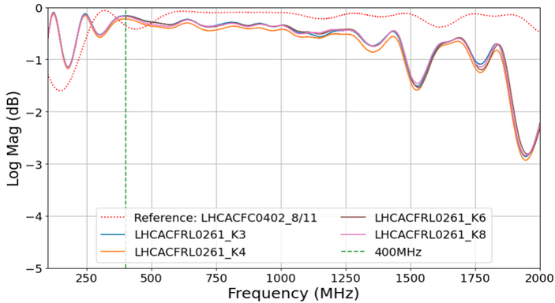

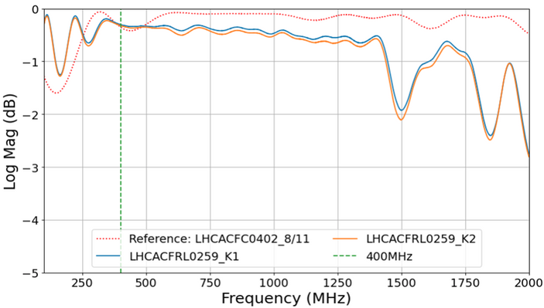
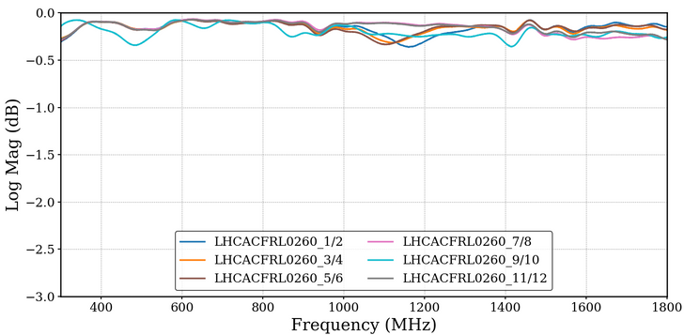
Part 2 - Qualification RF Lines
Internal RF Lines - DQW Cryomodule
CDD | Quantity
LHCACFRL0261 | x4
LHCACFRL0259 | x2
LCHACFRL0260 | x10
LHCACFRL0258 | x4
LHCACFRL0284 | x4
Notes:
So here’s an example of the package of pieces shipped for the first DQW cryomodule, and here is the measured results for the first set of RF lines and the external cryomodule adapters. You see all the measured results so far contain their own distinct ripples, but we are pleased with the general transmission characteristics and agreement between lines of the same type.

Slide 15


Part 2 - Qualification RF Lines
Internal RF Lines - DQW Cryomodule
CDD | Quantity
LHCACFRL0261 | x4
LHCACFRL0259 | x2
LCHACFRL0260 | x10
LHCACFRL0258 | x4
LHCACFRL0284 | x4
Very complex
& must accommodate several angles in a compact space
Notes:
On the final two pieces which actually go together in pairs

Slide 16
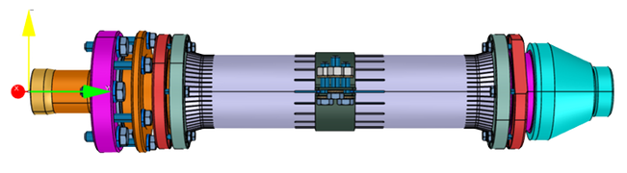

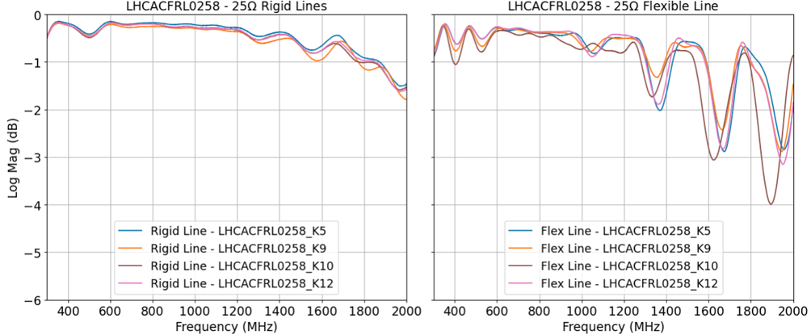
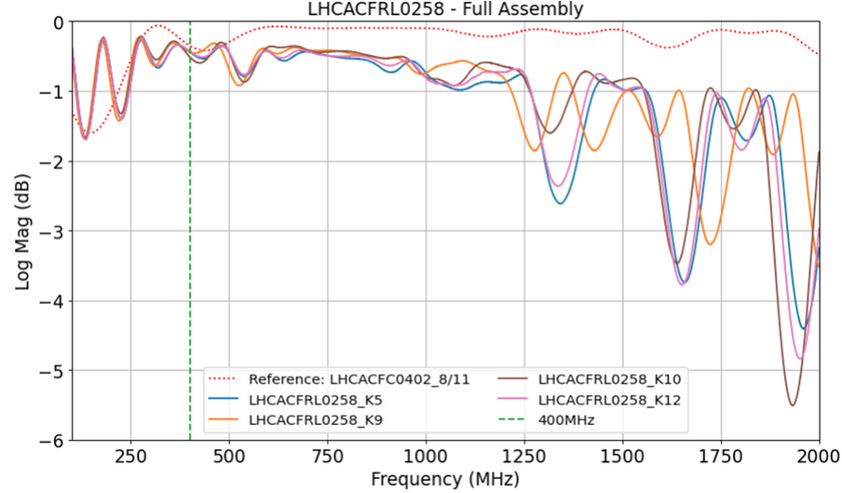
Part 2 - Qualification RF Lines
Internal RF Lines - DQW Cryomodule
Parts measured independently
Then together in assigned pairs
Notes:
So here on the left you see we measured each section individually, then together in pairs which are assigned depending on the angle of the flexible cable required. You can see that the majority of the ripple comes from flexible cable section.
The combined measurement result was verified in python by simulating the cascading of the two individual parts, the combined measurement is as expected.

Slide 17
SUMMARY
Part 1: DQW Series Cavities HOM Measurements
  First four series cavities HOM behaviour is expected from simulation and consistent between cavities
  Impedances computed and forwarded for analysis
  No issues meeting specification for fundamental power leakage through HOM couplers
Part 2: RF Lines & Adapter Qualification
  All cold test adapters measured & validated before shipment
  Campaign started to study the RF components, small adjustments and simulation
  All components for 1st DQW cryomodule qualified before shipment
Notes:
How to not just read all the bulletpoints....

Slide 18
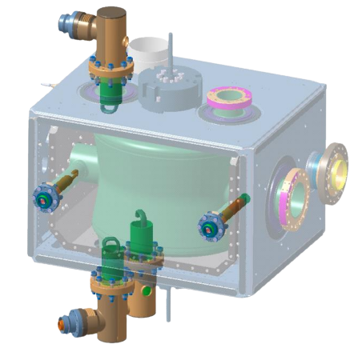
Thankyou!

