Slide 1
Is crab cavity noise feedback feasible?
Daniel Valuch
15th HL-LHC collaboration meeting, Geneva, 2.10.2025

Slide 2
Crab cavity noise feedback
In order not to blow-up the beam emittance, RF system of crab cavities must be very low noise (both LLRF and power).
Not possible to achieve only by the electronics itself, an active “noise” feedback is necessary.

Slide 3
Crab cavity noise feedback
Noise performance requirements for the feedback system beam position measurement units are σ₀ < 320 nm and σ₁ < 8.3 μrad. (bunch-by-bunch measurement levels).
The above measurement noise thresholds require extremely high precision measurements.
Fortunately, the closed loop bandwidth of the crab cavity with LLRF will only extend to 136 kHz. As a result, the noise bandwidth will also be limited to 136 kHz.
This relaxes the actual single bunch resolution threshold to σ₀ < 3.9 μm_{rms} and σ₁ < 100 μrad_{rms}. This is a tight, but achievable specification.
Baudrenghien, P. and Mastoridis, T.: Transverse emittance growth due to rf noise in crab cavities: Theory, measurements, cure, and high luminosity LHC estimates
DOI 10.1103/PhysRevAccelBeams.27.051001

Slide 4
Crab cavity noise feedback
We have created a model of the whole signal chain to calculate important parameters and probe sensitivity to various phenomena.
Specs still tight and very challenging, but achievable…
Beam
Sensor
Signals
Information

Slide 5
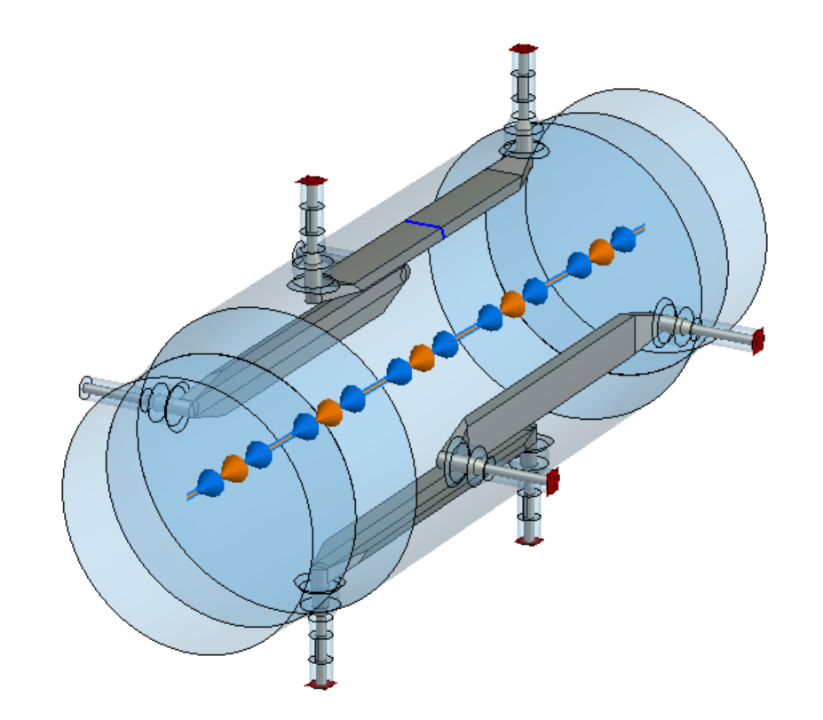
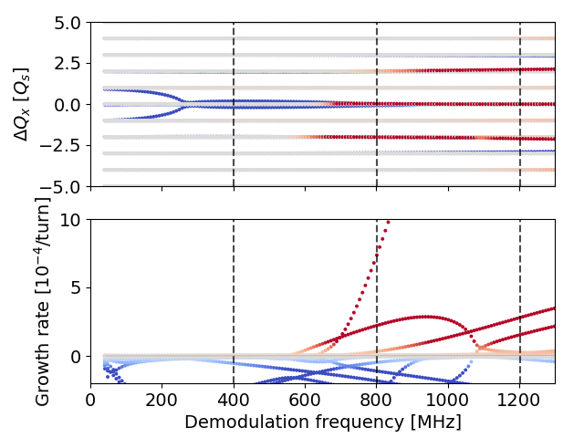
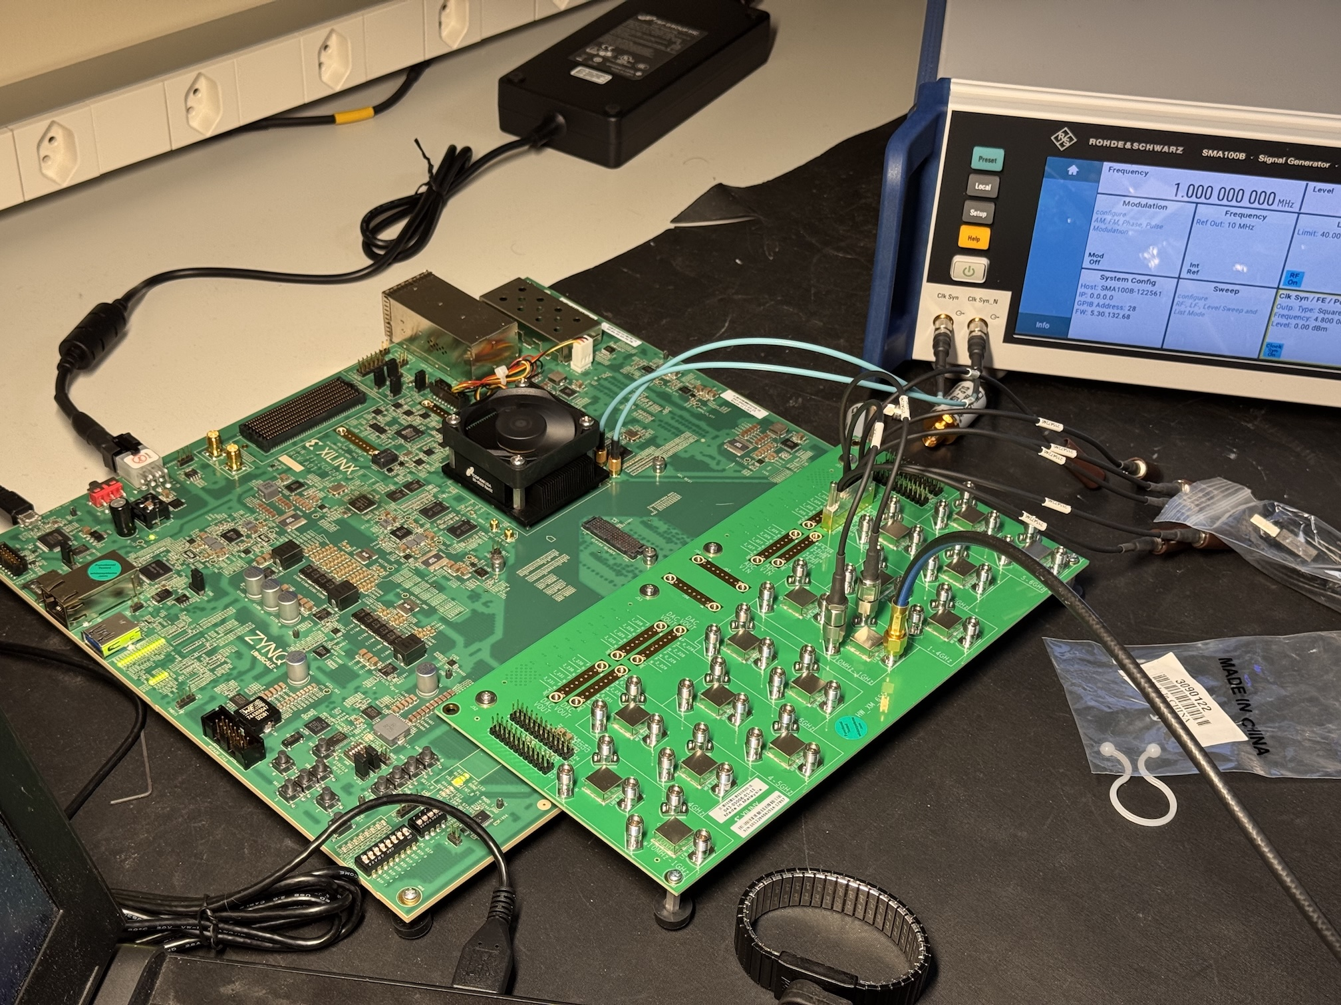
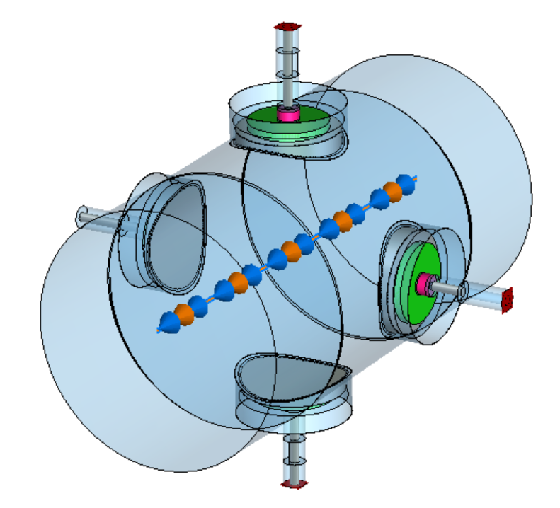
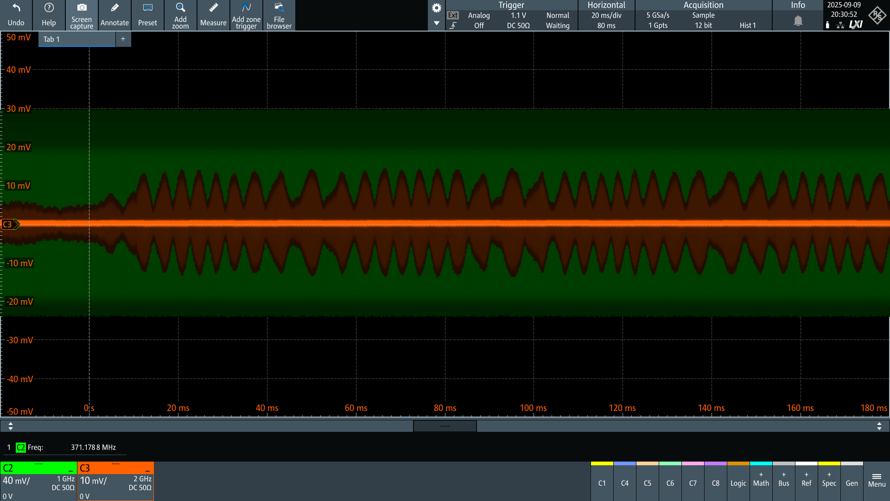
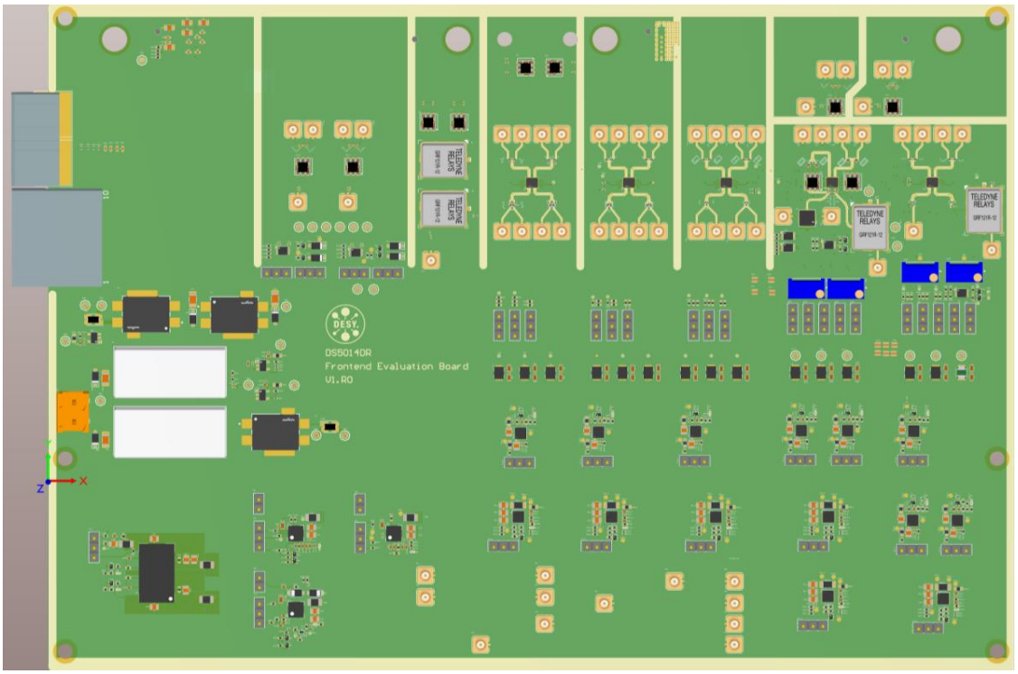

Progress so far
Selection of pickup
(stripline)
Selection of frequencies
(in process)
Selection of digitizers
(5 Gsps RF SoC)
Algorithms
(as LHC ADT)
Plus TB of real beam data from MDs
Each decision challenged by the very tight performance specification…

Slide 6
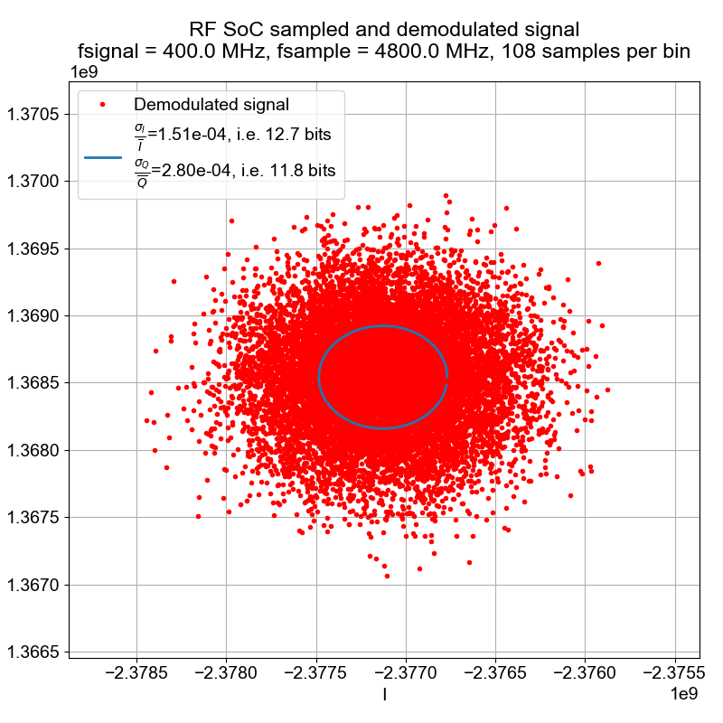
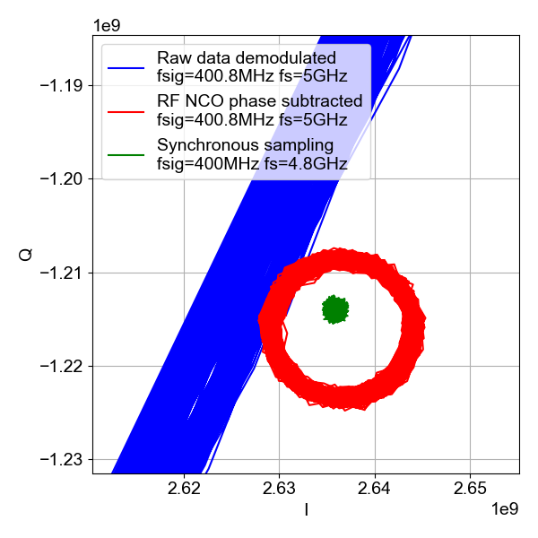


Evaluation of RF SoC performance
Very promising – with modern chips and scientific approach we can get almost the required single bunch performance. Provided we will take right decisions on how we acquire and treat the pickup signals…

Slide 7
Summary
Project is advancing
Pickups defined and design work ongoing (see Michal Krupa’s talk)
Measurement frequency to be selected shortly (3 options available)
Specs for critical components calculated, suitable key hardware identified
Evaluation of RF SoC digitizer proved it is suitable, contact with DESY to obtain uTCA boards established, expected lead time ~1 year
Processing algorithms defined
MD data being analyzed by various methods (see Wolfgang Hofles’s talk)
Decision to be taken by the project management on some LLRF details (internal presentation last week) – ongoing.
Some algorithms can be implemented into RF SoC evaluation board and can be tested with beam next year.

Slide 8
Summary
To be noted:
Crab Cavities without functioning noise feedback would make the emittance growth unacceptable…
One LHC fill lasts 12-17 hours, the machine is not forgiving.
Only marginally meeting the best today’s performance specification is not sufficient. The experience shows there are many unknowns, and we need maneuvering space to deal with them.
Therefore, for such a critical system in LHC, we must squeeze out every single possible performance reserve we can, it will be certainly needed later.

Slide 9
Summary
The work done so far indicates that the crab cavity noise feedback is feasible.

