Slide 1
Crabbing measurement resolution achieved in SPS with button
Wolfgang Höfle, Borna Boljkovac
Acknowledgements: R. Calaga, crab cavity team, SPS-OP, BE-ABP

Slide 2
Outline
Characteristics of the available button pick-up in the SPS and measurement set-up
Measurements with button pick-up during crab cavity SPS MDs in 2025 → 23.06.2025 with crab cavity phase scan
Offset subtraction: amplitude and phase view
Results for crabbing during cavity phasing with beam
Conclusions

Slide 3
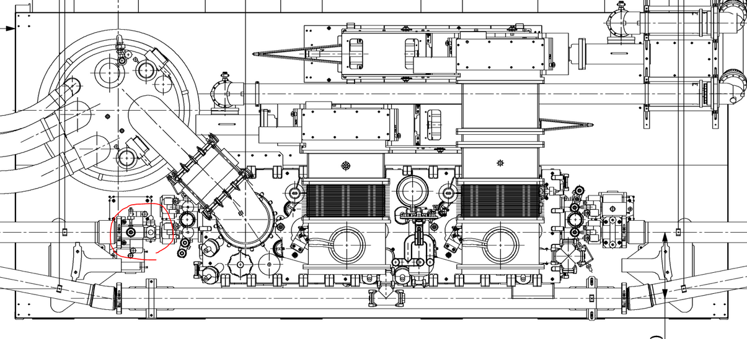
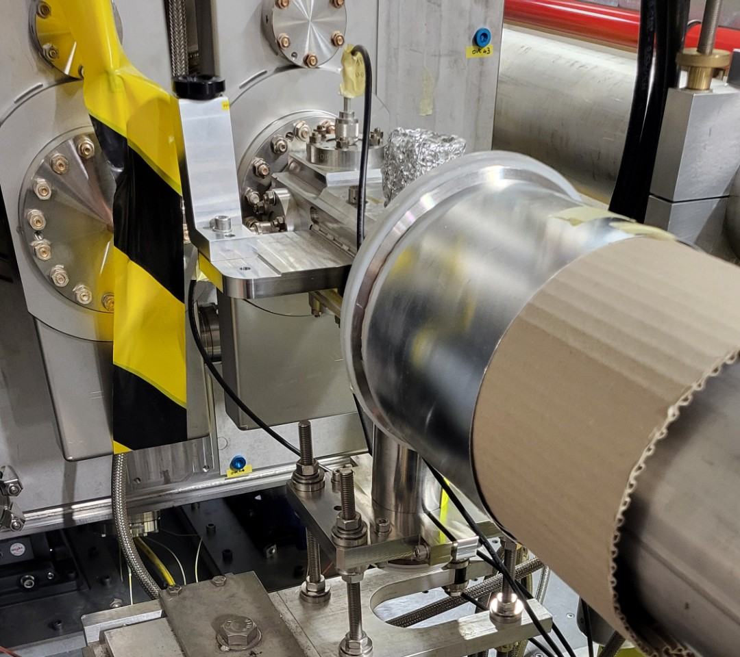
SPS LSS6 layout with button PU left of CCs
button PU rigidly connected to cryo-module
top view
button PU
crab cavity cryo-module
RFD cavities in 2025 (horizontal kicks)

Slide 4
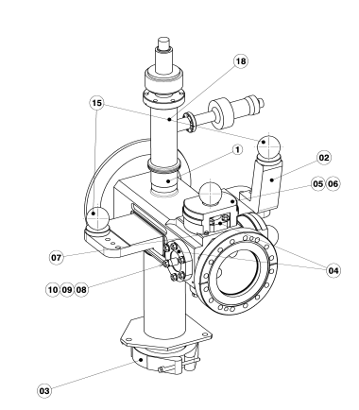
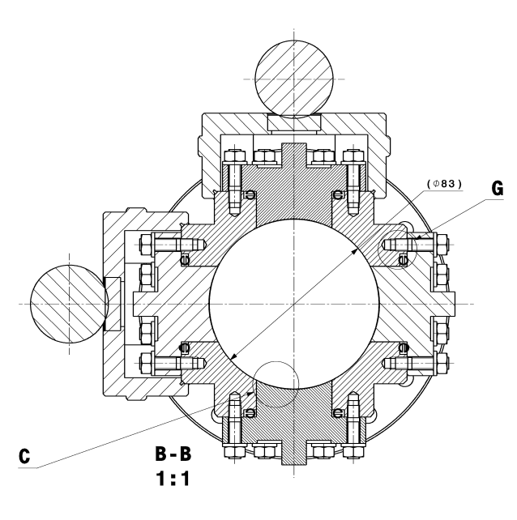
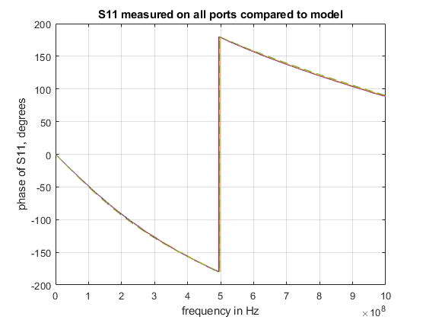
Button pick-up characteristics (SPS)
vacuum chamber D = 83 mm
feedthrough and button 34 mm diameter
modified LHC design for 80 mm chamber (“XRP”) fitted on SPS 83 mm chamber design
B-side
(wall)
A-side
(passage)
SPSVHCAF0015
seen at feedthrough
model: 10.9 pF
170 ps of 50 Ω line
usage of
signal @400 MHz

Slide 5
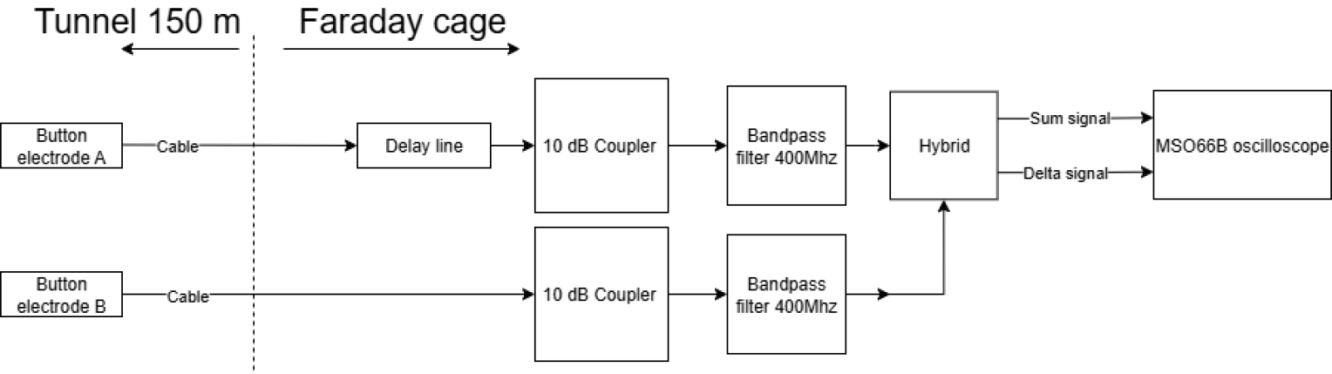
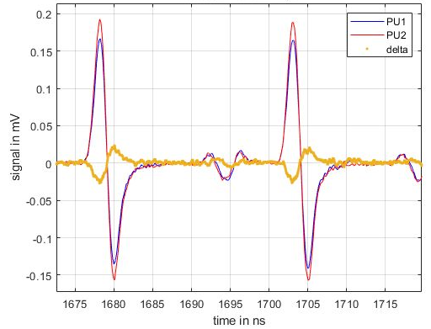
Measurement set-up
adjustable
at 400 MHz
~10.2 dB
(cable: 4.8 dB, splitter 5.4 dB)
-16.7⁰ (cable)
2.5 GHz bandwidth,
25 GS/s, 12 bit high res mode
2 mV/div (Δ)
10 mV/div (Σ)
  for lowest intensities of 2x10¹⁰ per bunch
possibility to add attenuators when high bunch intensity
test points terminated
“passive processing box”
A,B time aligned
possibility to add attenuators when high bunch intensity
low pass filter to reduce noise / interference possible
time and amplitude alignment of A, B
with beam going through center of pick-up of PU with no tilt (no crabbing nor angle
→ always small residual
reflection
(splitter)
Δ
Splitter in tunnel removed
between MDs of 23.06.25 and 16.07.25

Slide 6
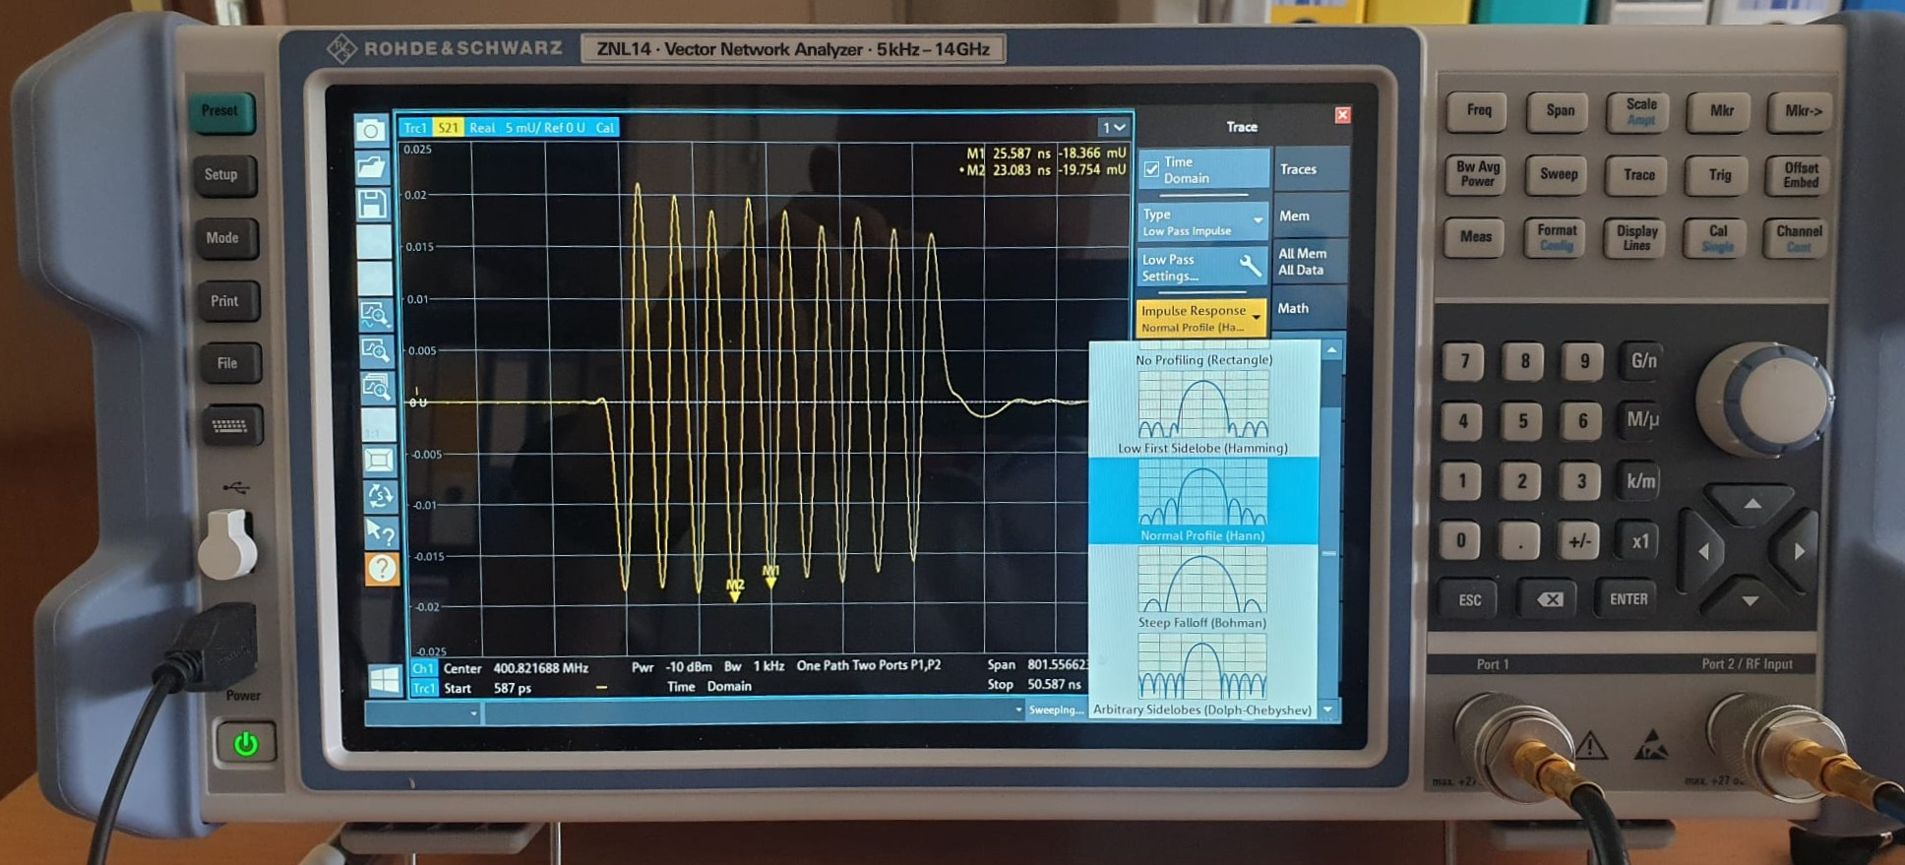
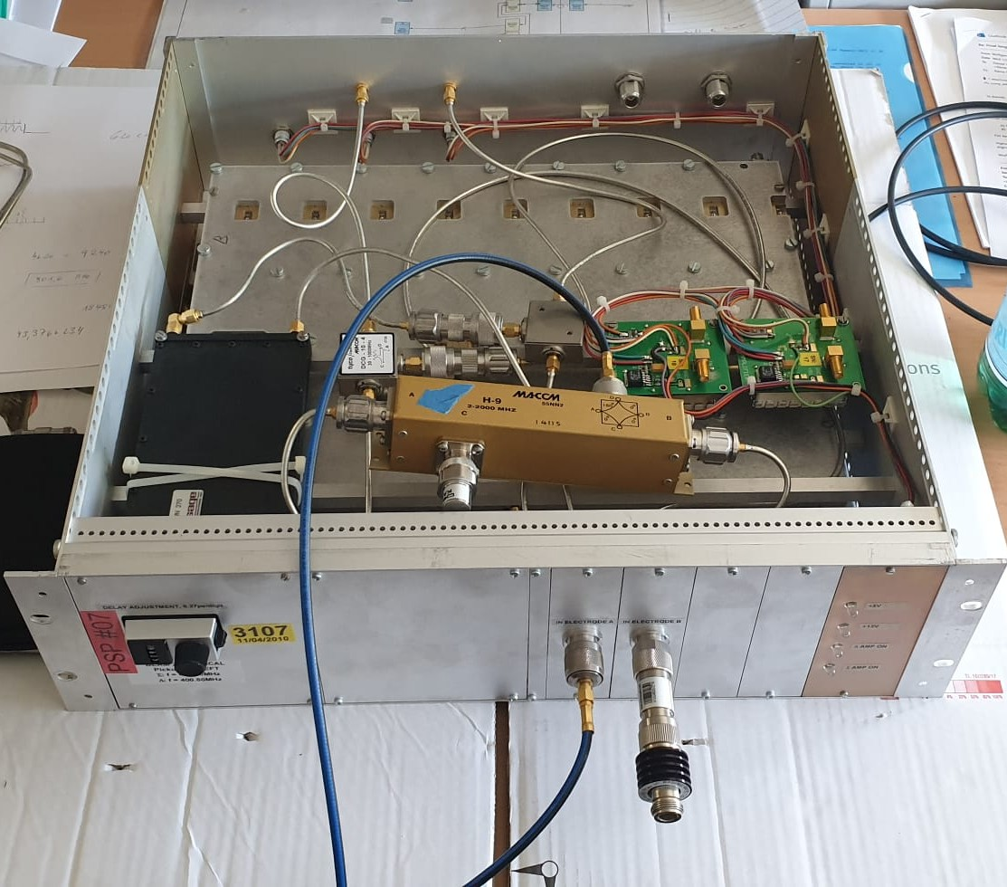
Processing crates (bandpass & hybrid)
crate #1: 400.4 MHz filter on Σ-Δ
crate #2: 400.8 MHz filter on A-B (23.06.25)
  best suited for SPS @270 GeV/c (400.787 MHz)
time domain transform on NWA (BP filter)
BPfilter
delay
adjustment on A
SPS harmonic number is 4620
filter is at 400.8 MHz
NWA sweep to 801.6 MHz
harmonic grid: “f_{rev}” to 18480xf_{rev}
“f_{rev}” here is 400.8 MHz / 9240
designed by D. Valuch
recuperated from initial
LHCADT installation
Hybrid H9
output (modulo a delay):
Σ = -(A+B)
Δ = -(B-A)

Slide 7
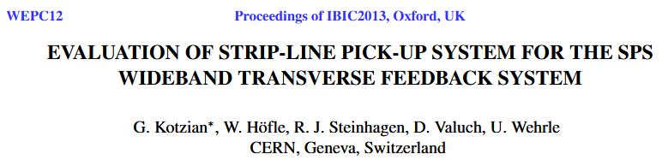





Offsets – an amplitude and phase view
Ansatz:
  Effects leading to offsets, i.e. Δ signal is not zero are
  Imperfection of the incoming signal side (assumed dominating part)
    attenuation A, B difference (cables, bandpass filters etc)
    phase difference A, B (from delays, cables band pass filters)
    incoming offsets from beam with respect to PU alignment
      position: A, B: coded in amplitude difference
      tilt (static or from crabbing): coded in A, B: delay (phase) difference
  Hybrid imperfections (Hybrid makes Σ and Δ signal)
    inclusion needs additional scrutiny with respect to above Ansatz
  https://cds.cern.ch/record/2317152/files/wepc12.pdf
phase difference
magnitude ratio
Imperfections in the set-up without any crabbing
  https://cds.cern.ch/record/2317152/files/wepc12.pdf
  mismatch before hybrid (amplitude and phase/delay)
  equations for V_{Δ} and V_{Σ} form system of non-linear equations for offsets

Slide 8
Phasors (400.x MHz) without crabbing (offset)
Offsets as observed on 23.06.2025 (noise injection MD):
  beam offset: small
  beam angle ~ 50 μrad (H. Bartosik from reference orbit measurement taken just before cavity phase scan started and analysed for angle)
  measurement set-up: very good, but delay difference A,B present (few degrees @400 MHz); filters 400 MHz very good matched, +/- 1 degrees
  magnitude ratios: ¦Δ/Σ¦ w/o crabbing: 0.091 – 0.0975 (depends on analysis method)
  phase differences between Δ,Σ w/o crabbing: 65.0 – 72.4 degrees (depends on analysis method)
400.(787) MHz phasors
Δ
angle
magnitude ratio: 0.0915
~65.1º
Σ

Slide 9
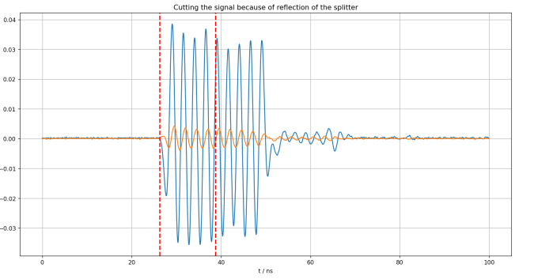
Results: typical signals acquired with scope
Σ
mV
reflection
Δ

Slide 10
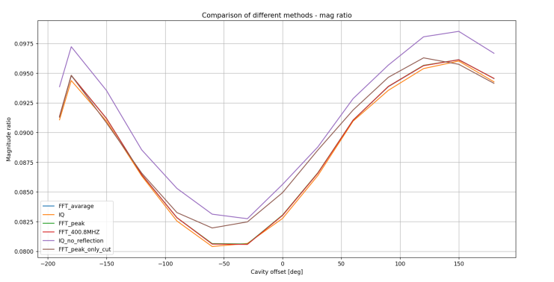
Results during cavity phasing C2
1 MV in C2
stay tuned for report by
Borna Boljkovac
(2025 summer student)
1st points are @cavity off

Slide 11
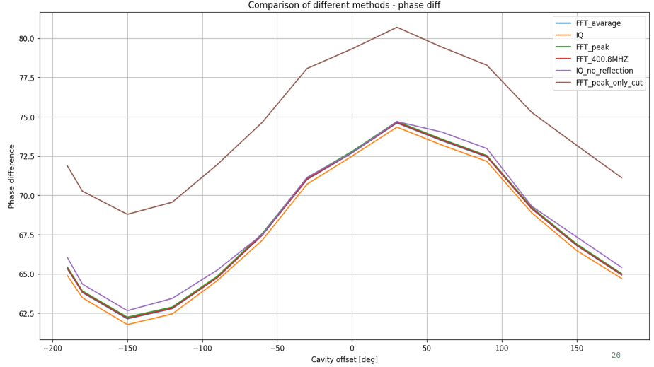
Results during cavity phasing C2
1st points are @cavity off

Slide 12
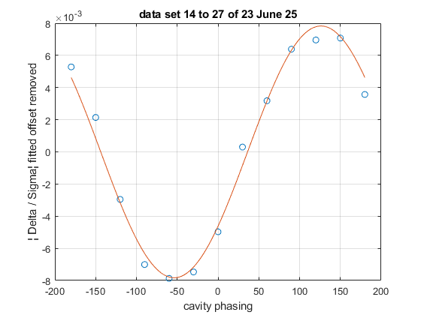
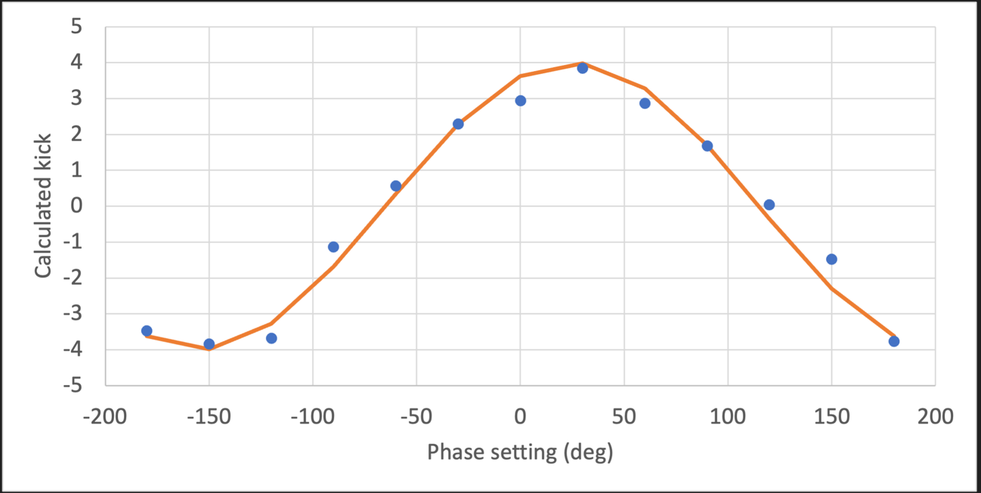
Offset removal – simple (pre-liminary)
simple removal of offset (fitting sine + offset)
C2 @1MV (phasing), C1 off
-65 degrees
-54 degrees
from YASP, needed kick to match closed orbit change from reference orbit
as determined in MD by ABP crew

Slide 13
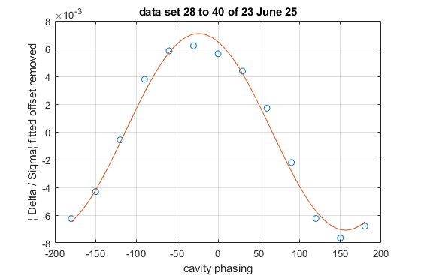
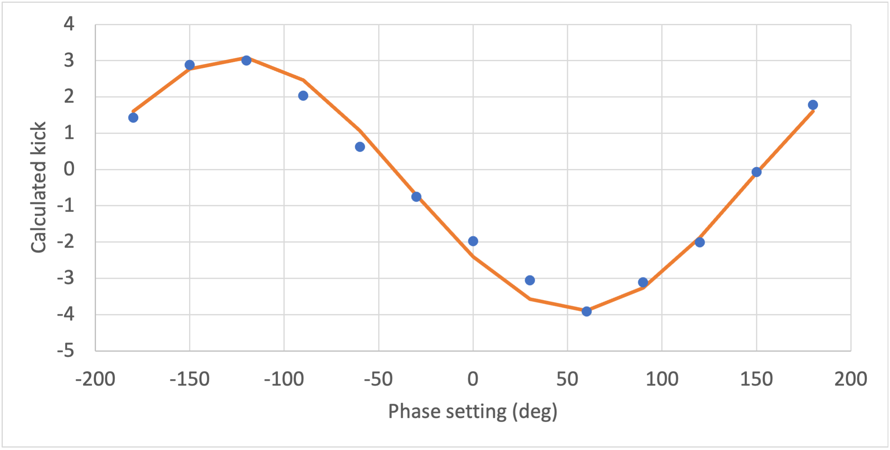
Offset removal – simple (pre-liminary)
simple removal of offset (fitting sine + offset)
C2 @1MV (full crabbing), C1@1 MV (phasing)
150 degrees
156 degrees
from YASP, needed kick to match closed orbit change from reference orbit
as determined in MD by ABP crew

Slide 14
Conclusions
measurement of crabbing by direct sampling of bandpass filtred Σ and Δ signals from button pick-up is possible
single turn measurement (!) with low intensity bunch (2x10¹⁰), suitable for commissioning has similar resolution as orbit method
sufficient resolution to quantify crabbing motion and crabbing voltage after additional calibration with bumps and beam tilts
correct offset subtraction is a critical subject to be further explored
  operation of systems in LHC with defined small offsets of beam in pick-up better than with zero offsets?
fixed frequency sampling and analysis of exact RF frequency bin in amplitude and phase possible i.e. in our case at 400.787 MHz
button pick-up sensitive to reflections
  after removal of the offending splitter → signals with bunch trains affected in the later MD on 16.07.2025 (trailing part of bunch train suffered reflection effect from surface); absorptive low pass would be needed, regular lowpass of limited use (was tested)
  → matched stripline pick-up is correct choice for LHC noise feedback

Slide 15
spare

Slide 16
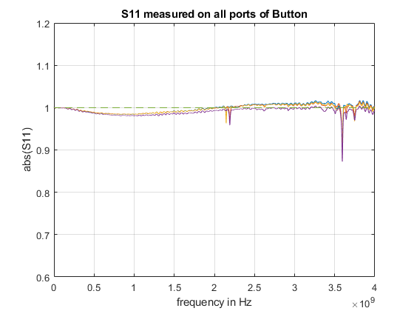
Button pick-up characteristics
more accurate calibration / measurement possible with proper measurement cables
vacuum chamber D = 83 mm
resonance free up to 2.1 GHz
SPSVHCAF0015
sensitivity not accessible by
S₁₁ measurements before installation

Slide 17
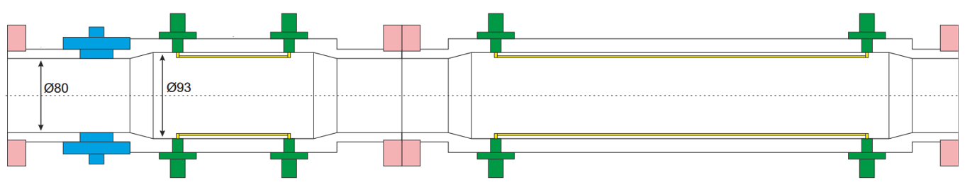
observing tilt and crabbing on a pick-up
tilted trajectory versus crabbing on button and stripline
L
L
beam (bunch) >> L
SPS 4σ = 4 ns … 1.7 ns
beam (bunch) >> L
tilted trajectory
accessible to CST simulations
we know in SPS MDs tilt w/o crabs less than 50 μrad (H. Bartosik for 23.06.25) + PU alignment
analytical formula tricky for button to apply
crabbing
crab cavity voltage phased to have maximum tilt in center of bunch, but bunch moves straight
for button analytic formula easy to apply (L<<4σ)
but «banana-shape» not accessible to CST wakefield solver; needs a (slower) PIC simulation
a new design is currently under review for HL-LHC
button (connection at center)
stripline (at ends, signal upstream, dashed)
BPTQR pickup
[Stripline] BPW / headtail
https://edms.cern.ch/ui/file/3069868/0.1/LHC-BPM-ES-0015-01.pdf

Slide 18



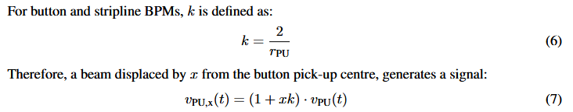
BPTQR analytical response
provided by M. Krupa (SY-BI), EDMS 2893433
  https://edms.cern.ch/ui/file/2893433/2/HL_LHC_BPTQR_analytical_response.pdf
voltage on button no loading
time domain response with loading (R₀ = 50 Ω)
(convolution)
sensitivity: provided by M. Krupa (SY-BI), EDMS
  https://edms.cern.ch/ui/file/2893433/2/HL_LHC_BPTQR_analytical_response.pdf
= 4 / D_{PU}
Where does the length L = 2 r_{b} come into play?

Slide 19
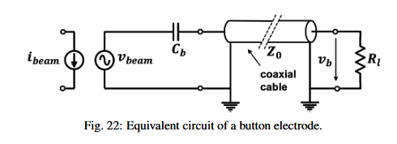

Approximation(s)
approximation L<<4σ (M. Wendt, CAS 2018, his draft):
  https://arxiv.org/pdf/2005.14081
  also neglected here: higher terms, off-axis in perpendicular plane
φ is called coverage, fraction of beam intercepted, changes along button
Δt is a transit time; approximation is that current must not change during Δt characteristics of button can be lumped together in the approximation in capacitance and beam pipe diameter

Slide 20
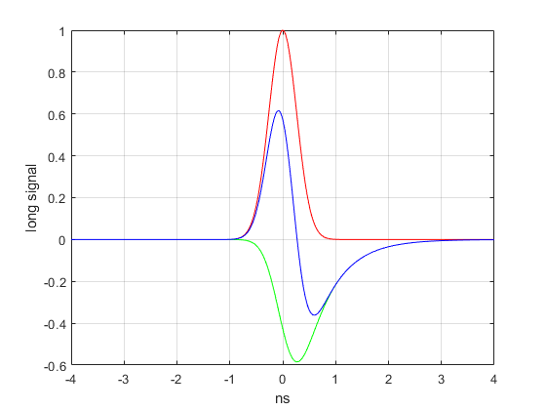
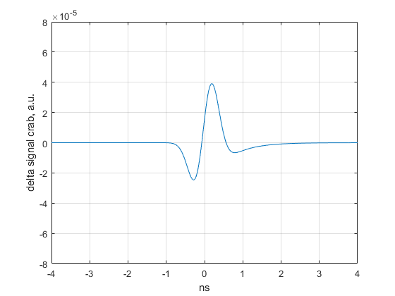
Button PU signals with crabbing (1)
longitudinal signals from button
(= signal when beam is offset)
shown are result (blue) and the two additive parts from the convolution
crab signal Δ
4σ = 1.05 ns
4σ = 1.05 ns

Slide 21
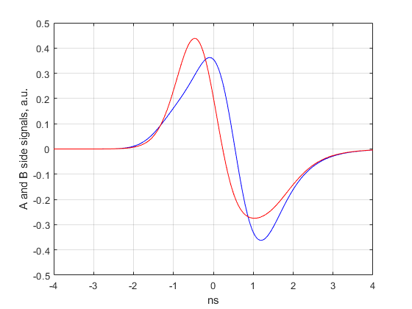
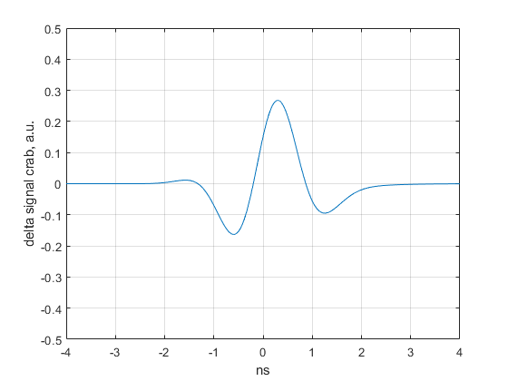
Button PU signal with crabbing (2)
crab signal A and B side
crab signal Δ = Α−Β
4σ = 2.7 ns
4σ = 2.7 ns

Slide 22
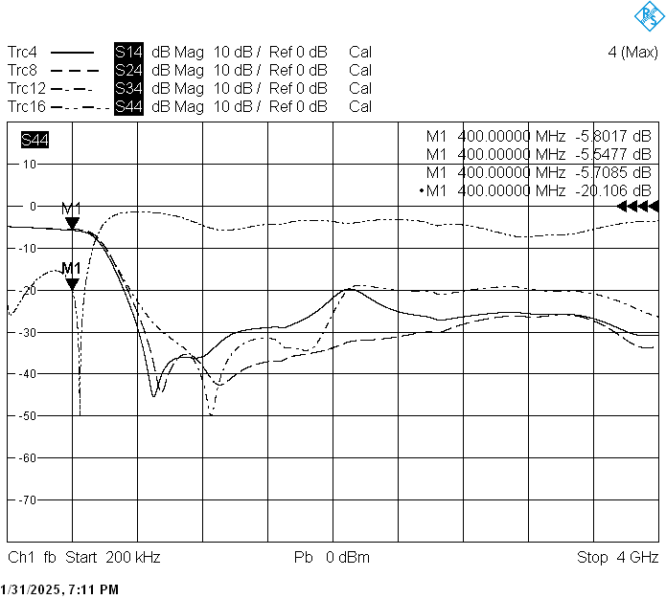
Splitters in tunnel
splitter minicircuits ZA3CS-400-3W-N+
  port S (port 4) to PU; port 2 terminated
  port 1 to RF FC (S₁₄ relevant)
  port 3 to BI (BI does not use its signal)
  back reflection from PU seen on port 1
    separation in time domain
    splitter could be removed in a future MD
A-side of PU: label « PU1 »: cable 3602855
  inner electrode (passage side) (671 ns)
B-side of PU: label « PU2 »: cable 3602856
  outer electrode (cavity, wall side side) (678 ns)
  7/8” cable between LSS6 cable tray and faraday patch, some differences in connector reflections for the two cable paths

Slide 23
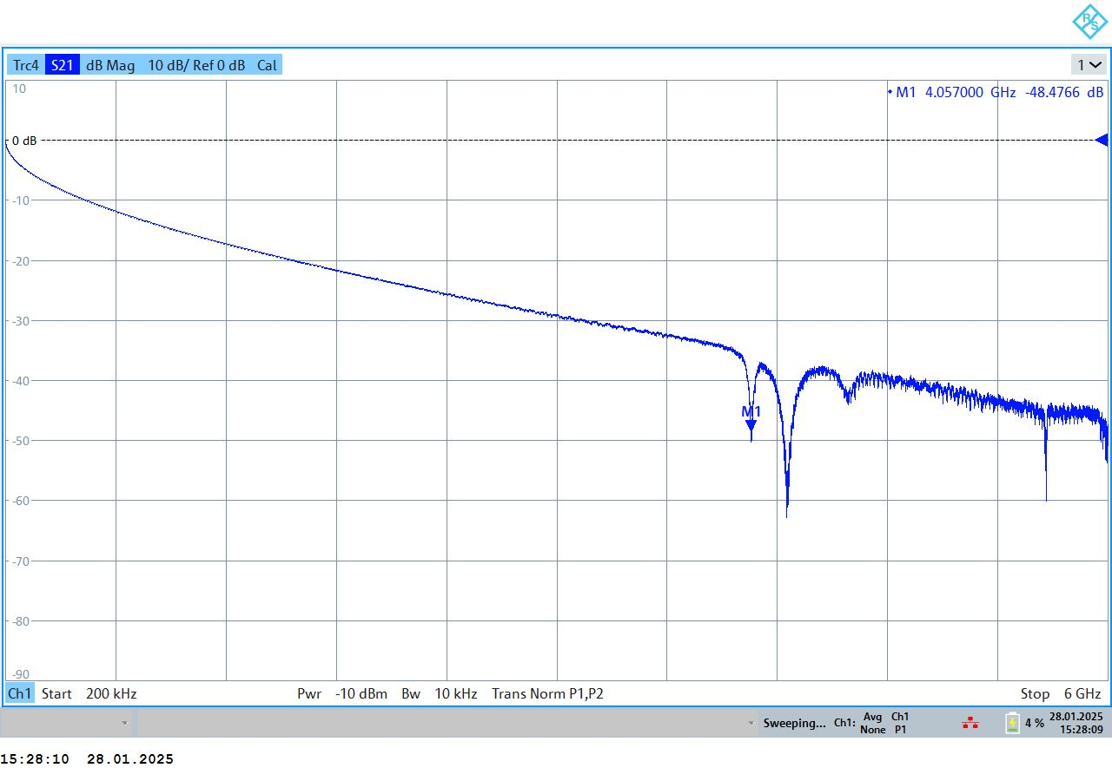
cables S21 joined together (attenuation)
round trip

Slide 24
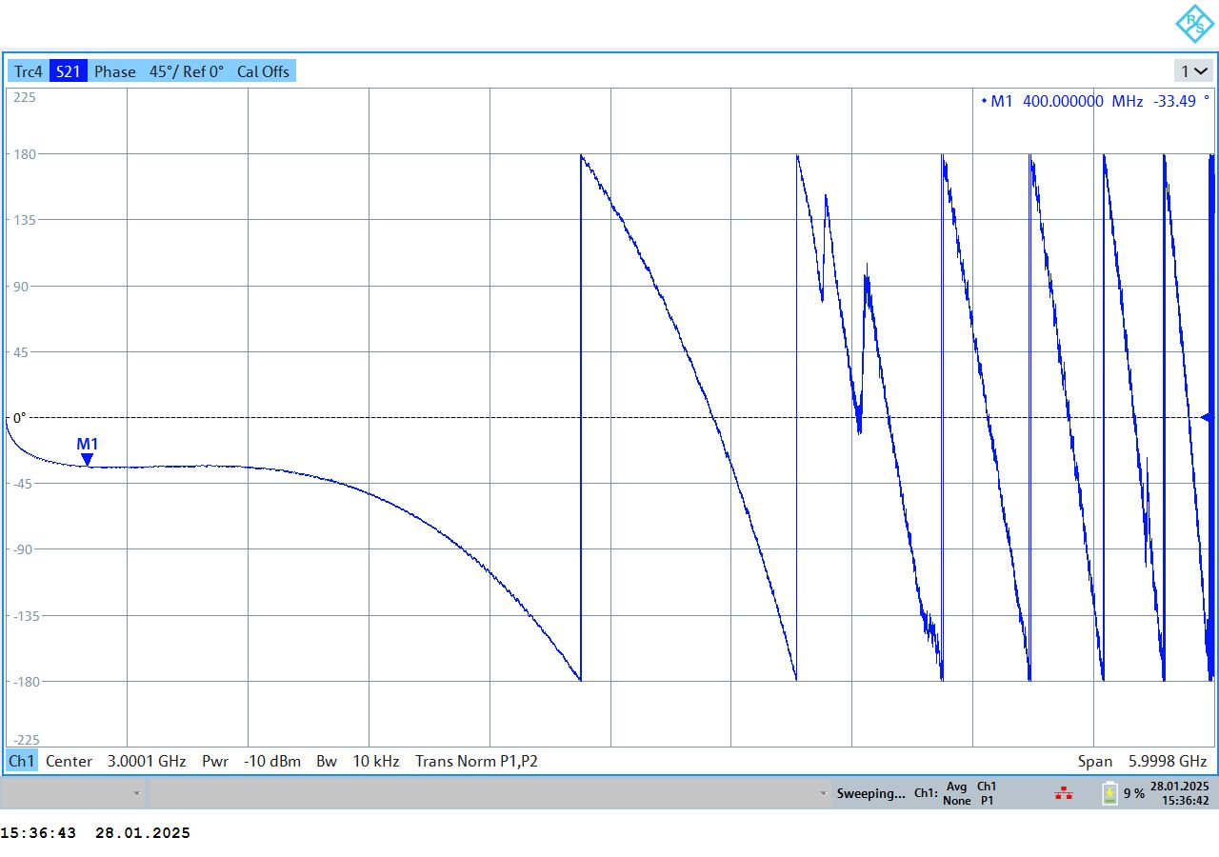
cables S21 joined together (phase)
round trip

Slide 25
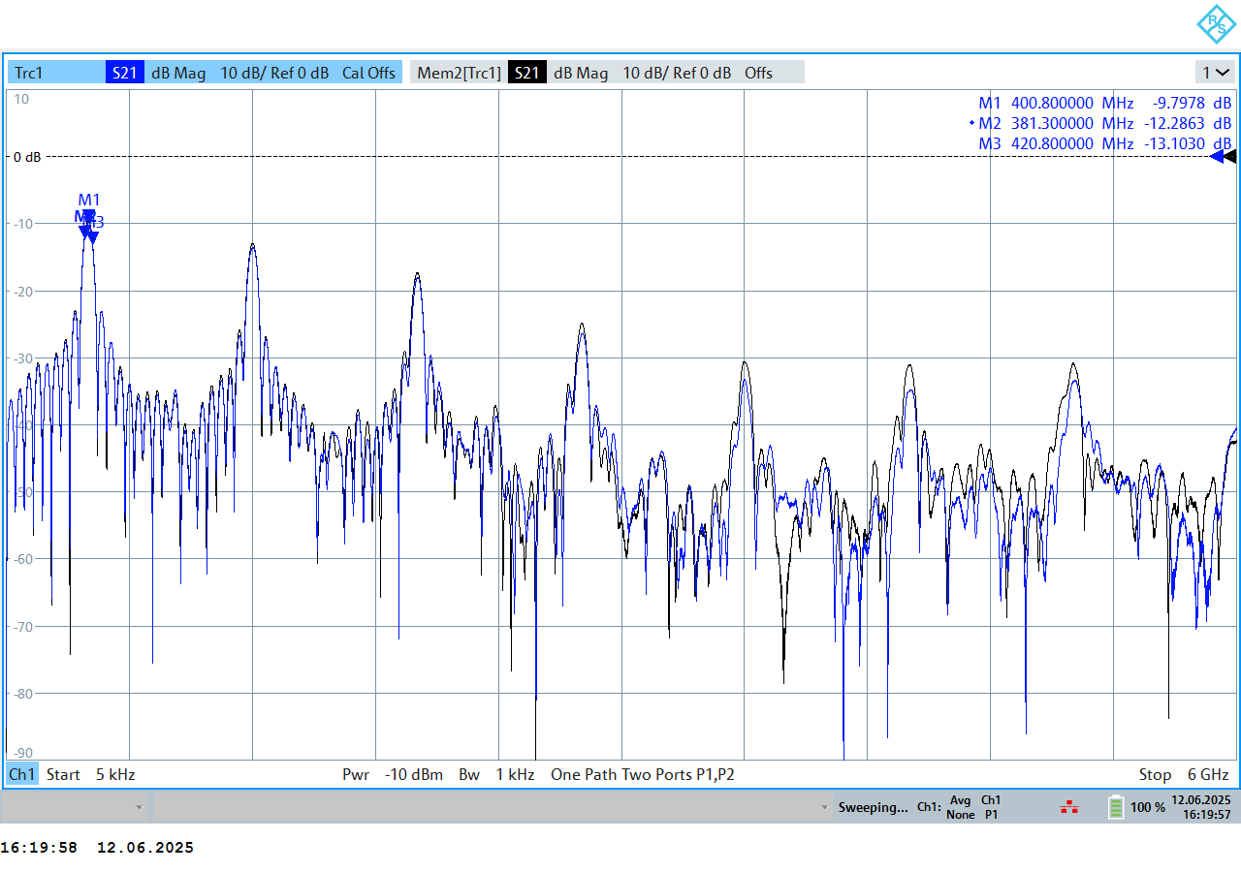
Processing crate #2
characteristics from inputs (A,B) to output (Σ,Δ)
no amplification
Passbands: f₀ + 2n x f₀
A→ Δ (mem)
B→ Δ

Slide 26
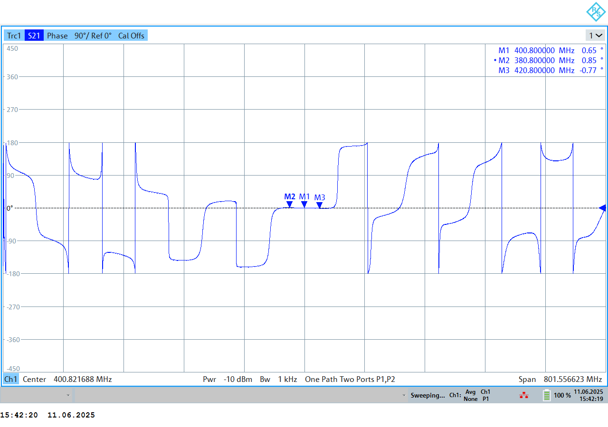
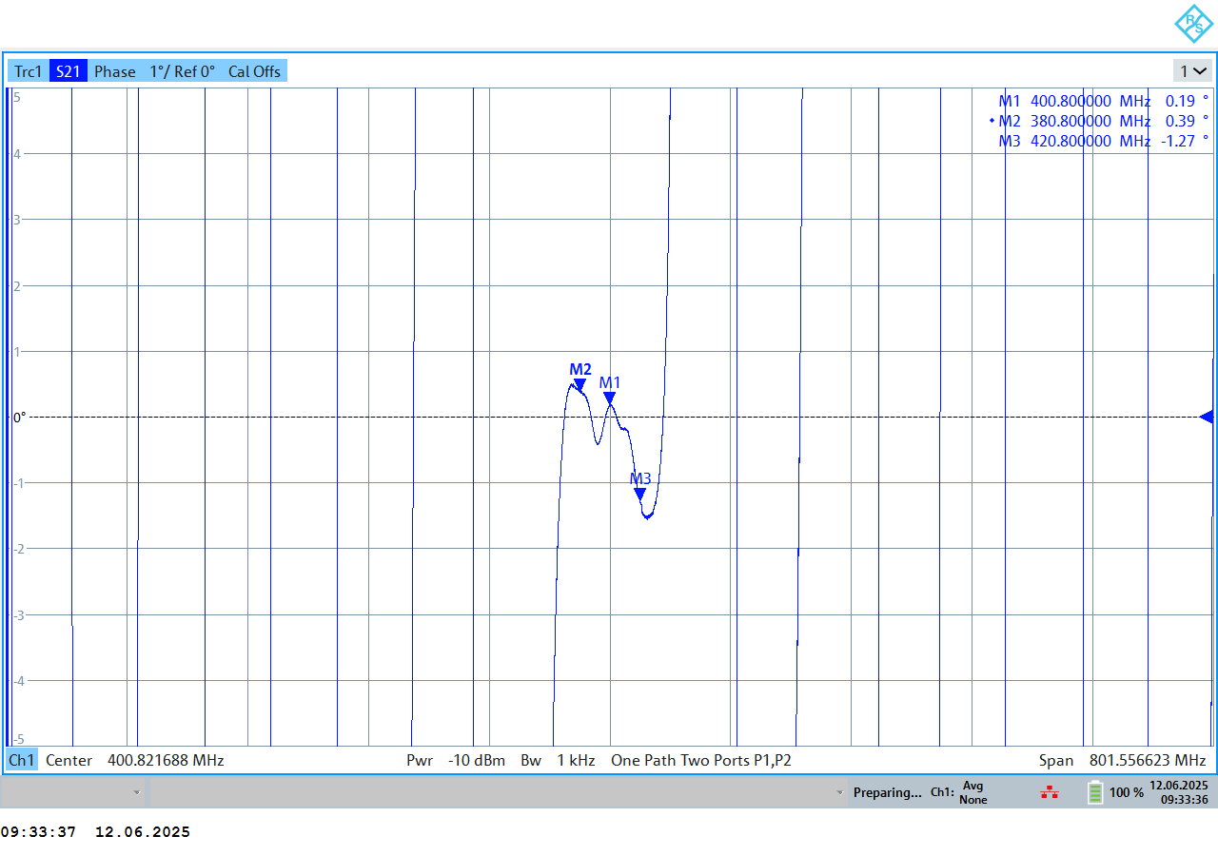
400.8 MHz – zoom - phase
A→Δ (plotted below in phase)
  reference delay chosen 25.587 ns
adjustment to have same reference delay for all four transmission parameters:
  residual phase variation within +/- 20 MHz bandwidth is ~ +/- 1 degree
90 degrees/div
1 degree/div
relevant bandwidth for bunch-by-bunch

Slide 27
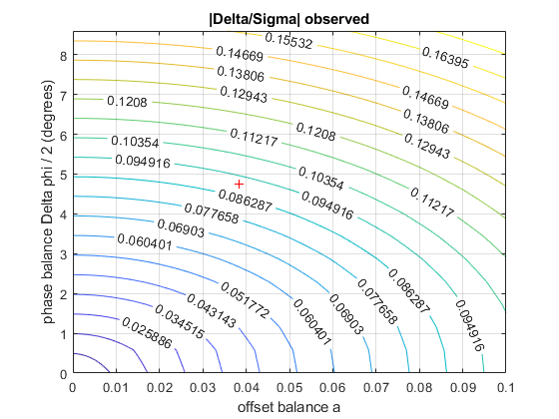
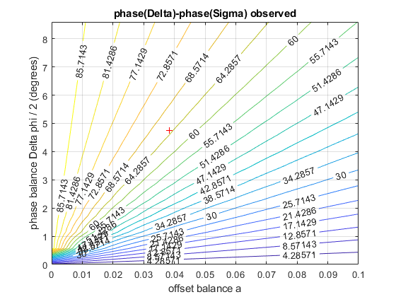
Contour plots
system of non-linear equations can be solved numerically for amplitudeand phase imbalance using amplitude ratio and phase difference
  offsets for amplitude ratio and phase difference to be subtracted from the measurements with crabbing cavity/cavities on

Slide 28
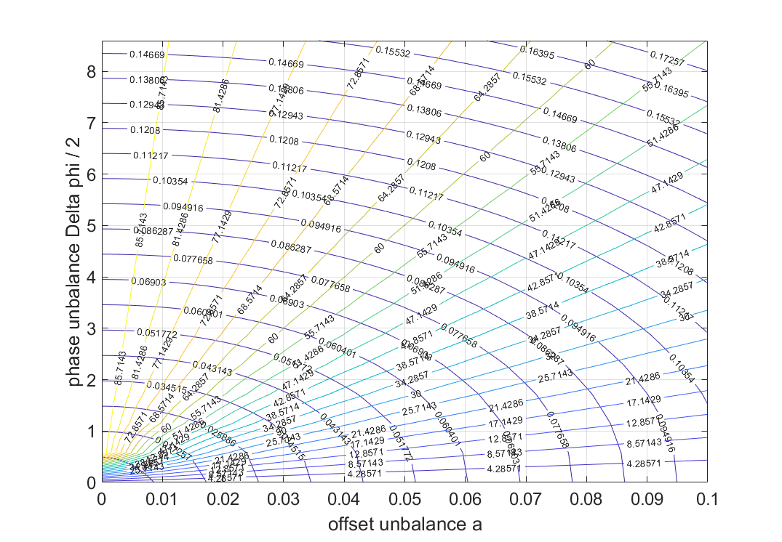
Contour plots
Two contour plots derived from Δ, Σ superimposed
  Phase between Δ, Σ → 65.1 degrees (from first look at FFTs @peak bin of Σ)
  Amplitude ratio Δ, Σ → 0.0915 (from 400.8 MHz)
  solution of system of two non-linear equations →
    phase unbalance: ~ 4.8 degrees (+/-) → +/- 33 ps at 400 MHz (total is 66 ps = 19.8 mm free space)
      assuming no angle in the button (!)
    amplitude unbalance: 4.8 % (+/-)

Slide 29
Preparations to see crabbing
Expectation when beam trajectory not following a straight line through the electrical centre:
  offset: amplitude of A and B signal changes
  tilted / crabbing: ~ quadrature signal A-B
    in addition to amplitude change of A and B, time shift appears
  28.05.2025: observation with PU processing crate #1
    400.4 MHz filter on Σ and Δ (i.e. after hybrid)
    at momentum of 26 GeV/c (injection)
  23.06.2025: observation with PU processing crate #2
    400.8 MHz filter on A and B (i.e. before hybrid)
    at momentum of 270 GeV/c (coast plateau)
  But beware of imperfections … phase or delay difference A, B also causes quadrature signal

Slide 30
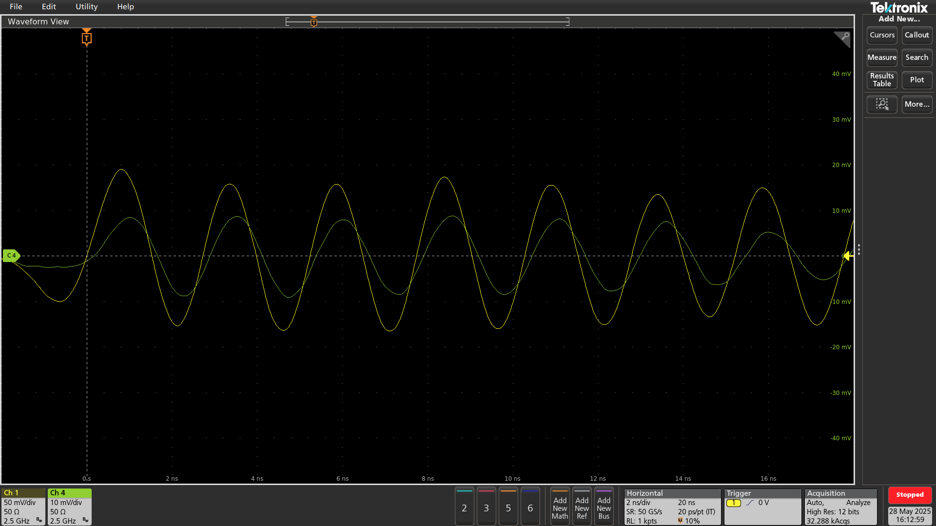
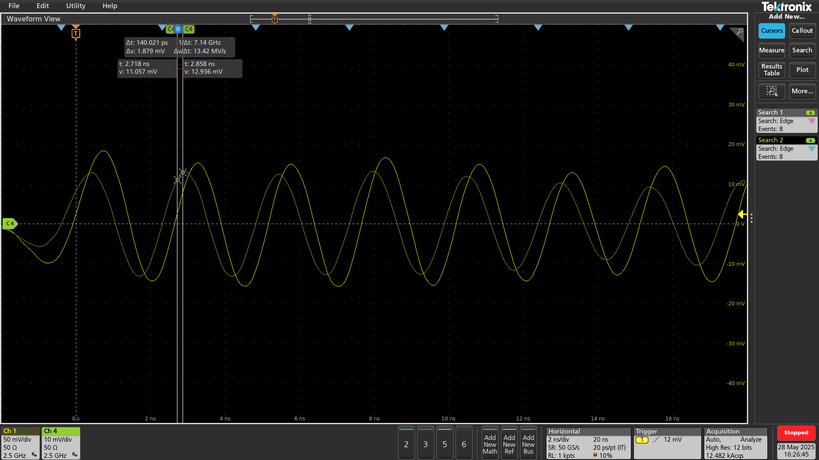
Sample shots 28.05.2025
1 MV cavity 1 and 1 MV cavity 2
Σ
Σ
Δ
Δ
16:12:59
16:26:45
CCs in-phase
CCs counter-phase

Slide 31
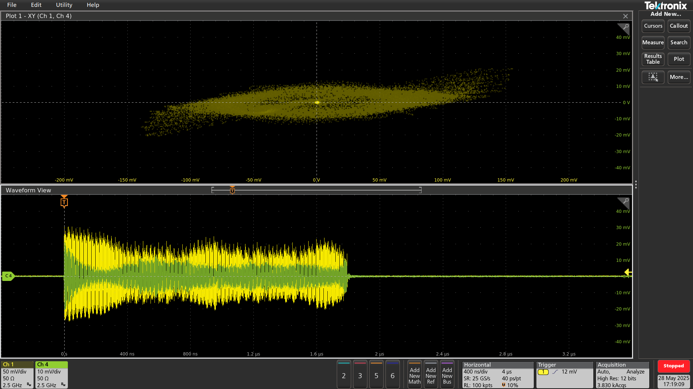
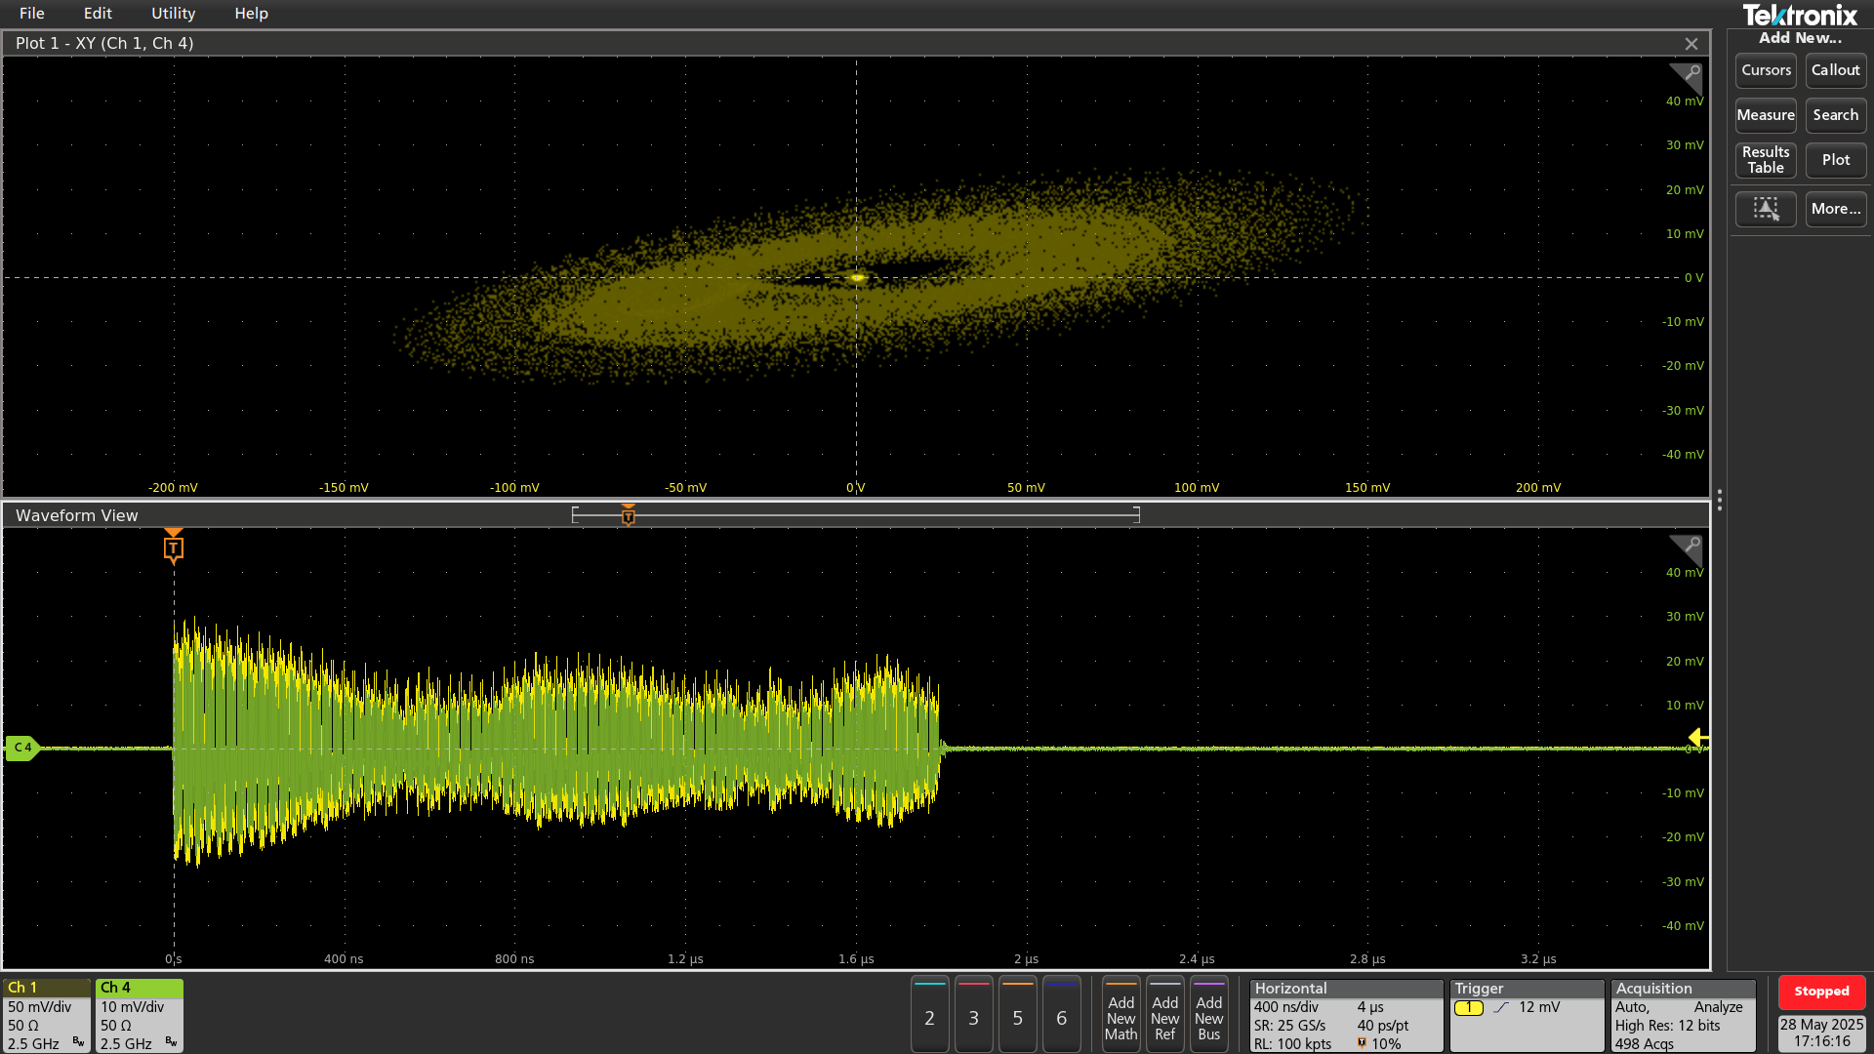
Sample shots 28.05.2025
revised (added)
1 MV cavity 1 and 1 MV cavity 2
Δ
Δ
Σ
Σ
17:16:16
17:19:09
CCs in-phase
CCs counter-phase

Slide 32
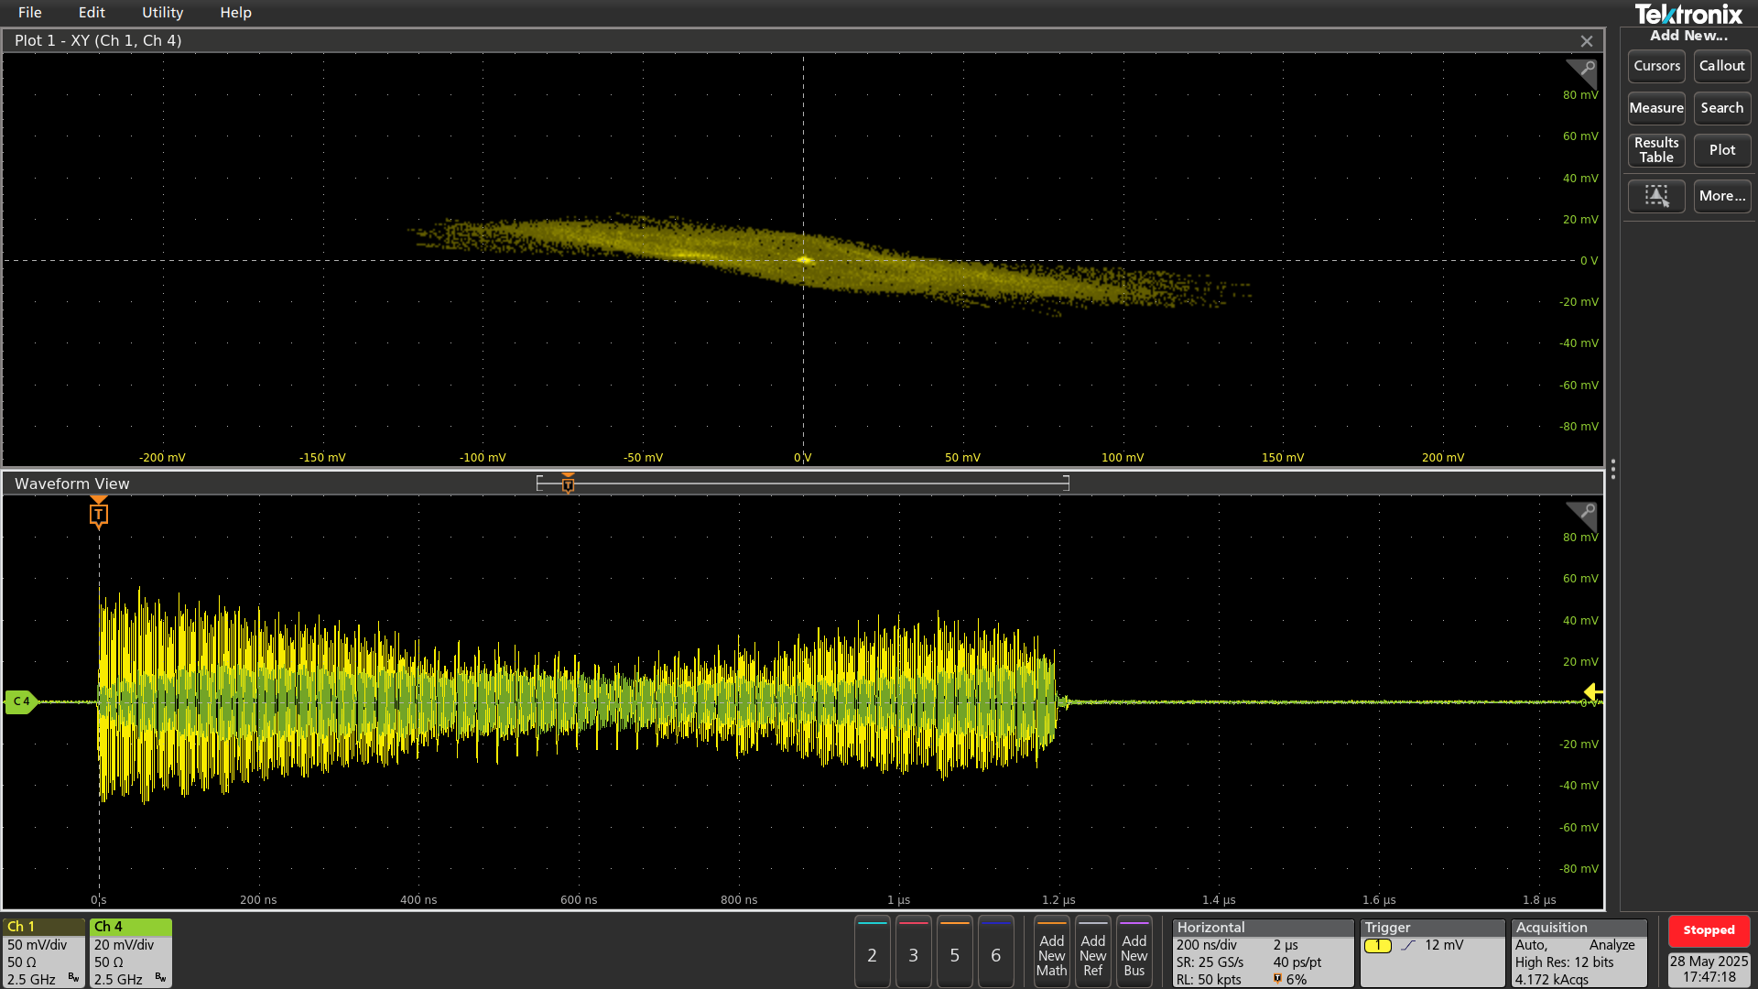
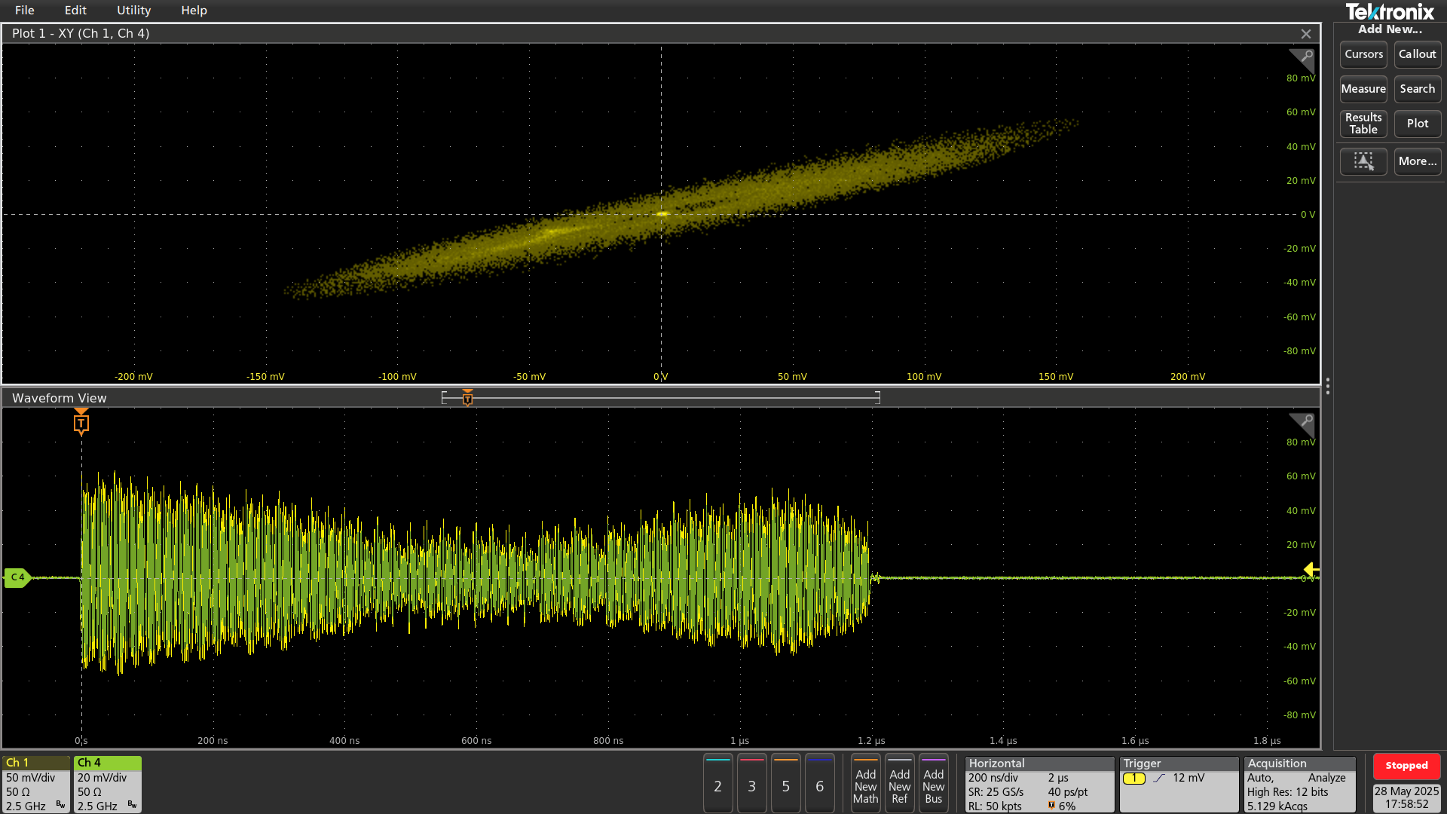
Example with bump
revised
Cavities not powered
Δ
Δ
Σ
Σ
-5 mm
17:47:18
+5 mm
17:58:52

Slide 33
Preparations to date
Check of button pick-up in 867 before installation in LSS6
  08.01.2025 (NWA, S₁₁)
Check of button pick-up in-situ after installation together with associated cabling to surface
  28.01.2025
  05.02.2025
Check of processing crate #1 best for injection energy at 26 GeV/c momentum (bandpass filter on sum & delta @400.4 MHz)
  quick characterisation in lab (S₂₁), pre-calibration with signal generator in BA6
  original configuration but amplification by-passed, 400 MHz bandpass filters on sum and delta
Check of processing crate #2 best for coast energy at 270 GeV/c (bandpass filter on A and B @400.8 MHz)
  measurements in lab after re-configuration: 09.06.2025-13.06.2025
  re-cabling of crate, 400 MHz bandpass filter on A and B, in line with plan for HL (D.V.)
  in-depth characterisation with NWA, pre-calibration with network analyser (A-B side)
    current pre-setting of A side: 5796 pre 23.06.2025
  installation in BA6 and beam-based alignment of A and B during MD on 23.06.2025 with final settings
  turn-by-turn trigger unit (VTU) commissioned for MD of 16.07.2025

Slide 34
Data available for analysis
23.03.2025 and 24.03.2025
  initial data, direct time domain, A and B side
02.04.2025
  bump scan, crab cavities not powered, A and B side
28.05.2025
  use of processing crate #1 at injection
  data at injection sum and delta with bunch trains and crabbing, cavities powered
23.06.2025
  use of processing crate #2 at 270 GeV/c
  data with single bunch and noise injection at 270 GeV/c
16.07.2025
  data with bunch trains from instability MD
12.11.2025 ? Program to be defined …

