Slide 1
Crab Cavity BPMs Status and outlook
M. Krupa for WP13
15th HL-LHC Collaboration Meeting, CERN, 02/10/2025

Slide 2
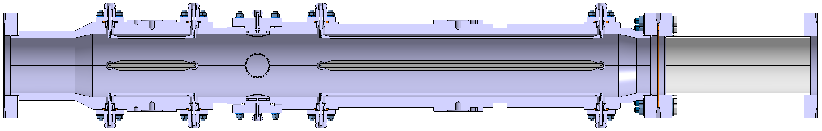
Introduction
Multi-purpose pick-up required for CC diagnostics:
A: cavity phasing (WP4)
B: cavity pick-up antena signal filtering (WP4)
C: cavity feedback (WP4)
D: direct monitoring of residual crabbing and instabilities (WP13 with RHUL)
Technology review (for D) in January 2025 (Indico, Review report, DMR):
Integrated button and stripline BPMs, full dual-plane implemenation
Beam direction
C
A+B
D

Slide 3
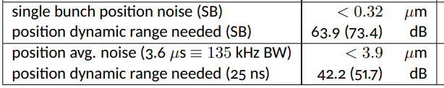
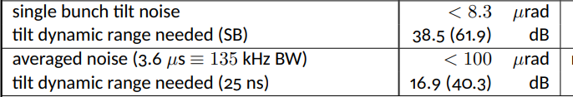
Specifications
WP4 specification defined in LHC-BPM-ES-0015
WP13 specification defined in LHC-BPW-ES-0001 – extrapolation from the existing head-tail monitor performance
Criterion | Key | Target | Units
Single bunch, single pass resolution at bunch centre for pilot bunch intensity | 100 | 50 | um
Single bunch, single pass resolution at bunch centre for nominal bunch intensity | 10 | 5 | um
Precision¹ of the measurement for nominal bunch intensity | 10 | 5 | um
Long term stability² of the offset for nominal bunch intensity | 50 | 20 | um
High frequency cut-off (-3dB) | 5 | 10 | GHz
Low frequency cut-off (-3dB) | ≤ 1 | ≤ 0.5 | MHz
In-band (between -1dB low and high cut-off roll-off) response variation | ≤ 1 | ≤ 1 | dB
Time resolution for single bunch, single pass measurement | 50 | 25 | ps
Acquisition length for a single bunch measurement on successive turns | > 1000 | 10000 | turn

Slide 4
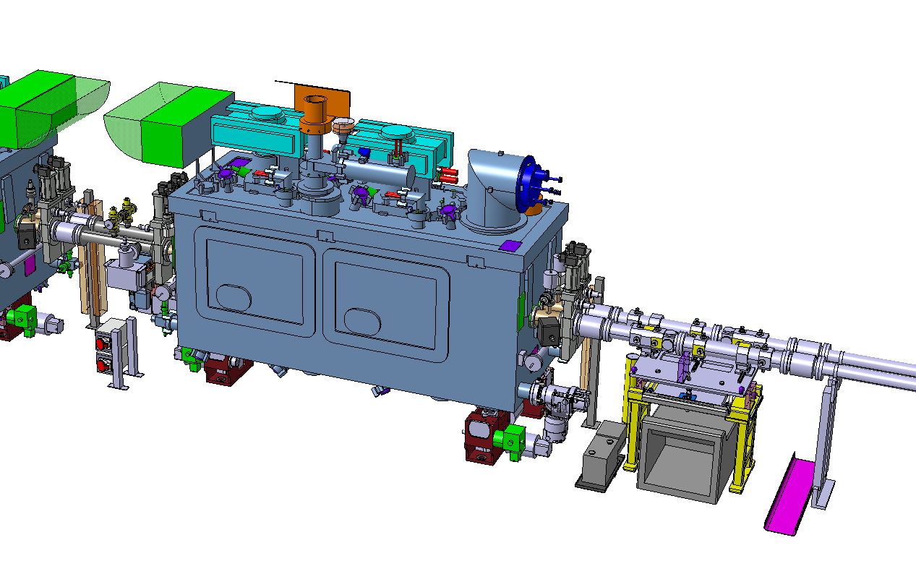
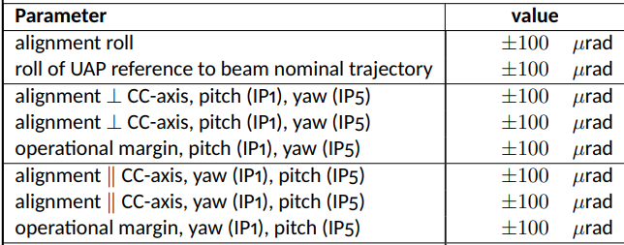
Other requirements & constraints
Installation next to CCs: high beta functions and favourable phase advance
Very tight angular alignment against the CCs required by WP4
Manual UAP – independent alignment of two beam lines (unique in the LHC)
Tests needed to validate the spec
Au + Cu coating for impedance reduction
Known process but tests required
NEG coating for e-cloud mitigation
No experience with NEG-coated BPMs
Discussions with TE-VSC started
Permanent bake-out jackets:
Heat- and rad-tolerant SiO2 cables
“Standard” RF termination – short access needed before and after each bake-out
Q4 / arc
BPM
CC

Slide 5
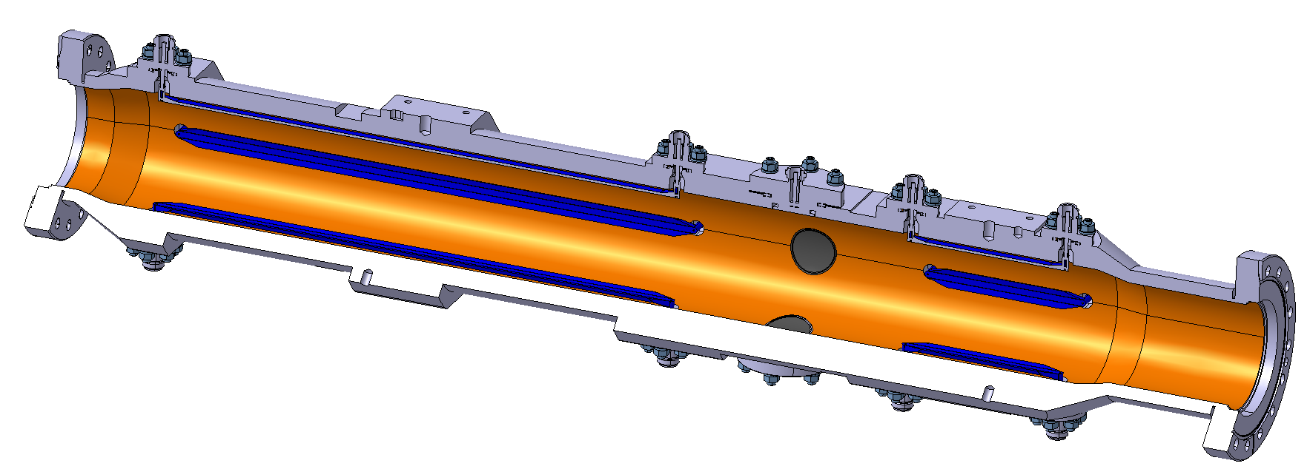
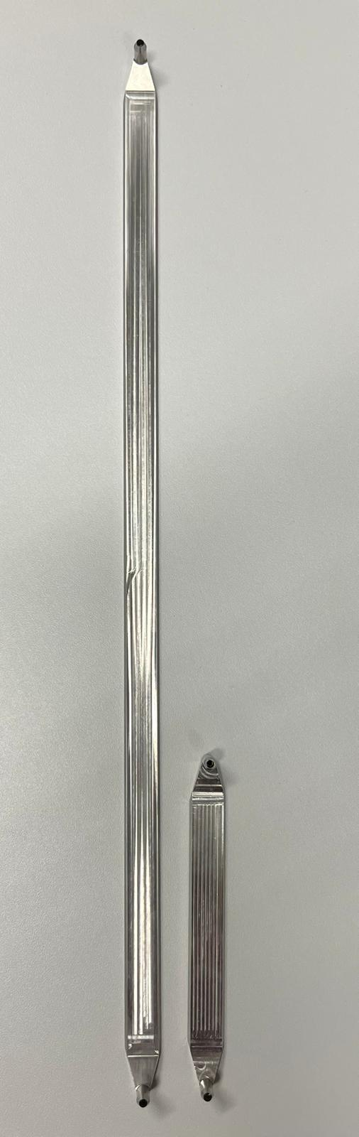
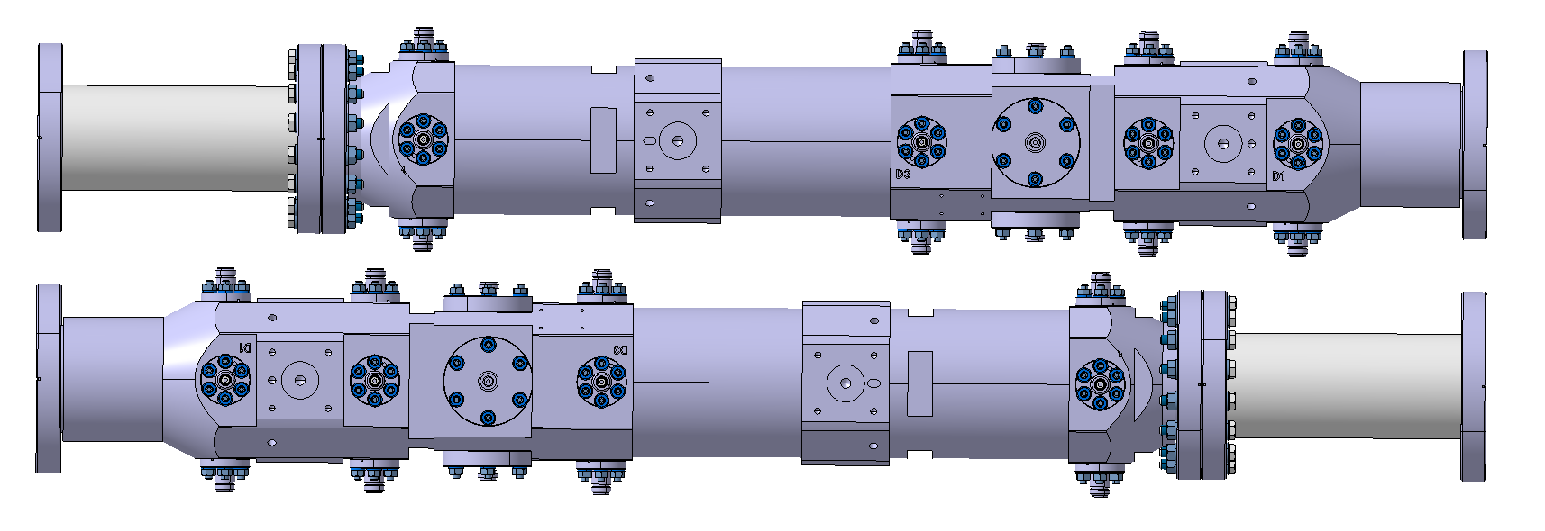
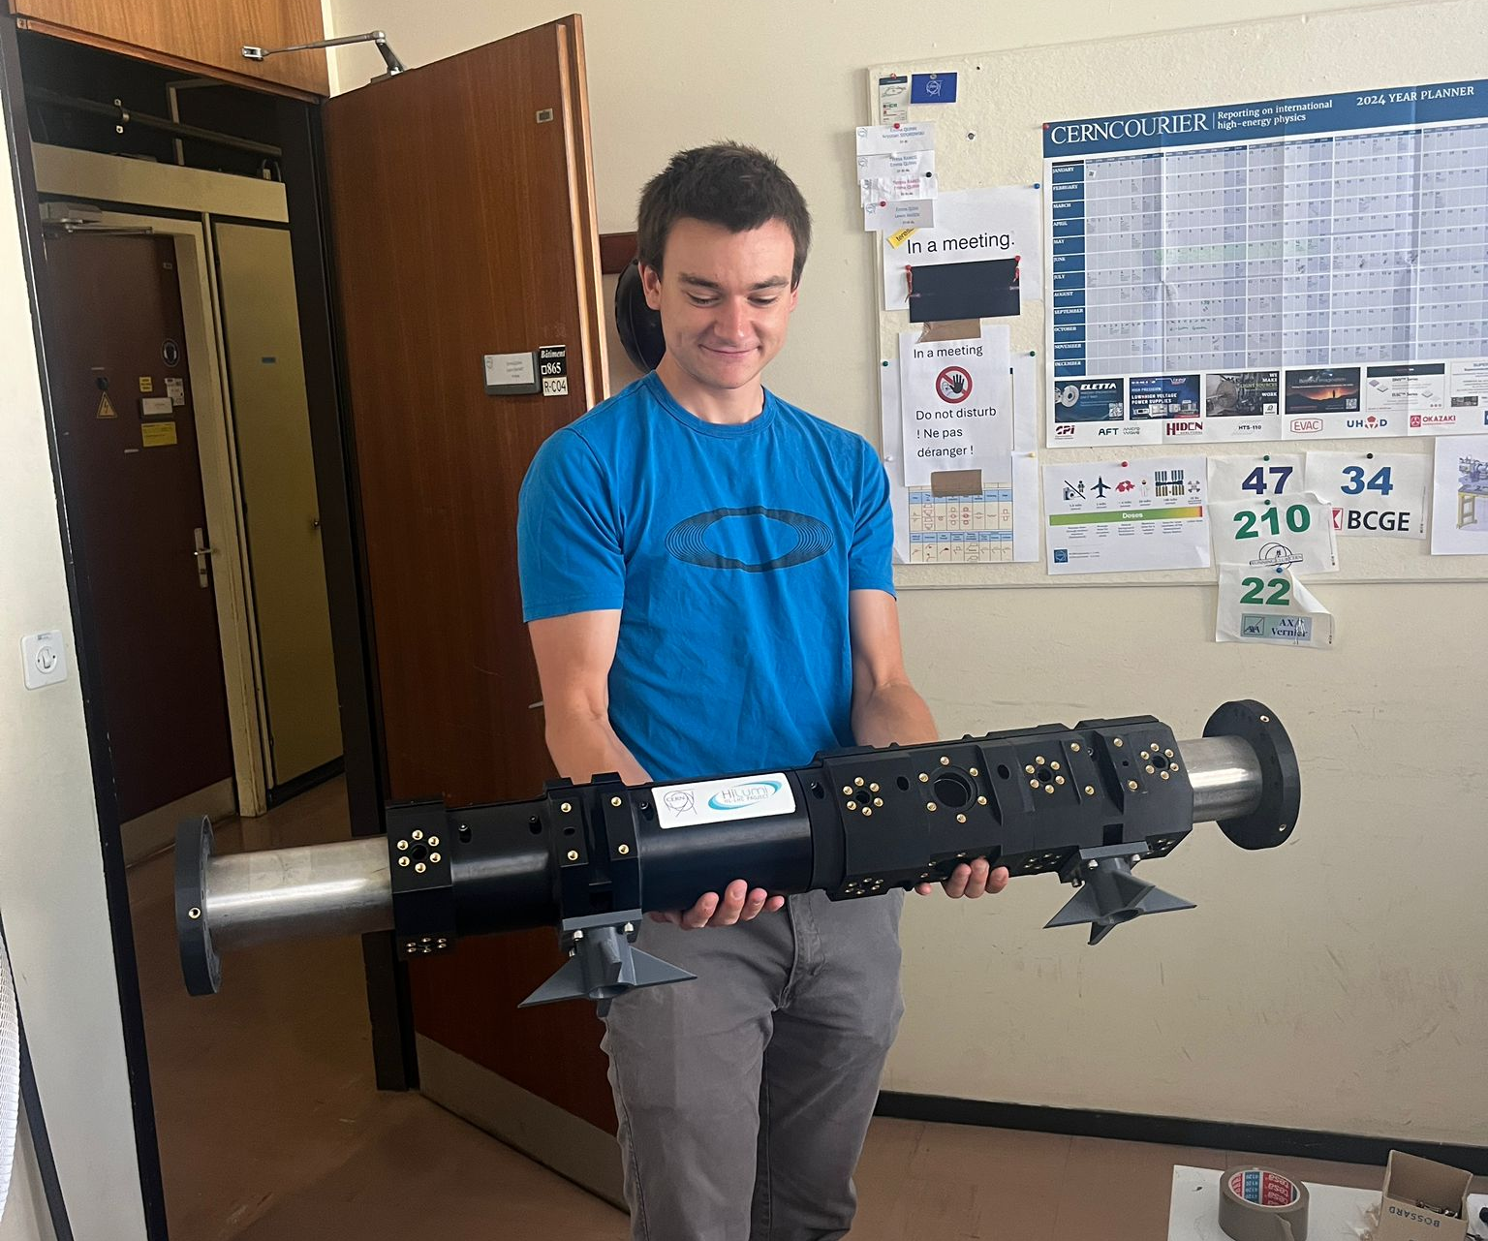
Design
Loann on Wed AM (WP13)
Preliminary design done by WP13
Advanced prototyping ongoing
Design freeze (and ECR) requested by December
Short stripline length to be confirmed by WP4
Hand-over to EN-MME for manufacturing drawings in 2026
Electrodes based on cryo BPMs
Thermomechanical simulations and tests needed – electrodes and feedthroughs during bake-out
All required tooling identified, design activities started
Biggest challenges: RF assembly, electrical qualification, handling

Slide 6
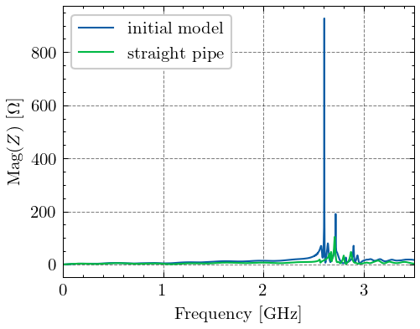
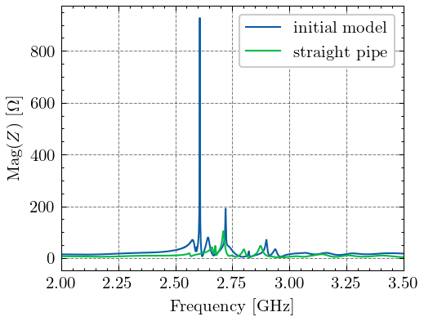
Impedance
Electromagnetic design verified and optimized with the Impedance Working Group
Impedance reduced by a factor of 9
Effective longitudinal broad-band impedance:
0.06% of the total LHC budget

Slide 7
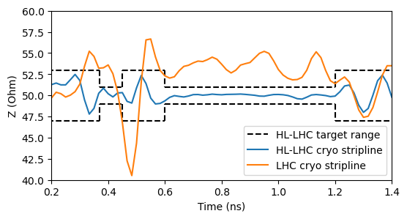
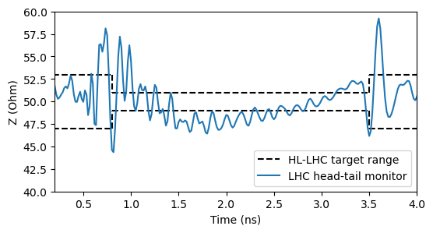
Expected performance (1)
WP4 functionalities: Noise floor will be dominated by the processing electronics
Intrinsic pick-up noise: < 0.1 μm in (400 MHz ± 68 kHz) BW
WP13 functionality:
Improved impedance matching of stripline electrodes
High-fidelity copy of the bunch longitudinal profile, improved BPM bandwidth
Daniel on Thu AM (WP2/WP4/WP13)

Slide 8
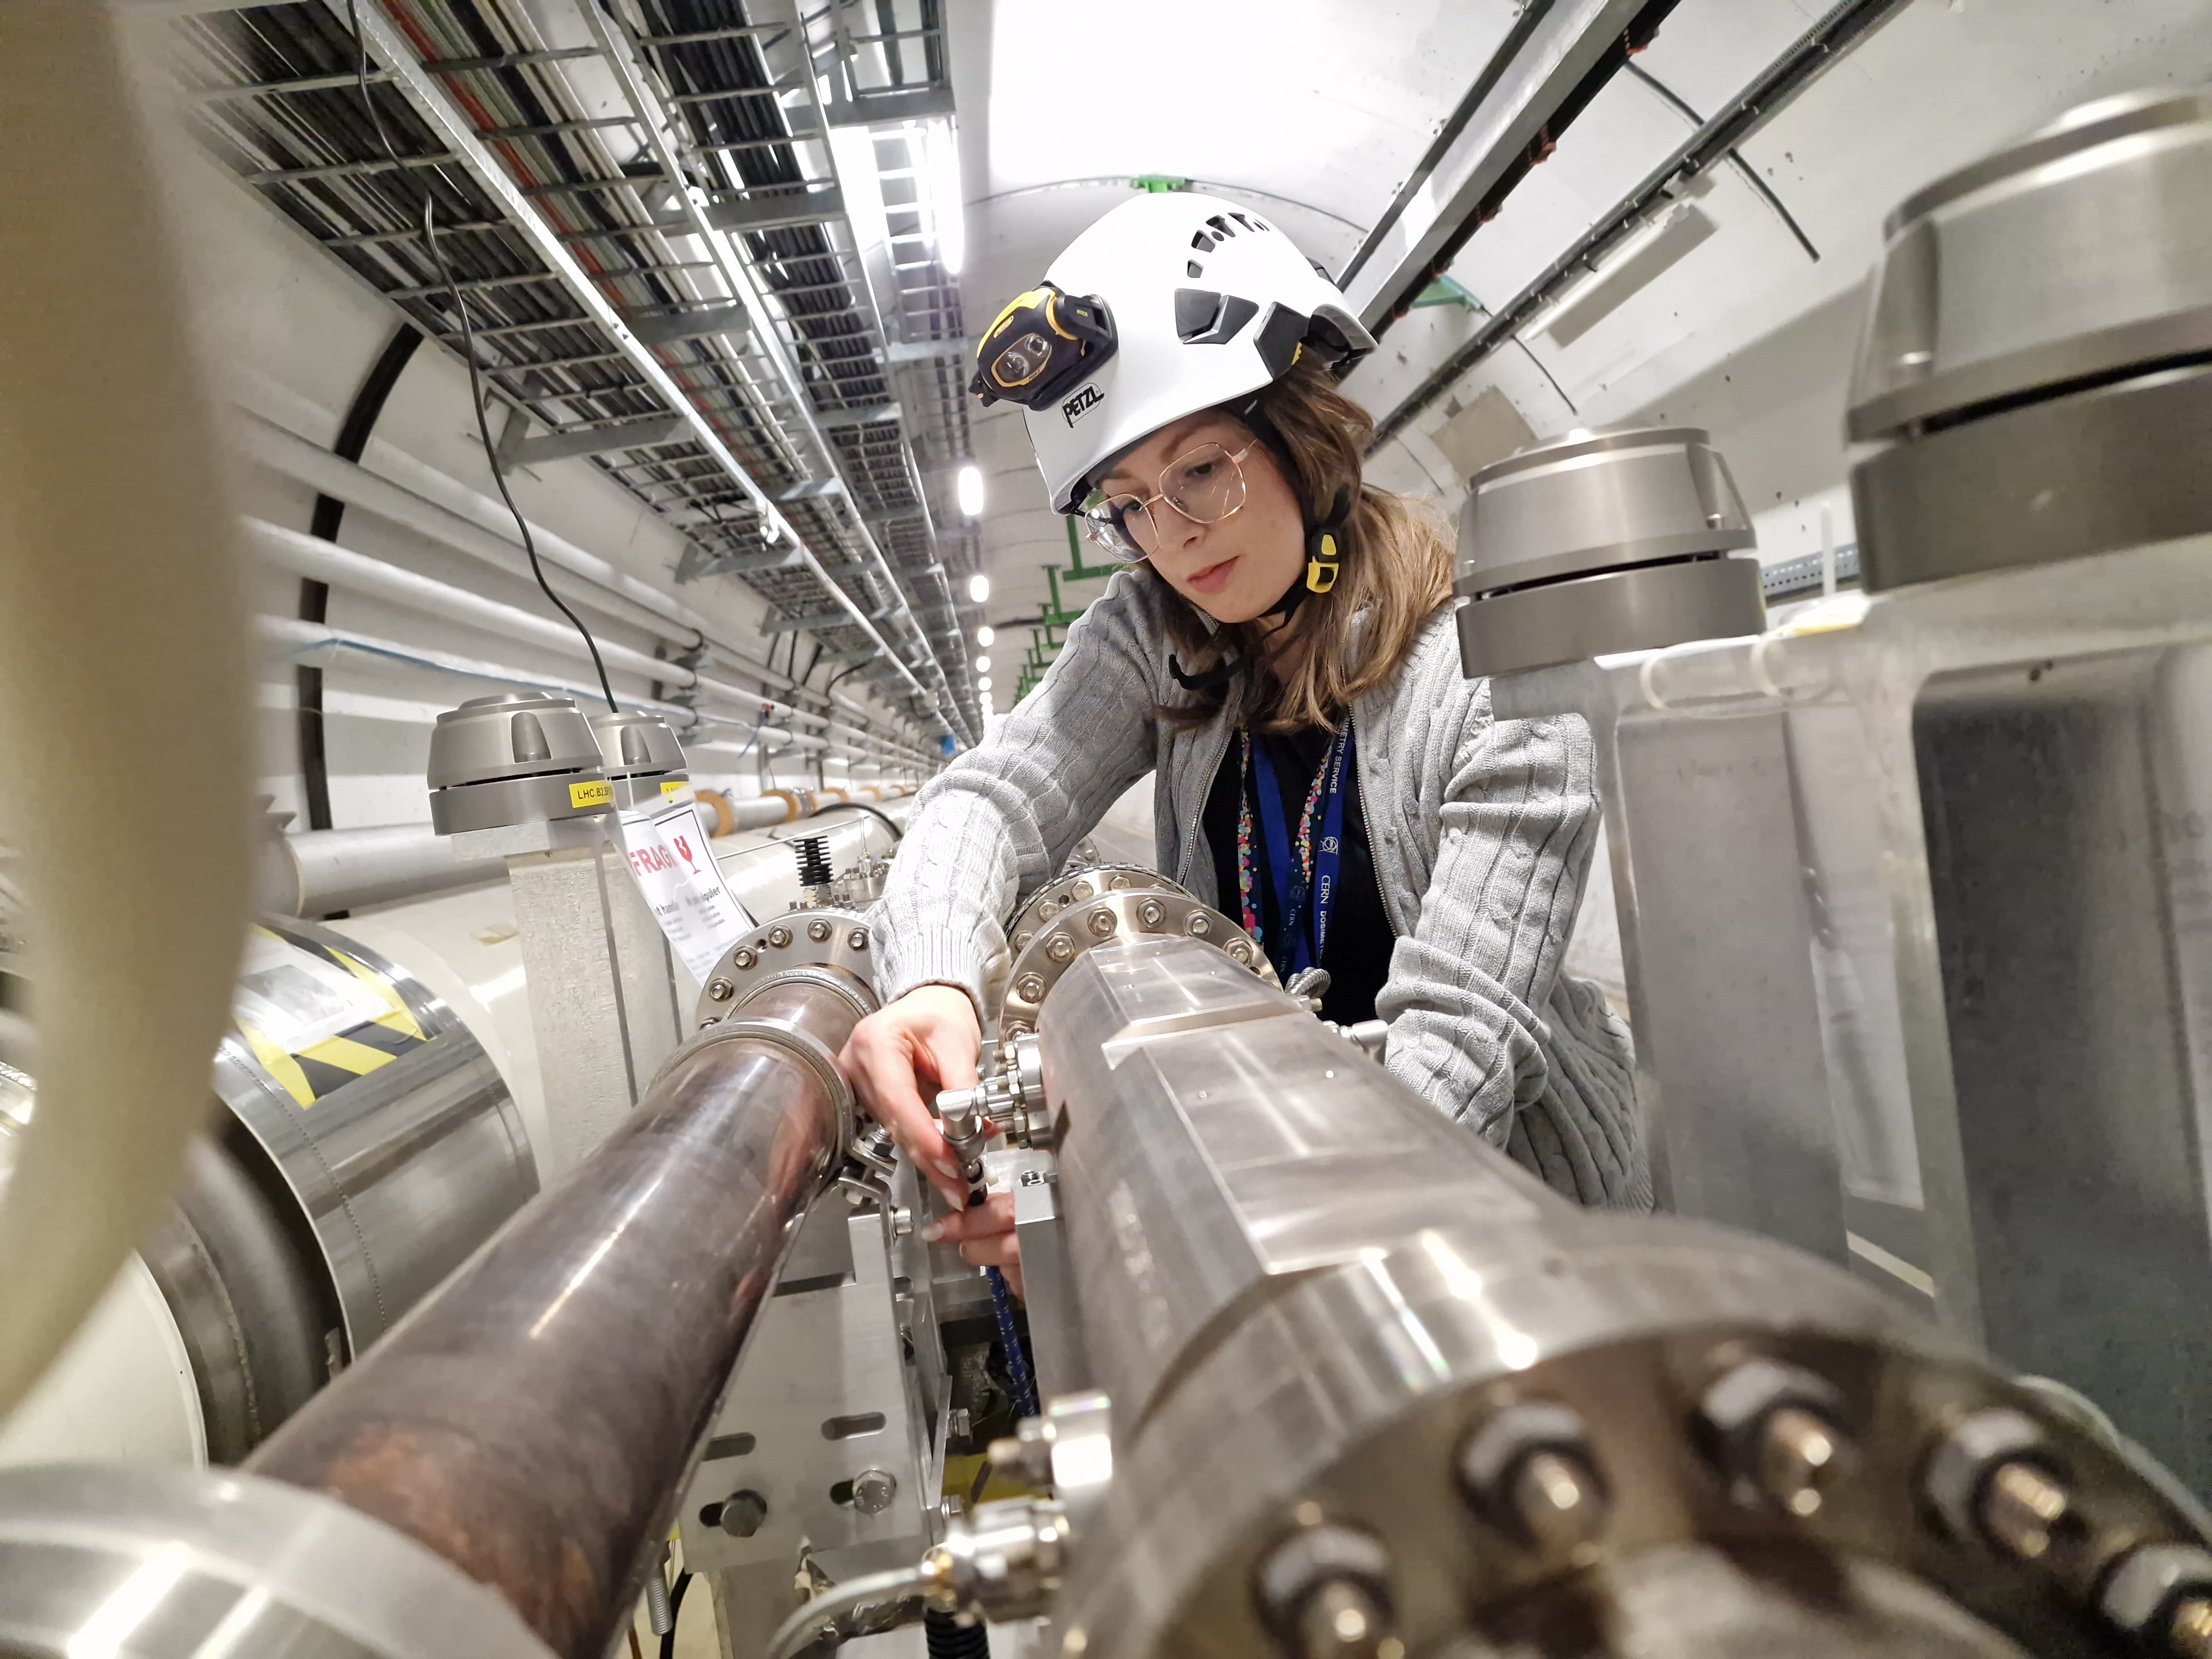
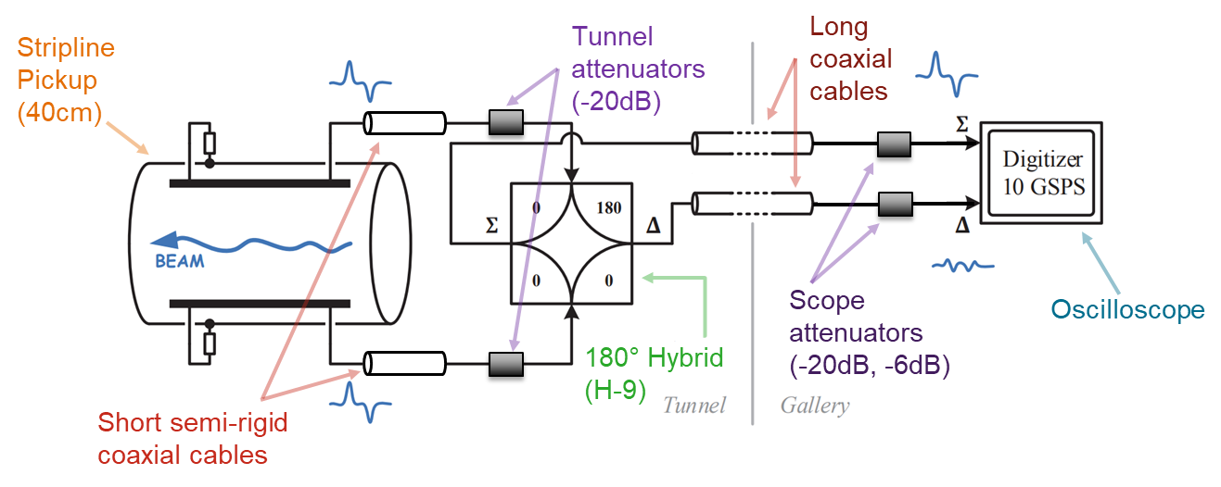
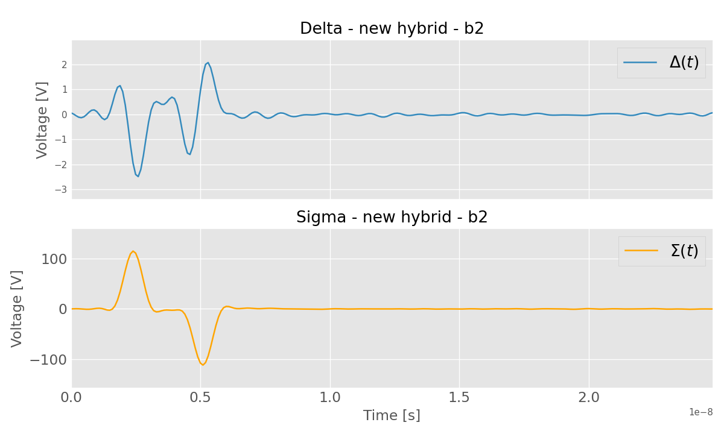
Expected performance (2)
Development of a new procedure for correction of imperfections of the front-end RF electronics
All existing head-tail monitors, including front-ends, measured and modelled
Technique validated offline using beam data, further computational optimization possible

Slide 9
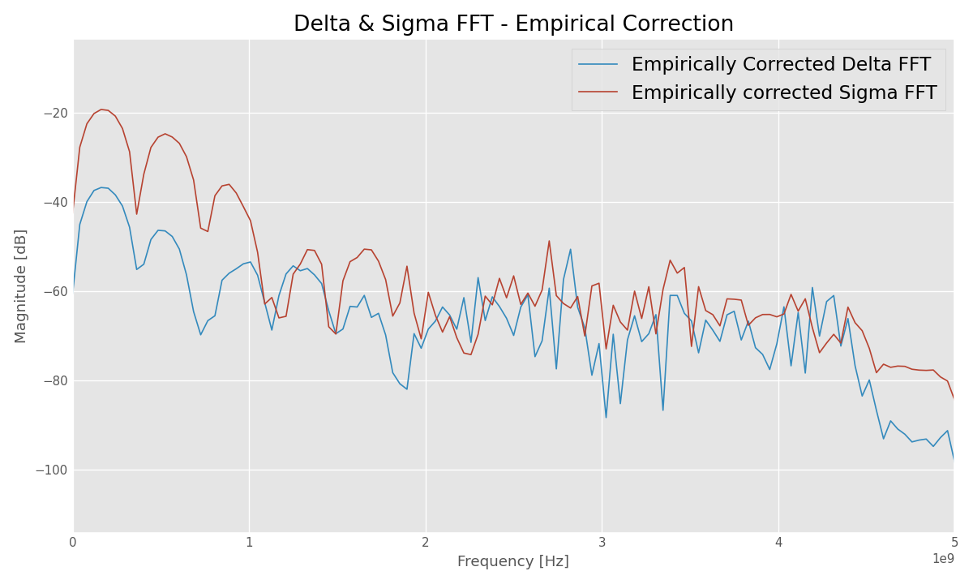
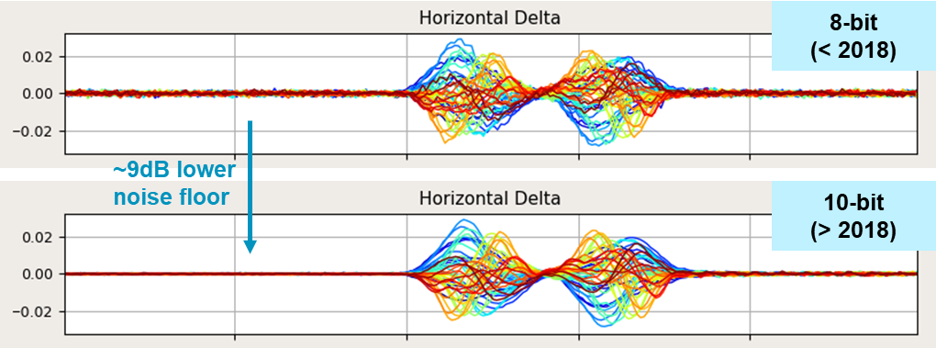
Expected performance (3)
Signal digitizer remains the bottleneck of the system
Commercial high-end oscilloscopes used currently
New digitizer will be procured as late as possible to leverage (slow) technology progress
Current technologies do not fully meet the WP13 specification
Electro-optical time-stretching read-out techniques under consideration to replace the traditional RF front-end
~ 50 dB DR
2 GHz
Andreas on Wed AM (WP13)

Slide 10
Budget and schedule
Budget of 852 kCHF defined based on in-house production of cryo BPMs and with inputs from technical groups (TE-VSC, BE-GM)
Partially financed through HL-UK2 contribution
Plan to commit most budget by mid 2027
Aggressive production schedule to maintain the momentum from cryo BPMs production and to have reasonable contingency
2025: design review and freeze, order of raw materials, prototyping
2026: pre-series production of BPMs, coating studies and tests, production of alignment platforms, assembly tooling production
2027: series production of BPMs, installation and handling tooling production
2029: tunnel installation (after CCs)

Slide 11
Summary
Operation of crab cavities requires new and challenging diagnostics to be deployed in the LHC
BPM design being finalized by WP13
Novel RF front-end solutions under study by WP13
Electronics design ongoing by WP4 and WP13
BPM based on “standard” technology but with significant technical challenges
Precise alignment
Electrical assembly
Coating
Handling
Budget and schedule defined and successfully followed so far

Slide 12
Thank you very much for your attention
Special thanks to colleagues from RHUL, ATS-DO, BE-ABP, BE-GM, EN-MME, SY-RF, TE-VSC for providing their support and expertise

Slide 13









EOMTS-Prototype in LHC Point 4
Surface (SX4 R-002)
Gallery (UA47/U0-001)
Tunnel (2438/U0-2438)
Femtosecond
laser
DCM 5 km
1 ns
PM fibre
90:10 splitter
DC bias voltage
Chirped volume
bragg grating
SM fibre
EO modulator
RF signal
4 ns
Attenuators (> 30 dB)
DCM 20 km
+12.5 ns
Stripline
$$p^{+}$$
stretched time
Balanced Photodetector
ADC (RFSoC)
500 m

