Slide 1

Cold mass at CERN
H. Prin, T. Bampton, N. Bourcey, N. Eyraud, L. Grand-Clement, O. Housiaux
15th HL-LHC Collaboration Meeting, CERN, 29 September -12 October 2025

Slide 2

Outline
Status of the HL-LHC cold mass production at CERN
Non-Conformities
Appraisal
Types
Mitigations and Improvements
Q10 with MS cold mass
Design
Welding developments
Summary

Slide 3
Cold Masses Production Status

Slide 4
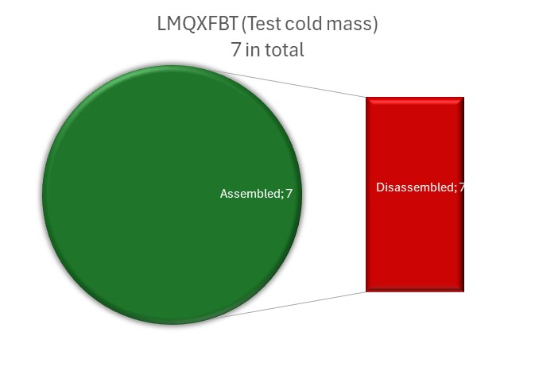
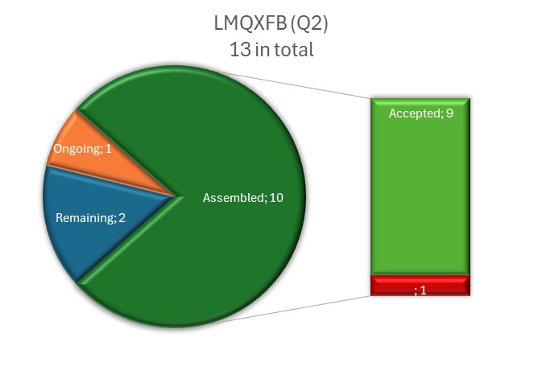
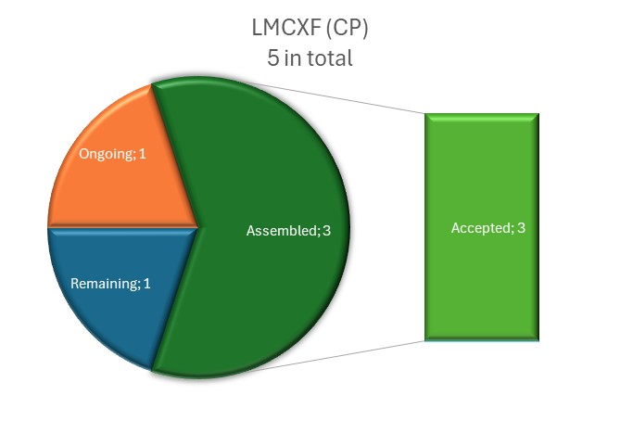
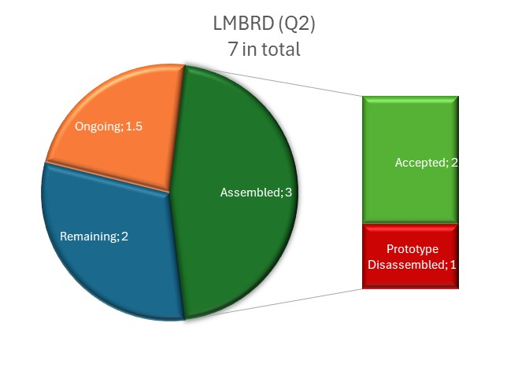
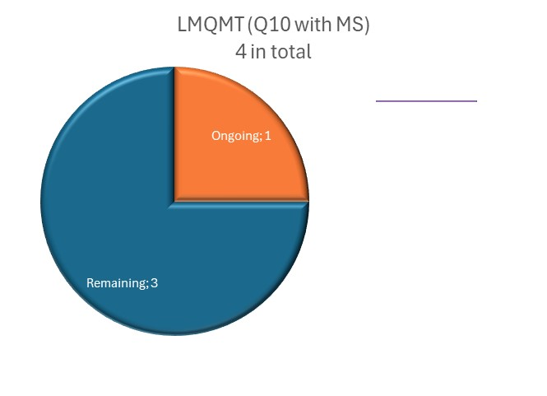
Status of the HL-LHC Cold Mass Production @ CERN per Type
 | Total | Assembled | Remaining | Ongoing | Accepted | Disassembled
LMQXFBT (MQXFB test) | 7 | 7 | 0 |  | 7 | 7
LMQXFB (Q2) | 13 | 10 | 2 | 1 | 9 | 1
LMCXF (CP) | 5 | 3 | 1 | 1 | 3 | 0
LMBRD (D2) | 7 | 3 | 2.5 | 1.5 | 2 | 1
LMQMT (Q10 with MS) | 4 | 0 | 3 | 1 | 0 | 0
Total | 36 | 23 | 8.5 | 4.5 | 14 | 9
Total without test and proto | 25 | 12 | 8.5 | 4.5 | 12 | 0

Slide 5
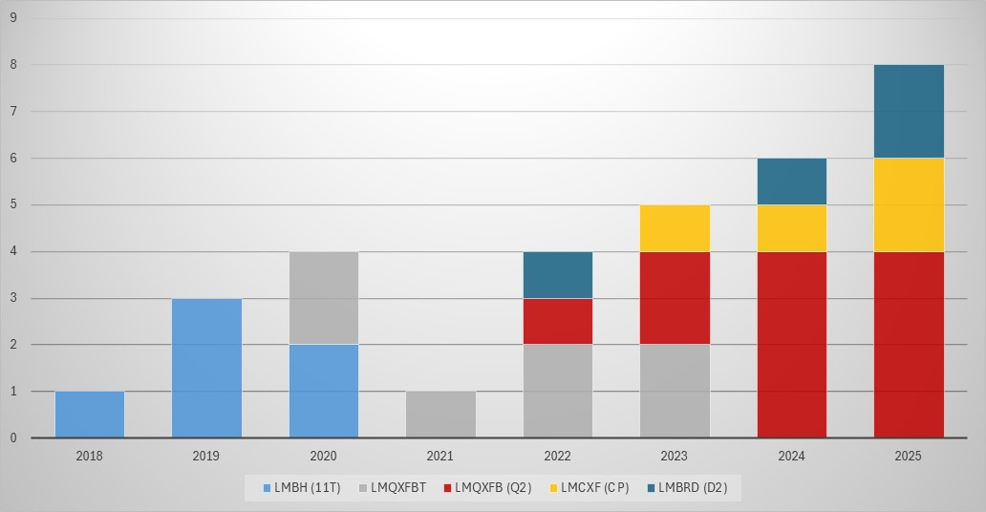
Status of the HL-LHC Cold Mass Production @ CERN per Year
LMBHB01
LMBHA01
LMBHA02
LMBHB02
LMQXFBT01
LMQXFBT02
LMBHA03
LMBHB03
LMQXFBT03
LMBRDP1
LMQXFB01
LMQXFBT04
LMQXFBT05
LMCXF01
LMQXFB02
LMQXFB03
LMQXFBT06
LMQXFBT07
LMBRD1
LMCXF04
LMQXFB04
LMQXFB05
LMQXFB06
LMQXFB07
LMBRD2
LMBRD3
LMCXF03
LMCXF05
LMQXFB08
LMQXFB09
LMQXFB10
LMQXFB11
+ STRING Activities
+ 4 LHC MB & 1 SSS Consolidated
+ 6 LHC MB Consolidated
+ 4 LHC MB Consolidated

Slide 6
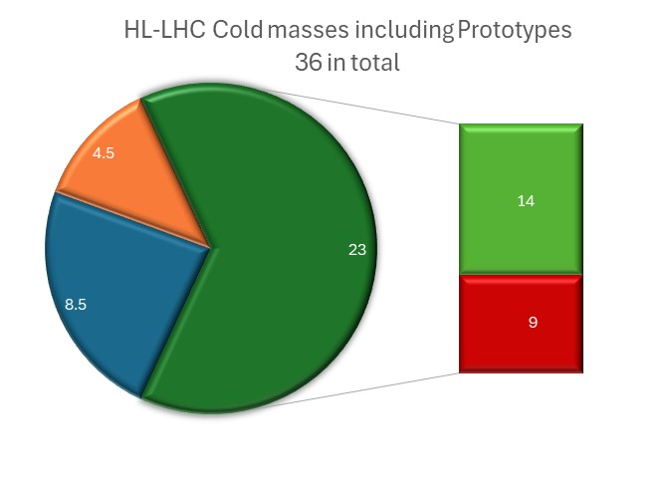
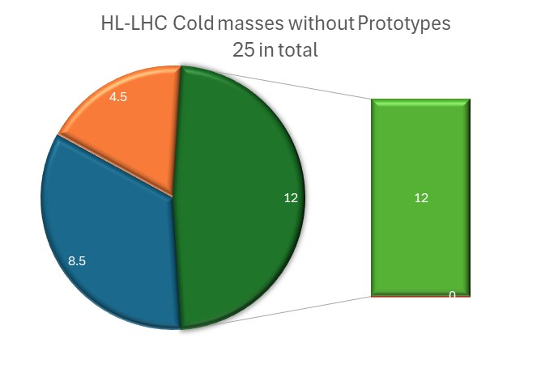
Overall Status of the HL-LHC Cold Mass Production @ CERN
13%
18%
48%
24%
64%
34%
By the end of 2025, LMBRD03, LMQXFB11 & LMCXF03 will be completed.
⇨ Q2: 10 (2 for the STRING, 8 for the machine) ✓, remaining 2 spares.
CP: 4 (1 for the STRING, 3 for the machine) ✓, remaining 1
D2: 3.5 (3 for the machine) ✓, remaining 1 for the machine + 2 spares

Slide 7
Cold Masses Non-Conformities

Slide 8
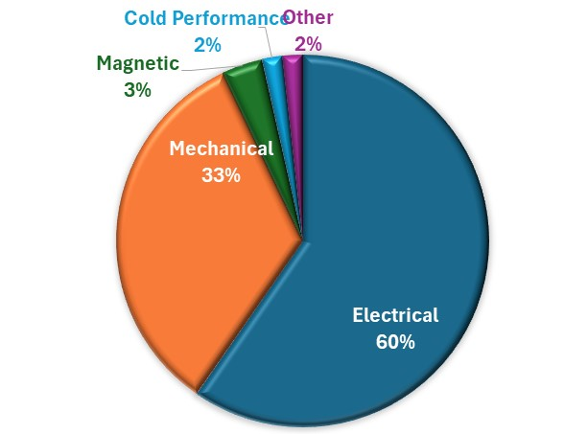
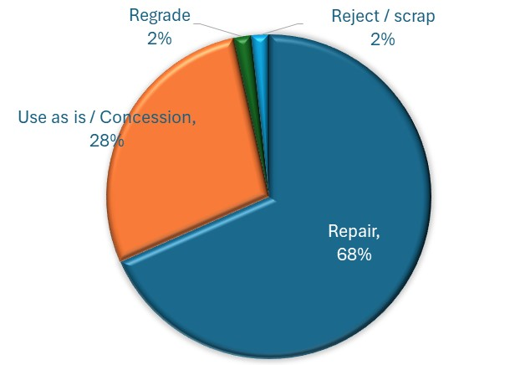
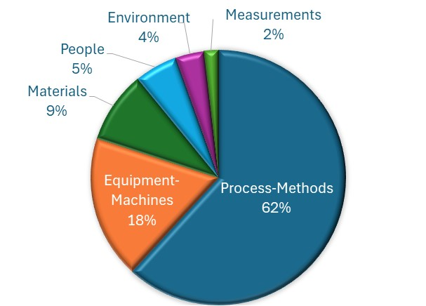
Cold Mass Production Appraisal of Non-Conformities
Out of the 23 cold masses already assembled or under assembly,
57 NCRs were generated and documented in EDMS.
Different classes:
Electrical,
Mechanical,
Magnetic,
Cold Performance,
Other…
Different criticality:
49 judged noncritical (Level 1 or 2)
8 critical (4 Level 3, 4 Level 4)
Dispositions:
Repair,
Use as is / Concession,
Regrade
Reject / scrap
Main cause:
Process-Methods,
Equipment-Machines,
Materials,
People (Human error),
Measurements

Slide 9


Electrical Non-Conformities
Cable or instrumentation wire issues:
Cut too short 8/34
(edms 3307432, 2897775, 2937542, 2864109, 2791057, 3088997, 3292827, 3292827)
Inversion 7/34
(edms 3329079, 3156684, 3157619, 3177310, 3289554, 3286510, 3156684)
Fault to ground or electrical weakness 6/34
(edms 3198687, 3298312, 3335774, 3069797, 3012323, 2940210)
Radial shift or bad positioning 6/34
(edms 3201778, 3290638, 3118941, 3231452, 3094407, 3118924)
Opening or damaged strand(s) 5/34
(edms 2507611, 2882880, 2975174, 2810943, 3237006)
Other:
IFS capillary local deformation: 1/34 (edms 3204416)
CP filling piece inversion 1/34 (edms 3289554)
MQXFB magnets tested in LMQXFBT cold masses previously
Additional electrical tests for closed V-taps by reversing power supply
Additional polarity measurements
HV values updated with respect of the magnet history
New spider design
Additional tooling for the shaping of the leads
HO corr. lead forming tooling updated
V-taps splicing control upgrade and fiberglass reinforcement

Slide 10
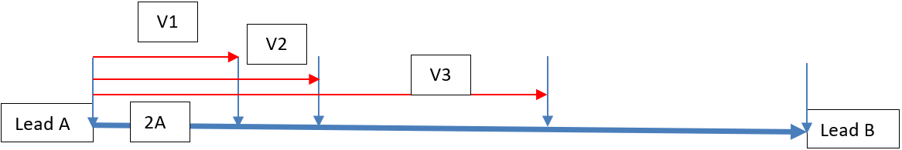
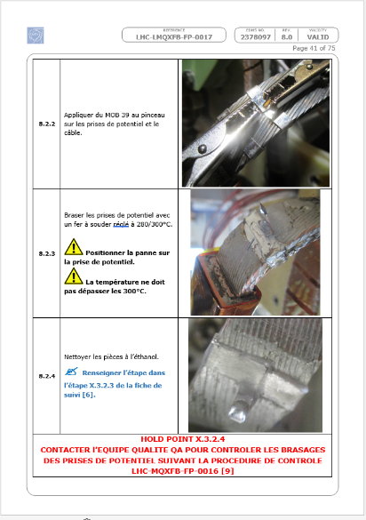
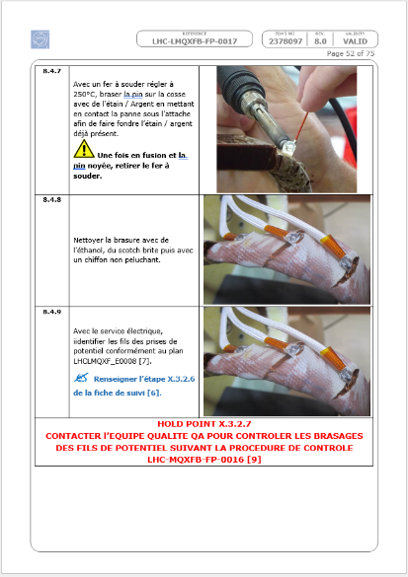
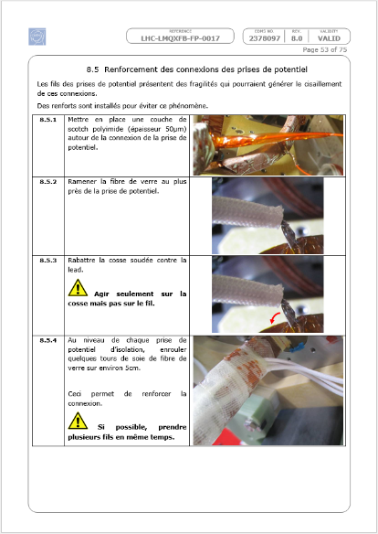

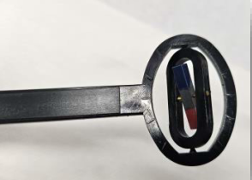
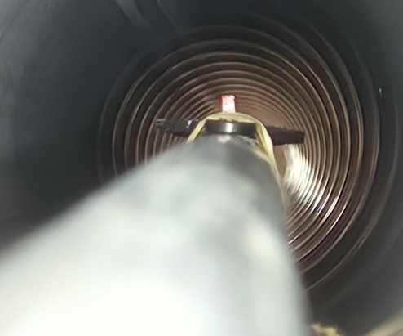

Electrical Non-Conformity Remedies 1/2
Additional electrical tests Absolute measurements with a common reference V-Tap Relative measurements in between the V-Taps Relative measurements in between the V-Taps reversing the power supply polarity | V-Taps soldering reinforcement See LHC-LMQXFB-FP-0017, activities 8.2, 8.4 & 8.5 Additional polarity measurements (+ see M. Pantella’s talk)

Slide 11
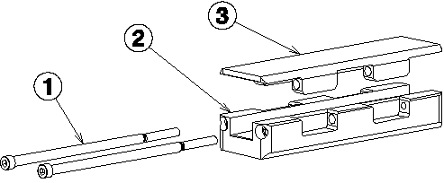
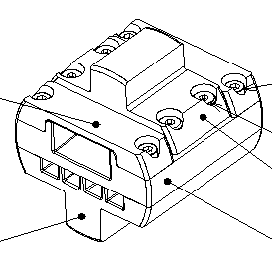
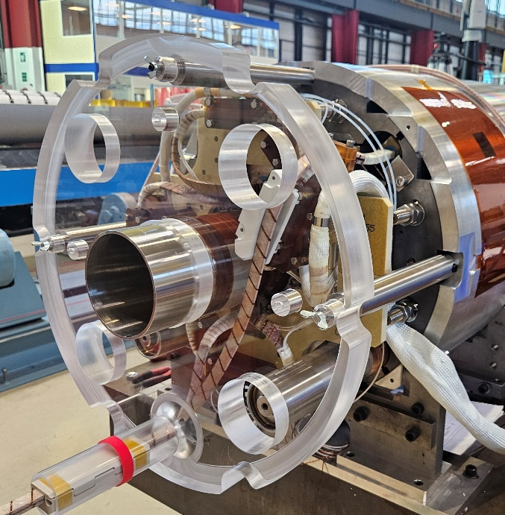
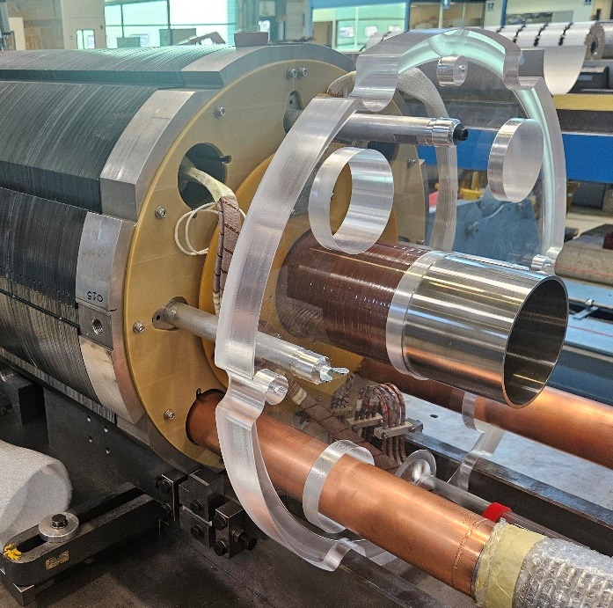
Electrical Non-Conformity Remedies 2/2
Spiders redesign Guiding length increased (50 ⇨ 150mm) ⇨ Smooth horizontal and vertical busbar curving Longer and improved support against the Lorentz forces De/re-mountability from the triple flange extremity Less components, easier to machine New spiders sent to FNAL for LMQXFA cold masses (Q1/Q3) Implementation not needed for the LMBXF cold masses (D1) | Busses shaping Tool Translucent dummy end covers to validate the routing of busses and leads during assembly and splicing To validate clarences of Busbar movements and location towards the cold bore and heat exchanger tubes, magnets and other elements

Slide 12


Mechanical Non-Conformities
Geometry out tolerance 8/20
(edms 3334115, 3300692, 2939308, 2885661, 3304815, 3334130, 3154354, 3286510)
Welding 5/20
(edms 3316617, 3318240, 2912807, 3340688, 3226359)
Minor repairs of few millimeters over the full length on almost every cold masses are documented but no NCR generated as the welds are conforming to the standards after repairs are conducted.
Handling 4/20
(edms 3332669, 3301285, 2913187, 3139883)
Shell developed length 2/20
(edms 3180091, 2773829)
Leak 1/20
(edms 3230342)
Tolerances will be reviewed in one of the next WGA meeting
Additional layers where the cables protection were burnt
Local grinding where the welding profile is too high
Additional care during handling with additional staff
Template mask of restricted sections of the pressure /leak vacuum vessel bench
Shell pairing
Re-machining of the developed length
Tooling for the N-line set up

Slide 13
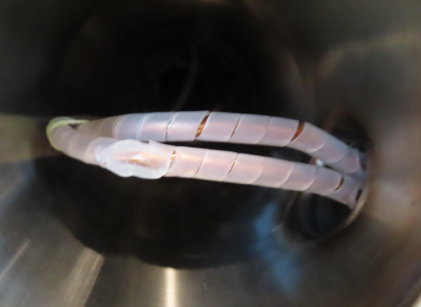
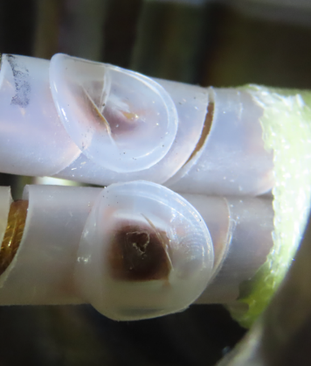
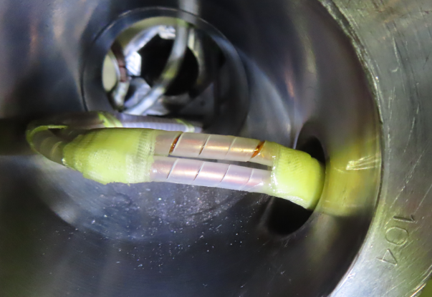
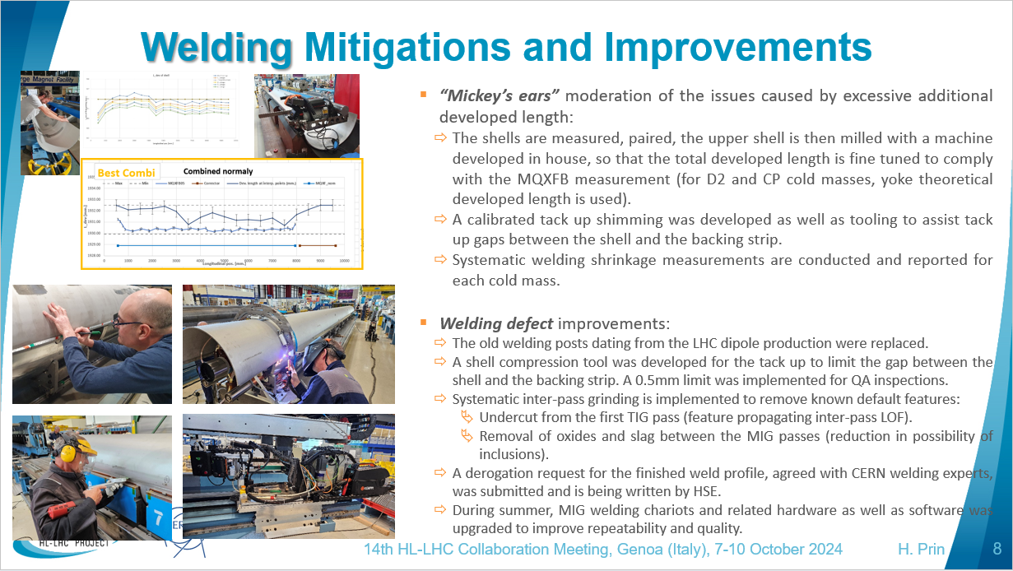
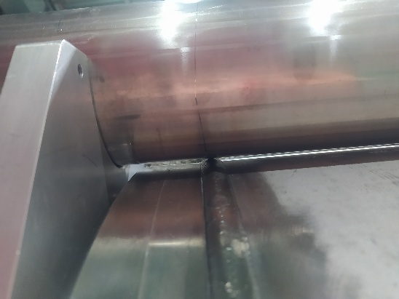
Mechanical Non-Conformity Remedies 2/2
Welding protections Additional layer of fiberglass around the protection of the CLIQ leads to prevent heat conduction during the weld of the caps and the bellows Local grinding of the weld profile Local grinding of the bead to prevent any interference between the end cover weld and the XB line on top | Shell developed length adjustment Mitigations were presented during the 14th HL-LHC collaboration meeting in Genoa (indico link)

Slide 14
Other Non-Conformities
Flat-top quenches on LMCXF1 in magnet MCBXFAP1
(edms 3219461)
MCBXFBP1e - Field quality
(edms 3195926)
MCBXFBP1d - required performance after training only in two quadrants out of four
(edms 2687264)
NCRs attached to the magnets but not directly linked to the cold mass construction

Slide 15
Q10 Cold Masses with Sextupoles

Slide 16
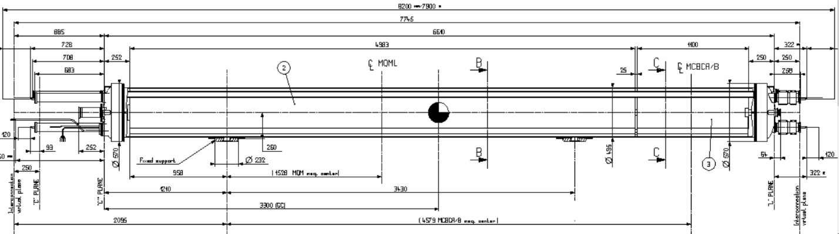
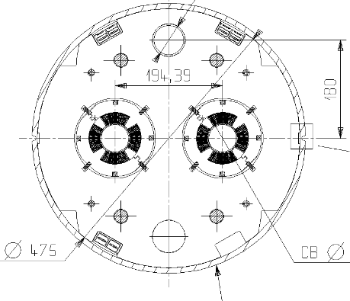
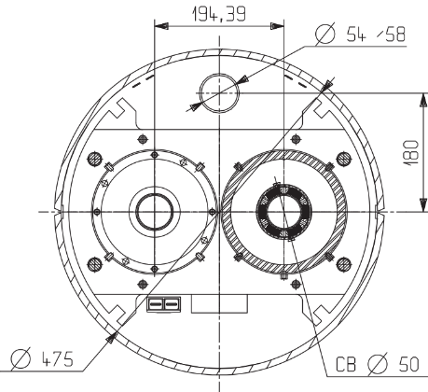
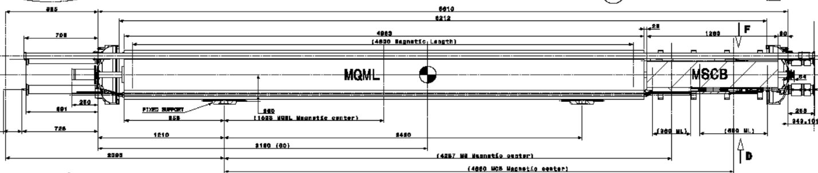
HL-LHC Q10 with MS
Present Q10 layout in the LHC
MCBC orbit corrector
Challenges:
Center the MSCB magnet yoke, partial Ø452mm, inside the Ø475mm shell inner diameter
Replace the 1.1m MCBC magnet with the 1.26m MSCB and transfer the M3 busses (RB circuit) expansion loops from inside the end cover to below the magnet yoke.
Remove the M1 and M2 busses (RQF and RQD) that were shortened in the Q11 during LS1 and provide support for the spool pieces busbars (RCO, RCD and RCS)
Route MS busses from the MSCB combined magnet in parallel to those in the orbit corrector ones up to the cold mass connection side and then in parallel to the 6kA busbars to reach the N-line. The 6kA plug might be transformed into a helium path restriction.
MQML quad. powered in standalone (6kA)
+ MCBCB orbit corr. powered in standalone (120A)
MSCB combined
sextupole-dipole corrector
Q10 with MS for the HL-LHC
MQML quad. powered in standalone (6kA)
+ MCB orbit corr. powered in standalone (60A)
+ MS sextupole corr. (600A) powered in series with MS
in half cells 14, 18, 22… (SF1 or 2, SD1 or 2)

Slide 17
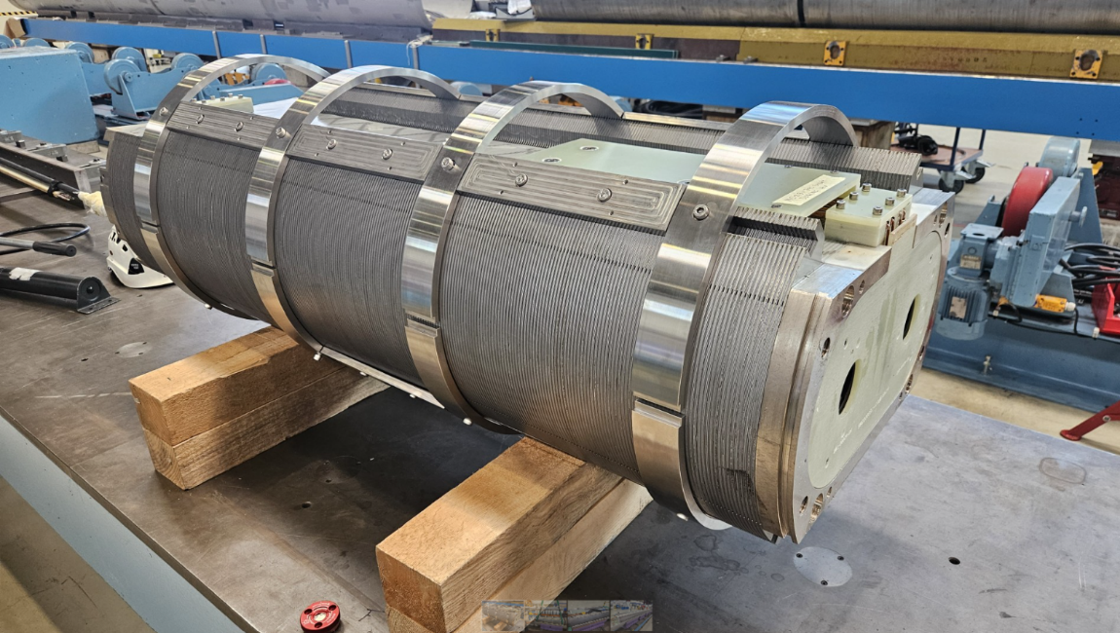
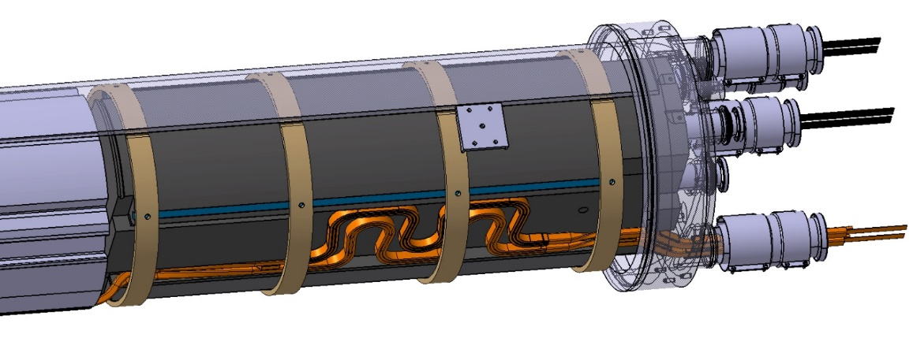
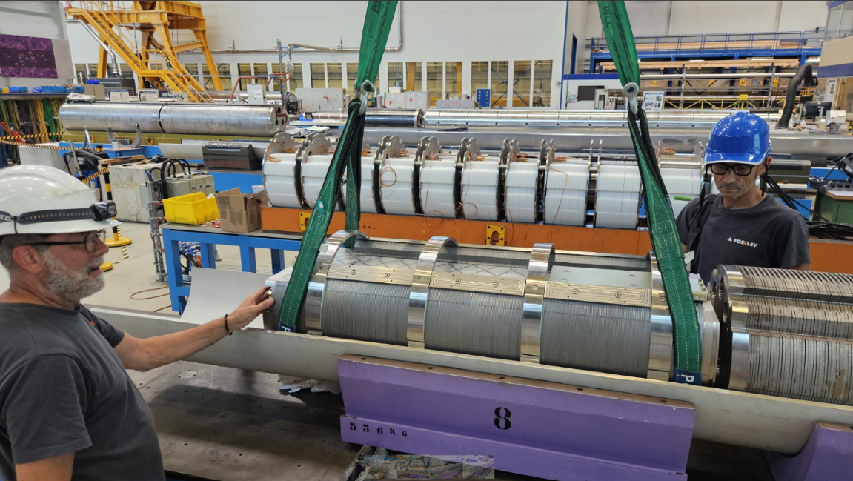
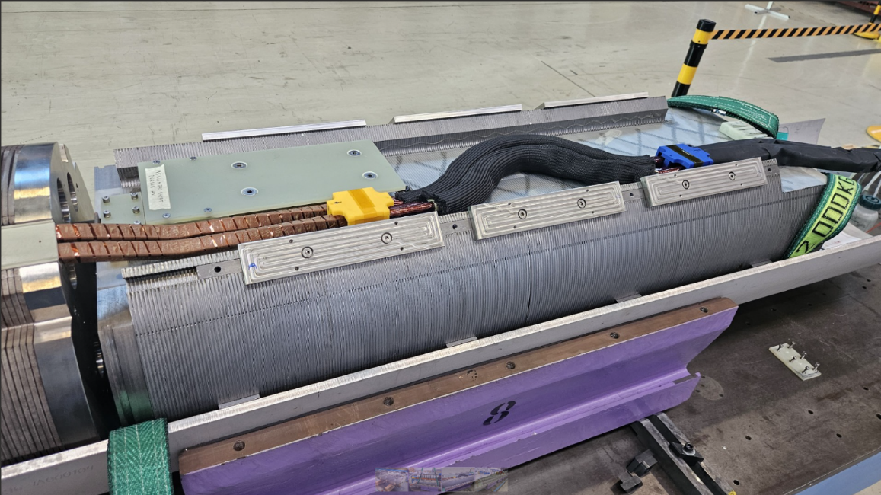
HL-LHC Q10 MSCBB and Busbars Integration
MSCBB magnet centering
MB busses extension loop

Slide 18
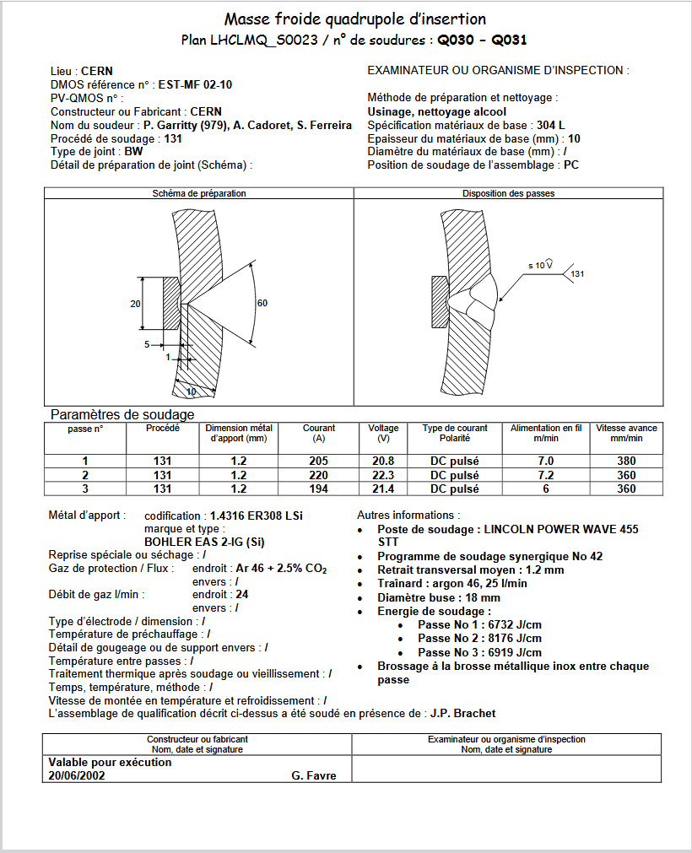
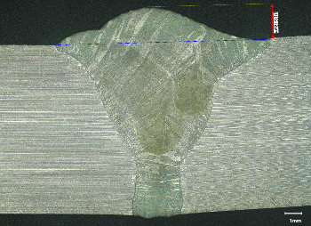
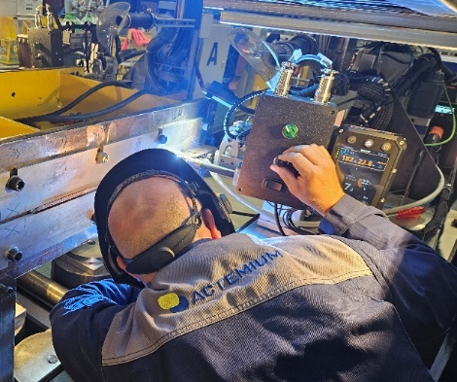
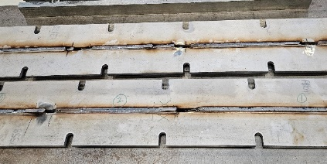
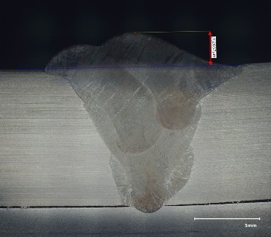
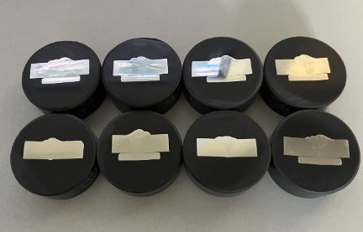
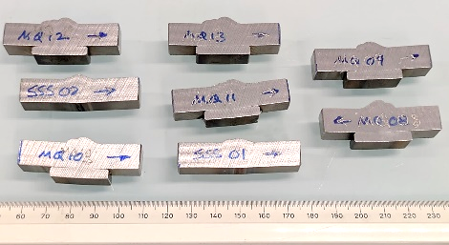
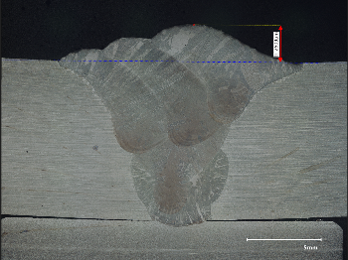
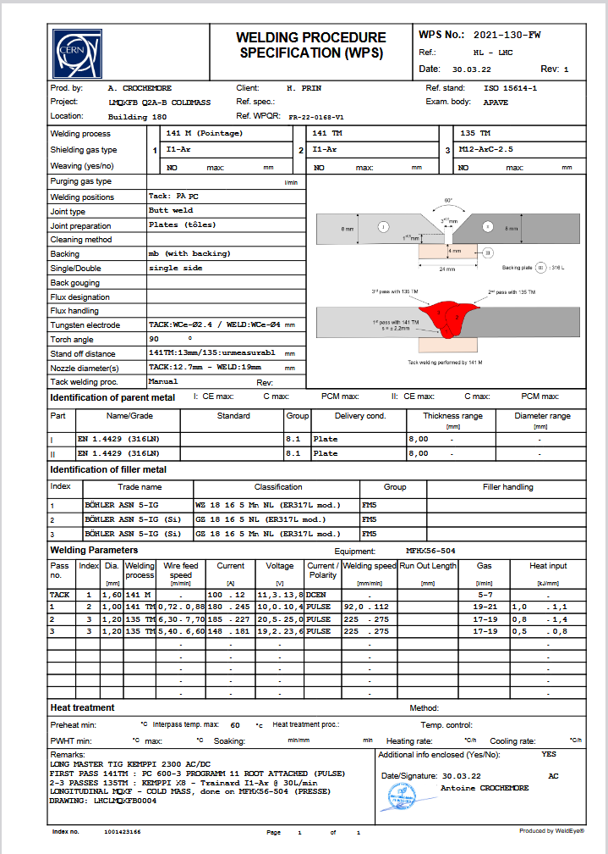
HL-LHC Q10 Ongoing Welding Developments
Test plates have been produced to evaluate the viability of modifying the HL-LHC longitudinal welding WPS
Report in edms 3355698
Adopting the HL-LHC cold masses WPS allows us to:
preserve the proven the HL-LHC welding standards and procedures,
maintain the 100% PAUT inspection quality control,
remove the need for modification of the weld parameters and re-qualification,
remove the need to re-qualify welders,
use of the existing in-house shell machining capacity to adapt the developed length.
3 MIG passes
WPS EST-MF-02-10
Developed in 2002 for IR CM masses
10mm thick 304L shells but welded
3 MIG passes
Backing strip with a groove (temporary)
3 types of processes
1 TIG + 3 MIG passes
1 TIG + 4 MIG passes
WPS 2021-130-FW
Developed in 2021 for HL-LHC CM
8mm thick 316LN shells with a 3.1mm nominal gap
1 TIG + 2 MIG passes
Permanent backing strip, part of the weld

Slide 19
Summary
CERN cold masses is presently 48% completed considering the assemblies for the tunnel, it will be 62% by the end of the year, 74% if we include the prototypes.
From 2026, 10 cold masses will remain to be delivered: 2x Q2, 1x CP, 3x D2 and 4x Q10. 6 of them will be operating in the tunnel, 4 will be spares.
The production rate has reached nominal for more than two year; the deliveries are strongly dependent on the magnet supplies.
Non-conformities raised in continuous procedures and tooling up-grades.
The LMF Team demonstrated that up to 8 cold masses can be delivered within one year, considering other activities in parallel like the setup and the repairs of the STRING.
2026 will be challenging as the production will concur with training activities for the tunnel, start of the LS3 for our personnel and a probable Run 2 for the STRING.

Slide 20
Thank you for your attention

Slide 21
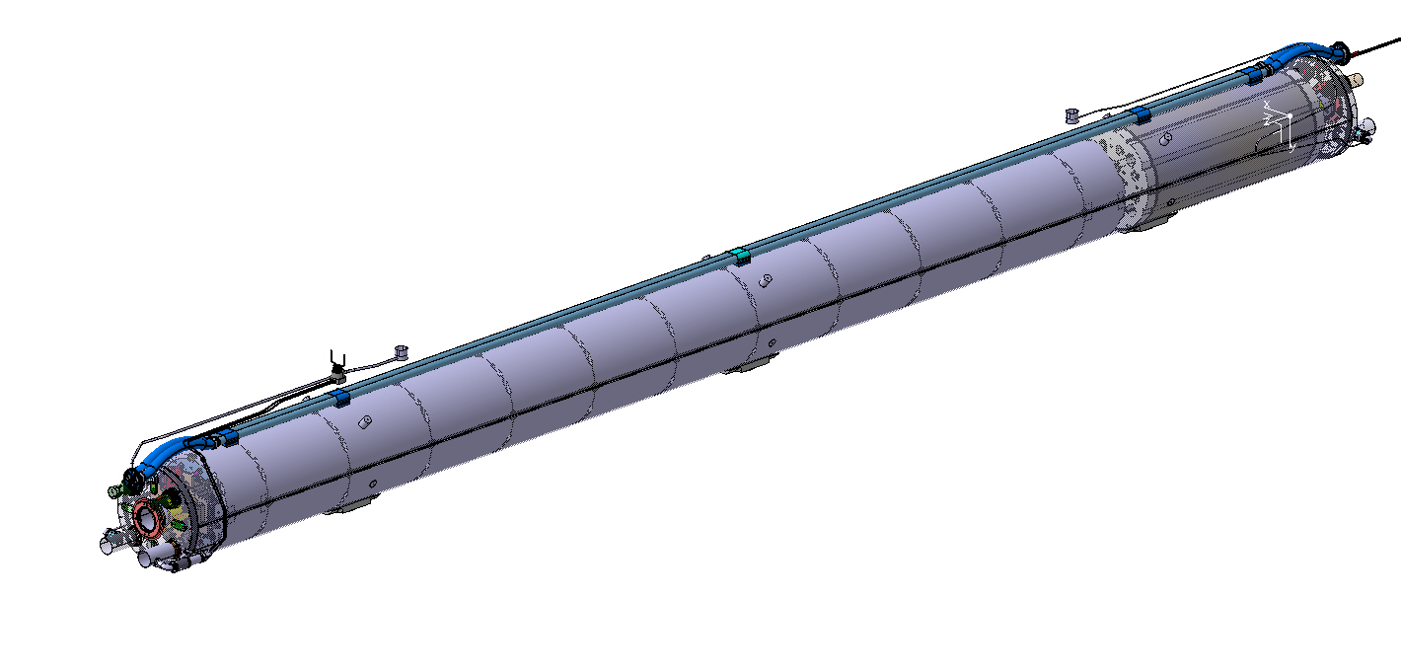
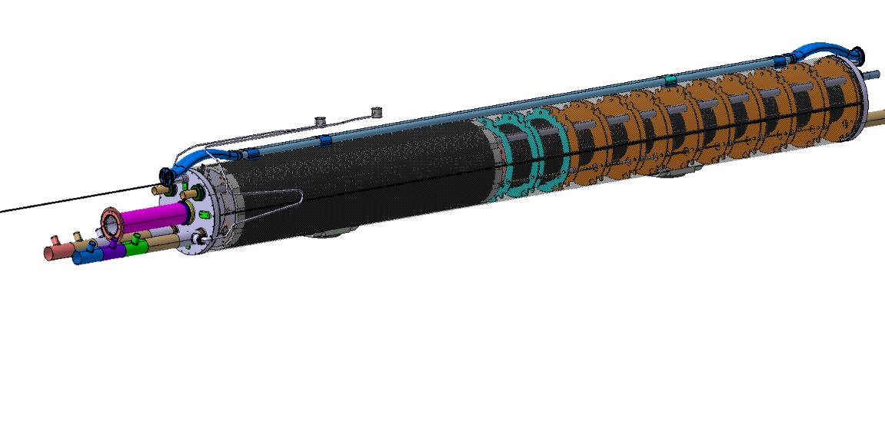



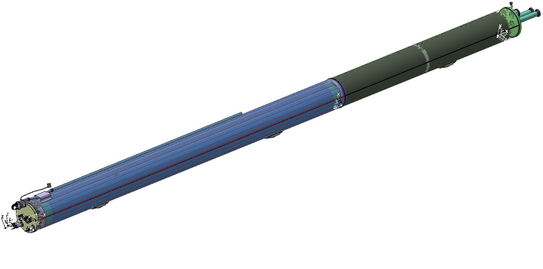
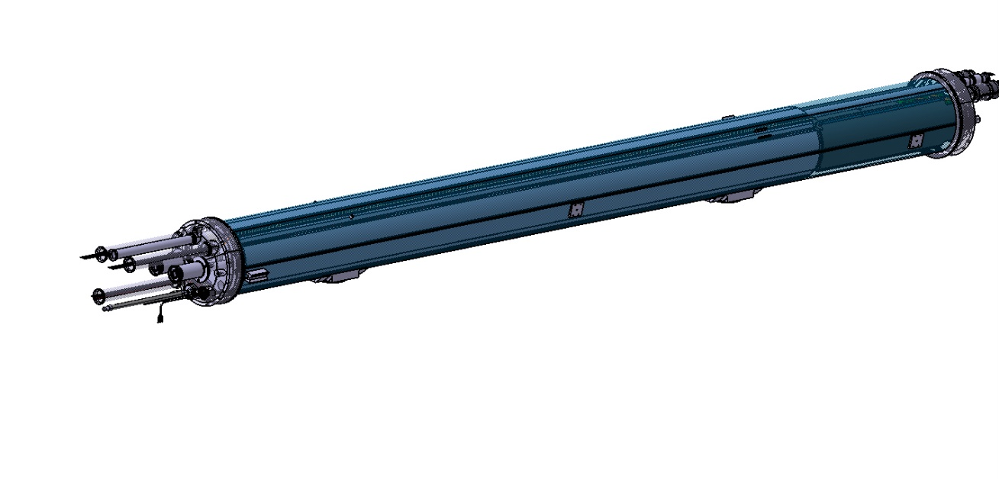


HL-LHC CERN cold masses: 4 types
Q2 LMQXFB Inner triplet quadrupole (x12)
CP LMCXF Corrector package (x5)
9.8m long
15.9 tons
6.2m long
9 tons
MCBXFB
NbTi nested orbit corrector
2.1/2.15T
1580/1430A
1.2m magnetic length
9 NbTi superferric
HO correctors
1.5 to 3.6T
184 to 174A
99 to 401mm magnetic length
MQXFB
Nb₃Sn quad
132.6T/m
16230A
7.2m magnetic length
MCBXFA
NbTi nested orbit corrector
2.1/2.15T
1580/1430A
2.2m magnetic length
D2 LMBRD Separation dipole (x7)
Q10 LMQMT DS quadrupole with MS (x4)
13.1m long
23.7 tons
6.6m long
8.1 tons
2xMCBRD
NbTi CCT orbit correctors
2.6T
394A
1.92m magnetic length
MSCBB
Combined NbTi sextupole and orbit corrector
MBRD
NbTi separation dipole
4.5T
12328A
7.8m magnetic length
MQML
NbTi quad used in the MS and DS in LHC
200T/m
5390A
4.8m magnetic length

