Slide 1

Evaluation of Thermal Contact Conductance in HL-LHC Collimator Jaws: Experimental Tests and Multiphysics Simulations
L. Puddu EN/MME
With the contribution of C. Accettura EN/MME, F. Carra EN/MME, R. Viscardi SY/STI
15th HL-LHC collaboration meeting, CERN, 29 September – 2 October 2025

Slide 2
Outline
Introduction and motivation
Workflow
Simulations:
Evaluation of the TCC
Operational scenarios
Final correlation
Conclusions

Slide 3
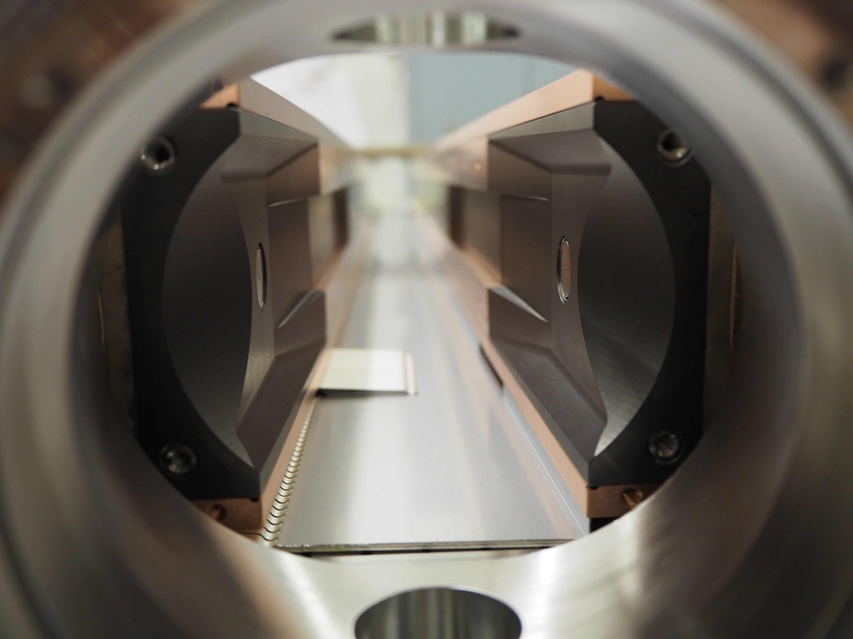
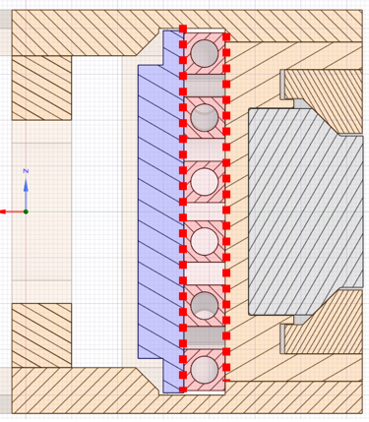
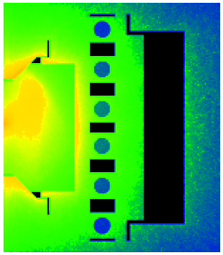

Introduction and motivation
The HL-LHC project requires the design of new collimators able to withstand high thermal loads.
Efficient cooling depends on the Thermal Contact Conductance (TCC) between components.
TCC strongly affects both temperature rise and jaw deformation, which are subject to strict operational limits.
Direct measurement of TCC is challenging because of the transient, non-linear and multiphysics nature of the problem.
water
Heat
$$h_{c}\left(P\right)=1.55 \frac{k_{s}m_{ab}}{σ}{\left(\frac{\sqrt{2}P}{E^{′}m_{ab}}\right)}^{0.94}$$
Empirical correlation for thermal contact conductance
cooling pipe interface

Slide 4
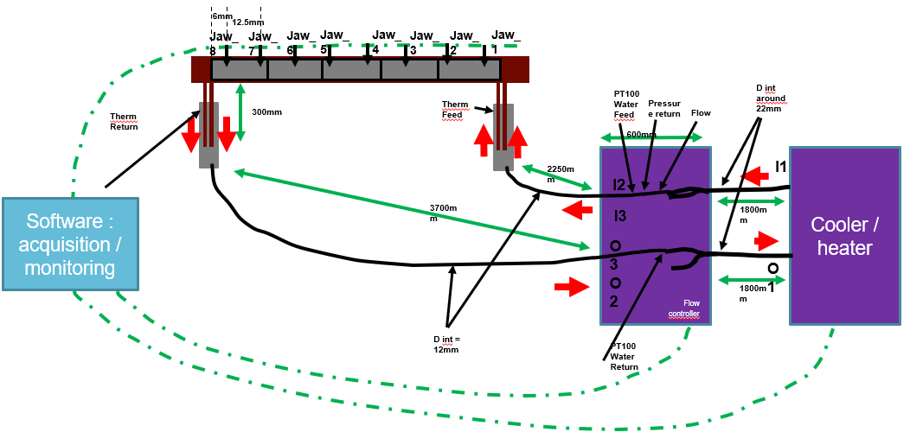
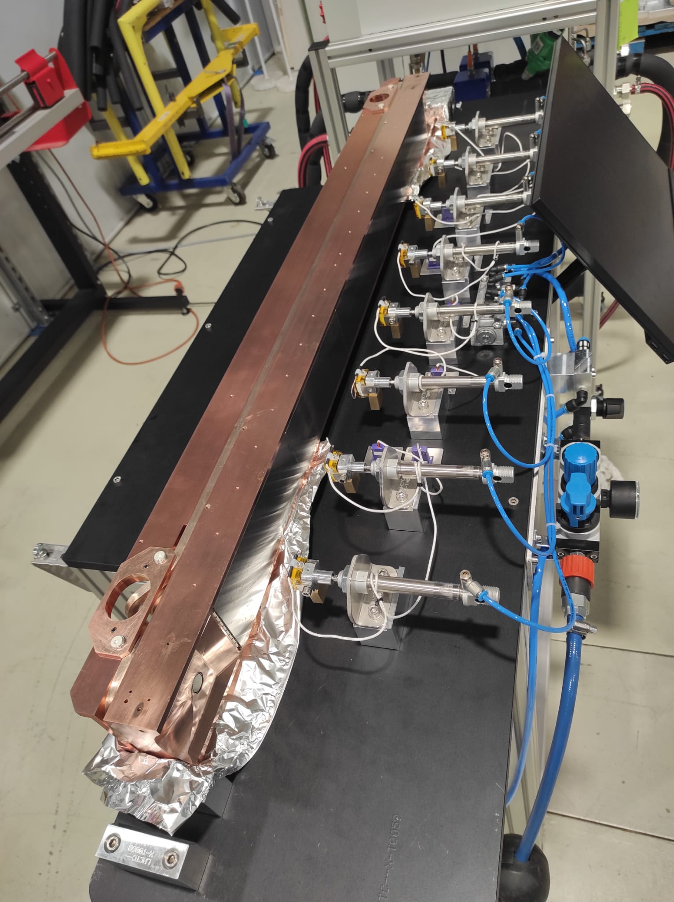
Introduction and motivation
Courtesy of D. Baillard
Dedicated test bench developed by SY-STI, using the characteristic time (τ) as an indirect indicator measured on each pre-series and series jaw:
Hot water at 70 °C is circulated through the cooling channels, while thermocouples placed on the active surface of the blocks record the temperature evolution.
The characteristic time (τ) is defined as the time required for the thermocouples to measure a temperature increase from 35 °C to 55 °C.
In parallel, multiphysics simulations (thermal, structural, fluid-dynamic) were used to link the experimental test and the functional specifications.
Correlating τ and TCC provides a powerful predictive method:
speeds up production,
avoids repeating simulations for each test,
defines acceptable τ values compatible with operational requirements.

Slide 5
Outline
Introduction and motivation
Workflow
Simulations:
Evaluation of the TCC
Operational scenarios
Final correlation
Conclusions

Slide 6
Workflow
How to link TCC experimental data to functional specifications:
Experimental TCC test
Numerical simulations

Slide 7

Workflow
How to link TCC experimental data to functional specifications:
Experimental TCC test
$$τ$$
Numerical simulations

Slide 8

Workflow
How to link TCC experimental data to functional specifications:
Experimental TCC test
$$τ$$
Numerical simulations
$$τ$$
TCC

Slide 9
Workflow
How to link TCC experimental data to functional specifications:
Experimental TCC test
$$τ$$
Numerical simulations
$$τ$$
To be checked
TCC

Slide 10
Workflow
How to link TCC experimental data to functional specifications:
Experimental TCC test
$$τ$$
Numerical simulations
$$τ$$
To be checked
TCC
Deformation
Temperature
Functional specification
To be compared with the limits imposed by

Slide 11
Workflow
How to link TCC experimental data to functional specifications:
Experimental TCC test
$$τ$$
2 different cases to be simulated:
$$τ$$
To be checked
TCC test bench (COMSOL)
TCC
Deformation
Operational Condition (ANSYS)
Temperature
Functional specification
To be compared with the limits imposed by

Slide 12
Workflow
How to link TCC experimental data to functional specifications:
Experimental TCC test
$$τ$$
During production:
Numerical simulations
$$τ$$
To be checked
TCC
Deformation
Temperature
TCC [kW/m²/K]
Functional specification
To be compared with the limits imposed by

Slide 13
Outline
Introduction and motivation
Workflow
Simulations:
Evaluation of the TCC
Operational scenarios
Final correlation
Conclusions

Slide 14

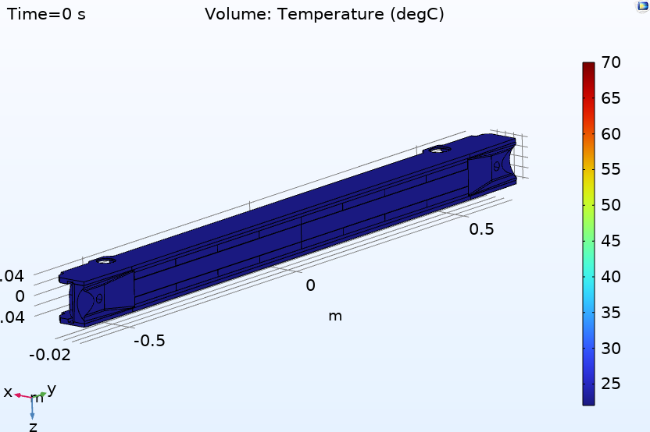
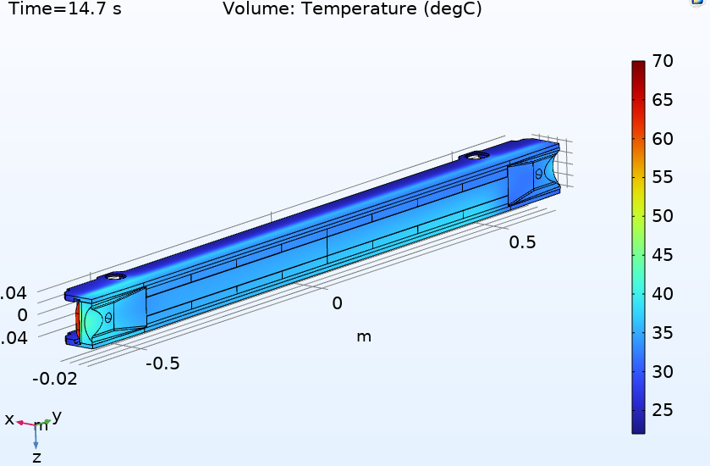
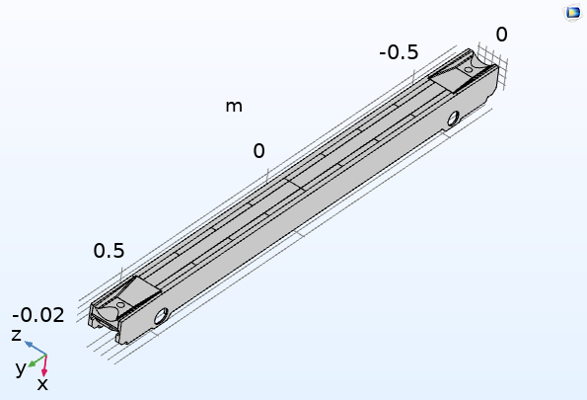
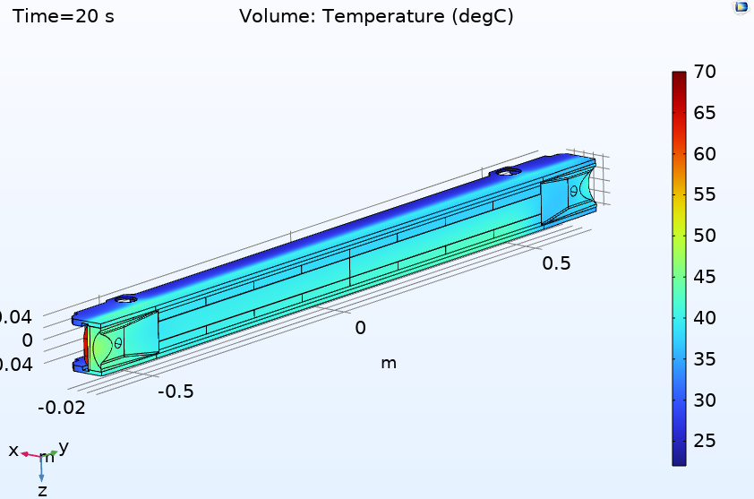
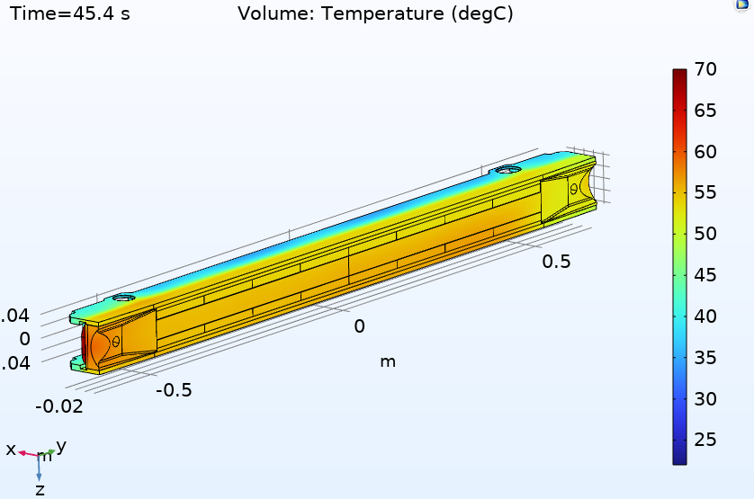
Evaluation of the TCC Benchmarking of test bench
TCC
𝜏
COMSOL multiphysics model coupling fluid-dynamics & thermal analysis:
Transient problem.
Input: TCC value.
Output: characteristic time (τ).
Correlation established between TCC and τ.
t=0 s
t=14 s
t=20 s
t=45 s

Slide 15
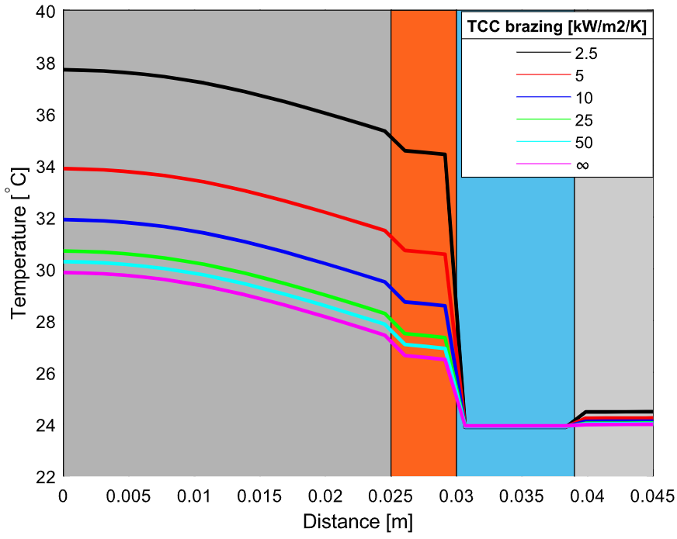
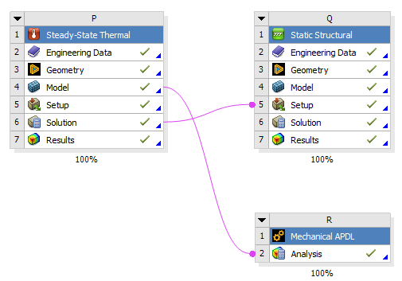

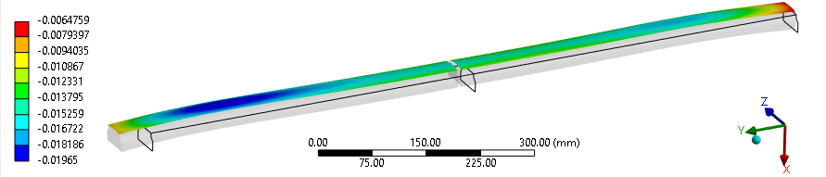
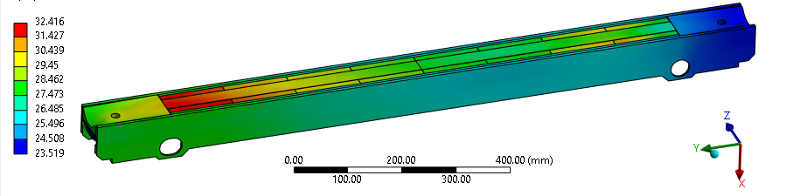
Operational scenarios
TCC
DEFORMATION
Power deposition
(FLUKA MAP)
TEMPERATURE
Deformation perpendicular to the beam [mm]
The operational case simulations are divided into thermal and structural simulations.
Technical specifications: define the maximum admissible deformation (most critical) and temperature.
Outcome: determination of the maximum acceptable TCC in agreement with the limits from the technical specifications
Temperature [°C]

Slide 16
Outline
Introduction and motivation
Workflow
Simulations:
Evaluation of the TCC
Operational scenarios
Final correlation
Conclusions

Slide 17
Correlation
By combining the results, the relationship between the limits from the functional specification and the characteristic time (τ) is obtained.
Allows setting a τ limit for each collimator family.
We verified that the temperature is always ok and for this reason the driving parameter limiting the TCC is the maximum deformation.
TCC [kW/m²/K]

Slide 18
Correlation
Collimator | Thermo-mechanical deflection* (um) | Self-weight deflection (um) | Geometrical tolerance (um) | Total deflection in steady-state operation (um) | Jaw type | Comments, References
TCSG | 75 | 30 | 40 | 145 | Brazed | Design case: skew TCSG.A6R7 [4]
TCSP | 50 | 30 | 40 | 120 | Brazed | [5]
TCSPM (MoGr) | 55 | 30 | 40 | 125 | Brazed | Design case: skew TCSG.A6R7 [4]. However: in that slot, a CFC TCSG is finally kept. Therefore, this is a pessimistic assumption for MoGr TCSPMs
TCSPM (graphite) | 15 | 30 | 40 | 85 | Brazed | Design case: TCSPMB4R7 [6]
TCTW | 65 | 30 | 40 | 135 | Brazed | When wire is off [7] Attention: when wire ON @350A à total deflection goes above 150 um
TCTP | 50 | 30 | 40 | 120 | Brazed | [2]
TCLPX | 15 | 0 | 100 | 115 | Bolted | [8]
TCLP** | 15 | 0 | 50 | 65 | Bolted | For TCLP5 (most loaded TCLP) [1],[9]
TCTPXH | <10 | 0 | 100 | 100 | Bolted | Thermomech. deflection considered negligible, as thermal loads are a factor 5 smaller than TCLP’s [1],[9]
TCTPXV | <10 | 30 | 100 | 130 | Bolted | Thermomech. deflection considered negligible, as thermal loads are a factor 7 smaller than TCLP’s [1],[9]
TCTPM** | <10 | 0 | 50 | 50 | Bolted | Thermomech. deflection considered negligible, as thermal loads are a factor 7 smaller than TCLP’s [1],[9]
F. Carra, ‘LHC Collimators: total jaw deflections in operation’, EDMS n. 2839280

Slide 19
Outline
Introduction and motivation
Workflow
Simulations:
Evaluation of the TCC
Operational scenarios
Final correlation
Conclusions

Slide 20
Conclusions
The proposed method is an effective tool to assess the quality of collimator thermal contacts during production (~70 jaws currently being manufactured).
It provides a practical link between experimental measurements and operational requirements, enabling the definition of acceptance criteria consistent with functional specifications.
Test bench results have shown good stability and reproducibility, with an uncertainty of about ±2 s in the characteristic time (τ).
Combining experiments and multiphysics simulations offers a reliable framework to ensure adequate thermal contacts and safe HL-LHC operation.

Slide 21
Thanks for your attention!

