Slide 1


Absolute neutrino mass scale
and the KATRIN experiment
Otokar Dragoun for the KATRIN Collaboration
Nuclear Physics Institute of the ASCR, Řež
dragoun@ujf.cas.cz
Colloquium -Towards CP Violation in Neutrino Physics Prague, October 7, 2011

Slide 2
Outline
1. Applied methods of m_{ν} measurements and current results
2. Educational role of previous β-decay experiments
3. Principle and technique of the KATRIN experiment
4. Expected results of KATRIN
A nuclear spectroscopist note on neutrino sources:
Each of you emits about 4000 neutrinos per second into 4π
due to β-decay of ⁴⁰K in your body
140 g of potassium, 0.01 % abundance of ⁴⁰K, T_{1/2} = 1.2· 10⁹ y

Slide 3
Applied methods of m_{ν} measurements and current results
Model independent methods
E² = p² c² + m² c⁴
laws of energy and momentum conservation
F = -e [E + (v x H)]
also called direct
or kinematic
Examples
two body decay of π⁺ at rest: π⁺ → μ⁺ + ν_{μ}
σ_{rel} = 3·10⁻⁶ for m_{π} , 4·10⁻⁸ for m_{μ} , 4·10⁻⁶ for p_{μ}
m(ν_{μ}) ≤ 190 keV at 90% C.L.
Ernst Otten: “A relativistic particle hides away its rest mass!”

Slide 4
Time-of-flight method Δt_{ν} = t_{c} – t
assuming m_{ν} = 2 eV
Δt_{ν} is too small for terrestrial experiments
e.g. in the OPERA experiment:
<E_{v}> = 17 GeV, d = 730 km, t_{c} = 2.4 ms
⇒ expected time delay Δt_{ν} = 2·10⁻²³ s
Extraterrestrial experiments:
e.g. for 10 MeV neutrinos from SN1987a
⇒ expected time delay Δt_{ν} = 0.1 s
BUT assumptions about the supernova explosion are needed

Slide 5
β-spectrum shape in the endpoint region
where (according to Fermi theory, 1934)
dN/dE ~ (E₀ – E)² · [ 1 – m²_{ν} /(E₀ – E)² ]^{1/2}
E₀ is the endpoint for m_{ν} = 0
Since neutrinos oscillate |ν_{α} > = Σ U_{αi} · |ν_{i} >
and |m_{i} – m_{k}| << ΔE_{instr}
β-spectrum analysis yields the effective mass
m²(ν_{e}) = m²_{β} = Σ |U_{ei}|² · m²_{i}
this is a weighted average, no phases
thus no possible cancellations

Slide 6
More sensitive but model dependent methods
search for 0νββ - nuclear matrix elements,
alternative modes of decay
supernova explosion - time distribution of emitted
neutrinos
cosmology
- mainly from cosmic microwave background
and large scale structures of galaxies
- up to 10 fitted parameters
- dark matter and dark energy (95% of the total)
are not yet explained

Slide 7
Current results
Particle Data Group
Effective ν mass from kinematic experiments:
m(ν_{e}) < 2 eV m(ν_{μ}) < 0.19 MeV m(ν_{τ}) < 18.2 MeV
β-decay π⁺ decay τ ̶ decay
Other methods:
T_{1/2}(0νββ) <m_{ν}>_{ββ} < 0.1 ̶ 0.9 eV, one claim for 0.4 eV
TOF (SN1987a) m(ν_{e}) < 5.7 eV
cosmology Σ m_{i} < 0.6 ̶ 1.7 eV
ν oscillations m_{i} ≥ 0.05 eV at least for the heaviest mass state

Slide 8
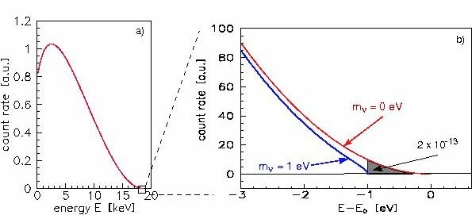
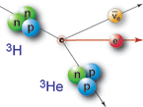
2. Educational role of previous β-decay experiments
Requirements for a β-ray spectrometer:
Simultaneously: - high energy resolution ΔE_{instr}
- large solid angle Ω_{input}
- low background

Slide 9
Neutrino mass from the β-spectrum shape
milestones
m_{ν} < 5 keV 1948
β-spectrum of ³⁵S (E₀=167 keV)
magnetic spectrometer
m_{ν} < 1 keV 1949
β-spectrum of gaseous tritium (E₀=18.6 keV)
proportional counter
m_{ν} < 60 eV 1972
β-spectrum of implanted tritium
magnetic spectrometer with 100 x increased source area
part of Q_{β} goes into excited states of daughter ³He⁺ ion
⇒ measured spectrum is a sum of partial β-spectra with various E_{0, i}

Slide 10
m_{ν} ≈ 30 eV ? 1980 - 1987
8 eV relic neutrinos would create all dark matter
excellent toroidal magnetic spectrometer
but tritium in complicated organic compound
underestimated energy losses of β-particles
wrong fitted E₀ supported by wrong Q_{β} from mass spectrometry
m²_{ν} < 0 ? 1991 - 1996
7 laboratories, 3 types of magnetic spectrometers
various solid and gaseous tritium sources
none of them m²_{ν} positive, two of them 6σ negative
wrong theoretical spectrum of final states? NO
but mostly underestimated energy losses of β-particles
m_{ν} ≈ 0 + up to 3% of m_{ν} =17 keV ? 1985-1994
from β-spectra of several radionuclides
observed only with semiconductor detectors
not found by magnetic spectrometers
caused by electron scattering in radioactive sources
and on spectrometer slits

Slide 11
m_{ν} < 2.3 eV Mainz neutrino mass experiment 2005
electrostatic retardation spectrometer
with adiabatic magnetic collimation
condensed tritium source
detailed analysis of systematic errors
m²_{ν} = ( ̶0.6 ± 2.2_{stat} ± 2.1_{syst} ) eV²
Similar results reported the Troitsk neutrino mass experiment
in 2003
spectrometer of the same type
gaseous tritium source
m²_{ν} = ( ̶2.3 ± 2.5_{stat} ± 2.0_{syst} ) eV²
but only after artificial correction of β-spectrum
with two additional fitting parameters
Final Troitsk result in 2011
enlarged data set
removed runs with unstable tritium density
m²_{ν} = ( ̶0.67 ± 1.89_{stat} ± 1.68_{syst} ) eV²
without any artificial correction

Slide 12
m_{ν} < 2.0 eV 2011
weighted average of Mainz (2005) and Troitsk (2011)
m²_{ν} = ̶0.6 ±1.9 eV²
⇒ m_{ν} < 2.0 eV at 95% C.L. using the conservative approach
During 63 years, β-ray spectroscopists improved
the model independent limit of experimentally observable m²_{ν}
by 6 orders of magnitude.
Next improvement by 2 orders of magnitude is expected from KATRIN

Slide 13
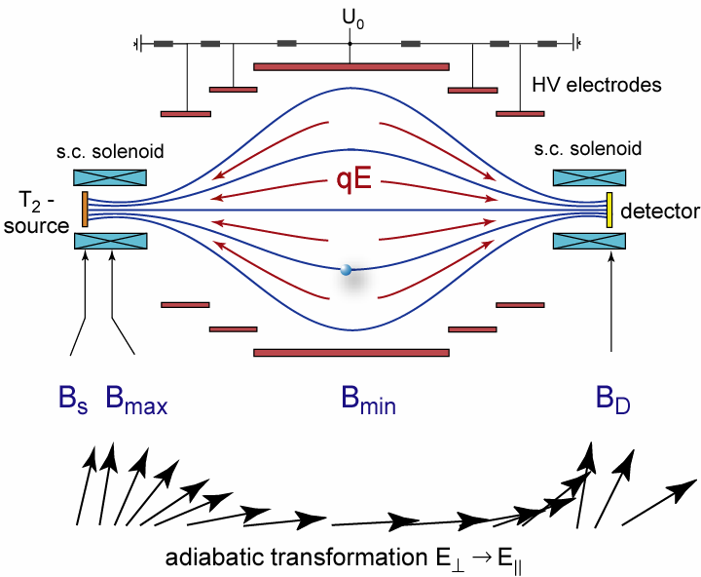
Electrostatic retardation spectrometer with adiabatic
magnetic collimation of electrons (MAC-E-filter)
Developed independently
at Mainz and Troitsk
(ΔE /E)_{instr} = B_{min} /B_{max}
sin θ_{max} = (B_{s} /B_{max})^{1/2}
Ω_{input} up to 50% of 4π
  Advantages:
  Large Ω_{input} and narrow line width ΔE_{instr}
  simultaneously
  No scattering on slits defining electron
  beam
  No high energy tail of the response
  function
  Disadvantage:
  Danger of magnetic traps for charged
  particles
Radioactive sources for β-spectroscopy
λ_{inel} (Al) = 30 nm for E_{e} = 20 keV
⇒ large source area S
large luminosity L = S · Ω_{input}
large spectrometer dimensions

Slide 14
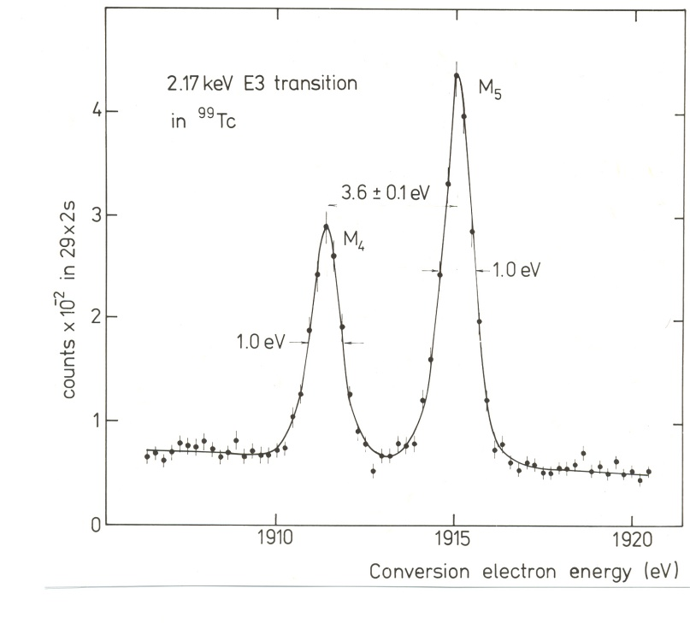
Principle and technique of the KATRIN experiment
at the Karlsruhe Institute of Technology (KIT = FZK + Tech. Uni.)
The next generation tritium β-decay experiment
measuring m_{ν} in sub-eV region in a model independent way
Founded in 2001 by physicists from Germany,
Russia, USA and Czech Republic
Our NPI ASCR has a long tradition
in nuclear electron spectroscopy
the best resolution in the field
(at expense of a low transmission)

Slide 15
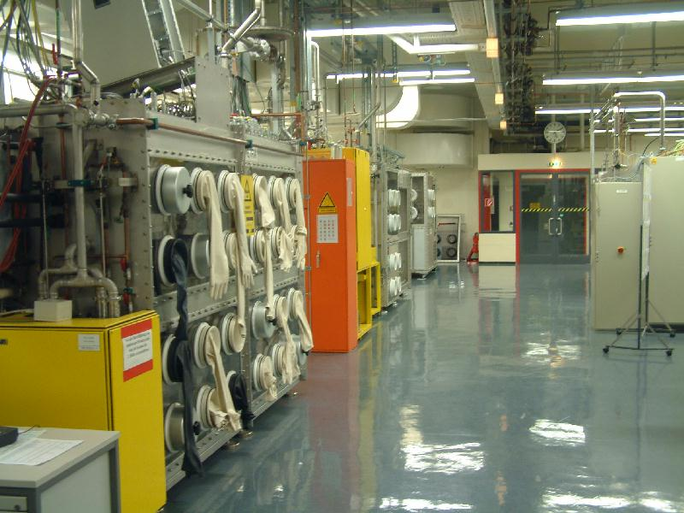
Tritium Laboratory Karlsruhe

Slide 16
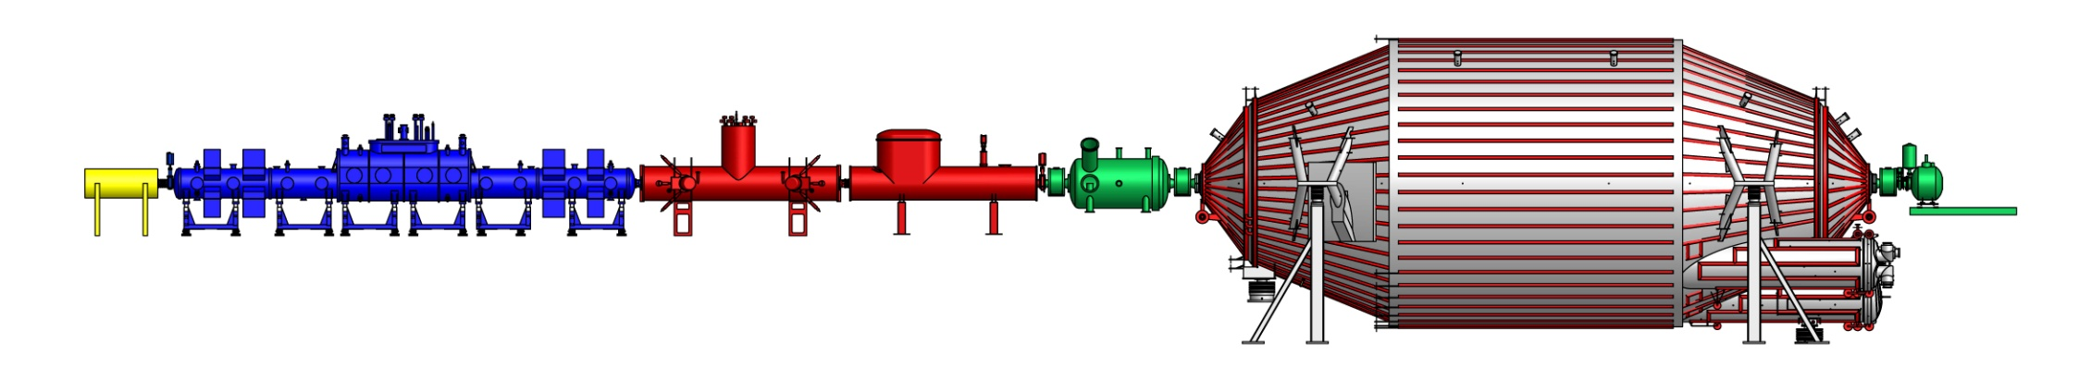
KATRIN main components
source and transport section | spectrometer section
source
parameter
stable tritium
column density
electron transport
tritium retention
reflection of low energy electrons
high precision energy analysis of electrons
position sensitive electron counter
rear
source (WGTS)
diff. pumping
pre-spectrometer
main spectrometer
detector
e⁻
e-
e⁻
e⁻
β-decay
10¹⁰ e⁻ /s
10¹⁰ e⁻ /s
10³ e⁻ /s
1 e⁻ /s
³He
³He
³He
³H
³H
3×10⁻³ mbar
±1 kV
10⁻¹¹ mbar
-18,4 kV
10⁻¹¹ mbar
-18,574 kV
~70 m

Slide 17
Technical challenges of KATRIN
Long term recirculation and purification of tritium on the kCi scale
isotopic composition (95% of T₂ ,TH, TD) checked by Raman laser spectroscopy
± 30 mK temperature stability of tritium in gaseous source at 27 K
achieved by liquid/gaseous phase transition on Ne
vacuum < 10⁻¹¹ mbar in volume of 1400 m³
TMP and non-evaporable getters, but cold traps to avoid spots of Rn
background of the position sensitive electron detector < 0.01/s
contribution from tritium in the main spectrometer < 0.001/s
no walls in the electron beam line: strong differential pumping + cryosorption
± 60 mV long-term stability of high voltage at 18.6 kV
unrecognized shift by 50 mV ⇒ 0.04 eV error in fitted m_{ν}

Slide 18
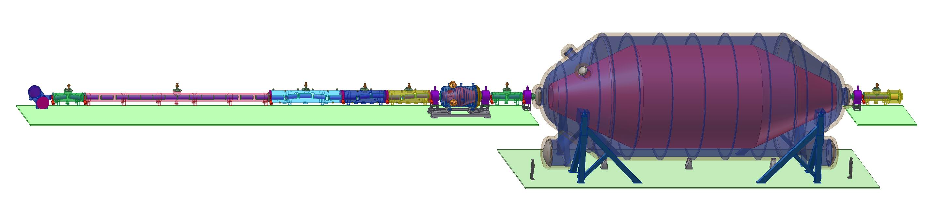
Windowless Gaseous Tritium Source
WGTS tube: stainless steel,10 m length, 90 mm diameter
Magnetic field:
3.6 Tesla (± 2%)
Source tube temperature:
27 K (± 0.1% stable)
16 m
T₂ injection rate:
1.8 cm³/s (± 0.1%)
T₂ injection
T₂ pumping
Total pumping speed:
12000 l/s
Isotopic
purity
>95%
at pressure of 3.4 ·10⁻³ mbar
Probably the most complex cryostat ever built

Slide 19
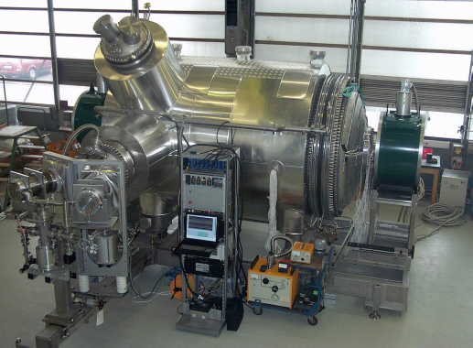
KATRIN electron pre-spectrometer
Aim: only the uppermost part of β-spectrum into the main spectrometer
10¹⁰ β/s → 10³ β/s
Vacuum chamber:
1.7 m in diameter,
3.4m in length
turbomolecular
pumps +getter strips
(Zr+V+Fe alloy)
10⁻¹¹ mbar achieved
Superconducting magnets

Slide 20
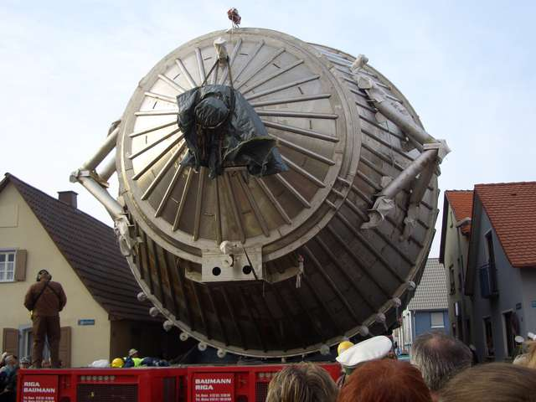
Vacuum chamber of the main spectrometer
9000 km on sea
around Europe
The last 7 km to
the KIT
diameter 10 m
length 23 m
weight 200 t

Slide 21
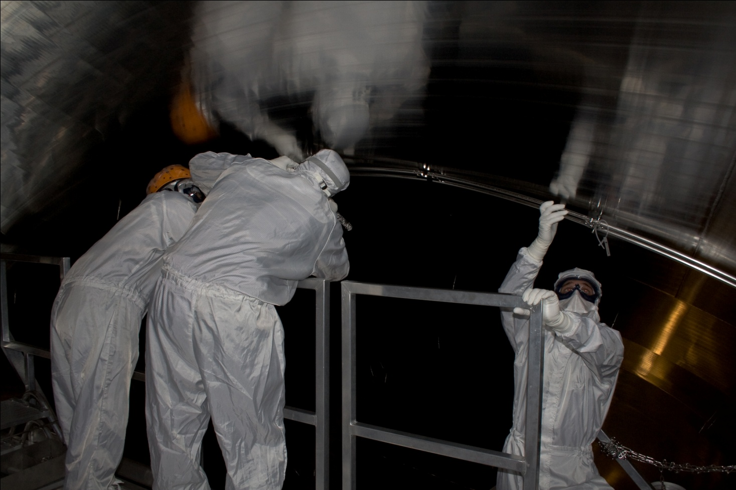
Wire electrodes of the main KATRIN spectrometer
s=25mm
r₂
Reduce background due to
secondary electrons from the wall
Secure precise form of the
retarding electrostatic field
no magnetic traps for e⁻ and ions
U₀-200V
r₁
d₂=70mm
U₀-100V
e⁻
d₁=150mm
U₀=-18.4kV
Spectrometer wall
240 modules
23 000 wires
Mounting wire electrodes
into a clean spectrometer interior

Slide 22
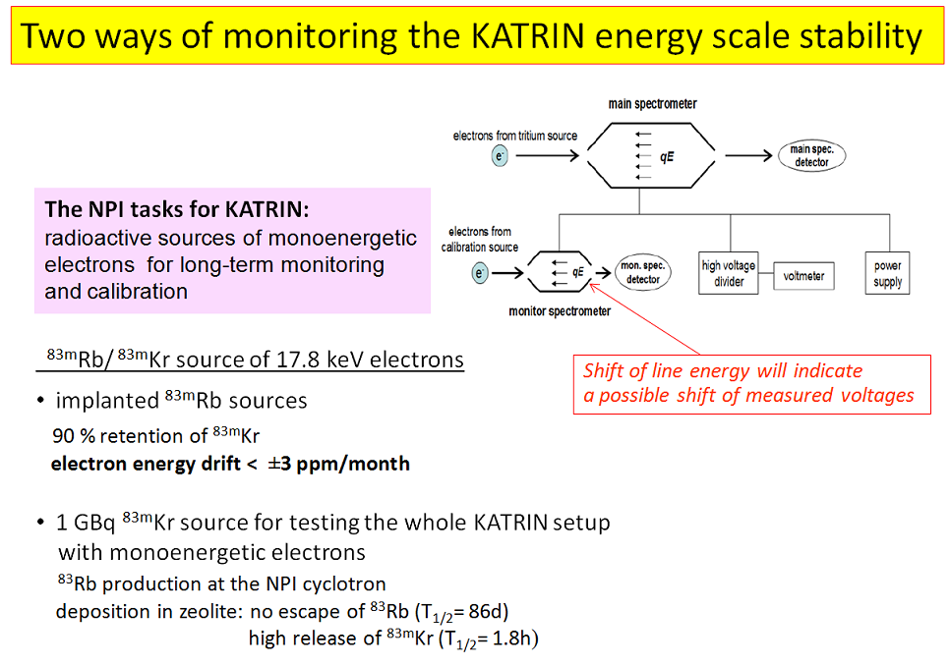
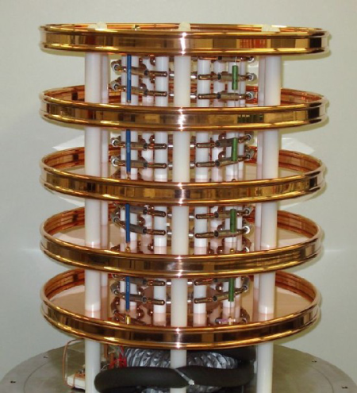
High-voltage divider
metrology precision

Slide 23
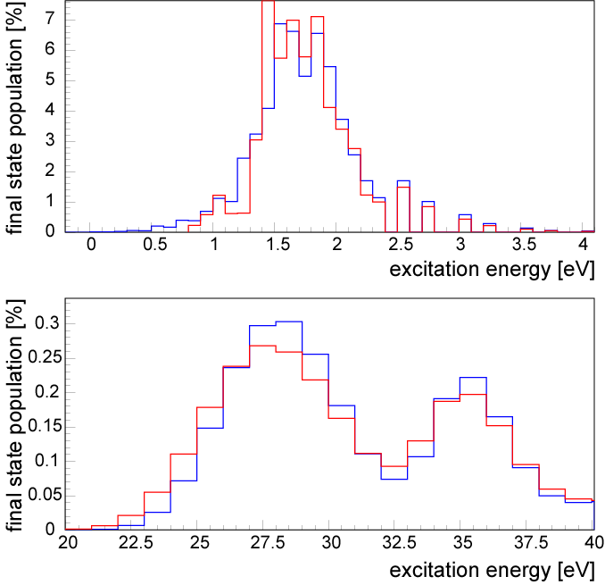
Analysis of measured β–spectrum: final (THe)⁺ states
dN/dE = K×F(E,Z)×p×E_{tot} ×Σ P_{i}(E₀-V_{i}-E_{e}) × [ (E₀-V_{i}-E_{e})² – m_{ν}² ]^{1/2}
P_{i}
rotational-vibrational
excitations of electronic
ground state
electronic excited states
V_{i}
(THe)⁺, (HHe)⁺ from
gaseous T₂ , HT
(Saenz et al., PRL 2000)

Slide 24
4. Expected results of KATRIN
1) The effective neutrino mass
If no neutrino mass is observed:
m_{ν} < 1 eV soon after the start of KATRIN (2013/14)
m_{ν} < 0.2 eV at 90% C.L. after 1000 days of measurement
(in 5 years)
Discovery potential m_{ν} = 0.35 eV (5σ effect)
In a model independent way
Regardless neutrino type (Dirac or Majorana)
Possible unaccounted right-handed couplings
will change the fitted m_{ν} by less than 10%

Slide 25
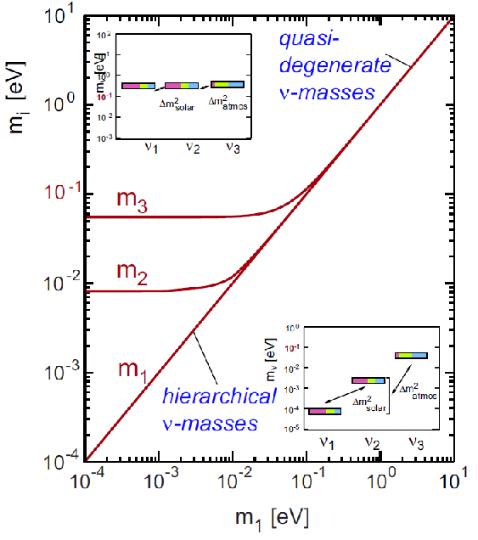
2) Distinguishing between the two neutrino mass scenarios
e.g. m₁≈ 0.30 eV, m₂≈ 0.31 eV, m₃≈ 0.35 eV
e.g. m₁≈0, m₂≈ 0.01 eV, m₃≈ 0.05 eV
Both in accord with oscillation experiments
KATRIN:
will explore the whole quasi-degenerate region
the hierarchical region is below its sensitivity

Slide 26
3) Contribution of relic neutrinos to the hot dark matter
0.001 < Ω_{ν} < 0.15
From ν oscillation experiments assuming hierarchical neutrino
masses with only one mass
eigenstate contributing to Ω_{ν}
From current tritium β-decay experiments
assuming quasi-degenerate neutrino masses
KATRIN
will be sensitive to Ω_{ν} = 0.01
It will either significantly constrain or fix
the role of neutrino hot dark matter

Slide 27
4) Sterile neutrinos with masses in the eV range
A possibility indicated by cosmology and several reactor and
accelerator oscillation experiments
Riis & Hannestad
arXiv:1008.1495v2
Kurie plot for tritium decay
KATRIN would see
sterile neutrinos
with
Δm²_{s1} = 6.49 eV²
|U_{e4}|² = 0.12
Δm²_{s2} = 0.89 eV²
|U_{e5}|² = 0.11
and similar cases.
Well separated from
signal of all three
light active neutrinos
m_{ν} = 5 eV
m_{ν} = 0
Two neutrino mixing:
m₁ = 5 eV, m₂ = 15 eV
|U_{e1}|² = |U_{e2}|² = 1/2
from Giunti and Kim:
Fundamentals of neutrino
physics and astrophysics (2011)

Slide 28
5) Local density of relic neutrinos
KATRIN tritium gaseous source as a target
for ν_{e} + T→³He⁺ + e⁻
with relic neutrinos
5.3 ·10¹⁹ tritium atoms, mass of 0.26 g
monoenergetic
E_{ν} = 2· 10⁻⁴ eV, ρ(ν_{e})_{average} = 56 cm⁻³ , σ = 8·10⁻⁴⁵ cm²
KATRIN sensitivity ρ(ν_{e})_{local} /ρ(ν_{e})_{average} ≥ 2·10⁹
arXiv: 1006.1886
Non observation will rule out certain hypotheses
about local neutrino gravitation clustering .

Slide 29
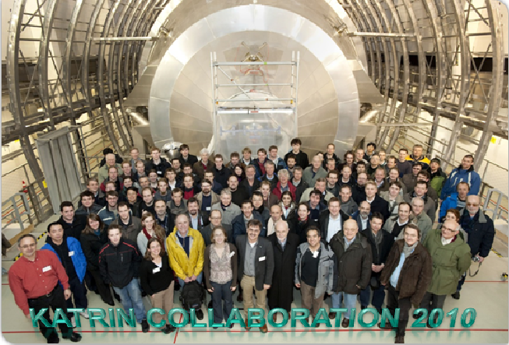
KATRIN Collaboration will do its best to fulfill these tasks

