Slide 1
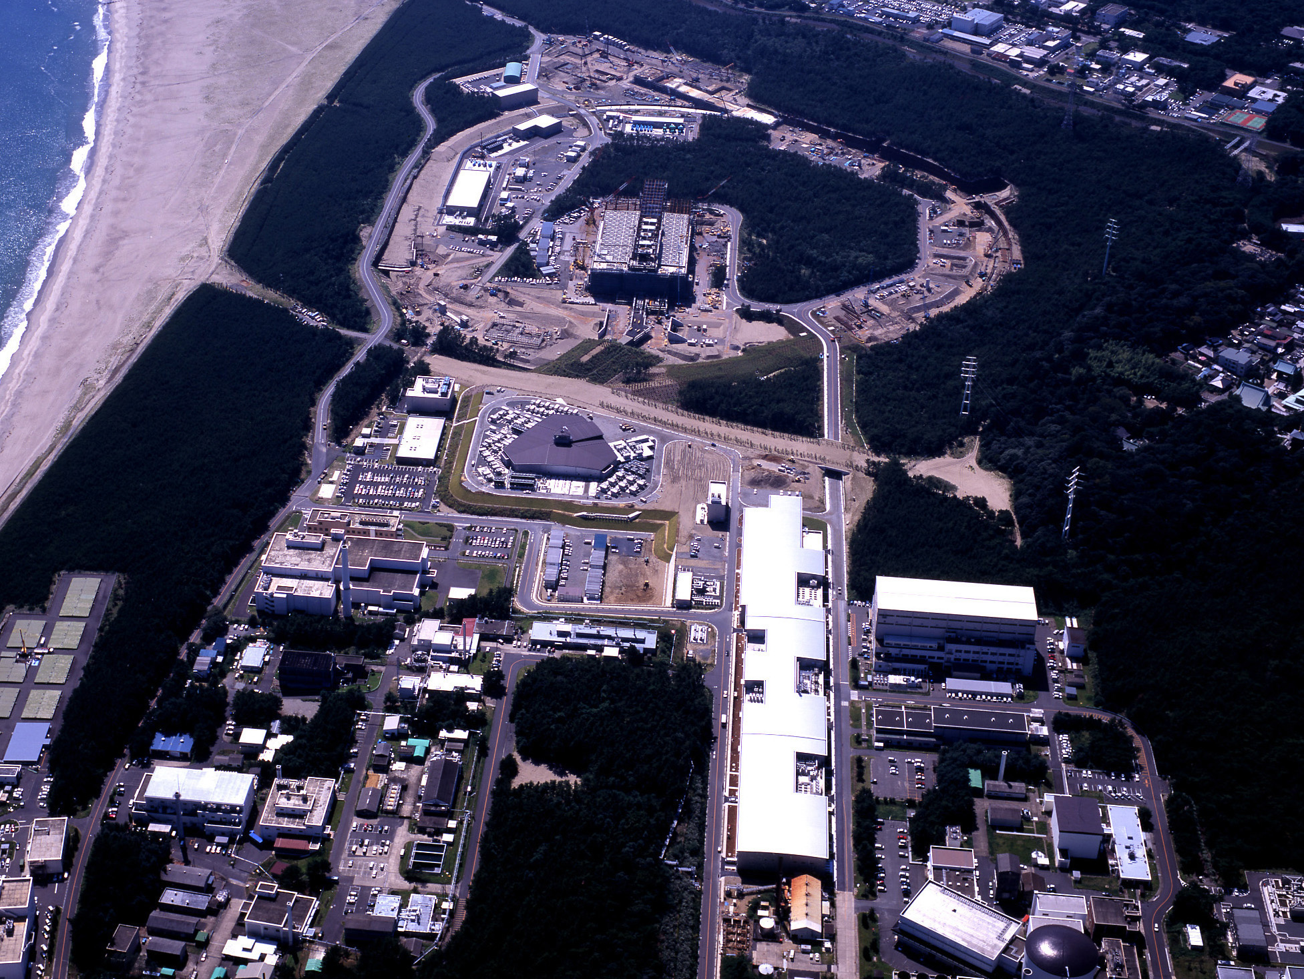


Recent Results and Prospects
in Neutrino Physics
Towards CP Violation in Neutrino Physics
Prague
October 7th, 2011
Dave Wark
Imperial/RAL

Slide 2
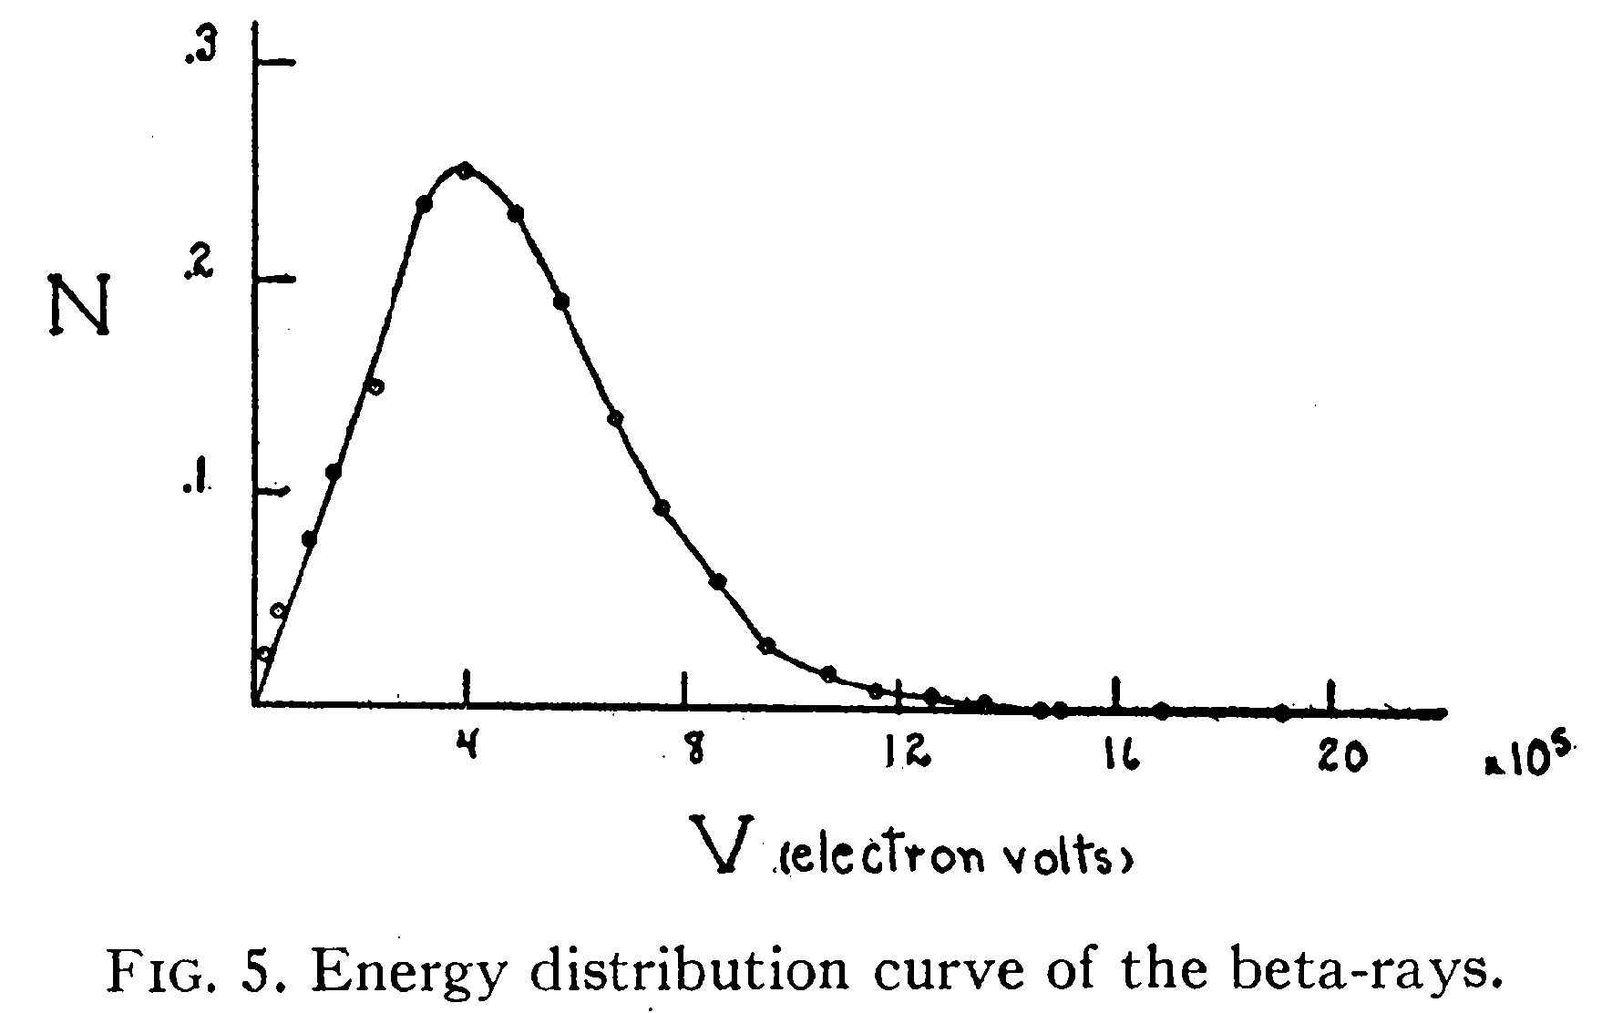
Where did the idea of the neutrino come from?
There were problems in the early days of β decay.
F. A. Scott, Phys. Rev. 48,
391 (1935)
β spectra were
continuous
Instead of
discrete
And the spins didn’t add up…
¹⁴C → ¹⁴N + e–
spin 0 spin 1 spin 1/2
Bohr: maybe energy/momentum not conserved in β decay?

Slide 3
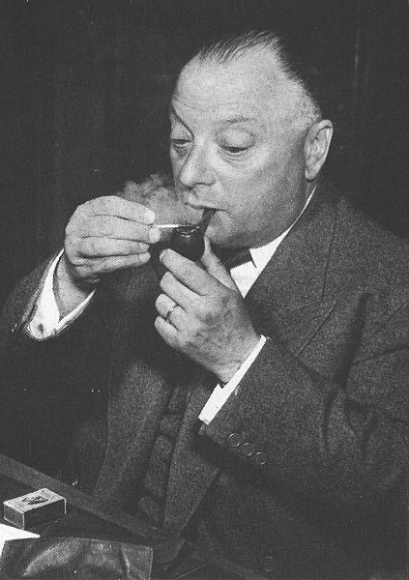
Pauli’s Solution…
Dear Radioactive Ladies and Gentlemen,
  As the bearer of these lines, to whom I graciously ask you to listen, will explain to you in more detail, how because of the "wrong" statistics of the N and Li⁶ nuclei and the continuous beta spectrum, I have hit upon a desperate remedy to save the "exchange theorem" of statistics and the law of conservation of energy. Namely, the possibility that there could exist in the nuclei electrically neutral particles, that I wish to call neutrons, which have spin 1/2 and obey the exclusion principle and which further differ from light quanta in that they do not travel with the velocity of light. The mass of the neutrons should be of the same order of magnitude as the electron mass and in any event not larger than 0.01 proton masses. The continuous beta spectrum would then become understandable by the assumption that in beta decay a neutron is emitted in addition to the electron such that the sum of the energies of the neutron and the electron is constant...
  I agree that my remedy could seem incredible because one should have seen those neutrons very earlier if they really exist. But only the one who dare can win and the difficult situation, due to the continuous structure of the beta spectrum, is lighted by a remark of my honoured predecessor, Mr Debye, who told me recently in Bruxelles: "Oh, It's well better not to think to this at all, like the new taxes". From now on, every solution to the issue must be discussed. Thus, dear radioactive people, look and judge. Unfortunately, I cannot appear in Tubingen personally since I am indispensable here in Zurich because of a ball on the night of 6/7 December. With my best regards to you, and also to Mr Back.
  Your humble servant
  . W. Pauli

Slide 4
How to detect them?
The detection of neutrinos was an extreme challenge for the experiments of the mid-twentieth century – Pauli, in fact, apologized for hypothesizing a particle that could not be detected.
In a Chalk River report in 1946, Bruno Pontecorvo pointed out the advantages of a radiochemical experiment based on ν_{e} + ³⁷Cl → ³⁷Ar + e⁻ (and even mentioned solar neutrino detection using this method).
However the first detection of neutrinos used another method…

Slide 5
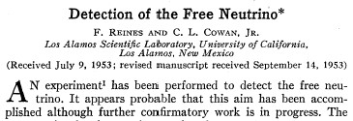
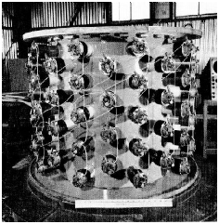
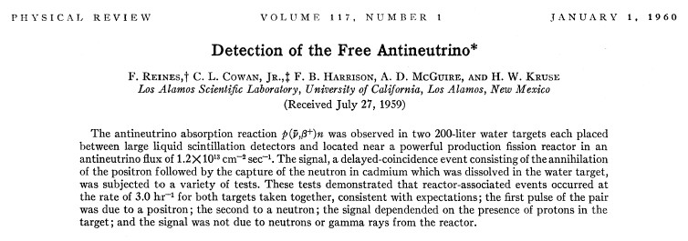
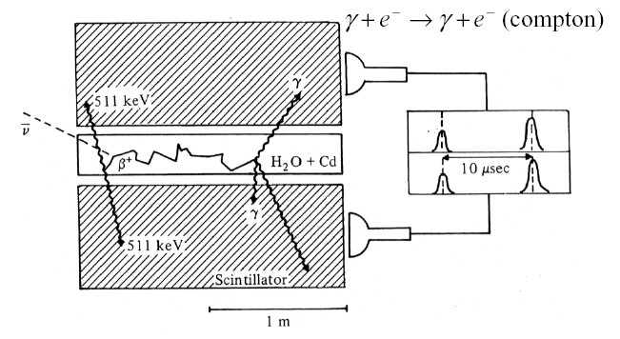
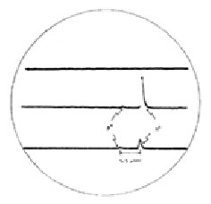

Slide 6
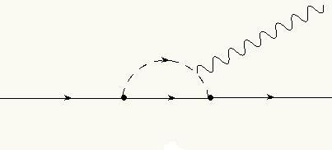
More Ancient History…
Question in the late 50’s: Are the neutrinos in these reactions the same thing?:
  n → p + e + ν π → μ + ν μ → e + ν + ν
If so, why no μ → e + γ via diagrams like?:
IVB
γ
μ
ν
e

Slide 7
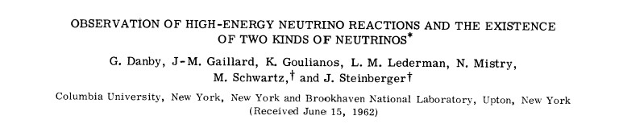
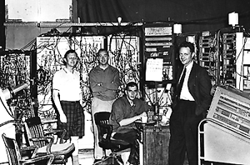
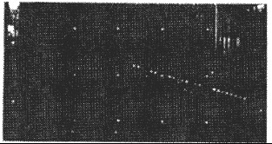
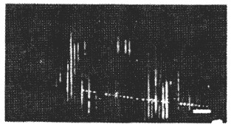
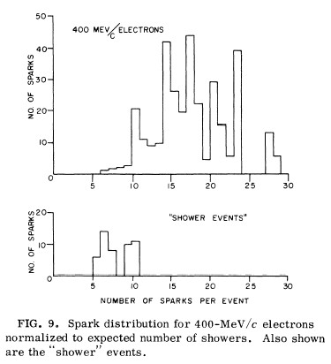
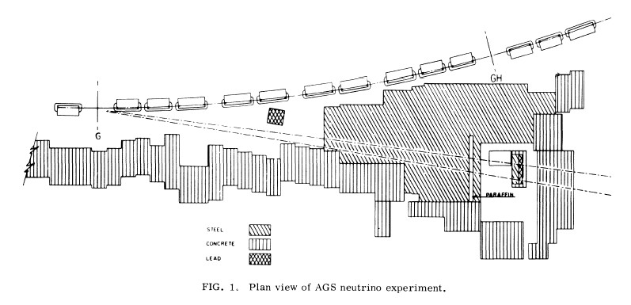
Next year will
be 50th anniversary!
μ event
e event

Slide 8
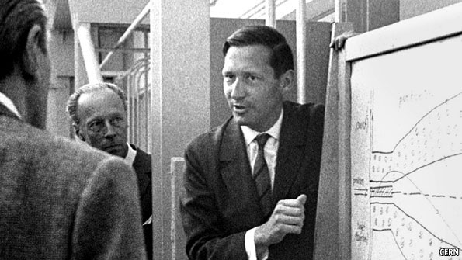
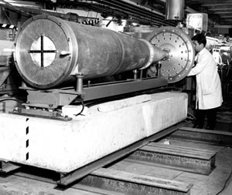
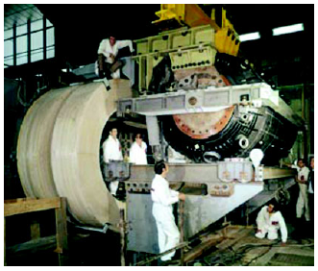
The Discovery of Neutral Currents
Simon van der Meer, 1925 - 2011
The 1st Neutrino Horn –
Van den Meer, CERN, 1961
The Gargamelle
CF₃Br Bubble Chamber

Slide 9
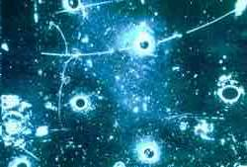
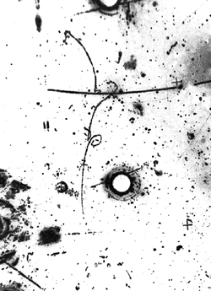
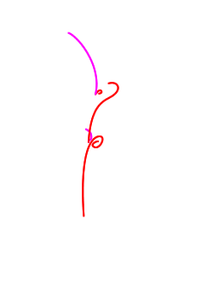
The Discovery of Neutral Currents
Most of the basic techniques were now in place, and since then we
have built them bigger/faster/more sensitive. Learn from my advisor....

Slide 10
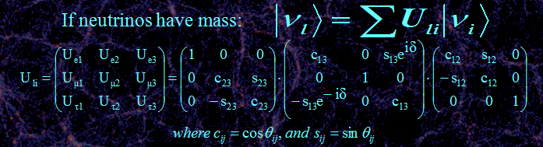
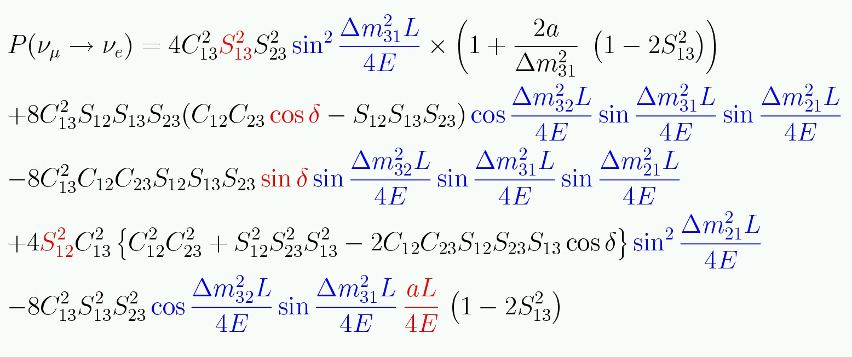
Three neutrino mixing.
Remember degeneracies
And covariances!

Slide 11
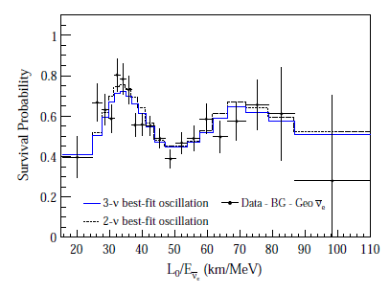
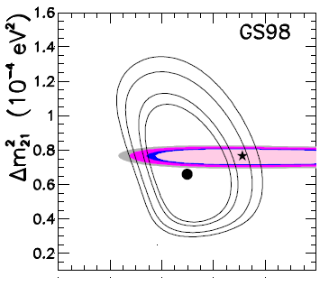

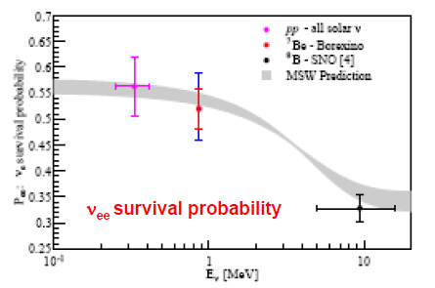
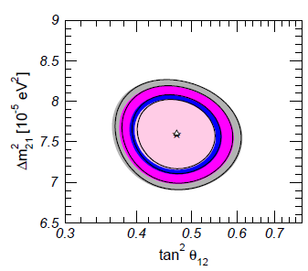
How well do we know θ₁₂?
Gonzalez-Garcia, Maltoni, Salvado
From Ranucci’s BOREXINO talk at EPS 2011

Slide 12
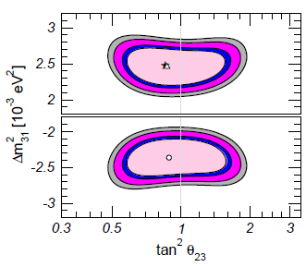
How well do we know θ₂₃?
Gonzalez-Garcia, Maltoni, Salvado

Slide 13
What is the pattern of neutrino masses?
It “probably” looks
something like this
Log m²
m₃
Δm²₂₃ ~ 2.5 x 10⁻³ eV²
m₂
Δm²₁₂ ~ 7.5 x 10⁻⁵ eV²
m₁
ν_{e}
ν_{μ}
ν_{τ}

Slide 14
What is the pattern of neutrino masses?
But it could look like this
Log m²
m₃
m₂
m₁
m₂
m₁
m₃
ν_{e}
ν_{μ}
ν_{τ}

Slide 15
This makes a factor of two difference in the
cosmological contribution, but a factor of two
on what?
Log m²
m₃
m₂
m₁
m₂
m₁
m₃
ν_{e}
ν_{μ}
ν_{τ}

Slide 16
Even more significant is the absolute scale.
Log m
1 eV
m₃
This?
m₂
m₁
Or this?
10⁻¹ eV
m₃
m₂
10⁻² eV
m₁
ν_{e}
ν_{μ}
ν_{τ}

Slide 17
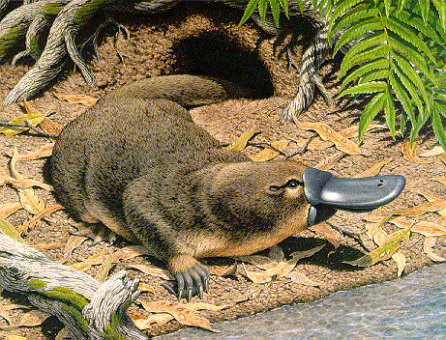
Does this look natural?

Slide 18
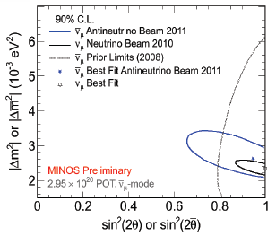

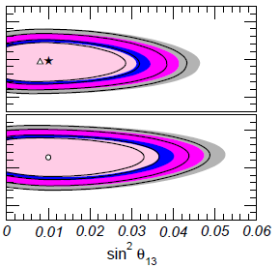
_
How well do we know θ₂₃?
Tension between ν and ν in MINOS relieved by new data....
Gonzalez-Garcia, Maltoni, Salvado
But what about
θ₁₃?

Slide 19
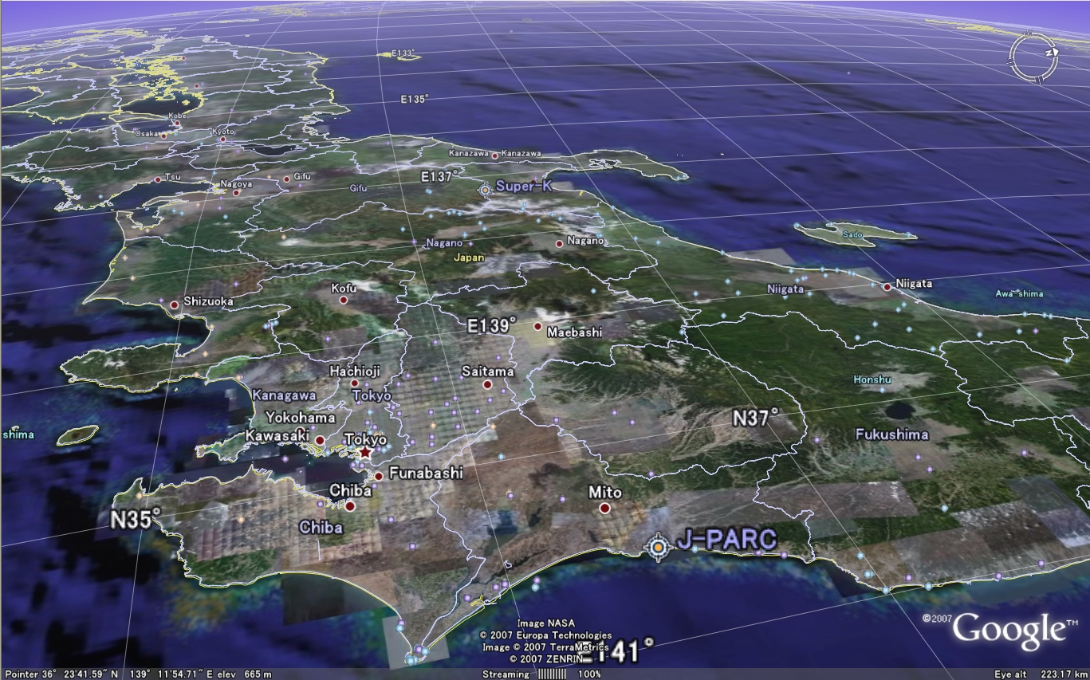

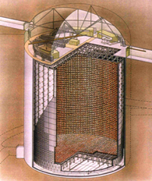
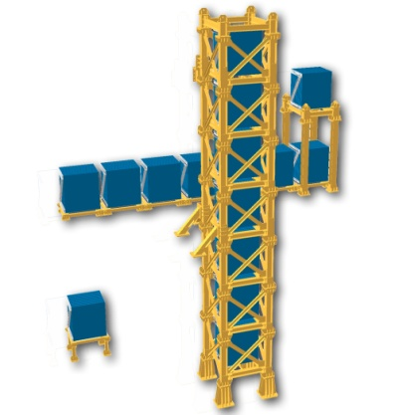
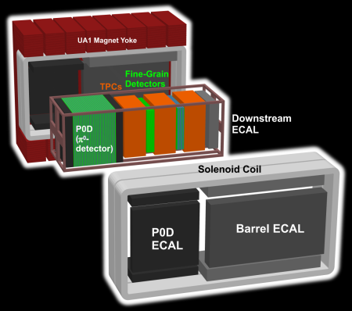
#

Slide 20
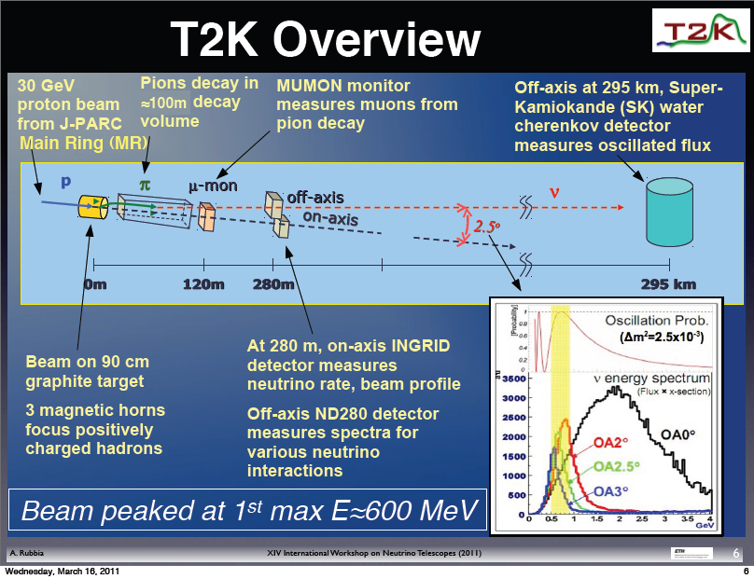

Slide 21
Off-Axis Pros –
  Increases flux at the oscillation maximum
  Reduces high-E tail, and thus NC backgrounds
  Reduces ν_{e} contamination from K and μ decay
Off-Axis Cons –
  Measure oscillations at a single L/E
  Increases near/far differences
  Have to know angle!
CCQE rel. σ max!

Slide 22
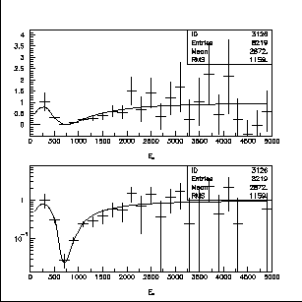
What are we trying to measure?
ν_{μ} disappearance
No oscillation
sin²2θ₂₃
Δm²= 2.5 x10⁻³ eV²
Δm²= 2.0 x10⁻³ eV²
Δm₂₃²
Precision measurements

Slide 23
What are we trying to measure?
ν_{e} appearance
sin²2θ₁₃

Slide 24
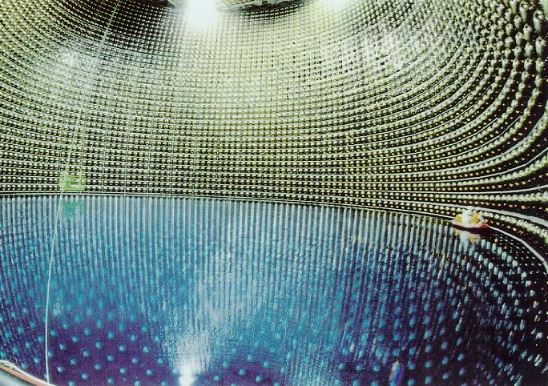
Optimal Far Detector – Super Kamiokande

Slide 25
Background
from NC
interactions
e
ν_{μ}
disappearance
signal
π⁰
ν_{e}
appearance
signal
μ
In this energy range, Super Kamiokande well understood,
Excellent for separating
electrons, μ, π⁰

Slide 26
Optimal Near Detector (?)
Naively you would want the near and far detectors to be “identical”, and then you just subtract.
That was where we started out, but it was clear from very early that a water Cerenkov was not usable at the “near” site (280m).
In fact near and far are never identical. There are differences in:
  Size (and everything that goes with that)
  Rate
  Geometry with respect to the beam (a much more severe problem in an off-axis geometry)
  Backgrounds
For the appearance experiment it is even more complicated, because half your backgrounds arise from the ν_{μ}, and these oscillate into ν_{τ} at the far detector.
So a straight subtraction is not possible, and you need to understand the beam and interactions in detail.
Dave Wark
Imperial College/RAL

Slide 27
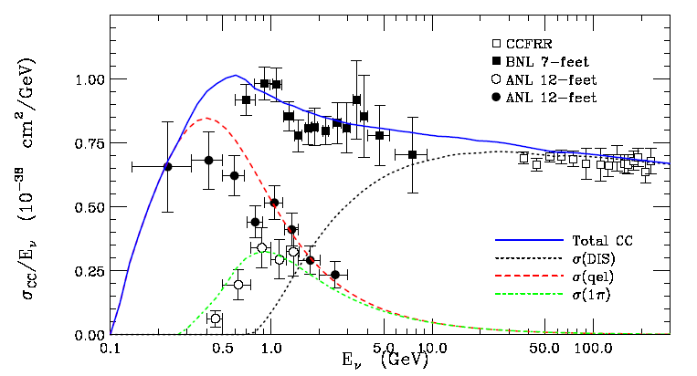
Critical σ’s poorly known in range 0.1-10 GeV.
Total ν_{μ} CC cross section
Data compiled by G.Zeller, hep-ex/0312061

Slide 28
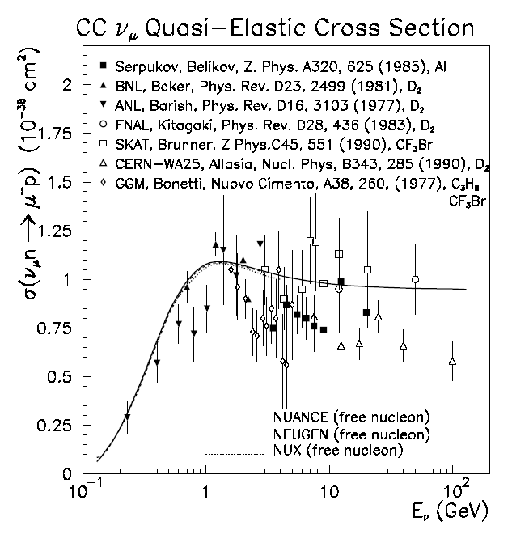
Cross sections are poorly known in range 0.1-10 GeV
Data compiled by G.Zeller, hep-ex/0312061

Slide 29
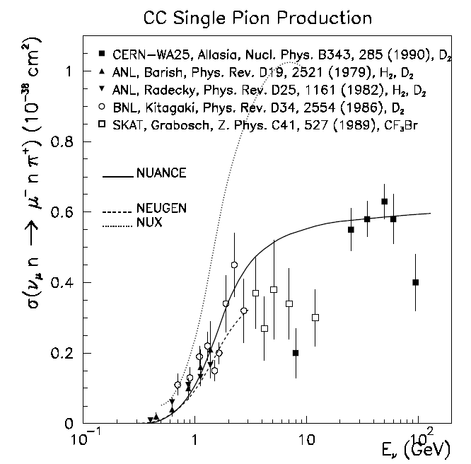
Cross sections are poorly known in range 0.1-10 GeV
Data compiled by G.Zeller, hep-ex/0312061

Slide 30
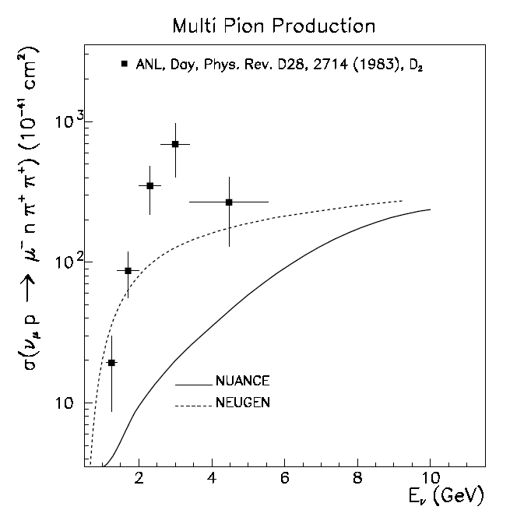
Cross sections are poorly known in range 0.1-10 GeV
Data compiled by G.Zeller, hep-ex/0312061

Slide 31
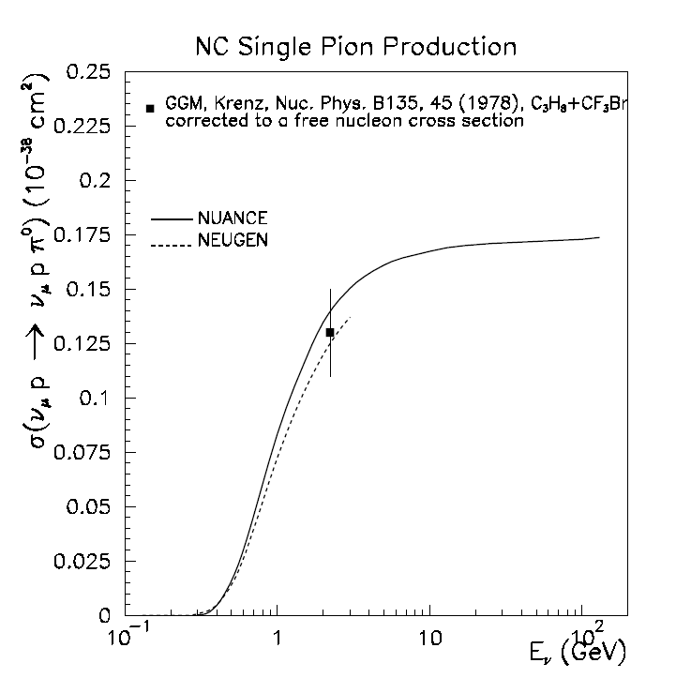
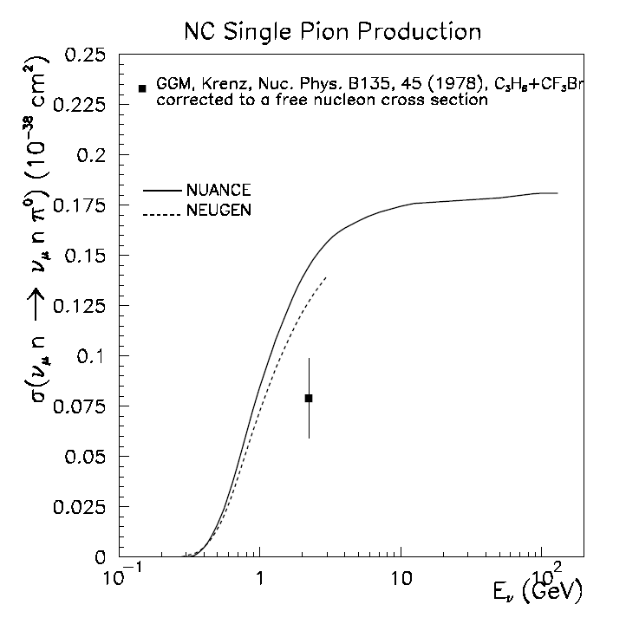
Some are worse than others…
Data compiled by G.Zeller, hep-ex/0312061

Slide 32
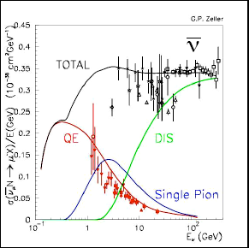
And lets not even talk about ν…
_

Slide 33
Optimal Near Detector (?)
Naively you would want the near and far detectors to be “identical”, and then you just subtract.
That was where we started out, but it was clear from very early that a water Cerenkov was not usable at the “near” site (280m).
In fact near and far are never identical. There are differences in:
  Size (and everything that goes with that)
  Rate
  Geometry with respect to the beam (a much more severe problem in an off-axis geometry)
  Backgrounds
For the appearance experiment it is even more complicated, because half your backgrounds arise from the ν_{μ}, and these oscillate into ν_{τ} at the far detector.
So a straight subtraction is not possible, and you need to understand the beam and interactions in detail.
The far detector must be huge, but the near detector doesn’t need to be, so you can make it much more complex (and capable), if you are willing to go with a different technology.
⇒ 280m near detectors
Dave Wark
Imperial College/RAL

Slide 34
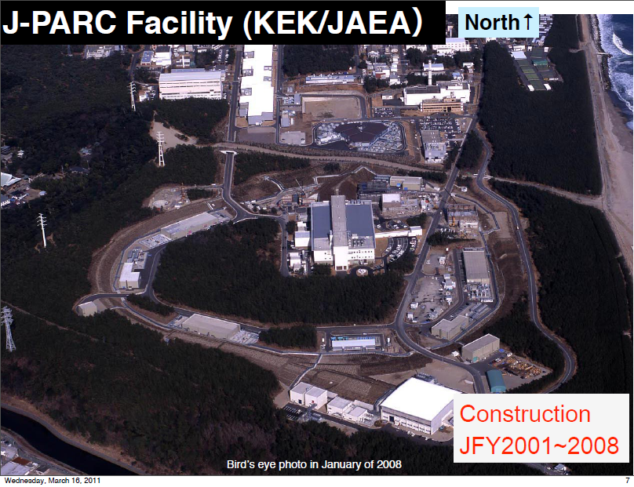

Slide 35
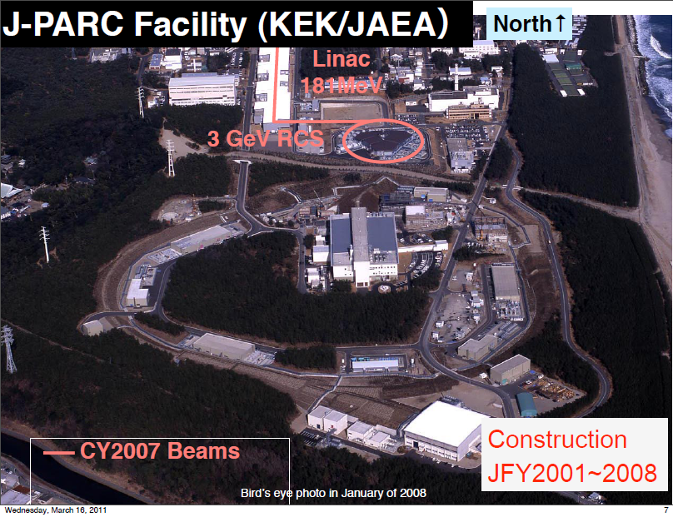

Slide 36
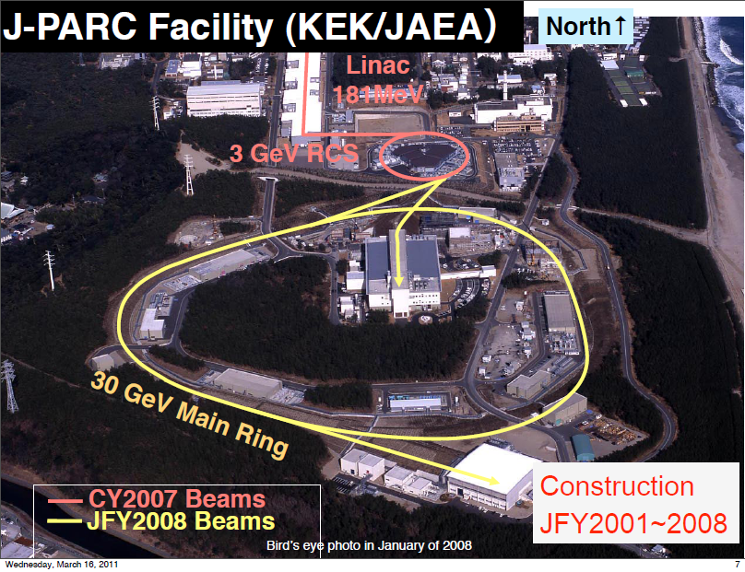

Slide 37
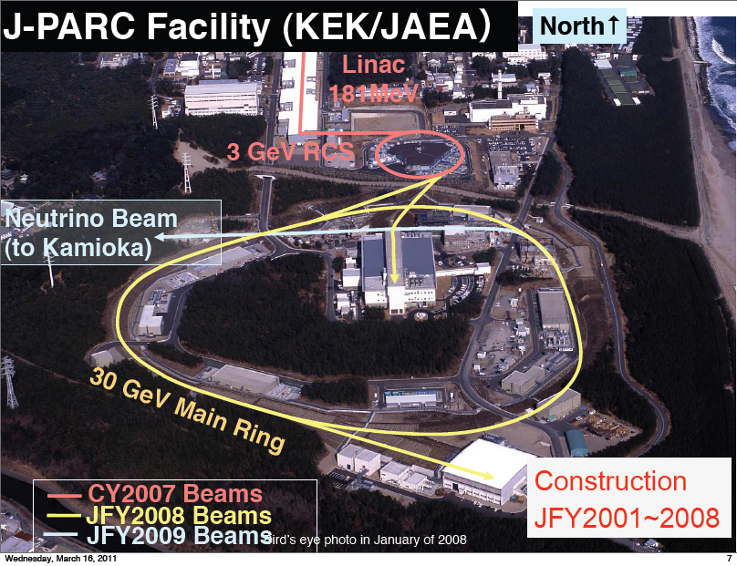

Slide 38
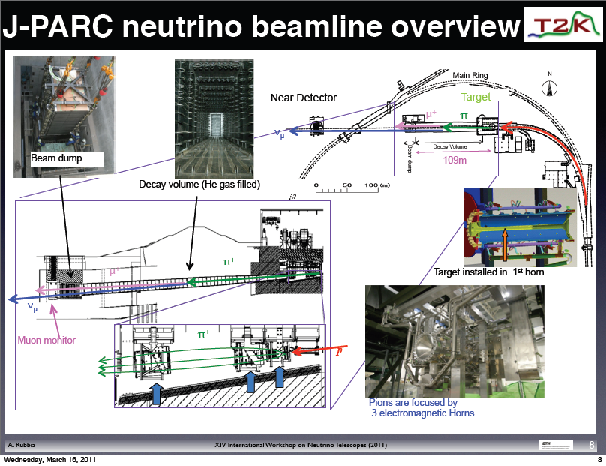

Slide 39


Slide 40


Slide 41


Slide 42


Slide 43


Slide 44


Slide 45



Slide 46








Slide 47


Slide 48


Slide 49





Τ2Κ ν_{e} Appearance Data Reduction
All cuts optimized for low statistics
and fixed before data taken.

Slide 50





Check many distributions....
No excess outside FV or in OD,
but KS prob. for R² is ~3%
You win some...
You lose some.

Slide 51


Slide 52



What about
θ₁₃?
T2K (2.5σ)
MINOS (1.7σ)
ν_{e} appearance, θ₁₃ > 0?
Interesting hints that
θ₁₃ > 0, but clearly
more data needed.

Slide 53


Slide 54


Slide 55



Slide 56




5/11, 14:46, all
Hell broke loose...
Much exterior damage, but
inside equipment shows no
major damage so far. Much
to check yet! Will try to
restart late this year...

Slide 57
What else to talk about?
Another round of supererbeams?:
  Water Cerenkov or Liquid Argon?
  Upgrade of T2K
  LBNE
  LBNO
The further future?:
  β beams
  Neutrino Factory
Cosmological ν
Supernovae ν and the OPERA time anomaly
Sterile neutrinos?
Support Experiments...

Slide 58

What will existing experiments yield?
Even some 90% CP violation sensitivity...
sin²2θ₁₃ = 0.1, NH
arXiv:0907.1896v1 [hep-ph] 10 Jul 2009

Slide 59


Slide 60

If oscillations
prove IH
If 0νββ decay
sets a limit here
Then neutrinos are Dirac...

Slide 61
Conclusions
Neutrino oscillations are the first confirmed physics beyond the SM!
Current indications are that sin²2θ₁₃ ≥ ~0.01, which could give existing experiments the first sensitivity to CP violation in the neutrino sector.
Do not assume we know everything that is going on – redundancy is essential!
There are three next-generation superbeam projects, and I think the physics will justify at least two.
In my opinion, a large LAr tracking calorimeter will be used in at least one experiment, making LAr development a high priority.
There will be many other opportunities for smaller-scale involvement in cross-section, hadron production, and perhaps short-baseline projects.
Neutrino experiments have a guaranteed future. JOIN US!
Dave Wark
Imperial College/RAL

Slide 63


Slide 64
OK, then what?
Three “conventional” beam proposals:
  An upgrade of T2K based on reaching 1.6 MW beam power and a new far detector.
  LBNE – a plan to build a new neutrino beam at Fermilab aimed at Homestake, where either a large water Cerenkov detector or a LAr tracking calorimeter would be built.
  LAGUNA-LBNO – three different options for new long baseline in Europe.
Return ↑

Slide 65

~kT scale LAr now a working technology
Must now work on scalability and cost
Must figure out how to analyze!

Slide 66

Return ↑

Slide 67






Scenarios in Japan
Kamioka L=295km OA=2.5deg
J-PARC
→1.7MW
Okinoshima L=658km OA=0.78deg
Almost On-Axis
Return ↑

Slide 68


Slide 69




US: Long Baseline Neutrino Experiment
CD 0: January 2010
1300 km
Collaboration:
288 members from 54 institutions (India, Italy, Japan, UK, US)
Continue to grow!

Slide 70


LAr Slight cheaper but riskier – Marx Committee
Return ↑
Alternative is
34 kT of LAr
Technology choice underway ....

Slide 71




Possible synergy with a NF beam
Joint Japanese/European approach
Possible synergy with a β beam

Slide 72


Slide 73


Slide 74

Exploring within LAGUNA an LoI for a 10 kT LAr with a muon ranger combined with a new beam in the NA.
Return ↑

Slide 75


CERN Beta Beams, Synoptic
RCS
SPL
Linac4
Dotted lines: alternative layouts
Linac
ISOL target
Molten Salt Loop
Collection
PR
6He
18Ne
ν-Beam
8B/8Li
Baseline
6He/18Ne
ECR
RFQ
Linac 100 MeV
PS
DR
SPS
PS and SPS existing
RCS
Decay Ring: Bρ ~ 500 Tm, B = ~6 T, C = ~6900 m, L_{ss}= ~2500 m, γ = 100, all ions
Return ↑
75
Notes:
What is changing is mainly the production

Slide 76


Neutrino Factory Baseline
MICE
@RAL
Two Magnetised Iron Neutrino Detectors (MIND):
  100 kton at 2500-5000 km
  50 kton at 7000-8000 km
Baseline constantly under
review in light of new
physics results
Return ↑

Slide 78

Slide from Yvonne Wong’s talk at TAUP ‘11

Slide 79

Slide from Yvonne Wong’s talk at TAUP ‘11

Slide 80

Slide from Yvonne Wong’s talk at TAUP ‘11

Slide 81




If you are measuring a mass, you must QUANTIFY the systematics!

Slide 82
SNO Systematic Flux Uncertainties
  Error Source
  Energy scale
  Energy resolution
  Non-linearity
  Vertex shift
  Vertex resolution
  Angular resolution
  High Energy γ’s
  Low energy background
  Instrumental background
  Trigger efficiency
  Live time
  Cut acceptance
  Earth orbit eccentricity
  ¹⁷O, ¹⁸O
  Experimental uncertainty
  Cross-section
  Solar Model
  CC error (%)
  -5.2, +6.1
  ±0.5
  ±0.5
  ±3.1
  ±0.7
  ±0.5
  -0.8, +0.0
  -0.2, +0.0
  -0.2, +0.0
  0.0
  ±0.1
  -0.6, +0.7
  ±0.2
  0.0
  -6.2, +7.0
  3.0
  -16, +20
ES error (%)
-3.5, +5.4
  ±0.3
  ±0.4
  ±3.3
  ±0.4
  ±2.2
  -1.9, +0.0
  -0.2, +0.0
  -0.6, +0.0
  0.0
  ±0.1
  -0.6, +0.7
  ±0.2
  0.0
  -5.7, +6.8
  0.5
  -16, +20
Unless a real error analysis is done
for astrophysical mass “limits” they
cannot really be considered
equivalent to laboratory limits.
In any case why would you
waste precious cosmological
data constraining m_{ν}?
Return ↑

Slide 84



February 1984
March 8,1987
A supernova
converts
~ 1 M⊙ to ν

Slide 85

Limit from SN1987a is m_{νe} > 23 eV (PDG)
Best you can do is ~5-10 eV, which isn’t good enough
Light and neutrinos got here on the same day after travelling
for ~160k yrs, so |v_{ν}-c|/c < 2×10⁻⁹ at E_{ν} ~ 10 MeV

Slide 86






Dusini at EPS
OPERA τ appearance event....
.... has no friends yet. Expect 1.65±0.16

Slide 87





TOF_{c} - TOF_{ν}
|v_{ν}-c|/c =
(2.48±0.28±0.30)×10⁻⁵
Return ↑

Slide 89





LSND Starts it all...
Short baselines
(L/E ~ 1)
and sterile ν.
MiniBooNE says....
No!
Yes?

Slide 90

Also extensive programme planned at Fermilab....
Return ↑

Slide 92


In the systematics dominated era
support measurements are essential!
One slide on hadron production

Slide 93





Neutrino interaction properties must
also be measured...
But also need....
Near Detectors....
Return ↑

