Slide 1
Technical Developments
Two Beam Module
A. Karlov (DUBNA, JINR)
03-Nov-2011

Slide 2
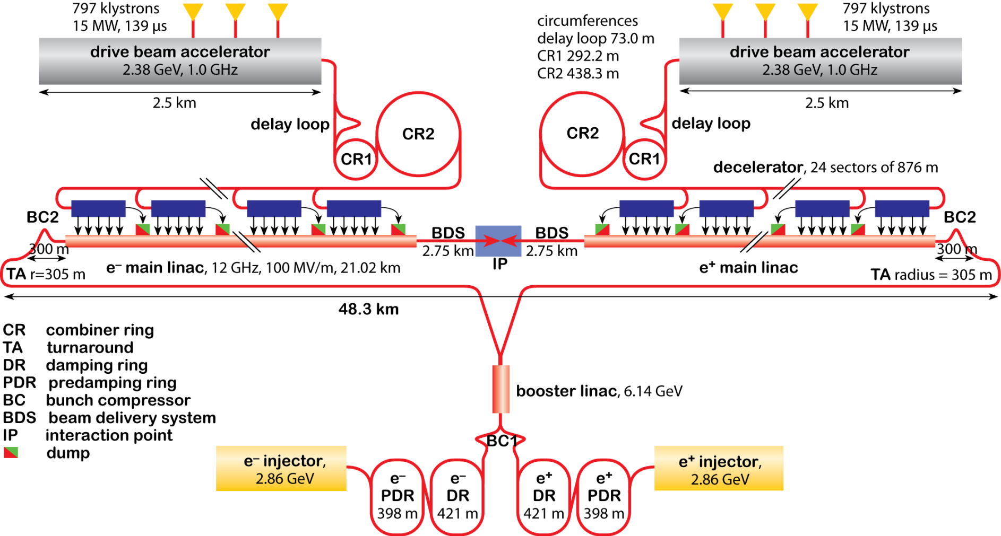
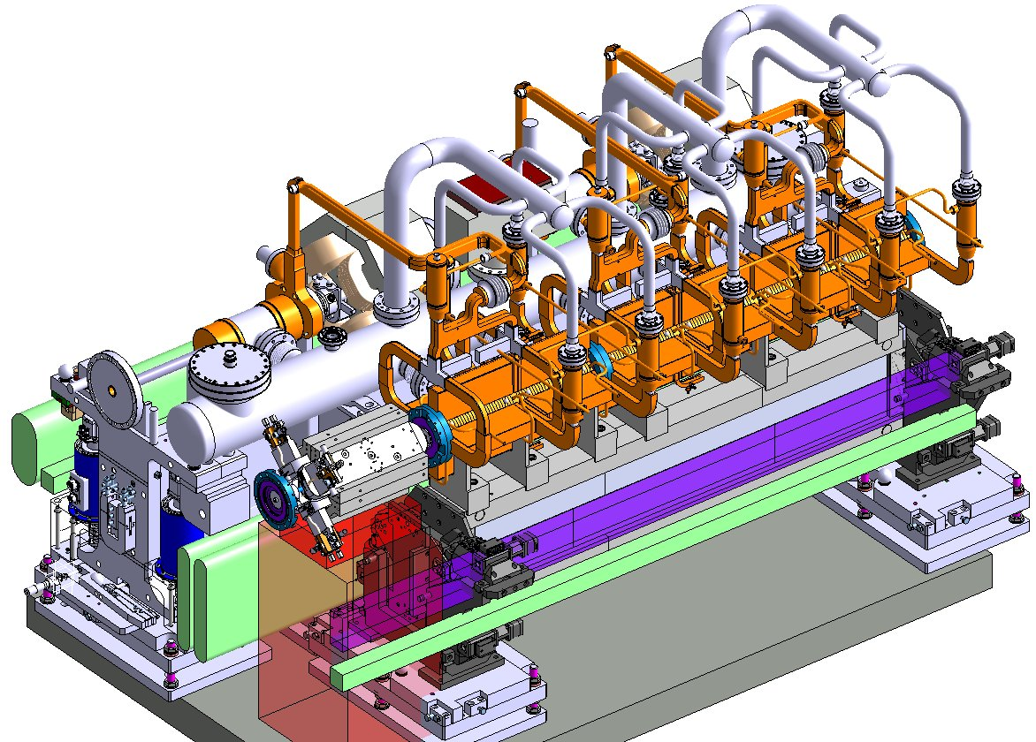
CLIC layout at 3 TeV
CLIC layout at 3 TeV
Two Beam Module Integration Layout

Slide 3
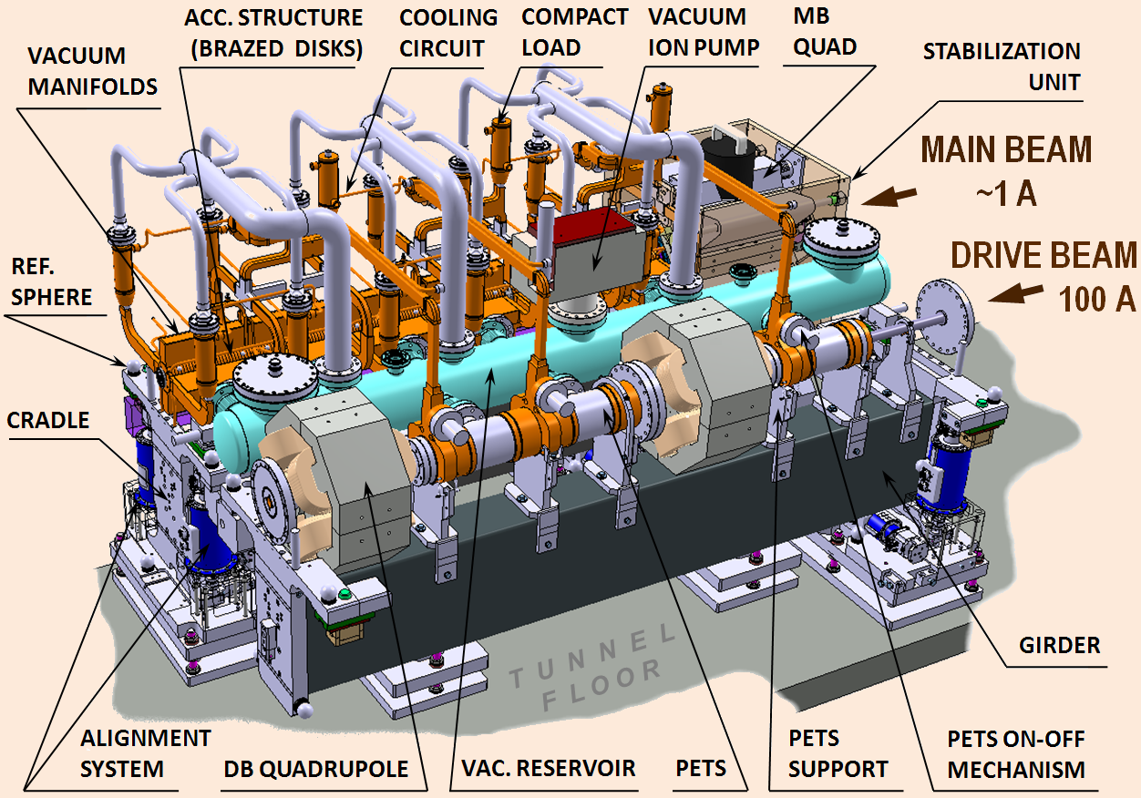
CLIC TBM
CLIC TWO BEAM MODULE
CLIC is based on the two-beam acceleration method in which the RF power for sections of the main linac is extracted from a second, low-energy, high-intensity electron beam running parallel to the main linac (drive beam). The drive-beam regularly powers two Accelerating Structures (AS) from one Power Extraction and Transfer Structure (PETS). Each module might contain up to four PETS, feeding two AS each, and two drive-beam quadrupoles, as a very dense lattice is required for the low-energy drive beam.

Slide 4
Tasks and activities
Engineering design of RF structures;
Engineering design of sub-units, i.e. “BPM - Drive Beam magnet vacuum chamber - PETS interconnection”
Definition of boundary conditions for alignment / stabilization systems;
Engineering design of cooling / supporting system
Integration of different systems components into module layout;
Engineering design of assembly toolings;
Procurement of corresponding components for test modules;
Definition and implementation of Quality Assurance system;
. . .
“BPM – DB Q vacuum chamber – PETS” unit
RF system components design & integration
Supporting & Alignment systems

