Slide 1
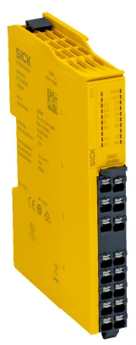
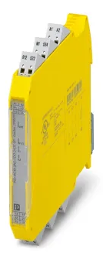

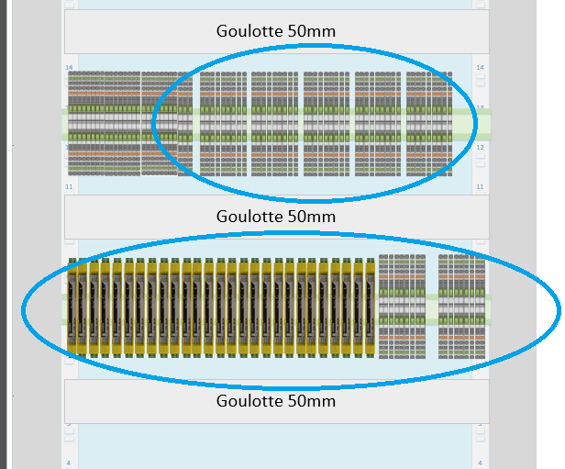

FAIR – Parallel powering – Follow up
1 – Space management & material selection
On field :
- Cabinet installation vs. layout design documentation check
- Actual QPS commutator check (cable length from CYCIP21 to CYCIP20)
- Cable tray, …
Safety relais : 24V / 3 NO safety contacts -> small frame (+/- 200 Chf)
Need to be tested (SM18) for validation !
Layout design for relais and terminal board (backplane)
Fit inside the electrical cabinet

Slide 2
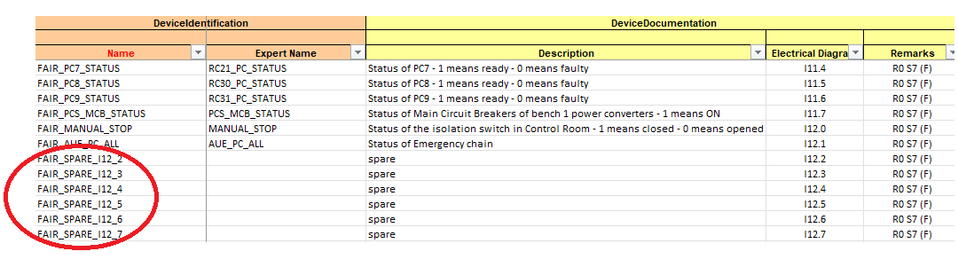
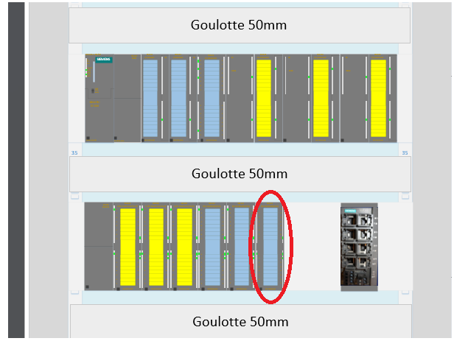
FAIR – Parallel powering – Follow up
2 – PLC signals configuration
New signals/logic design :
- Command through UNICOS supervision and digital output to relay in “standard* logic - Feedback into the “safety” logic
Software specification review
- 27 digital safety inputs available
- 9 digital “standard” outputs availabale -> Need to add a PLC module (+/- 800 Chf)
Fit inside the electrical cabinet

Slide 3
FAIR – Parallel powering – Follow up
3 – Need to done (in the next weeks/month)
- Test both relays and choose the better one
- Material order (budget code : 98062)
- Update electrical drawings and complete cabinet documentation
- Update software specification including user interface requests
4 – Then
- Software update
- Cabling modification organization

