Slide 1


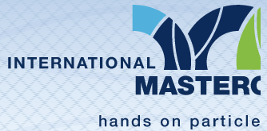
Particle therapy masterclass
Therapy planing of liver
University of sarajevo
Benjamin dedić

Slide 2
Table of content
ABSTRACT
C PHANTOM
THERAPY PLANING OF LIVER
COMPARISON FOR PHOTON AND PROTON THERAPY FOR LIVER
COMPARISON FOR PROTON AND CARBON ION THERAPY FOR LIVER
CONCLUSION

Slide 3
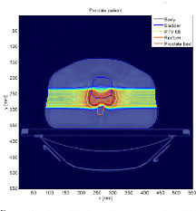
abstract
Loading in matRad, and loading the Liver phantom in matRad
Setting up bixels for our case, setting up angles of beams, in our case for photons they were 0, 180, 225, 270 and 315 degrees
After setting the angles we pressed calculate and following that we started optimizing
Every of thoese cases we have saved via the option Save to GUI
After the optimization we have saved the CT image and the DVH
We have repeated the above steps for proton and carbon beams but we only had one angle for them which was 315 degrees

Slide 4
C phantom
Here paste your C phantom CT scan with all beams that are applied
Here you will present the short introduction to C phantom and what are your conclusions on
Here paste and resize the setup of objectives and constraints
Here paste the DVH of the C phantom

Slide 5
liver
Liver organs at risk and targets
Spinal cord | OAR
Skin | OAR
Stomach | OAR
Liver | Target
Kidney_R | OAR
Kidney_L | OAR
Heart | OAR

Slide 6
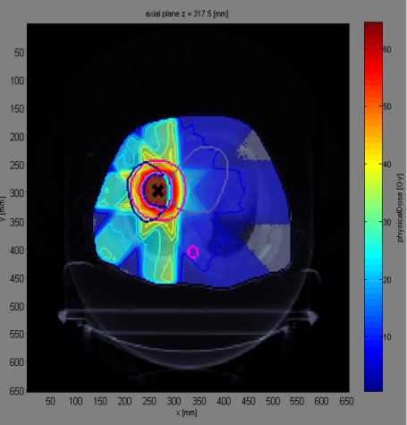
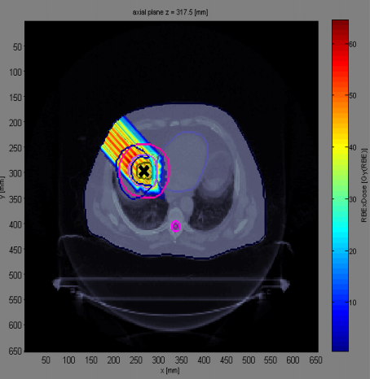
Comparison for photon and proton therapy for liver
Photon therapy
Proton therapy
As of using 5 beams uniformity of the dose distribution is equal to all of the beams but the intensity of the beam is not minimal in areas before and after the target
Beacuse of using only 1 beam dose distribution is high before and in the target volume but in the space after the target there is no dose

Slide 7
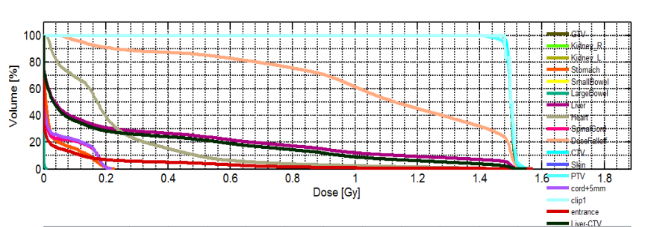
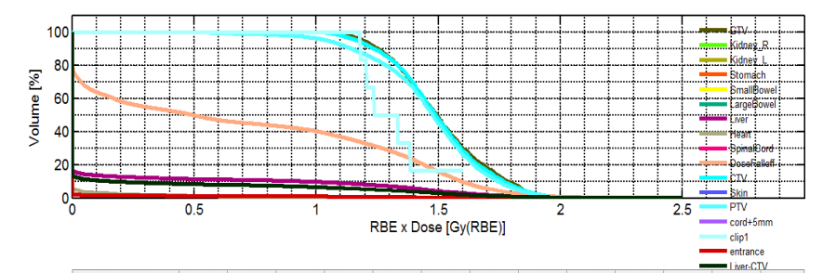
Comparison for photon and proton therapy for liver
Photon therapy
Proton therapy
Dose in the target volume has reached its required hight but the dose in other organs which are not marked as a target is higher for photons than for protons
Dose for the target volume in this case is higher than photon beams and the dose has fallen off much faster. Other organs which are not marked as targets have received much lower doses than with photons

Slide 8
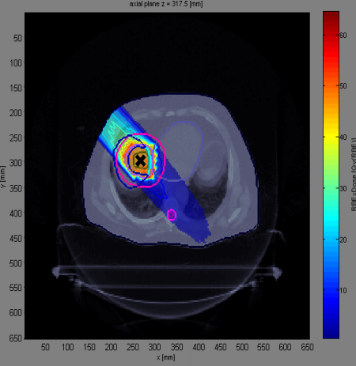
Comparison for proton and carbon ion therapy for liver
Proton therapy
Carbon ion therapy
Beacuse of using only 1 beam dose distribution is high before and in the target volume but in the space after the target there is no dose.
The dose is much lower in the area before the target volume, while in the target volume it reaches it‘s maximum. Area after the target volume has received a small amount of dose.

Slide 9
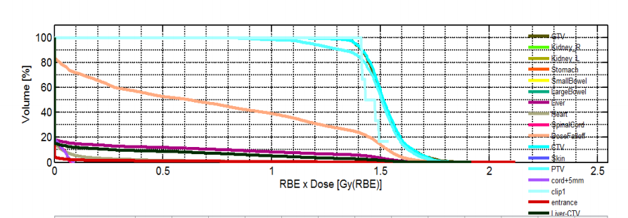
Comparison for proton and carbon ion therapy for liver
Proton therapy
carbon ion therapy
Target volume has received the maximum dose but it does not have a sharp dropoff in dose where the non target volumes have received a small amount of dose
Target volume has received the maximum dose but in the case for carbon ion therapy we can see that the dose dropoff is sharper than in the case for protons. Non targets have received the similar doses as with protons

Slide 10
conclusion
As stated before, we will discuss here the differences amongst photon, proton and carbon ion therapy
For photon therapy we have seen that even when using multiple beams we have still had results which are not as good as the results for proton therapy because of the dose falloff and the dose on surrounding organs
Regarding the differences between the carbon ion therapy and proton therapy we can see that the carbon ion therapy has a much sharper dropoff in doses for target organs, but for the case of one beam the results are very similar
In the conclusion we can say that the carbon ion therapy has the best results while the proton therapy follows closely behind and the photon therapy can be graded as the third best of the presented ones

Slide 11
Thank you for your attention

