Slide 1
Target Station Integration 25/6/25
Beatriz Martinez Sutil

Slide 2
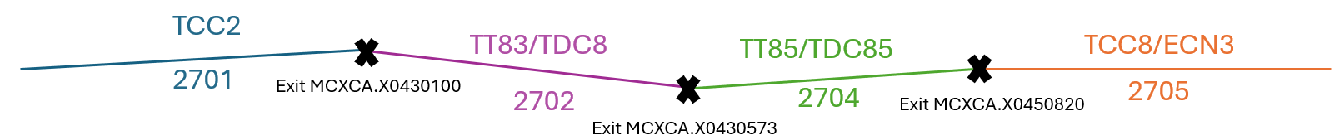
Division P42 beam line
The following Action was discussed with Sylvain – With the new MADX version, see how to divide the P42 line (all the modifications are in one full line currently)
MADX files with divisions:
https://gitlab.cern.ch/acc-models/acc-models-ea/-/tree/en-ea-le/P42/integration?ref_type=heads

Slide 3
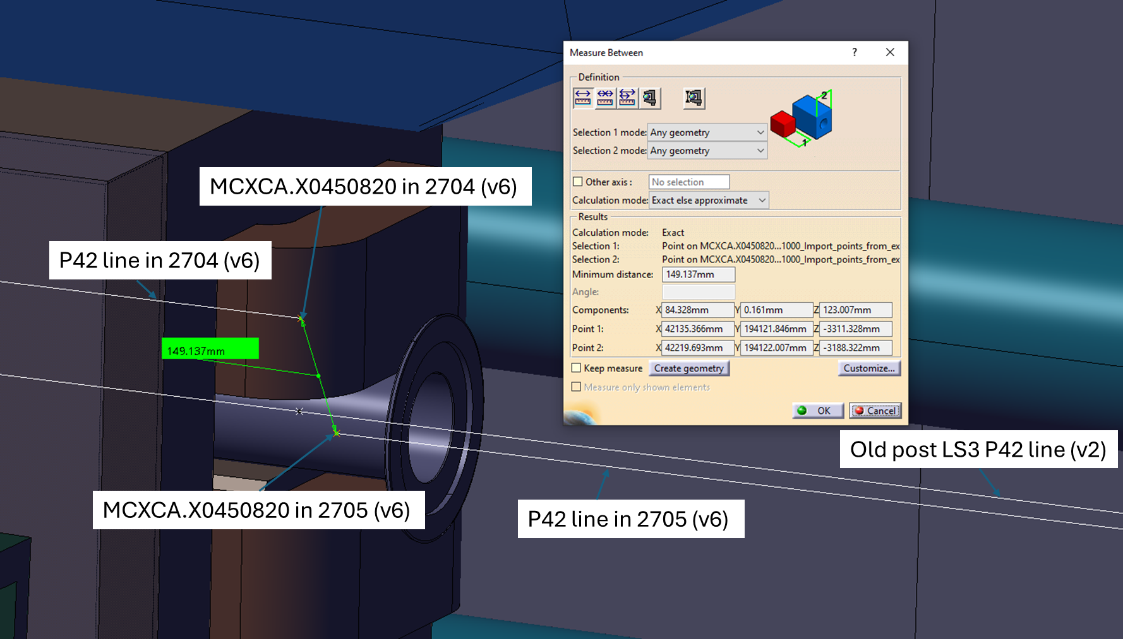
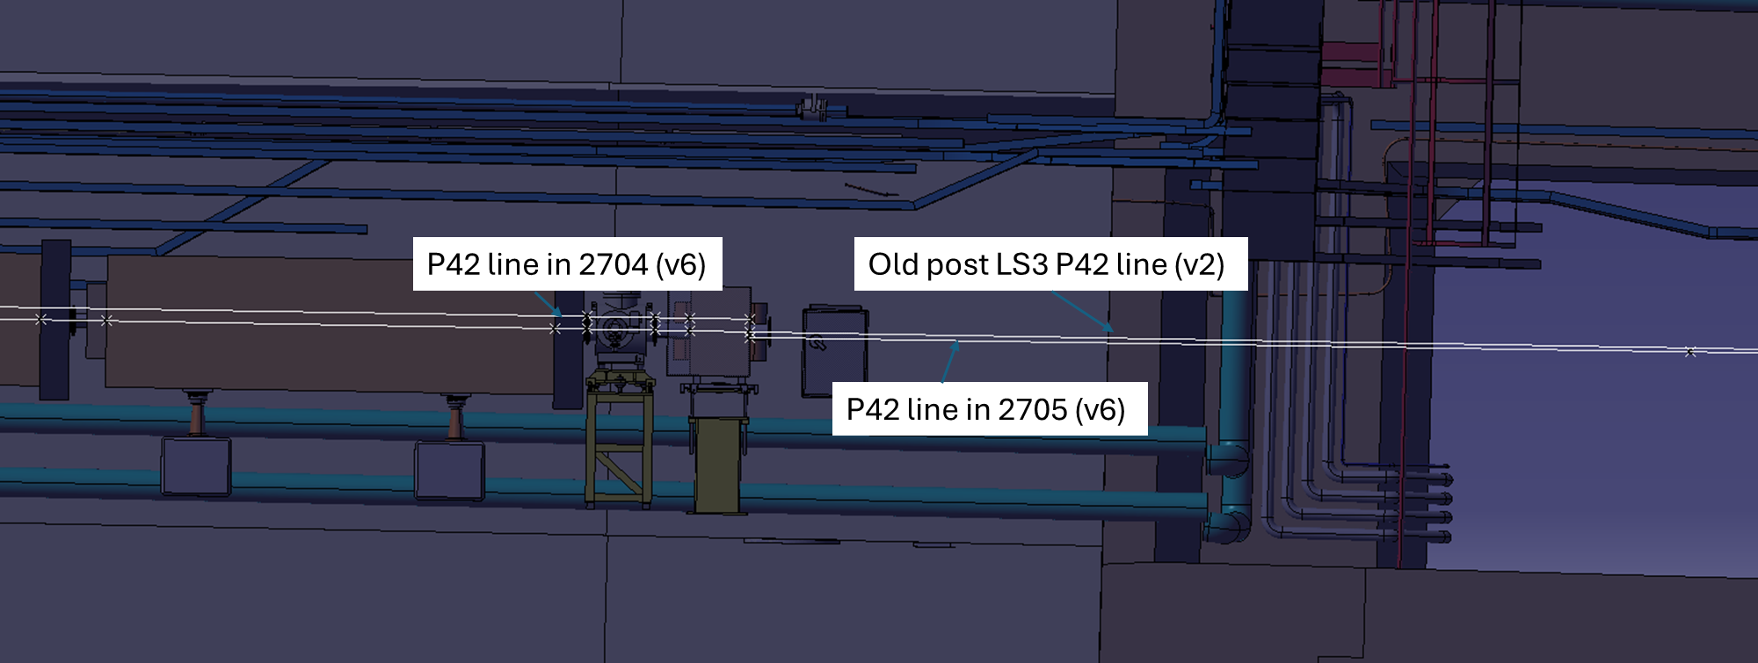
Division P42 beam line
The same point, after integrating together two part of the lines, it has an offset of 15cm.

Slide 4
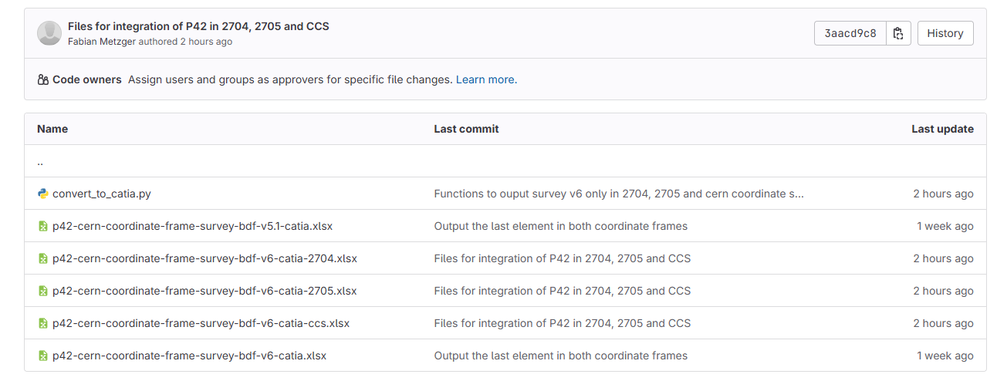
Division P42 beam line
Next steps:
Already in contact with Camille to check what is wrong.
Fabian provided the full beam line in CCS, 2704, 2705. I will check the transformation between them and report to Fabian and Camille.

Slide 5
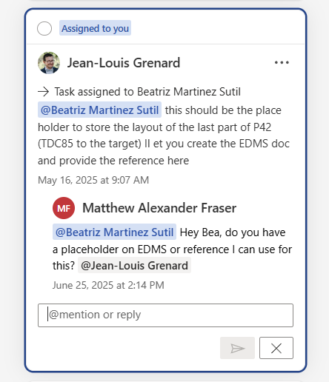
Division P42 beam line
EDMS for the drawing?
Link to the document

Slide 6
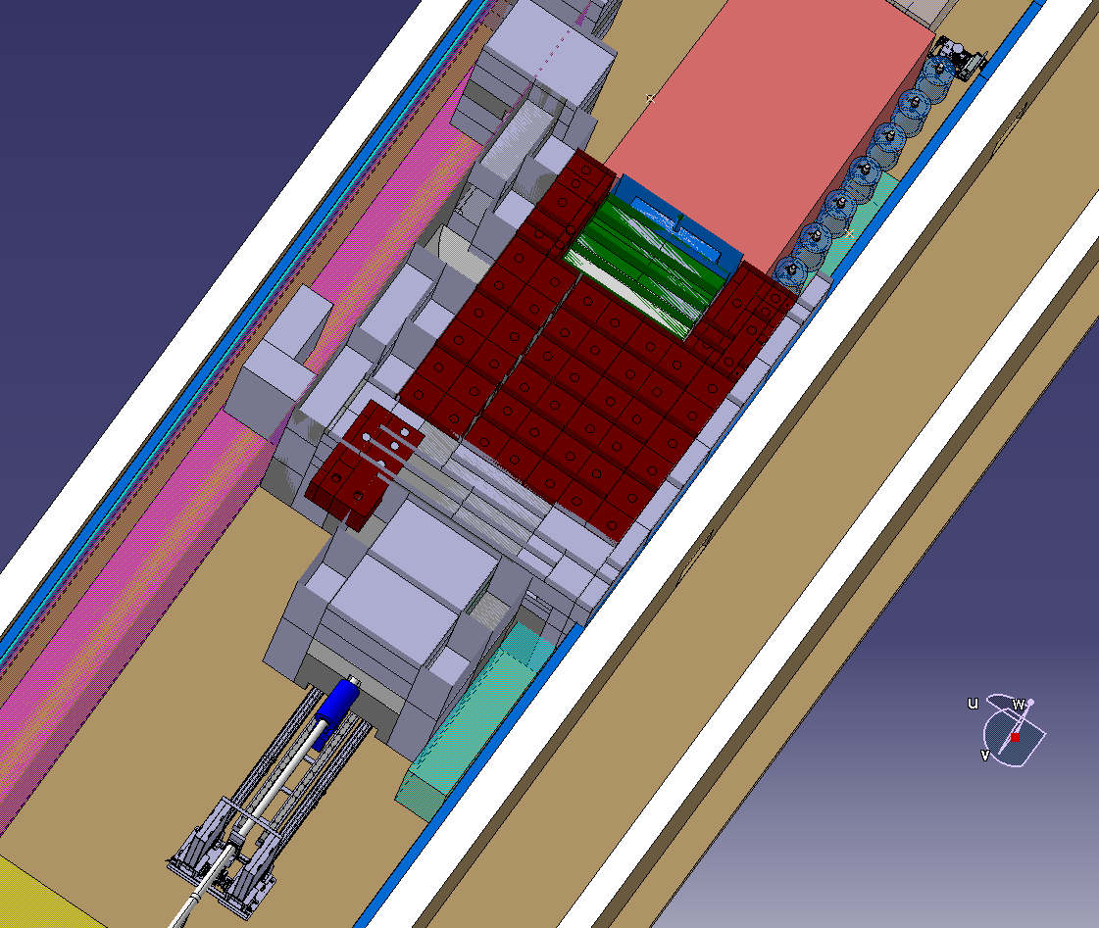
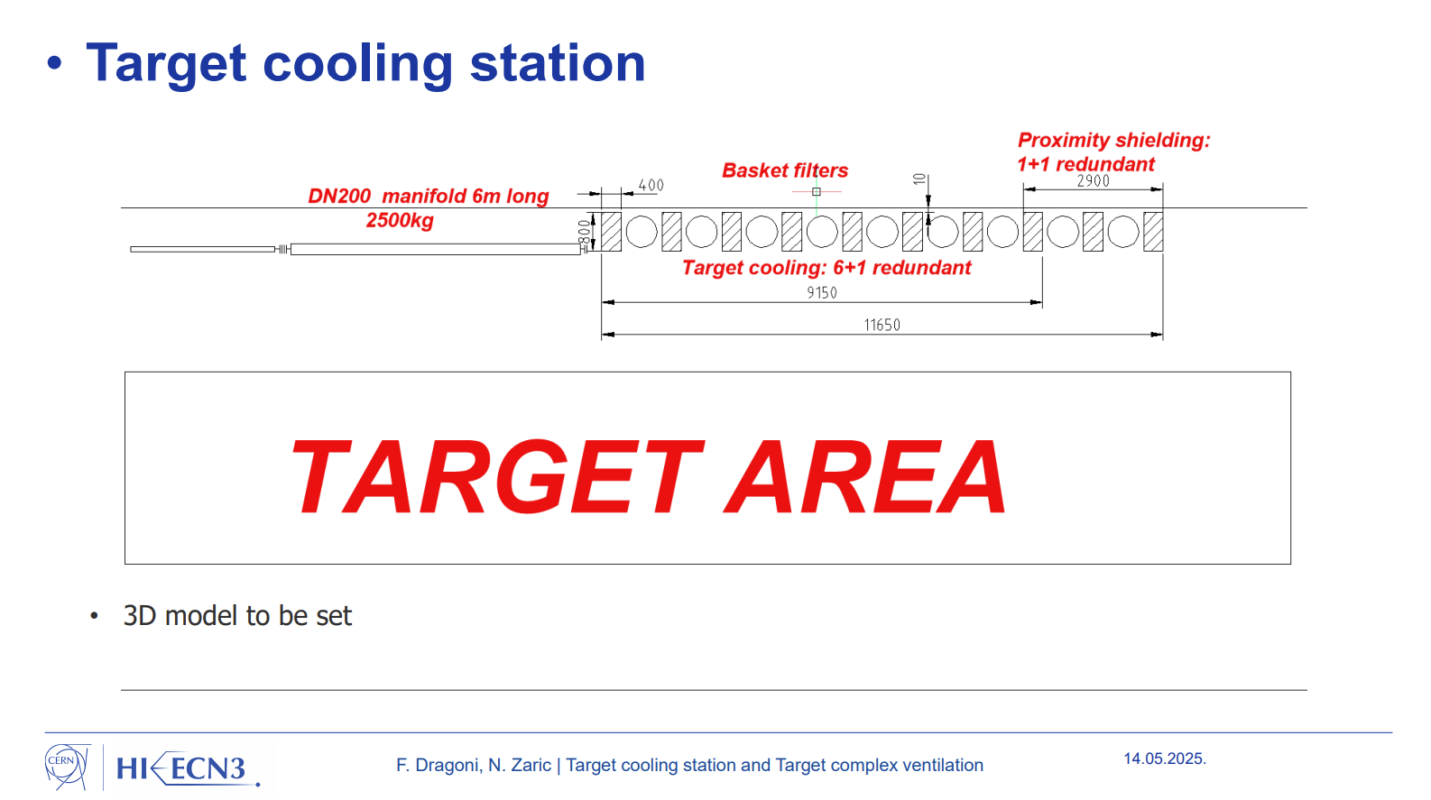
Space reservation CV
Action: Add the footprint of the cartridge and heat exchanger slide 6 18mx1mx1.6 that Nikola provided in the last WP4.
Location??

Slide 7
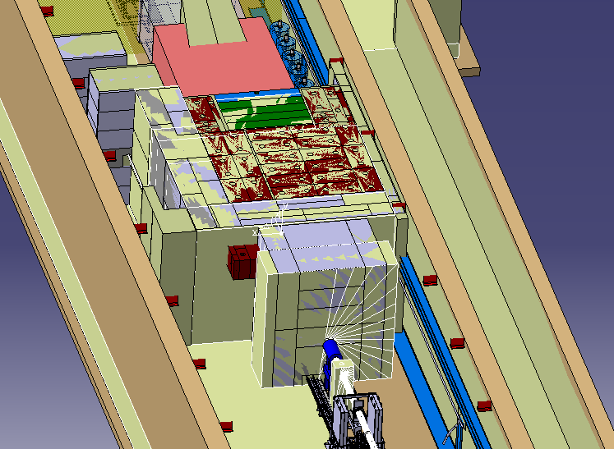
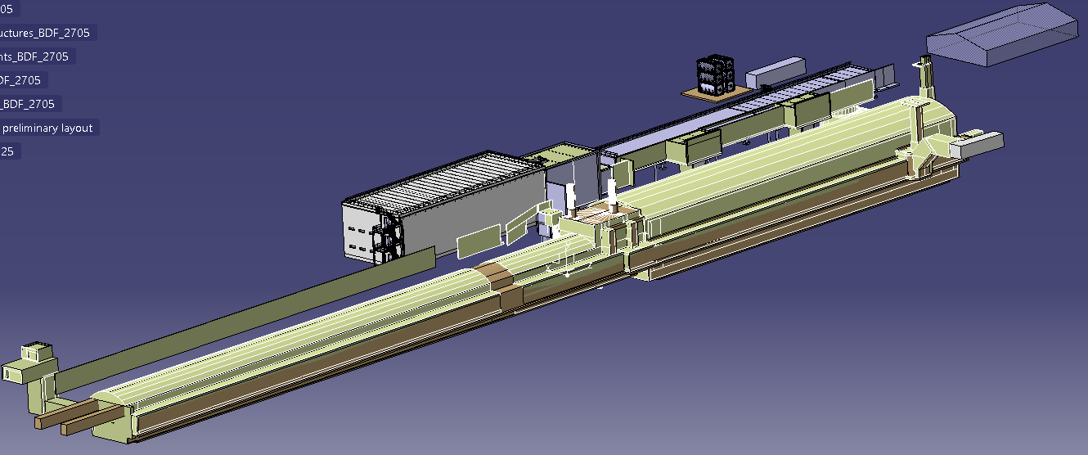
Fluka model
Create a study model superposing the fluka model and the integration model, situating the fluka model in its place
The product is in the HI-ECN3 integration CAD Team -> Fluka position can be changed by the CAD team users
ST1A49538_01

