Slide 1


Monte Carlo Modeling and Analysis of
Drell – Yan Events at LHC Energies
Using MadGraph
Thesis Defence
By:
Antonia Atanasova Kushleva
Faculty number: 8PH0760001
Sofia, September 2025

Slide 2
Contents:
- Introduction
- Overview of Standard Model Particles and High Energy Colliders
- Drell – Yan Processes
- Monte Carlo Simulations Of The Drell – Yan Process Using Generators MadGraph5 and PYTHIA8
- Invariant Mass Distributions in Drell–Yan
- Azimuthal Angle Difference ∆ϕ Between Muons
- Azimuthal Angle Difference ∆ϕ = ϕ(μ−) − ϕ(μ+)
- Dimuon pT vs. pz

Slide 3
Introduction
This thesis presents a Monte Carlo simulation and analysis of Drell – Yan (DY) processes (annihilation of quark and antiquark and decay into lepton-antilepton pair) in proton-
proton collisions using Monte Carlo generator MadGraph5. The study is focused on the production of muon anti-muon pairs. During DY quarks annihilate through the strong
interaction, while the lepton pair is created through the electroweak interaction-which
makes this process interesting to study.

Slide 4
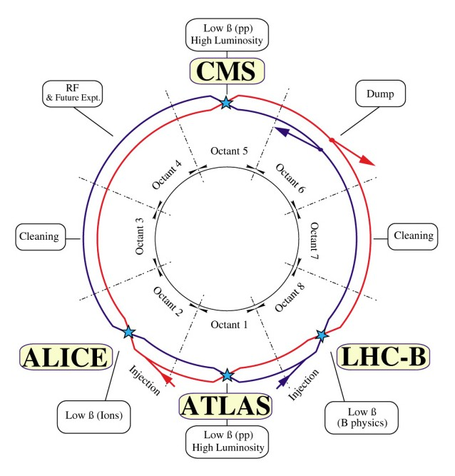
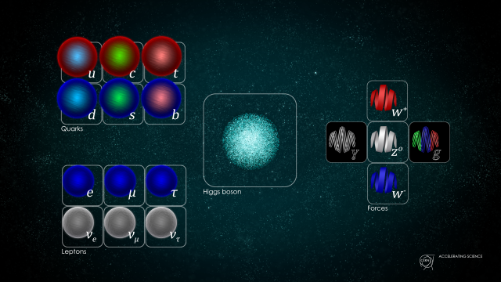
Overview of Standard Model Particles and High Energy Colliders
The particles of the Standard Model organized by type and interaction.
Schematic layout of the Large Hadron Collider (LHC) at CERN, showing its 27 – kilometer ring and the main experimental sites

Slide 5
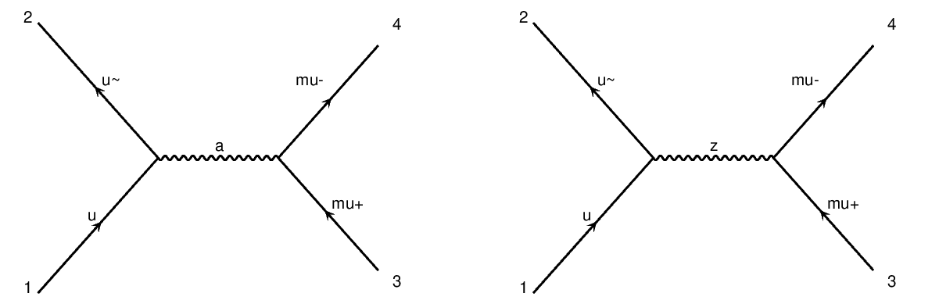
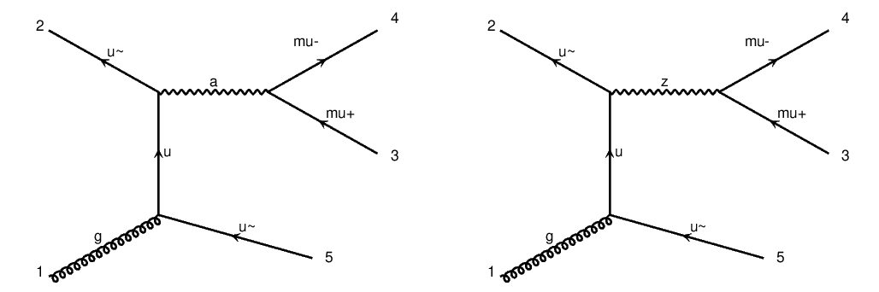
Drell – Yan Processes
The annihilation of a quark and an antiquark into a
photon, which subsequently decays into a muon-antimuon pair. The figure on right
shows the annihilation of a quark and an antiquark into a Z boson, which subsequently
decays into a muon-antimuon pair.
The annihilation of a quark and an antiquark into a virtual photon, which decays into a muon-antimuon pair as well as the creation of additional jets.Similarly, on the right we see the annihilation of a quark and an antiquark into a Z boson, which decays into a muon-antimuon pair and additional jets are created
again.

Slide 6
Monte Carlo Simulations Of The Drell – Yan Process Using Generators MadGraph5 and PYTHIA8
In this thesis, we use MadGraph5_aMC@NLO, version 2.9.21 (or simply MadGraph5), interfaced with PYTHIA8 to simulate the Drell–Yan process.
These two event generators work together to model proton–proton collisions, like those at the LHC, from the first interaction to the final observable particles.
MadGraph5 works at the parton level by modeling collisions between quarks inside protons. It generates events where a quark and an antiquark produce a virtual photon or Z boson, which then decays into a muon pair. It can also generate events with additional jets.
The output from MadGraph5 is saved as LHE files, which are then passed to PYTHIA8. PYTHIA8 simulates what happens after the initial collision: parton showers, hadronization (formation of hadrons from quarks and gluons), and particle decays. This produces fully simulated events like those seen in experiments.

Slide 7
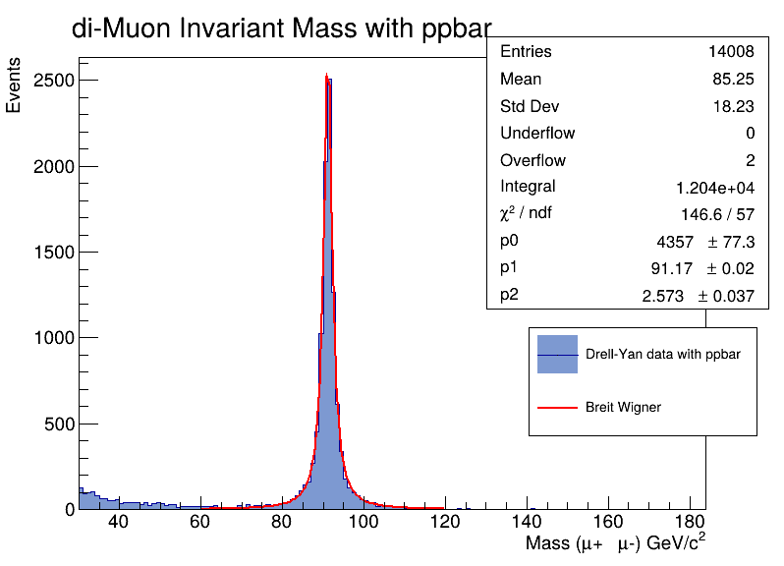
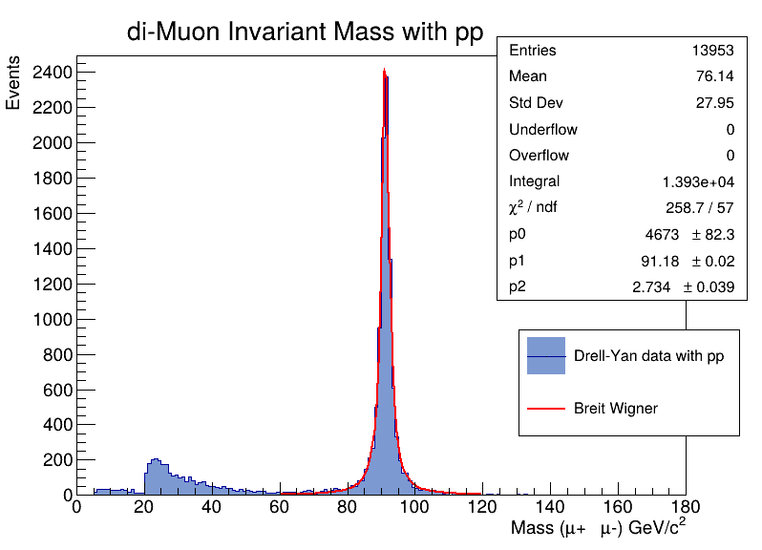
Invariant Mass Distributions in Drell–Yan

Slide 8
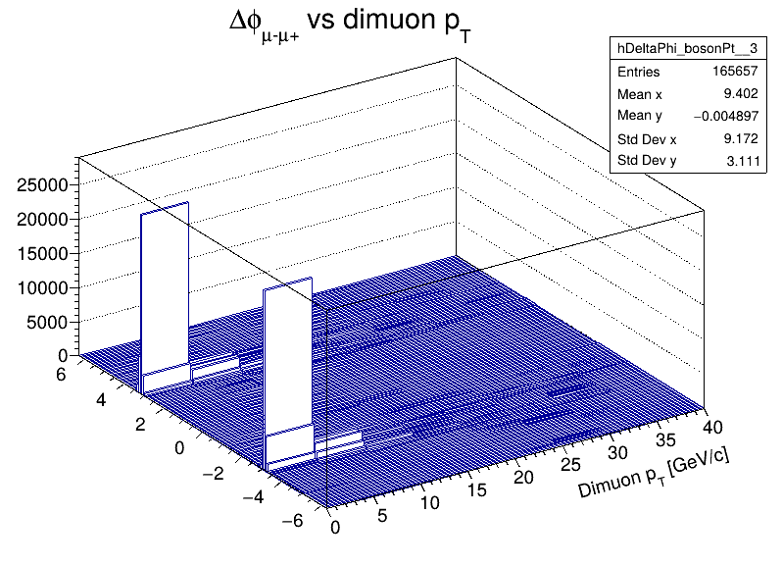
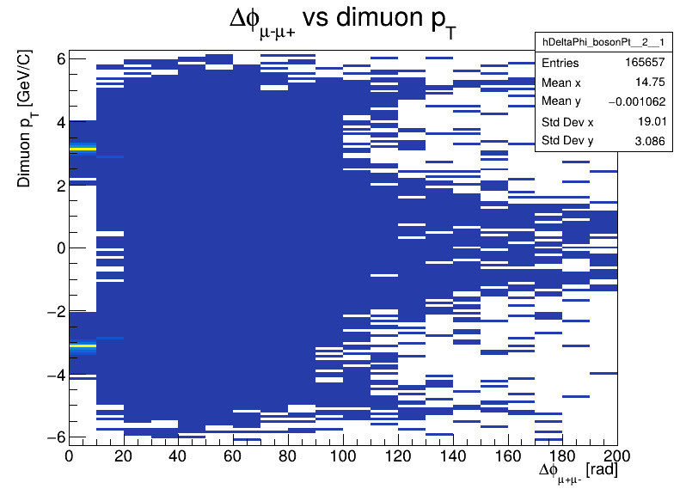
Azimuthal Angle Difference ∆ϕ Between Muons

Slide 9
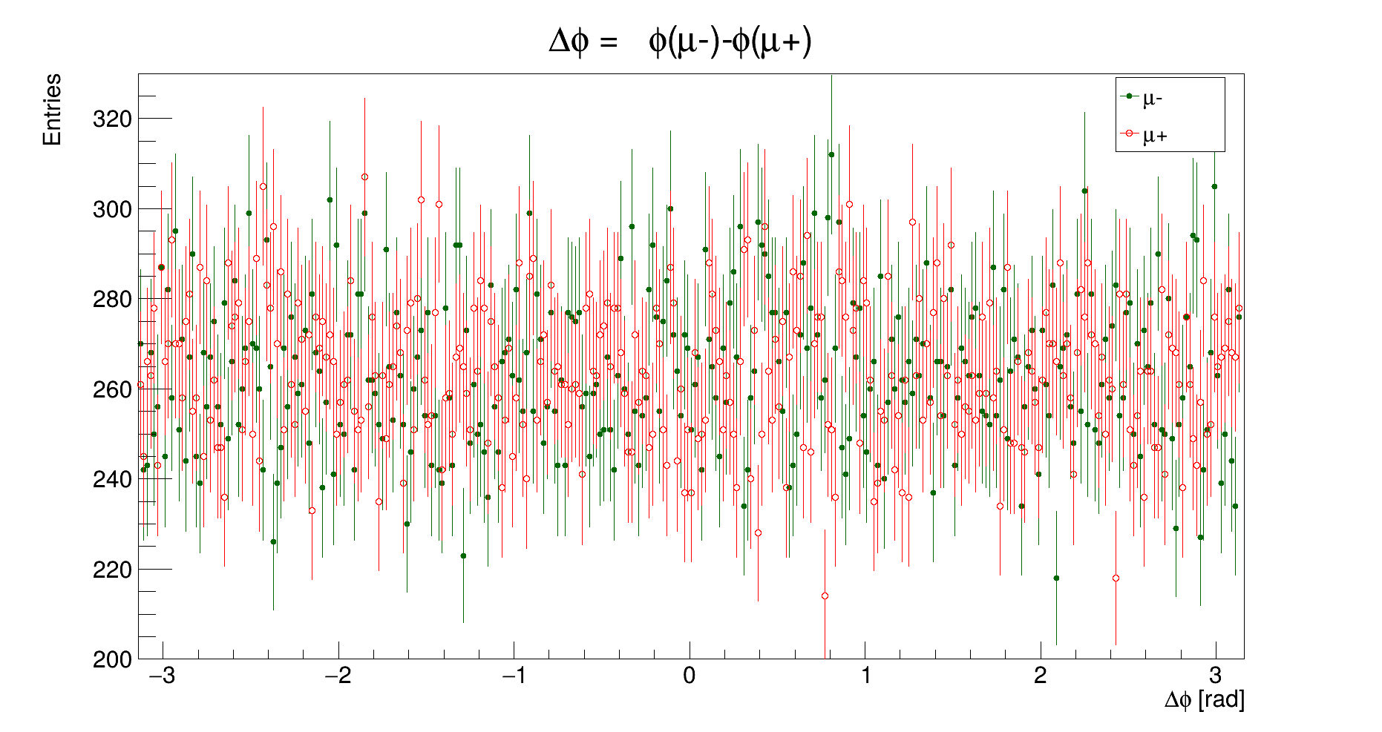
Azimuthal Angle Difference ∆ϕ = ϕ(μ−) − ϕ(μ+)

Slide 10
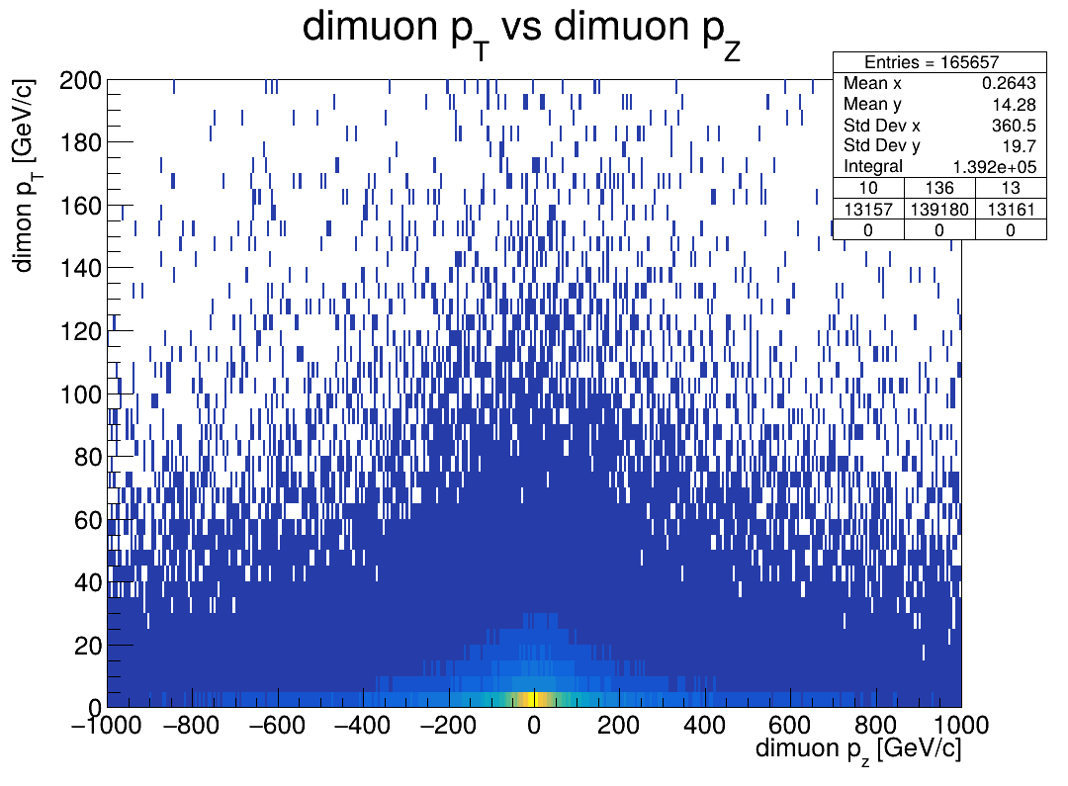
Dimuon pT vs. pz

Slide 11
Conclusion:
Monte Carlo simulations are a powerful tool for connecting theoretical models with experimental results in high-energy physics. By using Monte Carlo generators, such as MadGraph5 and PYTHIA8, we can model the Drell – Yan process, which is commonly observed in high energy physics. These simulations help us better understand particle interactions and study further the Standard Model.

Slide 12
Thank you for the attention!

