Slide 1
HL-LHC Signal Cabling
Patch Panel Study
Status #1
D. Gameiro (EN-EL-CS), G. Girardot (EN-EL-CS)
Thanks to R. Roche (EN-EL-DDO)
2025-06-20
EDMS 3313572
Indico 1560547

Slide 2
Contents
Patch-Suitable Cables & Patching Solution
Design & Integration
  UAs
  ULs
Next Actions on Preliminary Study
Roadmap

Slide 3


Patch-Suitable Cables & Patching Solution
Group | Total No. of Cables | No. of Patchable Cables | Proposed Patching Solution
BE-CEM | 4 (0.1%) | 4 | FIP box
BE-GM | 576 (16.0%) | 370 | Burndy
EN-AA | 8 (0.2%) | 0 | –
EP-CMT | 32 (0.9%) | 16 | Burndy
SY-BI / SY-RF | 552 (15.4%) | 0⁽¹⁾ | –
TE-CRG | 908 (25.3%) | 388 | Burndy (228) Harting (standard & H-EMC) (144) BNC-50 (16)
TE-MPE | 444 (12.3%) | 278 | Resin junction (38) PCB based OR Harting ⁽²⁾ (240)
TE-VSC | 1070 (29.8%) | 1062 | Burndy (540) Harting (4) BNC-50 (4) FIP box (8) Special crates (506)
Total | 3594 | 2118 (59%) | –
⁽¹⁾Cables disregarded for technical reasons.
⁽²⁾ Discussions on-going with WP07 to evaluate feasibility of Harting versus PCB system solutions.

Slide 4
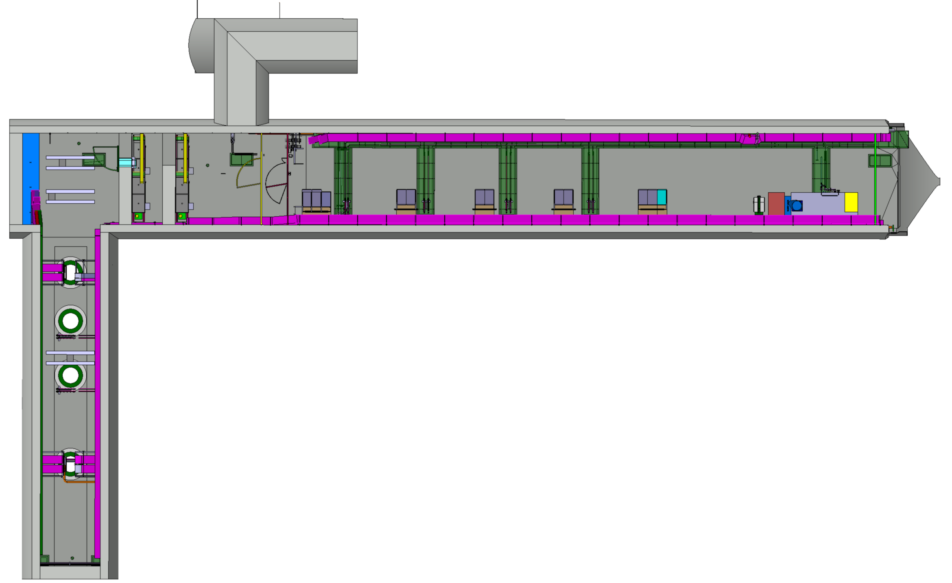
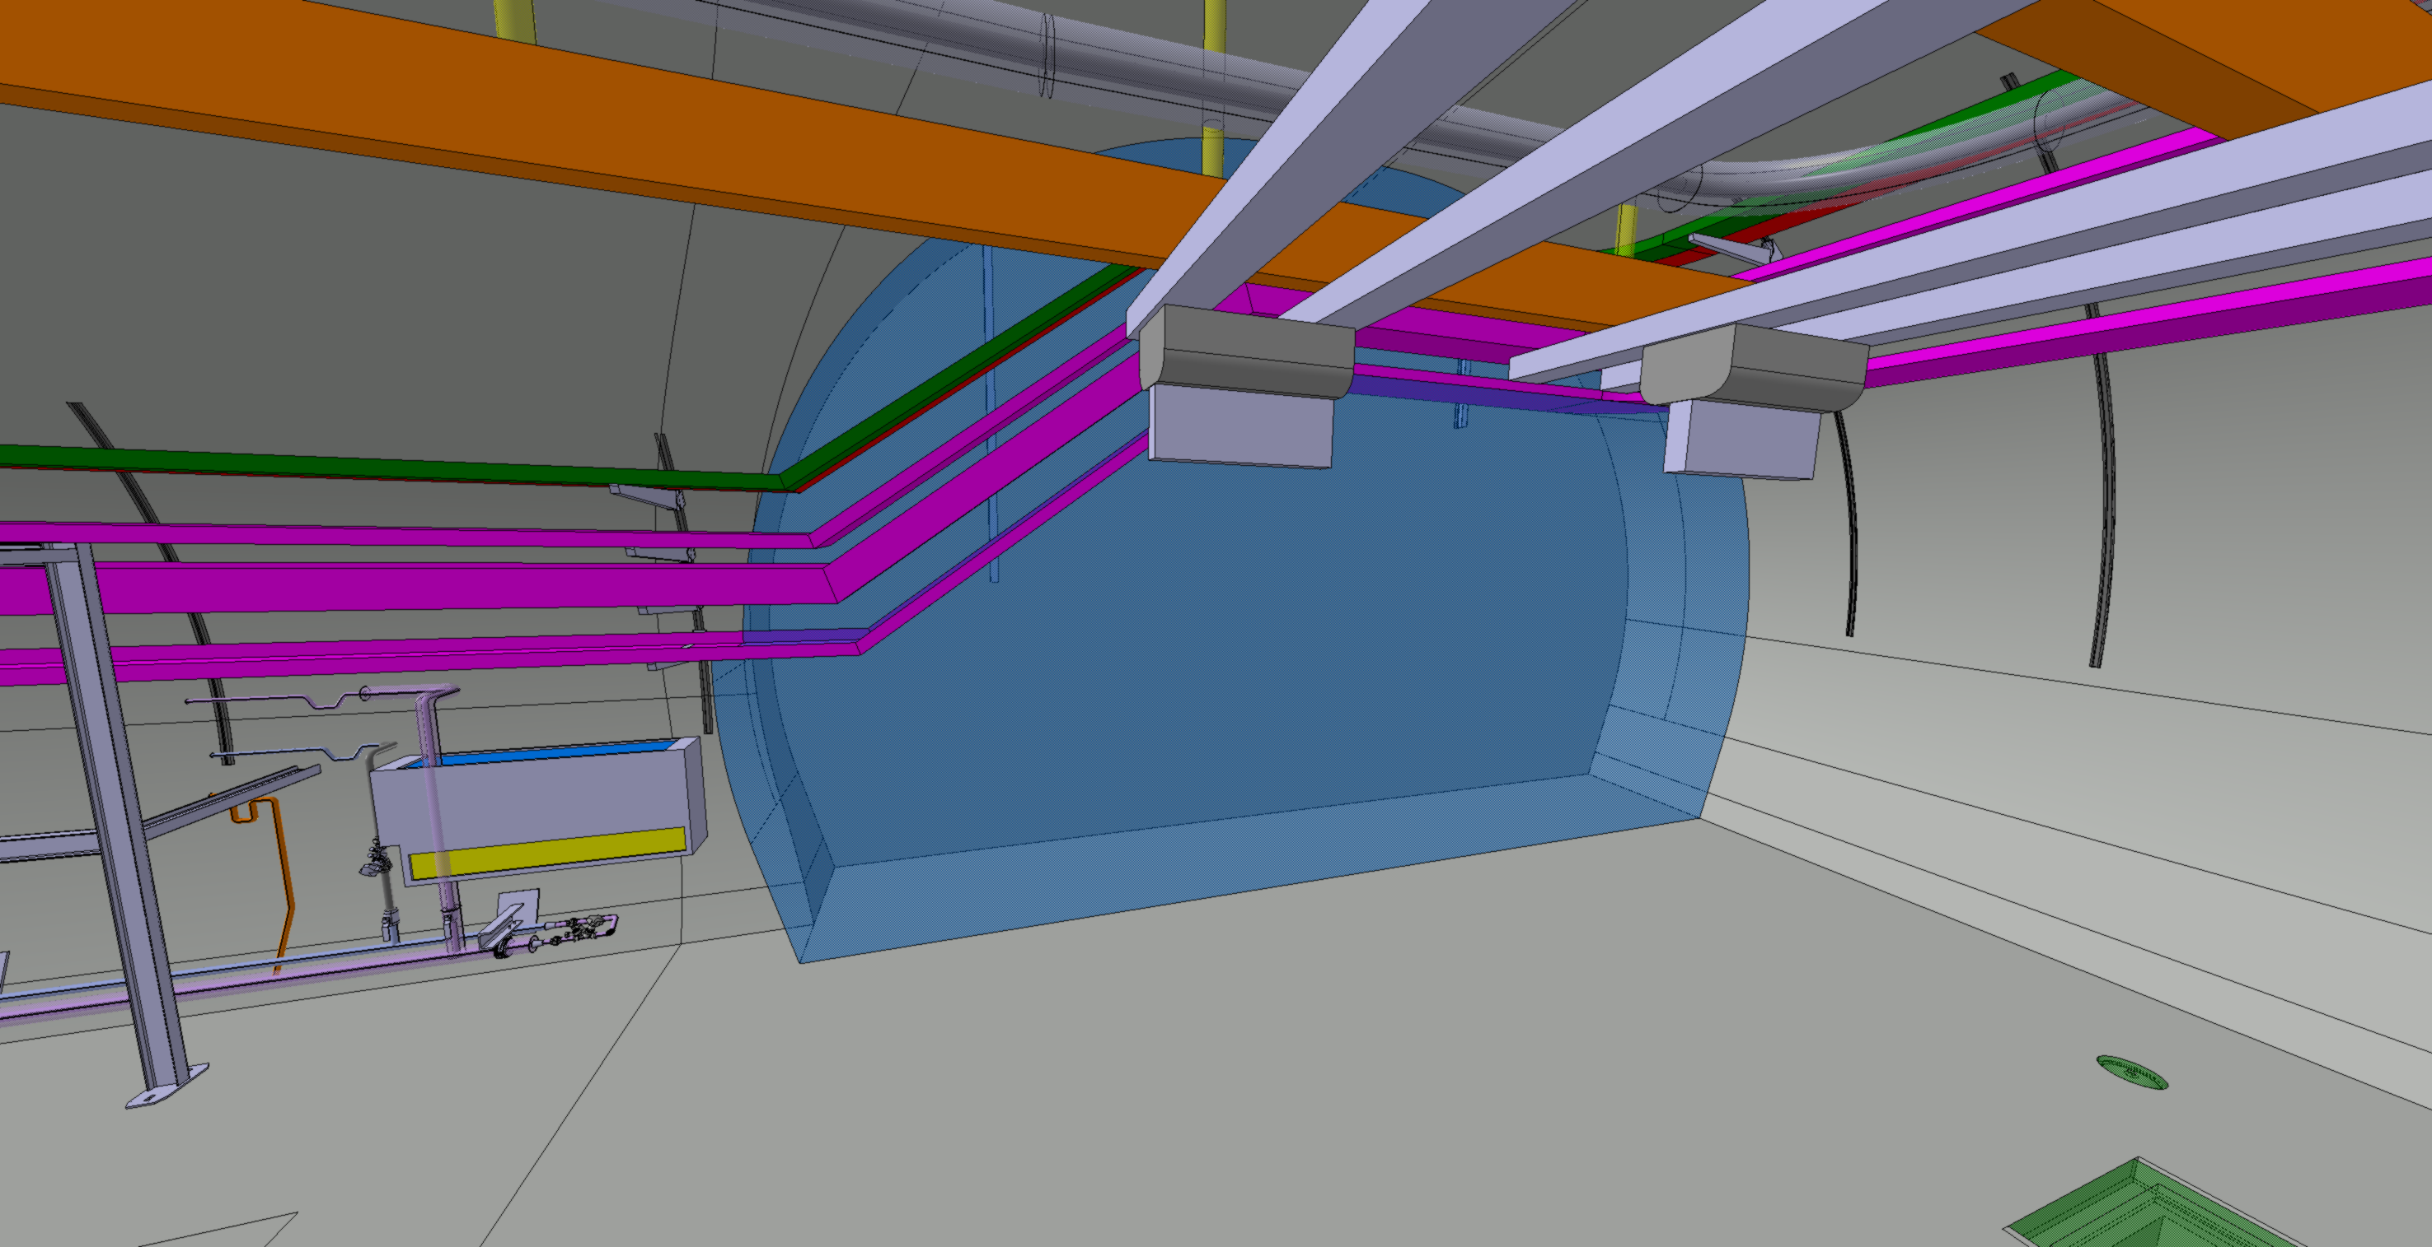
Design & Integration – UAs
Study on-going for worst-case UA – UA53 (246 cables).
Volume available for 2 standard LHC 45U 19” racks.
Patch panels with standard 19” width to be installed in the centre support frame parallelly to rack doors plane.
Resin-junctions attached to the wall / on Cablofil.
1 rack exclusively for TE-VSC with total allocation of 43U:
  Patch panel – 13U.
  Special crates 19” – 30U.
1 rack for all other groups with total allocation of 18U:
  BE-GM – 7U.
  EP-CMT – 3U.
  TE-CRG – 8U.

Slide 5
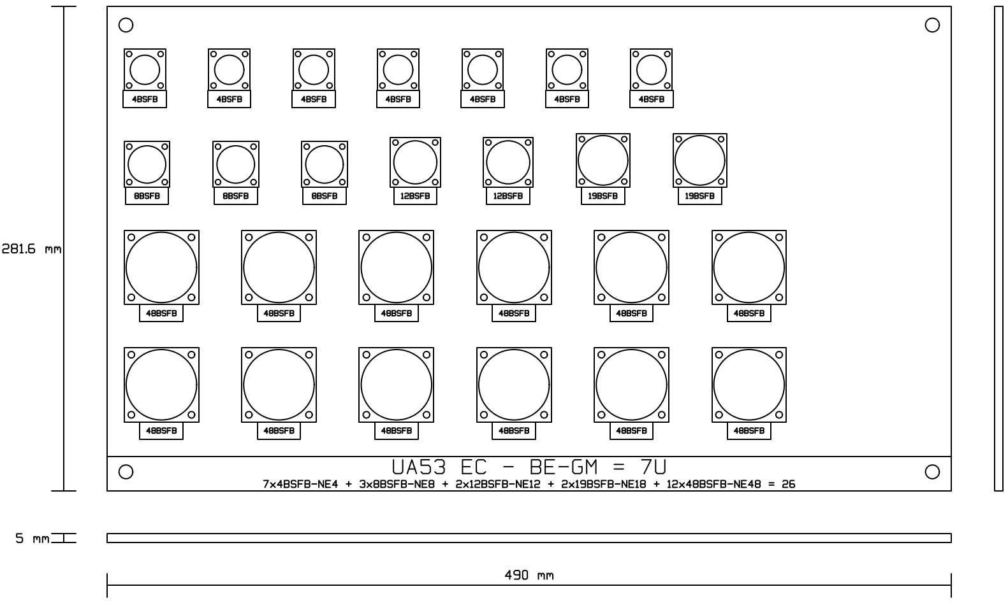

Slide 6
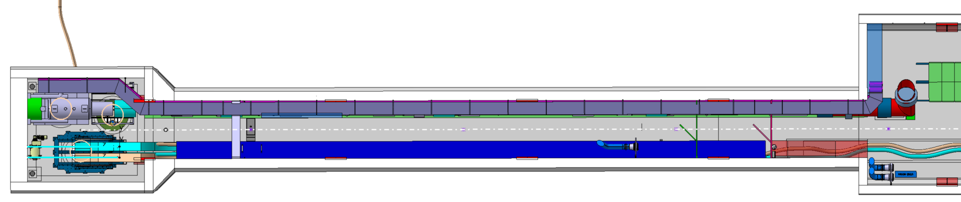
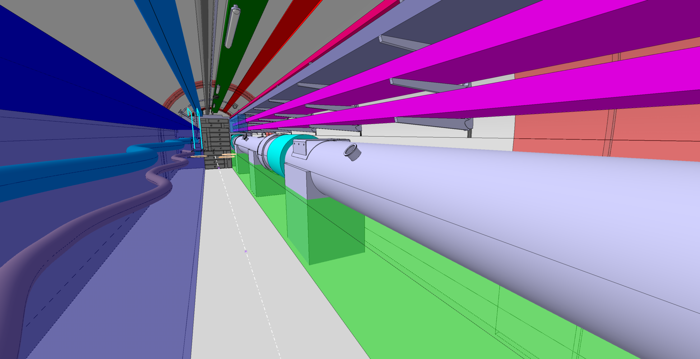
Design & Integration – ULs
Study on-going for worst-case UL – UL13 (253 cables).
Volume available longitudinally under QXL with cross-section area of 850mm x 600mm, in length sections of 3m~4m (between supports).
Patch panels to be supported in vertical rails fixed to the floor and/or wall with normal orientation collinear with QXL longitudinal direction. First approach to constraint maximum 1 patch panel every 1m longitudinal.
Individual patch panels per Group and system*.
FIP boxes and resin-junctions attached to the wall / to cable tray.
Preliminary study shows no evidence of integration blocking point.
*Systems impacted:
EC – “normal” signal cables.
ECP – potential EMC-offender cables.

Slide 7
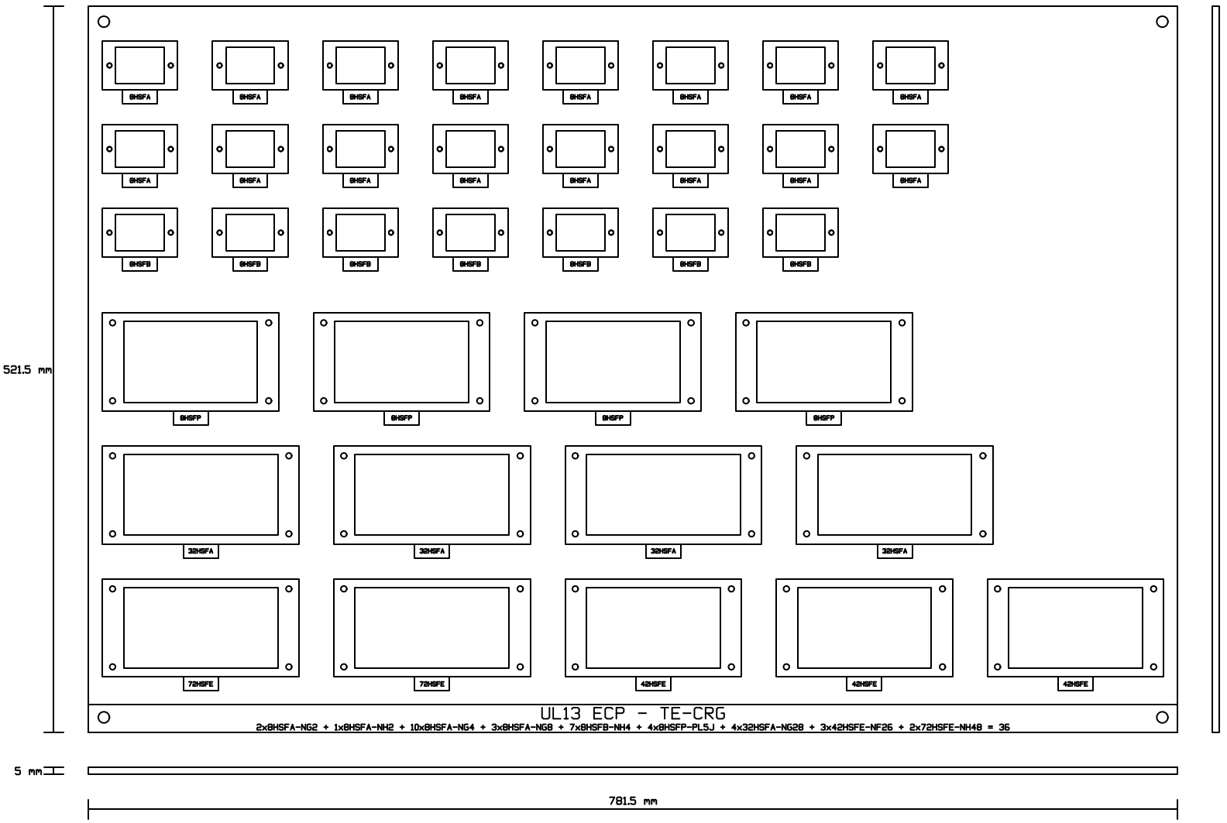

Slide 8
Next Actions on Preliminary Study
Further discussion with Groups on connector datasheet validation, assembly procedure definition and validation, grounding requirements, and other technical specifications.
Design finalization (with production of all CAD drawings).
3D integration.
EMC study and pre-validation (support from CERN EMC Working Group).
Cost and schedule analysis.
Representative prototype(s) production and validation.
Submission of draft Technical Specification for Groups and WP15 validation.

Slide 9
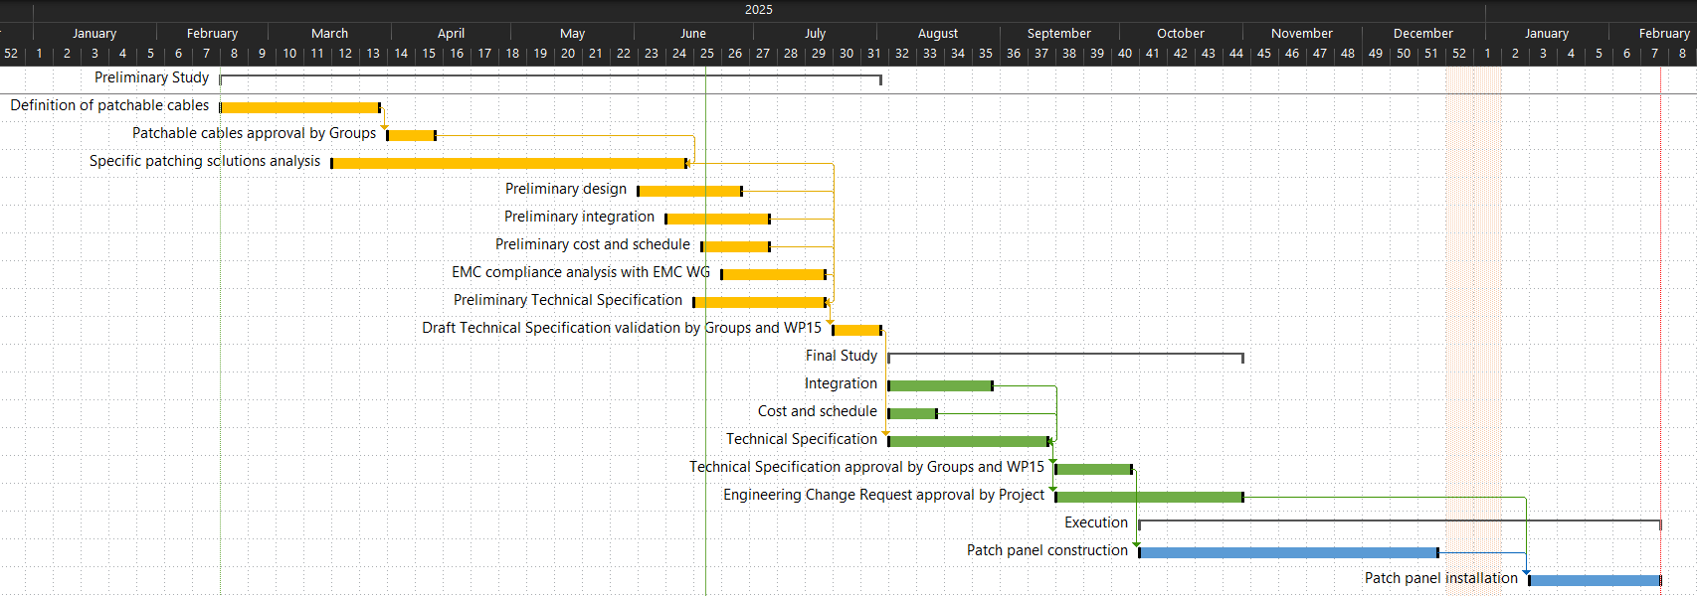
Roadmap

Slide 11
Backup Content

Slide 12
