Slide 1

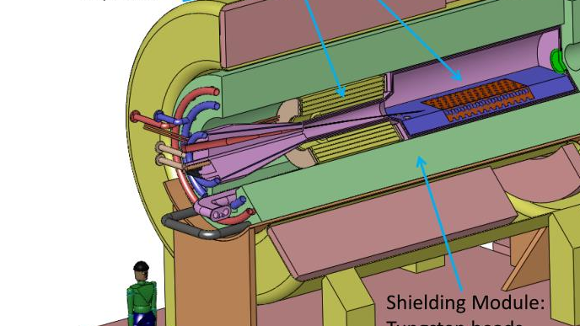
Target Studies for Muon Production
6/18/2025
Ruaa

Slide 2
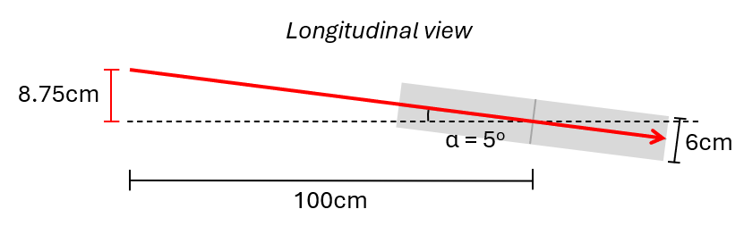
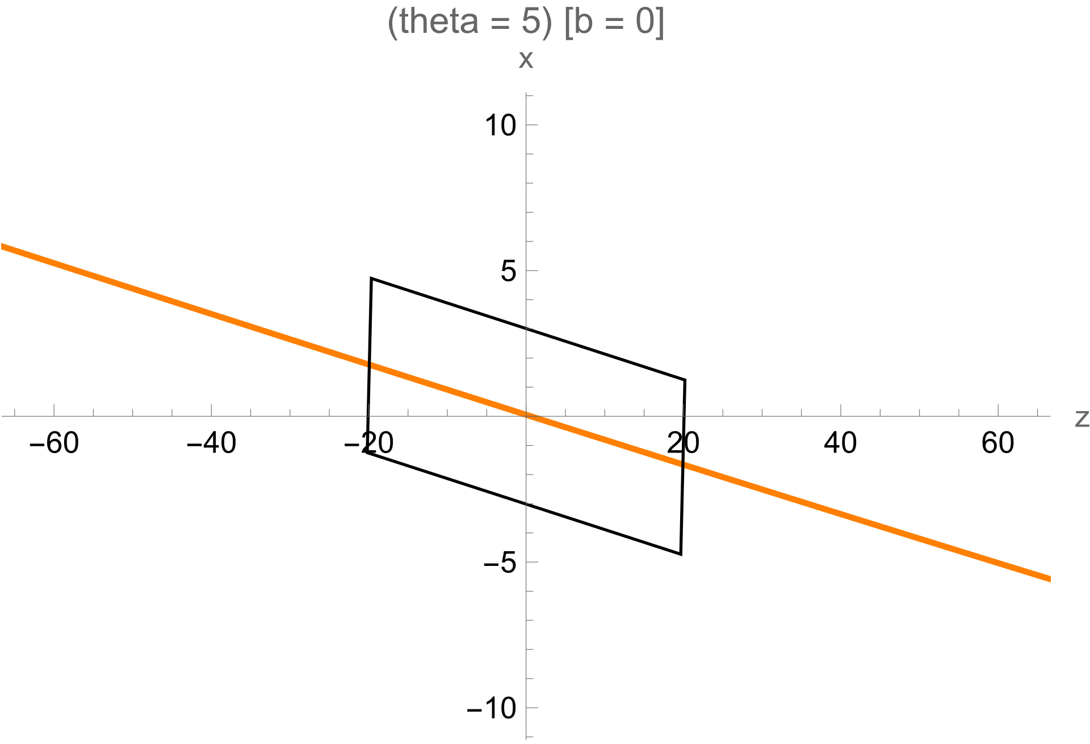
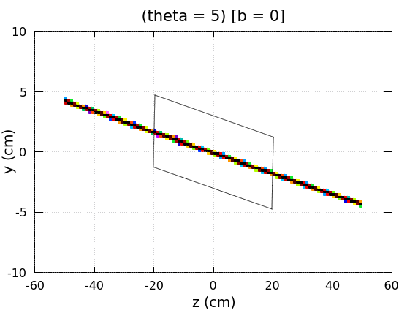
Beam Trajectory
Comparison between the analytical solution and the plot generated by Fluka for β = 0
Plot trajectories for a proton beam in a uniform 5T field.
Position of source: (x, y) = (8.75, 0), assume cylindrical symmetry. The x-coordinate was determined by trigonometry.
The diagram shows the beam trajectory for (α, β) = (5, β)
Here, the parameter β is adjustable.

Slide 3
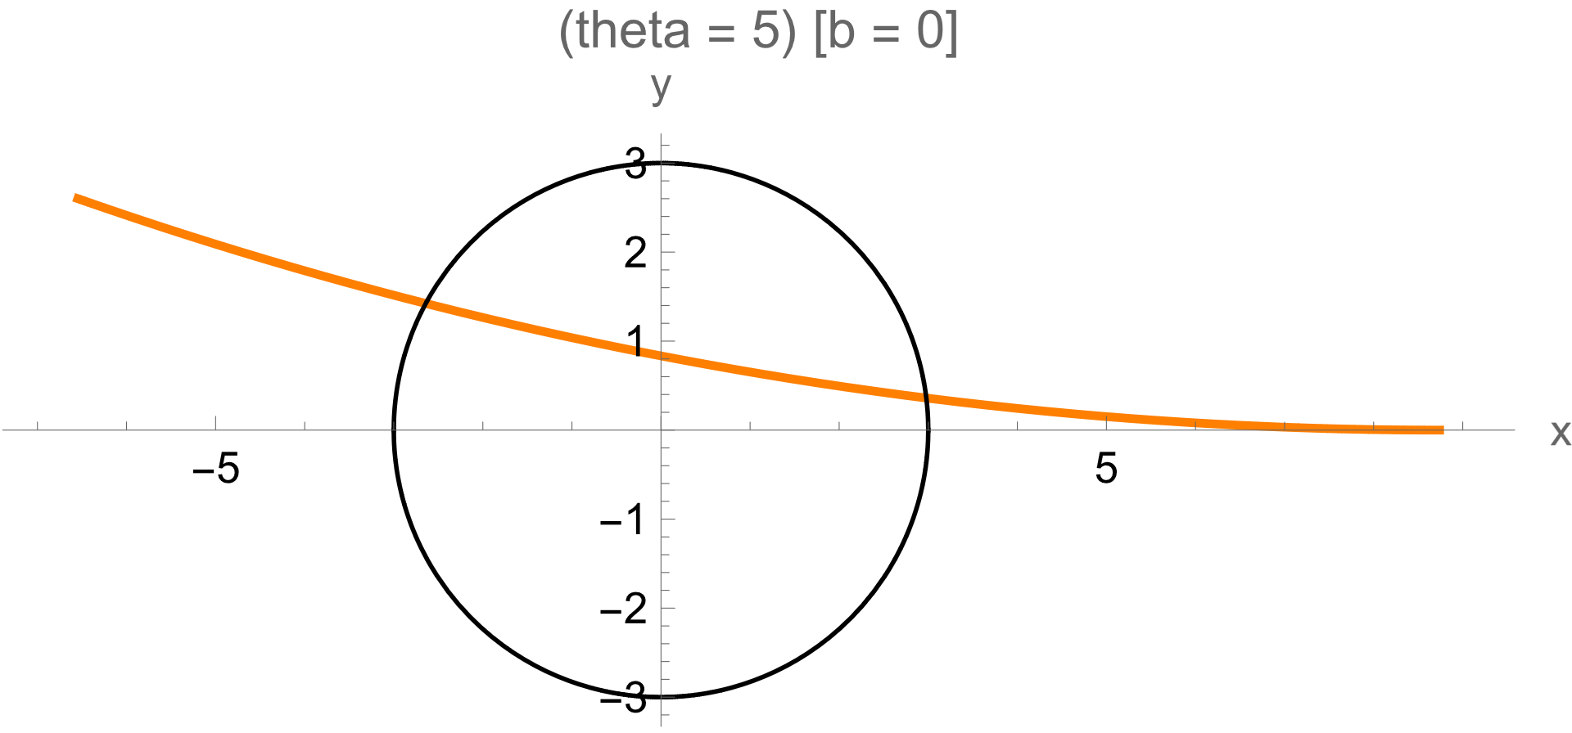
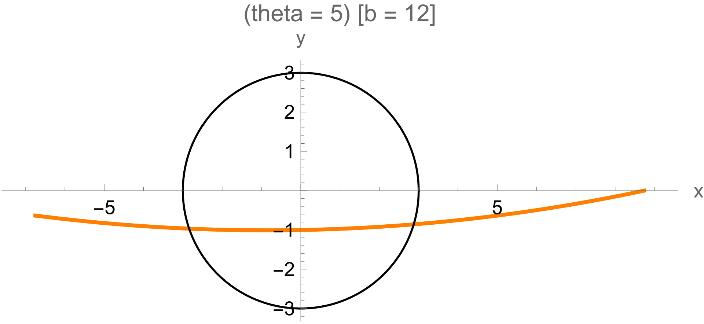
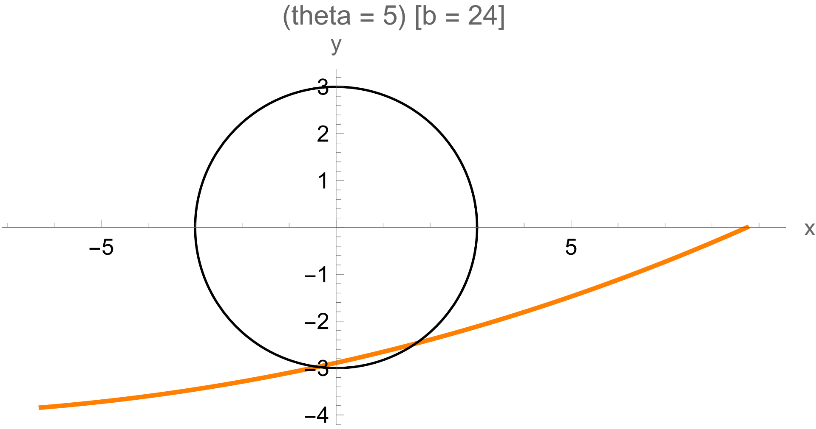
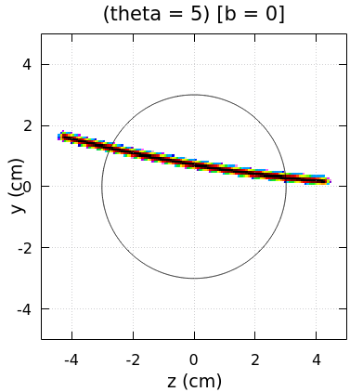
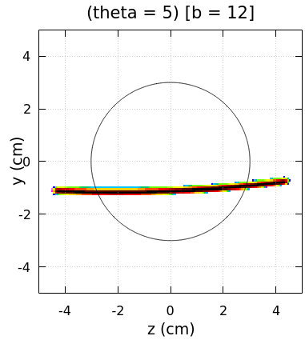
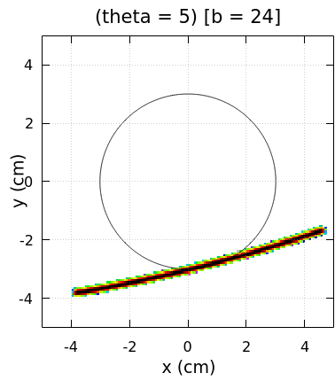
Beam Trajectory
Here I compare the beam trajectories of the analytical solution and the plots generated by Fluka for various values of β.

Slide 4
Improvements and next steps
I was able to compile the user-routine written by Daniele but couldn’t compile the one written by Alajos. I have emailed Alajos about this.
I am still working on applying the magnetic field profile of a solenoid into my setup. The new version of Fluka has feature that allows the implementation of analytical expressions of B-field.
Reading (H. Wiedemann – Particle Accelerator Physics):
- Chapters: 5.1 and 5.2

