Slide 1
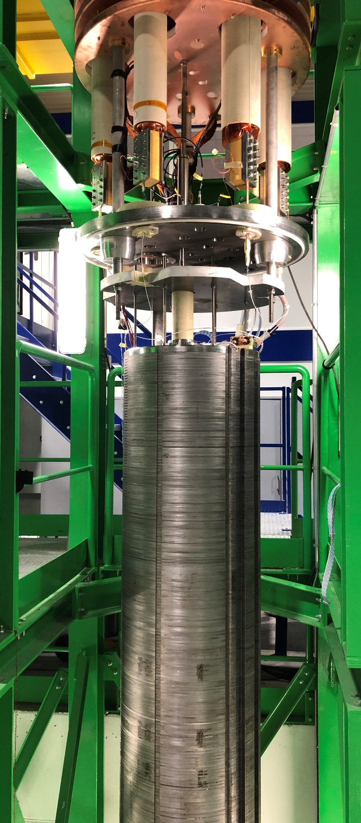
MCBRD05, MCBRD06, and MCBRD07 Test Results
Vincenzo Di Capua, Gerard Willering, Franco J. Mangiarotti, Jerome Feuvrier, Michael S. Boczan, Jean Luc Guyon
WP3 meeting, 25-06-2025

Slide 2
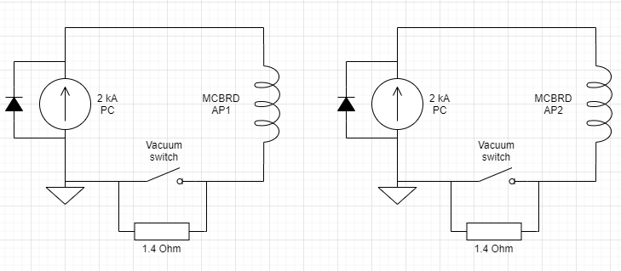
Magnet setup and conventions
From the connection side, with the leads at the top we consider:
  AP2 is on the left and AP1 on the right.
  AP1 has vertical magnetic field (MCBRD.H circuit in the D2 cryo-assembly) horizontal bending, and AP2 has horizontal magnetic field (MCBRD.V circuit) vertical bending.
Cold powering parameters: |  | 1.9 K
Nominal Current | A | 393
Ultimate current | A | 422
Short sample limit | A | ~800
Nominal ramp rate | A/s | 2
Baseline protection | Dump: 1.4 Ohm Crowbar: 7 mOhm

Slide 3
Magnets coils and voltage taps
MCBRD05:
6 voltage taps present per aperture.
Previous version included a current lead/voltage tap in the middle for CLIQ (identified as VCL)
Not installed for MCBRD05-06-07
A total of 12 voltage tap is present
Coil | Between voltage taps | Aperture
MCBRD_CB18 | EE12-EE17 | 1
MCBRD_CB19 | EE22-EE27 | 2
MCBRD06:
Coil | Between voltage taps | Aperture
MCBRD_CB14 | EE12-EE17 | 1
MCBRD_CB21 | EE22-EE27 | 2
MCBRD07:
Coil | Between voltage taps | Aperture
MCBRD_CB20 | EE12-EE17 | 1
MCBRD_CB23 | EE22-EE27 | 2

Slide 4
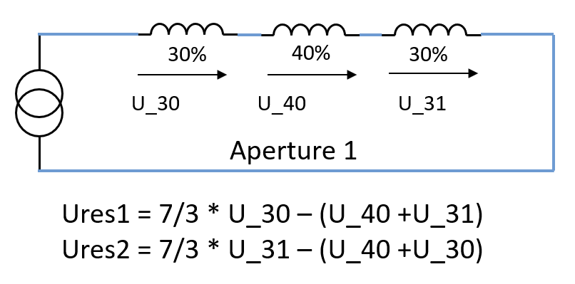
Protection scheme with UQDS
12 voltage channels, no current channels.
Only one threshold-discrimination time pair to apply to all 4 comparisons.
7/3 multiplying factor, hardwired in firmware.
Threshold on Ures is 50 mV for 10 ms (1 us granularity).
Threshold on splices 10 mV for 8 ms.
Same protection scheme adopted for horizontal tests and as during HL-LHC operations.
Quenching element | Effective tresholds T=50mV | Effective tresholds (mV)
U30, U31 | T * 3/7 | 21
U40 | T | 50
U30 & U31 | T * 3/4 | 37.5
U30 & U40 | T / 2 | 25
U31 & U40 | T / 2 | 25
U30 & U31 & U40 | T * 3 | 150

Slide 5
Timeline
From 05-02-2025 To 07-03-2025
From 08-05-2025 To 15-05-2025
MCBRD05
MCBRD06
MCBRD07
From 17-03-2025 To 28-03-2025

Slide 6
Test Plan
Temp | Test type | CD1 | CD 2
1.9 K | Electrical insulation test | 1620 V | 1620 V
 | Training | 422 A | 422 A
 | Combined powering, diagonal | 422 A, ++; --; +-; -+, 5 min | 422 A, ++; --; +-; -+, 5 min
 | Combined powering and holding current diagonal | 422 A, ++; --; +-; -+, 3.5 h | 422 A, ++; --; +-; -+, 3.5 h
 | Combined powering, operation range | i.e. Perimeter | i.e. Perimeter
 | Holding current | 393 A, ++, 20 h | 393 A, ++, 20 h
 | Magnetic measurements | +- 393 A (see next talk from L. Fiscarelli ) | -
 | Splices measurements | Staircase -422 A to 422A | -
 | RRR | 50 mA DC current | 50 mA DC current
4.5 K only for MCBRD06 | Training verification | 422 A | 422 A
Test plan in EDMS: https://edms.cern.ch/document/2745015/4.0
MCBRD05 in EMDS: https://edms.cern.ch/document/3282742
MCBRD06 in EDMS: https://edms.cern.ch/document/3263622
MCBRD07 in EDMS: https://edms.cern.ch/document/3303034

Slide 7
Electrical insulation test
Electrical insulation tests performed with Megger.
5 equidistant steps up to the maximum test voltage.
Passed = resistance between aperture coil and ground >10 GΩ at maximum test voltage.
Condition | Voltage (V) | MCBRD05 | MCBRD06 | MCBRD07
CD1 at 1.9 K before powering | 1620 | passed | passed | passed
CD1 at 1.9 K after powering | 1620 | passed | passed | passed
CD2 at 1.9 K before powering | 1620 | - | passed | passed
CD2 at 1.9 K after powering | 1620 | - | passed | passed
CD3 at 1.9 K before powering | 1620 | - | passed | -
CD3 at 1.9 K after powering | 1620 | - | Not perf | -

Slide 8
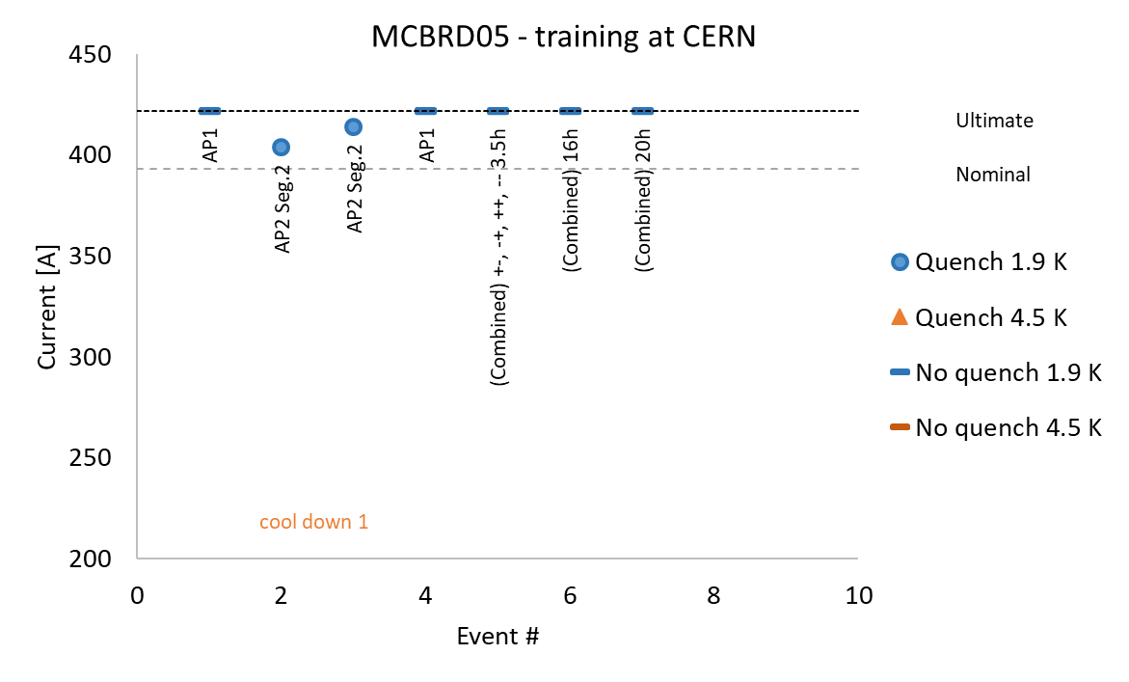
Training
Acceptance criteria: https://edms.cern.ch/document/2051870

Slide 9
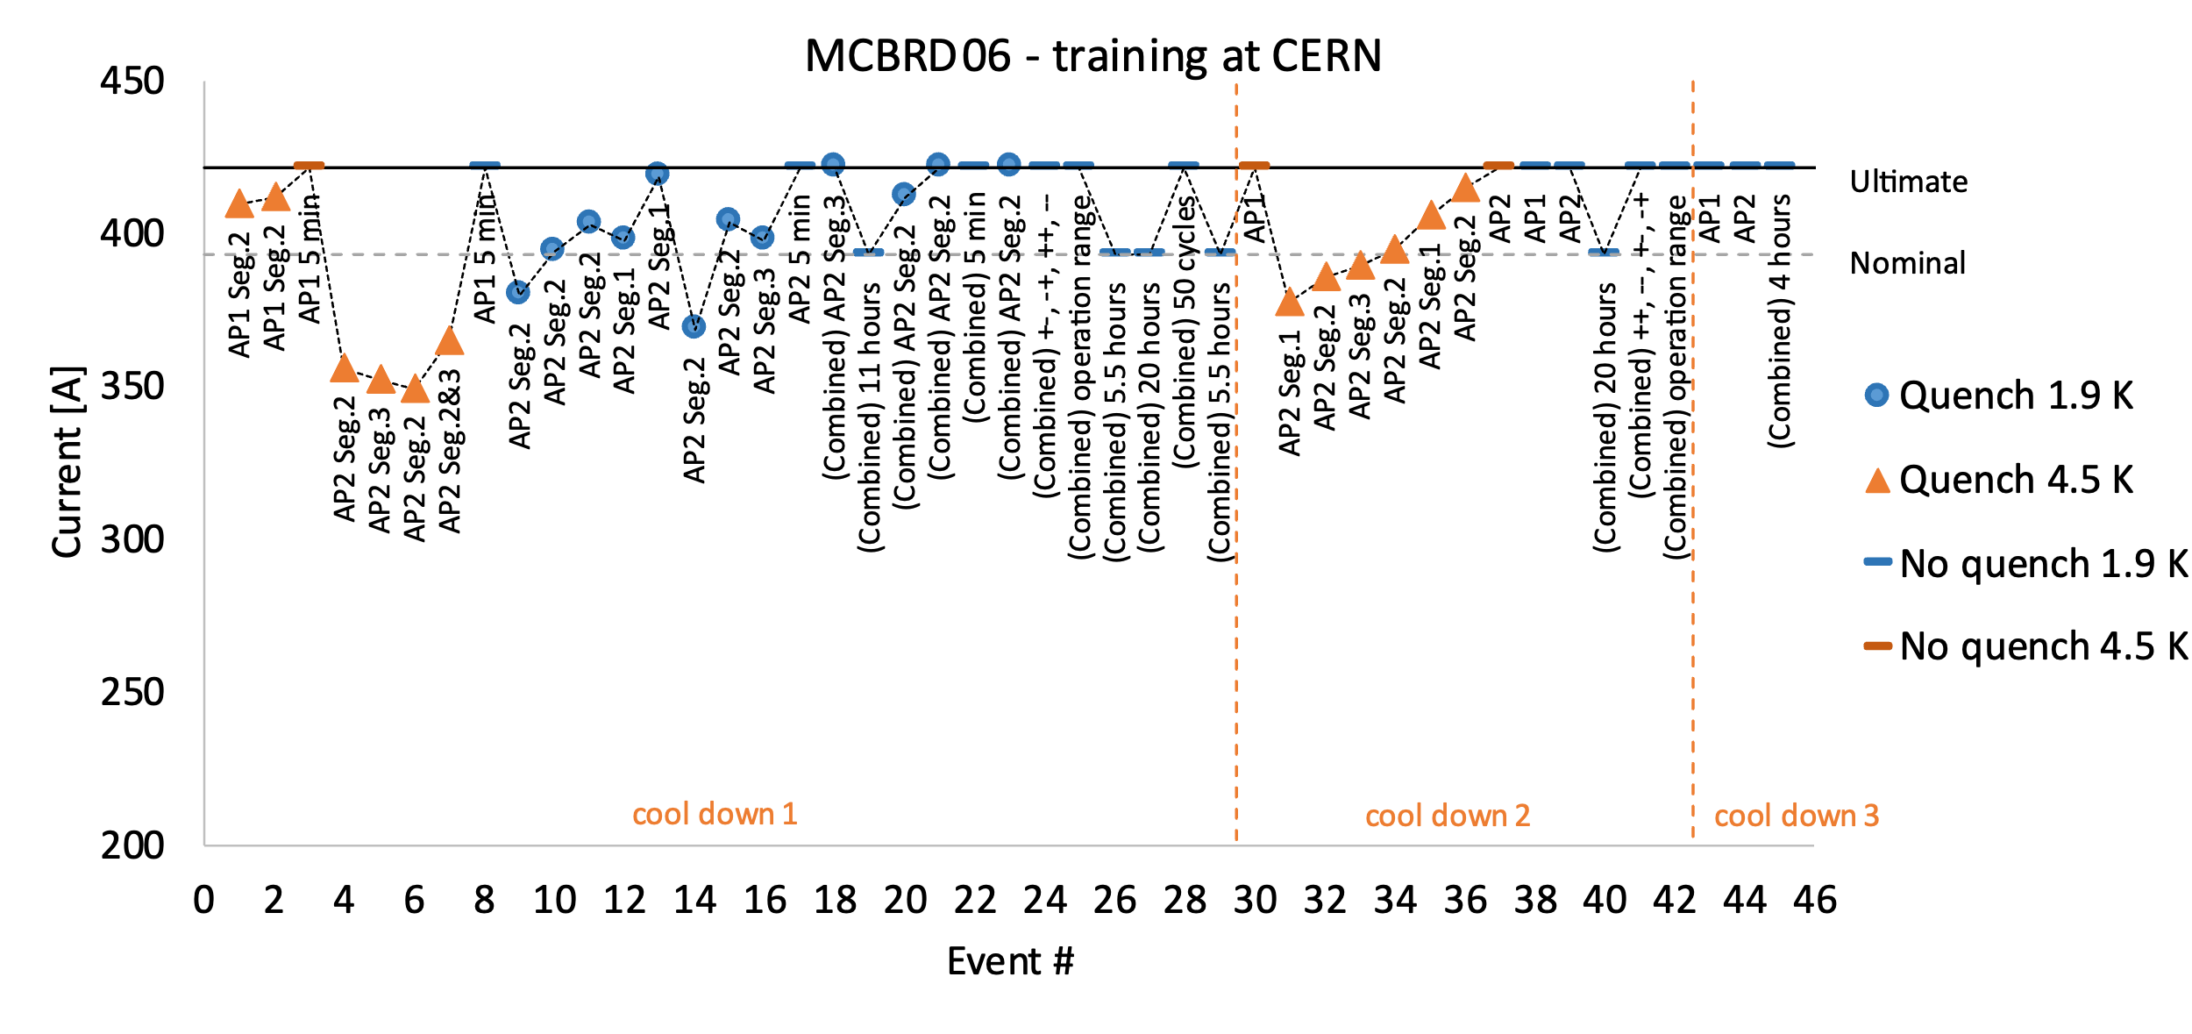
Training

Slide 10
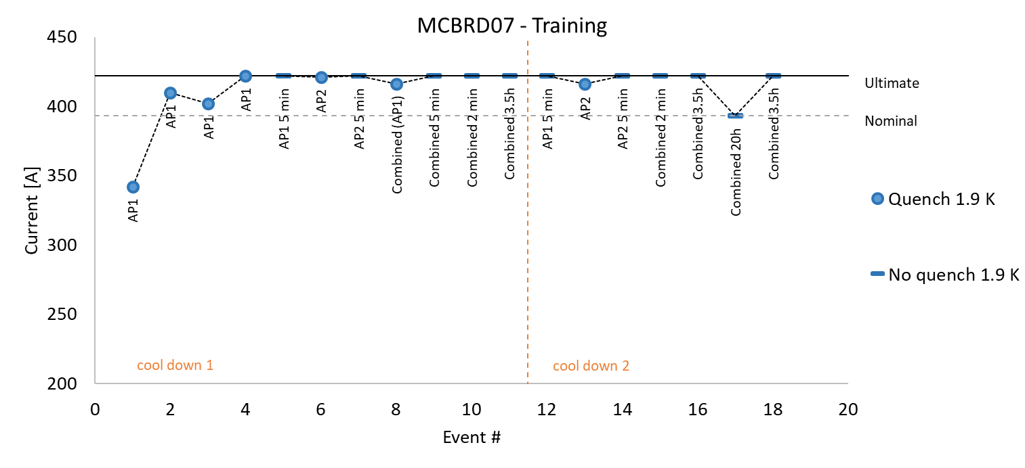
Training

Slide 11
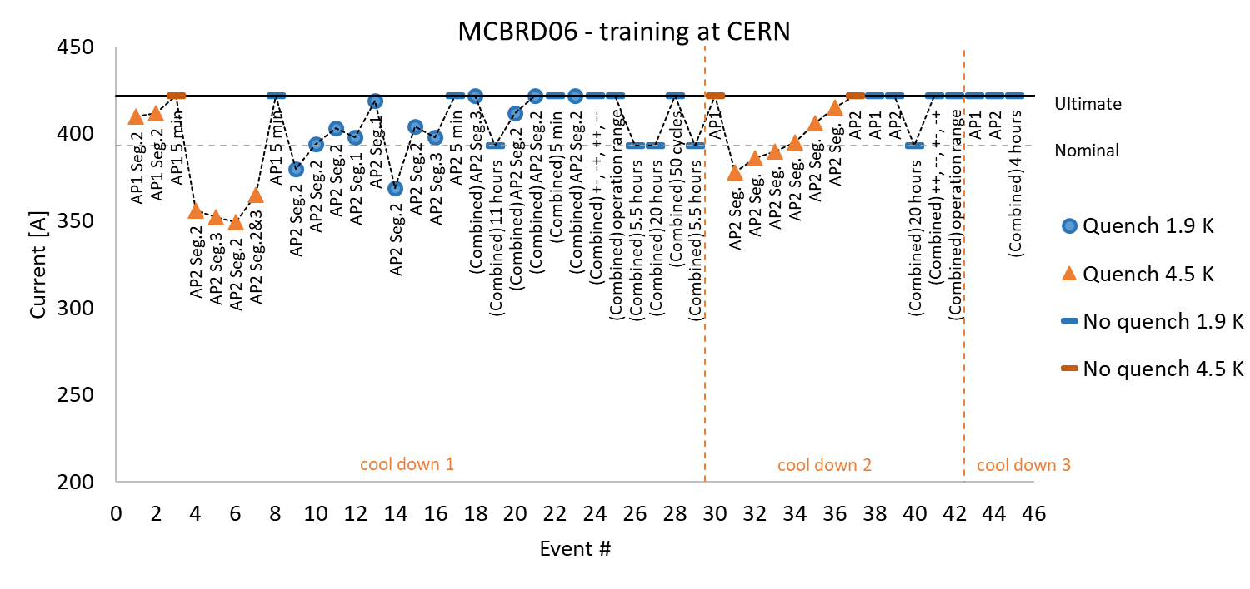
Training
MCBRD05: Magnet assembly tested at IMP before arriving to CERN. One single cool down at CERN.
MCBRD06: Tested also at 4.5 K to verify the training performed at IMP at 4.5 K.
MCBRD07: First test of the assembly. Apertures already tested individually.

Slide 12
Magnetic measurements
Field quality assessment.
Magnetic measurements have been performed at cold for both MCBRD05 and MCBRD07.
Magnetic measurements have not been performed for MCBRD06 due to a technical problem.
  Non-Conformity: https://edms.cern.ch/document/3267082
  Absence of threaded holes made impossible to install the magnetic measurement shaft.
For more details and results see next presentation from Lucio Fiscarelli (TE-MSC-MMM)

Slide 13
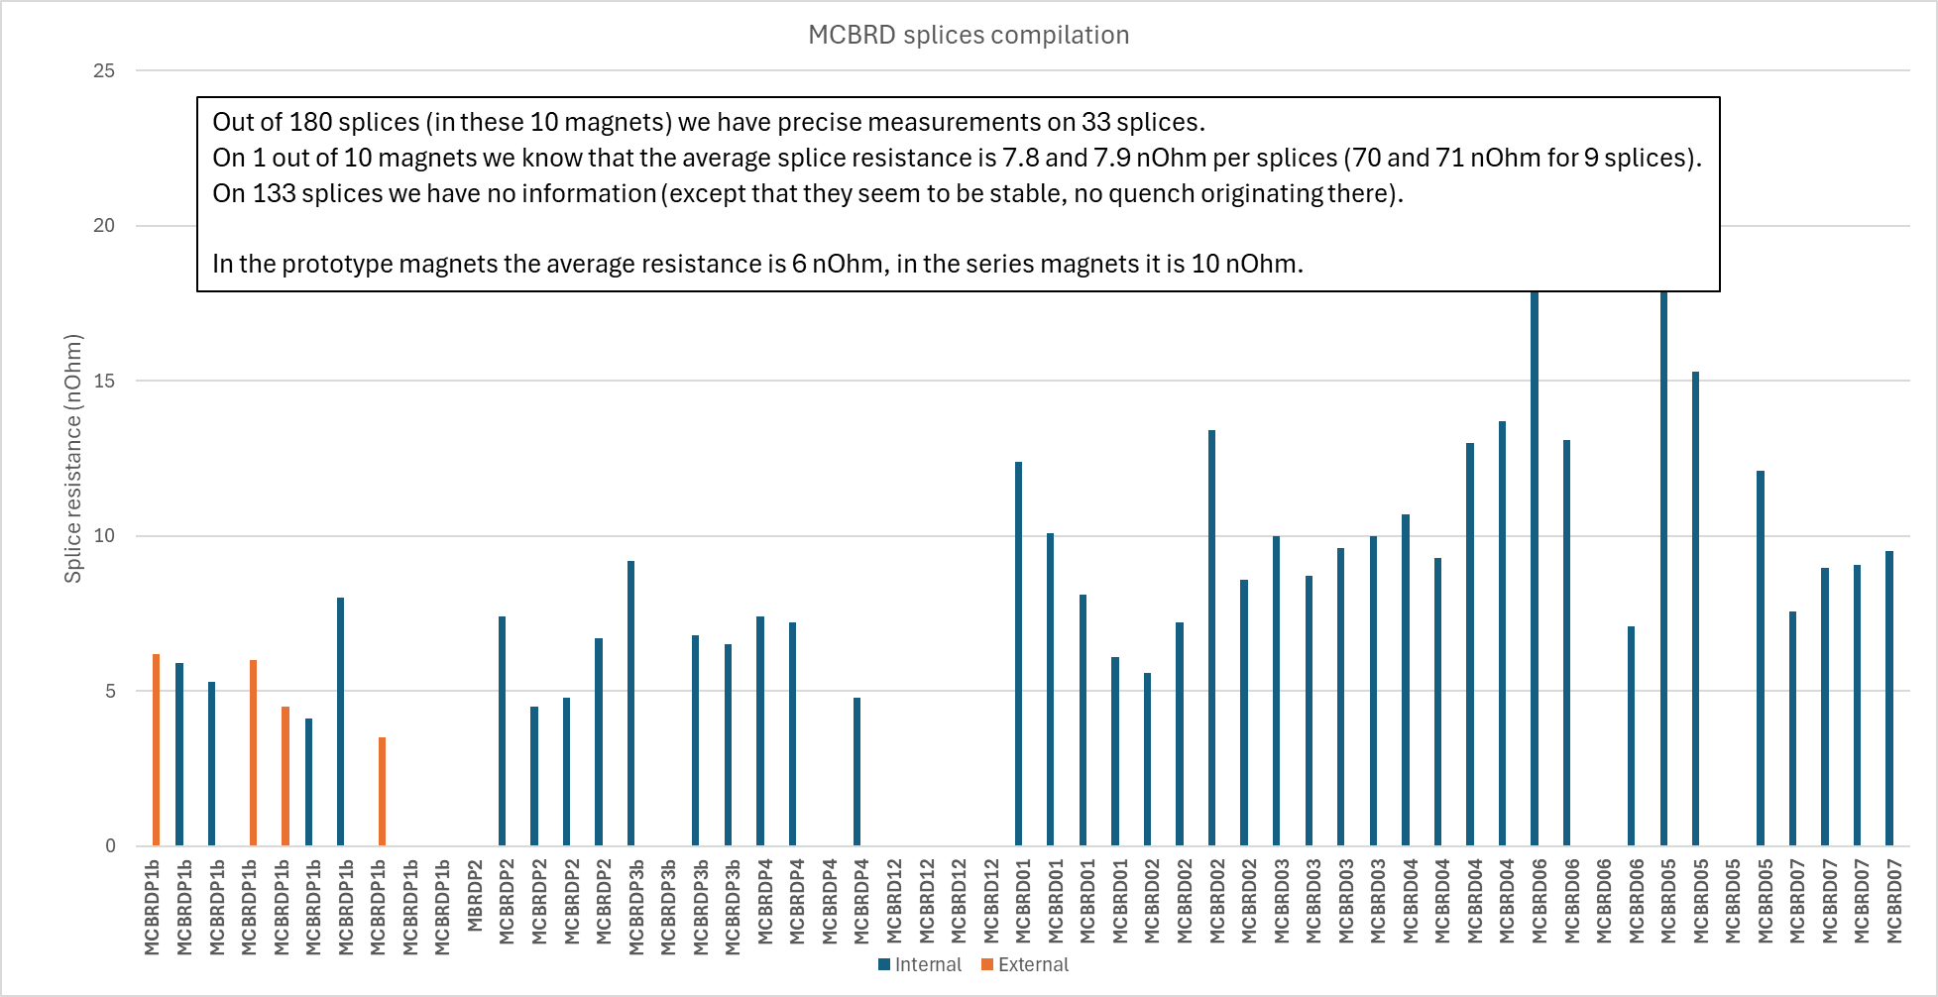
Splice measurements
MCBRD05:
Segment | R_{splice} (nΩ)
EE12-EE17 (9 splices) | 118 ± 15
EE22-EE27 (9 splices) | 113 ± 15
EE13-EE14 (1 splice) | 20.9 ± 0.2
EE15-EE16 (1 splice) | 15.3 ± 0.2
EE23-EE24 (1 splice) | -
EE25-EE26 (1 splice) | 12.1 ± 0.2
The single splice has a resistance in a range from 7 nΩ to 21 nΩ.
The cumulative resistance of nine splices for each coil is ~ 120 nΩ.
MCBRD06:
Segment | R_{splice} (nΩ)
EE13-EE14 (1 splice) | 19.4 ± 0.2
EE15-EE16 (1 splice) | 13.1 ± 0.2
EE23-EE24 (1 splice) | -
EE25-EE26 (1 splice) | 7.1 ± 0.2
MCBRD07:
Segment | R_{splice} (nΩ)
EE12-EE13 (2 splices) | 22 ± 8
EE13-EE14 (1 splice) | 7.6± 0.3
EE14-EE15 (3 splices) | 31 ± 11
EE15-EE16 (1 splice) | 9.0 ± 0.2
EE16-EE17 (2 splices) | 24 ± 8
EE22-EE23 (2 splices) | 18 ± 9
EE23-EE24 (1 splice) | 9.1 ± 0.3
EE24-EE25 (3 splices) | 25 ± 12
EE25-EE26 (1 splice) | 9.5 ± 0.2
EE26-EE27 (2 splices) | 19 ± 9

Slide 14
Splice measurements
Single splice resistance ~6 nΩ for porotypes.
Single splice resistance ~10 nΩ for series magnets.
MCBRD05, MCBRD06, and MCBRD07 are in terms of splice resistance well in line with the series production and the splice resistance is stable.

Slide 15
Residual Resistance Ratio (RRR)
Residual resistance ratio measured during one of the warmup.
No specific requirement on the RRR.
All three magnet perform well and showed a RRR > 200.
Circuit | R_room (Ω) | R_transition (Ω) | RRR
MCBRD05 – AP1 | 242 | 1.16 | 208
MCBRD05 – AP2 | 243 | 1.07 | 226
MCBRD06– AP1 | 240 | 1.15 | 208
MCBRD06 – AP2 | 240 | 1.06 | 226
MCBRD07 – AP1 | 243 | 1.05 | 231
MCBRD07 – AP2 | 240 | 1.07 | 225

Slide 16
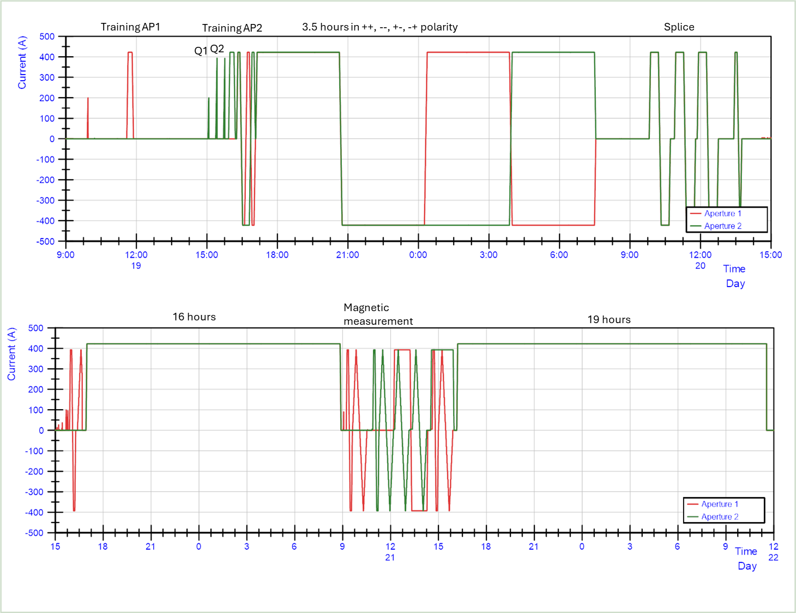
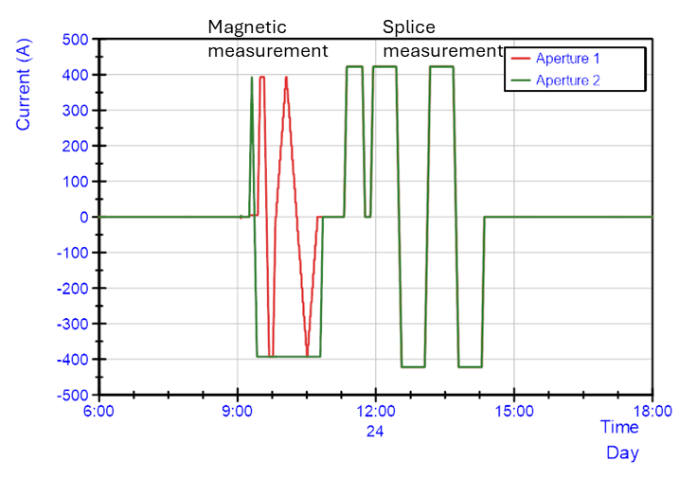
Powering overview MCBRD05
CD1
CD1
1.9 K
1.9 K
CD1
Current (A) | Cumulative time (hours)
393 (nominal current) | ~61
422 (Ultimate current) | ~61
1.9 K

Slide 17
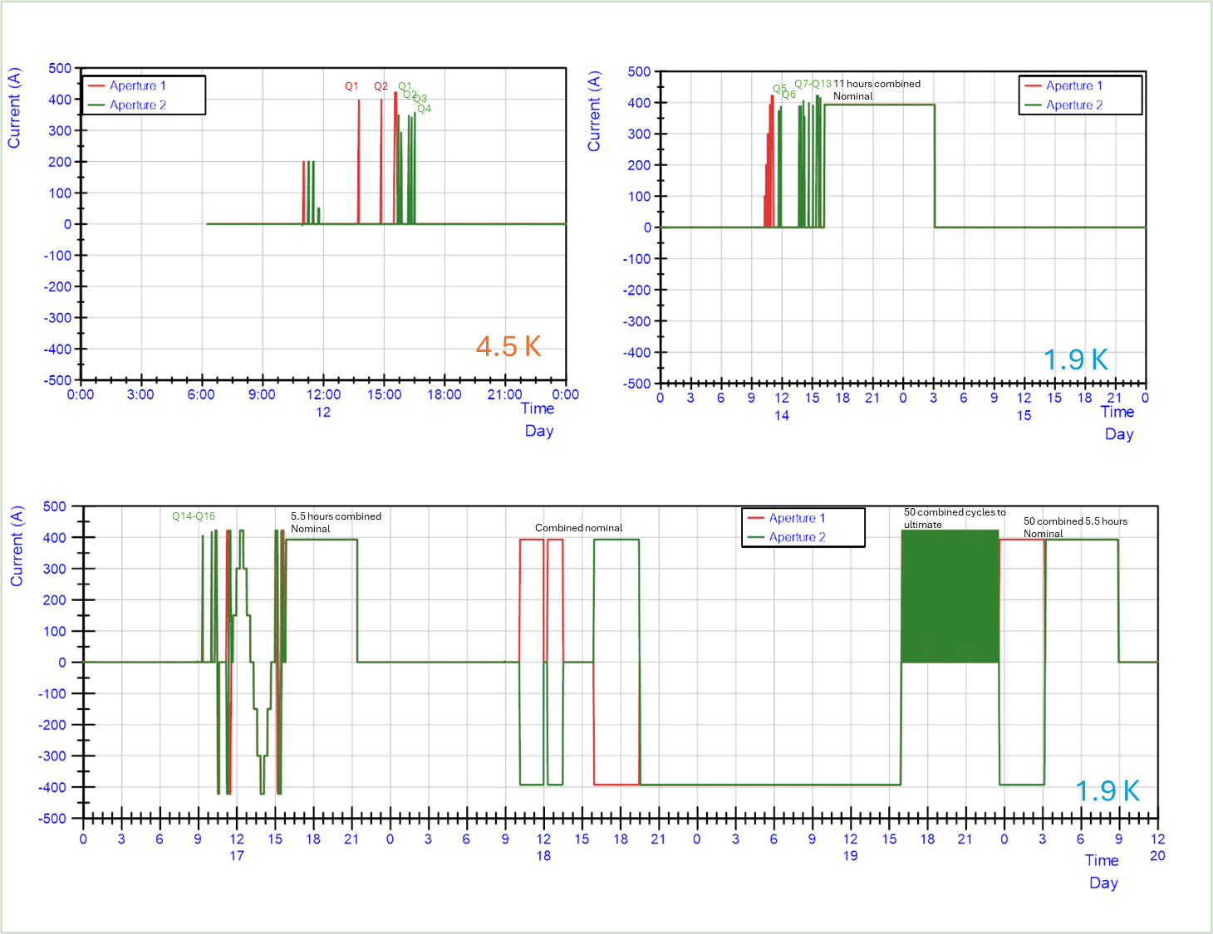
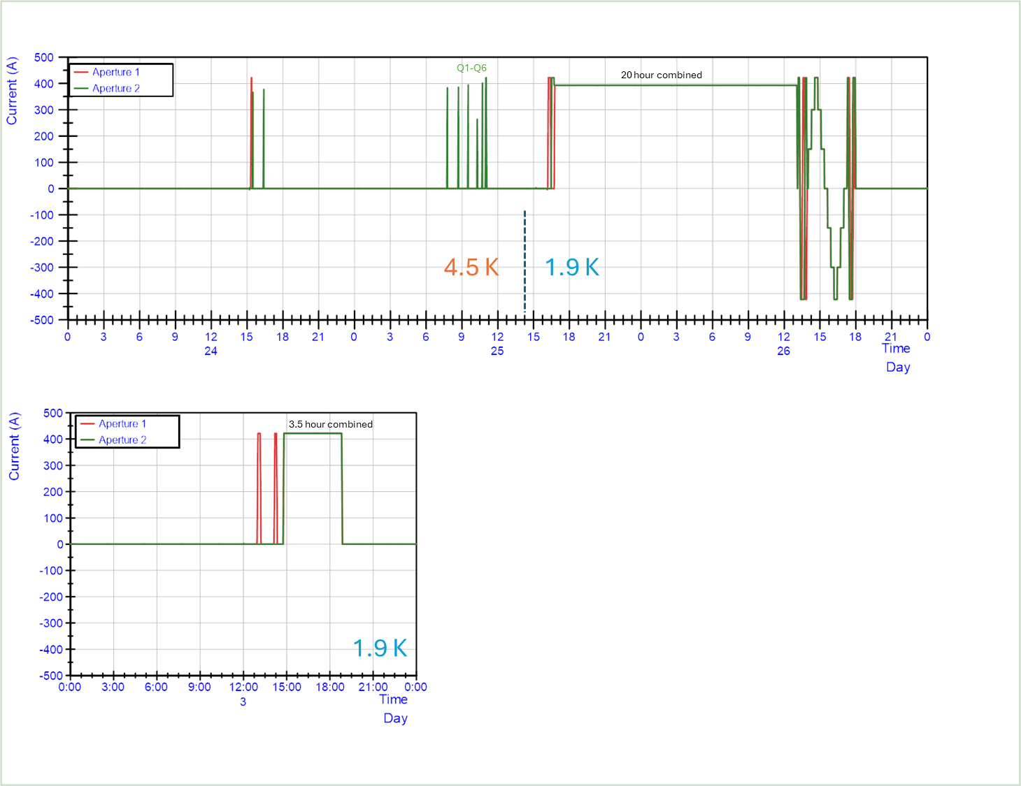
Powering overview MCBRD06
CD1
CD1
CD2
CD2
CD3
Current (A) | Cumulative time (hours)
393 (nominal current) | ~73
422 (Ultimate current) | ~21.5

Slide 18
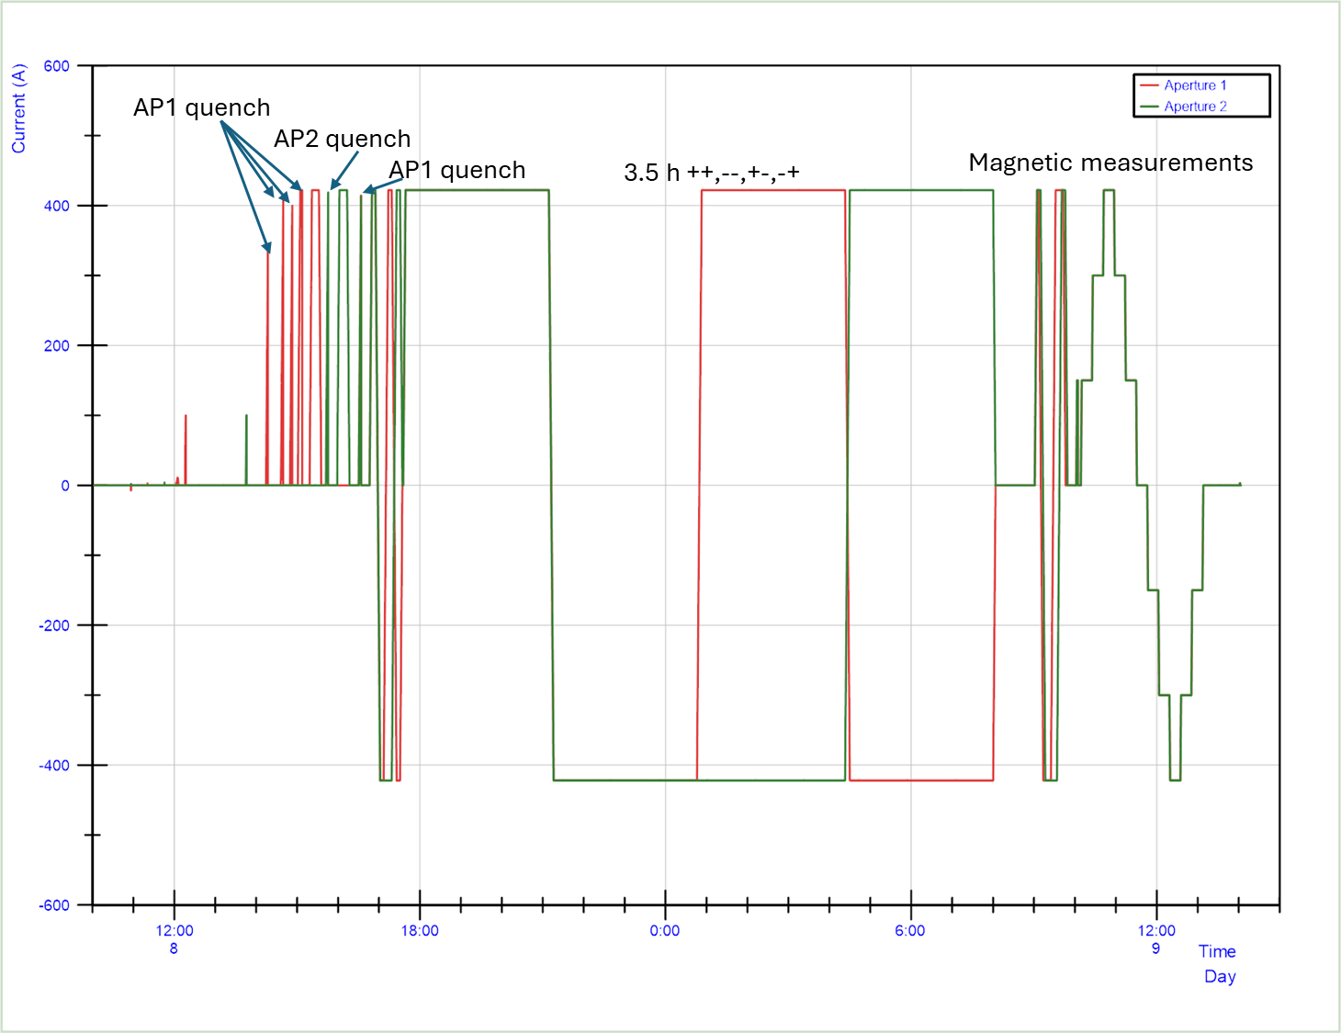
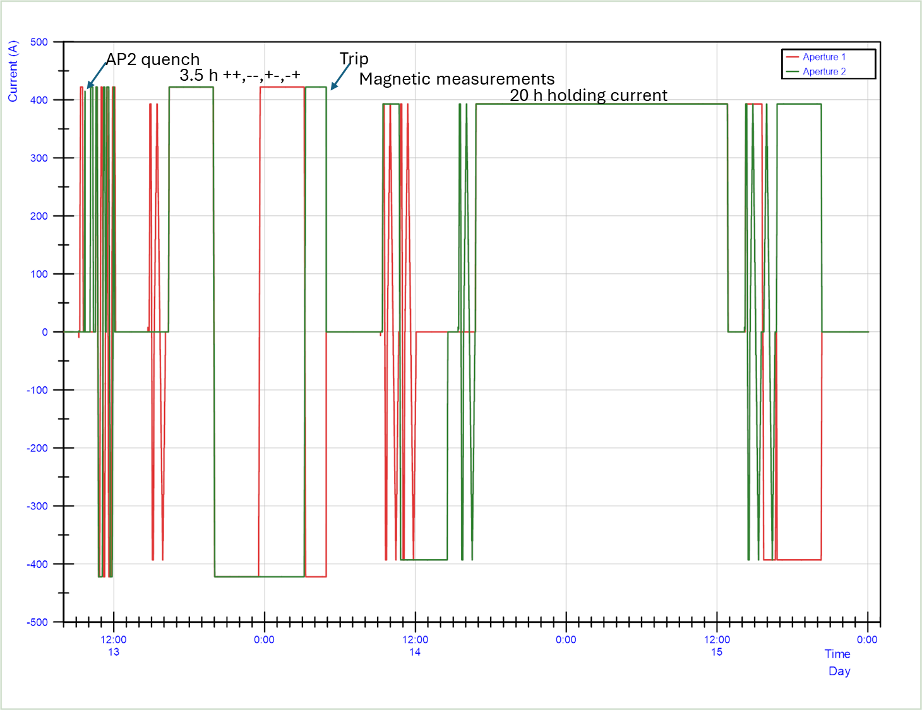
Powering overview MCBRD07
CD1
CD2
1.9 K
1.9 K
Current (A) | Cumulative time (hours)
393 (nominal current) | ~62
422 (Ultimate current) | ~35

Slide 19
Requirements
Requirement | Keywords | MCBRD05 | MCBRD06 | MCBRD07
1 | ±Iult steady state all combination combined powering at 1.9 K | passed | passed | passed
2 | Max 1 quench to Inom after TC | passed | passed | passed
3 | Field quality | See next talk | See next talk | See next talk
8 | Electrical insulation test | passed | passed | passed
9 | 20 Voltage taps | In line with production | In line with production | In line with production
10 | Resistance of 9 splices < 10nΩ | In line with production | In line with production | In line with production
12 | Ramp rate ±2 A/s without quench | passed | passed | passed
Acceptance criteria: https://edms.cern.ch/document/2051870

Slide 20
Conclusions
MCBRD05-06-07 have been successfully tested at CERN in the first six months of 2025.
Each magnet spent at least 60 hours above nominal current and at least 20 hours at ultimate current.
Almost all the requirements in the scope of the test plan have been satisfied.
The three magnets object of this presentation all performed well and have been qualified and accepted for installation.

Slide 21
Thanks!

