Slide 1





Muon Collider
D. Schulte
On behalf of the International Muon Collider Collaboration
Funded by the European Union (EU). Views and opinions expressed are however those of the author(s) only and do not necessarily reflect those of the EU or European Research Executive Agency (REA). Neither the EU nor the REA can be held responsible for them.
ESPPU, June , 2025

Slide 2
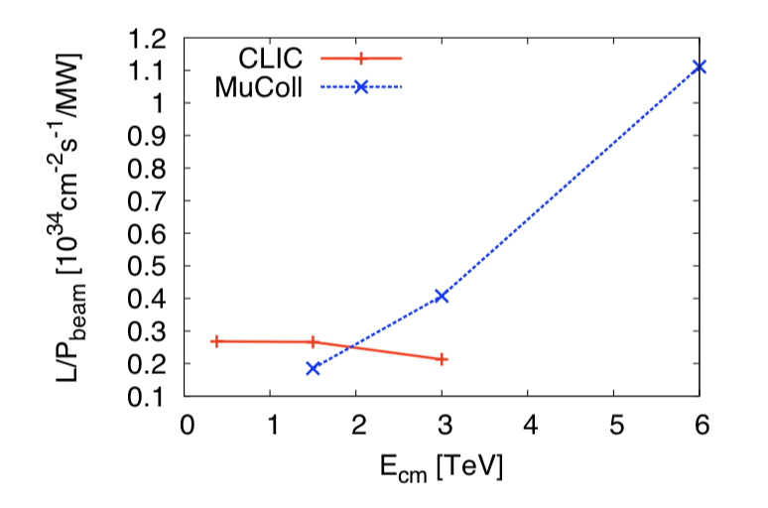
Muon Collider - unique project

Slide 3
Physics Case
European Strategy of Particle Physics Update – June 19, 2020:
High-priority future initiatives [..]
the accelerator R&D roadmap could contain:
[..] an international design study for a muon collider, as it represents a unique opportunity to achieve a multi-TeV energy domain beyond the reach of e⁺e–colliders,
and potentially within a more compact circular tunnel than for a hadron collider.
The biggest challenge remains to produce an intense beam of cooled muons, ……
P5 report – December , 2023:
National Academy of Science Recommendation - June 12 2025:
A collider with approximately 10 times the energy of the Large Hadron Collider (LHC) is crucial for addressing the big questions of particle physics and making discoveries.
A 10-TeV muon collider on the Fermi National Accelerator Laboratory (Fermilab) site would have similar discovery reach as a 100-TeV proton collider.
A muon collider combines the physics advantages of an electron-positron and a proton-proton collider, with a much smaller size.

Slide 4
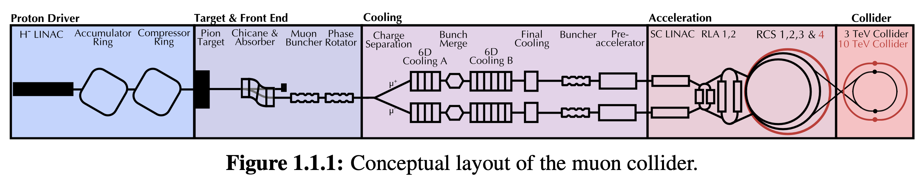
Muon Collider Concept
The main challenge is the short muon lifetime τ = γ x 2.2 μs
Protons produce pions which decay into muons which are captured
Ionisation cooling of muon in matter
Acceleration to collision energy
Short, intense proton bunch
Collision
A machine that collides unstable elementary particles has never been attempted before and requires significant research and development (R&D), international coordination, and a demonstrator project to establish its feasibility.
— an unprecedented machine requiring considerable research, development, and a feasibility demonstrator —
4

Slide 5


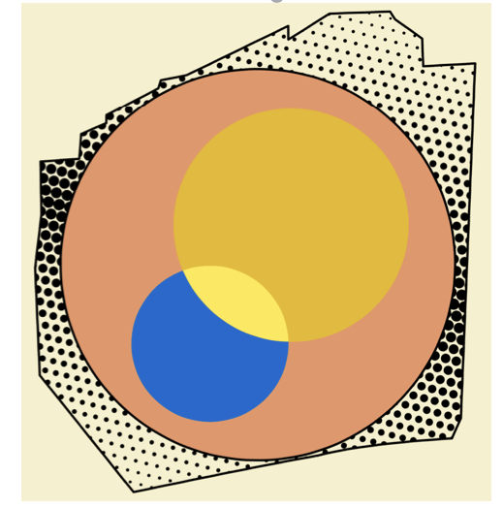
The International Collaboration
Collaboration launced Muon Collider Collaboration Meeting July 3, 2020 @ CERN remote
and formed after the European Accelerator R&D Roadmap 2022, currently hosted by CERN
61 formal member institutions, still growing
Strong EU (mailly Italy) and US contribution
R&D progamme developed with global community
In response to strategic requests:
Last ESPPU demanded integration into European Accelerator R&D Roadmap
EU is co-funding design study MuCol since 2023
Different US recommendations: Snowmass, P5 and National Academy of Science
IMCC carry out the R&D as a global community and develop options to host the collider at CERN or at Fermilab and potentially also other sites
Envisage to share leadership between CERN and Fermilab whenever the resources will be made available
5

Slide 6
IMCC Partners
IEIO | CERN
FR | CEA-IRFU
 | CNRS-LNCMI
 | Ecoles des Mines St-Etienne
DE | DESY
 | Technical University of Darmstadt
 | University of Rostock
 | KIT
UK | RAL
 | UK Research and Innovation
 | University of Lancaster
 | University of Southampton
 | University of Strathclyde
 | University of Sussex
 | Imperial College London
 | Royal Holloway
 | University of Huddersfield
 | University of Oxford
 | University of Warwick
 | University of Durham
 | University of Birmingham
 | University of Cambridge
NL | University of Twente
IT | INFN
 | INFN, Univ., Polit. Torino
 | INFN, LASA, Univ. Milano
 | INFN, Univ. Padova
 | INFN, Univ. Pavia
 | INFN, Univ. Bologna
 | INFN Trieste
 | INFN, Univ. Bari
 | INFN, Univ. Roma 1
 | ENEA
 | INFN Frascati
 | INFN, Univ. Ferrara
 | INFN, Univ. Roma 3
 | INFN Legnaro
 | INFN, Univ. Milano Bicocca
 | INFN Genova
 | INFN Laboratori del Sud
 | INFN Napoli
Mal | Univ. of Malta
EST | Tartu University
PT | LIP
SE | ESS
 | University of Uppsala
FI | Tampere University
 | HIP, University of Helsinki
LAT | Riga Technical University
CH | PSI
 | University of Geneva
 | EPFL
 | HEIA-FR
BE | Univ. Louvain
AU | HEPHY
 | TU Wien
ES | I3M
 | IFIC/CSIC
 | ICMAB
China | Sun Yat-sen University
 | IHEP
 | Peking University
 | Inst. Of Mod. Physics, CAS
 | University of CAS
KO | Kyungpook National University
 | Yonsei University
 | Seoul National University
India | CHEP
CA | Université Laval
US | Iowa State University
 | University of Iowa
 | Wisconsin-Madison
 | University of Pittsburgh
 | Old Dominion
 | Chicago University
 | Florida State University
 | RICE University
 | Tennessee University
 | MIT Plasma science center
 | Pittsburgh PAC
 | Yale
 | Princeton
 | Stony Brook
 | Stanford/SLAC
 | …
DoE labs | FNAL
 | LBNL
 | JLAB
 | BNL
Brazil | CNPEM
6
Signed MoC (61), requested MoC, contributor

Slide 7
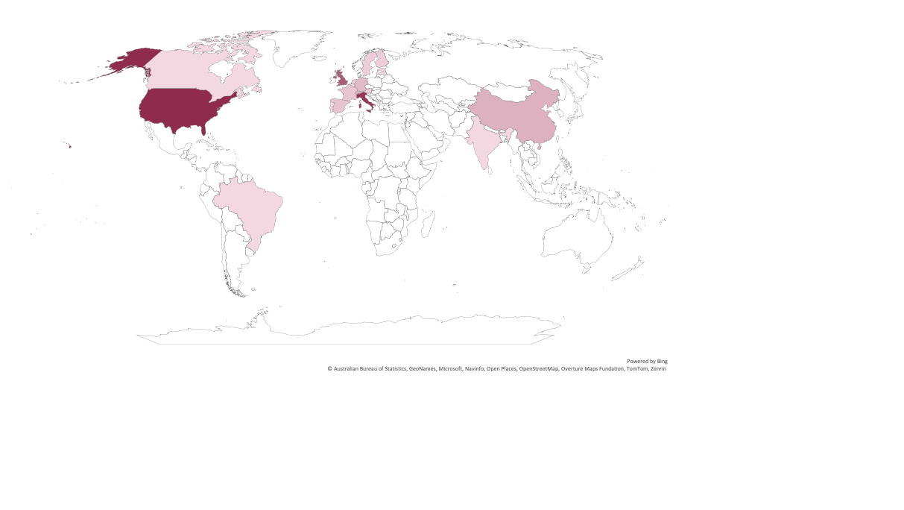
IMCC Countries and Institutes
ASIA
China
Sun Yat-sen University
IHEP
Peking University
Inst. Of Mod. Physics, CAS
University of CAS
Korea
Kyungpook National University
Yonsei University
Seoul National University
India
CHEP
AMERICA
Canada
Université Laval
U.S.A.
Iowa State University
University of Iowa
Wisconsin-Madison
University of Pittsburgh
Old Dominion
Chicago University
Florida State University
RICE University
Tennessee University
MIT Plasma science center
Pittsburgh PAC
Princeton
Stony Brook
Stanford/SLAC
Yale
FNAL
LBNL
JLAB
BNL
Brazil
CNPEM
EUROPE
CERN
Austria
HEPHY
TU Wien
Belgium
Univ. Louvain
France
CEA-IRFU
CNRS-LNCMI
Ecoles Mines St-Etienne
Germany
DESY
Tech. Univ. Darmstadt
University of Rostock
KIT
Estonia
Tartu University
Finland
Tampere University
HIP, Univ. of Helsinki
Latvia
Riga Technical Univ.
Netherlands
University of Twente
Malta
Univ. of Malta
Portugal
LIP
Spain
I3M
IFIC/CSIC
ICMAB
Sweden
ESS
Univ. of Uppsala
Switzerland
PSI
University of Geneva
EPFL
HEIA-FR
Italy
ENEA
INFN & Universities
Bari
Bologna
Ferrara
Firenze
Genova
LASA - Milano
Milano Bicocca
Padova
Pavia
Pisa
Roma1
Roma3
Torino
Trieste
INFN Nat. Labs
Frascati
Legnaro
Laboratori del Sud
UK
RAL
UK Research and Innovation
University of Lancaster
University of Southampton
University of Strathclyde
University of Sussex
Imperial College London
Royal Holloway
University of Huddersfield
University of Oxford
University of Warwick
University of Durham
University of Birmingham
University of Cambridge
Signed MoC (61) or requested MoC
contributor

Slide 8
ESPPU Submission Content
Muon Collider Assessment
Present physics case and green field designs and technologies
Parameters, lattice and component designs, beam dynamics, cost, …
Aim for 10 TeV with 10 ab⁻¹
  Aim for initial stage around 2050 (e.g. with 3 TeV and 1 ab⁻¹)
Back-up document (406p, 450 signatories)
R&D plan
The main timeline driver
Accelerator design, detector development, magnets, muon cooling technology, …
Implementation Considerations
Currently for CERN and for FNAL
Scaling from green field design, will develop detailed lattice designs after ESPPU
Technically limited schedule
Cost and power consumption scales
8

Slide 9
From here slides are too dense to include everything they can stay in reserve and you may select a few priority items….
I put slides from Donatella as example…

Slide 10
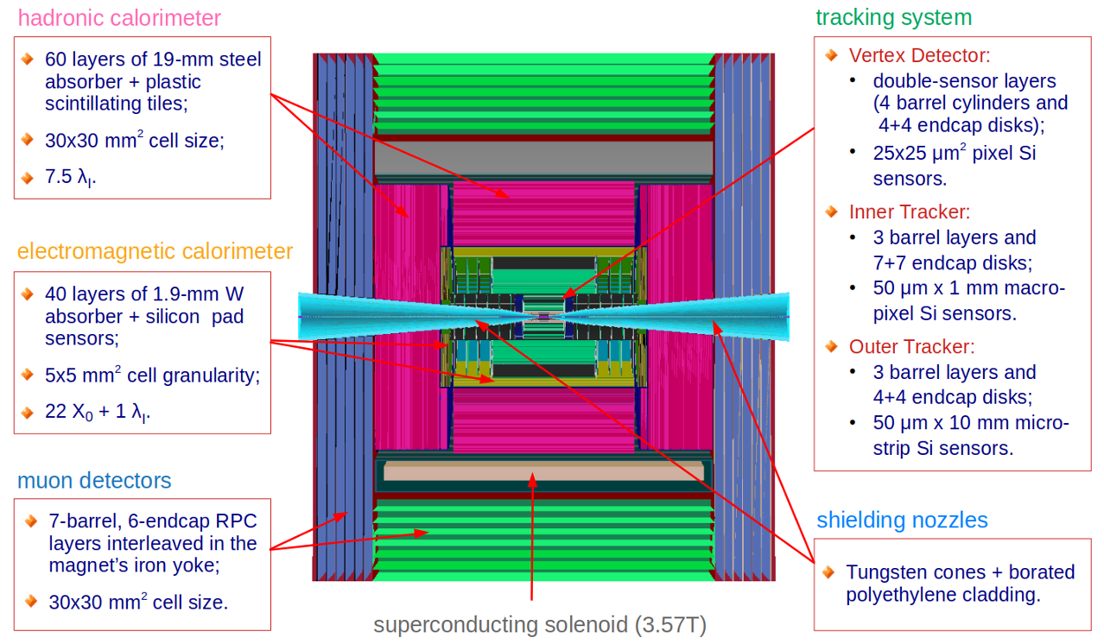
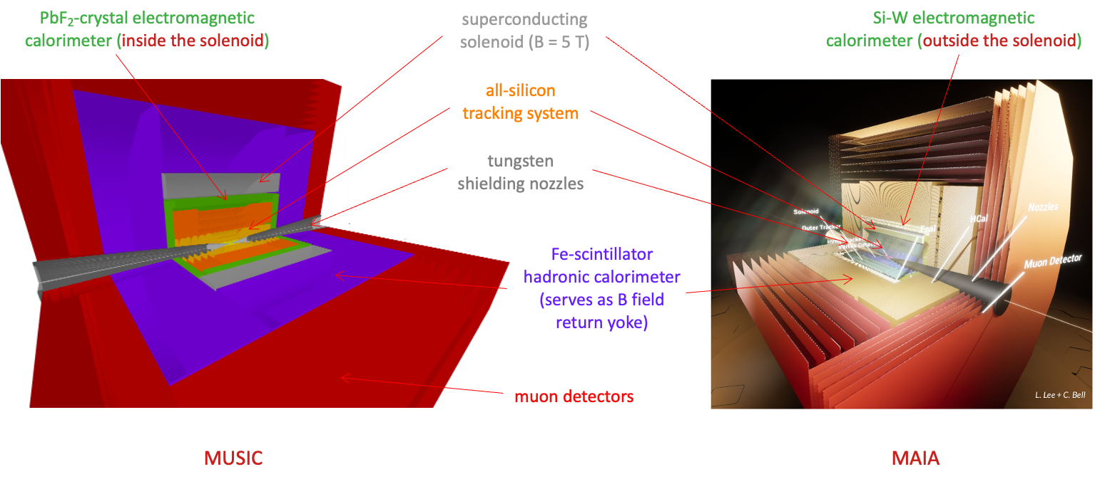
Physics and Detector Concepts
Challenges:
High-energy lepton detector requirements
Background from muon decay and beam-beam effects
Three proof-of-concept detectors, each with fully simulated
sub-detectors using GEANT and including beam-induced backgrounds:
One for muon collisions at √s=3 TeV
Two for muon collisions at √s=10 TeV
Detector performance and physics reach published

Slide 11
Achievements
Performance studies
Detailed design and simulations of MDI and background suppression
TO BE IMPROVED + figure
Detector technologies definition for optimized MuC detector requires a deep understanding of the machine-induced background, which in turn depends critically on the configuration of the interaction region and the surrounding shielding structure.
In the coming years:
mandatory MuC dedicated R&D to :
  optimize detector shielding structure and its integration with both detector and detector magnet;
  design a forward detector including this shielding structure, potentially requiring novel devices or innovative combinations of existing technologies.
Define sub-detector requirements enabling the development of technologies specifically optimized for muon collisions at different √s.
Contribute to R&D programs proposed for other facilities to evaluate and test the achievable performance of various components in a realistic muon collider environment. For example: silicon tracker close and far from interaction point, EM and HAD calorimeter, real time data processing…

Slide 12
From here slides are too dense

Slide 13
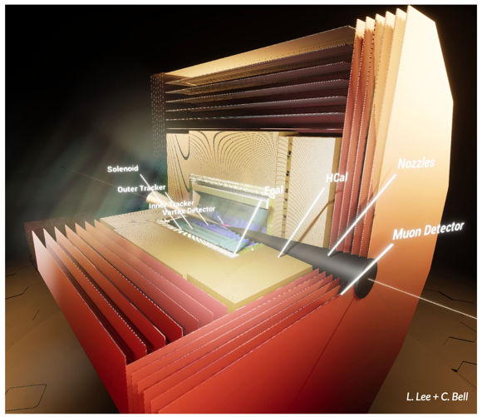
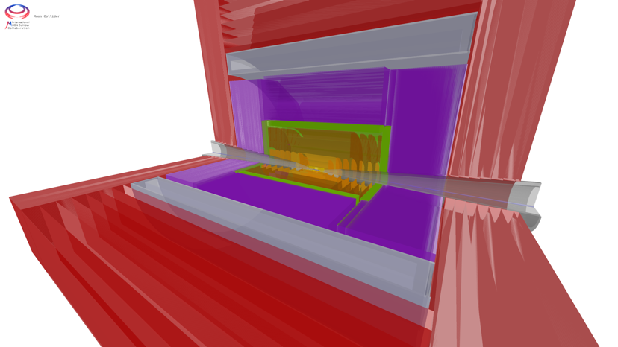
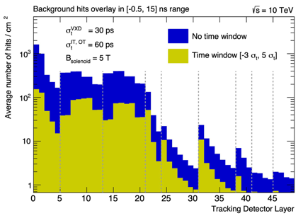
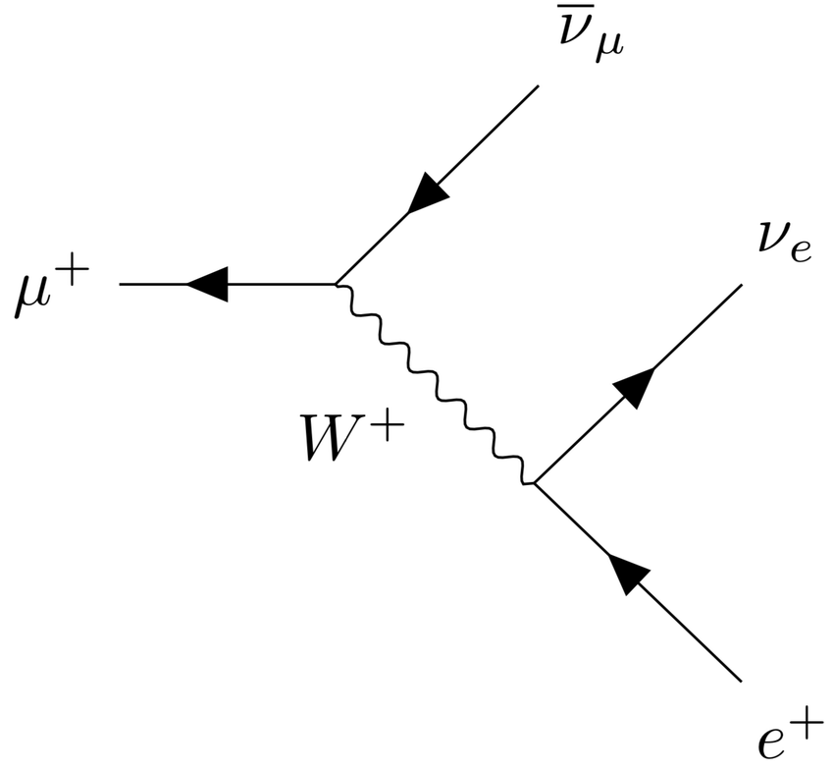
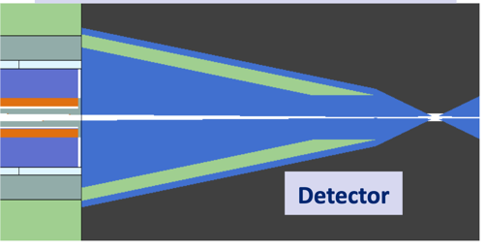
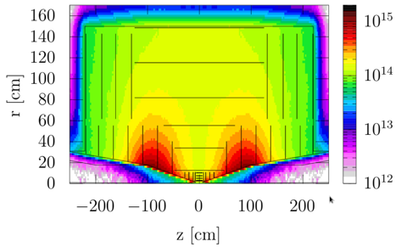
Physics and Detector Concepts
MUSIC
(MUon System for Interesting Collisions)
MAIA
(Muon Accelerator Instrumented Aperatus)
Challenges:
High-energy lepton detector requirements
Background from muon decay and beam-beam effects
Achievements
Two detector concepts are being developed
Performance studies
Detailed design and simulations of MDI and background suppression
Key conclusions:
In spite of background can do the important physics with near-term technology also thanks to HL-LHC developments
But background has an impact and important improvements are possible
Next aim to fully exploit muon collider capabilities
Increasing effort to use available time for further improvements and exploiting AI, ML and new technologies

Slide 14
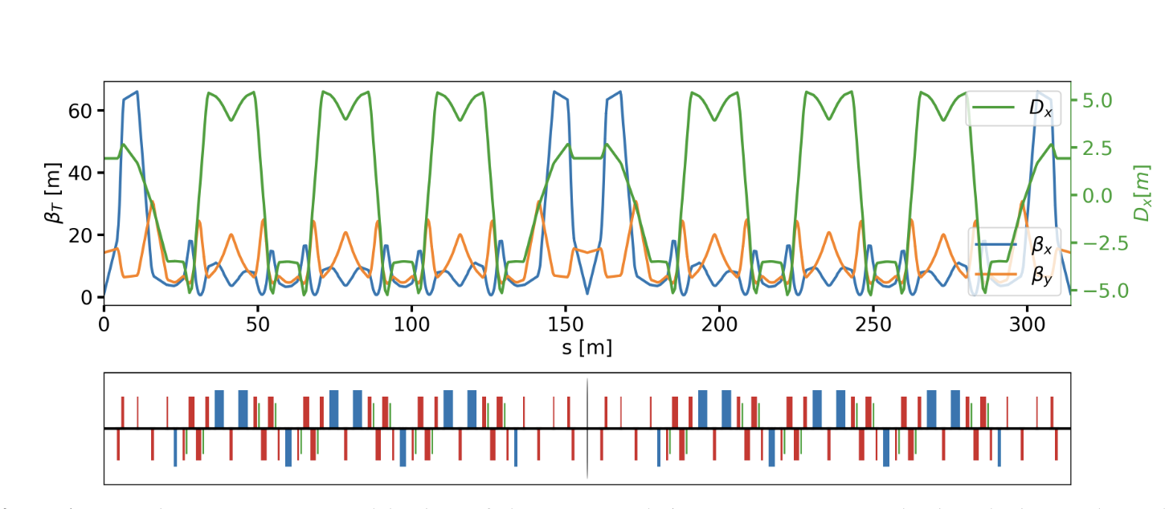
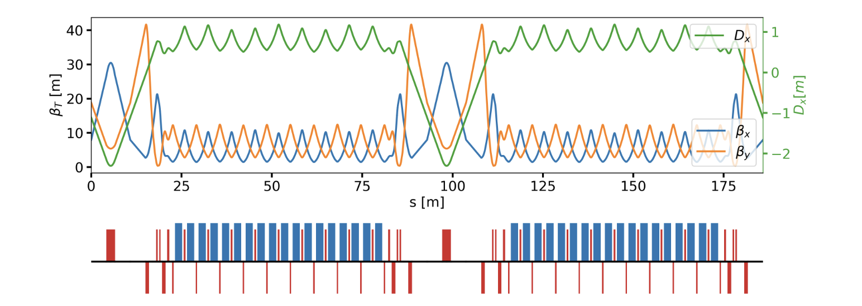
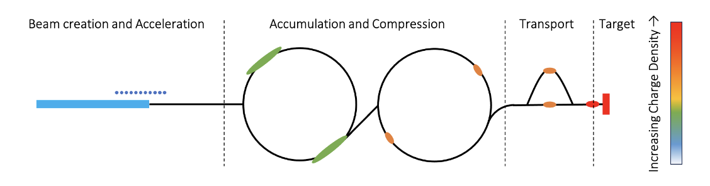
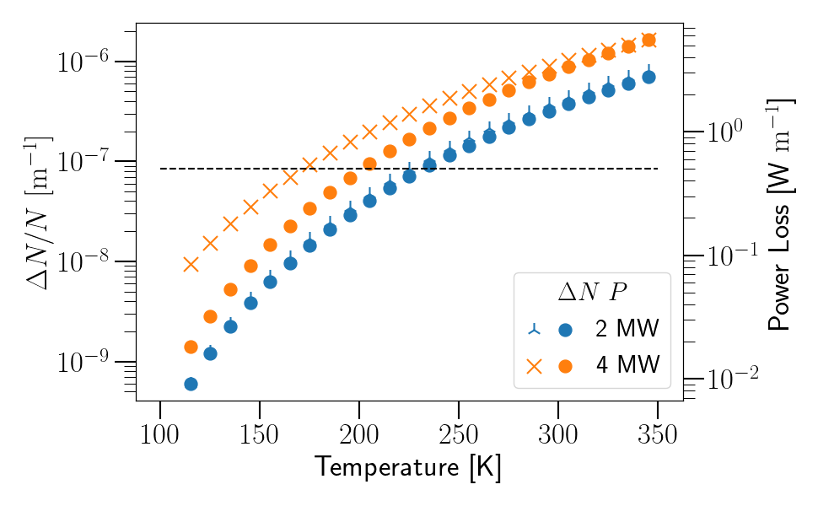
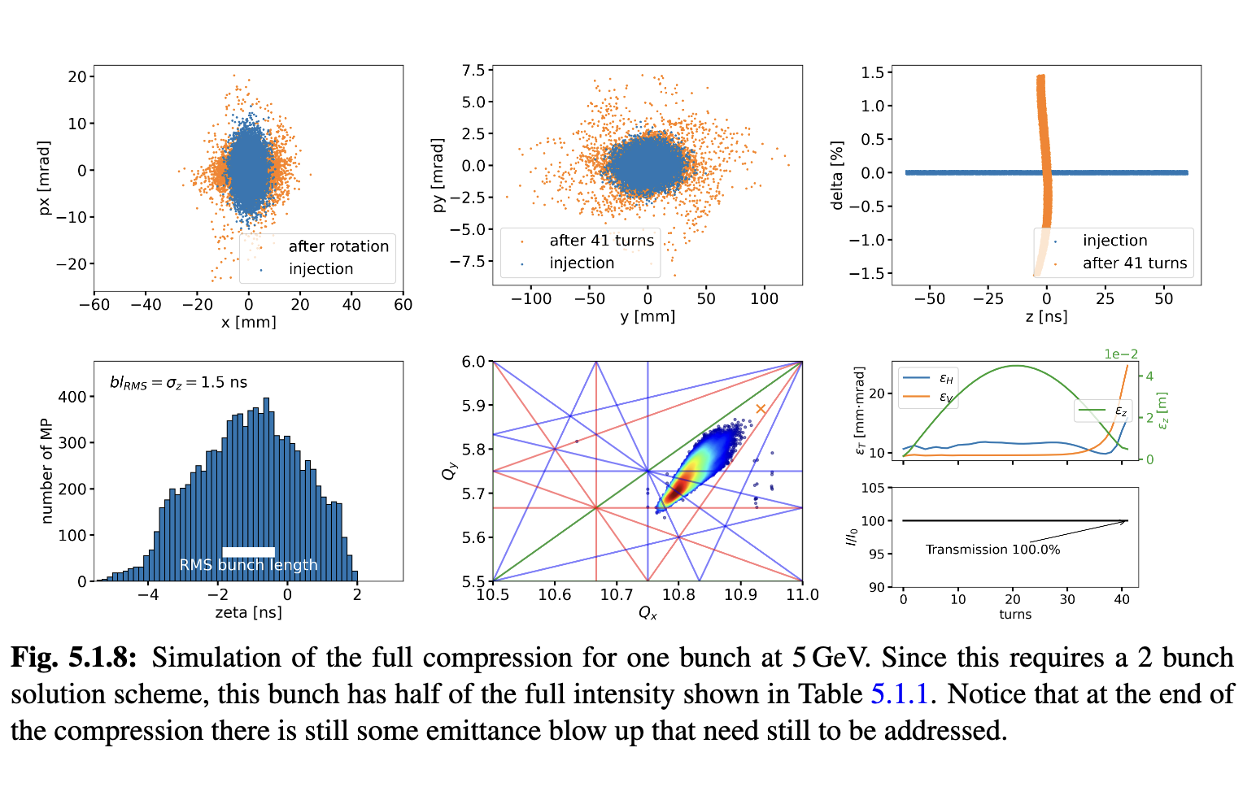
Proton Complex
Challenge:
2 MW, 5 GeV, 5 Hz,
5 x 10¹⁴ protons/pulse
Proton pulse accumulator and compressor rings
Achieved:
Accumulator and combiner ring lattices
First collective effects studies promising
One or two bunches in compressor, to be decided
Key conclusions:
Can compress 2 MW, 5 GeV proton beam to two 2 ns bunches, then merge them
  Optimisation in compressor ring for collective effects ongoing
For 4 MW need 10 GeV beam
Cool beamline to avoid ion loss from black body radiation

Slide 15
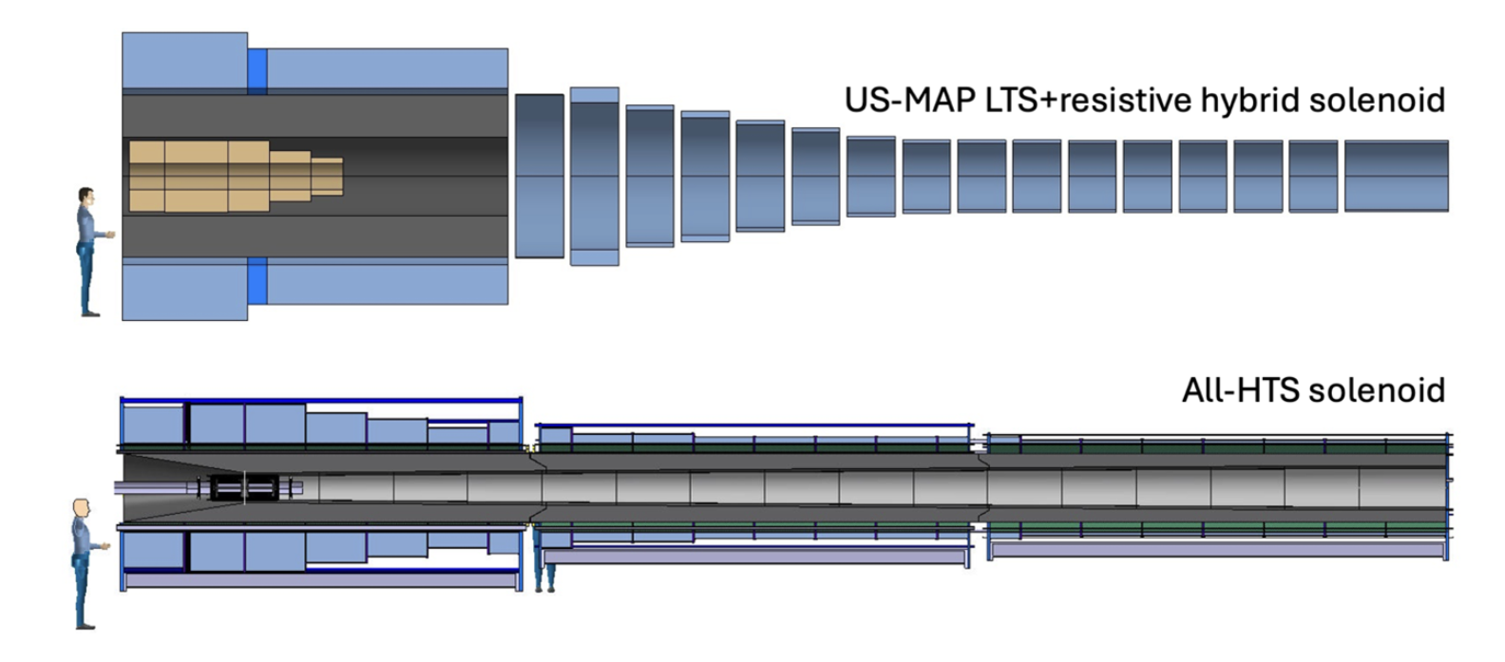
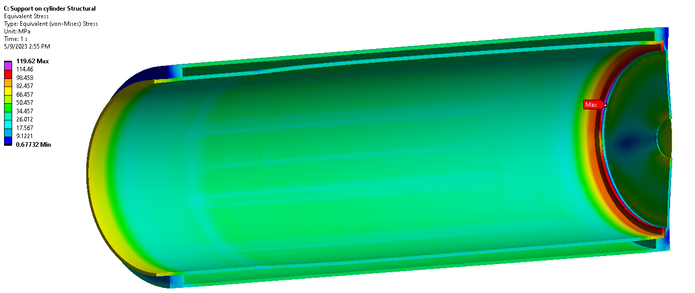
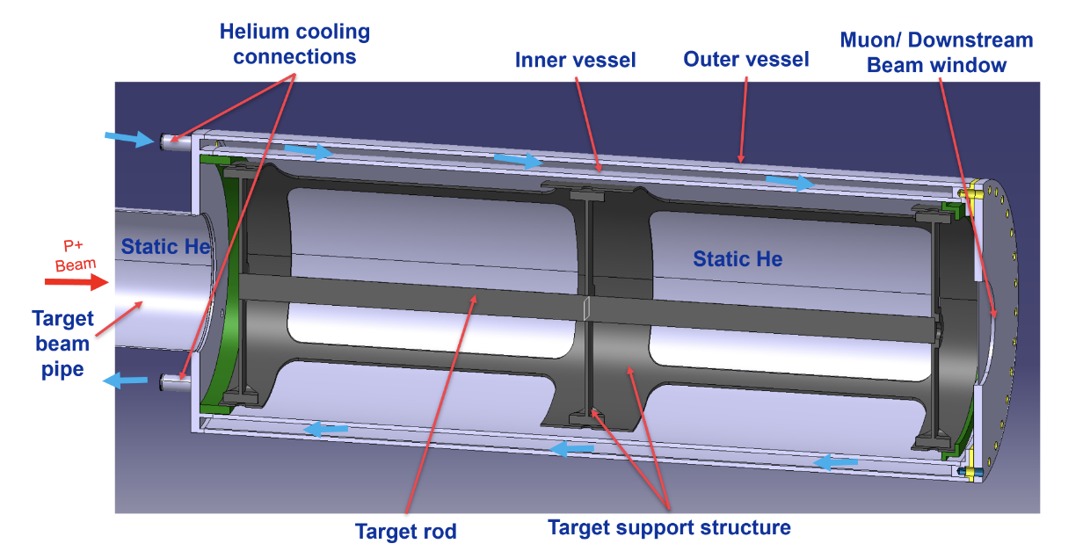
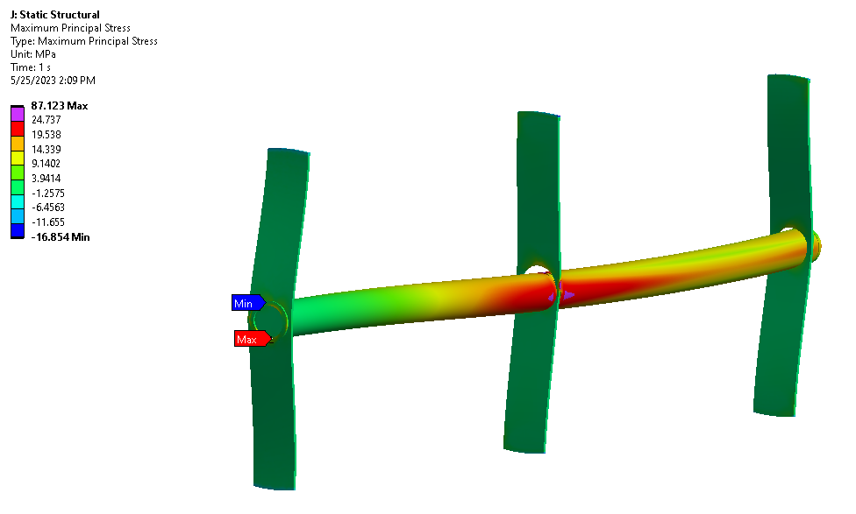
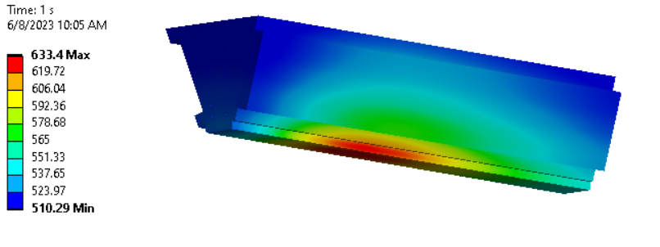
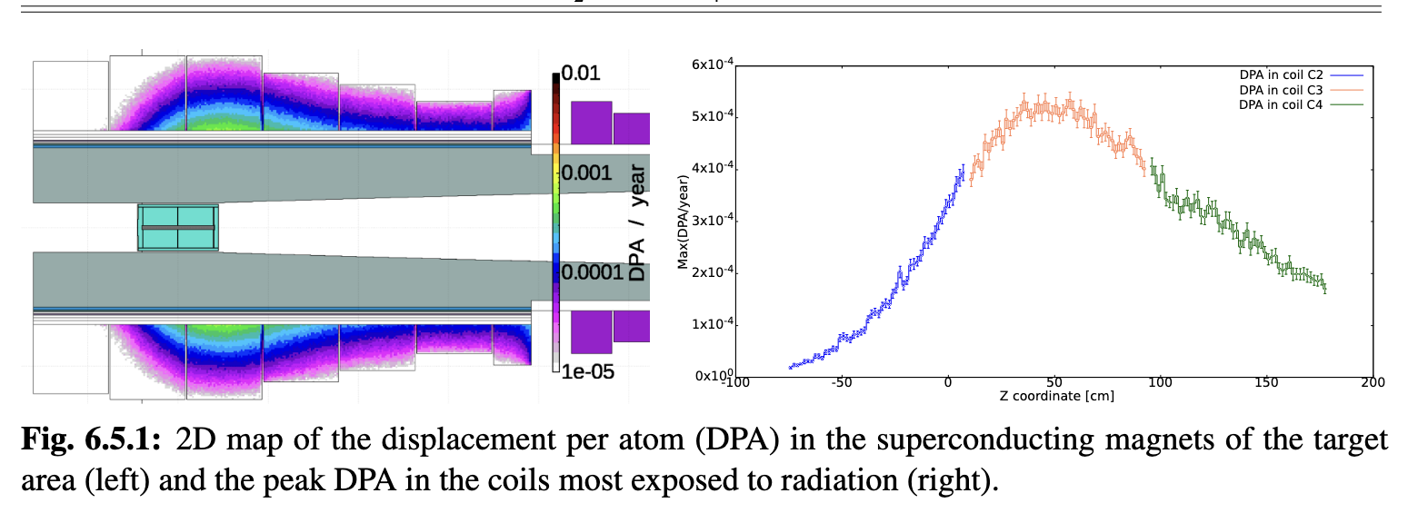
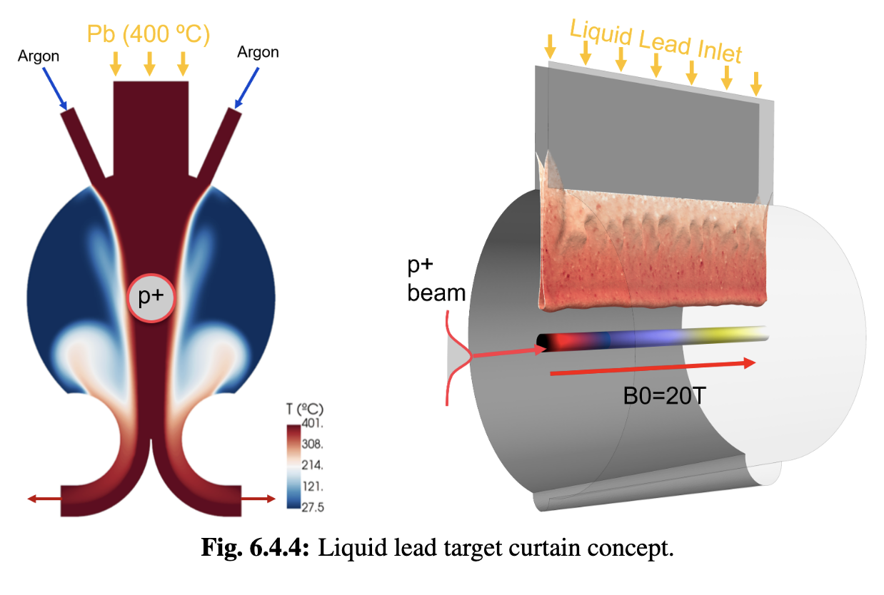
Target
Challenges:
2 MW, 5 Hz, 400 MJ/pulse target
Can we replace mercury with graphite?
Achieved:
Initial 2 MW graphite target conceptual design, pion yield optimised
HTS solenoid and shielding concept developed
Study of proton removal ongoing
Key conclusions:
Yield, magnet shielding, target stress, cooling, radiation are OK
Components survive 2 MW beam
Higher power alternatives to study:
  Graphite
  Liquid metal

Slide 16
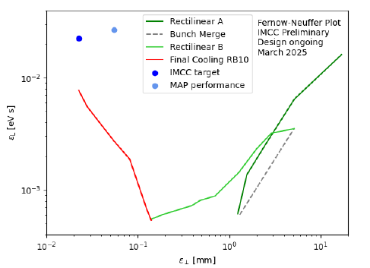
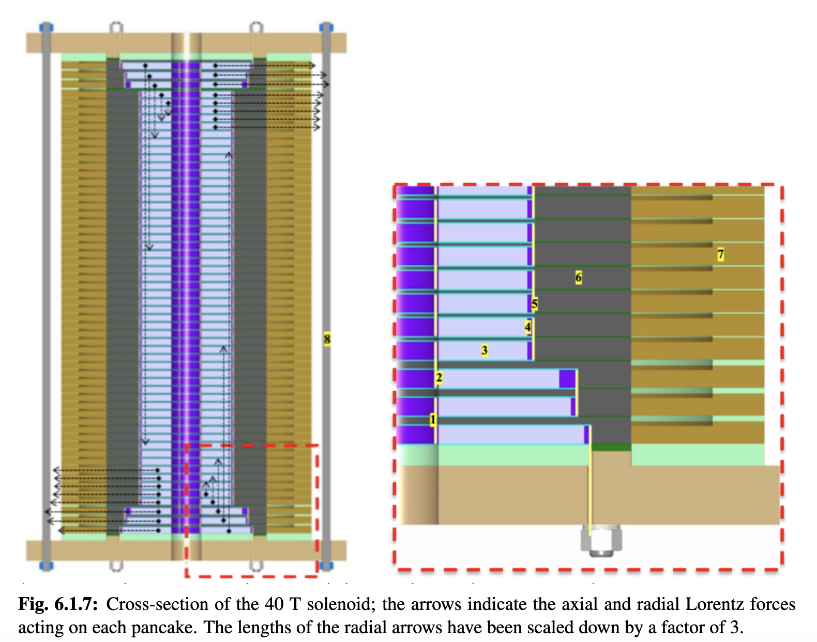
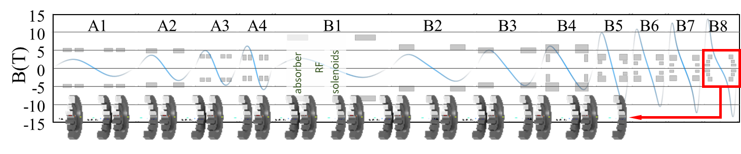
Muon Cooling Lattice Design
Challenges:
Novel, complex lattice with cavities and absorbers in solenoids
High magnetic field
Previous design (MAP)
Goal
Achieved
Achieved:
Much improved lattice design
Developed simulation tools: BDSIM and RFTrack
This allowed to start collective effects studies
Magnet scaled and conceptual designs for 6D cooling
40 T final cooling solenoid conceptual designs (55 T might be possible)
better
better
Key conclusions:
Can in principle reach or exceed performance target
Magnet models and prototypes should be built
Much improved longitudinal, may be useful for collider ring
Study of collective effects important

Slide 17
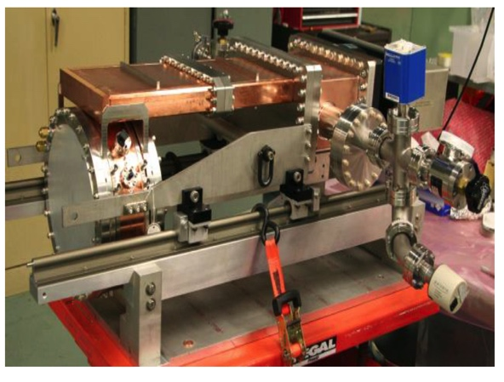
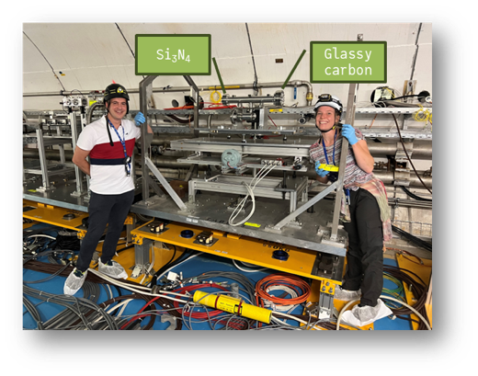
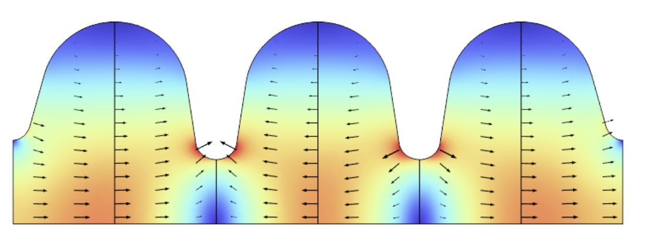
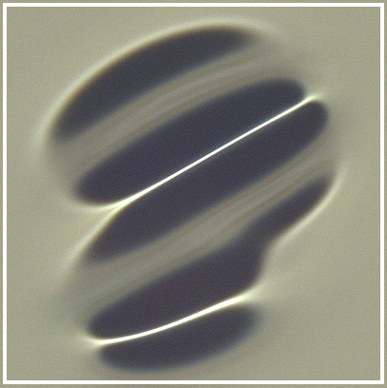
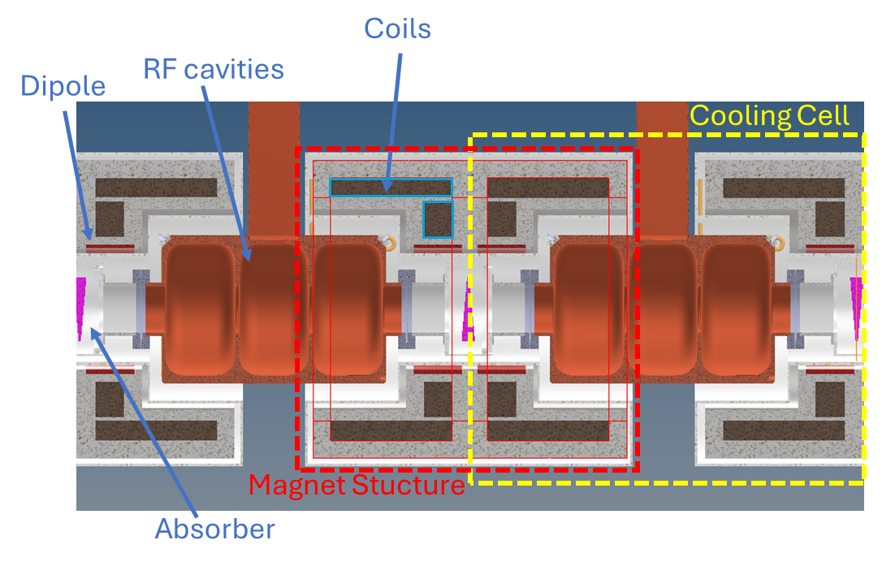
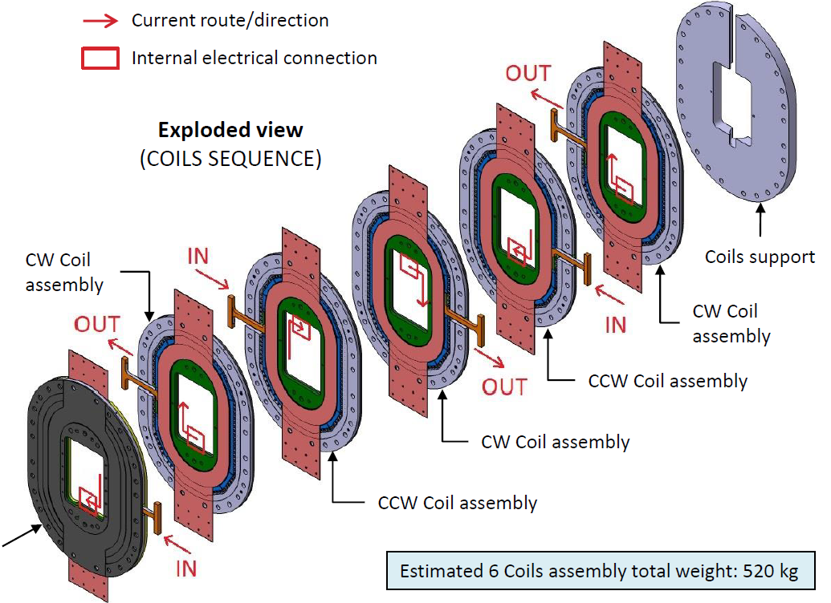
Muon Cooling Technology
Challenges:
NC RF cavities in magnetic field (30 MV/m)
HTS magnets (up to 40 T in final cooling)
Bright beam hard on absorbers and windows
  Can evaporise liquid hydrogen
MuCool demonstrated >50 MV/m in 5 T
H2-filled copper
Be end caps
MAP proved gradient
Initial RF designs
More RF design ongoing to optimise beamloading
First window tests performed with protons
Use of H2 gas in final absorbers
Key conclusions:
Ready to ramp-up effort, in particular prototyping and experimental work, also beamdynamics
Need RF test stands for experimental optimization
6D cooling cell engineering design almost ready

Slide 18
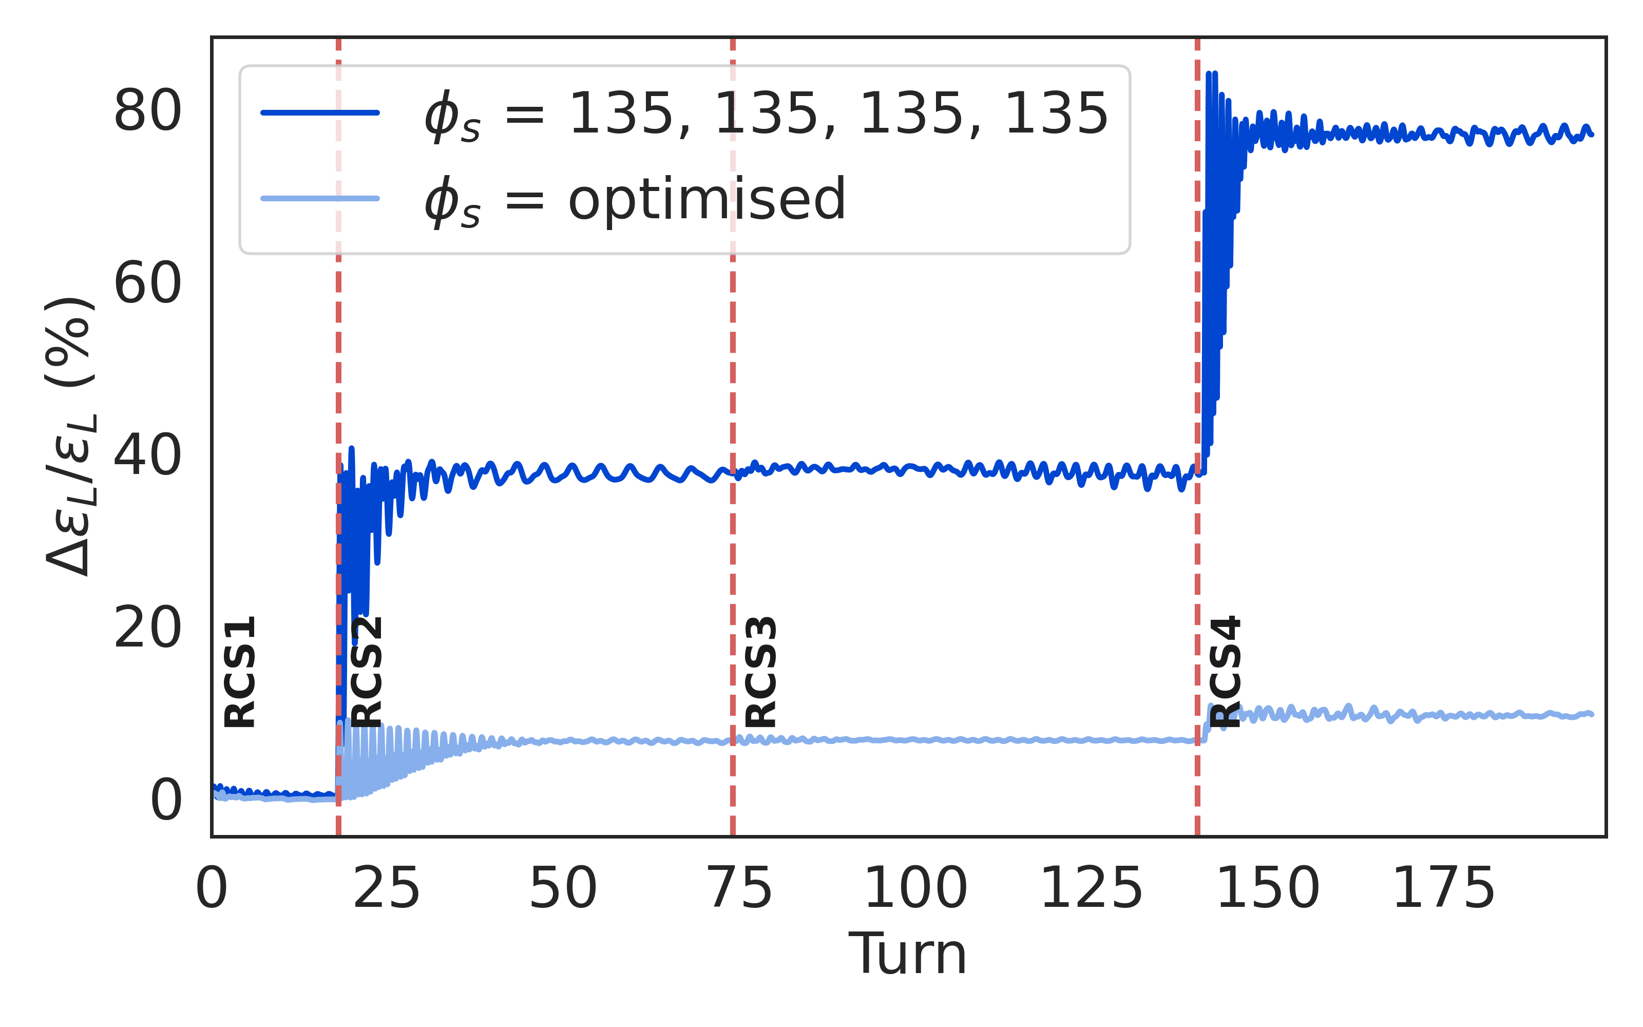
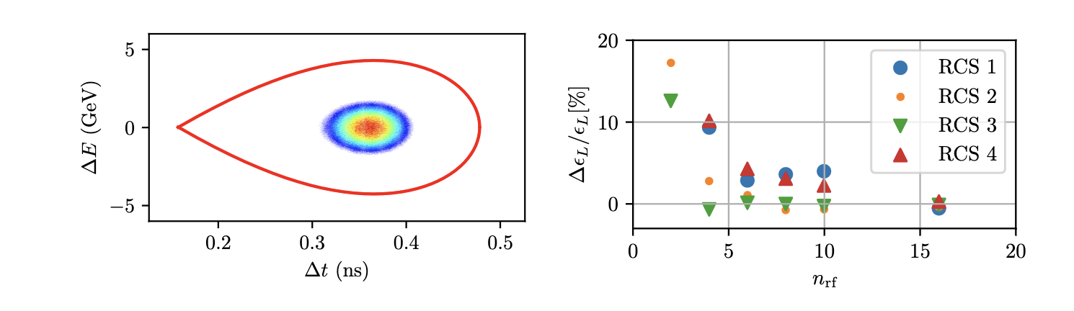
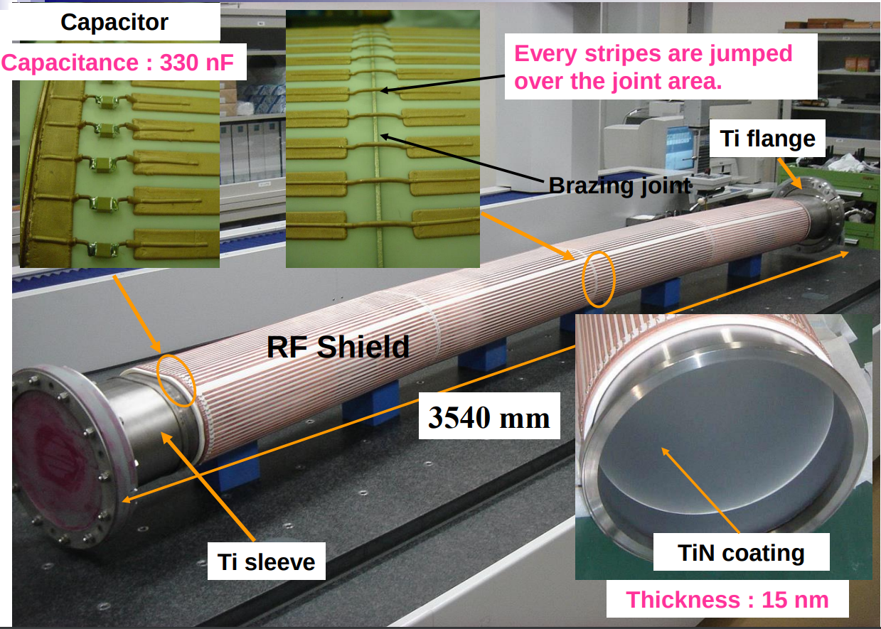
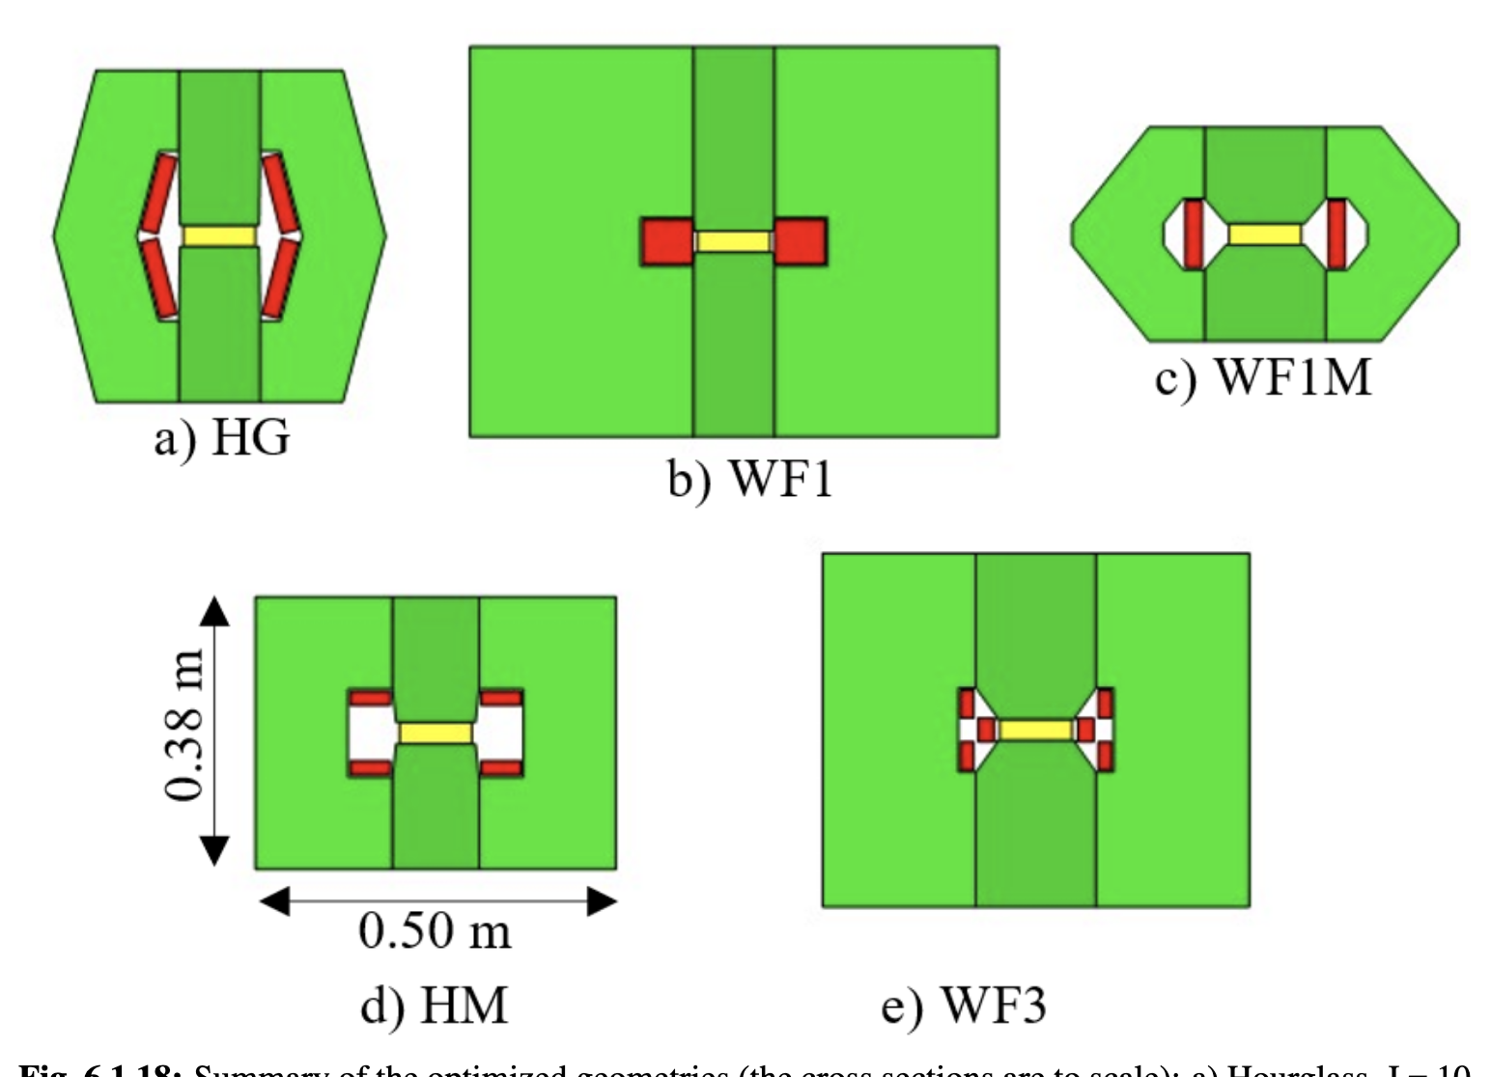
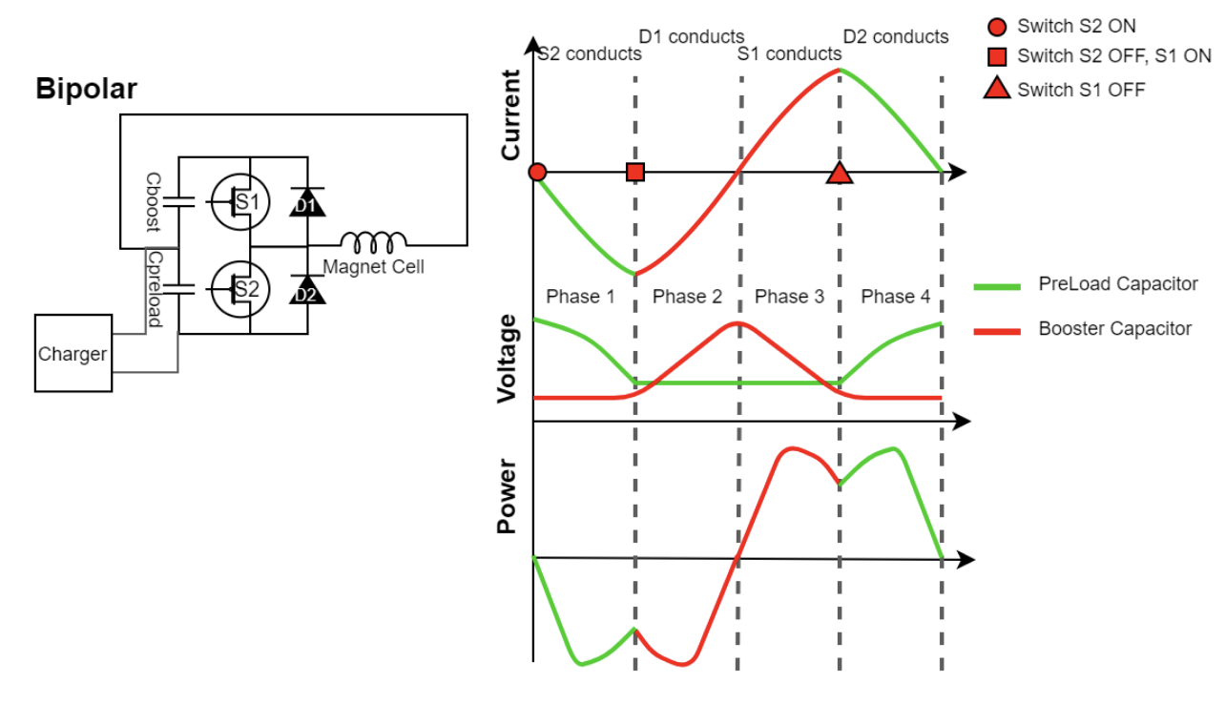
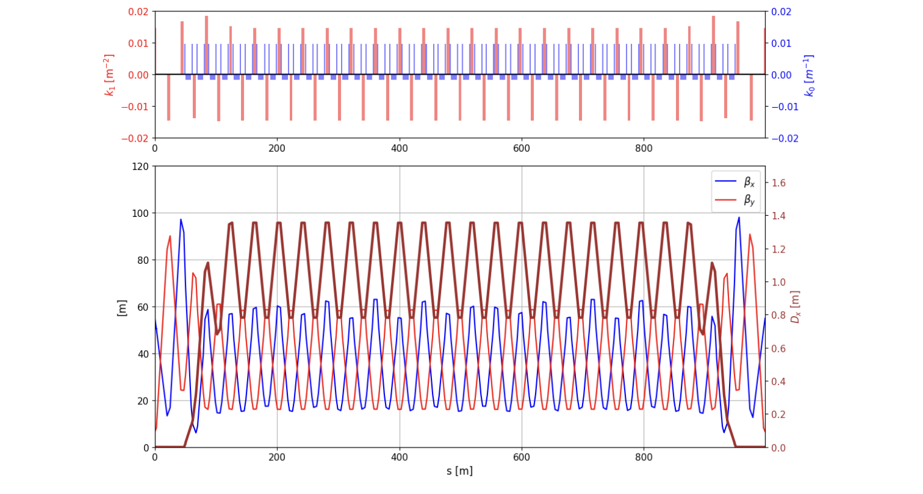
RCS Designs
Challenge:
Uses fast-pulsed normal magnets
5 Hz pulses of O(1-10ms)
6-35 km circumference
Cost
Recover energy from magnetic field
High bunch charge
Maintain beam quality
Achieved:
Lattices for all site independent RCSs
Beam propagation through complex
Conceptual design of magnets and power converters
Optimised design together with RF
RCS | E [J/m] | Loss [%] | P [MW]
SPS 1 | 5447 | 1.1 | 1.9
LHC 1 | 5678 | 1.6 | 12.8
LHC 2 | 5752 | 6.3/2 | 26.6
Key conclusions:
1.3 GHz TESLA-type cavities work
Emittance transport is OK
Cost and power is OK
Need to connect to initial linacs

Slide 19
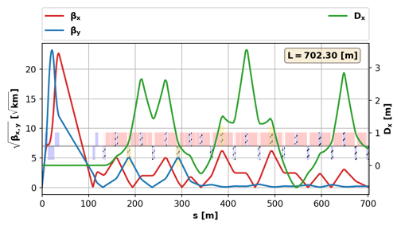
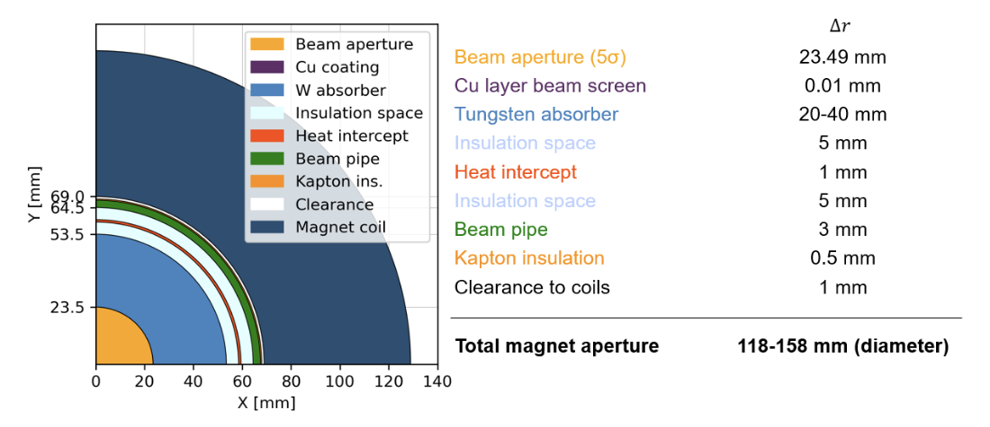
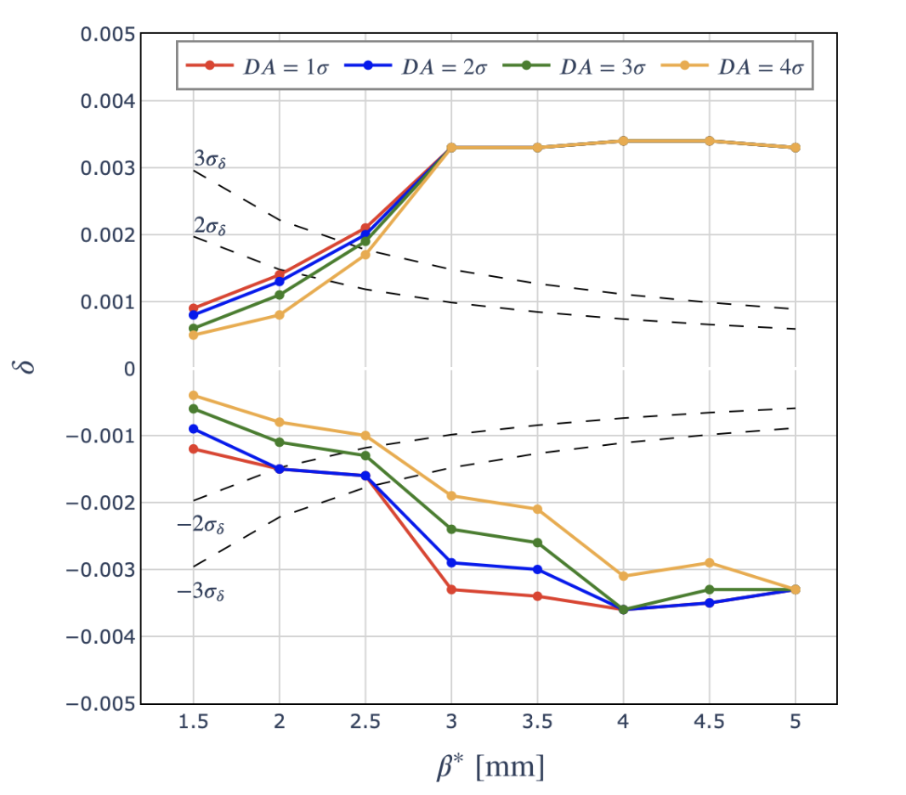
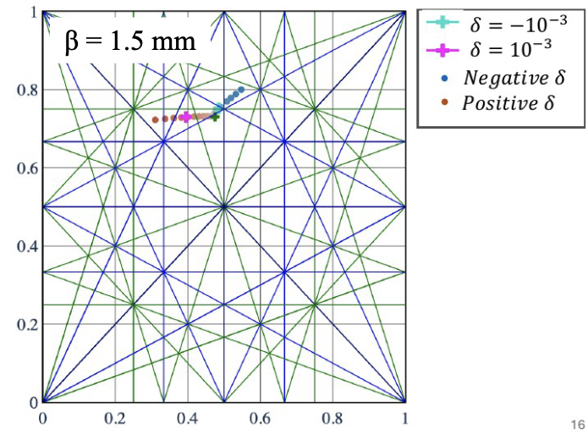
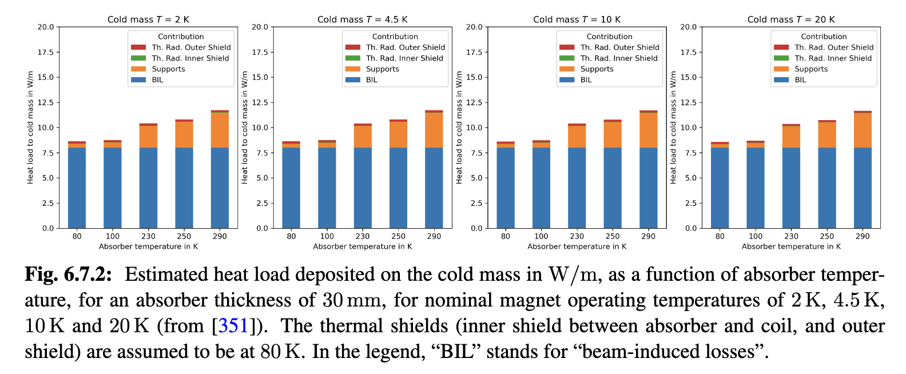
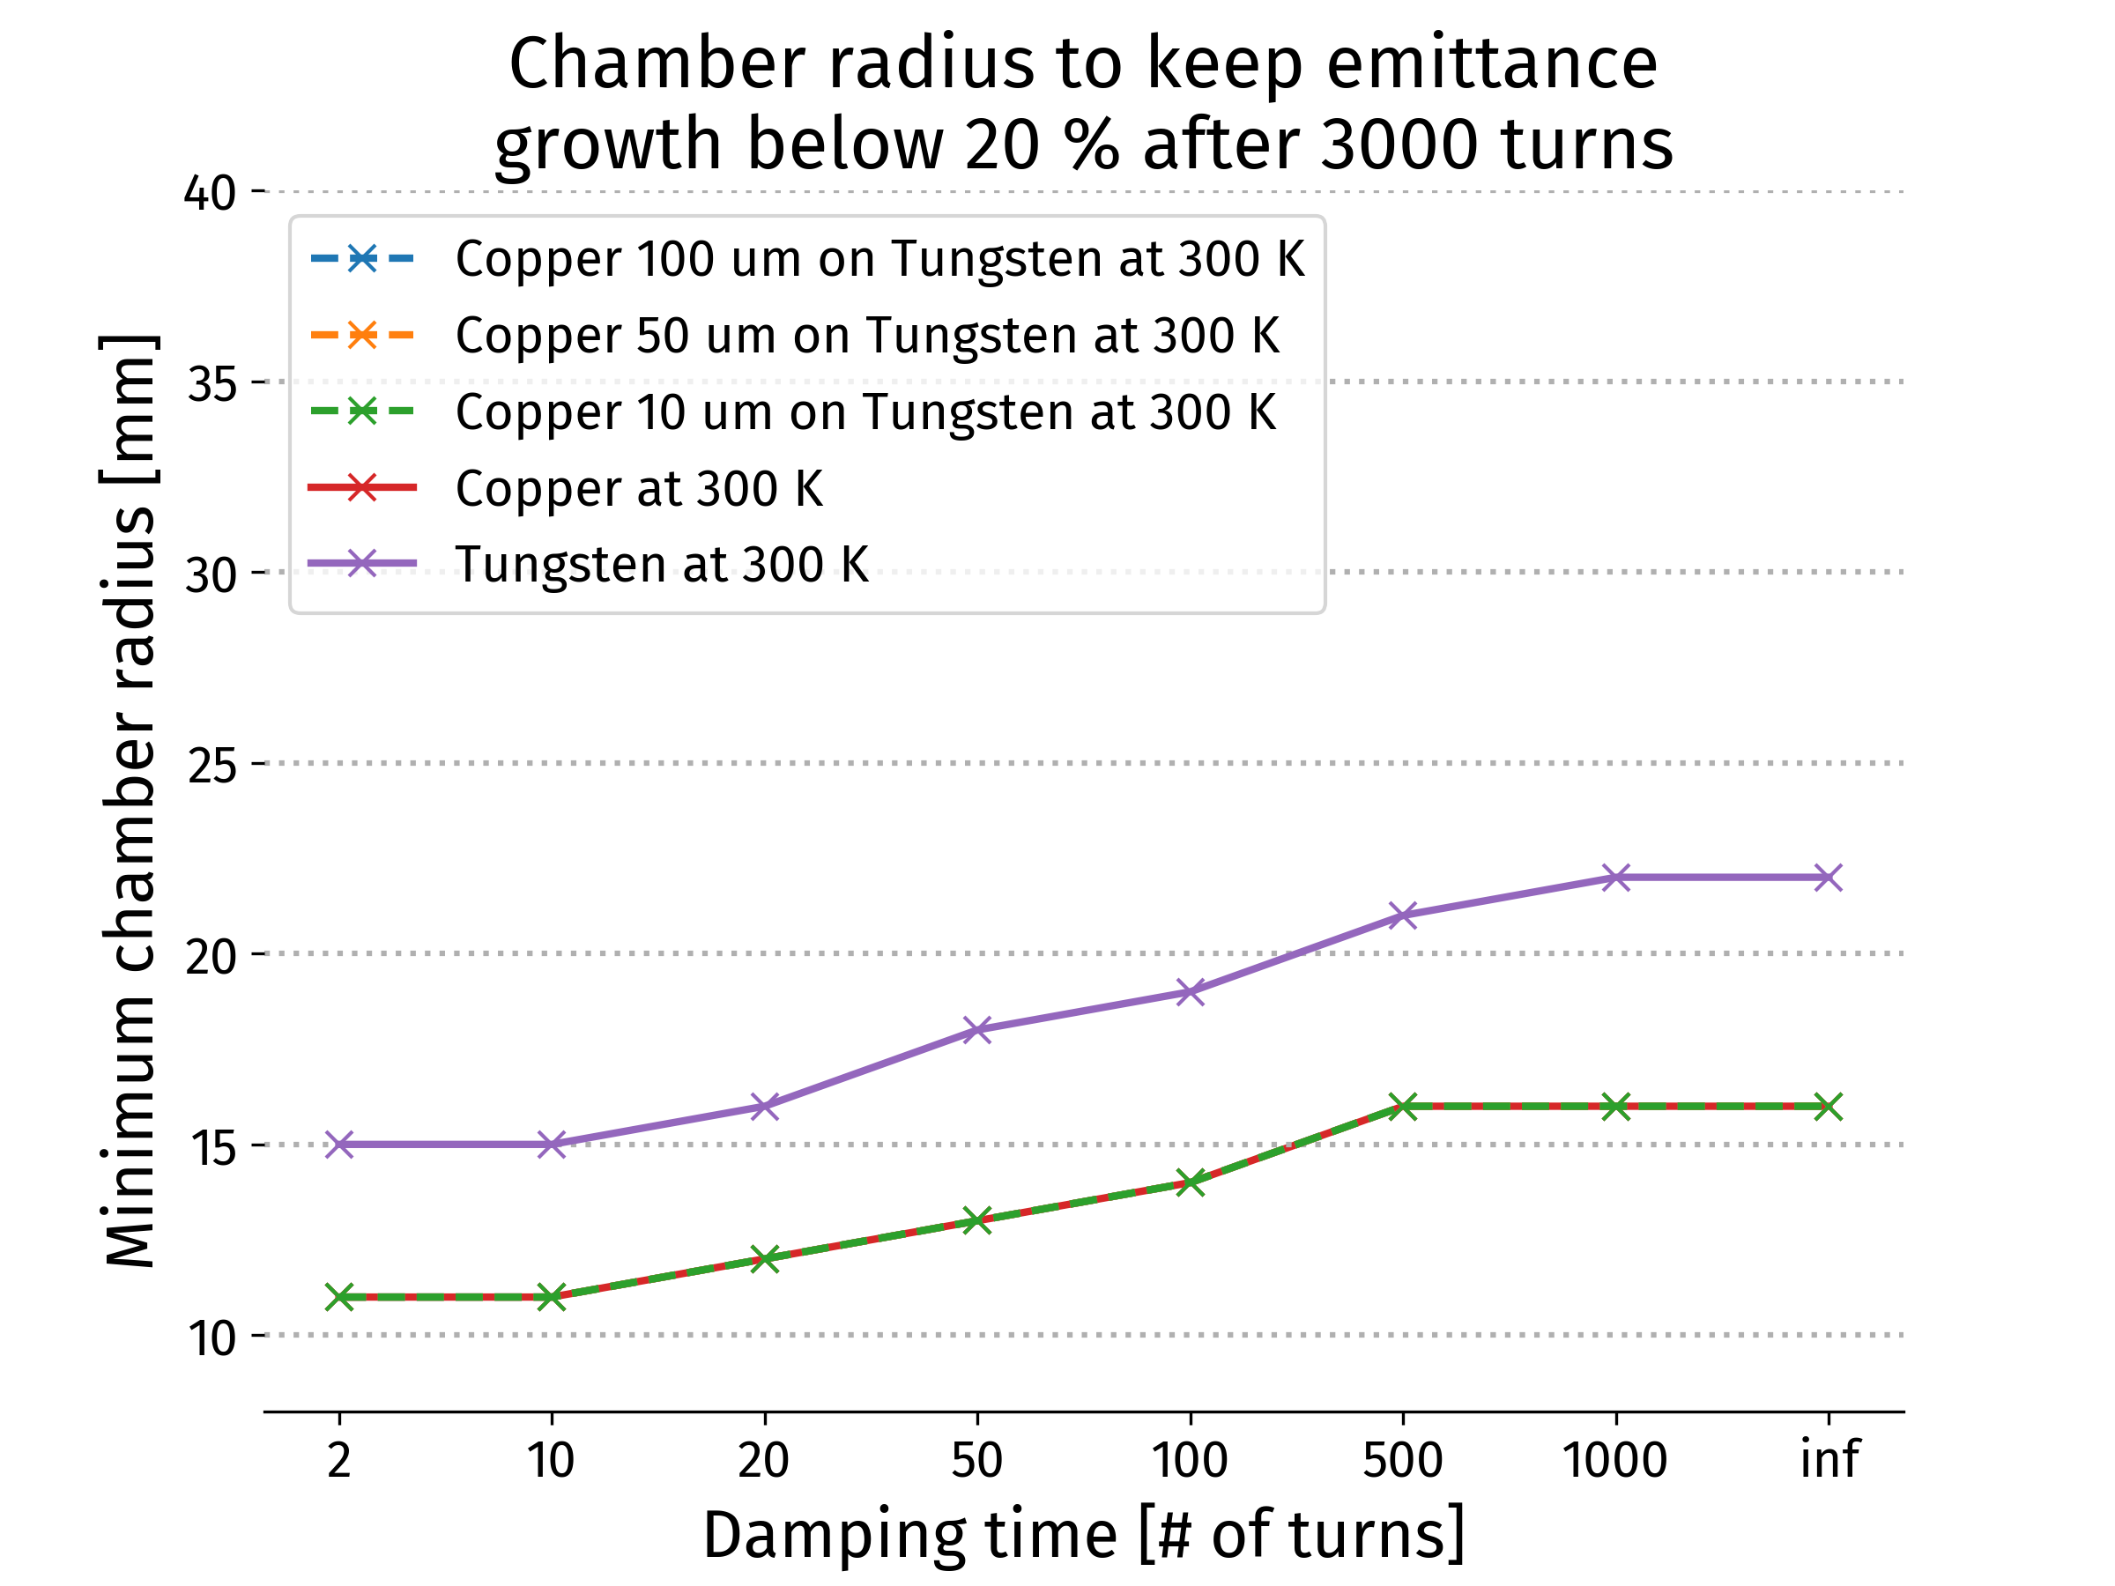
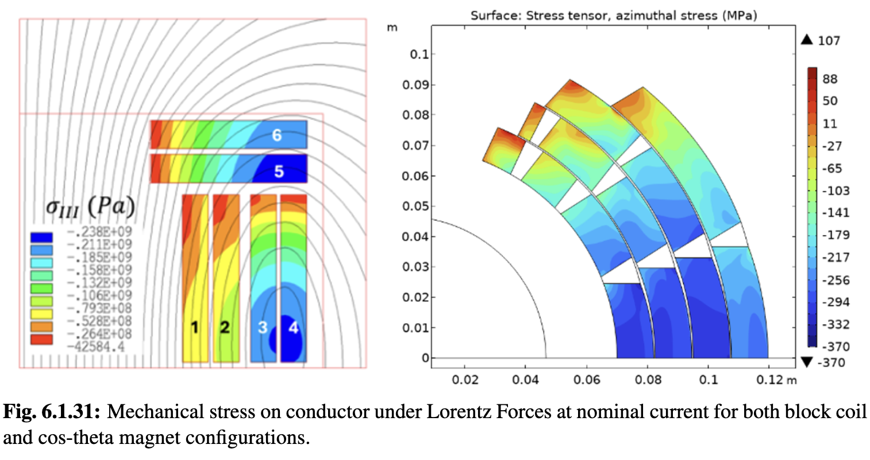
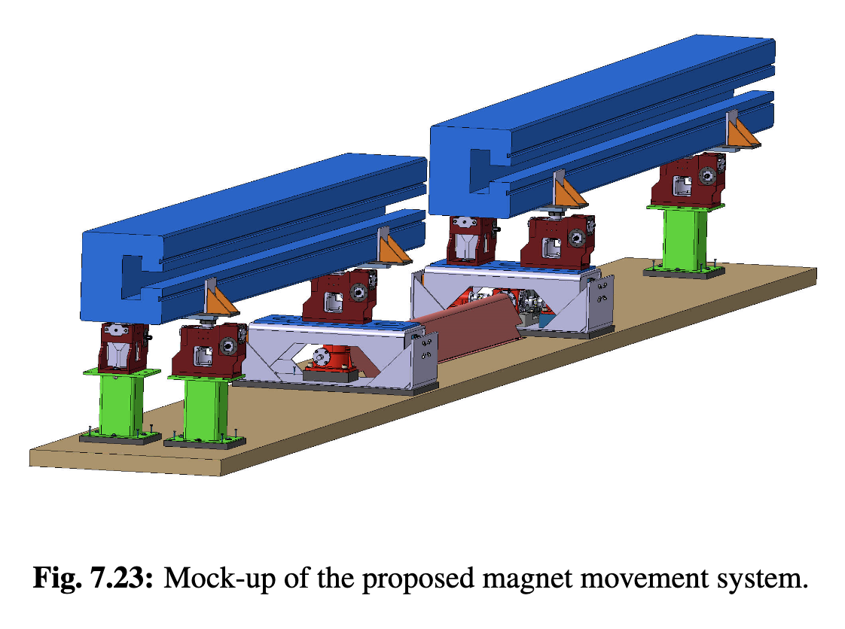
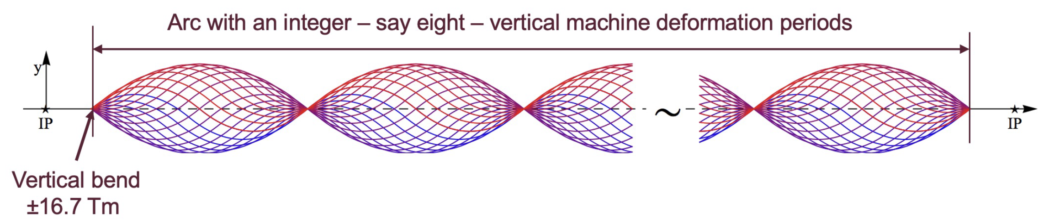
Collider Ring
Challenges:
500 W/m loss, magnet strength, lattice design with beta 1.5-5 mm, 0.1% beam energy spread
Shielding (30-40 mm)
Achieved:
Magnet shielding design
Magnet performance model and conceptual designs
Cryogenics conceptual design
Lattice reaches target beta-functions but not yet full target energy acceptance
First studies of mover system impact on beam
Impedance is OK
Cryogenic loads at different temperatures
Key conclusions:
Should improve energy acceptance somewhat
OK with energy spread predicted in muon cooling
Mover system OK for beam in regular arcs
Address imperfections next
Magnet Designs

Slide 20
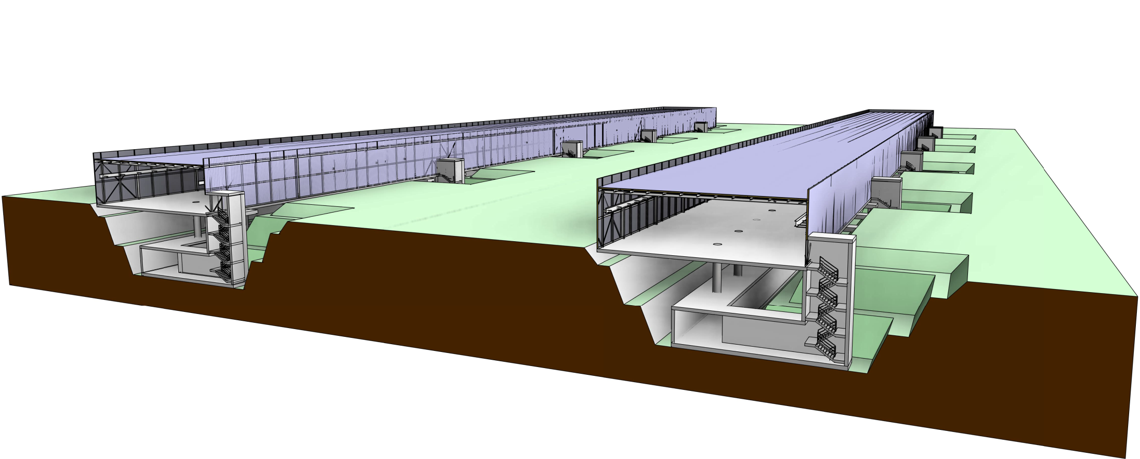
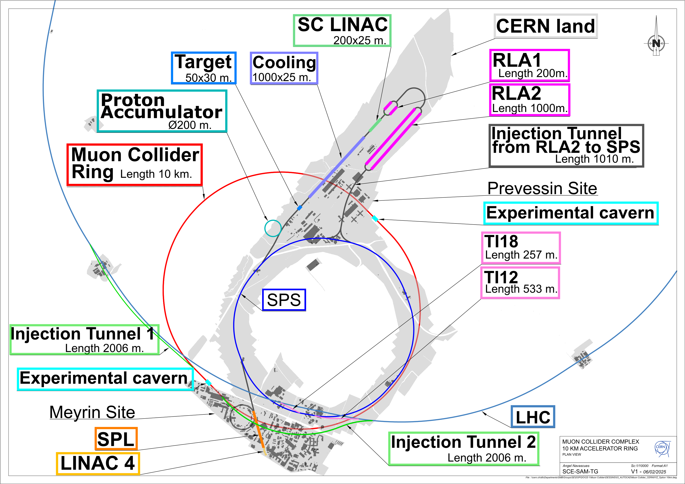


Site Specific Designs
Started studies for concrete site at CERN and Fermilab, looks very promising
CERN:
One RCS in SPS and two in LHC
Construct facility on CERN land
Adjusted parameters
(3.2 and 7.6 TeV, 10 TeV maybe possible)
Fermilab:
One RCS in Tevatron tunnel,
Three RCSs in one site-filler tunnel

Slide 21





Placement Studies
Challenge:
Obtain negligible neutrino flux
Achieved:
Detailed modelling
First good orientation found
Mover system concept
t₁
t₂
Arc mitigation concept
FLUKA and RP studies
Mover system design
Key conclusions:
Are close to a solution
More work to be done
Site study at CERN for experimental insertion

Slide 22



Cost and Power Scale
Design of the crucial collider areas/components has progressed
but more work is needed to provide:
overall optimisation
HTS cost model
Power estimate based on conceptual designs and scaling from know components, e.g.
Simulations of fast-ramping magnets and power converter
Detailed scaling for RCS cavities

Slide 23

Timeline and R&D Programme Proposal
Decision on demonstrator T₀
Initial final demonstrator
Timeline is driven by R&D
Most ambitious example to define R&D programme priorities
Assumes firm commitment to enable the muon collider as next flagship after HL-LHC
R&D is fully successful
No delays due to decision making
Other options
In Europe after a higgs factory
In the US to become leader at the energy frontier
Demonstration Phase 7 years
Project Preparation Phase 5 years
Construction Phase 9 years

Slide 24

R&D Programme
Accelerator design
Start-to-end design to validate and optimize performance, cost, power and risk
Muon cooling technology
Critical for timeline, implementation in steps
Need hardware, in particular RF test stands
==> work in progress
Cooling RF requires urgent test infrastructure
Detector
Strong potential for further physics improvement with technologies, AI and ML
Magnet programme
Have conceptual designs, need hardware
HTS solenoids have important synergy with society (also power converter)
Industry is ready to invest
Should not miss the opportunity
Detailed R&D programme proposal with deliverables defined

Slide 25



Muon Cooling Demonstrator
Launch into RF test stands and first module (700 MHz test stand) right away
Important decision in 2028: demonstrator site and sharing of effort
Initial funding for study of demonstrator at Fermilab approved
Two relatively inexpensive sites are studied for CERN
New ideas to use the muon beams for physics

Slide 26
R&D Plan Reviews
MuCol mid-term review
Very good technical progress
LDG Mid-term Review
Found good progress for Roadmap implementation
“75% of Roadmap goals have been achieved”
Recommendations:
Develop a Start-to-End Performance Simulator:
  This is (one of) the most urgent and crucial parts of the R&D plan
Define and fund a High-Field HTS and RF Development Strategy:
  This is an important part of the R&D plan
  New funding needed
Conduct an Independent Review of Scope, Schedule, and Costs:
  Initial review by our International Advisory Committee (IAC)
IAC review

Slide 27








Way Forward
Implement the proposed R&D plan, with deliverables and resources estimates for the next 10 years
Identify resources, sharing of work between partners
Need strong support of ESPPU
Central funding through CERN is instrumental
Started a task force to prepare the implementation
Exploit synergy with other particle physics and accelerators
Muons, neutrinos, …
Strong synergy with societal applications exist
HTS magnets for fusion reactors, wind power generators, motors, material science, health applications
Power converter
…
Design of 10 MW HTS wind generator
Collaboration on target solenoid/fusion with F4P, ERUOFusion, GaussFusion, ENI is key example
Have agreements that can lead to resources
An opportunity for particle physics to make an important impact on society
Early career experts are very motivated by the required and possible innovations

Slide 28
Conclusion
Since the ESPPU recommendation strong commitment
of the International Community at large to:
grow and work together effectively
consolidate the baseline design of the facility at 10+ TeV
Excellent technical progress has been made, in spite of resource limitations
Supported by LDG, MuCol, and IAC reviews
design and optimize the facility and the experiment: R&D plan
An R&D programme proposal for ten years has been defined
Focus on preparing its implementation (partners, resources, priorities, synergies)
Ionization cooling demonstrator is a priority
==> developing synergies on physics measurement
Reiterated strong support and interest in the US in the recent report by NAS

Slide 29
Conclusion
New lattice @ 10 TeV
Full simulation demonstrate physics feasibility and potential despite the BIB
Demonstrator is a Priority
Strong support of ESPPU for the R&D is important
To maintain the muon collider as a timely option for Europe, for the US or potentially for other regions
To profit from the strong impact of the R&D
  Motivation of early career scientists and engineers
  Technologies with high impact on society
A more centralised commitment to ensure funding will be beneficial
need for global coordination
Many thanks to the collaboration for all the work
Our web page: http://muoncollider.web.cern.ch
If you want to join: muon.collider.secretariat@cern.ch

Slide 30
Reserve

Slide 31
Key Target Parameters
Param. | Unit | Site independent |  | CERN 2 tunnels |  | CERN 1 tunnel
Sqrt(s) | TeV | 3 | 10 | 3.2 | 7.6 | 3.2 | 7.6
L/IP | 10³⁴ cm⁻²s⁻¹ | 1.8 | 17.5 | 2 | 10 | 0.9 | 7.9
Int L | ab⁻¹ | 1 | 10 | 1 | 10 | 1 | 10
Accumulation time | years | 2+2.8 | 2+2.9 | 2+2.5 | 2+5 | 2+5.6 | 2+6.3
C | km | 4.5 | 11.4 | 4.8 | 8.7 | 11 | 11
B_{dipole} | T | 11 | 14 | 11 | 14 | 4.8 | 11
Collider dipole technology |  | Nb3Sn | HTS | Nb3Sn | HTS | NbTi | Nb3Sn or HTS
Accumulation time: Time to obtain the integrated luminosity with two IPs.
Ramp-up over the first three years 5%, 25%, 70% of nominal.
31

Slide 32

Magnet R&D Impact
L. Bottura

Slide 33
R&D Impact Examples
Fusion for Energy (ITER EU Domestic Agency)
  Framework agreement and first addendum in final negotiation
  Contribution to the design of the HTS target solenoid, relevant to the central solenoid of DTT
EUROFusion (next step European fusion reactor)
  Framework agreement signed in 2023, first addendum signed in 2024
  Contribution to the design of the HTS target solenoid, relevant to the magnets of a Volumetric Neutron Source proposed as next step in the European fusion strategy
Gauss Fusion (one of the leading EU fusion start-ups)
  Consultancy agreement signed in 2023
  CERN contribution to the design of the LTS/HTS GIGA stellarator magnets, based on advances in the HTS target solenoid
ENI (oil and gas energy giant)
  Framework agreement and first addendum signed in 2024
  Collaboration on the conceptual design and project proposal for the CERN construction of a large bore HTS solenoid (20@20 model coil) relevant to the muon collider and fusion
Infineon Technologies Bipolar (world leader bipolar high-power semiconductors, focus on green grid)
  IFAST-2 proposal to INFRA-2025-TECH-01-02 (CERN, INFINEON, PSI)
  Proposal of fast pulsed power cell + magnet system sent to IFAST-2 coordination for ranking at TIARA
  Industrial interest in rapidly pulsed and large energy/power supplies
Note: Examples in Europe because we restarted here
Expect similar interest in all regions

Slide 34
Start-to-end Model
This is an important part of the proposed R&D plan
Due to resource limitations we had to set priorities in the LDG Roadmap:
Design of the collider areas with lattice challenges and contained Critical Technology Elements
Address the key challenges such as neutrino flux and beam-induced detector background
Development of missing critical simulation tools
Development of realistic performance targets for the components
Now available:
Initial cost model
Initial power consumption model
With increased resources can:
Design missing connecting systems
Further improve existing system designs
Refine cost and power consumption model
Optimise for risk and cost
Are introducing a formalized configuration management for the overall optimisation

Slide 35

Power Consumption Estimate
Power estimate is based on
Conceptual designs, e.g. fast-ramping magnets and power converter
Detailed estimates for RF systems
Cryogenics power estimates include beam losses and shielding
  More study for beam loss in RCS RF, maximum range (-4 to +9 MW for 3.2 TeV and -10 to 19 MW for 7.6 TeV)
For cryostats detailed scaling (e.g. pulse length, rate, etc.) from known cryostats has been applied
An overall estimate for general cooling and ventilation has been added
No overall optimization has been performed for the power consumption
RCS | E [J/m] | E_{iron} [J/m] | E_{copper} [J/m] | Loss [%] | P [MW]
SPS 1 | 5447 | 10 | 52 | 1.1 | 1.9
LHC 1 | 5678 | 9.2 | 80.6 | 1.6 | 12.8
LHC 2 | 5752 | 63.4 | 298 | 6.3/2 | 26.6
Energy in magnets, losses per cycle and total power at 5 Hz including cooling

Slide 36
Injector Complex
The injector complex needs to undergo optimization before detailed design.
Each component of the surface injector complex needs tailored civil engineering design based on individual component requirements.
Upon freezing the layout, detailed studies into the environment, topography and below ground services can be conducted.

Slide 37


Collider Ring and Interaction Region
A preliminary cross section of the Collider Ring has been established based on an LHC cross section.
The Interaction Regions haven’t yet been designed.
An Interaction Region from the FCC housing a single detector has been used for the preliminary costing exercise as well as the affiliated shafts and surface sites.
Therefore, specific designs tailored to the Muon Collider Ring need to be developed, specifically, cavern and shaft sizes for the Interaction Region as well as any further areas necessary to accommodate the required services.

Slide 38

Surface Structures
Ensuring the surface structures are housed where possible on CERN owned land is of upmost importance.
Geographical studies will confirm surface placement of the injector complex and particularly, the surface experimental sites if not to be housed on CERN land. Ensuring these surface sites are in turn located on feasible plots of land.
The Neutrino Flux model, however, aims to find an optimal Collider Ring placement with the surface experimental sites housed on CERN land.

Slide 39


Long Term R&D
With the aim to begin Civil Construction in 2040.
Site specific technical designs, site preparation, an environmental impact study and all the corresponding procedures in preparation for construction need to be conducted.
As well as the preparation for civil engineering construction works, obtaining all required permits, preparation of technical documentation, tenders and commercial documents.

Slide 40
RF and High-Field HTS Development Strategy
For the RF development:
The key challenge is the normal conducting RF in the muon cooling section
Attempt to remain within state of the art for the other parts
This might change once the commitment to a muon collider becomes stronger
This is therefore a part of the muon cooling technology development
Had good discussions with the LDG RF panel
SLAC is investing into an RF test stand
Also efforts at INFN and in the UK
A clear Roadmap for the development of HTS magnets exists and funding needs to be secured
The LDG should play an important role
The HTS solenoid technology is of high importance for societal applications
We can profit from developments driven by society
We can contribute to society
We see that this is leading to additional support for R&D
The power converter for the fast-ramping magnets are of high relevance for society

Slide 41


Muon Cooling Demonstrator
Challenge:
Demonstrate muon cooling technology in stages
Critical for timeline
Achieved:
Defined the scope and concept, made initial cost estimate, investigated three promising locations at CERN
Staged timeline to implement demonstrator
SLAC is moving forward building a 3/1.3 GHz test stand
Key conclusions:
Installation of demonstrator at CERN appears possible with limited cost
Fermilab has approved a study
RF test stands are critical and urgent
Consistent with implementation timeline
R&D plan
Project
preparation
Construction

Slide 42










Magnets
Achieved:
Systematic dipole/solenoid performance prediction (LTS and HTS)
  Aperture, field, cost, stress, loadline, protection, …
HTS solenoid designs (6D cooling, final cooling, target)
Normal-conducting fast-pulsed dipoles (HTS as alternative)
Technically limited R&D timeline developed
MuCol HTS conductor
Operating current: 61 kA
Did adjust collider ring field
HTS final cooling solenoid mechanical design
REBCO, 20 K
First HTS winding tests
Target HTS solenoid
Key conclusions:
Design work is basically done
Opportunity to ramp up effort (engineering designs, building models, …)
With sufficient resources HTS solenoids and Nb₃Sn dipoles could be ready for decision in 10-15 years, consistent with implementation timeline
HTS dipoles likely take longer
HTS pancakes 4 mm tape
Normal-conducting RCS pulsed magnets
42

Slide 43




Collective Effects
Goal:
Identify collective effects intensity bottlenecks
Achieved:
Initial studies for proton complex
Assessed impedances (beam screen and RF cavities) in RCSs and collider ring
  Studying counter-rotating beam impedance
Studies started on muon cooling
WEPM095
Key conclusions:
Impedances in RCSs and collider ring can be taken care of by design
Beam-beam can be handled by 20 turn feedback
Resistive wall in muon cooling is OK
Further key detailed studies: beam loading, longitudinal and transverse space charge in 6D cooling, impedance of cooling absorbers

Slide 44

R&D Plan Deliverables and Resources

Slide 45
R&D Plan Deliverables and Resources
Totals:
Duration 10 years
Accelerator: 300 MCHF material, 1800 FTEy
Detector: 20 MCHF material, 900 FTEy

Slide 46
European Accelerator R&D Roadmap
Reviews in Europe and the US found muon collider promising
Requires important innovation
European Strategy for Particle Physics Update (ESPPU) supported muon collider R&D in 2020
CERN Council charged Laboratory Directors Group (LDG) to develop Accelerator R&D Roadmap
Directors of institutes, e.g. INFN Frascati, PSI, DESY, RAL, CERN, …
LDG formed five panels, one on Muon Collider
Muon Collider panel developed an R&D Roadmap with the help of the global community until end of 2021
46
http://arxiv.org/abs/2201.07895

Slide 47
Muon Collider Roadmap CT
Protons produce pions which decay into muons which are captured
Short, intense proton bunch
Ionisation cooling of muon in matter
Acceleration to collision energy
Collision
- Proton driver
bunch compression
- Graphite target
- Target solenoid
- Muon cooling design
- 6D cooling solenoids
- 6D cooling RF cavities
- Final cooling solenoids
- Pulsed magnets and
power converters
- RCS RF system
Identified and prioritized with community
Other areas need now also to be addressed
(some work started)
- Collider ring dipoles
- Final focus quadrupoles
- Machine-detector interface
47

Slide 48
Muon Cooling Challenges
High field solenoids minimise beta-function and impact of multiple scattering
Energy loss = cooling
Multiple scattering = heating
48

Slide 49
The Collaboration
Collaboration formed 2022, currently hosted by CERN
EU co-funded design study MuCol started 2023
Already strong US contribution to IMCC ESPPU documents
  Forming national organisation to participate
  Several grants secured, also at labratories
  Addendum to CERN-DoE agreement in preparation
National Academy of Science:
Recommendation 1: The United States should host the world’s highest-energy elementary particle collider around the middle of the century. This requires the immediate creation of a national muon collider research and development program to enable the construction of a demonstrator of the key new technologies and their integration.
A collider with approximately 10 times the energy of the Large Hadron Collider (LHC) is crucial for addressing the big questions of particle physics and making discoveries. […]
A 10-TeV muon collider […] would have similar discovery reach as a 100-TeV proton collider. […]
Developing a U.S.-hosted muon collider would solidify U.S. […] leadership in particle physics and drive accelerator innovation
IMCC will carry out the R&D together and develop options to host the collider at CERN or at Fermilab and potentially also other sites
Envisage to share leadership between CERN and Fermilab
49

Slide 50
US and Collaboration
National Academy of Science:
Recommendation 1: The United States should host the world’s highest-energy elementary particle collider around the middle of the century. This requires the immediate creation of a national muon collider research and development program to enable the construction of a demonstrator of the key new technologies and their integration.
A collider with approximately 10 times the energy of the Large Hadron Collider (LHC) is crucial for addressing the big questions of particle physics and making discoveries. […]
A 10-TeV muon collider […] would have similar discovery reach as a 100-TeV proton collider. […]
Developing a U.S.-hosted muon collider would solidify U.S. […] leadership in particle physics and drive accelerator innovation
IMCC will carry out the R&D together and develop options to host the collider at CERN or at Fermilab and potentially also other sites
Envisage to share leadership between CERN and Fermilab
50

Slide 51
The Collaboration
Collaboration formed 2022, currently hosted by CERN
61 formal member institutions
In response to a request of the last ESPPU to explore a muon collider
Integrated into the European Accelerator R&D Roadmap
  Programme developed with global community
EU is co-funding design study MuCol since 2023
The study also responds to the US
  From Snowmass process, the P5 and now National Academy of Science
Already a growing US contribution to IMCC ESPPU documents
National Academy of Science:
Recommendation 1: The United States should host the world’s highest-energy elementary particle collider around the middle of the century. This requires the immediate creation of a national muon collider research and development program to enable the construction of a demonstrator of the key new technologies and their integration.
51

Slide 52
The Collaboration
Collaboration formed 2022, currently hosted by CERN, consider co-hosting by Fermilab
61 formal member institutions, still growing
Strong US contribution
R&D progamme developed with global community
In response to a request of the last ESPPU to explore a muon collider
Integrated into the European Accelerator R&D Roadmap
  Programme developed with global community
EU is co-funding design study MuCol since 2023
The study also responds to the US
  From Snowmass process, the P5 and now National Academy of Science
Already a growing US contribution to IMCC ESPPU documents
National Academy of Science:
Recommendation 1: The United States should host the world’s highest-energy elementary particle collider around the middle of the century. This requires the immediate creation of a national muon collider research and development program to enable the construction of a demonstrator of the key new technologies and their integration.
52

