Slide 1

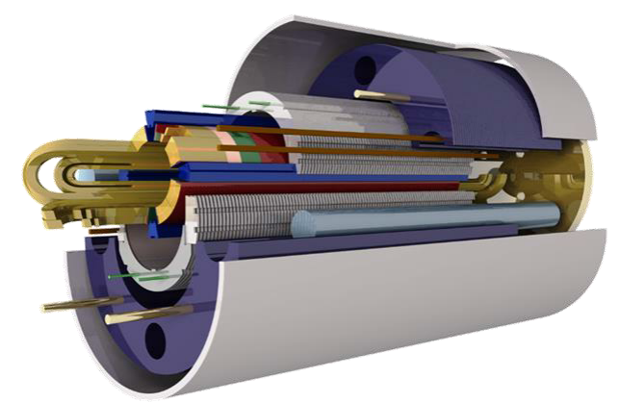
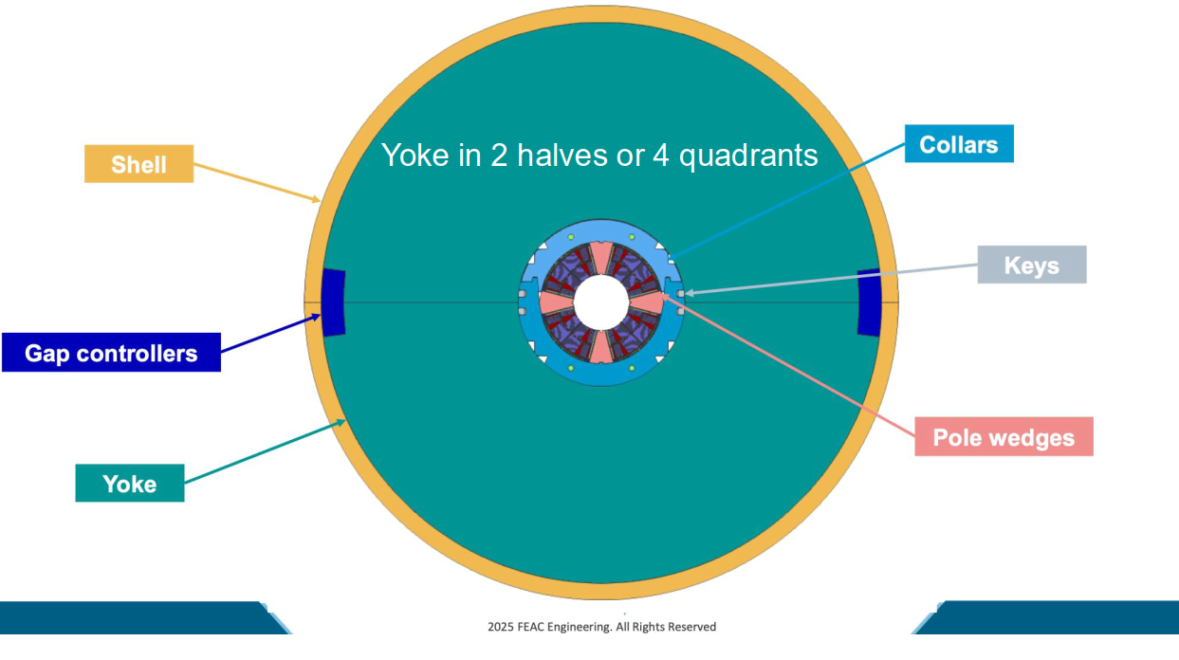
FCC Main Quadrupole Demonstrator Tooling
MAGNET DESIGN
Construct and test a short, 1..1,5 m model magnet in 1-in-1 configuration with coils made from Nb³Sn .
Magnet Design from FEAC Engineering P.C
11 T Dipole pole loading principle adapted to quadrupole geometry

Slide 2

FCC Main Quadrupole Demonstrator Tooling
TOOLINGS
Some tooling Design considerations
Tooling CAD models are parameterised (and can therefore be adapted later)
Tooling design is kept simple (no short parts)
Tooling CAD models are parameterised (and can therefore be adapted later)
Images courtesy

Slide 3
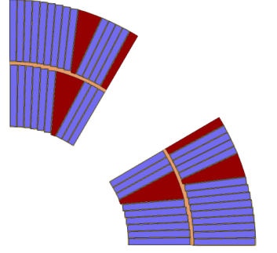
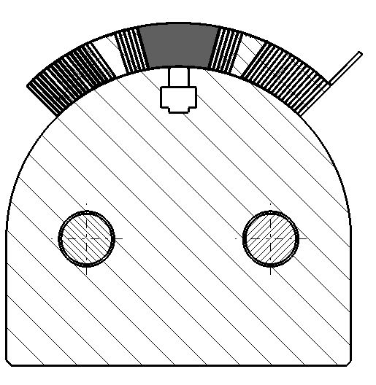
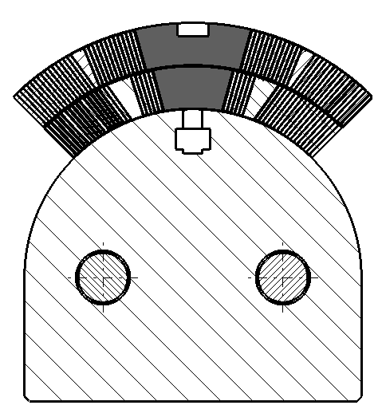
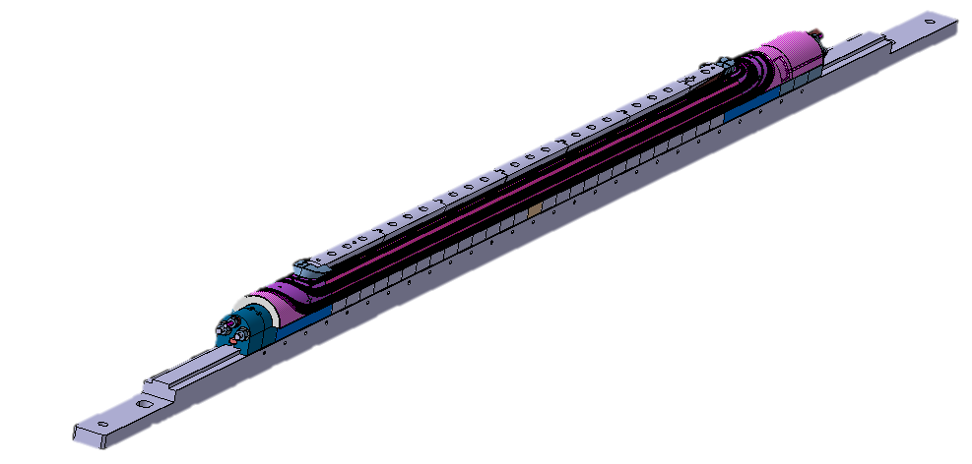
FCC Main Quadrupole Demonstrator Tooling
TOOLINGS
After Winding and Curing
 | TOOLING (Concept)
Winding | 11 T Dipole | MQXF
Mandrel |  | X
Clamps | X | X
Central post IL | X
Central post OL | X
Layer-jump clamping
Spool holder (OL cable)
ESC winding mandrel
Binder curing
IL Former center
IL Former NCE
IL Former CE
Curing base plate |  | X
Curing side bars |  | X
MQXF Winding Tool
Images courtesy
11T Winding Tool

Slide 4
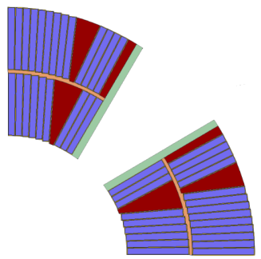
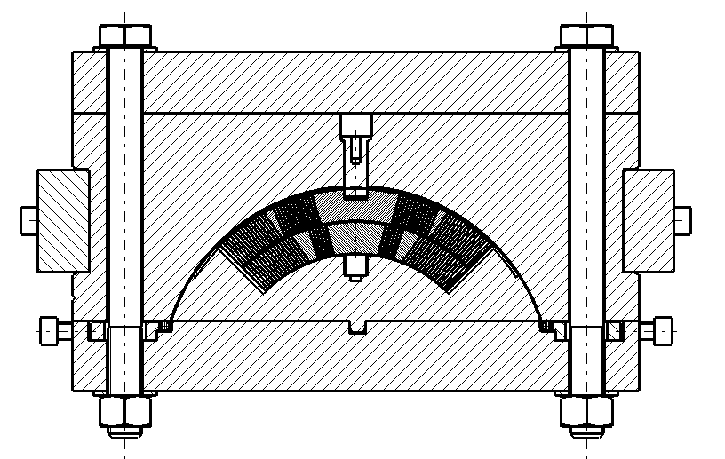
FCC Main Quadrupole Demonstrator Tooling
TOOLINGS
 | TOOLING (Concept)
Reaction | 11T Dipole | MQXF
Reaction central post | X
Reaction mandrel |  | X
Reaction base plate |  | X
Reaction side bars |  | X
Reaction central former
Reaction CE former
Reaction NCE former
Reaction CE end plate |  | X
Reaction NCE end plate |  | X
After Reaction
MQXF Reaction Tool
Images courtesy

Slide 5
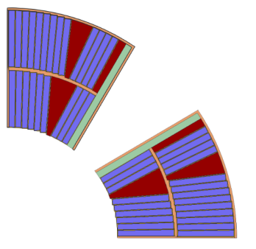
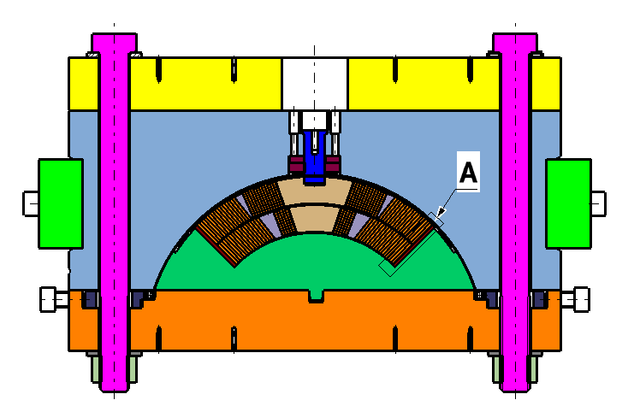
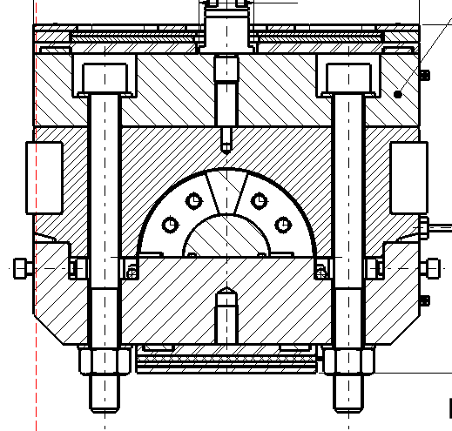
FCC Main Quadrupole Demonstrator Tooling
TOOLINGS
 | TOOLING (Concept)
Impregantion | 11T Dipole | MQXF
Impregnation central post | X
Mandrel
Impregnation base plate |  | X
inpregnation side bars |  | X
Impregnation central former
Impregnation CE former
Impregnation NCE former
Impregnation CE end plate |  | X
Impregnation NCE end plate |  | X
After Impregnation
MQXF Impregnation Tool
11T Impregntaion Tool
Central Post
Images courtesy

Slide 6
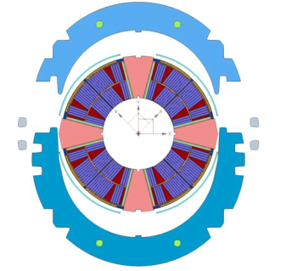
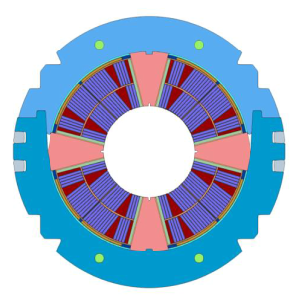
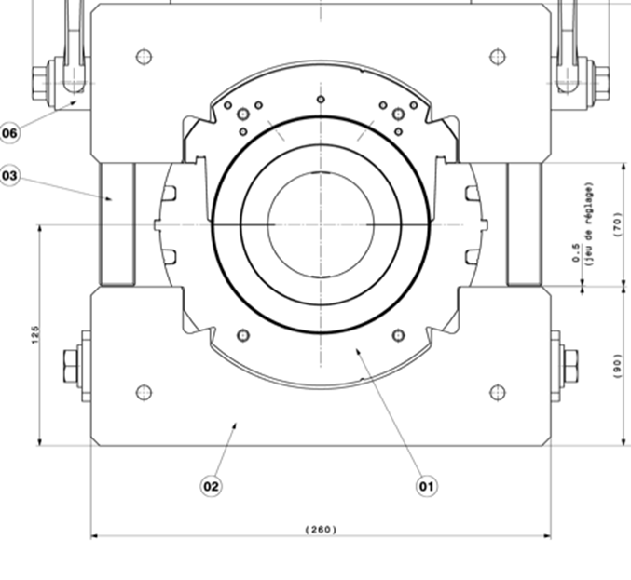
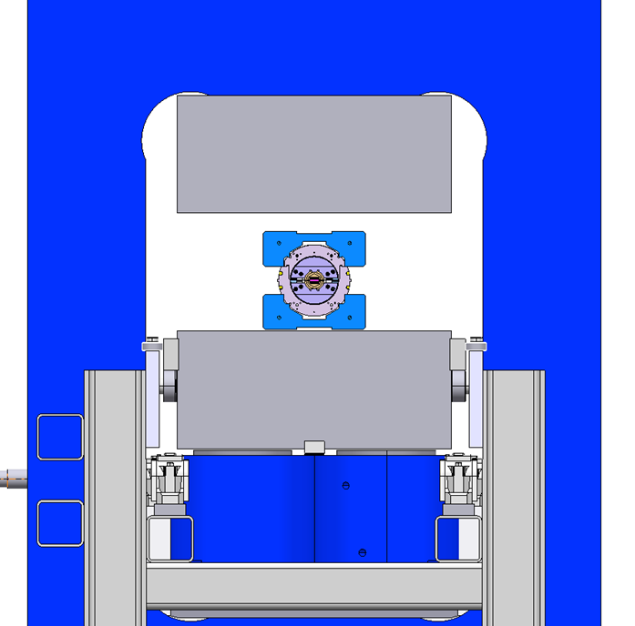
FCC Main Quadrupole Demonstrator Tooling
TOOLINGS
 | TOOLING (Concept)
Collaring | 11 T Dipole | MQXF
Assembly mandrel |  | X
Collaring press contact tool | X
Collaring key insertion tool | X
11T Collaring tool
Images courtesy

Slide 7
FCC Main Quadrupole Demonstrator Tooling
TOOLINGS
Yoke assembly | 11 T Dipole | MQXF
Yoke stacking tool | X
Yoking press contact tooling | X

Slide 8
FCC Main Quadrupole Demonstrator Tooling
NEXT STEPS
Discussion with Tooling experts and bring improvements to the existing Tooling concepts.
PARAMTRIC Tooling’s study based on discussion results.

