Slide 1



A New Readout Scheme for large RPC with high granualrity
I.Laktineh, Ch. Combaret, L. Mirabito
IP2I, Lyon, France

Slide 2
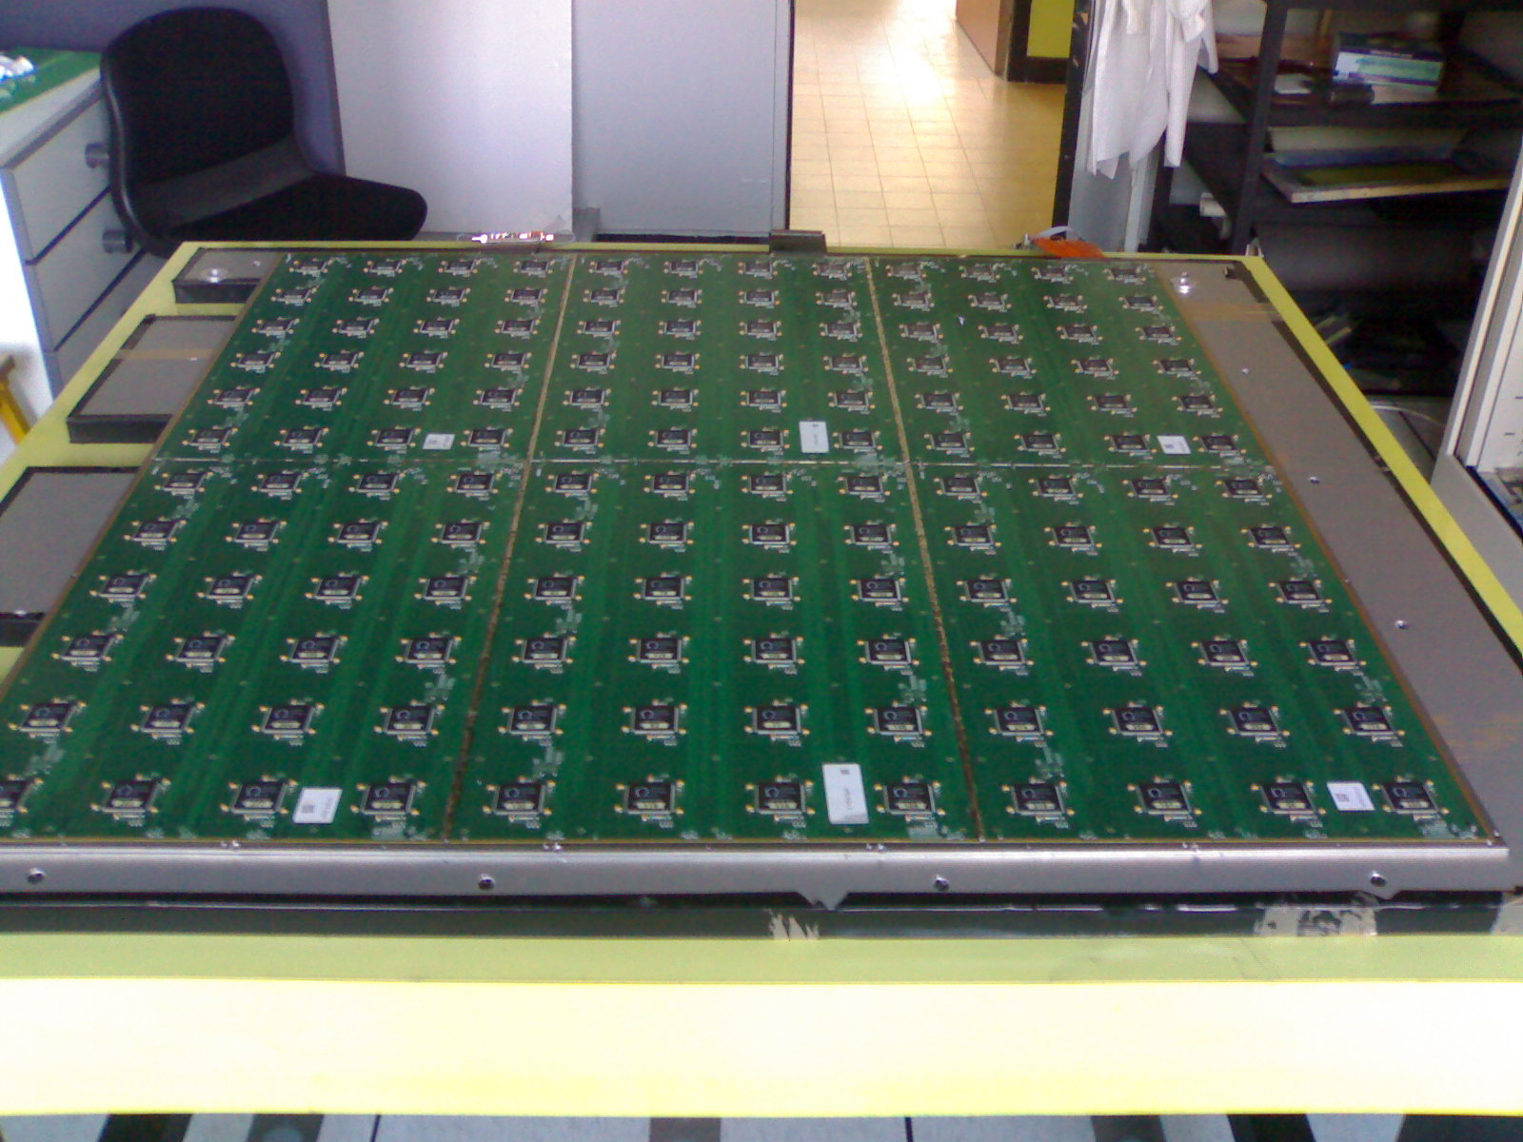
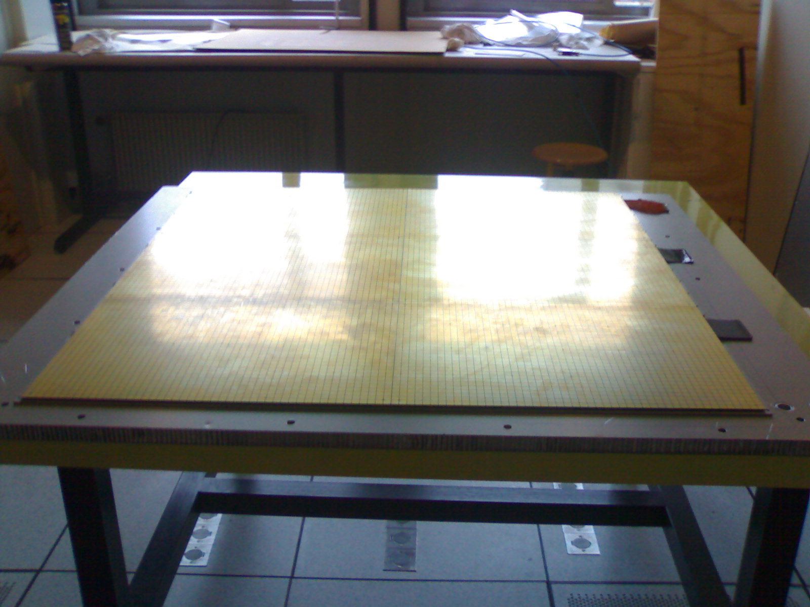
Readout of RPC
There are several ways to read out RPC:
Using one-end readout pick-up strips (either one direction on the anode side as for current CMS RPC or two directions: one on the anode and one on the cathode as for ATLAS)
or two-end readout using excellent time measurement as the one proposed for CMS iRPC upgrade project
Using pick-up PADs as for SDHCAL (CALICE)

Slide 3
Why we need a new readout concept?
Reducing the number of pads/pixels can lead to less spatial precision.
Using (x, y) based readout system is ok as far as limited surface detectors and low noise detectors are used.
Can we do something to save power and money while having the best possible spatial performances
?

Slide 4
There is a solution
PCT/EP2018/053561
Use pickup pads/pixels to have excellent granularity
Connect the pads/pixels in a special way: woven strips or interconnected pads
Two neighboring pixels are connected to two different strips of different directions
Each strip is connected to one electronic channel
Share the charge among a few ones
Cross the fired strip to determine the position
NXN → 3N : Reduction of electronic channels, power consumption and occupancy

Slide 5
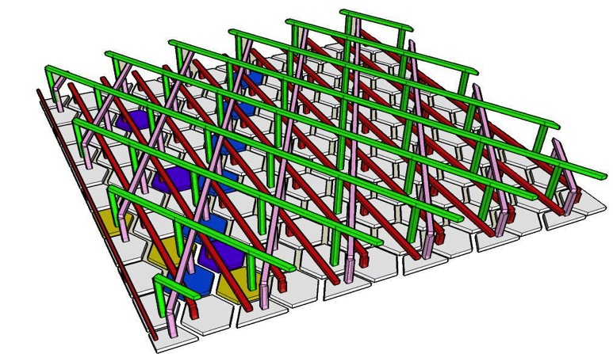
There is a solution
PCT/EP2018/053561
Use pickup pads/pixels to have excellent granularity
Connect the pads/pixels in a special way: woven strips or interconnected pads
Two neighboring pixels are connected to two different strips of different directions
Each strip is connected to one electronic channel
Share the charge among a few ones
Crossing the fired strip to determine the position
1 intersection
=
1 “Hit”
NXN → 3N : Reduction of electronic channels, power consumption and occupancy

Slide 8
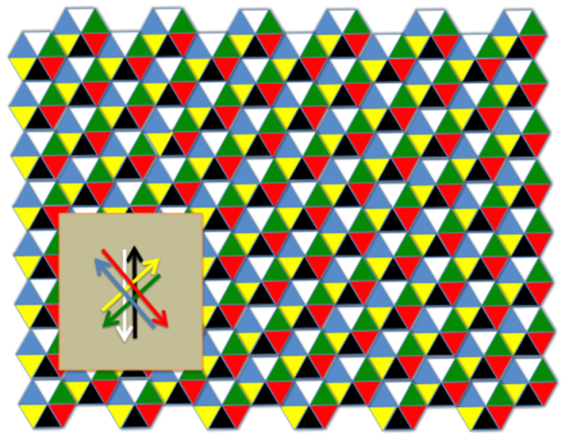
Important features:
The pad/pixel size should be slightly smaller than the charge extension to feed at least two pads/pixels. In gaseous detector this is always possible (RPC or resistive MPGD).
Having 3 or more directions allows one to eliminate ambiguities (ghost particles)
One can read the signal from both sides and get profit of the difference in time of signal arrival to confirm the position resolution and get the absolute time as well.

Slide 9
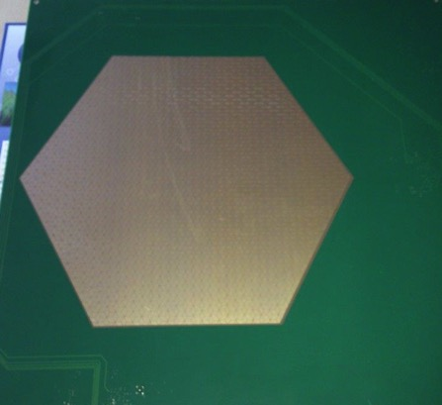
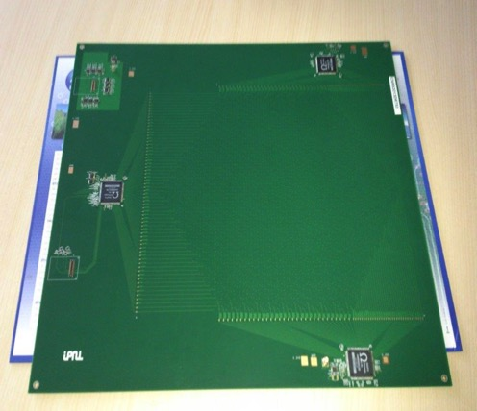
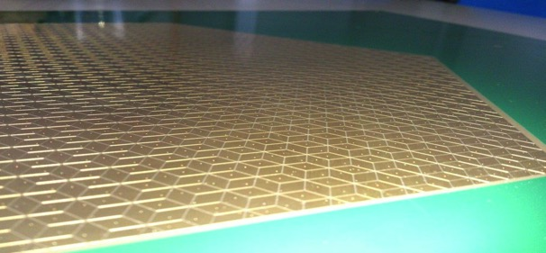
Realization
The new scheme was used to design a PCB with lozenges-based structure and
3 directions. The readout electronics was set on the same PCB. HARDROC2 ASICs (64-ch, 2-bit) conceived for SDHCAL are used.
30 cm
3 HR2 ASICs rather than 20 for the same surface
High granularity
Lozenge’s large diagonal : 8 mm

Slide 10
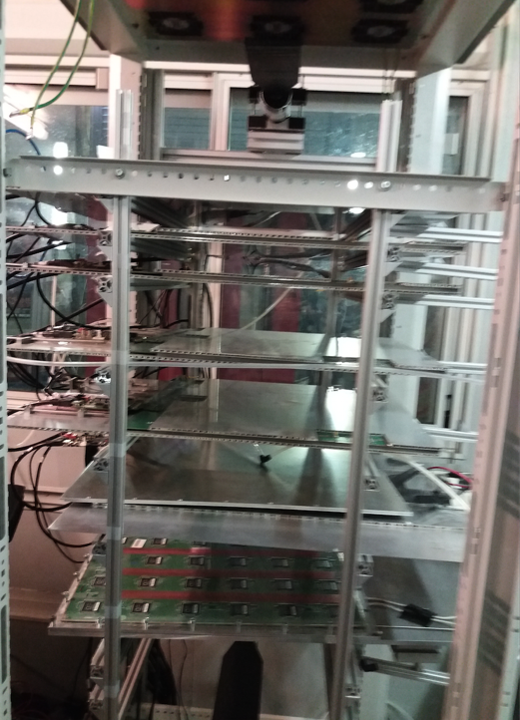
Setup with 5 detectors equipped with the new readout scheme

Slide 11
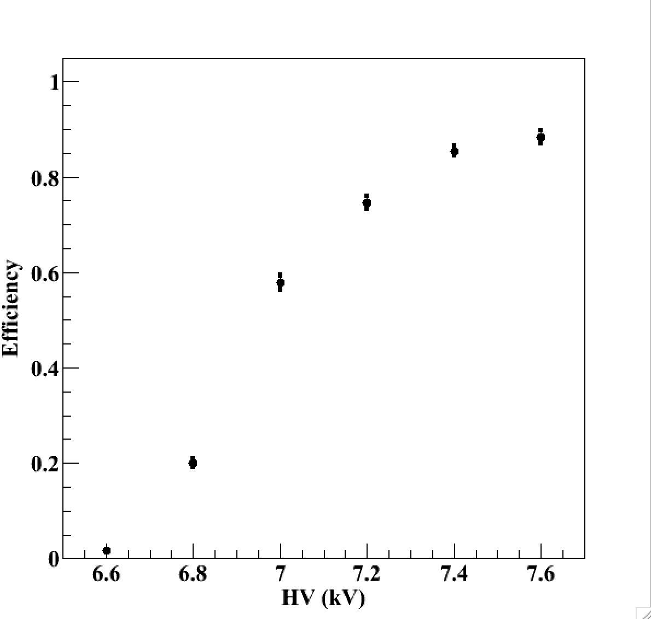
Efficiency vs HV
Threshold ≈ 80 fC
Triggerless mode
TFE(93%)
CO2 (5%)
SF6 (2%)

Slide 12
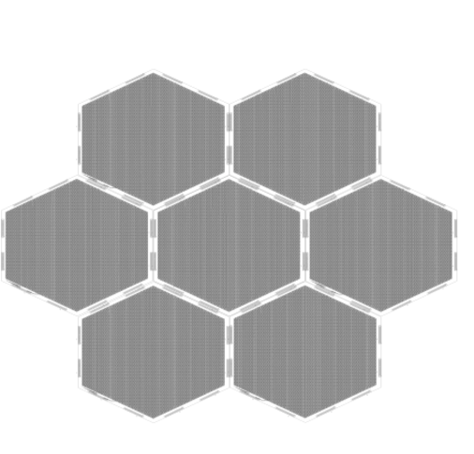
Large surface detectors
To instrument (very) large gaseous detectors the readout electronics could not be part of the PCB. It is therefore mandatory to separate strip panels from the readout electronics.
A simple scheme is proposed:
FEB
“Well matched impedance will help to keep the signal in good shape for long distances”

Slide 13
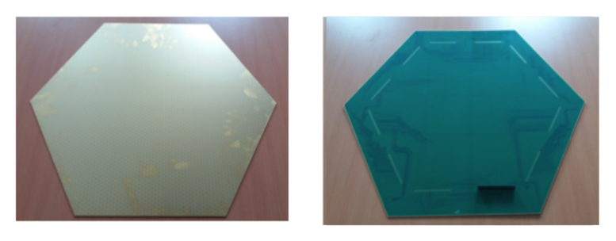
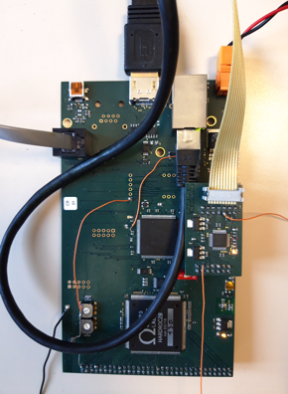
Large surface detectors
62 cm
A board hosting
One Hardroc2 ASIC
One Microcontroller
To be plugged directly on the back of the PCB, on the edge to read out 64 woven strips (1 HR2 ASIC).

Slide 14
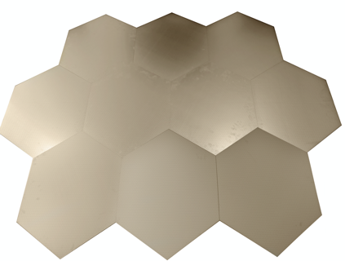

Large surface detectors
We need to build large detectors to be used as muon system in future experiments
(ILC, CEPC, FCC, Mathusla…) but also in the SDHCAL calorimetry concept and we propose to instrument them with the new concept.
For this we need to associate several PCB with no dead zone in-between.
Large detection area can be instrumented by assembling easily many PCB.

Slide 15
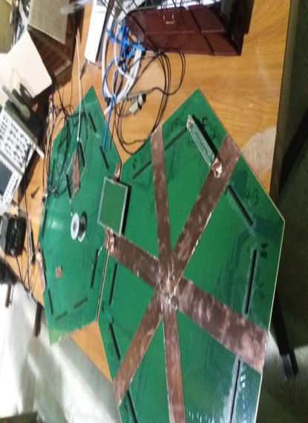
Large surface detectors
Connection of two neighboring PCBs is made through the connectors on the backside of the PCB.
No signal loss was observed by injecting a signal on the furthest end of the first PCB and detecting it on the opposite side of the second one.

Slide 16
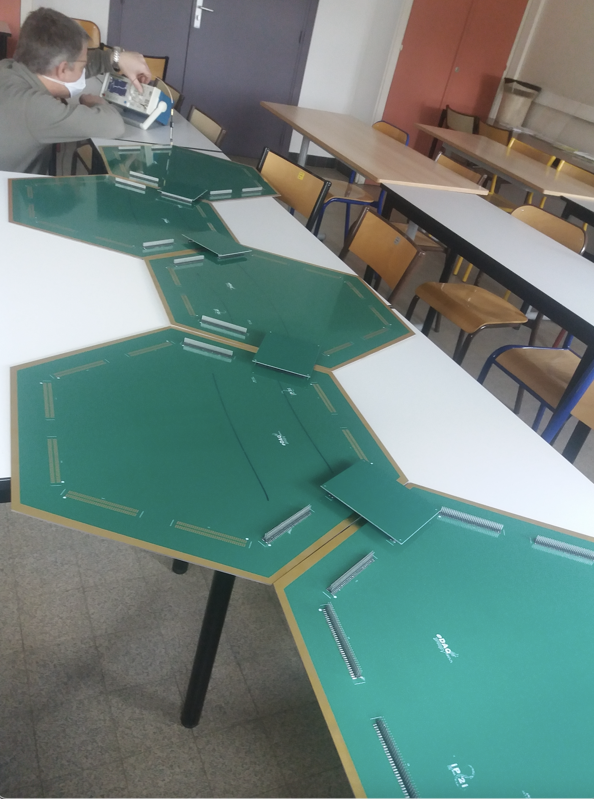
We added five of them

Slide 17
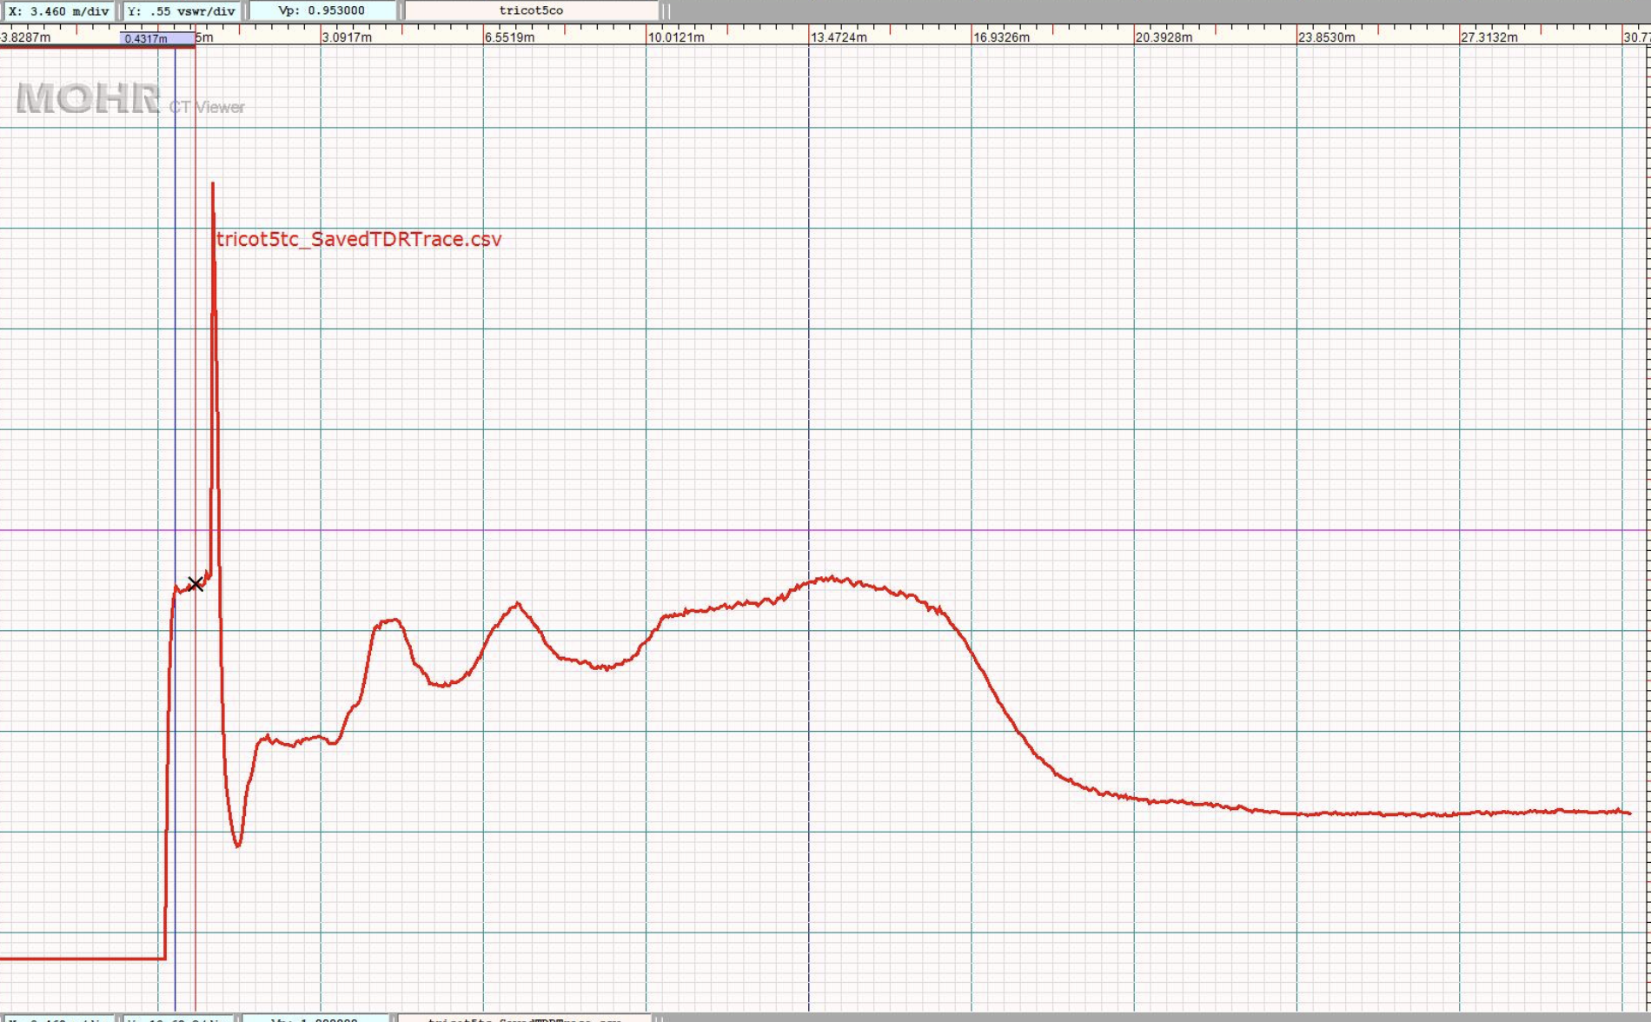
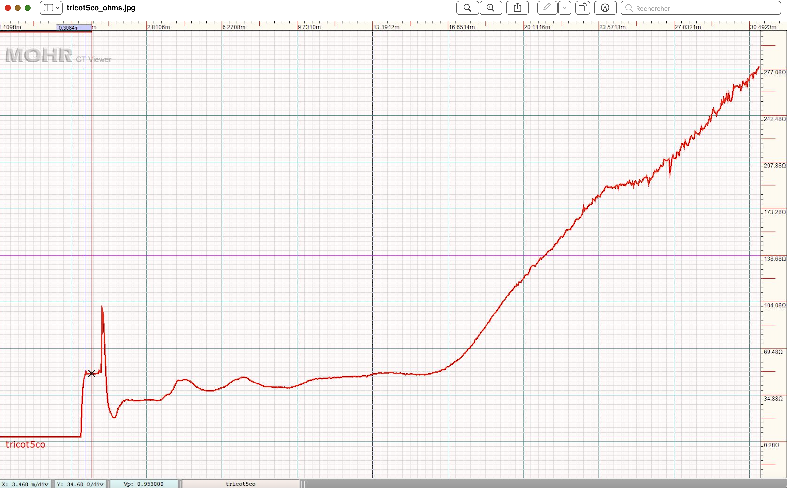
End point
Probe
50Ω
TDR measurement

Slide 18
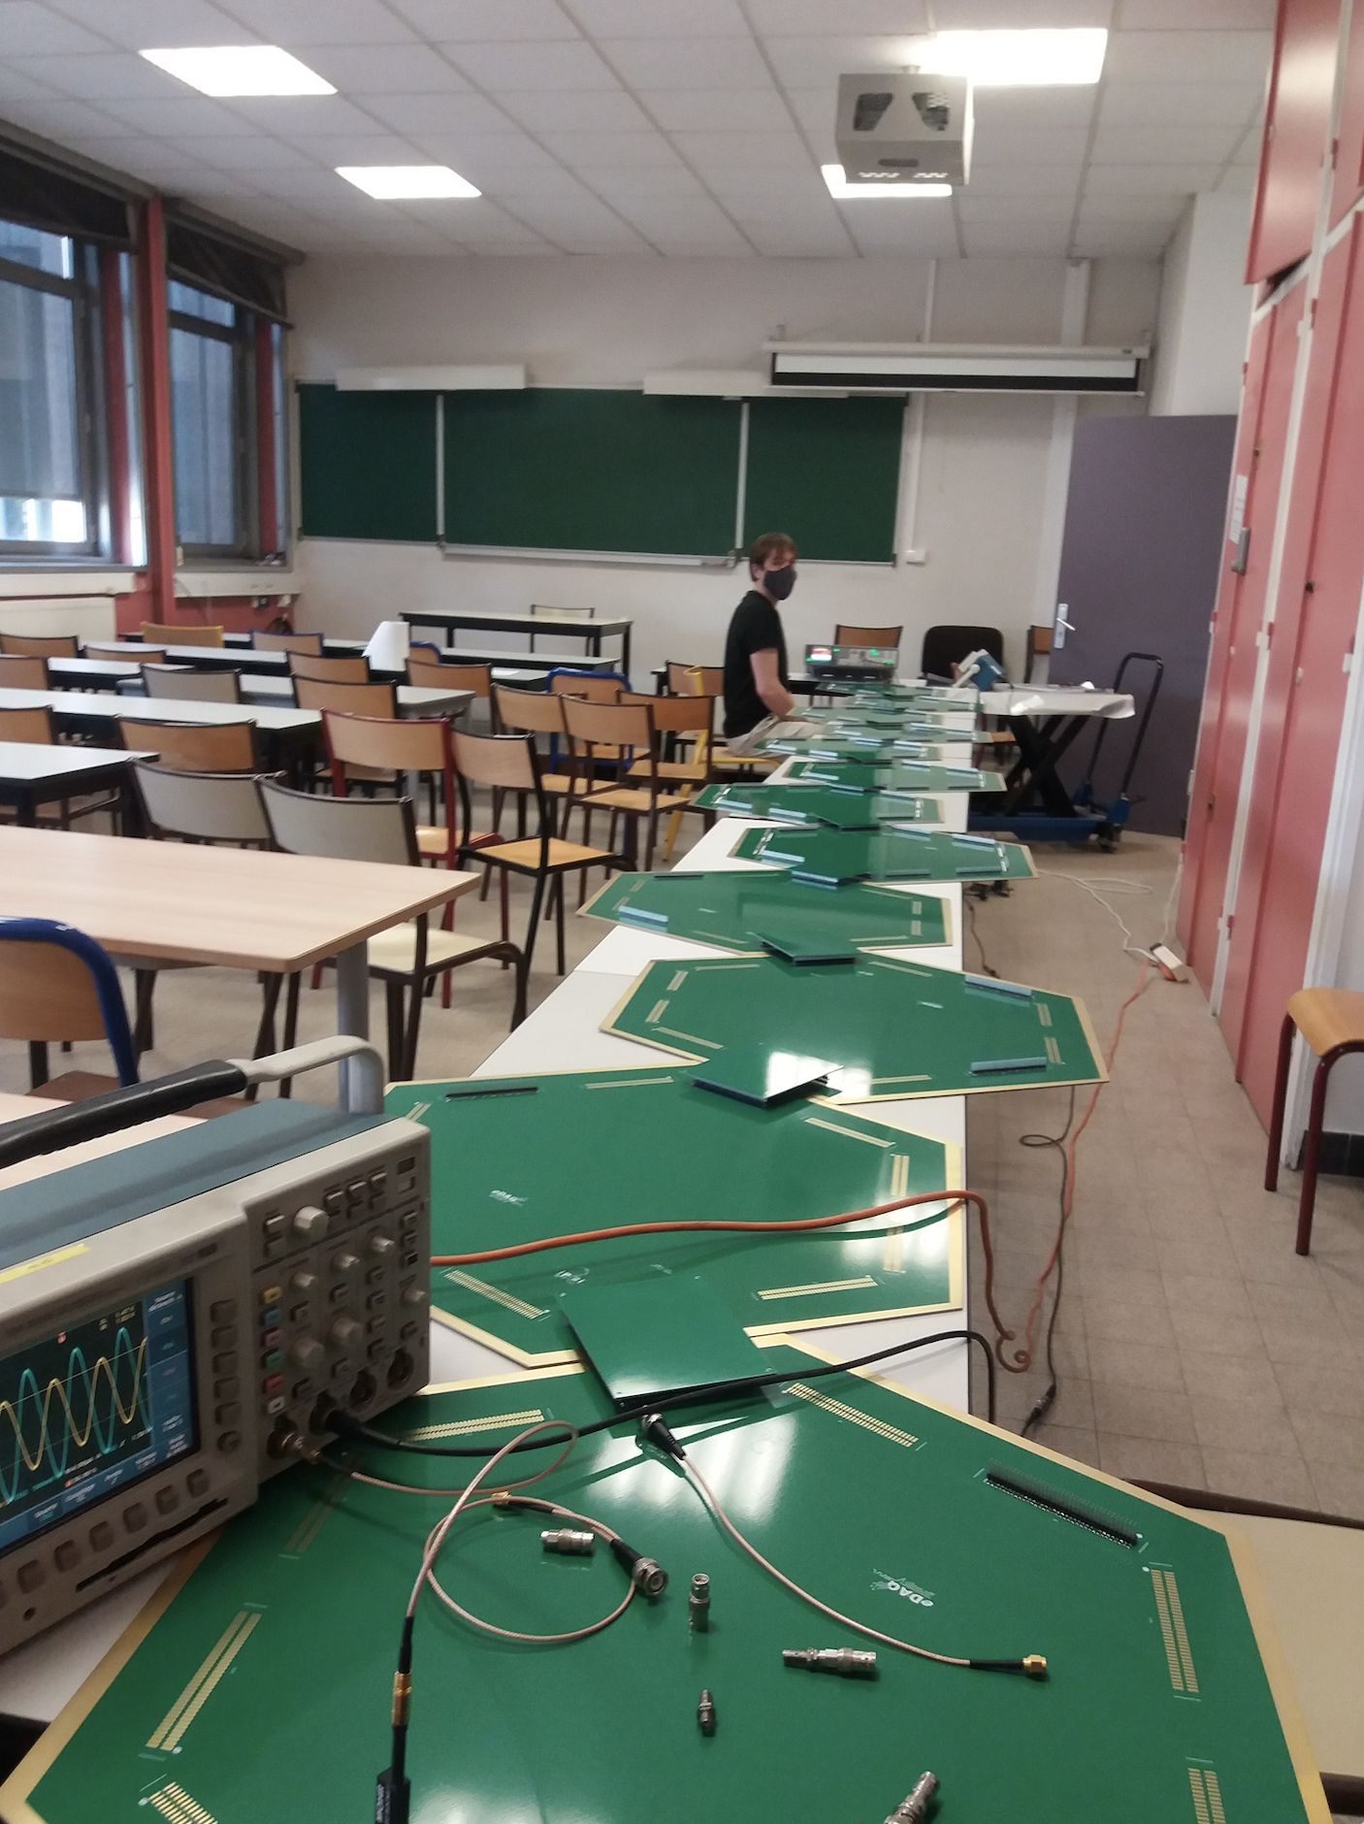
We added 10 of them

Slide 19
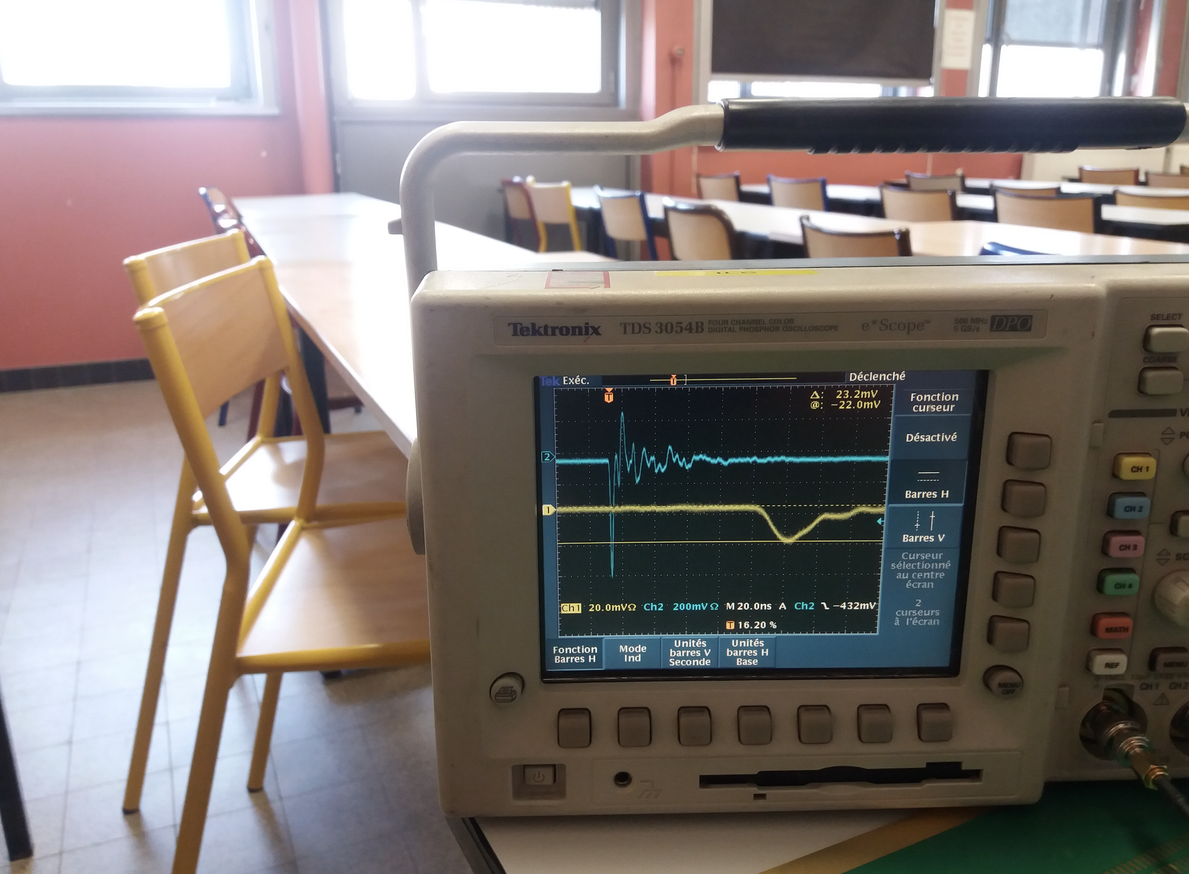
The shape of a RPC-like signal injected on one end and detected on the the opposite one ( > 7 m) is different but the charge loss is rather small).

Slide 20
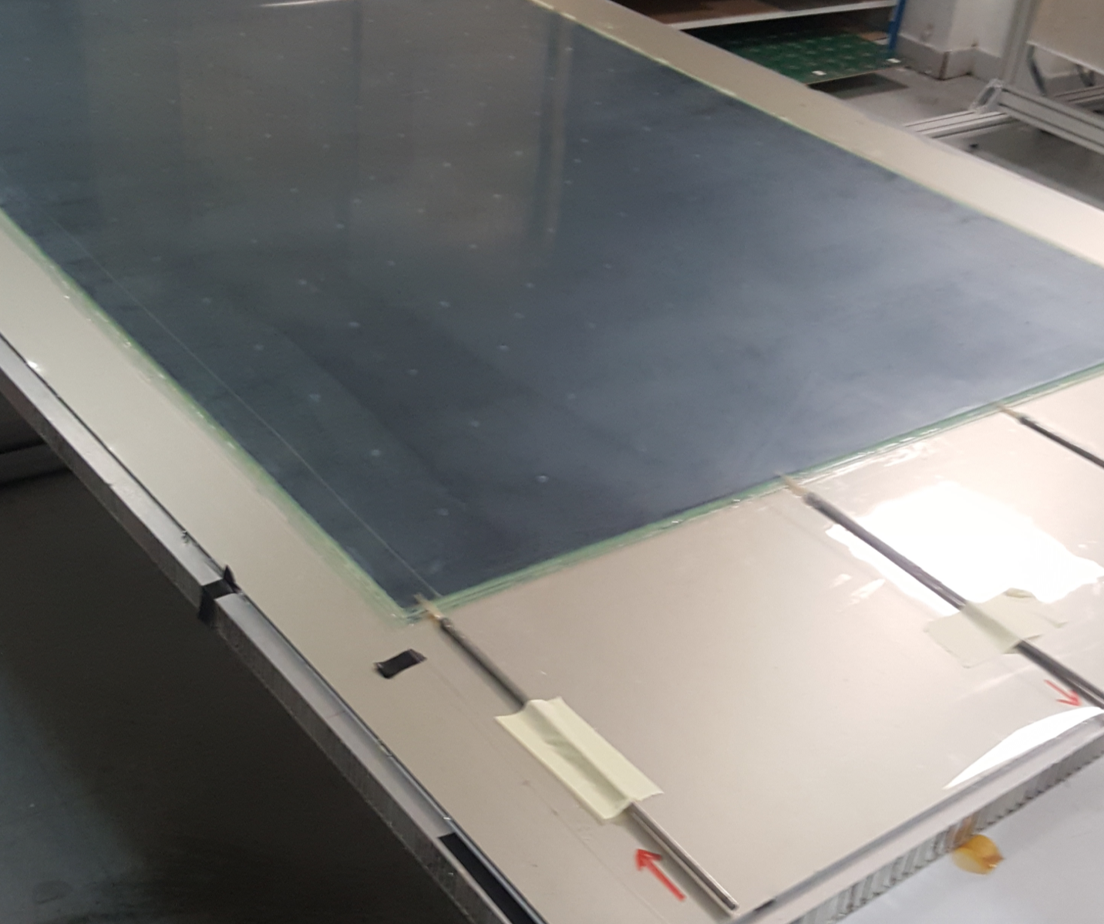
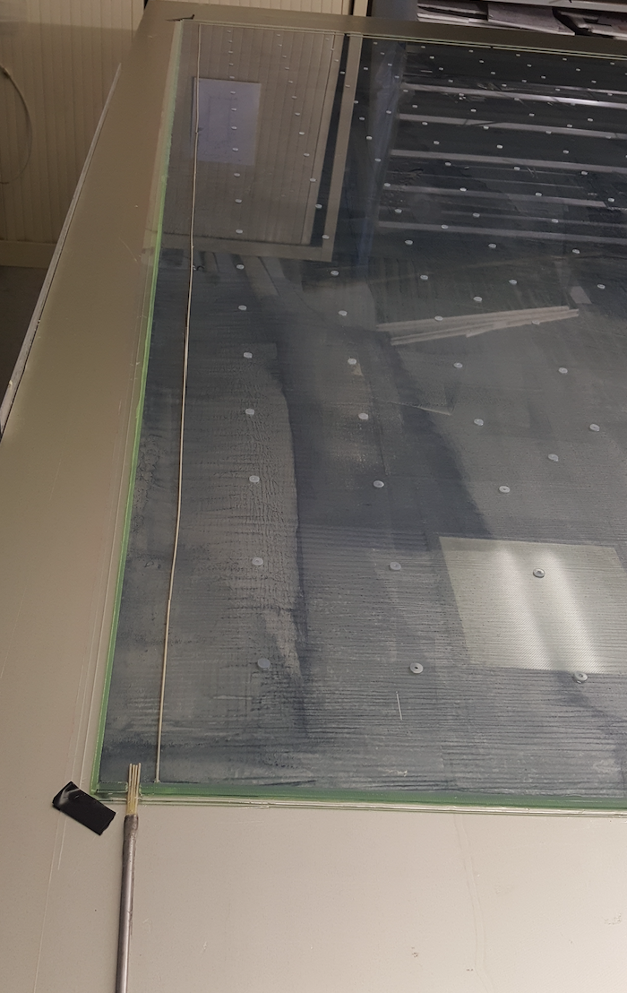
Large surface detectors
We built several large detectors (1 m x 2 m) to test the new concept

Slide 21
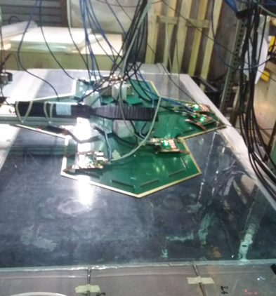
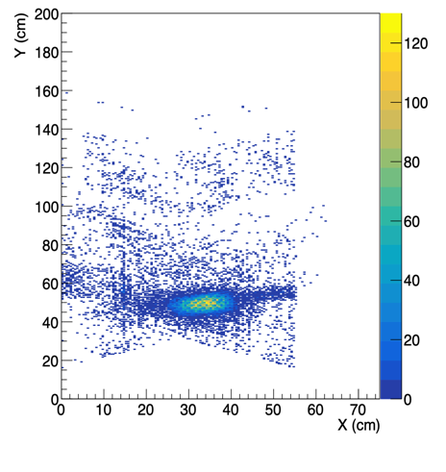
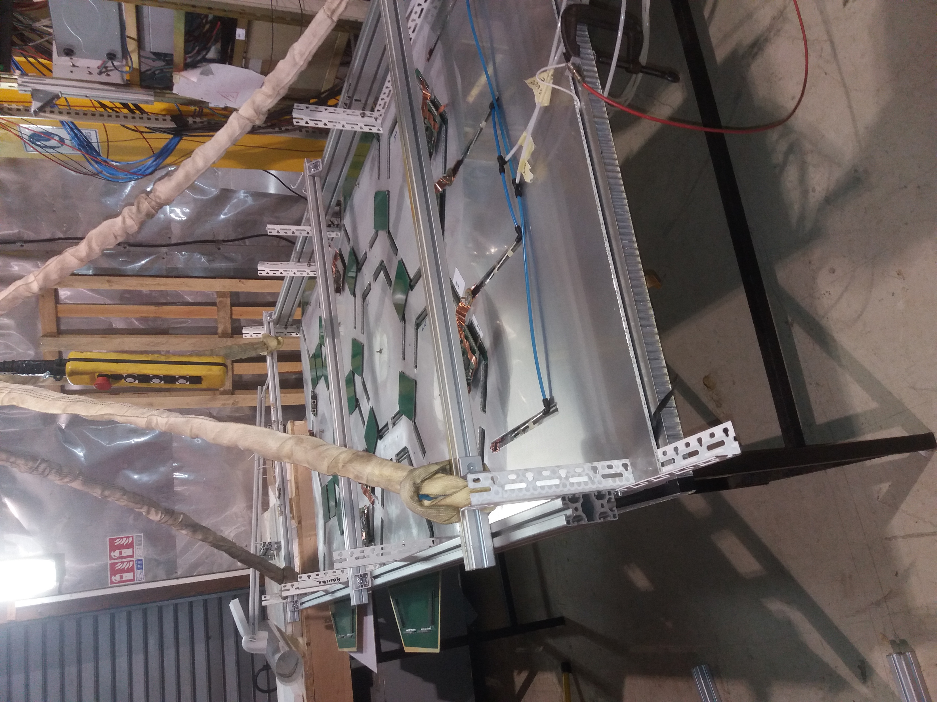
Large surface detectors
The new scheme is being tested on a large GRPC (2m x 1 m) with several PCBs
Reconstruction efficiency (1 direction efficiency is not included) is around 90%.

Slide 22
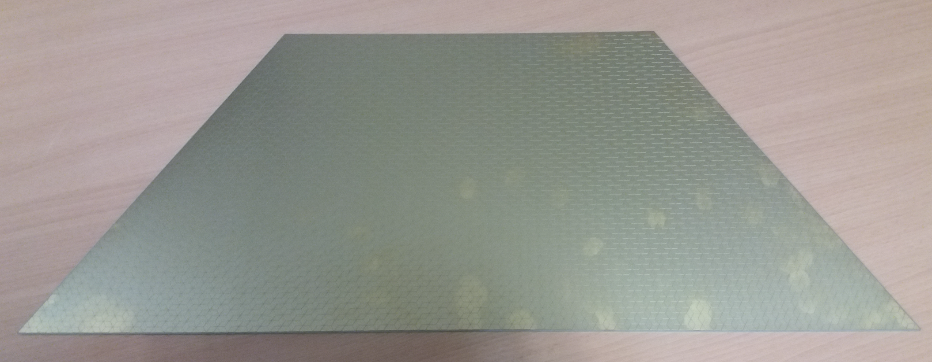
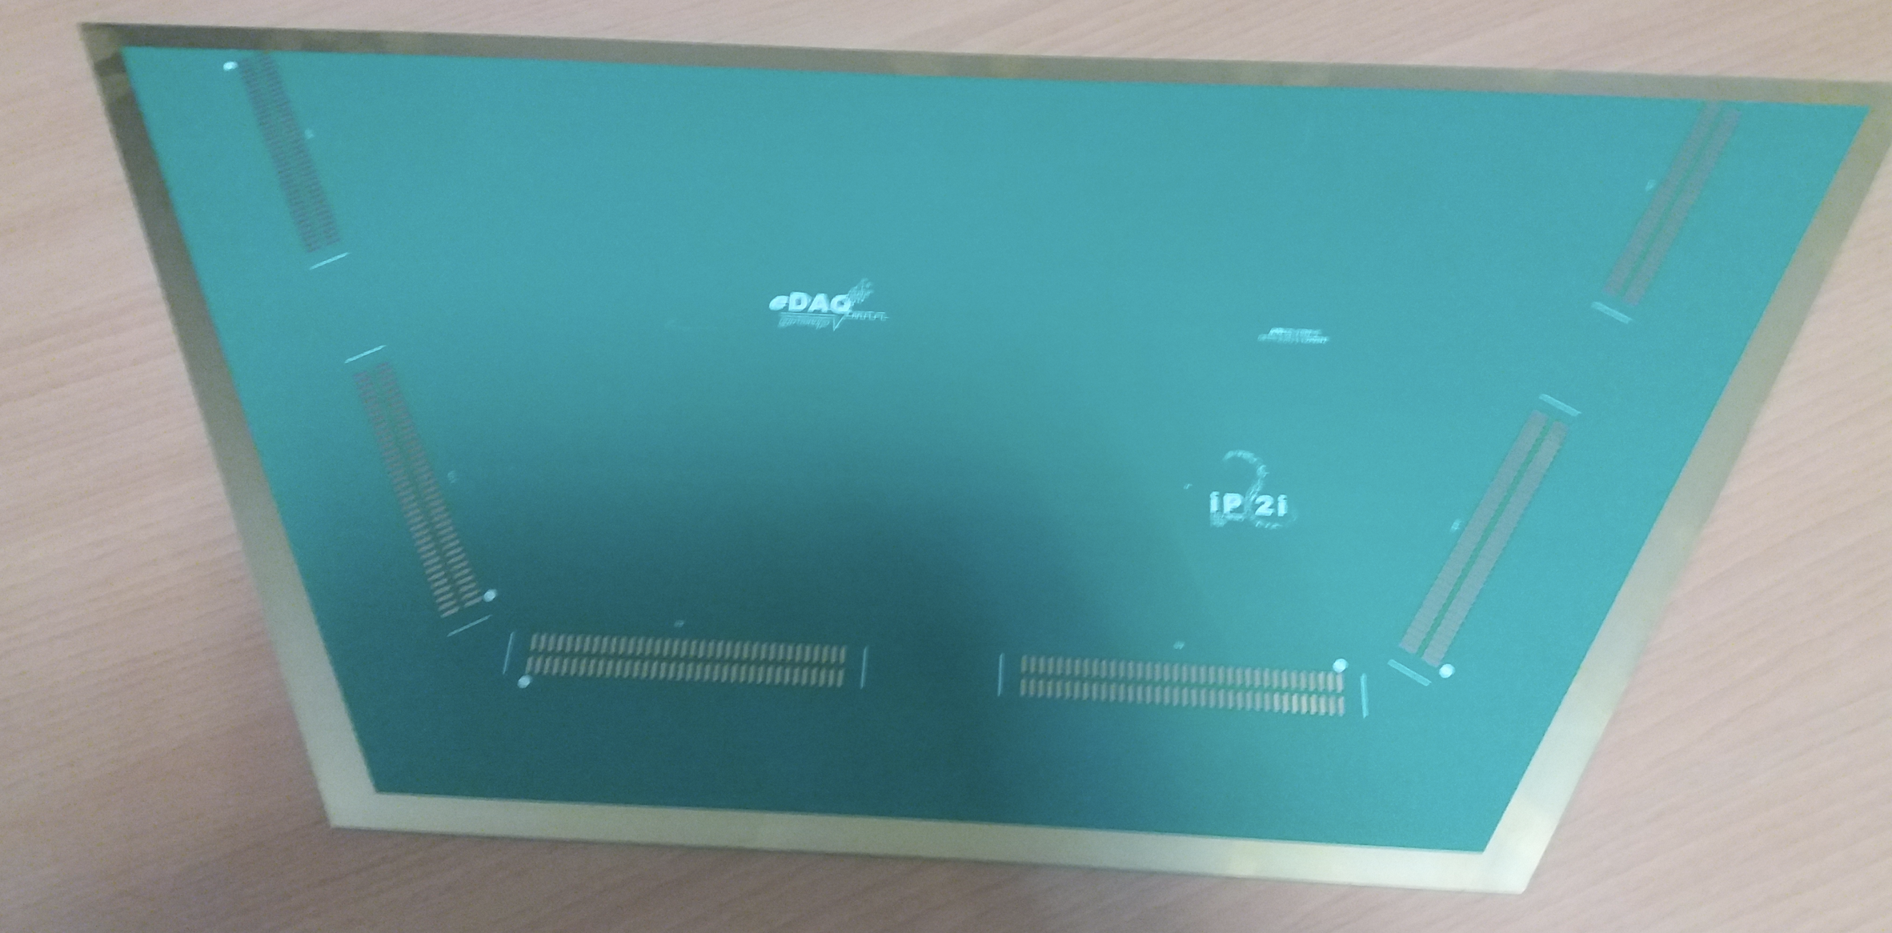
Large surface detectors
Half-hexagon PCBs were also designed and recently produced. Triangular PCB using the same concept were also designed.
Rectangular detectors could be efficiently covered.

Slide 23
Conclusion
A new scheme allowing a reduced cost and reduced power consumption without reducing the granularity is proposed to equip large RPC detectors
Large detectors or several small detectors put aside could be a good option

