Slide 1
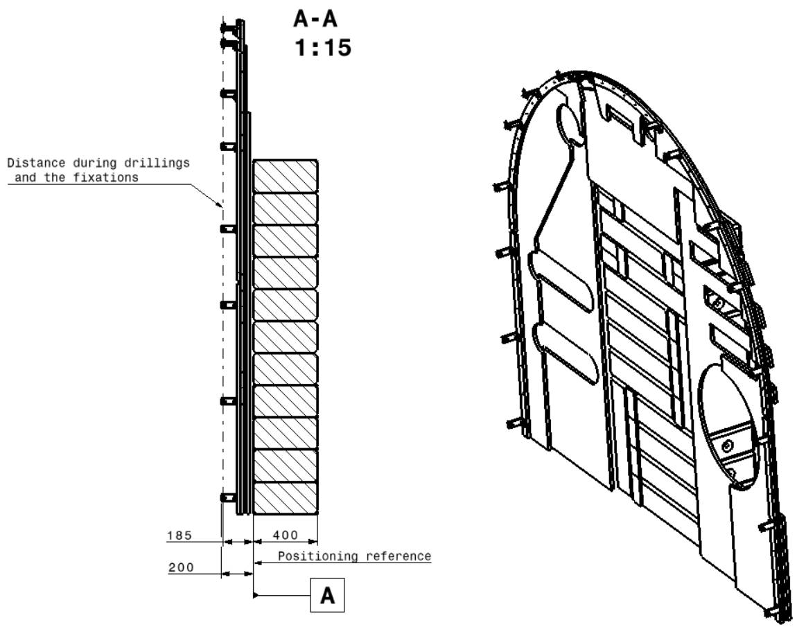
UL xx Shielding _HL_LHC

Slide 2
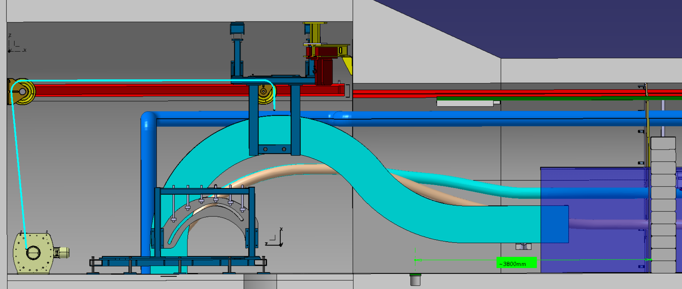
UL13 Shielding _HL_LHC for UL13_1102_INTEGRATION_ST1120286_01_a.02

Slide 3
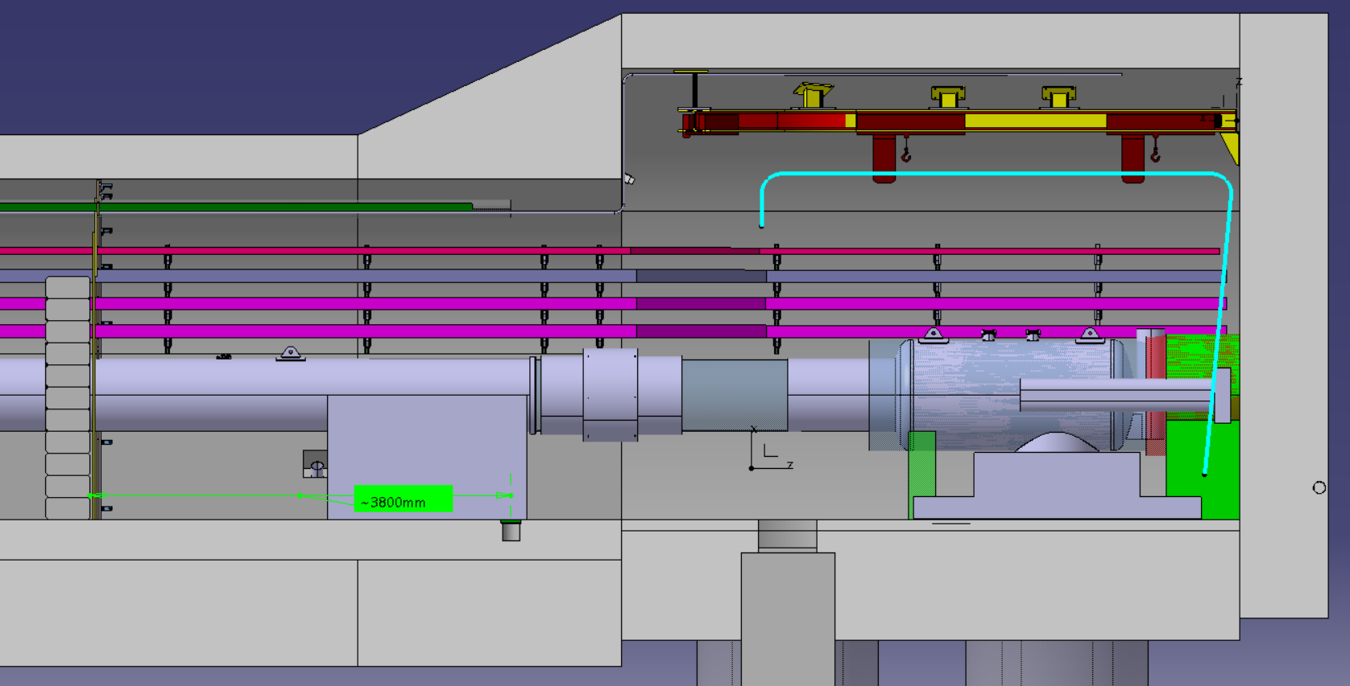
UL13 Shielding _HL_LHC for UL13_1102_INTEGRATION_ST1120286_01_a.02

Slide 4
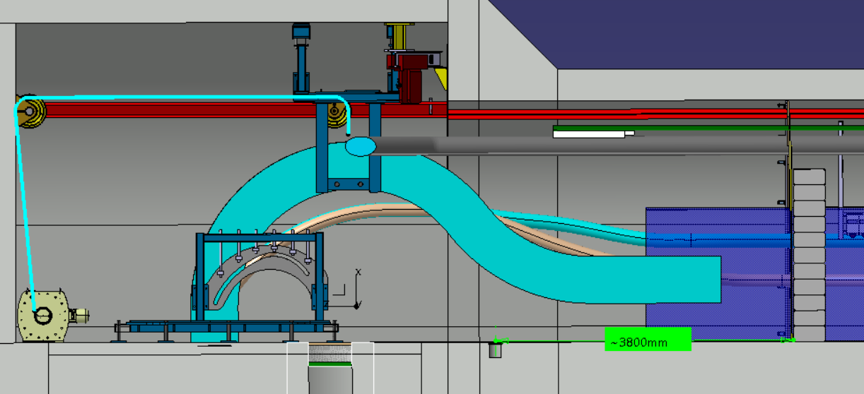
UL53 Shielding _HL_LHC for UL53_1503_INTEGRATION_ST1120277_01.a02

Slide 5
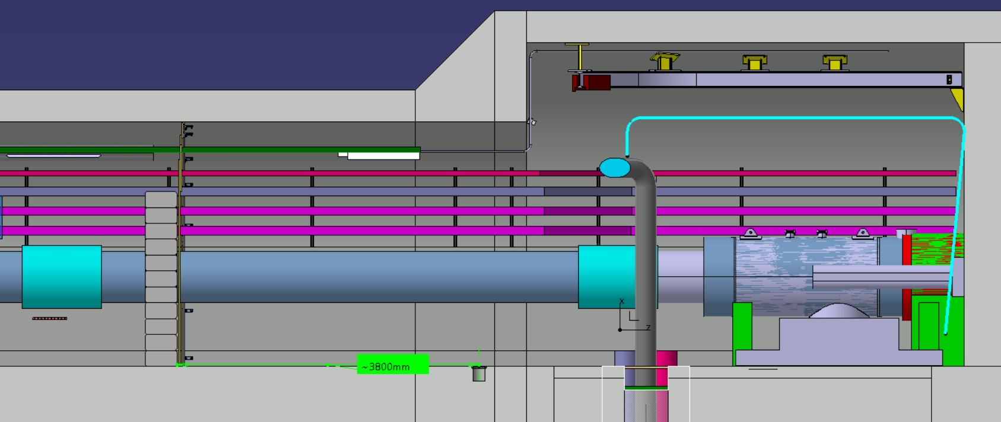
UL53 Shielding _HL_LHC for UL53_1503_INTEGRATION_ST1120277_01.a02

Slide 6
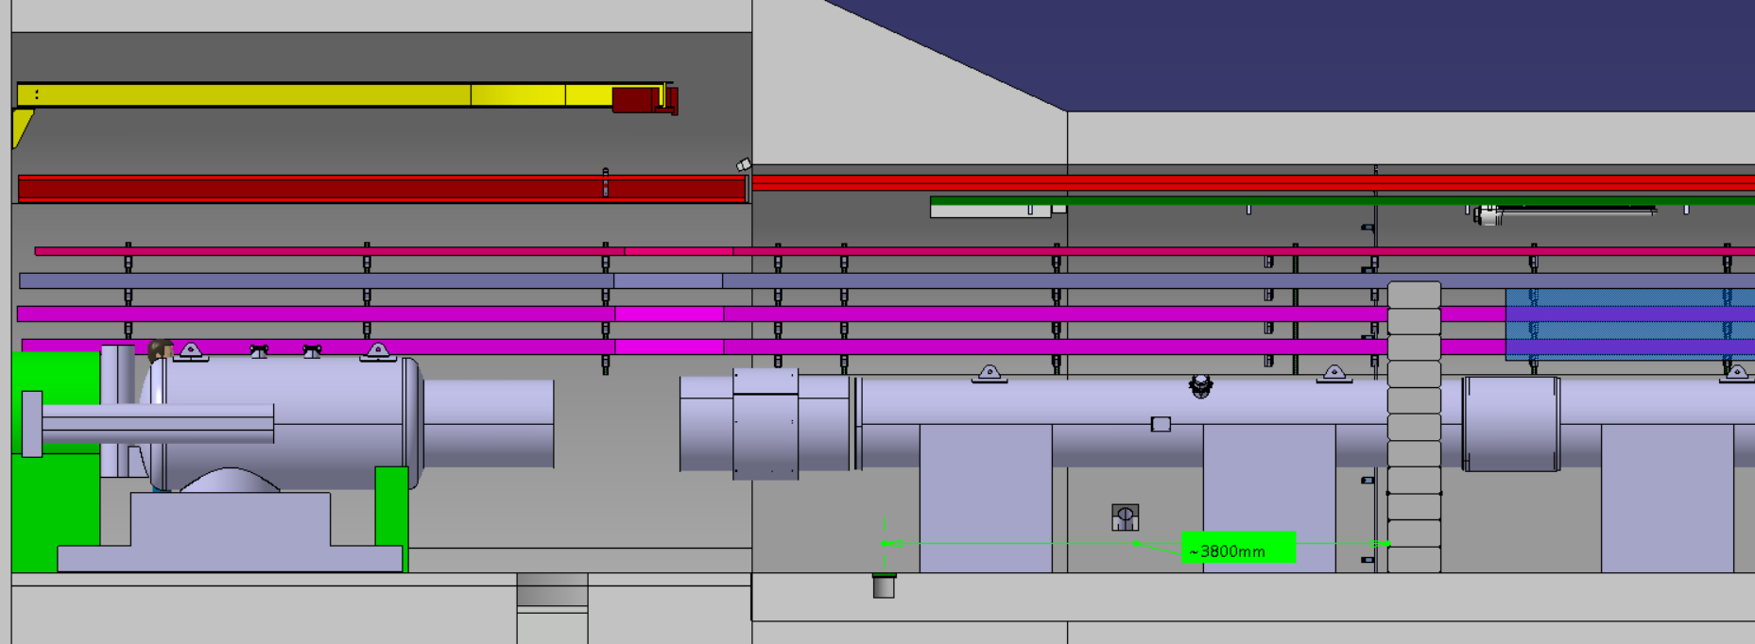
UL17 Shielding _HL_LHC for UL17_1102_INTEGRATION_ ST1120287_01_a.04

Slide 7
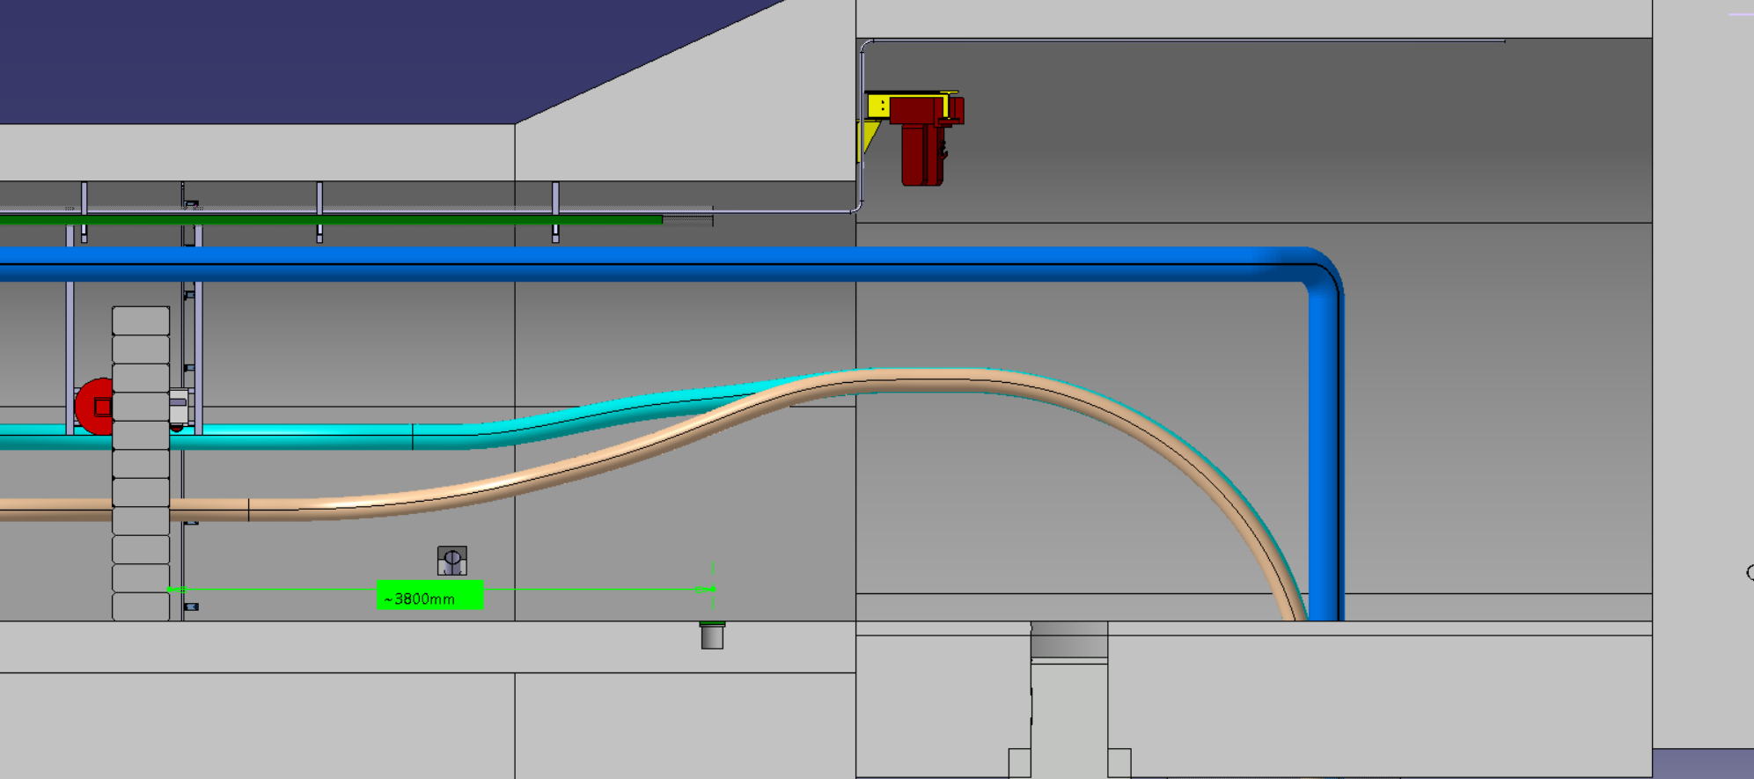
UL17 Shielding _HL_LHC for UL17_1102_INTEGRATION_ ST1120287_01_a.04

Slide 8
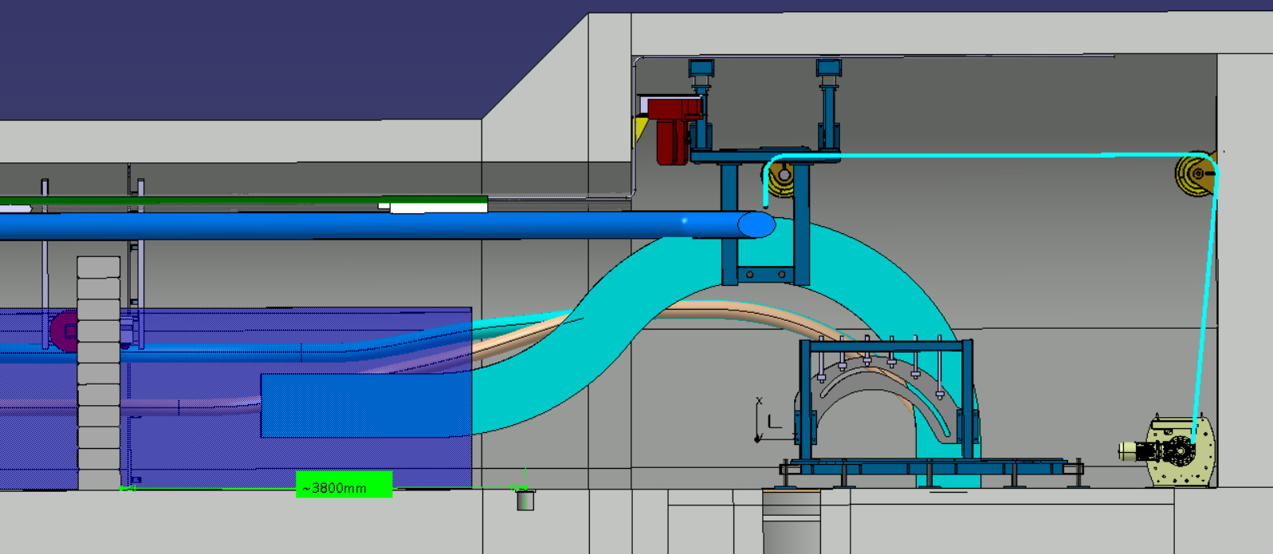
UL57 Shielding _HL_LHC for UL57_1103_INTEGRATION_ ST1120276_01 _a.02

Slide 9
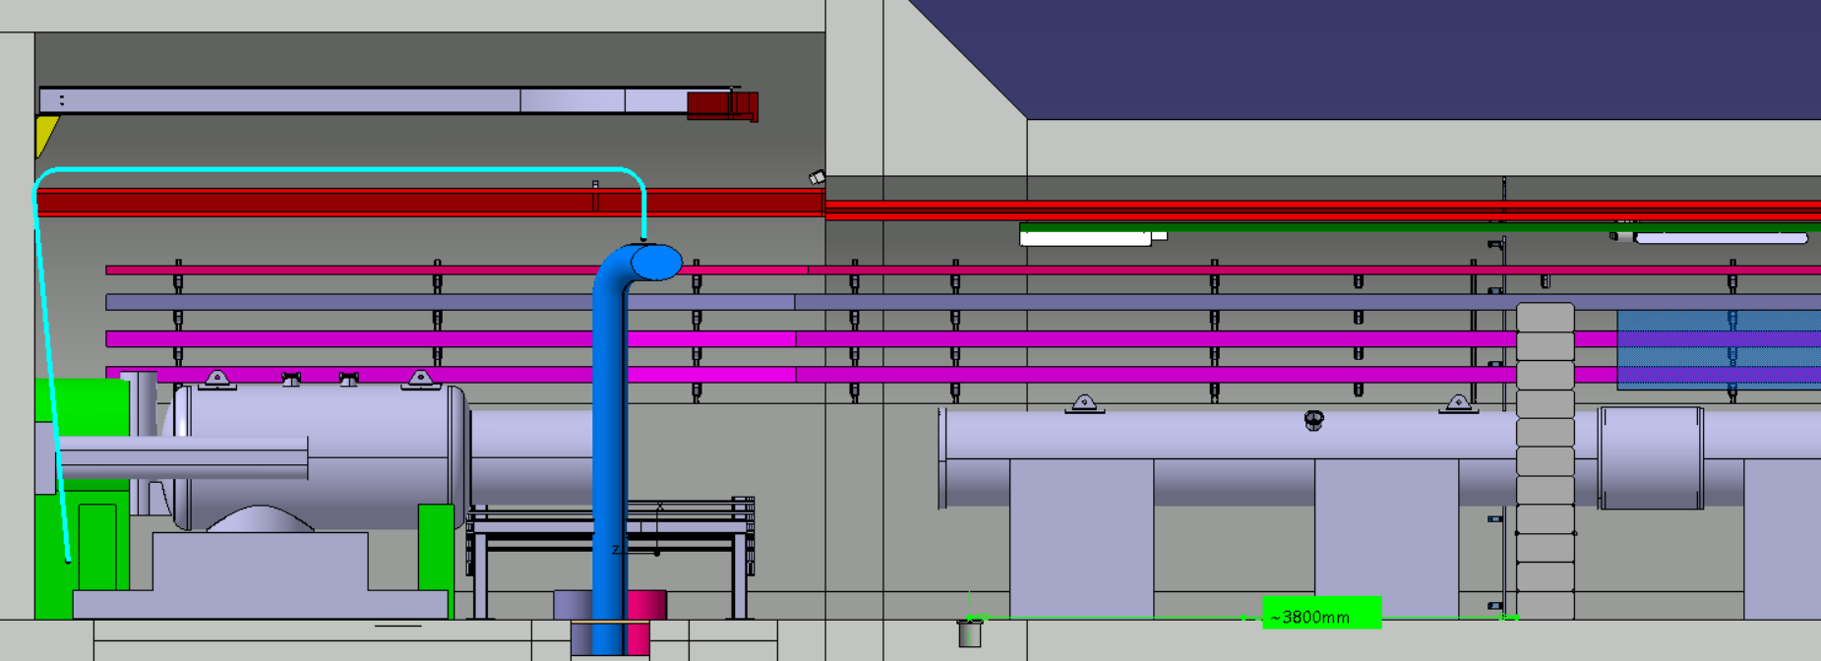
UL57 Shielding _HL_LHC for UL57_1103_INTEGRATION_ ST1120276_01 _a.02

