Slide 1
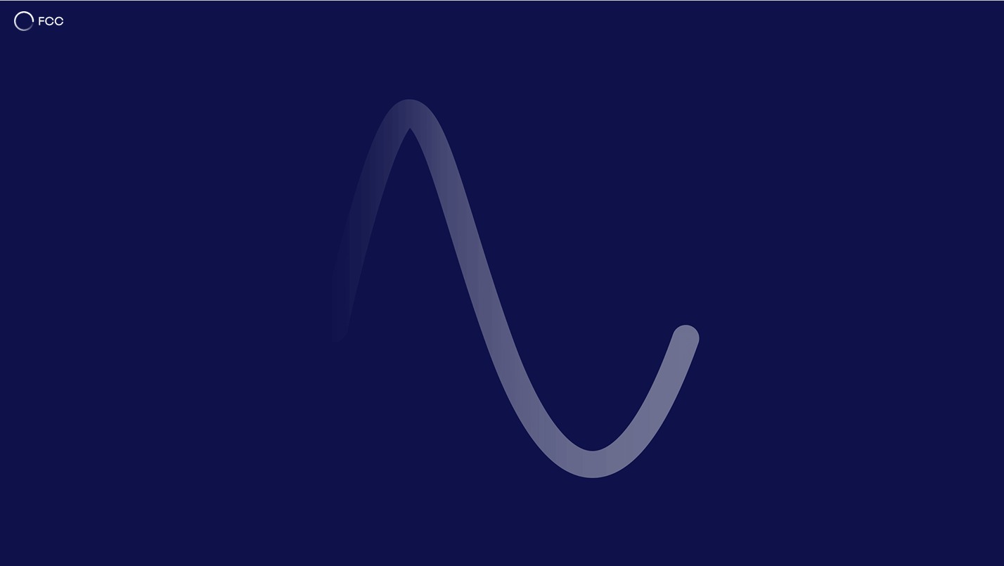
Absorber placement
Update #3
15th FCC-ee Radiation and Shielding Meeting, 25-06-2025
Marton Ady, Patrick Krkotic, Marco Morrone

Slide 2
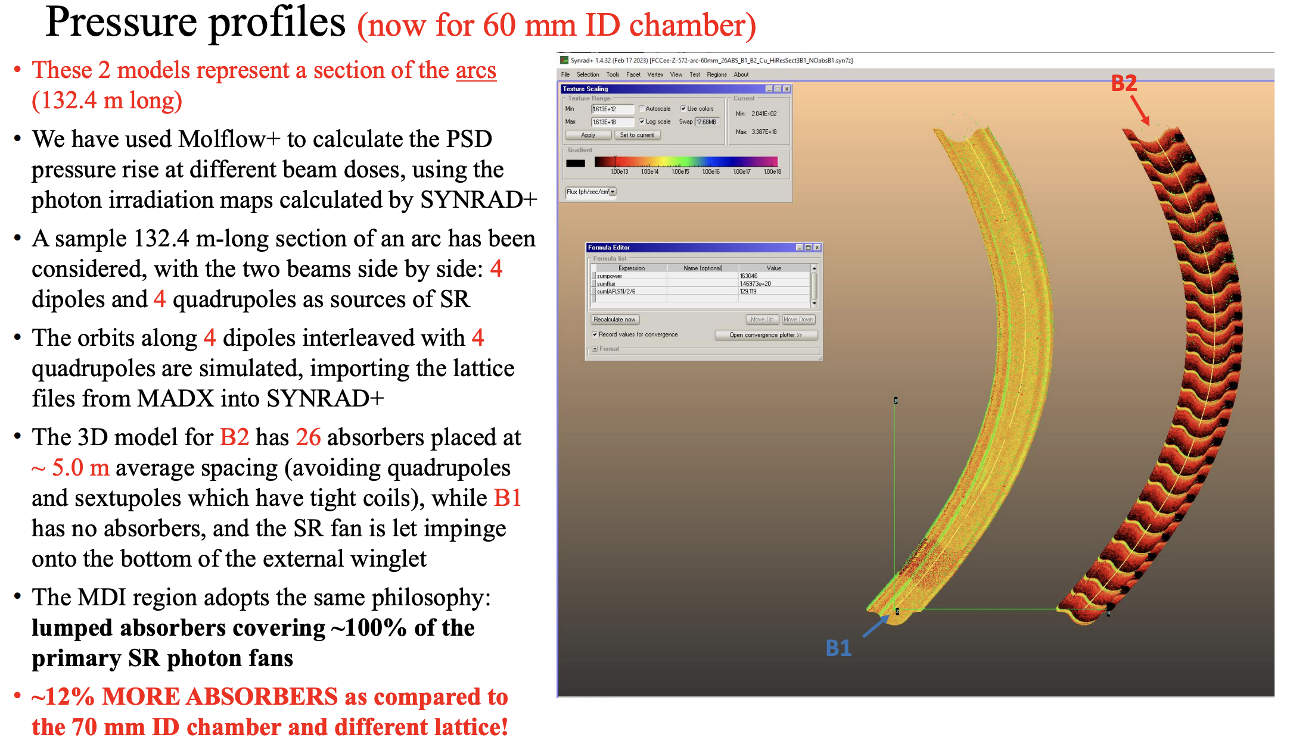
Roberto Kersevan’s work
3rd FCC-ee Radiation and Shielding Meeting, 13-03-2024
130m/5m spacing: 26 absorbers
Avoids quadrupoles and sextupoles
Absorber positions independent of dipoles
One absorber placed in 6.35m drift
Several absorbers at start/end of dipoles

Slide 3
Early 2025: New absorber layout goals
Repeat Roberto’s simulations with updated sawtooth model
Make positions dipole-dependent (periodic)
  Respect gap in the middle
  Respect space reserved for shielding (start/end)
Can we place 4 absorbers per dipole?

Slide 4
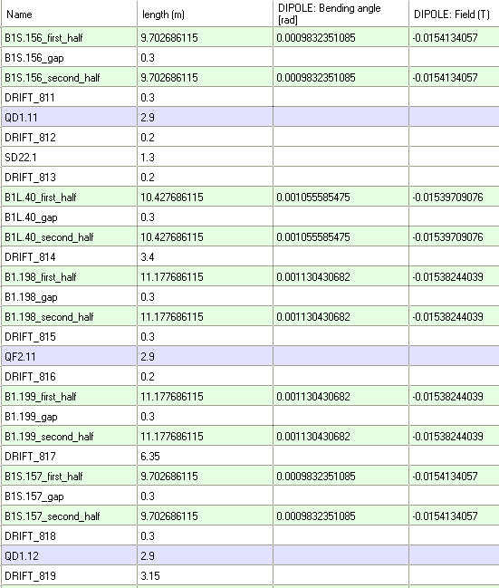
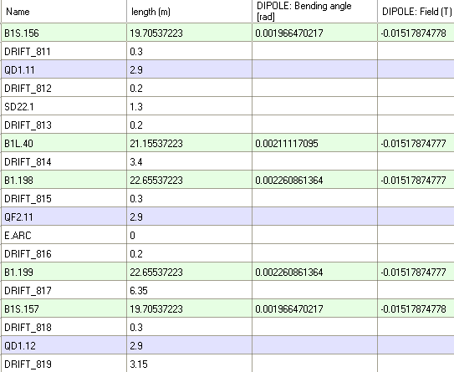
First step: manually edit magnets
130.2m 5-cell pattern in OpticsBuilder:
Lattice functions kept the same

Slide 5
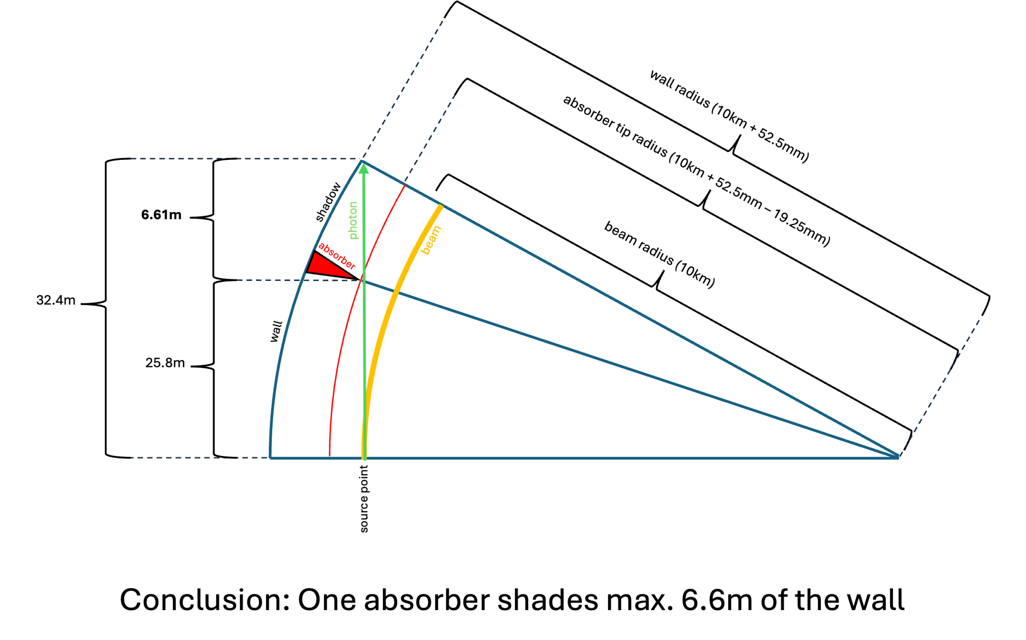
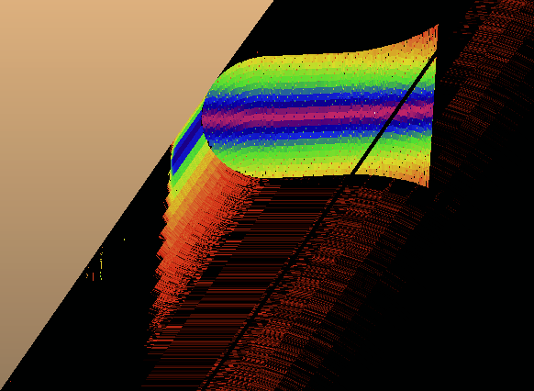
First attempt:
4 absorbers per dipole + 1 per long drift
ATDC meeting #20, 03-04-2025
B1 (22.655m)
B1L (21.155m)
B1S (19.7m)
55cm / 75cm reserved for shielding
Long drifts

Slide 6
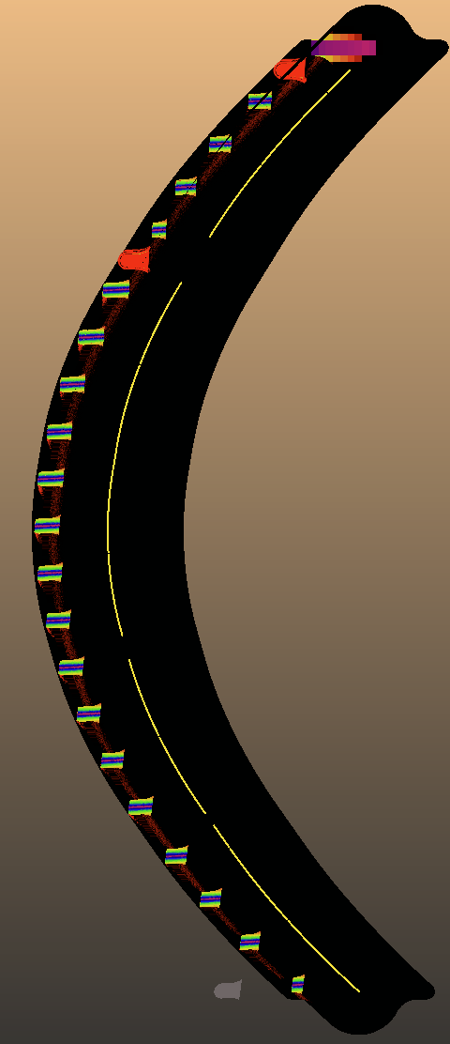
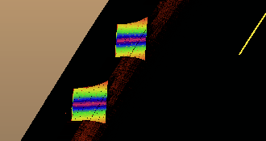
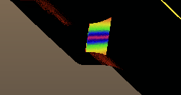
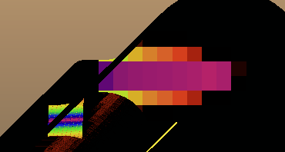

Addressing long drifts (in theory)
“Algorithm” so far for
absorber start positions:
B1S (19.7m)
0.75m
6.69m
12.63m
18.57m
B1L (21.155m)
0.75m
7.175m
13.6m
20.025m
B1 (22.655m)
1.95m
8.475m
15m
21.525m
+drift>6m:
Add as close to middle as possible
20kW -> 17.1kW downstream

Slide 7
Conclusion, March 2025:
Reducing the number of absorbers from 5 to 4 creates two issues
  Pushing the limits: 6 absorbers receive between 4 and 4.5kW power
  Large (>6m) drifts/quadrupoles require additional absorber
    We can unite these with the first absorbers of the next magnet on a case by case basis
    If this is not mechanically possible, we need to fall back to 5 absorbers
Current 6.525m spacing doesn’t provide perfect shading on curved walls
  Further analysis (PSD) if we can just live with this
  Or the absorber shape needs to be modified
  Or we fall back to 5 absorbers per cell
ATDC discussion: can we simply make the absorbers larger?

Slide 8
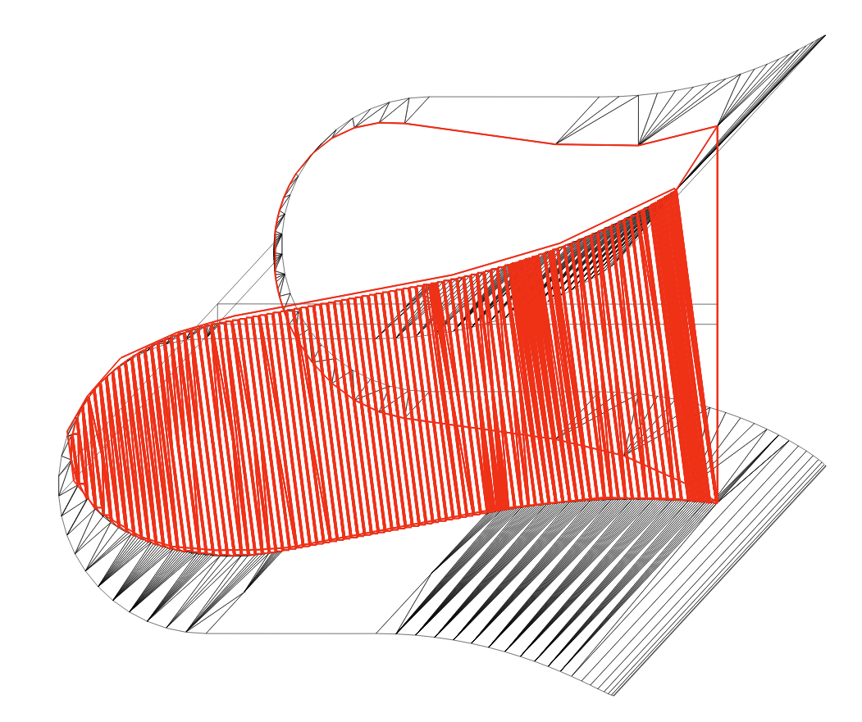
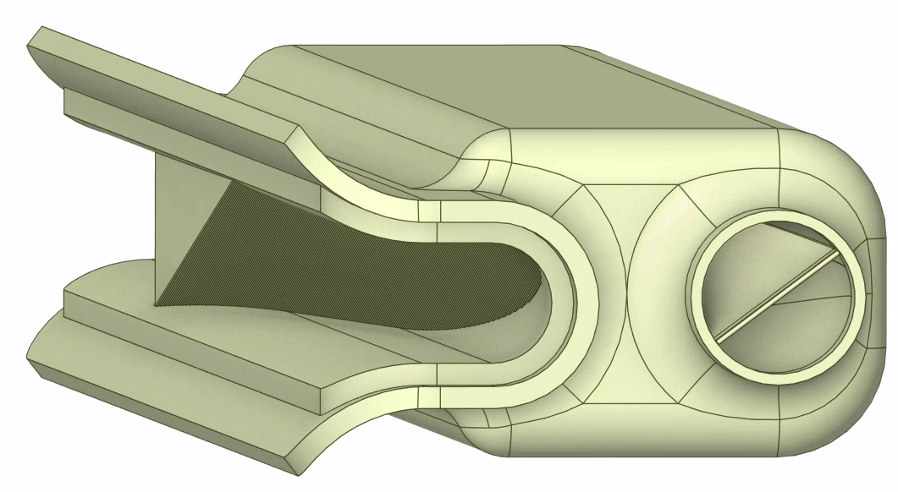
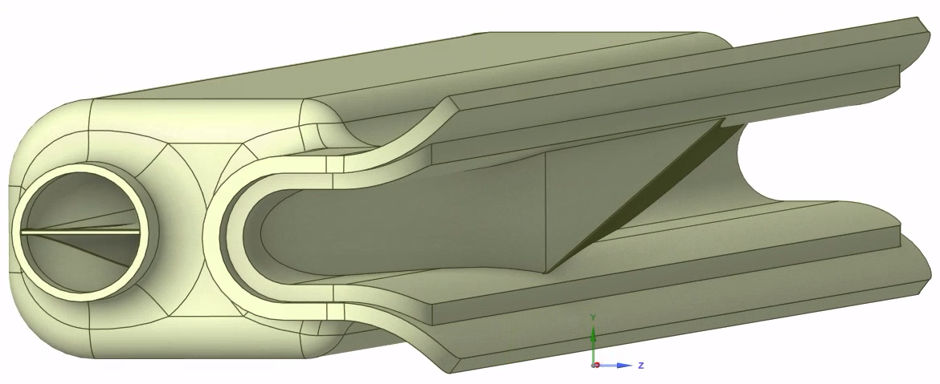
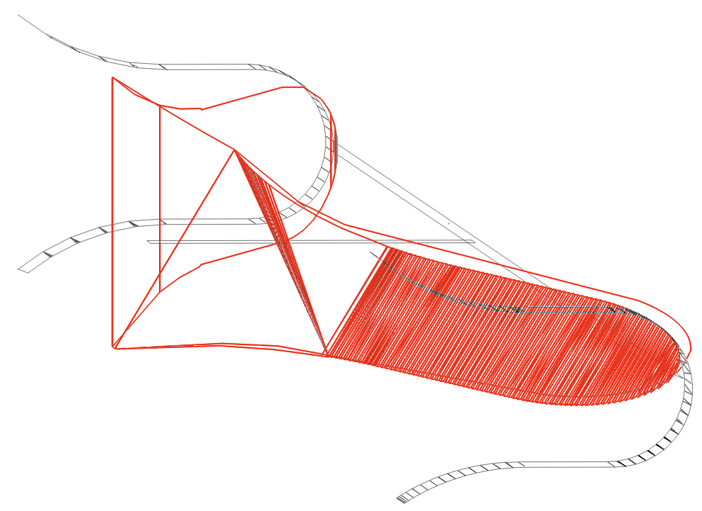
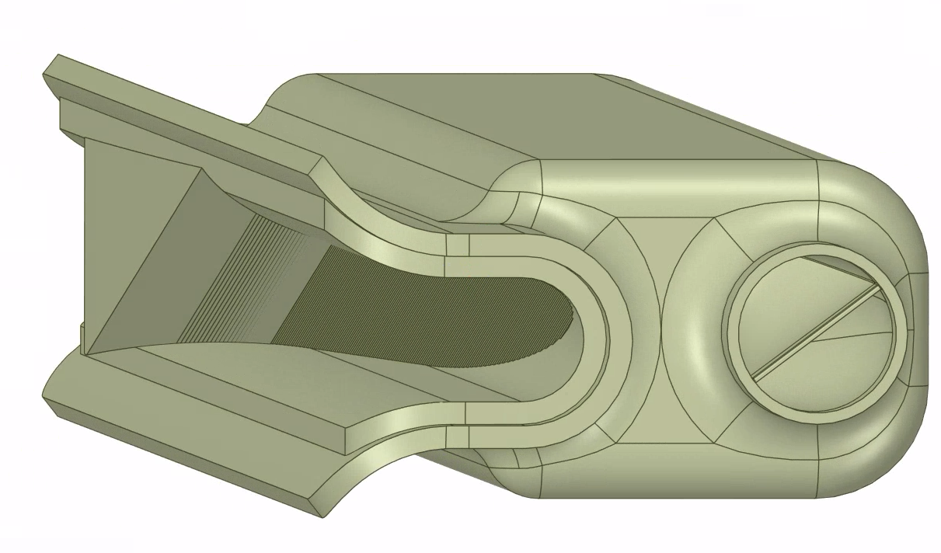
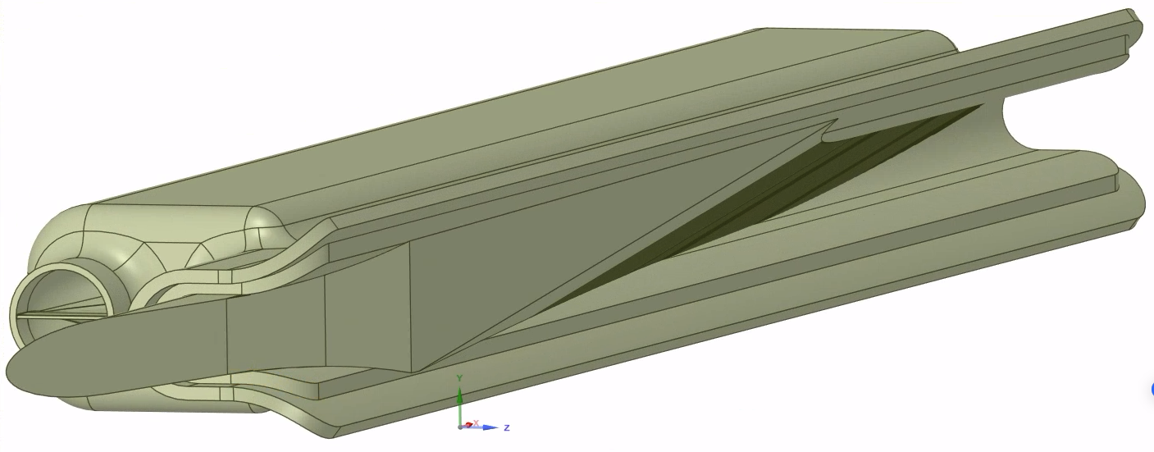
Second attempt (FCC week, 21-05-2025):
4 large absorbers
Original sawtooth absorber model (F. Santangelo)
L=38cm
Modification (preliminary, partial sawtooth)
+4mm
L=46.5cm

Slide 9
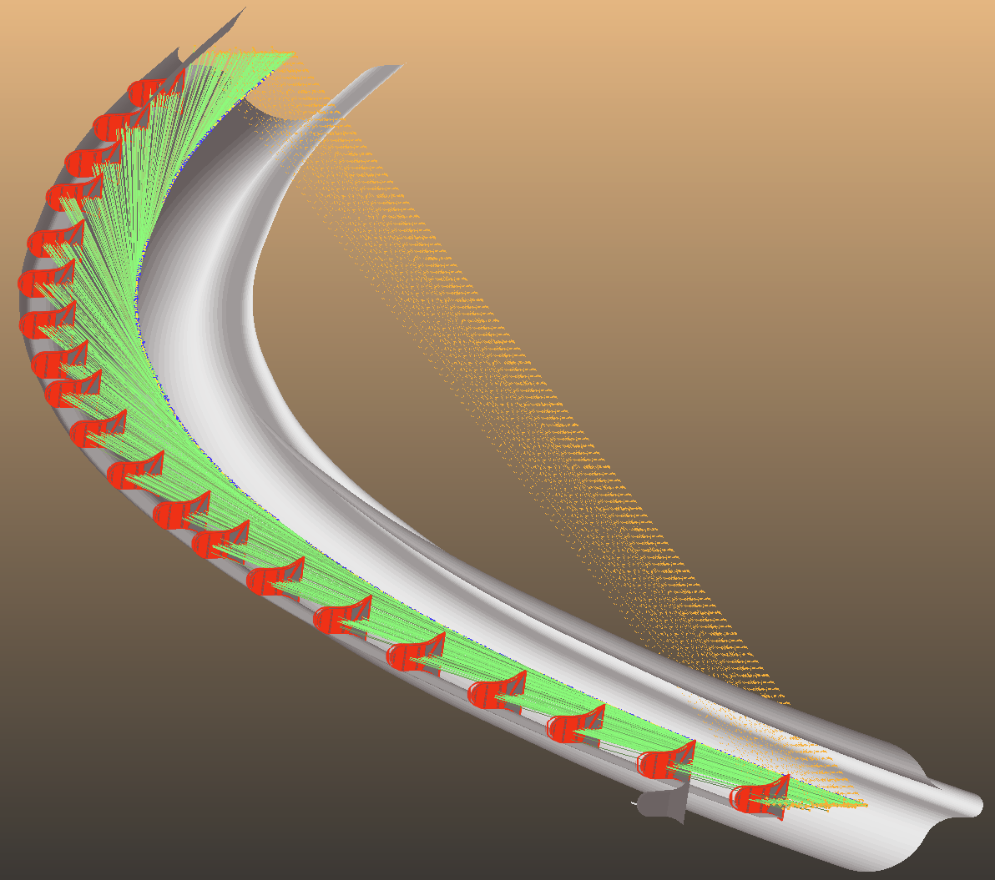
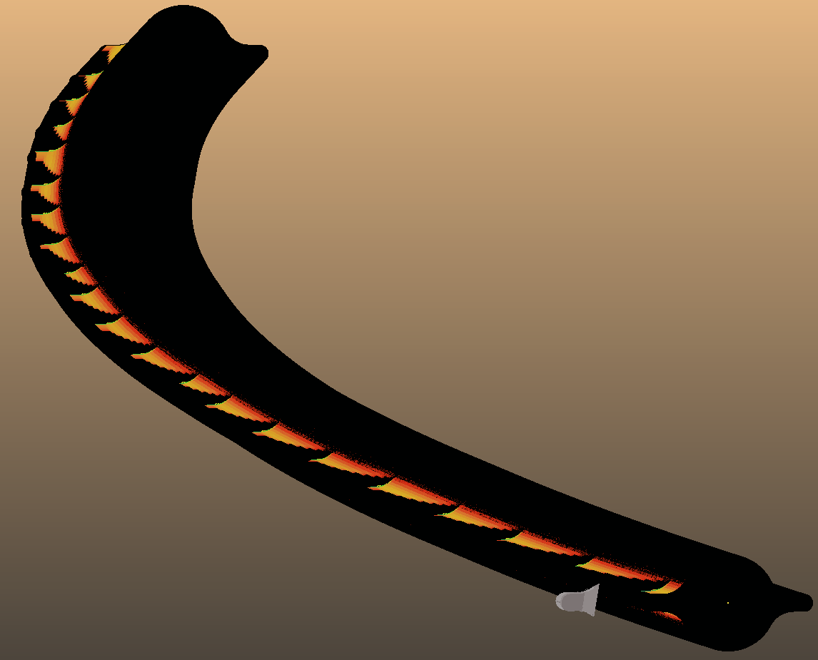

4 larger absorbers per dipole:
Negligible direct hits on outer walls
W/cm²
Total on wall: 0.22W

Slide 10
Conclusion, May 2025:
Increasing the absorber protrusion shows complete shadowing
Total power (5.3kW) – check with cooling simulations
46.5cm too long for 3D printer
Impedance validation required
If above passed, 4 absorbers/magnet feasible

Slide 11
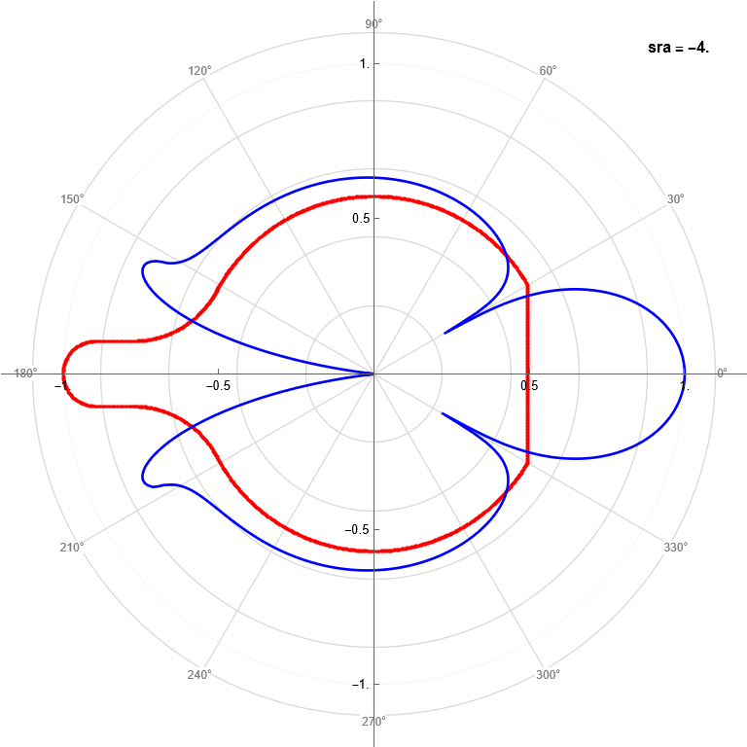
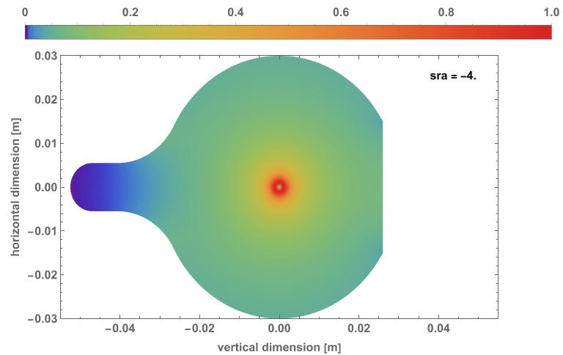
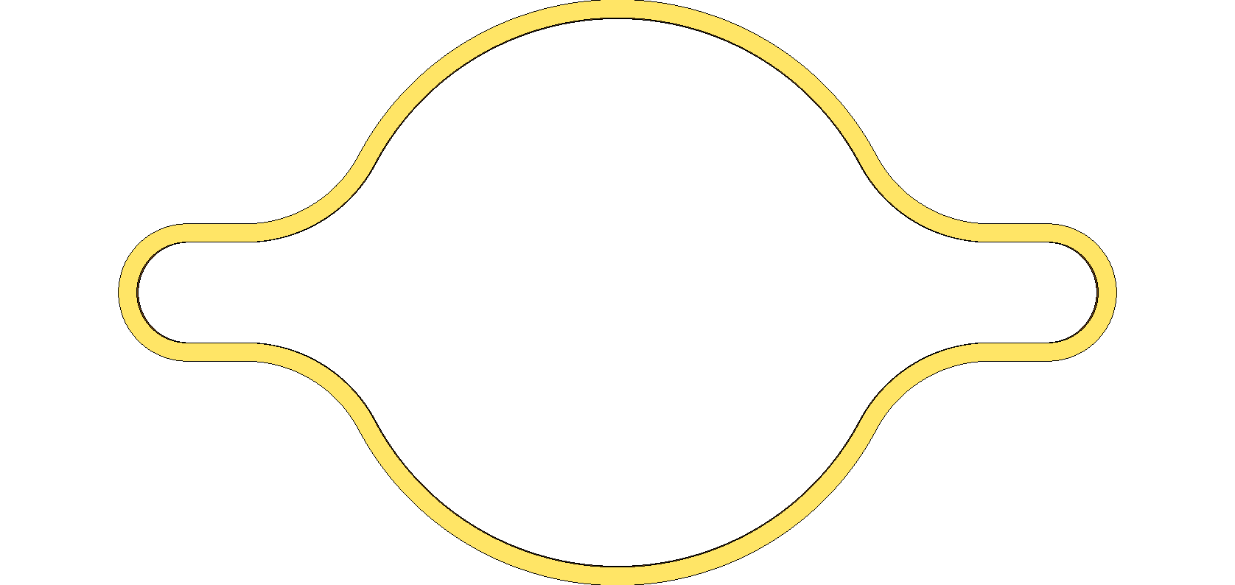
Impedance simulations – first results
Patrick Krkotic, 8th FCC VTCM meeting, 23-06-2025
Electric field
Current

Slide 12
New absorber placement, June 2025
beam direction
original (4/dipole)
B1 (22.655m)
B1L (21.155m)
B1S (19.7m)
55cm / 75cm reserved for shielding
B1 (22.655m)
d₁
d₁
d₂
d₂
B1L (21.155m)
B1S (19.7m)

Slide 13
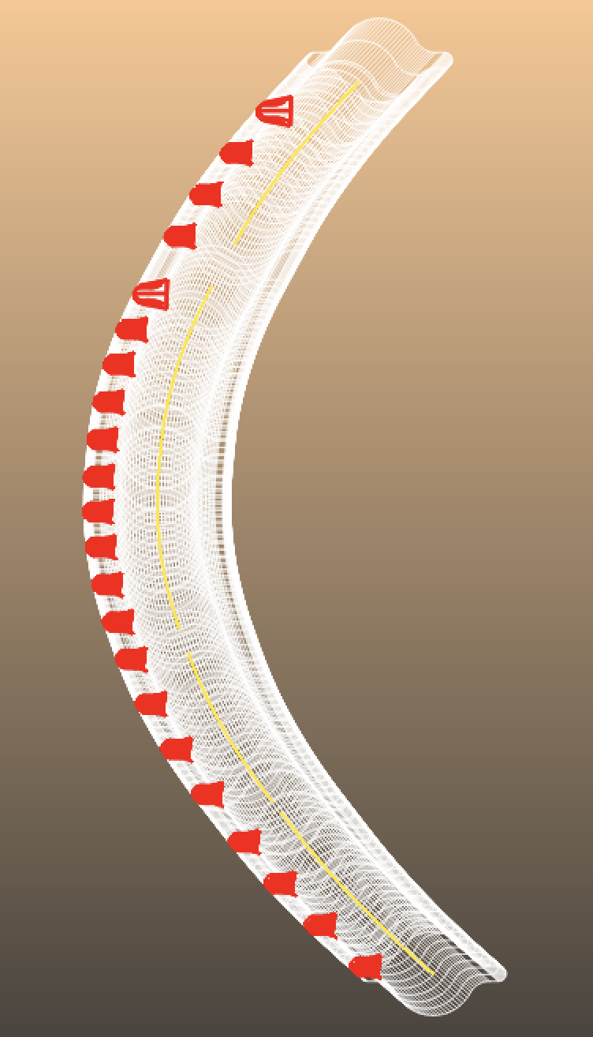
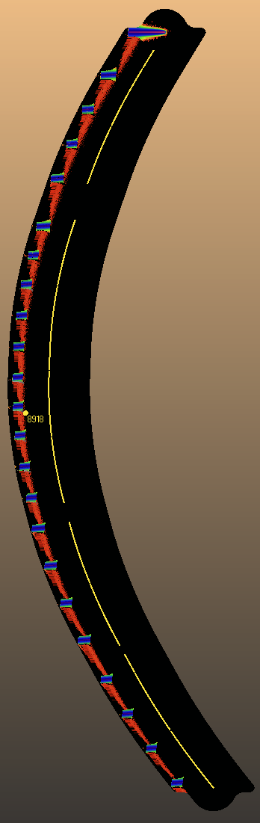
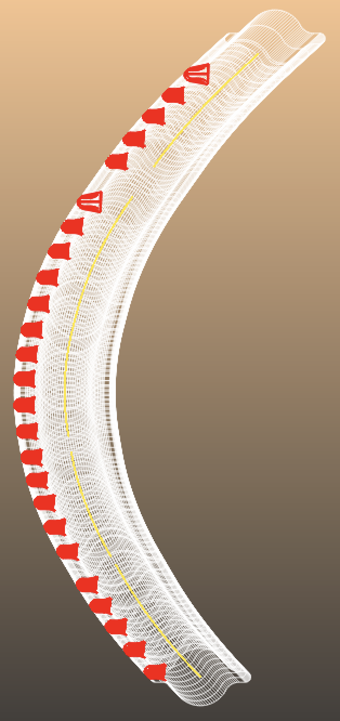
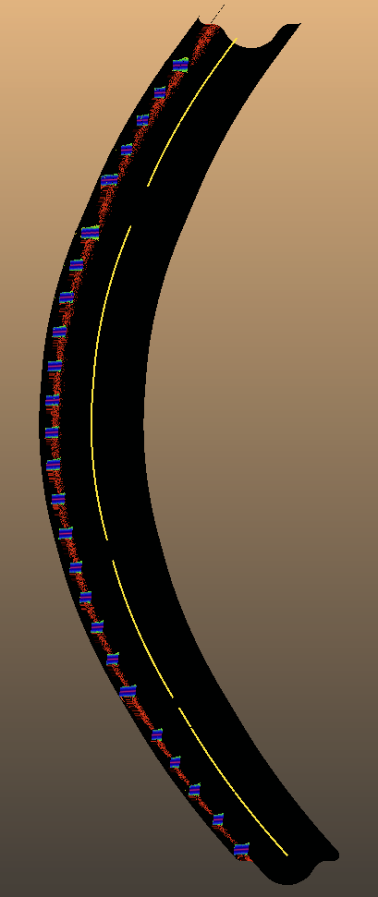
Working solutions
4 or 5 absorbers/dipole (total 22)
5 absorbers/dipole (total 25)

Slide 14
Cooling analysis

Slide 15
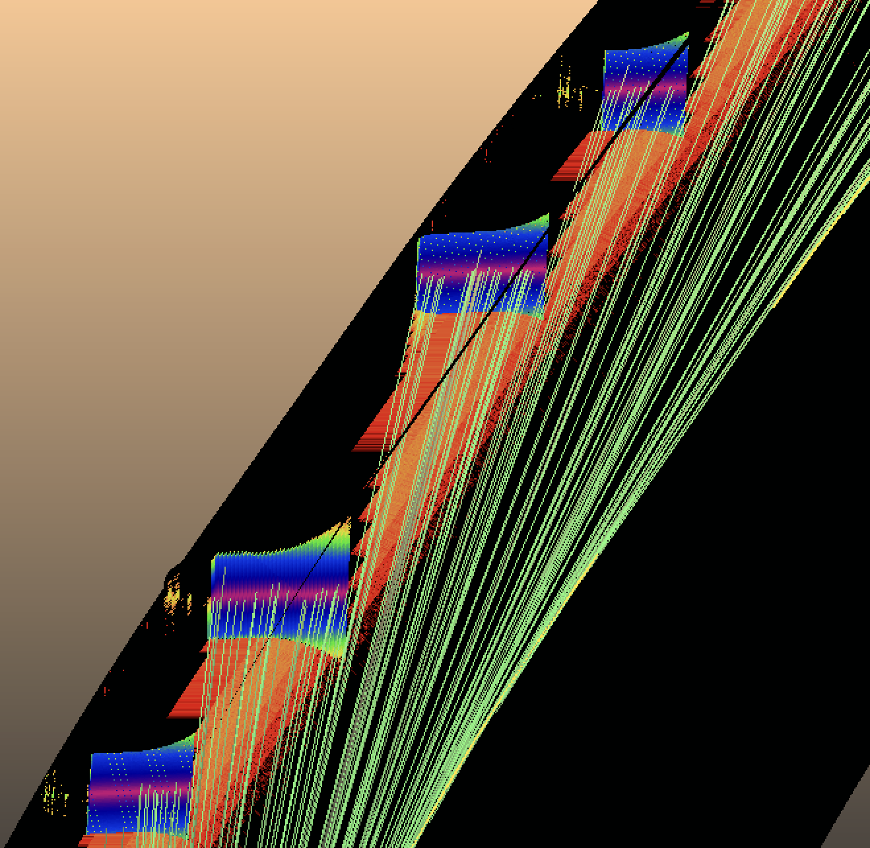
The case against the long drifts
7.6m
Power (W)

Slide 16
Conclusion
Two working, periodic solutions
  One for least amount of absorbers (22 / 130m)
  One for standard amount of absorbers / dipole (25 / 130m)
Shadowing long drifts requires wider absorbers
  Impedance increases
  Zero misalignment tolerance in outward direction
  Can we manufacture?
  Can the new optics have shorter drifts?
Limitations of this study
  One configuration studied of possible 8
Future actions
  Cooling simulations
  Impedance calculations
  Complete misalignment study

