Slide 1
Update on the SR shielding studies for FCC-ee
B. Humann, A. Lechner

Slide 2
Introduction
Splitting of dipoles
Power load and power density
Dose levels in the tunnel
Future steps
  Simplify shielding structure
  LCC vs GHC optics

Slide 3
Introduction
Splitting of dipoles
Power load and power density
Dose levels in the tunnel
Future steps
  Simplify shielding structure
  LCC vs GHC optics

Slide 4
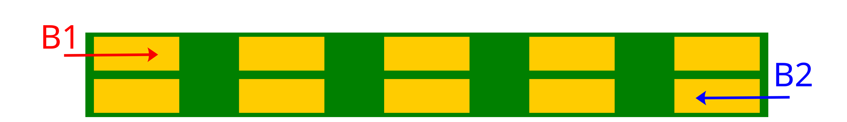
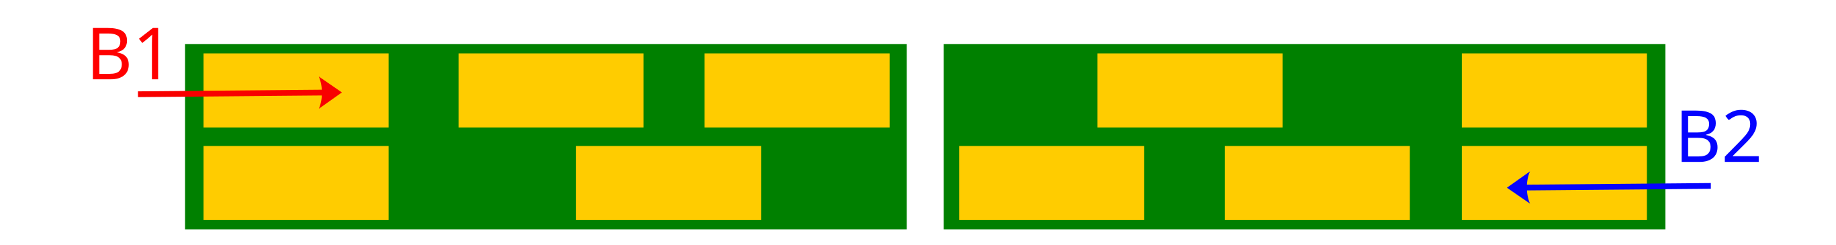
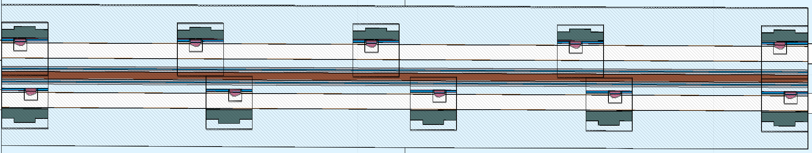
Splitting the dipoles (i)
So far (FCC Week 2025): 19m/21m/22m long dipoles with 5 equidistantly placed photon stoppers per beam (130cm including shielding).
For various reasons (transport, vacuum chamber length,…) shorter magnets with a maximum length of 12m are required
Current conceptual solution:
  Splitting the dipole into two halves with a 30cm gap
  Placement of the photon stoppers asymmetrically, which has the disadvantage of an uneven weight distribution
e-
e+
30cm (virtual) gap

Slide 5
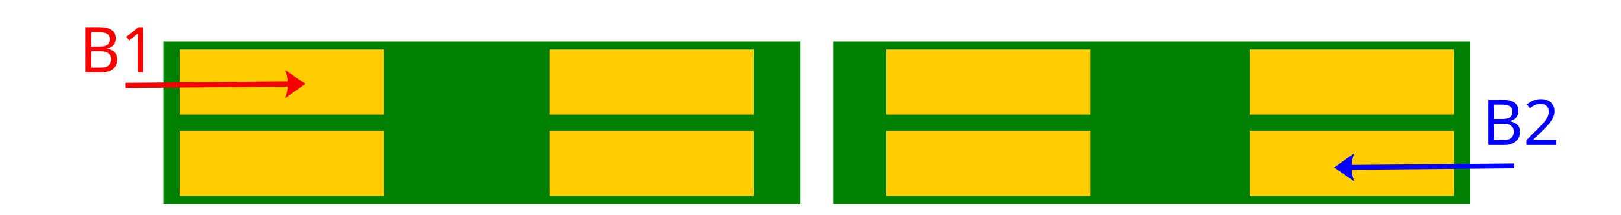
Splitting the dipoles (ii)
So far (FCC Week 2025): 19m/21m/22m long dipoles with 5 equidistantly placed photon stoppers per beam (130cm including shielding).
For various reasons (transport, vacuum chamber length,…) shorter magnets with a maximum length of 12m are required
Potential conceptual solution:
  Reducing the number of photon stoppers from 5 to 4 while increasing their length, allowing for a symmetric layout
  Requires photon stoppers to reach into circular part of VC, possibly increasing impedance to unacceptable levels
  Currently under study by TE/VSC

Slide 6
Introduction
Splitting of dipoles
Power load and power density
Dose levels in the tunnel
Future steps
  Simplify shielding structure
  LCC vs GHC optics

Slide 7
Power load on the components
 | 30cm gap |  | FCC-Week 2025
Photon stoppers | 80.7% | ~2.7kW/stopper | 80.7%
Radiation shielding | 4.5% | ~154W/shielding | 3.7%
Vacuum chambers | 5.1% | 65.11W/m | 5.2%
Dipoles | 9.6% | 147.35W/m | 10.1%
Environment | <0.05% | 0.62W/m | <0.05%
Overall similar power distribution on the accelerator components and the tunnel environment
Slightly less impact on the dipole
  Possible further reduction if changing busbars to copper
22m long magnet: 3.24kW on the yoke (~147.35W/m)

Slide 8
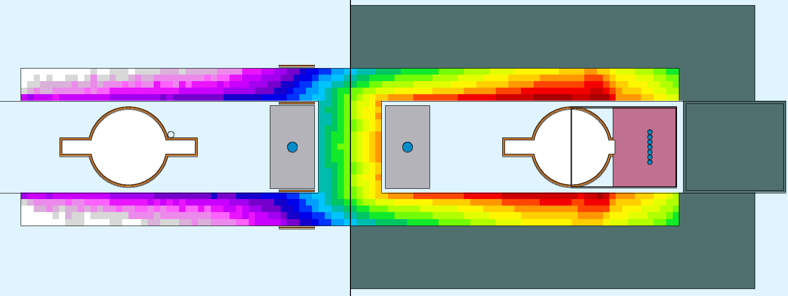
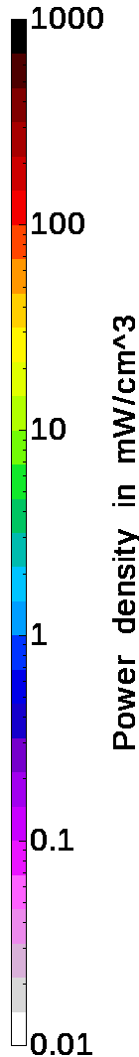
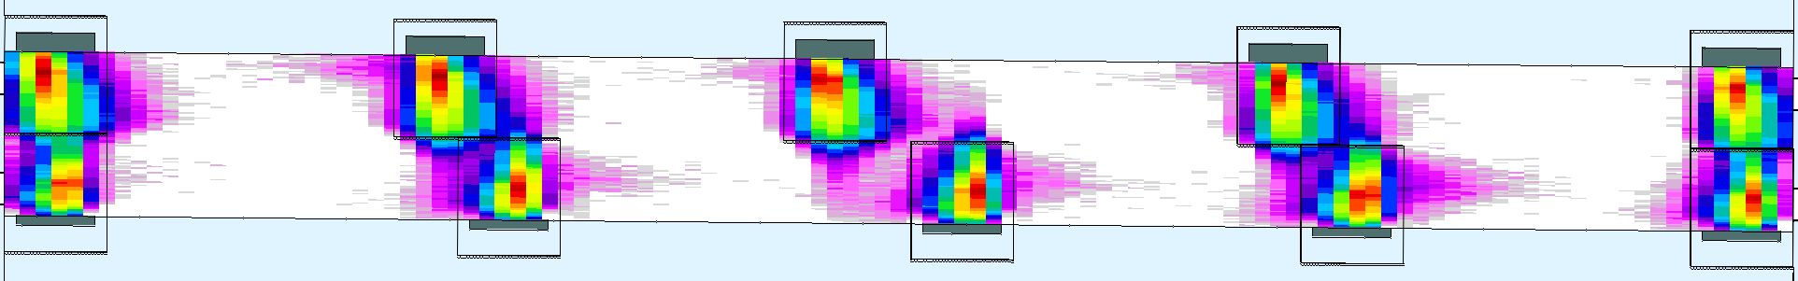
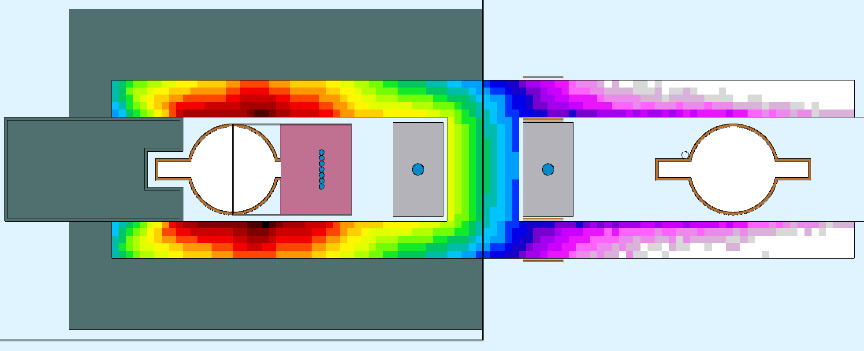
Power density on the yoke
Power density strongly localized around photon stoppers
Up to 700mW/cm³ around photon stopper location
B1
B2
So far, no active cooling of dipole yoke
  Some cooling required (?) as heat will go into tunnel air otherwise

Slide 9
Introduction
Splitting of dipoles
Power load and power density
Dose levels in the tunnel
Future steps
  Simplify shielding structure
  LCC vs GHC optics

Slide 10
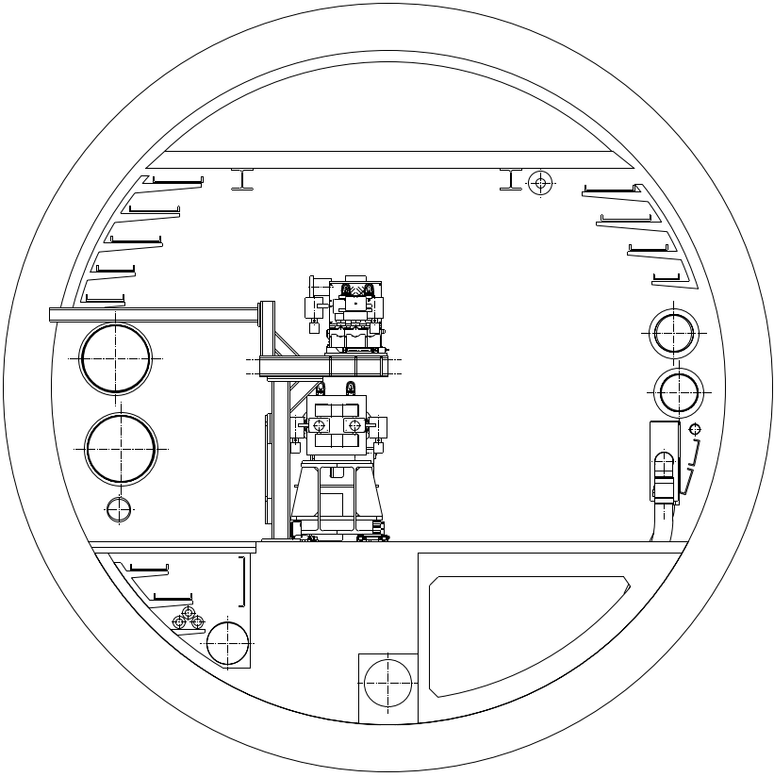

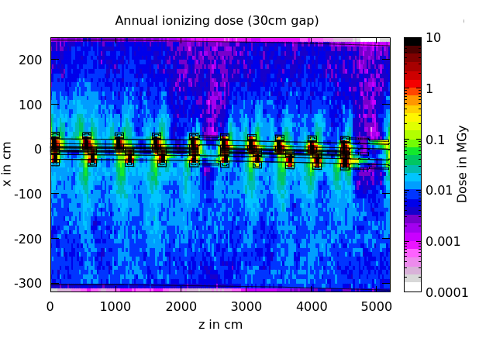
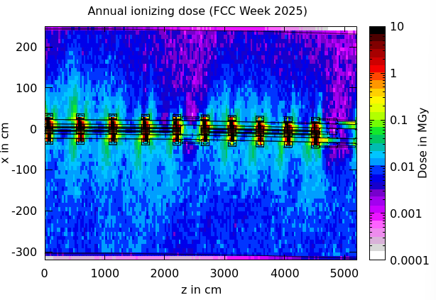
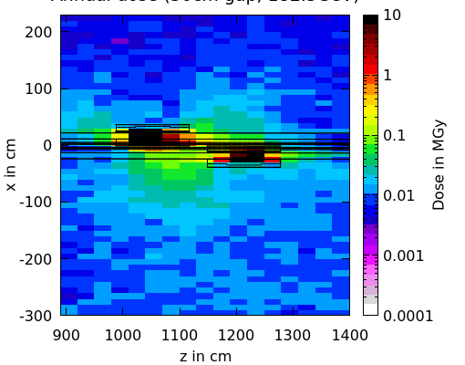
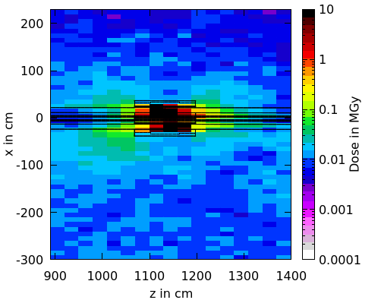
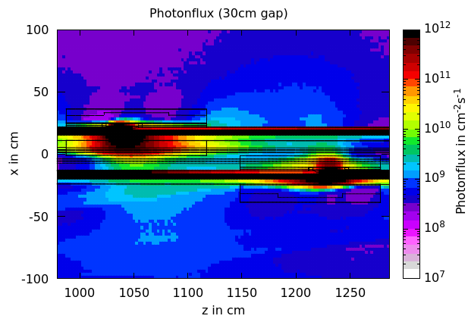
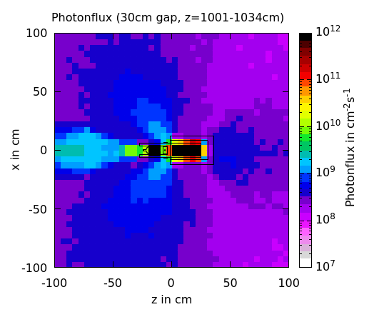
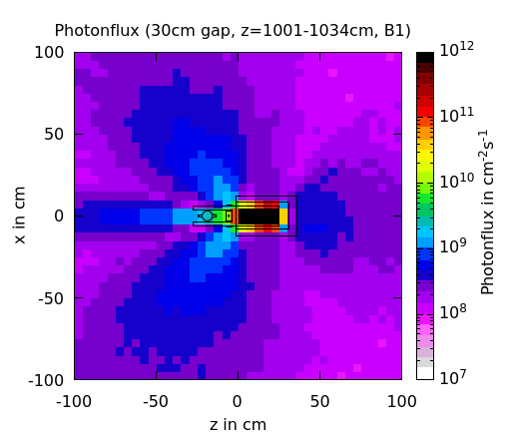
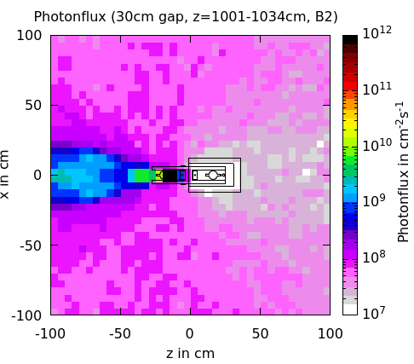
Dose levels in the tunnel
Slight increase in the overall radiation load with higher leakage for the asymmetric layout
Shielding is more efficient with aligned photon stopper positions
30cm gap
FCC Week 2025
total
B1
B2
=
+

Slide 11
Conclusion on the asymmetric layout
Generally: several disadvantages if shielding structure not located aligned
Weight distribution (~350kg/shielding structure)
Placement of supports and subsequently the electronics bunker
Leakage of dose
  Radiation loads profit from symmetric shielding placement as they also shield each other
  If no symmetric layout can be found, possibly shielding material required to go over central part of dipole
Currently running symmetric 3+2 shielding placement

Slide 12
Introduction
Splitting of dipoles
Power load and power density
Dose levels in the tunnel
Future steps
  Simplify shielding structure
  LCC vs GHC optics

Slide 13
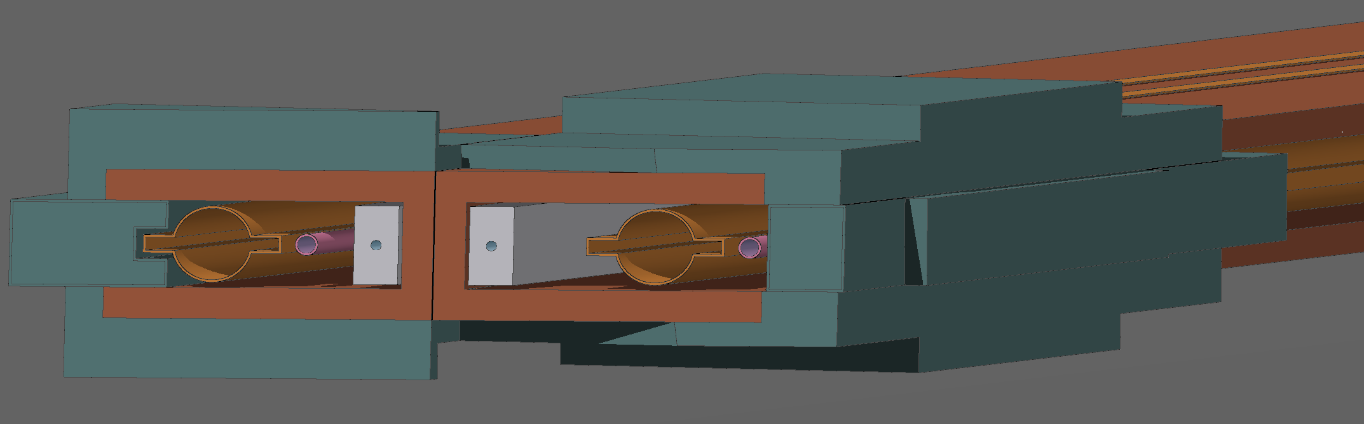
Future steps: simplification of the shielding structure
The current shielding design contains several steps to provide various shielding thickness around the absorber
Simplify the design to a more uniform layout
  Possibly higher weight due to increase of shielding material
  Save cost thanks to easier manufacturing process

Slide 14
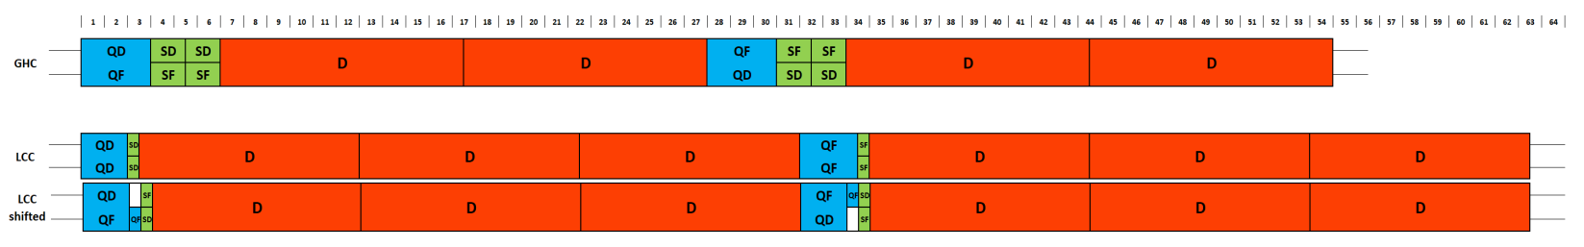
Future steps: GHC vs LCC optics comparison
Request from the FCC-ee Layout and Optics Design WG to study radiation load for the LCC optics as well
Perform simulations with same shielding with LCC optics to provide values for comparison
Currently various input still needed (optics file, magnet split of 30m long dipoles, photon stopper locations)

