Slide 1




Transverse beam dynamics of a misaligned quadrupoles magnet
Introduction
Study the change in emittance and other beam parameters due to the vibration impact
The vibration is simulated from the experimental data of LHC tunnel using 2D Inverse Fourier Transform which considers both absolute and relative motions of magnets elements.
Analytical calculations for a simple case
The emittance growth in a periodic FODO lattice
Element by element tracking
Multiturn tracking
Outlines
A misaligned quadrupole causes dipole kick (Latina 2016)
(See appendix)
If every particles get the same amount of kick $<Δx^{′}> =Δx^{′}=k_{1}L_{q}Δx_{misalign},$ then the above implies that $Δε_{x}=0$
The misalignment not only causes the kicks but also the dispersion and betatron oscillation excitation (Latina 2016).

Slide 2








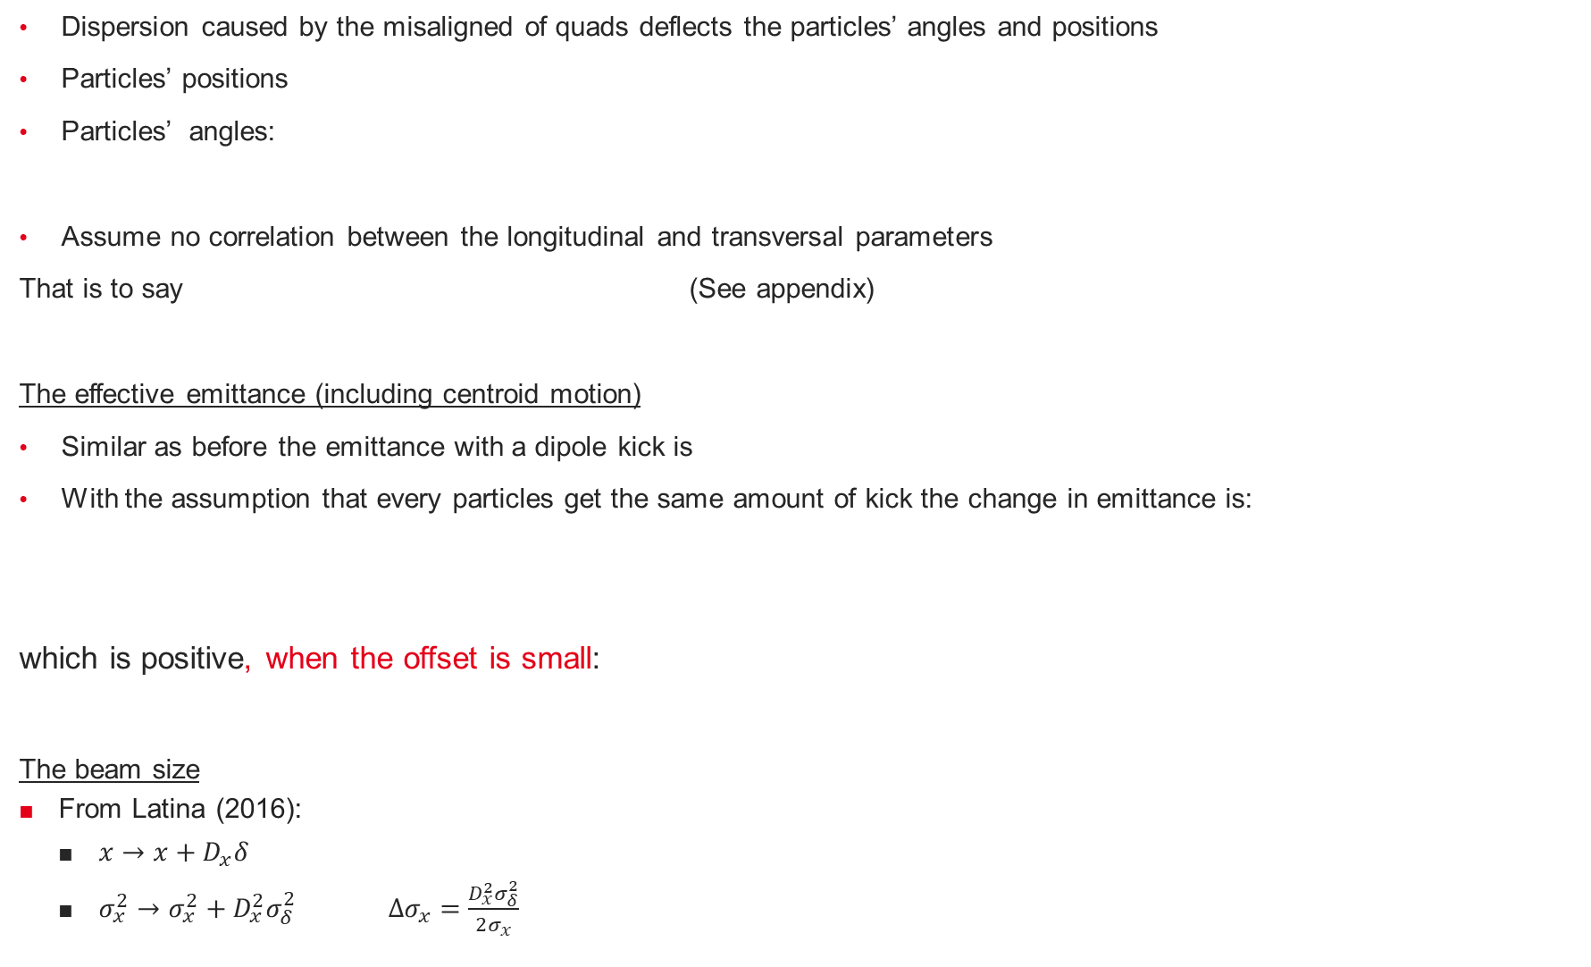
Dispersion caused by the misaligned of quads deflects the particles’ angles and positions
Particles’ positions
Particles’ angles:
Assume no correlation between the longitudinal and transversal parameters
That is to say (See appendix)
The effective emittance (including centroid motion)
Similar as before the emittance with a dipole kick is
With the assumption that every particles get the same amount of kick the change in emittance is:
which is positive, when the offset is small:
The beam size
From Latina (2016):
$x→x+D_{x}δ$
$σ_{x}^{2}→σ_{x}^{2}+D_{x}^{2}σ_{δ}^{2} Δσ_{x}=\frac{D_{x}^{2}σ_{δ}^{2}}{2σ_{x}}$
Same for every particles
Depends on particle $δ$

Slide 3
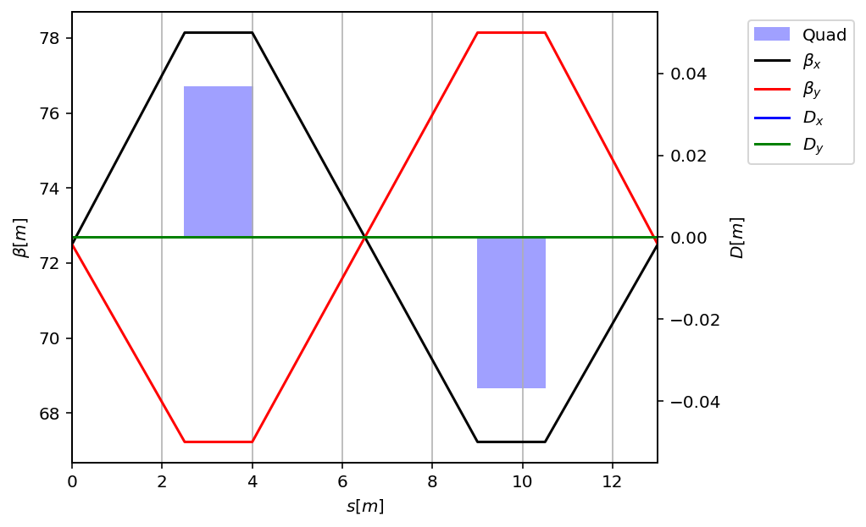
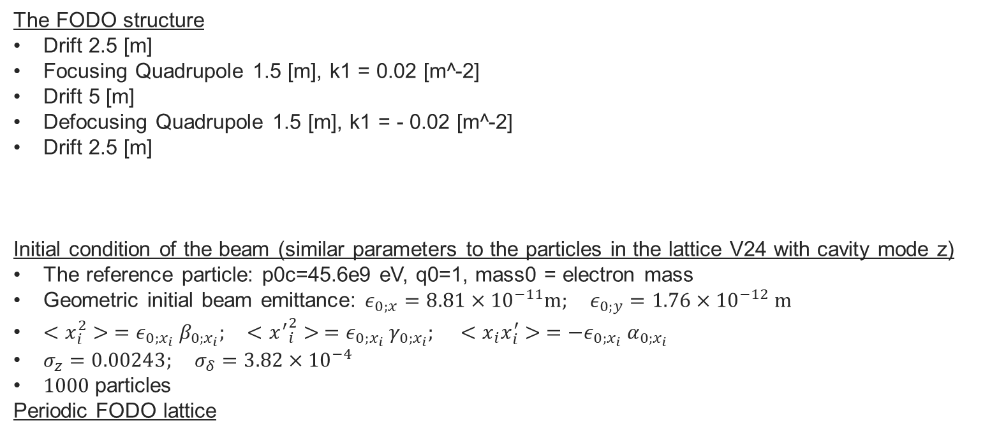
Emittance Growth in hypothetical periodic FODO lattice
The FODO structure
Drift 2.5 [m]
Focusing Quadrupole 1.5 [m], k1 = 0.02 [m^-2]
Drift 5 [m]
Defocusing Quadrupole 1.5 [m], k1 = - 0.02 [m^-2]
Drift 2.5 [m]
Initial condition of the beam (similar parameters to the particles in the lattice V24 with cavity mode z)
The reference particle: p0c=45.6e9 eV, q0=1, mass0 = electron mass
Geometric initial beam emittance: $ε_{0;x}=8.81×{10}^{−11}m; ε_{0;y}=1.76×{10}^{−12} m$
$<x_{i}^{2}> =ε_{0;x_{i}} β_{0;x_{i}}; <{x^{′}}_{i}^{2}> =ε_{0;x_{i}} γ_{0;x_{i}}; <x_{i}x_{i}^{′}> =−ε_{0;x_{i}} α_{0;x_{i}}$
$σ_{z}=0.00243; σ_{δ}=3.82×{10}^{−4}$
$1000$particles
Periodic FODO lattice
…
FODO = 1
FODO = 2
FODO = 3
FODO = n

Slide 4
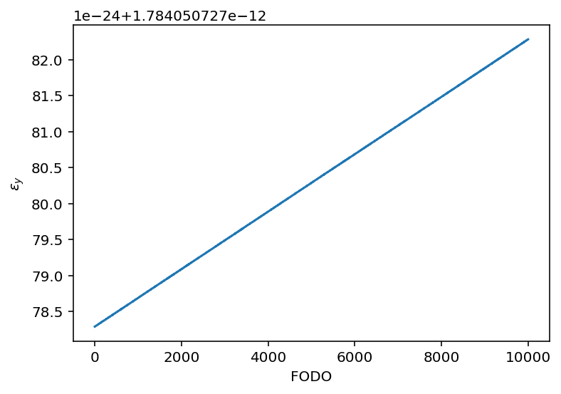
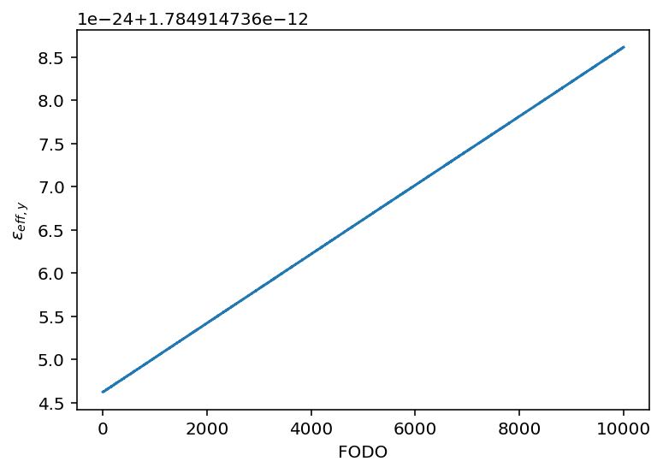
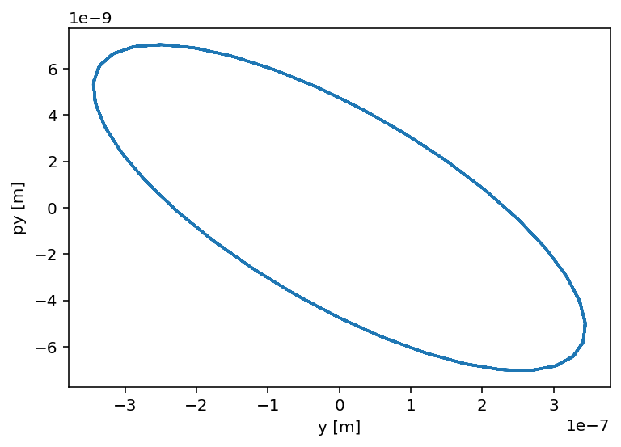
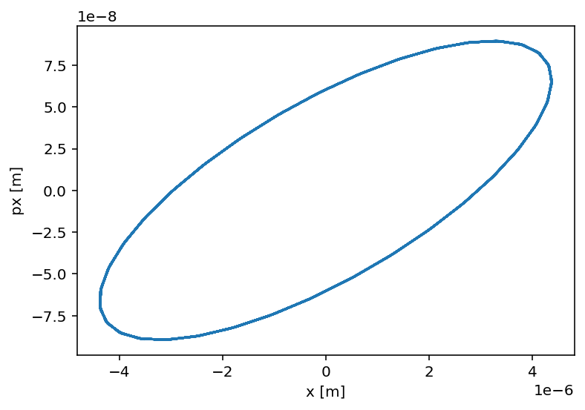
Without the displacement being applied
The emittance and the effective emittance is about constant
Both formulars give almost the same values.
Centroid motion
The centroid of the beam
form small ellipses that doesn’t
change their size over the increase
In longitudinal coordinate s.
Negligible changes
[m]
[m]

Slide 5
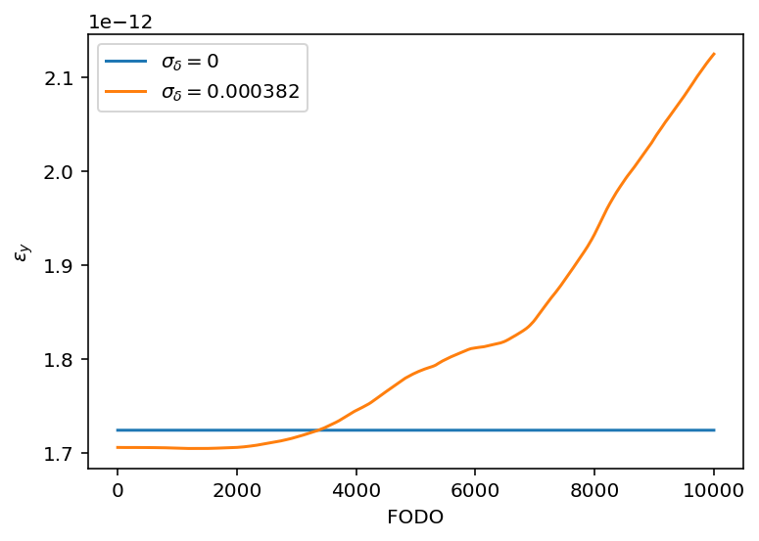
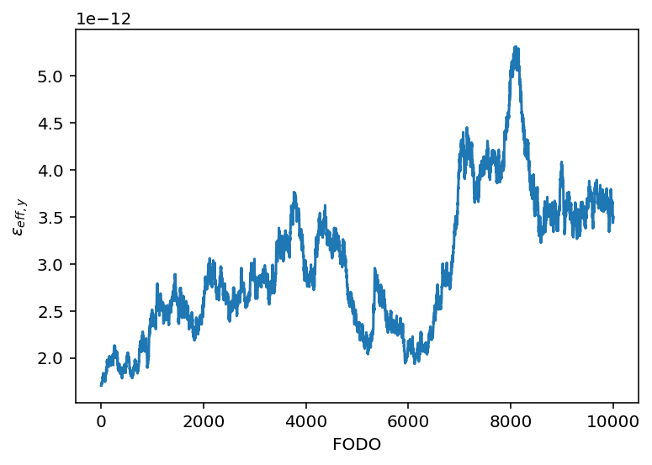
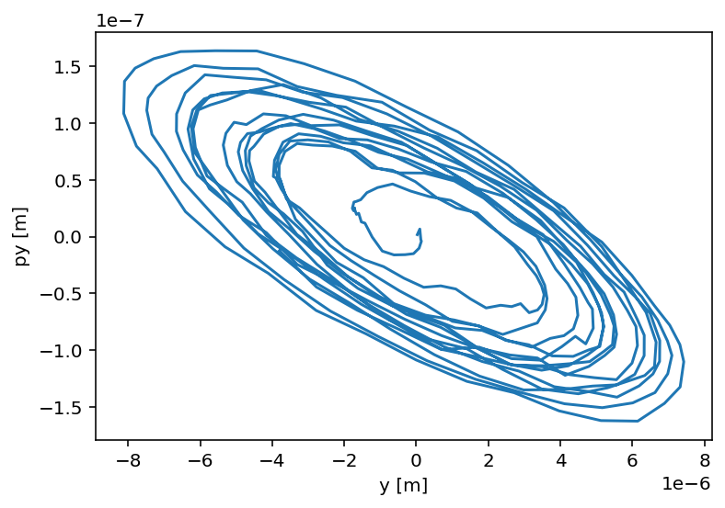


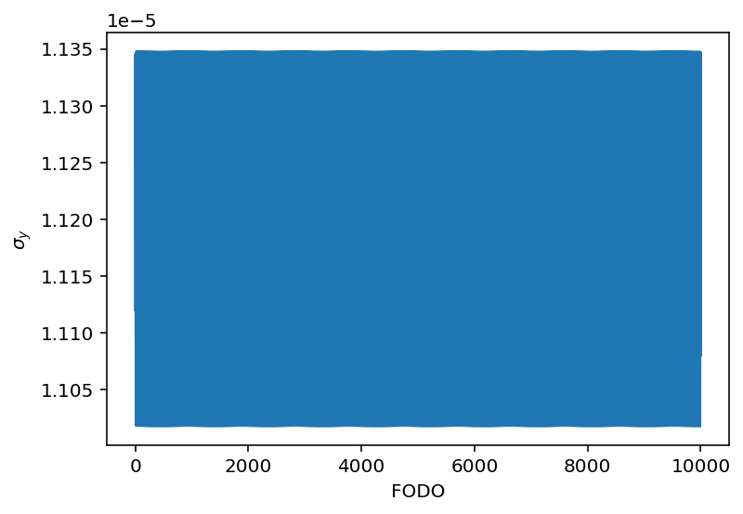
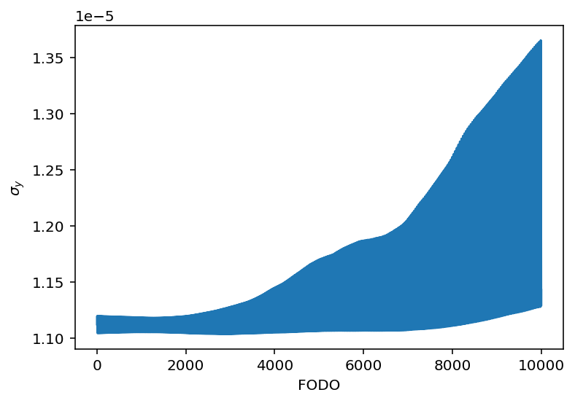



With quadrupoles being displace by gaussian distribution with standard deviation of 0.1 micron in both horizontal
and vertical directions
The centroid drifts off the center increasing the size of ellipse as the number of FODO increase. The diverge oscillation of the results effective emittance to increase
The emittance increases monotonically. The slope depend on the energy spread.
The effective emittance also shows signs of increasing, but not monotonically.
The vertical beam size with $σ_{δ}$ = 0 [m] fluctuates
from 1.10e-5 [m] to 1.13e-5 [m], but doesn’t show
Any signs of increase.
The vertical beam size with $σ_{δ}$ = 0 [m] also
fluctuates but increases over the longitudinal
coordinate.
Centroid motion: y-py
[m]
[m]
$σ_{δ}$ = 0 [m]
$σ_{δ}$ = 0.000382 [m]
[m]

Slide 6
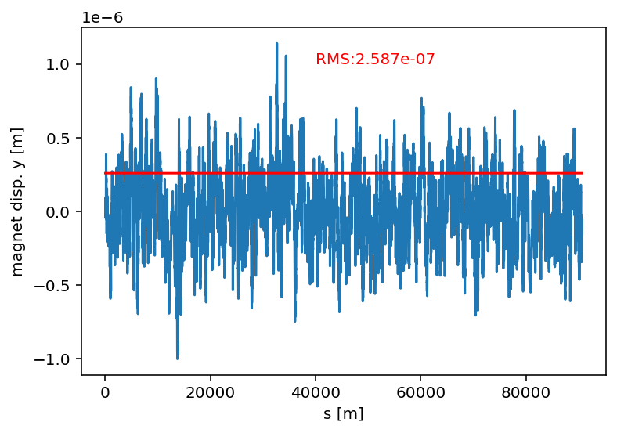
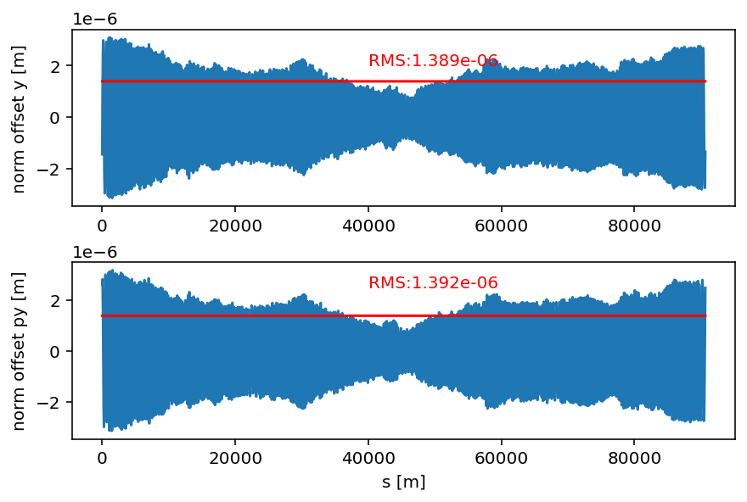
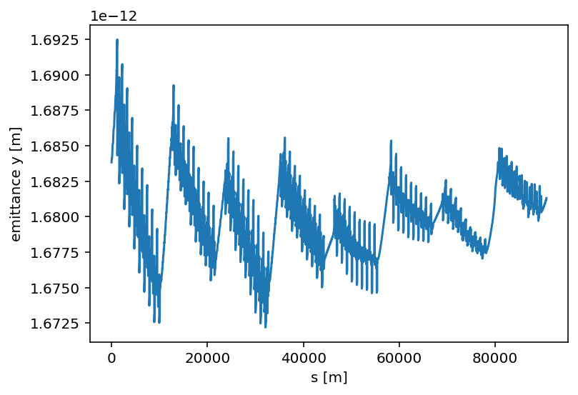
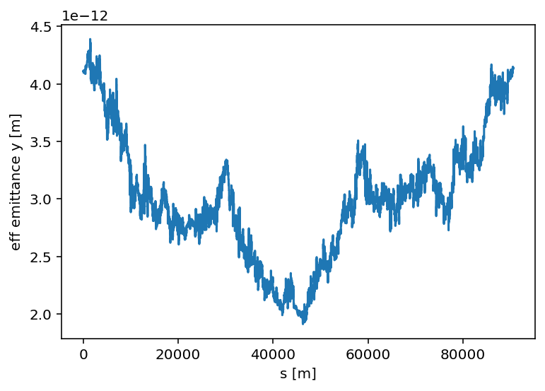
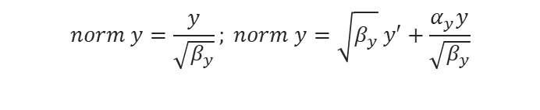
Element by element tracking lattice V24 with Cavities mode z
for ele in range(0, …):
…
line.track(particles, ele_start=ele, ele_stop=ele+1)
...
Initial beam is matched to the distorted lattice using
the matched gaussian bunch
The lattice is distorted by vibration in the vertical direction with
technical noises and the mechanical support being considered (1 seed)
Emittance is calculated by
(IP2)
$$norm y=\frac{y}{\sqrt{β_{y}}}; norm y=\sqrt{β_{y}} y′+\frac{α_{y}y}{\sqrt{β_{y}}}$$

Slide 7
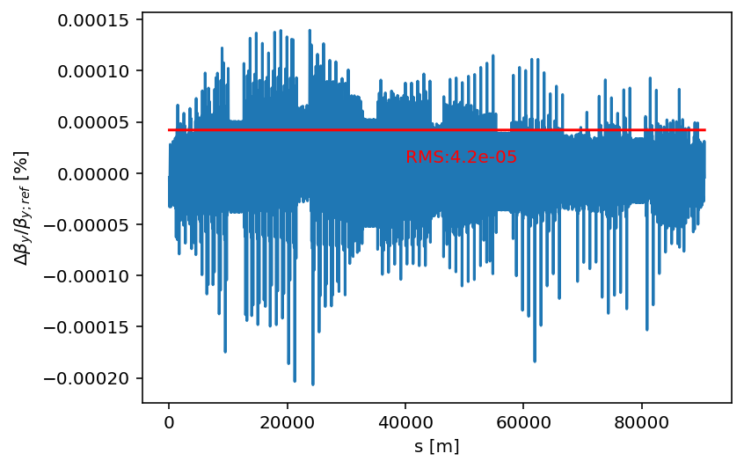
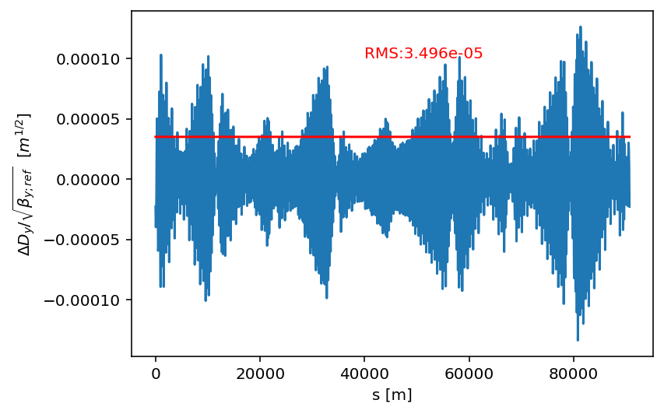
Beta-beating and Dispersion from twis
Observation and comparison to the results from the periodic FODO lattice
The emittance remains almost the same (small dispersion)
The centroid motion doesn’t grow as in the periodic FODO lattice
The change in the effective emittance dominates by the centroid motion

Slide 8
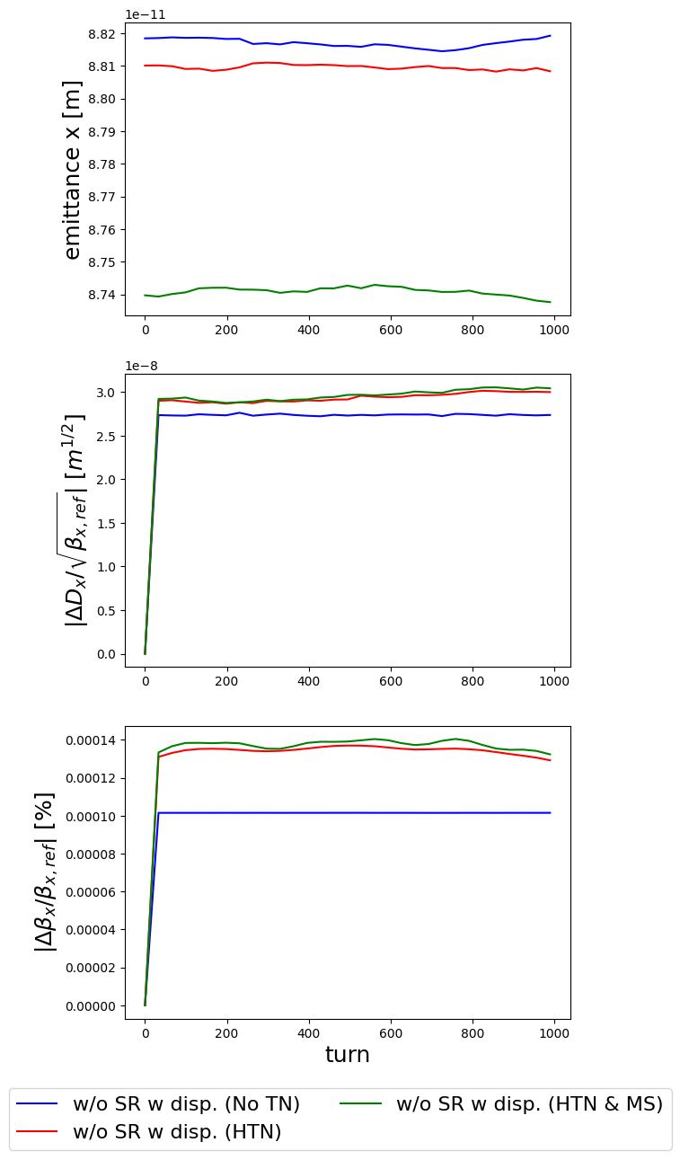
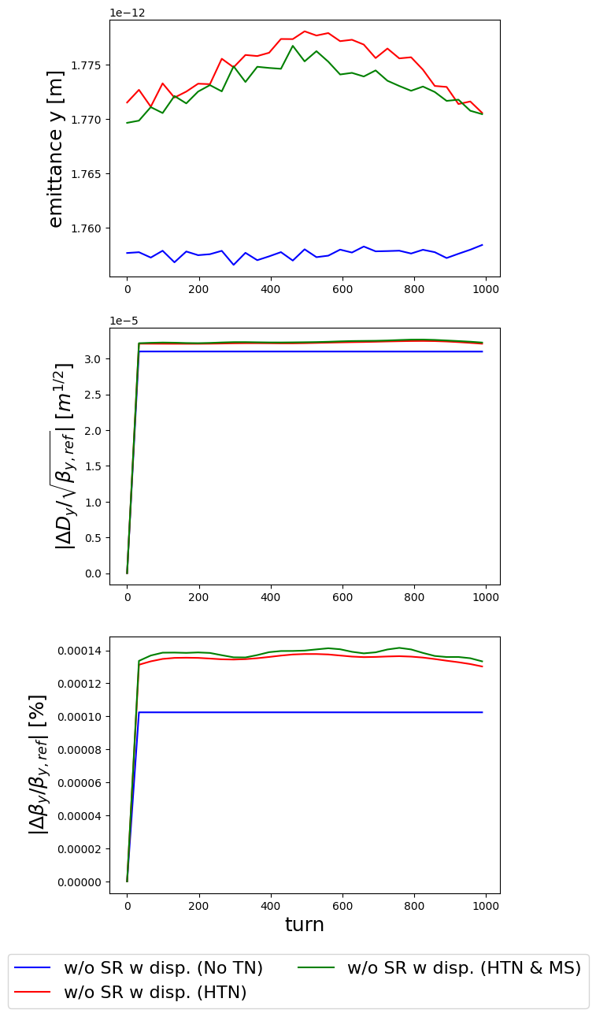
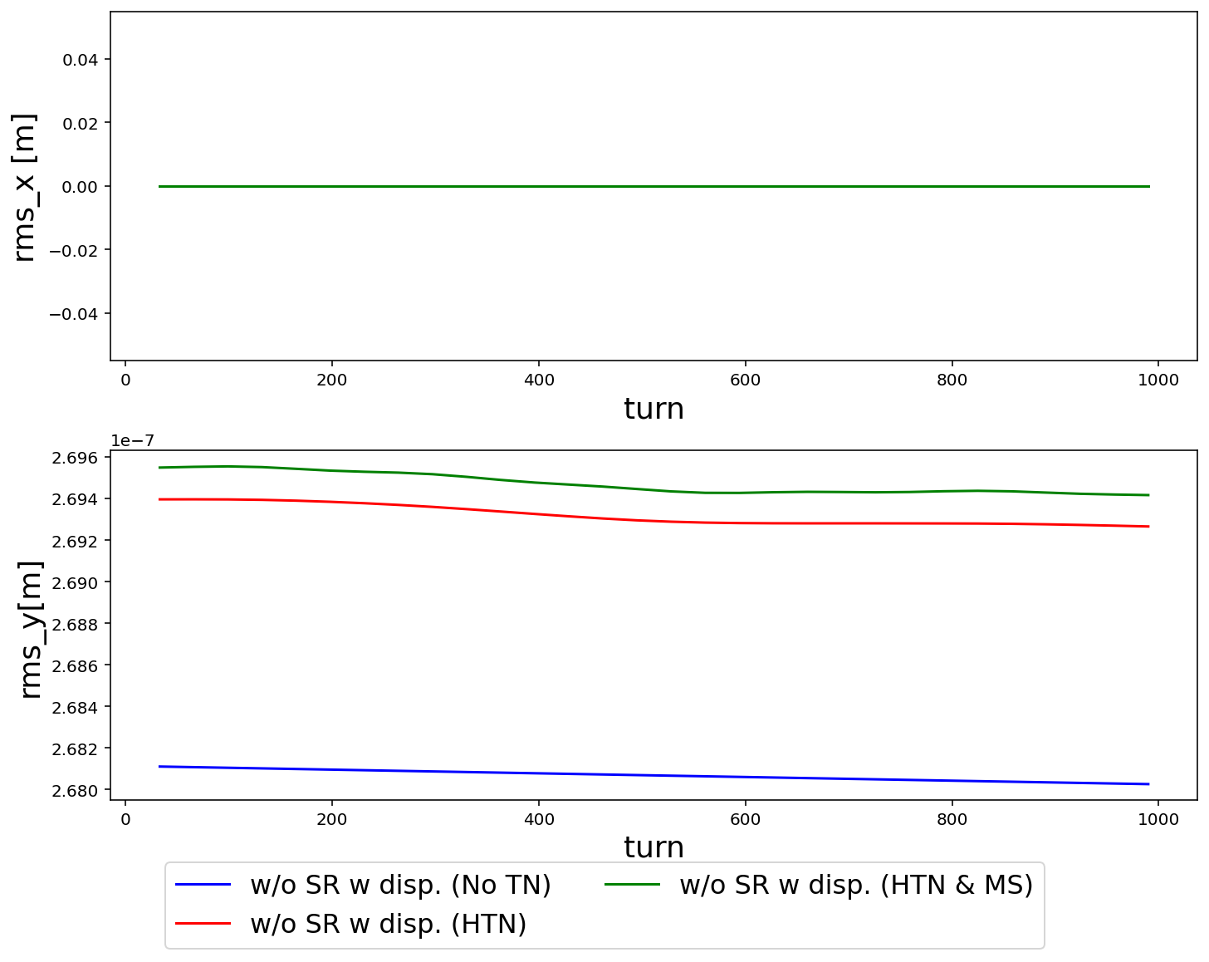
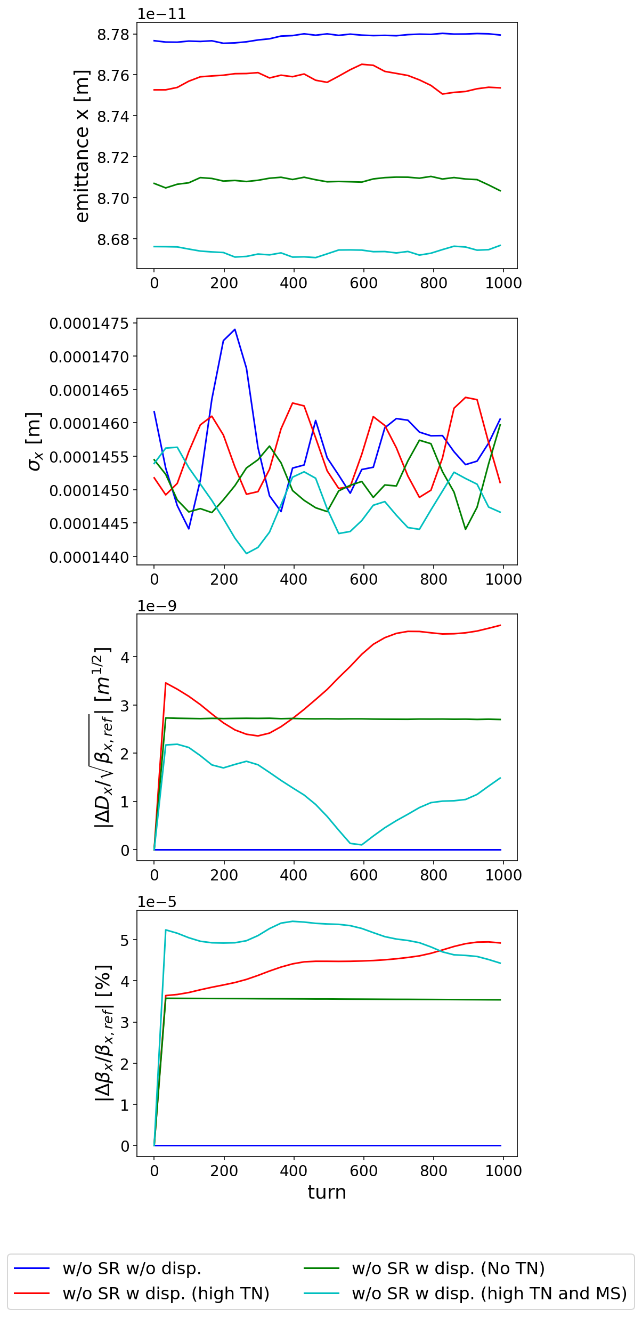
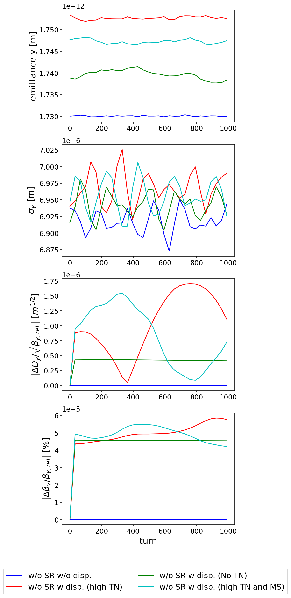
FCC-ee Multiturn tracking lattice V24 with Cavities mode z
Input misalignment error
The seeds of the displacement were control more strictly by:
No technical noise (NTN)
High technical noise (HTN) = NTN + technical noise
High technical noise with the mechanical support (HTN & MS) = NTN + (technical noise)*(mechanical support transfer function)
Initial beam is matched to the distorted lattice using the matched gaussian bunch
The results from the previous presentation
Horizontal
Vertical
The simulations with the distorted lattice shows means over 100 seeds with different displacements being applied, all starting from 1000 particles.

Slide 9
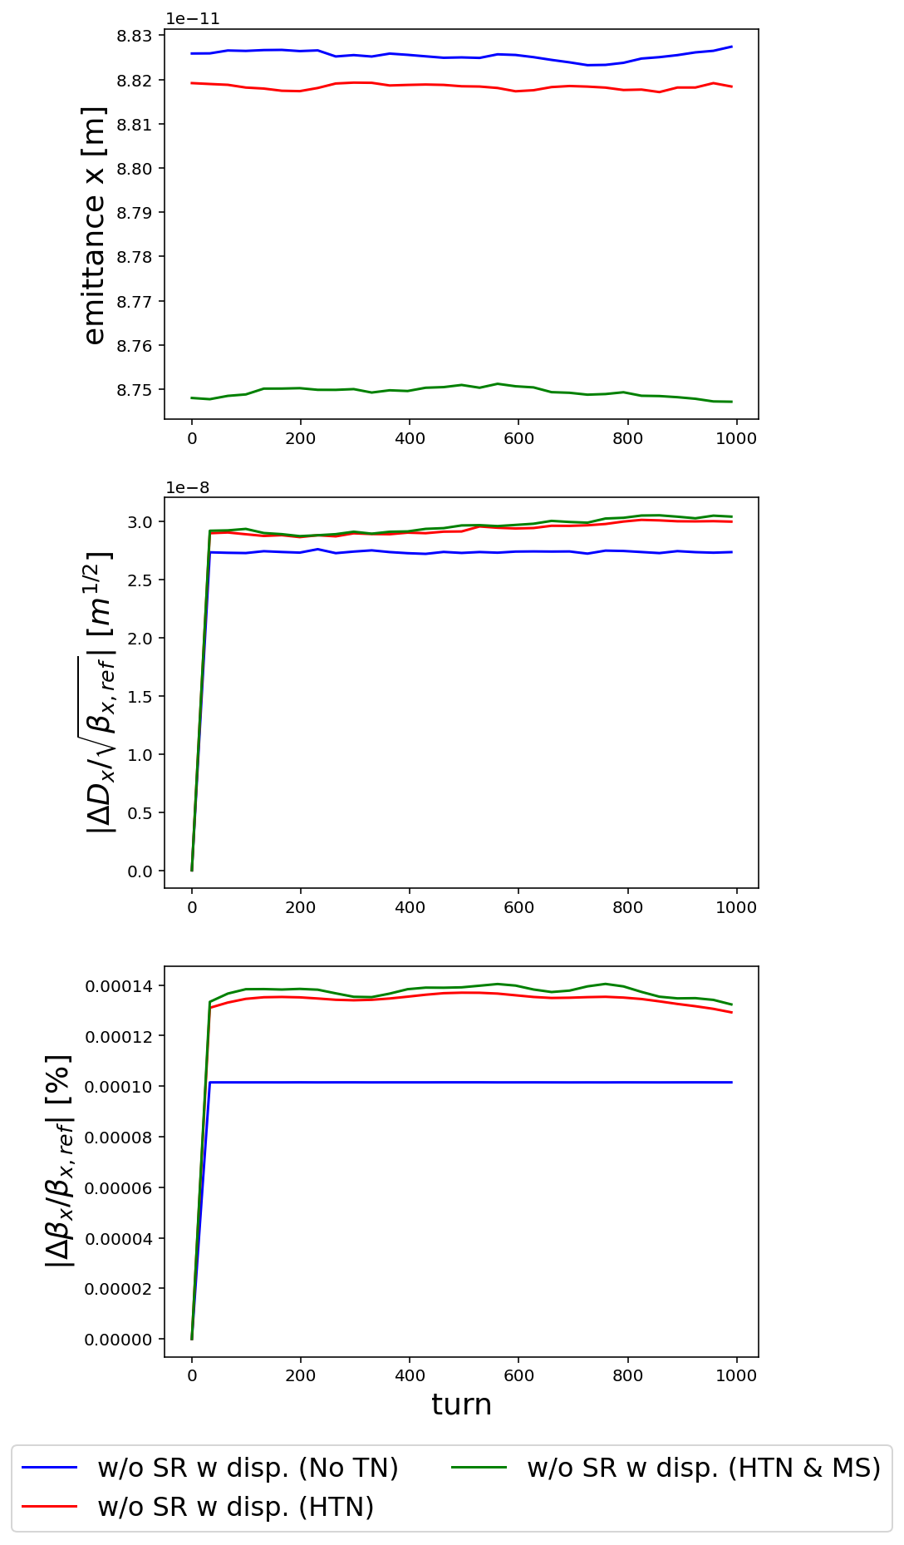
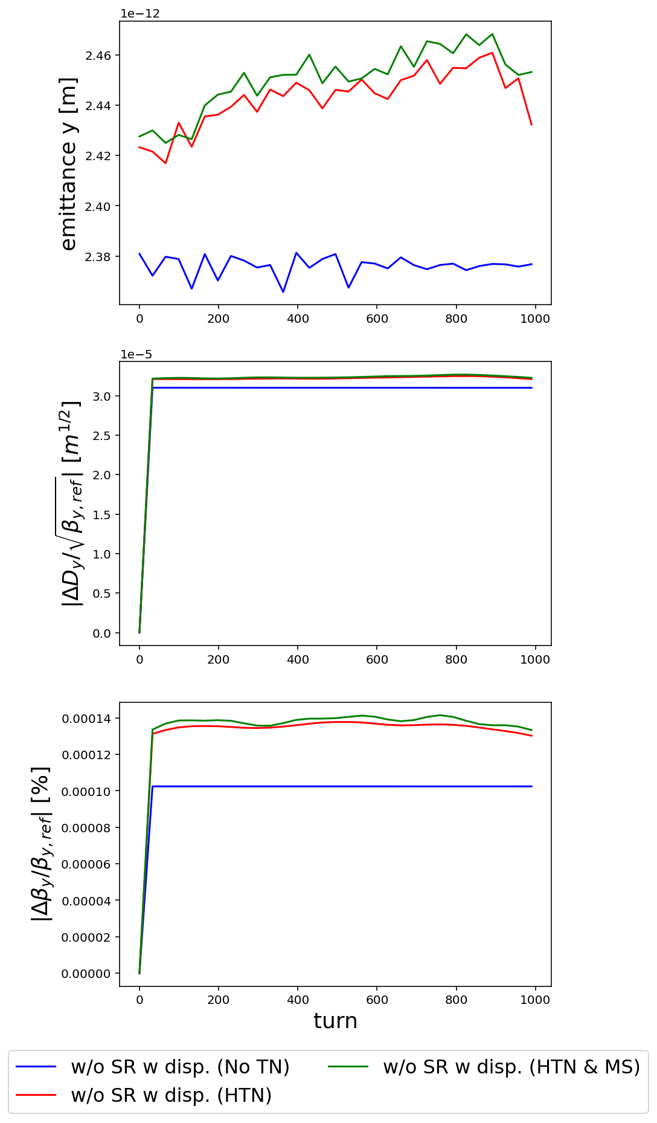
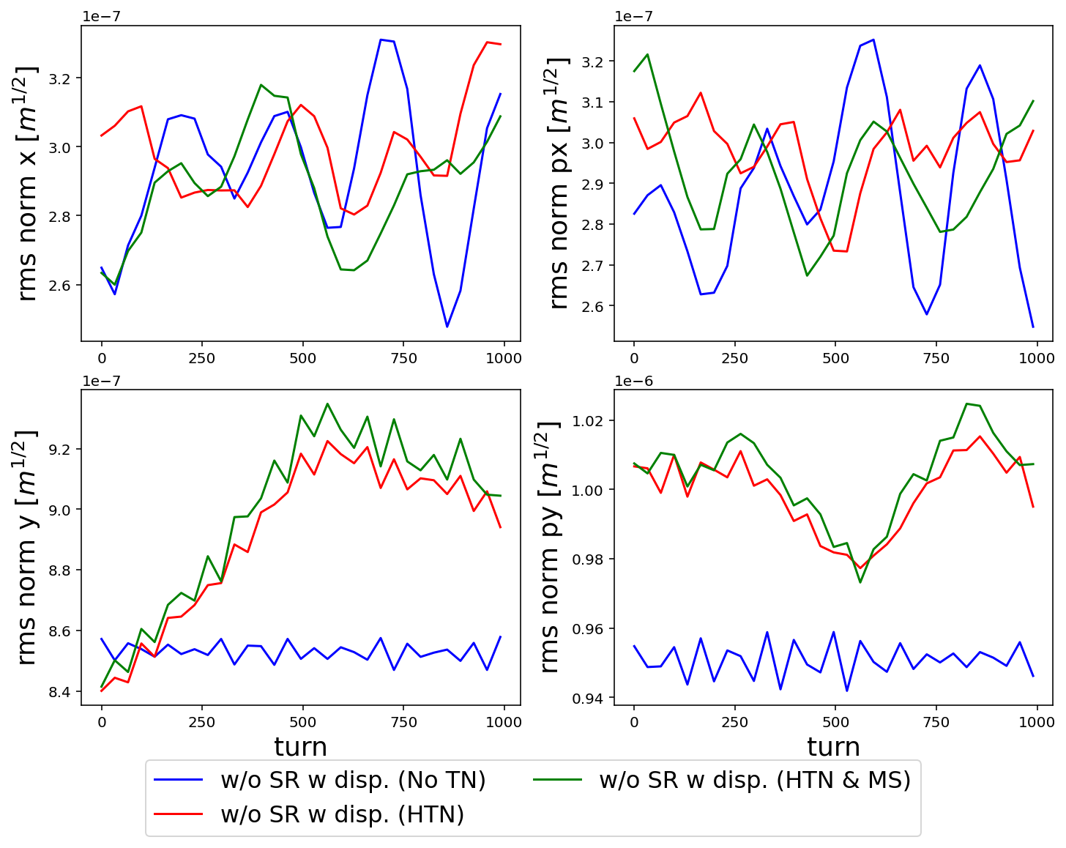
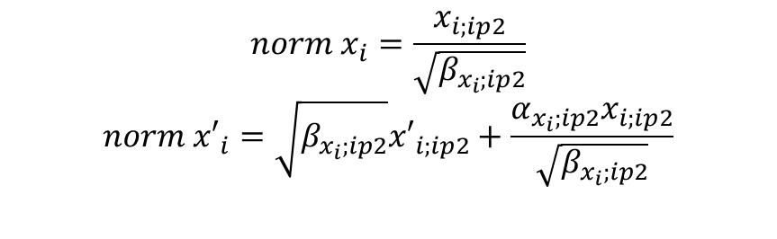
Centroid Motion computed at IP2
Effective Emittance
$$norm x_{i}=\frac{x_{i;ip2}}{\sqrt{β_{x_{i};ip2}}}$$
$$norm {x′}_{i}={\sqrt{β_{x_{i};ip2}}x′}_{i;ip2}+\frac{α_{x_{i};ip2}x_{i;ip2}}{\sqrt{β_{x_{i};ip2}}}$$
The simulations with the distorted lattice shows means over 100 seeds with different displacements being applied, all starting from 1000 particles.

Slide 10
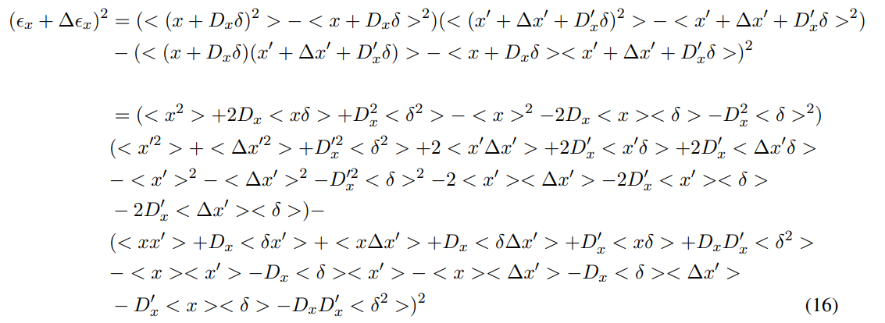


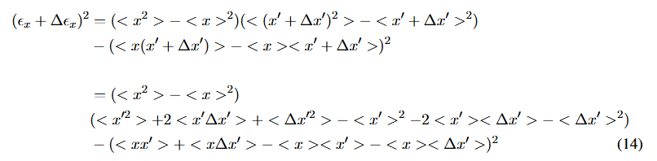
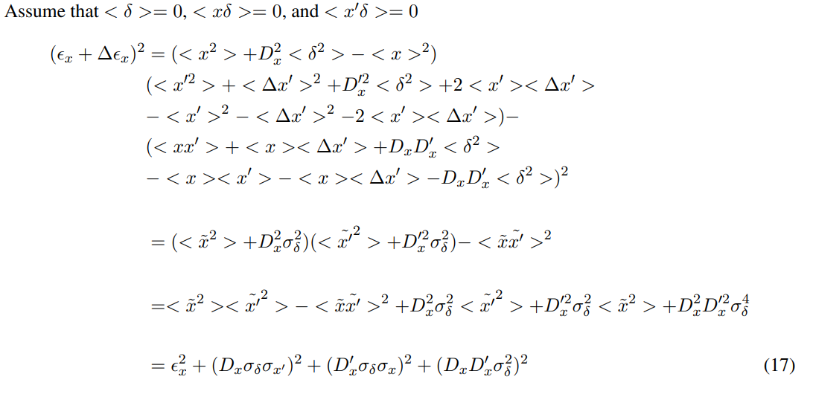
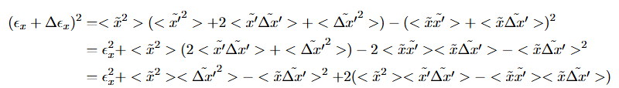
References
Latina, A., 2016. Effects of Element Misalignments on Accelerator Performance. PowerPoint. URl: https://indico. cern. ch/event/458671/contributions/2187799/attachments/1289619/1920127/Presentation. pdf. (accessed: 28.07. 2025).
With the dispersion taken into account
Appendix

Slide 11
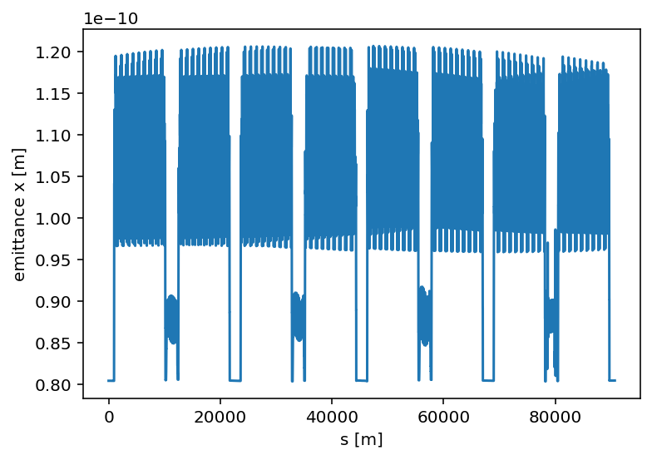
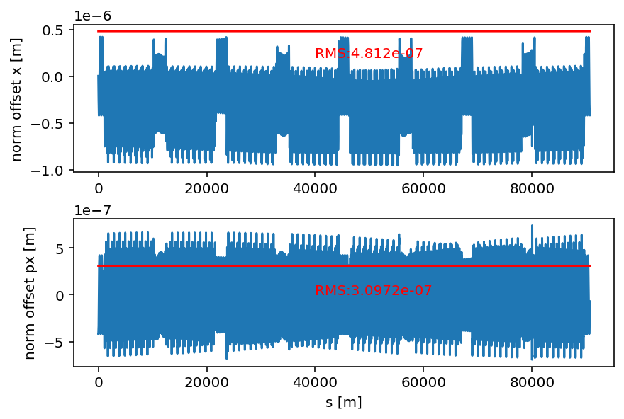

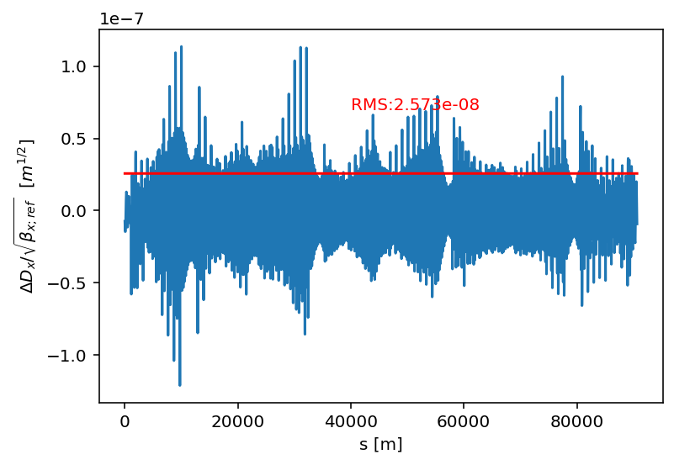
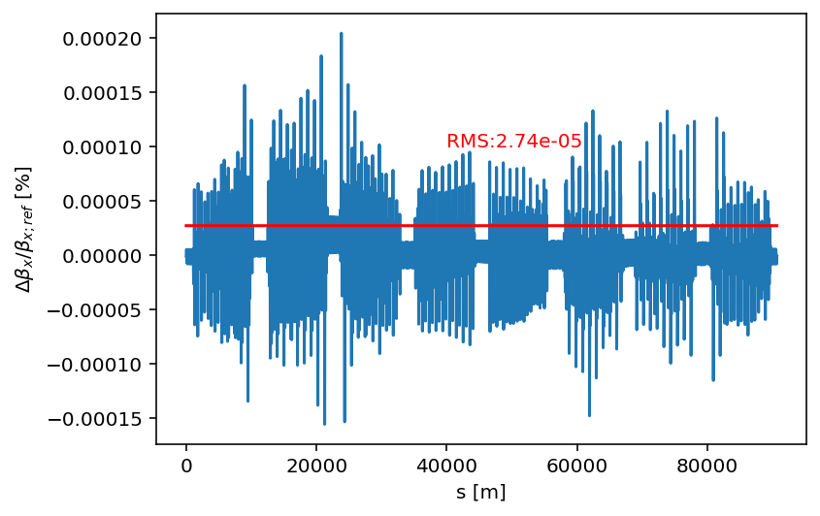
FCC-ee Element by element tracking
Coupling Effects to the horizontal direction

Slide 12
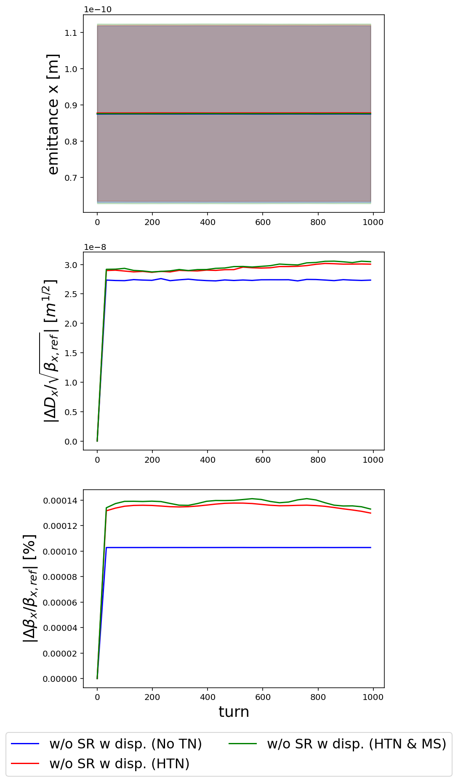

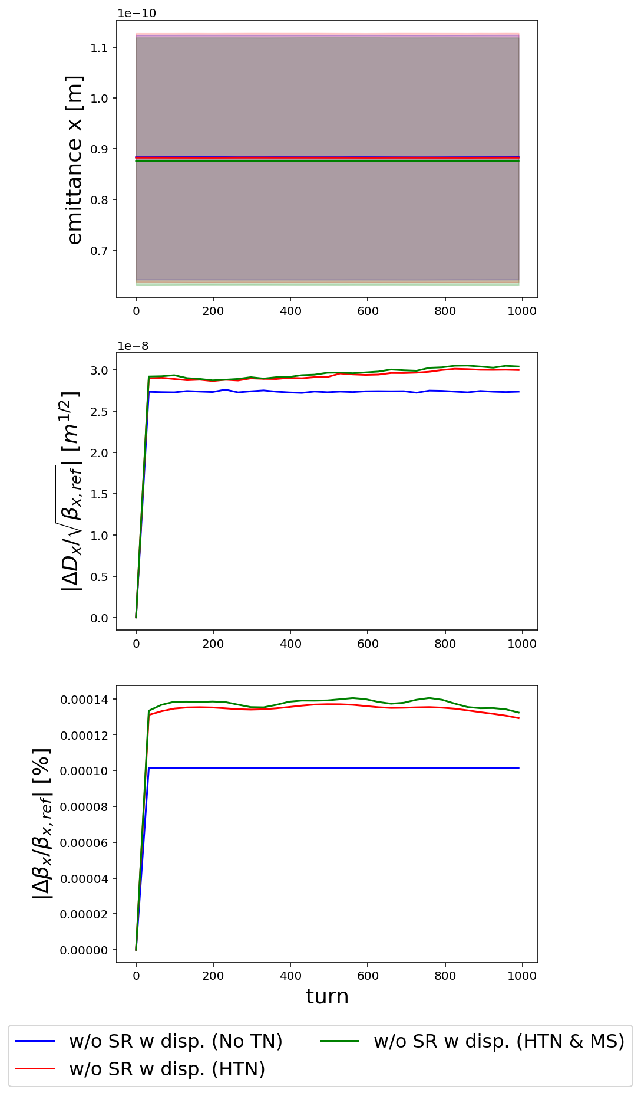
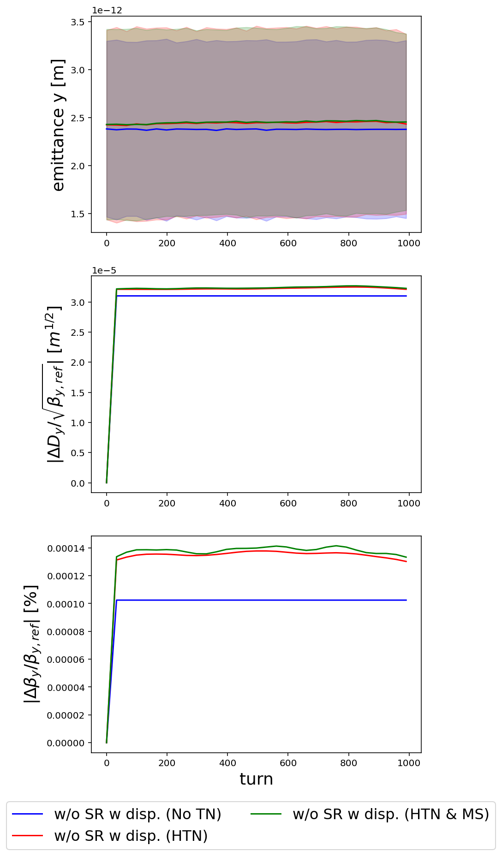




FCC-ee Multiturn tracking
$$±2σ$$
$$±2σ$$
$$±2σ$$
$$±2σ$$

