Slide 1
Processability, thermomechanical properties and radiation hardness of silicones and polyurethanes
Melanie Albeck
19.06.2025

Slide 2
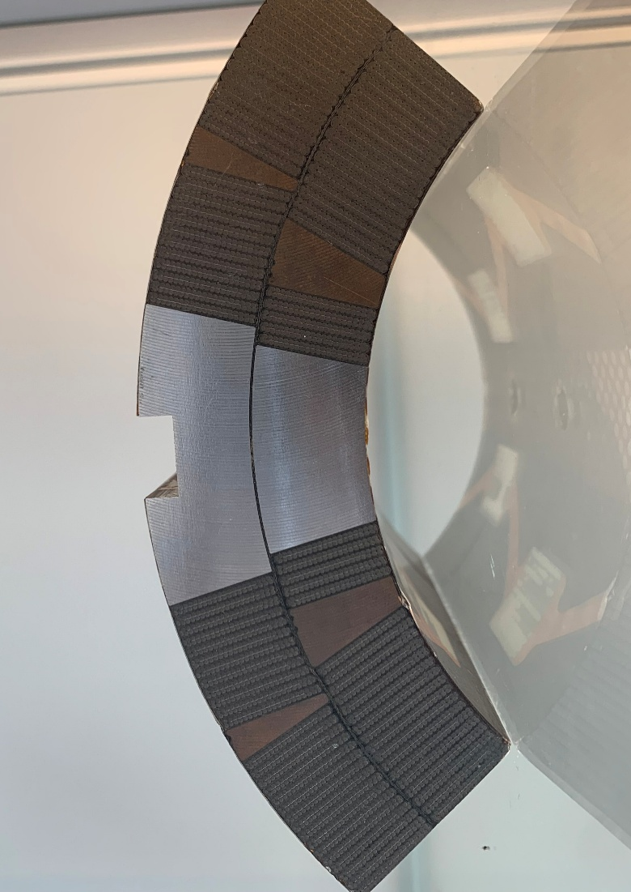
Introduction
Polymers are necessary in superconducting magnets for dielectric insulation and for the impregnation of magnet coils made of fragile conductors.
The processability of the uncured resin mixtures, the thermomechanical properties of the cured resin, and their resistance to ionizing radiation were studied.
Viscosity was measured as a function of temperature and time at constant temperature. Dynamic mechanical analysis (DMA) was performed to measure the viscoelastic properties of the cured samples as a function of temperature. Irradiation-induced aging of different polyurethanes and silicones was evaluated through tensile tests at room temperature, as well as bending and impact tests in liquid nitrogen.
Insulation
Magnet coil

Slide 3
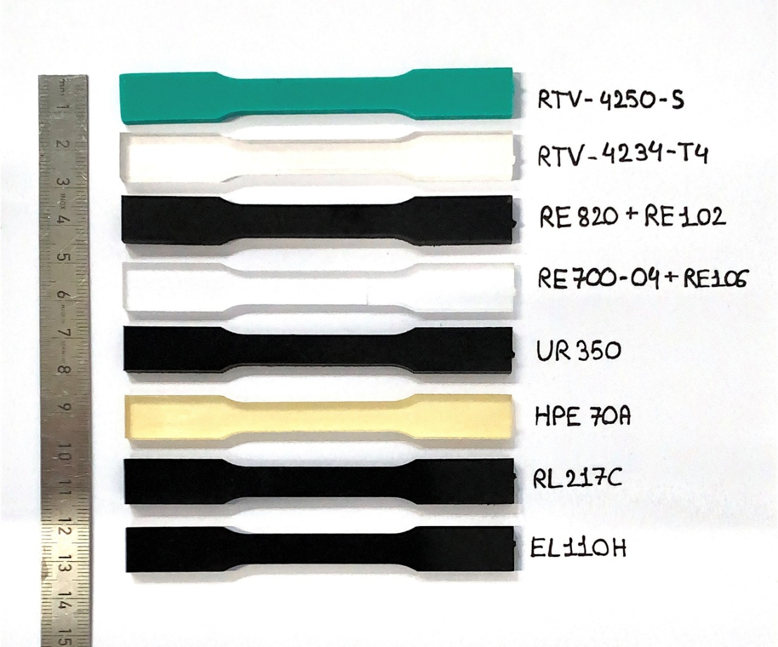
Samples and irradiation
Photograph of the 4 mm thick tensile samples of the 2 silicones and 6 polyurethanes.
The materials were exposed to high-energy gamma rays from a cobalt-60 source. Irradiation was performed in air at 20–25 °C with a dose rate of about 2 kGy/h.

Slide 4
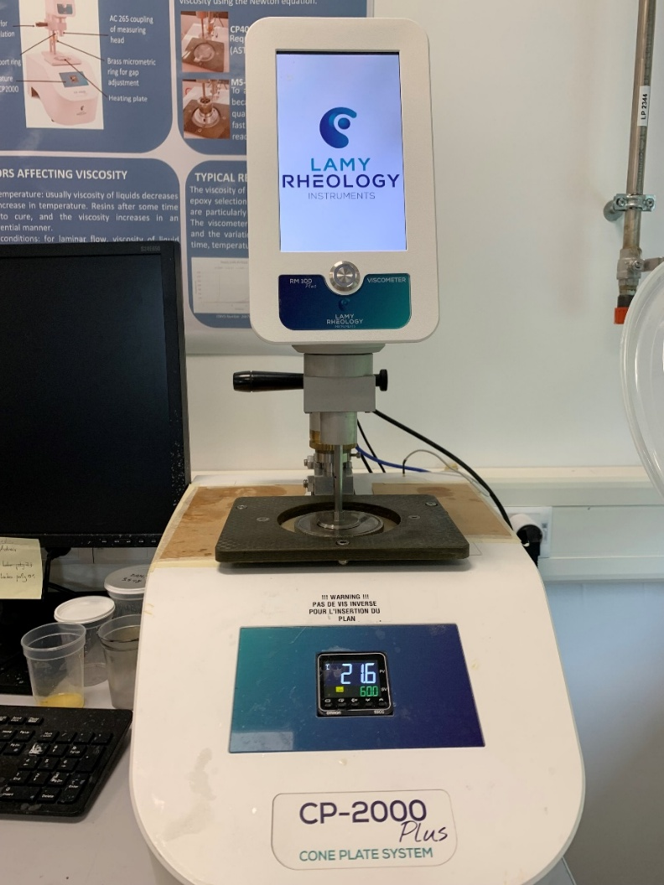
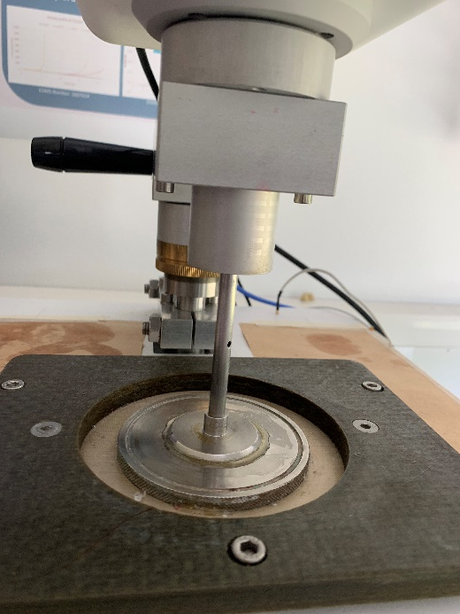
Viscosity test
Viscosity is assessed by measuring the flow resistance of a liquid as a function of time
Lamy Rheology CP2000 plus cone-plate viscometer operated in speed control
The viscosity is measured with a 40 mm diameter tool (CP4005)
Shear rate of 120 s-1
Data acquisition with RheoTex software
Two types of measurements :
  Viscosity as a function of duration at 20°C and at 60°C
  Viscosity as a function of temperature with a ramp rate of 9°C/min
Lamy Rheology CP2000 plus cone-plate viscometer with the CP4005 tool

Slide 5
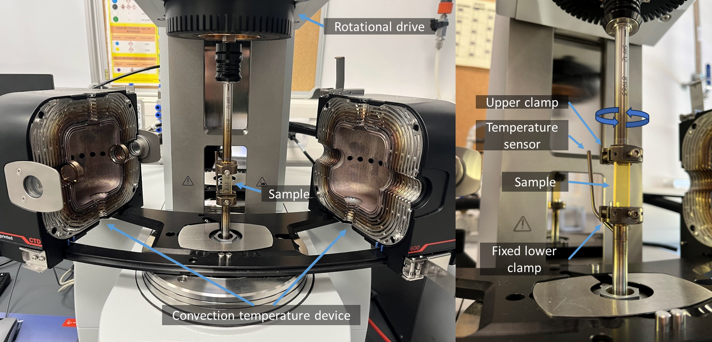
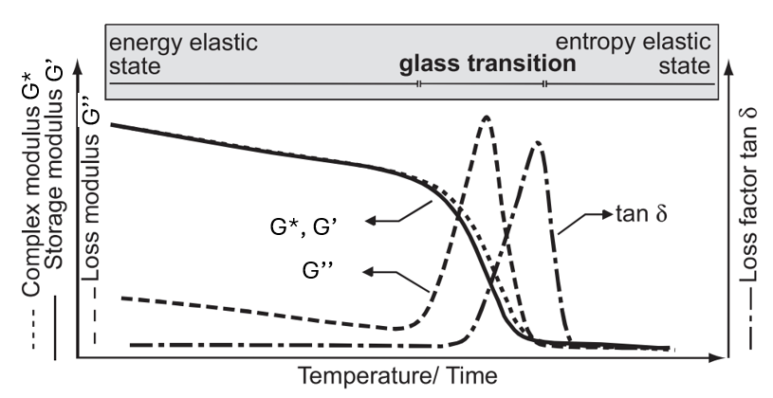
DMA tests
DMA MCR702e Anton Paar
DMA measurements were carried out over a temperature range from -150 °C to +200 °C.
Tests between -150 °C and room temperature were performed using a liquid nitrogen cooling unit in order to reach the glass transition temperature (Tg) of silicones and PU
The Tg were determined according to ASTM D4065, at a frequency of 1 Hz and with a temperature ramp of 2 K/min.
DMA MCR702e Anton Paar
G’ : storage modulus, represent the stiffness of a viscoelastic material
G’ rubbery : storage modulus at the rubbery plateau, where the temperature range is above the glass transition temperature (Tg)
G’’ : loss modulus, represent the viscous behaviour of a material
tan delta : ratio of loss modulus to storage modulus, it is a measure of the energy lost
Diagram of typical DMA curves of an amorphous polymer

Slide 6
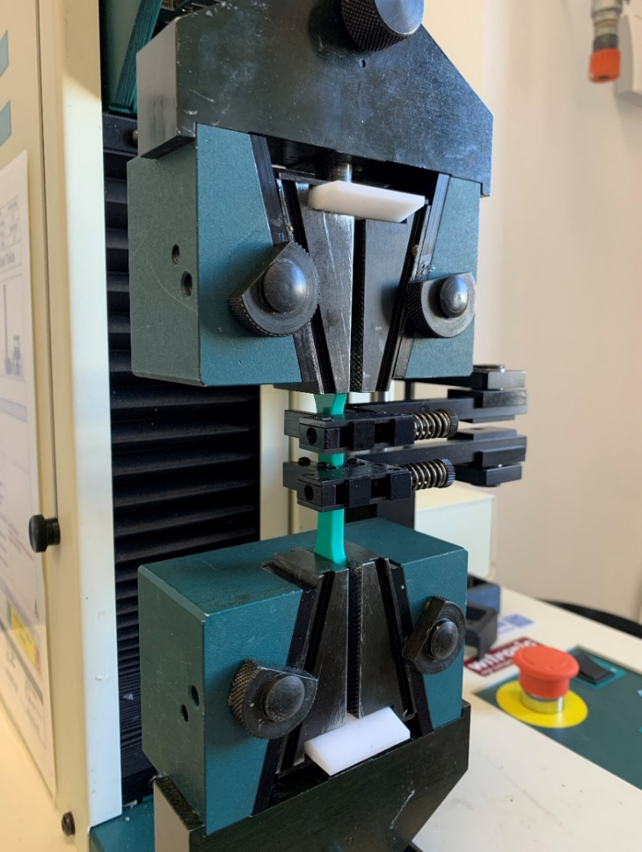
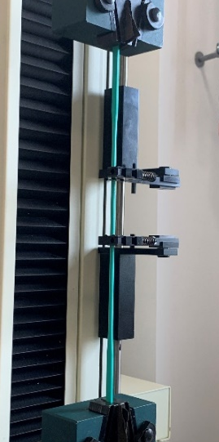
Tensile stress-strain measurement
Radiation damage is assessed by measuring the tensile stress at fracture in tensile configuration as a function of strain.
Tinius Olsen H5kT universal test machine
The strain is measured with an extensometer with a gauge length of 10 mm
Constant crosshead speed of 100 mm/min
Data acquisition with Tinius Olsen Horizon software according to “ISO 37 : Tensile test of elastomers”
Preload of -2 N
The engineering stress is calculated from the cross section of the unloaded samples
The true stress at fracture is much higher than the engineering stress
Grips
Extensometer (10 mm)
Sample
Tinius Olsen H5kT universal machine in tensile configuration

Slide 7
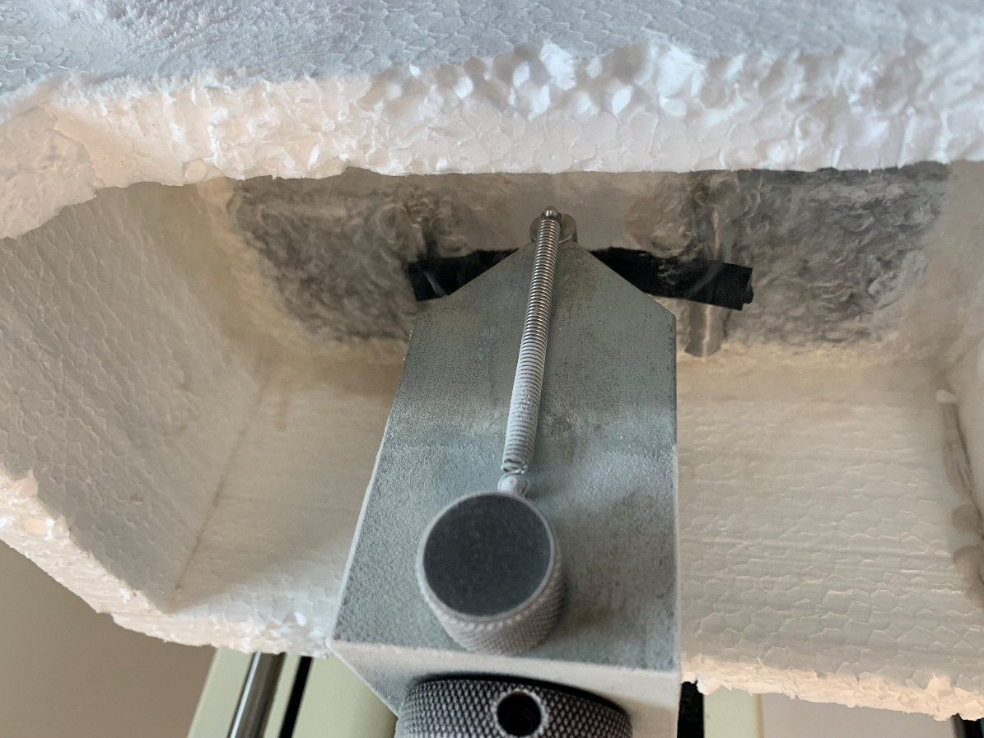
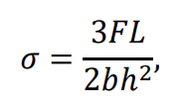

Flexural stress-strain measurement in liquid nitrogen
Radiation damage is assessed by measuring the flexural stress at fracture in flexural configuration as a function of strain.
Tinius Olsen H5kT universal test machine
Tinus Olsen FSB-5kN load cell with a force resolution of 0.2 N
Ø=10 mm loading supports and Ø=10 mm bending die
Span length of the loading supports is 16 times the sample thickness
Constant crosshead speed of 2 mm/min
Data acquisition with Tinius Olsen Horizon software according to “ISO 178 : 2010 Plastics-Flexural properties – LVDT”
Preload of -2 N
Flexural stress 𝜎 was calculated as
with thickness ℎ and width 𝑏 of the sample, length 𝐿 of the support span, and the force at fracture 𝐹.
Bending die Ø=10 mm
Sample
Liquid $N_{2}$
Loading supports Ø=10 mm
Tinius Olsen H5kT universal machine in flexural configuration

Slide 8
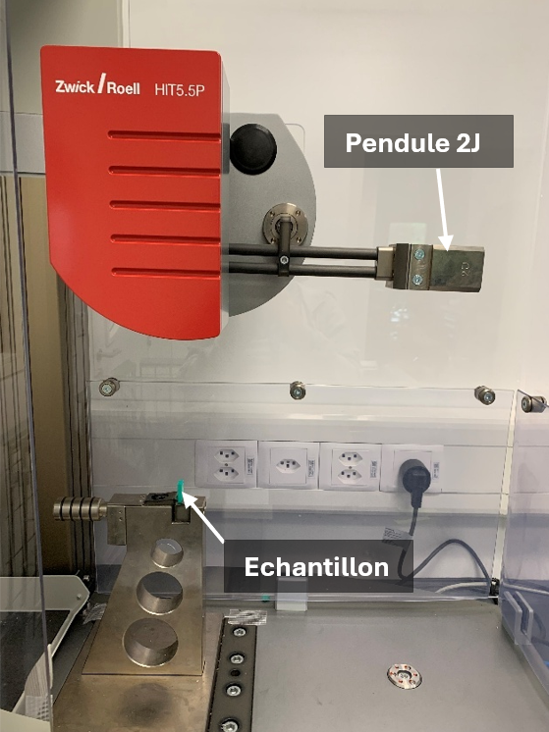
Impact test in liquid nitrogen
Radiation damage is assessed by measuring the resistance of the materials to dynamic loads.
Zwick and Roell HIT5.5P impact pendulum with 2 J energy.
Shock tests were carried out in the Dynstat configuration according to the DIN 53435 standard.
Unnotched samples with a nominal thickness of 4 mm, a width of 10 mm, and a length of 20 mm were used.
Since all tested polyurethanes and silicones are in the rubbery state at room temperature, the samples were pre-cooled in liquid nitrogen at 77 K before the impact tests.
Zwick and Roell HIT5.5P 2J impact pendulum

Slide 9
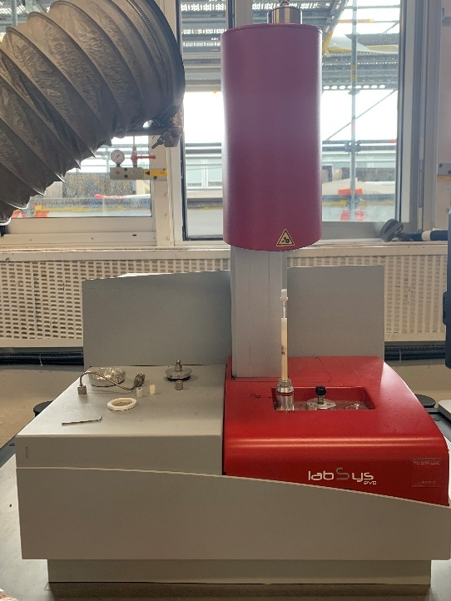
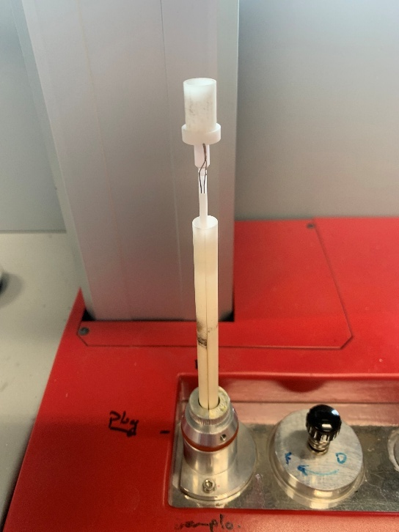
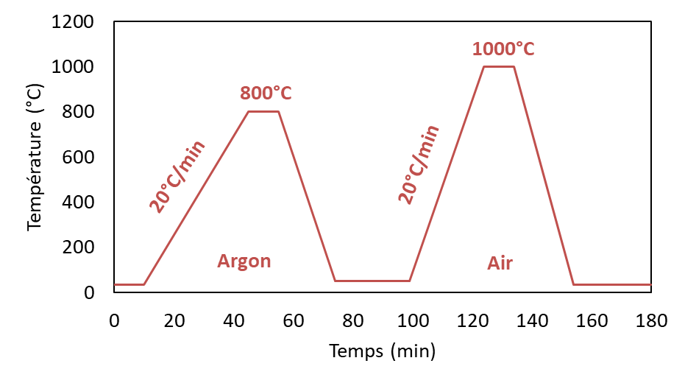
TGA test
Thermogravimetric analysis (TGA) was performed to assess the thermal stability of the materials and their degradation behavior.
TGA LABSYS evo
Measure the mass loss of a sample as a function of temperature, thus allowing the identification of decomposition temperatures, thermal residues, and successive degradation stages.
The temperature increased up to 800 °C at a rate of 20 °C/min under argon atmosphere
A second temperature ramp up to 1000 °C was carried out at 20 °C/min under air atmosphere
LABSYS evo TGA with ceramic crucible
Temperature ramp of the TGA cycle

Slide 10
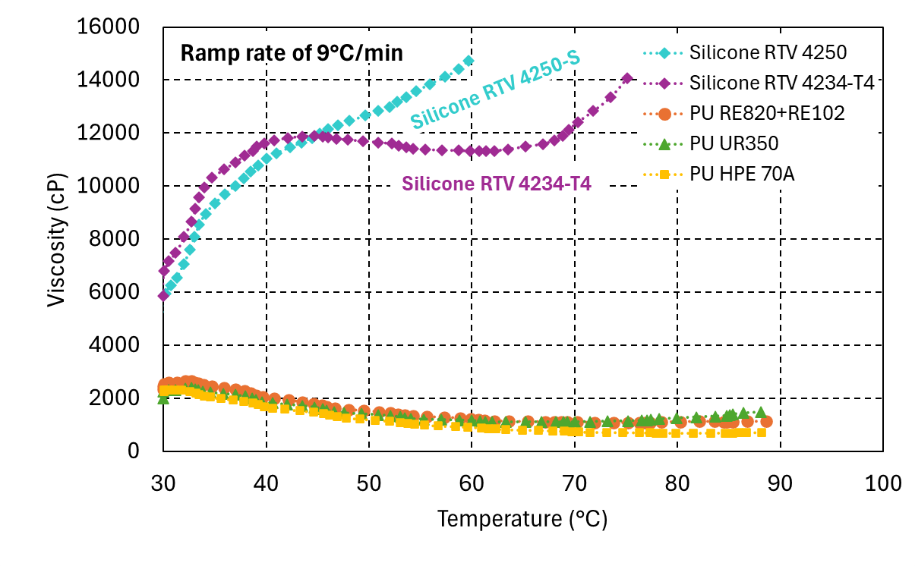
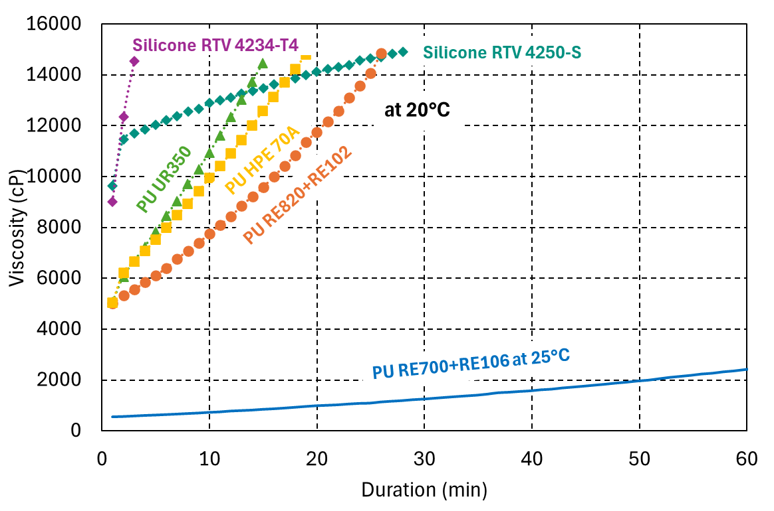
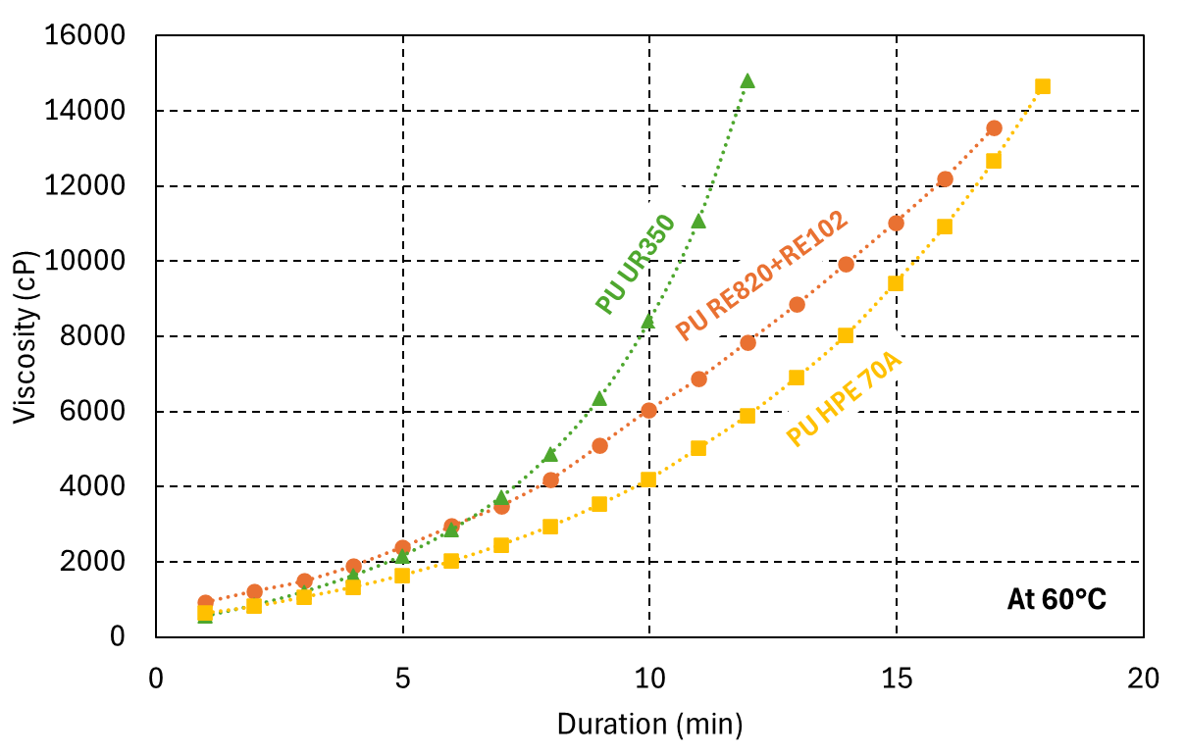
Viscosity measurement
The two silicones have higher viscosity at room temperature and viscosity increases with increasing temperature.
In contrast, the viscosity of the polyurethanes decreases with increasing temperature.
At 60°C, the viscosity of the three polyurethanes tested is about 1000 cP.
The lowest viscosity is measured for the RE700+RE106 polyurethane, which reaches a minimum viscosity of 550 cP at 25°C.
Viscosity as a function of temperature of different silicones and polyurethanes with a 9°C/min temperature ramp
Viscosity as a function of duration of different silicones and polyurethanes at 20°C (RE700-4 curve courtesy C. Urscheler)
Viscosity as a function of duration of polyurethanes at constant temperature of 60°C

Slide 11
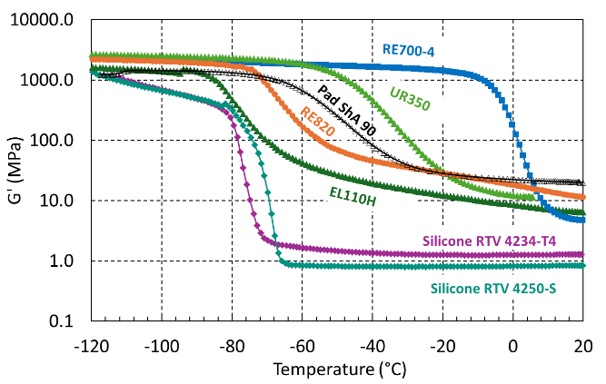
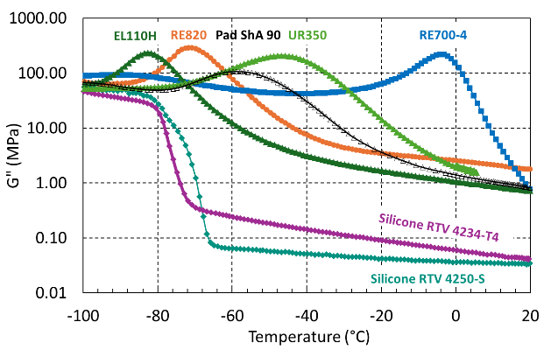
Viscoelastic properties of the cured resins
Storage modulus (G’) and loss modulus (G’’) of silicones and polyurethanes as a function of temperature.
All the tested materials have a glass transition temperature below room temperature.
The PU Sika RE700-04 exhibits the highest glass transition temperature, with a Tg of -5 °C. In comparison, the silicones have rubbery moduli (G’rubbery) below 1 MPa, which indicates a low crosslink density.
PU, on the other hand, exhibit G’rubbery moduli around 10 MPa, indicating a higher degree of crosslinking.

Slide 12
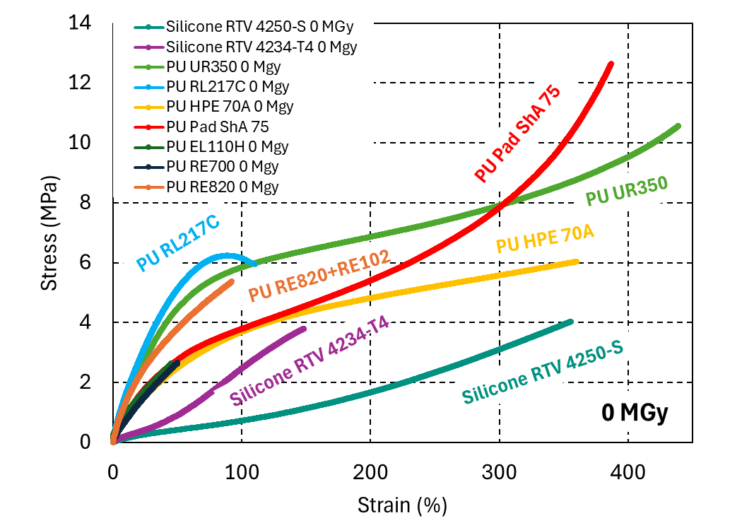
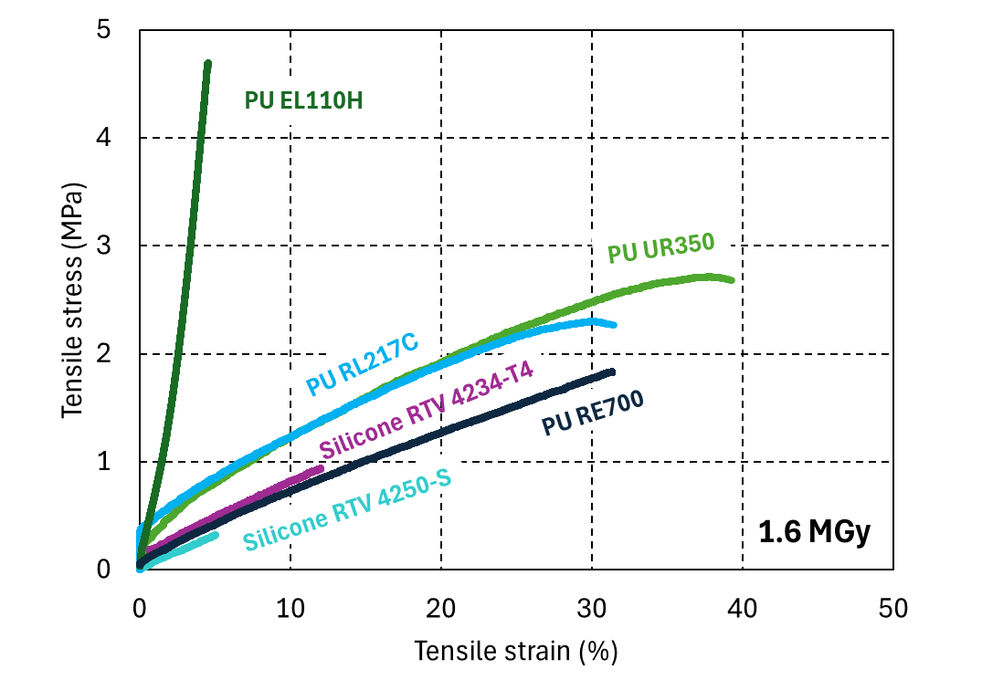
Tensile properties at RT before and after 1.6 MGy gamma irradiation
Stress as a function of strain of different silicones and polyurethanes at 0 MGy
Stress as a function of strain of different silicones and polyurethanes after 1.6 MGy
Radiation damage can be assessed from the degradation of the strain at rupture.
The polyurethanes have a higher strain after irradiation compared to the silicones.
The PU RE700 is the least affected (strain at fracture is reduced of about 40%).
The Young’s moduli of the two silicones are lower than the polyurethane for the non irradiated samples.

Slide 13
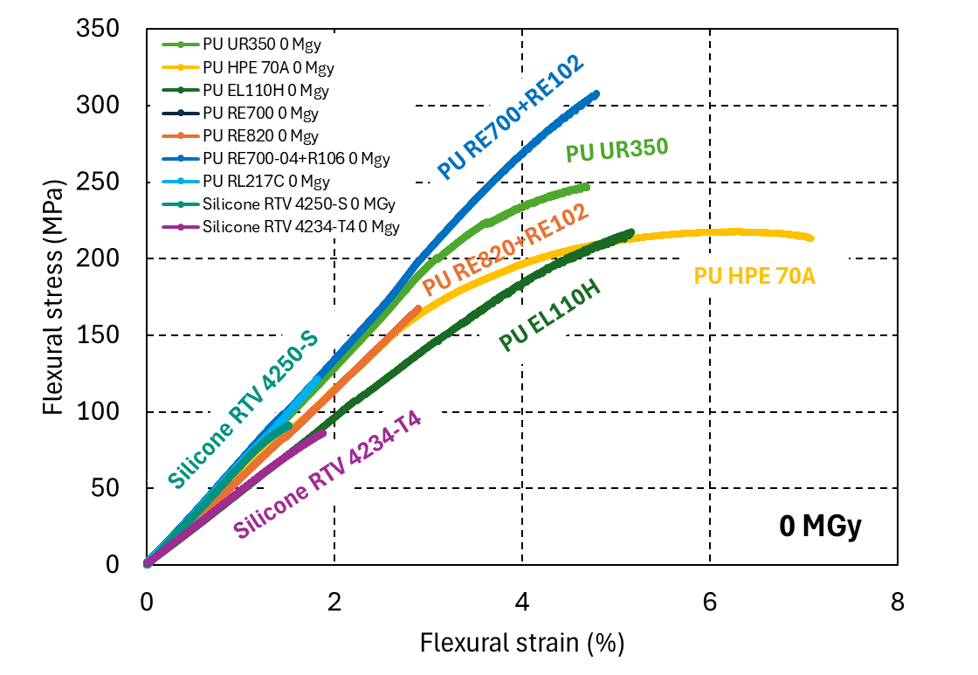
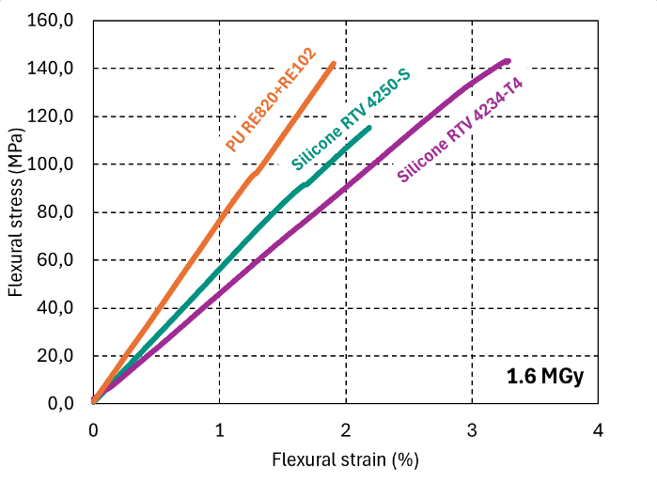
Effect of 1.6 MGy gamma irradiation on the flexural properties at 77K
Stress-strain curves in flexion at 77 K for silicones and polyurethanes before and after gamma irradiation of 1.6 MGy.
The non-irradiated silicones and polyurethanes exhibit similar elastic moduli, on the order of 6 GPa.
In this glassy state, the stiffness of the materials is primarily influenced by intermolecular interactions, such as Van der Waals forces, which limit chain mobility.

Slide 14
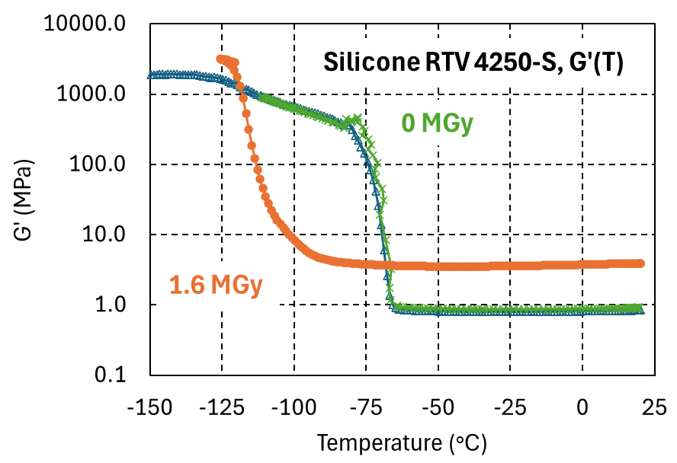
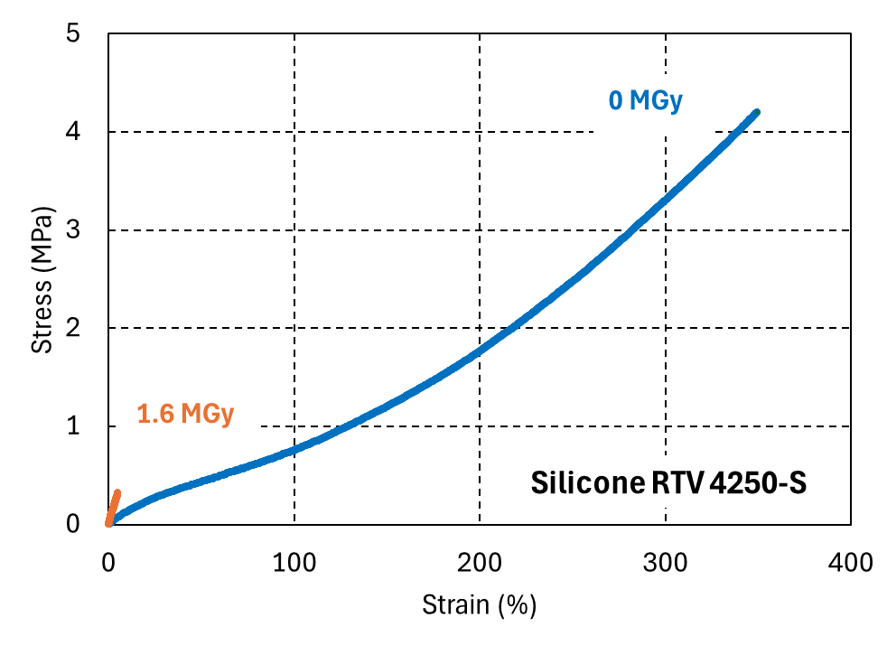
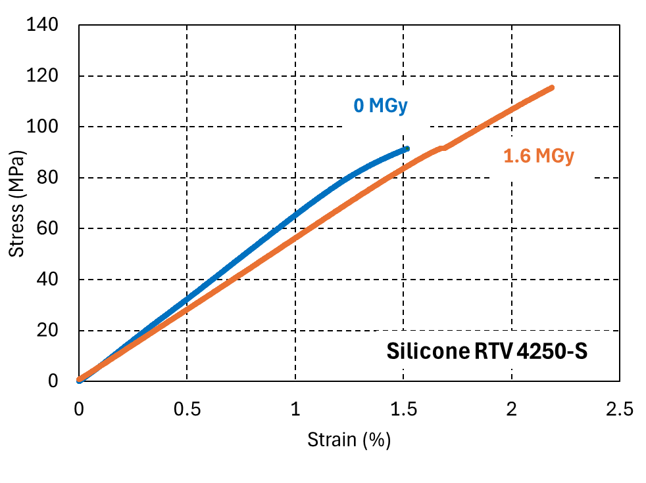
Comparison of Silicone RTV-4250-S results
G’(T) before and after gamma irradiation of 1.6 MGy
stress-strain curves in uniaxial tension at room temperature before and after gamma irradiation of 1.6 MGy
stress-strain curves in flexion at 77 K before and after gamma irradiation of 1.6 MGy.
A particular behavior was observed in the silicones: despite the increase in G’rubbery after irradiation, these materials maintain better mechanical stability and a higher flexural resistance at 77 K.

Slide 15
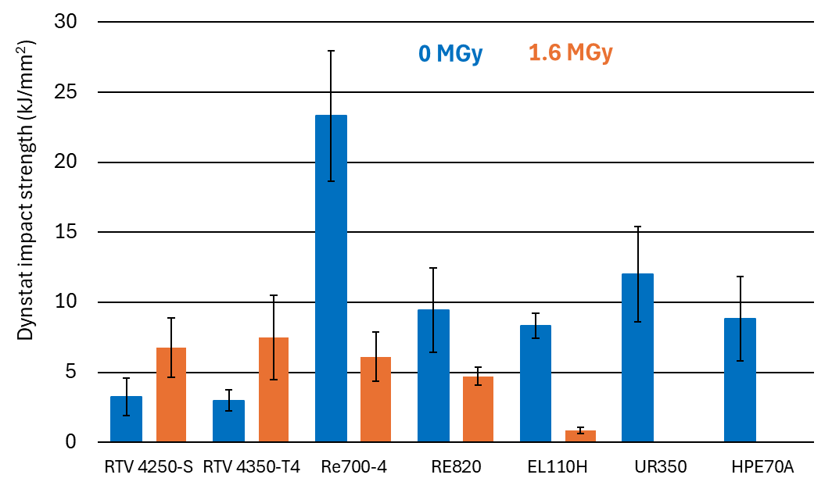
Effect of 1.6 MGy gamma irradiation on the impact properties at 77K
Only the two tested silicones show an improvement in their impact resistance at 77 K after an irradiation of 1.6 MGy, due to irradiation-induced crosslinking, their energy absorbed during impact increases from 4 kJ/mm² to approximately 8 kJ/mm²
In contrary, after irradiation, the PUs exhibit lower impact resistance. Some PUs, such as UR350 and HPE70A, are particularly degraded after irradiation due to molecular chain scission. They become too brittle and disintegrate in liquid nitrogen.
PU RE700-4 stands out as the material with the highest impact resistance, reaching a value of 24 kJ/mm² at 77 K before irradiation.
Impact resistance before and after gamma irradiation of 1,6 MGy.

Slide 16
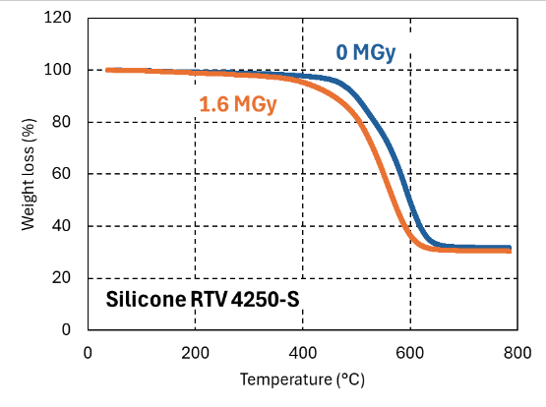
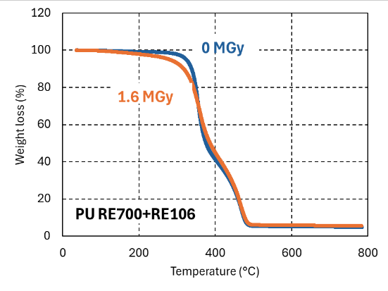
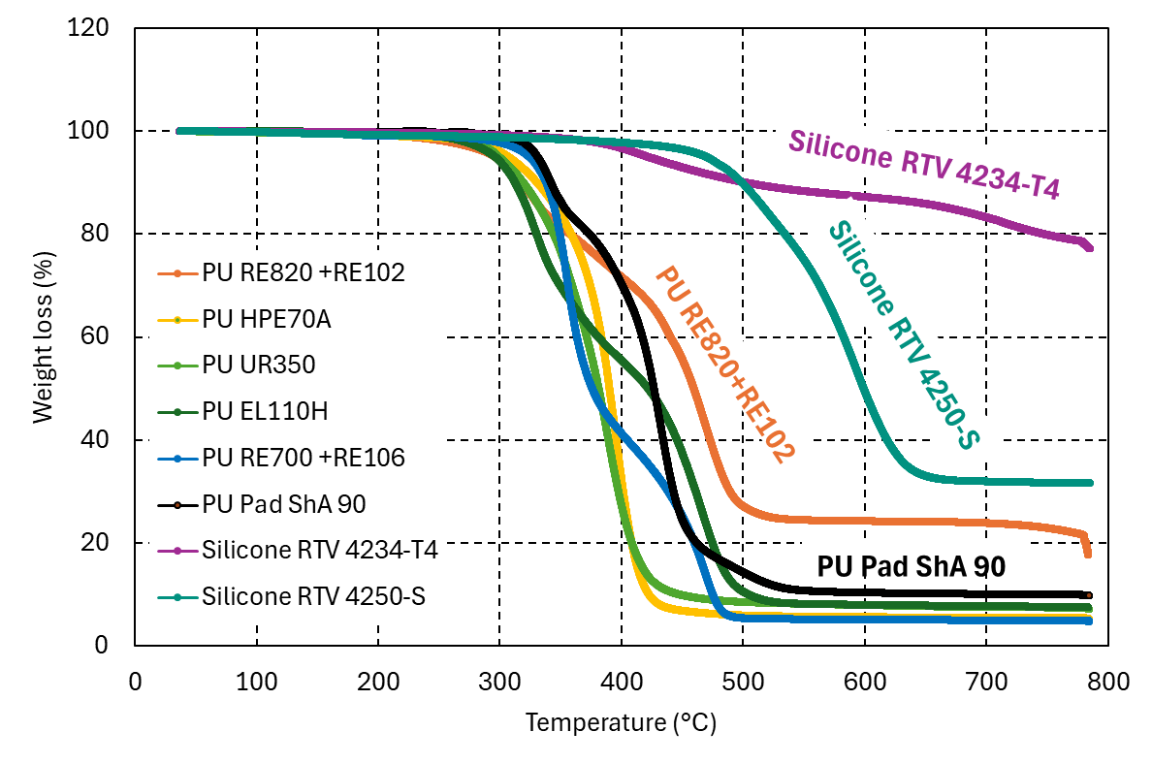
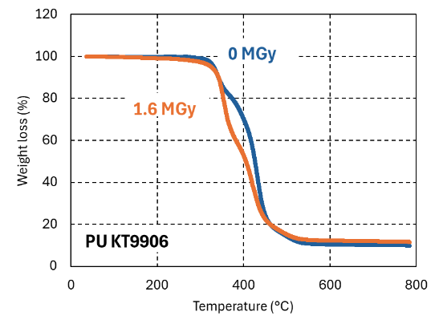
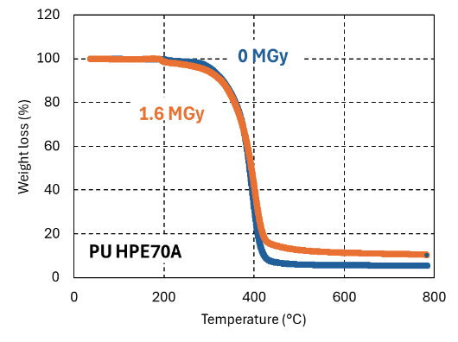
Effect of 1.6 MGy gamma irradiation on the thermogravimetric properties at 77K
Mass loss as a function of temperature before irradiation
Mass loss as a function of temperature before and after irradiation at 1,6 MGy
Silicones are the materials that exhibit the lowest mass losses during the temperature increase. In particular, silicone RTV 4234-T4 shows a mass loss limited to about 20% of its initial mass.
The degradation temperatures of silicones are high, around 400 °C, which indicates good thermal stability compared to polyurethanes.
Samples irradiated at 1.6 MGy were also tested using TGA, and they did not show significant differences between them.

Slide 17
Conclusion and outlook
The study examines viscosity, mechanical properties, and radiation resistance of various polyurethane and silicone resins for superconducting coil impregnation.
Polyurethanes have too high viscosity before curing; the RE700-4+RE106 system has low initial viscosity but a relatively short pot life. It also have excellent mechanical properties after curing, resisting doses up to about 1.6 MGy.
Irradiation improves mechanical properties (rubbery modulus G′ and Young’s modulus at room temperature) in some silicones
This makes RE700-4+RE106 a promising candidate for superconducting coil impregnation.
Further studies are suggested on other low-viscosity polyurethanes, varying irradiation doses, and irradiation in liquid helium to better define dose limits.

