Slide 1
The Frontier Technologies Group
Alberto Di Meglio
FTI Group Leader – Head of IT Innovation

Slide 2
The Frontier Technologies and Initiatives Group manages the IT Departments collaboration programmes and frameworks on new technologies in collaboration with the IT Technical Delivery groups, the CERN community, industry and other academic and international organisations. It also oversees the communication, outreach and education activities to support the execution of the IT strategy, develop skills in emerging technologies, and maximise the visibility and impact of the IT Department on science and society
IT-FTI
Frontier Technologies and Initiatives

Slide 3
Our missions
Collaborations and Partnerships
Physics Software Engineering
Computing and Data Science
Technology Infrastructures
Learning and Education
Communications and Outreach

Slide 4
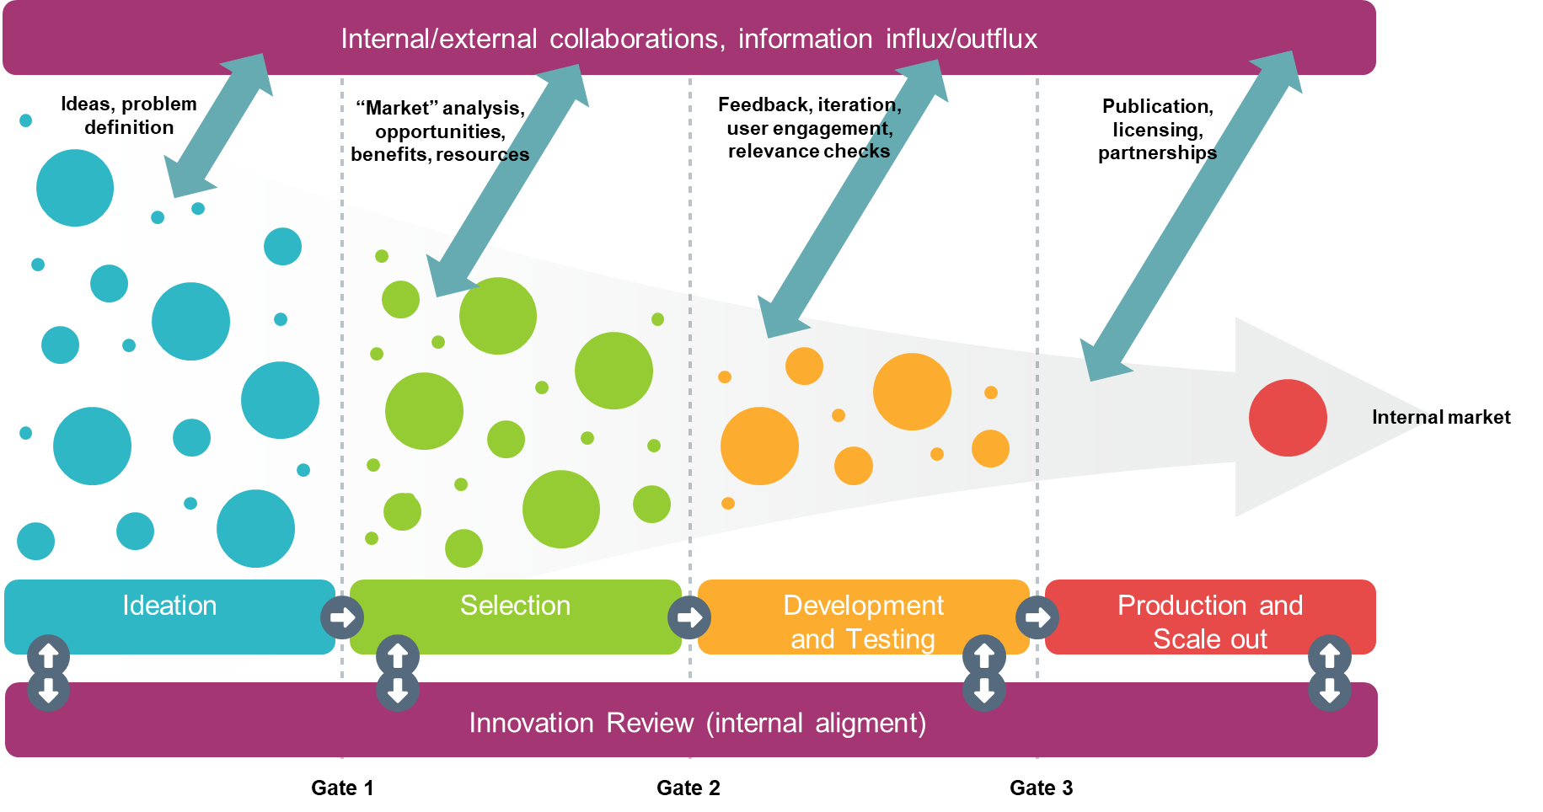
Open Innovation 2.0
“Innovation is the process of turning ideas into solutions to generate value”

Slide 5
Innovation scopes
Project-based
Innovation
Innovation resulting from continuous service improvements
Ideation
Innovation activities within stated objectives, expected results, transformation in addition to evolution, longer-term impact, dedicated resources, formal monitoring and reporting
User requirements
Strategies
Part of the continuous optimisation and evolution of services in each Group, within baseline
Informal channels and discussions, multiple formats

Slide 6
Innovation and Collaborations Channels
1
2
3
4
5
6
IT Dep.
Projects
Engagement Technical delivery
Ideation
Core strategic activities
KT
Projects
KT Fund
Medical Apps
CIPEA
Impact Fund
CERN & Society Foundation,
etc.
CERN openlab
Short and Medium-Term
Public/private R&D partnerships with industry and academia
CERN Programmes
Quantum Technology Initiative
NextGen
AI Initiatives
Strategic Partnerships
Other international organisations
Long-term industrial collaborations
EC Programmes
Horizon
Europe
EOSC
EuroHPC
EQF
Open Science
Programmes complementarity and alignment

Slide 7
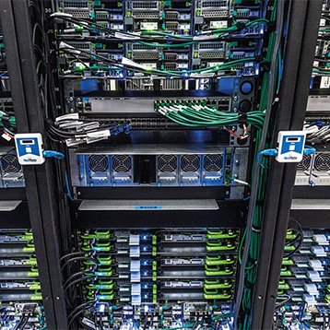


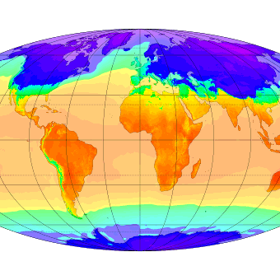
Exascale Technologies A comprehensive investigation of HPC and Cloud infrastructures, frameworks, tools to support key scientific workloads and applications
Strategic Innovation Areas
Artificial Intelligence
Analysis and development of algorithms, optimisation for new architectures,
interpretability,
synergies between Physics and other sciences
Quantum
Computing
Assess the potential impact of quantum computing in HEP and other sciences, work on integration of quantum and HPC, establish leading edge collaborations
Multi-Science Collaborations
Share the expertise and knowledge generated across all activities with other sciences, create collaborations with impact on societal challenges

Slide 8






















CERN openlab
Strategic Directions
Enhance industry and research partnerships, in particular within Europe, leveraging on CERN ILOs.
Established Industry and
Research Members
Industry and Research Members
in Pre-Agreement Stage
CERN openlab as incubator for strategic partnerships.
R&D Directions
Prospective Industry and
Research Members
Sustainable Infrastructures
Heterogenous Computing, Platforms and HPC Systems
Computing Architectures and Software Engineering
Advanced Storage, Data Management and Networks
Infrastructures and Techniques for Artificial Intelligence
Applications for Society and Environment
Emerging Technologies
CERN openlab is a public-private partnership that since 2001 has been creating innovative R&D collaborations to shape the future of computing for fundamental research and society.
New Materials for Long-Term Digital Storage
Digital Twins
Structured Three-year Phase Cycles
Systematically Assess Technological Evolution
Anticipate future needs
Delineate overarching thematic priorities
More than 150 projects, in nearly 25 years, in distributed computing, large-scale storage, control systems, AI, digital twins.

Slide 9
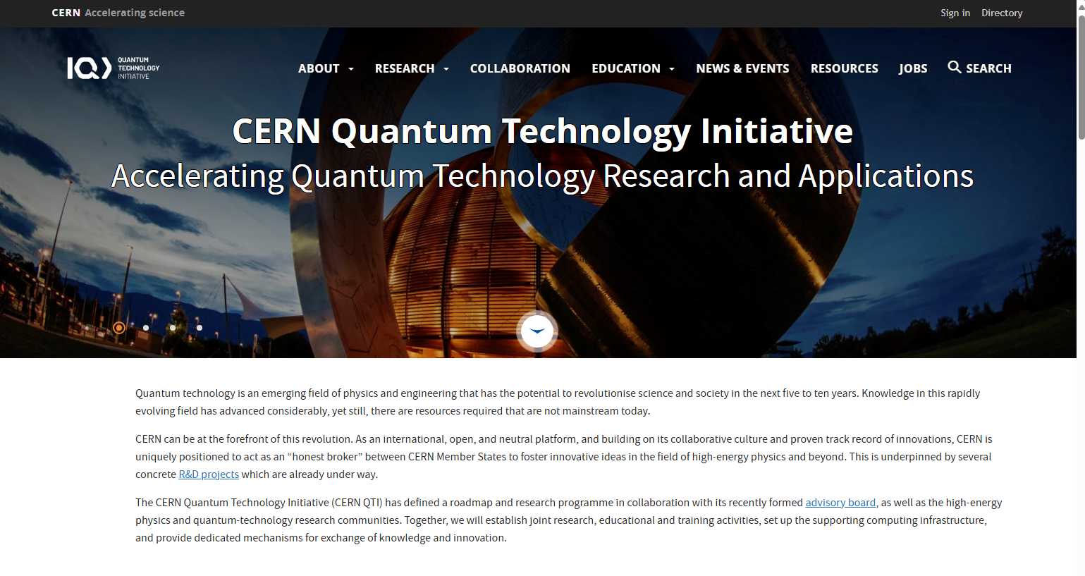

Slide 10
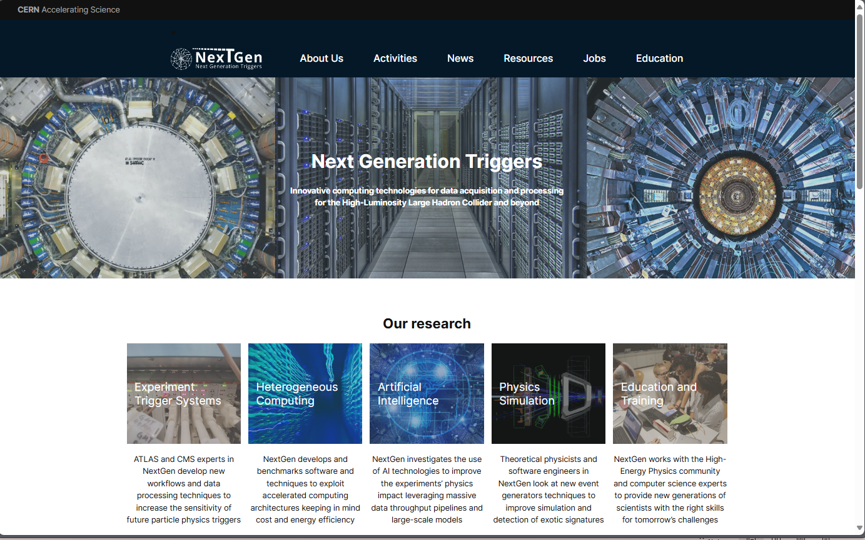

Slide 11





Leveraging state-of the-art artificial intelligence (AI) technologies to accelerate progress towards a world with Zero hunger and advance humanitarian action across the world
A strategic partnership on AI between the Government of Luxembourg, the World Food Programme (WFP), the European Centre for Nuclear Research (CERN) and the Luxembourg Institute of Science and Technology (LIST)

Slide 12
Technology Infrastructures and Platforms
Heterogeneous Architecture Testbed
On-premise and cloud resources for R&D and testing (CERN openlab)
Cloud Operating Model & FinOps
Sovereign and agnostic multi-cloud framework for provisioning and monitoring public cloud services
High-Performance Computing Collaborations
Projects and resource access through collaborations with HPC centres
AI Platform and Services
Design, deployment and operation of a common AI/LLM platform and services for the CERN communities

Slide 13
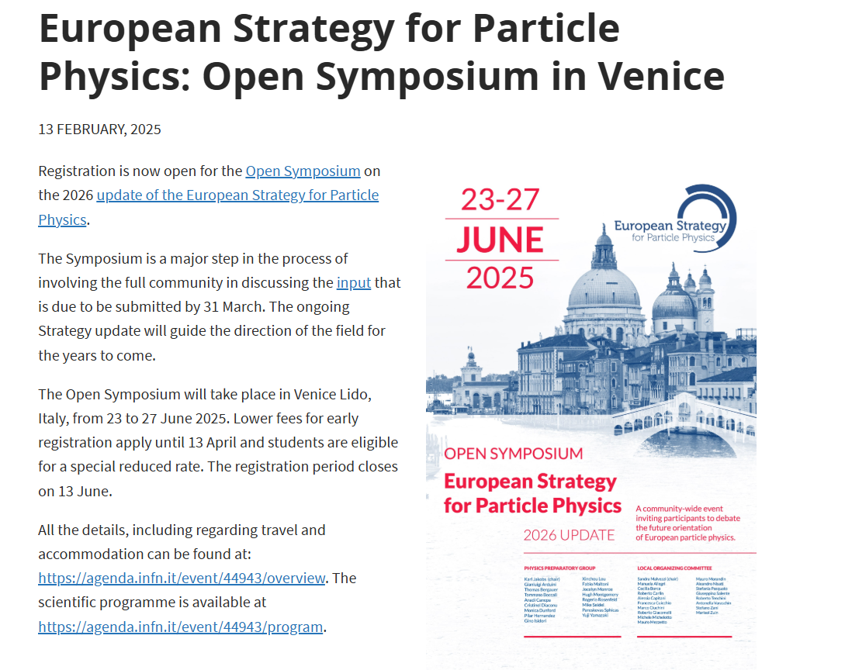
The European Strategy for Particle Physics is the cornerstone of Europe’s strategy-setting process for the long-term future of the field. Mandated by the CERN Council, the Strategy takes into account results from the LHC and other facilities in the world, the international physics landscape and developments in related fields with the aim to maximise scientific returns. “The ESG should review and update the Strategy and add other items identified as relevant to the field, including accelerator, detector and computing R&D” (Update of the European Strategy for Particle Physics: Remit of the European Strategy Group, June 2024) There is a recognition of the growing need of computing resources for science and a drive to find efficient solutions to address this need in the coming years beyond our current capacity.
Preparing for the future

Slide 14

We welcome Oracle today at CERN to share a vision and a concrete set of actions to build together efficient compute services platforms able to support today’s and tomorrow’s requirements of our highly-demanding, ever-growing scientific and technology programme. We want to capitalise on more than 30 years of valuable collaboration with Oracle in CERN openlab and build a strong strategic partnership for the future.
Call to action

Slide 15



FTI
Thanks!

