Slide 1
AI in CERN Industrial Control Systems
Fernando Varela
Presented by Rafal Kulaga
26/06/2025

Slide 2
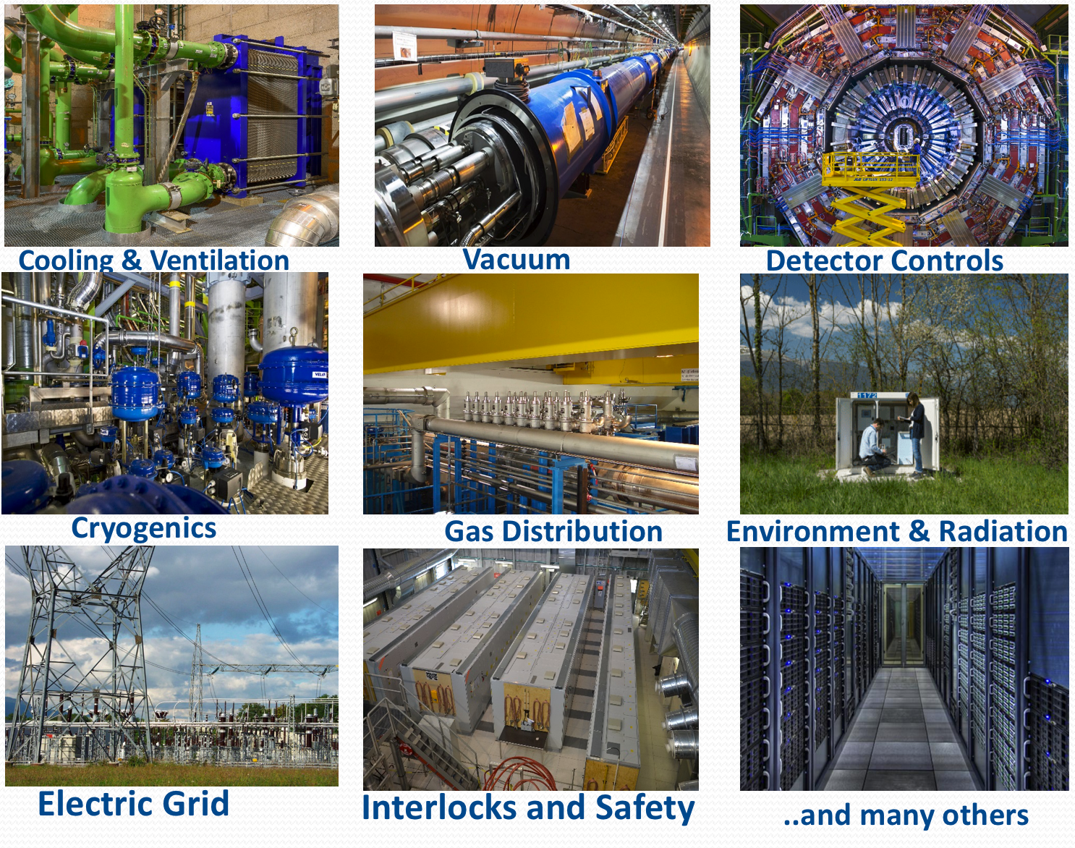
CERN Industrial Control Systems
>850 Mission Critical Control Systems in the Accelerator Complex, Experiments and Technical Infrastructure
Millions of IOs
Large distributed Control Systems with up to 160 nodes
Sharing a common archiving system (Oracle and TimescaleDB)
Archiving rates up to 100,000 changes/s
~200 TB of accumulated data
​
Many of the use-case are common with Industry
F. Varela | AI in CERN Industrial Control Systems

Slide 3
Software Engineering
Increase efficiency and automation of error-prone tasks through copilots/assistants
UC1 - Retrieval of information from local-knowledge bases
Code generation in DSL
UC2 - WinCC Open Architecture: CTRL/CTRL++, JS/TypeScript, C++
UC3 - Siemens and Schneider PLCs
UC4 - C/C++ for OPC UA Server/Client generation (Industrial middleware)
UC5 - Code refactoring including WinCC OA DSL
UC6 - Diff of PLC code among different vendors
UC7 - Migration of PLC code from one vendor to another one
UC8 - Generation of Unit-tests including WinCC OA DSL
UC9 - Explanation and Code documentation: Doxygen, UML and developer’s doc
F. Varela | AI in CERN Industrial Control Systems

Slide 4
Control System Engineering
Increase efficiency and automation of error-prone tasks through copilots/assistants
UC10 - Automatic generation of either specs files or full PLC-based control systems (PLC+SCADA) from Process Functional Analysis (text + images)
UC11 - Extraction and visualisation of PLC FSM, etc.
UC12 - Explanation and Control System documentation, e.g. User Manuals
F. Varela | AI in CERN Industrial Control Systems

Slide 5
AI-assisted Operation
Enriching functionality of Control Systems through copilots/assistants
UC13 - Operation interaction with Control System via Natural Language
e.g. what were the ten hottest racks in the computing center over the last week?
UC14 - Propose corrective actions in the event of problems
e.g. recommend to open valve XXX since YYY is starting to heat up
UC15 - Automatic generation of optimised operational scenarios
(process stability, performance, sustainability, …)
UC16 - Root-cause analysis in the event of alarm avalanches
UC17 - Anomaly detection
UC18 - Predictive maintenance
F. Varela | AI in CERN Industrial Control Systems

Slide 6
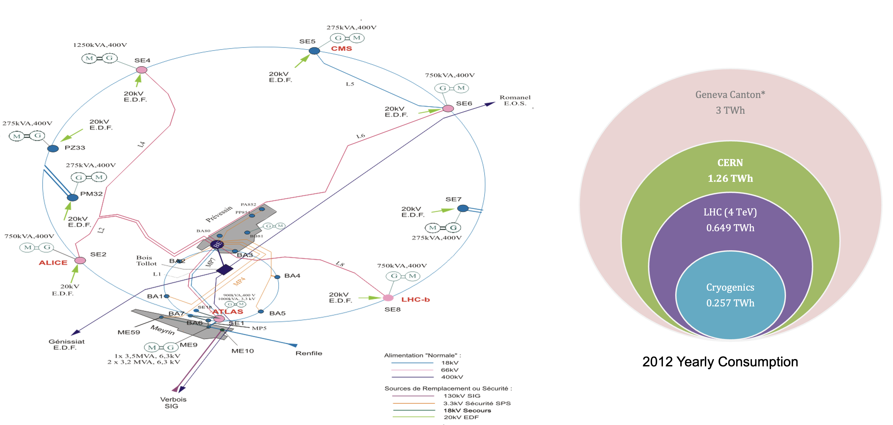
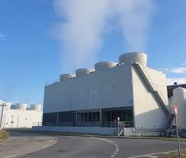
Sustainability – optimizing energy consumption
Large Industrial HVAC installations, large energyvores!
Is it more efficient to operate 2 towers at higher power or 4 at lower power to deliver the same cooling power?
F. Varela | AI in CERN Industrial Control Systems

Slide 7
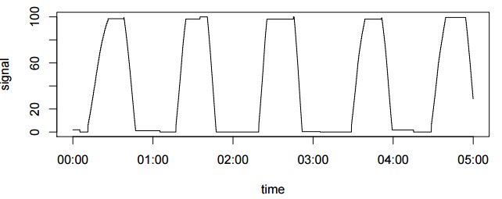
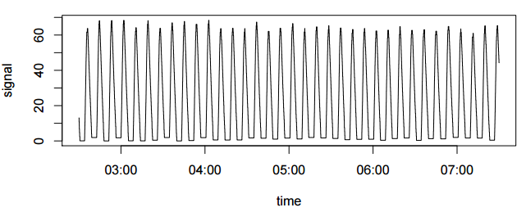
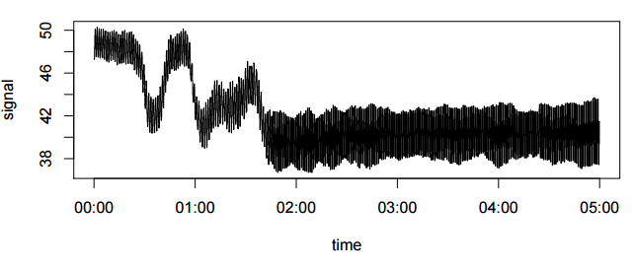
Anomaly Detection - Oscillation analysis for cryogenics valves
Goal: detect anomalous oscillation of valves → Lifespan of valves in km!
Impact on:
Process system stability and safety
Communication load
Maintenance (overuse of valves)
Performance (Physics time)
Over 34000 physical instrumentations and channels
12136 AI, 4856 AO,4536 DI,1568 DO,8000 spare and virtual channels, ~4000 analog control loops
F. Varela | AI in CERN Industrial Control Systems

Slide 8
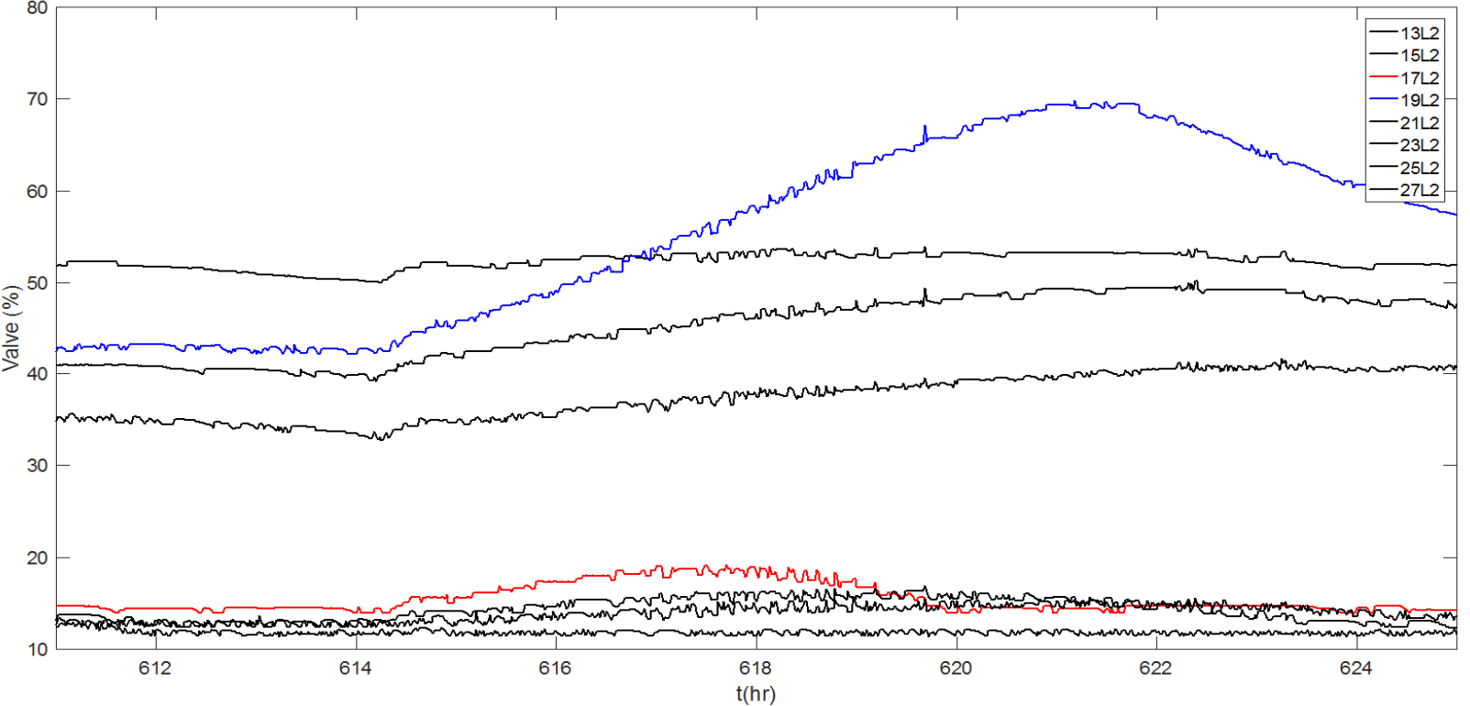
Anomaly detection in CRYO signals
Valves CV910 positions in L2 (26th June 2017)
Possible causes
hardware failures/degradations
wrong tuning/structure
false measurements…
Impact
Process stability and safety
Maintenance (overuse of valves)
Performance and downtime
Beam dump!
Direct impact on the operational cost!!!
F. Varela | AI in CERN Industrial Control Systems

Slide 9
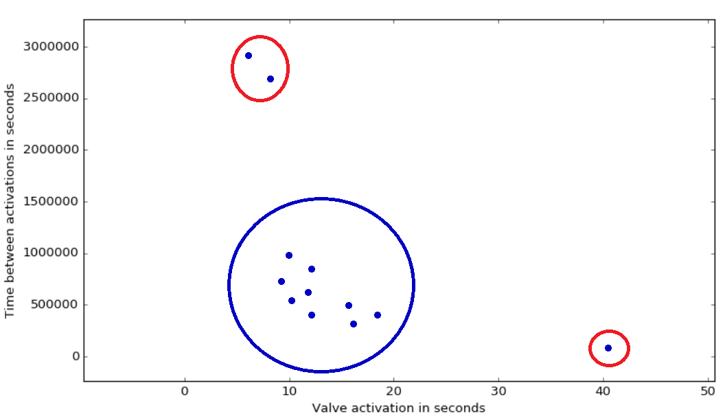
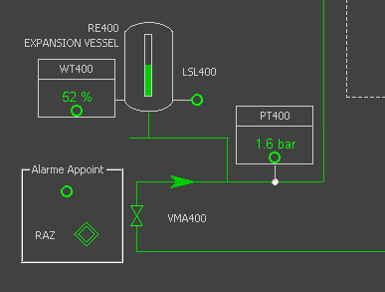

Leak detection in HVAC Systems
Distinguish emptying the tank due to normal operation from leaks
Distribution of valve openings [FSED_001_VMA400]
F. Varela | AI in CERN Industrial Control Systems

Slide 10
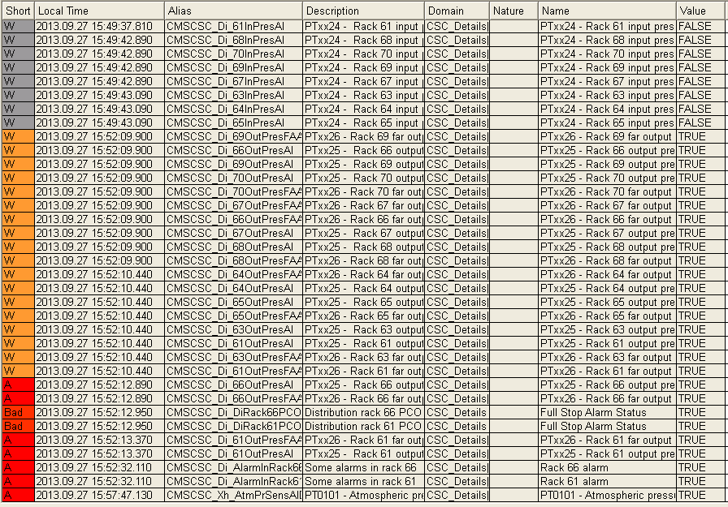
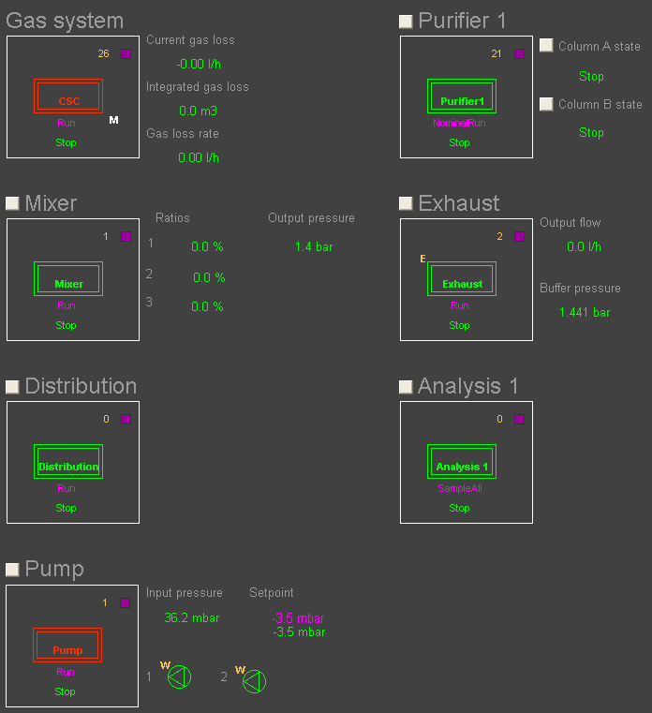


Root-cause analysis in Experiments Gas Control Systems
Domino effect
Misleading feedback!
Actual problem in the distribution and not in the Pump
Fault in the distribution system
Alarms flooding
Alarms flood: a single fault can generate up to thousands of events
The 1st alarm is not necessarily the most relevant for the diagnosis
The same fault generates different events sequence depending on the system status
A single fault can stop the whole control process
F. Varela | AI in CERN Industrial Control Systems

Slide 11
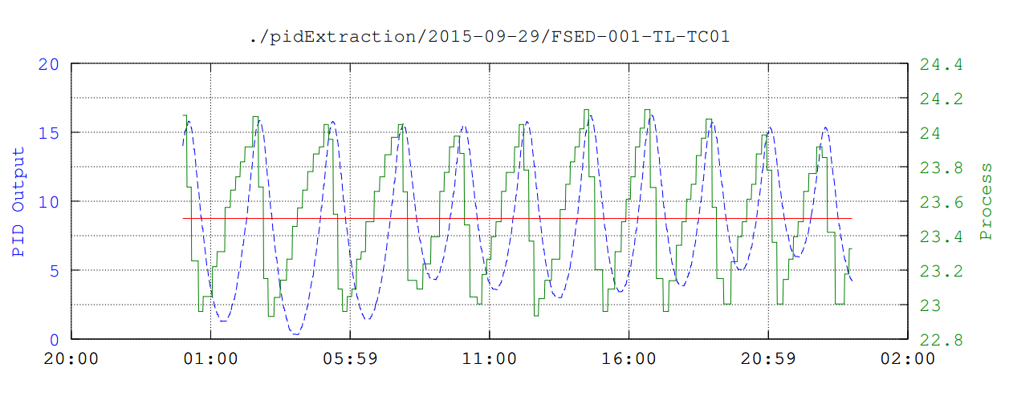
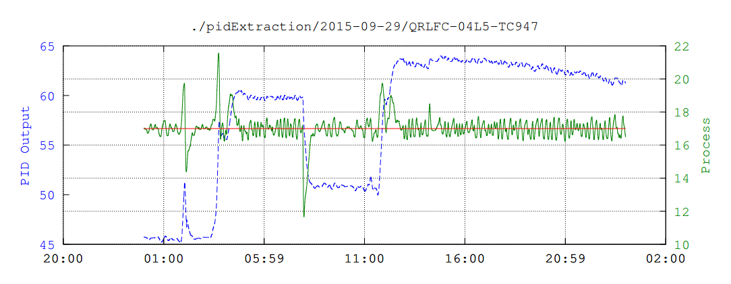
Evaluation of PID performance on Dynamic Systems
Misbehaving PID
v
w
u
y
Controller
Process
SP
MV
CV
Well-behaving PID
F. Varela | AI in CERN Industrial Control Systems

Slide 12
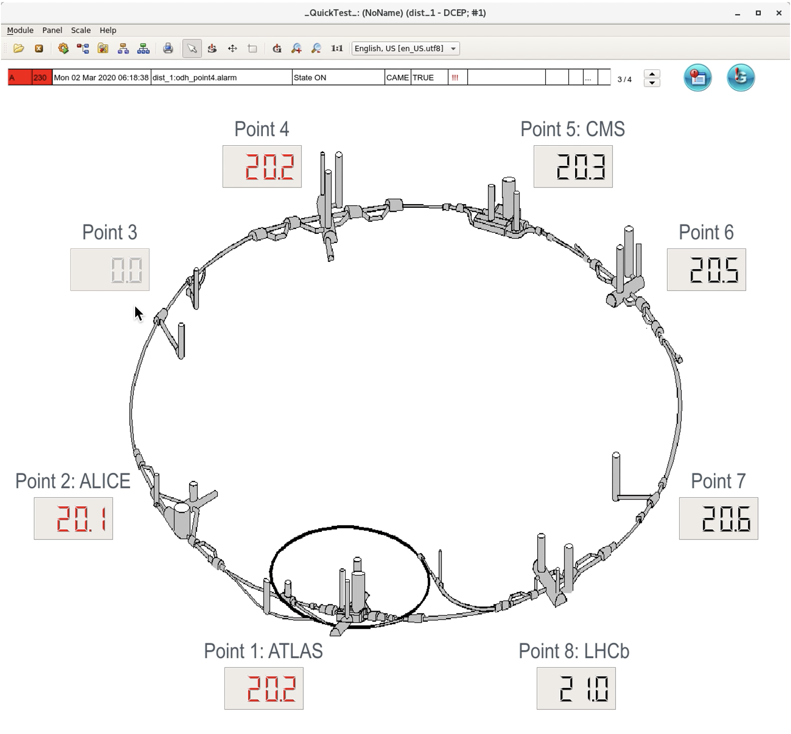
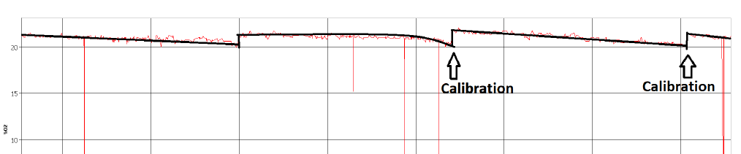
Oxygen % Monitoring in the LHC tunnel
378 oxygen sensors are spread across the LHC tunnel
Periodically sensors get clogged
We want to avoid false alarms
Anticipate when recalibration is required
Similar problems exist for large Industrial HVAC Systems at CERN presently involving a significant amount of € for scheduled maintenance
F. Varela | AI in CERN Industrial Control Systems

Slide 13
Conclusion
CERN Industrial Control Systems are the perfect testbed to push the boundaries of AI solutions
Giant, heterogeneous landscape
Shared data backbone (Oracle) allows cross-domain learning
18 concrete use cases, 3 value pillars
Software productivity (UC1-9) – 30 % faster code delivery estimated
Engineering quality (UC10-12) – auto-generated specs & PLCs
Operational excellence (UC13-18) – fewer alarms, longer component life, lower energy consumption
CERN’s 850 industrial control systems + tens of millions of signals open the floor to an enormous potential to cut downtime, optimise energy consumption and cutting costs
F. Varela | AI in CERN Industrial Control Systems

Slide 14
Thank you!

