Slide 1
1
General Information
And follow up
Frank Zimmermann
209th FCC-ee Accelerator Design Meeting
2 July 2025

Slide 2
minutes from previous meeting – thanks Peter Kicsiny !
RF parameters: beam loading, polarisation, beam-beam, effect of cavity failure, LCC/GHC
3 errors need to be considered…; we need to know the magnitude of the last error
resonance driving terms and radiation damping
SuperKEKB BBA reproducibility – can we get data from other rings – ESRF-EBS, PETRA III, SLS-2…?
Xsuite/SAD discrepancy for injection efficiency
“LCC lattice developments will resume as soon as P. Raimondi gets his laptop.”

Slide 3
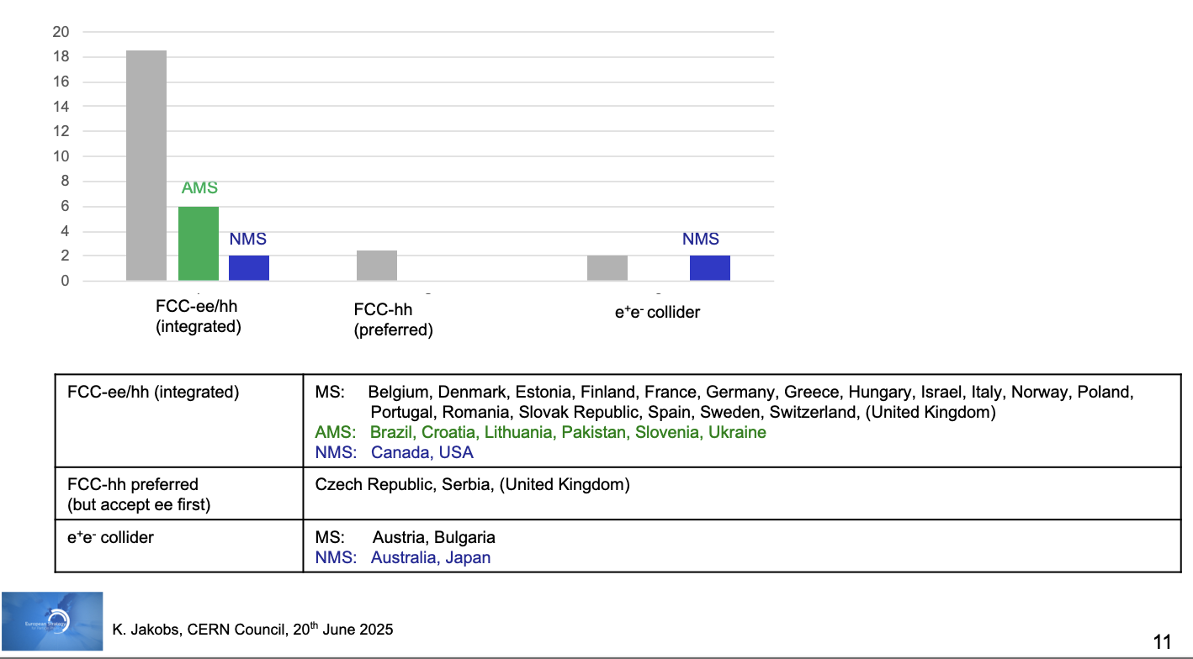
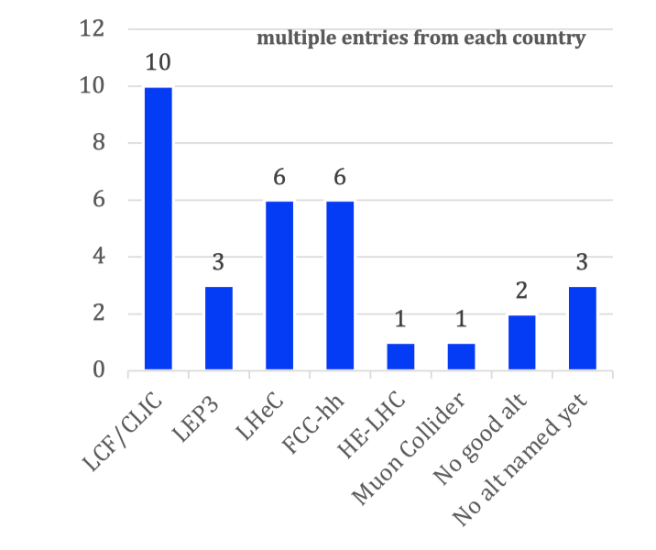
National input to the ESPP
Fabiola Gianotti, today
Preferred option
Alternative if preferred option not feasible
MS
Publicly available at: https://indico.cern.ch/event/1439855/contributions/
Summary compiled by European Strategy Group
FCC all but guaranteed to become Plan A; no single contender for Plan B
Addt’l strong support for FCC from US National Academy of Sciences, Engineering & Medicine:
“Recommendation 2: The United States should participate in the international Future Circular Collider Higgs factory currently under study at CERN to unravel the physics of the Higgs boson.”

Slide 4

Photo Trevor Sherwin
Karl Jakobs: “Key messages from the Symposium”
Venice, Friday 27 June
Final Words
Over the past years very significant progress has been made towards the realisation of the next flagship project at CERN
FCC: Successful completion of the Feasibility Study; No technical showstoppers identified
Overwhelming support for the integrated FCC-ee/hh programme by the HEP communities in the CERN Member
and Associate Member states and beyond;
The strong support is largely based on the superb physics potential and the long-term prospects (FCC-ee /hh)
Discussions on the financial feasibility are ongoing (CERN management and Council)
Fabiola Gianotti, today

Slide 5
Photo Trevor Sherwin
Karl Jakobs: “Key messages from the Symposium”
Venice, Friday 27 June
Final Words
Discussions on the prioritisation of alternative options are ongoing
Linear colliders (LCF, CLIC) present as well mature options for a Higgs factory at CERN
LEP3 and LHeC could be considered as “intermediate” collider projects
The differences in the physics potential (→ Physics Briefing Book), review of the technical readiness and the final input from the national HEP communities (due by 14 Nov.) will be important ingredients in the final recommendations by the European Strategy Group
Fabiola Gianotti, today

