Slide 1


Studies with corrected lattice + beam-beam
L. van Riesen-Haupt, P. Kicsiny, Y. Wu, X. Buffat, T. Pieloni, R. Tomas
July 2025
Work supported by the Swiss Accelerator Research and Technology (CHART)

Slide 2
Path to Detailed Studies
Facilitating Detailed Simulations
Quantifying Performance
Performance of Detailed Lattices
Dedicated Corrections

Slide 3
Path to Detailed Studies
Facilitating Detailed Simulations
Simulation tools with different effects
Benchmarking simulation tools
Quantifying Performance
Performance of Detailed Lattices
Dedicated Corrections

Slide 4
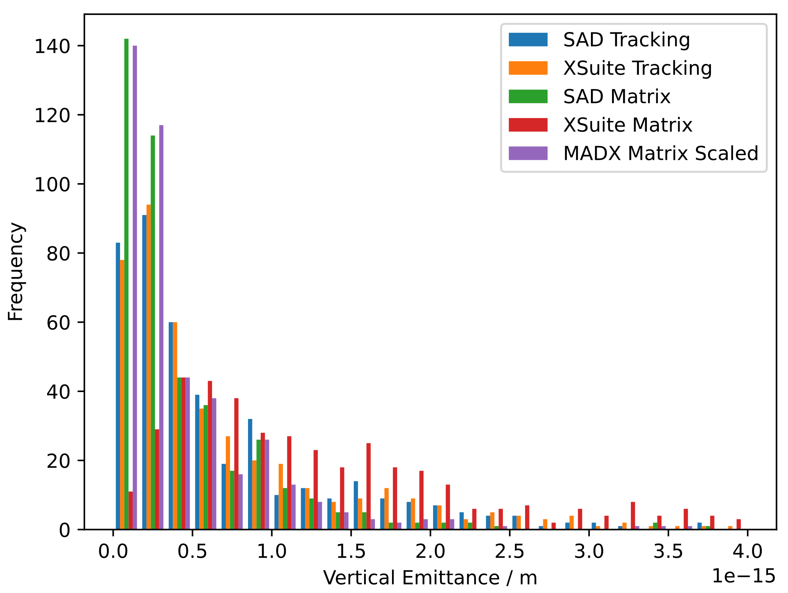
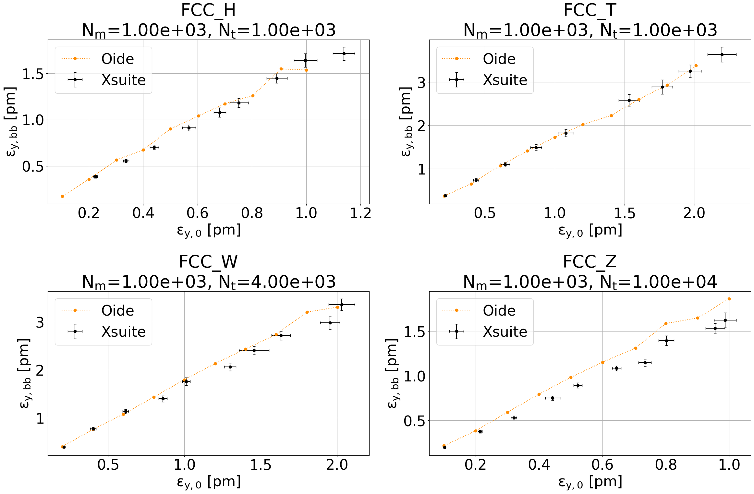
Simulation Tools and Benchmarking
Comprehensive simulations made possible by Xsuite Talk by G Iadarola
  Allows simulation of multiple effects
  Development in close exchange with FCC-ee team
    Beam-beam module developed as CHART effort
Thorough benchmarking campaign ensuring accurate simulation of
  Radiation (vs SAD and MADX)
  Lattice errors (vs SAD and MADX)
  Beam-beam effects
Needs expert input and experience
  Set up meaningful simulations with perturbations
  Compute performance indicators from tracking data
  Interpret results

Slide 5
Path to Detailed Studies
Facilitating Detailed Simulations
Simulation tools with different effects
Benchmarking simulation tools
Quantifying Performance
Performance of Detailed Lattices
Dedicated Corrections

Slide 6
Path to Detailed Studies
Facilitating Detailed Simulations
Simulation tools with different effects
Benchmarking simulation tools
Quantifying Performance
Implement traditional indicators
Performance of Detailed Lattices
Dedicated Corrections
Introduction of new indicators
Standardised indicators

Slide 7
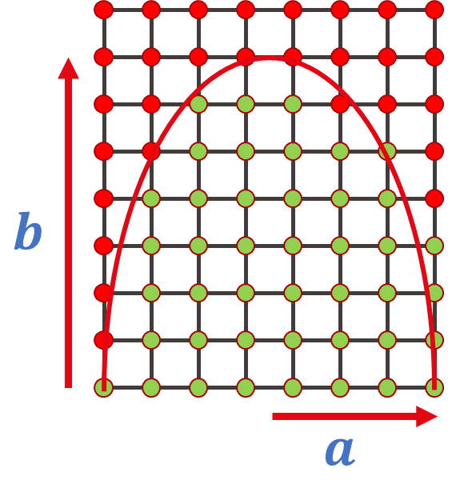
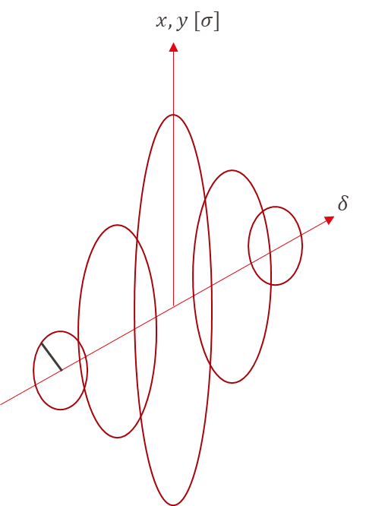
Traditional Indicators
Many traditional indicators tested and implemented
  Work towards quantifiable indicators
Indicators studied (and benchmarked)
  Optics
  Equilibrium emittances
    Matrix and tracking methods
  Dynamic aperture
    Quantified by ellipse
  Momentum acceptance
    Multiple ellipses
  Lifetime
  Luminosity

Slide 8
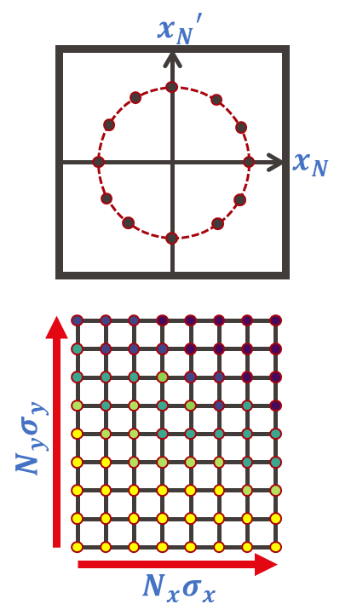
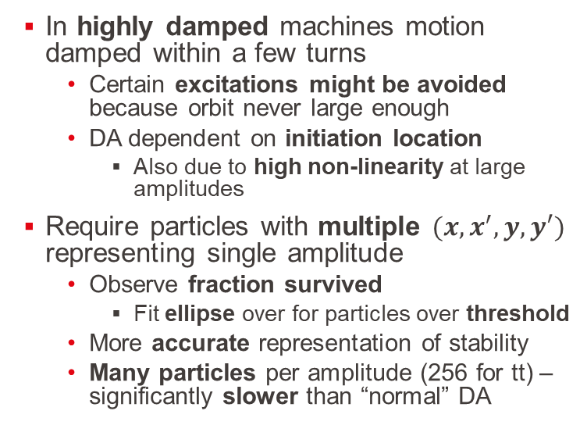
New Indicators
Example: DA
In highly damped machines motion damped within a few turns
  Certain excitations might be avoided because orbit never large enough
  DA dependent on initiation location
    Also due to high non-linearity at large amplitudes
Require particles with multiple $(x,x^{′},y,y′)$ representing single amplitude
  Observe fraction survived
    Fit ellipse over for particles over threshold
  More accurate representation of stability
  Many particles per amplitude (256 for tt) – significantly slower than “normal” DA

Slide 9
To do: Standardise Indicators
Important to standardise how we determine indicators
  Prevent duplicating efforts
  “Fair” comparisons between lattices and correction strategies
  Uniform targets
Achieve this by
  Communicating and documenting methods in presentations and publications
  Sharing scripts for methods in systematic way

Slide 10
Path to Detailed Studies
Facilitating Detailed Simulations
Simulation tools with different effects
Benchmarking simulation tools
Quantifying Performance
Implement traditional indicators
Performance of Detailed Lattices
Dedicated Corrections
Introduction of new indicators
Standardised indicators

Slide 11
Path to Detailed Studies
Facilitating Detailed Simulations
Simulation tools with different effects
Benchmarking simulation tools
Quantifying Performance
Implement traditional indicators
Performance of Detailed Lattices
Impact of individual effects
Dedicated Corrections
Introduction of new indicators
Standardised indicators
Understanding interplay

Slide 12
Lattice Perturbations - Strategy
Simulation of beam-beam with individual lattice errors
  Misalignments of magnet groups
  Multipole errors
  Optics perturbations at the interaction point
Opportunity to introduce one type of error at a time
  Understand individual interplay with beam-beam effects
Help pinpoint priorities in tolerances and correction strategies
Develop and test methods of lattice setup and performance indicators simulations
  Ensure implementation of individual perturbations works as expected (benchmark when possible) before applying all

Slide 13
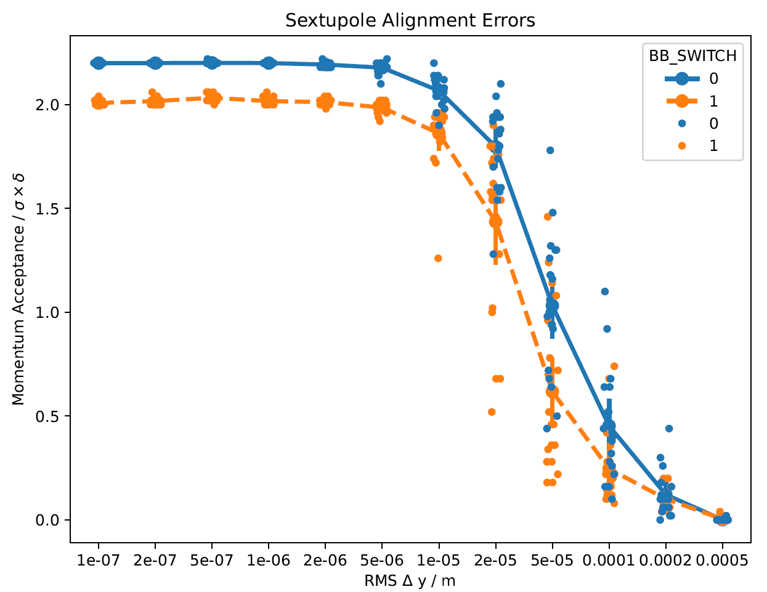
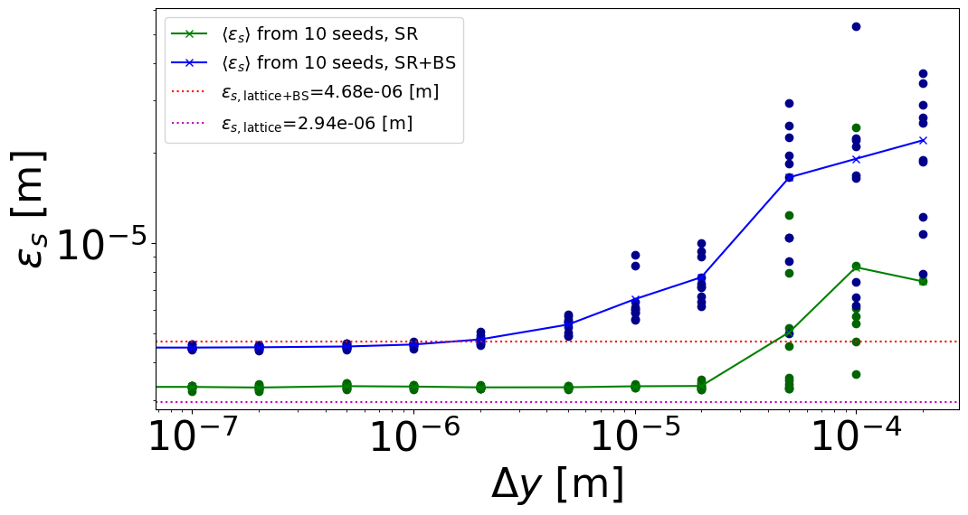
Lattice Perturbations
Two forms of lattice perturbations studied
  Vertical misalignments
    Arc quadrupoles
    Arc sextupoles
  Exciting multipoles between interaction points
Simulations performed with and without beam-beam
  Primary aim to understand impact beam-beam has in the presence of errors
Rematching of tune using arcs but no dedicated interaction point corrections
  Only coarse indicator for tolerances

Slide 14
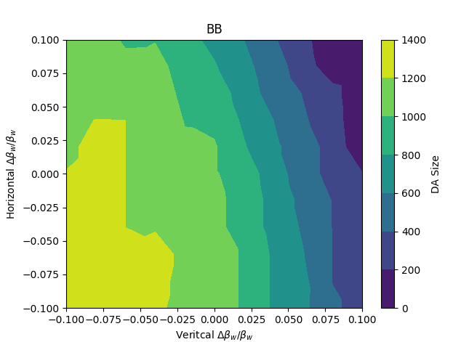
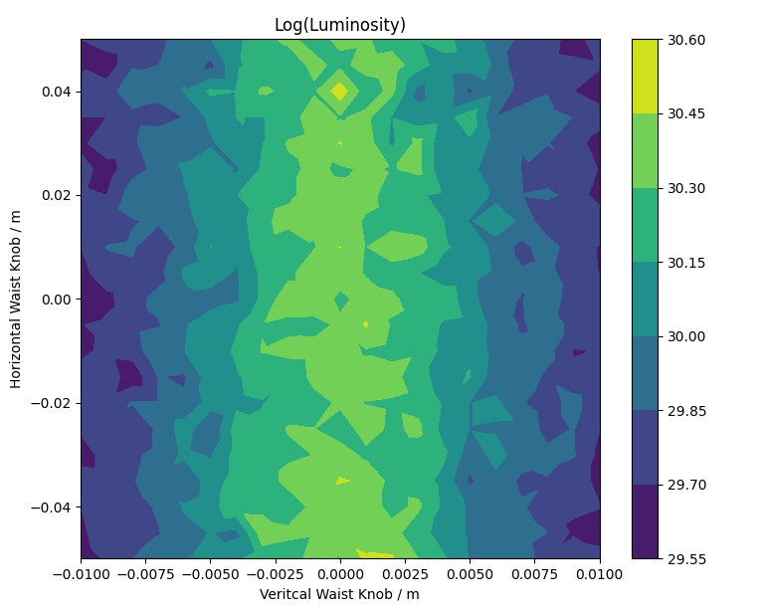
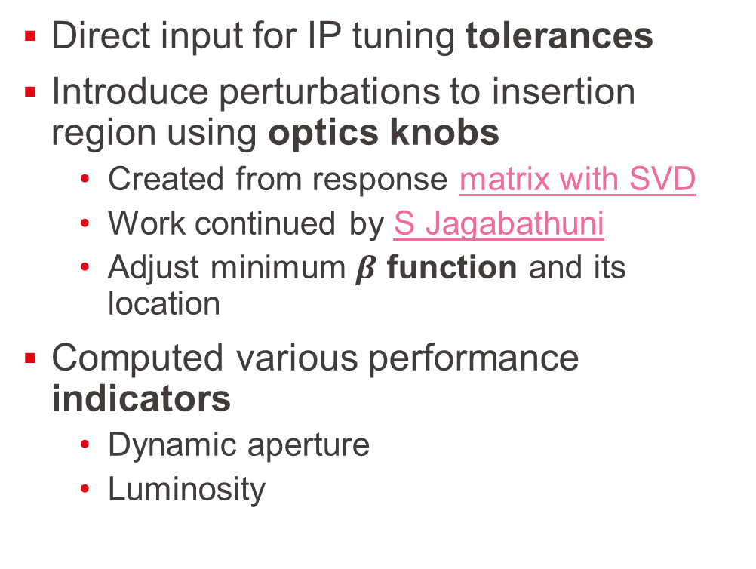
Insertion Region – Optics Perturbations
Direct input for IP tuning tolerances
Introduce perturbations to insertion region using optics knobs
  Created from response matrix with SVD
  Work continued by S Jagabathuni
  Adjust minimum $β$ function and its location
Computed various performance indicators
  Dynamic aperture
  Luminosity

Slide 15
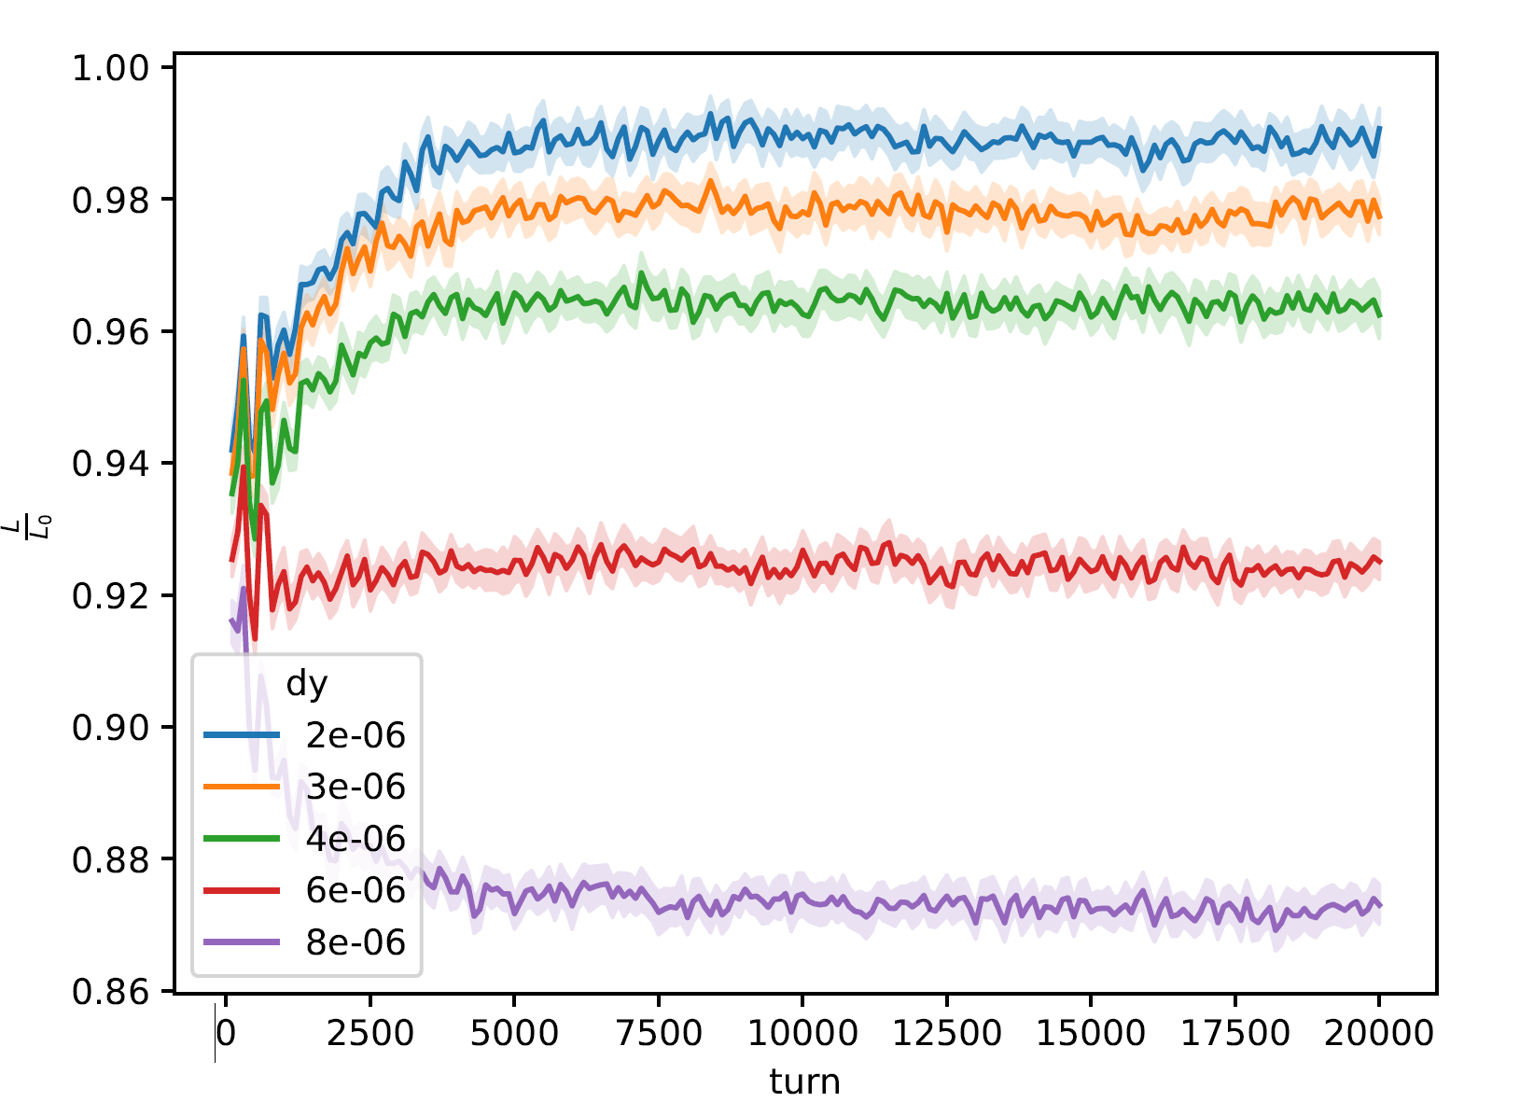
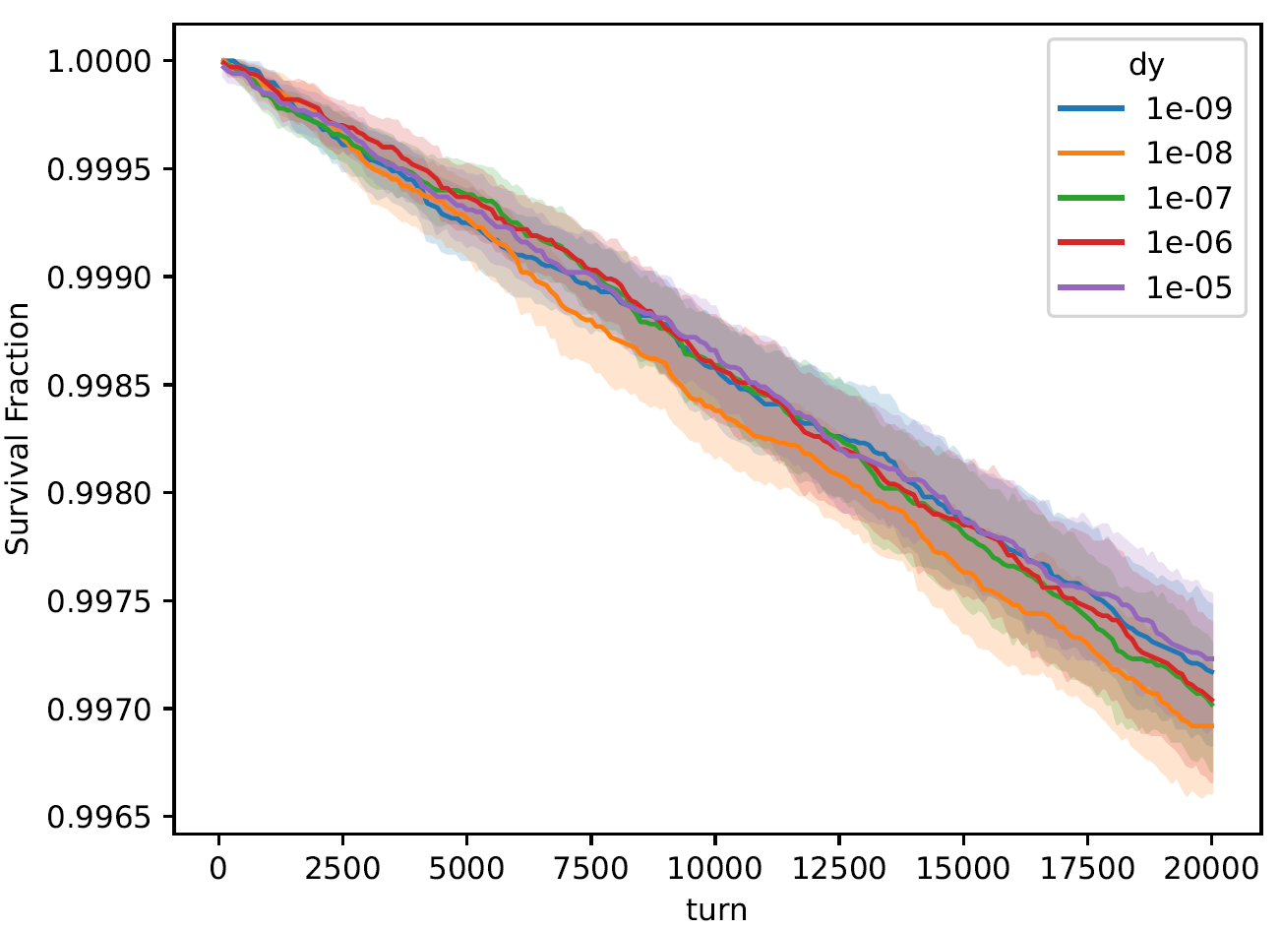
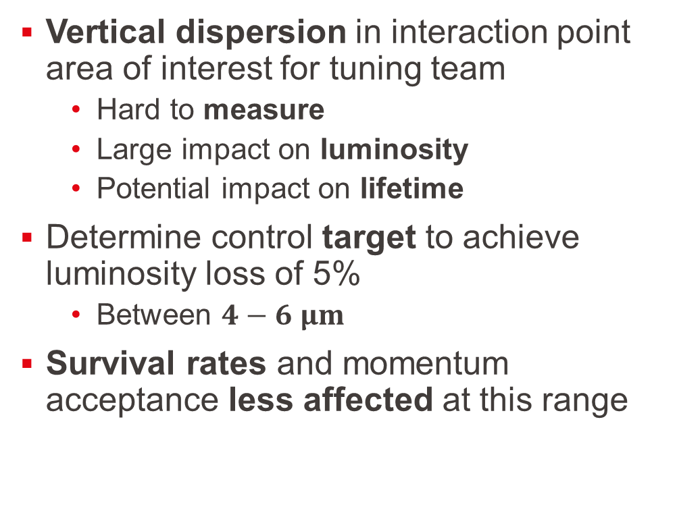
Insertion Region – Dispersion
Vertical dispersion in interaction point area of interest for tuning team
  Hard to measure
  Large impact on luminosity
  Potential impact on lifetime
Determine control target to achieve luminosity loss of 5%
  Between $4−6 μm$
Survival rates and momentum acceptance less affected at this range

Slide 16
Path to Detailed Studies
Facilitating Detailed Simulations
Simulation tools with different effects
Benchmarking simulation tools
Quantifying Performance
Implement traditional indicators
Performance of Detailed Lattices
Impact of individual effects
Dedicated Corrections
Introduction of new indicators
Standardised indicators
Understanding interplay

Slide 17
Path to Detailed Studies
Facilitating Detailed Simulations
Simulation tools with different effects
Benchmarking simulation tools
Quantifying Performance
Implement traditional indicators
Performance of Detailed Lattices
Impact of individual effects
Dedicated Corrections
Introduction of new indicators
Standardised indicators
Understanding of predictive power
Understanding interplay

Slide 18
Rough Overview of Timescales
Simulation | Number of Particles | Number of Turns
Optics | ~1 | ~few
Emittance – Matrix | ~1 | ~few
Dynamic Aperture | ~100 | ~few damping times (50-5000)
Emittance – Tracking | ~1k | ~few damping times (50-5000)
Damped Dynamic Aperture | ~10k | ~few damping times (50-5000)
Momentum Acceptance | ~10k | ~few damping times (50-5000)
Luminosity | ~10k | ~few damping times (50-5000)
Lifetime | ~100k | ~20k

Slide 19
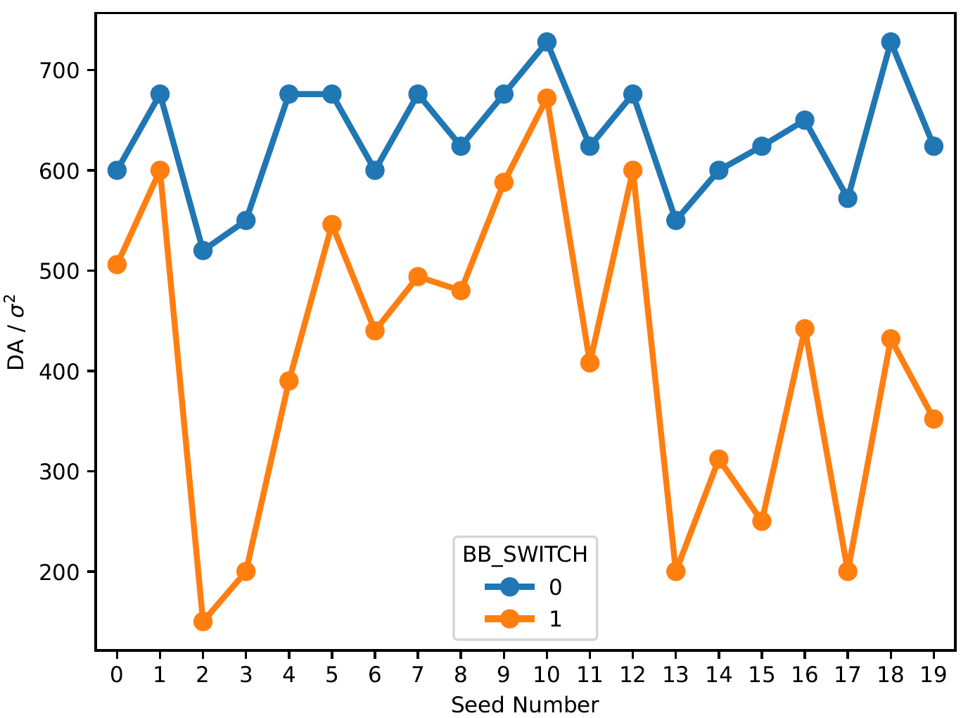
Correlations and Efficient Indicators
Understand correlations between effects and observables
  If and how adding an effect changes indicators evenly
  How different indicators are correlated
Allow for simplified models and predictions
  Save computing time
Long-term aim: create large repository of simulation setup and results

Slide 20
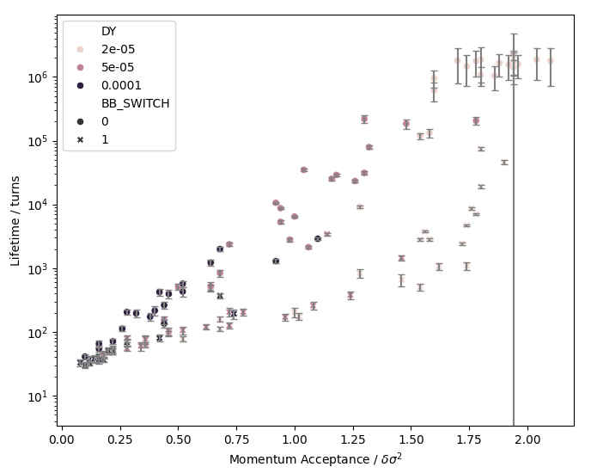
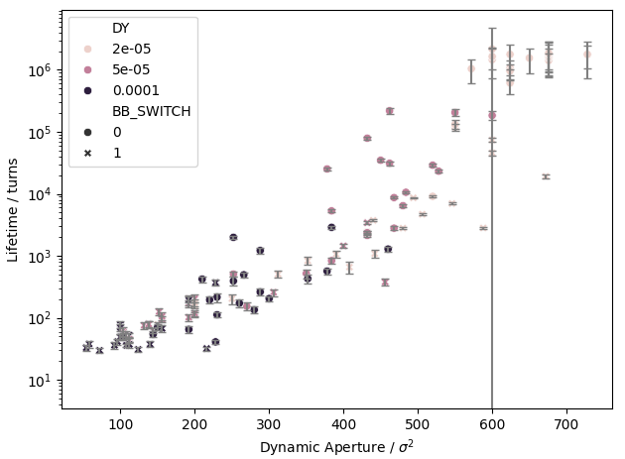
Dynamic Aperture vs Lifetime
Lifetime simulations significantly slower than computing DA/MA
  Traditionally optimise these with aim to maximise lifetime
Simulation with various sextupole misalignment seeds and amplitudes
  Compute DA, MA and lifetime
Clear trend between DA/MA and lifetime
  Additional variance by an order of magnitude
  Additional or better indicators needed to fully describe lifetime

Slide 21
Path to Detailed Studies
Facilitating Detailed Simulations
Simulation tools with different effects
Benchmarking simulation tools
Quantifying Performance
Implement traditional indicators
Performance of Detailed Lattices
Impact of individual effects
Dedicated Corrections
Introduction of new indicators
Standardised indicators
Understanding of predictive power
Understanding interplay

Slide 22
Path to Detailed Studies
Facilitating Detailed Simulations
Simulation tools with different effects
Benchmarking simulation tools
Quantifying Performance
Implement traditional indicators
Performance of Detailed Lattices
Impact of individual effects
Dedicated Corrections
Introduction of new indicators
Standardised indicators
Understanding of predictive power
Understanding interplay
Performance of lattice in full detail
Application of corrections

Slide 23
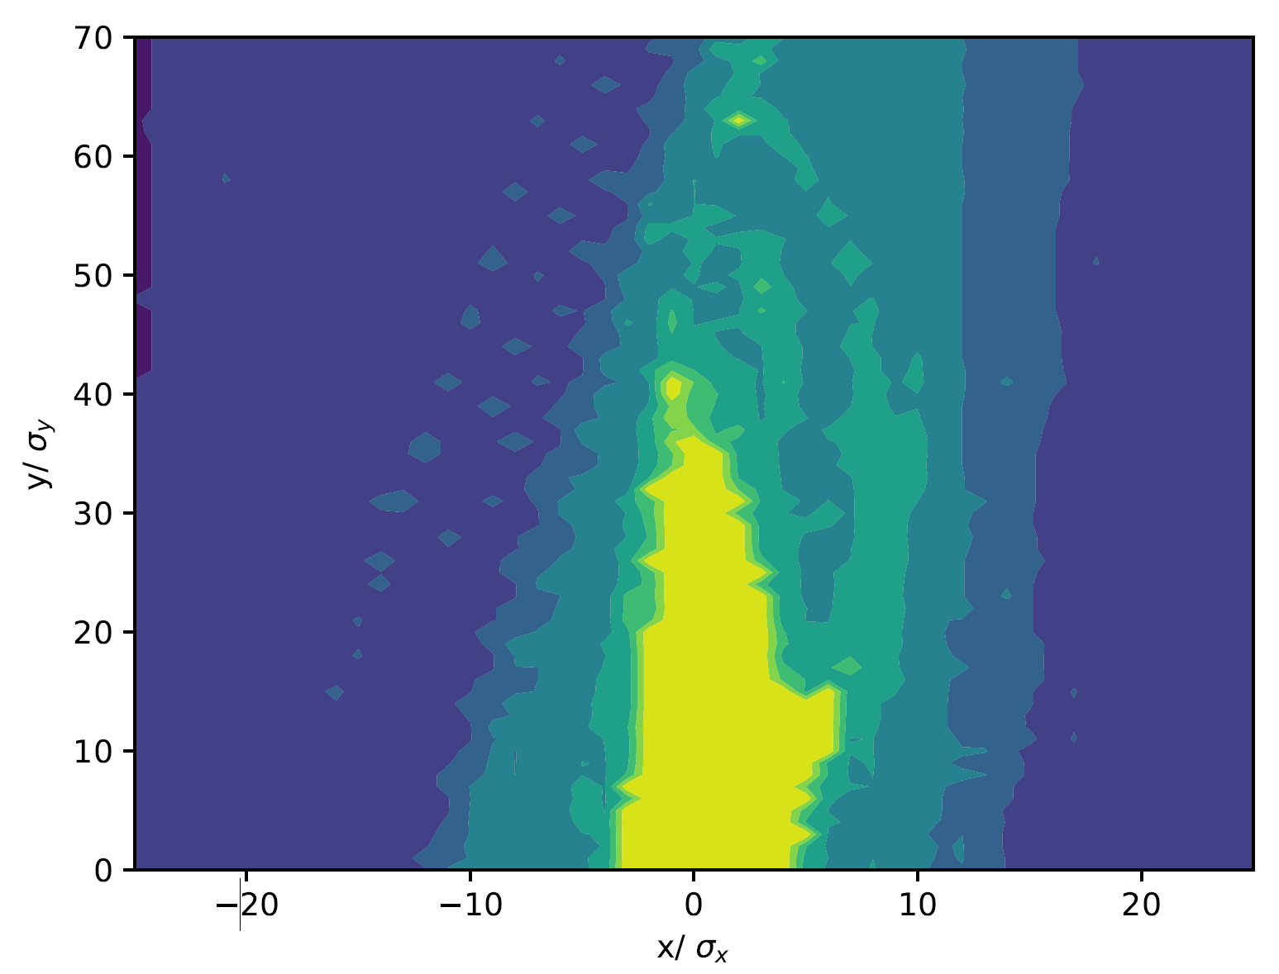
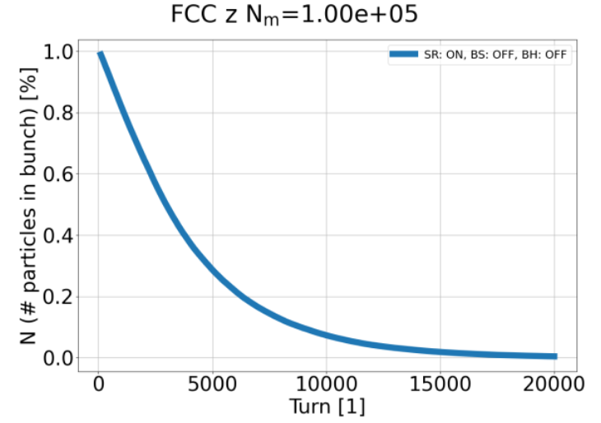
Errors and Correction
Applied beam-beam perturbations to lattices with global errors and corrections
Lattice with arc errors and corrections provided by Yi Wu
  Errors applied and thorough global correction applied in MADX
    Interleaved optics and orbit corrections
    Ramping of sextupoles
  Acceptable dynamic aperture but only 2 seconds lifetime

Slide 24
To Do: Lattices with Corrections
Aim to test on other corrected lattices
  E.g. lattices extensively corrected by E Musa et al.
    Requires translation from pyAT
  Lattices with dedicated tuned IPs
Gather and study results from different lattices
  Understand difference in performance
  Improved understanding of predictive power
Aim to create more targeted correction approaches
  From knowledge gained by sensitivity and full studies
  Using faster metrics during optimisation steps

Slide 25
Path to Detailed Studies
Facilitating Detailed Simulations
Simulation tools with different effects
Benchmarking simulation tools
Quantifying Performance
Implement traditional indicators
Performance of Detailed Lattices
Impact of individual effects
Dedicated Corrections
Introduction of new indicators
Standardised indicators
Understanding of predictive power
Understanding interplay
Performance of lattice in full detail
Application of corrections

Slide 26
Path to Detailed Studies
Facilitating Detailed Simulations
Simulation tools with different effects
Benchmarking simulation tools
Quantifying Performance
Implement traditional indicators
Performance of Detailed Lattices
Impact of individual effects
Understand shortcomings of current correction
Dedicated Corrections
Introduction of new indicators
Standardised indicators
Understanding of predictive power
Understanding interplay
Performance of lattice in full detail
Efficacy of corrections
Application of corrections
Additional/novel corrections
Iterate

Slide 27
Summary
Able to perform comprehensive simulations
  Full lattice, radiation, misalignments, field errors, systematic IP perturbations, beam-beam interaction …
  Implemented and benchmarked broad range of performance indicators
  First studies with corrected lattices and beam-beam – only possible with lattices corrected (in MADX) and translated to X-suite – lattice by Yi Wu
Deeper understanding of performance indicators
  New indicators defined and tested
  First correlation studies – more data to be produced, including from corrected lattices
  Aim to be able to use fast, reliable indicators whenever possible
Long-term aim: Improve corrections in light of beam-beam
  Determine efficacy of broader range of corrections
  Develop new corrections based on findings (and use fast indicators)

