Slide 1
XBPF divergence measurement test in M2
Inaki Ortega (SY-BI)
186th EATM – 24/06/2025

Slide 2
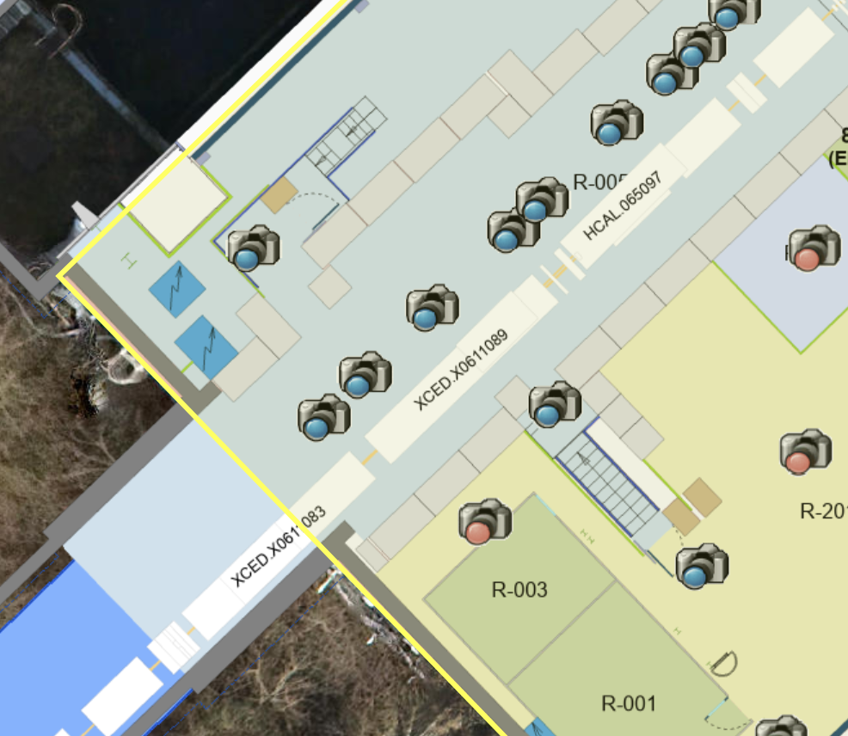
Goal: measure beam divergence in M2 using the new North Area XBPF.
Demonstrate that 1mm fibres meet the requirements, so no change to 0.5mm is needed for these specific devices.
The horizontal FISCs will remain in place, allowing for a direct comparison with the XBPF.
XFFV.065.099
The FISCs require more than 40 spills to measure beam divergence, whereas the XBPF can achieve this in a single extraction.
This location in M2 is particularly interesting for several reasons:
It offers access to various types of beam.
It is located close to the BI barrack, facilitating installation.
XFFV.065.078
HNB201

Slide 3
Installation during oxygen run. Removal on the 13th of August.
ECR just submitted: https://edms.cern.ch/document/3313838/0.1
Steps:
Disconnect the XFFV.X0611078 and the XFFV.X0611099 from vacuum.
Replace XFFV.X0611078 and XFFV.X0611099 with the new North Area XBPF prototypes, then reconnect to the beamline vacuum.
Connect the pneumatic systems of the new XBPFs to the M2 compressed air line 20 meters away.
Pull one optical fibre per XBPF to barrack HNB201 for communication between the XBPF and the VME electronics.
Move a VME crate to HNB201 for control and acquisition, and deploy the BXBPF FESA classes.

Slide 4
