Slide 1
White Rabbit Timing
Ioan Kozsar on behalf of the team, 186th EATM Meeting, June 24th 2025

Slide 2
Outline
Introduction
Consolidation project
Status
Pilot Deployments
Monitoring
Support
Planning
Conclusions

Slide 3
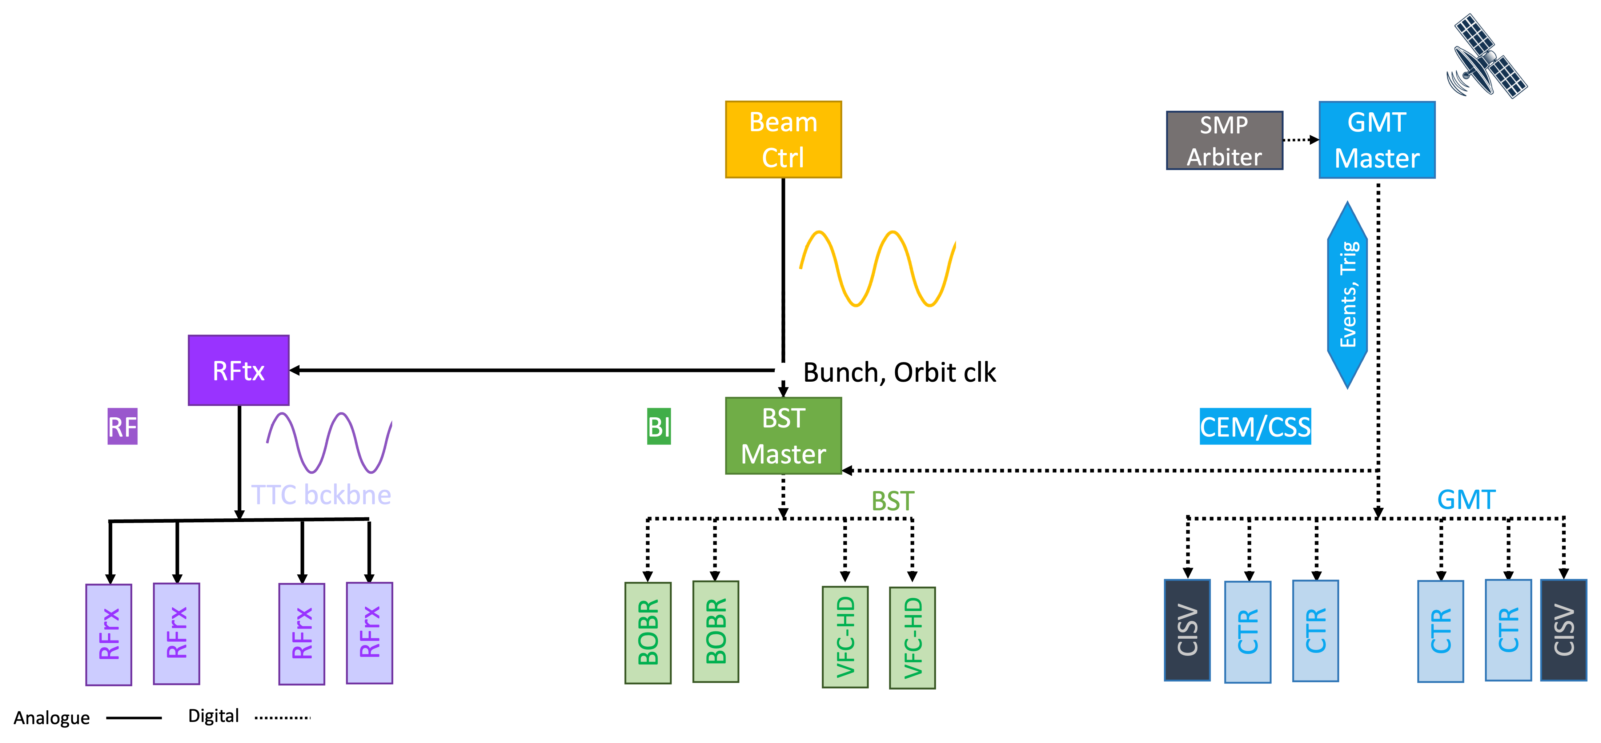
Introduction – Legacy Timing System(s)
Event-based timing system
Distribution of events and triggers
RS-485, thousands of receivers
Courtesy E. Gousiou

Slide 4
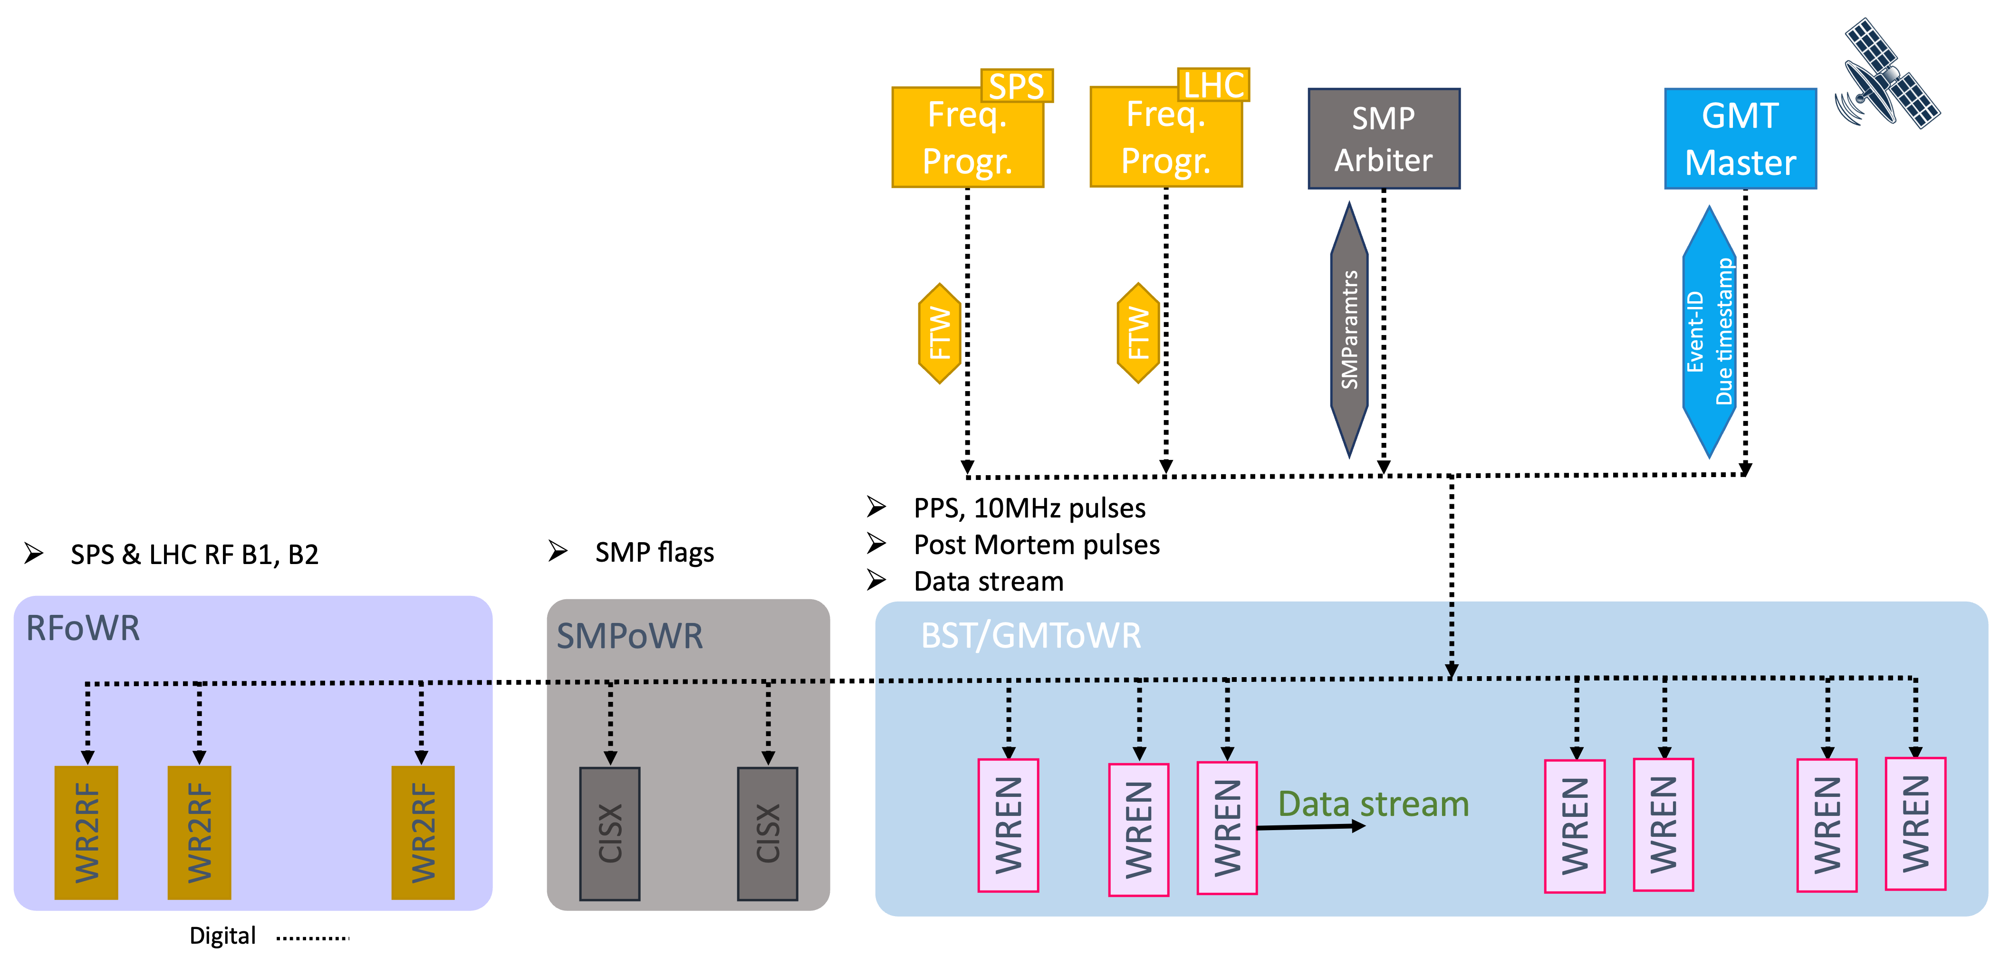
Introduction – Future Unified Timing System
One common optical network
Higher bandwidth
Same or better node performance
White Rabbit technology
Courtesy E. Gousiou

Slide 5
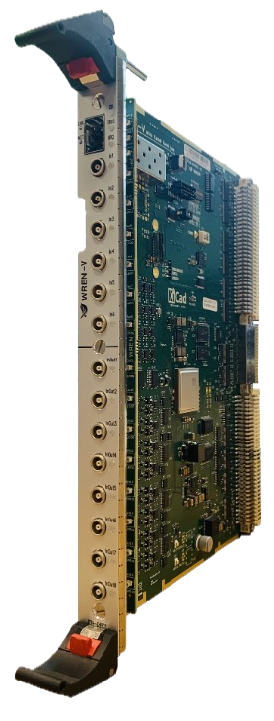
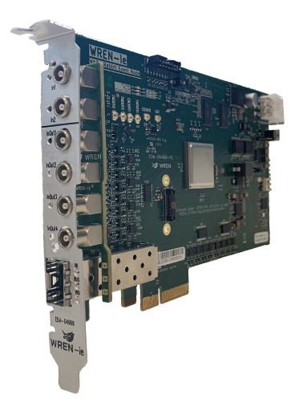

Consolidation Project
Detailed description
  EDMS 3088857
Network layout
  https://confluence.cern.ch/display/HWI/Network+Layout
New White Rabbit hardware

Slide 6
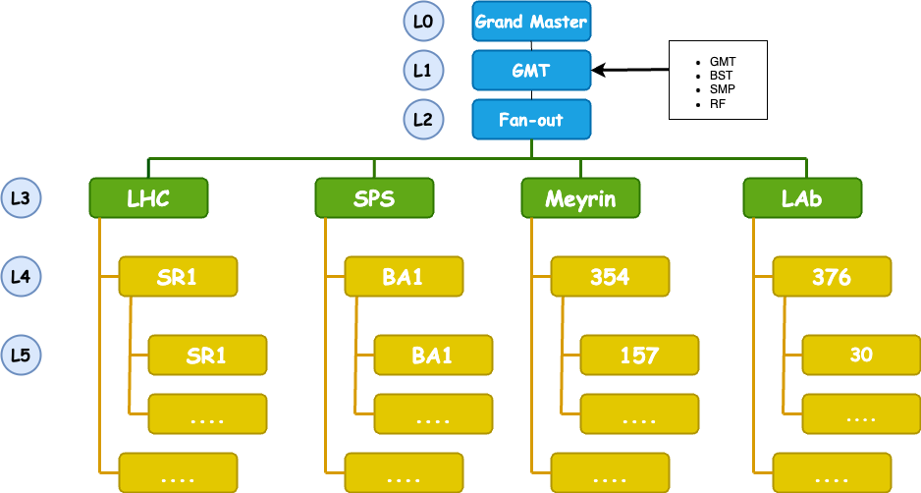
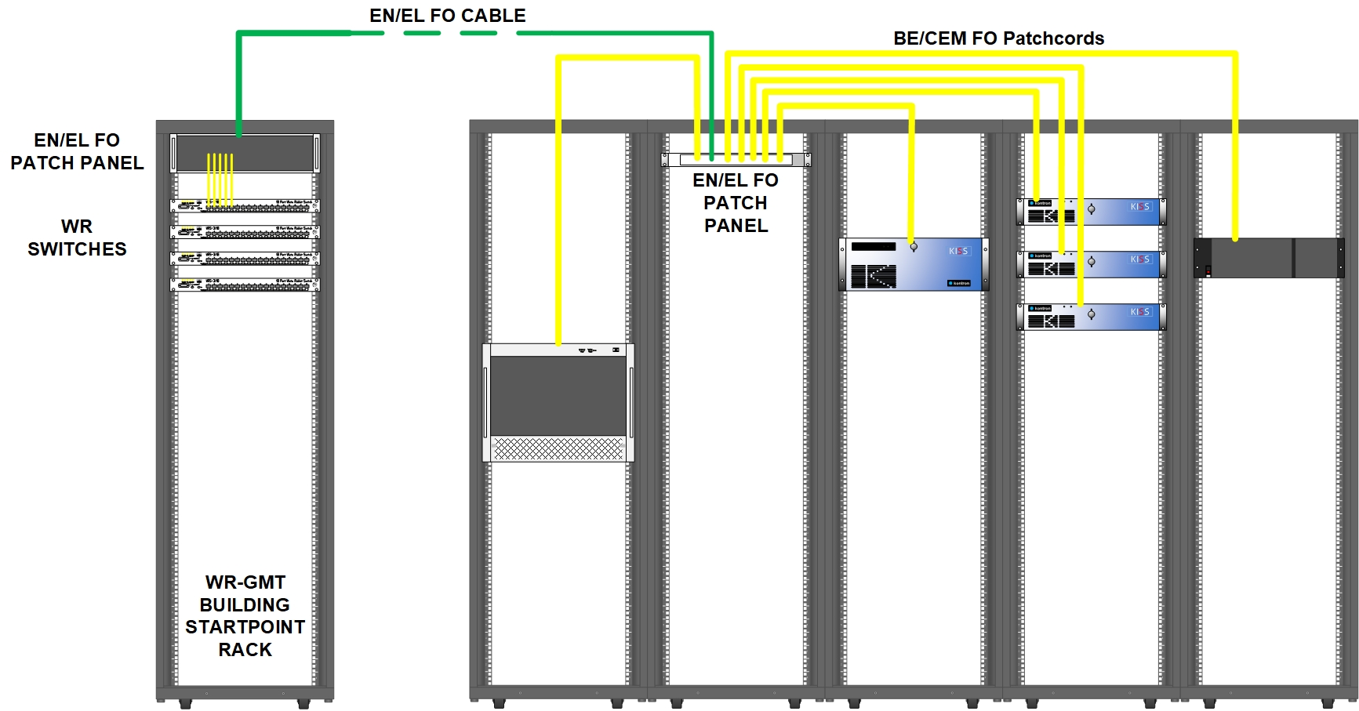
Status
Status
    Initial OF requests submitted to EN-EL in 2022
      Initial estimate 1.5 MCHF (covering all existing CTR deployments)
    ~300 WRS (6 layers network), ~1000 WREN (VME, PCIe, PXIe)
      Redundancy (hot-spares) up to layer 4
    Network optimisation
      EN-EL-FO & BE-CEM-IN
    Hardware and software procurement
      CEM, CSS, BI, RF, MPE

Slide 7
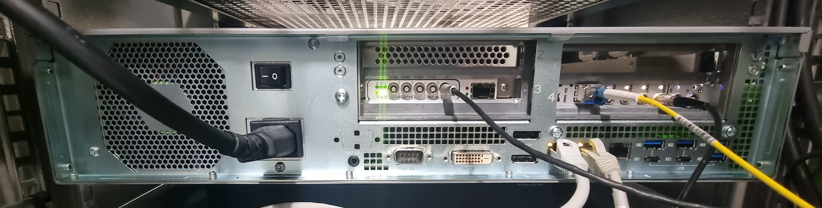
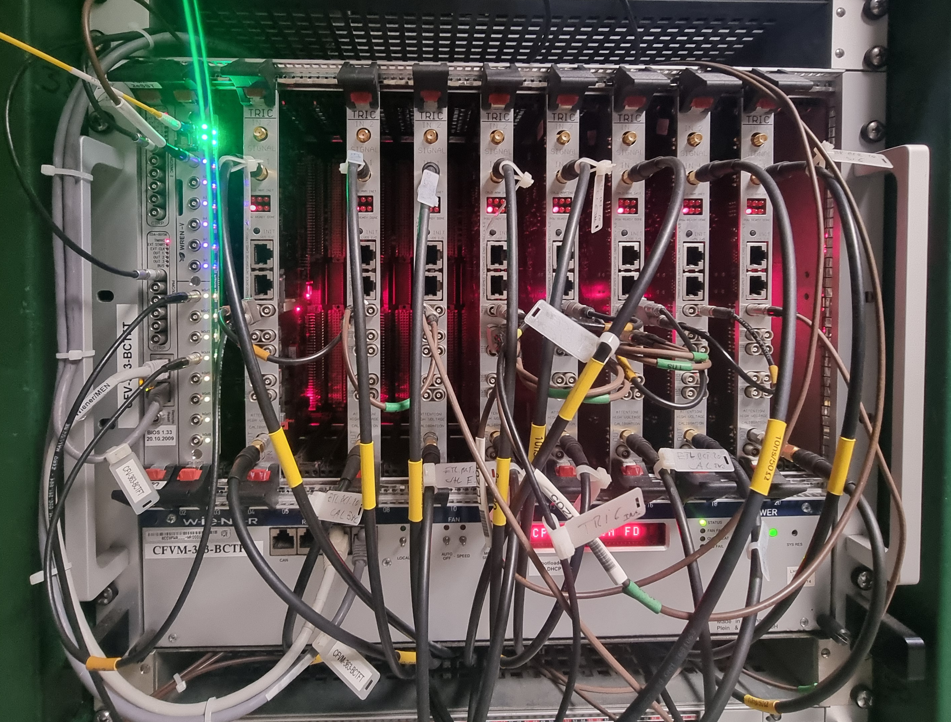
Pilot Deployments
2024 – priority labs – DONE
  SY-RF, SY-BI, SY-EPC, SY-EPC, TE-MPE, BE-CSS, BE-CEM
  WREN first versions, pre-series
  ~2000 operational FECs
2025
  LN3 & LEIR – SY-BI & SY-EPC – DONE
    FO infrastructure ready for more
  FAIR – now! – hard deadline (maintenance shutdown)
  SM18 – mid-July 2025 – hard deadline (maintenance shutdown)
  3MeV – September 2025

Slide 8
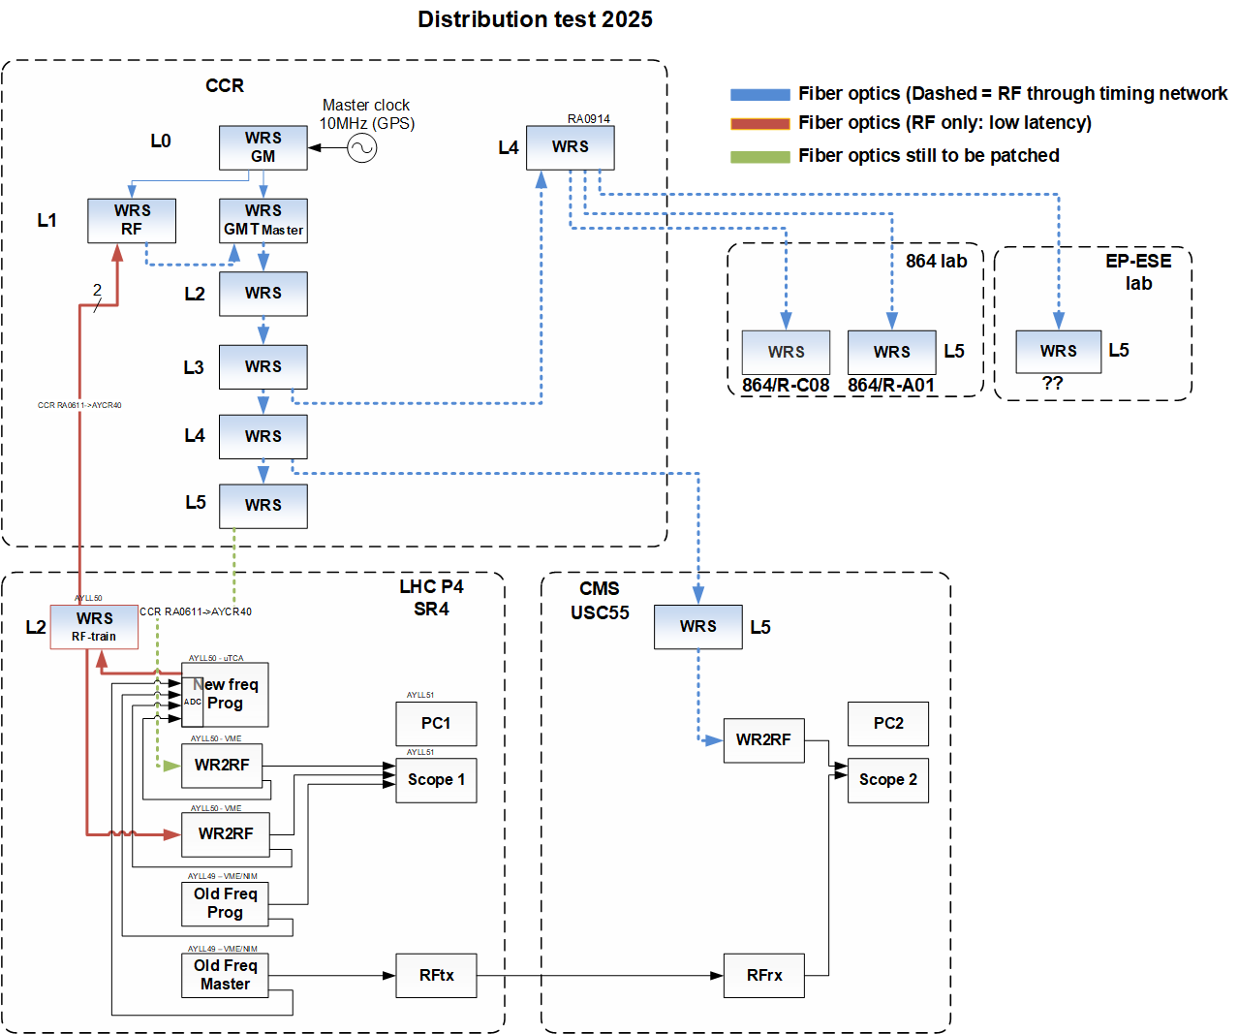
Pilot Deployments
SR4 → CCR → CMS – DONE
Courtesy
G. Hagmann & A. Spierer

Slide 9
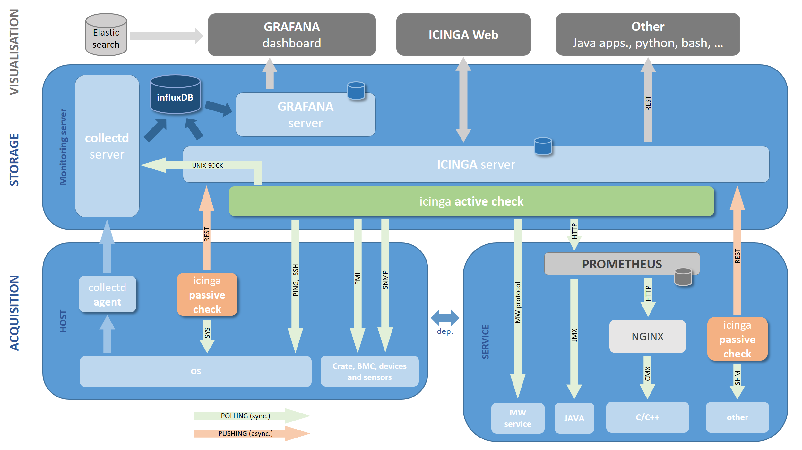
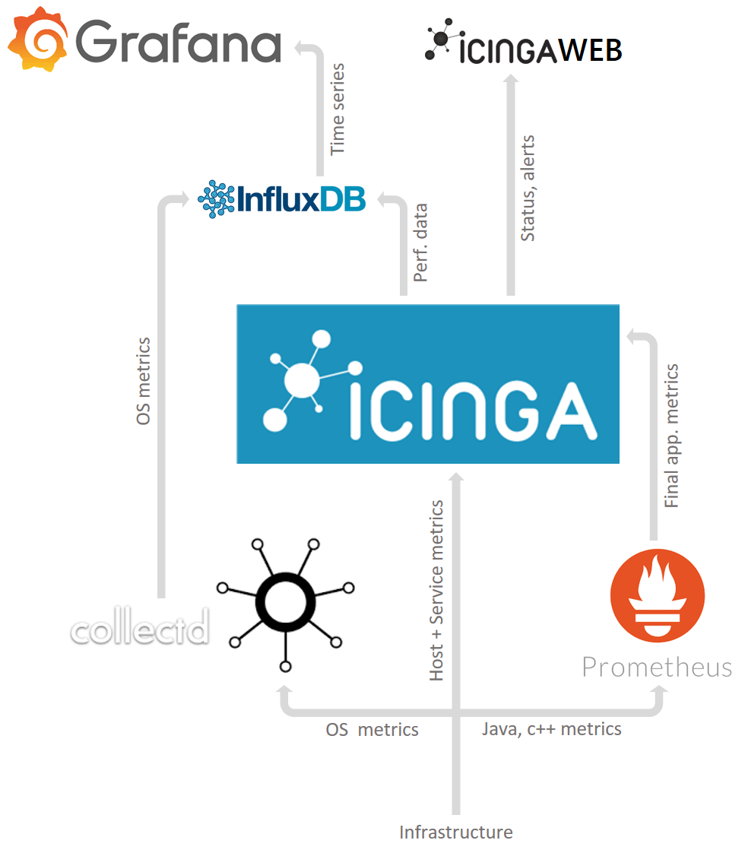
Monitoring
Integrated into COSMOS (BE-CSS)
  https://confluence.cern.ch/display/COS/COSMOS+-+Controls+Open+Source+MOnitoring+System
  Email & SMS notifications
  Default for CEM-IN supported hardware

Slide 10

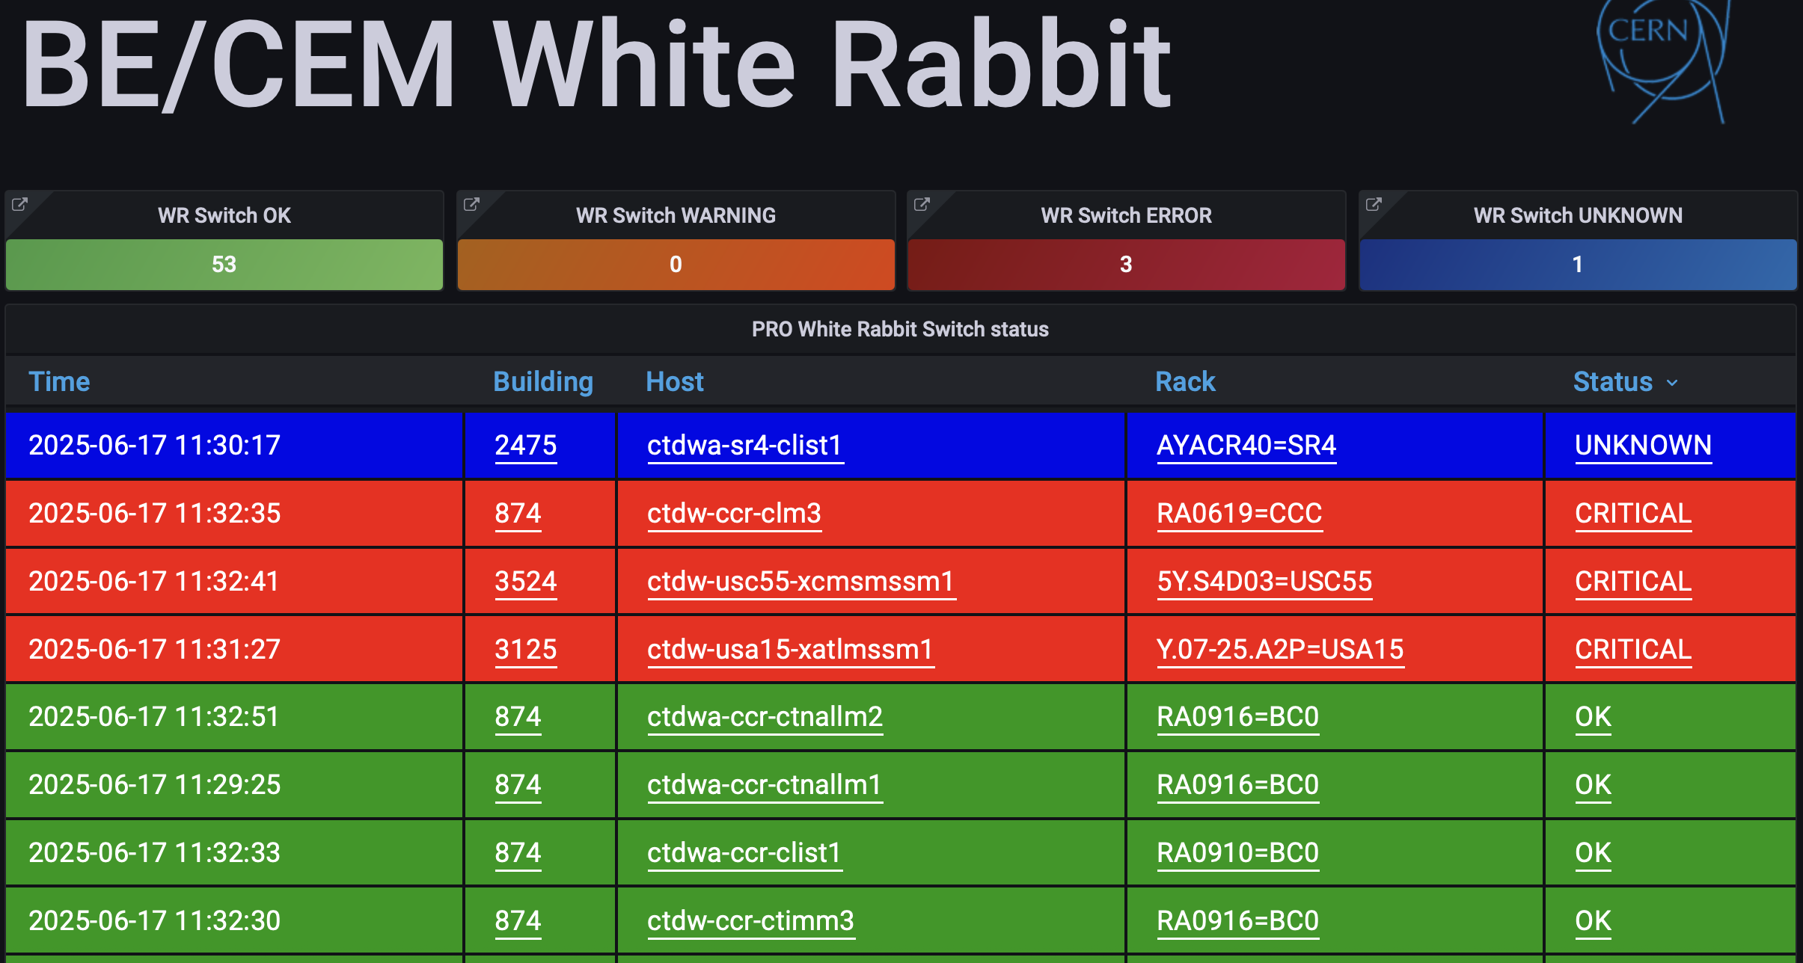
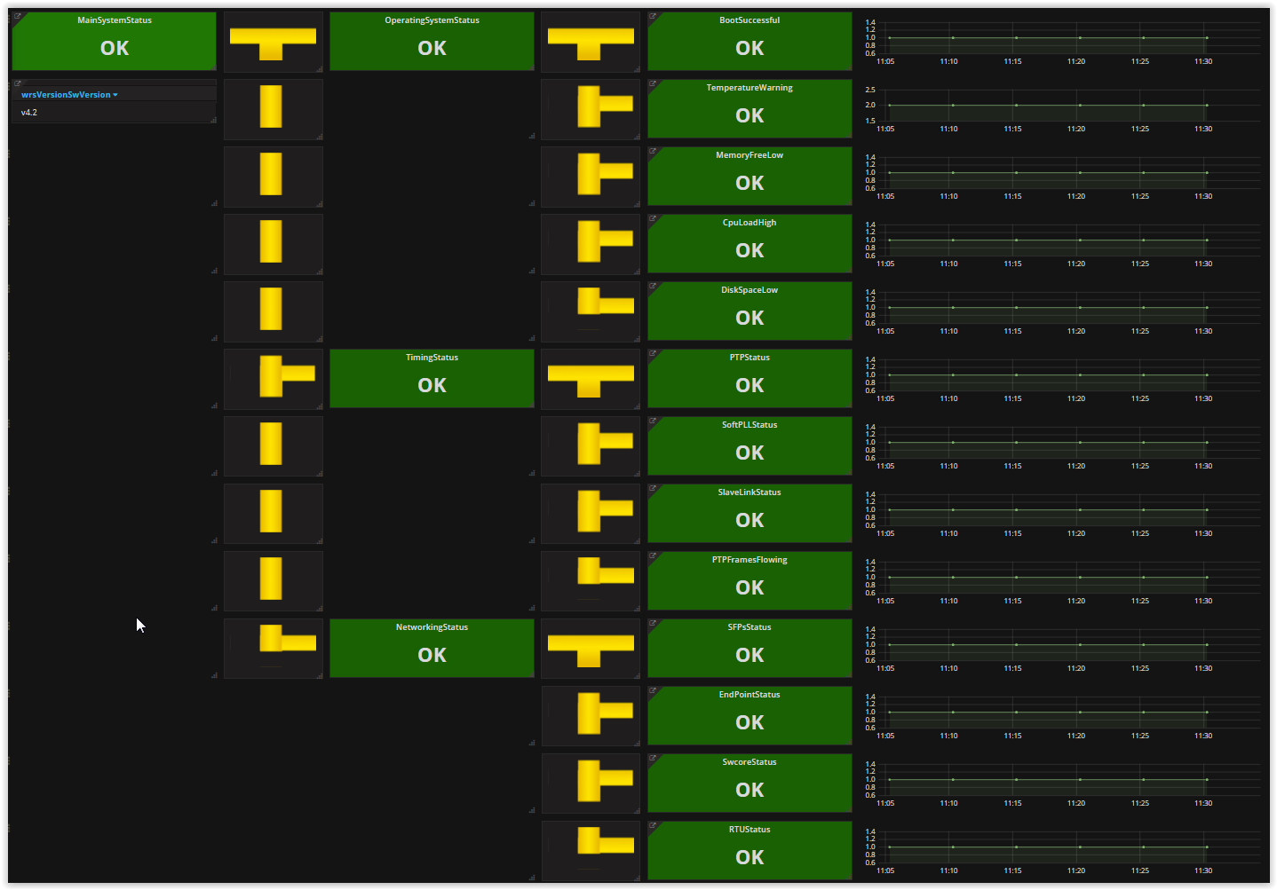
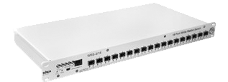


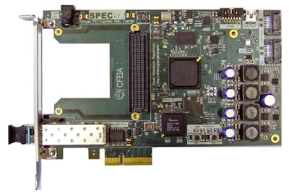
Monitoring
ICINGA
  WRS – TN/GPN network – management port
  WREN – WR network
SNMP
SNMP
WR Switch
WR NEtwork MOnitor
(Icinga Satellite)
Courtesy J.Palluel
WR Node

Slide 11
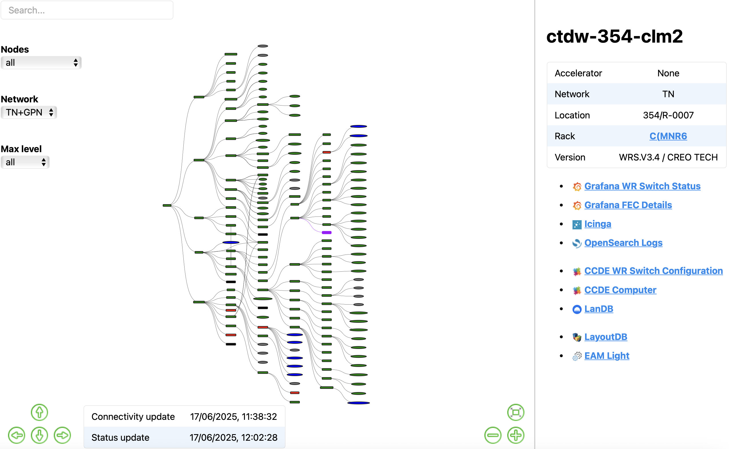
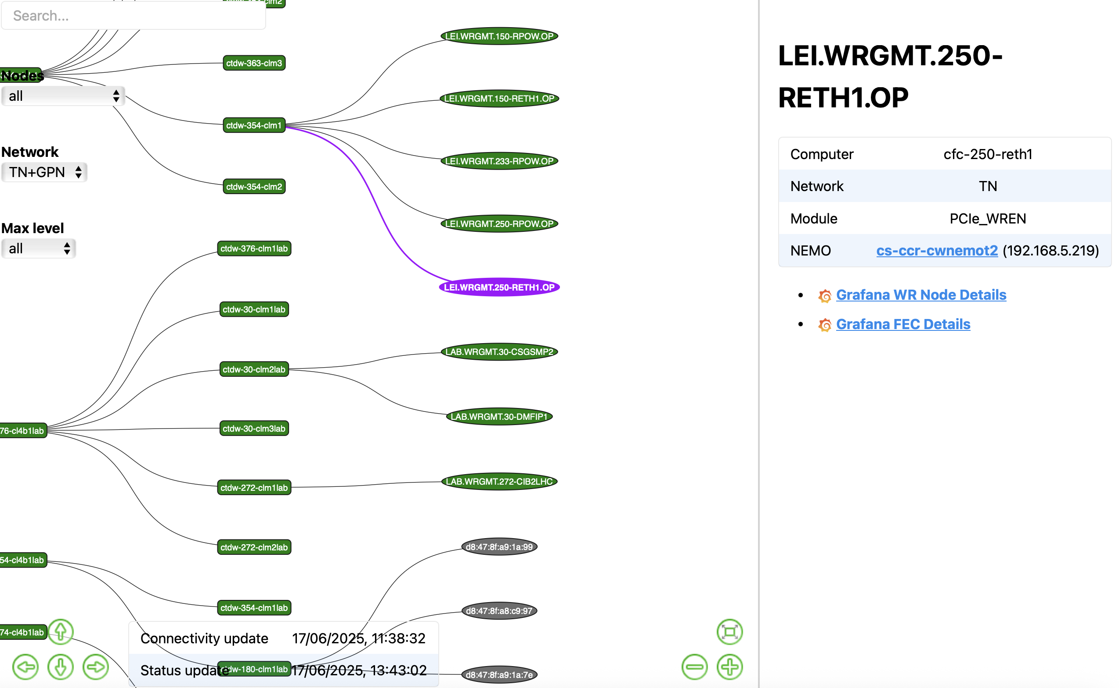
Monitoring
Custom diagnostics application (WRS + WREN)
  https://mondi.app.cern.ch/whiterabbit/network
  On top of COSMOS architecture, automatically generated (config from CCDB, cabling from LayoutDB)

Slide 12
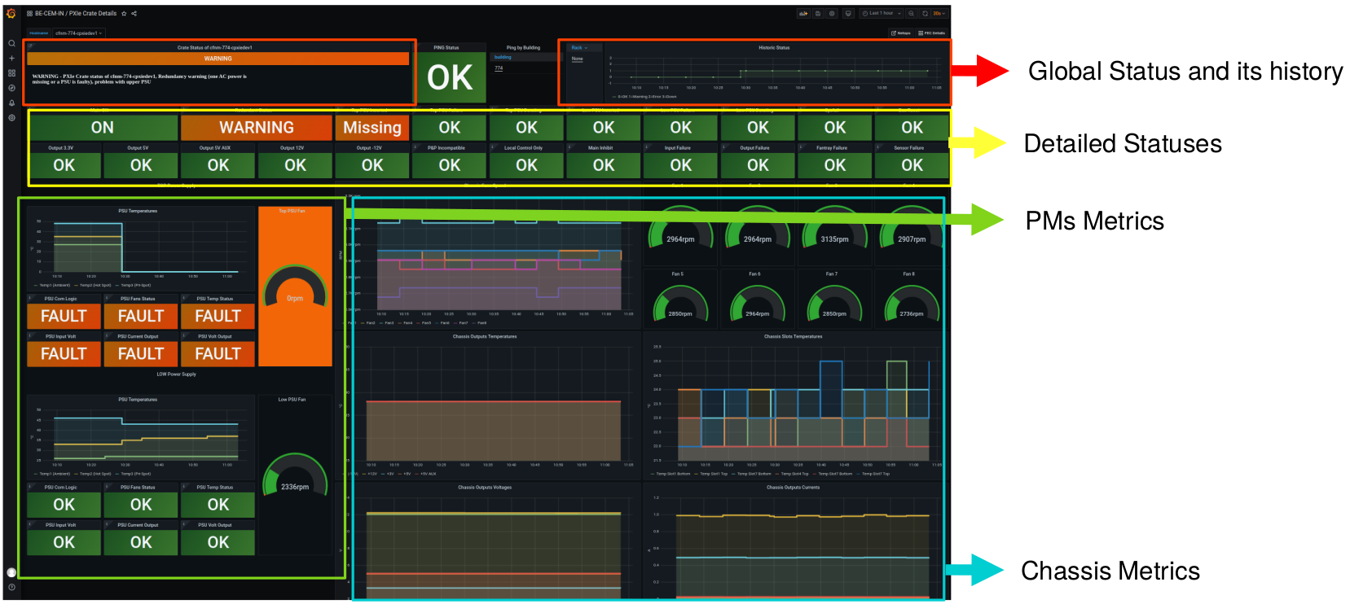
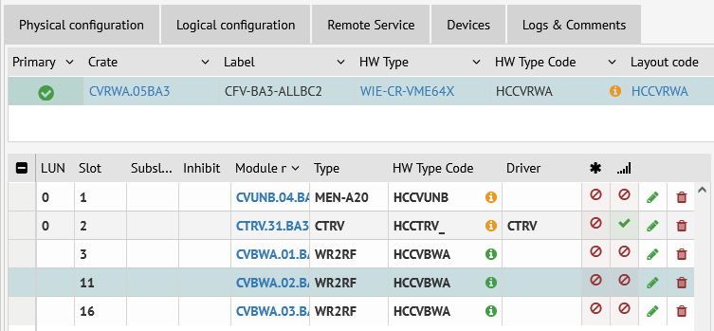
BE-CEM-IN Support
CEM-IN support – best-effort
  > 99% availability ➔ no stand-by (piquet) service
SLA for supported hardware – lifetime warranty
  Spares can be provided for on-site storage – shorten downtime
  Complete lifecycle management
    Procurement
    Spares management
    Reliability tracking
    Maintenance
  Configuration, Deployment, Documentation
  Monitoring and diagnostics
  Consolidation & upgrades
COSMOS monitoring - Courtesy J.Palluel
CCDB configuration

Slide 13
Planning
LS3 Planning
  PLAN A in LS3: LHC & SPS (PLAN B in LS3: LHC only) → complete FEC migration
    SPS decision in Q4 2025
    FO deployment → entire CERN complex
    HL-LHC deployments – WR only ➔ LHC cannot be delayed
    SMP distribution – WR only ➔ SPS & LHC
  Detailed planning → work in progress, depending on EN-ACE coordination (co-activities)
    “Countdown to LS3” event – 3-4 September 2025 (LHC – September 20)

Slide 14
Conclusions
Massive coordination effort
  Providers: BE-CEM & BE-CSS & SY-RF & SY-BI & TE-MPE & EN-EL & EN-ACE teams
  Users: ATS + Experiments – collaboration and feedback welcome!
LHC migration confirmed, SPS pending (high probability)
Expecting longer re-commissioning period
Pilot deployments – teething issues, no major/blocking issues – very useful!

Slide 16
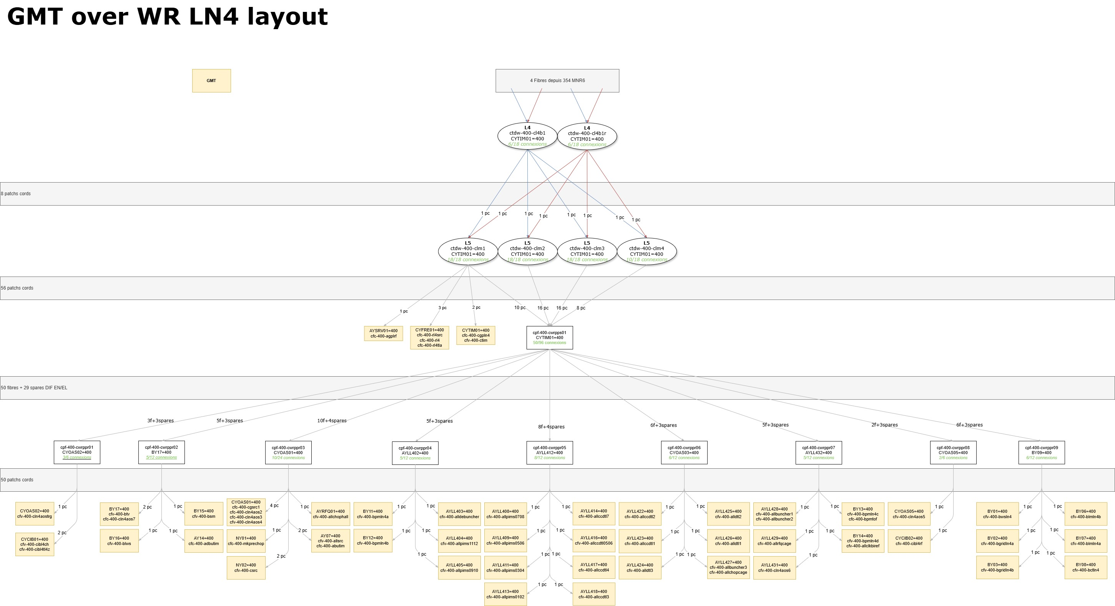
Optimization example – LN4

