Slide 1

ECR/Documents for Information and Approval
Giulia Romagnoli and Natalya Kahn for BE-EA, 2025-06-24
EA Documents - Agile Board - CERN Central Jira

Slide 2
LIST OF DOCUMENTS for Info
FOR INFORMATION EATM
Summary | Reporter | EA Projects | EDMS number | EDMS Status
AD Target Safety Overview | Florence Pirotte | AD | 3190393 - AD-L-SF-0004 | Engineering Check
BOREAL Converter Functional Specification for NA-CONS | Dimitris Xystras | North Area, NA-CONS | 2813628 - SPSX-R-ES-0003 | Under Approval
Functional Specification of Polaris Converter Family for TT20 and North Area Consolidation | Ivan Josifovic | North Area, NA-CONS | 2801702 - SPSX-R-ES-0001 | Under Approval
NCR - Removal of Cable Tray Supports for Pipe Passage | Iliasse Derrag | North Area, NA-CONS | 3253647 - SPSX-H-QN-0001 | Released
NORTH AREA Dry Risers and other EN-CV fire safety equipment installation | Jani Lehtinen | North Area, NA-CONS | 3287586 - SPSX-SF-WD-0007 | Engineering Check
Consolidation of XCET Cherenkov Detectors in NACONS Project | Giulia Romagnoli | North Area | 2802361 - SPSX-B-WD-0004 | Released
Functional Specifications for the North Area Targets in TCC2 | Dipanwita Banerjee | North Area NA-CONS, HI-ECN3 | 3194385 - SPSX-T-ES-0010 | Under Approval
HI-ECN3 Building 911 New Door and Doorstep Implantation | Guillaume Cnudde | North Area, HI-ECN3 | 3300544 - SPSX-J-ER-0012 | Released
Safety Assessment for the XCM Magnetic Collimators | Naini Mandal | North Area | 3300555 - SPSX-TC-RPT-0003 | Released
User Requirements for XTCX Fixed Collimators in North Area Beamlines | Dipanwita Banerjee | North Area | 2802303 - SPSX-TC-ES-0008 | Released
Engineering Specification XCET of the Neutrino Platform Beamlines | Giulia Romagnoli | North Area | 2671493 - SPSX-X-ES-0001 | Released
Update of HiRadMat Beam Parameters | Francesco Velotti | HiRadMat | 2418077 - HRM-T-EP-0001 | Engineering Check

Slide 3
LIST OF DOCs for FUTURE APPROVAL
ECR INFO/FUTURE APPROVAL EATM
Summary | Reporter | EA Projects | EDMS number | EDMS Status
Production/Installation of a New Access Gangway to TELMAX/ASACUSA Platforms | Francois Butin | AD | 3307640 - AD-LJ-EC-0028 | Under Approval
MDX Magnet Installation for User Set-Up in T10 | Maarten Van Dijk | East Area | 3212841 – PSZ-M-EC-0002 | In Work
Re-installation of XCED Detector on H6 Beamline in PPE136 | Miguel Santos | North Area | 3286149 – SPSX-B-EC-0018 | Engineering check
GIF++ Bunker Extension in Phase 2 | Martin Jaekel | North Area | 3223563 – SPSX-J-EC-0011 | Under Approval
Installation of a New Hydrogen Buffer outside EHN1 for the NA61/SHINE Experiment | Bartosz Maksiak | North Area | 3197663 – SPSX-J-EC-0009 | Engineering check
Temporary Installation of Two XBPFs in M2 for Beam Divergence Measurement | Inaki Ortega Ruiz | North Area | 3313838 – SPSX-B-EC-0020 | Engineering check
Small Modifications to the Instrumentation in PPE134 | Nikos Charitonidis | North Area | 3252972 – SPSX-L-EC-0011 | Engineering check
NA-CONS Fire-Resistant Partitions 3 - Partitions #09, #10, #11, #12, #13, #14, #17 and #33 | Adem Kaymak | North Area, NA-CONS | 3286649 – SPSX-SF-EC-0017 | Engineering check
BA81 Extension Ventilation | Jani Lehtinen | North Area, NA-CONS | 3156846 – SPSX-U-EC-0001 | Under Approval
Starpoint installation in BA80 during YETS 25-26 (IT-CS) | Christian Burlet | North Area, NA-CONS | 3314109 – SPSX-ED-EC-0001 | In Work
BA80 Power Converters for NA-CONS and the HI-ECN3 Bump Magnets | Ivan Josifovic | North Area, NA-CONS, HI-ECN3 | 3164018 – SPSX-R-EC-0001 | Engineering check

Slide 4
LIST OF DOCs for APPROVAL
ECR APPROVAL EATM
Summary | Reporter | EA Projects | EDMS number | EDMS Status
Re-installation of Modified Vacuum Chamber in East Area F61.MBXHD025 during TS 2025 | Giulia Romagnoli | East Area | 3305038 - PSZ-V-EC-0003 | Under Approval

Slide 5
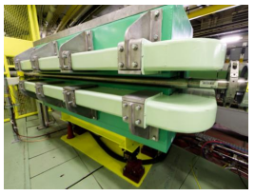
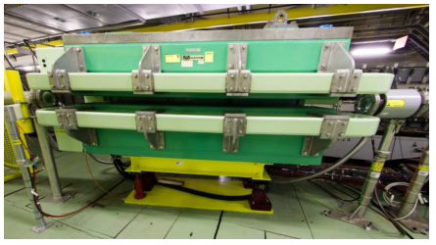
ECR Under Approval
PSZ-V-EC-0003
Version 0.3
Re-installation of Modified Vacuum Chamber in East Area F61.MBXHD025 during TS 2025
By Giulia Romagnoli
This ECR describes the re-installation of the vacuum chamber inside the F61.MBXHD025 magnet in the F61 PS ring extraction line towards the East Area.
During YETS 24/25, a vacuum chamber was installed in the F61.MBXHD025 magnet at the request of CHIMERA/HEARTS for operation of T08 with low-energy ions.
During polarity checks, the chamber was found to move and was removed.
After post-mortem investigation, the two primary causes were found to be:
Lack of electrical insulation
Inadequate mechanical attachment within the magnet
The chamber assembly has been modified and will be tested before reinstallation.
The ECR provides more information about:
Electrical insulation
  Kapton foil
  Enamel flanges
  One-sided ground connection
Mechanical attachment
  Specially designed brackets
  C-shaped brackets
  U-shaped brackets
  Epoxy resin washers

Slide 6
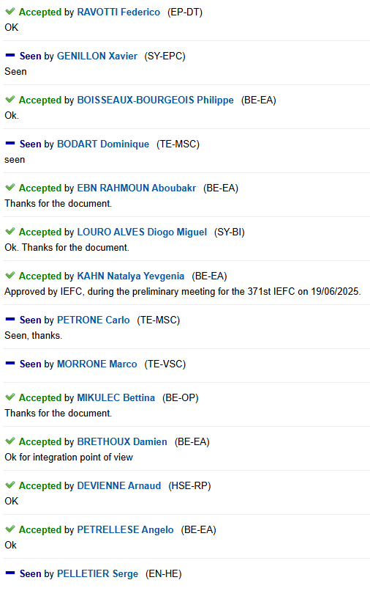
ECR Under Approval
PSZ-V-EC-0003
Version 0.3
Re-installation of Modified Vacuum Chamber in East Area F61.MBXHD025 during TS 2025
By Giulia Romagnoli
Seeking approval from EATM

Slide 7
Thank you!

