Slide 1
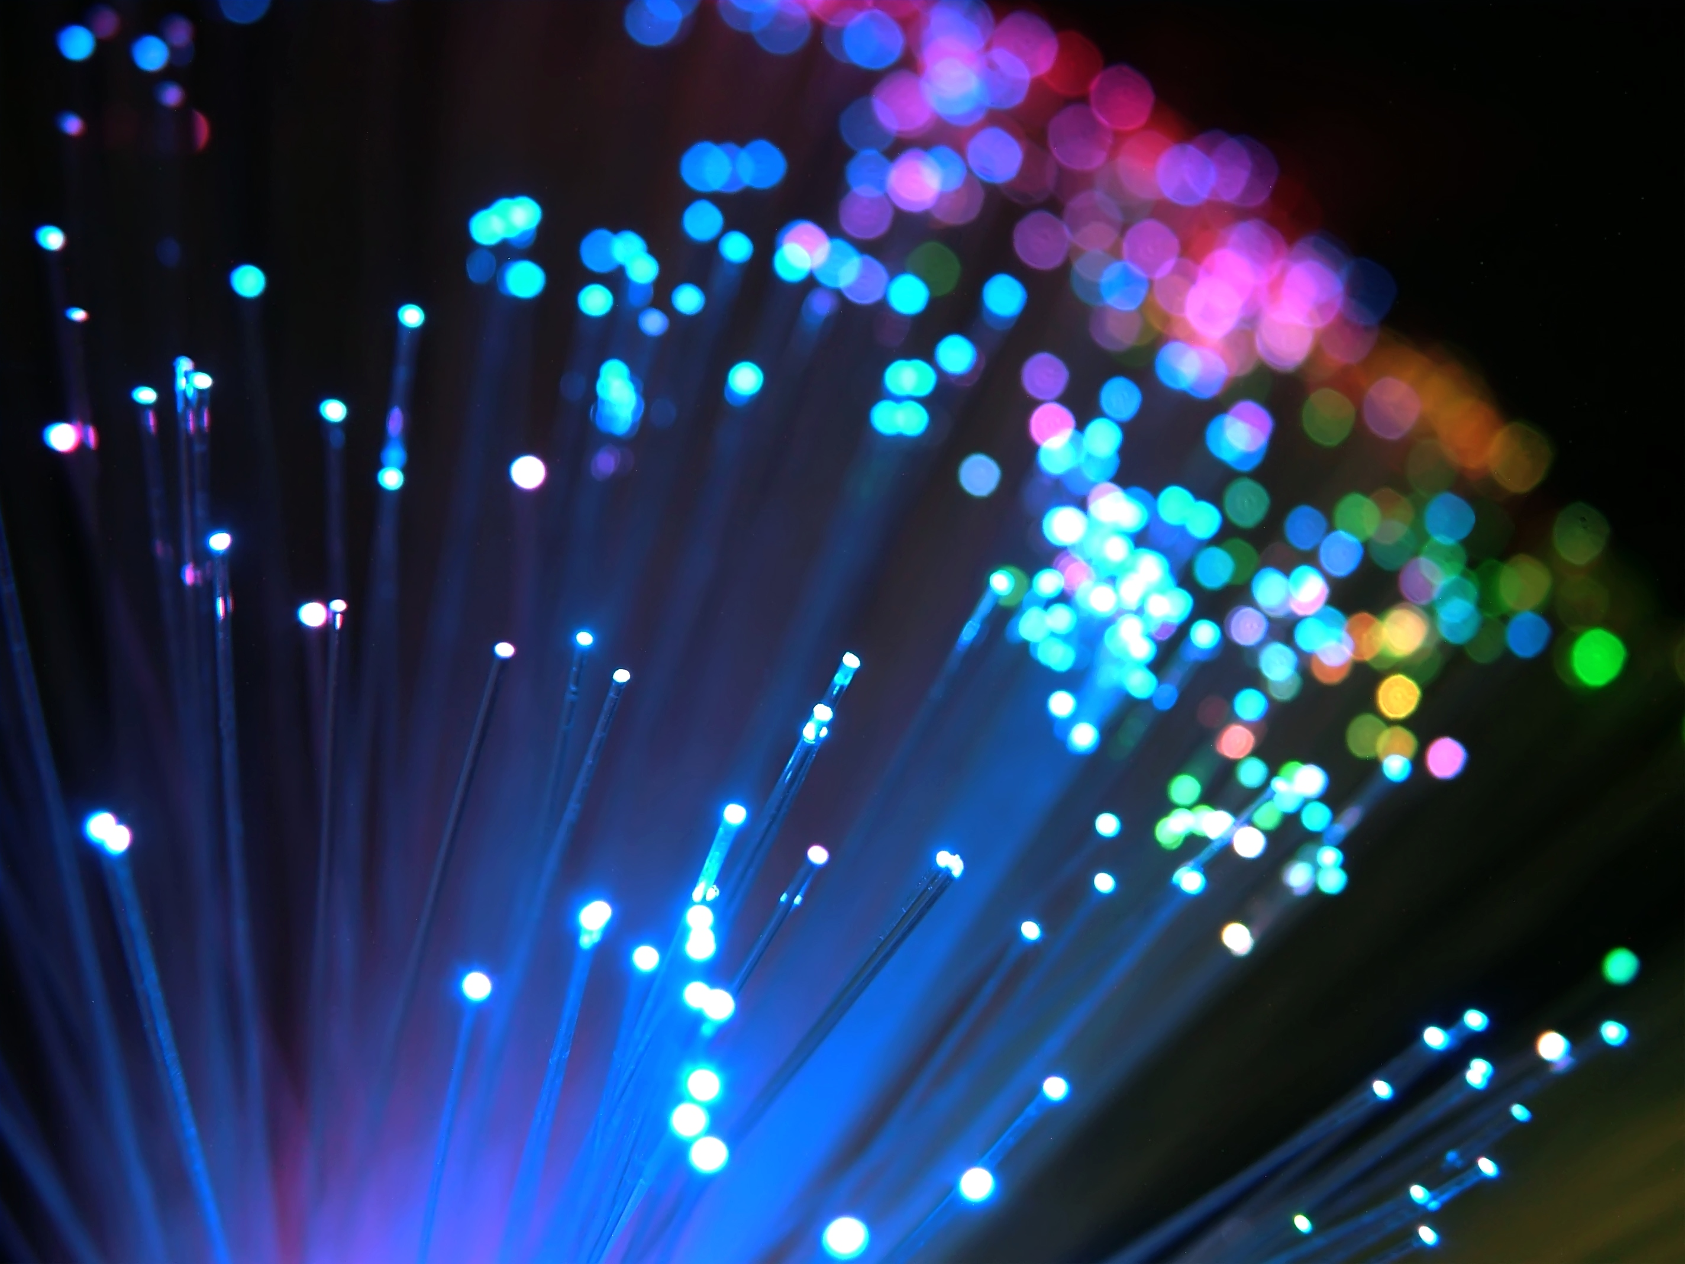
Fiber Optic Sensors For HTS magnets
28.09.11
Melanie Turenne

Slide 2


Acknowledgements
This work was partially supported by the US DOE SBIR Program
Collaborators include:
Muons, Inc.
Dr. Rolland Johnson
Dr. Gene Flanagan
Muons, Inc.
North Carolina State University
Department of Materials Science and Engineering
Dr. Frank Hunte
Dr. Justin Schwartz
Liyang Ye

Slide 3
Overview
Background on optical fibers
Optical fiber sensors
Application in HTS magnets
Sensor technologies: Brillouin, FBGs, Rayleigh
Research
Bi2212 process monitoring
Cryogenic calibration
YBCO quench detection
Conclusions and Future work
Notes:
Disclaimer: the fibers, manufacturing techniques, and sensing approaches are specific to my research and other forms may exist

Slide 4
Overview
Background on optical fibers
Optical fiber sensors
Application in HTS magnets
Sensor technologies: Brillouin, FBGs, Rayleigh
Research
Bi2212 process monitoring
Cryogenic calibration
YBCO quench detection
Conclusions and Future work
Notes:
Disclaimer: the fibers, manufacturing techniques, and sensing approaches are specific to my research and other forms may exist

Slide 5
Basics of optical fibers
Optical fibers act as waveguides to transmit light down their core
Core and cladding have slightly different indexes of refraction which causes total internal reflection
Made of high purity glass – silicon dioxide (SiO₂), aka silica
Can be doped with Ge, F, H, RE depending on application
Notes:
Slide 5: If you were on the top of an ocean filled with optical quality glass, you could clearly see the bottom

Slide 6
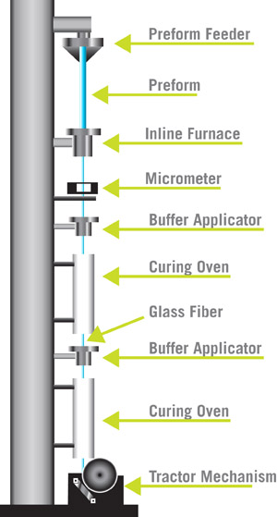
How optical fibers are made
Glass pre-form is made, heated (to 2000 °C) in a vertical orientation and pulled through a draw tower
Coatings are applied for individual applications
www.fiberinstrumentsales.com/blog/2010/04/26/how-are-fiber-optics-made/
Notes:
Glass preform made by heating gases (SiCl₄, GeCl₄, O₂) in a quartz tube and allowing soot to deposit on surface, forming glass; both the tube and soot are heated until tube softens and collapses on itself; the sooty glass forms the core and the quartz tube is the cladding
Pulled through draw tower at 10 to 20 m/s
Coatings are applied for individual applications

Slide 7
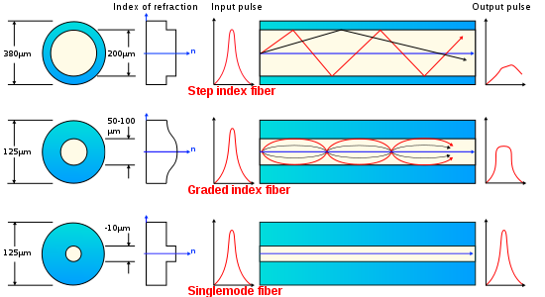
Types of optical fibers
en.wikipedia.org/wiki/Optical_fiber
Notes:
Step-index fibers AKA multi-mode fibers; abrupt change from core to cladding so light is reflected; larger core than SMF, thus multiple modes allowed; 800 to 1300 nm (LED source)
Graded-index fibers have gradual change in refractive index between core and cladding and thus bend the light
Single-mode fibers support only one mode of light, between 1300 and 1550 nm (IR)

Slide 8
Properties of optical fibers (SMF)
Tensile strength > 700 MPa
Minimum bend radius is typically 100 times the fiber’s radius
Gold coating = 155 μm
Cladding = 125 μm
Core = 9 μm
Notes:
700 MPa is the minimum requirement to pass quality control
Optical fiber cables typically have a minimum bend diameter of 10 times the cables diameter

Slide 9
Various sensing applications
Sensors for temperature, strain, radiation, pressure, position
Extrinsic sensors measure a change outside the fiber body, e.g. Fabry-Perot interferometers
Intrinsic sensing takes place within the fiber, where physical changes to the fiber reflect changes in the light passing through it
Notes:
Fabry-Perot interferometers: two reflectors on either side of an optically transparent medium; sensitive to spacing between the reflectors, which change as the temperature, pressure, etc. change.

Slide 10
Overview
Background on optical fibers
Optical fiber sensors
Application in HTS magnets
Sensor technologies: Brillouin, FBGs, Rayleigh
Research
Bi2212 process monitoring
Cryogenic calibration
YBCO quench detection
Conclusions and Future work
Notes:
Disclaimer: the fibers, manufacturing techniques, and sensing approaches are specific to my research and other forms may exist

Slide 11
Motivation for HTS
Quench detection in HTS magnets is difficult due to the slow normal zone propagation velocity
Traditional voltage tap methods do not have the spatial resolution necessary for practical application in HTS systems, and are more cumbersome
Thus more advanced sensors capable of distributed sensing are required
HT processing of Bi2212
Peak temperature held for only a short time period
Temperature reaches ~900 °C in a pure oxygen environment
Precise local temperature information is needed to optimize performance

Slide 12
Advantages of optical fiber sensors
Immune to RF and electromagnetic waves
Small and lightweight
Low loss
Available in long lengths (50 km)
Distributed (or quasi-distributed) sensors

Slide 13
Major challenges
Low cryogenic sensitivity – coatings required
Bi2212 heat treatment survivability and compatibility of fiber, coating, and conductor
Separation of temperature and strain effects
Balance of temporal and spatial resolution
Integration into large-scale magnet systems
Placement
Protection during winding, processing and operation
Calibration

Slide 14
Overview
Background on optical fibers
Optical fiber sensors
Application in HTS magnets
Sensor technologies: Brillouin, FBGs, Rayleigh
Research
Bi2212 process monitoring
Cryogenic calibration
YBCO quench detection
Conclusions and Future work
Notes:
Disclaimer: the fibers, manufacturing techniques, and sensing approaches are specific to my research and other forms may exist

Slide 15
Brillouin Scattering

Slide 16

Brillouin scattering theory
Light is scattered off acoustic phonons and is shifted by some Brillouin frequency
where n is the index of refraction, V_{a} is the acoustic velocity, and λ is the wavelength of incoming light

Slide 17
Brillouin sensing
Three properties are measured in order to simultaneously determine temperature and strain:
Brillouin power (intensity)
Frequency shift
Line-width (FWHM)
At room temperature, these values vary linearly; however at cryogenic temperatures they are nonlinear

Slide 18
Previous Brillouin research
Mahar et al., explored Brillouin scattering for LTS magnets (thesis 2008, MIT)
Mapped the Brillouin parameters under various strain and temperature conditions for superconducting magnet application
Achieved moderate temporal resolution of 0.5 s, but only a 5 m spatial resolution
Might be acceptable for LTS, but probably not for HTS systems

Slide 19
Fiber Bragg gratings (FBGs)

Slide 20
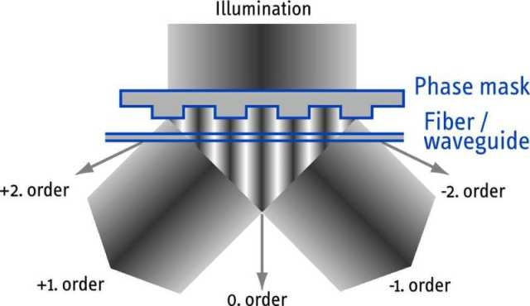
FBG fabrication
Gratings are a local, periodic change in the refractive index of a fiber’s core
Written into a fiber by exposure to UV light through a phase mask
www.ibsen.dk/phasemasks/fbgphasemasks

Slide 21
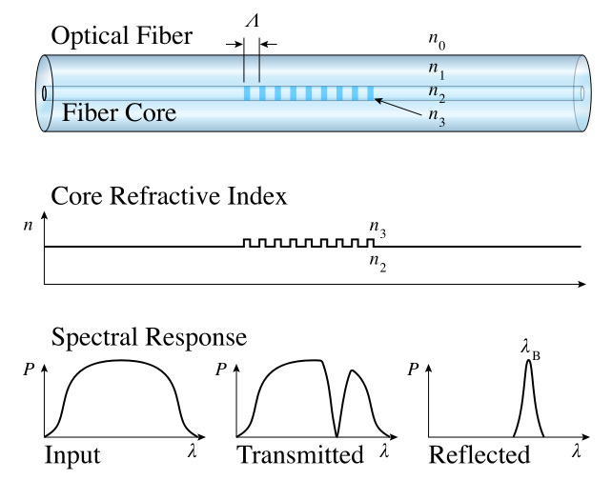
Bragg wavelength
Each grating reflects a single Bragg wavelength, λ_{B}:
λ_{B} = 2nΛ where n is the refractive index and Λ is the grating pitch
en.wikipedia.org/wiki/Fiber_Bragg_grating

Slide 22
Basic principles
Changes in the temperature or strain state of the fiber change the Bragg wavelength:
Δλ_{B} = λ_{B}[(1-ρ_{α})ε + (α+ξ)ΔT]
where ρ_{α} is the photoelastic constant, α is the coefficient of thermal expansion and ξ is the thermo-optic coefficient
λ_{B} = 2nΛ

Slide 23
Sample FBG signal
Reflected power (dB)
Wavelength (nm)
λ_{B}
λ_{B}+Δλ

Slide 24
Application of FBGs
Multiplexing possible – write many gratings on one fiber
Time division multiplexing (TDM)
Wavelength division multiplexing (WDM)
Systems can monitor up to 64 fibers at once
Interrogation system costs ~$20K-40K with speeds of 1Hz - 2 MHz

Slide 25
Rayleigh scattering

Slide 26
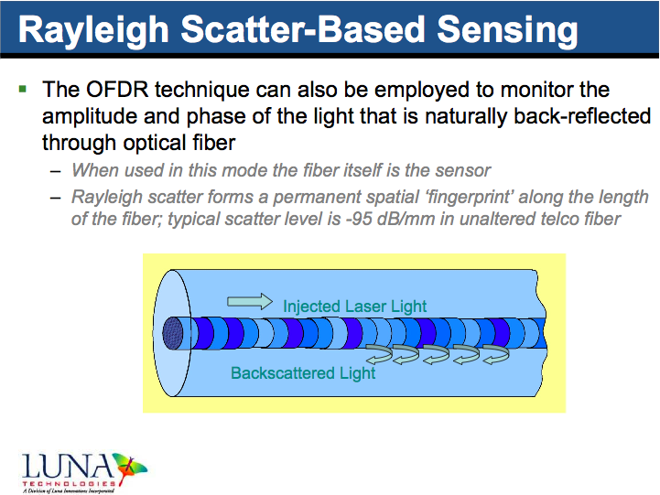

Slide 27
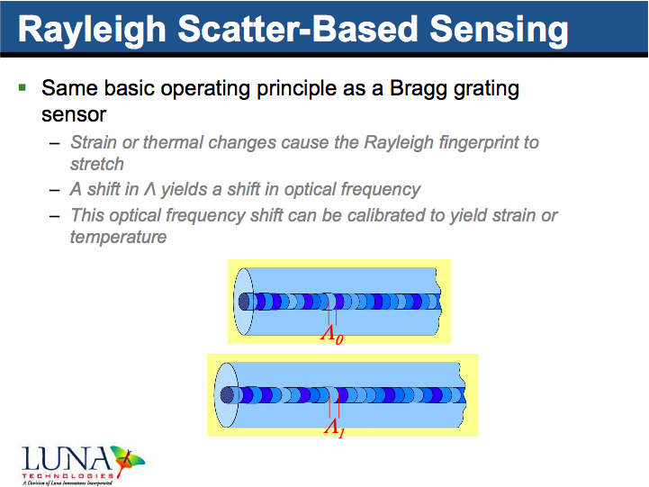

Slide 28
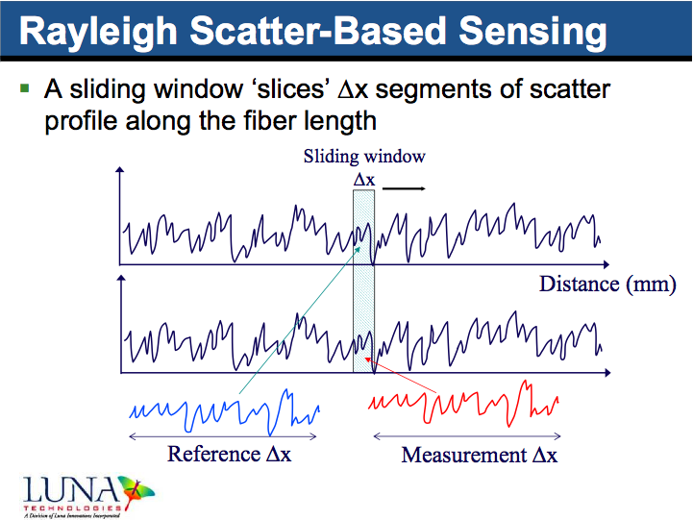

Slide 29
Sample signal from Luna OBR

Slide 30
Application of Rayleigh scattering
Entire fiber serves as distributed sensor
Calibration over temperature range and for specific coating conditions may be necessary
Balance must be found between temporal, spatial resolution and monitoring length

Slide 31
Comparison of relevant sensing techniques for HTS applications
Fiber Bragg Gratings
Rayleigh Scattering
Pros
Conceptually simple
Grating multiplexing possible (TDM, WDM)
Multiple fiber sampling
Fast (2 MHz sampling rate)
Cons
Cost of gratings ($10-$100 each)
Only quasi-distributed sensing
Erasure above 650 °C
No separation of strain/temperature
Pros
No post-processing of fiber needed
Survive high temperatures
Truly distributed sensing
High spatial resolution
Cons
High processing time (>10s)
Calibration dependent
Hardware more expensive
Sensitive to vibrations
No separation of strain/temperature

Slide 32
Overview
Background on optical fibers
Optical fiber sensors
Application in HTS magnets
Sensor technologies: Brillouin, FBGs, Rayleigh
Research
Bi2212 process monitoring
Cryogenic calibration
YBCO quench detection
Conclusions and Future work
Notes:
Disclaimer: the fibers, manufacturing techniques, and sensing approaches are specific to my research and other forms may exist

Slide 33
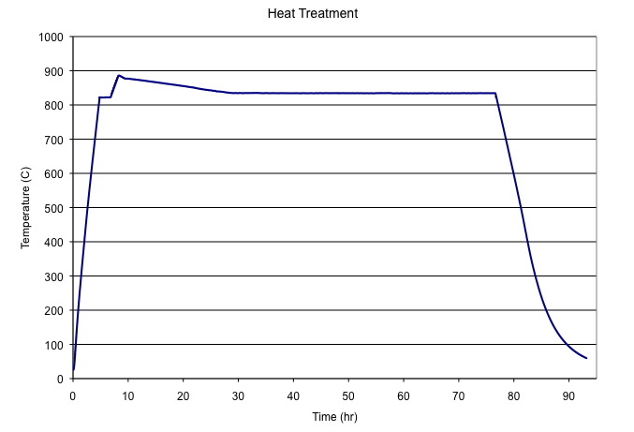
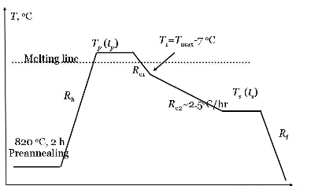
Bi2212 Heat Treatment Process Monitoring
NOT TO SCALE

Slide 34
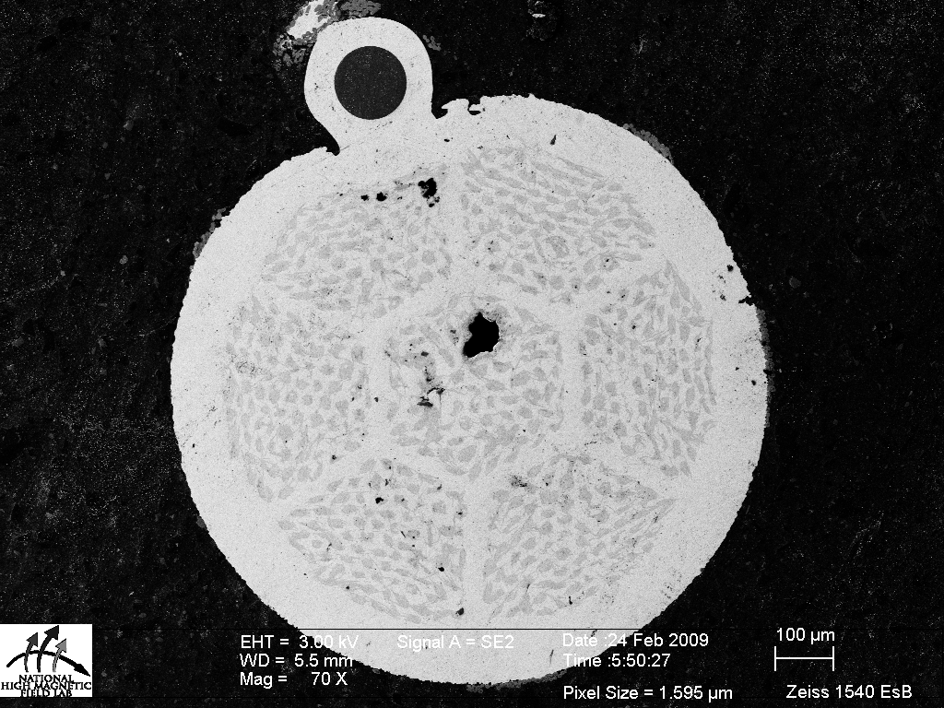
Bi2212 process monitoring Compatibility of gold fibers and Bi2212
SEM/EDS images
Ic testing
Ic varied only 2% from control, well within statistical variation
Fiber
66.3% Ag
33.7% Au
78.4% Ag
21.6% Au
Sample | 1.0 μV/cm I_{C} (A) | 0.1 μV/cm I_{C} (A)
With fiber | 279 | 231
W/o fiber | 284 | 235
4.2 K, 5 T background field
D = 1000 μm
Notes:
SEM: metallic interdiffusion yields good thermal bonding

Slide 35
Bi2212 process monitoring FBGs
Erasure at ~650 °C

Slide 36
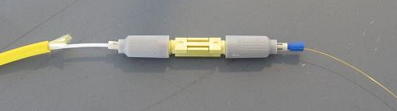
Bi2212 process monitoring Rayleigh scattering
to TC monitoring computer
Insulation
FO Loc 1
FO Loc 2
Gold furnace
Quartz tube
Thermocouples
Gold coated fiber
Patchcord
Splice
LUNA OBR
to LUNA
monitoring computer
Experimental set-up

Slide 37
Bi2212 process monitoring Rayleigh scattering

Slide 38
Bi2212 process monitoring Rayleigh scattering
FO Loc 1
FO Loc 2

Slide 39
Cryogenic Calibration

Slide 40
Cryogenic Calibration FBGs (1)
Two “strain-free” FBGs with different Bragg wavelengths were attached to a copper plate fitted with a heater
The plate was submerged in liquid nitrogen and a heater was used to heat the sample to room temperature
Thermocouples and a Cernox thermometer monitored the temperature of the plate

Slide 41
Cryogenic Calibration FBGs (2)

Slide 42
Cryogenic calibration Rayleigh scattering (1)
Four coated fibers were calibrated down to 50 K using a cryocooler
Acrylate (telecommunications grade) fiber
Gold as-received fiber
Gold annealed (120 °C for 20 hours) fiber
Gold + nGimat doped titanate fiber
The average spectral shift (from a 281 K reference scan) along the length of the fiber was found for various temperatures between 50 K and 295 K, in a “strain-free” state

Slide 43
Cryogenic calibration Rayleigh scattering (2)
Acrylate fiber most sensitive (largest spectral shift)
Gold fibers approximately the same; need better bonding of gold to silica fibers

Slide 44
Quench Detection in YBCO CC

Slide 45
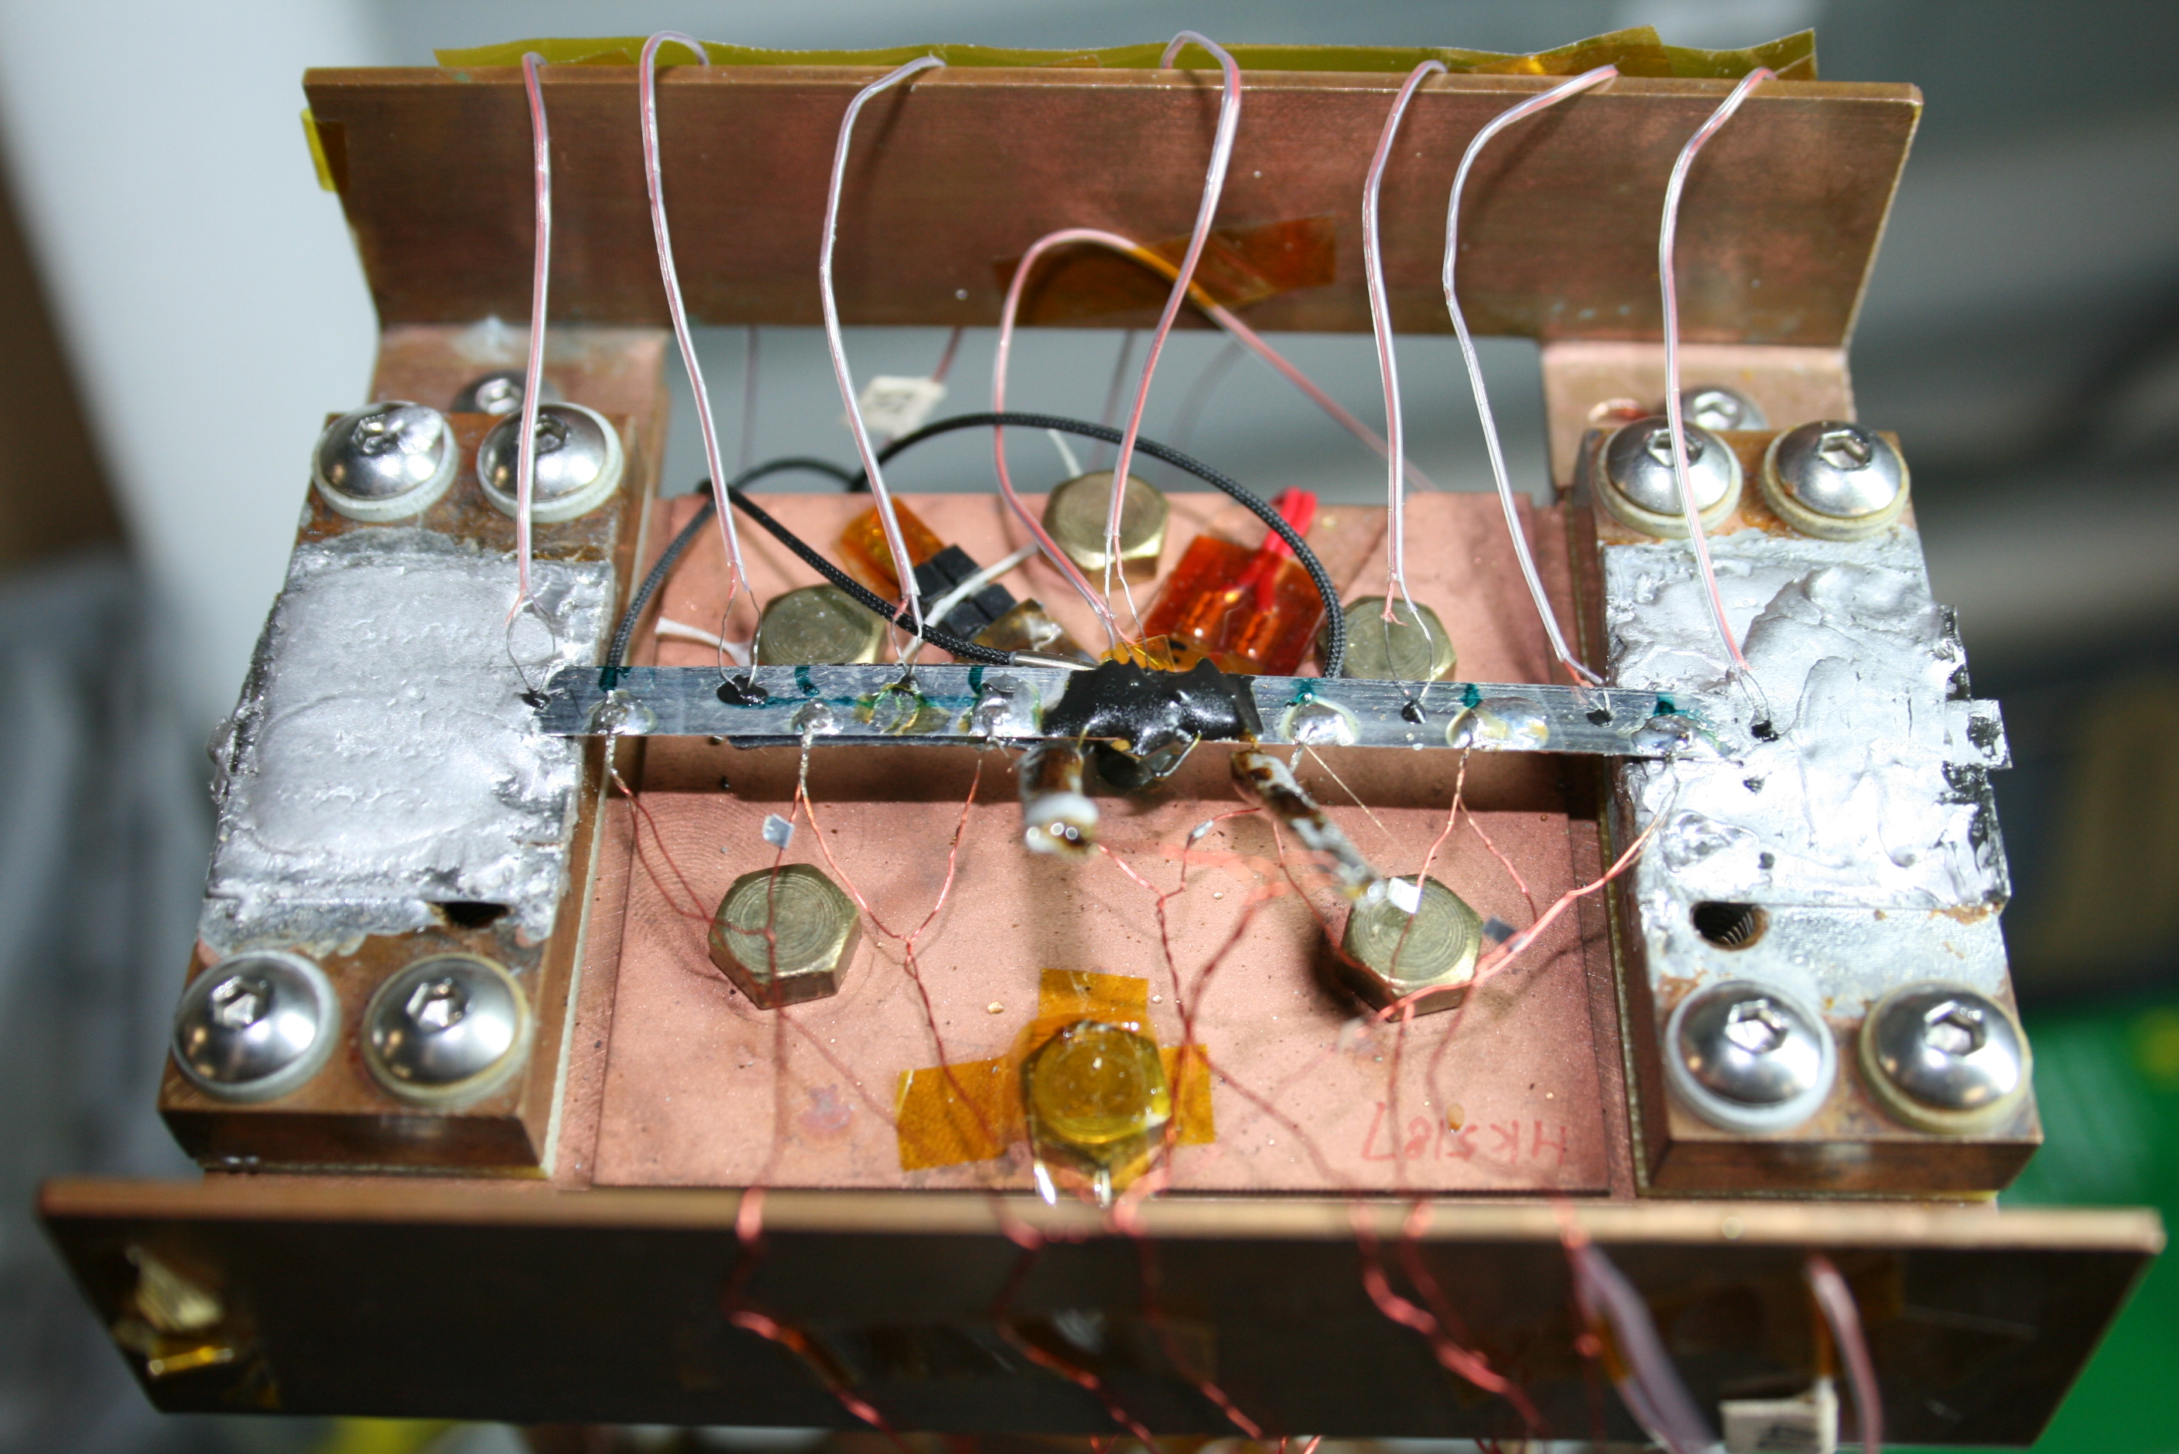
Quench Detection FBGs (1)
Operating on coldhead of cryocooler at 65 K
Applied constant current at 60% I_{C} (150A/240A)
Quench initiated by a heater pulse
TC37
TC36
TC35
TC34
TC33
TC32
TC31
V20
FO Strain Gauge
FO Temp
Probe
HTR
V25
V24
V22
V21
V = voltage tap
V23
TC = thermocouple

Slide 46
Quench Detection FBGs (2)
F. Hunte et al, PAC09

Slide 47
Quench Detection Rayleigh scattering (1)
A 10 cm long straight sample of AMSC YBCO was fitted to the cold head of a cryocooler
Instrumented for quench measurement
One side with thermocouples, voltage taps
Gold + nGimat fiber attached to opposite side
Sample temperature varied from 45 to 55 K
Cryocooler was switched off for measurements; transport current of 200 A was applied and quench triggered with pulse from heater wire; fiber was scanned every 4 seconds

Slide 48
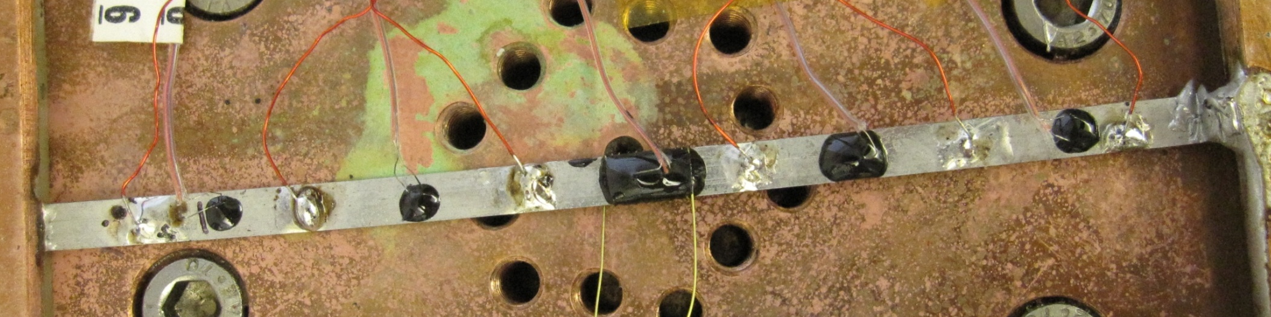
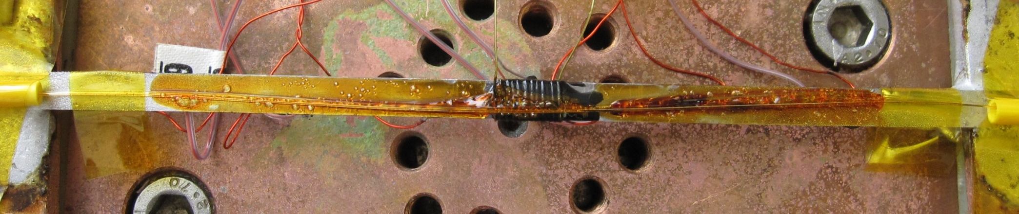
Quench Detection Rayleigh scattering (2)
Voltage taps
TC6
TC3
TC5
TC2
TC1
Coldhead
Heater
Optical fibers attached with GE varnish

Slide 49
Quench Detection Rayleigh scattering (3)

Slide 50
Quench Detection Rayleigh scattering (4)
YBCO
TC6
TC5
TC3
TC2
TC1

Slide 51
Overview
Background on optical fibers
Optical fiber sensors
Application in HTS magnets
Sensor technologies: Brillouin, FBGs, Rayleigh
Research
Bi2212 process monitoring
Cryogenic calibration
YBCO quench detection
Conclusions and Future work
Notes:
Disclaimer: the fibers, manufacturing techniques, and sensing approaches are specific to my research and other forms may exist

Slide 52
Conclusions (1)
Investigating FBGs and Rayleigh backscattering for application in HTS magnets
Bi2212 process monitoring
Bi2212 and gold fibers compatible during HT
Type I FBGs not suitable; chemical composition gratings (CCGs) and Type II fsIR FBGs may be
Rayleigh scattering looks promising!
YBCO quench detection
Successful proof-of-concept with FBGs
Preliminary success using Rayleigh scattering

Slide 53
Conclusions (2)
Optical fiber sensors have the capability to provide distributed temperature and strain measurements for superconducting magnet systems, but a large-scale effort needs to be undertaken in order to make them a viable, reliable, and trusted sensing technology

Slide 54
Future Work Short Term Goals
Investigate additional coatings for enhanced cryogenic sensitivity and protection of the fibers
Introduce strain gauges for quantitative measurements of strain/temperature on Rayleigh quench experiment
Optimize low-temperature Rayleigh DAQ
Instrument small YBCO coil with coated optical fibers and measure quench using Rayleigh
Heat treat small Bi2212 coil using Rayleigh backscattering; possibly test at cryogenic temperatures

Slide 55
Future Work Long Term Goals
Further quench studies using FBGs
Faster scanning rates (1 kHz)
Multiple FBGs in small YBCO coil
Investigate CCGs and fsIR FBGs for Bi2212 process monitoring
Implement a faster processing platform for analyzing Rayleigh data, with the aim of significantly improving temporal resolution (new SBIR phase I grant)
Develop fiber sensing package, including fiber coatings and sheathing/sleeve for magnet integration

Slide 56
One more thing…
Need a collaboration between people/groups with experience in:
Optical fiber technology
Superconducting magnet design
Cryogenic and vacuum systems
Signal processing
Together we can make this a reality!

Slide 57
Thank you for your attention!

Slide 58
Relevant publications
High temperature compatibility of Bi2212 and gold-coated optical fibers (M. Turenne, PAC09)
High temperature testing of traditional FBGs (M. Turenne, SOFE09) and fs-IR FBGs (unpublished)
High temperature testing of gold coated fibers using Rayleigh backscattering (M. Turenne, ASC 2010)
Cryogenic quench measurements of YBCO using FBGs (F. Hunte, PAC09)
Brillouin scattering for superconducting magnets (S. Mahar, thesis, MIT 2008)

Slide 59
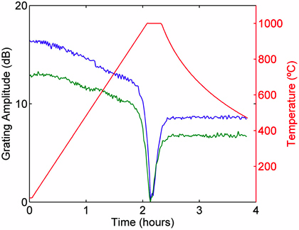
High temperature FBGs Chemical composition gratings (CCGs)
Similar to FBGs but with much higher thermal capacity
Formed by annealing fibers with existing FBGs near 1000 °C
FBG is erased
CCG grows in its place
May be solution to Bi2212 monitoring
spie.org/x39542.xml?pf=true&ArticleID=x39542

Slide 60
High temperature FBGs Ultrafast laser writing
Temperature resistant FBGs can also be formed by writing the grating using ultrafast lasers (fsIR)
This creates color centers and/or local damage at the grating location, which requires more energy to diffuse
Reduces the need for hydrogen pre-loading
fsIR gratings can withstand temperatures upwards of 1000 °C for hundreds of hours

