Slide 1
P42 optics optimisation
Aleksandr Gorn, Francesco Maria Velotti, Matthew Fraser (SY-ABT-BTP)
Fabian Metzger, Laurie Nevay (BE-EA-LE)
10.07.2025

Slide 2
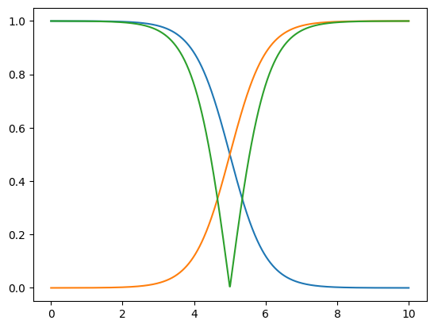
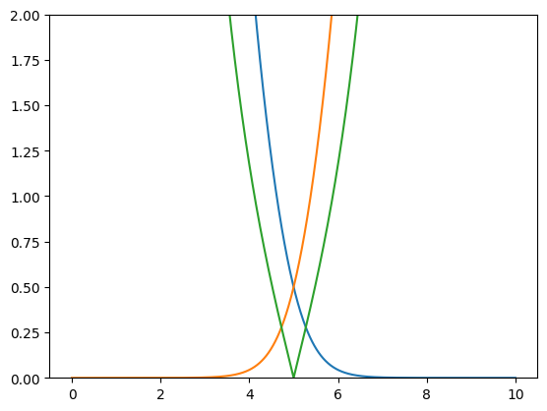
Model improvements
Updates to the optimizer:
New scenarios: no-ramping, post-ls3-no-ramping.
Old sequence is used for scenarios without ‘post-ls’ (today, no-ramping).
New penalty functions
Old penalty functions
New penalty functions

Slide 3
Model improvements
Updates to the optimizer:
New scenarios: no-ramping, post-ls3-no-ramping.
Old sequence is used for scenarios without ‘post-ls’ (today, no-ramping).
ToDo’s:
Beam centroid needs to be taken into account while calculating the envelope (wrong beam size at XTAX)
Aperture constraint should be fixed for the tilted elements.

Slide 4
Model improvements
Updates to the optimizer:
New scenarios: no-ramping, post-ls3-no-ramping.
Old sequence is used for scenarios without ‘post-ls’ (today, no-ramping).
ToDo’s:
Beam centroid needs to be taken into account while calculating the envelope (wrong beam size at XTAX)
Aperture constraint should be fixed for the tilted elements.
(aper_1’, aper_2’) = Rotation Matrix x (aper_1, aper_2)
(aper_1, aper_2)
(aper_1, aper_2)
Vector (aper_1’, aper_2’) does not represent real apertures after rotation!

Slide 5
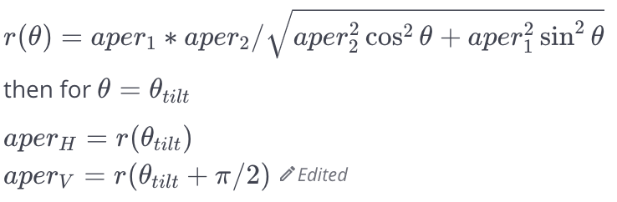
Model improvements
Updates to the optimizer:
New scenarios: no-ramping, post-ls3-no-ramping.
Old sequence is used for scenarios without ‘post-ls’ (today, no-ramping).
ToDo’s:
Beam centroid needs to be taken into account while calculating the envelope (wrong beam size at XTAX)
Aperture constraint should be fixed for the tilted elements.
We can approximate aperture with ellipse
aper_2
aper_2’
aper_1
aper_1’

Slide 6
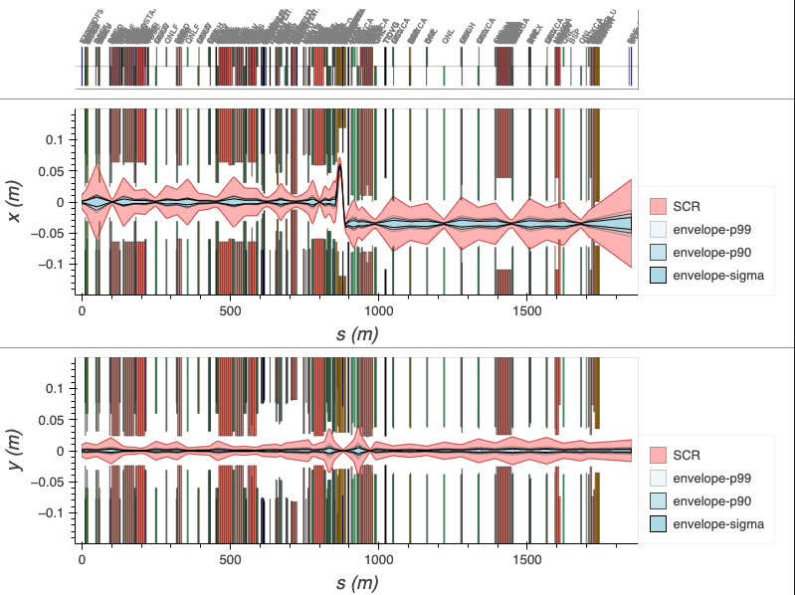
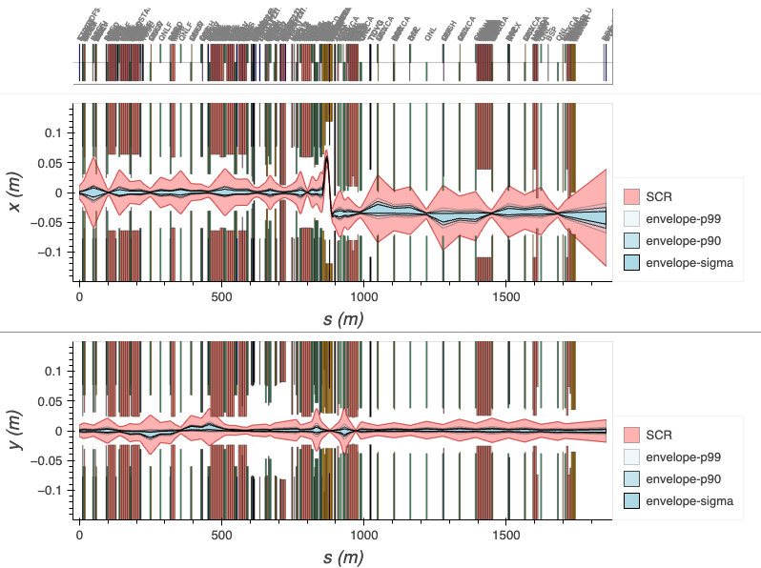
Lattice
Everything is ramping
Nothing is ramping

Slide 7
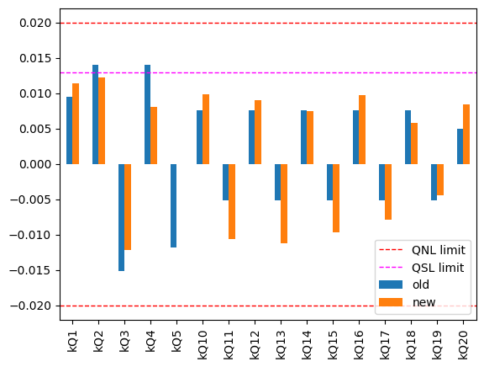
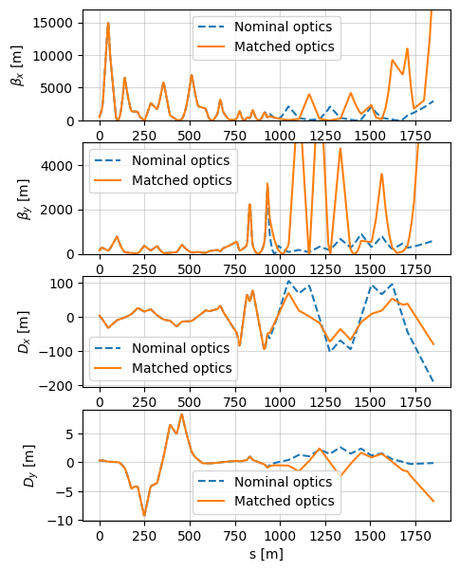
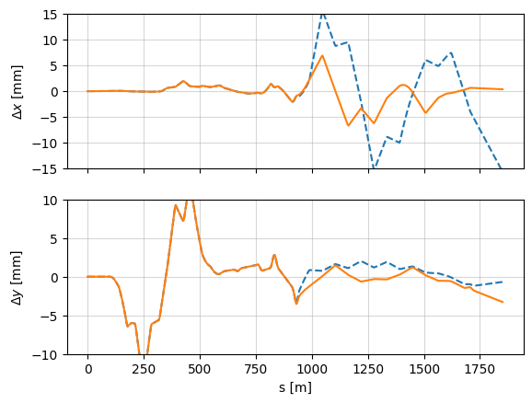
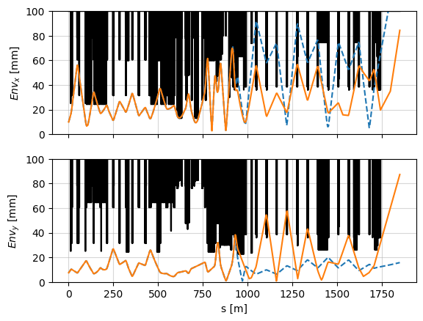
Optimisation results for no-ramping case
Settings
Scenario: post-ls3-no-ramping
Target beam size at BDF: 12 mm
Knobs: only quadrupoles in P42
Optics
Momentum sweep
Beam envelope
The optimizer run took about 2h, but it managed to suppress the momentum sweep in H almost completely.

Slide 8
Summary
Few things to improve in the optimizer
It is possible to suppress the momentum sweep only with optics even for non-ramping setup
Although, envelope gets too large at some locations

Slide 9
Thanks for your attention!

Slide 10
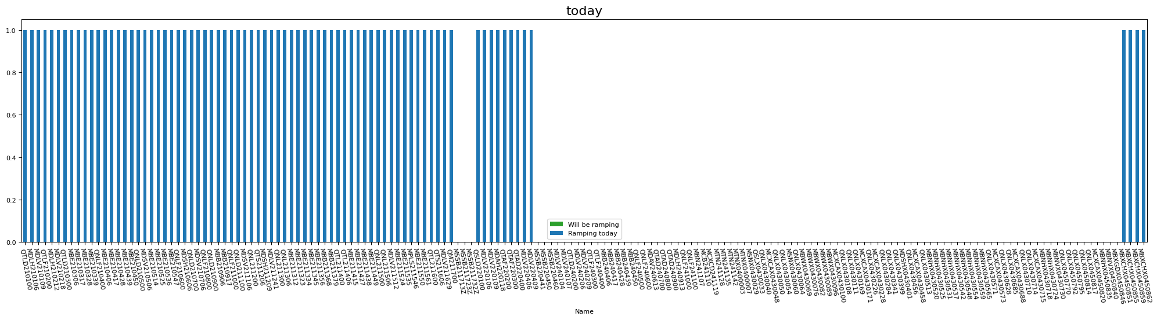
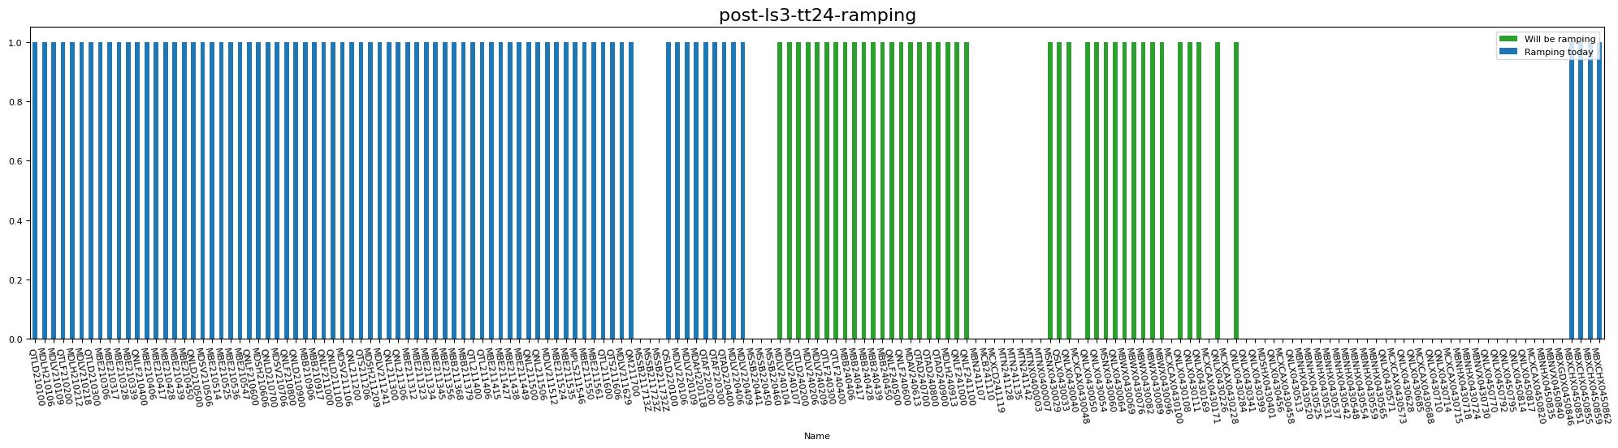
Ramping scenarios

Slide 11
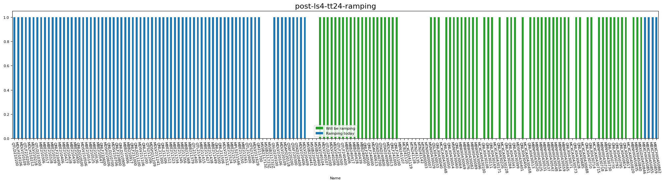
Ramping scenarios

Slide 12
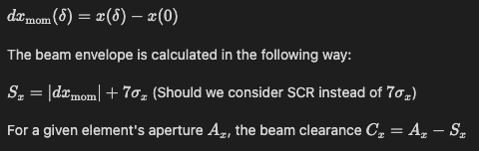
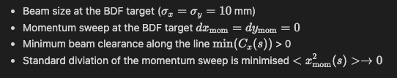
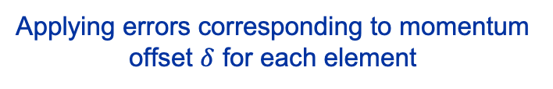
Optimizer tool
Optimizer step
Penalty functions
Initial twiss
Applying errors corresponding to momentum offset $δ$ for each element
Momentum dependent twiss
Constraints
Calculating penalties
Changing the settings

Slide 13
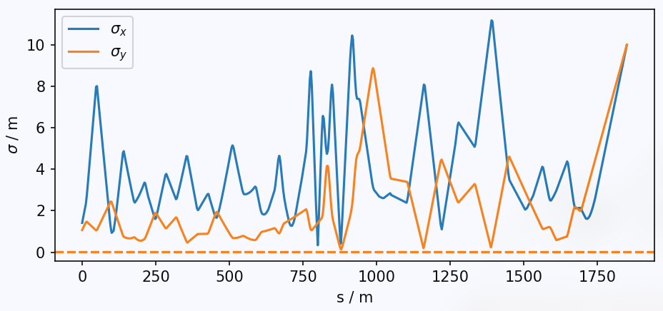
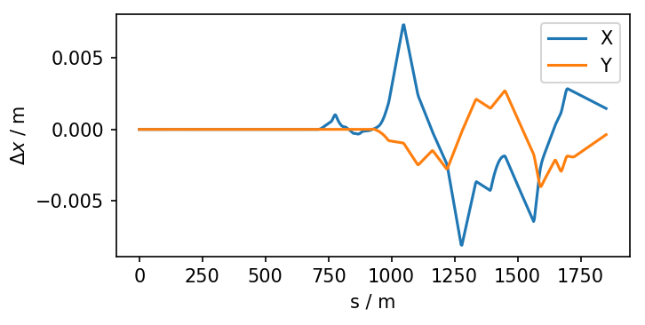
Francesco’s results
Knobs: Only Quads in P42

Slide 14
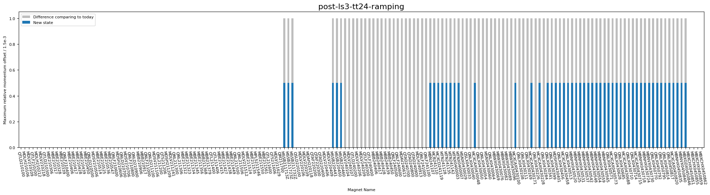
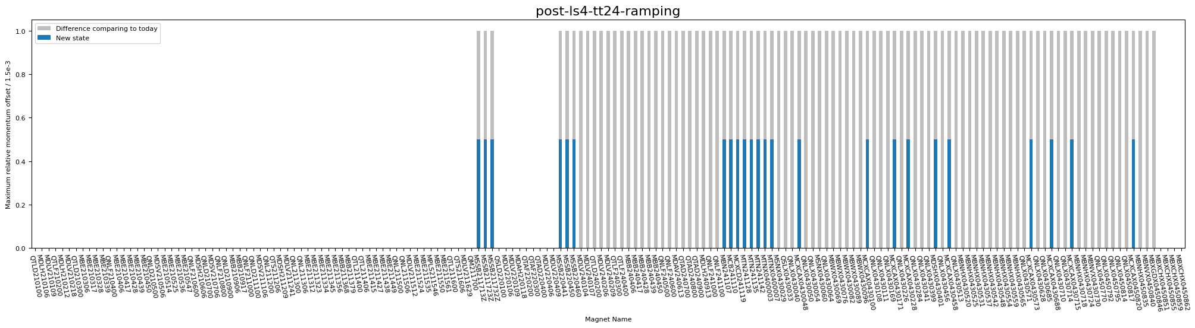
Ramping scenarios

