Slide 1
TT20 survey
Aleksandr Gorn, Matthew Fraser, Francesco Velotti, Jules Braken, Patrick Bestmann
19.11.2025

Slide 2
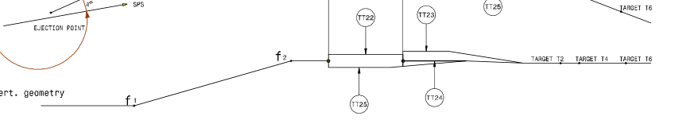
Motivation
The beam splitters (MSSB.*) will be removed and reinstalled during LS3 on new supports and the TCSCs will be entirely consolidated.
We need to know the positions of the beam line elements today so that we can put the equipment back correctly. None of us were involved in the design process, and the rationale for choices do not seem to have been well documented. We should agree together on how we want to realign the equipment when reinstalling.

Slide 3
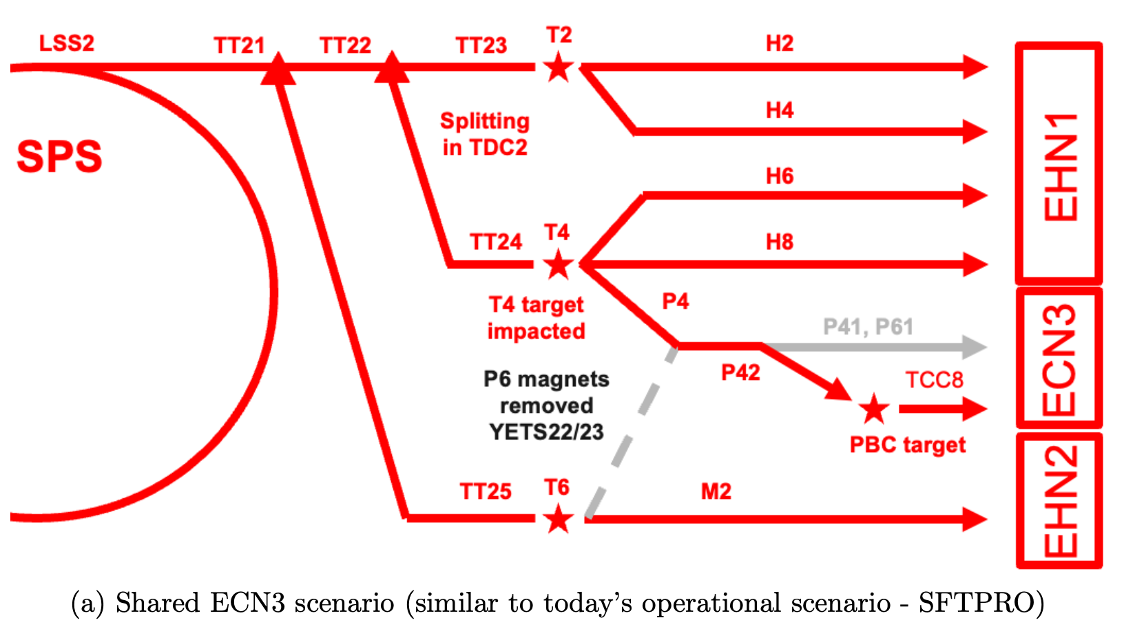
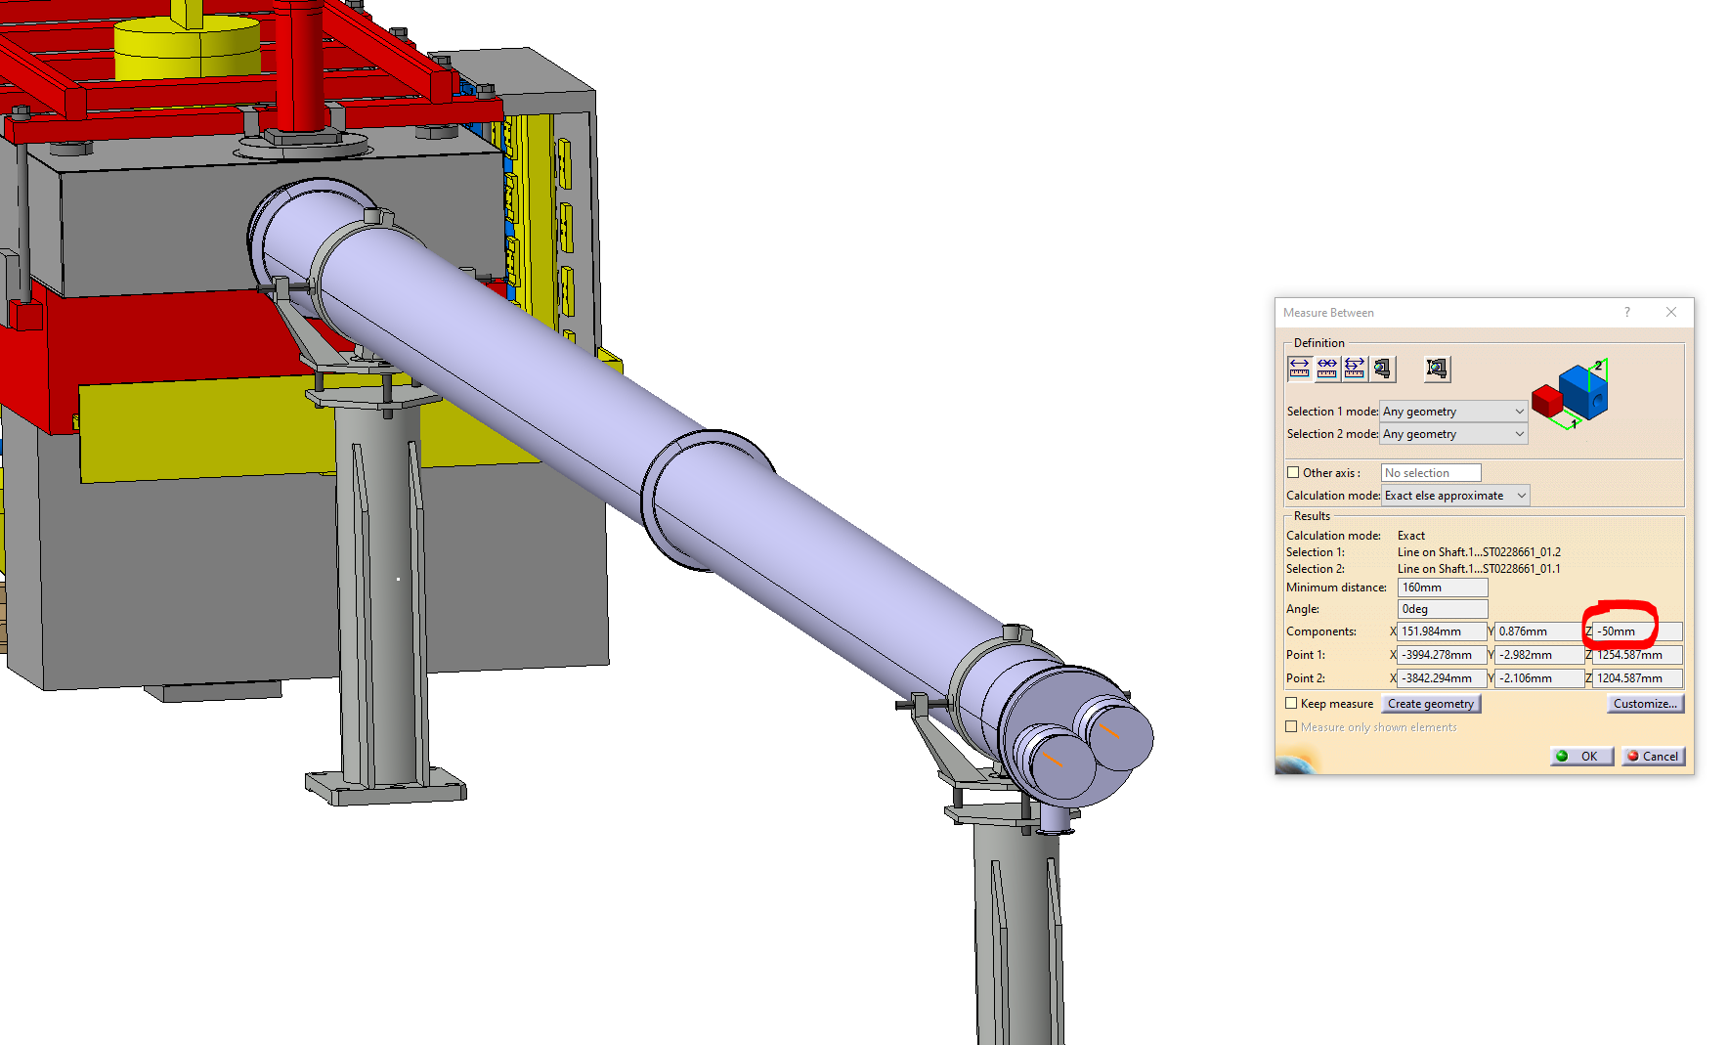
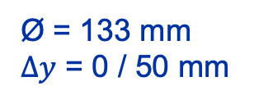
TT20 splitters
Shared delivery: splitting
Deflected right by B field
Losses
~ 5%
B
Continues straight, undeflected
Ø = 133 mm
$Δy$ = 0 / 50 mm

Slide 4
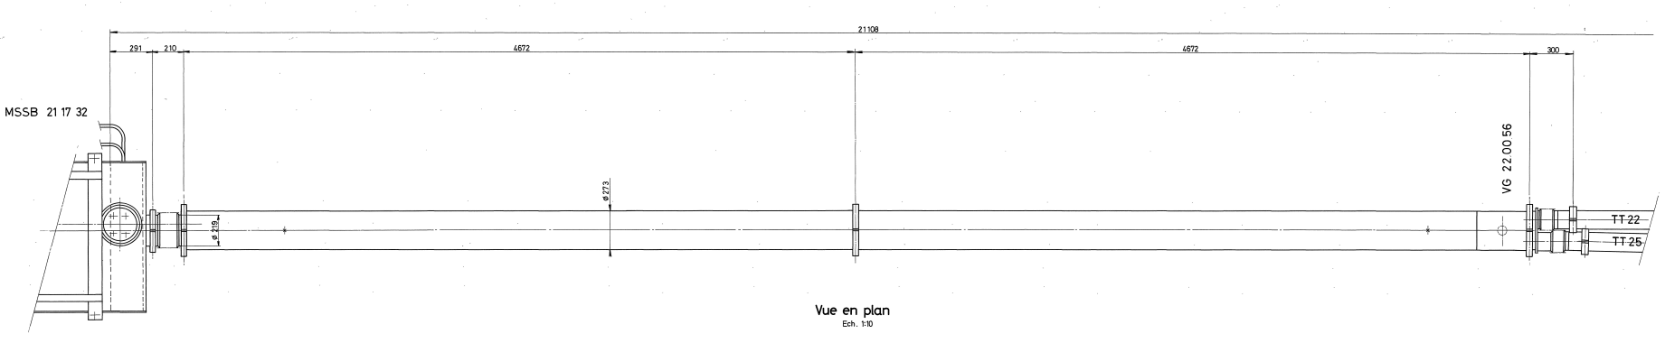
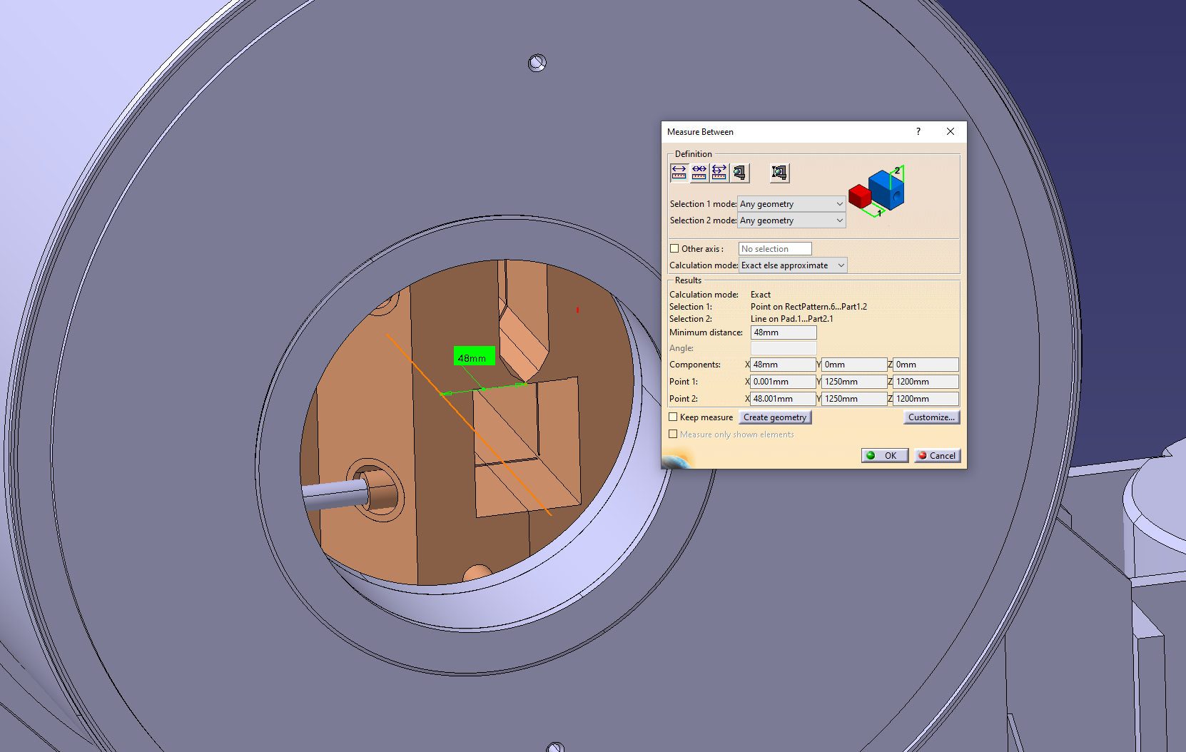
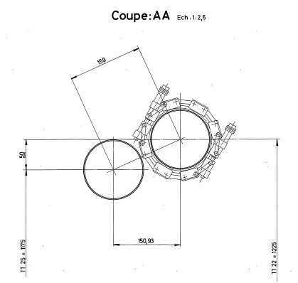
TT20 splitters
10.145 m for Splitter 1 and 10.4 m for Splitter 2
48 mm H offset

Slide 5
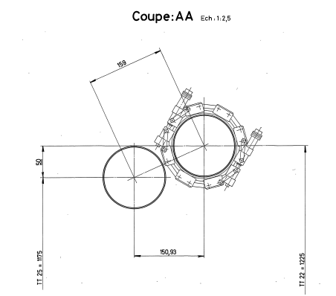
TT20 splitters
What we would want to have ideally:
  The center of the MSSB blade is horizontally aligned with the center of the top orifice, and vertically with the center of the whole vacuum flange.
  Horizontal separation of the beams matches the offset between the orifices.
  The roll is chosen to maximize the beam aperture.
We should leave some margin here
48 mm H offset
And maximize this gap by adjusting the roll angle

Slide 6
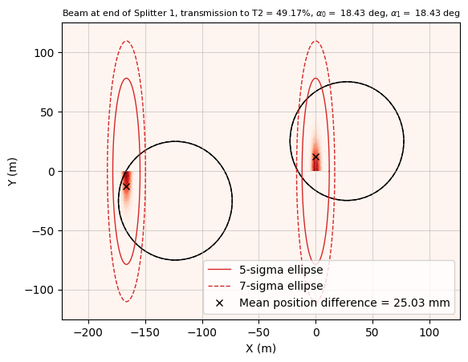
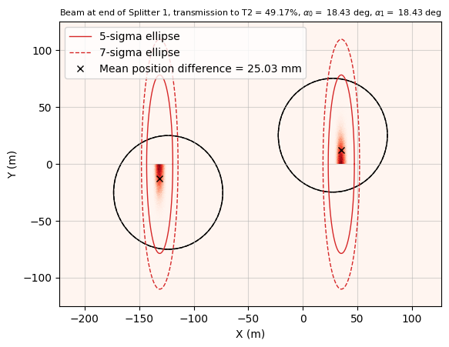
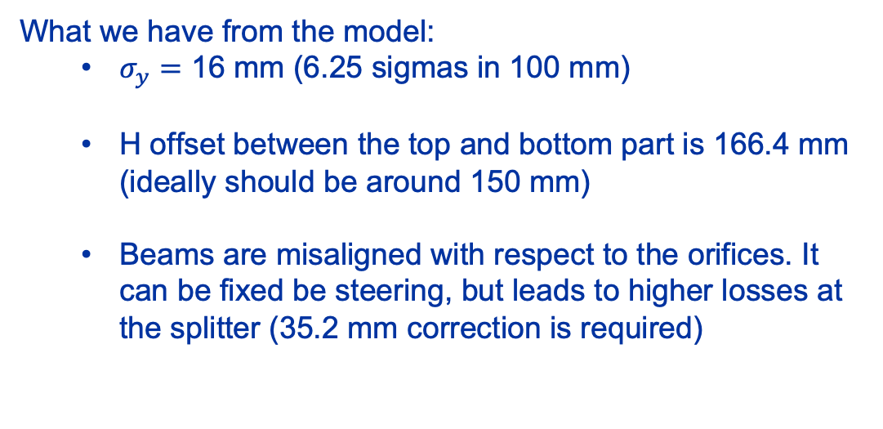
TT20 splitters
No H correction
What we have from the model:
  $σ_{y}=$ 16 mm (6.25 sigmas in 100 mm)
  H offset between the top and bottom part is 166.4 mm (ideally should be around 150 mm)
  Beams are misaligned with respect to the orifices. It can be fixed be steering, but leads to higher losses at the splitter (35.2 mm correction is required)
With H correction (35.2 mm)
48 mm H offset

Slide 7
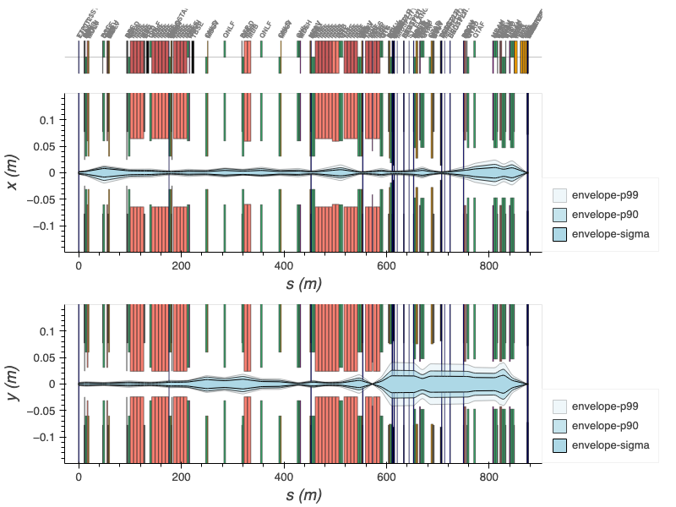
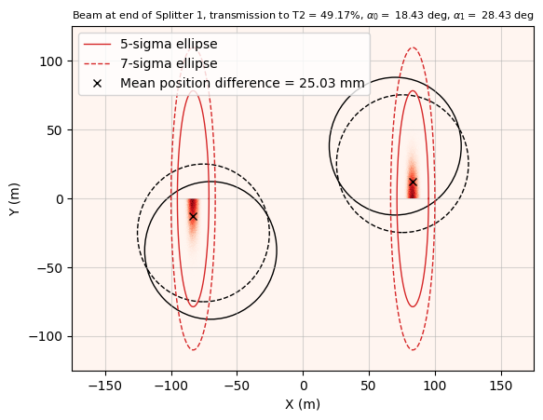
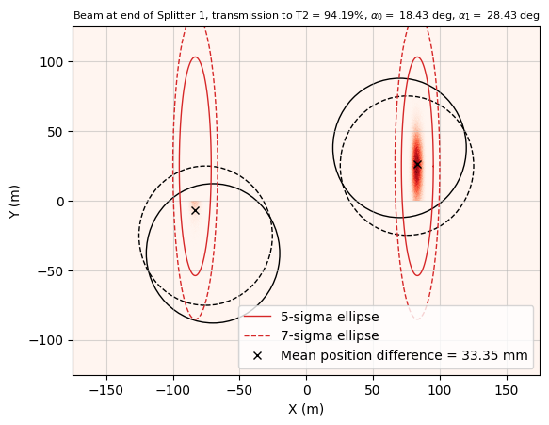
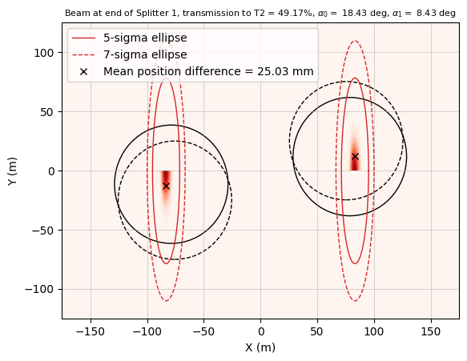
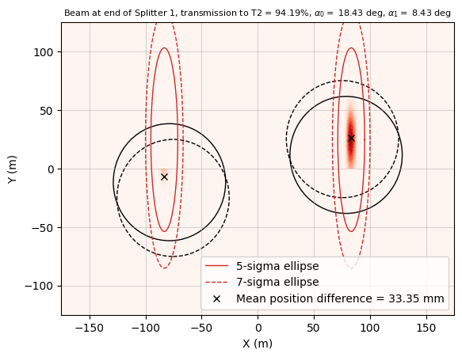
Beam envelopes at TT20 splitters
50% : 50% sharing
95% : 5% sharing
Beam loss < 0.01% for both
Beam loss = 0.08% (init), <0.01% (adj)
Angle + 10°
Beam loss < 0.01% for both
Beam loss = 0.08% (init), 1.15% (adj)
Splitter 1
Splitter 2
Current roll angle is OK, but we can consider increasing it by 5-10 deg. This will reduce the losses, but also the safe margin from the masked side of the beam from 25 mm (1.6 sigma) to 12mm (0.77 sigma).
Angle - 10°

Slide 8
Next steps
Summary
  Current configuration seems to be OK from from the model, but there are few things that can be improved (to be checked with operational settings):
    H alignment of the vacuum pipe with respect to the MSSB blade can be reduced (48 mm -> 12 mm)
    As well as the MSSB kick (by 10%)
    The roll angle can be larger by 5-10 deg.
  Compare the model with operational settings

Slide 9
Thanks for your attention!

Slide 10
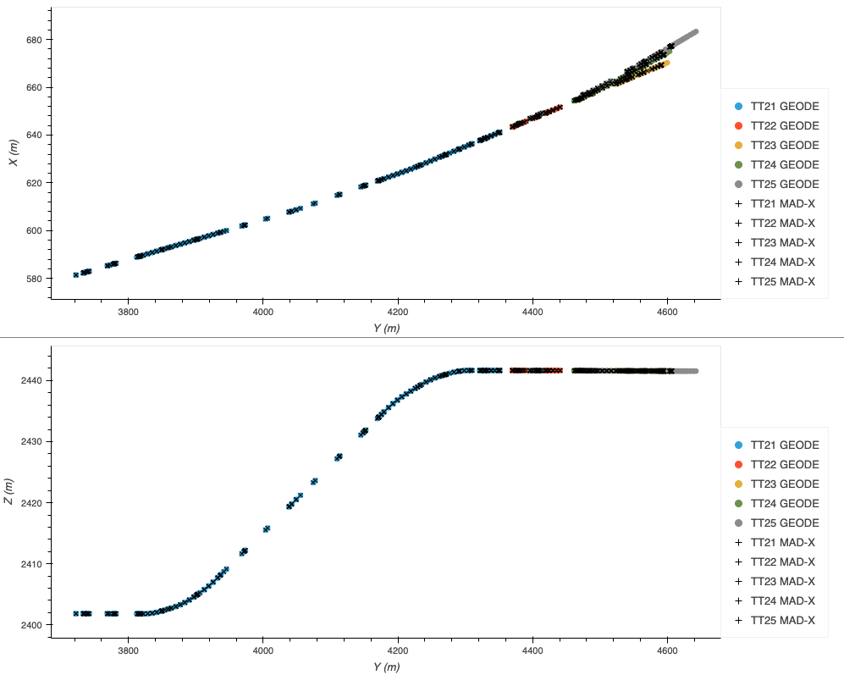
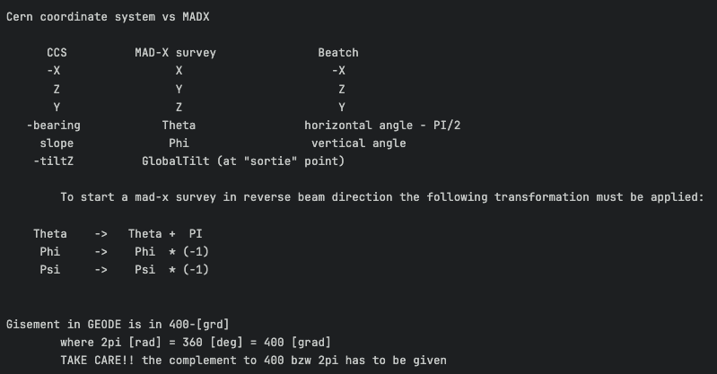
TT20 survey GEODE vs. Acc-models
SPS
NA targets
Splitter 1
Splitter 2
Splitter 1
Splitter 2

Slide 11
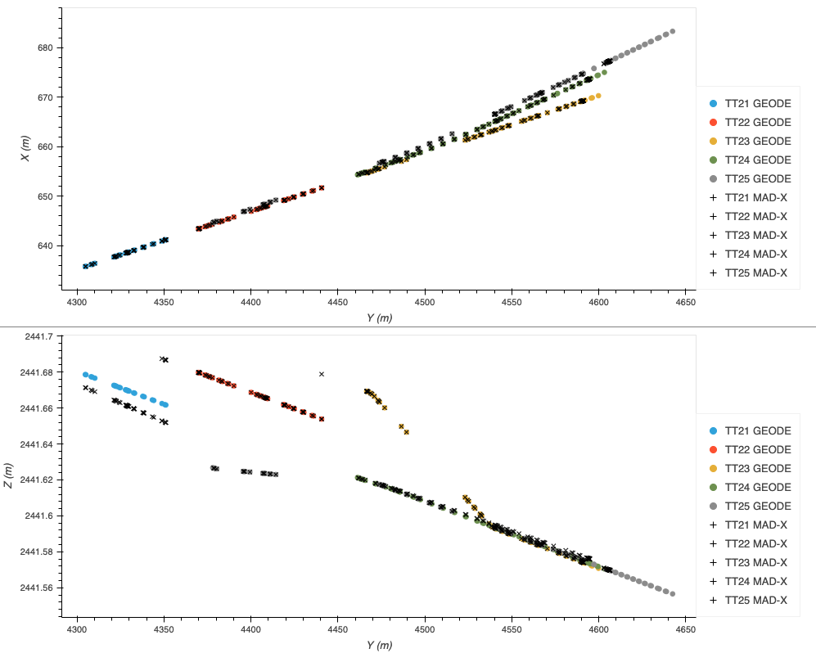
TT20 survey GEODE vs. Acc-models
Anne Valérie | X | Y | Z | theta | phi | psi
TT21 (EJPT) | -581.392613 | 2401.833640 | 3722.156030 | -0.082608 | -0.000236 | 0.000000
TT22 (MSSB.211732.end?) | -640.916137 | 2441.687523 | 4348.860956 | -0.116550 | -0.000364 | 0.000000
TT23 (MSSB.220460.end?) | -651.664777 | 2441.678882 | 4440.666264 | -0.116551 | -0.000364 | 0.000000
TT24 (MSSB.220460.end?) | -651.729122 | 2441.628512 | 4440.658560 | -0.124750 | -0.000346 | 0.000000
TT25 (MSSB.211732.end?) | -640.980466 | 2441.637521 | 4348.853255 | -0.124750 | -0.000364 | 0.000000
Initial conditions from GEODE
TT22
TT23
TT21
GEODE | X | Y | Z | theta | phi | psi
TT21 (EJPT) | -581.392613 | 2401.833640 | 3722.156030 | -0.082608462 | -0.000236 | 0.000000
TT22 (BSGV.220075.start) | -643.37074 | 2441.67984 | 4369.82595 | -0.11655042 | -0.000364 | 0.000000
TT23 (BSGV.230111.start) | -654.69405 | 2441.66940 | 4466.53953 | -0.11655056 | -0.000364 | 0.000000
TT24 (BSGV.240102.center) | -654.31747 | 2441.62131 | 4461.29904 | -0.12475035 | -0.00034620 | 0.000000
TT25 (BSGV.250089.center) | -644.64276 | 2441.62681 | 4378.05782 | -0.12475021 | -0.00036390 | 0.000000
TT25
TT24
Splitter 1
Splitter 2

Slide 12
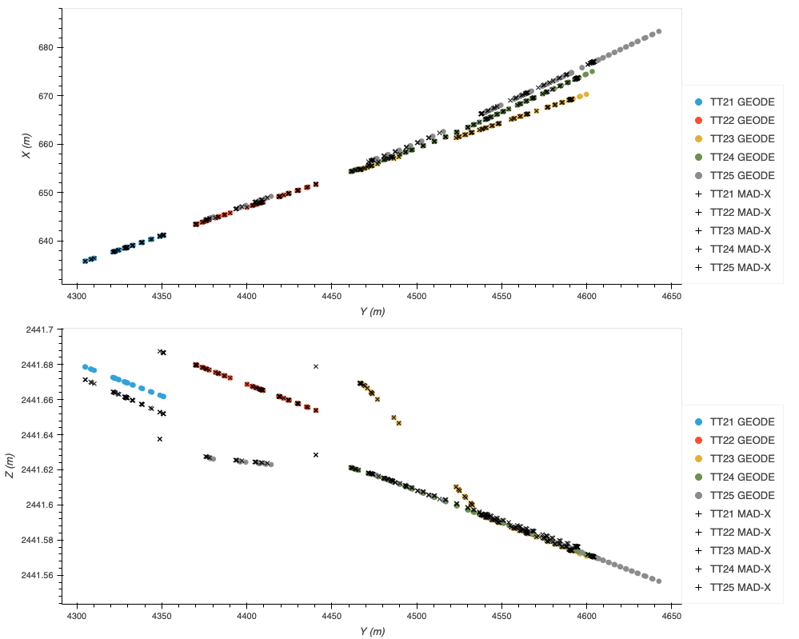
TT20 survey GEODE vs. Acc-models
Anne Valérie | X | Y | Z | theta | phi | psi
TT21 (EJPT) | -581.392613 | 2401.833640 | 3722.156030 | -0.082608 | -0.000236 | 0.000000
TT22 (MSSB.211732.end?) | -640.916137 | 2441.687523 | 4348.860956 | -0.116550 | -0.000364 | 0.000000
TT23 (MSSB.220460.end?) | -651.664777 | 2441.678882 | 4440.666264 | -0.116551 | -0.000364 | 0.000000
TT24 (MSSB.220460.end?) | -651.729122 | 2441.628512 | 4440.658560 | -0.124750 | -0.000346 | 0.000000
TT25 (MSSB.211732.end?) | -640.980466 | 2441.637521 | 4348.853255 | -0.124750 | -0.000364 | 0.000000
Initial conditions from Anne Valérie
TT22
TT23
TT21
GEODE | X | Y | Z | theta | phi | psi
TT21 (EJPT) | -581.392613 | 2401.833640 | 3722.156030 | -0.082608462 | -0.000236 | 0.000000
TT22 (BSGV.220075.start) | -643.37074 | 2441.67984 | 4369.82595 | -0.11655042 | -0.000364 | 0.000000
TT23 (BSGV.230111.start) | -654.69405 | 2441.66940 | 4466.53953 | -0.11655056 | -0.000364 | 0.000000
TT24 (BSGV.240102.center) | -654.31747 | 2441.62131 | 4461.29904 | -0.12475035 | -0.00034620 | 0.000000
TT25 (BSGV.250089.center) | -644.64276 | 2441.62681 | 4378.05782 | -0.12475021 | -0.00036390 | 0.000000
TT25
TT24
Splitter 1
Splitter 2

Slide 13


TT20 survey GEODE vs. Acc-models
Offsets between TT22 and TT25 and between TT23 and TT24 are 50 mm as expected
TT22
TT23
TT21
$Δy_{1}$ = 50 mm
$Δy_{2}$ = 50 mm
TT25
TT24
Splitter 1
Splitter 2

Slide 14
Summary
50 mm separation between TT22 and TT25 and between TT23 and TT24 seems OK from the beam envelope point of view (as well as 0 mm). In GEODE the lines have exactly this offset.
Initial conditions from Anne Valérie agree with GEODE except for the TT25. Most probably because of the different chosen starting point.
MADX model of TT20 from acc-models agrees quite well with GEODE:
  TT21: 10 mm error in V. It grows through the line, so might come from rounding of the initial conditions.
  TT22: um level error, negligible
  TT23: um level error, negligible
  TT24: 2-3 mm error in V. Also grows along the line.
  TT25: um level error if initials are taken from GEODE, negligible.

