Slide 1
BOND
Updates on coil mock-ups
N. Lusa and J. Ferradas Troitino
24/06/2025

Slide 2
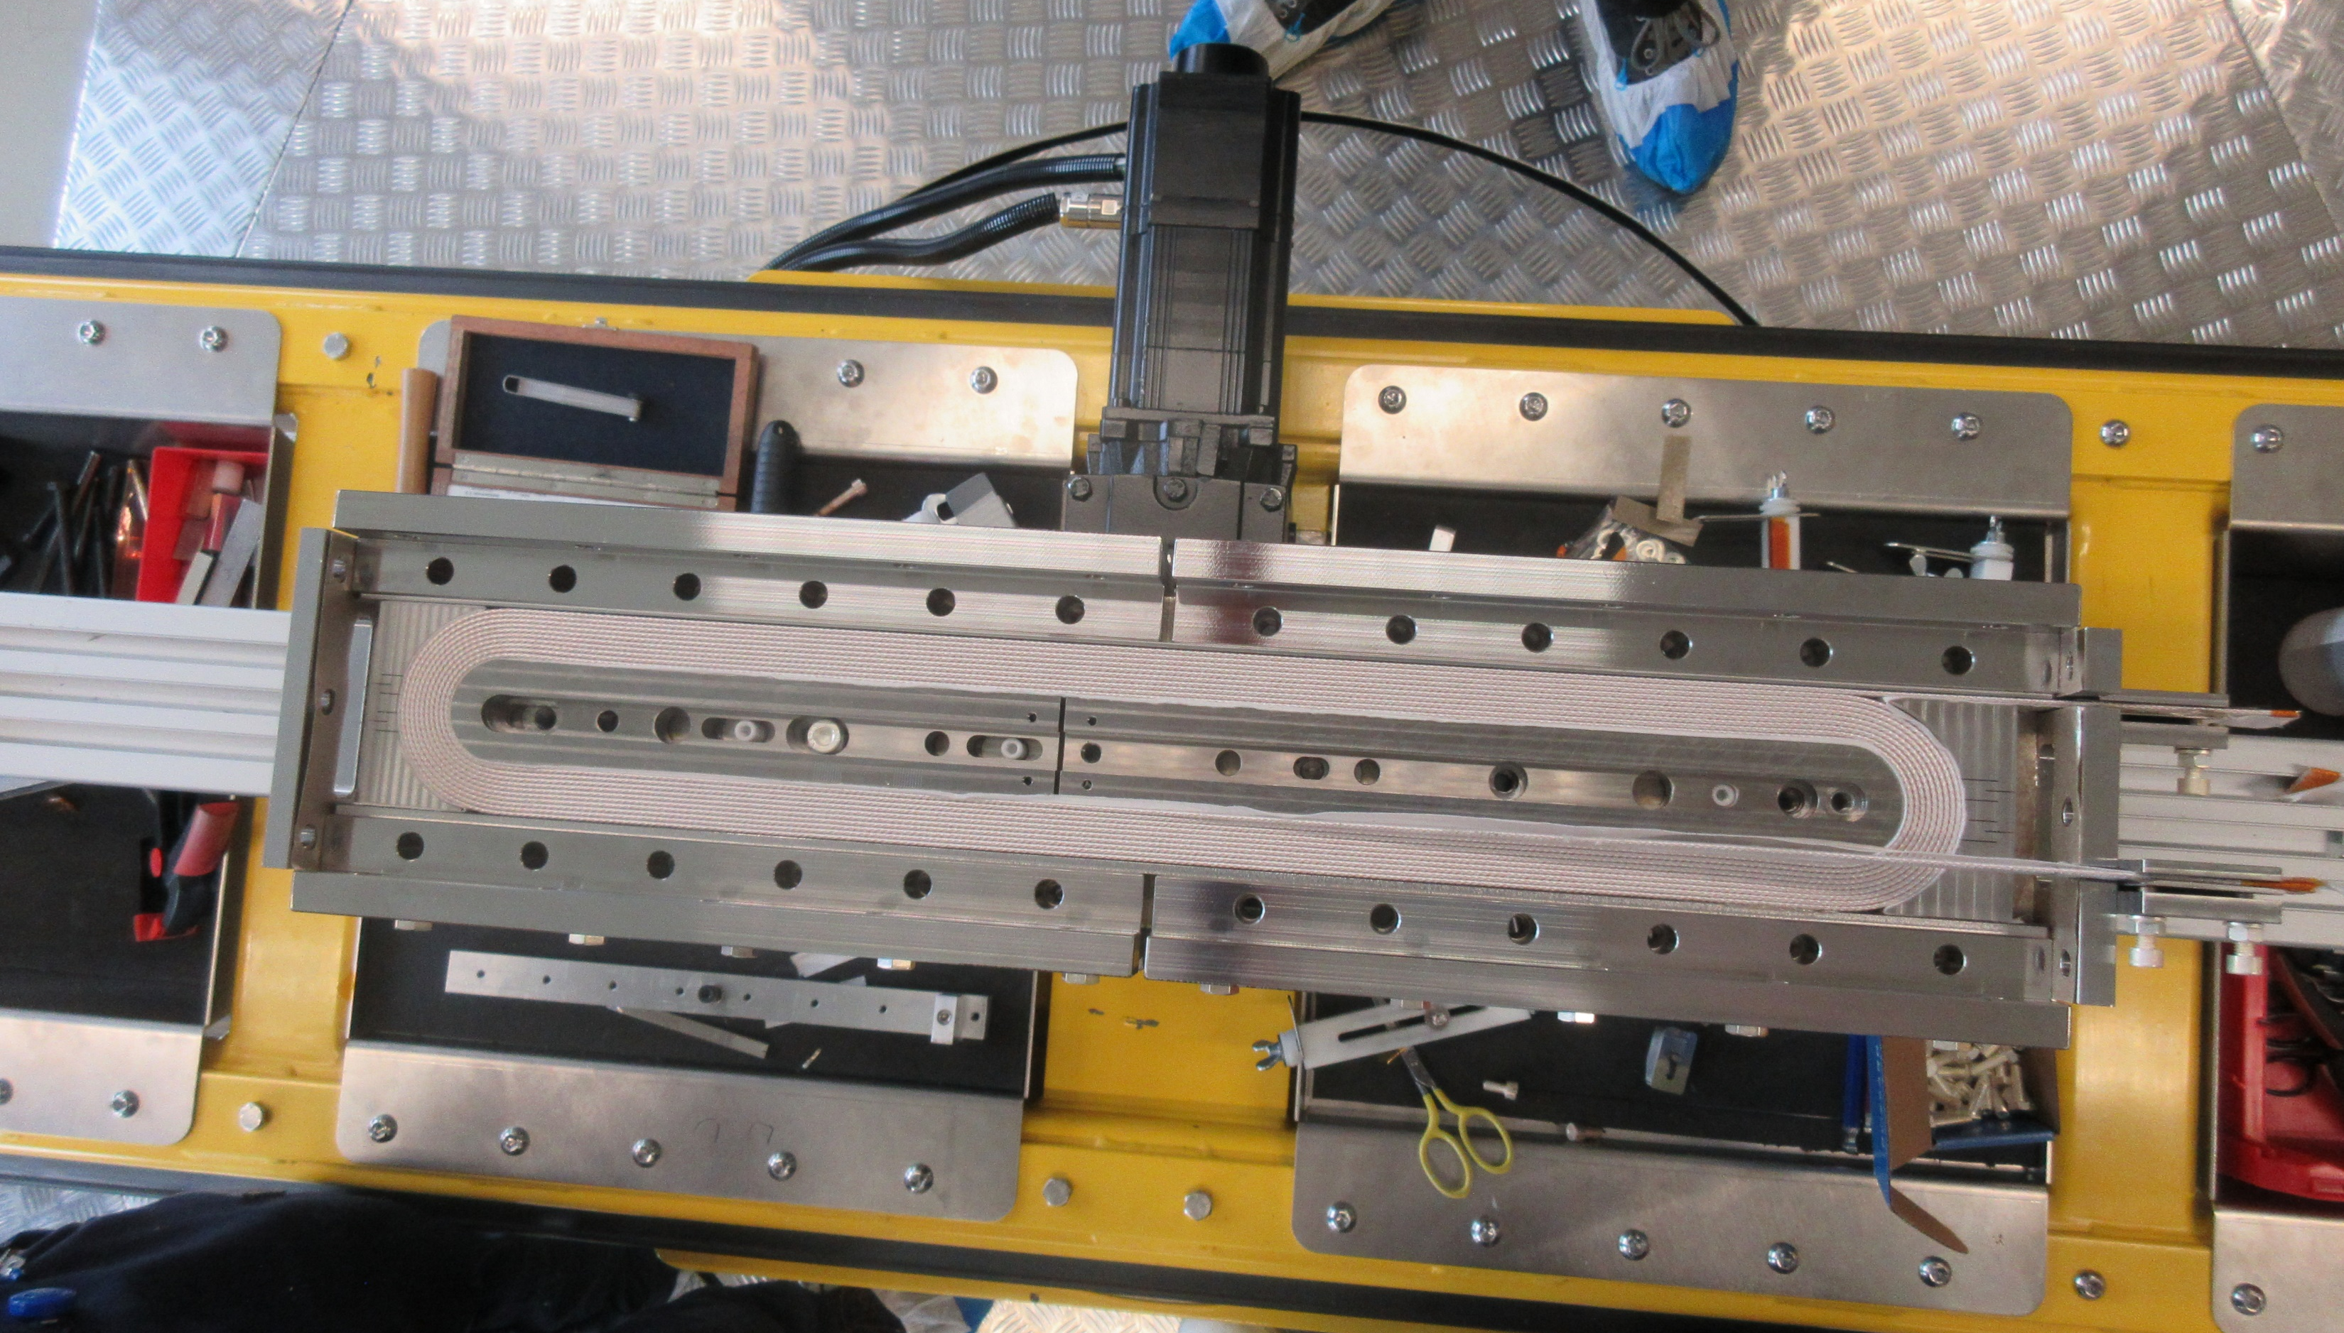
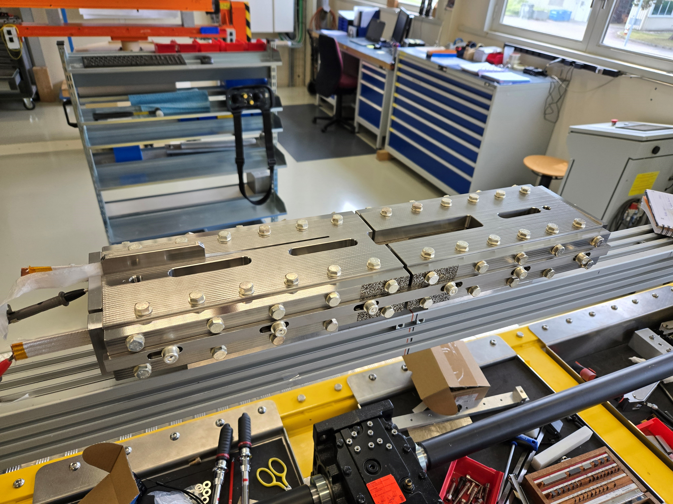
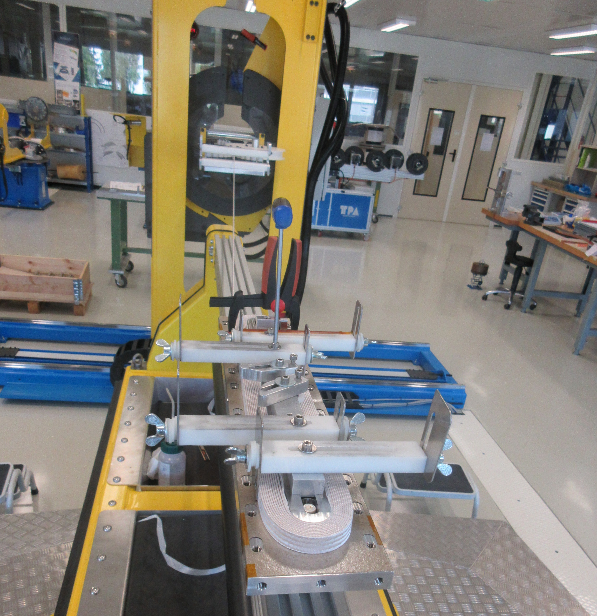
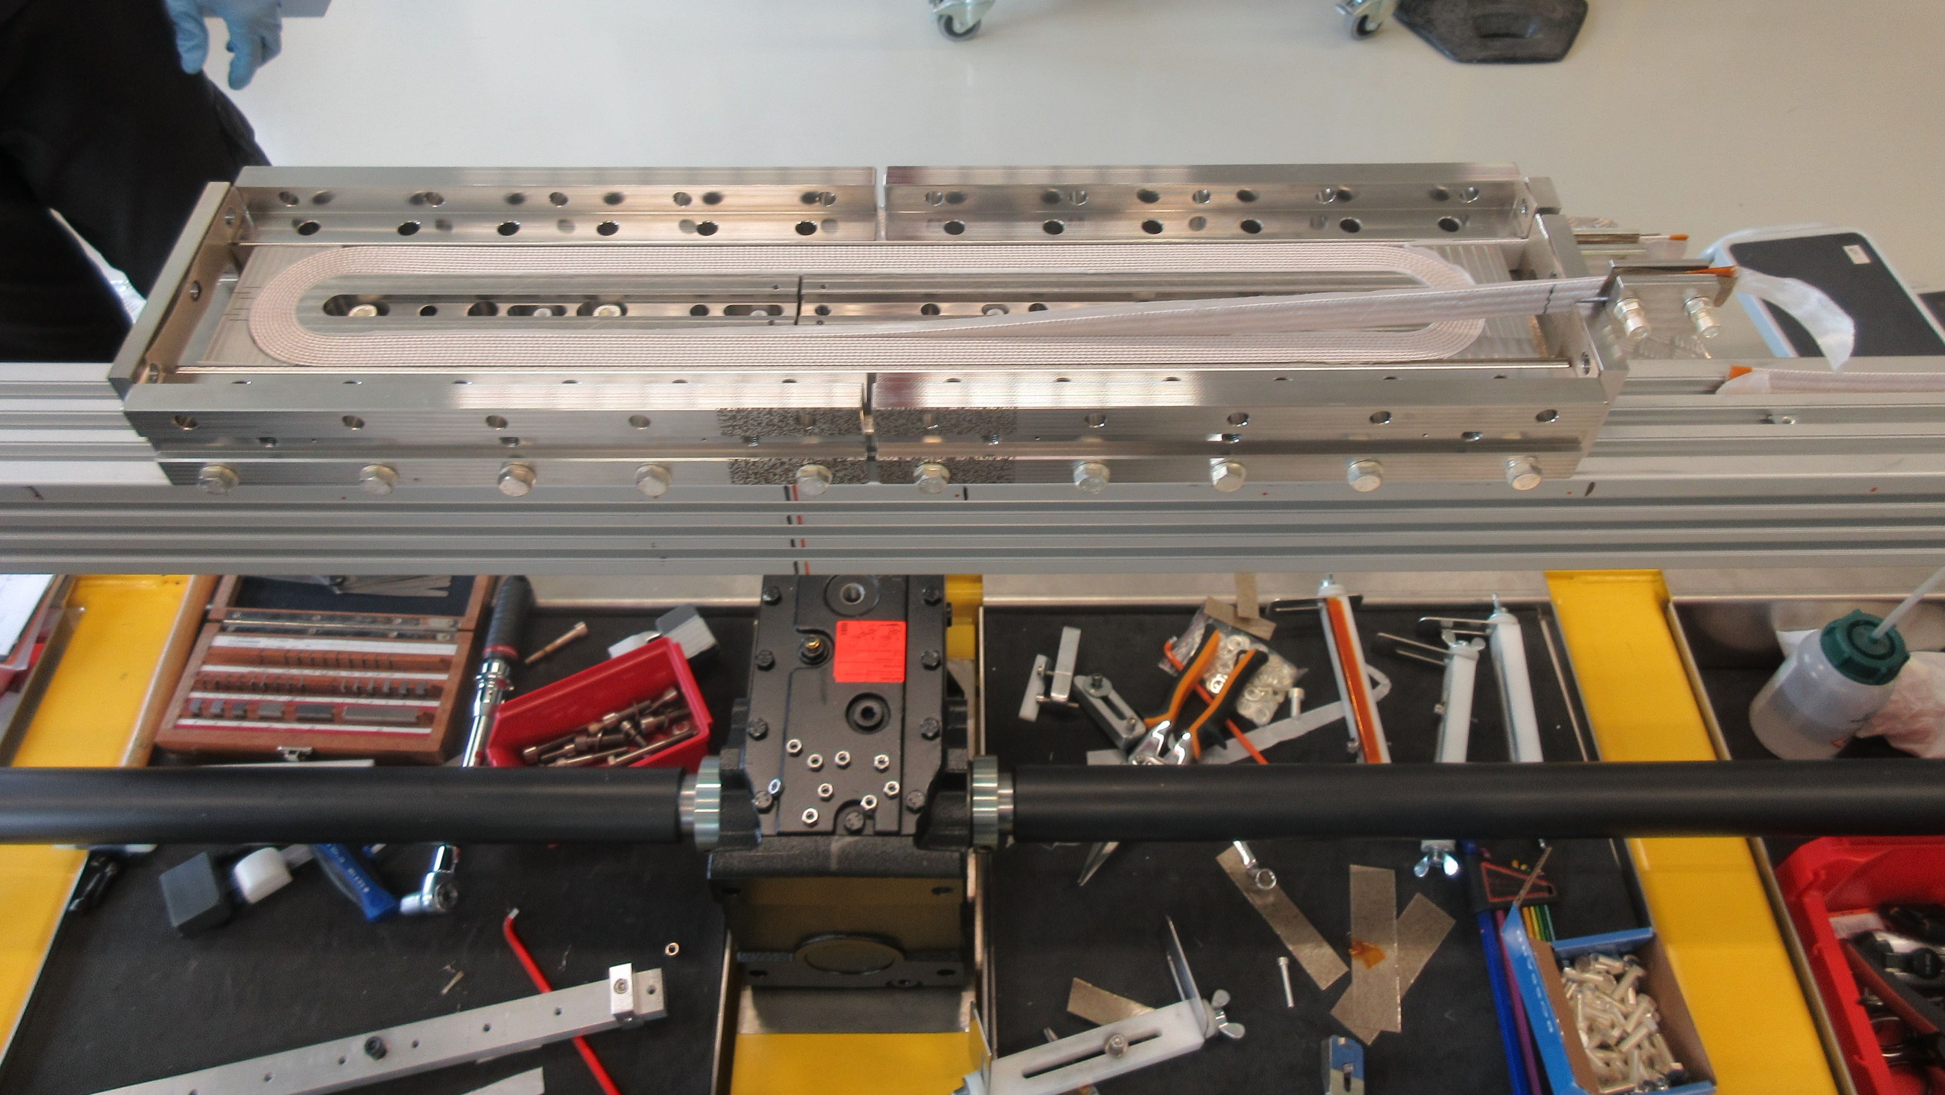
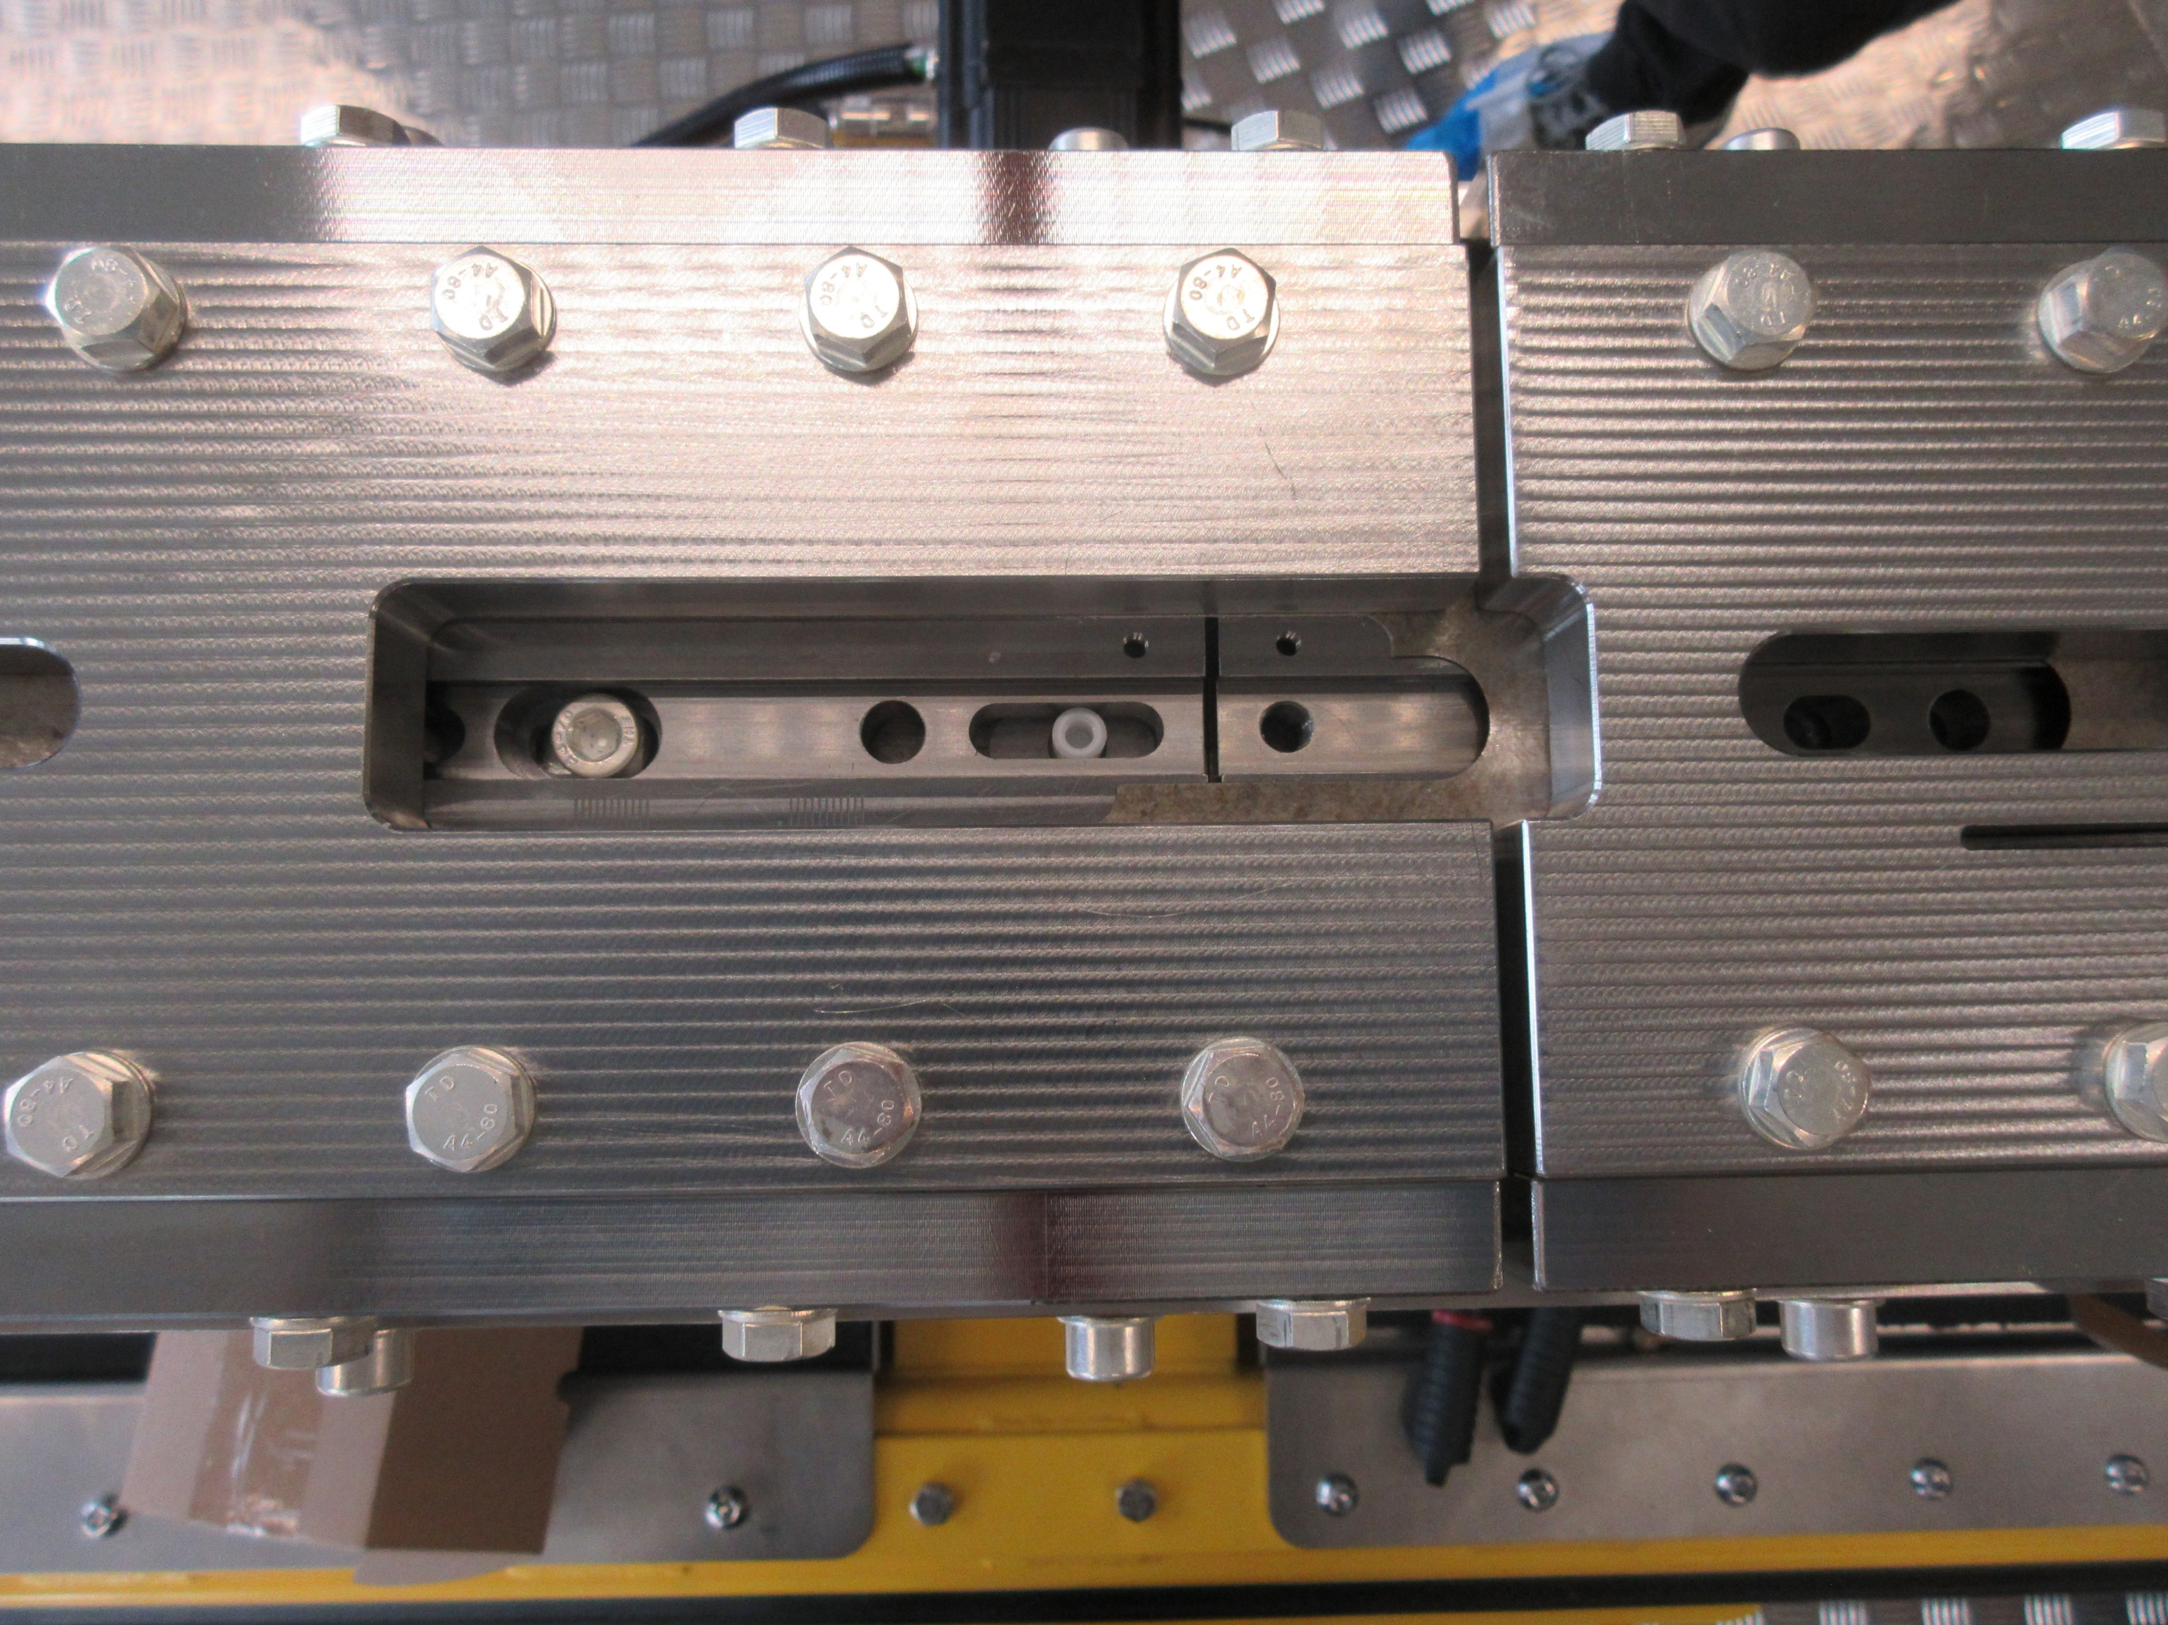
Racetrack coil mock-up: winding and reaction
Winding of the coil and assembly of the mold was done on June the 10th
  Winding tension 20kg constant all along the winding
    This parameter has an impact on the pole gap
  Pole and mold gaps
    2mm between poles and 4mm between plates for the 1st mock-up test
  Pole fixation configuration
    No pin in the oblong hole in the fixed pole (removed after winding)
    No bolts in the fixed pole during RHT
    1 bolt on the floating pole during RHT (the one closer to the pole gap) and the 2 pins in the oblong holes
  Full Nb₃Sn reaction cycle under Argon atmosphere in B.112 (MQXFS reaction cycle adapted to the small mock-up) with DIC system

Slide 3
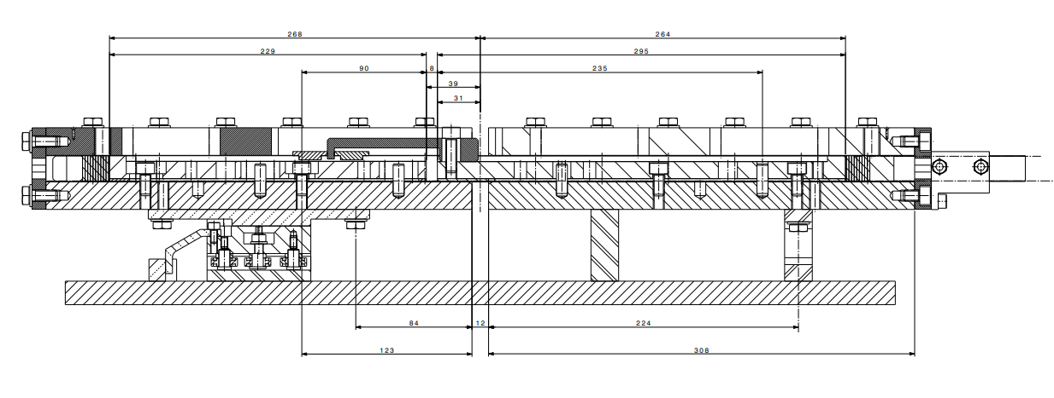
Racetrack coil mock-up
2
4

Slide 4
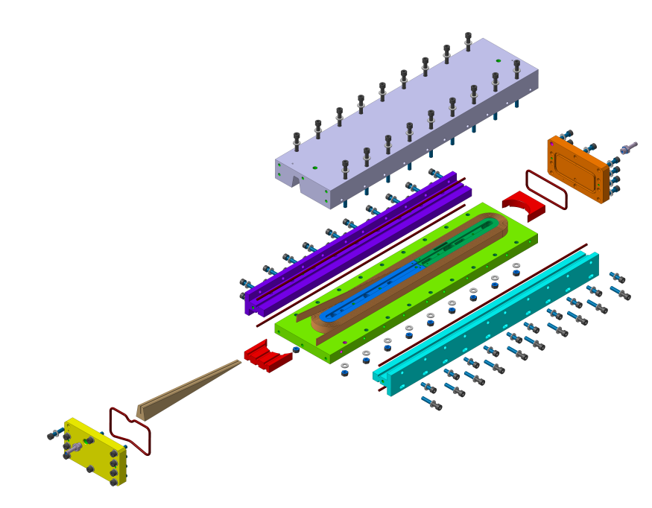
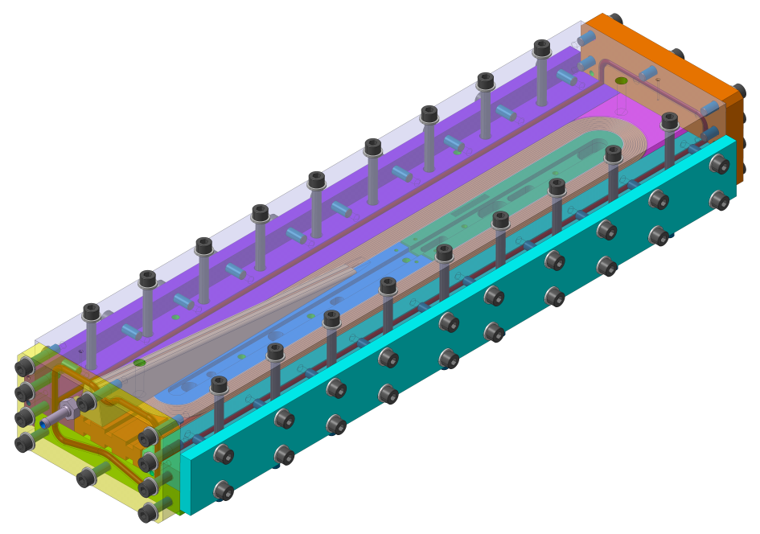
Racetrack coil mock-up: epoxy impregnation
Impregnation mold design finished and parts under manufacturing in B.183
  Layer jump impregnated to avoid leak problems and simplify the procedure
  Aluminum mold and PLA 3D printed parts
Courtesy of B. Pellet

Slide 5
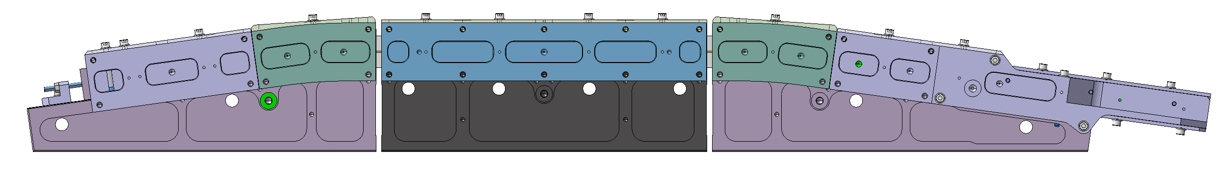
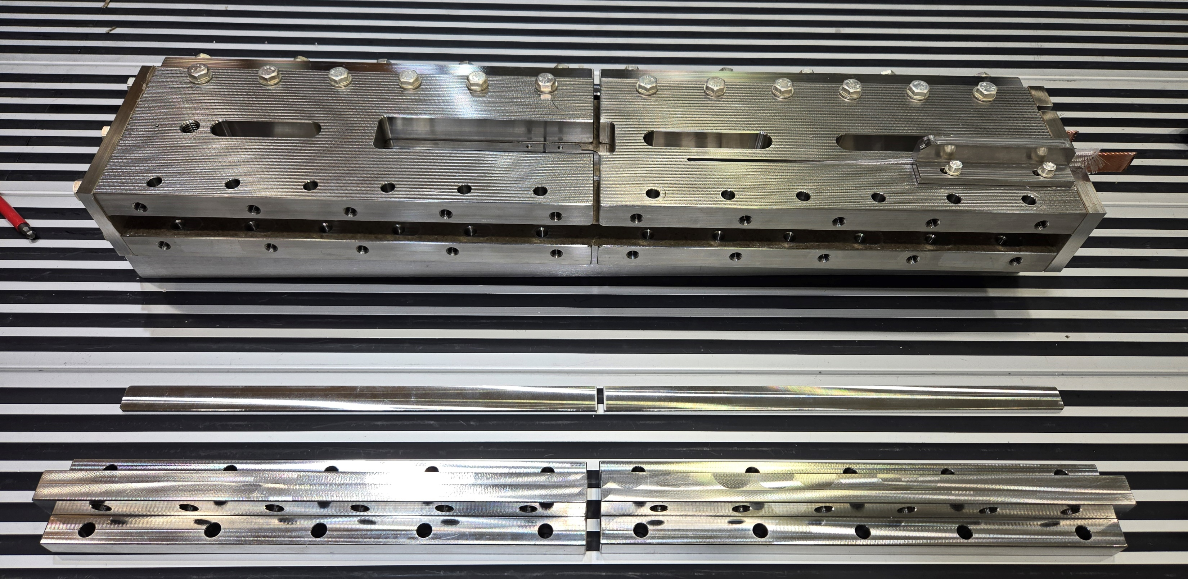
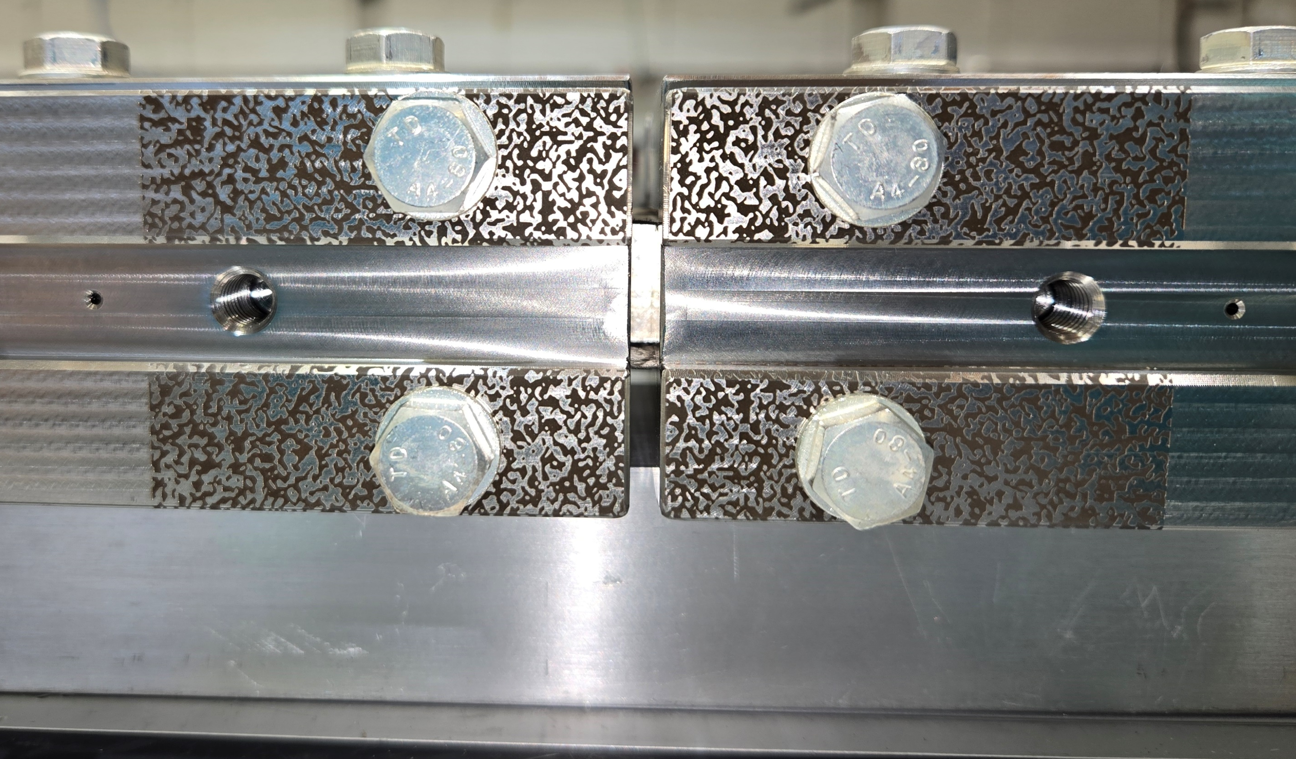
Modification implemented
To have a more representative set-up, like the real BOND reaction mold, and to investigate the impact of a sectorized mold on Nb₃Sn sub-elements, a modification was performed at the level of the lateral shim
  Segmented shim, i.e. 4mm gap between them as for the lateral pushers

Slide 6
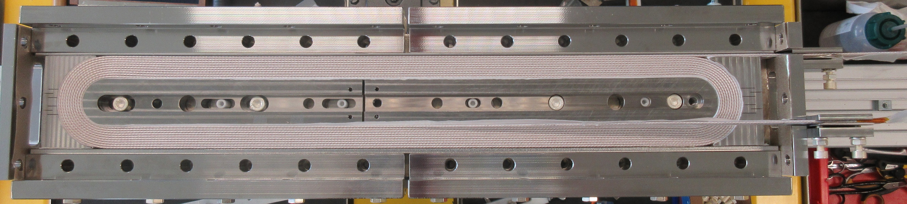
Post-mortem inspections
Coil will be cut after impregnation in correspondence of the transitions between poles and plates
  Check the impact of the gap fixed during the winding on the Nb₃Sn cable behavior
  No cryogenic cycle nor powering
Up to 4 mock-ups are planned for the moment, where different configurations will be tested
Metallographic inspections looking for broken filaments (meeting with Stefano’s team on 20/06/25)
1st mock-up could be ready in about 1 month time

Slide 7
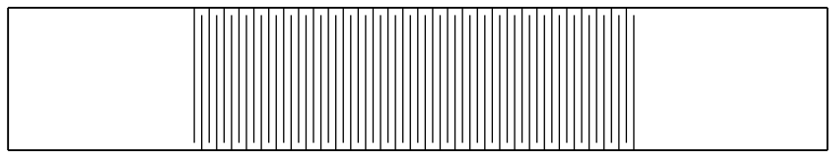
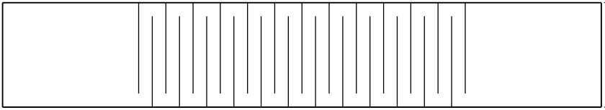
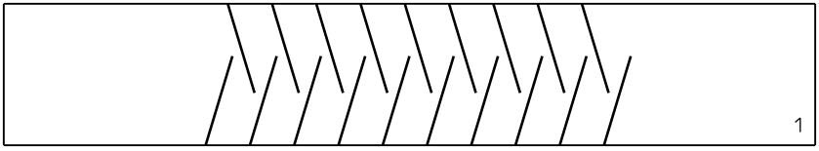
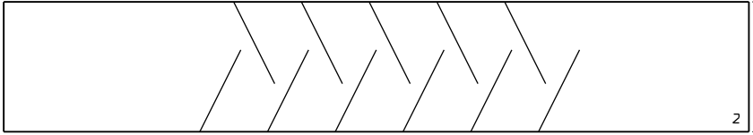
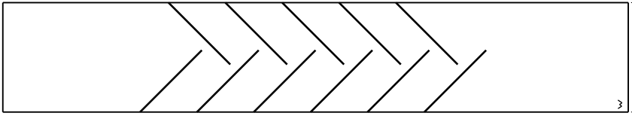
Improvement axes
Up to now, by design, only 2 mica layers are bridging and supporting the cable across the gap in the sectorized reaction mold
  “Flexible” metallic midplane shims may be envisaged to support laterally the turns
    They need to adapt to the flared geometry during reaction heat treatment cycle
  Tests ongoing to determine the more adequate cut pattern
    Laser cut in the main workshop, cut width around 0.5mm

Slide 8
Thank you

Slide 9
Spare slides

Slide 10

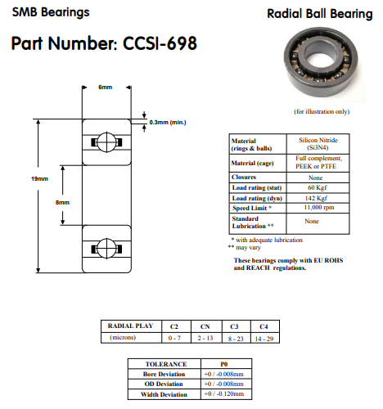
Selected solution
The selected sliding system is made by circular ceramic bearings
Just as a reminder, for the mock-ups, the following bearings were chosen
  Full Si₃N₄ bearings without cage CCSI-698

Slide 11
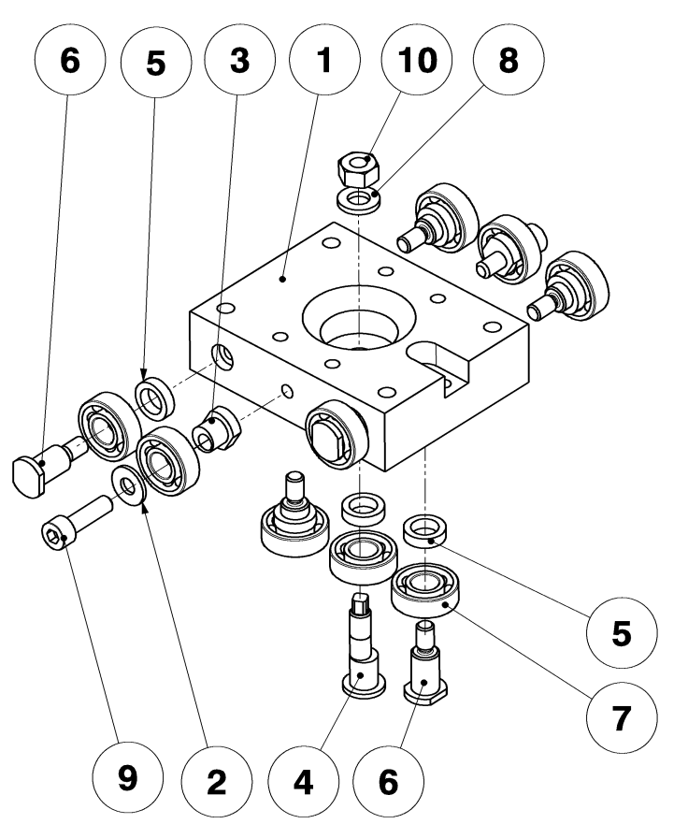
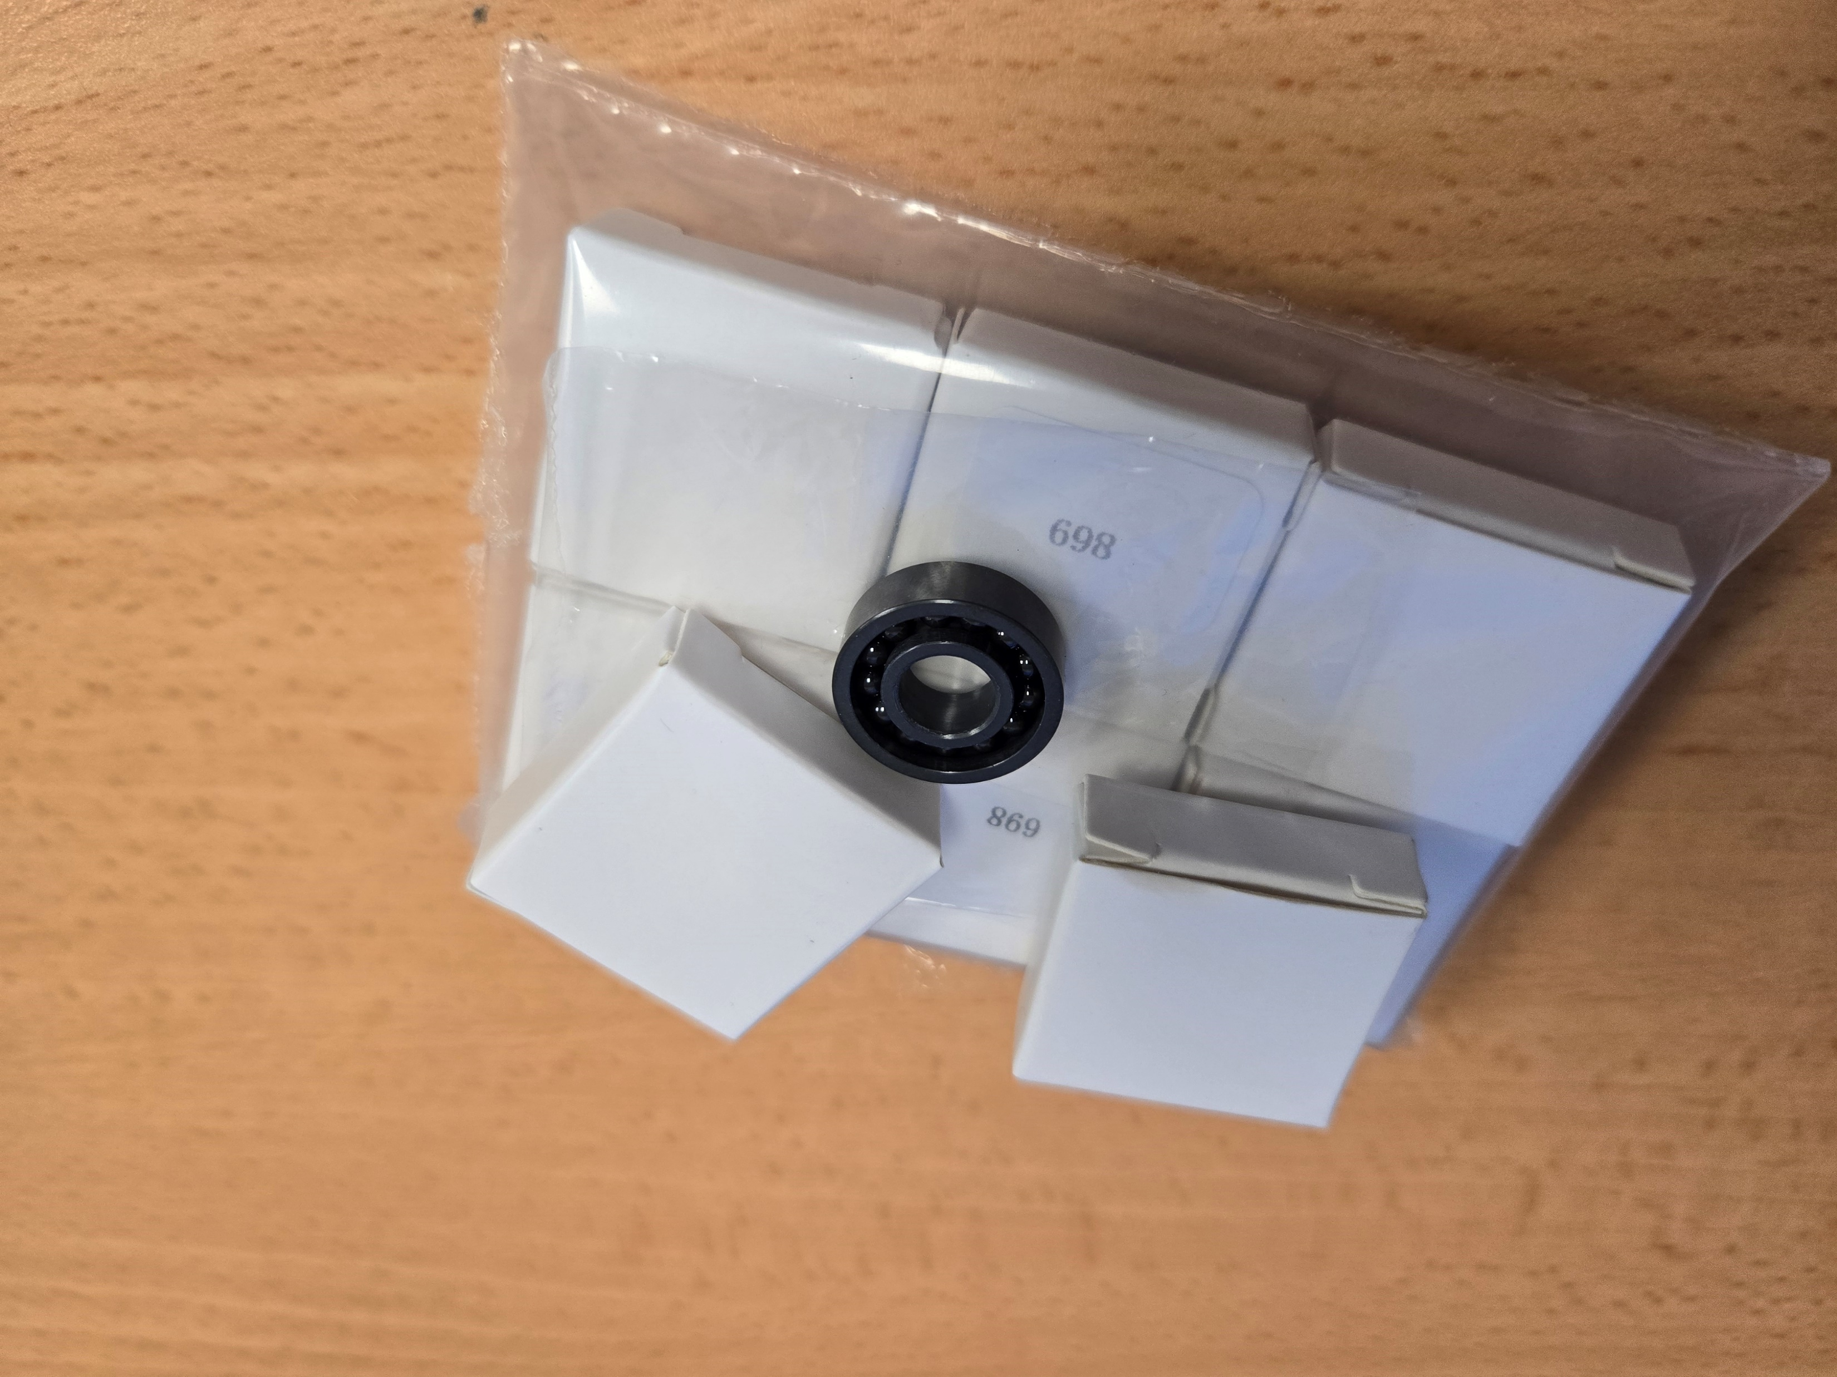
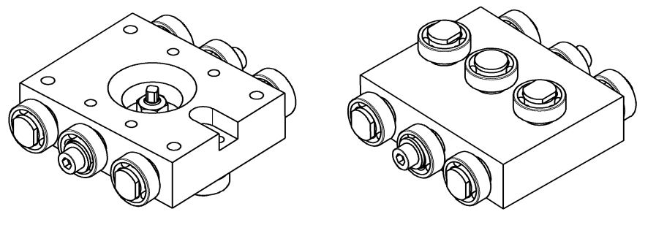
Circular Ceramic Bearings
Full Si₃N₄ ball bearings without cage
  Can be used up to 1200°C at low speed and low axial loads
  In principle for temperatures between 500-900°C a GH4099 nickel-based alloy cage could be used (not stored at the time of the PO)
The implementation and assembly of such system could be more challenging w.r.t. another system
  Fitting shaft/bearing must be careful check both at ambient and high temperatures to
    Ensure the alignment of the mold parts during the whole reaction cycle
    Make sure that interference fits due to differential thermal expansions do not reduce the radial play of the bearing to an unacceptable level (or shaft and housing fits should always accommodate for differences in expansion coefficients)
  3 bearings per raw where the central one is installed in an eccentric axis for alignment
  Parts #2, #3, #4, #5, #6 are made of Invar
Courtesy of B. Pellet

Slide 12
Circular Ceramic Bearings
Based on supplier’s exchanges, the theoretical lifetime (in hours) with
  60kgf radial load
  1kgf axial load
  100rpm speed
    L_{90% reliability} = 455h
    L_{95% reliability} = 291h
    L_{99.5% reliability} = 35h
The actual theoretical life is longer if we consider negligible speed
  At 10rpm speed → L_{99.5% reliability} = 350h
In our case the bearings will not even complete 1 turn:
  About 18° rotation (≈ 3mm) for basic mock-ups
  About 30° rotation (≈ 5mm) for racetrack coil mock-up
  At 1rpm speed → L_{99.5% reliability} = 3500h
  Tests should be carried out to assess the real lifetime

