Slide 1
Coherent Effects and Impedances section (CEI) – general information
BE-ABP-CEI
Coherent Effects and Impedance
Giovanni RUMOLO
David AMORIM
Chiara ANTUONO
Miltiadis BOZATZIS
Xavier BUFFAT
Elena DE LA FUENTE GARCIA
Dora GIBELLIERI
Fredrik GRØNVOLD
Evangelos KATRALIS
Peter KICSINY
Jintao LI
Elena MACCHIA
Lotta METHER
Elias MÉTRAL
Nicolas MOUNET
Luca SABATO
Daniel SCHULTE
Leonardo SITO
Roxana SOÓS
R TAYLOR
Carlo ZANNINI
Giovanni Rumolo
CEI Section Meeting, 14/08/2025
Scientific secretary: Roxana Soós
https://indico.cern.ch/event/1561960/

Slide 2
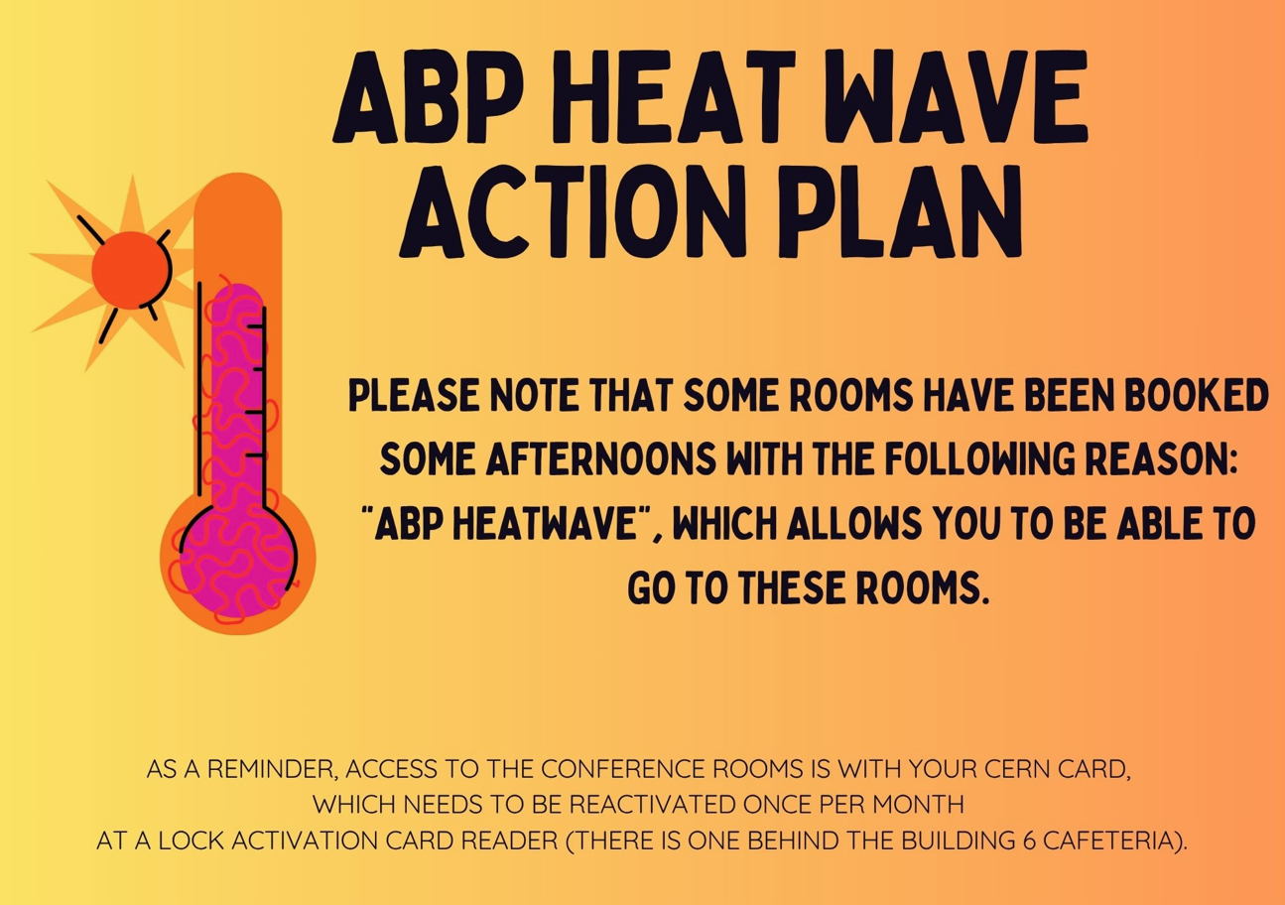
Arising matters
Heat wave action plan currently in action
Average temperatures exceeding 25ºC must be forecast for at least three consecutive days for a heatwave to be officially declared
At least until the end of this week
List of available rooms sent out by Stéphanie last Monday
Thursday afternoon: 6/2-004 after this meeting + Auditorium + 6/2-008
Friday afternoon: 6/2-008 + 6/2-004 after INC meeting from 4pm + Auditorium

Slide 3
Arising matters
Resumption of language courses
Starting on Wednesday, August 13th, registration for French and English language courses, as well as placement tests, will once again be available on the Learning Hub
The courses will be taught by the same teachers as before
Traveling to HB2025
Please take note of Stéphanie’s email from 11 August when organizing your travel
Flights to Shenzhen are far cheaper than flights to Huizhou, therefore it is encouraged to take the former and then reach by taxi the HB venue (about 1h away – 160 CHF). Taxis will be exceptionally reimbursed under presentation of the receipt outside of the per-diem
Please follow the indications given by Stéphanie (screenshots, etc.)

Slide 4
LHC schedule
Efficient luminosity production despite 6L2 damaged warm transition module

Slide 5
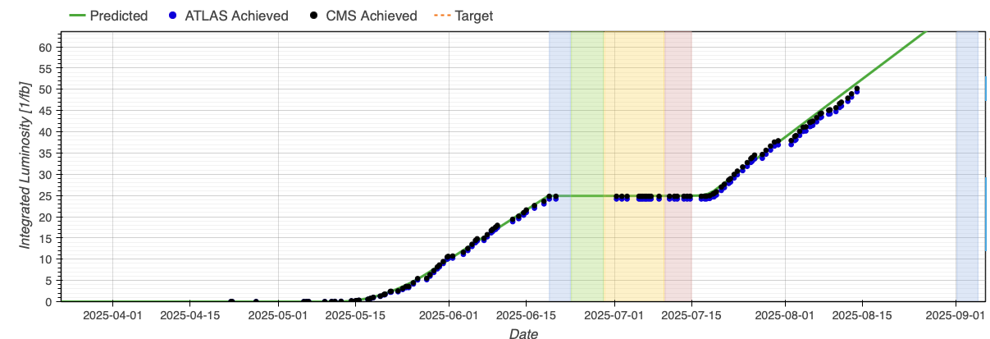
Integrated luminosity so far
Very close to updated projection, steady production for the moment in spite of 6L2 non-conforming transition module – only minor spikes during some fills

Slide 6
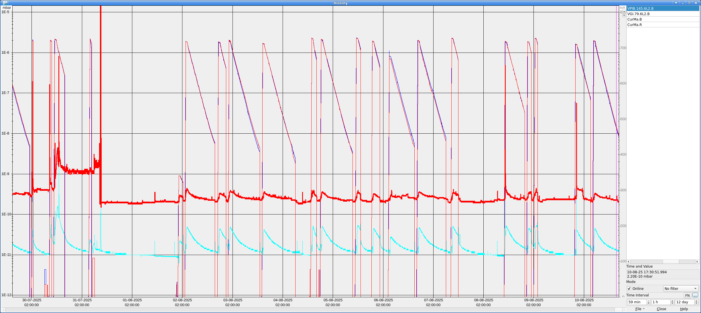
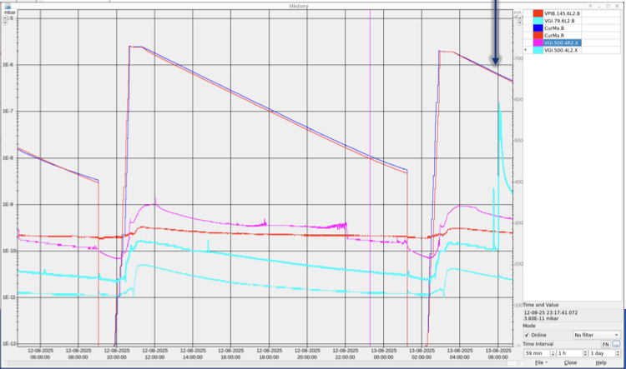
Integrated luminosity so far
Very close to updated projection, steady production for the moment in spite of 6L2 non-conforming transition module – only minor spikes during some fills
Yesterday morning in 4L2 (800mm chamber)

Slide 7
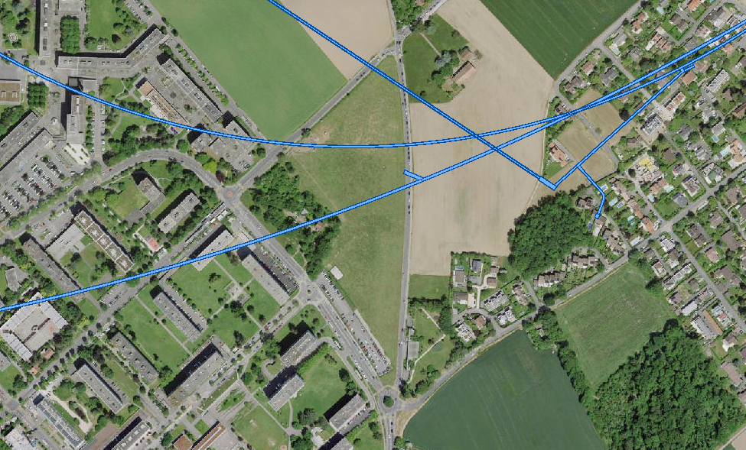
Upcoming
Gamma-radiography of damaged warm vacuum modules in 6L2 foreseen tomorrow morning during access for FASER emulsion exchange
Vibration tests next week
Construction of secondary school in Meyrin, next to the Mategnin border, located directly above the LHC tunnel (depth ~100m).
TI8
LHC
Cell 24 R8

Slide 8
Upcoming
Gamma-radiography of damaged warm vacuum modules in 6L2 foreseen tomorrow morning during access for FASER emulsion exchange
Vibration tests next week
Construction of secondary school in Meyrin, next to the Mategnin border, located directly above the LHC tunnel (depth ~100m).
Need to build support concrete pillars down to 30m underground (~65m from LHC tunnel), which will require drilling with pneumatic hammers and possibly impact LHC operation for the duration of the works (about 3 weeks)
Contractor will perform a test of the hammers in W34 (week of 18.08) with LHC in stable beams, including possible ‘tuning’ of the hammer frequency setting
Ongoing discussion on possible need to review intensity limits (also in MDs) due to 6L2, LBOC devoted to this subject next week

Slide 9
Injectors schedule
Last week’s 8b4e MD was quite successful
2x 56b with 2.3e11 p/b after scraping
Desired brightness achieved
Main limitation remains pressure spikes in 200 MHz cavities
More conditioning might be needed with this beam if we want to accelerate more than 2 trains
Today MD with LIU BCMS ongoing

Slide 10
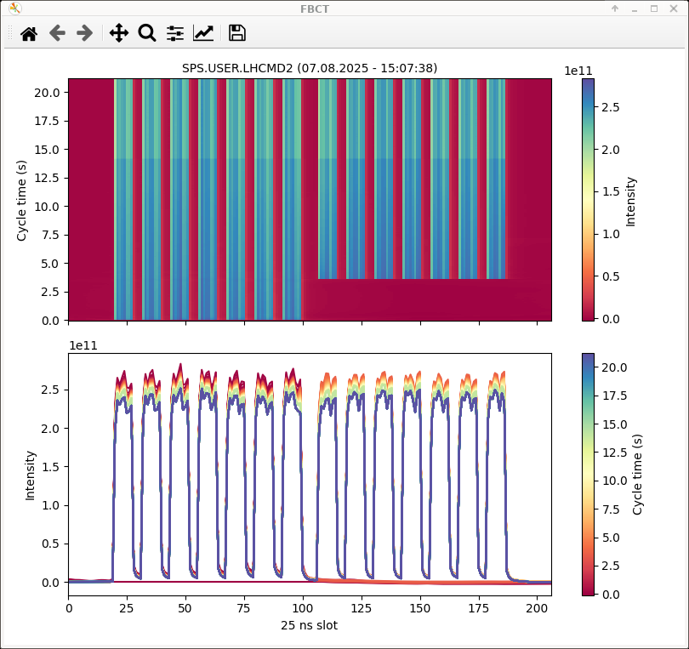
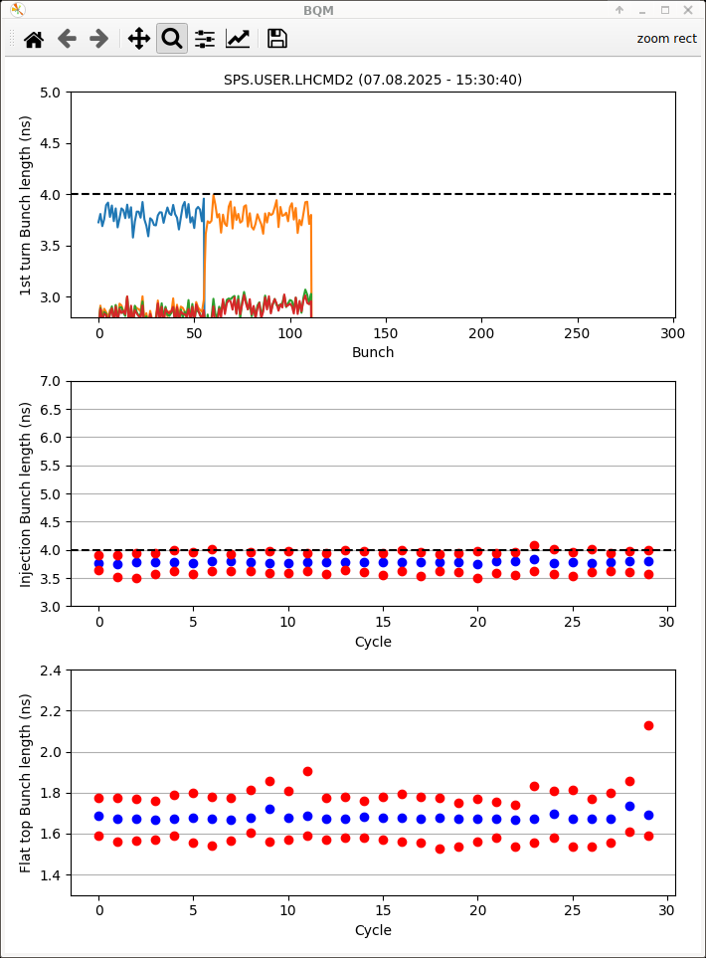
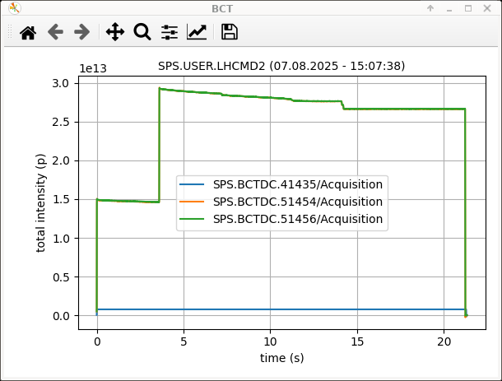
8b4e beam in injectors
Last week’s achievement
2x 56b extracted with 2..3e11 p/b and 1.65 ns bunch length

Slide 11
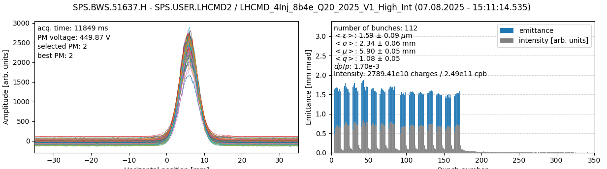
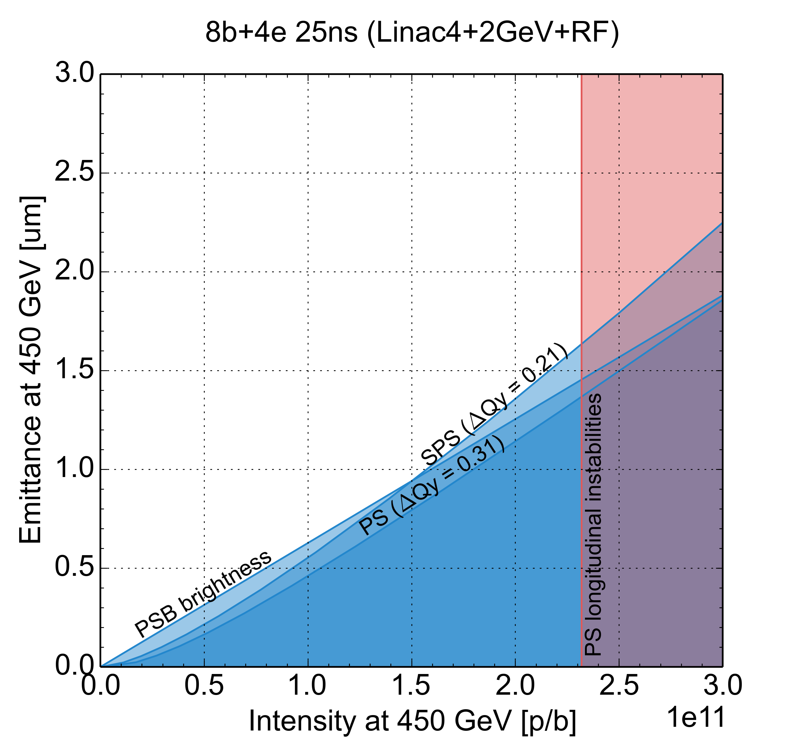
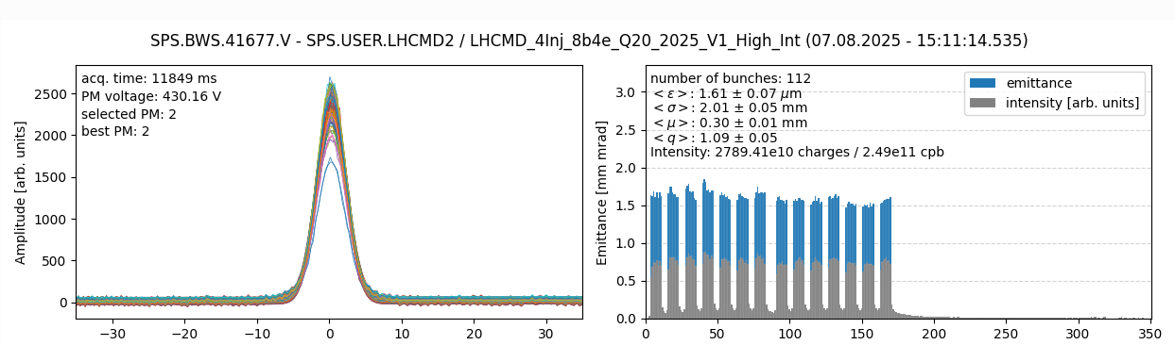
8b4e beam in injectors
Last week’s achievement
2x 56b extracted with 2..3e11 p/b and 1.65 ns bunch length
Brightness as expected from limitation diagram (WP 20.15, 20.22)

Slide 12
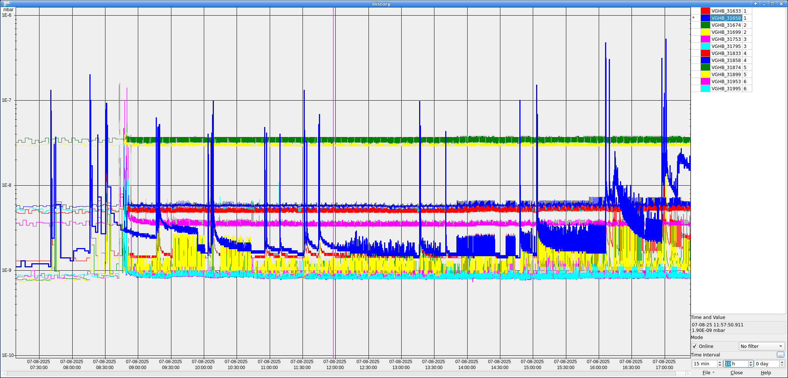
8b4e beam in injectors
Last week’s achievement
2x 56b extracted with 2..3e11 p/b and 1.65 ns bunch length
Brightness as expected from limitation diagram (WP 20.15, 20.22)
Still to work on
“Spiky” emittance growth when Qx=0.13 with no clear signs of instability visible from BBQ, LHC BPMs or Head-Tail monitor, what is the origin?
Vacuum spikes in Cavity 1 and Cavity 2 and pressure not recovering quickly enough when injecting 3 trains

Slide 13
News from projects?
HL-LHC
Muon collider
FCC

