Slide 1
SPS high intensity Crab Cavity MDs and related studies
C. Antuono, N. Mounet, X. Buffat
Many thanks to: C. Zannini, I. Mases Sole, E. De La Fuente, L. Giacomel, R. Calaga, G. Papotti, K. B. Lee, H. Bartosik and the SPS operation team

Slide 2
OUTLINE
Introduction and motivations
High intensity SPS MD
Predictions and mitigations studies with model
Conclusions

Slide 3
OUTLINE
Introduction and motivations
High intensity SPS MD
Predictions and mitigations studies with model
Conclusions

Slide 4
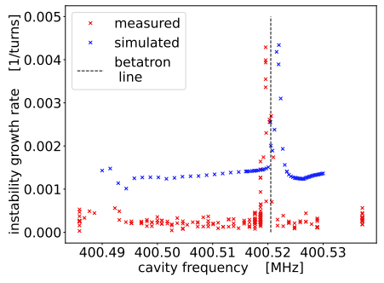
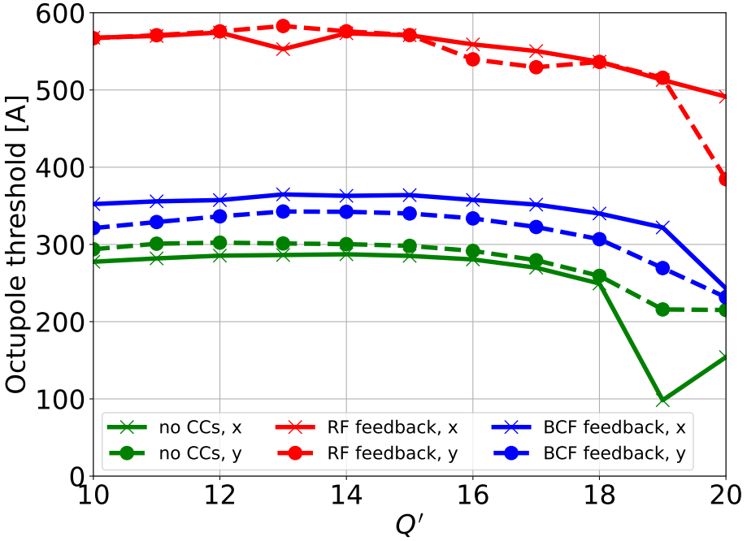
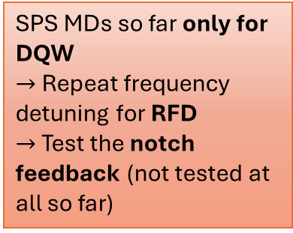
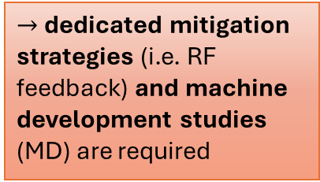
Introduction and motivations
The Crab Cavities (CC) are a vital component of the HL-LHC baseline:
  Their fundamental mode induces a strong and narrow-band contribution to the impedance model resulting in a coupled-bunch instability
    Landau damping and transverse damper are not sufficient to effectively suppress the instability
$→$ dedicated mitigation strategies (i.e. RF feedback) and machine development studies (MD) are required
Past studies demonstrate:
  Fast instabilities when cavities are tuned closed to a betatron frequency
  In HL, mitigation from standard RF feedback is not enough, while the comb feedback looks promising
    For the SPS case the notch filter feedback can be used as proof of concept of the HL-LHC comb feedback
SPS MDs so far only for DQW
$→$Repeat frequency detuning for RFD
$→$Test the notch feedback (not tested at all so far)
L. Giacomel et al.@2024 HL-LHC collab. meeting
High intensity MD
at the SPS on 16/07

Slide 5
OUTLINE
Introduction and motivations
High intensity SPS MD
  Predictions with model
  Analysis of MD#2 observations
  Analysis of MD#3 observations
Predictions and mitigations studies with model
Conclusions

Slide 6
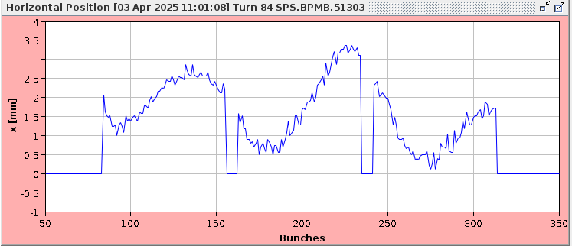
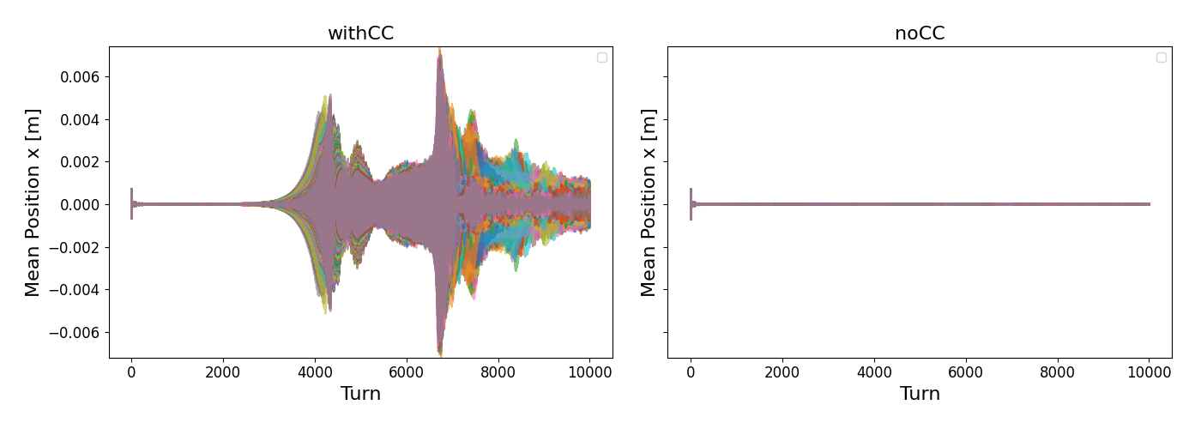
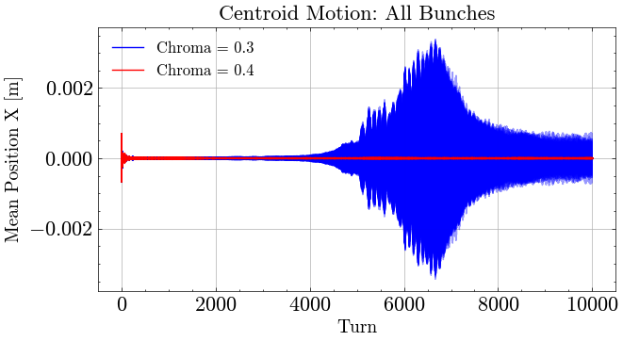
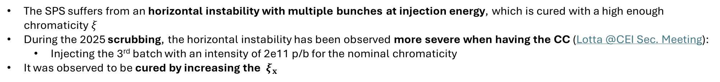
Observations during scrubbing: SPS horizontal instability
The SPS suffers from an horizontal instability with multiple bunches at injection energy, which is cured with a high enough chromaticity $ξ$
During the 2025 scrubbing, the horizontal instability has been observed more severe when having the CC (Lotta @CEI Sec. Meeting):
  Injecting the 3rd batch with an intensity of 2e11 p/b for the nominal chromaticity
It was observed to be cured by increasing the $ξ_{x}$
The scrubbing observations are confirmed also in tracking simulations
Impact of Crab Cavity
Effect of chromaticity

Slide 7
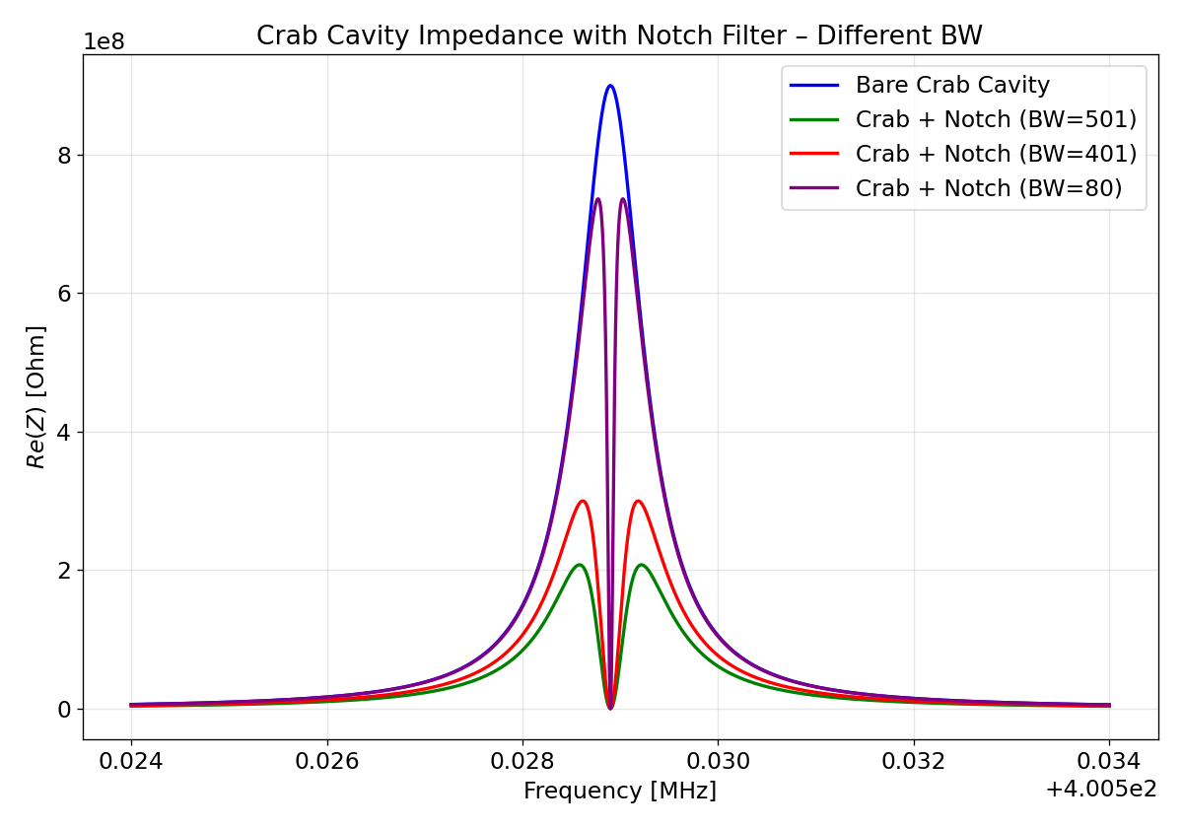
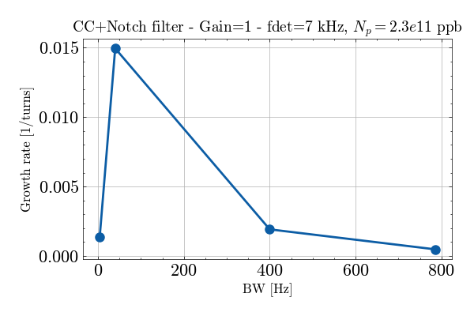
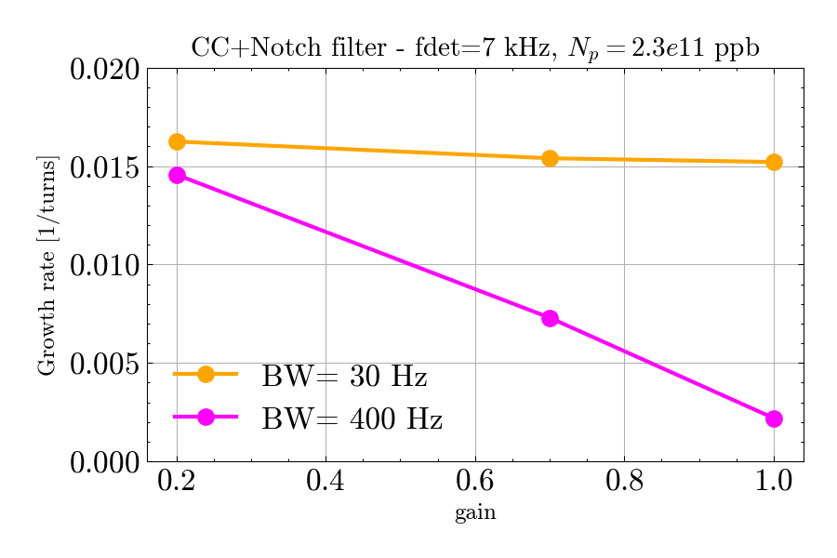
Notch filter simulations : impact of gain and bandwidth
The effectiveness of the comb filter for the HL-LHC era can be preliminarly tested in the SPS
  It could be done using the notch filter
For BW=30 Hz the gain does not have much influence
Additional simulations data points ongoing
Having larger BW is quite beneficial

Slide 8
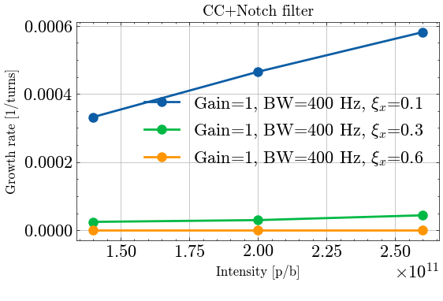
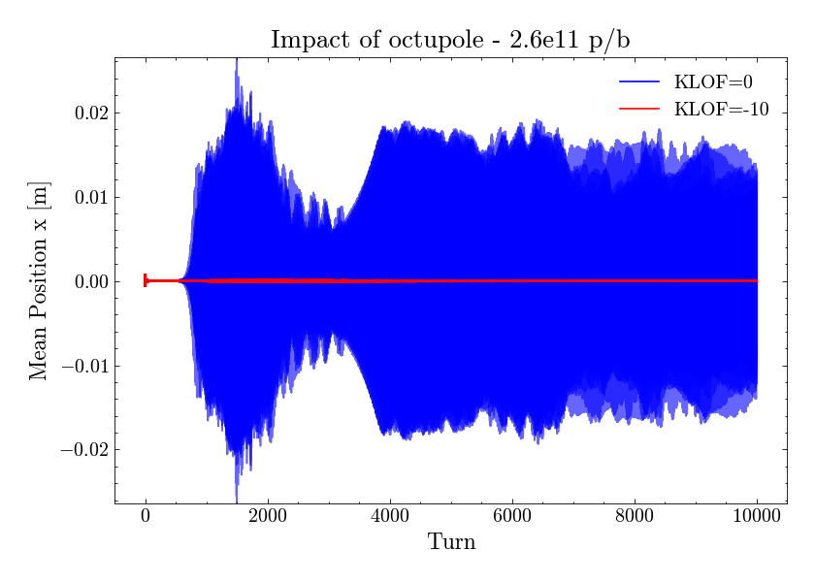
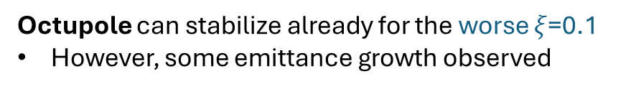
CC + Notch filter simulations : impact of octupole and chroma
Octupole can stabilize already for the worse $ξ$=0.1
However, some emittance growth observed

Slide 9
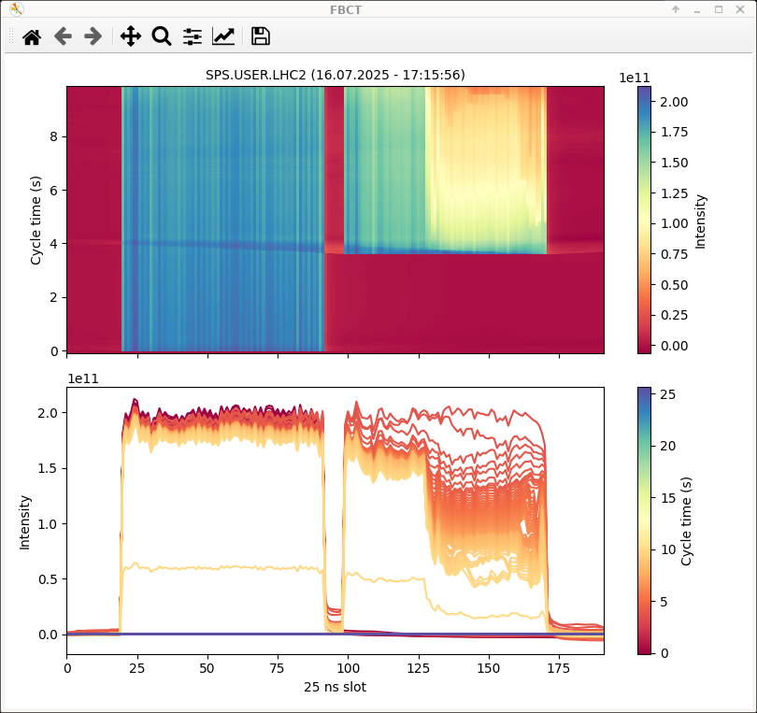
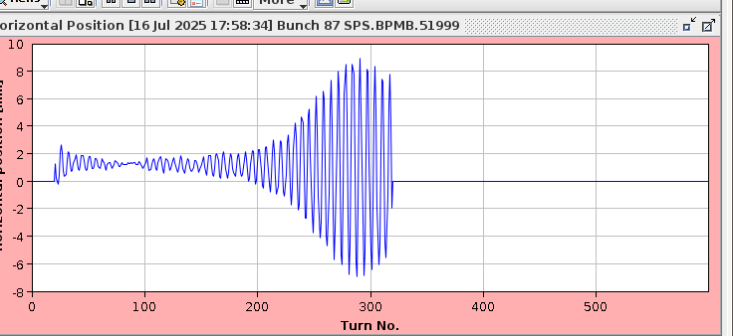
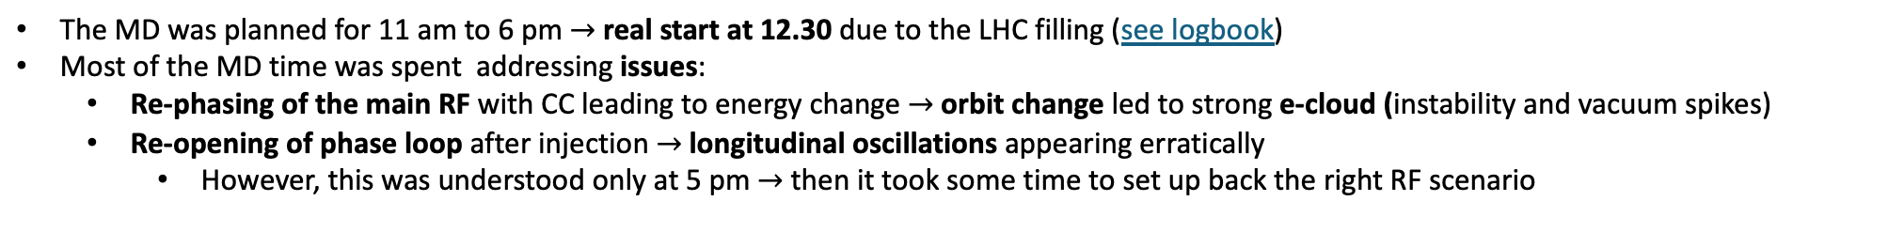
MD summary
The MD was planned for 11 am to 6 pm $→$ real start at 12.30 due to the LHC filling (see logbook)
Most of the MD time was spent addressing issues:
  Re-phasing of the main RF with CC leading to energy change $→$ orbit change led to strong e-cloud (instability and vacuum spikes)
  Re-opening of phase loop after injection $→$longitudinal oscillations appearing erratically
    However, this was understood only at 5 pm $→$ then it took some time to set up back the right RF scenario
MD started only at 5.39 pm
Useful MD data taken only during the last 20 minutes
Instability while detuning the cavity frequency
Very fast instability on the betatron sideband!
The initial plan was to test also:
Effect of standard RF feedback with detuning on betatron sideband
Scan of notch feedback gain with detuning on betatron sideband
Given the encountered issues, only the test with the bare crab cavity while detuning the fundamental mode, was performed

Slide 10
OUTLINE
Introduction and motivations
Observations during scrubbing at the SPS
High intensity SPS MD
  Analysis of MD#2 observations
  Analysis of MD#3 observations
Predictions and mitigations studies with model
Conclusions

Slide 11
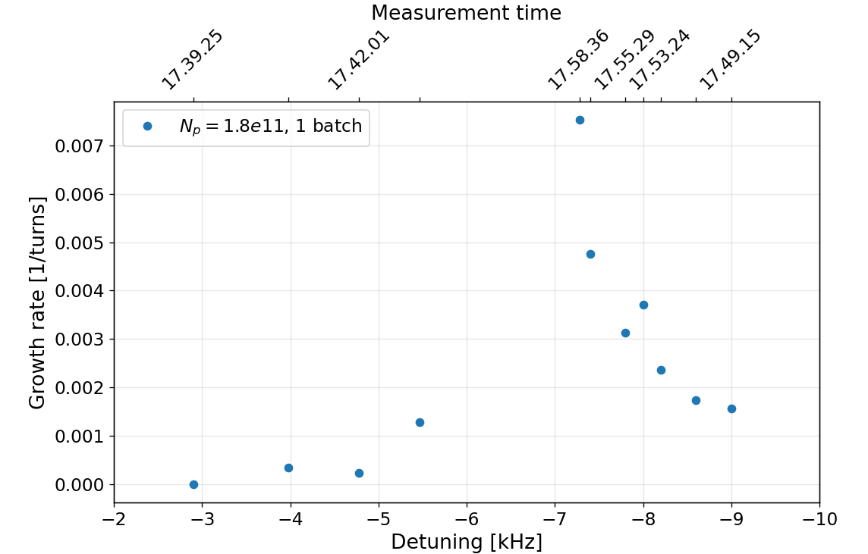
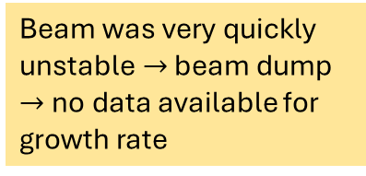
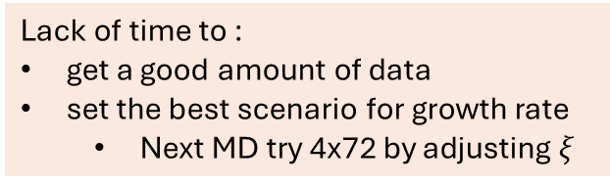
MD#2 : growth rate as a function of cavity detuning
Beam was very quickly unstable$→$ beam dump $→$no data available for growth rate
Clear stronger instability approaching the betatron line (~7kHz detuning)
Cavity detuning w.r.t. the cavity central frequency of 400.528 MHz
Expected destabilizing betatron line (~7 kHz)
Lack of time to :
get a good amount of data
set the best scenario for growth rate
  Next MD try 4x72 by adjusting $ξ$

Slide 12
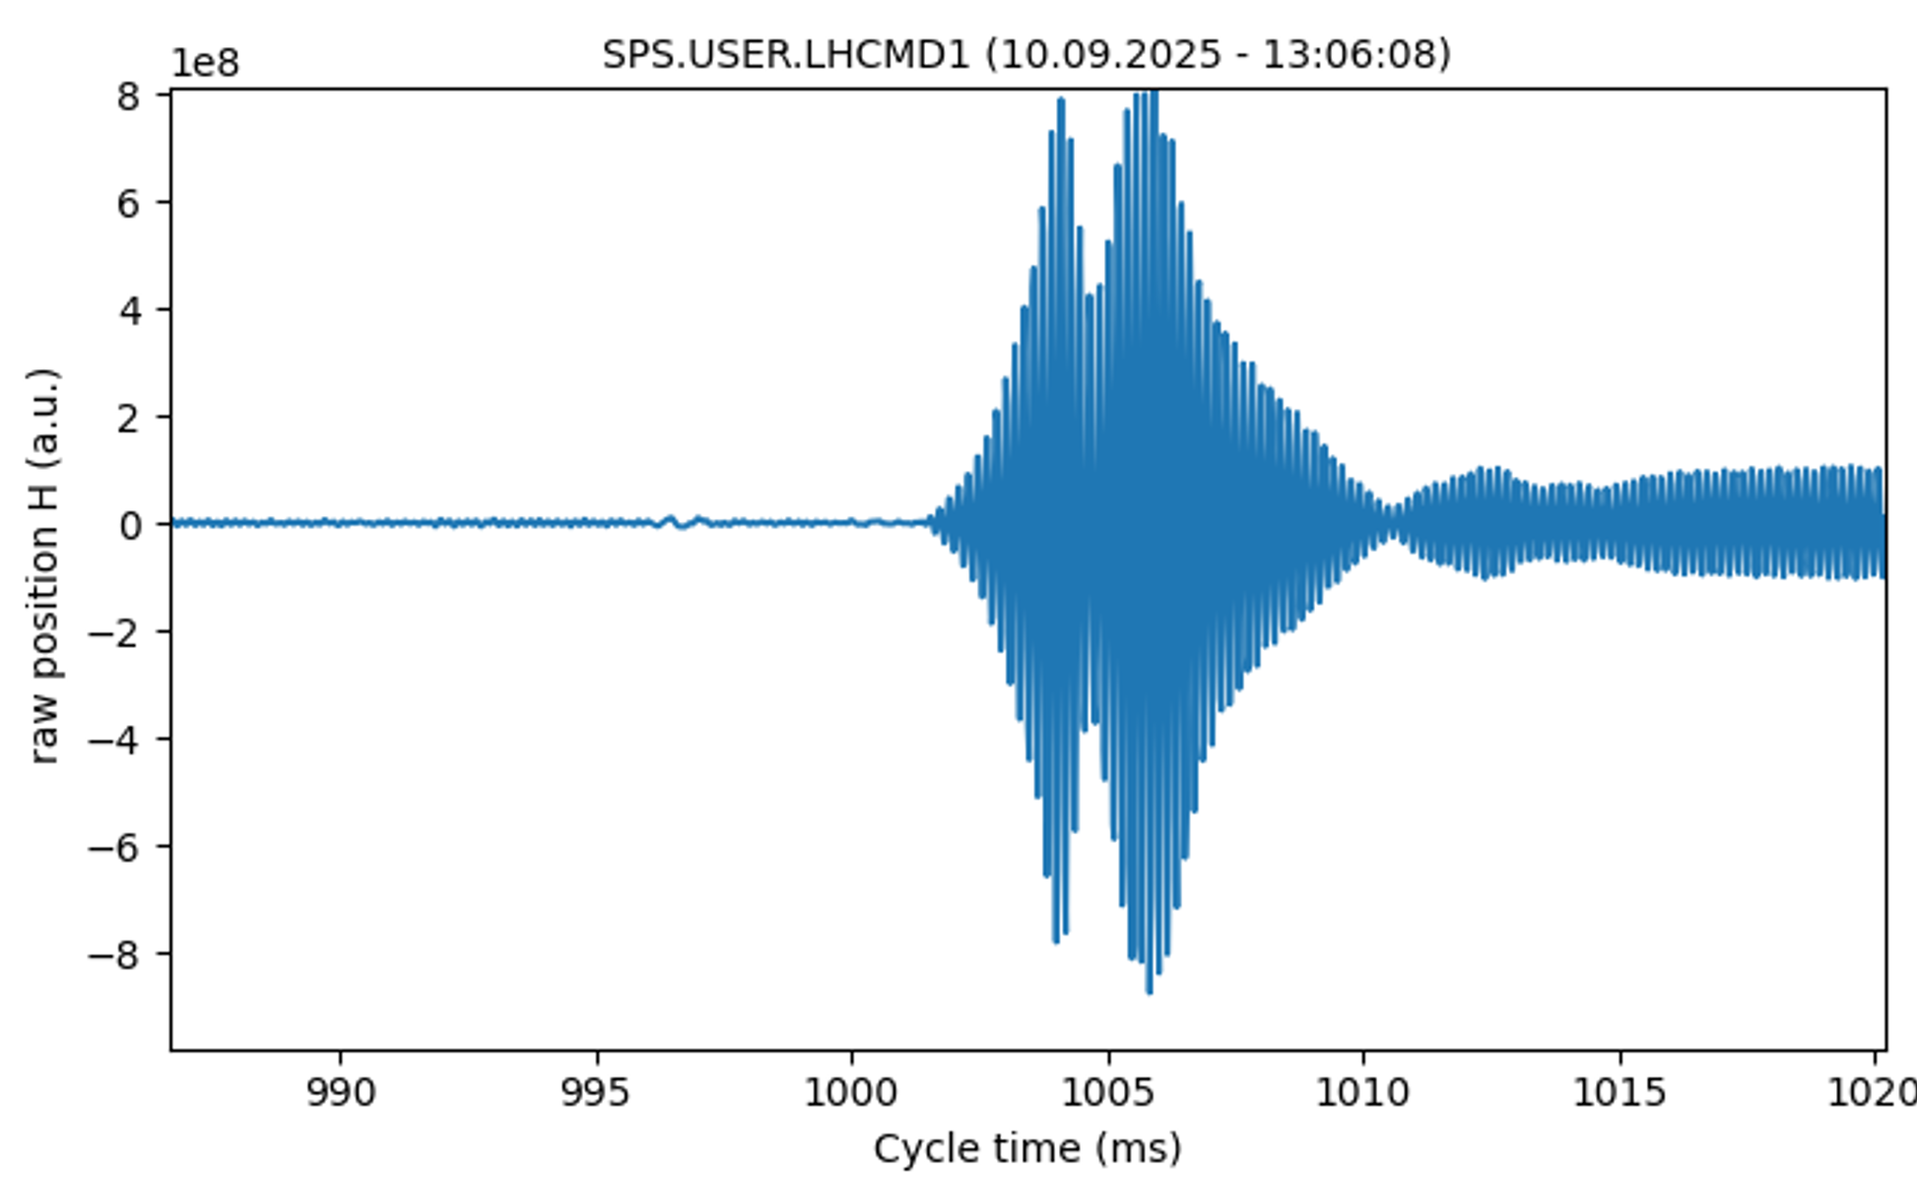
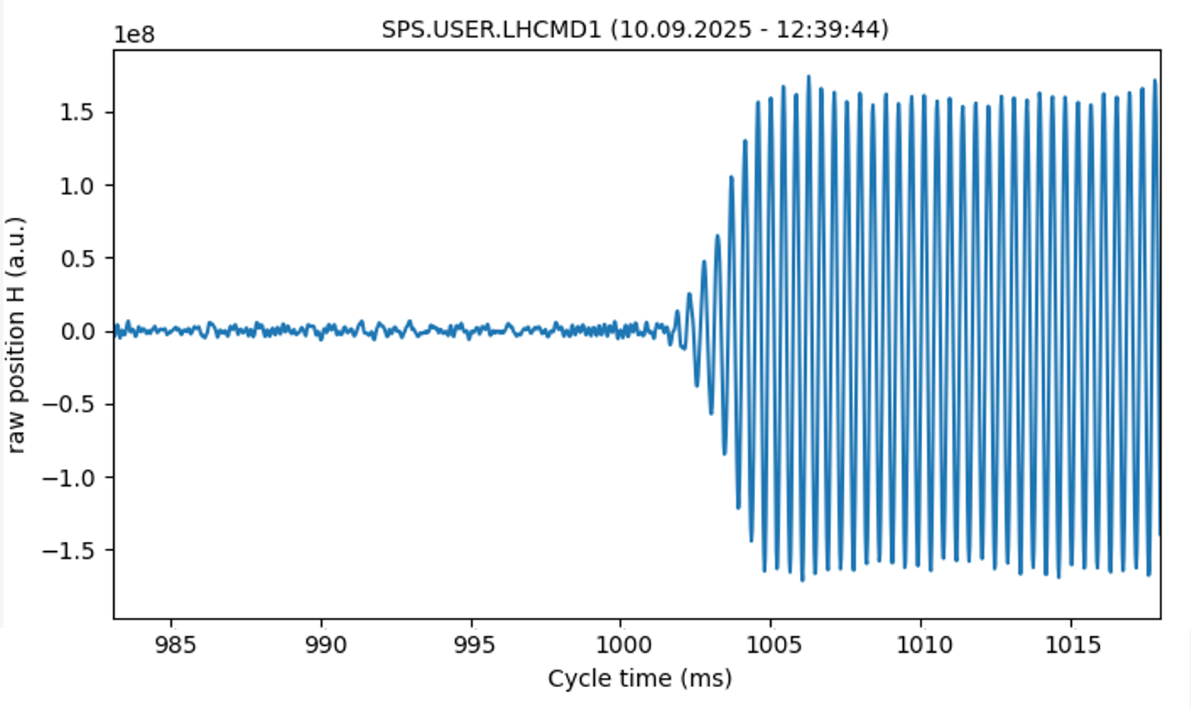
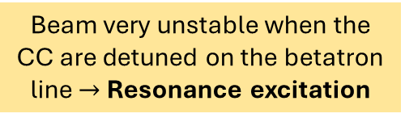
MD#3 : single-particle instability with CCs ON
Resonance excitation process : when CC ON kicks with same frequency of the destabilizing betatron line $→$ single-particle instability
  test with pilot bunch to confirm it
Beam very unstable when the CC are detuned on the betatron line$→$ Resonance excitation
Det.=5.6 kHz
Det.=2.2 kHz
Instability even far from the betatron line: broadband effect
Counter-phasing is not small enough to have kick that is not on the same frequency of the destabilizing betatron line
The CC is ON when applying the Notch filter
Not possible to test the RF Notch feedback
Not expected for HL-LHC: CCs should not be detuned on the destabilizing line

Slide 13
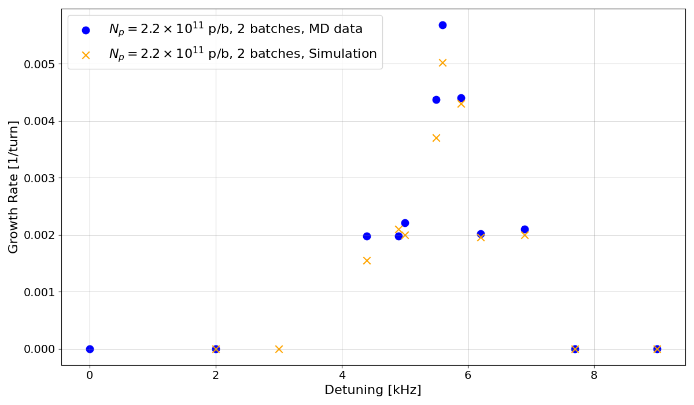
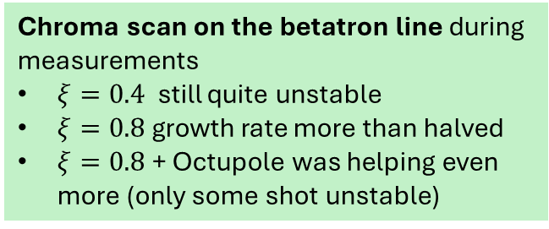
MD#3 : growth rate as a function of cavity detuning
Clear stronger instability approaching the betatron line (~5.6 KHz detuning)
Expected destabilizing betatron line ~ (5.6 kHz) of detuning
Cavity detuning w.r.t. the cavity central frequency of 400.5289 MHz
Chroma scan on the betatron line during measurements
$ξ=0.4$ still quite unstable
$ξ=0.8$ growth rate more than halved
$ξ=0.8$ + Octupole was helping even more (only some shot unstable)

Slide 14
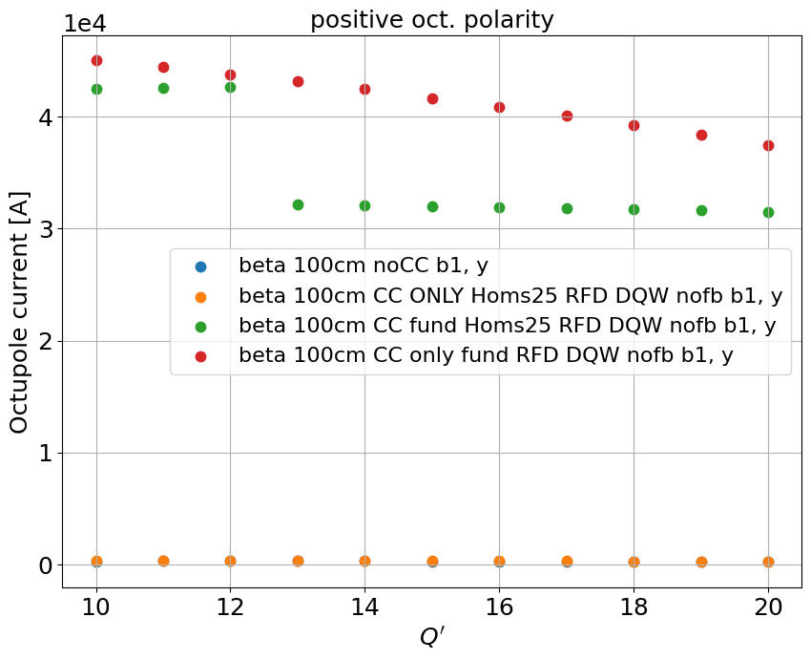
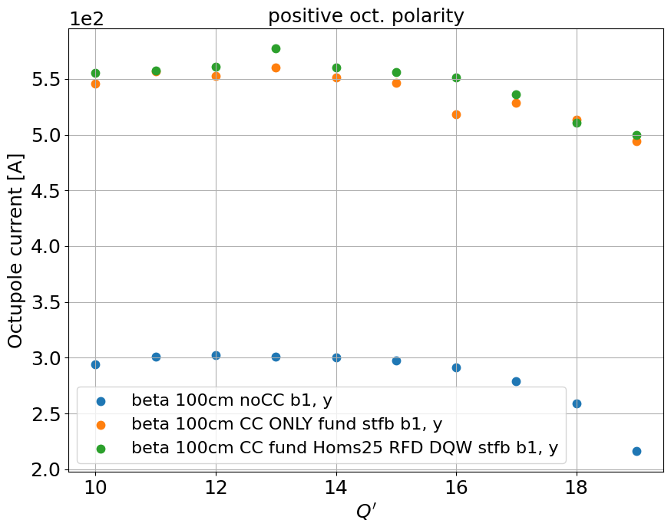
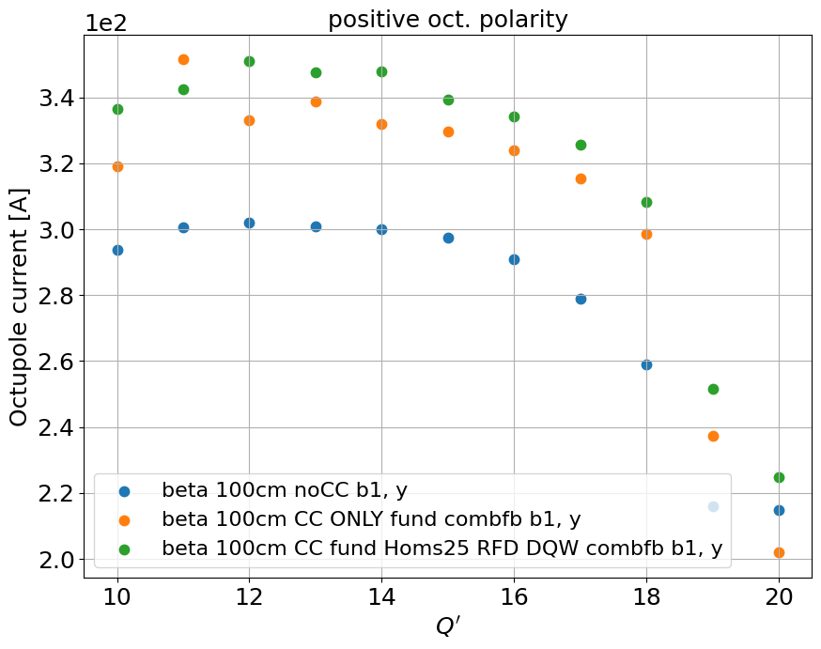

Impact of measured HOMs
In this case we have, for each beam, 4 DQW and 4 RFD crab cavities (CC)
  The HOMs of RFD CCs are computed from simulations (J. Mitchell, Nov. 2019)
  The HOMs of DQW CCs are from A. Edwards measurements (more info in her talk)
Impact on stability
Flat top case, before collapse $β^{∗}=1 m$, round optics
Max. 6 % increase
Max. 9 % increase
Max. 20 % increase

Slide 15

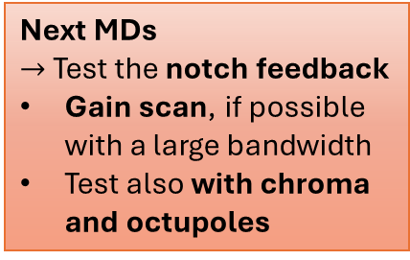

Conclusions and next steps
We presented observation of beam instability measurements at the SPS with the RFD Crab Cavity
  Both during the scrubbing and the high intensity tests the Crab Cavity makes more severe the SPS horizontal instability
    Chromaticity and octupole can help to mitigate the instability
      However, they do not fully suppress it when the cavity is detuned on the betatron line
During high intensity tests (MD#2 & #3) we could progress in the understanding of the instability
  Behaviour with the cavity detuning characterized and in agreement with expectations
  However, the combination of the resonance excitation together with the non perfect counter-phasing did not allow the test with the Notch filter
The beam observations are consistently reproduced in tracking simulations
The growth rate of the RFD cavity scan with detuning shows good agreement with simulations
  Therefore, the model it is employed to make predictions with the notch filter feedback
    It demonstrates a beneficial impact of the notch filter when having a larger bandwidth ($≥$ 400 Hz) and the full gain
    However, to fully suppress the instability chromaticity and octupoles should be used
Next MDs
$→$Test the notch feedback
Gain scan, if possible with a large bandwidth
Test also with chroma and octupoles
$→$Refine tracking simulations for benchmark and predictions

Slide 16
Backup

Slide 17
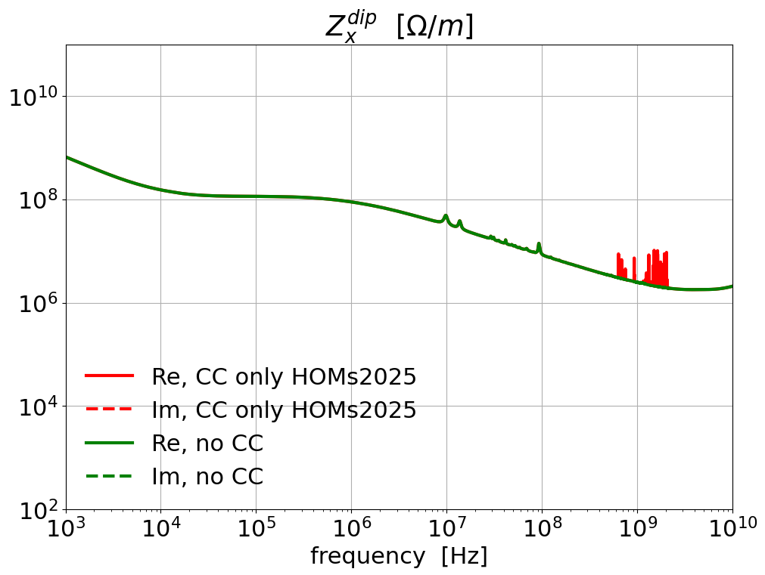
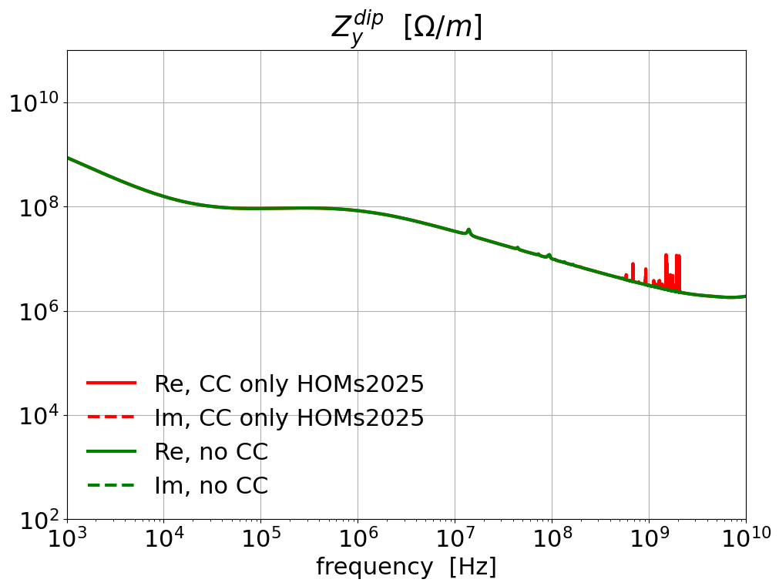

Impact of measured HOMs
In this case we have, for each beam, 4 DQW and 4 RFD crab cavities (CC)
  The HOMs of RFD CCs are computed from simulations (J. Mitchell, Nov. 2019)
  The HOMs of DQW CCs are from A. Edwards measurements (more info in her talk)
Comparison between model without CC and model with only DQW and RFD HOMs
Impact on stability
Flat top case, before collapse $β^{∗}=1 m$, round optics
From 2% to 20 % increase in y

Slide 18
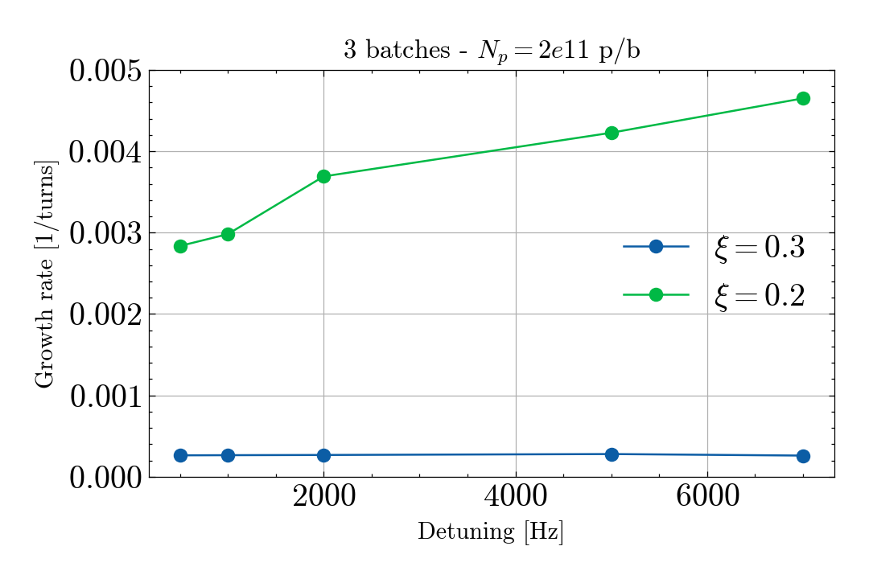
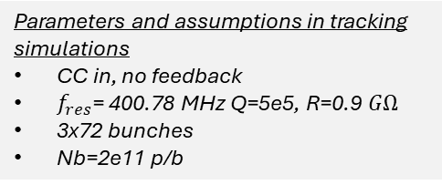
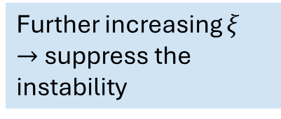
SPS horizontal instability simulations: growth rate as a function of cavity detuning
In simulations the scrubbing scenario is reproduced (3x72 bunches and $N_{p}=2$e11 p/b)
Parameters and assumptions in tracking simulations
CC in, no feedback
$f_{res}$= 400.78 MHz Q=5e5, R=0.9 $GΩ$
3x72 bunches
Nb=2e11 p/b
Further increasing $ξ$
$→$ suppress the instability

Slide 19
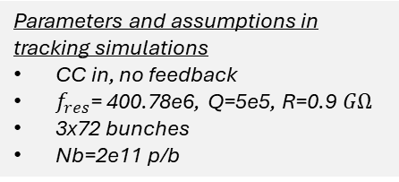
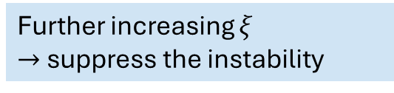
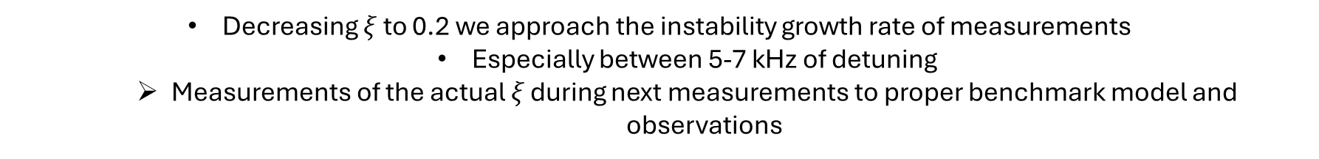
SPS horizontal instability simulations: growth rate as a function of cavity detuning
In simulations the scrubbing scenario is reproduced (3x72 bunches and $N_{p}=2$e11 p/b )
Coherent with scrubbing measurements
Parameters and assumptions in tracking simulations
CC in, no feedback
$f_{res}$= 400.78e6, Q=5e5, R=0.9 $GΩ$
3x72 bunches
Nb=2e11 p/b
Further increasing $ξ$
$→$ suppress the instability
Decreasing $ξ$ to 0.2 we approach the instability growth rate of measurements
  Especially between 5-7 kHz of detuning
  Measurements of the actual 𝜉 during next measurements to proper benchmark model and observations

Slide 20
OUTLINE
Introduction and motivations
Observations during scrubbing at the SPS
High intensity SPS MD
  Analysis of #MD2 observations
  Analysis of #MD3 observations
Predictions and mitigations studies with model
  Studies with RF Feedback
  Cure with chroma and octupoles
Conclusions

Slide 21
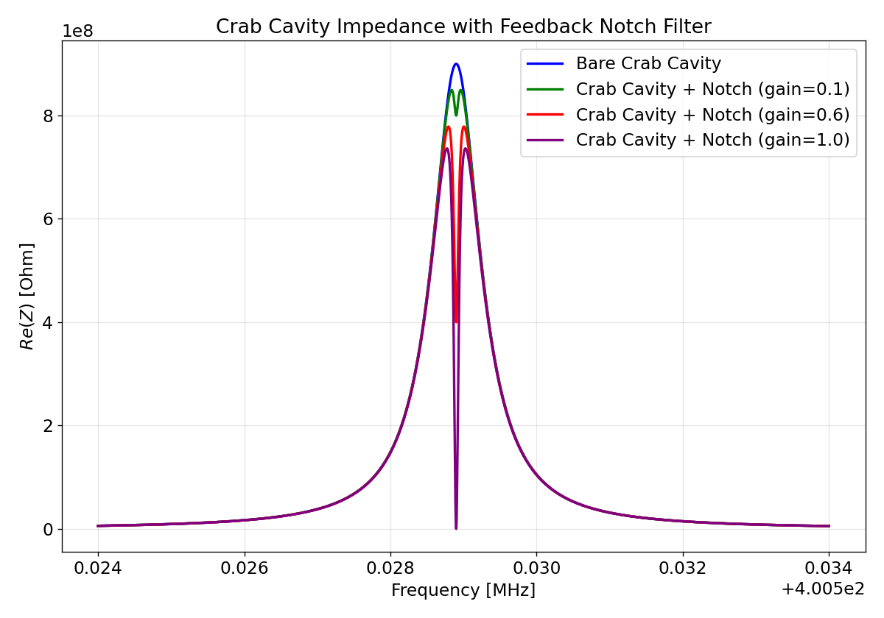
CC with Notch filter feedback
The notch filter feedback is implemented as an inverse resonator on the crab cavity impedance
It is characterized by a gain and bandwidth (BW)
Simulation studies with notch filter feedback performed in the standard scenario of 4x72 bunches

Slide 22
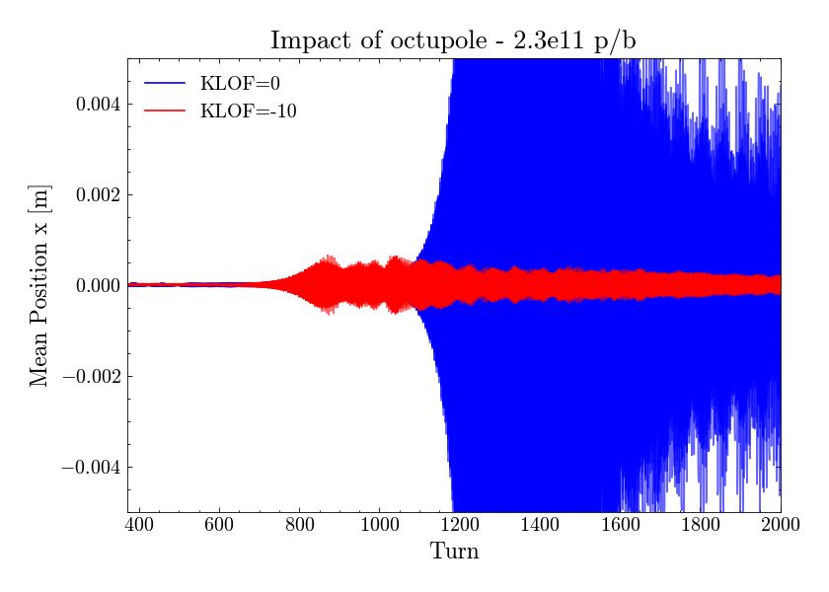
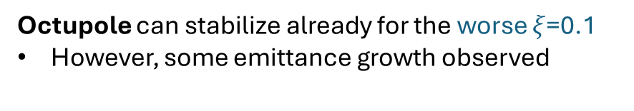
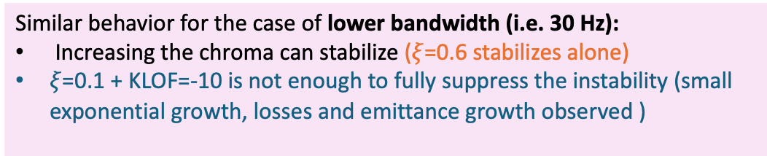
CC + Notch filter simulations : impact of octupole and chroma
Octupole can stabilize already for the worse $ξ$=0.1
However, some emittance growth observed
Similar behavior for the case of lower bandwidth (i.e. 30 Hz):
Increasing the chroma can stabilize ($ξ$=0.6 stabilizes alone)
$ξ$=0.1 + KLOF=-10 is not enough to fully suppress the instability (small exponential growth, losses and emittance growth observed )

Slide 23
OUTLINE
Introduction and motivations
Observations during scrubbing at the SPS
High intensity SPS MD
Predictions and mitigations studies with model
Conclusions

Slide 24
BACKUP

Slide 25
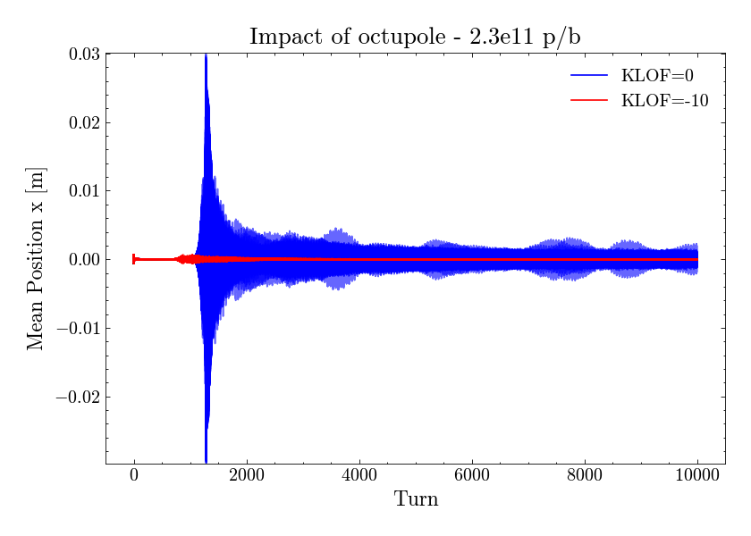
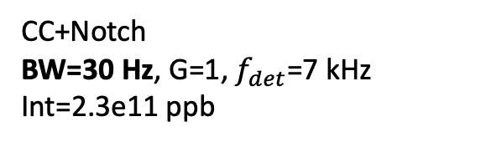
CC + Notch filter simulations : impact of octupole and chroma for BW=30 Hz
CC+Notch
BW=30 Hz, G=1, $f_{det}$=7 kHz
Int=2.3e11 ppb
Int 2.3e11 | Growth rate (1/turns)
Chroma 0.3 | 0.015
Chroma 0.5 | 0.00113
Chroma 0.6 | STABLE
We did not have the time to test this systematically during MD…only during scrubbing we could verify the beneficial impact of the chromaticity

Slide 26
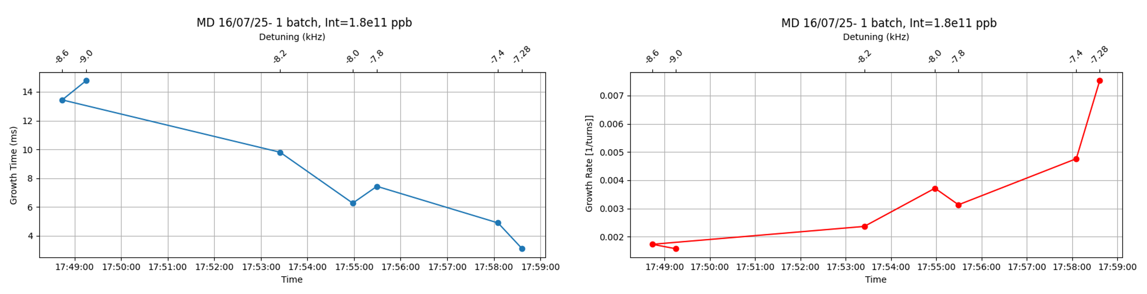
MD : growth rate as a function of cavity detuning
Start at 17.39:
  until 17.49: either very unstable (and subsequent beam dump) or stable
Cavity detuning w.r.t. the cavity central frequency of 400.528 MHz
Clear stronger instability approaching the betatron line (~7kHz detuning)
Difficult to extract the same trend on the other side:
from -7 up to -6 kHz (from acquired data either beam stable or immediately unstable)
Poor amount of data available due to the many issue and small amount of time

Slide 27
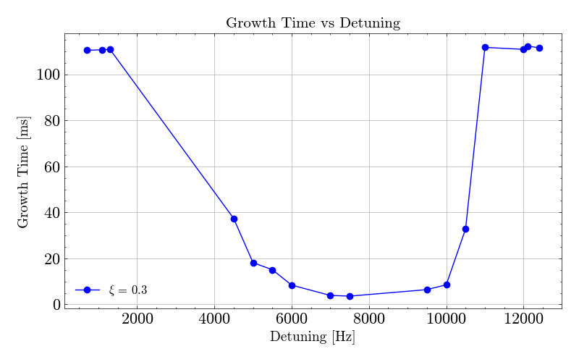
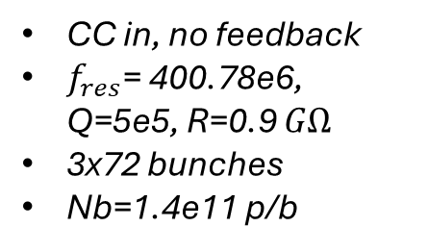
GT as a function of $f_{res}$ from simulations at zero chroma (4 batches)
CC in, no feedback
$f_{res}$= 400.78e6, Q=5e5, R=0.9 $GΩ$
3x72 bunches
Nb=1.4e11 p/b

Slide 28
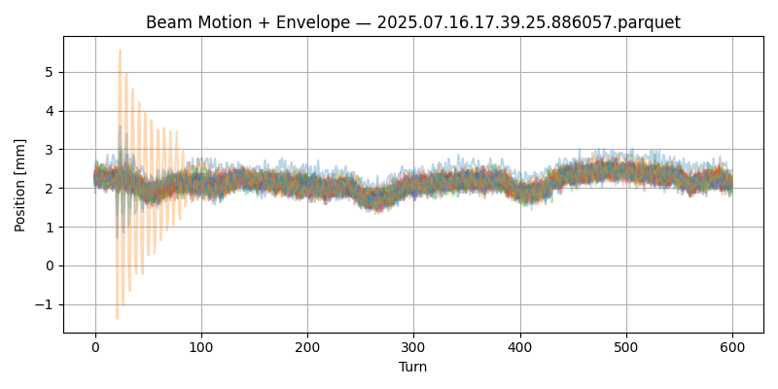
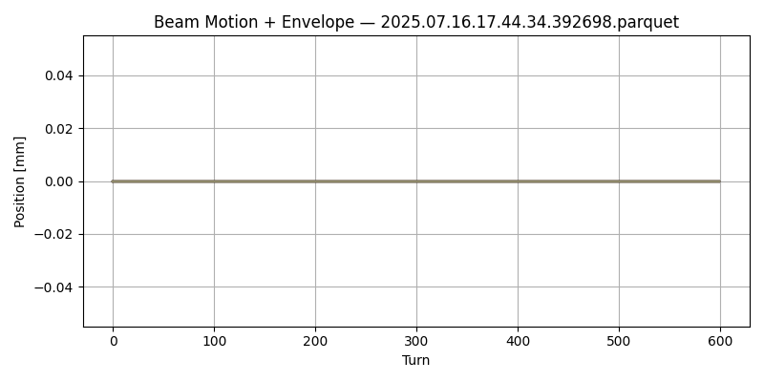



MD time from 17.39 up to 17.47
Det: -2.9 kHz
From 17.39 up to 17.43 beam stable
  Detuning from 2.9 kHz up to 6.7kHz
  Around -6 kHz I do not really start to see beam unstable as around -8 kHz)
    Maybe we were not in the best condition to finely scan around 7 kHz the instability growth rate
      Try next time to get more unstable and play with chroma to find better scenario to measure the GR (?)
At 17.43.53 with det=-7.02 kHz beam so unstable that we were dumped
From 17.44 up to 17.47.41: No available data for growth rate
From 17.47 up to 17.49 beam stable
Det: -7.02 kHz
Det: -6.7 kHz
Det: -6.7 kHz

Slide 29


Horizontal raw data: beam centroid motion

Slide 30


Betatron lines and synchrotron satellites
7 kHz
The analytical detuning to hit the destabilizing betatron line is in agreement with simulations

Slide 31

Effect of satellites

