Slide 1
Tranverse impedance studies for HL-LHC
C. Antuono, N. Mounet
Thanks to: D. Amorim, X. Buffat, E. De la Fuente, L. Giacomel, I. Karpov, J. Li, L. Mether, G. Rumolo, B. Salvant, L. Sito, C. Zannini

Slide 2
Outline
Introduction
HL-LHC impedance model update
Results from beam-based measurements
Summary

Slide 3
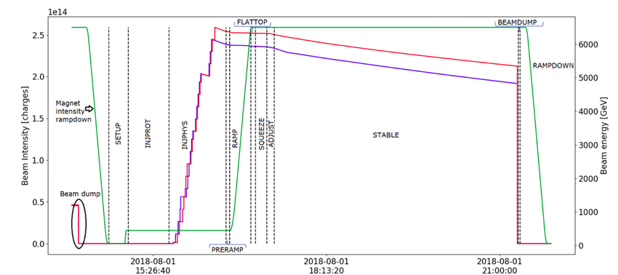

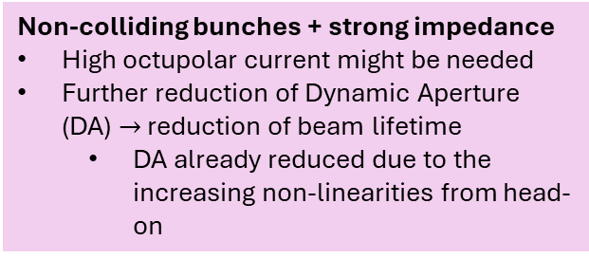
LHC cycle and impedance-related stability
Accurate quantification of the LHC impedance contribution is crucial
Especially for beam stability and overall machine performances$→$assess impact of new components to be installed
Most critical scenario for impedance-related stability is at FLAT TOP when collimators are closed
High octupole current needed to keep the beam stable
During COLLISION stability is less critical thanks to the strong Landau damping from beam-beam head-on tune spread
BUT might become critical
Non-colliding bunches + strong impedance
High octupolar current might be needed
Further reduction of Dynamic Aperture (DA) $→$ reduction of beam lifetime
DA already reduced due to the increasing non-linearities from head-on
HL-LHC with the Crab Cavities has to be further studied
At INJECTION the main concern is e-cloud-related stability
High octupole current are needed to keep the beam stable

Slide 4
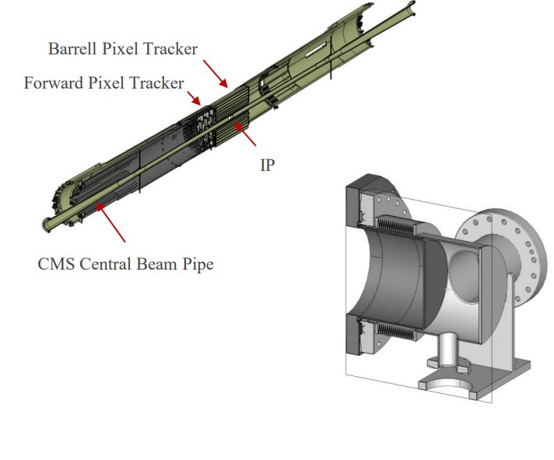
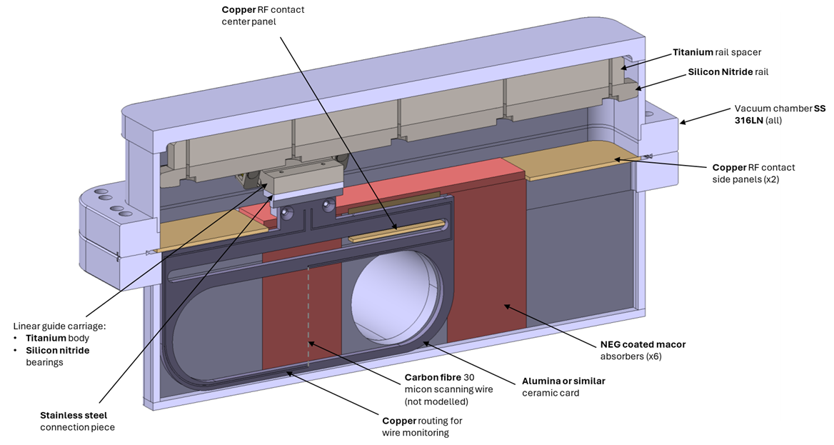
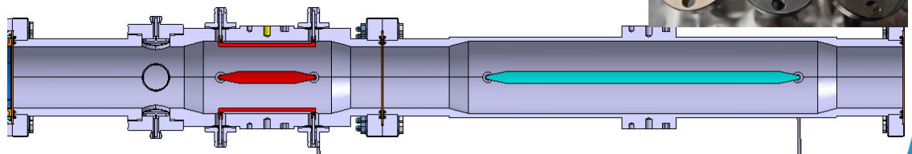
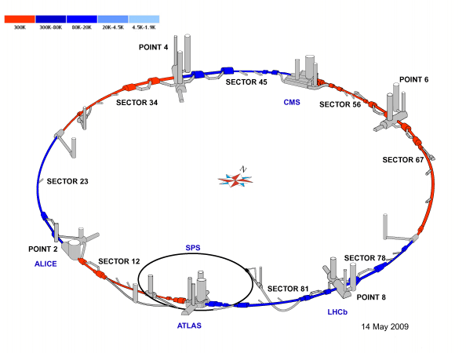
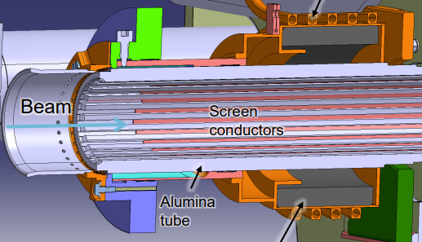
HL-LHC impedance model
HL-LHC Roman Pot
HL-LHC Wire scanner
HL-LHC CC BPM
CMS unshielded bellows
MKI-cool
And maybe more request will come…
MKI-cool
e.g. ALICE unshielded bellows
e.g. ATLAS modification layout

Slide 5
HL-LHC impedance model & stability at Flat Top
LHC recent installations | Longitudinal Increase of effective Im(Z/n) w.r.t . baseline* | Transverse Increase of octupolar current w.r.t .baseline*
Unshielded bellows | 0.35 mΩ | < 0.001
DRFs | 0.13-0.67 mΩ | < 0.01 A
TWO CRYST | < 0.02 mΩ | < 0.01 A
Rotated Roman Pots
MKIs-cool | TBC | -0.1 A
Recent updates from Nov. 24
All computations performed with PyWIT (Xwakes) ( LHC impedance model and DELPHI simulations
HL-LHC Roman Pot
HL-LHC Wire scanner
HL-LHC CC BPM
In only with stable beams
No increase in transverse w.r.t to the baseline octupolar current thanks to MKI-cools
CMS unshielded bellows
MKI-cool
Longitudinal stability is at the limit
New HL-LHC installations… | Longitudinal Increase of effective Im(Z/n) w.r.t . baseline* | Transverse Increase of octupolar current w.r.t .baseline*
MKIs-cool | TBC | -0.1 A
Roman Pot | - | +0.03 A
CC BPM | - | +0.01 A
Wire scanner | 0.035 mΩ | < 0.005
CMS Un. bellows | 0.45 mΩ | +0.03 A
What does it mean limit? Could/should we quantify better ?
Not possible to probe LLD
Not clear impedance baseline
Raise this point to longitudinal colleagues
Maybe though IWG?
And maybe more request will come…
Investigate collision phase
12 non-colliding bunches
MKI-cool
e.g. ALICE unshielded bellows
Should we launch an impedance reduction campaign?
e.g. ATLAS modification layout
Longitudinal baseline: 75-135 mΩ *
Transverse baseline ~300 A *
* M. Zampetakis's talk at the HiLumi annual meeting
* C. Lannoy’s talk at the HiLumi annual meeting

Slide 6
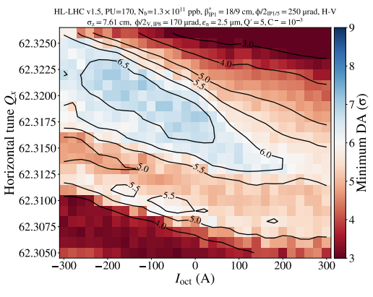
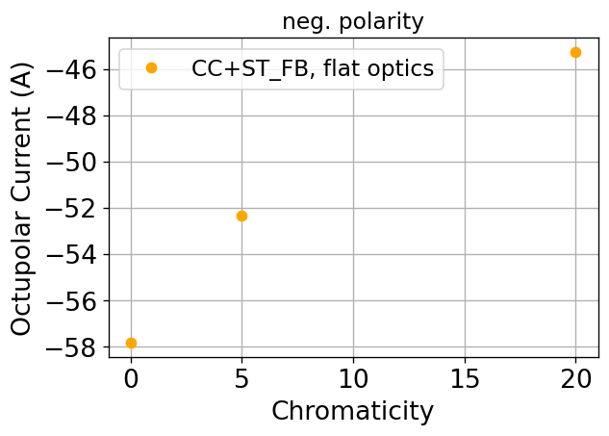
Stability during collision: non colliding bunches
The impedance during collision might increase due to presence of devices which are inserted and close to the beam (i.e. Roman Pots) and due the critical crab cavity fundamental mode, which can be suppressed only by the standard feedback during this phase.
Preliminary DELPHI simulations:
High octupolar current,~ -160 A with round optics
Improved with flat optics, ~-50 A required which lie well in the DA acceptance region
Pessimistic scenario considering a fully filled machine
Tracking simulations are required to confirm these results
Refining of simulations ongoing

Slide 7
Outline
Introduction
HL-LHC impedance model update
Results from beam-based measurements
Collimator tune shift at flat top
Growth rate at injection
Summary

Slide 8
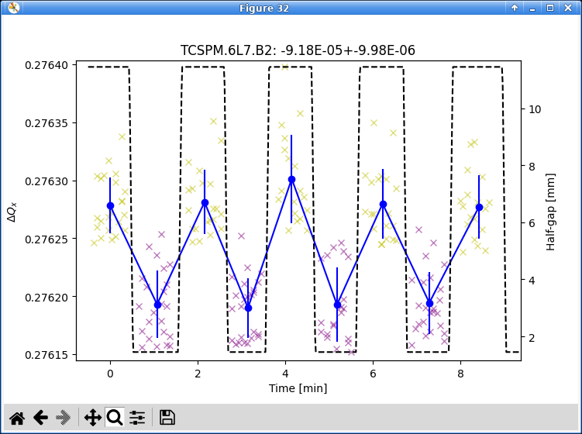
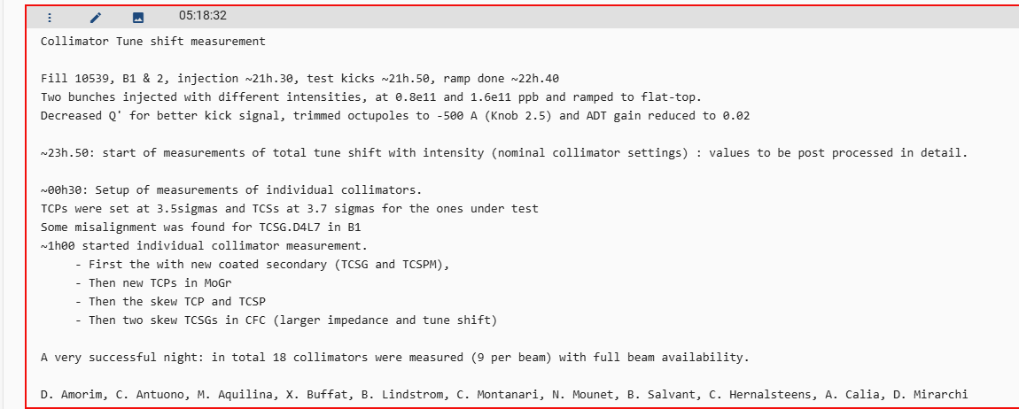
LHC IR7 collimator tune shift
Next steps:
Comparing measurement over the years
More detailed post processing with comparison with model expectations
Stefano R. proposed to measure also IR3 if time and schedule allow!

Slide 9
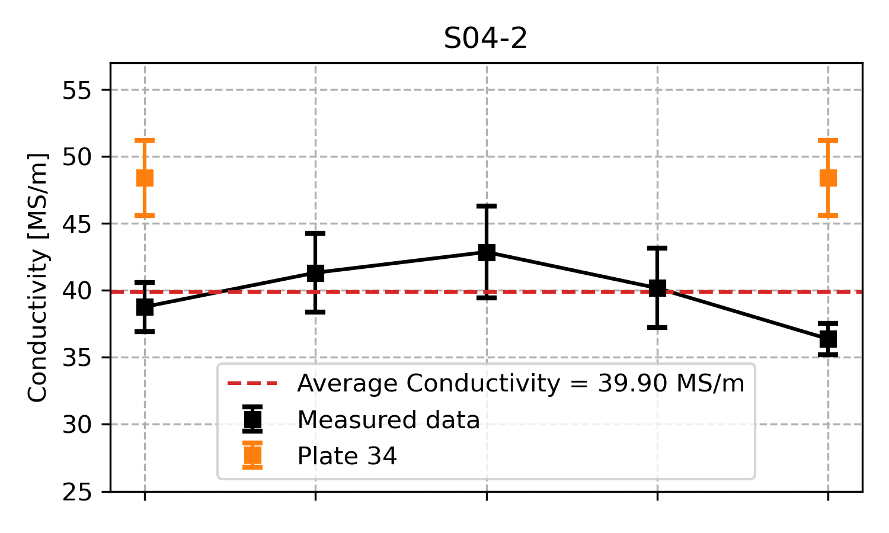
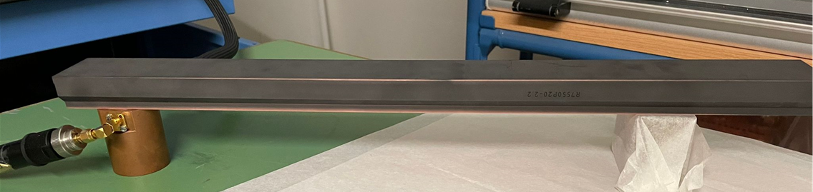
Validation/follow-up of new HL-LHC collimator
For HL-LHC low-impedance collimators are needed and under production (see HL-LHC low-impedance collim. at IPAC2018)
Impedance measurement campaign of TCSPM, TCLPX and TCTPXH(V) full assembly is a crucial step
Pre-series planned for December
Series will arrive from end of 2026 summer: 4 collimators every 4 weeks !!!
Impedance characterization of jaw material for TCSPM started already in 2023 and finished???
Say smt about Julian ongoing simulations?
L. Sito at WP5.2 meeting, 22/04/24
Resonant cavity method
Block to characterize
cavity

Slide 10
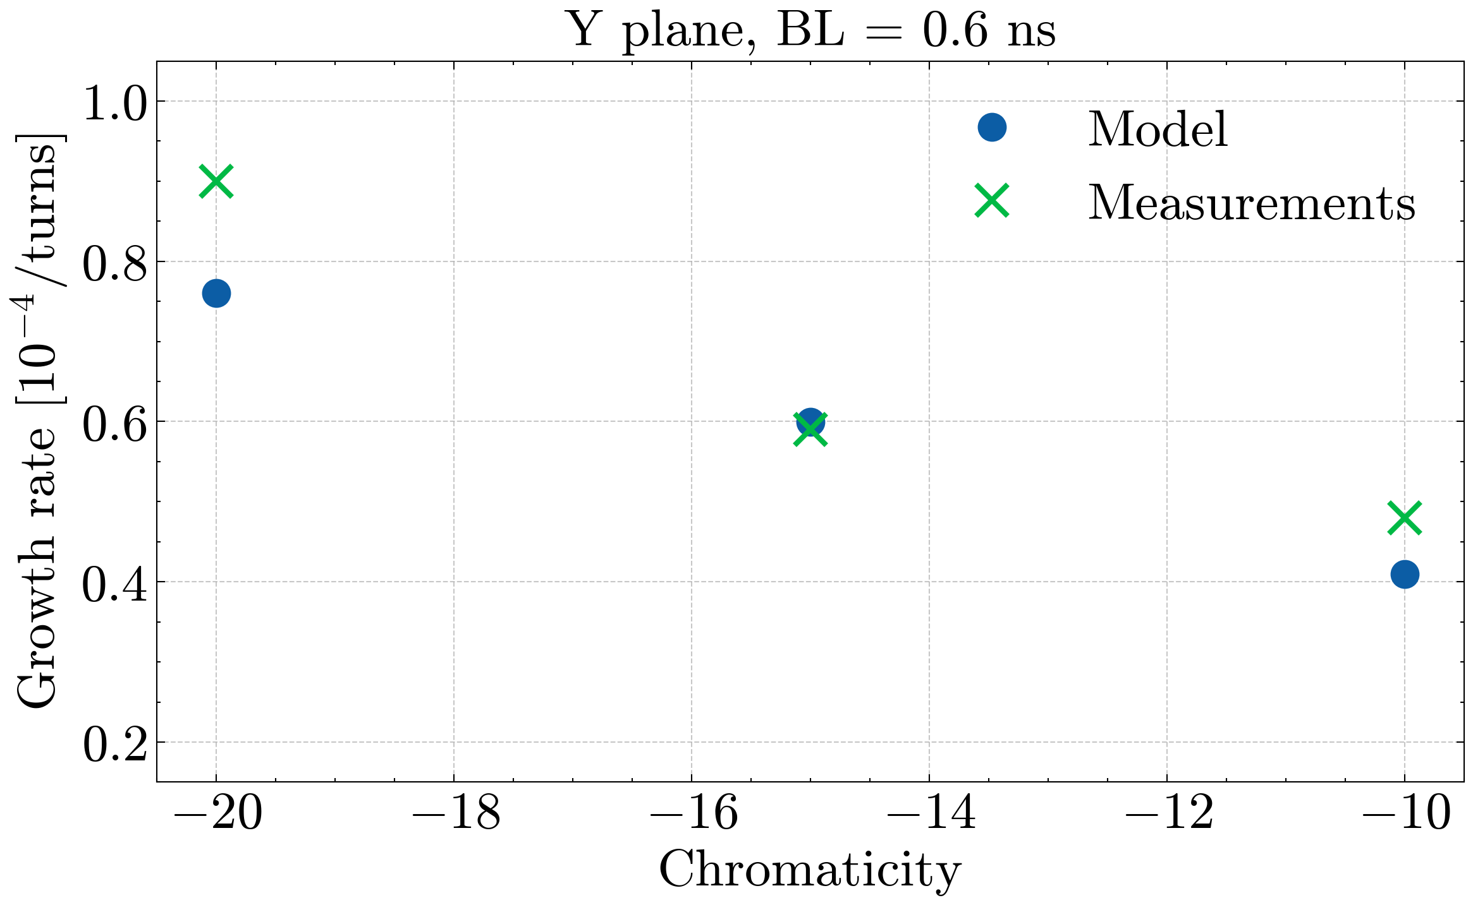
Single bunch growth rate at injection
Preliminary results from LHC test of Sept. 2025
Significantly reduced discrepancy between model and measurement
Finish post processing…
Further steps:
Finalize/improve analysis of MD data
Refinement of impedance model (i.e. additional bench measurements of non movable devices)
Finalize/improve tracking simulations (i.e. space charge, residual octupoles etc.)
Next MD block: tune shift measurements
Very preliminary measurement results are not far from simulated growth rates
The remaining discrepancy could be related to:
Uncertainties in the impedance model
Possible residual Landau damping in measurements
Uncertainties in the online analysis during measurements
Direct space charge not yet accounted in simulations

Slide 11
Outline
Introduction
HL-LHC impedance model update
Results from beam-based measurements
Collimator tune shift at flat top
Growth rate at injection
Summary

Slide 12
Backup

Slide 13
Summary
LHC and HL-LHC impedance model are being followed-up
Carry on the collimator measurement campaign
Follow-up on collimator settings/optics/changes/MDs when needed
Refine the models through bench measurements, simulations and addition of missing devices
review of general model (material, geometry etc.)
Follow-up longitudinal side with RF colleagues
In view of HL-LHC stability:
Crab cavities studies to be continued
Non-colliding bunches stability to be further explored

Slide 14
Preliminary results from LHC test of Sept. 2025
Significantly reduced discrepancy between model and measurement

Slide 15
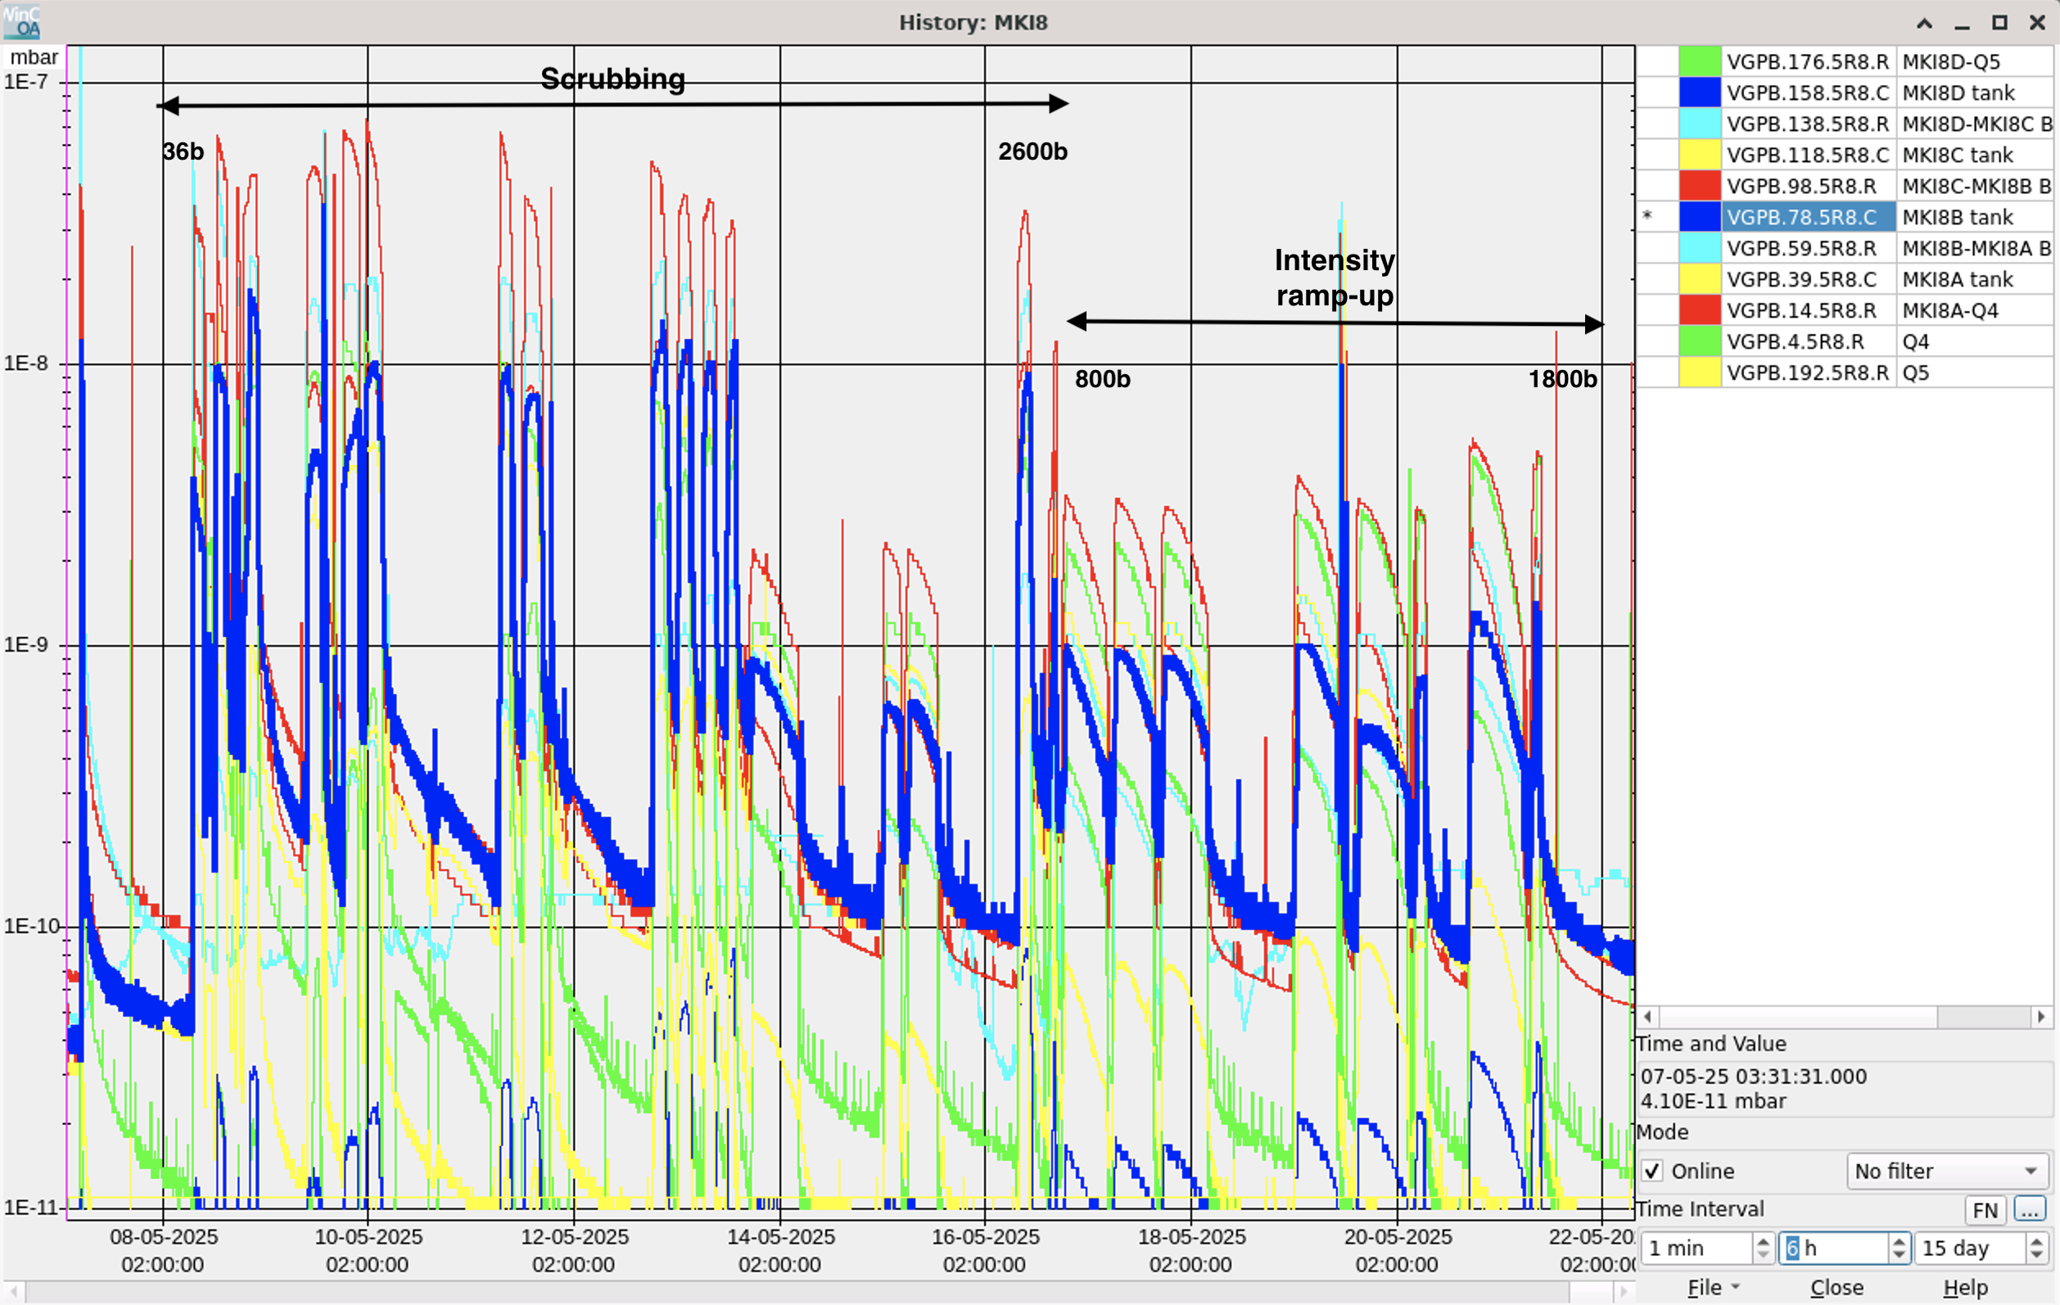
Scrubbing MKI (from Lotta)
Last Friday:
Scrubbing qualification with nominal filling scheme for physics: The filling was prolonged to ~1.5h due to issues in the SPS, therefore the fill is not very representative. - Both chromaticity and octupoles had to be increased during the fill to improve stability: Q': 20 --> 25, MO: 2.5 --> 4.0. - During the filling, the pressure in MKI B2 exceeded the NOMINAL vacuum thresholds in the A magnet (2.6e-9 mbar) and in the A-Q4 interconnect (1e-8 mbar).
Pressure evolution in magnet B (magnet A looks very similar)
Now we are at 1800b in physics and we are at ~75% of the threshold . The next step is 2400b: likely that it will cross the threshold
Experts may be willing to be flexible with the operational threshold for a while.

Slide 16
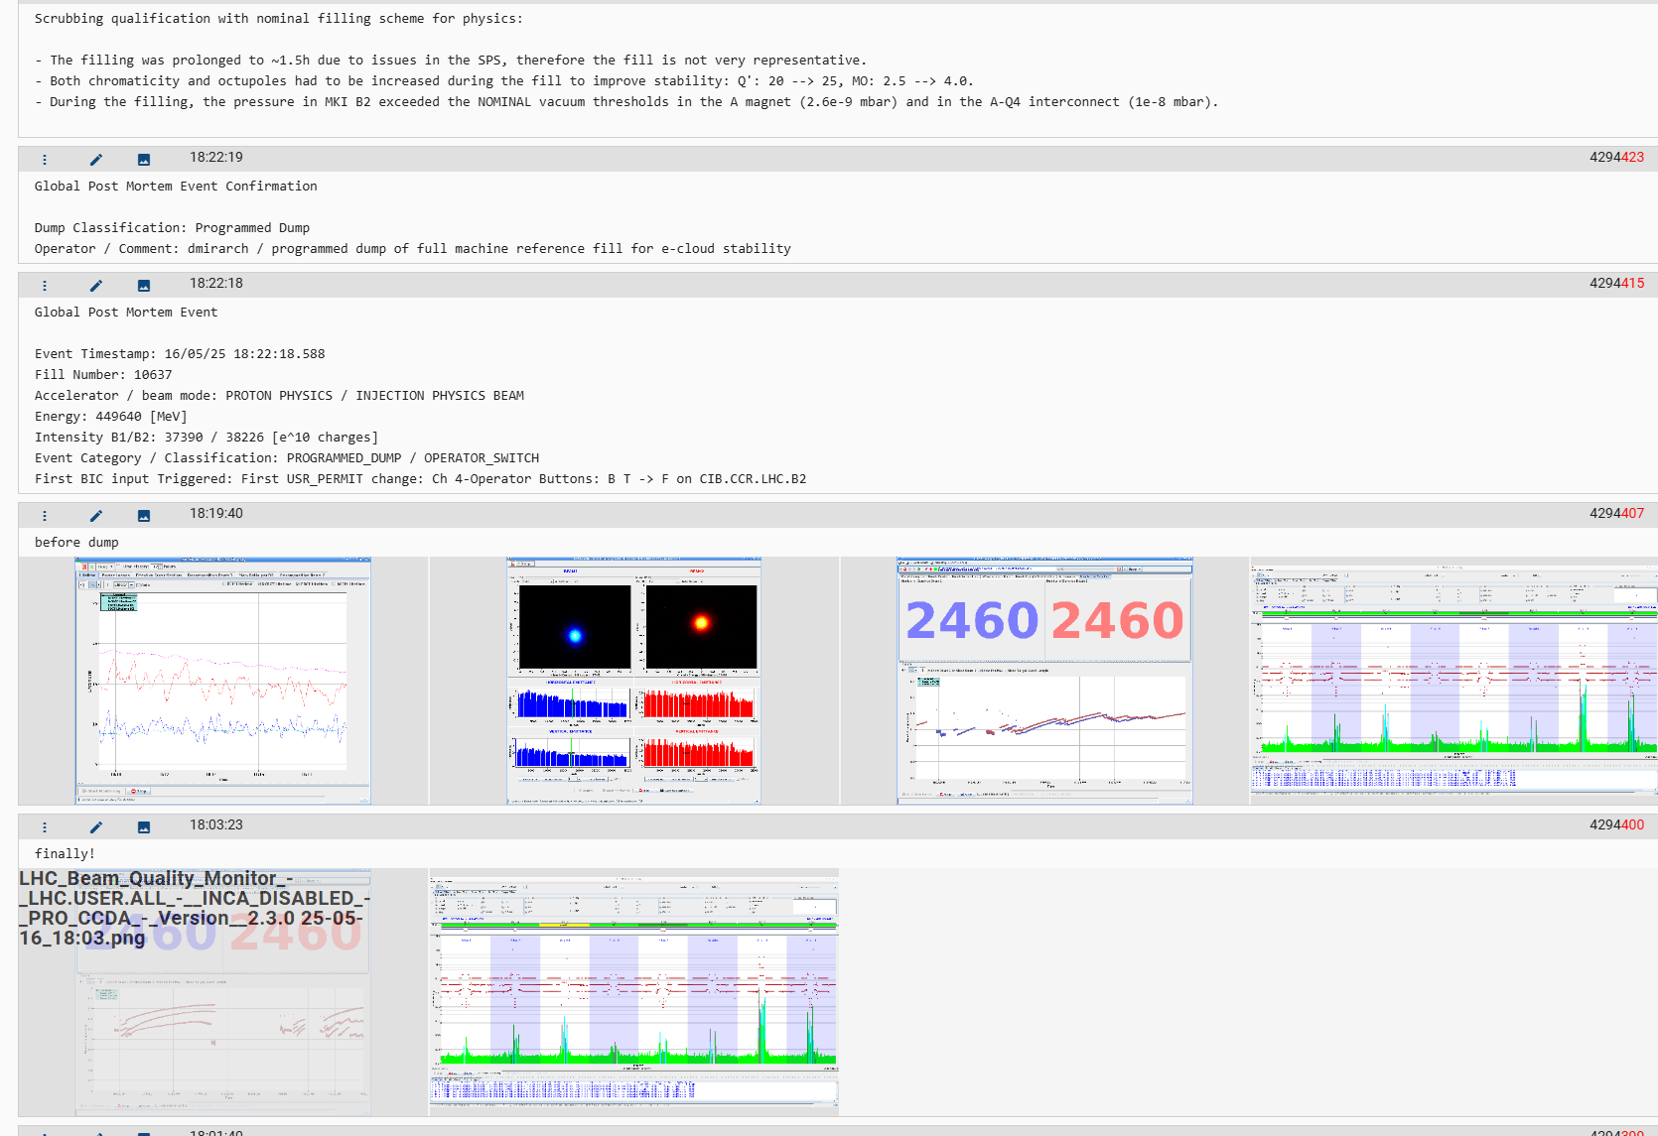

Slide 17
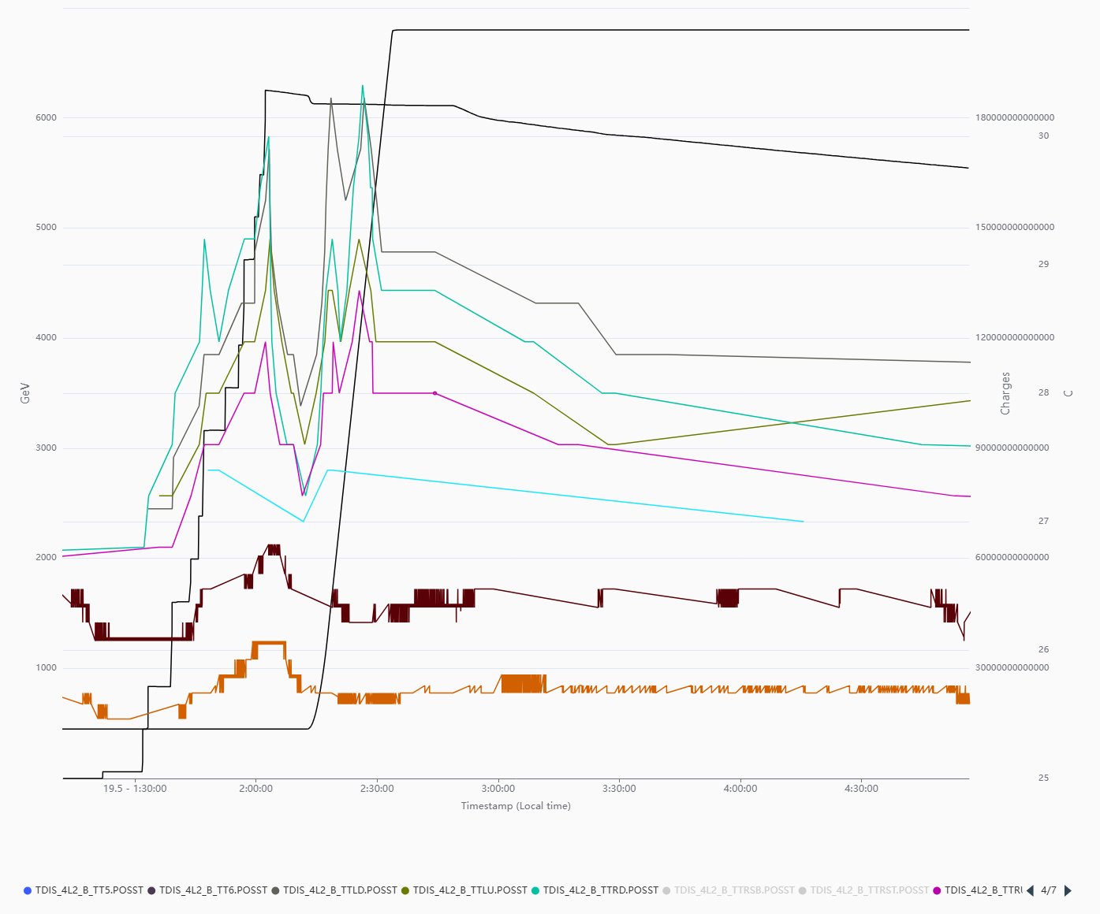
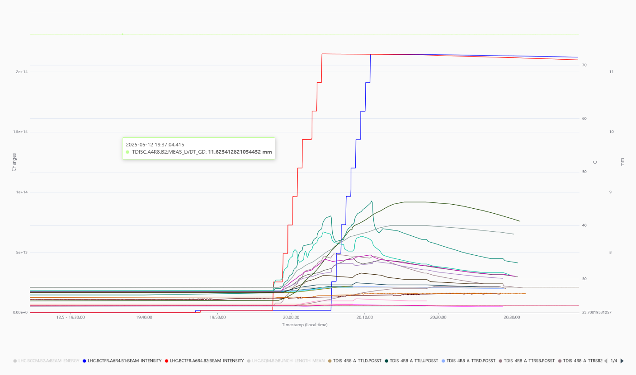
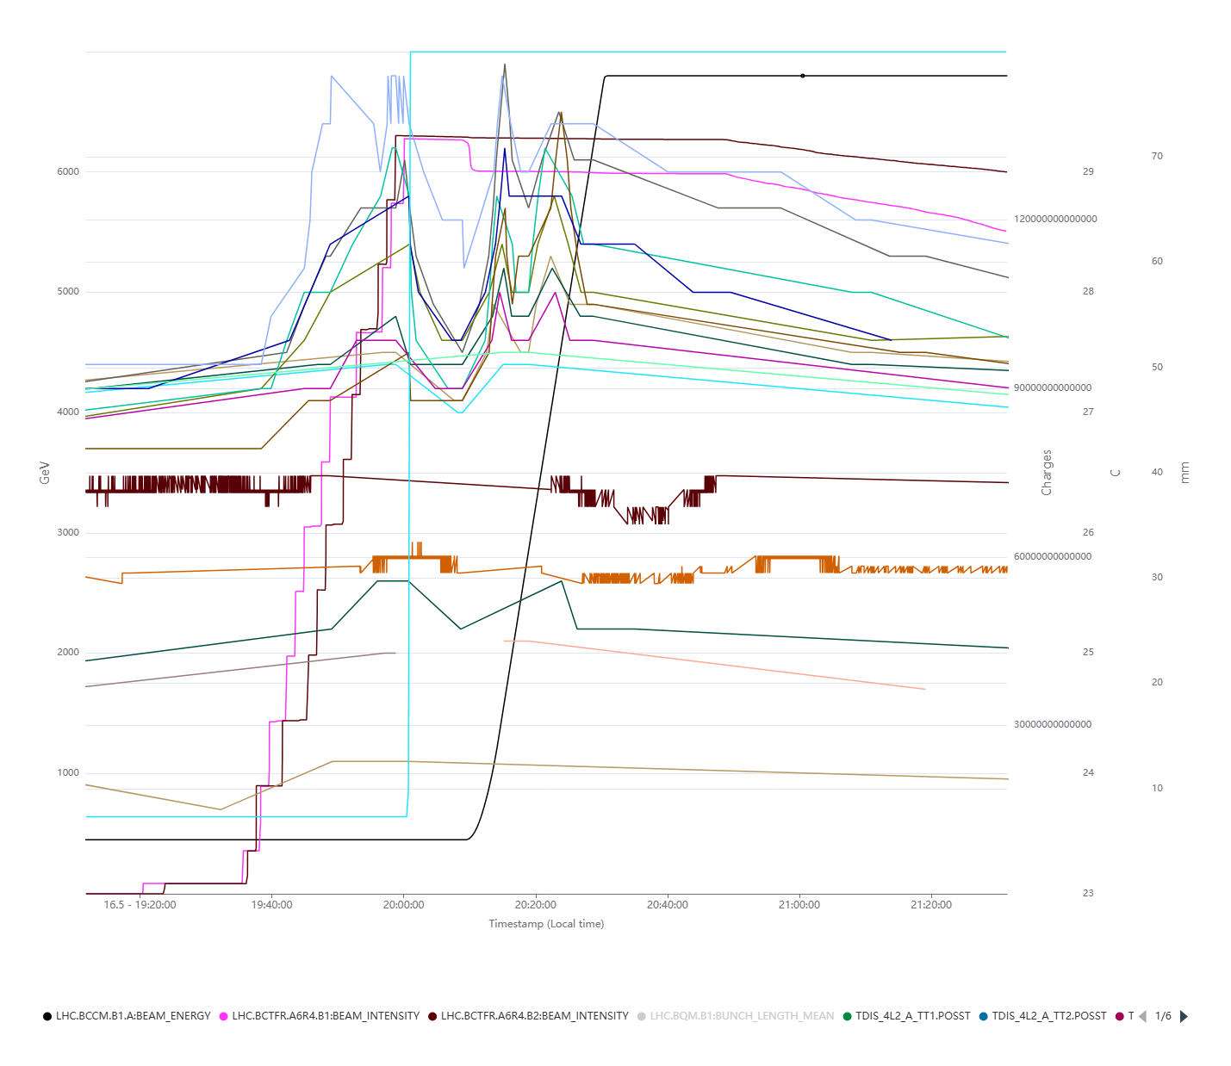
TDIS observation at the LHC
TDIS8, the recently installed showed some temperature increase
17-18 /05: 1800b flatop
16 /05
From 27 up to 42 degrees
However, tiny increase are observed with the full machine (~2600b)
After shielding of probes and the recent upgrade temperature
reading looks more realistic
The recent readings are lower than the initial ones
No critical issue during scrubbing

Slide 18
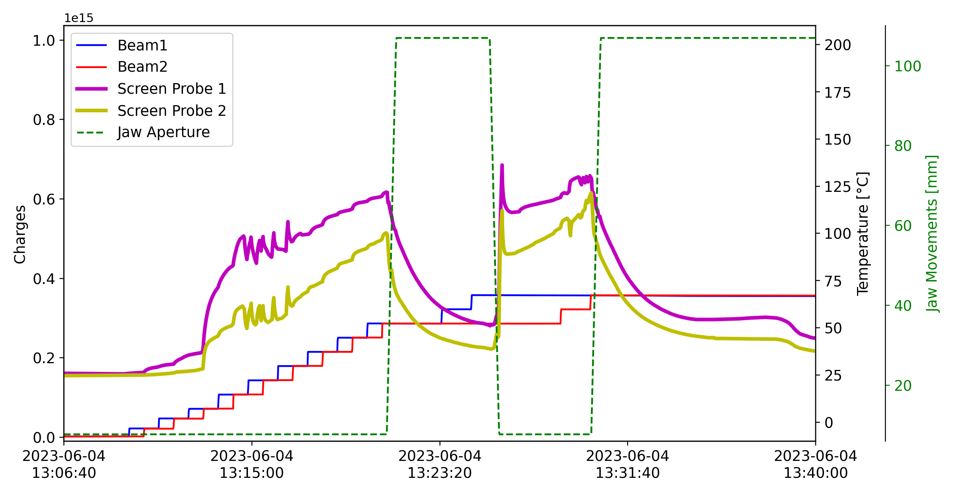
TDIS observation at the LHC
2023: Unexplained high temperature signals in the: caused interlocks and limited LHC filling
Temp. decrease with opened jaws
Temp. decrease with opened jaws
interlock
Reaching the interlock…
Temp. increase with closed jaws

Slide 19
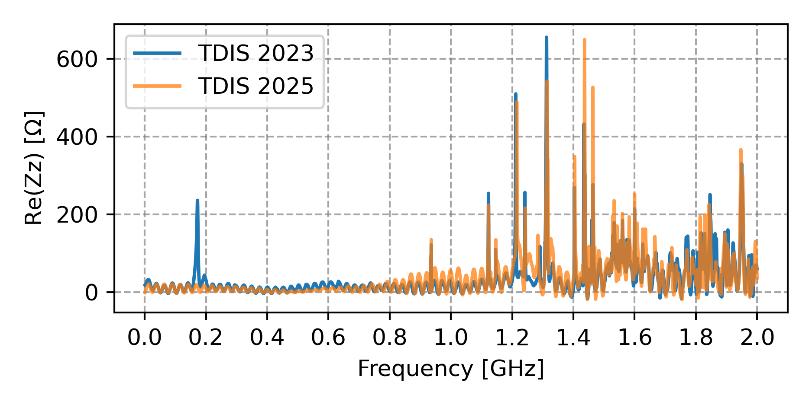
TDIS in 2025 Run
2025 TDIS will benefit of several improvements
Improved shielding of existing screen temperature probes
Two additional fully shielded screen temperature probes (same as MKIs)
Impedance measurements*:
Contrary to 2023, no correlations with jaw aperture, probe type and
TDIS device
Moreover, the unexpected low frequency resonance not detected
Impedance measurements on 2024 TDIS desirable
Impedance measurements
Given the findings so far, the issue in 2023 seems to be correlated with the observed non-conformities
However, the origin of the non-conformity is unknown
For conforming TDIS no impedance induced issues are expected
* L. Sito et al. at the 92nd IWG meeting

Slide 20
General impedance models improvement and perspective

Slide 21
Discrepancies between LHC impedance model and beam observables
Disagreement mainly observed from the single bunch tune shift measurements
Refinement of the impedance model
Review of the resistive wall contribution
Correct material modelling
Resistive wall length
LHC beam screen bench measurements at cryogenic temperatures

Slide 22
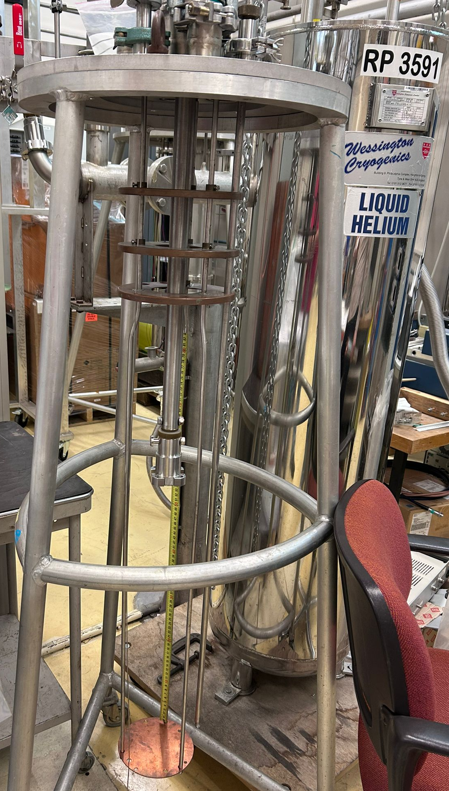
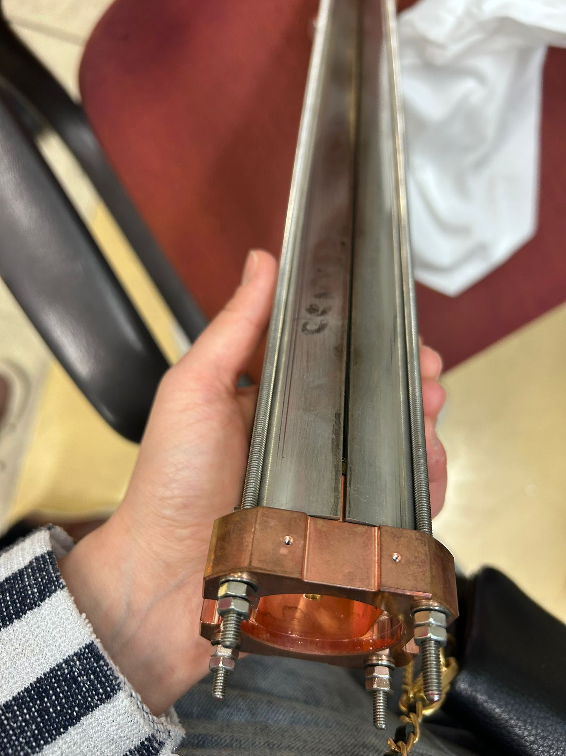
LHC beam screen measurement
Review of the resistive wall contribution:
LHC beam screen bench measurements at cryogenics temperature are under investigations
Vacuum colleagues are equipped with a cryogenic setup which allows to perform wireless impedance measurements
Visual inspection done, procurement of ad-hoc flanges to properly excite the device
Plan to perform the measurements by the end of summer !
Flanges arrived!
Ongoing setup preparation…measurement in the next weeks

Slide 23
Discrepancies between LHC impedance model and beam observables
Disagreement observed from the single bunch tune shift measurements
Refinement of the impedance model
Review of the resistive wall contribution
Review of geometric impedance contribution
Correct material modelling
Resistive wall length
Check coherence with the aperture model
LHC beam screen bench measurements at cryogenic temperatures
Additional beam-based measurements
Additional tracking simulations required to compare with all previously available measurements
MD block: perform ad hoc tune shift/growth rate measurement trying to disentangle contribution from collimator
Total tune shift (single and multi-bunch) at injection

